Slide 1

CAGI slide pack guidelines
I agree to my slides being used according to the following terms:
Vikas Pejaver
Authors: please include THIS slide at the beginning of your presentation to indicate that you agree with reuse of your slides in CAGI presentations, according to the terms below, and digitally sign by writing your name above.
•
•
To disseminate the CAGI results, I encourage all CAGI participants to remix these CAGI slides for inclusion in their oral and poster presentations
CAGI participants may use or publish any content of these slides only in compliance with the CAGI Data Use Agreement
CAGI participants may not cite or publish any content of these slides except with the written permission of the originating author or in the primary CAGI publications
CAGI participants must acknowledge the original authors of these slides and CAGI 2013. Include the acknowledgement banner across the bottom
CAGI participants must include the CAGI credits slide in their presentations
Slides with a red slash (no remix) may not be included in a presentation unless all attendees are registered CAGI participants who signed the data use agreement
Slides with a red X over the entire slide may not be used in any circumstances
Slides with a blue slash (embargoed) may not be used unless the embargo is explicitly lifted
Slides without slash or X may be tweeted unless flagged with the “No tweet” icon.
CAGI participants using these slides must explain the “No tweet” icon, which means that the slide content should not be disseminated outside the presenting conference hall. If the presentation venue permits pervasive tweeting, you may not include these slides in your talk
•
•
•
•
•
•
•
•
•
•
Note for slide authors: we expect all CAGI participants to abide by these restrictions, and will make best effort to ensure they are followed. However, but bear in mind that we have limited means of enforcing them, and therefore the restrictions cannot be guaranteed.

Slide 2


A performance-based approach to establish standards for missense variant impact prediction tools
Vikas Pejaver, Sean D. Mooney, Predrag Radivojac
CAGI* Workshop December 6, 2019

Slide 3
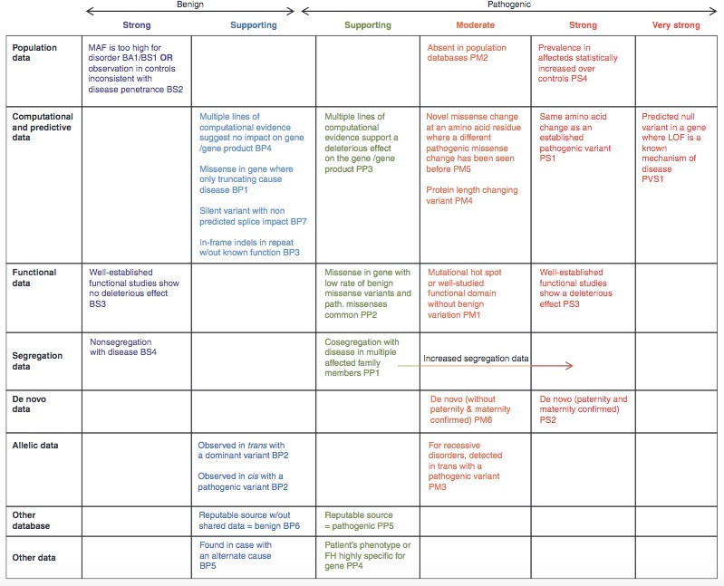
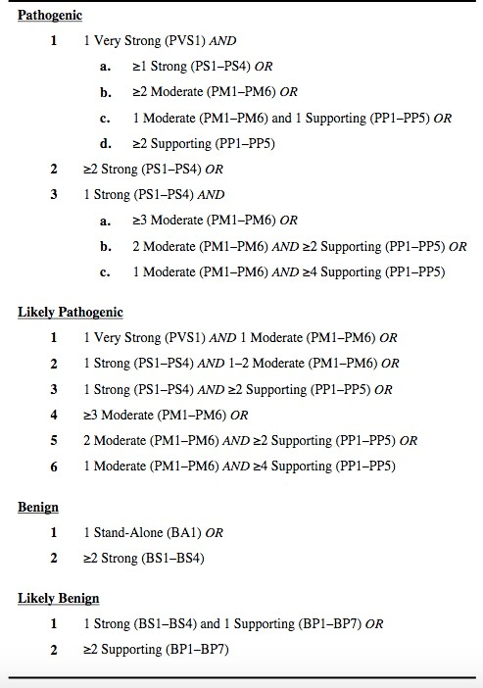
Variant impact prediction in ACMG/AMP guidelines
Richards S et al. 2015. Standards and guidelines for the interpretation of sequence variants: a joint consensus recommendation of the American College of Medical Genetics and Genomics and the Association for Molecular Pathology. Genet Med. doi:10.1038/gim.2015.30
3

Slide 4
Standards for tools and usage
Which tools to consider?
What thresholds to use?
Hard standards: recommend a “go-to” method and how it should be used
+ Easy for end-users (no need to peek under the hood)
  Stifles innovation in methodology
  Resistance to new and improved methods
We propose “Soft standards”: recommend multiple method(s) that fulfill performance threshold(s)
  Requires more investment of time and effort from end-users
+ Greater transparency in terms of performance expectations
+ Sets standards for tool development as well
4

Slide 5
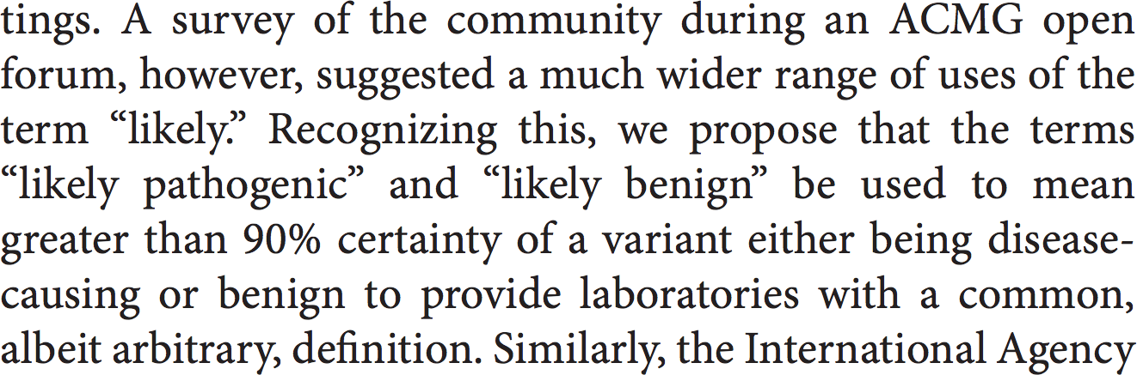
Performance criteria
P (Y = 1) · P (f (x) = 1
|Y = 1)
P (Y = 1|f (x) = 1) =
> 0.9
P (f (x) = 1)
We interpret this as precision or positive predictive value (PPV)
To align with the five classes in the ACMG/AMP classification, we extend to four thresholds corresponding to:
  60 and 80% PPV for pathogenic variants
  60 and 80% NPV for benign variants
Richards S et al. 2015. Standards and guidelines for the interpretation of sequence variants: a joint consensus recommendation of the American College of Medical Genetics and Genomics and the Association for Molecular Pathology. Genet Med. doi:10.1038/gim.2015.30
5

Slide 6
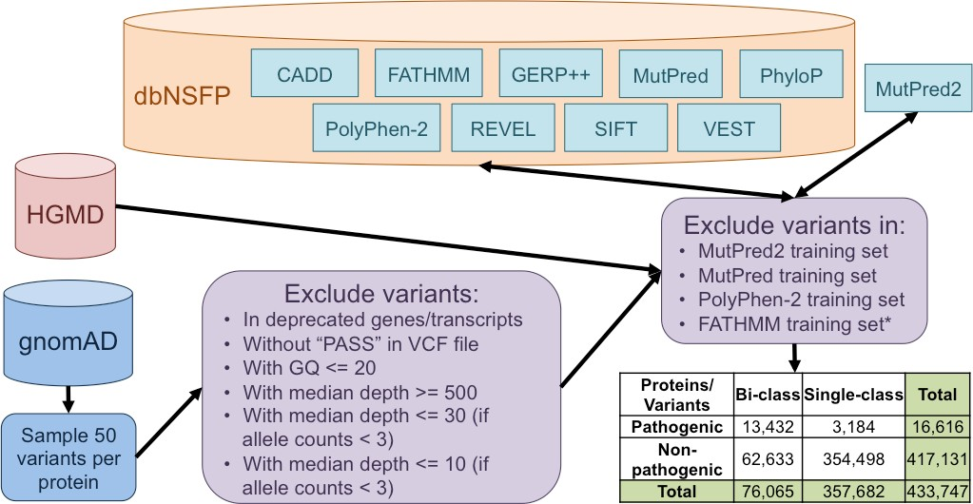
Our analysis

Slide 7
Not all tools reach a positive predictive value of 90%
All proteins
Method | AUC | PPV = 0.9 |  |  |  | NPV = 0.9
 |  | Spec. | Sens. | PPV | NPV | Spec. | Sens. | PPV | NPV
CADD | 0.7943 | NA | NA | NA | NA | 0.6680 | 0.7649 | 0.1730 | 0.9077
FATHMM | 0.8639 | 0.9973 | 0.2777 | 0.9226 | 0.9620 | 0.7694 | 0.7970 | 0.2275 | 0.9015
GERP++ | 0.6748 | NA | NA | NA | NA | 0.0004 | 0.9998 | 0.0778 | 0.9034
MutPred | 0.8117 | 0.9992 | 0.1046 | 0.9153 | 0.9692 | 0.5765 | 0.8485 | 0.1446 | 0.9021
MutPred2 | 0.8726 | 0.9991 | 0.1605 | 0.9393 | 0.9672 | 0.7810 | 0.7991 | 0.2354 | 0.9002
PhyloP | 0.7634 | NA | NA | NA | NA | 0.4283 | 0.8855 | 0.1167 | 0.9006
PolyPhen-2 | 0.8187 | NA | NA | NA | NA | 0.6460 | 0.8341 | 0.1658 | 0.9001
REVEL | 0.9591 | 0.9944 | 0.6397 | 0.9054 | 0.9271 | 0.9666 | 0.7505 | 0.6548 | 0.9005
SIFT | 0.7988 | NA | NA | NA | NA | 0.5570 | 0.8565 | 0.1402 | 0.9003
VEST | 0.8419 | 0.9999 | 0.0649 | 0.9837 | 0.9704 | 0.6889 | 0.8209 | 0.1821 | 0.9012

Slide 8
Performance drops on proteins with both types of variants
Bi-class proteins
Method | AUC |  |  | PPV = 0.9 |  |  |  | NPV = 0.9
 |  |  |  | Spec. | Sens. | PPV | NPV | Spec. | Sens. | PPV | NPV
CADD |  |  |  | NA | NA | NA | NA | 0.6159 | 0.8099 | 0.1536 | 0.9092
FATHMM |  |  |  | 0.9995 | 0.0346 | 0.9340 | 0.9713 | 0.0098 | 0.9970 | 0.0783 | 0.9116
GERP++ |  |  |  | NA | NA | NA | NA | 0.0007 | 0.9996 | 0.0778 | 0.9237
MutPred |  |  |  | 0.9999 | 0.0454 | 0.9590 | 0.9710 | 0.4775 | 0.8741 | 0.1237 | 0.9024
MutPred2 |  |  |  | 1.0000 | 0.0090 | 0.9436 | 0.9721 | 0.6529 | 0.8301 | 0.1679 | 0.9012
PhyloP |  |  |  | NA | NA | NA | NA | 0.2002 | 0.9465 | 0.0908 | 0.9033
PolyPhen-2 |  |  |  | NA | NA | NA | NA | 0.6152 | 0.8416 | 0.1558 | 0.9003
REVEL |  |  |  | 0.9977 | 0.3397 | 0.9271 | 0.9587 | 0.8760 | 0.7746 | 0.3452 | 0.9002
SIFT |  |  |  | NA | NA | NA | NA | 0.5611 | 0.8517 | 0.1407 | 0.9026
VEST |  |  |  | 1.0000 | 0.0023 | 0.9976 | 0.9722 | 0.5913 | 0.8479 | 0.1489 | 0.9002
0.7705
0.7466
0.6197
0.7887
0.8239
0.7093
0.8063
0.9069
0.7989
0.8126

Slide 9
Tools vary in their thresholds and use-cases
Thresholds - all proteins
Method | PPV |  |  | NPV
 | 90% |  | 60% | 90% | 80% | 60%
CADD | NA |  | NA | 24.30 | 15.89 | 0.47
FATHMM | 4.34 |  | 3.32 | 0.50 | -2.58 | -5.15
GERP++ | NA |  | NA | -11.75 | -11.75 | -11.93
MutPred | 0.93 |  | 0.89 | 0.48 | 0.10 | 0.07
MutPred2
PhyloP | NA |  | NA | 2.20 | -0.31 | -2.26
PolyPhen-2 | NA |  | NA | 0.76 | 0.06 | 0.01
REVEL | 0.79 |  | 0.68 | 0.70 | 0.46 | 0.23
SIFT | NA |  | NA | 0.95 | 0.30 | 0.01
VEST | 0.99 |  | 0.97 | 0.60 | 0.26 | 0.08
Thresholds – bi-class proteins
Method | PPV |  |  |  |  |  | NPV
 | 90% |  |  |  |  | 60% | 90% | 80% | 60%
CADD | NA |  |  |  |  | NA | 23.93 | 3.80 | 0.38
FATHMM | 7.11 |  |  |  |  | 5.25 | -4.51 | -5.43 | -5.90
GERP++ | NA |  |  |  |  | NA | -11.56 | -11.56 | -11.75
MutPred | 0.96 |  |  |  |  | 0.93 | 0.45 | 0.09 | 0.07
MutPred2
PhyloP | NA |  |  |  |  | NA | 0.80 | -3.22 | -8.40
PolyPhen-2 | NA |  |  |  |  | NA | 0.69 | 0.04 | 0.01
REVEL | 0.92 |  |  |  |  | 0.85 | 0.67 | 0.37 | 0.13
SIFT | NA |  |  |  |  | NA | 0.95 | 0.30 | 0.01
VEST | 1.00 |  |  |  |  | 0.98 | 0.54 | 0.20 | 0.04
80%
NA 4.09 NA 0.92
NA NA 0.76 NA 0.98
80%
NA 6.18 NA 0.95
NA NA 0.90 NA 1.00
0.89 0.87 0.82 0.52 0.28 0.11
0.95 0.93 0.90 0.46 0.19 0.07

Slide 10
Summary
Tools can be selected based on the PPV and NPV criteria
Thresholds can be selected based on these measures as well
Our approach can be repeated regularly as new data accumulates
Potential modifications
  ClinVar instead of HGMD
  Per-gene or per-disease performance
  More robust filtering against training data
Acknowledgments
CAGI* Workshop Travel Fellowship
NLM K99 Pathway to Independence Award
The eScience Institute postdoctoral fellowship

