Slide 1

CAGI slide pack guidelines
I agree to my slides being used according to the following terms:
_______Predrag Radivojac_______
Authors: please include THIS slide at the beginning of your presentation to indicate that you agree with reuse of your slides in CAGI presentations, according to the terms below, and digitally sign by writing your name above.
To disseminate the CAGI results, I encourage all CAGI participants to remix these CAGI slides for inclusion in their oral and poster presentations
CAGI participants may use or publish any content of these slides only in compliance with the CAGI Data Use Agreement
CAGI participants may not cite or publish any content of these slides except with the written permission of the originating author or in the primary CAGI publications
CAGI participants must acknowledge the original authors of these slides and CAGI*. Include the acknowledgement banner across the bottom
CAGI participants must include the CAGI credits slide in their presentations
Slides with a red slash (no remix) may not be included in a presentation unless all attendees are registered CAGI participants who signed the data use agreement
Slides with a red X over the entire slide may not be used in any circumstances
Slides with a blue slash (embargoed) may not be used unless the embargo is explicitly lifted
Slides without slash or X may be tweeted unless flagged with the “No tweet” icon.
CAGI participants using these slides must explain the “No tweet” icon, which means that the slide content should not be disseminated outside the presenting conference hall. If the presentation venue permits pervasive tweeting, you may not include these slides in your talk
Note for slide authors: we expect all CAGI participants to abide by these restrictions, and will make best effort to ensure they are followed. However, but bear in mind that we have limited means of enforcing them, and therefore the restrictions cannot be guaranteed.

Slide 2

Overcoming (many) challenges in evaluating the accuracy of variant interpretation
Predrag Radivojac
Khoury College of Computer Sciences
Northeastern University

Slide 3
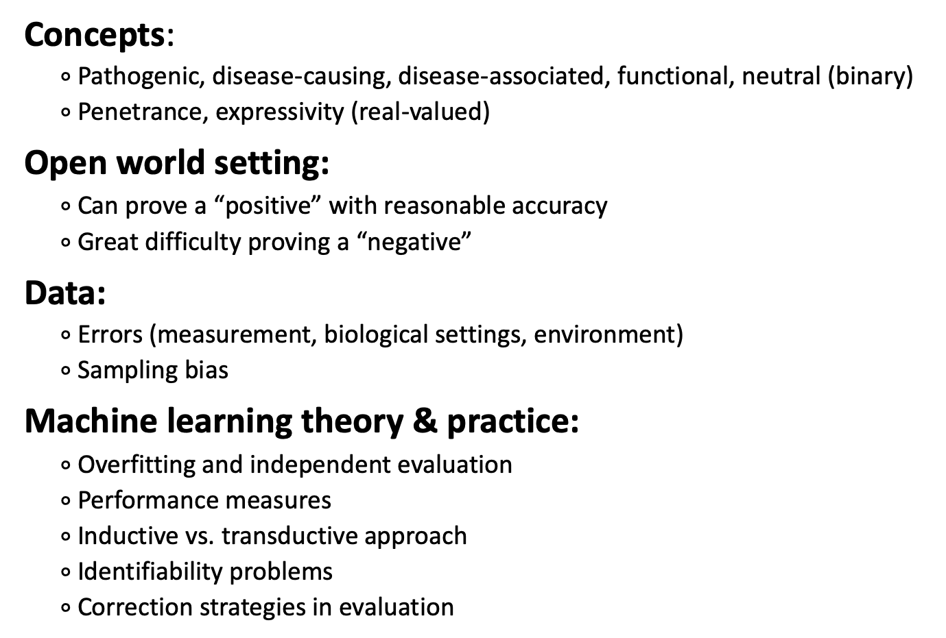
Why is Evaluation Complex?
Concepts:
$∘$ Pathogenic, disease-causing, disease-associated, functional, neutral (binary)
$∘$ Penetrance, expressivity (real-valued)
Open world setting:
$∘$ Can prove a “positive” with reasonable accuracy
$∘$ Great difficulty proving a “negative”
Data:
$∘$ Errors (measurement, biological settings, environment)
$∘$ Sampling bias
Machine learning theory & practice:
$∘$ Overfitting and independent evaluation
$∘$ Performance measures
$∘$ Inductive vs. transductive approach
$∘$ Identifiability problems
$∘$ Correction strategies in evaluation
We don’t know how
to evaluate!
We know how
to evaluate!
Stephen
Pedro

Slide 4



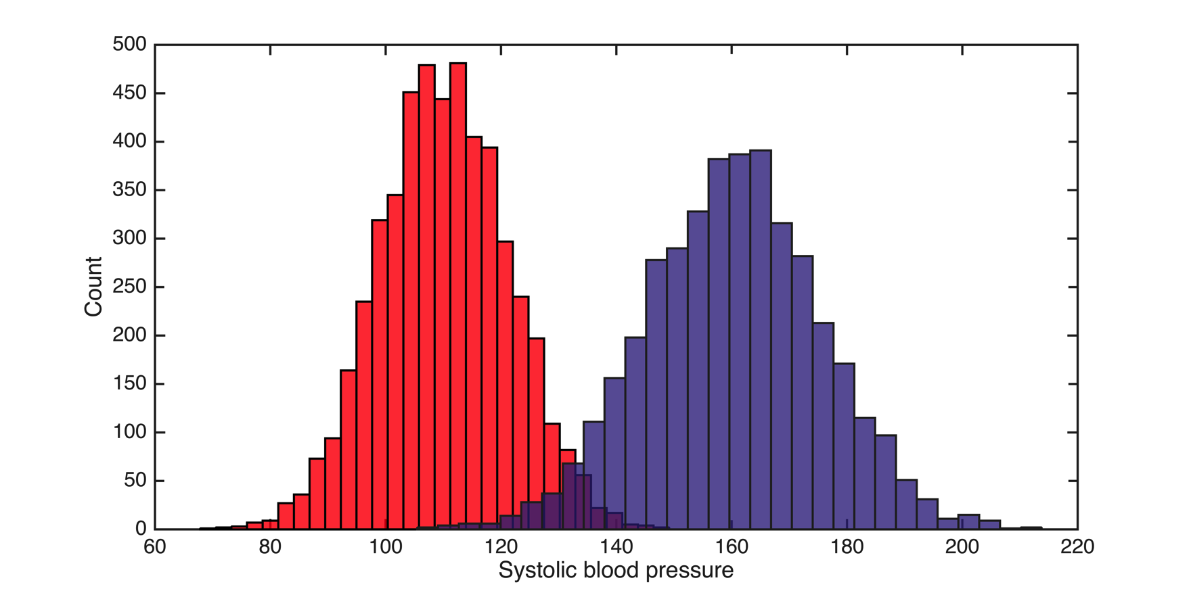

Supervised Learning

Slide 5

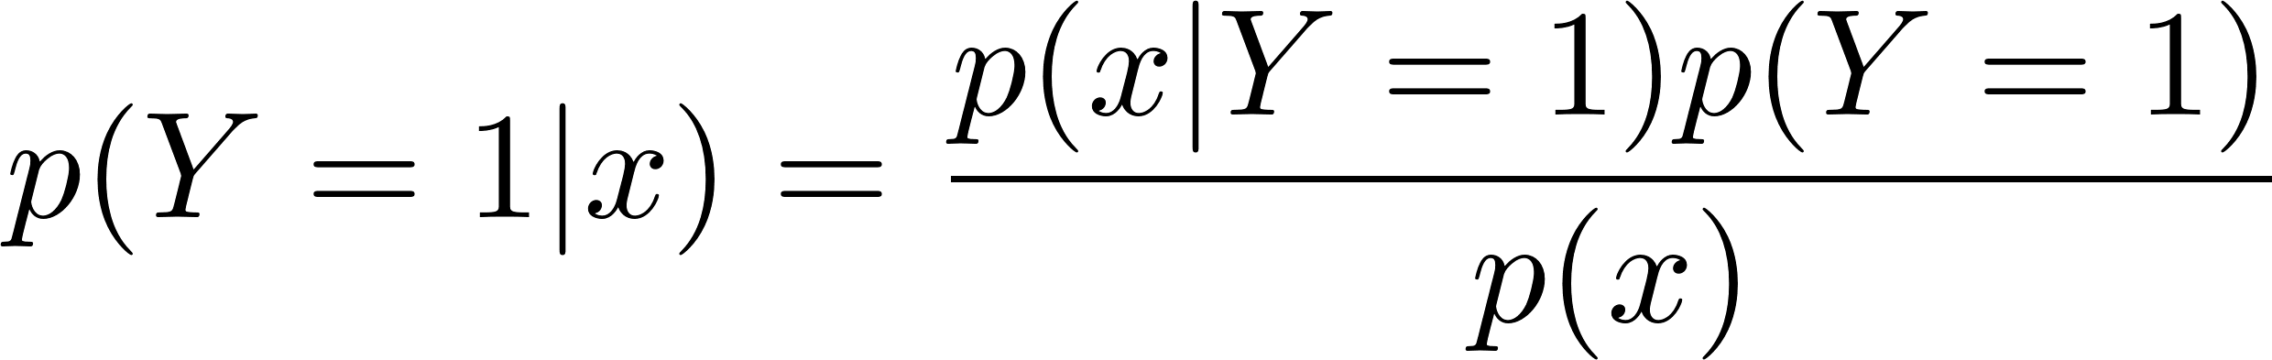
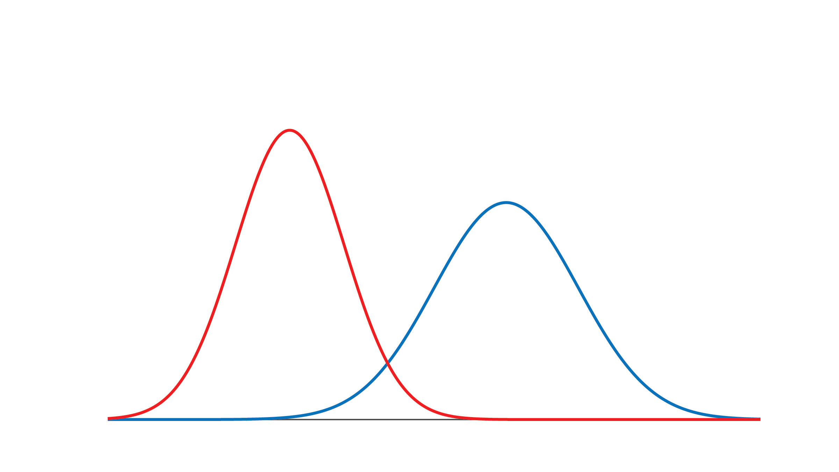
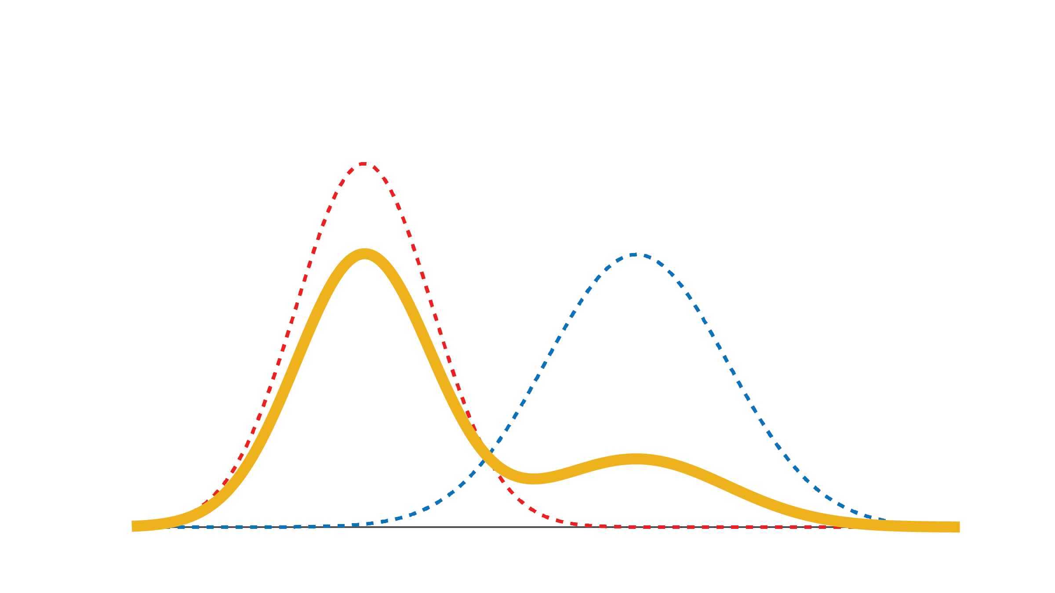
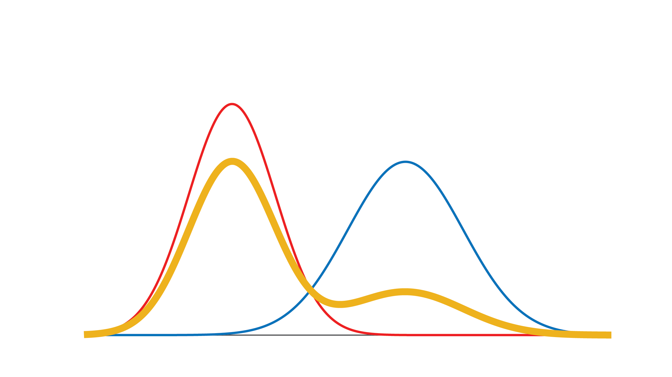
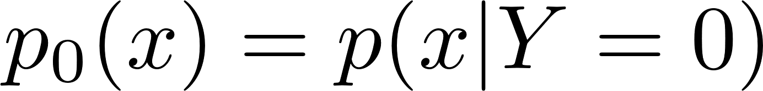
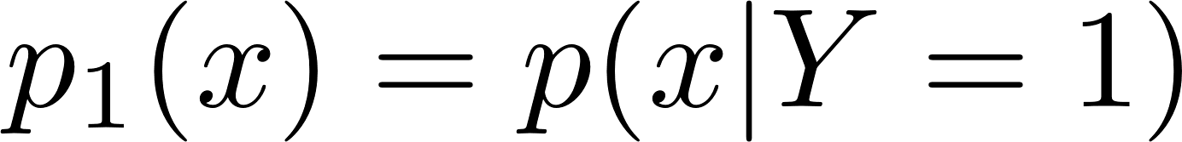
Supervised Learning
Jain et al. arXiv:1601.01944 (2016); Jain et al. NIPS 2016.

Slide 6
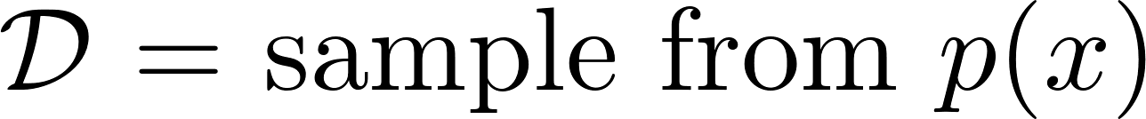
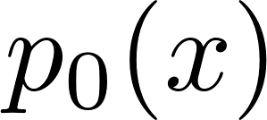
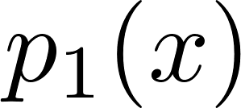
Semi-Supervised Learning
Jain et al. arXiv:1601.01944 (2016); Jain et al. NIPS 2016.

Slide 7
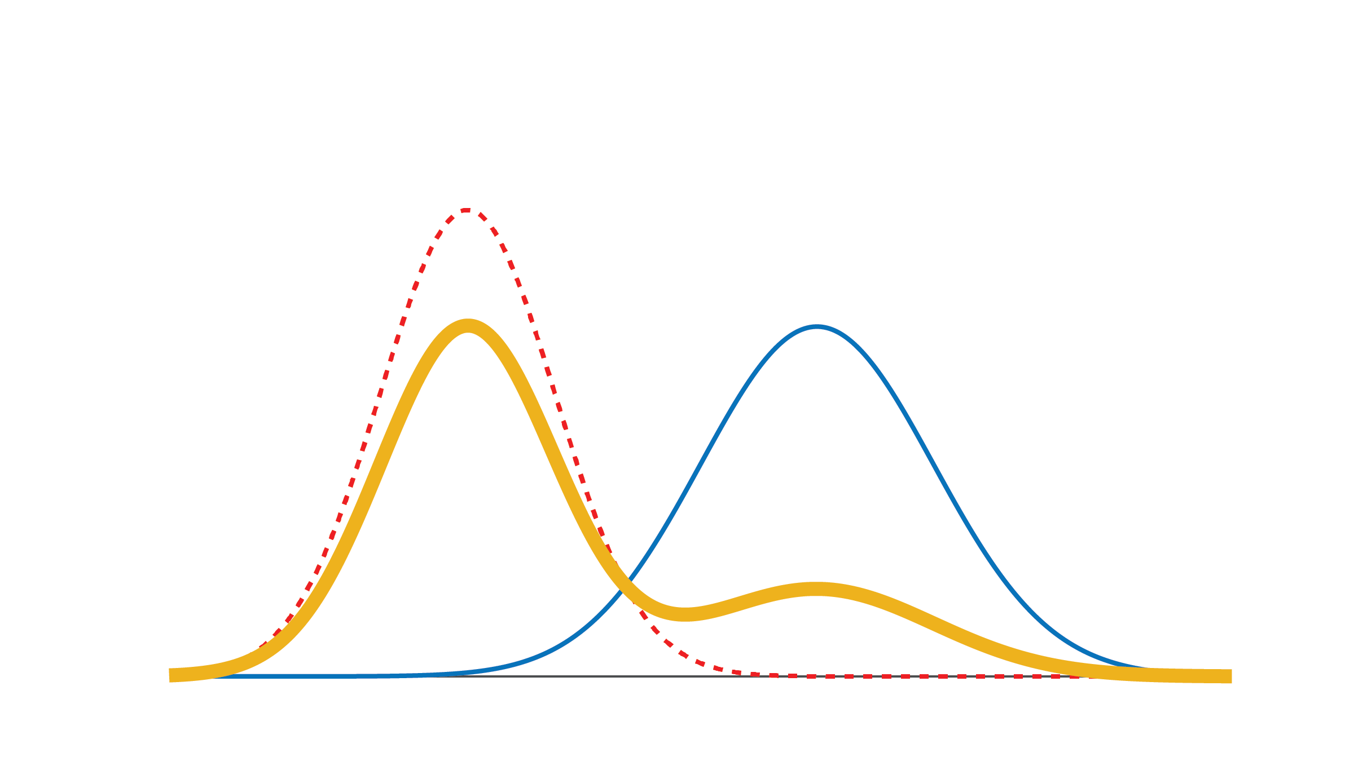
Positive-Unlabeled Learning
Jain et al. arXiv:1601.01944 (2016); Jain et al. NIPS 2016.

Slide 8
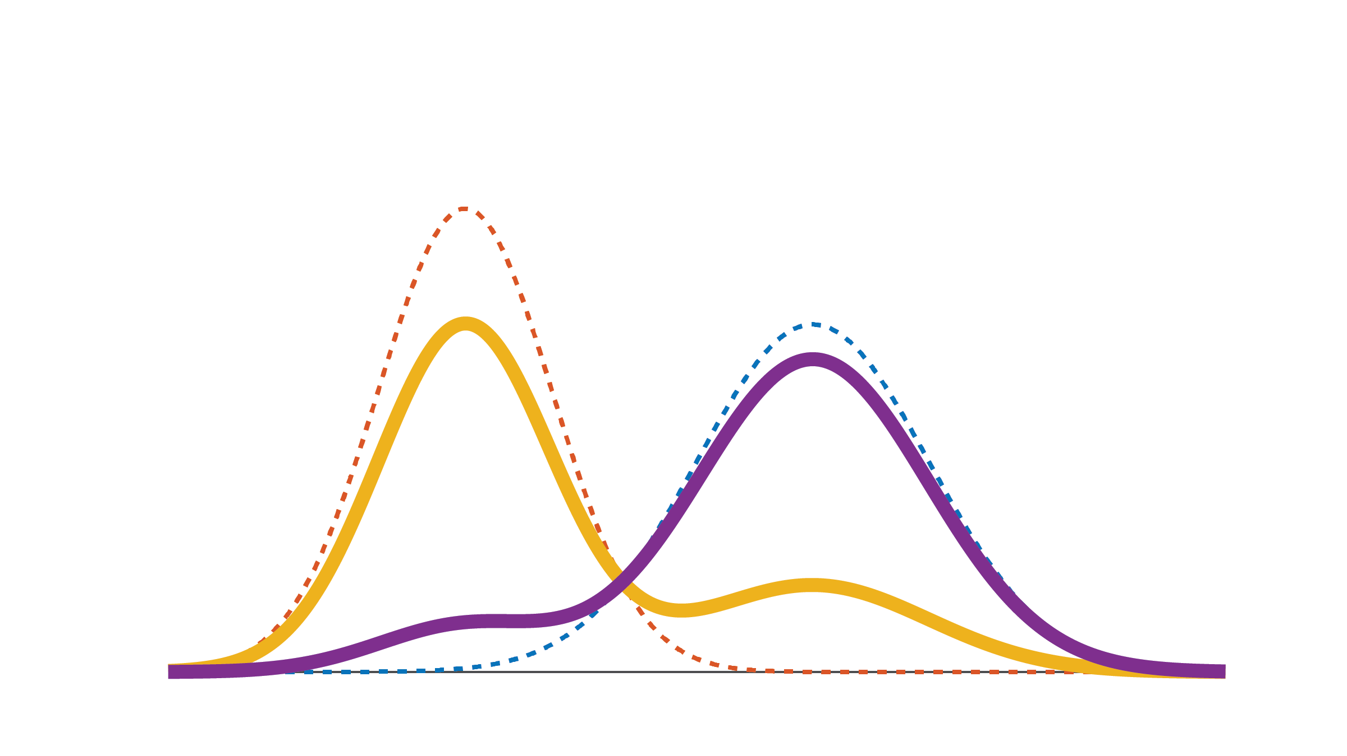
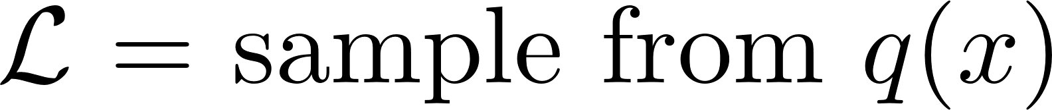
Noisy Positive-Unlabeled Learning
Jain et al. arXiv:1601.01944 (2016); Jain et al. NIPS 2016.

Slide 9
Unsupervised Learning
Jain et al. arXiv:1601.01944 (2016); Jain et al. NIPS 2016.

Slide 10

Prediction is Based on Posteriors
Jain et al. arXiv:1601.01944 (2016); Jain et al. NIPS 2016.

Slide 11
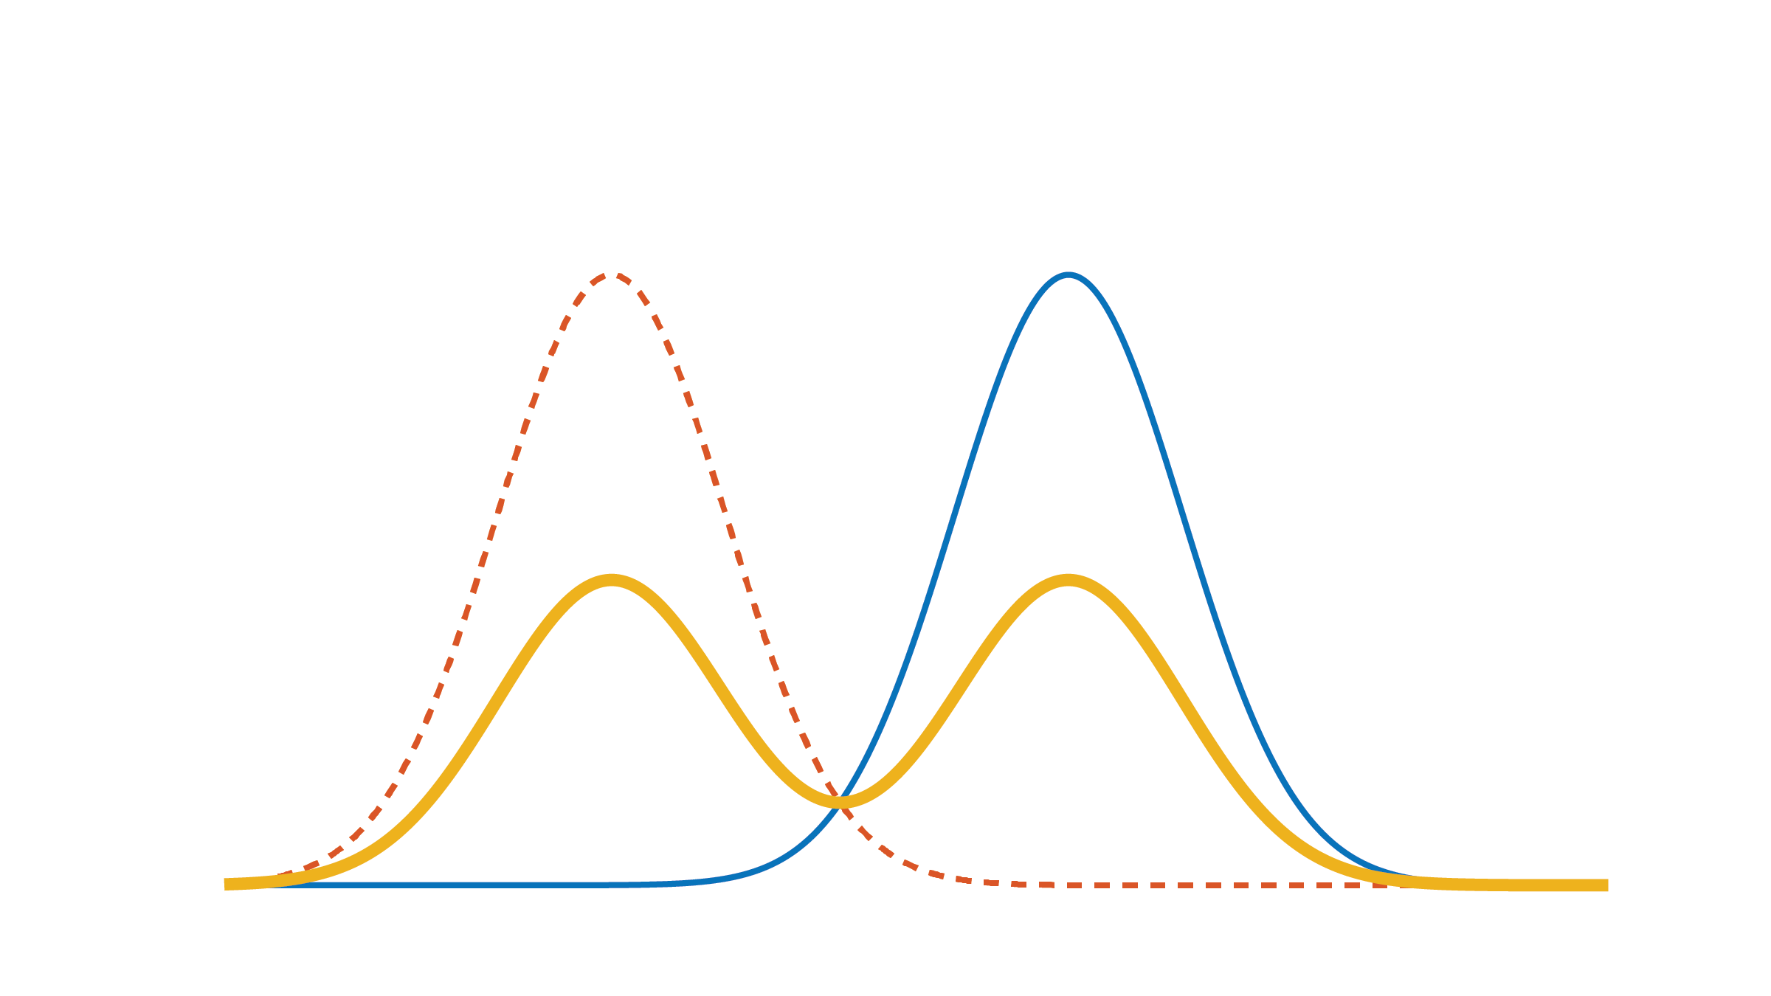
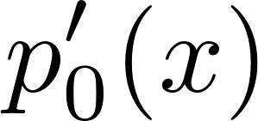
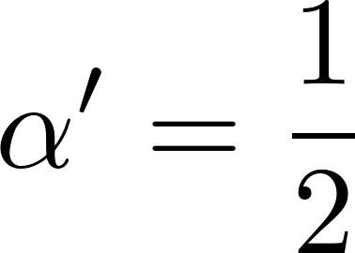
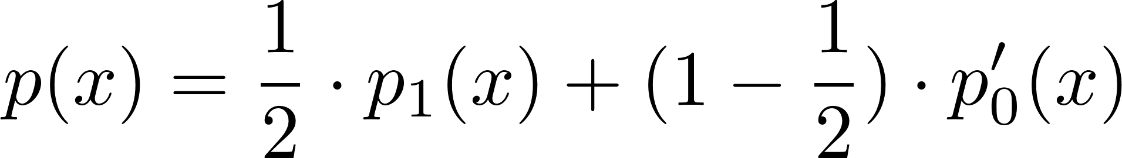
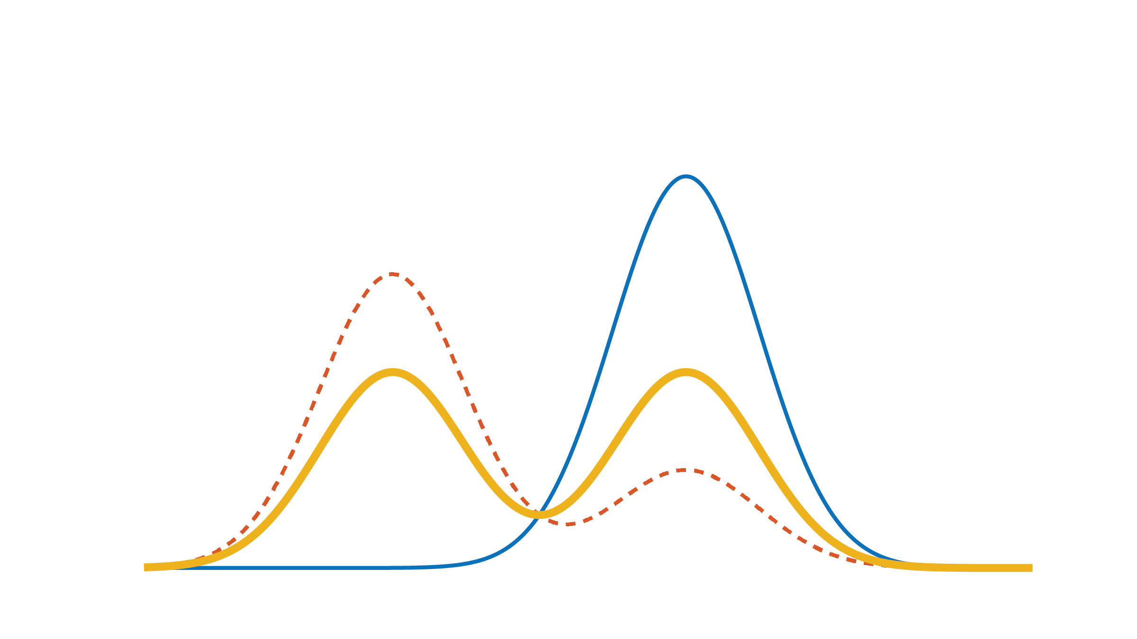
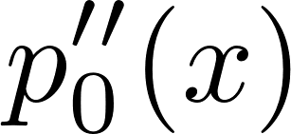
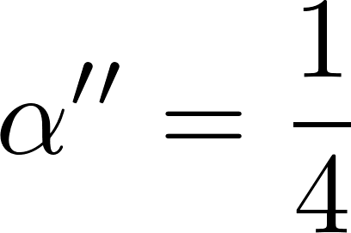
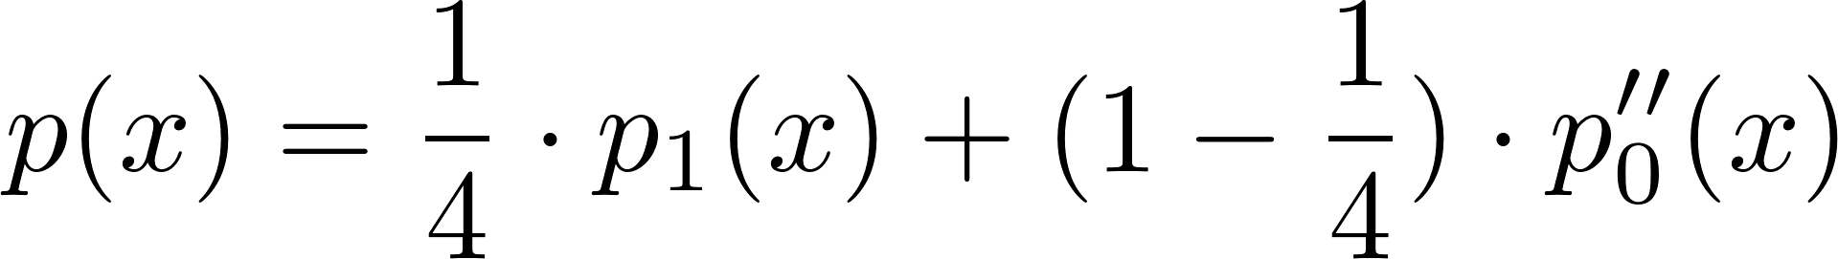
Identifiability
Jain et al. arXiv:1601.01944 (2016); Jain et al. NIPS 2016.

Slide 12

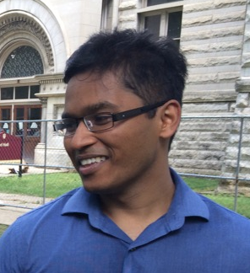
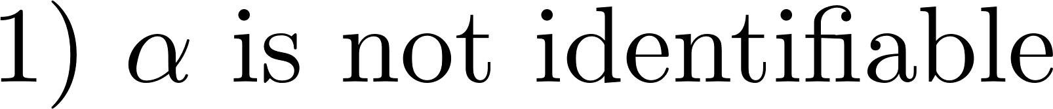
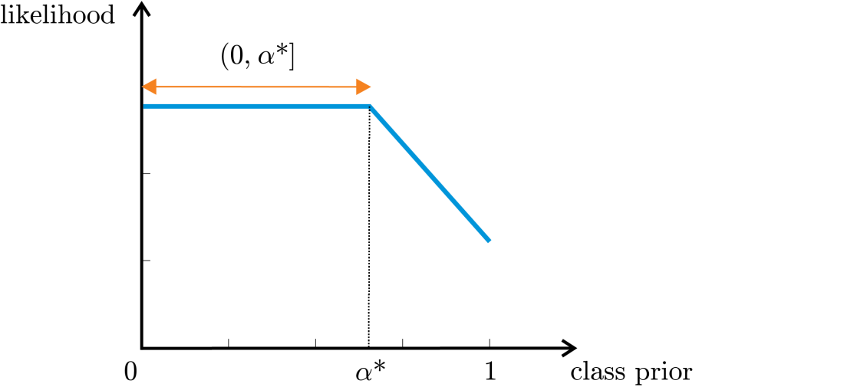
The AlphaMax Algorithm
Shantanu Jain
Blanchard et al. J Mach Learn Res (2010). Jain et al. arXiv:1601.01944 (2016)

Slide 13
The AlphaMax Algorithm
Jain et al. arXiv:1601.01944 (2016).

Slide 14
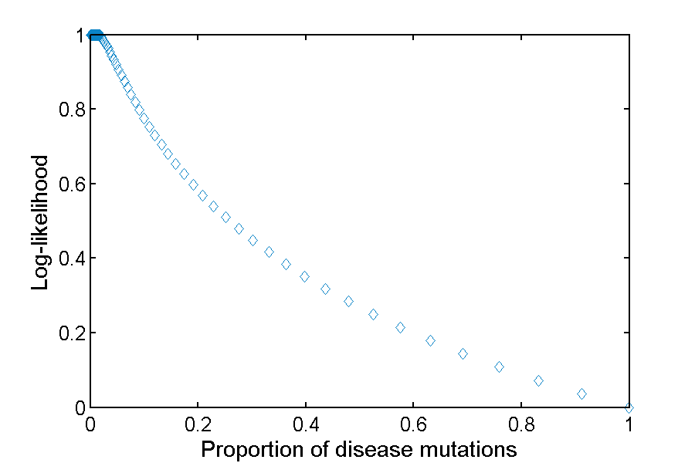
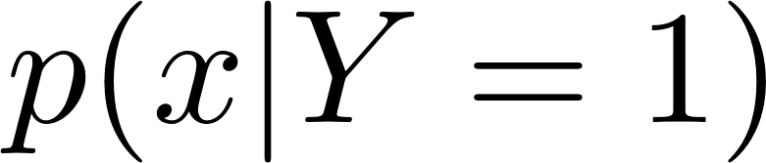
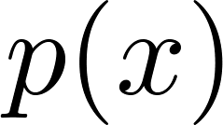
Fraction of Pathogenic Missense Variants
1.5% missense variants pathogenic in
an individual’s exome
Pejaver et al. bioRxiv: 134981 (2017).

Slide 15

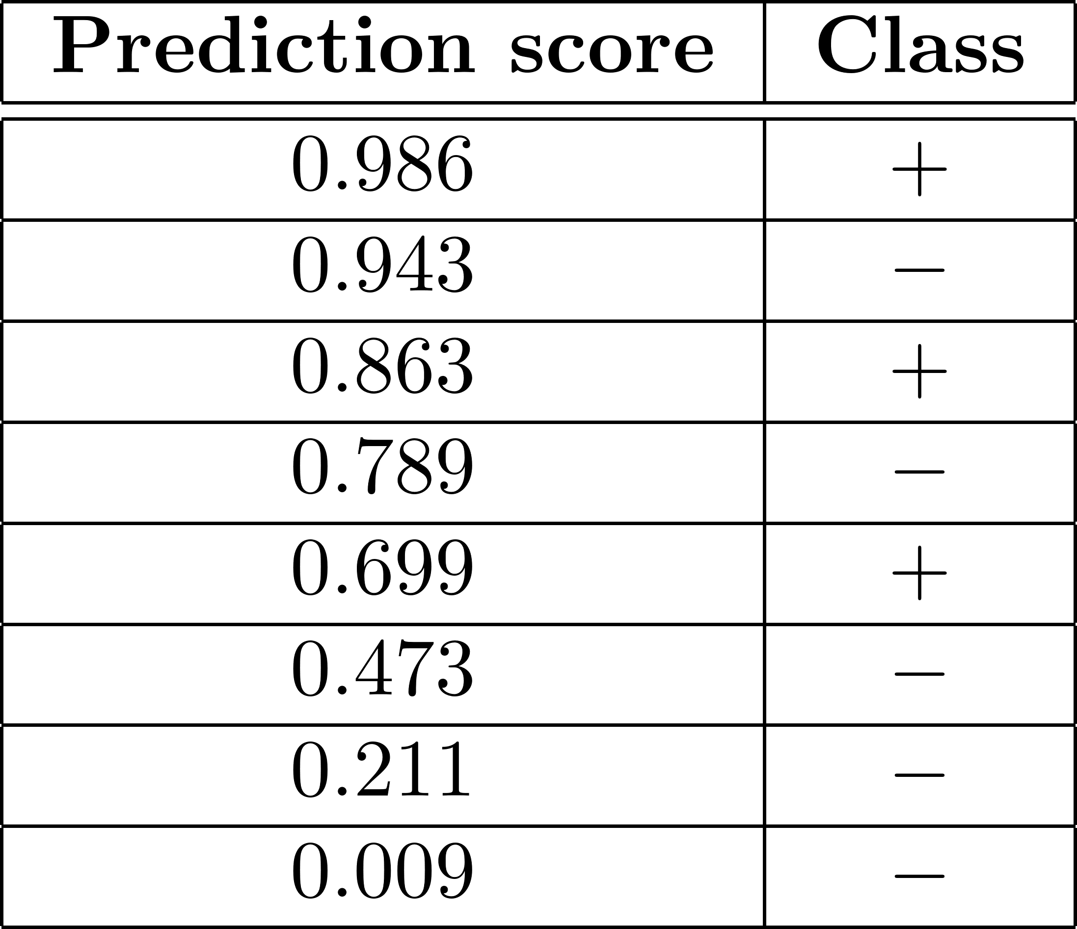

Impact on Area Under the ROC Curve
Jain et al., AAAI 2017

Slide 16

Impact on Area Under the ROC Curve
Jain et al., AAAI 2017

Slide 17

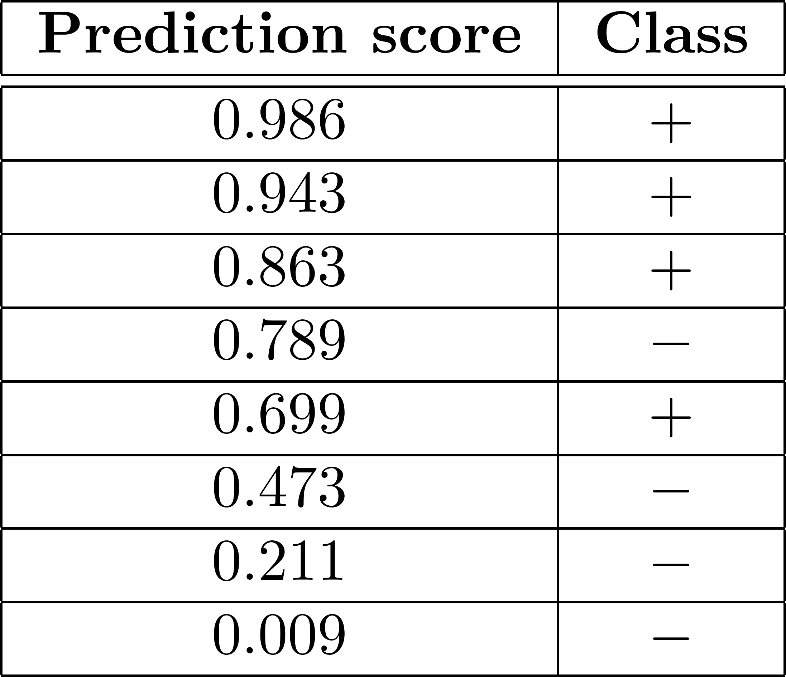
Impact on Area Under the ROC Curve
Jain et al., AAAI 2017

Slide 18
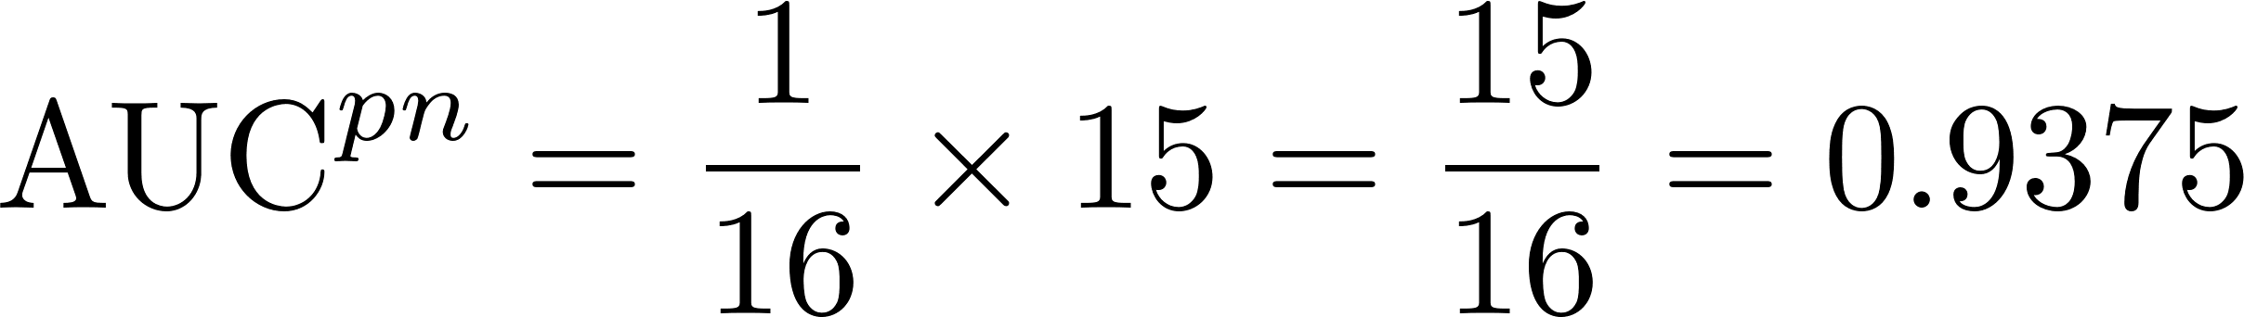
Impact on Area Under the ROC Curve
Jain et al., AAAI 2017

Slide 19


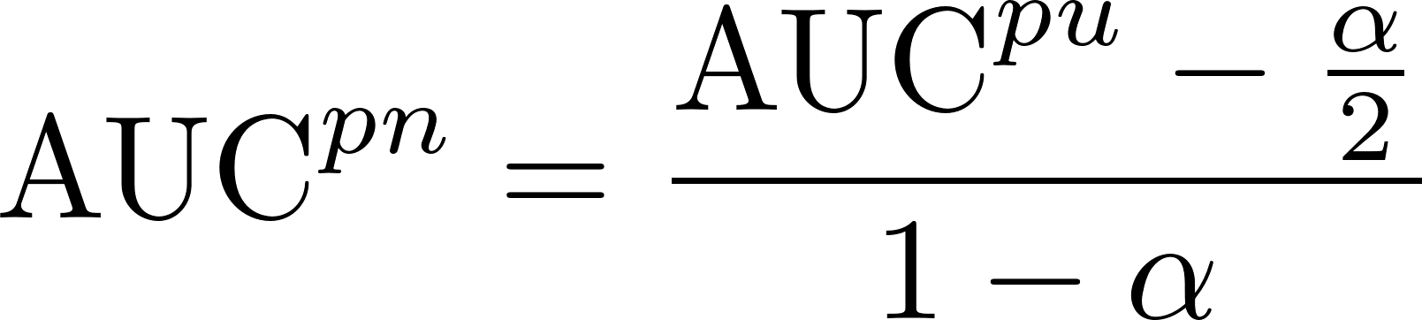

Impact on Area Under the ROC Curve
Menon et al., ICML 2015; Jain et al., AAAI 2017

Slide 20
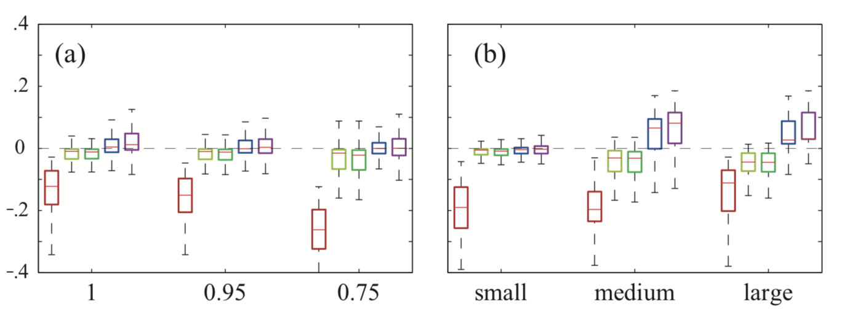

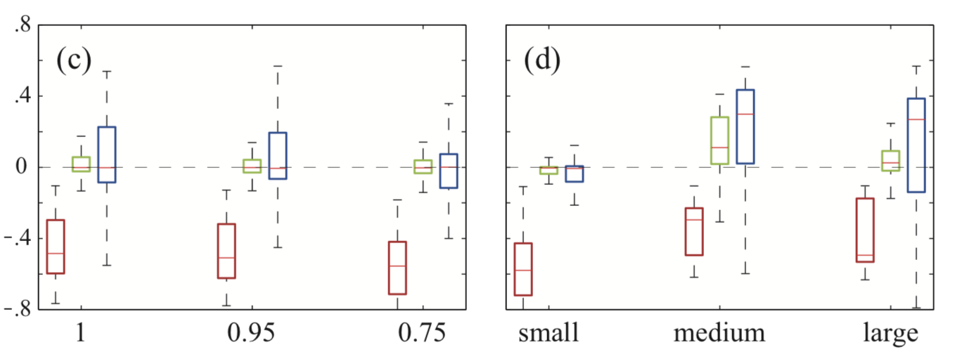
Impact on Area Under the ROC and Precision-Recall Curves
AUC-ROC
AUC-PR
Jain et al., AAAI 2017

Slide 21
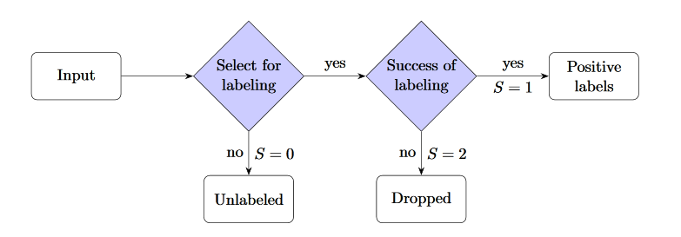
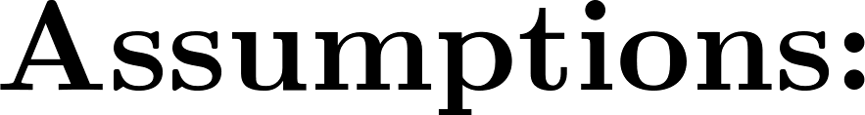

Corrections for Posteriors
Jain et al. arXiv:1601.01944 (2016); Jain et al. NIPS 2016.

Slide 22


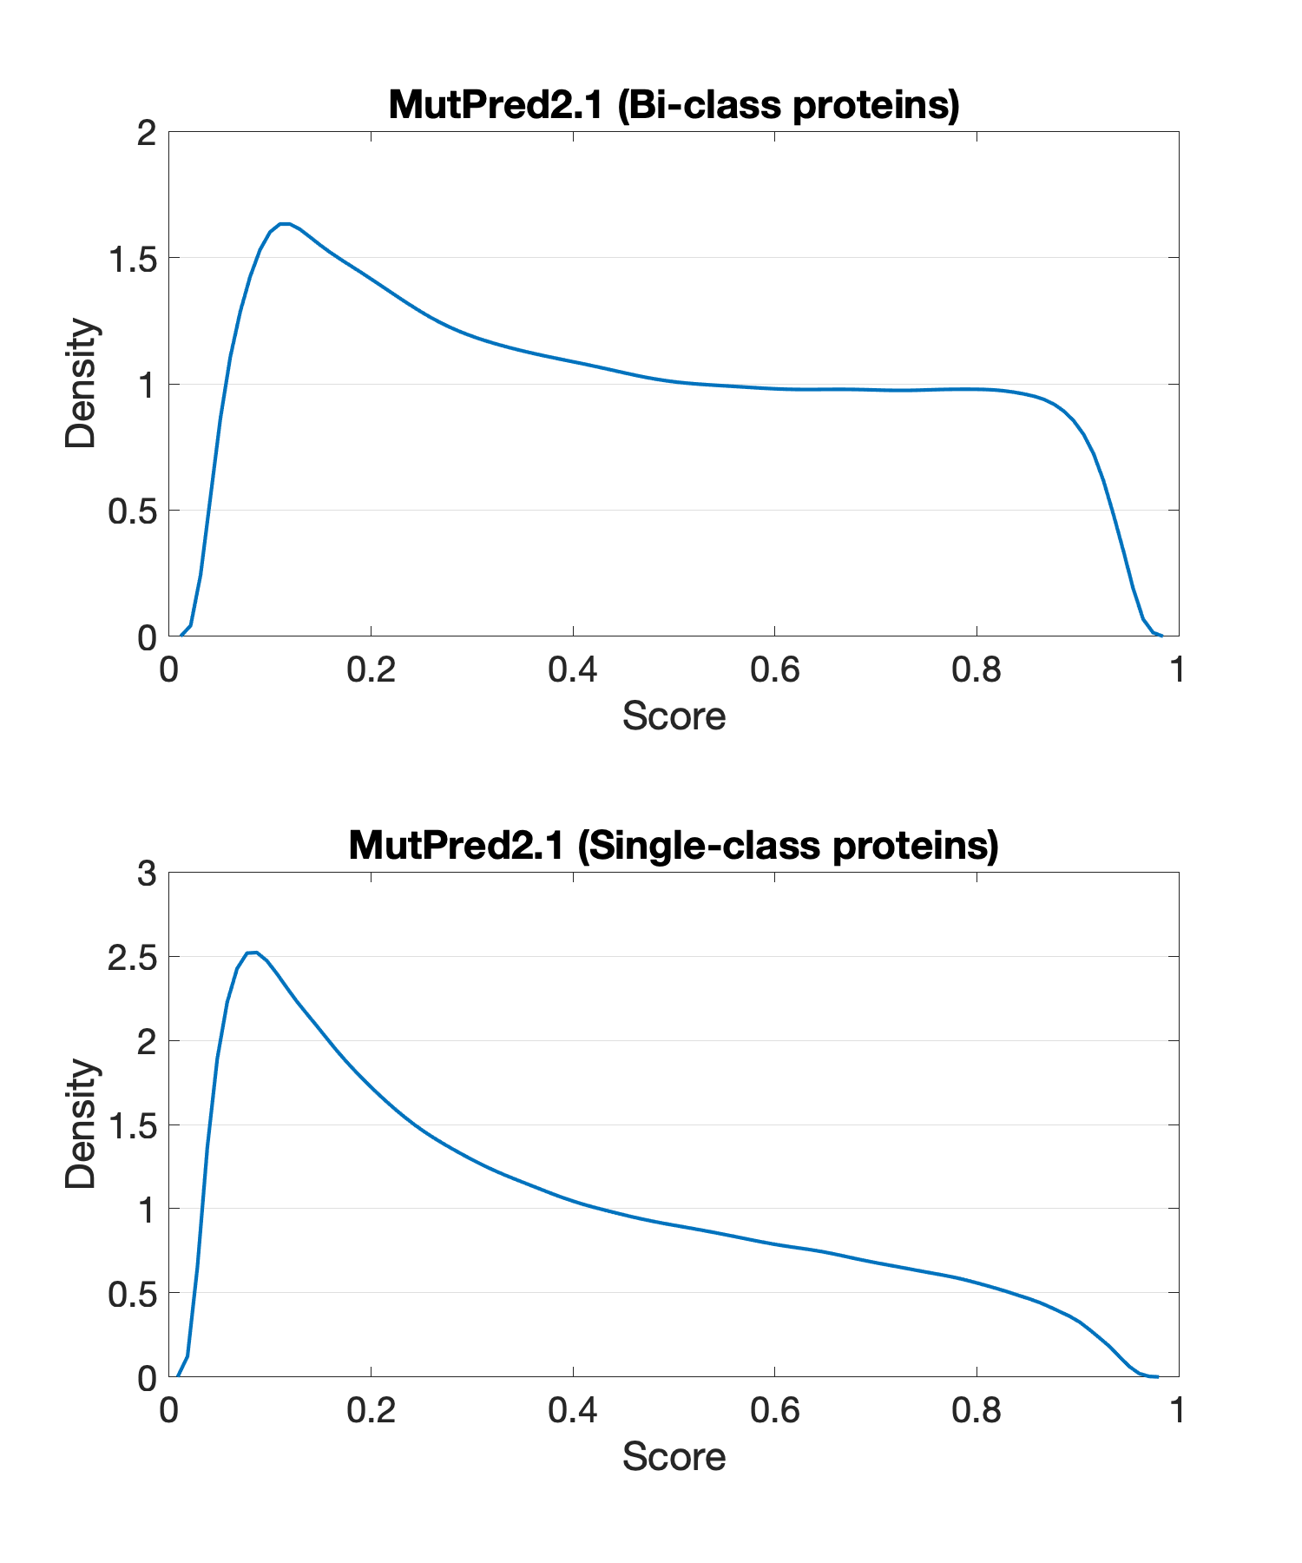
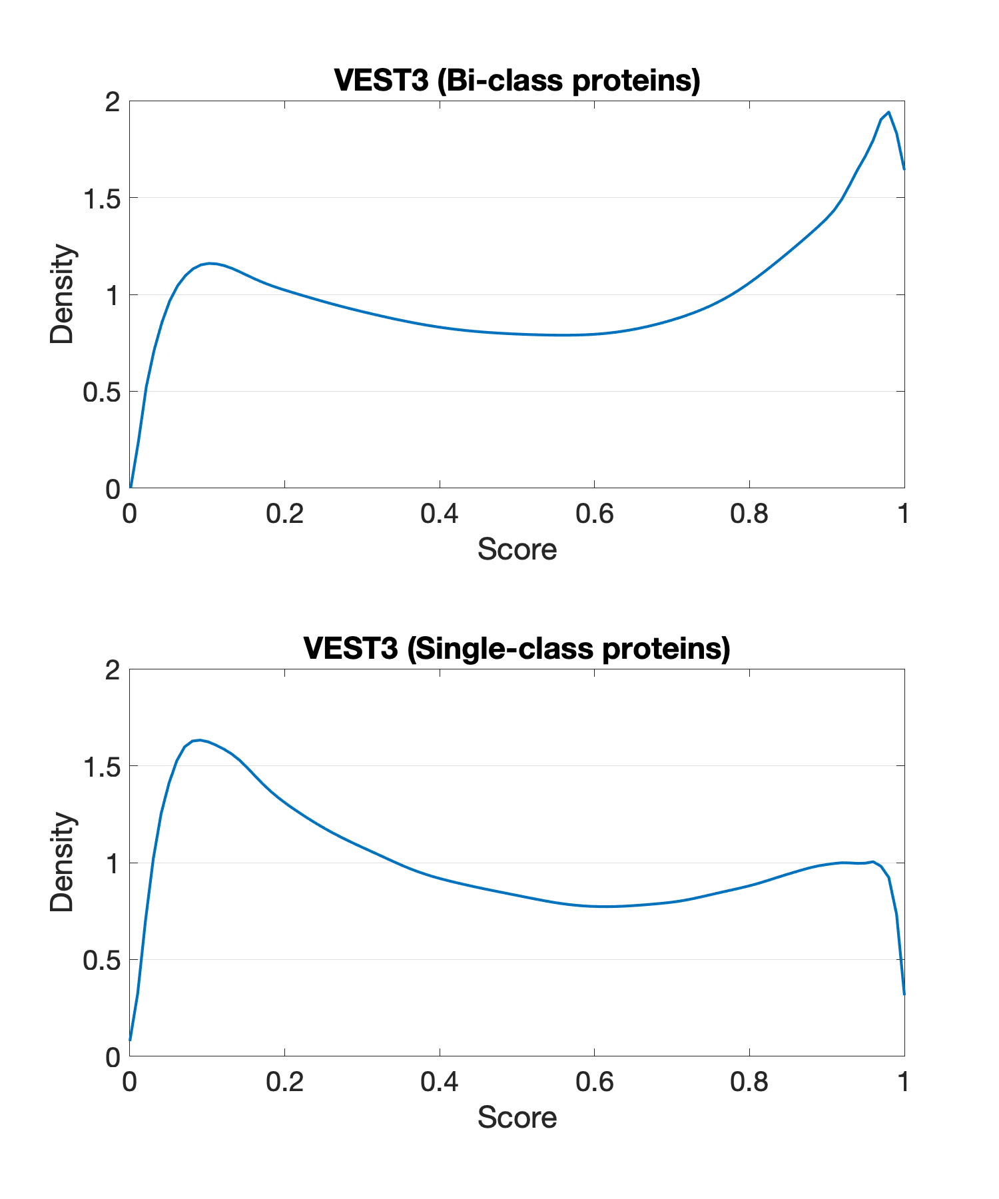
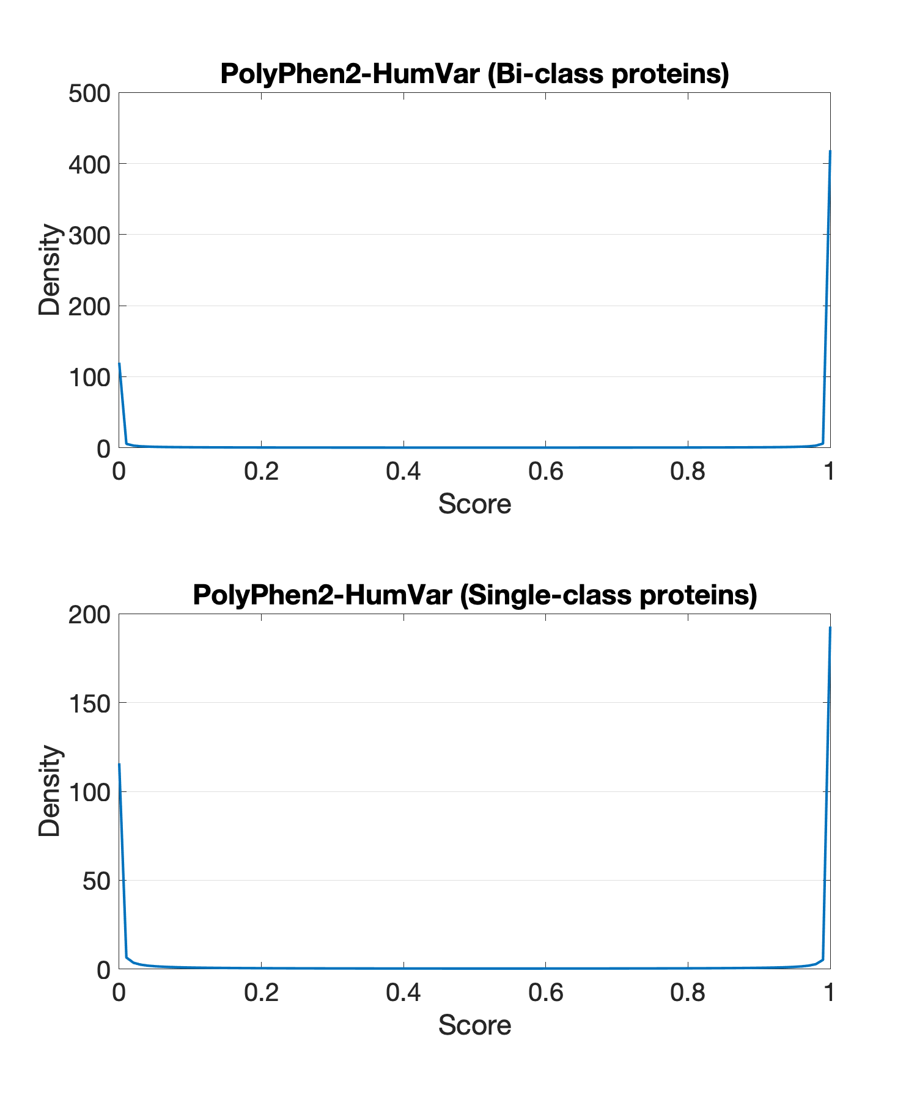
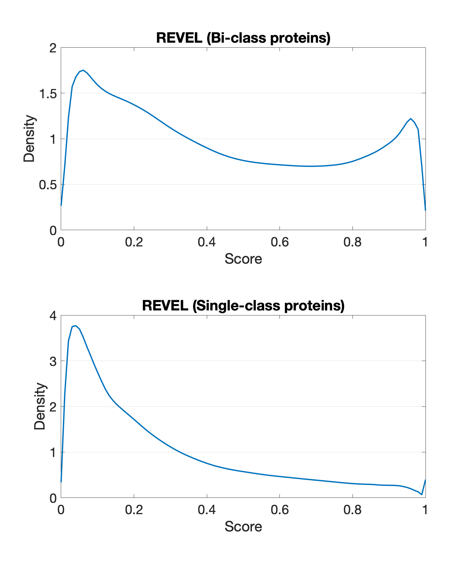
Estimating Posteriors: Score Distributions

Slide 23
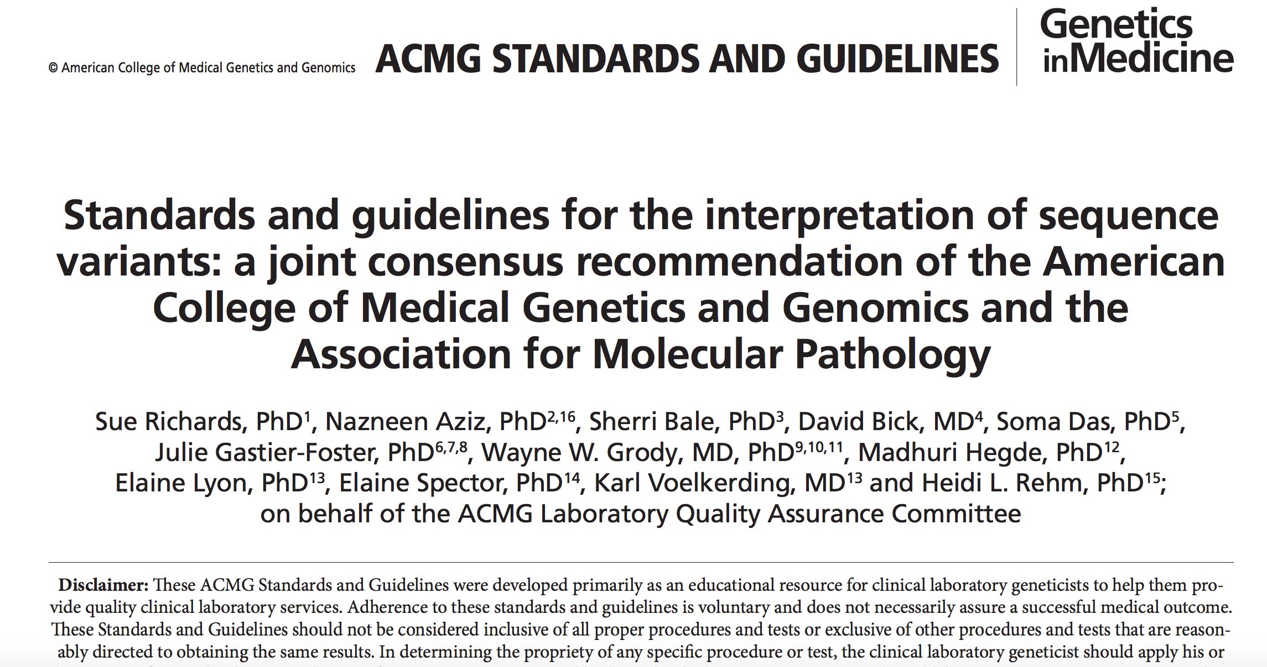
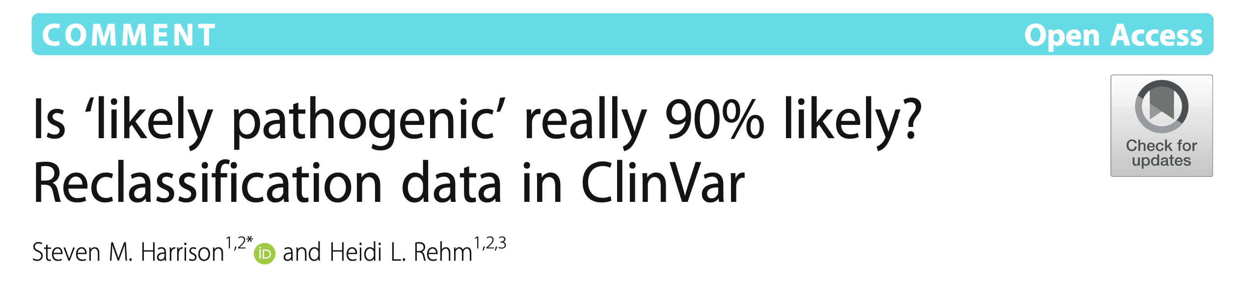

Slide 24
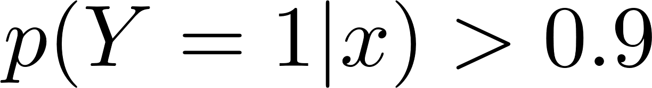
Likely Pathogenic

Slide 25
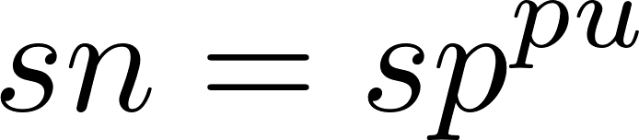
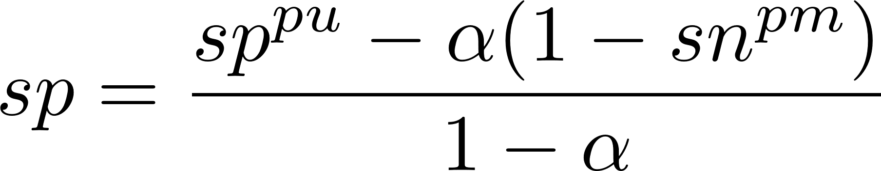
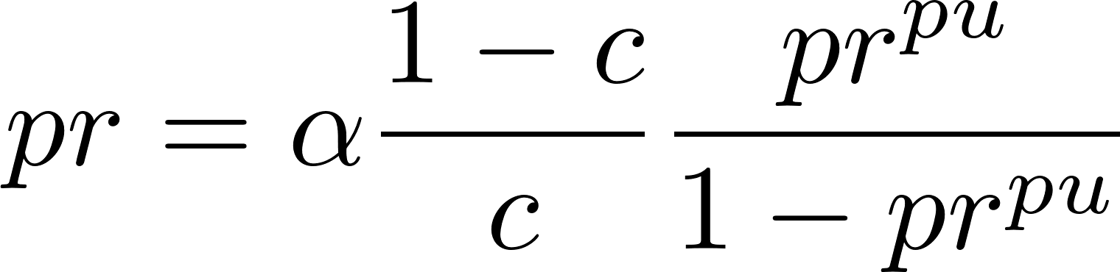
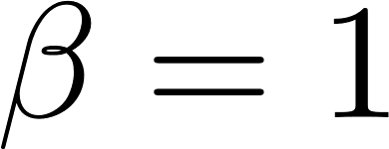
Estimating Precision: Corrections
Jain et al., AAAI 2017; Ramola et al., PSB 2019.

Slide 26

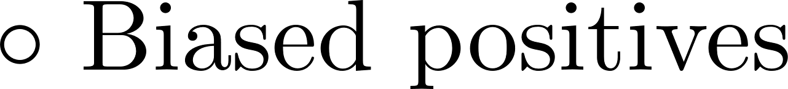
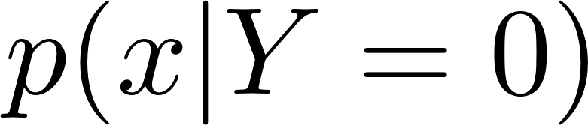
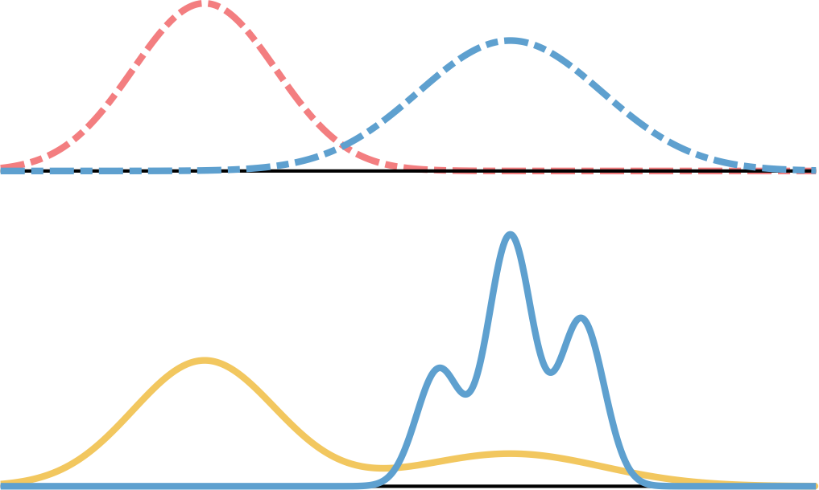


Final Thoughts
Pejaver et al. Hum Mutat. 2019; Jain et al. AAAI 2020.

Slide 27











Thank You
Vikas
Jose
Moses
Kym
Jose
Sujun
Shantanu
Tyrese
Abraham
Sean, UW
Lilia, UCSD
Martha, Alberta
Yuxiang
Sujun
Mary Anne
David, Cardiff
Jonathan, UCSD
Michael, Indiana
Ruiyu

