Slide 1

CAGI slide pack guidelines
I agree to my slides being used according to the following terms:
Kymberleigh Pagel
Authors: please include THIS slide at the beginning of your presentation to indicate that you agree with reuse of your slides in CAGI presentations, according to the terms below, and digitally sign by writing your name above.
To disseminate the CAGI results, I encourage all CAGI participants to remix these CAGI slides for inclusion in their oral and poster presentations
CAGI participants may use or publish any content of these slides only in compliance with the CAGI Data Use Agreement
CAGI participants may not cite or publish any content of these slides except with the written permission of the originating author or in the primary CAGI publications
CAGI participants must acknowledge the original authors of these slides and CAGI 2013. Include the acknowledgement banner across the bottom
CAGI participants must include the CAGI credits slide in their presentations
Slides with a red slash (no remix) may not be included in a presentation unless all attendees are registered CAGI participants who signed the data use agreement
Slides with a red X over the entire slide may not be used in any circumstances
Slides with a blue slash (embargoed) may not be used unless the embargo is explicitly lifted
Slides without slash or X may be tweeted unless flagged with the “No tweet” icon.
CAGI participants using these slides must explain the “No tweet” icon, which means that the slide content should not be disseminated outside the presenting conference hall. If the presentation venue permits pervasive tweeting, you may not include these slides in your talk
Note for slide authors: we expect all CAGI participants to abide by these restrictions, and will make best effort to ensure they are followed. However, but bear in mind that we have limited means of enforcing them, and therefore the restrictions cannot be guaranteed.

Slide 2





OpenCRAVAT: the Open Custom- Ranked Analysis of Variants Toolkit
Kymberleigh Pagel
Karchin Lab Department of Biomedical Engineering Institute of Computational Medicine
Johns Hopkins University
K A R C H I N L A B
https://opencravat.org @OpenCRAVAT

Slide 3


Variant annotation and analysis is important to tackling genetic disease
OpenCRAVAT addresses the gap between the amount of available data and our ability to use that information
Platform for sharing and integration of genetic annotations
Developers can provide data directly to the app store
Open source and locally installable
Genomic Features
Annotations
Machine Learning Algorithms

Slide 4
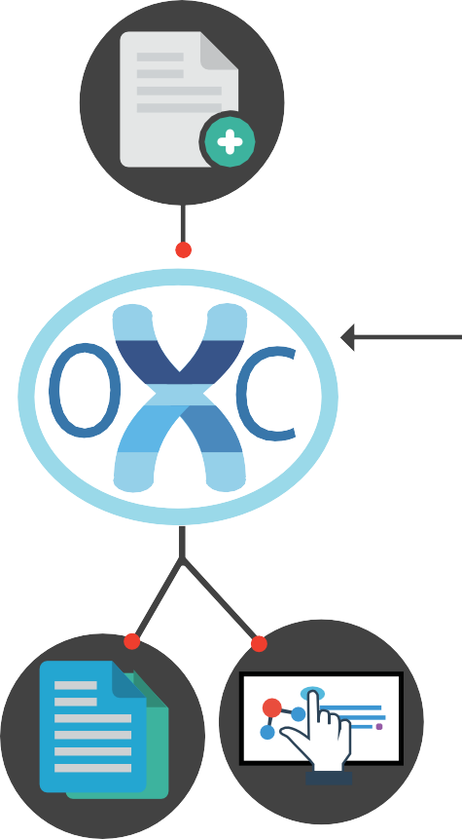
OpenCRAVAT impacts every step of variant analysis
Install resources from the app store
Annotate input variants
Filter and analyze
Export and share results
Input Variants
Selected annotations
Store
For CAGI, use of OpenCRAVAT can address issues with data availability
Excel and text output
Interactive viewer
Available on both GUI and command line

Slide 5
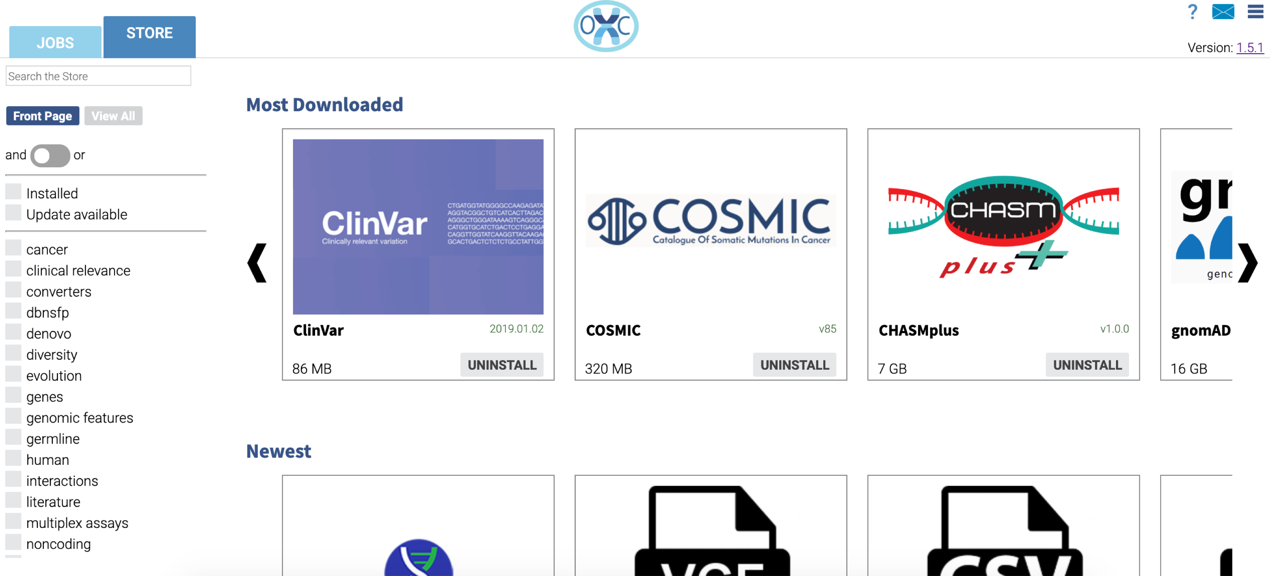
70+ tools, updated weekly
Seeking new tools and resources
OpenCRAVAT app store
Store data locally, preserve privacy
Precomputed predictions for some well-used
tools, e.g. Sift and REVEL

Slide 6
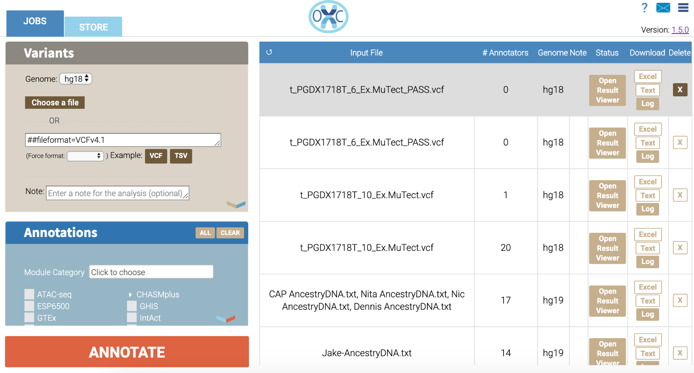
Command
Line
cravat input.vcf –l hg19 –t vcf -a clinvar
Submit annotation job
Graphical interface
View previous jobs

Slide 7
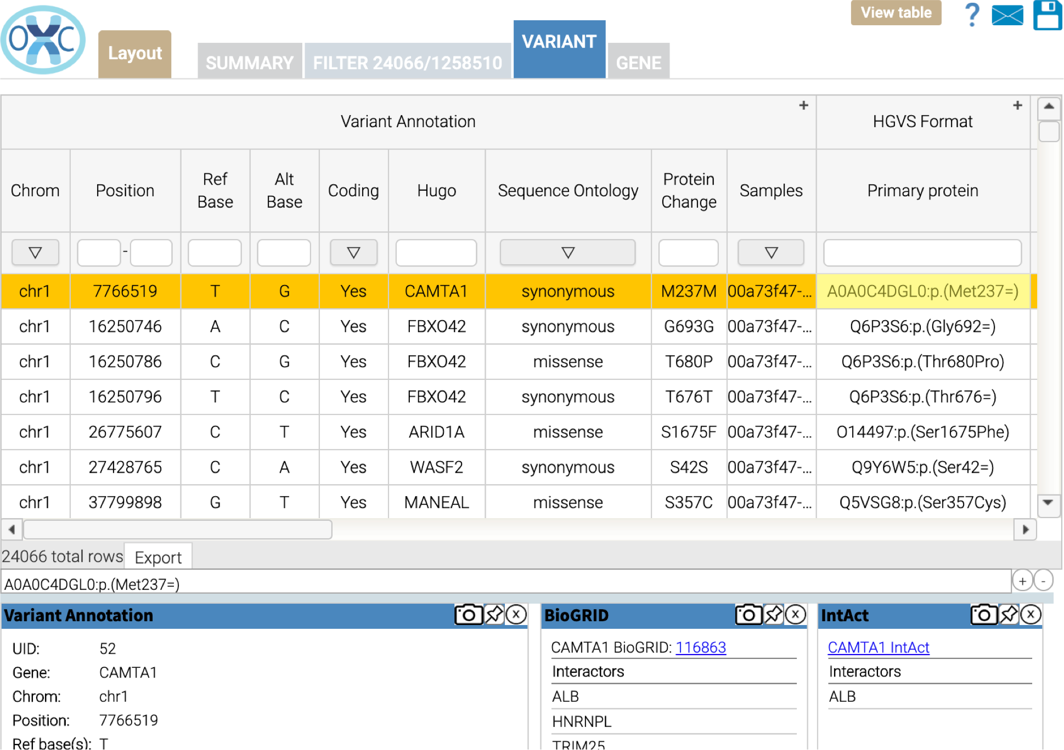
OpenCRAVAT for CAGI
Outstanding tools from 100s of groups are available –not easy to integrate
  OpenCRAVAT can support these needs
Flexible and modular architecture accommodate different tasks
  Command line or interactive interface
App store to share methods and assessment/visualization apps
Sharable output files – individual methods, aggregated predictions, and analysis results

Slide 8
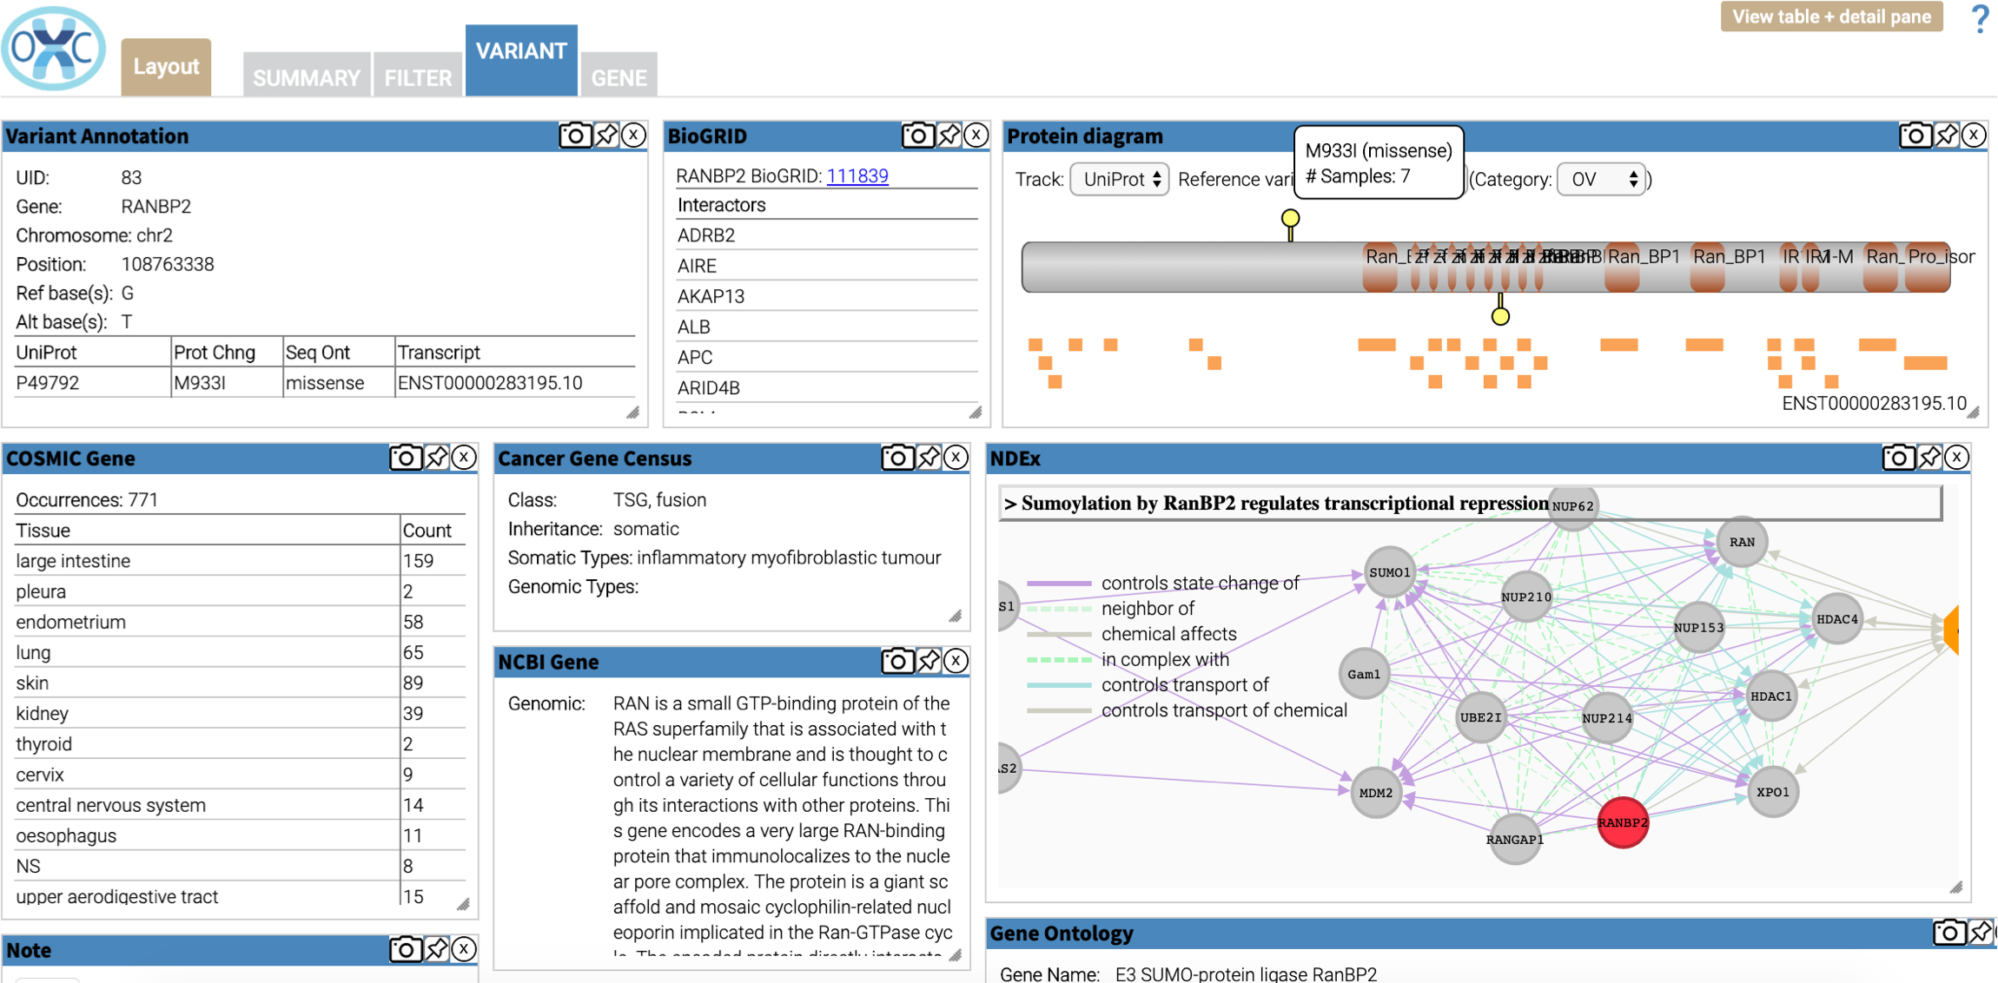
Fast, flexible aggregation means more time for assessment
Interactive interface
  Explore, filter, and compare predictions
  Develop presentation-quality visualization apps, e.g. ROC curves
Share aggregated prediction data in pipeline-friendly output file formats (VCF, TSV, etc.)
  Allows assessors and other interested parties to fully analyze results
  Assessors are not tethered to interactive interface

Slide 9





Principal Collaborators and Funding
Karchin Lab Rachel Karchin Noushin Niknafs Collin Tokheim Chris Douville Lily Zheng
In Silico Solutions
Michael Ryan Rick Kim
Kyle Moad
Other collaborators
Ben Busby Christian Townes
Katherine Van Winkle
Funding for OpenCRAVAT/MuPIT
support@cravat.us http://opencravat.org
@OpenCRAVAT
Information Technologies for Cancer Research, NCI (grants U01-CA180956, U24CA204817)

