Slide 1

CAGI slide pack guidelines
I agree to my slides being used according to the following terms:
Andrew Sharo
Authors: please include THIS slide at the beginning of your presentation to indicate that you agree with reuse of your slides in CAGI presentations, according to the terms below, and digitally sign by writing your name above.
To disseminate the CAGI results, I encourage all CAGI participants to remix these CAGI slides for inclusion in their oral and poster presentations
CAGI participants may use or publish any content of these slides only in compliance with the CAGI Data Use Agreement
CAGI participants may not cite or publish any content of these slides except with the written permission of the originating author or in the primary CAGI publications
CAGI participants must acknowledge the original authors of these slides and CAGI 2013. Include the acknowledgement banner across the bottom
CAGI participants must include the CAGI credits slide in their presentations
Slides with a red slash (no remix) may not be included in a presentation unless all attendees are registered CAGI participants who signed the data use agreement
Slides with a red X over the entire slide may not be used in any circumstances
Slides with a blue slash (embargoed) may not be used unless the embargo is explicitly lifted
Slides without slash or X may be tweeted unless flagged with the “No tweet” icon.
CAGI participants using these slides must explain the “No tweet” icon, which means that the slide content should not be disseminated outside the presenting conference hall. If the presentation venue permits pervasive tweeting, you may not include these slides in your talk
Note for slide authors: we expect all CAGI participants to abide by these restrictions, and will make best effort to ensure they are followed. However, but bear in mind that we have limited means of enforcing them, and therefore the restrictions cannot be guaranteed.

Slide 2
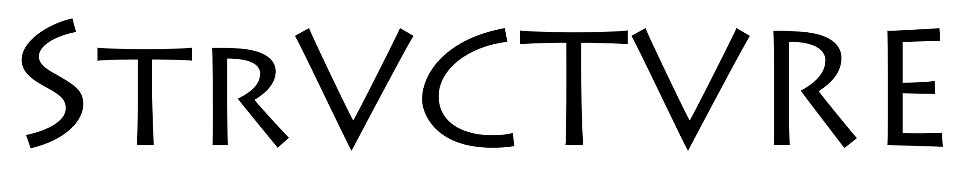
classifies pathogenic structural variants
Andrew Sharo
Brenner Group
Notes:
Hello, my name is Andrew Sharo, I’m a PhD student in Steven Brenner’s group at UC Berkeley. Today I’m going to tell you about a method we’ve been working on called strvctvre, which learns from existing databases of structural variants to predict which structural variants, if any, seen in a proband, are likely to be pathogenic.

Slide 3

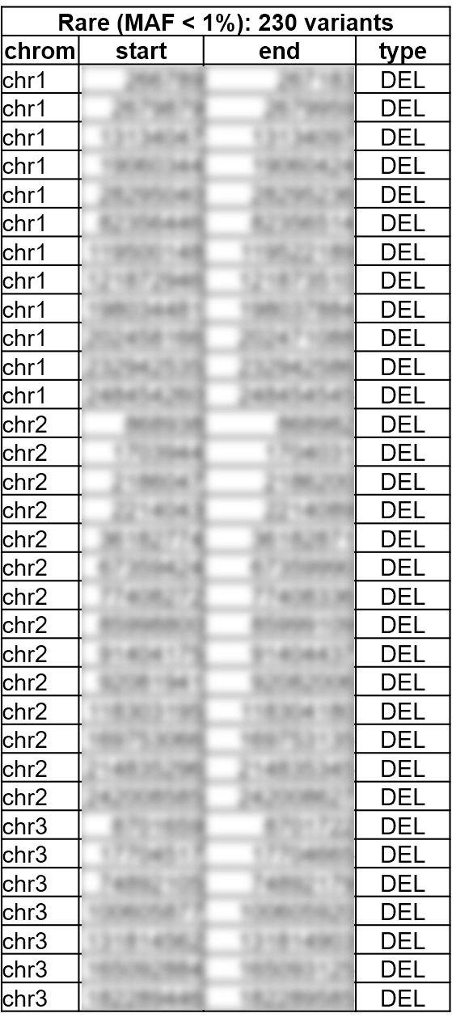
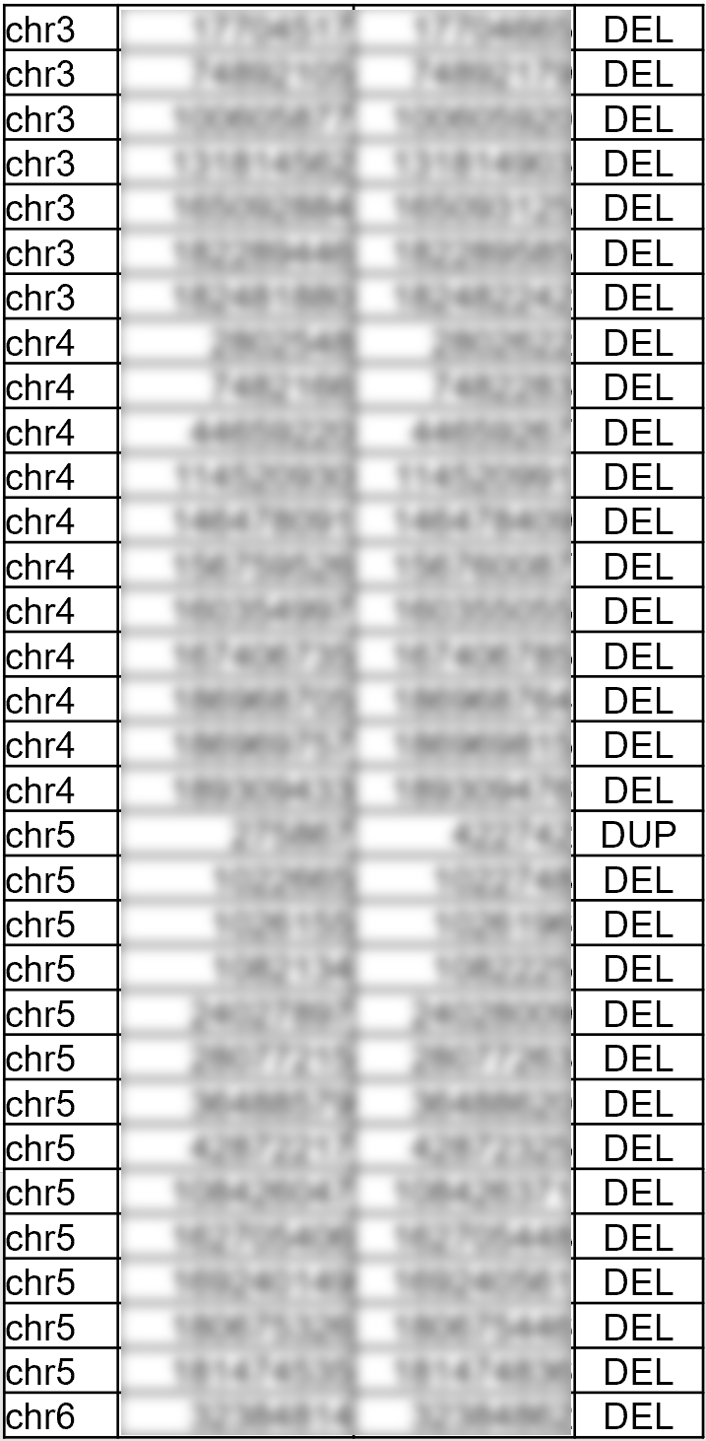
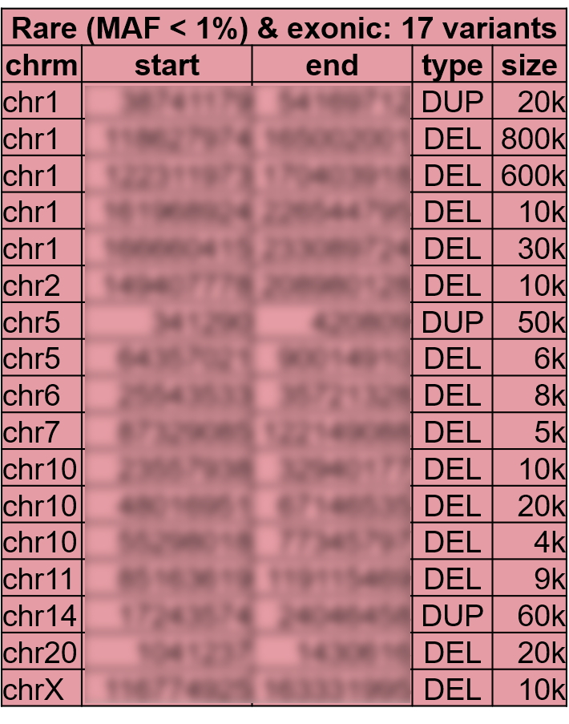



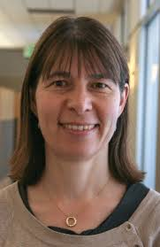

There are many variants to consider after applying available structural variant filters
*blurred and jumbled
for privacy
Cohort
of 50 individuals
https://pixabay.com/fr/illustrations/dessin-animé-enfants-enfant-1099728/
x 50
5 year old male
developmental delay,
hirsutism, seizures,
hypotonia, constipation
Dario
Boffelli
David
Martin
Pui
Kwok
Anne
Slavotinek
Joseph
Shieh
Notes:
I didn’t set out to create a structural variant impact predictor, instead I was looking for causal variants in a cohort of 50 probands with suspected rare genetic disorder, and for whom we had high resolution structural variant data. Analyzing this cohort was a team effort between researchers at multiple institutions. To give you a sense of the challenge, let’s focus on just a single case. In our study, there was a male proband with these phenotypes, which don’t match uniquely to any rare disorder. Analysis of his single nucleotide variants and indels through a trio exome yielded nothing of interest. So, to analyze his structural variants I began by retaining variants with a cohort frequency of less than 1%, which still gave 230 deletions and duplications in this proband, a fraction of which I’ve shown here. Even after retaining only those rare variants overlapping exonic regions, I had 17 deletions and duplications to consider, which poses a scientific challenge to thoroughly investigate each variant for whether it could be disease causing based on what we know about the genomic context, but is doable given time and resources. I wondered what automated methods were already available to help me approach this problem, and to at least prioritize which structural variants to manually investigate first.

Slide 4
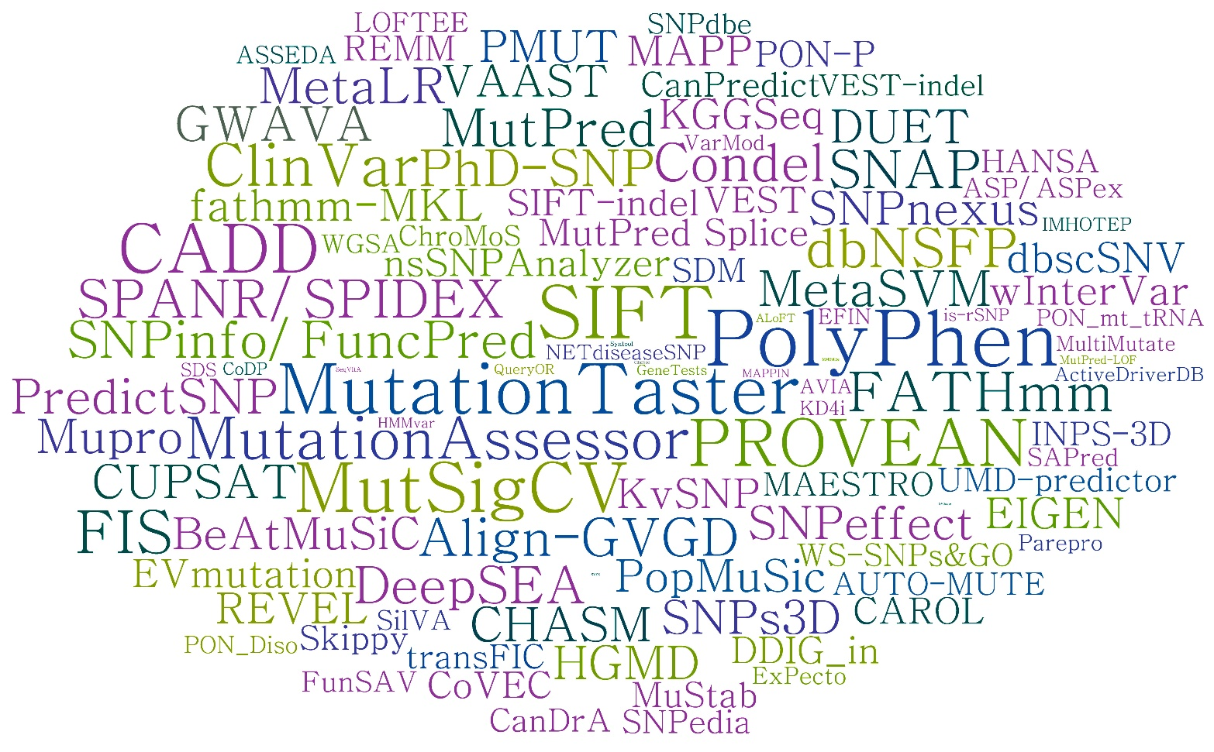

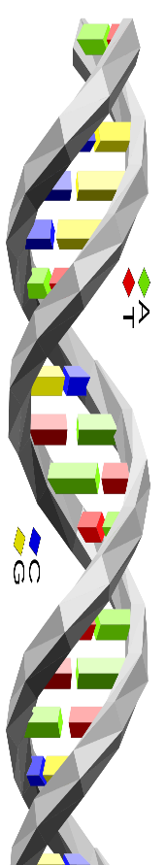
There are many variant impact predictors
but few focus on structural variants
More likely pathogenic
SVScore
A
G
C
G
T
G
G
SVFX
T
https://commons.wikimedia.org/wiki/File:Dna-SNP.svg
More likely benign
Hu et al. 2019. Hum Mutat. 40:1202-1214
Kumar et al. 2019. BioRxiv:739474
Ganel et al. 2017. Bioinformatics 33:1083-1085
Notes:
So I turned to the PANoply of variant impact predictors. Here I’m showing a word cloud of them, where size corresponds to the log of the number of citations, many of you probably recognize some of the popular ones. And for those who aren’t familiar, these impact predictors take in a variant, typically a single nucleotide variant or amino acid variant and output a score that correlates to how pathogenic it’s predicted to be. And I searched for predictors that focus on structural variants, and I found only two, SVFX and SVScore. SVFX focuses on somatic cancer mutations and complex diseases, so it’s not designed for this task, and SVScore aggregates CADD scores across structural variants, but I wanted to incorporate more features, so I decided I would make a method trained and focused on germline structural variants, which I called struvctvre.

Slide 5
There are many variant impact predictors but few focus on structural variants
More likely pathogenic
chr10
28615991-28617464
DEL
More likely benign
Structural Variant Classifier Trained on Variants Rare and Exonic
Notes:
Similar to existing impact predictors, the input to strvctvre is just the chromosome, start, and end position of the structural variant in question, and what type of variant it is. Right now, we only score deletions and duplications, due to training data limitations. The output from Strvctvre is a score from 0 to 1, with larger scores indicating a structural variant is more likely to be pathogenic. Again, due to training data limitations, right now we only score variants that overlap an exonic region.

Slide 6
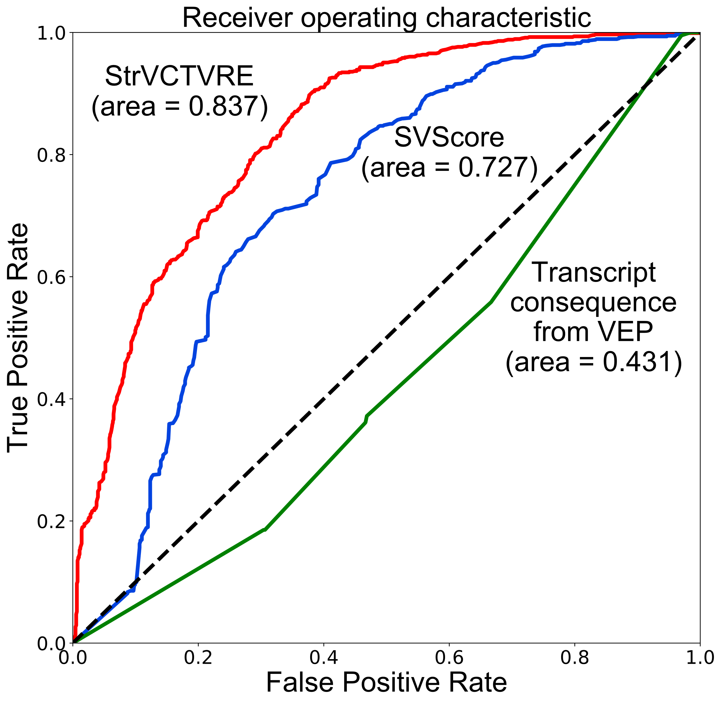
StrVCTVRE performs well on held-out validation dataset
Leave-one-chromosome-out validation:
Test (ClinVar)
Training data
(ClinVar, gnomAD, Apes)
chr1
Test data
Test (ClinVar)
Training data
(ClinVar, gnomAD, Apes)
Training data
…
chr2
StrVCTVRE score threshold
of 0.368
Test data
Test (ClinVar)
Training data
(ClinVar, gnomAD, Apes)
Training data
chrY
Notes:
To assess Strvctvre’s performance, we had it train on structural variants on all chromosomes except one, and tested on the held-out chromosome, iterating through each chromosome. And I should mention that we trained on structural variants from ClinVar, gnomAD, and apes, but tested only on our clinVar data. Here on the ROC plot, I’m showing you the concatenated performance across all held-out chromosomes. Looking at StrVCTVRE in red, you can see that if I want a 90% chance of finding the causal variant, I am able to eliminate about 60% of variants from consideration, at a strvctvre score threshold of 0.368.

Slide 7
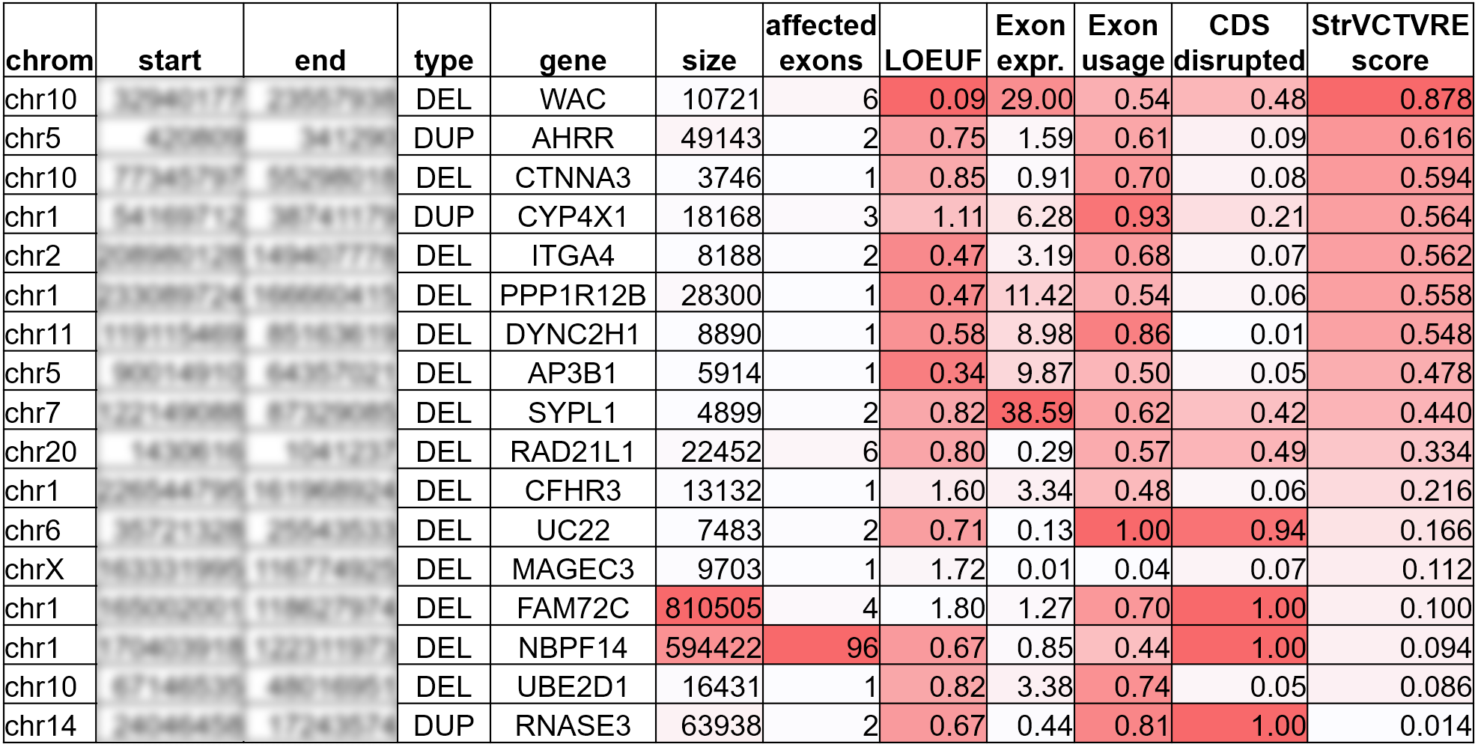

StrVCTVRE prioritizes correct variant from case
WAC Phenotype Associations
Hearing Impairment
Seizures
Course Facial Features
Hypotonia
ADHD
Strabismus
Hirsutism
Constipation
Developmental Delay
Anxiety
Sleep Disturbances
Proband
Seizures
Hypotonia
Hirsutism
Constipation
Developmental Delay
Notes:
Returning to our initial case, we can take this list of 17 structural variants, and score each of them with Strvctvre on the far right. Here we see that using that .368 cutoff eliminates almost half the variants from consideration, as expected. But really, there’s no need to use a hard cutoff, it’s better for this score to be considered as a continuous metric, giving less priority to a variant as its score gets lower. Of course, I picked a good example case, and the top variant as ranked by strvctvre, a 10kb deletion on chr10 in WAC was found to be the causative variant by our collaborators when they used clinical intuition and manual analysis. Even though strvctvre does not consider patient phenotypes, it was still able to prioritize a variant where the phenotypes matched. After sequencing parents, this variant was found to be de novo, and using ACMG Guidelines, this was classified as a pathogenic variant.

Slide 8
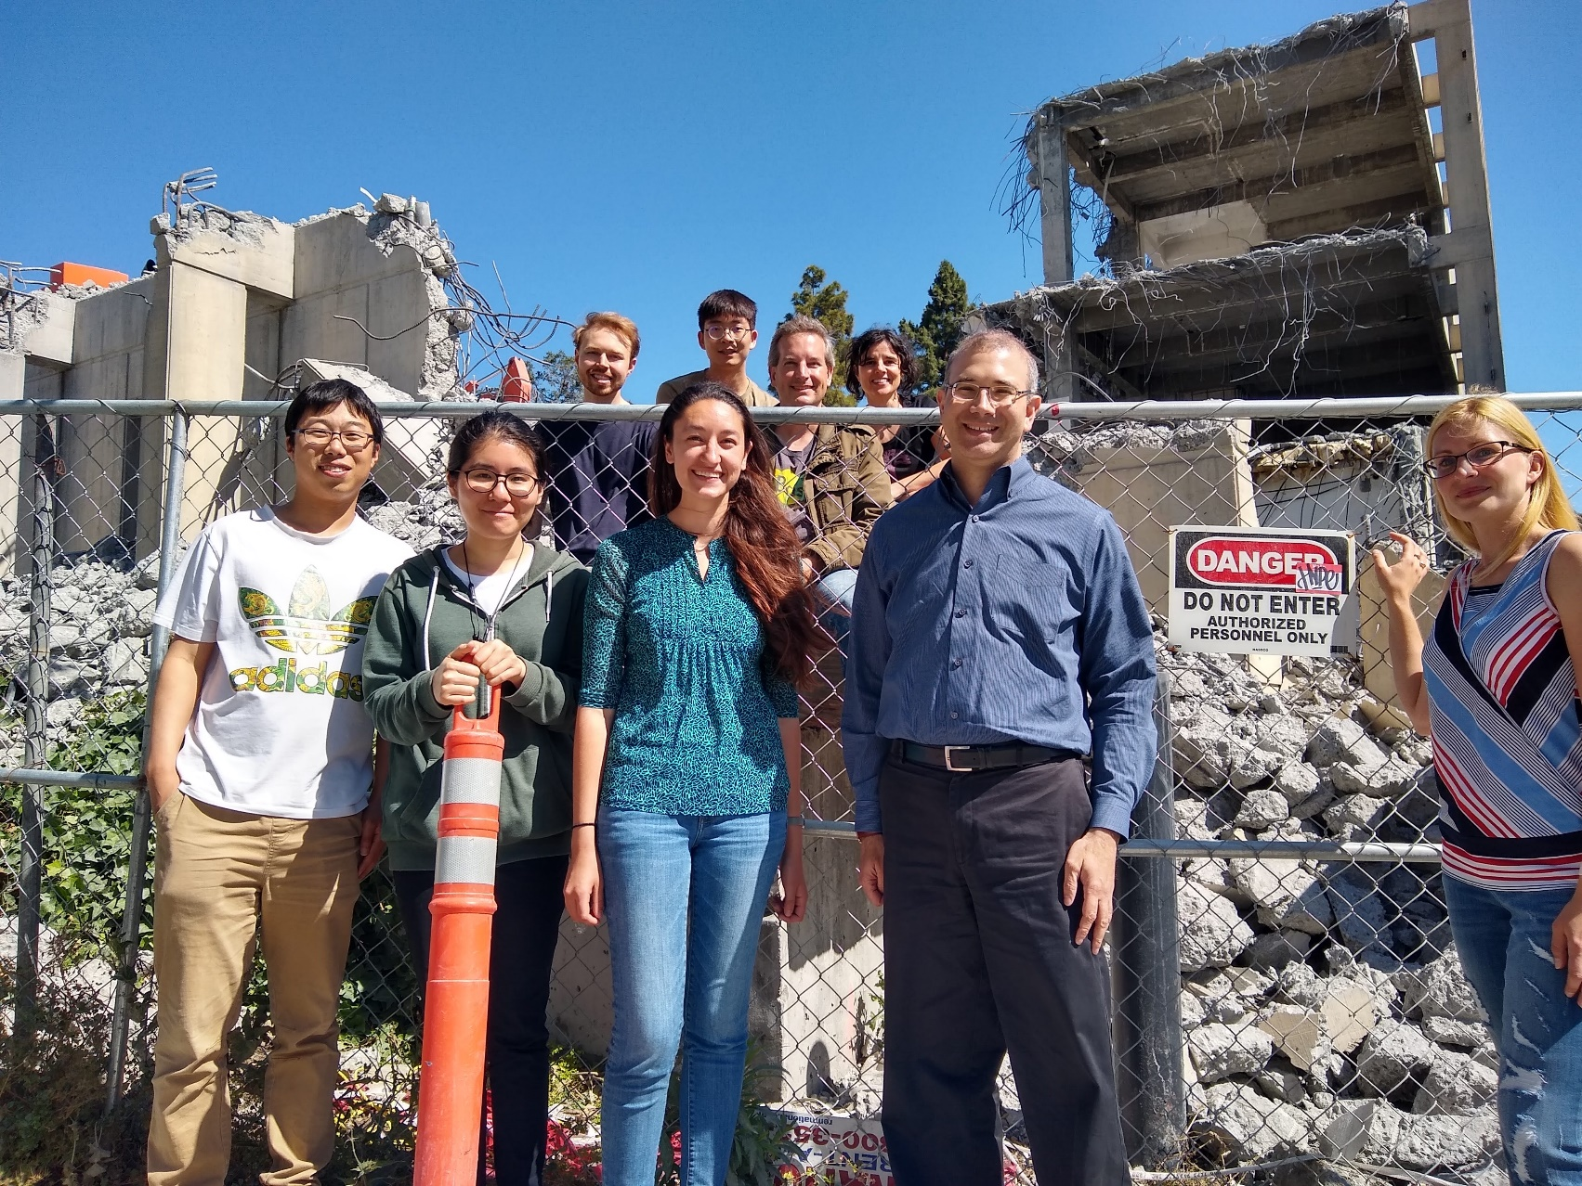


Acknowledgements
Zhiqiang Hu
Aashish Adhikari
Steven Brenner
Joseph Shieh
Anne Slavotinek
Karen Wong
David Martin
Pui Kwok
Dario Boffelli
DGE 1752814
Tata Consultancy Services
Notes:
I’d like to thank the lab: here we are with a very large structural variant. And with that, I’ll take any questions.

Slide 9
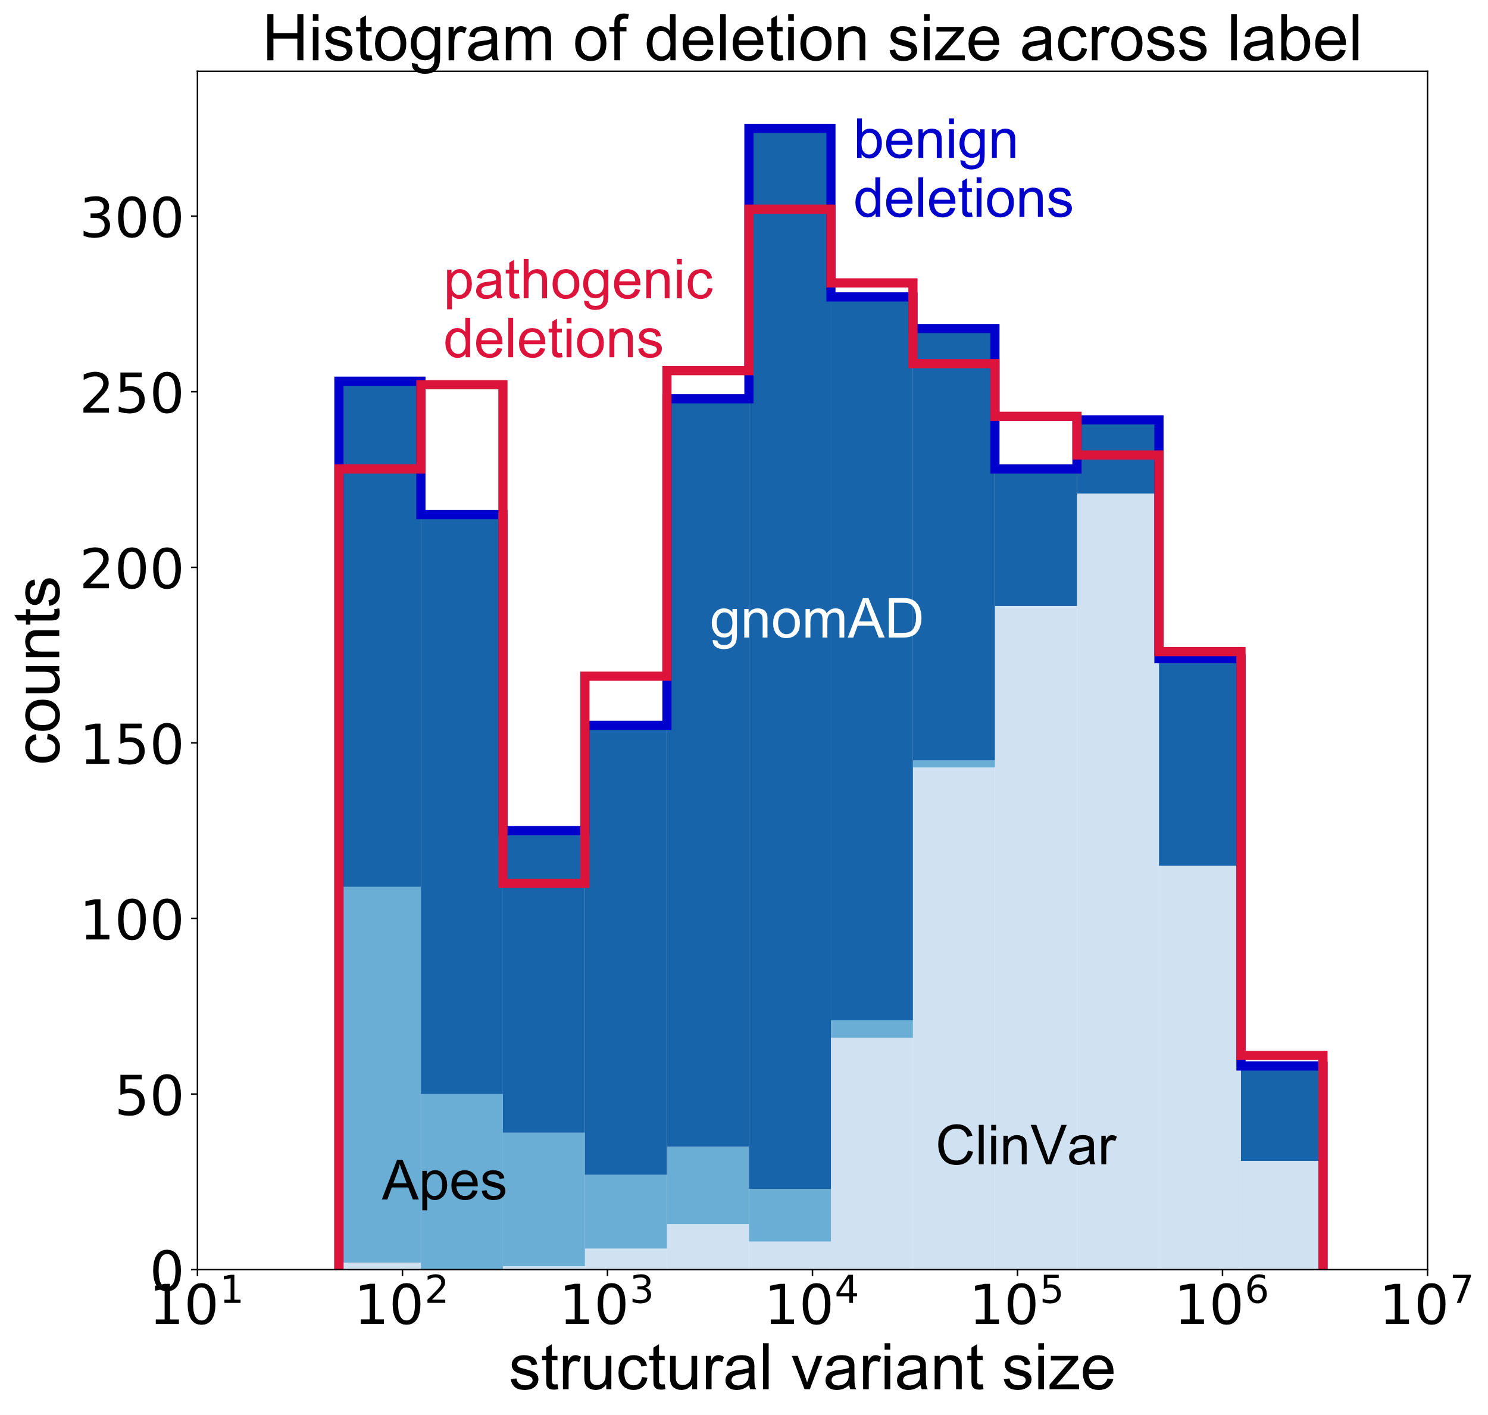
Summary
Structural Variant Classifier Trained on Variants Rare and Exonic
email: sharo@berkeley.edu

