Slide 1
CAGI Exome and Whole Genome Challenges
Sean D. Mooney, PhD
Professor, Department of Biomedical Informatics and Medical Education
Chief Research Information Officer, UW Medicine
University of Washington, Seattle
Created for CAGI 2019
genomeinterpretation.org
Sean D. Mooney, UW

Slide 2
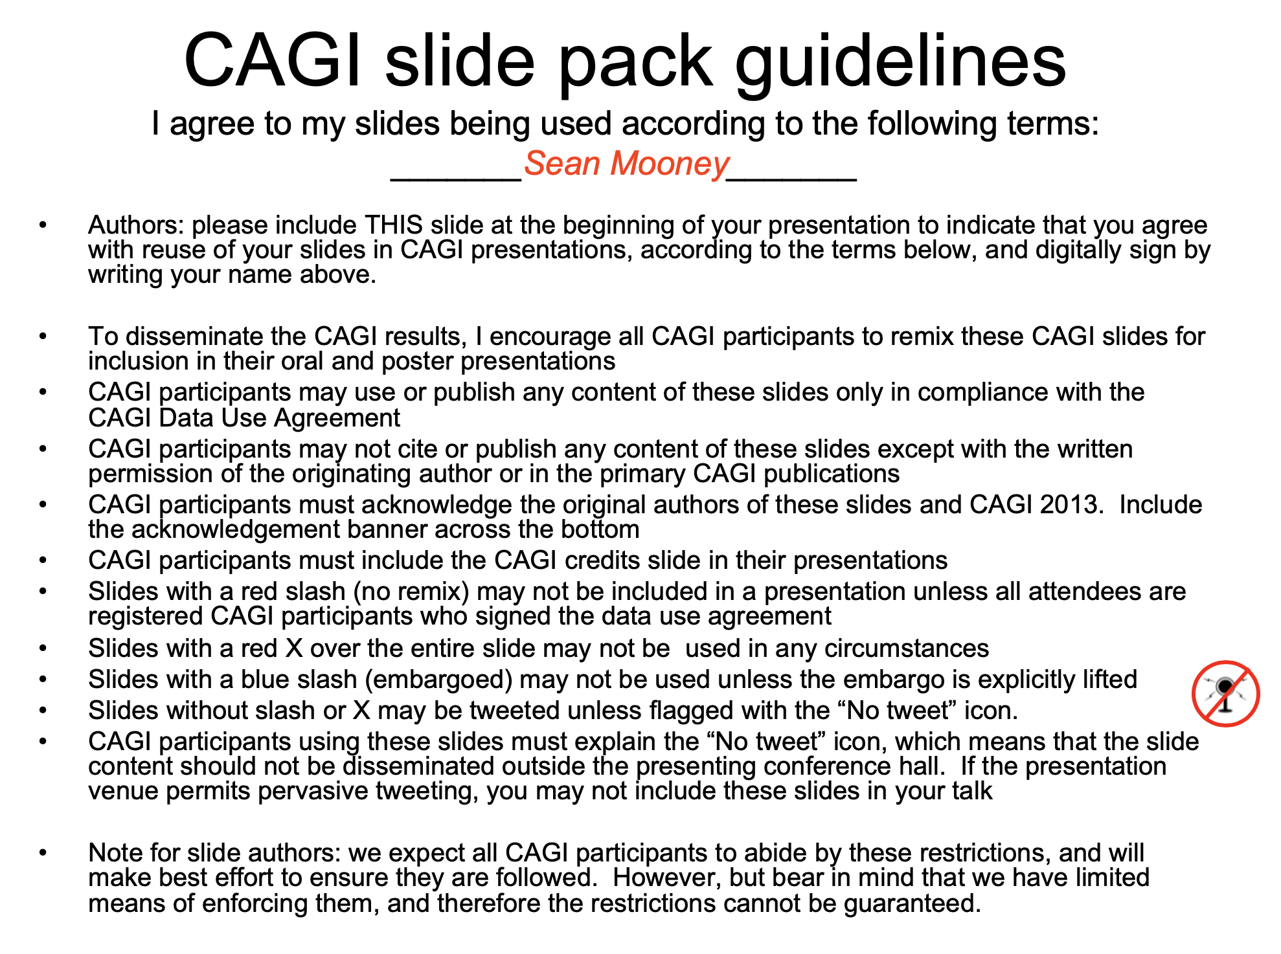
Created for CAGI 2019
genomeinterpretation.org
Sean D. Mooney, UW

Slide 3
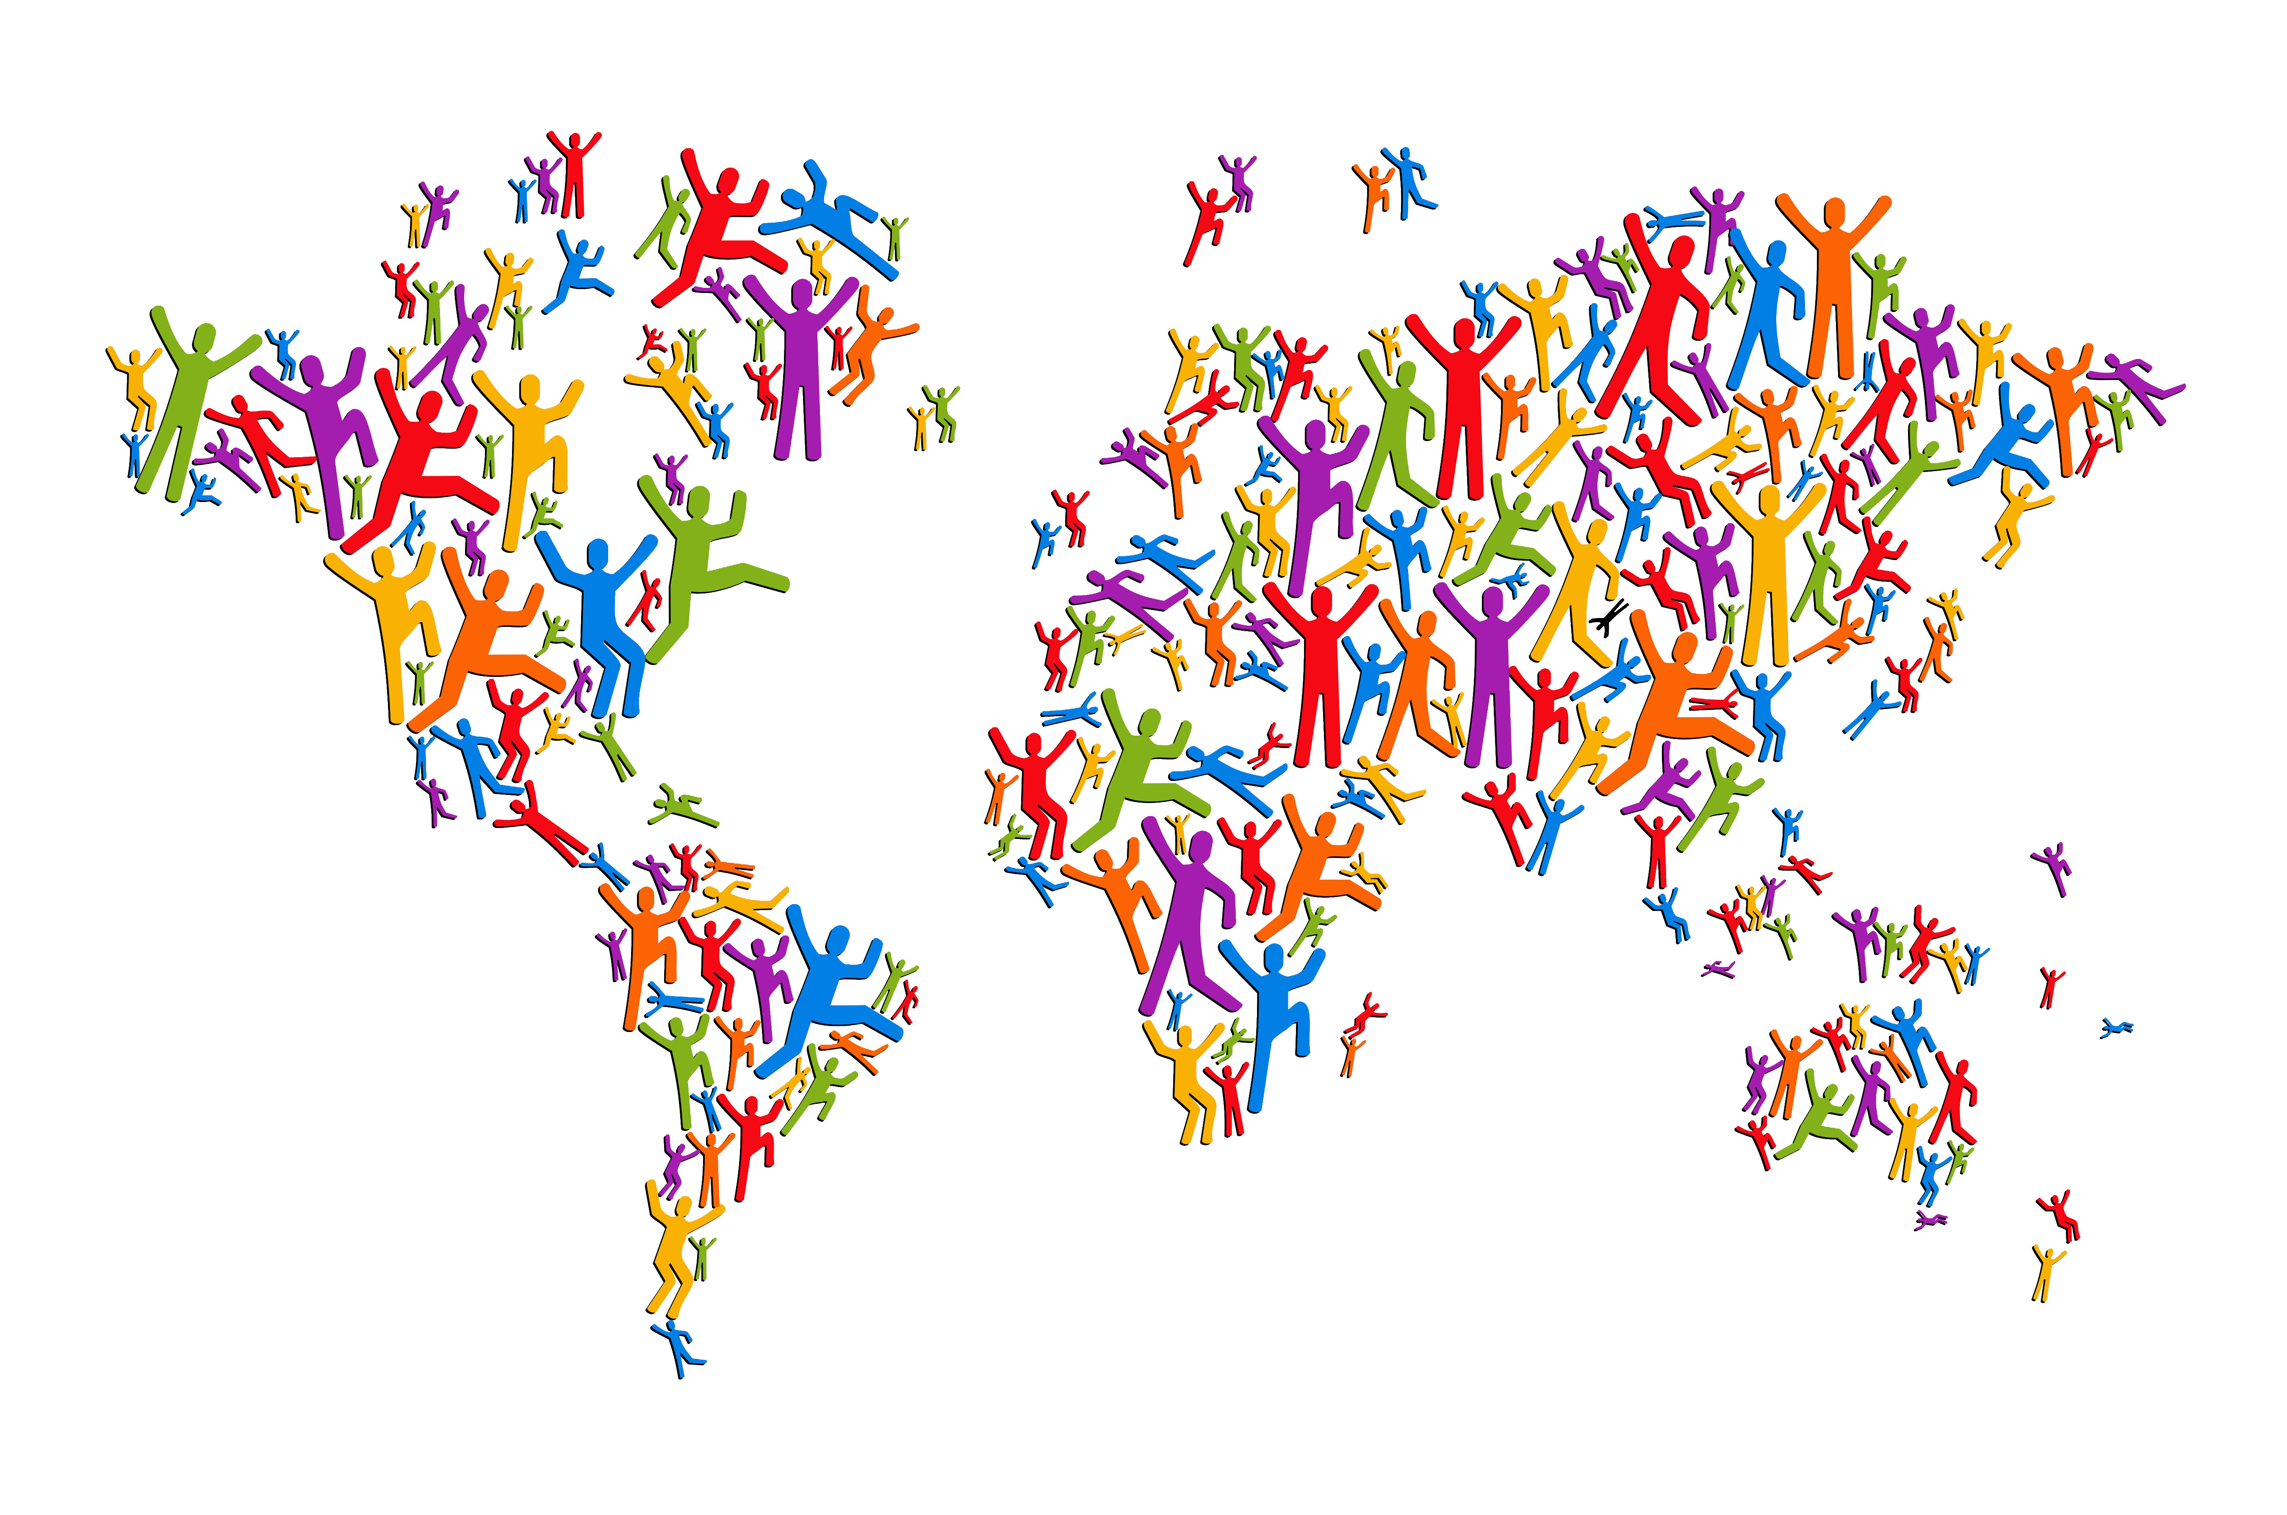
Citizen science can work … in the right way
Method community challenges solve problems faster and in more innovative ways than traditional project models
http://blog.vistage.com/wp-content/uploads/2015/03/shutterstock_128031185.jpg
Created for CAGI 2019
genomeinterpretation.org
Sean D. Mooney, UW

Slide 4
These are the exome/genome challenges
From exome or whole genome, predict phenotypes
These challenges are good for potentially solving these problems:
  For identifying causative or pathogenic variants
  Discovering or replicating associations between genetic variants and conditions or phenotypes
  Building or validating polygenic risks scores based on sequences
Created for CAGI 2019
genomeinterpretation.org
Sean D. Mooney, UW

Slide 5
High level challenge
Approach is straight forward, and several challenges have been developed around this:
  1) Identify the which individuals have certain specific phenotypes/variables
  2) Identify whether an individual was a case or a control in a study
  3) Match a list of phenotypes to an individual
Created for CAGI 2019
genomeinterpretation.org
Sean D. Mooney, UW

Slide 6
The Big Picture:
In this talk I will have six (or so) key points, or lessons learned, which I will bring up when I hit them

Slide 7
Whole Exome and Whole Genome Challenges
PGP Challenge I (CAGI 1+2) – Identify presence absence of list of binary traits or predict numerical or other phenotypes
PGP Challenge II (CAGI 3+4) – Match individuals with list of phenotypes/PRMs
Crohns Disease (CAGI 2-4) – Identify case control status (64 cases, 47 controls)
Biopolar (CAGI 4) – 500 cases and controls (500 for training and 500 for ranking)
Warfarin Dosing (CAGI 4) – 50 training and 53 for evaluation to predict Warfarin dose (w/ clinical co-variates)
SickKids – 25 clinical and 24 undiagnosed whole genomes
Created for CAGI 2019
genomeinterpretation.org
Sean D. Mooney, UW

Slide 8
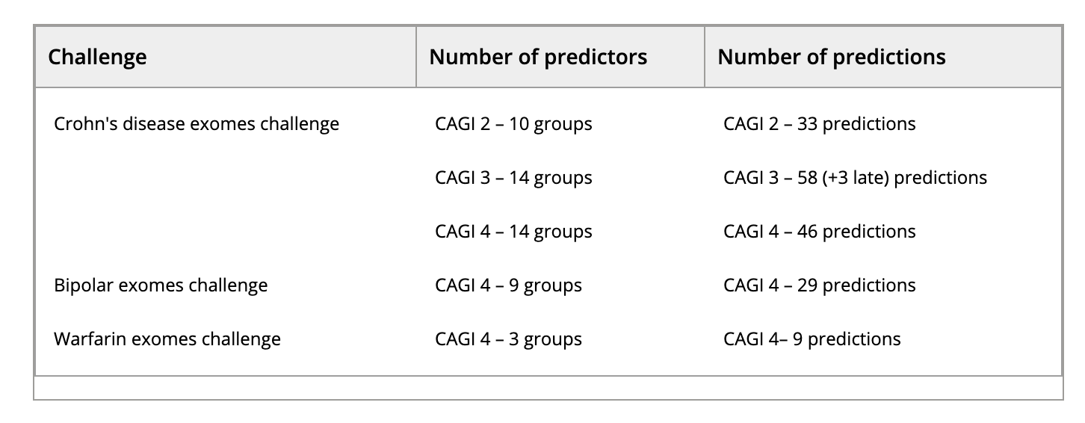
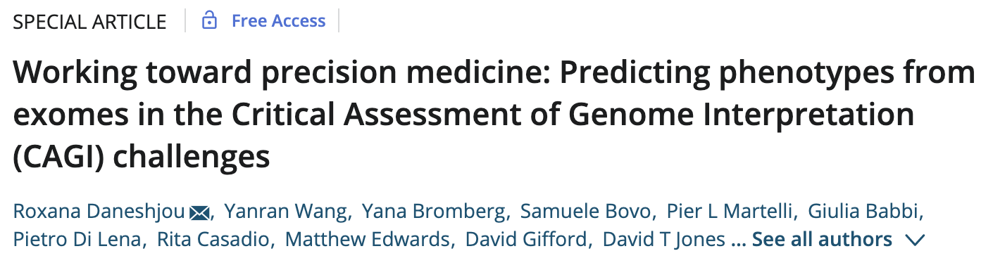
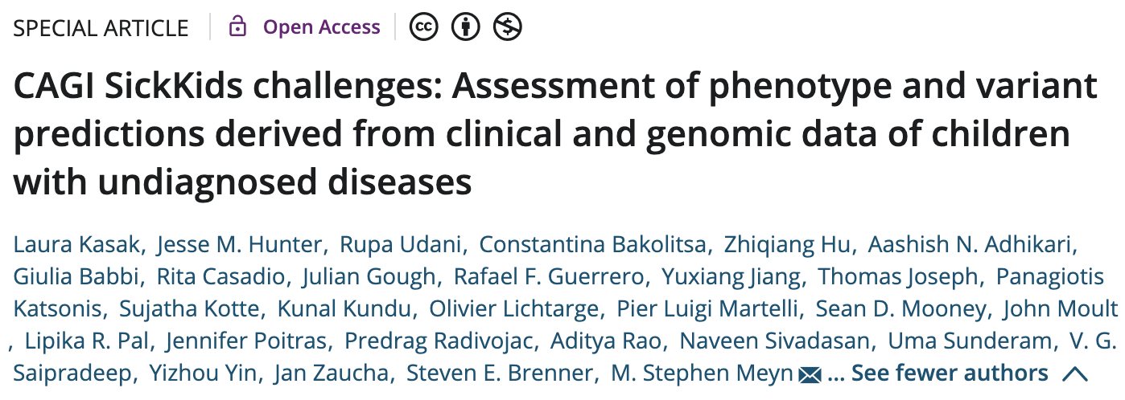
Exome and Whole Genome Challenges
I will discuss four challenges, exome and genome based. The PGP challenge(s) and these:
Created for CAGI 2019
genomeinterpretation.org
Sean D. Mooney, UW

Slide 9
Key Point #1:
CAGI has played a critical role in exposing trainees to genetics, new types of advanced data before it is otherwise available.

Slide 10
Who in this room was a trainee when they first participated in CAGI?
From my group, I’m not sure but I believe at least 10 trainees were exposed to genetics data likely for the first time through CAGI
Created for CAGI 2019
genomeinterpretation.org
Sean D. Mooney, UW

Slide 11
Key Point #2:
CAGI and other community challenges an important role in improving data quality and reproducibility of scientific works before they make it to publications.

Slide 12
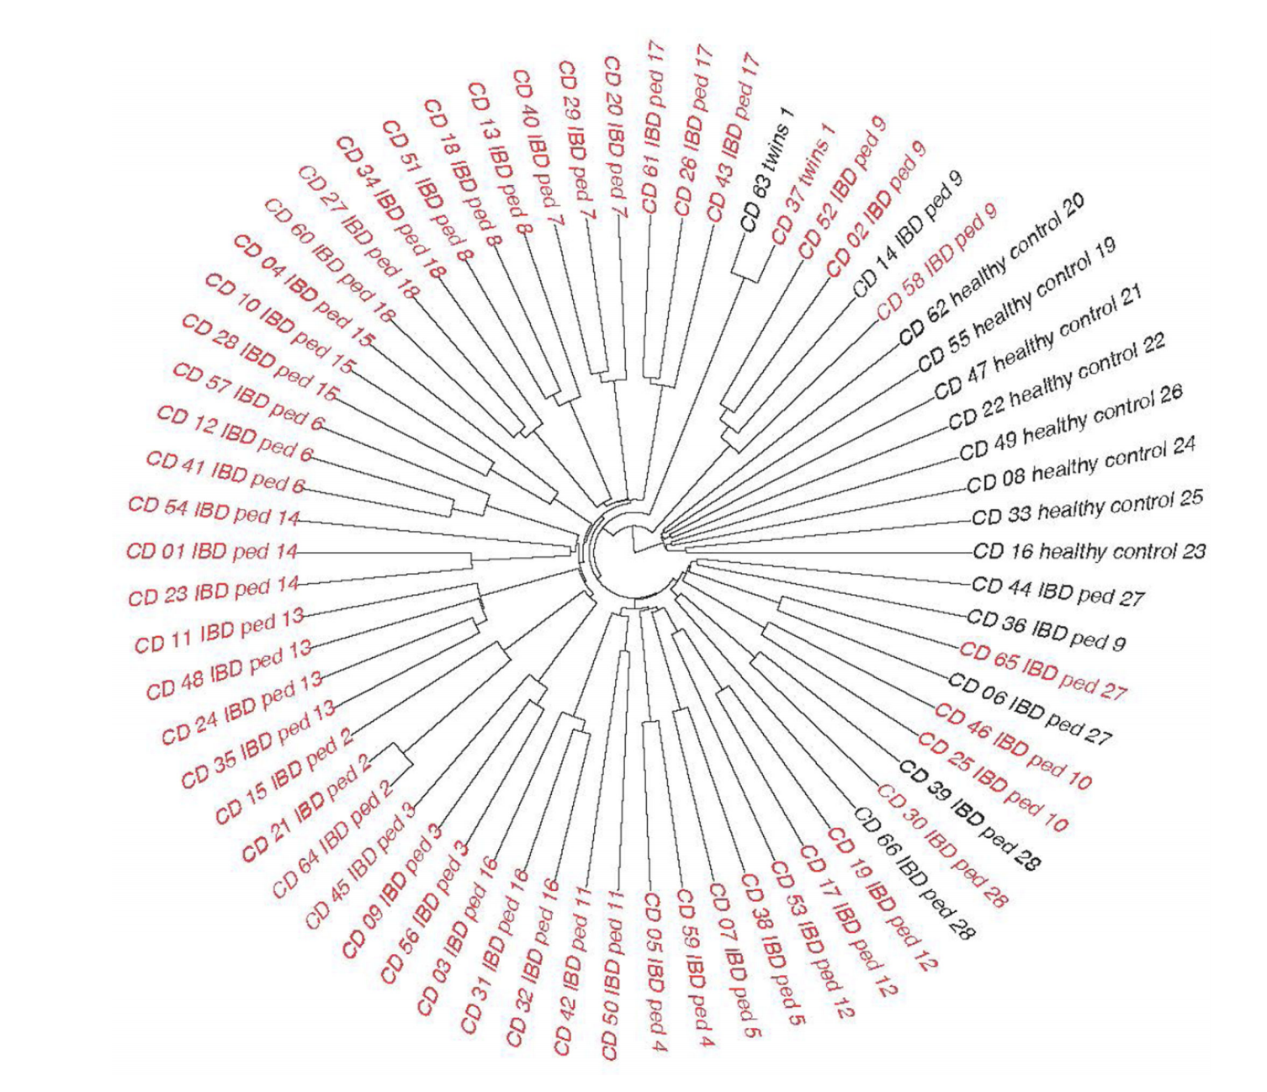

Slide 13
Crohns Challenge
Even without accurate predictions, CAGI has played a role in data quality:
Created for CAGI 2019
genomeinterpretation.org
Sean D. Mooney, UW

Slide 14
Crohn’s Challenge
The 2011 (CAGI 2) dataset has 56 exomes (42 cases, 14 controls), all of German ancestry.
The 2013 (CAGI 3) dataset has 66 exomes (51 cases, 15 controls).
The 2016 (CAGI 4) dataset, was to identify cases from controls in 111 unrelated German ancestry exomes (64 cases, 47 controls).
Created for CAGI 2019
genomeinterpretation.org
Sean D. Mooney, UW

Slide 15
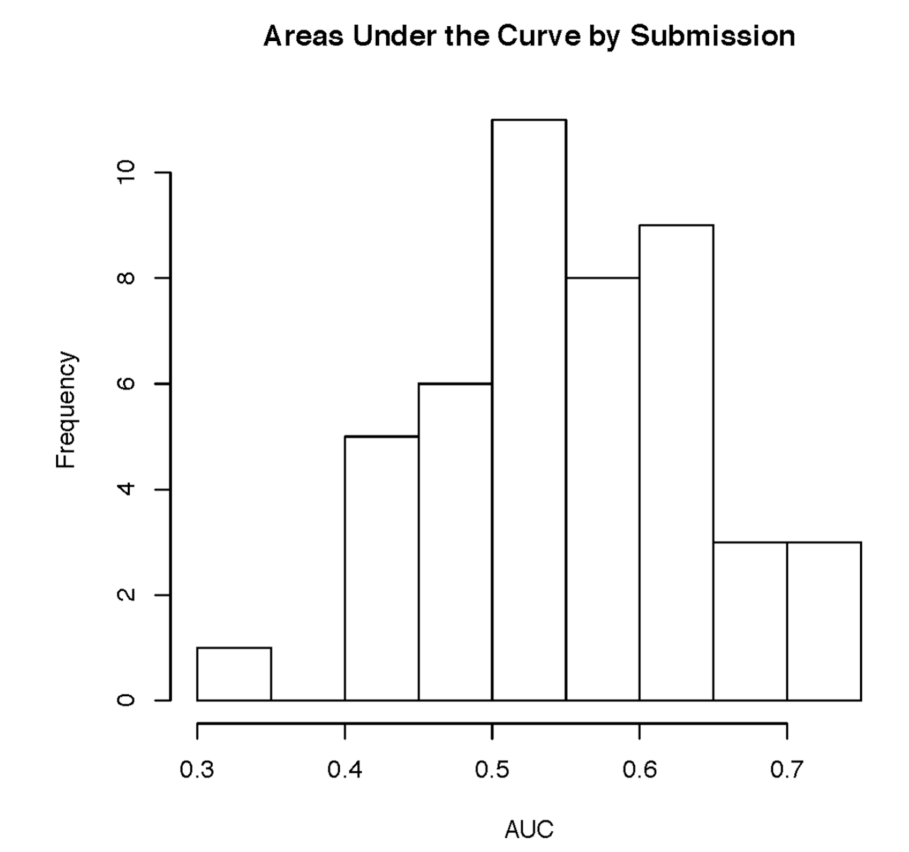
Crohn’s Challenge – Submission AUCs
The best methods ranged in AUC from .65-.75 with good data
Created for CAGI 2019
genomeinterpretation.org
Sean D. Mooney, UW

Slide 16
Bipolar Challenge
Bipolar disorder:
is a mood disorder marked by elevated mood (mania or hypomania) and depressed mood that disrupts an individual’s ability to function
the lifetime risk of bipolar disorder is 0.5–1%
high component of heritability, with studies demonstrating a 40–70% monozygotic twin
1000 exomes of unrelated bipolar disorder cases and age/ancestry- matched controls of Northern European ancestry.
500 exomes were used as the training set and 500 exomes for the prediction set
Created for CAGI 2019
genomeinterpretation.org
Sean D. Mooney, UW

Slide 17
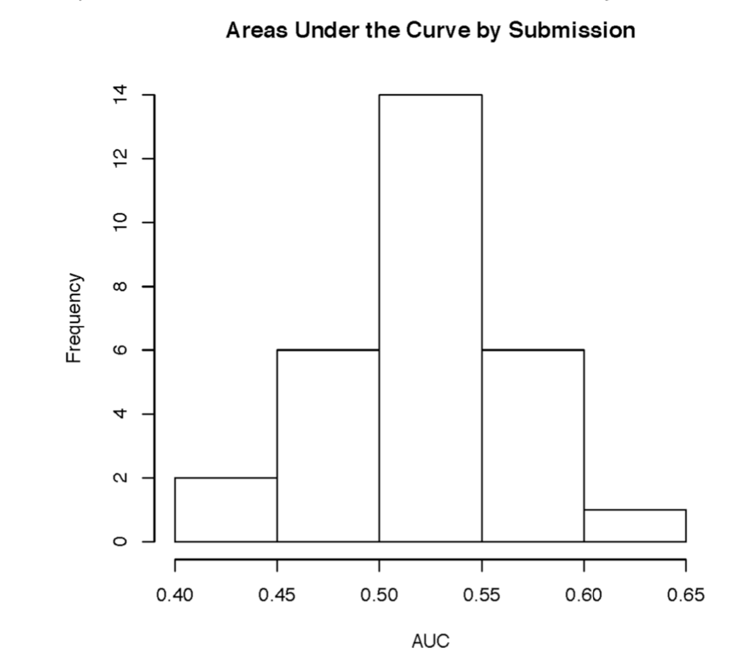
Bipolar Challenge – Submission AUCs
The best method was done by pure data scientist(s) and not biologists
Created for CAGI 2019
genomeinterpretation.org
Sean D. Mooney, UW

Slide 18
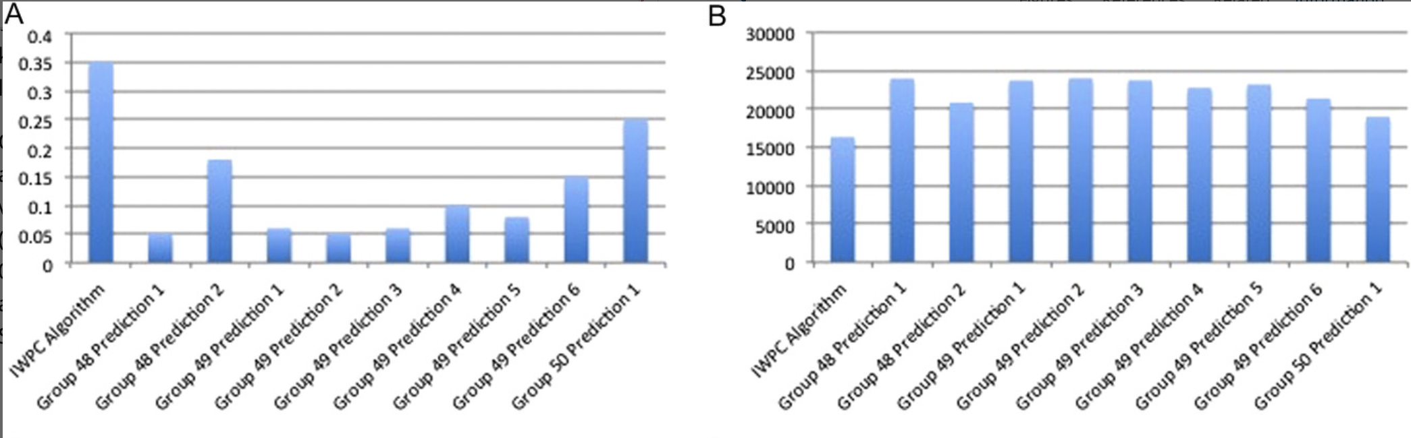
Warfarin Challenge
The R2 of the top prediction method was 0.25, compared to 0.35 for the IWPC prediction method, one of the best performing predictive algorithms.
A: R2 between predicted doses and actual doses for each group's prediction
method as well as the IWPC algorithm.
B: Sum of squared errors for each group's prediction method and the IWPC algorithm.
Created for CAGI 2019
genomeinterpretation.org
Sean D. Mooney, UW

Slide 19
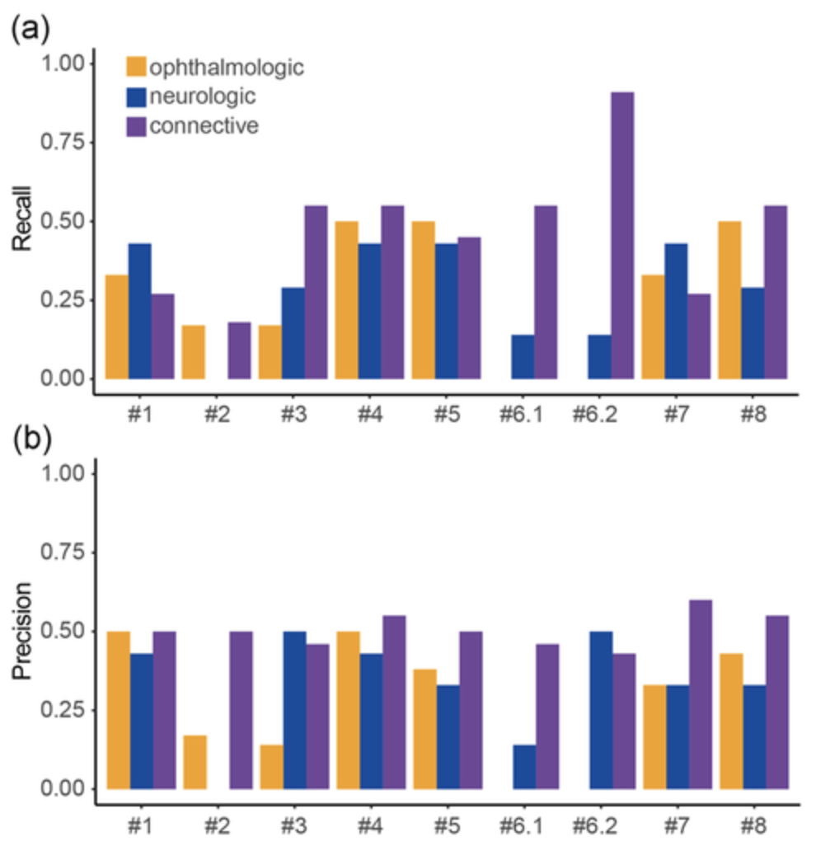
SickKids Challenge
“The performance of matching genomes to categories was no better than random but two groups performed significantly better than chance in matching genomes to patients.
Two of the ten variants proposed by two groups in CAGI4 were deemed to be diagnostic, and several proposed pathogenic variants in CAGI5 are good candidates for phenotype expansion. “
Challenge: Match category, match genome, propose variants.
The challenge cohort consisted of six patients
with ophthalmologic disorders, seven with
neurologic disorders, and 11 with connective
tissue disorders
Created for CAGI 2019
genomeinterpretation.org
Sean D. Mooney, UW

Slide 20
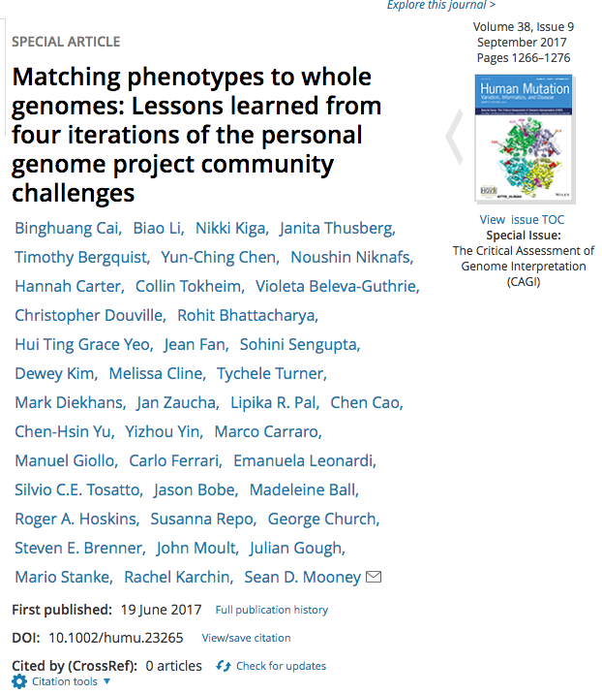
The PGP Challenge
Four iterations of the CAGI: Personal Genome Project challenge
Few goals are more pure to genome interpretation than predicting traits from raw sequence (or genotype) data
In this challenge, phenotypes/traits are predicted for real people with genetic data
Dataset provided by Personal Genome Project and George Church, Harvard Medical School
Phenotypes provided by CAGI organizers in consultation with George Church

Slide 21
The First Round of the PGP Challenge
Genome
Binary Traits: Leukemia, Cavities etc. Y / N
Numerical Traits: age, triglyceride etc.
Categorical Traits: blood type, eye color,
ancestry etc.
Created for CAGI 2019
genomeinterpretation.org
Sean D. Mooney, UW

Slide 22
ABOUT CAGI 2011
Challenge 2011
  Predict probability of 10 genomes (participants) having 32 binary traits and 8 numerical traits
  We also invite predictions on any additional genetic phenotypes.
Additional:
  One the of PGP10 individuals has irritable bowel syndrome. Predict who that individual is.
  One of the PGP10 individuals is color-blind. Predict who he is.
  One of the PGP10 individuals is not color-blind but she has a color-blind father and an affected son. Predict who that individual is.
Created for CAGI 2019
genomeinterpretation.org
Sean D. Mooney, UW

Slide 23
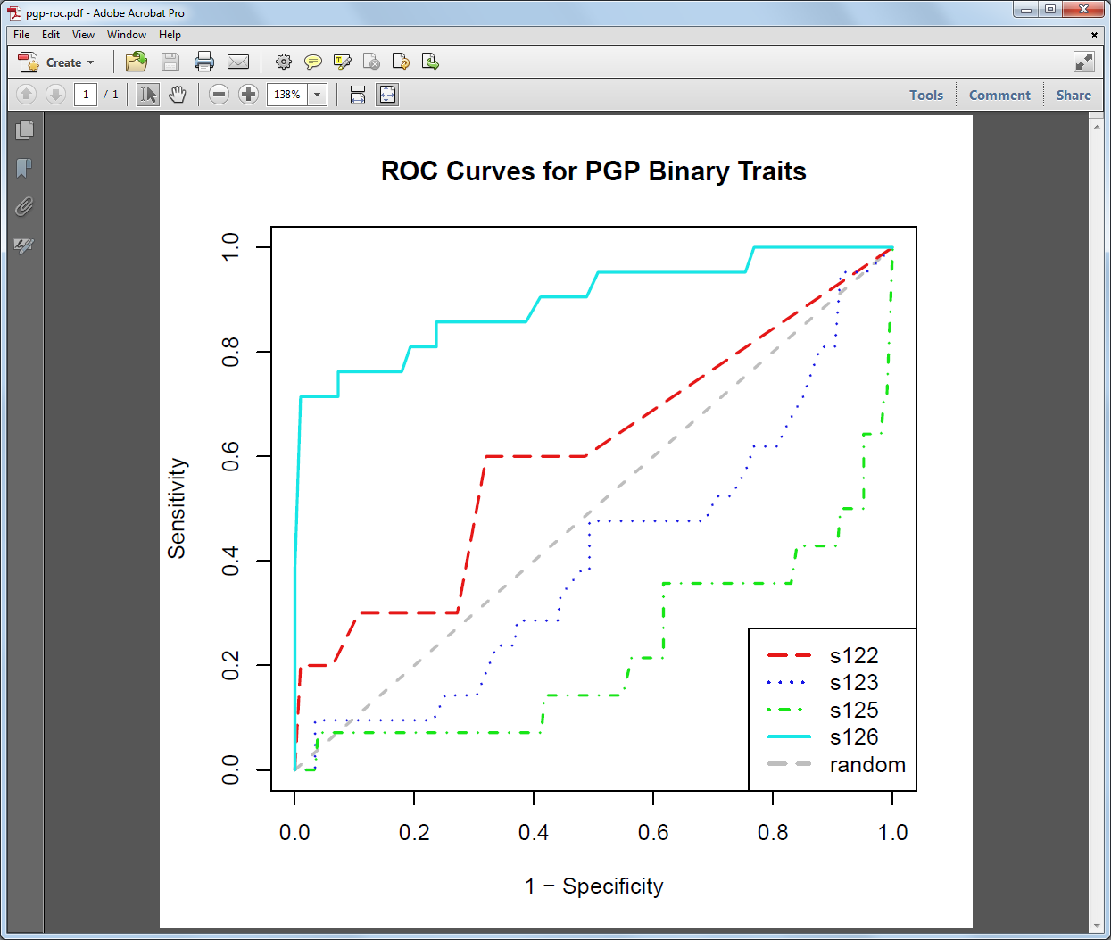
The binary traits - ROC
Only S126 (Karchin lab) was statistically significant in PGP Challenge 2011
Created for CAGI 2019
genomeinterpretation.org
Sean D. Mooney, UW

Slide 24
Key Point #3:
CAGI has facilitated the development of new methods that are novel, interesting and should have an impact over time.

Slide 25
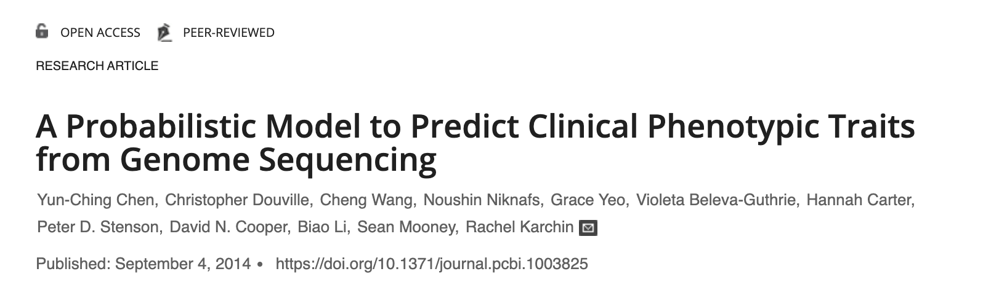
Example: Chen, et al. PLoS Comp Bio 2014
Genome interpretation
Created for CAGI 2019
genomeinterpretation.org
Sean D. Mooney, UW

Slide 26
CAGI challenge became a matching game in 2013
Participant Genome 1
Profile 1
Participant Genome 2
Profile 2
Participant Genome 3
Profile 3
Participant Genome 77
Profile 291
Each profile contains 239 binary traits.
There are 214 decoy profiles that match no given genome data.
Each genome contains variants covering the whole genome.
Predicted profiles are assigned probability values.
Created for CAGI 2019
genomeinterpretation.org
Sean D. Mooney, UW

Slide 27
This, like other challenges had some initial data quality issues
First, a number of individuals had been profiled using 23andMe data and had posted that data on their profiles. 27 were there and if teams picked up on this, 27 could be correctly identified by trivially matching variants.
Second, as Mary Wahl (then at Harvard) pointed out to us, 108 profiles (excluding duplicate profiles) never had a sample (saliva or blood), taken for them! No sample … no genome.

Slide 28
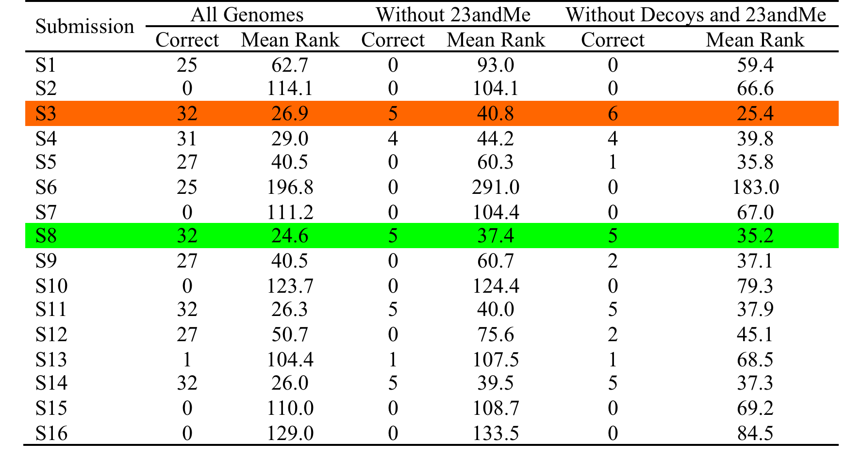
PGP Challenge 2013
Karchin Team:
Identified 6 genomes correctly out of 77
Average Rank of 25.4
Created for CAGI 2019
genomeinterpretation.org
Sean D. Mooney, UW

Slide 29
PGP Challenge 2015
Challenge 2015 has the format same as Challenge 2013
  Predict match of 23 genomes (participants) to 101 profiles (78 decoys)
  Each profile is a self-reported list of 239 binary traits
  Includes both Mendelian traits and “complex” traits
Optional, “interest only” submission was available to predict individual traits from genomes – however no group submitted
Created for CAGI 2019
genomeinterpretation.org
Sean D. Mooney, UW

Slide 30
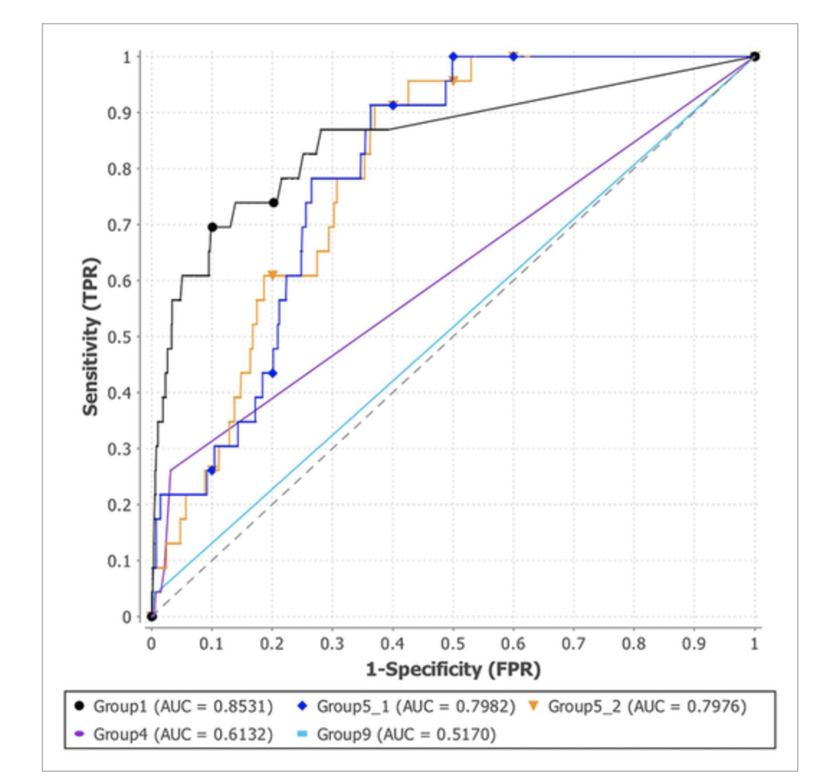
ROC AUC – Group 35 performed better
Created for CAGI 2019
genomeinterpretation.org
Sean D. Mooney, UW
Notes:
The numbers are generated by the AUC package. If we need to format them to 2 decimals, I will process the image itself.
Binghuang Understand I think what they are trying to convey but need major editing to be included.

Slide 31
Key Point #4:
CAGI like challenges are quantifying benchmarks, improvement and general interest over time

Slide 32
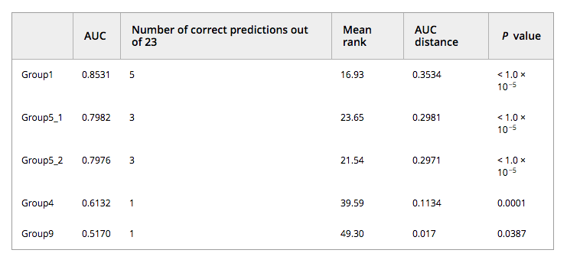
PGP Challenge 2015 – Improvement?
In 2013, the best submission correctly matched 6 out of 50 (12%), in 2015 the best matched 5 out of 23 (22%):
Created for CAGI 2019
genomeinterpretation.org
Sean D. Mooney, UW

Slide 33
Key Point #5:
CAGI like challenges are the key for enabling harmonization of data science, biotechnology assays and clinical decision making

Slide 34
Data science can bring together variance in biotech and clinical decision making?
Genetics is uniquely poised to address issues of data science, experiments and clinical decisions and to help improve clinical decision making
Data Science
Machine learning
Clinical Decisions
Includes potentially many heterogenous data points
High Throughput Variant Impact Assays
Measures function of many variants
Genetic Data
Patient Data
Etc.
Created for CAGI 2019
genomeinterpretation.org
Sean D. Mooney, UW

Slide 35
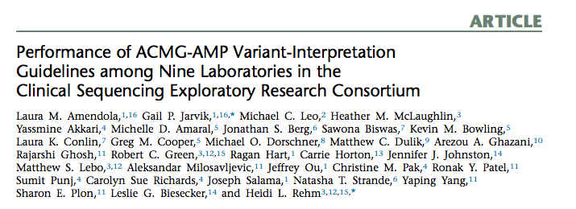
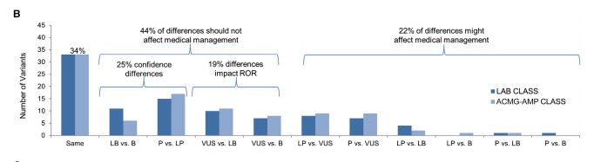
CSER Community Challenge
Example: Calling pathogenic variants – laboratories don’t always agree
Created for CAGI 2019
genomeinterpretation.org
Sean D. Mooney, UW

Slide 36
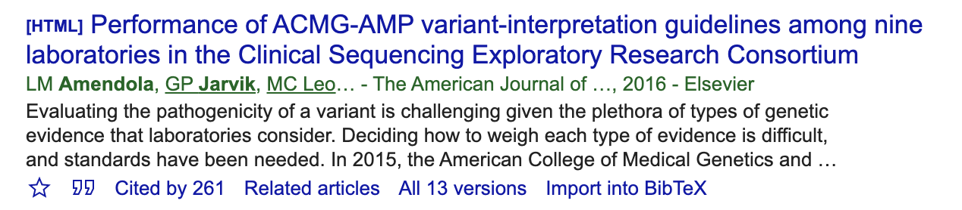
CSER Study Impact
Published in 2016
Created for CAGI 2019
genomeinterpretation.org
Sean D. Mooney, UW

Slide 37
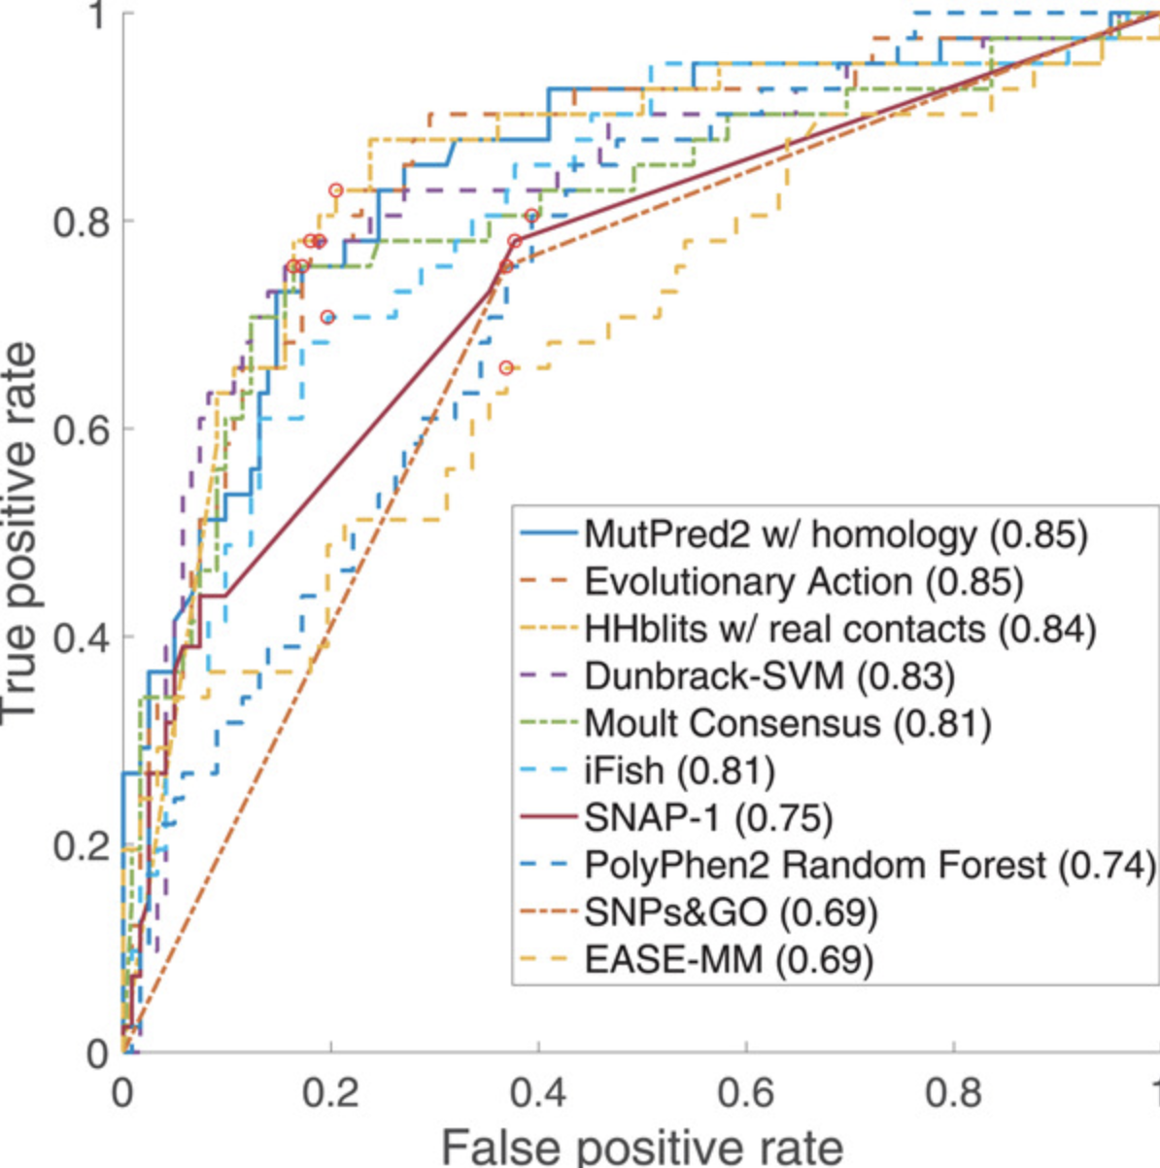
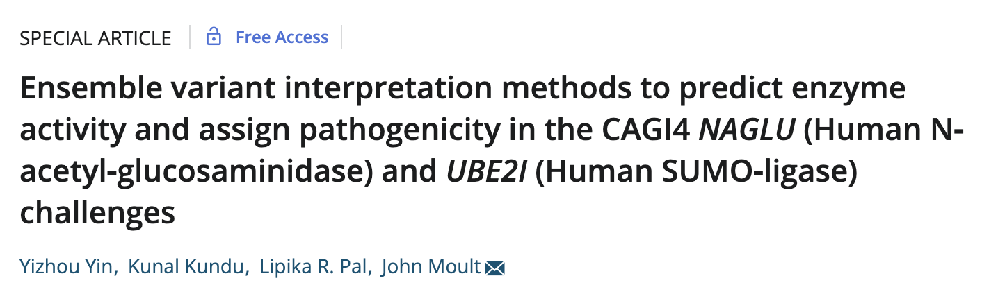
Data science can bring together variance in biotech and clinical decision making?
Historically, data science method evaluation has been held to a gold standard of clinical decisions or in vitro experiments
Created for CAGI 2019
genomeinterpretation.org
Sean D. Mooney, UW

Slide 38
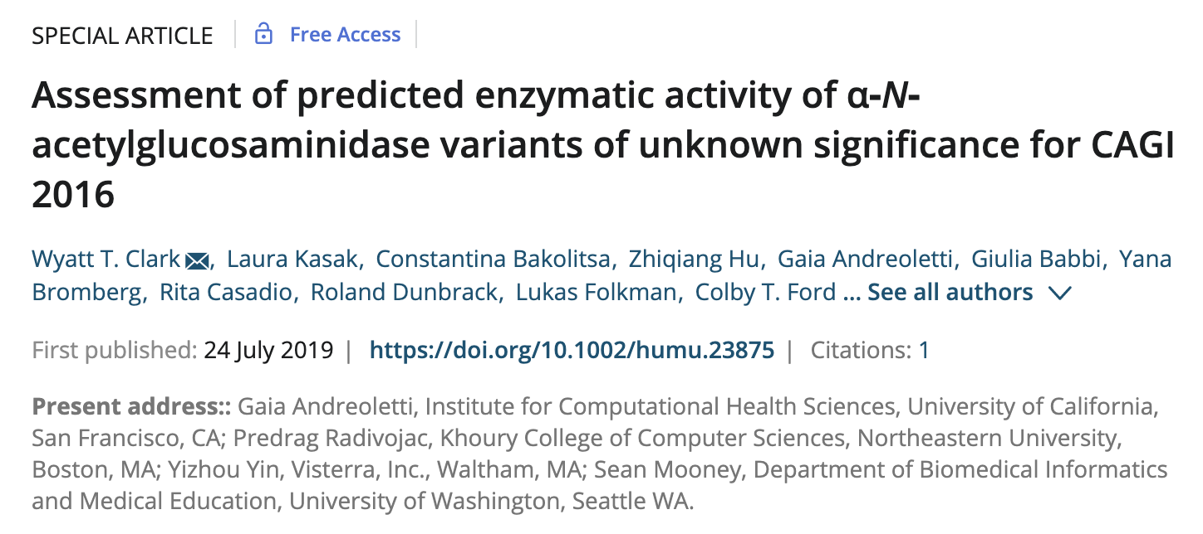
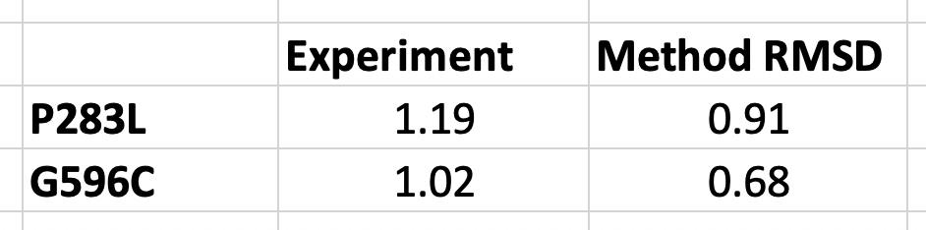
Data science can bring together variance in biotech and clinical decision making?
Historically, data science method evaluation has been held to a gold standard of clinical decisions or in vitro
Two of the “hard” variants with high experimental activity (NAGLU P283L and G596C) are predicted destabilizing, consistent with the sequence analysis results and inconsistent with experiment.
Created for CAGI 2019
genomeinterpretation.org
Sean D. Mooney, UW

Slide 39
Key Point #6:
CAGI needs to identify a key problem or problems that it can solve and to work on challenges that focus on those problems

Slide 40
Some Future CAGI Ideas
Understand Pathogenicity Better
Pathogenicity is treated like the weather report:
  30% chance of rain means?
    30% chance of rain on me
    Rain 30% of the time?
    Rain in 30% of the places?
    30% chance of rain in any place?
We need a better definition
  Use context and biology to improve our understanding of an impactful variant
  All variants are not binary in terms of being pathogenic or not
  All variants show some degree of phenotypic expressivity
  Need to understand phenotype better and it’s relationship to pathogenic variants
Created for CAGI 2019
genomeinterpretation.org
Sean D. Mooney, UW

Slide 41
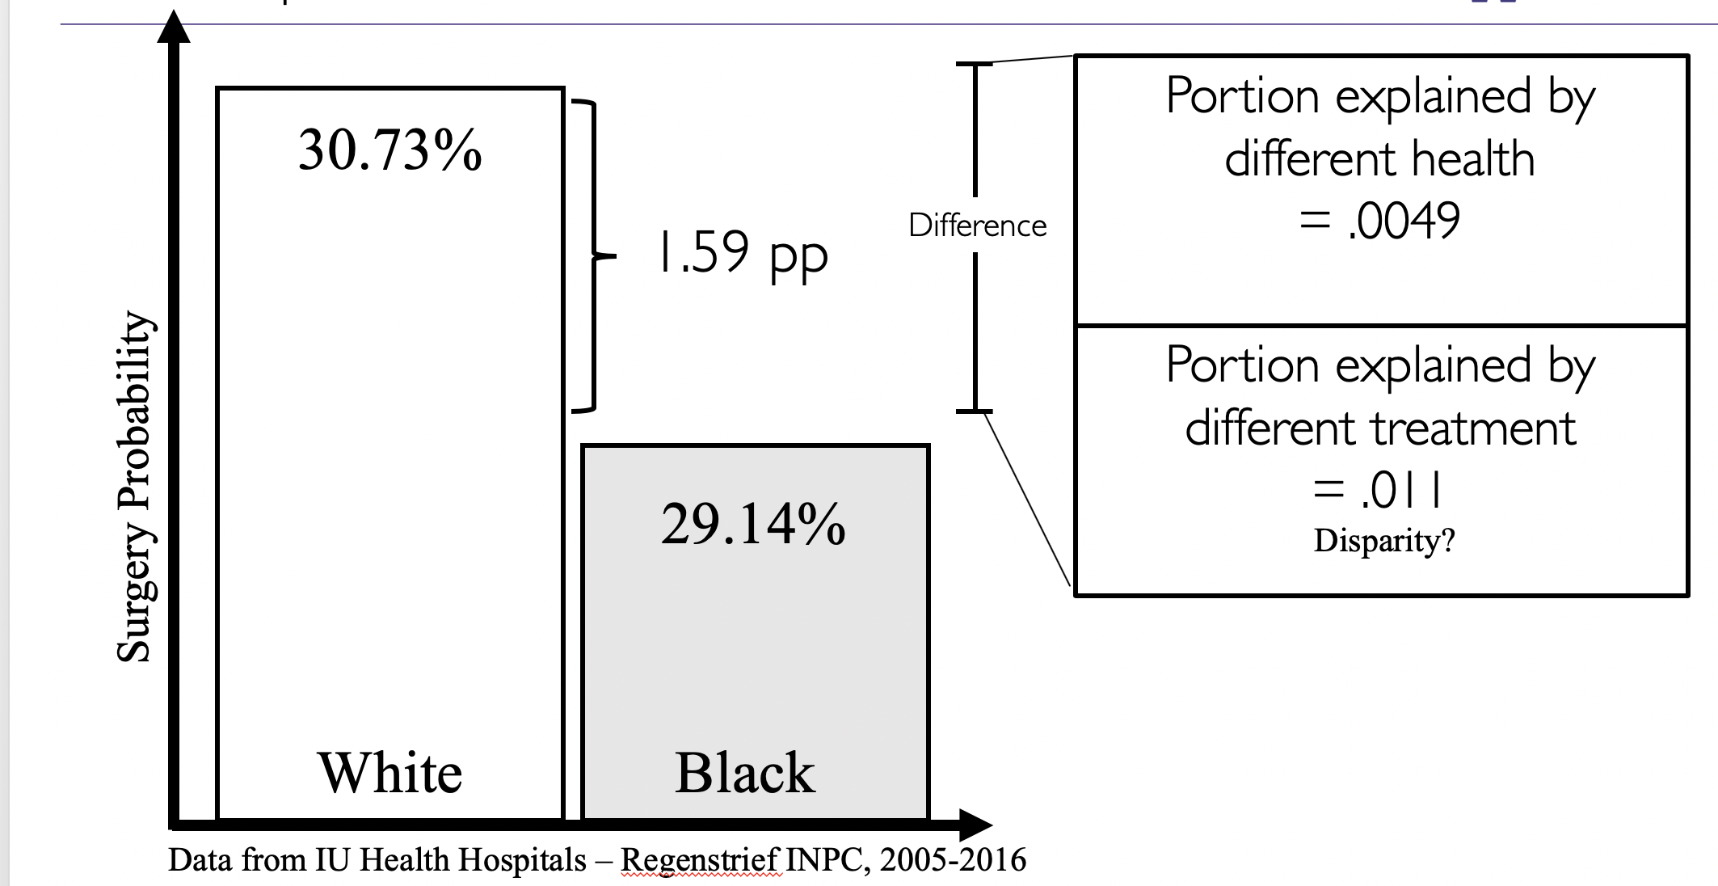
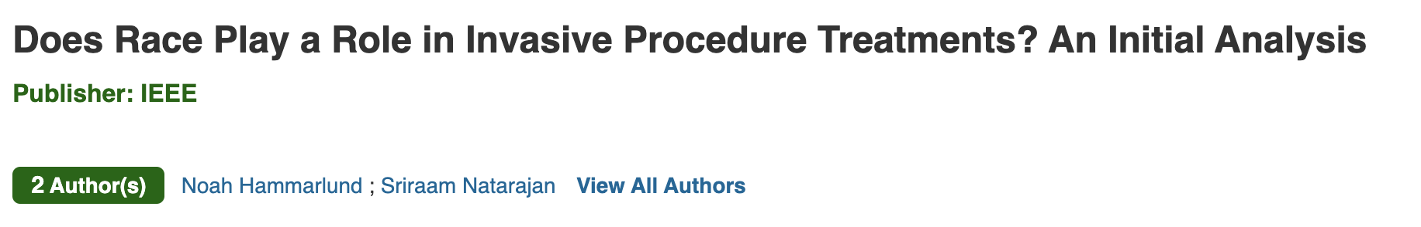
Some Future CAGI Ideas
Ethnicity differences in polygenic risk scores
eMERGE IV is going to implement PRS and this is opportunity for CAGI
How do PRS work across ethnicities and other minority groups?
An example from clinical research:
Credit: Noah Hammarlund, UW
Created for CAGI 2019
genomeinterpretation.org
Sean D. Mooney, UW

Slide 42
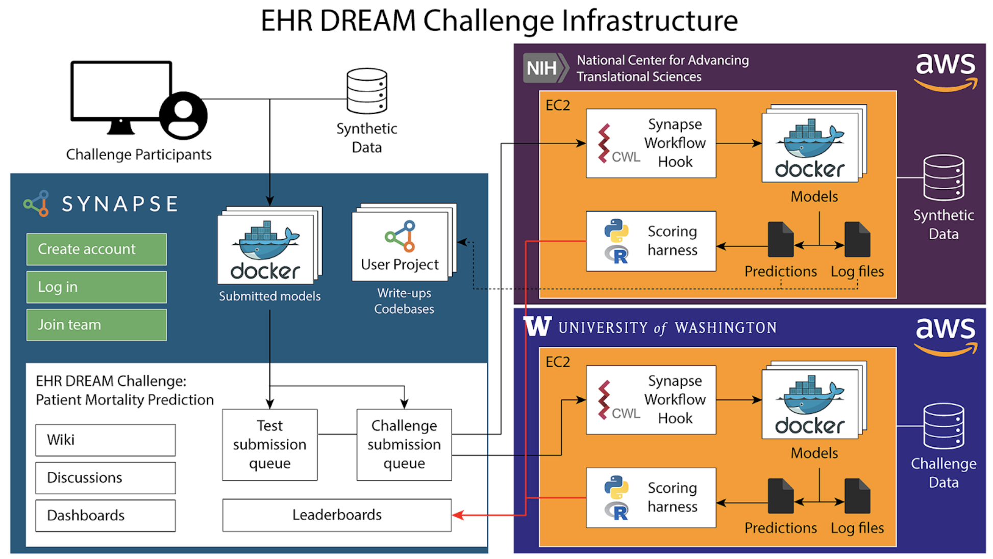
Some Future CAGI Ideas
There are some advantages to NOT data sharing
We’ve been running prospective Model – To – Data Challenges with electronic health records
Credit Thomas Schaffter, Sage Bionetworks and Tim Bergquist, UW
Created for CAGI 2019
genomeinterpretation.org
Sean D. Mooney, UW

Slide 43
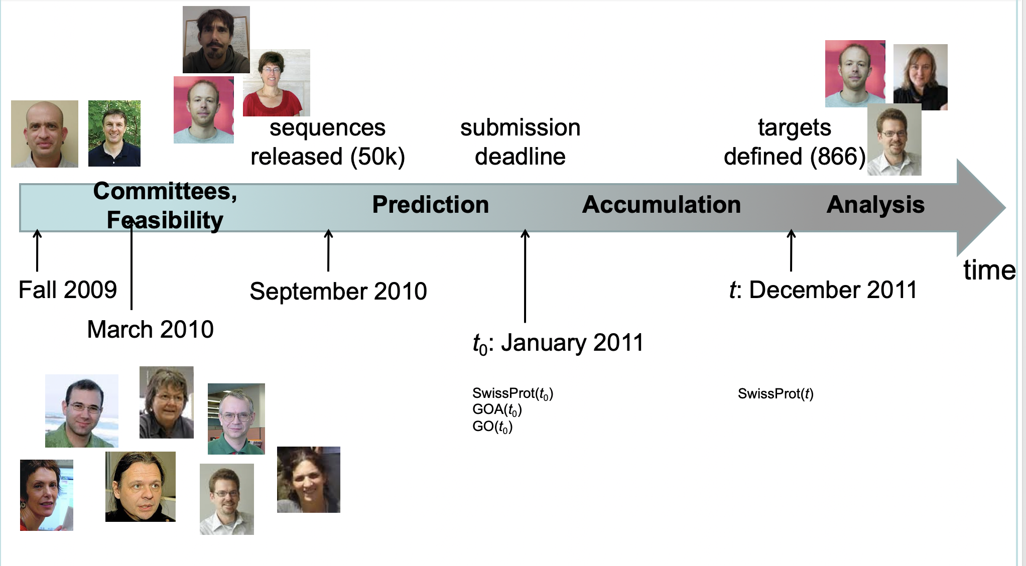
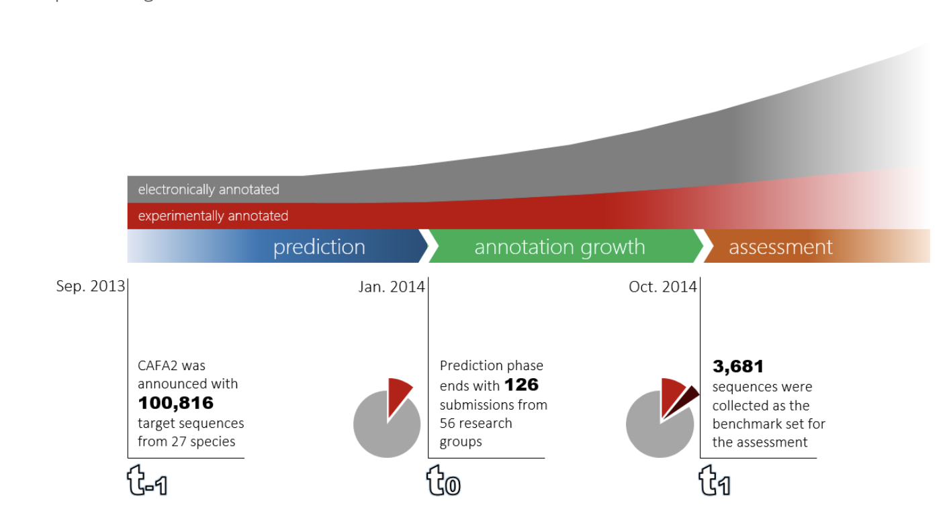
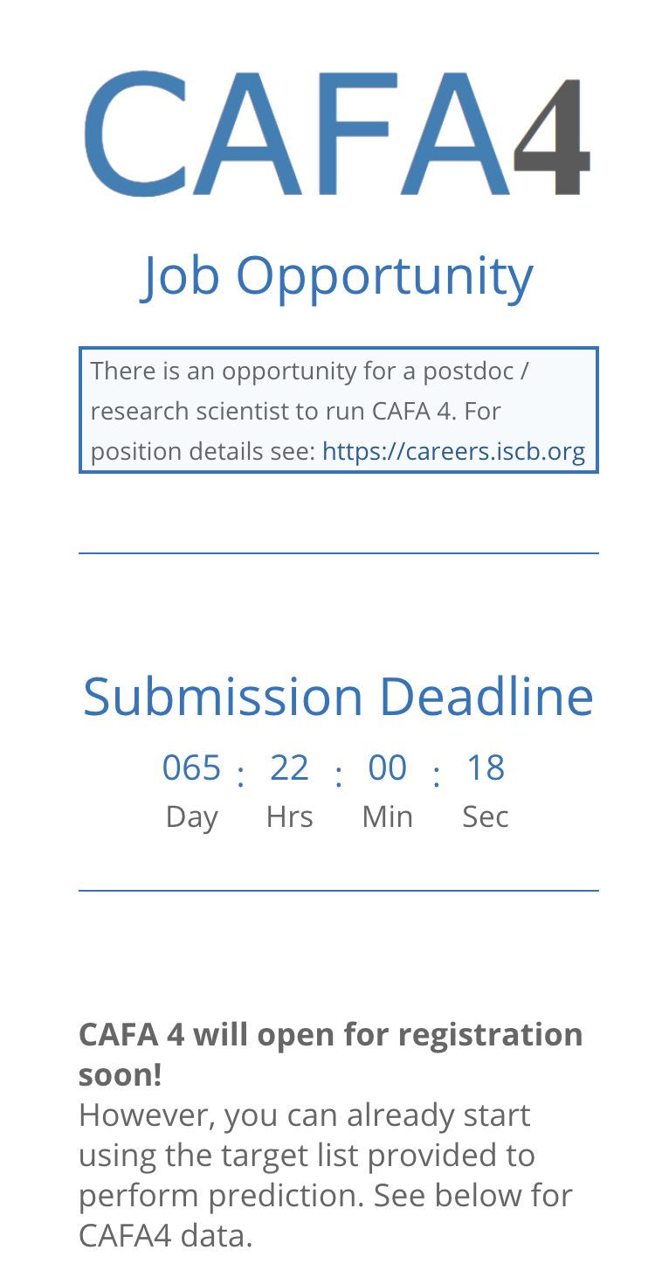
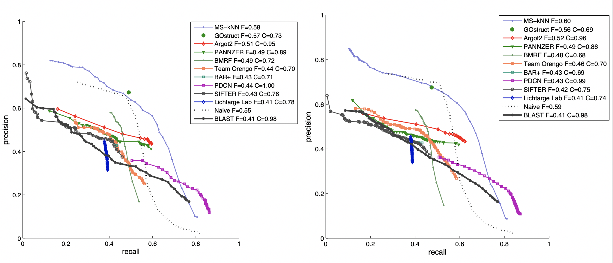
Some Future CAGI Ideas
Prospective challenges can get at problematic overlap with training data
CAFA and the EHR challenge is prospective, that is, they rely on future discoveries to asses data science
CAFA II from 2013-2015
CAFA I from 2009-2012
CAFA IV
Created for CAGI 2019
genomeinterpretation.org
Sean D. Mooney, UW

Slide 44


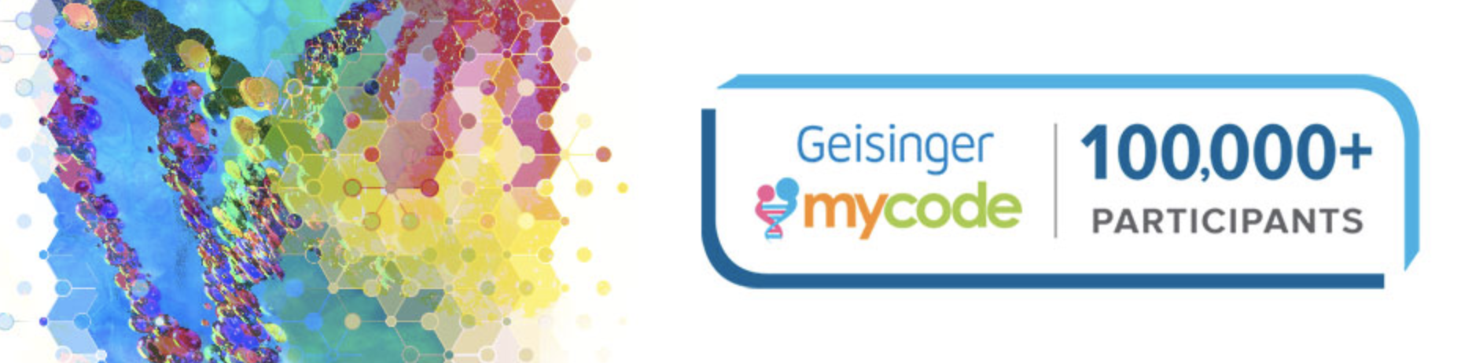
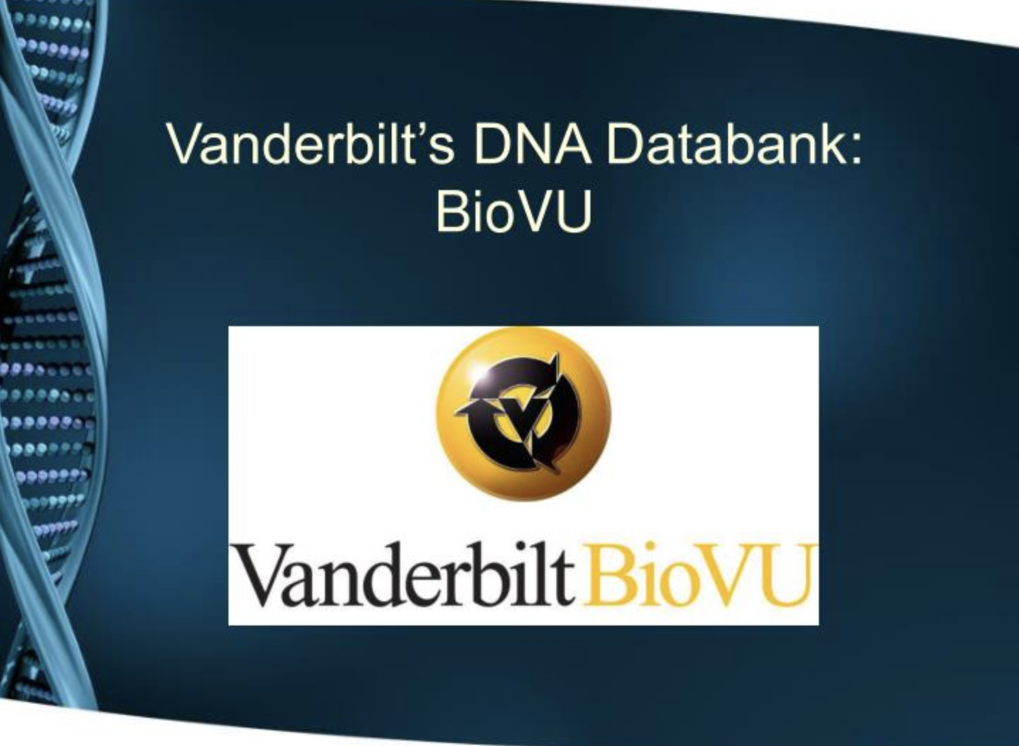
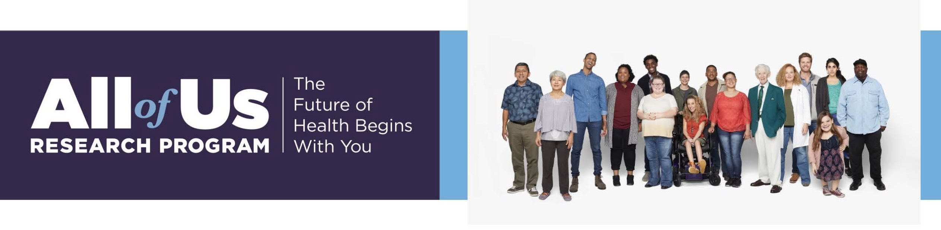
Opportunity 1: Research Biobanks
Many broad consent research databases
Created for CAGI 2019
genomeinterpretation.org
Sean D. Mooney, UW

Slide 45
CAGI meeting ONLY
Created for CAGI 2019
genomeinterpretation.org
Sean D. Mooney, UW

Slide 46
CAGI meeting ONLY
Created for CAGI 2019
genomeinterpretation.org
Sean D. Mooney, UW

