Slide 1

CAGI slide pack guidelines
I agree to my slides being used according to the following terms:
_______Anne O’Donnell Luria_______
Authors: please include THIS slide at the beginning of your presentation to indicate that you agree with reuse of your slides in CAGI presentations, according to the terms below, and digitally sign by writing your name above.
To disseminate the CAGI results, I encourage all CAGI participants to remix these CAGI slides for inclusion in their oral and poster presentations
CAGI participants may use or publish any content of these slides only in compliance with the CAGI Data Use Agreement
CAGI participants may not cite or publish any content of these slides except with the written permission of the originating author or in the primary CAGI publications
CAGI participants must acknowledge the original authors of these slides and CAGI 2013. Include the acknowledgement banner across the bottom
CAGI participants must include the CAGI credits slide in their presentations
Slides with a red slash (no remix) may not be included in a presentation unless all attendees are registered CAGI participants who signed the data use agreement
Slides with a red X over the entire slide may not be used in any circumstances
Slides with a blue slash (embargoed) may not be used unless the embargo is explicitly lifted
Slides without slash or X may be tweeted unless flagged with the “No tweet” icon.
CAGI participants using these slides must explain the “No tweet” icon, which means that the slide content should not be disseminated outside the presenting conference hall. If the presentation venue permits pervasive tweeting, you may not include these slides in your talk
Note for slide authors: we expect all CAGI participants to abide by these restrictions, and will make best effort to ensure they are followed. However, but bear in mind that we have limited means of enforcing them, and therefore the restrictions cannot be guaranteed.

Slide 2
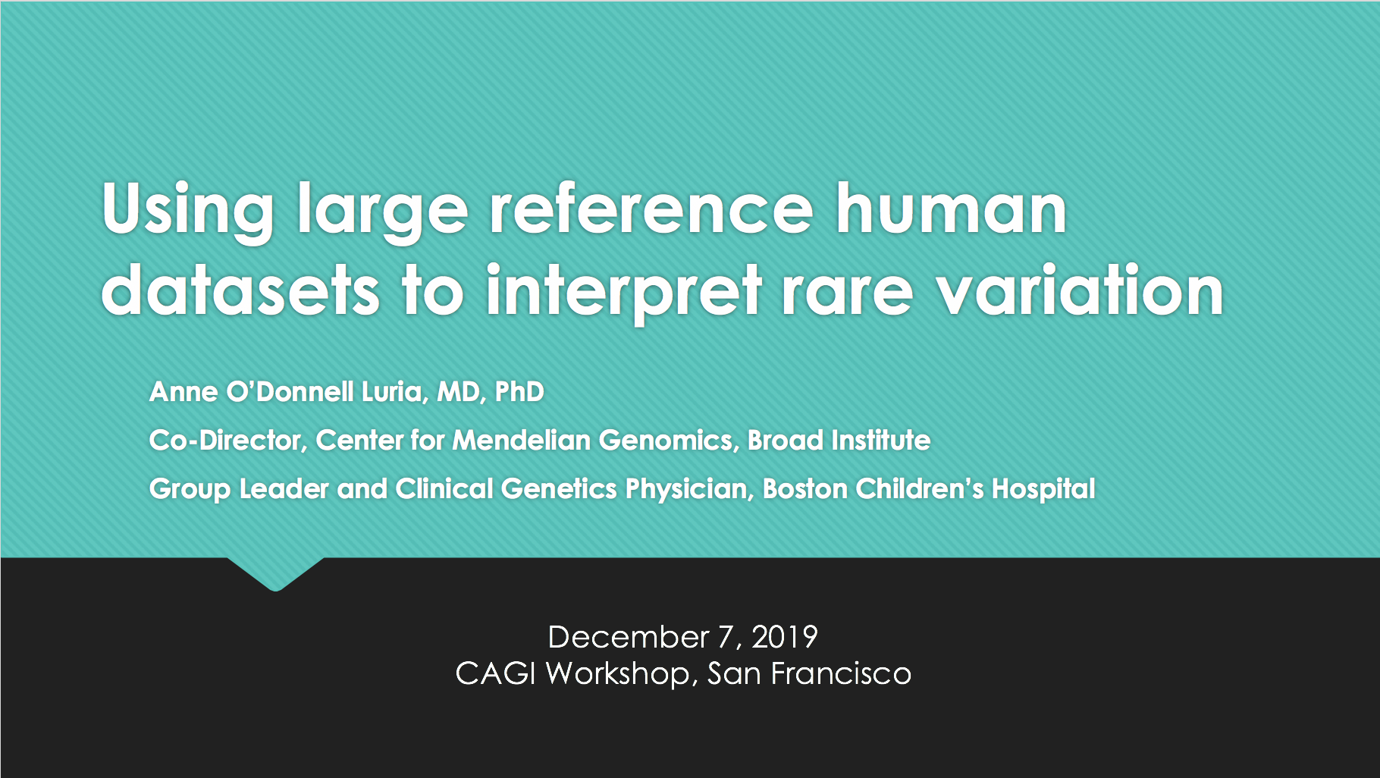


Slide 3



Harnessing the power of allele frequency
vs
Making sense of one exome requires tens of thousands of exomes (or genomes) to reveal rare variants
Sequenced and analyzed >6,000 families with rare disease

Slide 4

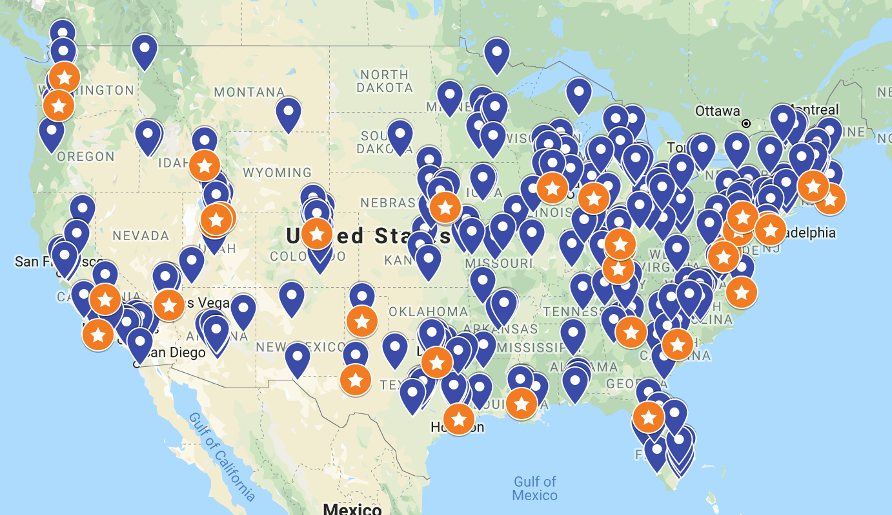
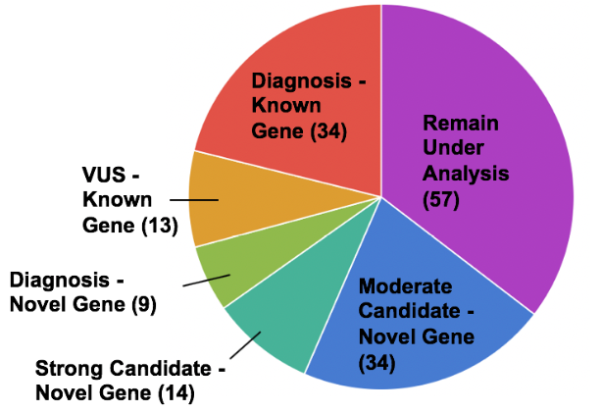
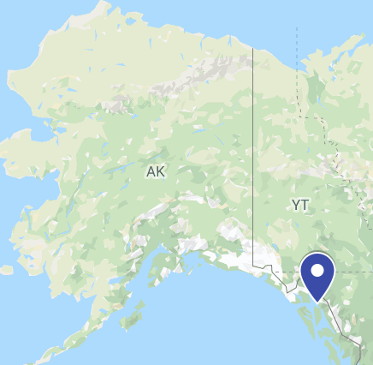


“Making genomic research accessible to the rare disease community”
raregenomes.org
Data shared through: duos.broadinstitute.org
Identify causes of undiagnosed monogenic diseases
Share information broadly to drive rare disease research
Return results to families with the help of their providers
Engage participants as partners in the research process
Numbers to date
1177
422
161
50
13
11
Individuals
Enrolled
Families
enrolled
Cases Analyzed
Reportable Results
Functional
Studies
In Progress
Publications
in
Progress
Enrolled participant
Reportable results
Notes:
Melanie 39/111= 35%
45 states + DC

Slide 5
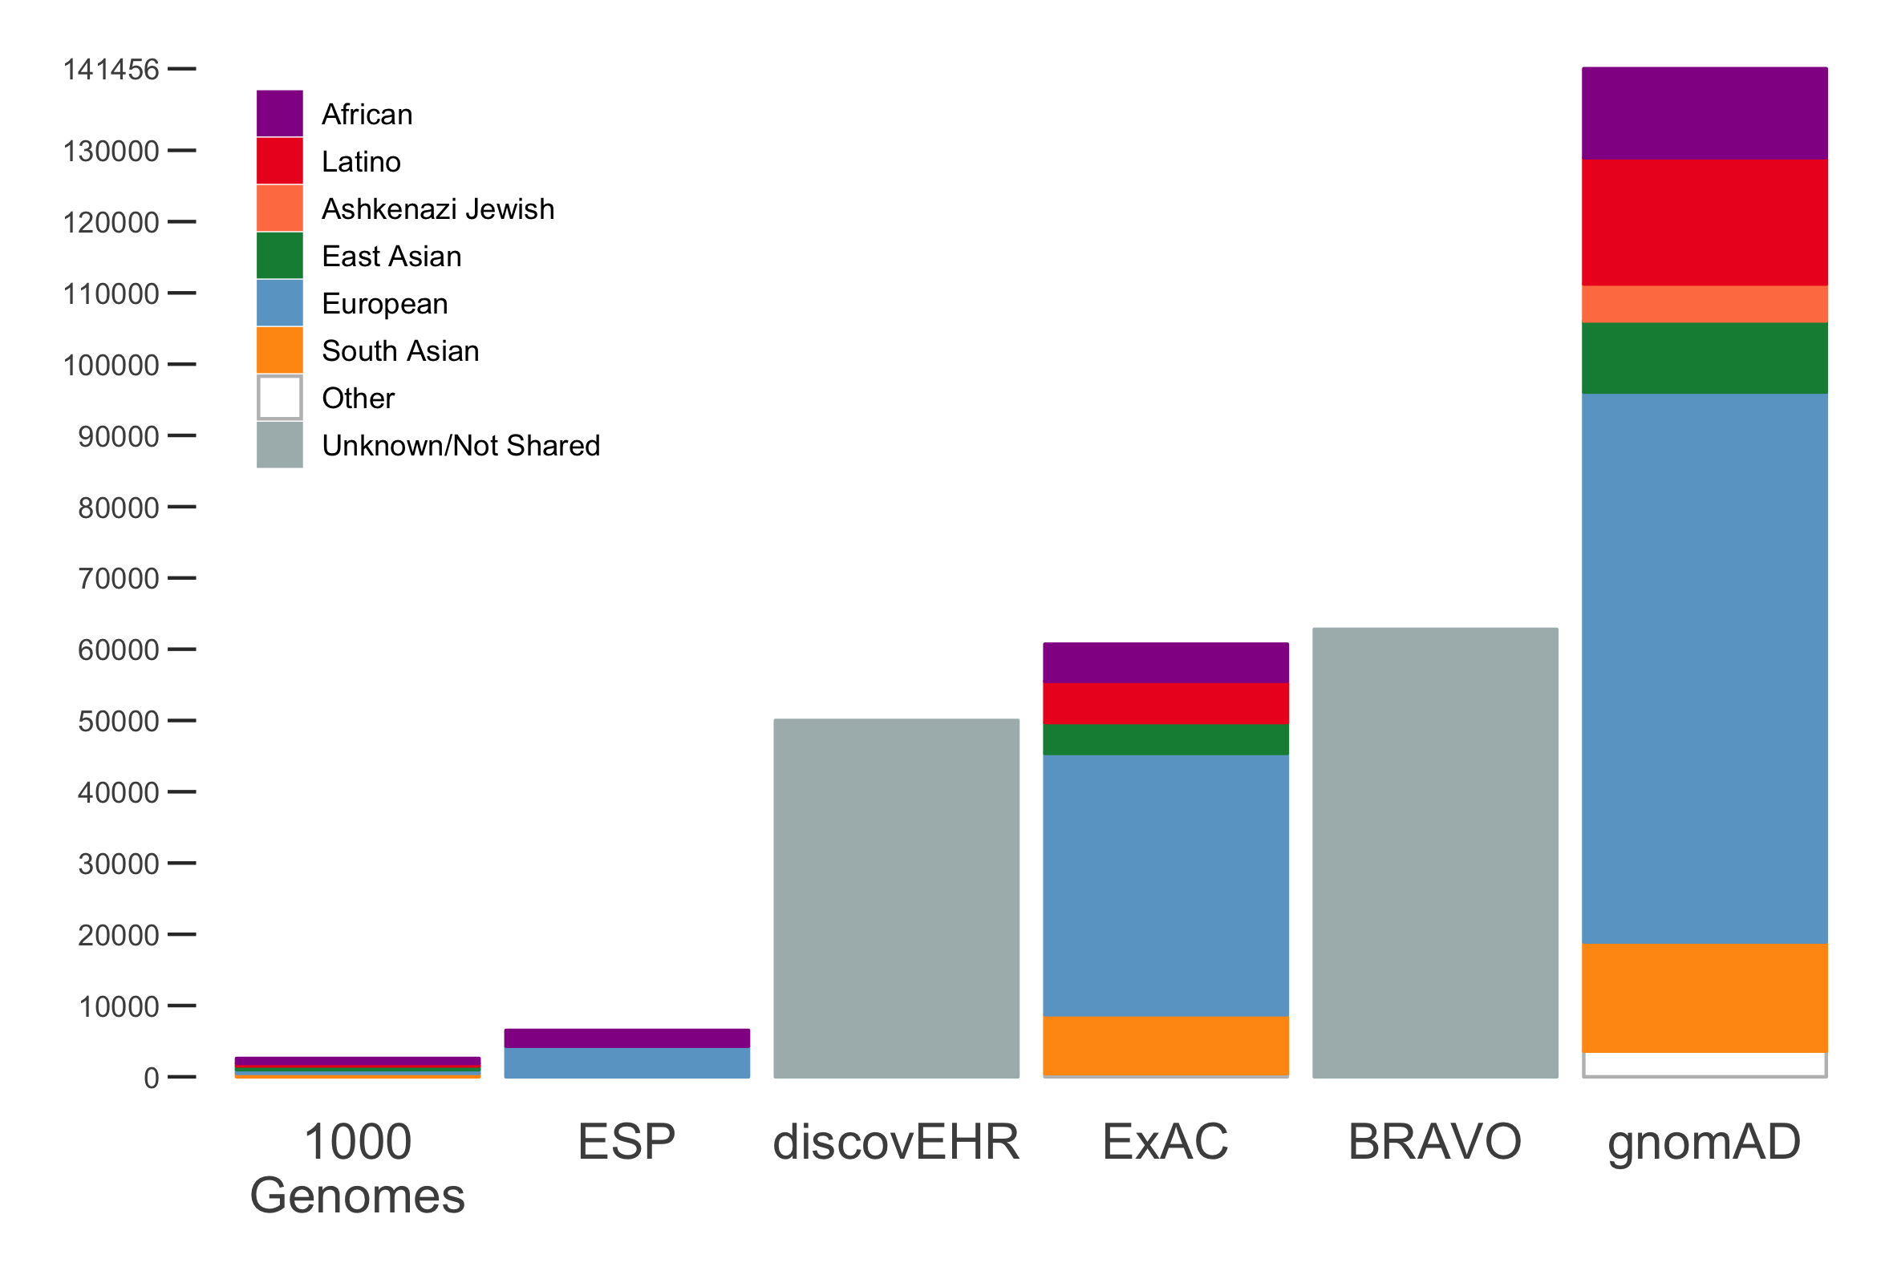
Increasing the scale of reference databases
10/2017
gnomAD v2: >140,000 individuals on hg37
  125,748 exomes and 15,708 whole genomes
gnomAD v3: 71,702 genomes on hg38 (some overlap with gnomAD v2 samples) released 10/2019
10/2014
10/2018
2016
2010
2012
Notes:
In order to discover the high-impact rare LoF variants, our group and others have undertaken large sequencing projects to catalog natural genetic variation.
Today, I'm going to describe recent efforts using the larger Genome Aggregation Database (gnomAD) which comprises 125K exomes and 15K genomes, generously provided by over 100 PIs. Today, I'm happy to announce that we are releasing a new version of this callset with a few thousand more samples. If you've been using the ExAC or gnomAD datasets...

Slide 6
Data sharing
Data processed through same pipeline and called jointly
Daniel MacArthur
Aarno Palotie
Andres Metspalu
Anne Remes
Adolfo Correa
Andre Franke
Ann Pulver
Ben Glaser
Ben Neale
Bong-Jo Kim
Bruce Cohen
Carlos Pato
Carlos A Aguilar Salinas
Christina Hultman
Christine M. Albert
Christopher Haiman
Clicerio Gonzalez
Colin Palmer
Craig Hanis
Dan Roden
Dan Turner
Dana Dabelea
Daniel Chasman
Danish Saleheen
David Altshuler
David Goldstein
Dawood Darbar
Dermot McGovern
Diego Ardissino
Donald Bowden
Dost Ongur
Emelia J. Benjamin
Erkki Vartiainen
Erwin Bottinger
Gad Getz
George Kirov
Gil Atzmon
Harlan M. Krumholz
Harry Sokol
Heribert Schunkert
Hilkka Soininen
Hugh Watkins
Jaakko Kaprio
Jaana Suvisaari
James Meigs
James Ware
James Wilson
Jaspal Kooner
Jaume Marrugat
Jeanette Erdmann
Jeremiah Scharf
John Barnard
John Chambers
John D. Rioux
Jose Florez
Josée Dupuis
Judy Cho
Juliana Chan
Kari Mattila
Kyong Soo Park
Laurent Beaugerie
Leif Groop
Lorena Orozco
Lori Bonnycastle
Maija Wessman
Mark Daly
Mark McCarthy
Markku Laakso
Martti Färkkilä
Matthew Bown
Matthew Harms
Matti Holi
Michael Boehnke
Michael O'Donovan
Michael Owen
Mikko Hiltunen
Mikko Kallela
Mina Chung
Ming Tsuang
Moore Shoemaker
Nazneen Rahman
Nilesh Samani
Olle Melander
Pamela Sklar
Patrick T. Ellinor
Patrick Sullivan
Peter Nilsson
Ramnik Xavier
Ravindranath Duggirala
Rinse Weersma
Roberto Elosua
Ronald Ma
Ruth Loos
Ruth McPherson
Samuli Ripatti
Sekar Kathiresan
Seppo Koskinen
Soo Heon Kwak
Stephen Glatt
Steve McCarroll
Steven A. Lubitz
Subra Kugathasan
Tai Shyong
Tariq Ahmad
Teresa Tusie Luna
Terho Lehtimäki
Tim Spector
Tõnu Esko
Tuomi Tiinamaija
Veikko Salomaa
Yik Ying Teo
Young Jin Kim
Jerome Rotter
Steven Rich
Broad Genomics Platform
Broad Data Sciences Platform

Slide 7
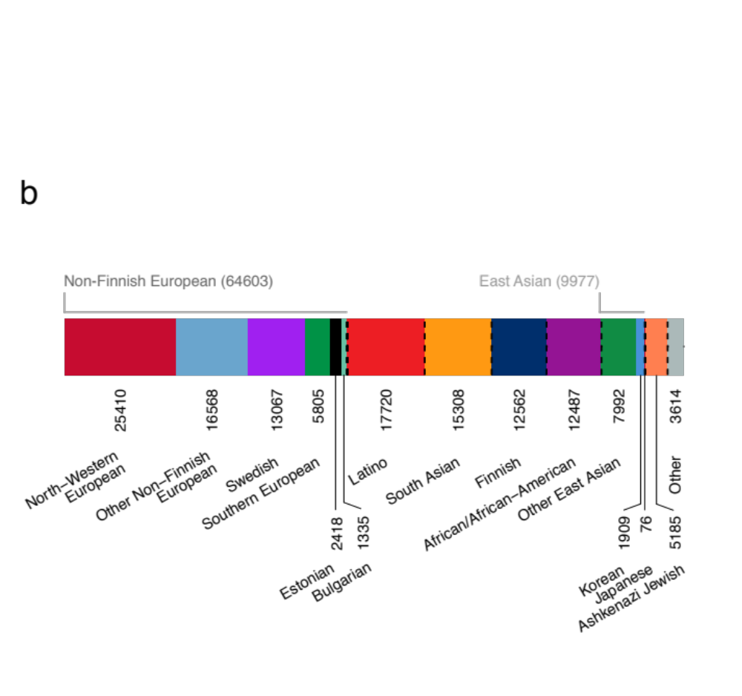
Who’s in these databases?
gnomAD v2
Short read Illumina data primarily from case-control studies of complex adult-onset diseases (e.g. type 2 diabetes, heart attack, migraine, bipolar)
Depleted as much as possible of people known to have severe pediatric disease, and their first-degree relatives
Individual level data not shared & phenotype data not available
55% Male; Mean age 54 years
Use the filtering allele frequency (FAF) – statistically adjusted popmax AF (Whiffin, GiM, 2017)
Aggregate sites VCF of entire dataset available for download

Slide 8



East Asian
South Asian
Latino
African
European
Five-fold reduction in number of very rare variants with large reference databases
# variants remaining after filtering
# variants remaining in an exome after applying a 0.1% filter across all populations
Both size and ancestral diversity increase filtering power
6K
60K
Lek et al., Nature, 2016

Slide 9
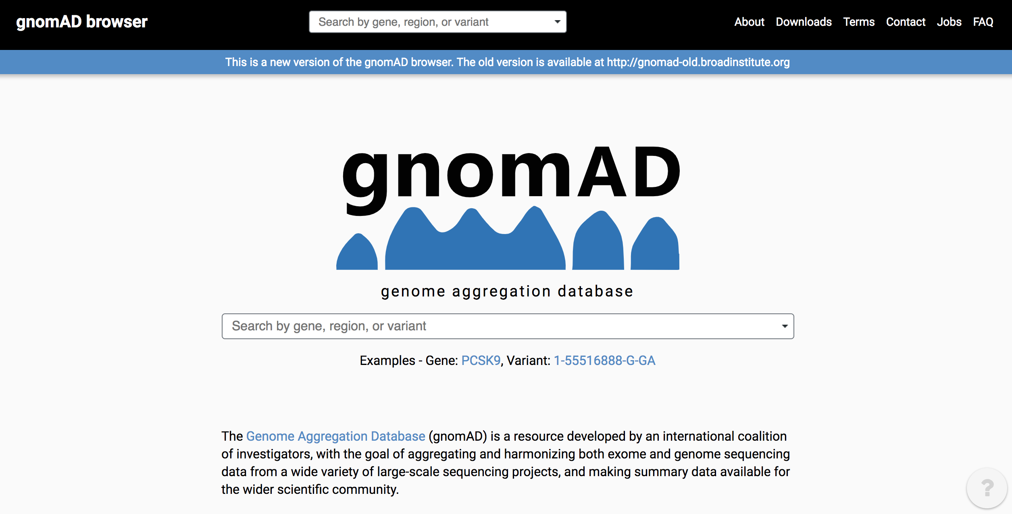
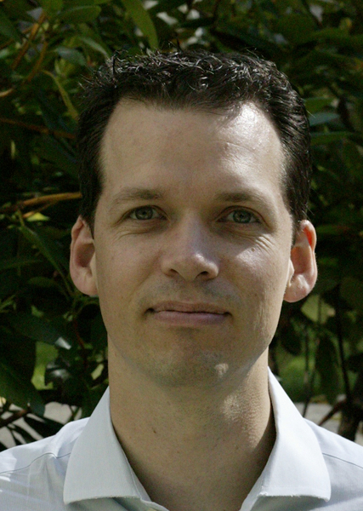

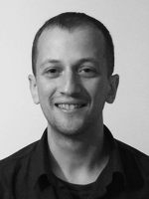
Matthew
Solomonson
Nick
Watts
Daniel MacArthur
Ben Weisburd
Konrad Karczewski
Laurent Francioli
Grace Tiao
Jessica Alfoldi
Heidi Rehm
Mark Daly
Intro presentation: https://tinyurl.com/gnomad-primer
  http://gnomad.broadinstitute.org

Slide 10
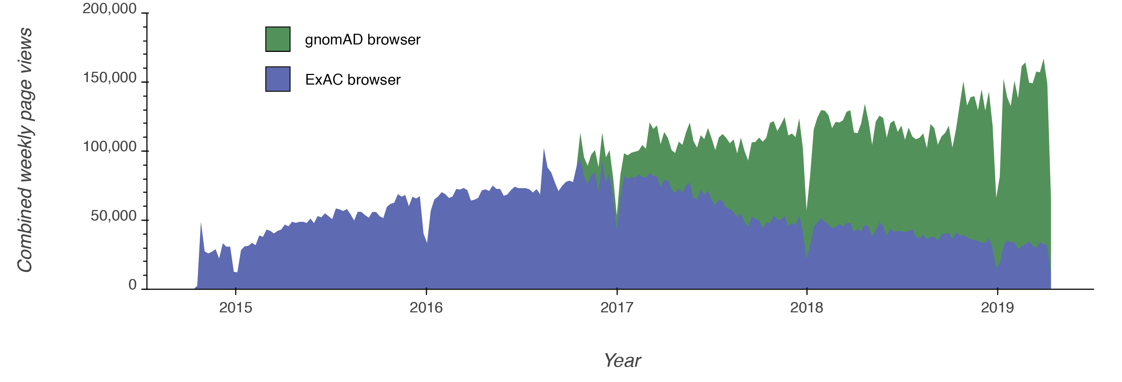
gnomAD’s impact
20.8 M pageviews of the ExAC and gnomAD browsers, by 230,000 users from 166 countries
Aided in the diagnosis of over 50,000 rare disease families
3,962 papers have cited the ExAC paper
Notes:
Citations, diagnoses, impact

Slide 11
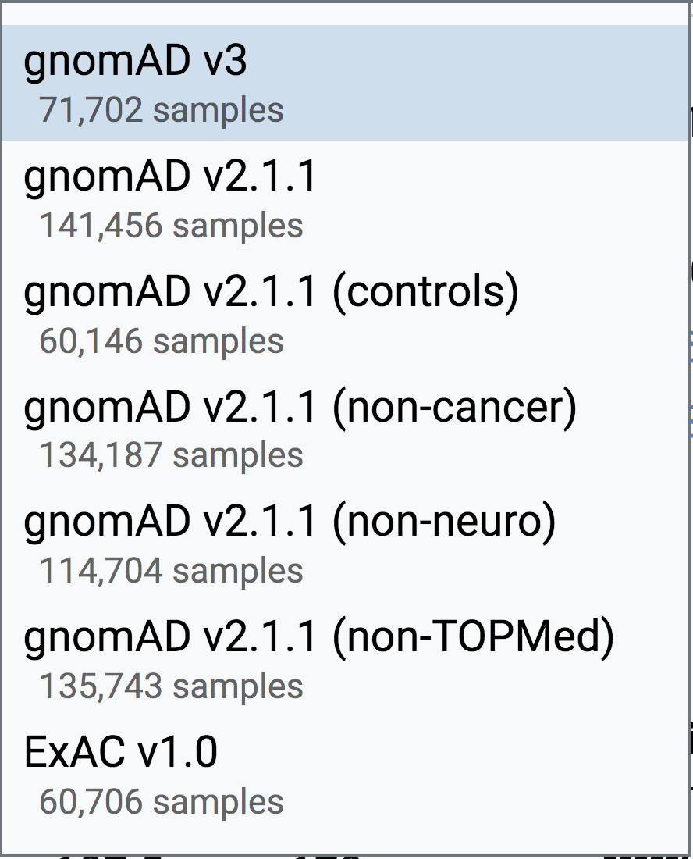
Datasets and subsets

Slide 12
Tools for interpreting genetic variation
Constraint
Regional missense constraint and MPC scores
Transcript based annotation (pext scores)

Slide 13
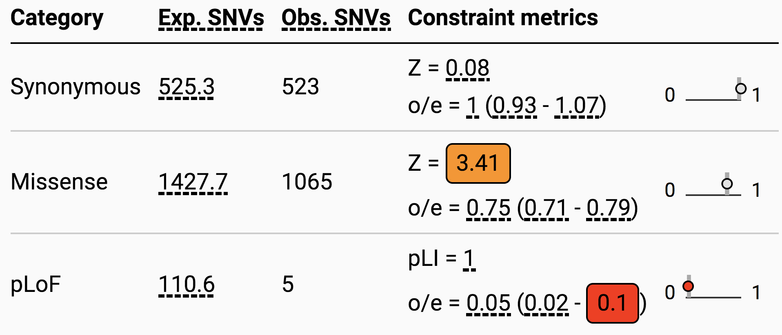
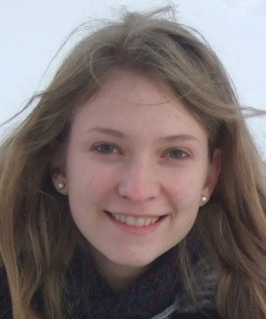
Developed a mutational model to calculate expected number of variants per gene
Kaitlin Samocha
Daniel MacArthur
Mark Daly
(Samocha et al. 2014; Lek et al. 2016)

Slide 14
Constraint metrics
Used z-scores to assess depletion from expectation
For pLoF variants, correlation with gene length (short genes under powered)
(Samocha et al. 2014; Lek et al. 2016)

Slide 15
Constraint metric: pLI
For pLOF, used expectation maximization algorithm to transform into pLI score (0-1, with 1 being most constrained)
pLI = probability loss of function intolerance score
Recommend pLI >0.9
# of genes
pLI
(Samocha et al. 2014; Lek et al. 2016)

Slide 16
LoF constraint is a spectrum not a dichotomy
non-essential
complex disease
beneficial
recessive disease
haploinsufficient disease
embryonic lethal
Notes:
Imagine if we could put each of the 20K genes in the genome along a spectrum of sensitivity to functional disruption, that is, the clinical or phenotypic impact that a loss-of-function variant might have in that gene.
For instance, here over on the left are genes where we’ll never see LoF variants in living humans as these would be incompatible with human life. In the middle are variants and genes that we typically study in the clinical genetics space, from causal variants for dominant and recessive diseases to risk factors for complex disease. On the right, we have genes that are relatively tolerant of LoF variation, potentially even homozygous inactivation.
And unlike in model organisms, where we can effectively engineer such mutations, there are obvious technical and ethical barriers to doing so in humans. But when we sequence healthy individuals or individuals with common diseases, we find plenty of genes inactivated, in the form of naturally-occurring predicted loss-of-function variants (or pLoFs). However…

Slide 17

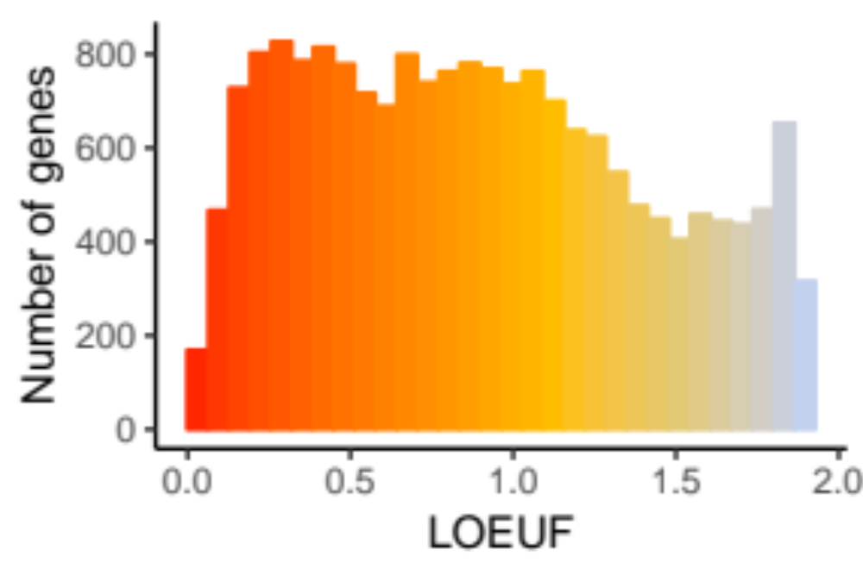
Constraint metric: LOEUF
LOEUF is a continuous metric
The upper bound of the 90% confidence interval of the observed/expected ratio of predicted loss-of-function variants
Many genes are extremely depleted (<35%) observed compared to expected
  >70% of these have no known disease phenotype
Konrad
Karczewski
Karczewski, bioRxiv, 2019

Slide 18
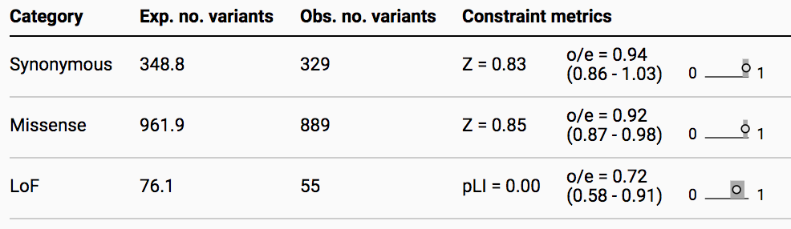
Important notes on constraint
Primarily for dominant disease genes
Do not expect to see strong constraint signal for recessive disease genes
Not necessarily a sign of a strong phenotype – can see evidence of constraint from mild degrees of negative selection
Selection occurs through reproduction so deleterious effect must be during reproductive years
  Example: BRCA1 does not show evidence of loss of function constraint
BRCA1
Autosomal dominant
Breast and ovarian cancer

Slide 19
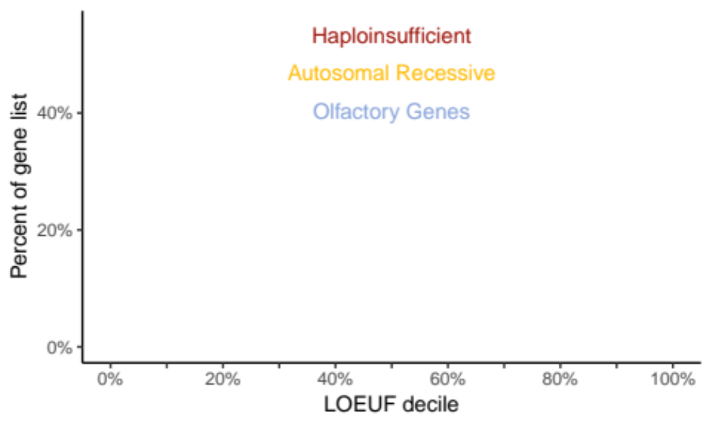
Resolving the spectrum of LoF intolerance
Binning this spectrum into deciles
More depleted
More constrained
More tolerant
Less constrained
Notes:
So we can bin this metric into deciles, which I'll show on every slide from here on out with the left ...

Slide 20
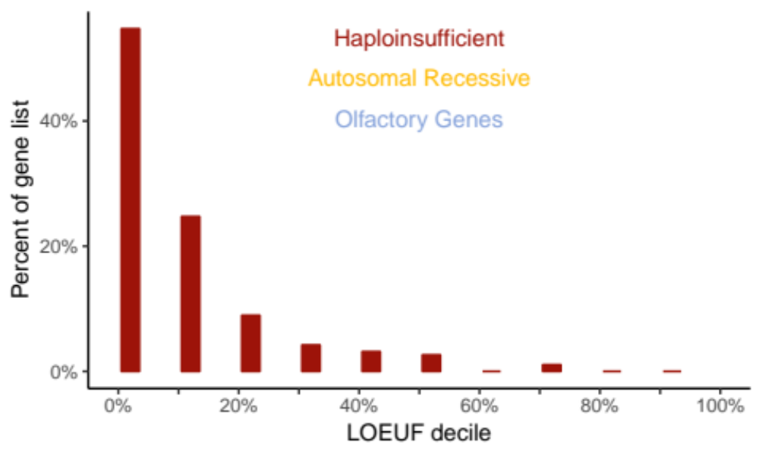
Resolving the spectrum of LoF intolerance
Known haploinsufficient genes have ~10% of the expected pLoFs
Notes:
116 - manually curated haploinsufficient developmental delay genes

Slide 21
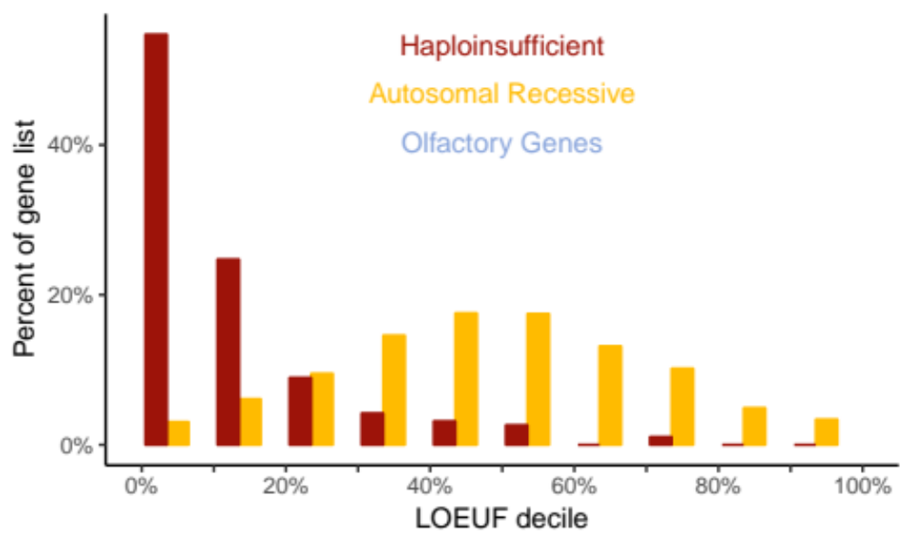
Resolving the spectrum of LoF intolerance
Autosomal recessive genes are centered around 60% of expected
Gene list from:
Blekhman et al., 2008
Berg et al., 2013
Notes:
1164

Slide 22
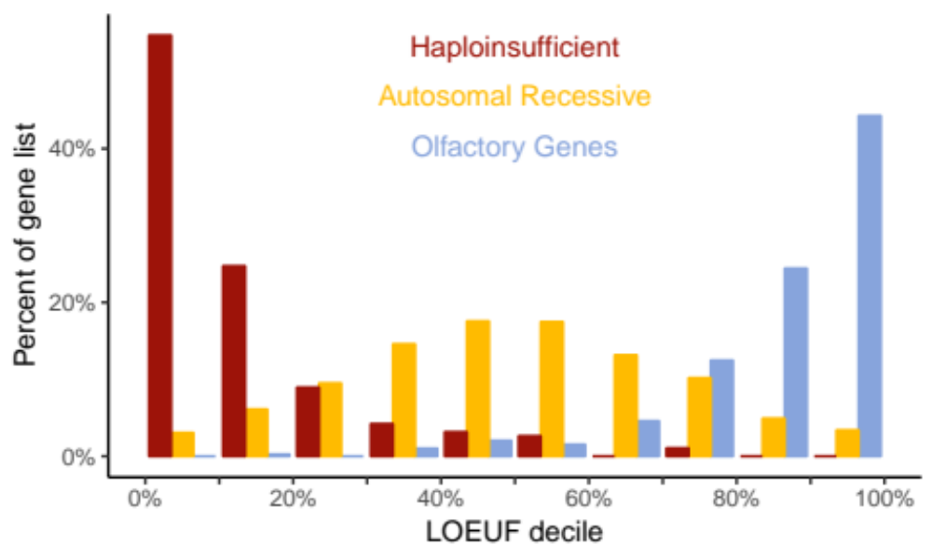
Resolving the spectrum of LoF intolerance
Some genes, e.g. olfactory receptors, are unconstrained
Notes:
350
so the metric is well-calibrated, and importantly this means we now have improved LoF tolerance scores for all protein-coding genes in the genome

Slide 23
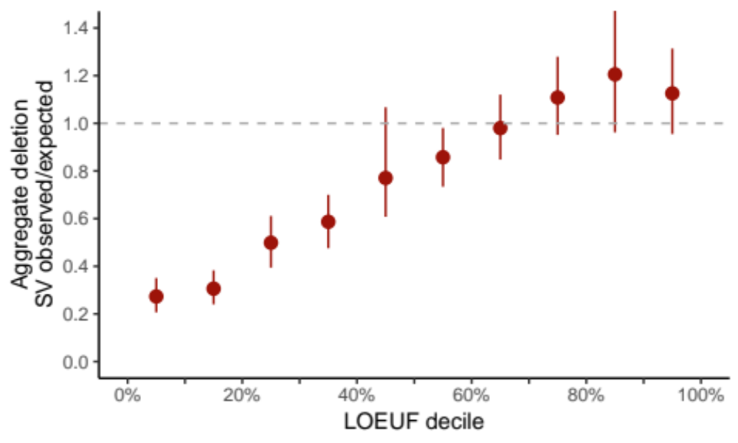
Constraint spectrum reflects patterns of structural variation
Harrison Brand
Ryan Collins
Called SVs in 14,245 individuals with 30X WGS
9,860 rare (<1%), heterozygous, autosomal LoF deletions
Occurrence correlates with SNV constraint metric
Michael Talkowski
broad.io/gnomad_sv
Notes:
We next explored the correlation between constraint against SNVs with patterns of structural variation. Ryan and Harrison called SVs in 14K individuals, identifying about 10K rare biallelic autosomal LoFs that disrupt gene function.
When they looked at the occurrence of SVs in each of the constraint deciles, they found that on average, the constrained genes had a strong depletion of structural variation,
Important to note that this is not a per-gene SV metric, as even this dataset of 15K has less than one rare LoF SV per gene.
For more information on this dataset, see the recently posted preprint

Slide 24
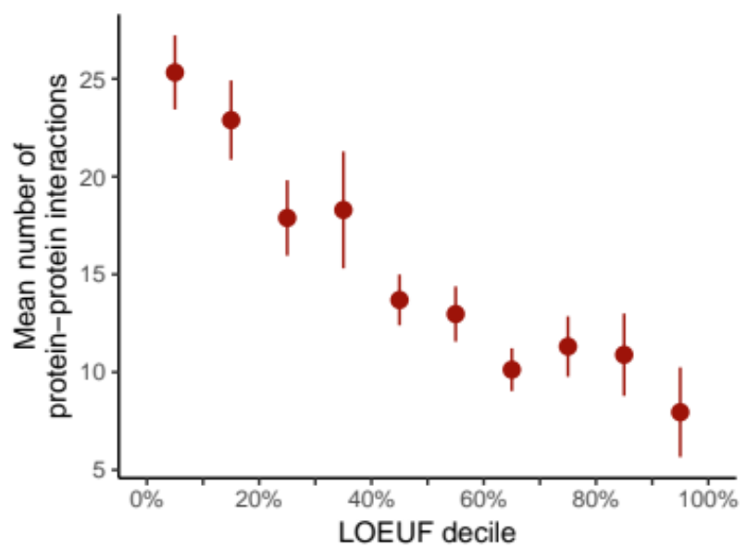
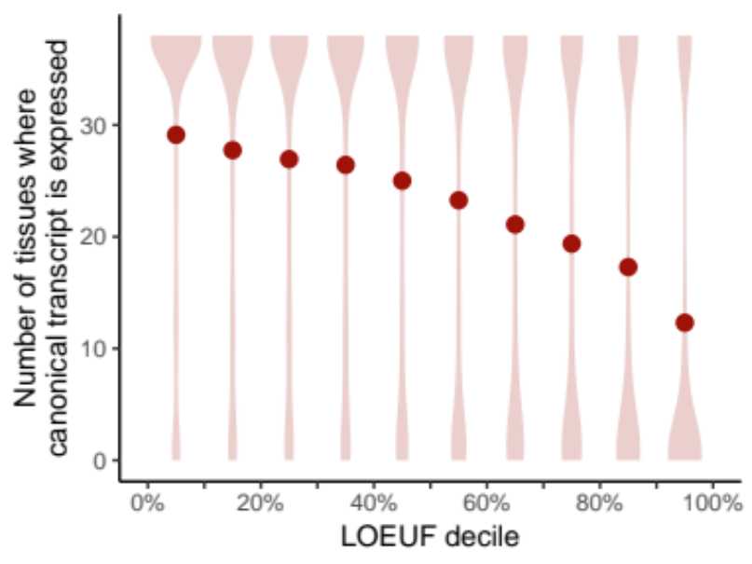
Constraint metrics are correlated with biological relevance
Protein-protein interactions
Gene expression
Konrad Karczewski

Slide 25
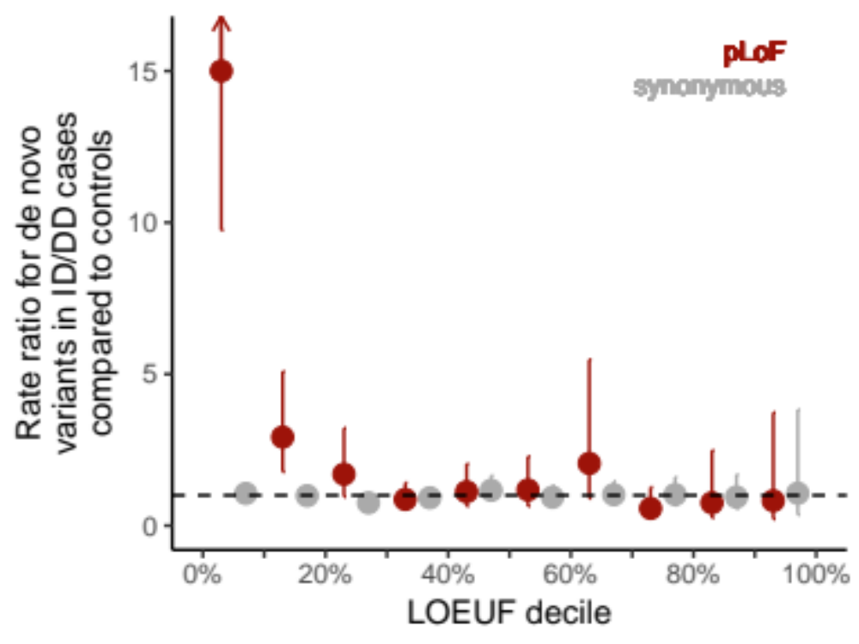
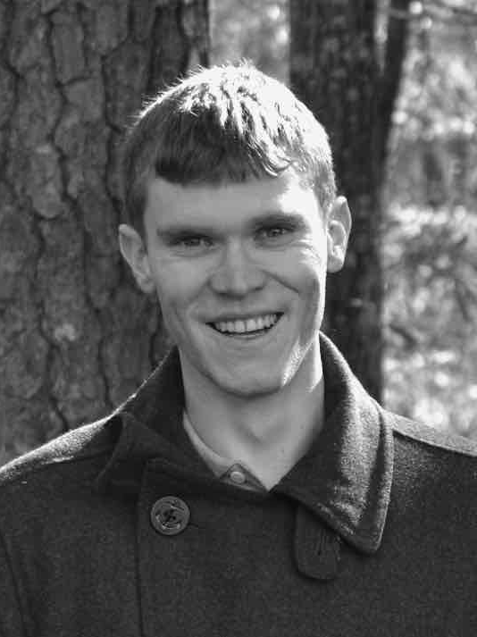
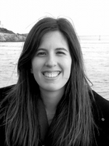
Constraint improves rare disease diagnosis
Patients with developmental delay/intellectual disability are 15X more likely to have an de novo LoF in a constrained gene
  8,095 de novos in 5,305 cases
  2,623 de novos in 2,179 controls
Jack
Kosmicki
Beryl
Cummings
Notes:
If we look at the burden of de novo LoFs in patients with developmental delay or intellectual disability, we observe a 15-fold increased rate in the top 10% most constrained genes in the genome, in cases compared to controls. So in other words, this lowest decile contains genes where a single LoF mutation will prevent you, by an estimable amount, from progressing through a healthy development during childhood.

Slide 26
Regional missense constraint and MPC scores
Kaitlin Samocha
Samocha, bioRxiv, 2017

Slide 27
Amino acid refinement around any significant breakpoint between the two regions
Example gene: 401 missense variants expected and 199 (~50%) observed.
Observed
missense
140
152
15
16
4
19
40
214
Expected
missense
Samocha, bioRxiv, 2017

Slide 28
Amino acid refinement around any significant breakpoint between the two regions
Example gene: 401 missense variants expected and 199 (~50%) observed.
Observed
missense
140
152
15
16
4
19
40
214
Expected
missense
155
168
unconstrained
44
233
constrained
(92%)
(19%)
Samocha, bioRxiv, 2017

Slide 29
Amino acid refinement around any significant breakpoint between the two regions
Example gene: 401 missense variants expected and 199 (~50%) observed.
Observed
missense
140
152
13 2
8 8
4
19
40
214
Expected
missense
153
160
unconstrained
46
241
constrained
(96%)
(19%)
Samocha, bioRxiv, 2017

Slide 30
Only 15% of genes have evidence of regional missense constraint
Number of regions | Number of transcripts | Percentage of transcripts
1 | 15,215 | 84.9%
2 | 1,717 | 9.6
3 | 904 | 5.0
4 | 56 | 0.3
5 | 13 | < 0.1
6 | 5 | < 0.1
7 | 2 | < 0.1
8 | 31 | < 0.1
Samocha, bioRxiv, 2017

Slide 31
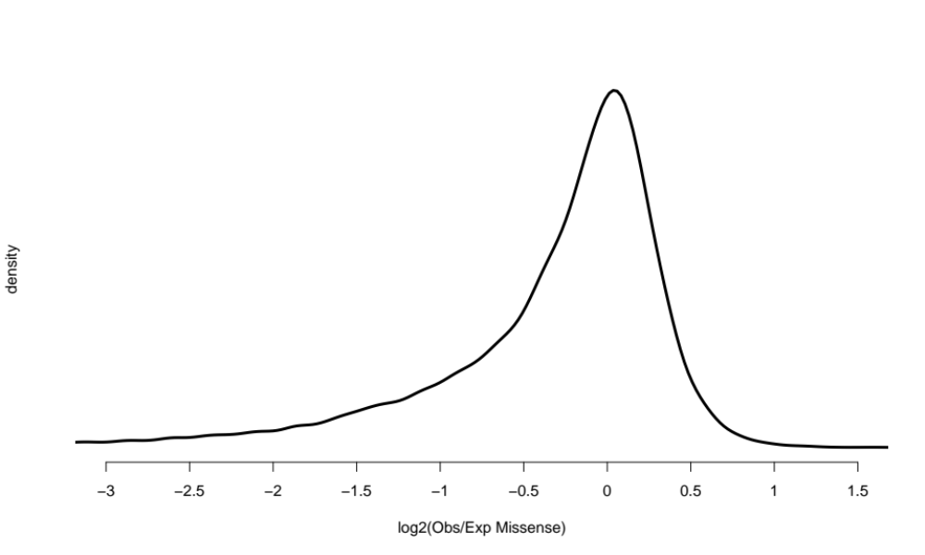
Excess of coding sequence depleted of missense variation
Samocha, bioRxiv, 2017

Slide 32
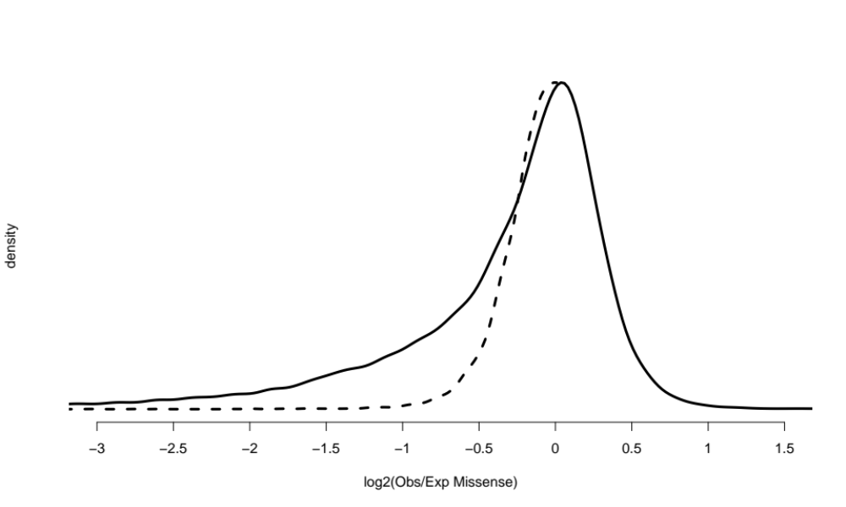
Excess of coding sequence depleted of missense variation
Samocha, bioRxiv, 2017

Slide 33
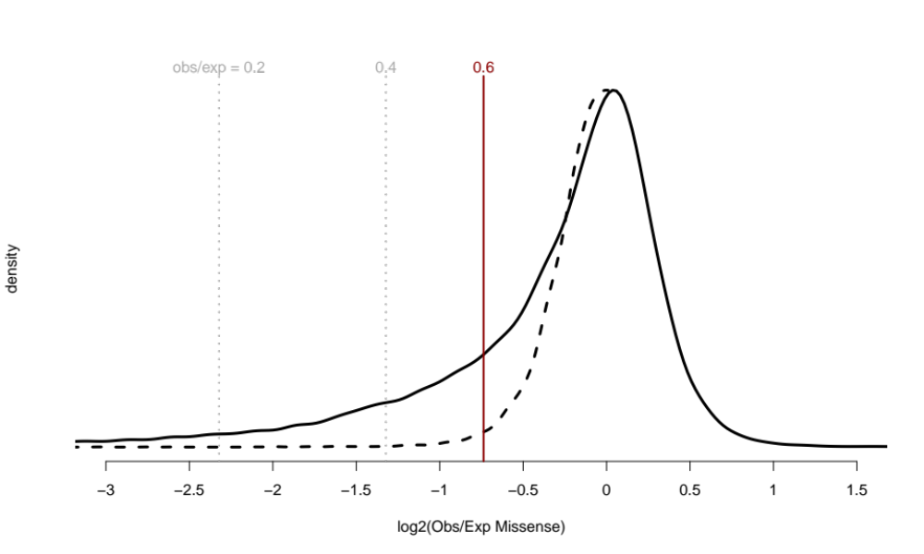
Excess of coding sequence depleted of missense variation
Samocha, bioRxiv, 2017

Slide 34

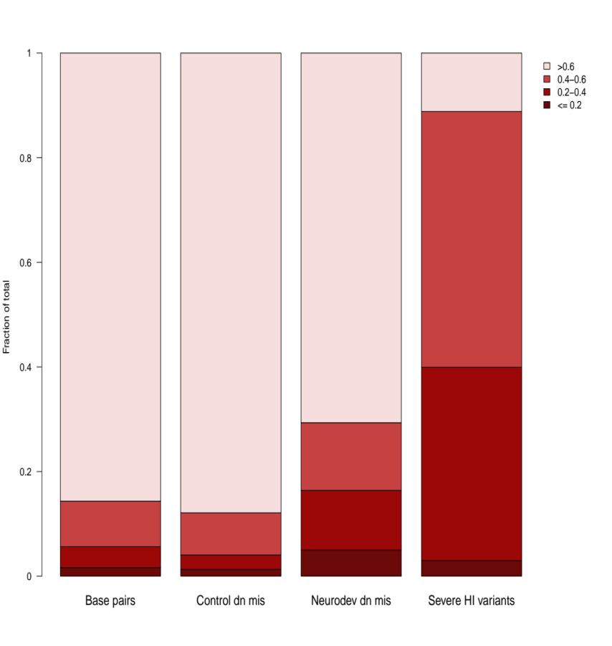
Most missense depleted regions contain disproportionate amount of pathogenic variants
1
> 0.6
0.4-0.6
0.2-0.4
≤ 0.2
Observed / expected missense variants
0.8
0.6
Fraction of total
0.4
0.2
0
Coding
base pairs
Controls
Neurodev disorders
ClinVar
pathogenic

Slide 35
Most missense depleted regions contain disproportionate amount of pathogenic variants
1
> 0.6
0.4-0.6
0.2-0.4
≤ 0.2
Observed / expected missense variants
0.8
2,078 de novo variants in controls
0.6
Fraction of total
0.4
0.2
0
Coding
base pairs
Controls
Neurodev disorders
ClinVar
pathogenic

Slide 36
Most missense depleted regions contain disproportionate amount of pathogenic variants
1
> 0.6
0.4-0.6
0.2-0.4
≤ 0.2
Observed / expected missense variants
0.8
2,078 de novo variants in controls
ClinVar variants in haploinsufficient genes that cause severe disease*
0.6
Fraction of total
0.4
0.2
0
Coding
base pairs
Controls
ClinVar
pathogenic
ClinGen and team curation

Slide 37
Most missense depleted regions contain disproportionate amount of pathogenic variants
1
> 0.6
0.4-0.6
0.2-0.4
≤ 0.2
Observed / expected missense variants
0.8
2,078 de novo variants in controls controls
5,620 de novo variants in cases with a neurodevelopmental disorder
ClinVar variants in haploinsufficient genes that cause severe disease*
0.6
Fraction of total
0.4
0.2
0
Coding
base pairs
Controls
Neurodev disorders
ClinVar
pathogenic

Slide 38

Combine variant and gene level information
Variant
Conservation across species
Deleteriousness of amino acid substitution
  Polarity
  Impact on structural features
  Disruption of binding sites
AATCATCGATGT
AATCATTGATGT
Patient
Gene
Local missense constraint
Samocha, bioRxiv, 2017

Slide 39
Missense badness: a human-specific amino acid deleteriousness metric
Arginine
Glutamine
195K possible occurrences
missense constrained
regions of the exome
unconstrained
regions of the exome
36%
25,429
71,415
Observed
Possible
64%
75,174
117,722
Missense badness Arg -> Gln = 0.36 / 0.64 = 0.56

Slide 40
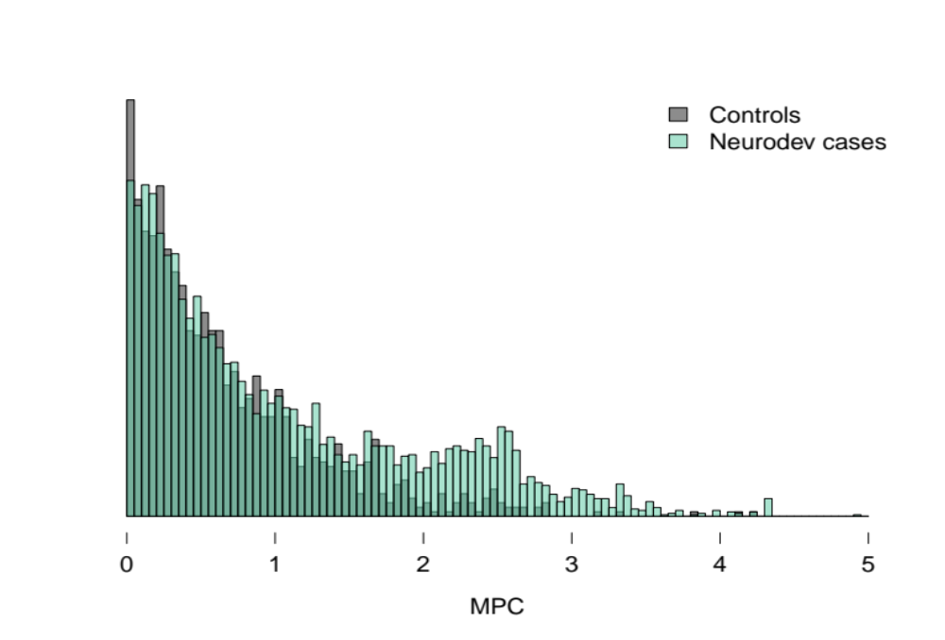
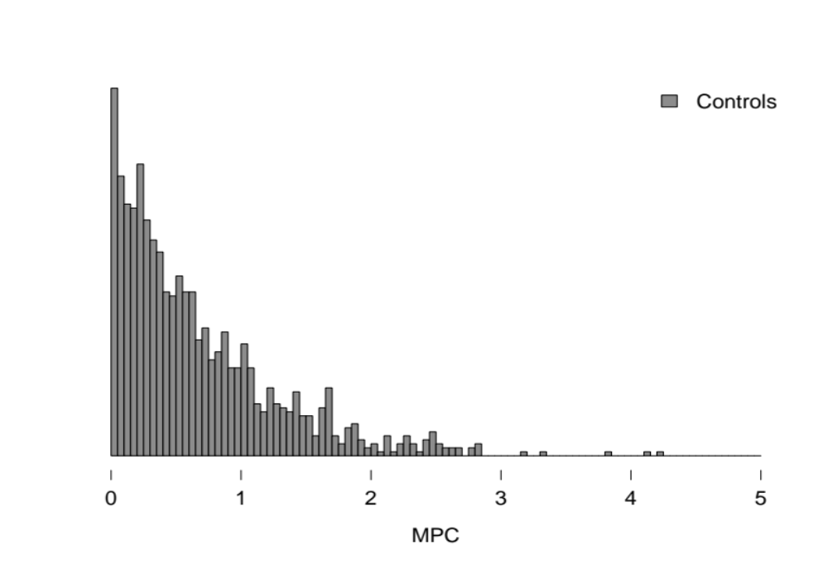
MPC = Missense badness + PolyPhen-2 + Constraint
MPC

Slide 41
MPC = Missense badness + PolyPhen-2 + Constraint
MPC

Slide 42
0.507 per case
0.504 per control
0.185 per case
0.124 per control
0.162 per case
0.028 per control
Corrected for difference in rate of synonymous variants
OR ~1.01
OR ~1.49
OR ~5.79
MPC

Slide 43
0.507 per case
0.504 per control
0.185 per case
0.124 per control
0.162 per case
0.028 per control
Corrected for difference in rate of synonymous variants
OR ~1.01
OR ~1.49
OR ~5.79
As compared to de novo pLoF variants in this cohort: OR 6.7
MPC

Slide 44
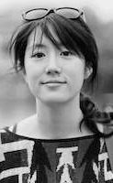
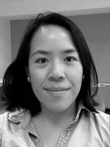
MPC and regional constraint
Currently generated on the ExAC dataset
Reimplementing on the gnomAD dataset
Katherine
Chao
Grace
Tiao

Slide 45
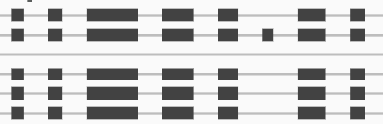
Deleterious looking variants of low biologic importance
We report the worst possible consequence of a variant but these aren’t always clinically relevant
Nonsense or missense variant in exon that is in a minority of transcripts
Intronic variant in majority of transcripts
Is this exon even expressed?

Slide 46


Transcript-based variant interpretation
Transcript quantification
Transcript 1
1 TPM
Transcript 2
20 TPM
Transcript 3
5 TPM
*
Genome
broad.io/tx_annotation
Cummings et al. (MacArthur), bioRxiv, 2019
Beryl
Cummings
Notes:
Our in our appraoch we define the expression of a base as the sum of the expression of the transcripts that it falls on

Slide 47
Transcript-based variant interpretation
Transcript quantification
Transcript 1
1 TPM
Transcript 2
20 TPM
Transcript 3
5 TPM
Genome
Median transcript expression in a GTEx tissue
26 TPM
1
TPM
21
TPM
    One value per tissue
21 TPM
Notes:
In the first exon all of the bases are represented on all the transcripts, so we add those values up

Slide 48
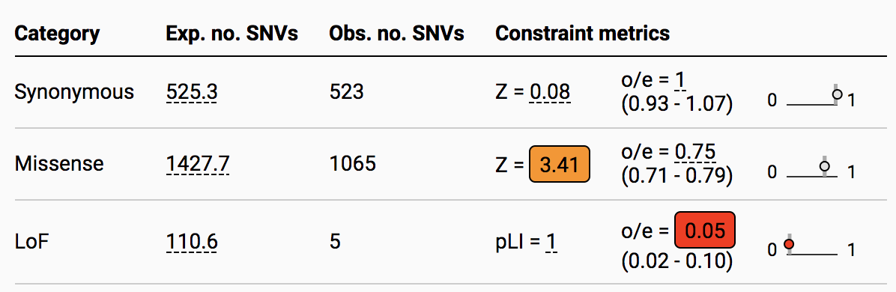
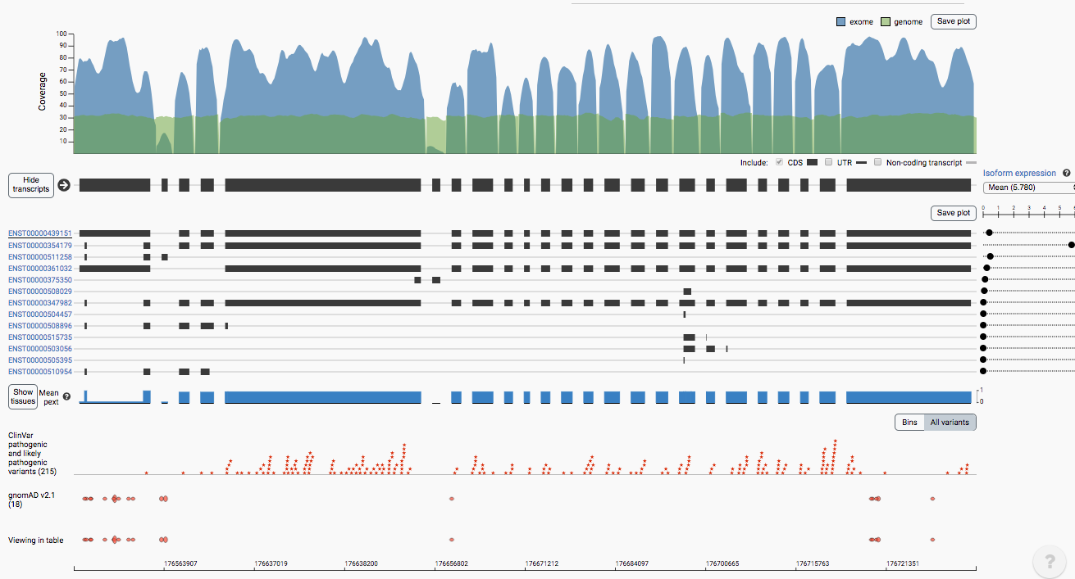
pext scores in gnomAD
broad.io/tx_annotation
Beryl Cummings et al. (MacArthur), bioRxiv, 2019
Nick Watts

Slide 49
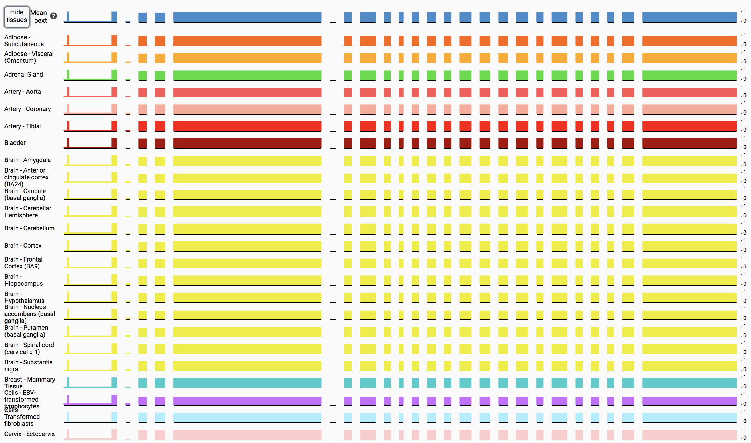
Tissue pext scores

Slide 50
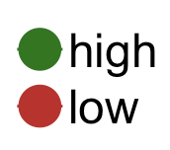
Application to de novo variant analysis in DD/ID & ASD
Collated ~14,000 de novo variants from 10 studies
Developmental Delay / Intellectual Disability
Expression bin
Variants in Kosmicki, Nature Genetics, 2017
Notes:
And the question is, if we set out our threshold to say exons with very little evidence of expression across gtex are we accurately filtering out annotation errors.
So firstly we compared variants in a larger list of 62 haploinsufficient, now looking at high quality nonsense variants in gnomAD in these genes versus variants in ClinVar.
And the expectation is that ClinVar is a bonafide list of pathogenic variants whereas we expect gnomAD to be enriched for errors.

Slide 51
Thank you
gnomAD Leadership
Mark Daly (PI)
Heidi Rehm (PI)
Daniel MacArthur
Anne O’Donnell Luria
Michael Talkowski
Ben Neale
Grace Tiao
Matt Solomonson
Jessica Alfoldi
Production team
Eric Banks
Charlotte Tolonen
Christopher Llanwarne
David Roazen
Diane Kaplan
Gordon Wade
Jeff Gentry
Jose Soto
Kathleen Tibbetts
Kristian Cibulskis
Laura Gauthier
Louis Bergelson
Miguel Covarrubias
Nikelle Petrillo
Ruchi Munshi
Sam Novod
Thibault Jeandet
Valentin Ruano-Rubio
Yossi Farjoun
Analysis team
Konrad Karczewski
Laurent Francioli
Grace Tiao
Kristen Laricchia
Beryl Cummings
Eric Minikel
Kaitlin Samocha
Irina Armean
James Ware
Nicola Whiffin
Qingbo Wang
Ryan Collins
Cotton Seed
Tim Poterba
Arcturus Wang
Chris Vittal
Structural Variation team
Ryan Collins
Harrison Brand
Konrad Karczewski
Laurent Francioli
Nick Watts
Matthew Solomonson
Xuefang Zhao
Laura Gauthier
Harold Wang
Chelsea Lowther
Mark Walker
Christopher Whelan
Ted Brookings
Ted Sharpe
Jack Fu
Eric Banks
Michael Talkowski
Coordination
Jessica Alföldi
Website team
Matt Solomonson
Nick Watts
Ben Weisburd
Konrad Karczewski
Ethics team
Andrea Saltzman
Molly Schleicher
Namrata Gupta
Stacey Donnelly
The vast majority of the data storage, computing resources, and human effort used to generate this call set were donated by the Broad Institute
Funding
NIGMS R01 GM104371
(PI: MacArthur)
NIDDK U54 DK105566
(PIs: MacArthur and Neale)
NHGRI U24 HG010262
(PI: Phillipakis)
NIMH R56 MH115957
(PI: Talkowski)
Broad Genomics Platform
Stacey Gabriel
Kristen Connolly
Steven Ferriera

Slide 52
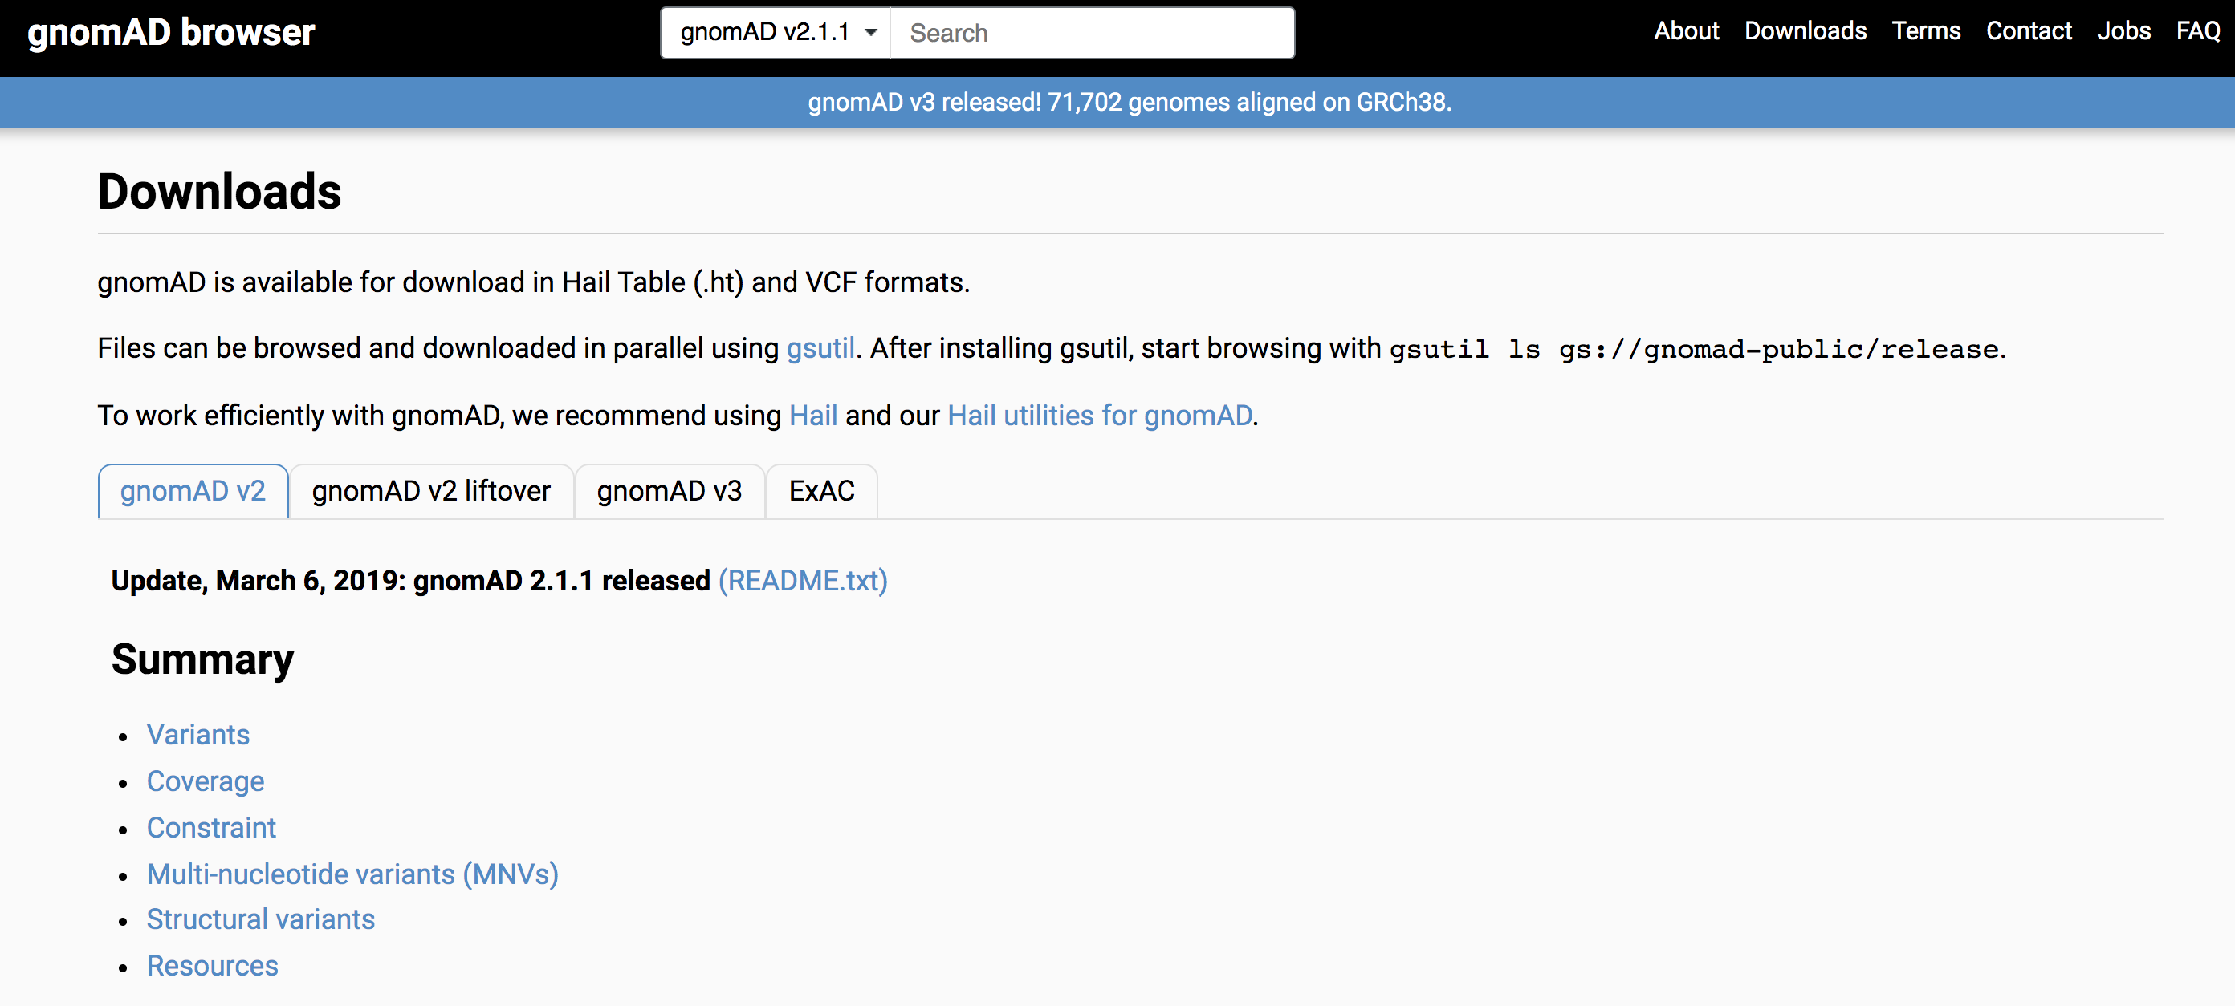
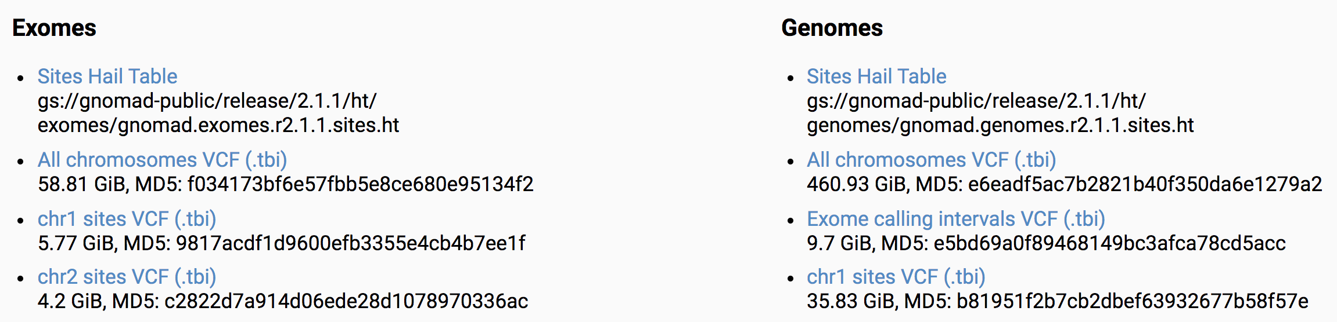
I’ll be hiring 1-2 computational postdocs in 2020 to work on gnomAD and rare disease related projects
odonnell@broadinstitute.org

Slide 54

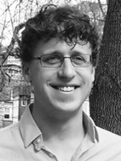







The gnomAD preprints on bioRxiv (MacArthur lab)
http://broad.io/gnomad_lof
http://broad.io/gnomad_drugs
http://broad.io/gnomad_lrrk2
http://broad.io/tx_annotation
http://broad.io/gnomad_mnv
http://broad.io/gnomad_uorfs
http://broad.io/gnomad_sv

Slide 55
Comparing MPC to other metrics
Jointly ranked de novo missense variants from cases and controls by each metric and evaluated the fraction of case variants in the top 10%. The total proportion of case variants is 0.8 (5113/6382), so a metric with no predictive value would match this overall rate.
 | MPC | M-CAP | CADD | PolyPhen-2
Fraction of top 10% from cases | 0.95 | 0.93 | 0.86 | 0.85
Odds ratio | 5.43 | 3.52 | 1.58 | 1.44
p-value | 1.48x10⁻²⁸ | 4.35x10⁻²⁰ | 1.46x10⁻⁴ | 2.66x10⁻³
Jagadeesh et al 2016; Kircher et al 2014; Adzhubei et al 2010

Slide 56
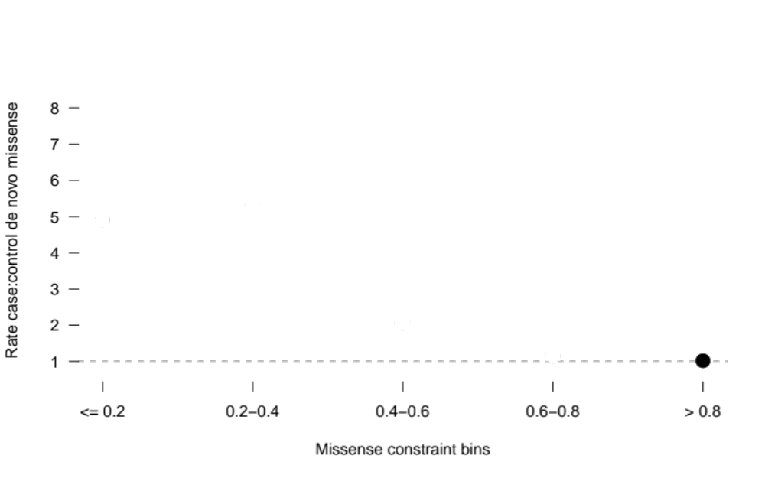
Highly missense constrained regions are enriched for de novo missense variants in cases with a neurodevelopmental disorder
5,620 cases
2,078 controls
Rate case:control de novo missense
Observed / expected missense variants
Samocha, bioRxiv, 2017

Slide 57
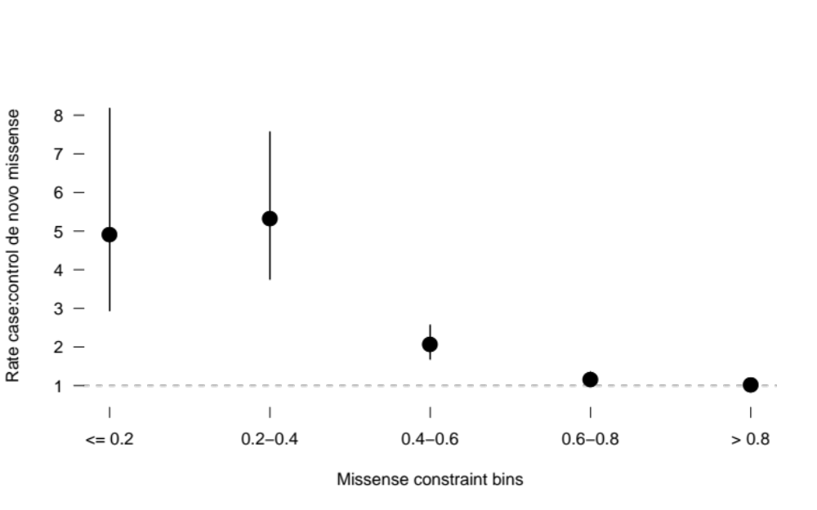
Highly missense constrained regions are enriched for de novo missense variants in cases with a neurodevelopmental disorder
5,620 cases
2,078 controls
Rate case:control de novo missense
Observed / expected missense variants

Slide 58
3’ bias prevents us from simply looking at read-pileup at exons
AAAAA
5’ →
LAMA2
→ 3’
Notes:
So one way one might think to do this is to simply look at coverage of region in RNA-seq data. However this would be a very confounded due to a phenomenon called 3’ bias.
Whereby due to RNA degradation during library prep, you’re more like to sequence the 3’ end of gene, vs the 5’ end. And here I’m showing you a real example, of a midsize gene where it’s clear that if you were simply counting up reads, you would say that the exon 55 is more highly expressed than exon 5, even if biologically they are found on the same transcripts.

Slide 59
Our approach
Use transcript-level quantifications that use discriminatory reads between transcripts to estimate isoform level expression values
Accounts for:
  3’ bias
  Mapping bias
  Exon length
  Isoform length
Isoform level quantifications (RSEM) from the GTEX v7 dataset to derive per-tissue expression metrics for all exons
Notes:
Our approach to get around this is to leverage isoform level quantification methods that assign a expression value to each transcript in a gene by way of using discrimatory exons between transcript.
And it’s completely true that these tools don’t always assign the true transcript expression level especially for genes for many isoforms and are generally imperfect
But they do broadly account for things like 3’ bias as well as other biases such as exon or isoform length.
So in our approach we turn to the GTEx project, which has performed isoform level quantifications on all their RNA-seq samples, with a tool called RSEM which is considered to be one of the best tools for isoform quantifications

