Slide 1

CAGI slide pack guidelines
I agree to my slides being used according to the following terms:
_______Nilah Ioannidis_______
Authors: please include THIS slide at the beginning of your presentation to indicate that you agree with reuse of your slides in CAGI presentations, according to the terms below, and digitally sign by writing your name above.
To disseminate the CAGI results, I encourage all CAGI participants to remix these CAGI slides for inclusion in their oral and poster presentations
CAGI participants may use or publish any content of these slides only in compliance with the CAGI Data Use Agreement
CAGI participants may not cite or publish any content of these slides except with the written permission of the originating author or in the primary CAGI publications
CAGI participants must acknowledge the original authors of these slides and CAGI 2013. Include the acknowledgement banner across the bottom
CAGI participants must include the CAGI credits slide in their presentations
Slides with a red slash (no remix) may not be included in a presentation unless all attendees are registered CAGI participants who signed the data use agreement
Slides with a red X over the entire slide may not be used in any circumstances
Slides with a blue slash (embargoed) may not be used unless the embargo is explicitly lifted
Slides without slash or X may be tweeted unless flagged with the “No tweet” icon.
CAGI participants using these slides must explain the “No tweet” icon, which means that the slide content should not be disseminated outside the presenting conference hall. If the presentation venue permits pervasive tweeting, you may not include these slides in your talk
Note for slide authors: we expect all CAGI participants to abide by these restrictions, and will make best effort to ensure they are followed. However, but bear in mind that we have limited means of enforcing them, and therefore the restrictions cannot be guaranteed.

Slide 2
Assessment of the
“annotate all missense” CAGI challenge
Nilah Ioannidis, PhD
Assistant Professor, UC Berkeley
Center for Computational Biology
Department of Electrical Engineering and Computer Sciences
CAGI Workshop
December 7, 2019

Slide 3
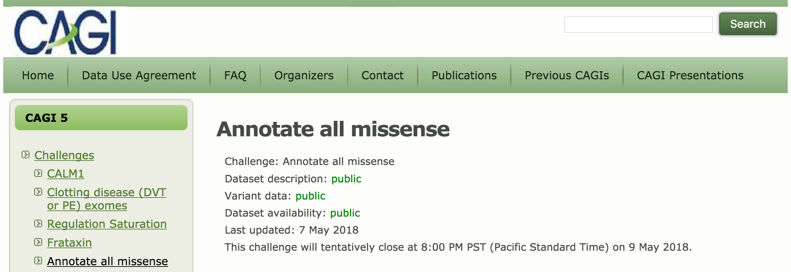
“Annotate all missense” CAGI challenge
Challenge:
Predict the significance of every possible missense variant in the human genome, using a list provided by dbNSFP¹.
Scores from 0 (benign) to 1 (deleterious).
¹ Liu et al, Human Mutation (2016).

Slide 4
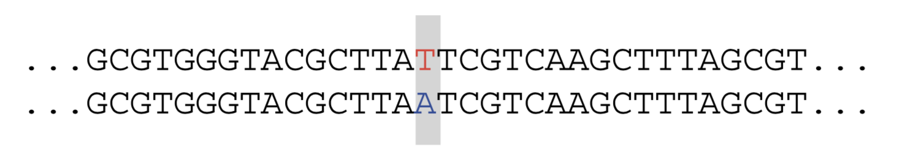
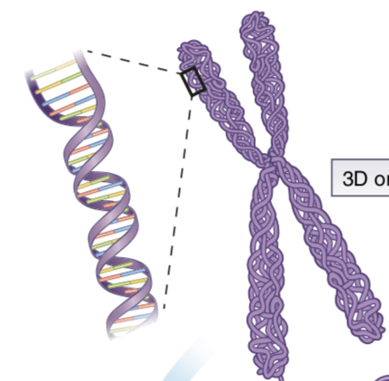
Missense variant statistics
81M possible missense variants in human genome
~10,000 missense variants per individual
~100-400 rare missense variants (< 0.5% frequency) per individual
Notes:
150-200 protein truncating variants
10,000 protein sequence altering variants
500,000 variants overlapping known regulatory regions
2,000 variants associated with traits in GWAS
25-30 known pathogenic in ClinVar
Stats from 1KG, https://www.nature.com/articles/nature15393

Slide 5
Submissions to the CAGI challenge
Submission | # of scored variants | % scored
VEST 4 ¹ | 80,202,879 | 98.9%
MutPred ² | 70,436,255 | 86.9%
INPS (Bologna Biocomputing) ³ | 68,107,718 | 84.0%
Ankara, Turkey | 594,798 | 0.7%
¹ Carter et al, BMC Genomics (2013).
² Li et al, Bioinformatics (2009).
³ Fariselli et al, Bioinformatics (2015).

Slide 6
Submissions to the CAGI challenge
Submission | Model | Training data | Features
VEST 4 | Random forest | HGMD vs. ESP (AF > 1%) | 86 features from SNVBox
MutPred | Random forest | HGMD vs. Swiss-Prot | 14 protein-level features
INPS (Bologna Biocomputing) | Support vector regression | Experimental measurements of protein stability (△△G) | 7 protein-level features
Ankara, Turkey | Analytic hierarchy process (AHP) | None | dbSNP, EntrezGene, KEGG, Gene Ontology

Slide 7

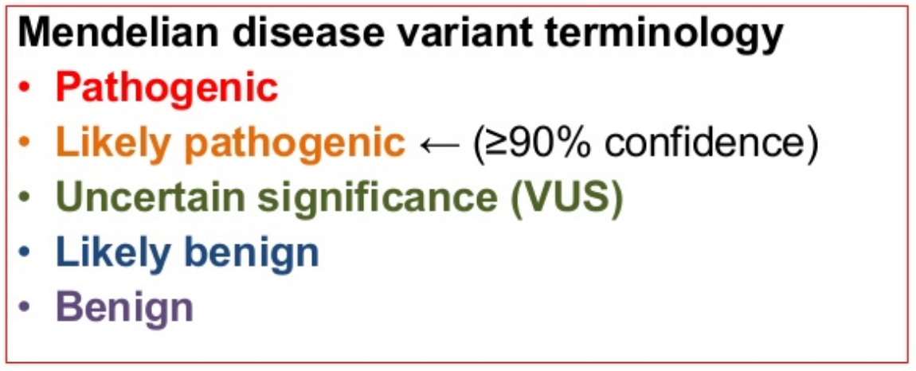
Assessment strategy
Test set requirements:
Missense variants newly annotated after May 2018.
ClinVar dataset:
New missense variant records created June 1, 2018 or later
Pathogenicity assertions:

Slide 8
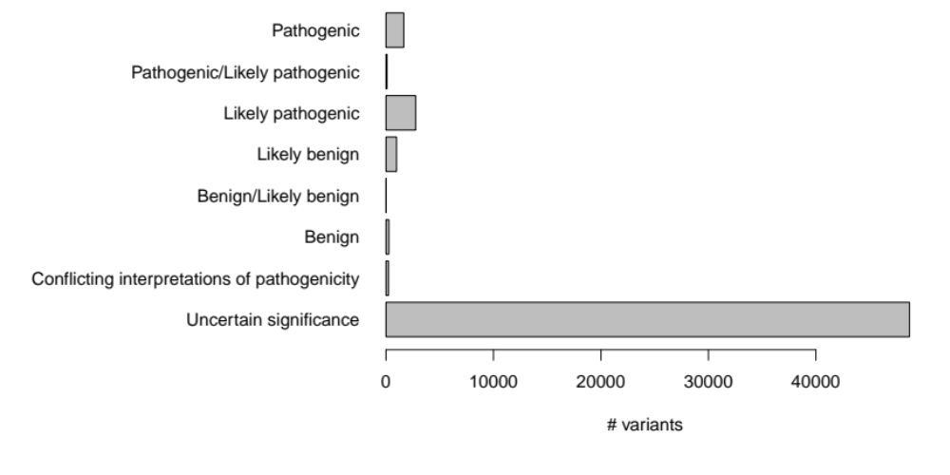
ClinVar June 2018 missense variant set
Distribution of pathogenicity assertions:
n = 1655
n = 89
n = 2759
n = 984
n = 9
n = 271
n = 240
n = 48717

Slide 9
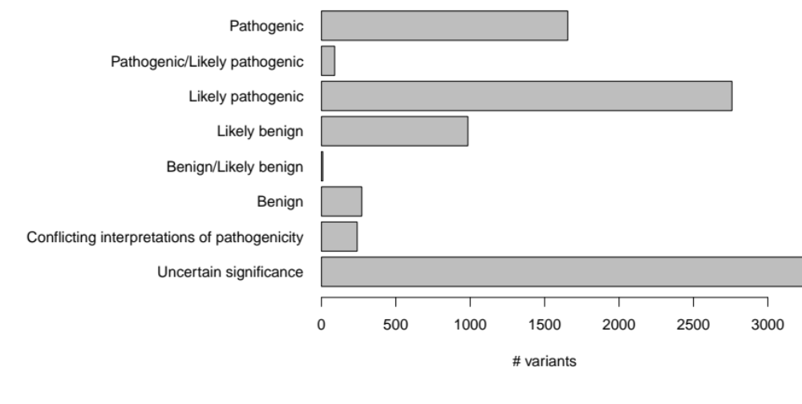
ClinVar June 2018 missense variant set
Distribution of pathogenicity assertions:
n = 1655
n = 89
n = 2759
n = 984
n = 9
n = 271
n = 240
n = 48717

Slide 10
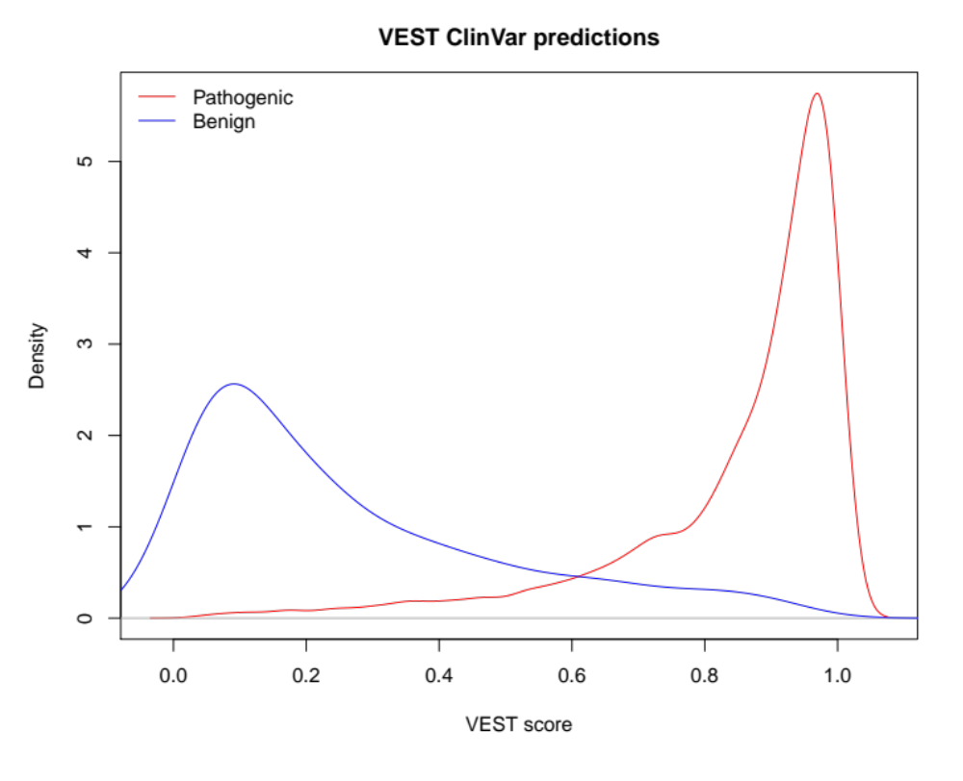
Score distributions: VEST 4

Slide 11
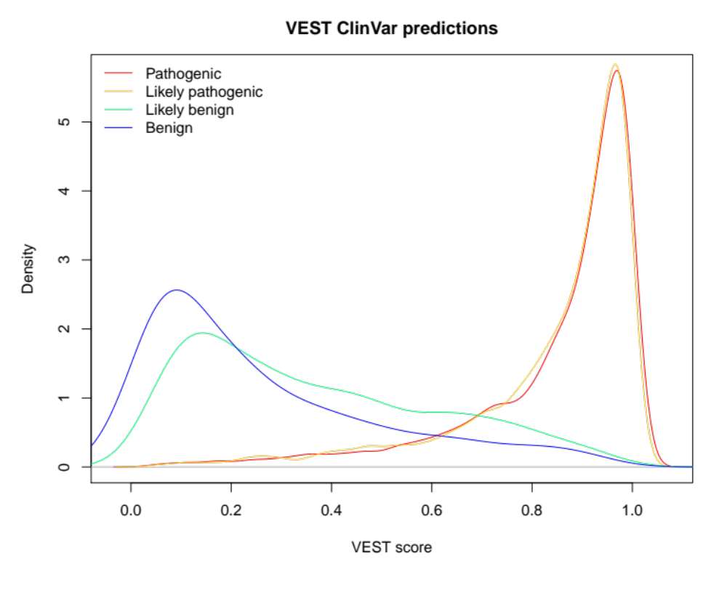
Score distributions: VEST 4

Slide 12
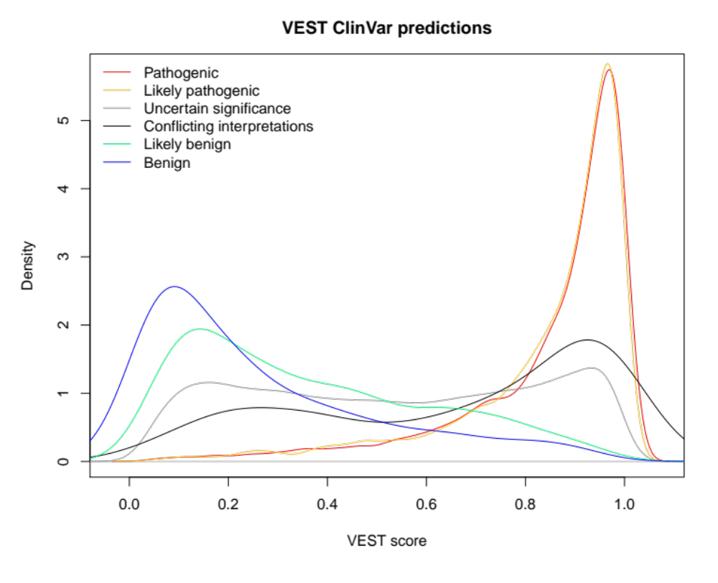
Score distributions: VEST 4

Slide 13
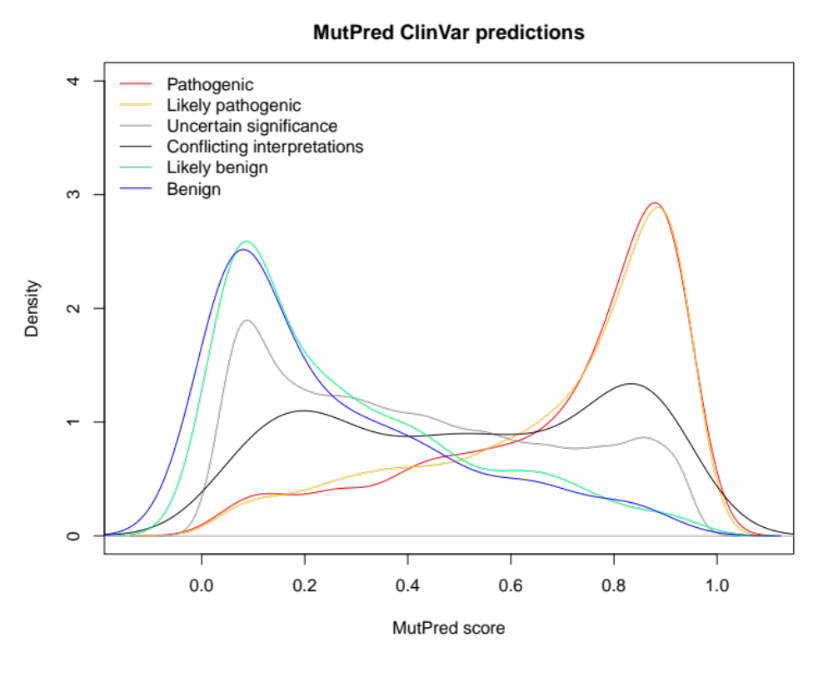
Score distributions: MutPred

Slide 14
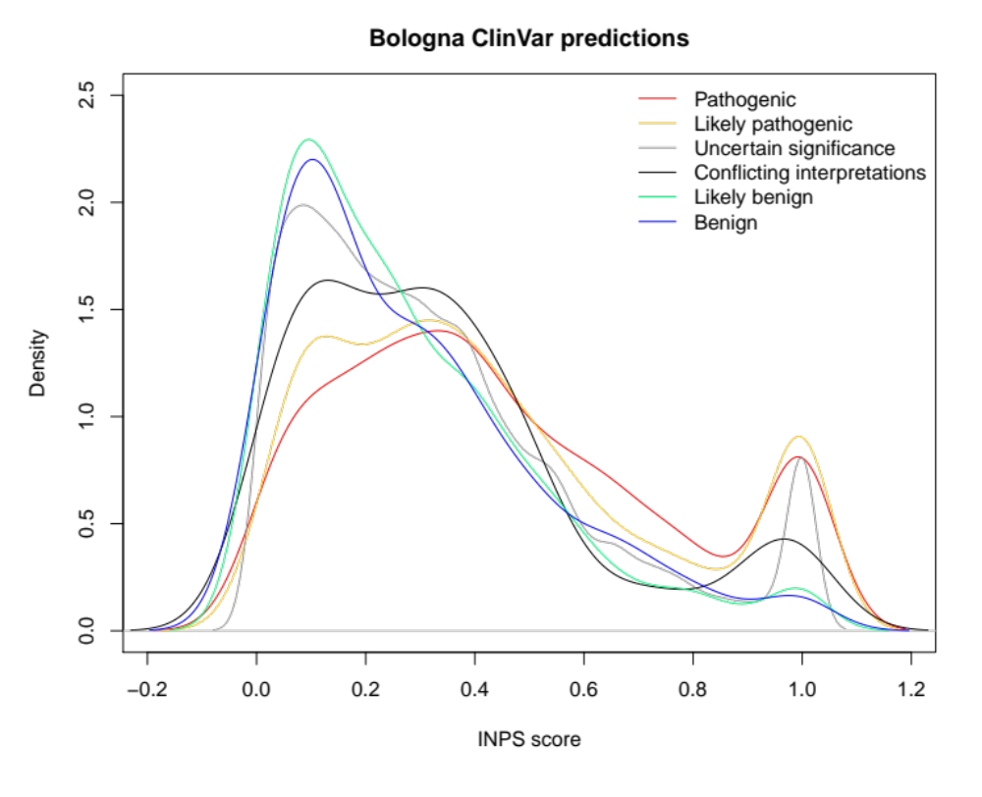
Score distributions: INPS
Notes:
Note that these predict effects on protein stability only, so maybe picking up just a subset of pathogenic variants (others could affect e.g. ligand binding but not stability).

Slide 15
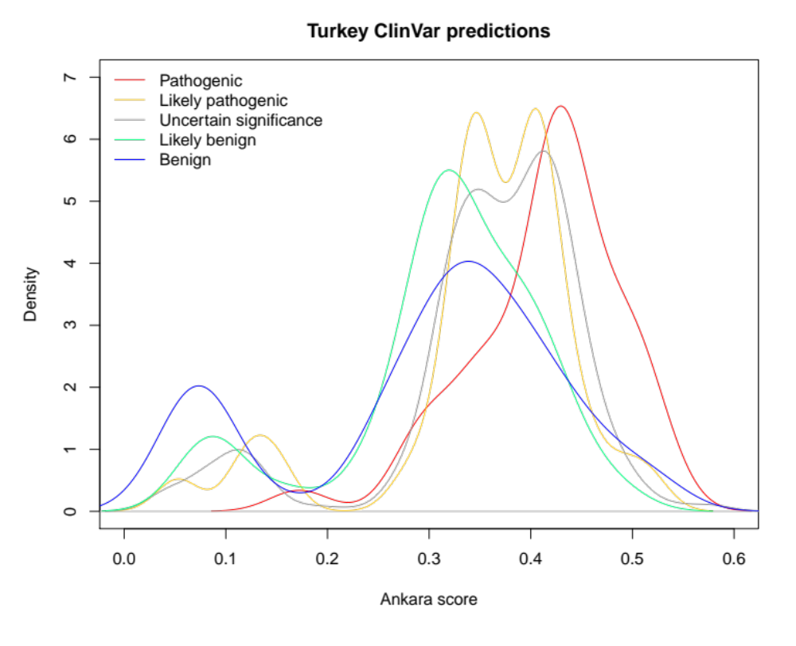
Score distributions: Ankara

Slide 16
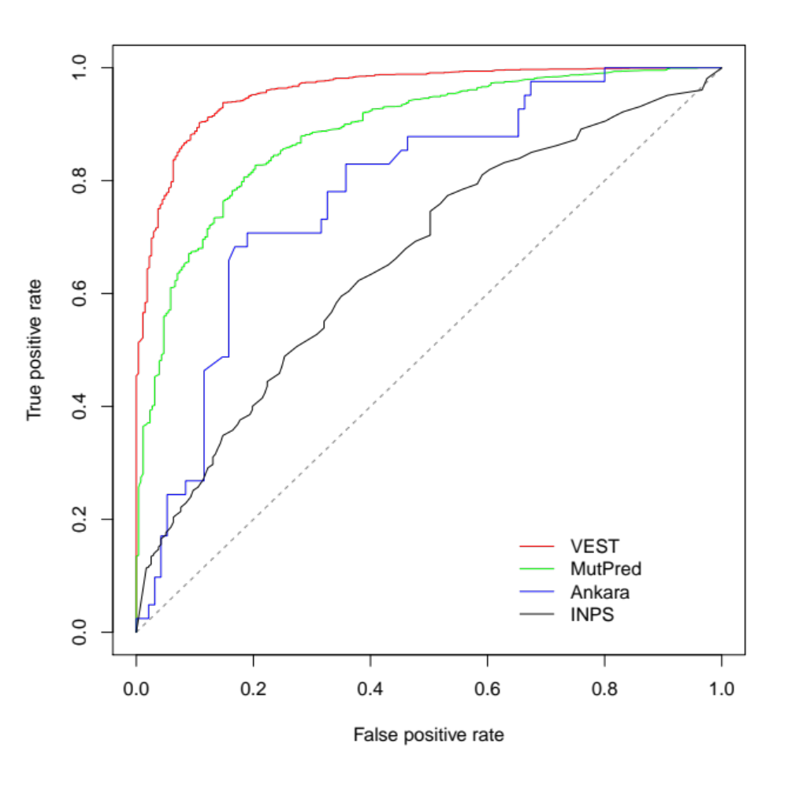
Test set #1: confident assertions
Positive:
Pathogenic
(n = 1655)
Negative:
Benign
(n = 271)
AUC
0.959
0.886
0.781
0.661

Slide 17
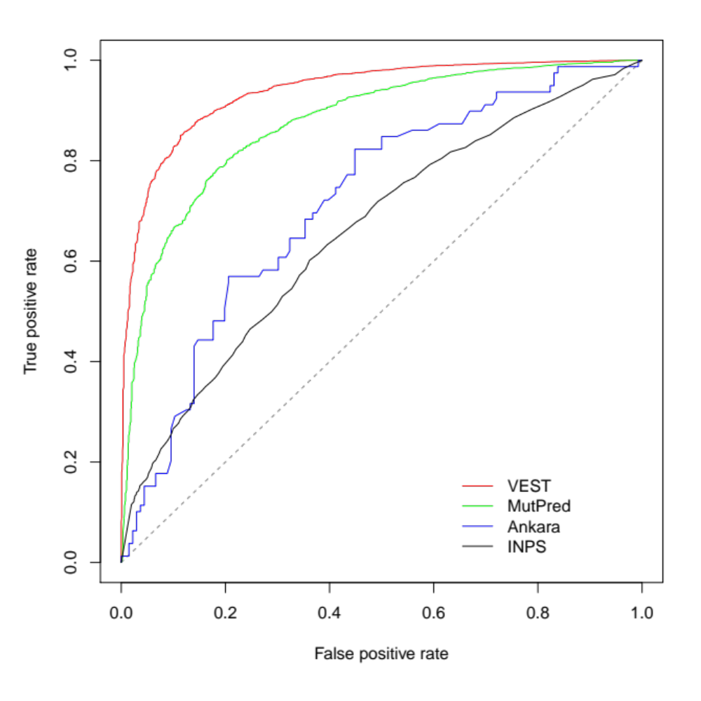
Test set #2: including likely assertions
Positive:
Pathogenic
Pathogenic/Likely pathogenic
Likely pathogenic
(n = 4503)
Negative:
Benign
Benign/Likely benign
Likely benign
(n = 1264)
AUC
0.939
0.875
0.718
0.659

Slide 18
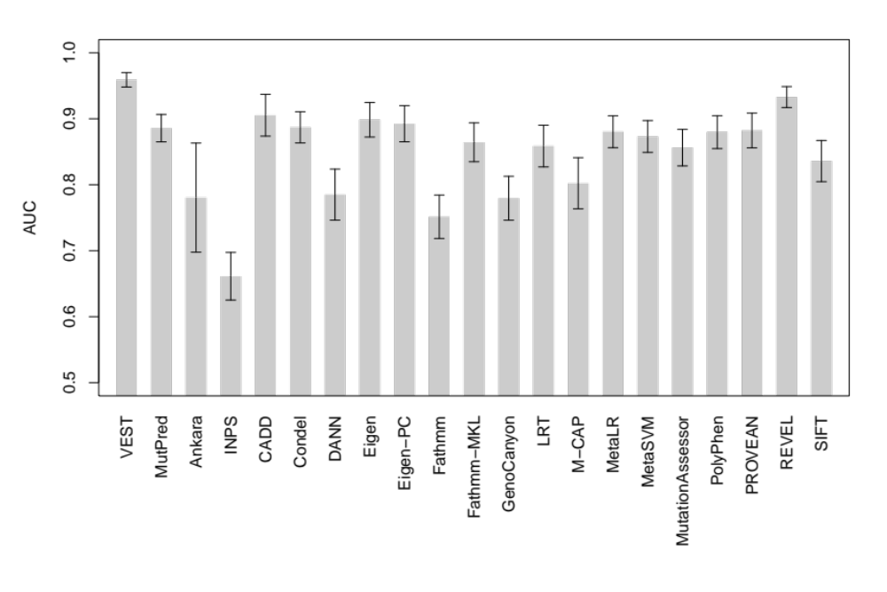
AUC comparison: Test set #1
Additional predictors available from dbNSFP¹
¹ Liu et al, Human Mutation (2016).

Slide 19
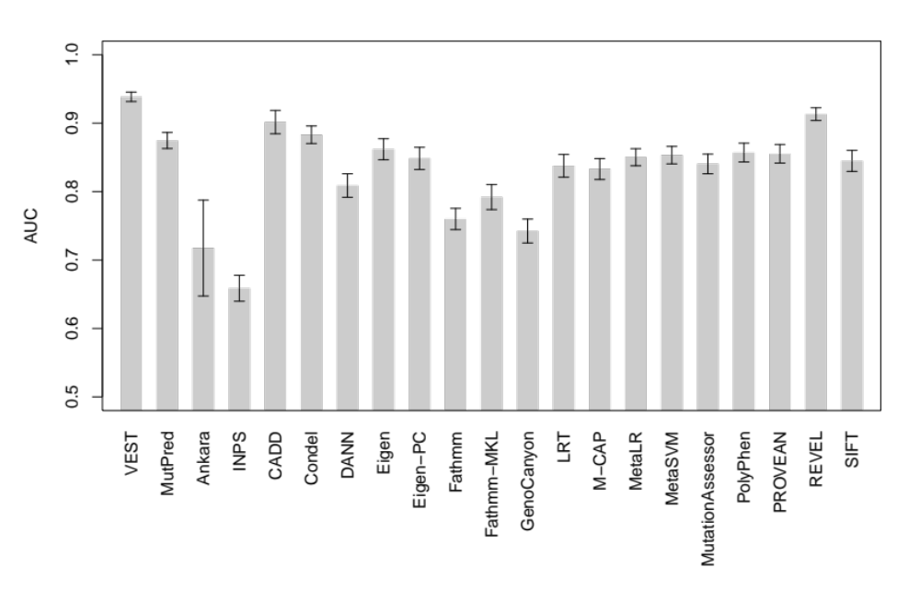
AUC comparison: Test set #2

Slide 20
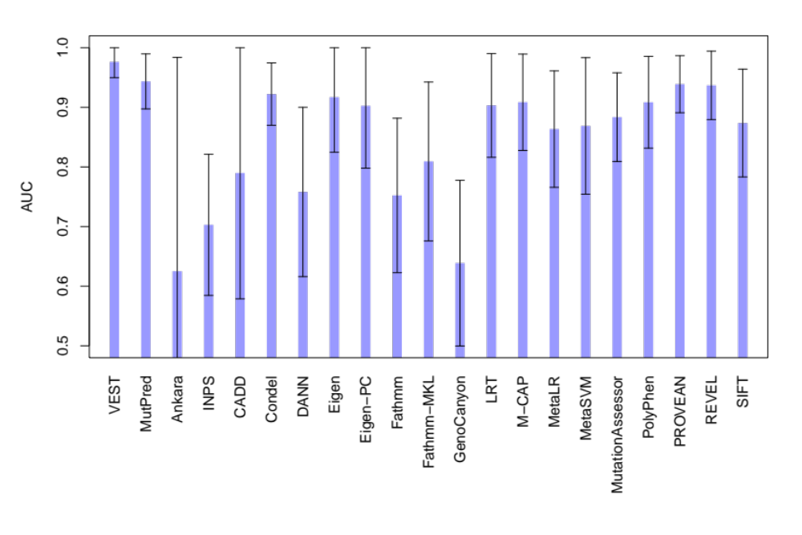
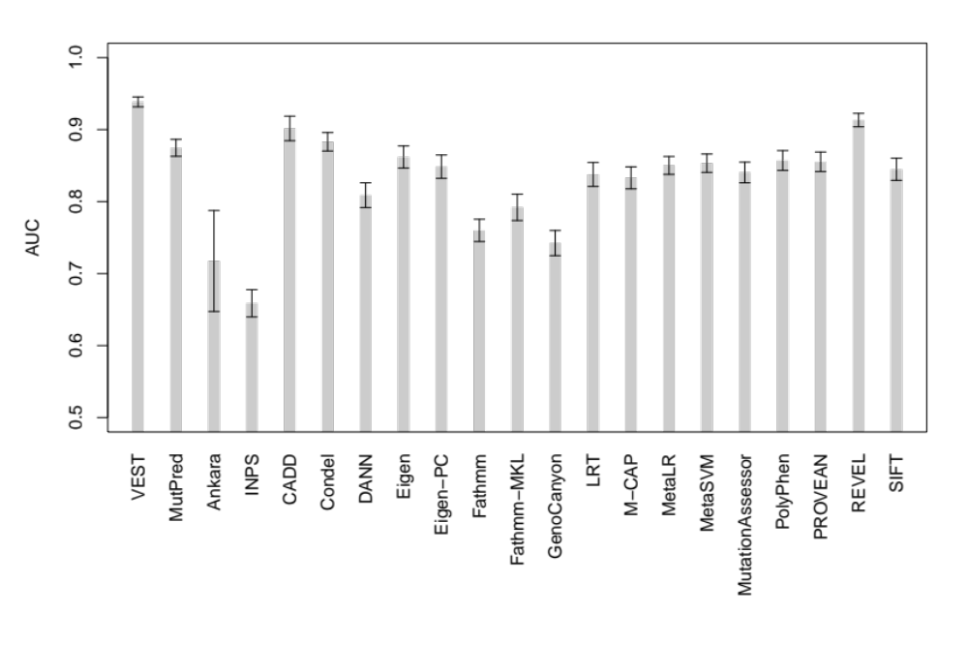
Multiple submitters or expert panel
Notes:
Only for test set #2 because of low numbers
neg=24
pos=176

Slide 21
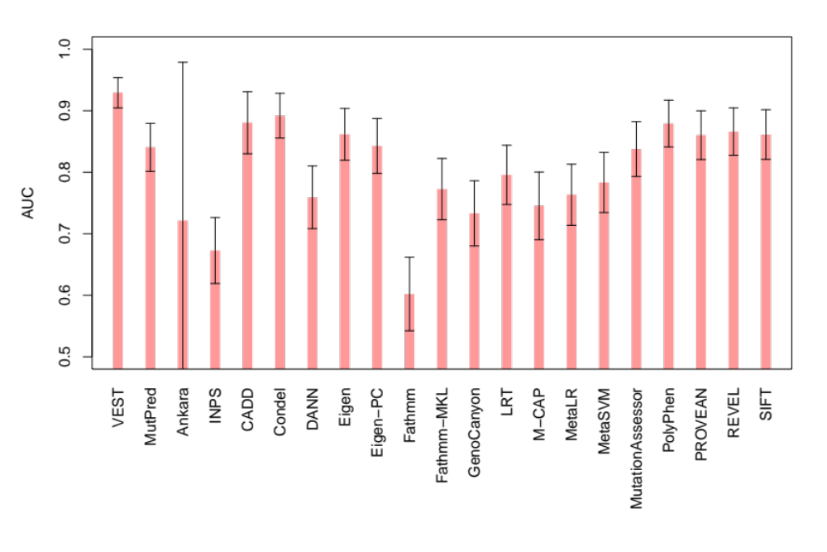
Balanced gene set
Notes:
222 genes in common

Slide 22
Challenges
Circularity:
Existing prediction tools are used to assign pathogenicity assertions to new variants.
Focus on variants whose assertions have changed based on new clinical / experimental data?
Defining the task:
Pathogenic vs. deleterious vs. protein disrupting vs. functional.
Tools designed for a specific task (e.g. disrupting protein stability) may do poorly when evaluated on a general task validation set.

Slide 23
Acknowledgements
Stanford University
Elizabeth Tran, Joe Rothstein, Weiva Sieh, Alice Whittemore
Trevor Hastie, Carlos Bustamante
Stanford ClinGen team
International Consortium for Prostate Cancer Genetics (ICPCG)
MutPred collaborators
Vikas Pejaver, Predrag Radivojac
CAGI organizers
CAGI participants
Patients and research participants

