Slide 1

CAGI slide pack guidelines
I agree to my slides being used according to the following terms:
_______Steve Mount_______
Authors: please include THIS slide at the beginning of your presentation to indicate that you agree with reuse of your slides in CAGI presentations, according to the terms below, and digitally sign by writing your name above.
To disseminate the CAGI results, I encourage all CAGI participants to remix these CAGI slides for inclusion in their oral and poster presentations
CAGI participants may use or publish any content of these slides only in compliance with the CAGI Data Use Agreement
CAGI participants may not cite or publish any content of these slides except with the written permission of the originating author or in the primary CAGI publications
CAGI participants must acknowledge the original authors of these slides and CAGI 2013. Include the acknowledgement banner across the bottom
CAGI participants must include the CAGI credits slide in their presentations
Slides with a red slash (no remix) may not be included in a presentation unless all attendees are registered CAGI participants who signed the data use agreement
Slides with a red X over the entire slide may not be used in any circumstances
Slides with a blue slash (embargoed) may not be used unless the embargo is explicitly lifted
Slides without slash or X may be tweeted unless flagged with the “No tweet” icon.
CAGI participants using these slides must explain the “No tweet” icon, which means that the slide content should not be disseminated outside the presenting conference hall. If the presentation venue permits pervasive tweeting, you may not include these slides in your talk
Note for slide authors: we expect all CAGI participants to abide by these restrictions, and will make best effort to ensure they are followed. However, but bear in mind that we have limited means of enforcing them, and therefore the restrictions cannot be guaranteed.

Slide 2
CAGI 2019 – San Francisco
The status of splicing prediction.
Steve Mount
University of Maryland

Slide 3
CAGI 2019 – San Francisco
The status of splicing prediction.
“There have been improvements in splicing prediction, but it lags behind missense prediction”
Steve Mount
University of Maryland

Slide 4
CAGI 2019 – San Francisco
The status of splicing prediction.
“There have been improvements in splicing prediction, but it lags behind missense prediction”
It’s getting better.
Dinucleotide mutations almost always impact splicing
Prediction of the effects of mutations in core splice site signals is comparable to prediction of missense.
Auxiliary signals can have a big impact but prediction may never be as good as missense prediction.
The CAGI5 splicing challenges and other developments in the field.
Steve Mount
University of Maryland

Slide 5
outline
Classes of splicing signal
‘invariant’ dinucleotides (GT-AG)
core splicing signals
auxiliary signals
Splicing mutation outcomes
Data relevant to prediction of impacts on splicing mutation outcomes
Current methods (How are we doing?)
Challenges for splicing impact predictions
Considerations for clinical diagnostics and future CAGI challenges

Slide 6
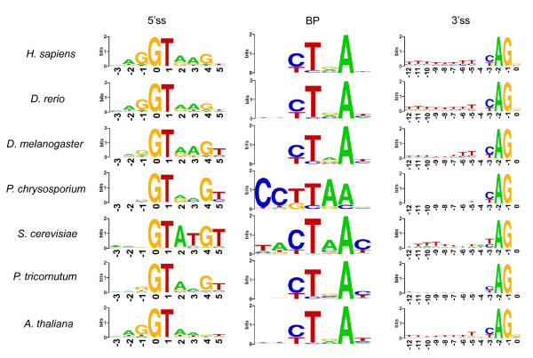
Classes of splice site signal
Classes of splicing signal
‘invariant’ dinucleotides (GT-AG)
core splicing signals

Slide 7
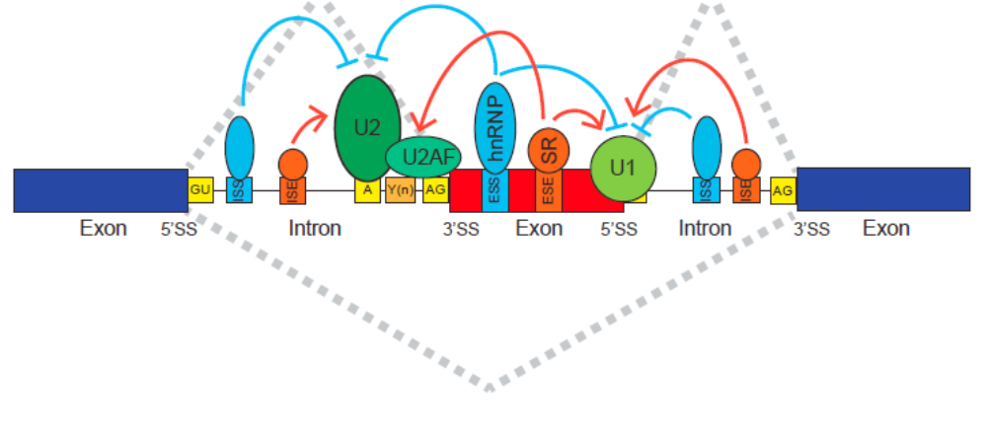
Splice site recognition
Classes of splicing signal
auxiliary splicing signals
Auxiliary signals are recognized by various RNA binding proteins
From The Expanding Landscape of Alternative Splicing Variation in Human Populations.
by: Eddie Park, Zhicheng Pan, Zijun Zhang, Lan Lin, Yi Xing
American journal of human genetics, Vol. 102, No. 1. (04 January 2018), pp. 11-26

Slide 8
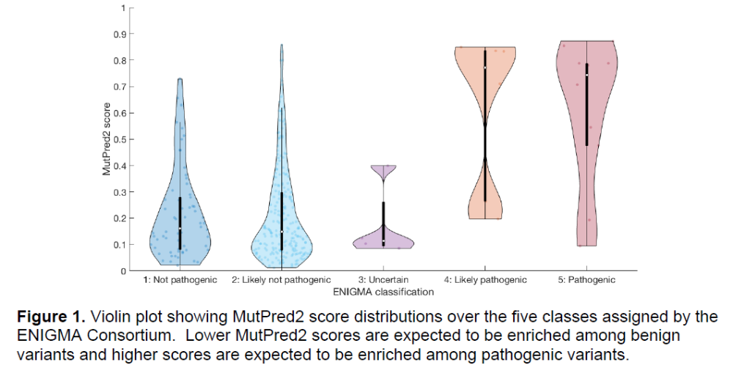
Missense and synonymous mutations are often ESE or ESS or cryptic splice site activation mutations.
Exonic splicing mutations?

Slide 9
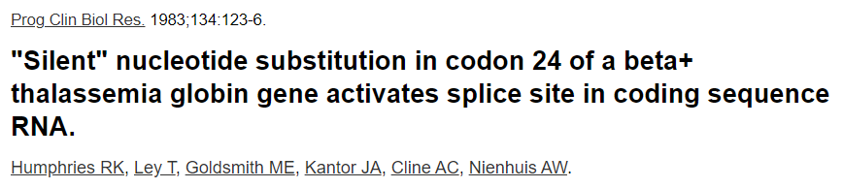
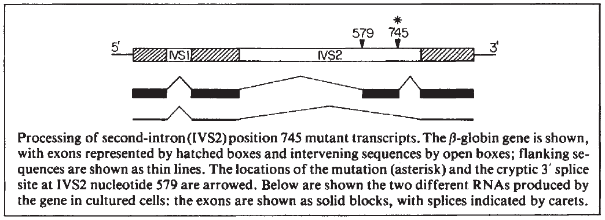
We’ve known since 1983 that auxiliary splicing signals can be deleterious
missense
“deep intron” mutations

Slide 10
outline
Classes of splicing signal
Splicing mutation outcomes
intron retention
exon skipping
cryptic splice site activation
alternative splice site switch
Data relevant to prediction of impacts on splicing mutation outcomes
Current methods (How are we doing?)
Challenges for splicing impact predictions
Considerations for clinical diagnostics and future CAGI challenges

Slide 11
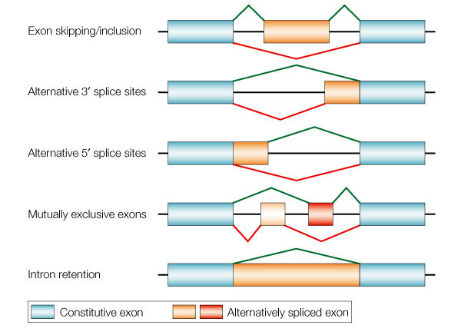
Alternative splicing
Reproduced from Cartegni, L., Chew, S. L. & Krainer, A. R. Listening to silence and understanding nonsense: exonic mutations that affect splicing. Nature Rev. Genet. 3, 285-298 (2002) © Macmillian Magazines Ltd.

Slide 12
Splicing mutation outcomes
Intron retention
Exon skipping
Cryptic site activation (or choice)
or

Slide 13
Splicing mutation outcomes
Intron retention
Exon skipping
Cryptic site activation (or choice)
or

Slide 14
Splicing mutation outcomes
exon skipping
Intron retention
Exon skipping
Cryptic site activation (or choice)
or

Slide 15
Splicing mutation outcomes
cryptic site activation
Intron retention
Exon skipping
Cryptic site activation (or choice)
or

Slide 16
Classes of splicing signal
Splicing mutation outcomes
Data relevant to prediction of impacts on splicing mutation outcomes
  sequence (splice sites vs. non-splice sites)
impact on gene expression or disease
high-throughput assays
binding sites for, activity of, splicing factors (e.g. Encode)
Current methods (How are we doing?)
Challenges for splicing impact predictions
Considerations for clinical diagnostics and future CAGI challenges

Slide 17
Data relevant to prediction of impacts on splicing mutation outcomes
  sequence (splice sites vs. non-splice sites)
impact on gene expression or disease
high-throughput assays
binding sites for, activity of, splicing factors
CLIP methods
binding site (high-throughput selection)
in vitro assays
profiles of splicing changes due to splicing factor mutation

Slide 18
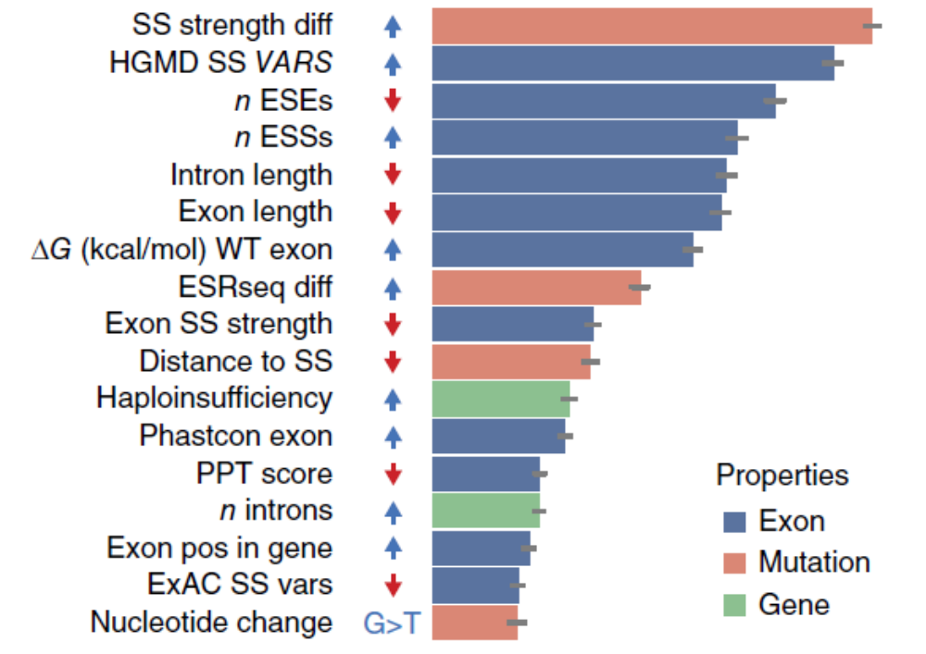
Features predictive of results from high throughput assays.
Data from Fairbrother group
(MaPSy challange)
Figure from Fairbrother group
(MaPSy challange)

Slide 19
Classes of splicing signal
Splicing mutation outcomes
Data relevant to prediction of impacts on splicing mutation outcomes
Current methods (How are we doing?)
CAGI5
MMSplice
SpliceAI
Special purpose (e.g. cryptic exons)
Incorporation of RNA-seq data
Challenges for splicing impact predictions
Considerations for clinical diagnostics and future CAGI challenges

Slide 20
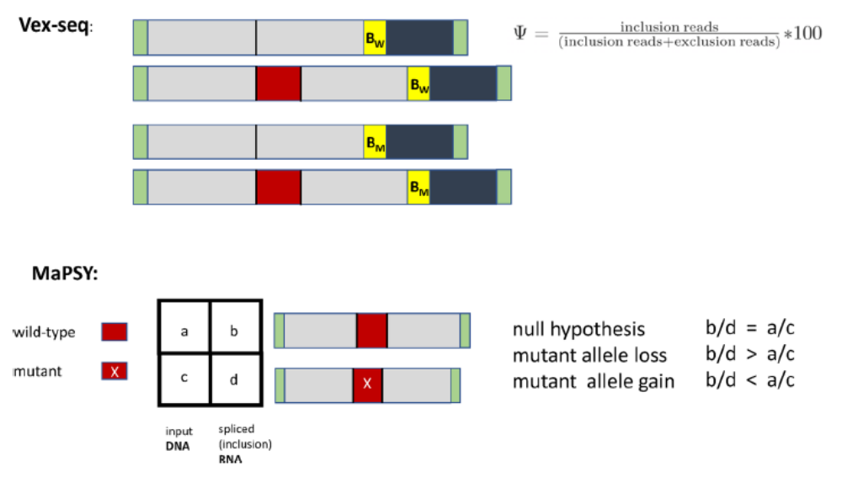
CAGI5 Splicing challenges:
Vex-seq and MaPSy
Both
limited to cassette exon skipping vs. inclusion
Vex-seq
mutant barcode allows intron variants
favors alternative splicing events
quantitative (prediction of delta-Ψ)
compares inclusion to skipped
MaPSY
limited to exon variants
data in the form of a 2-by-2 table
favors skipping of constitutive exons
categorical (hypothesis test)
but raw counts were provided
compares included_mut to included_wt

Slide 21
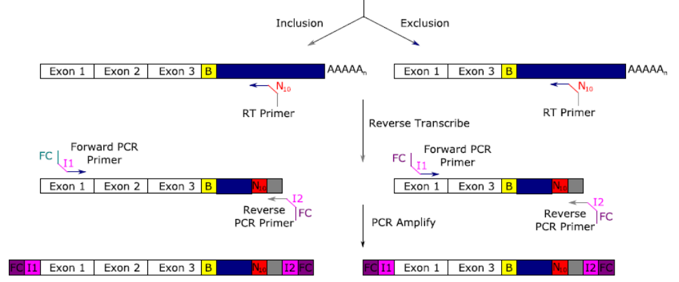
Vex-seq
Prediction on PSI, (included/total)

Slide 22
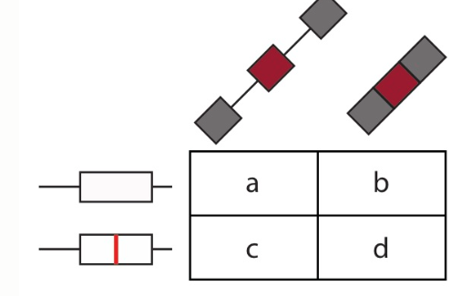

MaPSy
Wild-type
If the mutant allele is not spliced in, then d will be low and b/d will be greater than a/c
Mutant
DNA input
Exon inclusion
Participants should provide the probability that each variant is an Exonic Splicing Mutation (that passed the 1.5 fold change and a two-sided Fisher’s exact test adjusted with 5% FDR both in vitro and in vivo).
In addition, given the input read counts of the WT input (a) and MT input (c) the participants should predict the log2 allelic skew ratio for in vivo and in vitro panels for each pair in the test set.

Slide 23
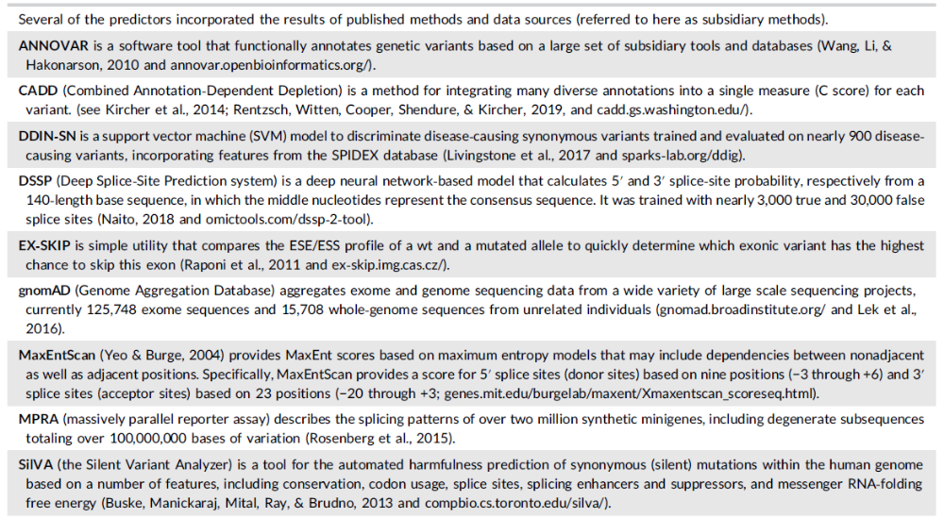
All predictors but two used a combination of known methods

Slide 24
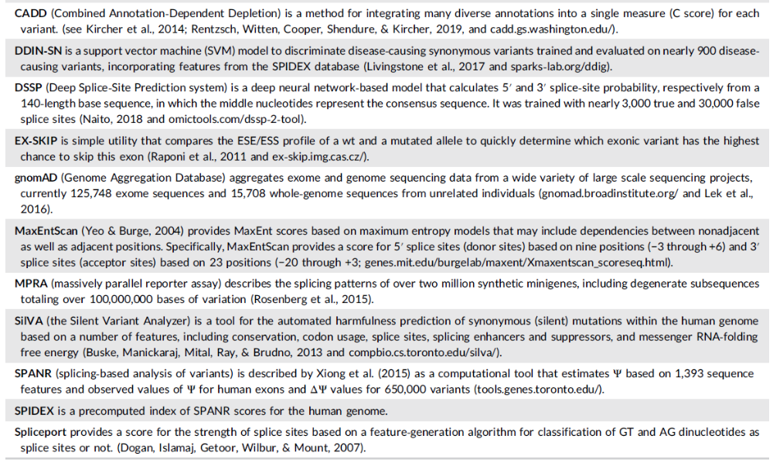

Slide 25
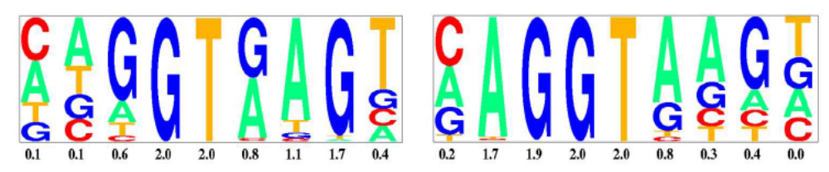
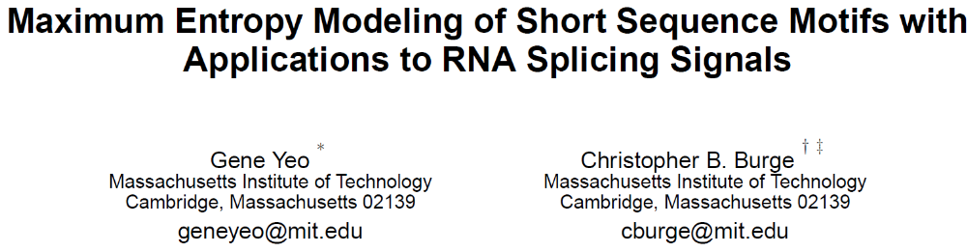
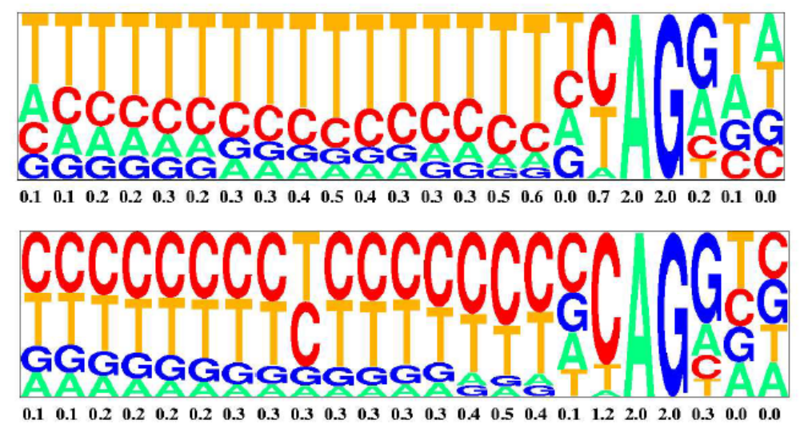
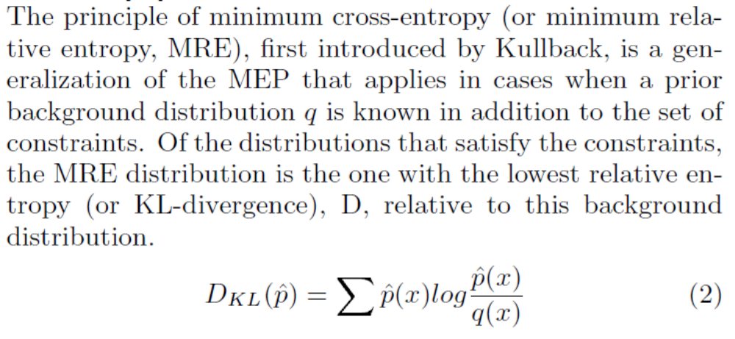

Slide 26
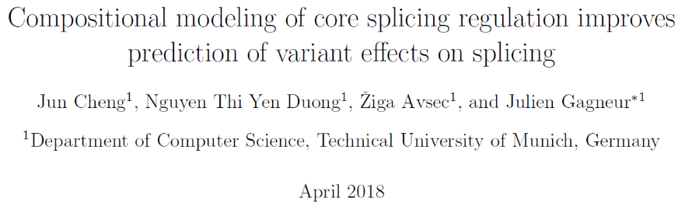
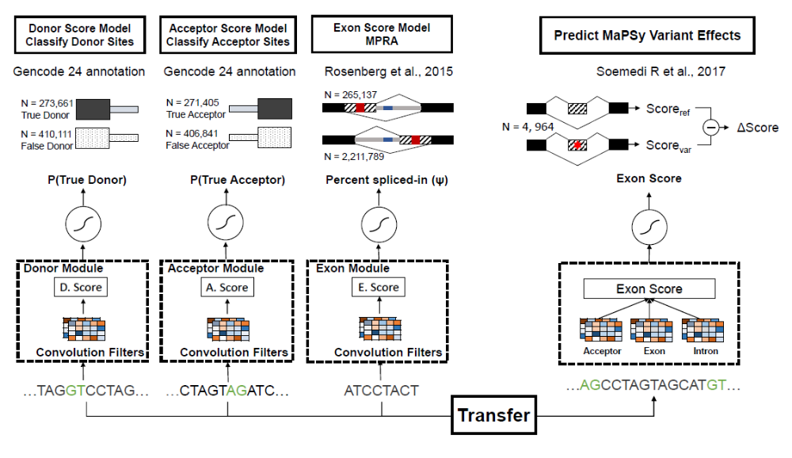
Munich approach

Slide 27
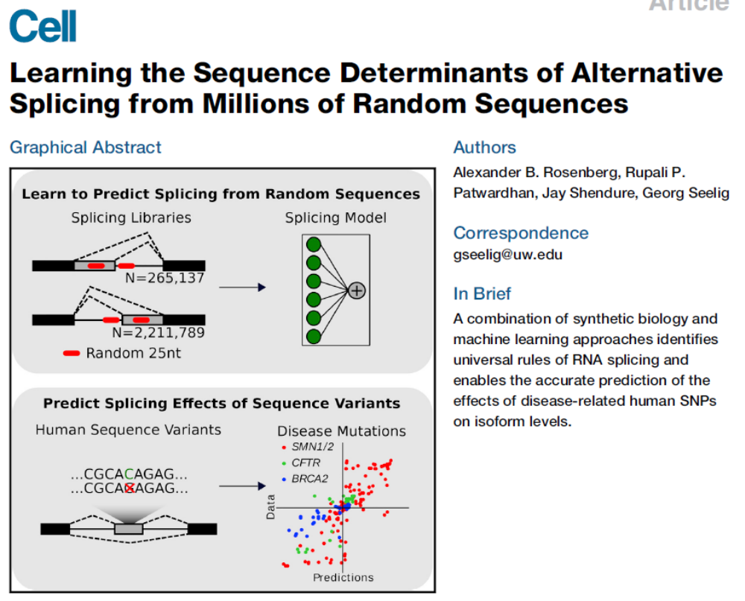
Munich approach

Slide 28
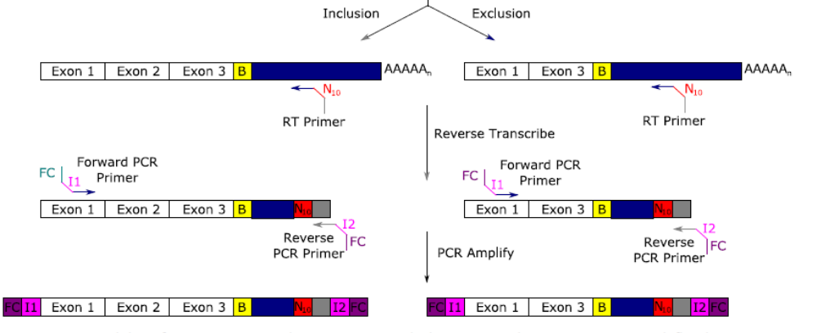

Vex-seq
CAGI Participants are asked to predict the outcome of the Vex-seq experiment. This is expressed in terms of ΔΨ, (delta PSI, or Percent Spliced In), between the variant Ψ and the reference Ψ

Slide 29
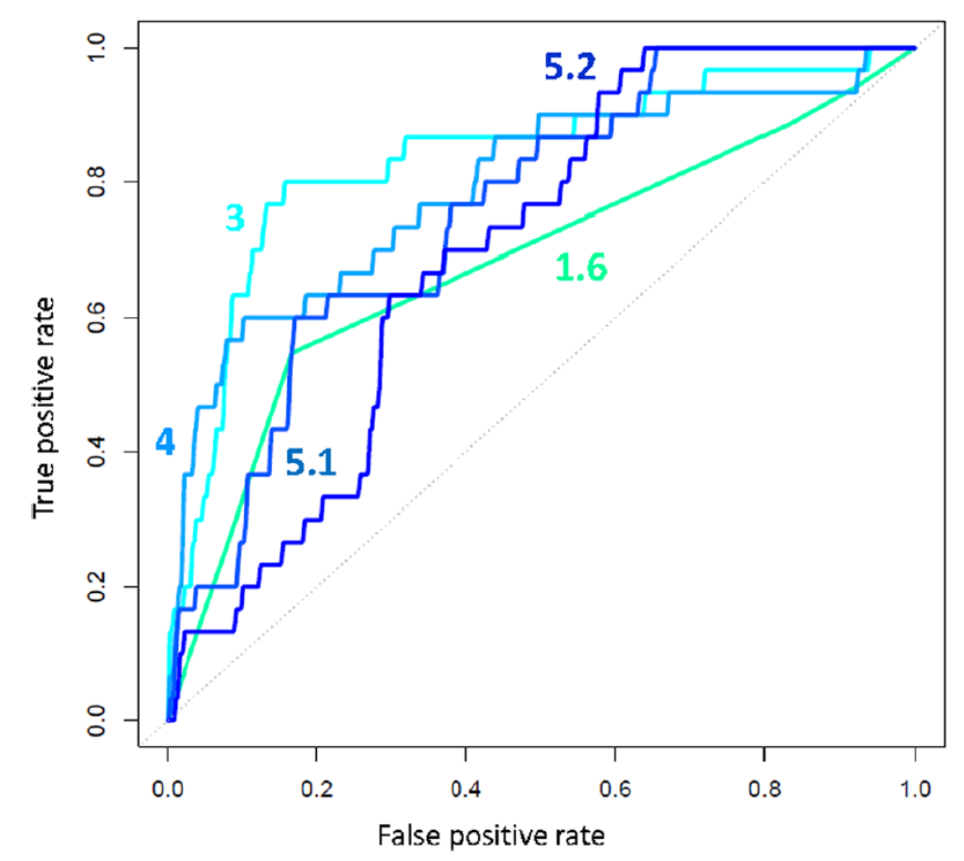
Vex-seq Ψ - performance
Vex-seq
Spearman correlation coefficients
per group
 | 1 | 2 | 3 | 4 | 5 | 6
All | 0.15 | 0.20 | 0.38 | 0.07 | 0.14 | 0.32
Exon | 0.20 | 0.16 | 0.41 | 0.00 | 0.08 | 0.28
Intron | 0.07 | 0.06 | 0.24 | 0.01 | 0.02 | 0.22
SS | 0.20 | 0.16 | 0.41 | 0.00 | 0.08 | 0.28

Slide 30
Conclusion: Modular predictions work

Slide 31
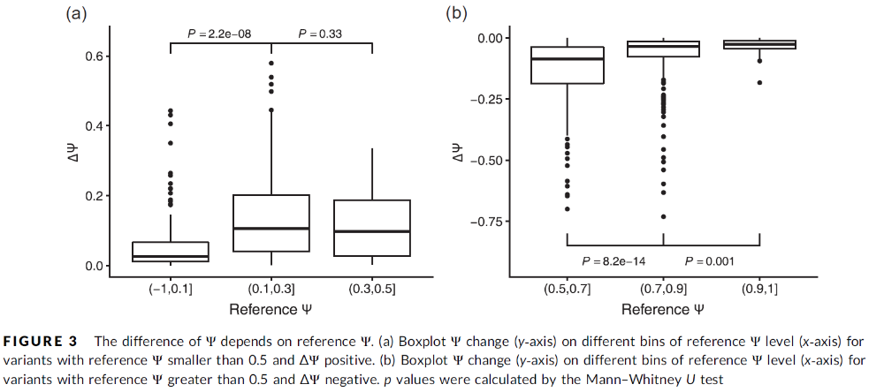
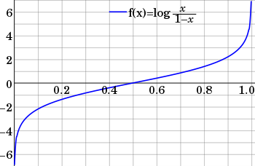
The problem with PSI
Vex-seq asked for prediction of delta-PSI but it’s easier to predict using a logit transformation.
Cheng et al. 2019. “CAGI5 Splicing Challenge: improved exon skipping and intron retention prediction with MMsplice

Slide 32
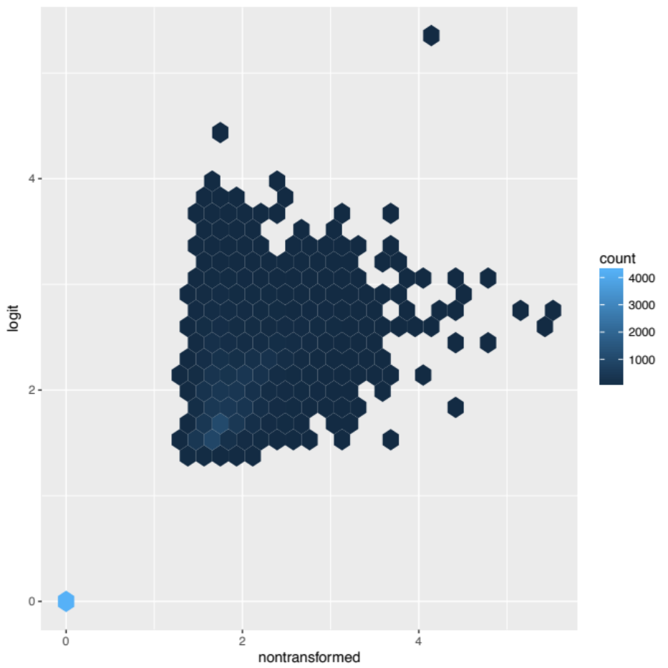
When ranked by p-value, there is little correlation between logit and nontransformed significant cases of differential alternative splicing.
-log(p-value)
R²: 0.4344
This is my own data (Nazario and Wu) analyzed in my lab (by Haley Wight).

Slide 33
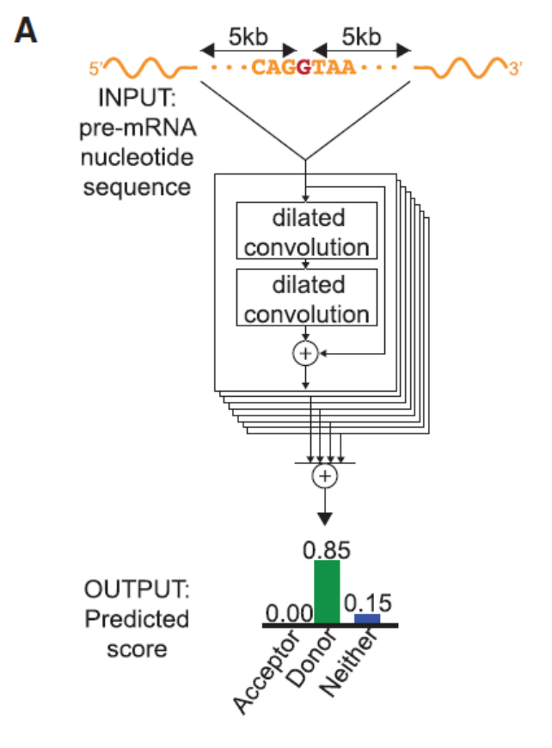
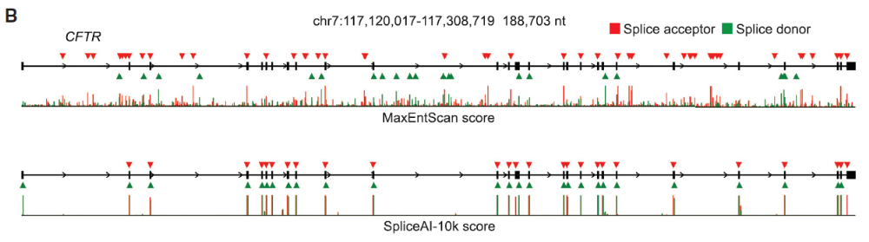
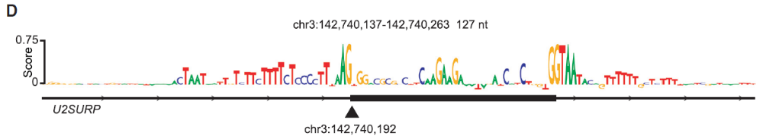
SpliceAI from Illumina

Slide 34
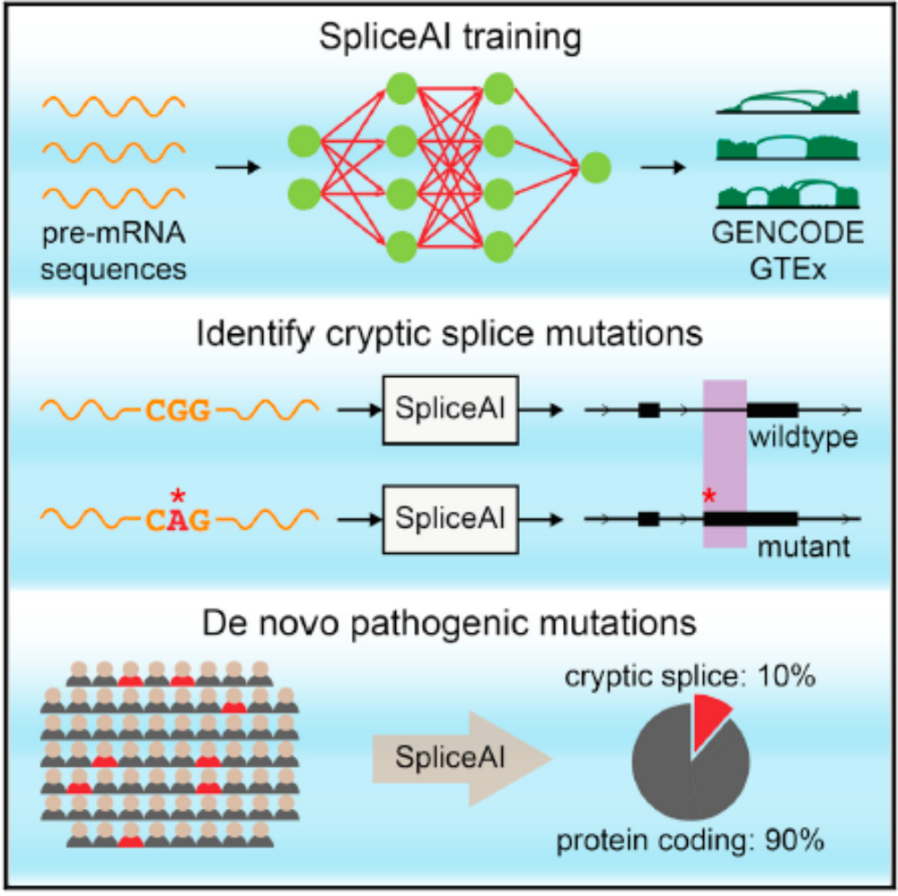
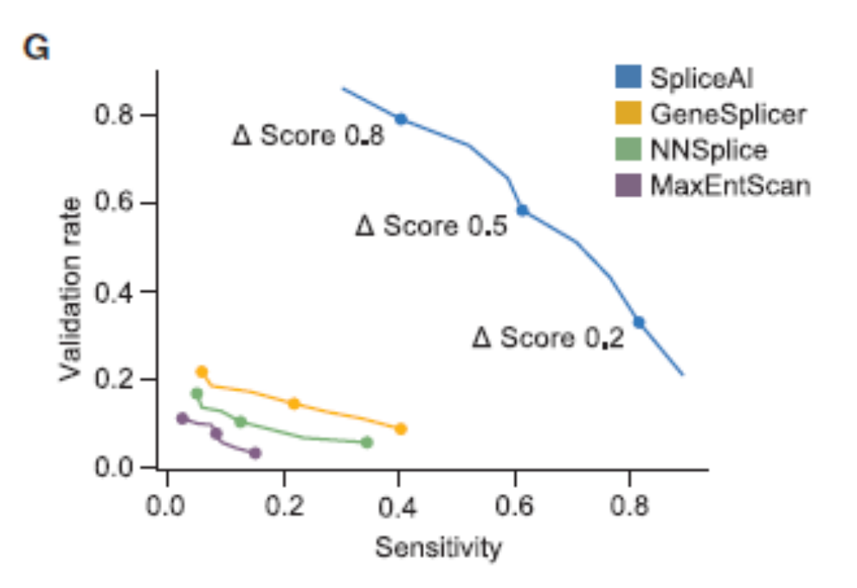
SpliceAI from Illumina

Slide 35
SpliceAI from Illumina
Sarafim Batzoglou will speak tomorrow morning

Slide 36
Classes of splicing signal
Splicing mutation outcomes
Data relevant to prediction of impacts on splicing mutation outcomes
Current methods (How are we doing?)
Challenges for splicing impact predictions
Context effects (effects of flanking exons)
Deep intron mutations that activate cryptic splice sites and cryptic (poison) exons
Weak exons
Tissue- and cell-type specific splicing
Considerations for clinical diagnostics and future CAGI challenges

Slide 37
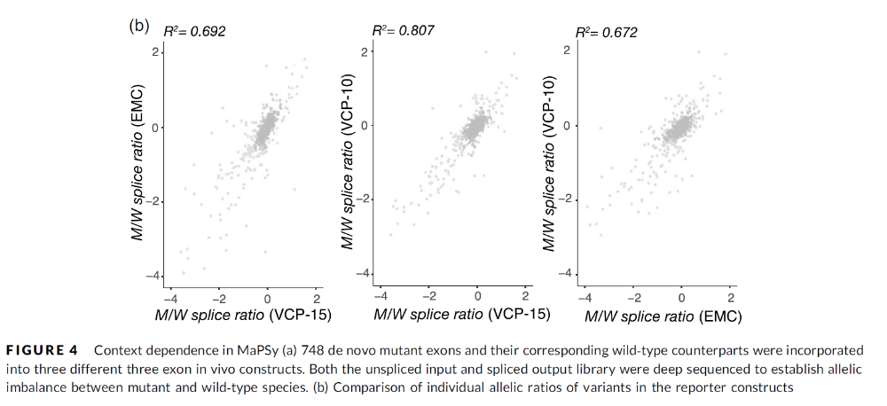
Challenges for splicing impact predictions: context
Figure from Rhine et. al.
“Future Directions for high-throughput spicing assays in precision medicine”
Human Mutation
VCP exon 10
VCP exon 15
EMC7 exon 3
748 test exons from the SSC
ACTN4

Slide 38
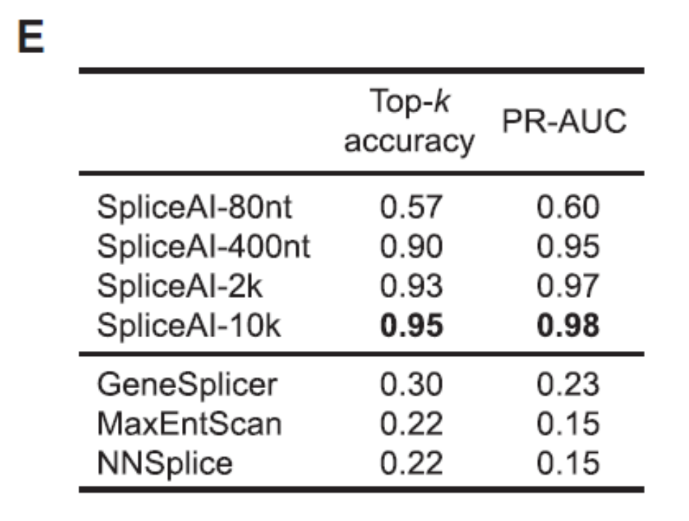
Challenges for splicing impact predictions: context
SpliceAI was developed on four window sizes. More sequence gives a significant improvement, even beyond the length of typical introns.

Slide 39
Challenges for splicing impact predictions
Context effects (effects of flanking exons)
Deep intron mutations that activate cryptic splice sites and cryptic (poison) exons
Weak exons
Many well-studied disease genes with disease-causing loss-of-function have splicing variants that cluster in specific introns.
Tissue- and cell-type specific splicing

Slide 40
Classes of splicing signal
Splicing mutation outcomes
Data relevant to prediction of impacts on splicing mutation outcomes
Current methods (How are we doing?)
Challenges for splicing impact predictions
Considerations for clinical diagnostics and future CAGI challenges Predict effects on disease rather than an assay (with imperfections of its own)
Challenges on specific genes with known splicing vulnerability
Challenges on specific genes with known impact on disease
Parsing RNA-seq data (genome-wide)?

Slide 41
Considerations for clinical diagnostics and future CAGI challenges \
Predict effects on disease rather than an assay
- assays are always imperfect
Challenges on specific genes with known impact on disease
- we can use data from large WGS surveys for diseases (autism, hyperlipidemia, cancer) with a list of known genes with loss-of-function phenotypes.
Challenges on specific genes with known splicing vulnerability
- ID the splicing defects among VUS
Parsing RNA-seq data (genome-wide)?
- WGS plus RNA-seq data → spot the splicing defect
Identification of weak exons in a high throughput way
- This may be part of the above challenges.
In general – making degree of confidence the thing on which predictors are evaluated.
-Tell people in advance exactly how their predictions will be assessed.

