Slide 1

CAGI slide pack guidelines
I agree to my slides being used according to the following terms:
_______John Moult_______
Authors: please include THIS slide at the beginning of your presentation to indicate that you agree with reuse of your slides in CAGI presentations, according to the terms below, and digitally sign by writing your name above.
To disseminate the CAGI results, I encourage all CAGI participants to remix these CAGI slides for inclusion in their oral and poster presentations
CAGI participants may use or publish any content of these slides only in compliance with the CAGI Data Use Agreement
CAGI participants may not cite or publish any content of these slides except with the written permission of the originating author or in the primary CAGI publications
CAGI participants must acknowledge the original authors of these slides and CAGI 2013. Include the acknowledgement banner across the bottom
CAGI participants must include the CAGI credits slide in their presentations
Slides with a red slash (no remix) may not be included in a presentation unless all attendees are registered CAGI participants who signed the data use agreement
Slides with a red X over the entire slide may not be used in any circumstances
Slides with a blue slash (embargoed) may not be used unless the embargo is explicitly lifted
Slides without slash or X may be tweeted unless flagged with the “No tweet” icon.
CAGI participants using these slides must explain the “No tweet” icon, which means that the slide content should not be disseminated outside the presenting conference hall. If the presentation venue permits pervasive tweeting, you may not include these slides in your talk
Note for slide authors: we expect all CAGI participants to abide by these restrictions, and will make best effort to ensure they are followed. However, but bear in mind that we have limited means of enforcing them, and therefore the restrictions cannot be guaranteed.

Slide 2
Missense interpretation now and in future

Slide 3
disease related mutations in monogenic diseases
(~7000 diseases, ~2000 genes)
Stenson et al, 2013, Curr Protoc Bioinformatics
Notes:
Hgmd paper pie chart for missense mutation’s role in monogenic disease?
Do not write all example
Other genetic variations include indel, copy number variation (CNV), large amplification and deletion, translocation, chromosomal abnormalities
Non-synonymous mutations could cause disease by various mechanisms
RNA level: expression, splicing
Protein level: folding, activity, thermo-stability, half-life, interactions with other macromolecules and post-translational
Current status is missense+nonsense -> 56%

Slide 4
Part 1: How well have missense methods worked in CAGI?

Slide 5
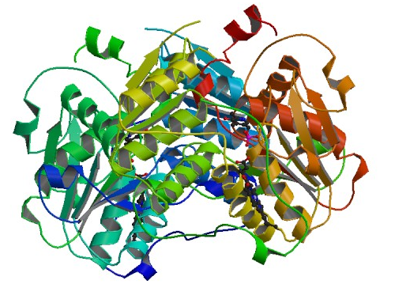
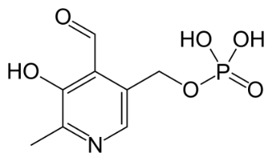

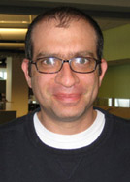
Cystathionine β-Synthase (CBS) single amino acid mutations
Homocysteine
Cystathione
Cysteine
Serine
cystathionase
CBS
Treat with high dose of B6
PLP
CBS variants associated with homocystinuria
In 2011 84 mutations assessed experimentally
Dataset provided by Jasper Rine, University of California, Berkeley
Assessed by Iddo Friedberg, Miami University

Slide 7
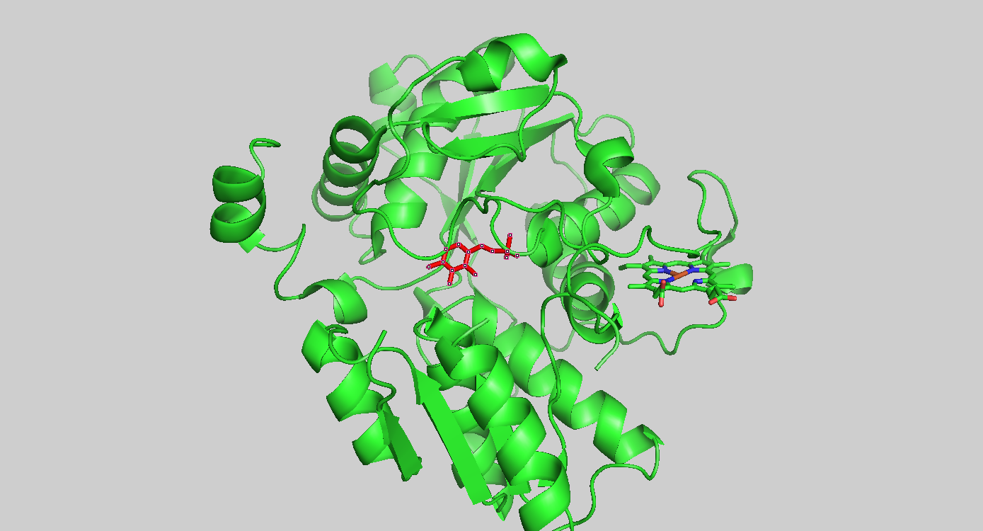

Slide 8
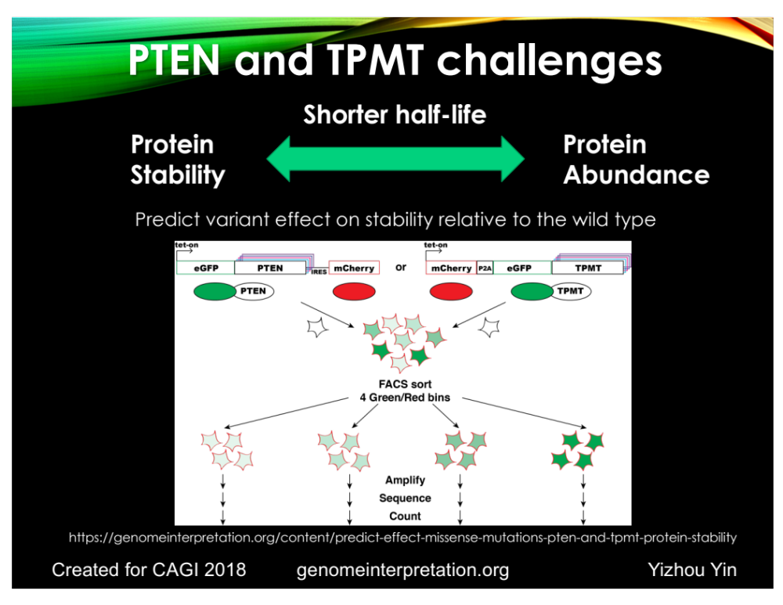
Kenneth Matreyek, Lea Starita and Doug Fowler
PTEN intro slide

Slide 9
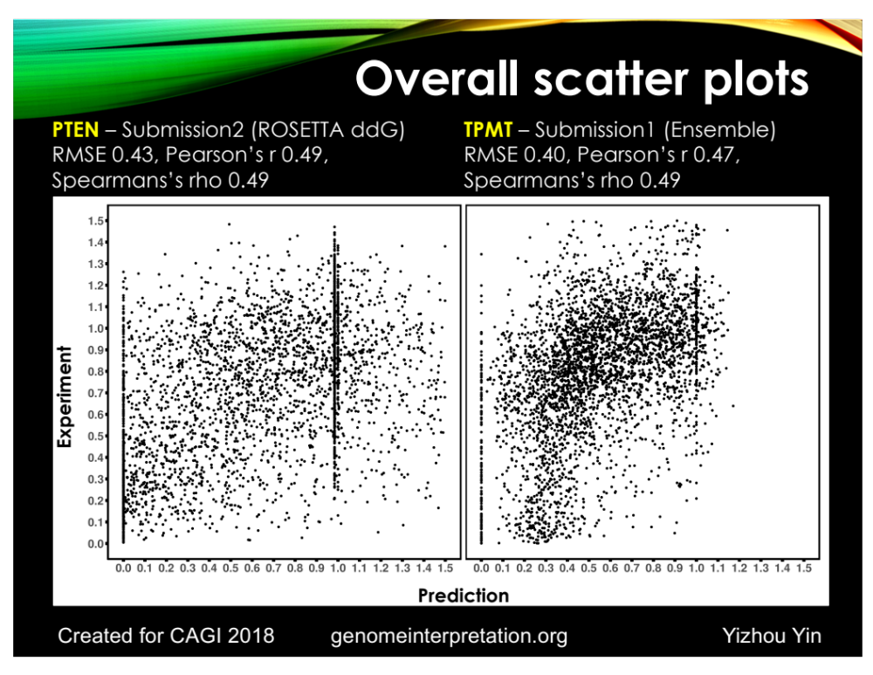

Slide 10
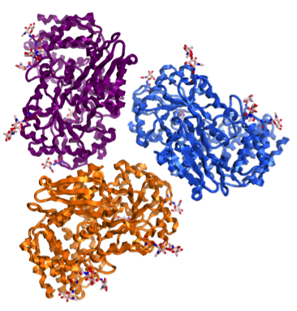
MPS IIIB (Sanfilippo Type B)
Autosomal recessive lysosomal storage disease
α-N-acetylglucosaminidase (NAGLU)
Severe neurological disease
  Birth incidence: ~0.5 per 100,000
  Global MPS IIIB patient population: 1,000~2,000
H₂COSO₃⁻
OH
O
O
OH
IDU GlcNAc
H₂COSO₃⁻
HNSO₃⁻
IIIA
OH
O
O
IIID
IDU GlcNAc
OH
IIIC
MPS IIIB
H₂COSO₃⁻
NH₂
OH
O
O
OH
IDU GlcNAc
H₂COH
HNAc
OH
O
O
Iduronic
acid
α1 4
GlcNAc
OH
Heparan Sulfate (HS)
Glycosaminoglycan (GAG)
Human
NAGLU
(Trimer)
HNAc
N-acetylglucosamine(GlcNAc)
Haust. Connect Tissue Res (1986); Meikle. JAMA (1999); Poorthuis. Hum Genet (1999); Baehner. J Inherit Metab Dis (2005); Heron. Am J Med Genet (2010); Valstar. J Inherit Metab Dis (2008, 2010); Poupetova. J Inherit Metab Dis (2010)
Created for CAGI 2016
genomeinterpretation.org
Jon Lebowitz

Slide 11
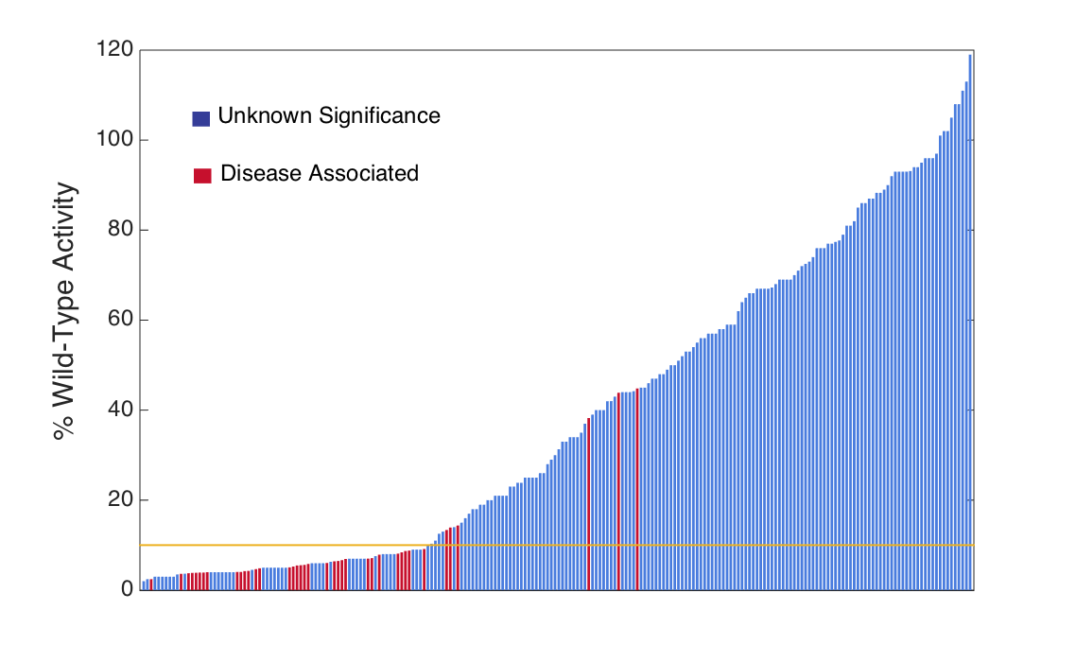
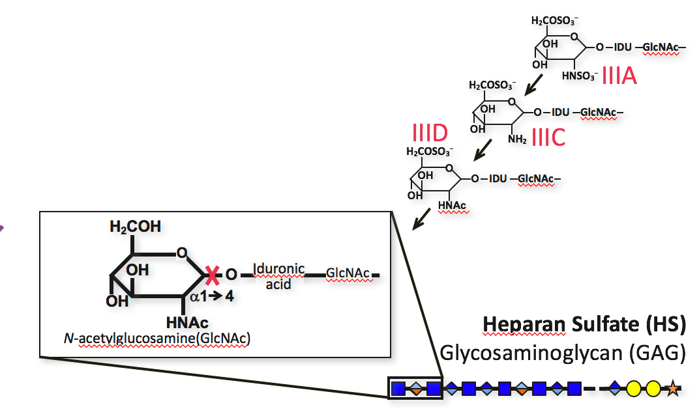
MPS IIIB (Sanfilippo Type B)
Activity profile of mutant NAGLU proteins: Deleterious variants are rare
Created for CAGI 2016
genomeinterpretation.org
Jon LeBowitz

Slide 12
Experimental activity
Mooney-2
Predicted activity
Notes:
But we note this prediction was reliable for variants predicted to have less than 10% of wild type.. This subset seems distinct from the others. Spearman 0.61
Notably, this involves some of the variants that are most clinically relevant, as the disease occurs when activity is below 10-20%. There is a hope to within ClinGen to give computational predictions a higher weight in those cases they are demonstrated to perform well. Further assessment of this sort could thus help tremendously in being able to assign impact to variants currently designated as VUS.

Slide 13
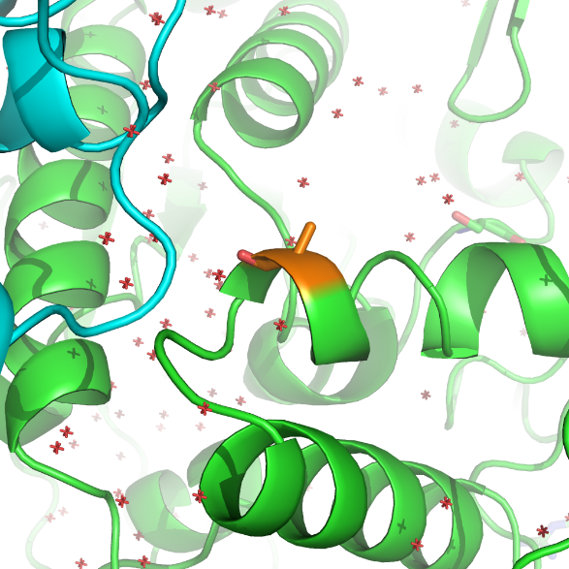
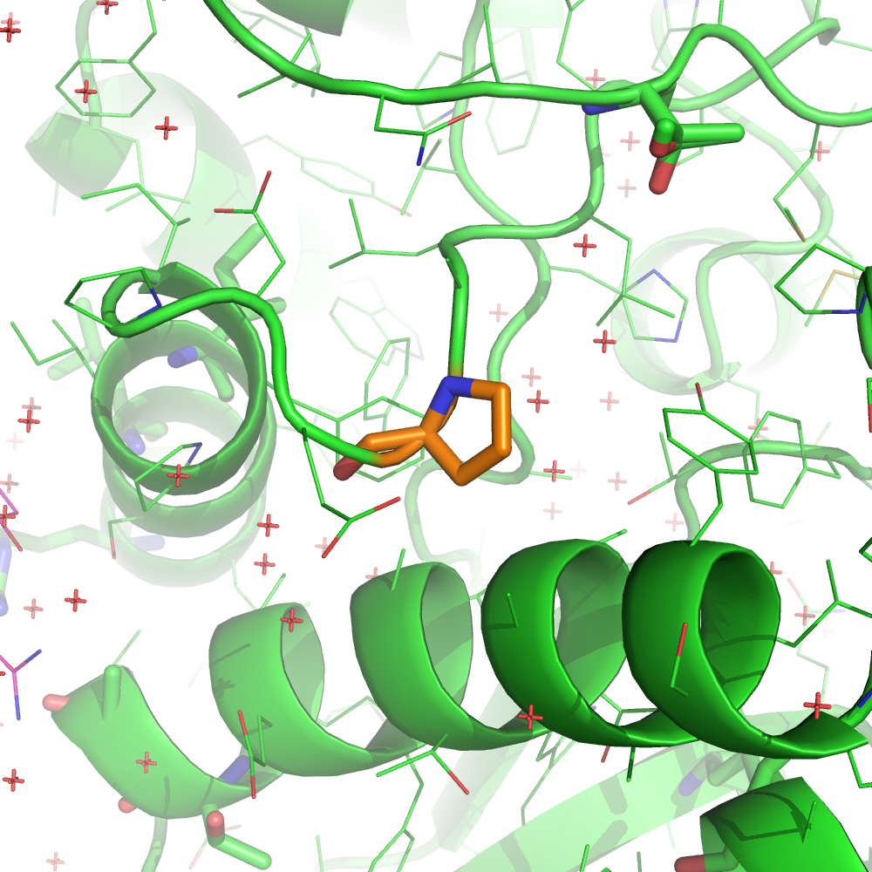
NAGLU prediction outlier examples
A627V
P283L
Variable position
High impact: 1 / 11 methods
Conserved position
High impact: 11 / 11 methods
FOLDX ddg: +2.7 kcal/mol
Created for CAGI 2016
genomeinterpretation.org
Yizhou Yin
Notes:
A627V: variable position, conserved only in close species homolog
E251K: very variable position with both types of charges, no co-evolving position
P283L: conserved position
#Remove the E251K
# remove foldx ddg for A627V
#?add position conservation
A627
Entropy: 3.15, relative_entropy: 1.43
3 hits in the 300 alignment, no hits in homologs
SNPs3d profile predict high impact
FOLDX ddg +0.64 kcal/mol
P283L
Entropy: 0.87, relative_entropy: 0.39
1 hit in both 300 alignment and homologs

Slide 14
Messages:
The missense challenges have been a major benefit to the field. Now onto the next stage.
Choose challenge data sets that address where we are now.
Have a means of following up on puzzling results.
We still don’t actually have a good quantitative measure of how well missense methods work.

Slide 15
Part 2: What lies underneath all this?

Slide 17
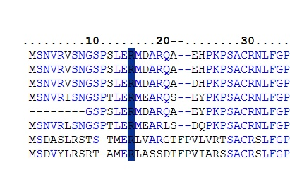
Evolutionary signal methods

Slide 18
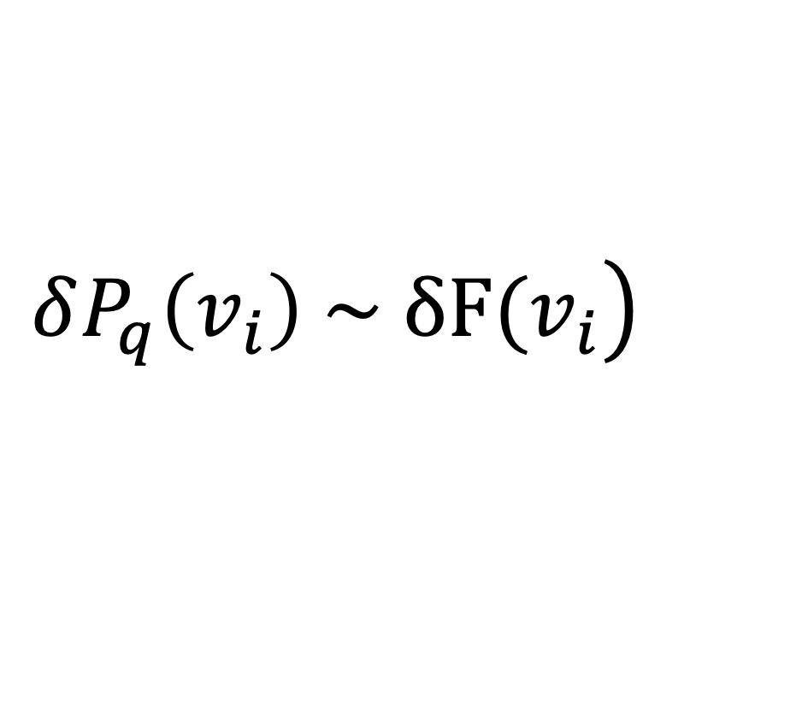
$$\left.δP_{q}\left(v_{i}\right) \sim δF(v_{i}\right)$$

Slide 19
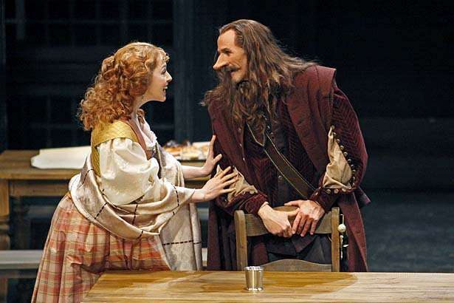
Cyrano de Bergerac
Toronto Star

Slide 20
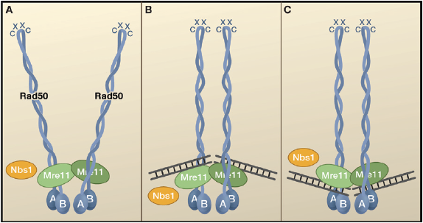
RAD50 - MRN Challenges:

Slide 21
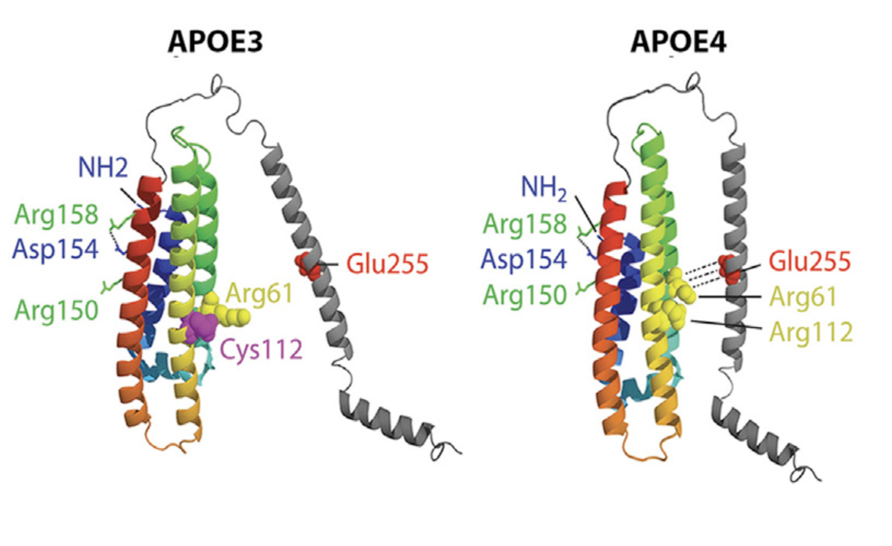
Zhong and Weisgraber, 2009

Slide 22
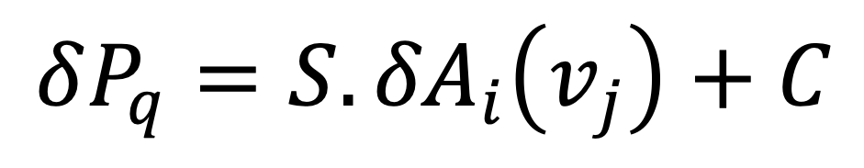
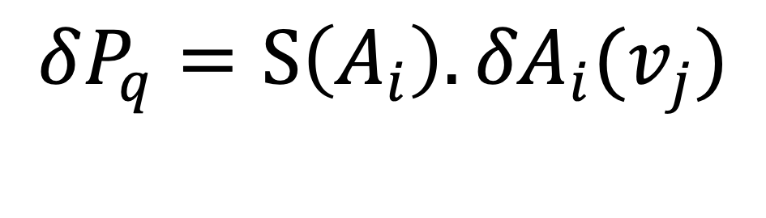
Function based methods
$$δP_{q}=S\left(A_{i}\right).{δA}_{i}(v_{j})$$
$$δP_{q}=S.{δA}_{i}\left(v_{j}\right)+C$$

Slide 23
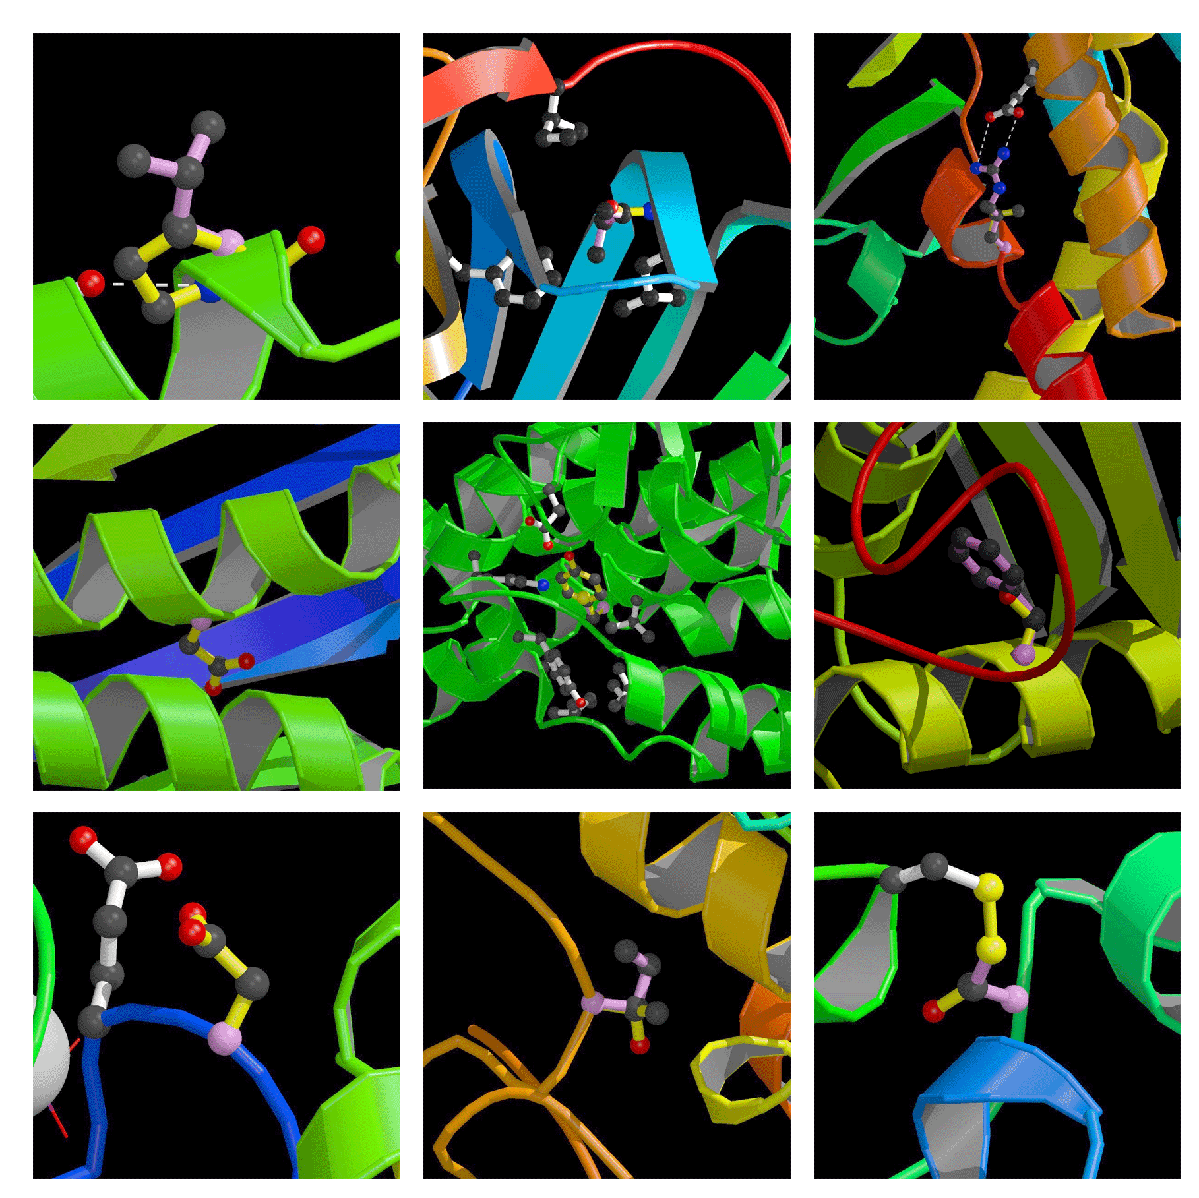

Slide 24
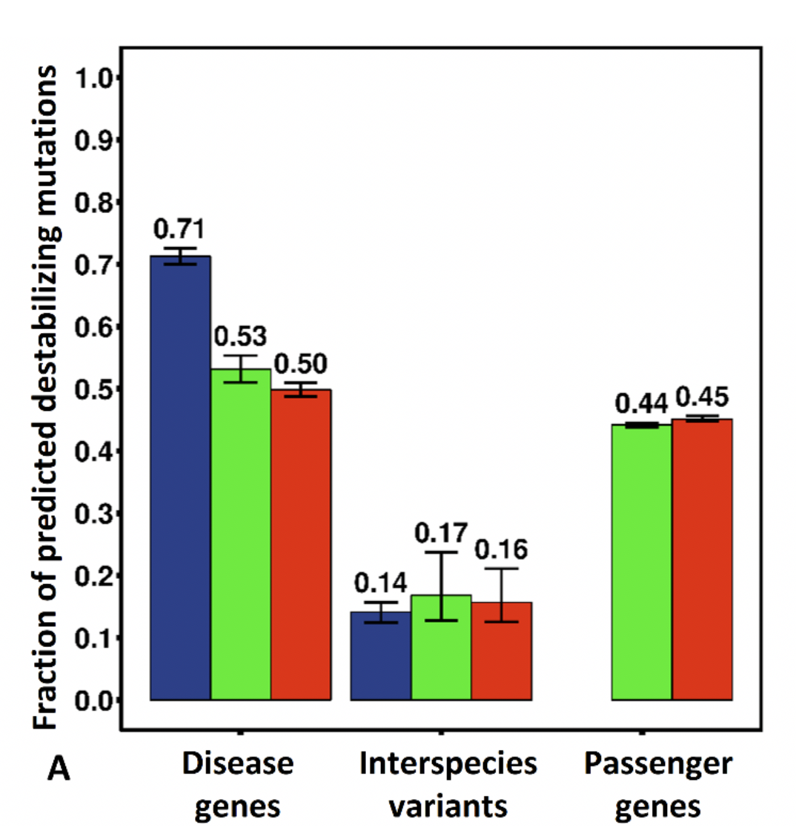
Notes:
FIGURE 7: Fraction of predicted destabilizing mutations. (A) More than 70% of monogenic disease mutations are destabilizing compared with only about half of mutations in cancer driver genes. The value for passenger gene mutations is not much lower than for driver genes. (B) The predicted destabilizing fraction is substantially lower on the surface than in the core for both types of disease. (C) Dependence on the fraction of mutations predicted destabilizing on the fraction of surface mutations. Each point is for one gene. The less mutations on the surface, the higher the fraction that predict destabilizing, and monogenic disease genes (blue) tend to have a lower surface fraction than cancer genes. (D) Relationship between the fraction predicting deleterious and recurrence for cancer mutations. The driver gene destabilizing fraction increases with recurrence, consistent with a mixture of driver and passenger mutations in these genes. There is no trend for passenger gene mutations. Results are for SVMs trained on monogenic disease surface and core mutations separately.
Error bars show 95% confidence intervals derived from 100 rounds of bootstrapping.

Slide 25
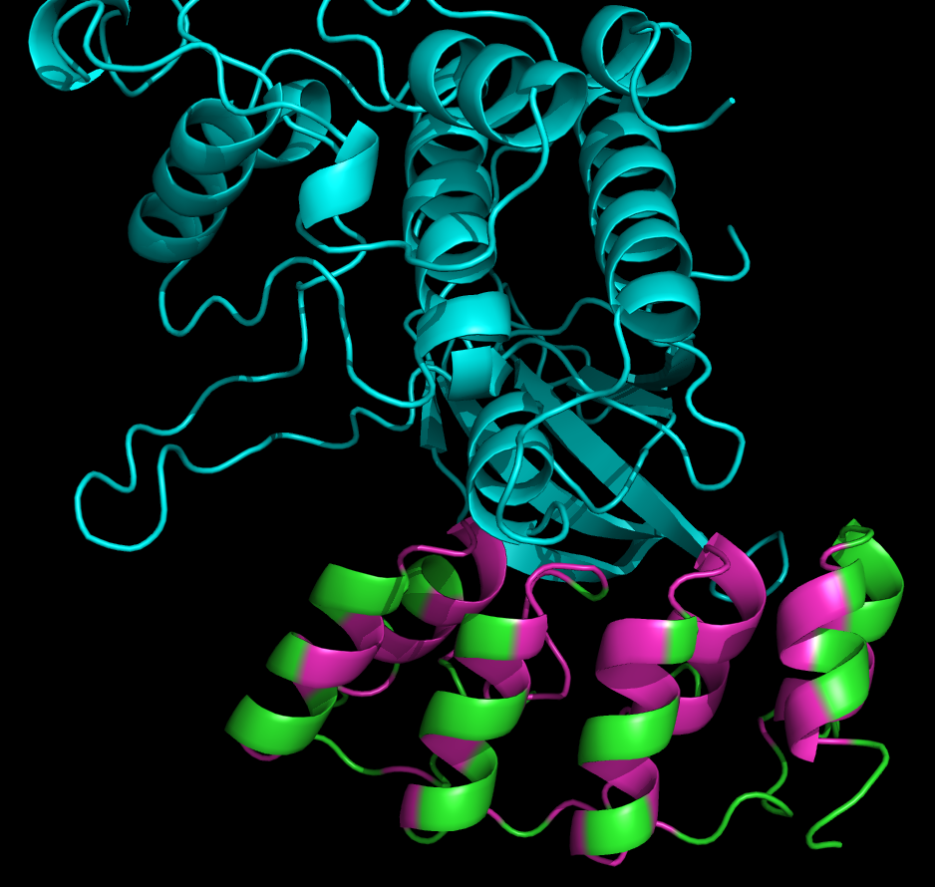
P16 Challenge:

Slide 26
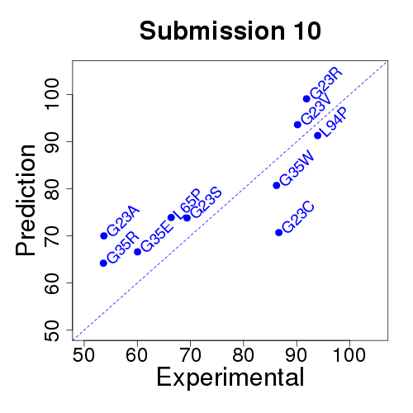
SPARKS (Yaoqui Zhou)
Dataset provided by Maria Chiara Scaini, University of Padova
Assessed by Silvio Tossatto, University of Padova

Slide 27
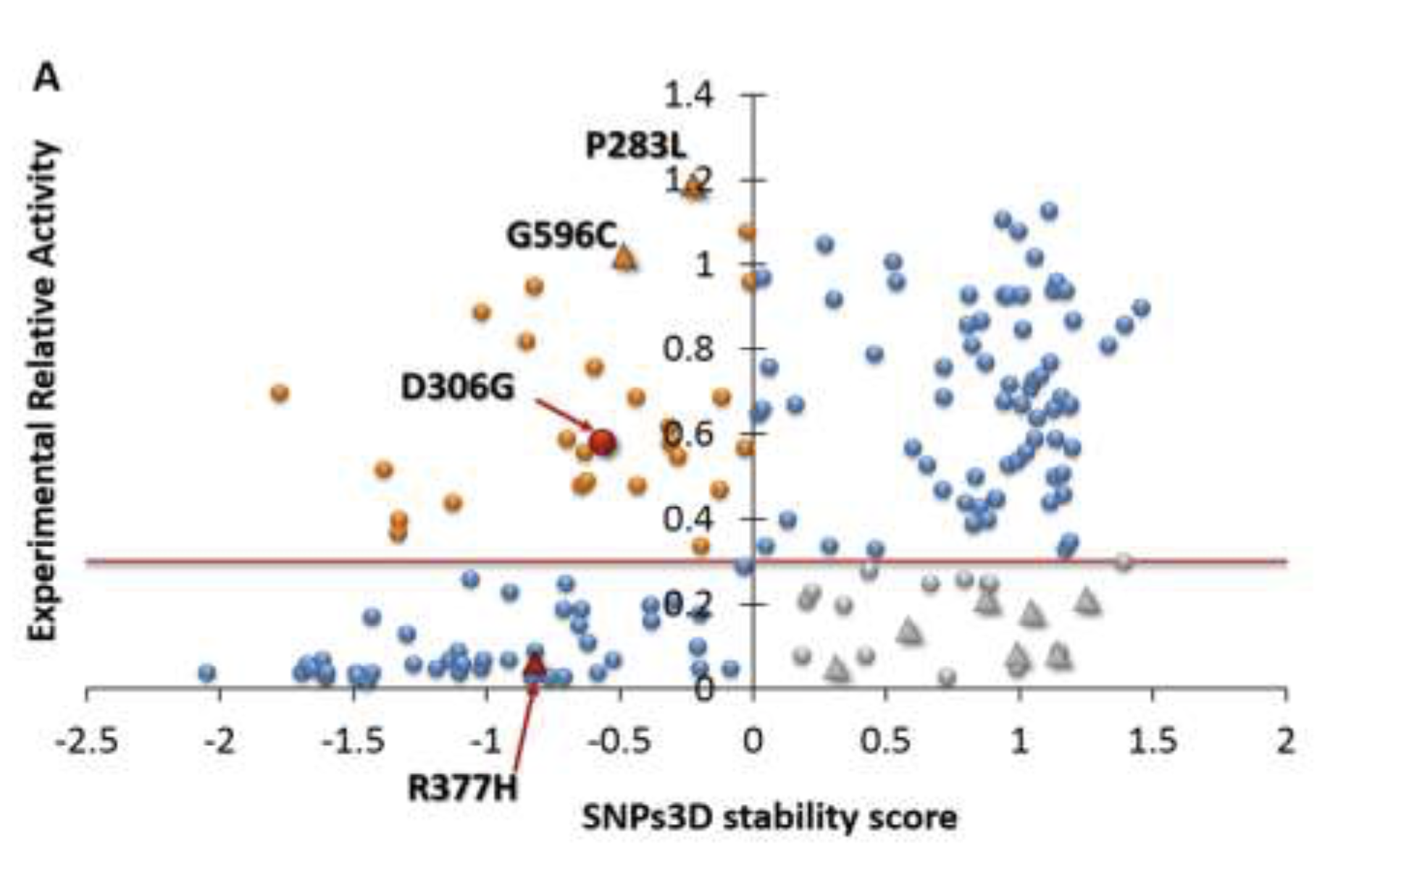
Notes:
3A) Scatter plot comparing SNPs3D stability scores with experimental relative enzyme activity of NAGLU. Blue point variants in the lower left quadrant (68% of all those with low (> 0.3) activity) are predicted to destabilize the structure. Those at the upper right are predicted not destabilizing, consistent with their high activity. Those at the lower right (gray) are predicted to have low activity for reasons other than destabilization. The upper left quadrant variants (orange) are predicted destabilizing even though the experimental activity is high. Triangles show the location of the ten ‘hard to predict’ variants.

Slide 28
Messages:
It’s a miracle the methods are any use at all.
There will always be failures for particular mutations.
Structure provides insight into molecular mechanism.
Beware of false negatives with structure.
We need an up-to-date structure method - it may be AI.

Slide 30
Part 3: The future

Slide 31
ACMG Variant Classification
Pathogenic
Likely Pathogenic
Variant of Uncertain Significance (VUS)
Likely Benign
Benign
Created for CAGI 2016
genomeinterpretation.org
Beth Buckley

Slide 32
Reliability analysis

Slide 33
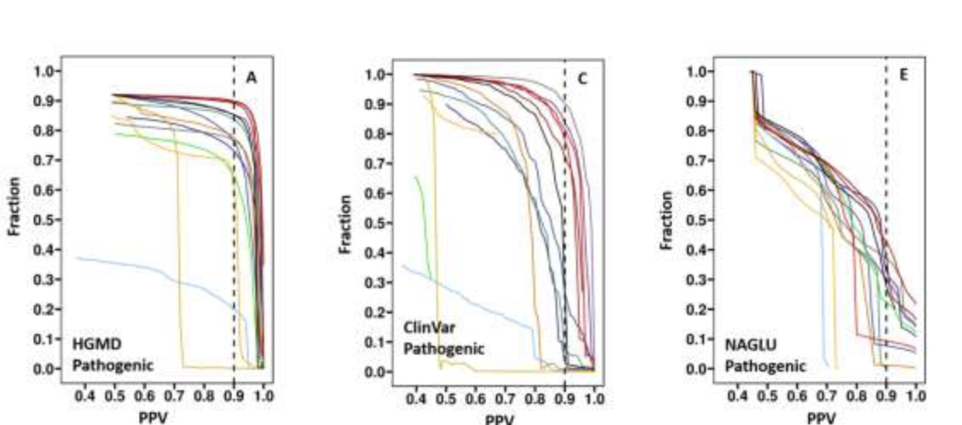
Notes:
Figure 7. Fraction of data for which pathogenicity or benign status is predicted at a specified level of confidence, as a function of the confidence level, for HGMD (7A, 7B), ClinVar (7C, 7D) and the NAGLU challenge dataset (pathogenicity cutoff of 0.3, 7E, 7F). Vertical dashed lines show the 0.9 reliability threshold. For each dataset, the left panel shows the fraction of pathogenic variants meeting a reliability (PPV) threshold as a function of threshold and the right panel shows the equivalent data for reliability of benign assignment (NPV). Our ensemble methods and REVEL perform best on the HGMD and ClinVar sets respectively. Overall, even in the demanding NAGLU dataset, a substantial fractions of variants can be assigned as pathogenic or benign with high confidence. NAGLU dataset using an activity of 0.3 as the pathogenicity threshold, 43% of the pathogenic variants are predicted with 90% or better accuracy, and 56% benign assignments are 90% or better correct. However, the dependence of accuracy on threshold is steep for both these numbers, and precise values are likely to be dataset specific.

Slide 34
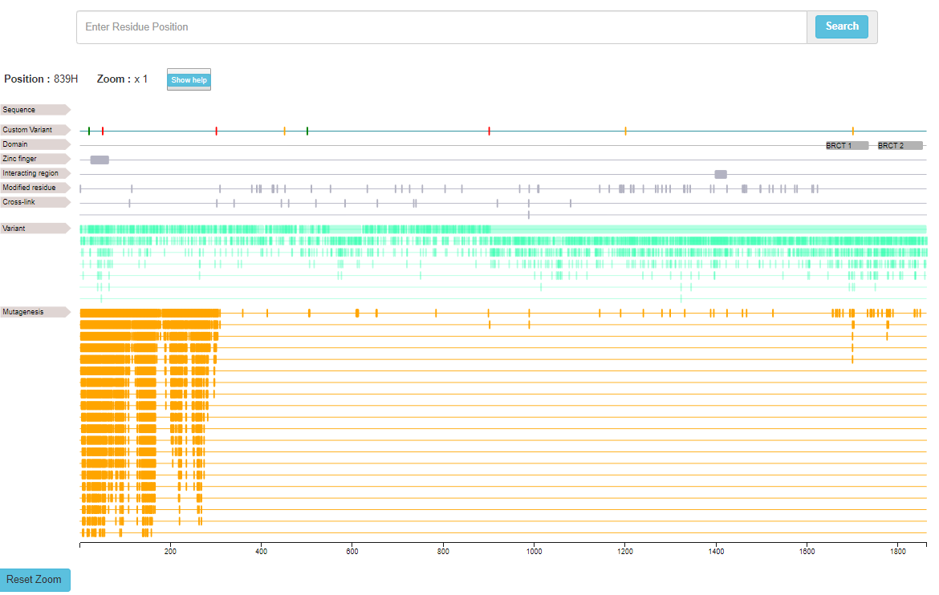
Zoom in to the entered residue number
1397 – 1424
Interaction with PALB2
Sequence feature tracks
Notes:
Protein sequence features can be visualized/navigated using sequence viewer.
The test interface was designed using the open source java script library feature-viewer, used in the neXtProt website. This library uses API to fetch the data from neXtProt for any given accession number.
The below interface shows the sequence features of BRCA1 protein.

Slide 35
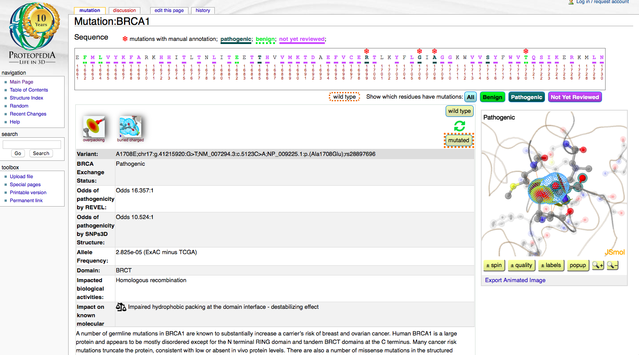
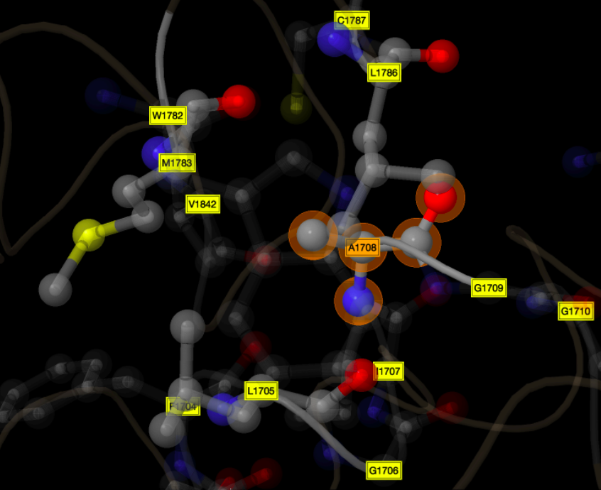
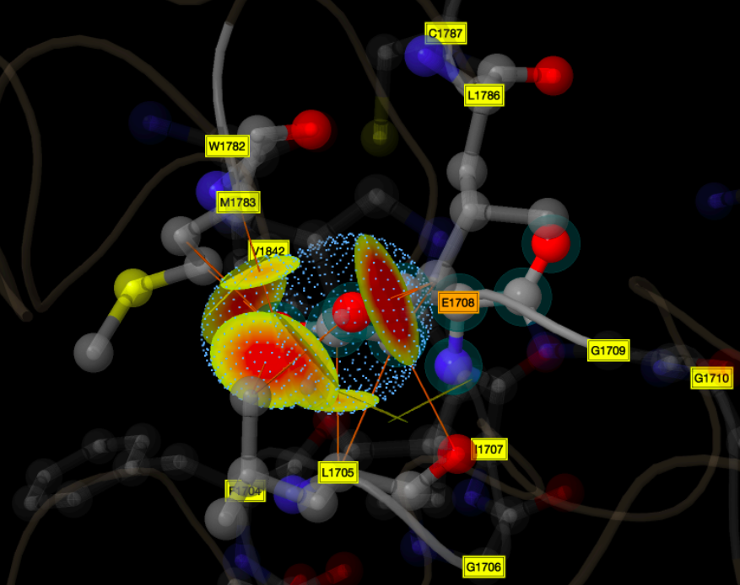
http://proteopedia.org/w/Mutation:BRCA1
Notes:
Selected A1708E (Ala1708Glu) from proteopedia for BRCA1 BRCT domain. Slides are attached here.
John - This is the only mutation I found with stability icon (which we approve) and pathogenic. For others, we didn't approve the icons or snps3d figure - you know they didn't implement the new snps3d changes - so need to be restrictive.
This residue is at the BRCT domains interface. Mutation is disrupting hydrophobic packing - two destabilizing icons are shown here (from SNPs3D structure model) overpacking due to change from Ala to Glu and buried charge. This mutation is affecting protein stability.
First slide: Inserted BRCT domain pdb structure from 1T15.pdb with A1708 in stick mode. Here the focus is on BRCT domain structure, its interface and location of A1708. BRCA1 is disrupting homologous recombination and thereby DNA repair activity. Different mutations at the BRCT domains are pathogenic - A1708E is one of them. Now we can view the mechanism elements in proteopedia - how it is destabilizing the structure.
Second slide (animated): Proteopedia page of A1708E. Web address is on the top. Then highlighting 3 main areas - top sequence slider, left annotation part and right structure viewer in JSmol. Then wild type structure will pop up and then mutated structure - side by side for comparison and destabilizing icons are visible above those. Prepared the popup figures in black background - ready to change if you don't like.

Slide 36
Messages:
The methods will never be perfect.
But its possible to identify reliable subsets.
Combining evolutionary and structure information should increase high confidence subsets – maybe with AI.
Gene specific resources are the future.

Slide 37
Acknowledgements
CAGI
Steven Brenner,
Roger Hoskins,
Gaia Andraletti,
Susanna Repo
Moult Group
Lipika R. Pal
Kunal Kundu
Yizhou Yin
Albert Yu
Zhen Shi
Peng Yue
Funding:
NLM, RM, NIGMS, NHGRI, NCI

Slide 39

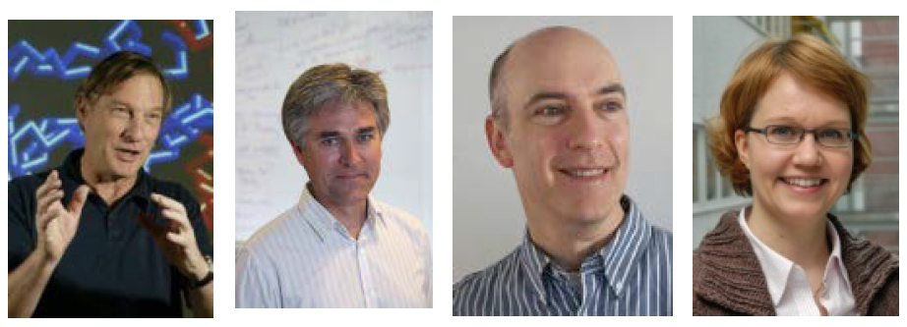
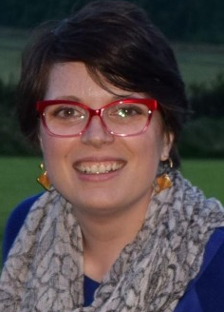

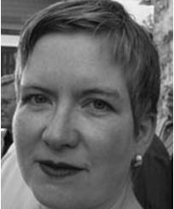
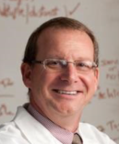

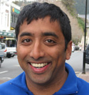
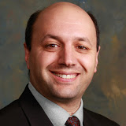
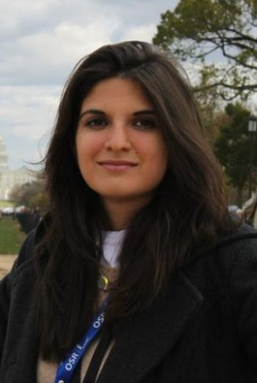
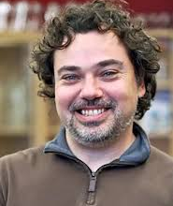
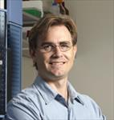
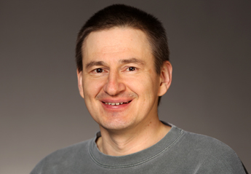
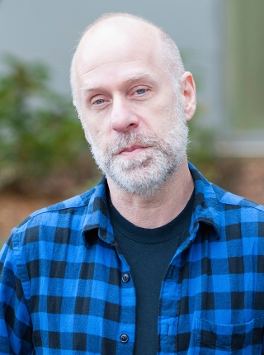
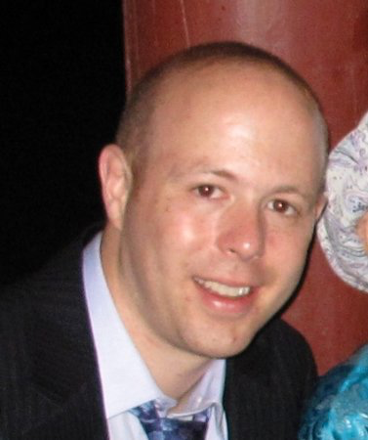
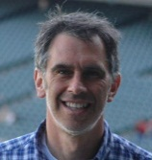
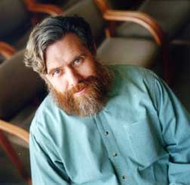

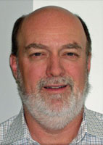

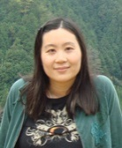
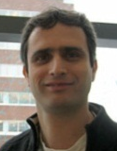
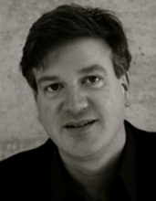
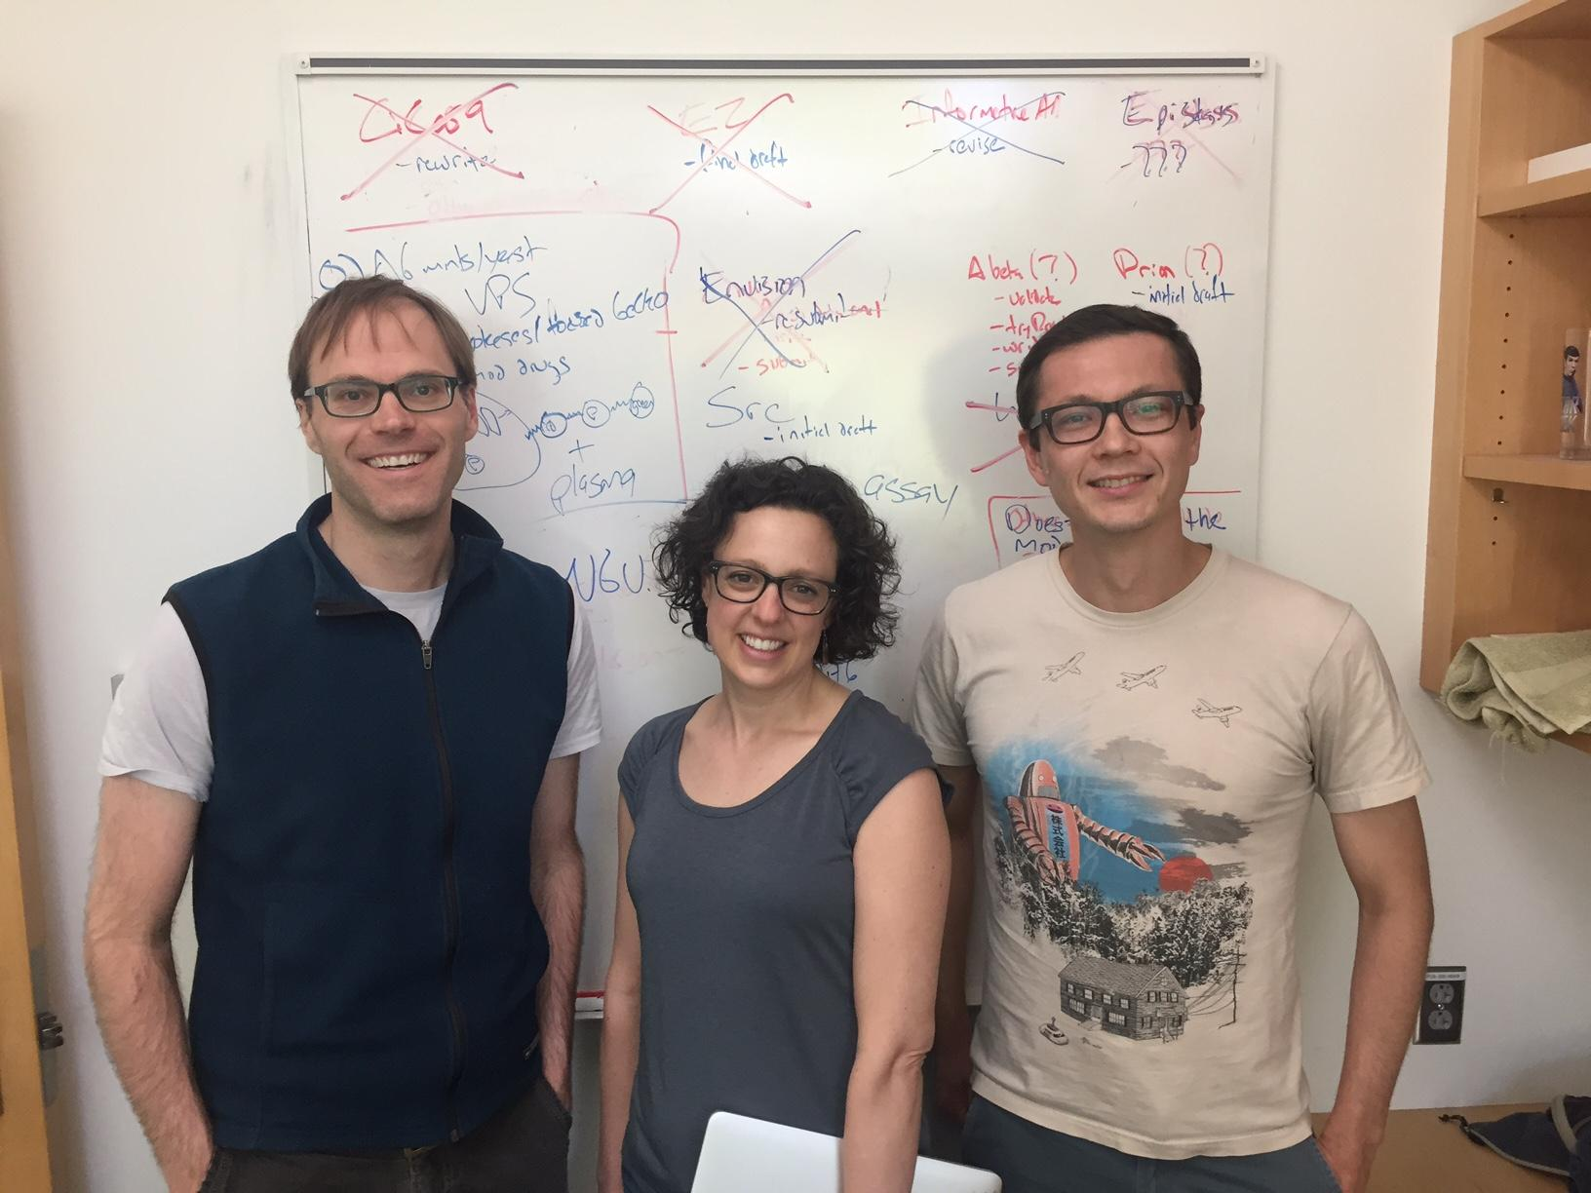
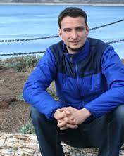
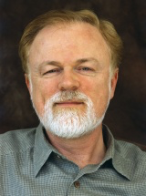
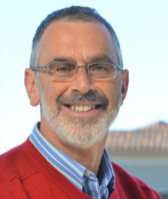


































































CAGI Acknowledgements
Data Providers
Russ Altman
Adam P. Arkin
Madeleine P. Ball,
Jason Bobe,
Paolo Bonvini,
Bethany Buckley,
George Church,
Garry R. Cutting,
Emma D’Andrea,
Lisa Elefanti,
Aron W. Fenton,
Andre Franke,
Nina Gonzaludo,
Joe W. Gray,
Linnea Jannson,
John P. Kane,
Pui-Yan Kwok,
Rick Lathrop,
Jonathan H. LeBowitz,
Federica Lovisa,
Angel C. Y. Mak,
Mary J. Malloy,
Richard McCombie,
Chiara Menin,
M. Stephen Meyn,
John Moult,
Robert Nussbaum,
Mehdi Pirooznia,
James B. Potash,
Clive R. Pullinger,
Jasper Rine,
Frederick Roth,
Pardis Sabeti,
Jeremy Sanford,
Maria C. Scaini,
Nicole Schmitt,
Jay Shendure,
Molly Sheridan,
Michael Snyder,
Tim Sterne-Weiler,
Paul L. F. Tang,
Sean Tavtigian,
Ryan Tewhey,
Silvio C. E. Tosatto,
Jochen Weile,
G. Karen Yu,
Peter Zandi.
Assessors
Aashish Adhikari,
Marco Carraro,
John-Marc Chandonia,
Rui Chen,
Wyatt T. Clark,
Roxana Daneshjou,
Roland Dunbrack,
Iddo Friedberg,
Gad Getz,
Nick Grishin,
Rachel Karchin,
Anat Kreimer,
Stephen. Meyn,
Sean D. Mooney,
Alexander A. Morgan,
John Moult,
Robert Nussbaum,
Jeremy Sanford,
David B. Searls,
Artem Sokolov,
Josh Stuart,
Shamil Sunyaev,
Sean Tavtigian,
Silvio C. E. Tosatto,
Qifang Xu,
Nir Yosef
Data Providers
Organizers
Scientific Council
Patricia Babbitt,
Atul Butte,
Garry Cutting,
Laura Elnitski,
Reece Hart,
Ryan Hernandez,
Rachel Karchin,
Robert Nussbaum,
Michael Snyder,
Shamil Sunyaev,
Joris Veltman,
Liping Wei
Advisory Board & Scientific Council
Ethics Forum
Assessors
@CAGInews
Website Development
genomeinterpretation.org
Website Development
Sadhna Rana
Navya Dabbiru
Stephen Yee
Maya Zuhl,
Sri Jyothsna Yeleswarapu
Gaurav Pandey
Ethics Forum
Wylie Burke
Flavia Chen
Julie Harris-Wai
Kirsten Isgro
Barbara A. Koenig
Robert Nussbaum
Mark Yarborough
Predictors: Allison Abad, Ogun Adebali, Ivan Adzhubey, Talal Amin, Johnathan R. Azaria, Giulia Babbi, Eraan Bachar, Benjamin Bachman, Minkyung Baek, Greet De Baets, Michael Beer, Violeta Beleva-Guthrie, Bonnie Berger, Brady Bernard, Rajendra Bhat, Rohit Bhattacharya, Samuele Bovo, Marcus Breese, Aharon S. Brodie, Yana Bromberg, Binghuang Cai, Colin Campbell, Chen Cao, Emidio Capriotti, Marco Carraro, Rita Casadio, Billy H. W. Chang, Shann-Ching Chen, Yun-Ching Chen, Chien-Yuan Chen, Melissa Cline, Andrea Corredor, Carla Davis, Mark Diekhans, Rezarta I. Dogan, Christopher Douville, Ian Driver, Roland Dunbrack, Joost van Durme, Andrea Eakin, Matthew Edwards, Gokcen Eraslan, Hai Fang, Carlo Ferrari, Anna Flynn, Lukas Folkman, Colby T. Ford, Adam Frankish, Zaneta Franklin, Yao Fu, Alessandra Gasparini, Tom Gaunt, David Gifford, Manuel Giollo, Nina Gonzaludo, Valer Gotea, Julian Gough, Yuchun Guo, Jennifer Harrow, Marcia Hasenahuer, Lim Heo, Ramin Homayouni, Raghavendra Hosur, Cheng L. V. Huang, Peter Huwe, Sohyun Hwang, Tadashi Imanishi, Jules Jacobsen, Chan-Seok Jeong, Yuxiang Jiang, David T. Jones, Daniel Jordan, Beomchang Kang, Rachel Karchin, Panagiotis Katsonis, Sunduz Keles, Manolis Kellis, Nikki Kiga, Dongsup Kim, Eiru Kim, Jack F. Kirsch, Michael Kleyman, Andreas Kraemer, Anshul Kundaje, Kunal Kundu, Pui-Yan Kwok, Ernest Lam, Dae Lee, Gyu R. Lee, Insuk Lee, Pietro Di Lena, Emanuela Leonardi, Andy Li, Jun Li, Yue Li, Biao Li, Olivier Lichtarge, Chiao-Feng Lin, Rhonald C. Lua, Angel Mak, Pier L. Martelli, David Masica, Zev Medoff, Aziz M. Mezlini, Rahul Mohan, Alexander M. Monzon, Sean D. Mooney, Matthew Mort, John Moult, Steve Mount, Eliseos Mucaki, Jonathan Mudge, Nikola Mueller, Chris Mungall, Katsuhiko Murakami, Yoko Nagai, Noushin Niknafs, Abhishek Niroula, Conor M. L. Nodzak, Yanay Ofran, Ayodeji Olatubosun, Kymberleigh Pagel, Lipika R. Pal, Taeyong Park, Nathaniel Pearson, Vikas Pejaver, Jian Peng, Alexandra Piryatinska, Catherine Plotts, Predrag Radivojac, Aditya R. Rao, Aliz Rao, Graham Ritchie, Peter Rogan, Frederic Rousseau, Jana M. Schwarz, Joost Schymkowitz, Chaok Seok, George Shackelford, Sohela Shah, Maxim Shatsky, Ron Shigeta, Hashem A. Shihab, Jung E. Shim, Junha Shin, Sunyoung Shin, Ilya Shmulevich, Bradford R. Silver, Nasa Sinnott-Armstrong, Ben Smithers, Yesim A. Son, Mario Stanke, Nathan Stitziel, Andrew Su, Laksshman Sundaram, Paul Tang, Nuttinee Teerakulkittipong, Natalie Thurlby, Janita Thusberg, Kevin Tian, Collin Tokheim, Silvio C. E. Tosatto, Yemliha Tuncel, Tychele Turner, Ron S. Unger, Aneeta Uppal, Gurkan Ustunkar, Jouni Valiaho, Mauno Vihinen, Mary Wahl, Michael Wainberg, Meng Wang, Maggie Wang, Yanran Wang, Xinyuan Wang, Li-San Wang, Liping Wei, Qiong Wei, Rene Welch, Stephen Wilson, Chunlei Wu, Lijing Xu, Qifang Xu, Yuedong Yang, Christopher Yates, Yizhou Yin, Chen-Hsin Yu, Dejian Yuan, Jan Zaucha, Haoyang Zeng, Maya Zuhll
Advisory Board
Russ Altman,
George Church,
Tim Hubbard,
Scott Kahn,
Sean Mooney,
Pauline Ng,
Susanna Repo,
John Shon,
Join
CAGI 6!
Notes:
lkjsdkljrs

