Slide 1


Missense Mutations Missense Mutetions Missense Motations Missense Mutationz Missense Mutateons
A CAGI* Talk
Iddo Friedberg Iowa State University
@iddux
1

Slide 2

CAGI slide pack guidelines
I agree to my slides being used according to the following terms: Iddo Friedberg
•
Authors: please include THIS slide at the beginning of your presentation to indicate that you agree with reuse of your slides in CAGI presentations, according to the terms below, and digitally sign by writing your name above.
•
To disseminate the CAGI results, I encourage all CAGI participants to remix these CAGI slides for inclusion in their oral and poster presentations
CAGI participants may use or publish any content of these slides only in compliance with the CAGI Data Use Agreement CAGI participants may not cite or publish any content of these slides except with the written permission of the originating author or in the primary CAGI publications
CAGI participants must acknowledge the original authors of these slides and CAGI 2019. Include the acknowledgement banner across the bottom
CAGI participants must include the CAGI credits slide in their presentations
Slides with a red slash (no remix) may not be included in a presentation unless all attendees are registered CAGI participants who signed the data use agreement
Slides with a red X over the entire slide may not be used in any circumstances
Slides with a blue slash (embargoed) may not be used unless the embargo is explicitly lifted Slides without slash or X may be tweeted unless flagged with the “No tweet” icon.
CAGI participants using these slides must explain the “No tweet” icon, which means that the slide content should not be disseminated outside the presenting conference hall. If the presentation venue permits pervasive tweeting, you may not include these slides in your talk
•
•
•
•
•
•
•
•
•
•
Note for slide authors: we expect all CAGI participants to abide by these restrictions, and will make best effort to ensure they are followed. However, but bear in mind that we have limited means of enforcing them, and therefore the restrictions cannot be guaranteed.

Slide 3
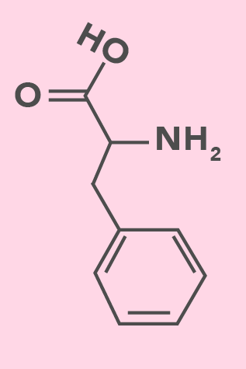
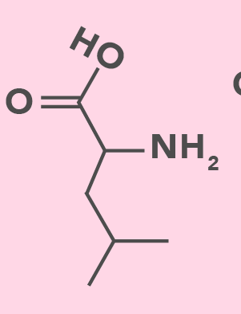
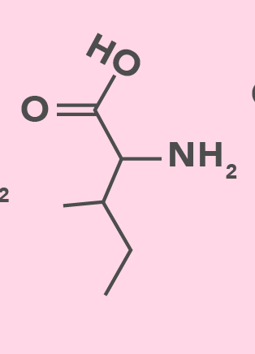
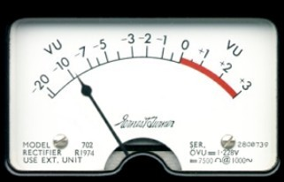

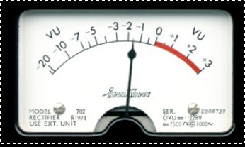
Missense Mutations
CUU → CUC
CUU → AUU
CUU → UUU
(Leu)
(Leu → Ile)
(Leu → Phe)
Silent = same aa
Quiet = similar AA
Noisy = different AA

Slide 4
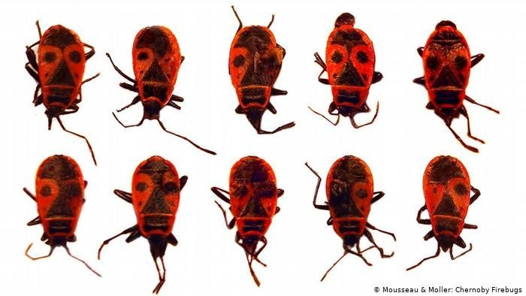

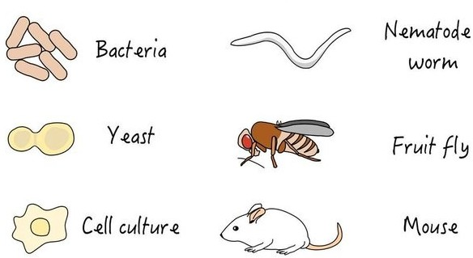
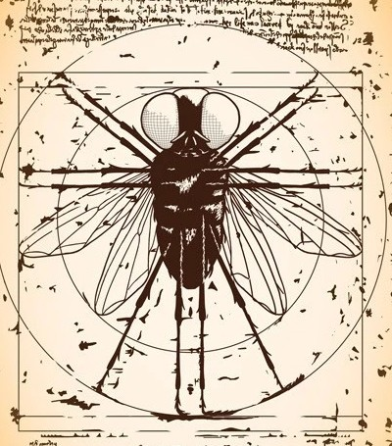
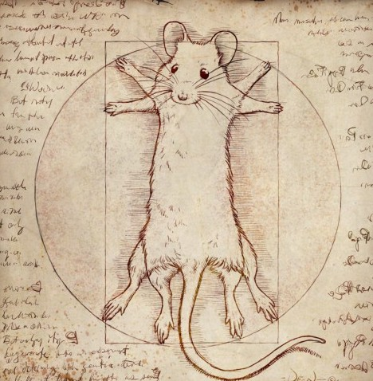
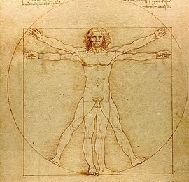
Challenges
Assessing effect in the model system
Choosing mutations
Choosing the model system
Translation to humans
Daniel Krüger /EMBL

Slide 5
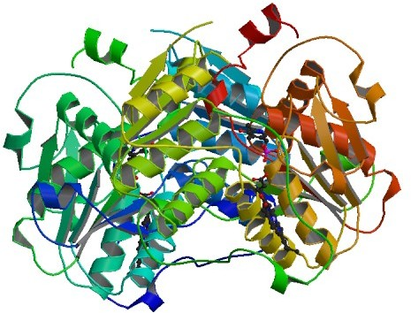
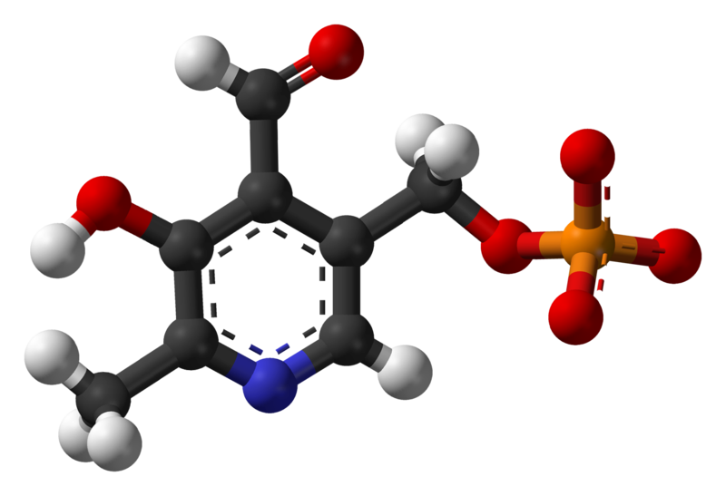
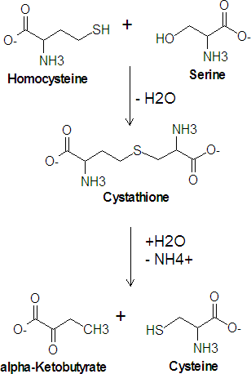
Cystathione Beta Synthase
●
Transsulfuration pathway is critical for creating cysteine from the essential amino acid methionine
+
Control by varying concentrations of PLP (vitamin B6 )
[HomoCys]
µmol/L
●
PLP
Hyperhomo
CBS
cysteinemia
10
Down's

Slide 6
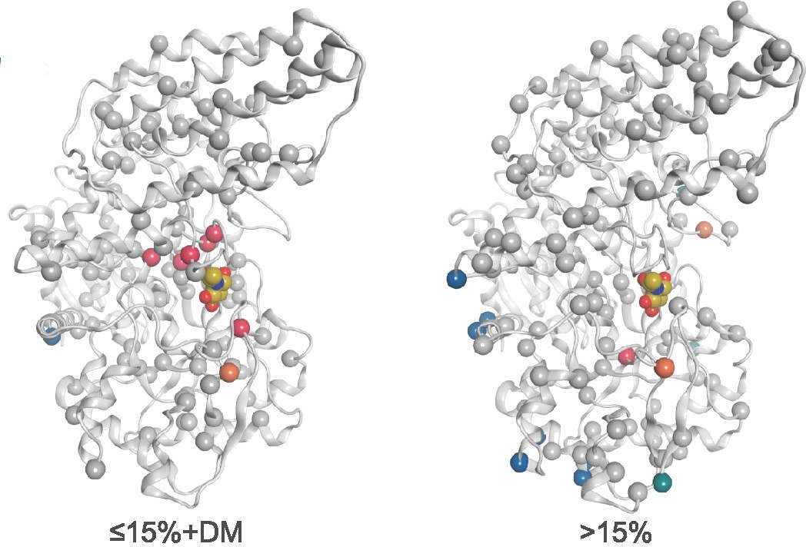
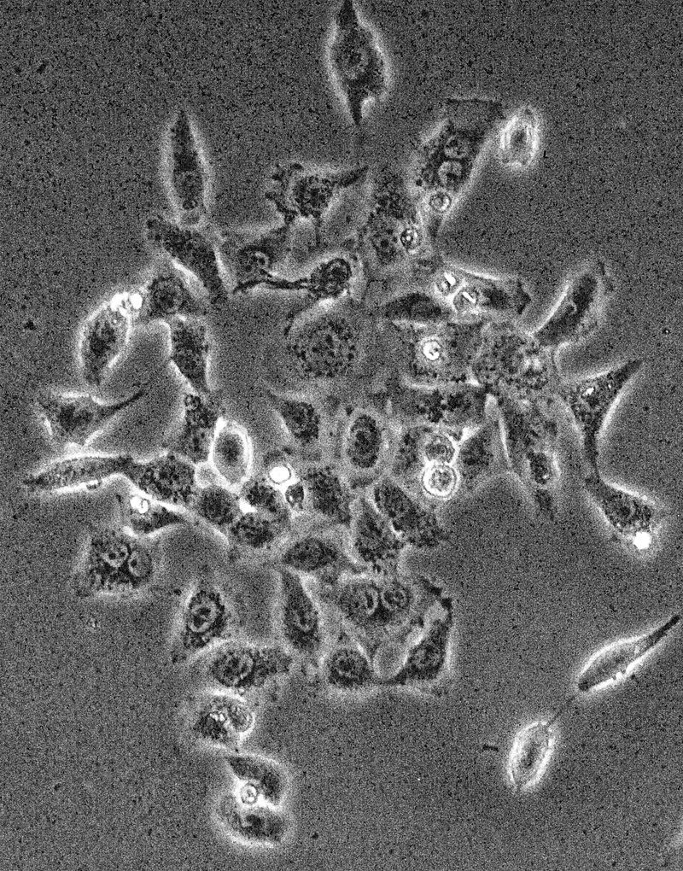
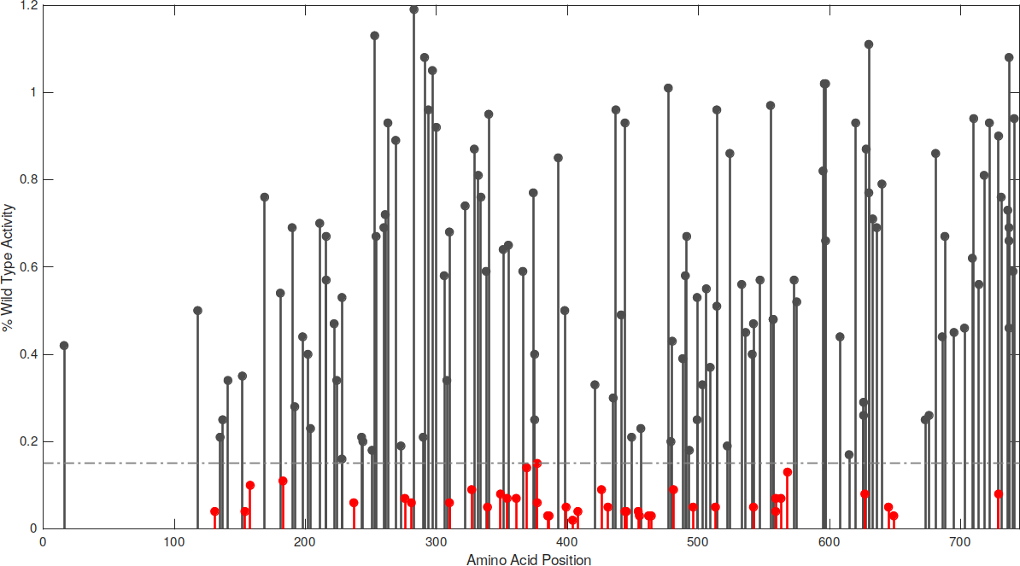

Alpha-N-Acetylglucoseaminidase (NAGLU)
Sanfilippo type B / MPSIIIB: lysosomal accumulation of heparan sulfate 1:200,000 incidence, life expectancy in the teens
x
HEK293
x
% of WT
x
AA position
Clark et al PloS 1 2018

Slide 7
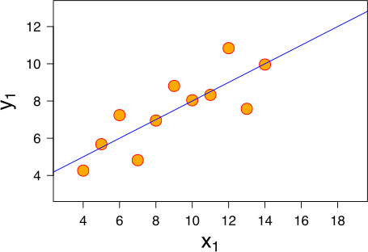
Assessing Missense Mutations: Pearson’s correlation
Good?
Prediction 1
Real mutation effects

Slide 8
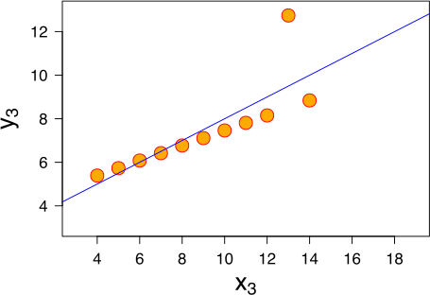
Assessing Missense Mutations: Pearson’s correlation
Good?
Better?
Prediction 1
Prediction 2
Real mutation effects
Real mutation effects

Slide 9
Assessing Missense Mutations: Pearson’s correlation
x = 9
var(x)= 11
Y= 7.50
var(y)=4.125
R^2=0.816 y=3.000+0.500x
Anscombe’s quartet

Slide 10
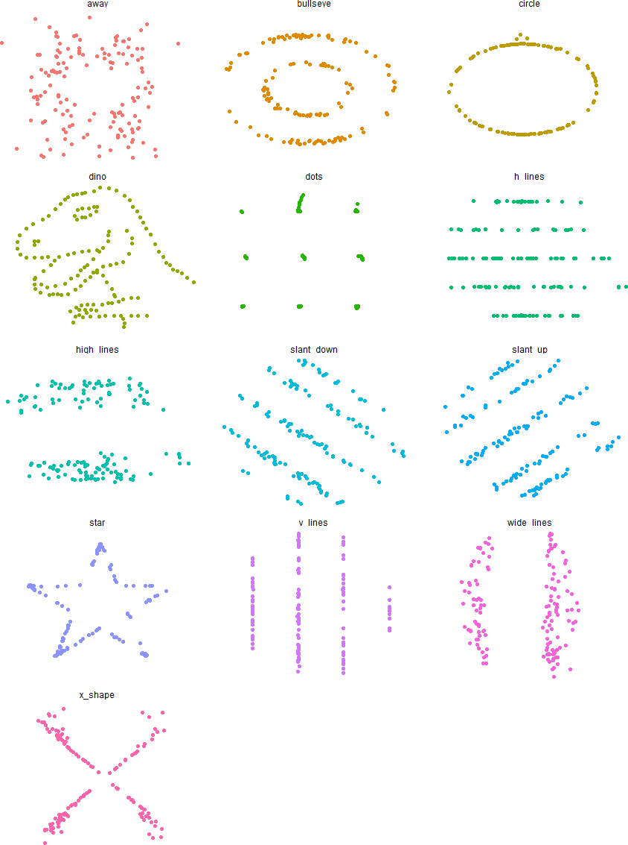
The Datasaurus Dozen
X mean : 54.26 Y Mean : 47.83 X SD : 16.76
Y SD : 26.73
Corr : 0.06

Slide 11
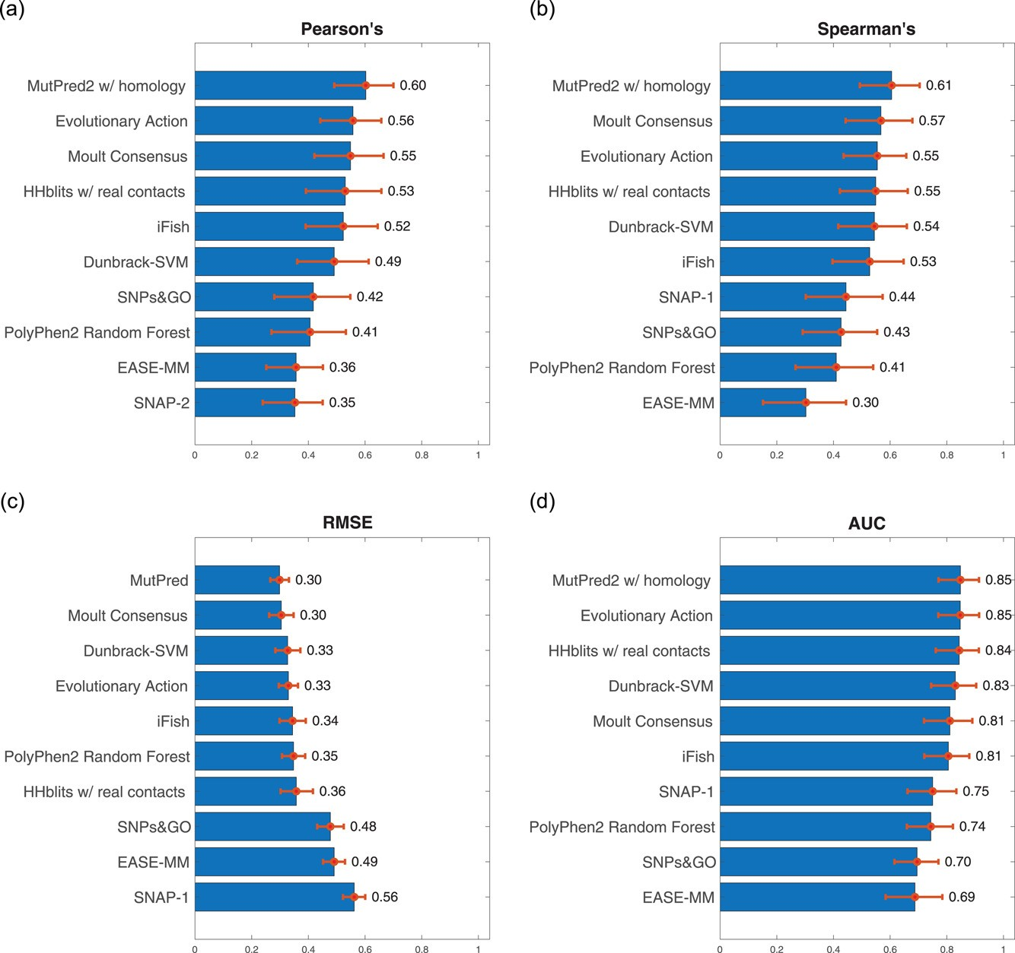
NAGLU predictions compared

Slide 12
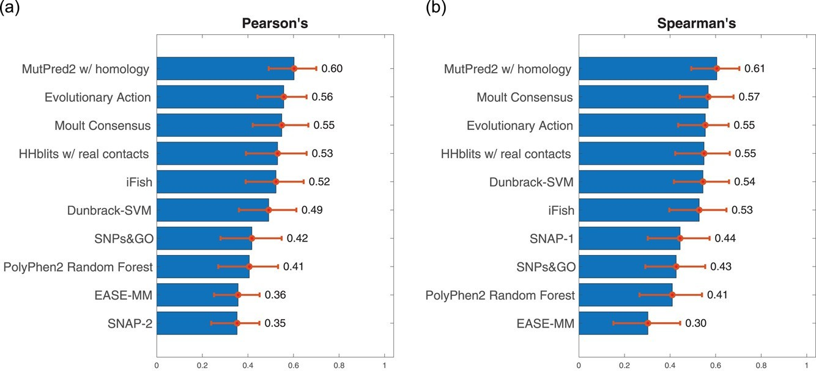
NAGLU top 10 predictions compared: No Significant Differences?

Slide 13
NAGLU top 10 predictions compared Cohen’s d Effect Size

Slide 14
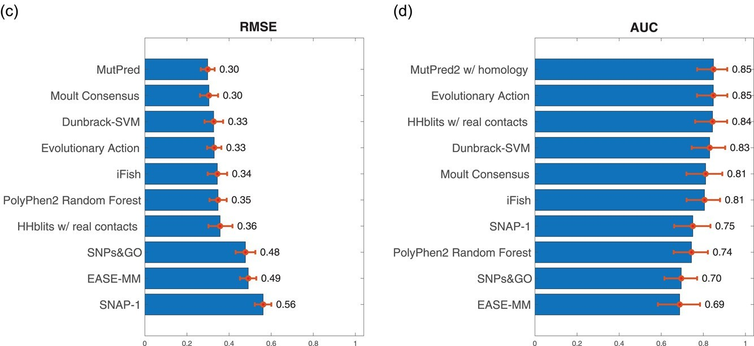
RMSE & AUC

Slide 15
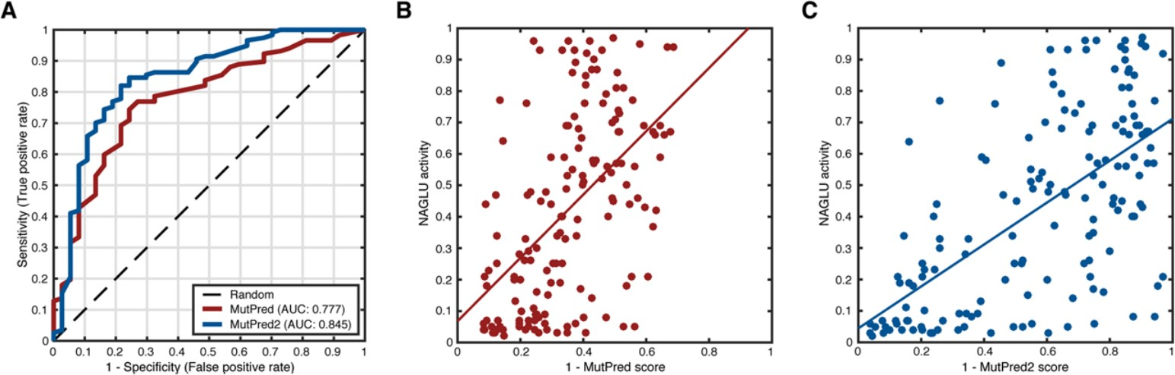
Looking at correlations
Pejaver et al Human Mutation. 2017;38:1092–1108

Slide 16
SUMO Conjugase
5,000 UBE21 mutants in yeast Assay type: yeast growth
●
●
Jing Zhang et al HUMU 2017 38:1051

Slide 17
SUMO Conjugase
5,000 UBE21 mutants in yeast Assay type: yeast growth
“Most participants ignored calibrating their predictions...”
“most predictors are capturing qualitative effects of mutations… however, the quantitative agreement between predictions and experimental measurements remain modest”
“Different numeric scales … can skew the performance… the shrinkage of numeric prediction scale may lead to better RMSD”
“A standard rescaling procedure..[should] be applied [in future CAGIs]
●
●
●
●
●
●
Jing Zhang et al HUMU 2017 38:1051

Slide 18
Questions that Need to be Asked
Correlations, esp. Pearson, is a poor assessment measure, esp. in aggregate
ROC slightly better, but dependent on thresholding, restricted to binary predictions Value of binary predictions?
Thresholding for deletrious / benign / advantageous?

Slide 19


Slide 20
We have more data in model organisms than in humans
But are these data translatable?
Kriston L. McGary et al. PNAS 2010;107:14:6544-6549

Slide 21
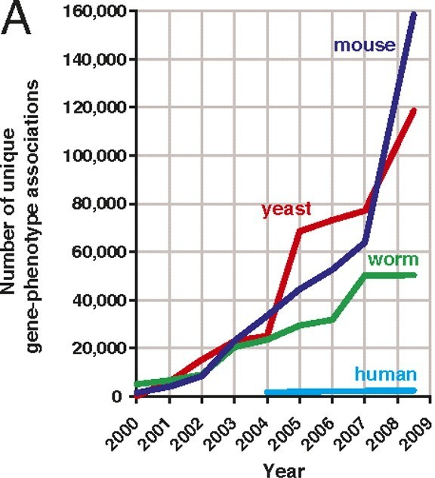
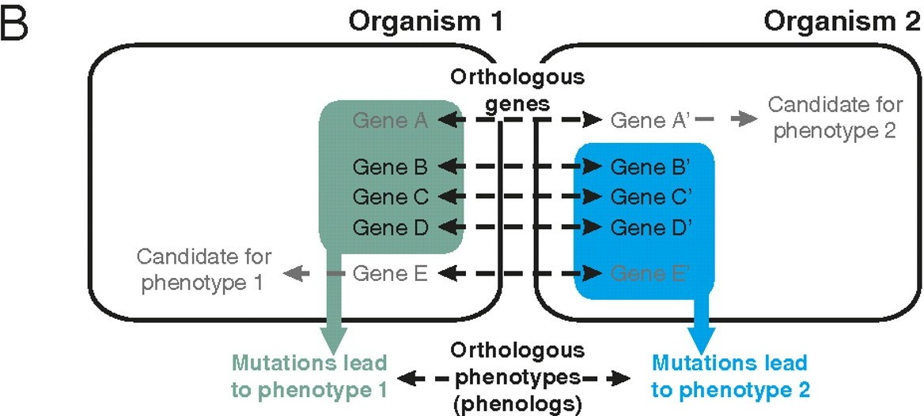
Kriston L. McGary et al. PNAS 2010;107:14:6544-6549

Slide 22
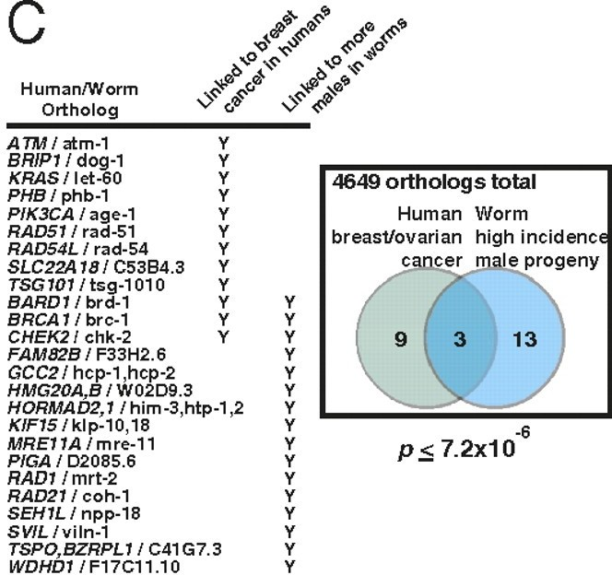
Kriston L. McGary et al. PNAS 2010;107:14:6544-6549

Slide 23
Phenologs
➔
Phenotypes originating from homologous genes
➔
Discover new candidate genes
➔
Discover new disease models
➔
Bottleneck: curation requires intensive & laborious literature searches

Slide 24



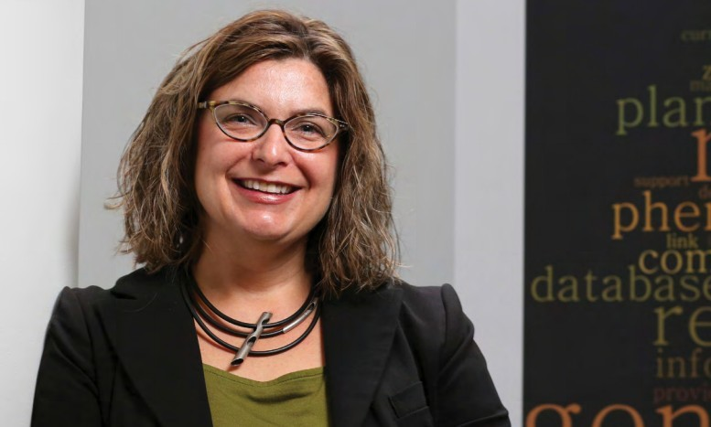
Making text phenotypes computable
Entity
Quality
whole plant (PO:0000003)
decreased height (PATO:0000569)
“Plants are shorter than normal.”
EQ Statements, easy to compute on:
uniform structure (E modified by Q)
uniform vocabulary (ontologies)
Concept reviewed in Deans et al. PLoS Biol., 2015
Ian Braun Carolyn Lawrence-Dill
Project Goal: To automate the process of translating text phenotypic data into information-rich and easy- to-compute-on EQ statements.

Slide 25
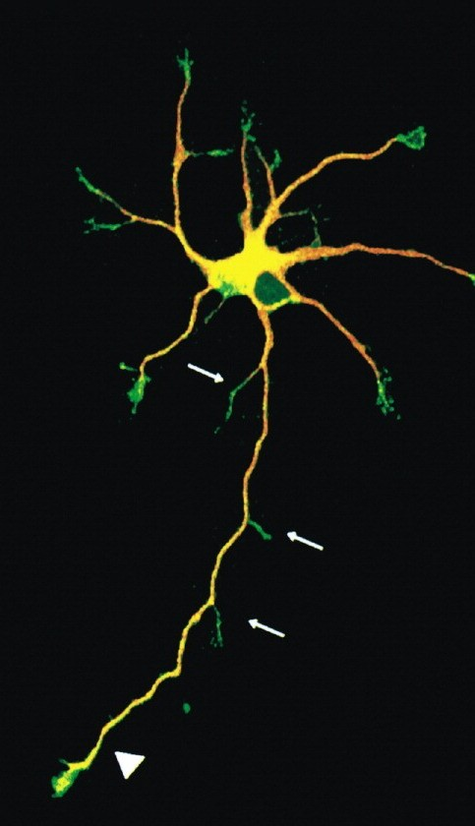
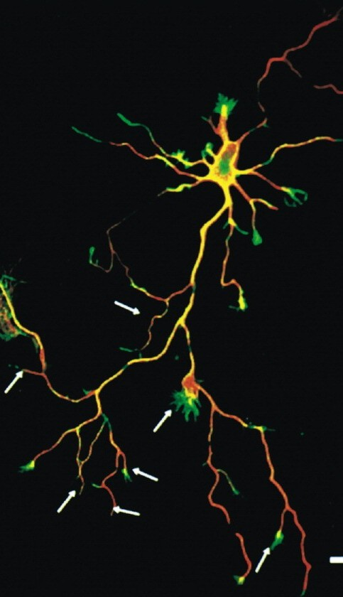
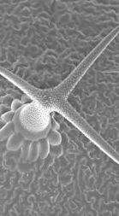
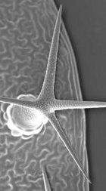
What can we do with computable phenotypes?
Wildtype Mutant
“...neuron extends more long collaterals in [mutant] than [wt].”
E:
+ Q:
neuron
Gene A
increased branching
Sequence similarity, common pathways, etc.
Homma et al., 2003
Similarity
“...[wt] trichomes had three branches. [...] In [mutants], trichomes had four branches”
E:
+ Q:
trichome
Gene B
increased branching
Lu et al., 2004

Slide 26
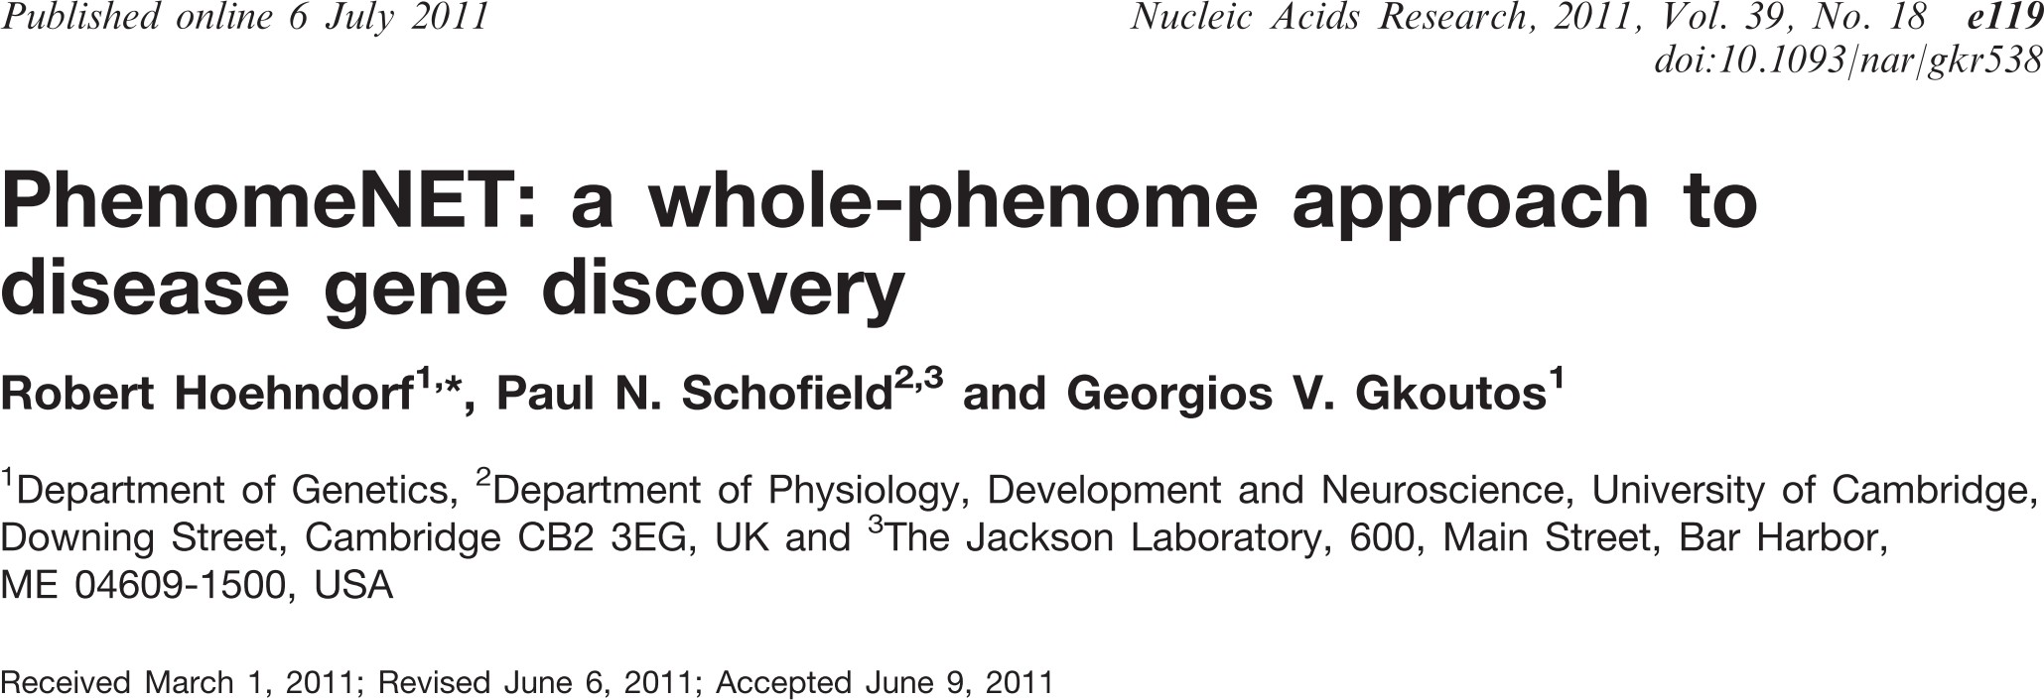
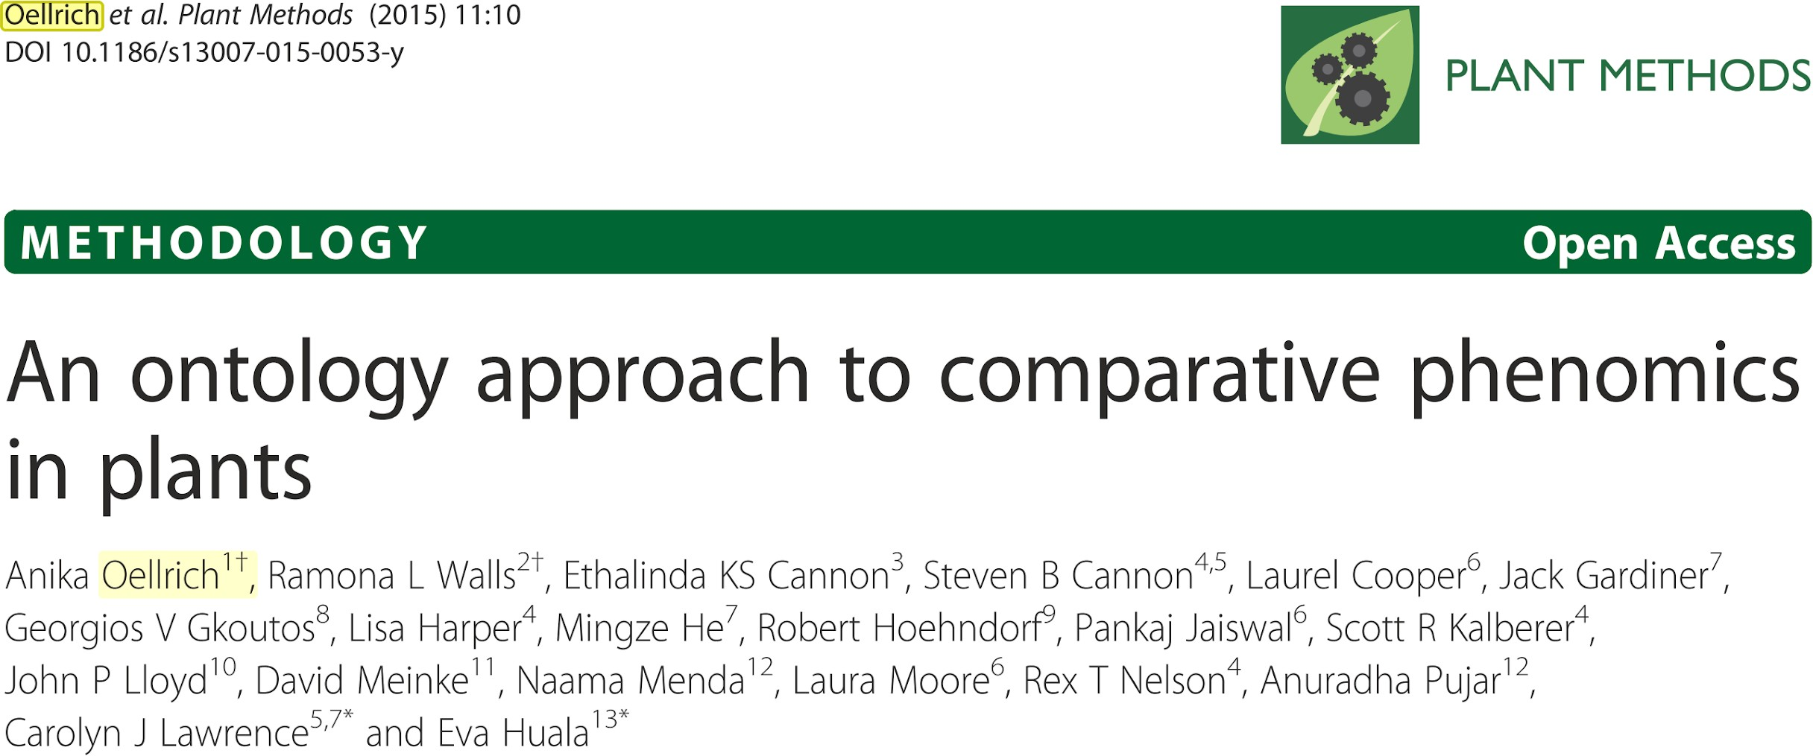
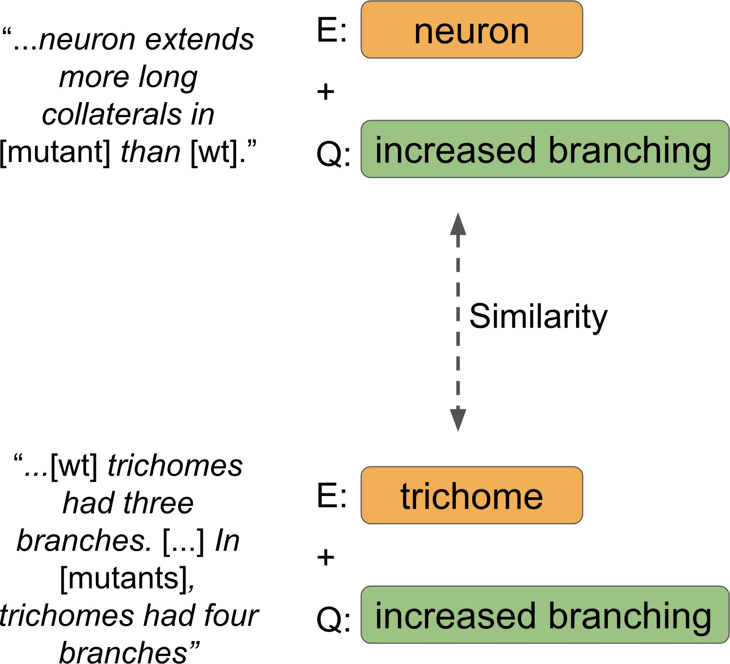
Candidate gene prediction with phenologs
The method works... but manual translation to EQ statements is a limiting step.
Translation to EQs
Phenotype Text Data
Candidate Genes
(n > 1,000)

Slide 27
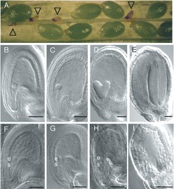
Arabidopsis phenolog to Sanfilippo type B
Arrows: aborted seeds
Can phenologs improve predictions of missense mutations?
wt
cyl1/+

Slide 28
Phenologs as Models
Typically used for adding candidate genes
Can be used to better assess genotype → phenotype connections, including missense mutations
Opening up new avenues for CAGI
●
●
●

Slide 29
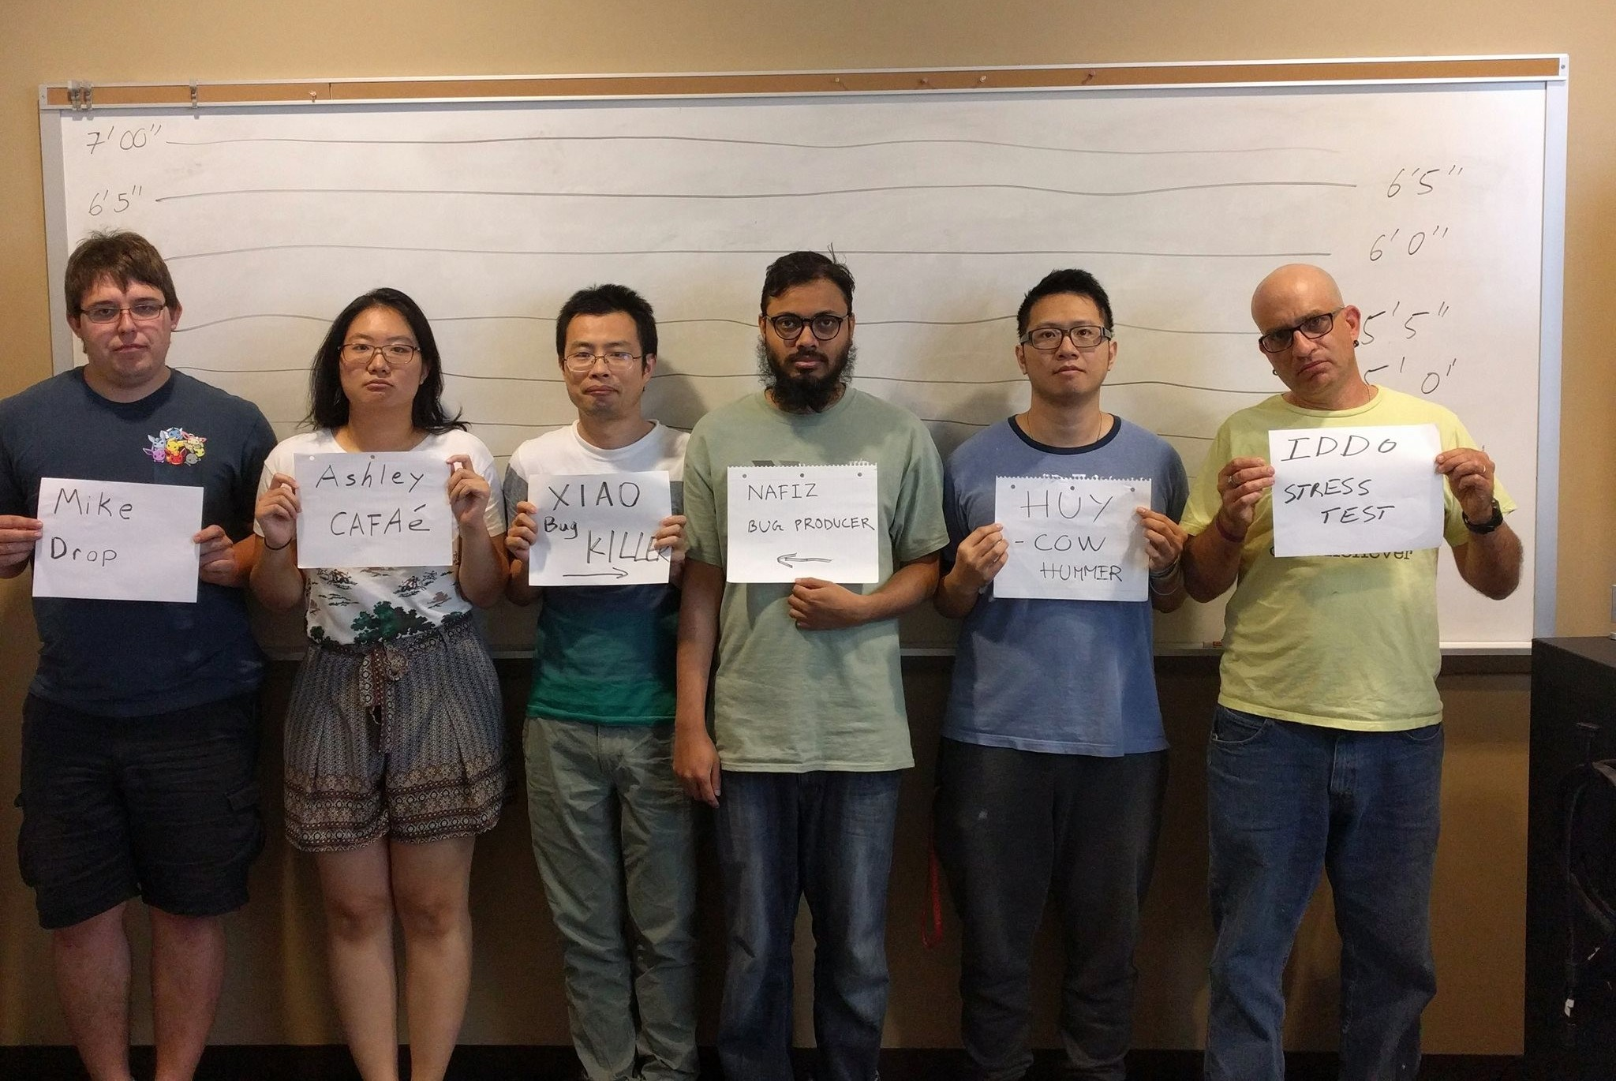
Thanks
Constantina Bakolitsa Laura Kasak
Steven Brenner
CAGI community My lab members
●
●
●
●
●

