Slide 1

CAGI slide pack guidelines
I agree to my slides being used according to the following terms:
_______Erwin Frise_______
Authors: please include THIS slide at the beginning of your presentation to indicate that you agree with reuse of your slides in CAGI presentations, according to the terms below, and digitally sign by writing your name above.
To disseminate the CAGI results, I encourage all CAGI participants to remix these CAGI slides for inclusion in their oral and poster presentations
CAGI participants may use or publish any content of these slides only in compliance with the CAGI Data Use Agreement
CAGI participants may not cite or publish any content of these slides except with the written permission of the originating author or in the primary CAGI publications
CAGI participants must acknowledge the original authors of these slides and CAGI 2013. Include the acknowledgement banner across the bottom
CAGI participants must include the CAGI credits slide in their presentations
Slides with a red slash (no remix) may not be included in a presentation unless all attendees are registered CAGI participants who signed the data use agreement
Slides with a red X over the entire slide may not be used in any circumstances
Slides with a blue slash (embargoed) may not be used unless the embargo is explicitly lifted
Slides without slash or X may be tweeted unless flagged with the “No tweet” icon.
CAGI participants using these slides must explain the “No tweet” icon, which means that the slide content should not be disseminated outside the presenting conference hall. If the presentation venue permits pervasive tweeting, you may not include these slides in your talk
Note for slide authors: we expect all CAGI participants to abide by these restrictions, and will make best effort to ensure they are followed. However, but bear in mind that we have limited means of enforcing them, and therefore the restrictions cannot be guaranteed.

Slide 2


Benchmarking an artificial intelligence method for fast diagnosis of rare genetic disease
Erwin Frise, Martin G. Reese, Francisco M. De La Vega
Fabric Genomics Inc, Oakland, California, USA
Barry Moore, Mark Yandell
Department of Human Genetics, Utah Center for Genetic Discovery, University of Utah
Shimul Chowdhury, Narayanan Veeraraghavan, Stephen F. Kingsmore
Rady Children's Institute for Genomic Medicine
© Copyright 2018 Francisco De La Vega
Notes:
I would like to share with you our views of how genomics and artificial intelligence converge to empower precision medicine, and how we use these technologies at Fabric Genomics.

Slide 3
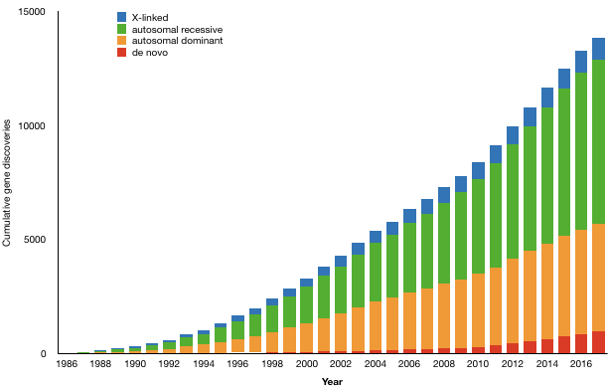
Number of genes for Mendelian conditions is growing
Estimated >10,000 rare genetic disease exist
Currently about 4,000 elucidated
Prevalence of rare diseases of 3.5–5.9%,
263–446 million persons affected globally
After Bamshad, Nickerson, Ching, AJHG, 2019

Slide 4
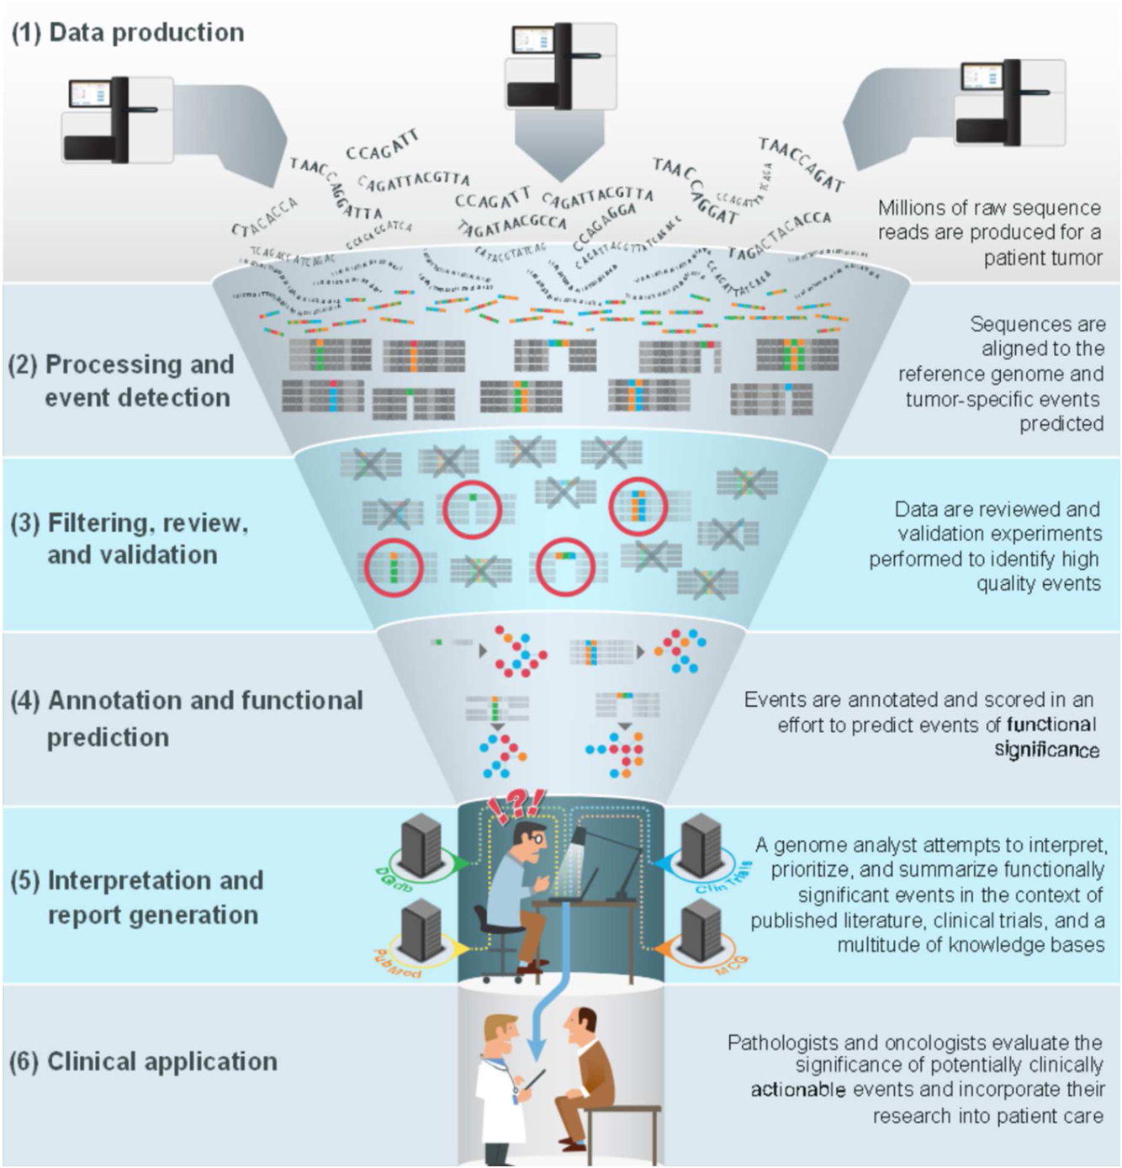

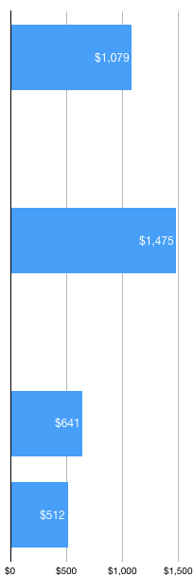
Typical Turn Around Time
26-72 h
Align
2-8 h
Call Variants
>1 h
Annotate Variants
>1 h
Interpret Variants
12-48+ h
Clinical Report
3-6 h
Adapted from: Good, B. M., Ainscough, B. J., McMichael, J. F., Su, A. I. & Griffith, O. L. Organizing knowledge to enable personalization of medicine in cancer. Genome Biology 15, 438 (2014).
Total: 2-5+ days
Adapted from: The cost and diagnostic yield of exome sequencing for children with suspected genetic disorders: a benchmarking study. Dragojlovic, et al, Genet. in Medicine, 2018.
Notes:
This is a schematic of the clinical sequencing workflow, starting with the generation of sequencing data above, down to read alignment and variant calling, variant annotation with prior knowledge, and manual assessment of the evidence of short list of candidate variants by specialized clinical geneticists, before the report can be shared the patient and doctor.
* > [advance]
A recent benchmark study provides an analysis of the cost of each of the major step in the workflow, showing that today sequencing is not the major cost driver, and that bioinformatics analysis and manual clinical review are targets for efficiency improvements.
Elaine Mardis once famously said that we could achieve the thousand-dollar genome, but that interpretation costs would dominate; this statement is still valid today, even if the price tag is lower!

Slide 5
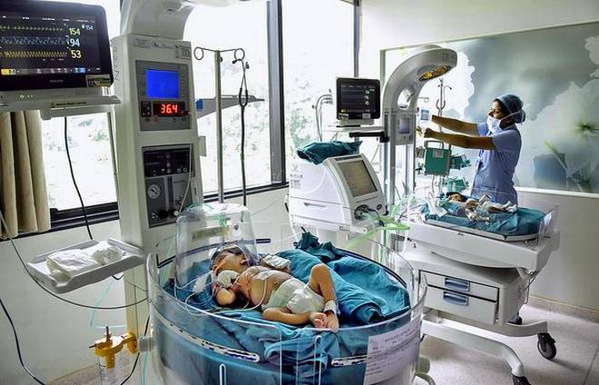
Need for rapid WGS diagnosis in the NICU
Genetic diseases are common the NICU setting
  Structural birth defects (3-5%)
  Inborn errors of metabolism (0.5%)
  Neurodevelopmental disorders (3%)
  Aneuploidy (0.3%)
Leading cause of mortality in NICU and PICU*
Disease progression can be rapid in infants
  Efficiency in interpretation is paramount – speed matters
* Smit el at, 2019; Willing et al, 2015.

Slide 6


VAAST & Phevor
Variant deleteriousness
VAAST (2011)
  The first personal genome interpretation algorithm
  Probabilistic integration of evidence
Phevor (2014)
  Integrates patient phenotypes with genetic information
  Leverages latent knowledge in biomedical ontologies
Biomedical Ontologies
A collaboration with the University of Utah

Slide 7
VAAST and Phevor prioritize candidate disease causing variants
In top 20 hits for 75% of cases
1000 Genomics England cases
Causative candidate variants n=644
450 probands with positive findings
Phevor+VAAST
Cumulative Causal Candidates (%)
VAAST
Rank Order
© Copyright 2018 Fabric Genomics Inc.
Notes:
(1) Causitive variant candidates (N=644) have been selected by expert review but have not been confirmed clinically. Data is based on positive findings for 450 families.
(2) Genes with rank >20 were not exhaustively reviewed. Support from Genomics England Tiers, ClinVar, and HGMD were evaluated independent of top 20 Phevor rank.

Slide 8
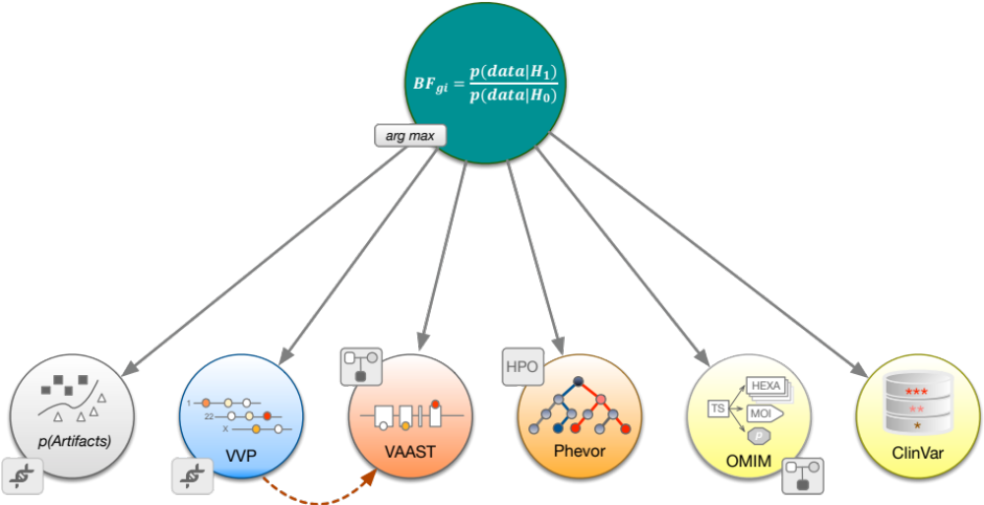
Fabric GEM – Taking VAAST & Phevor fast forward
Automatically selects best models
© 2019 Fabric Genomics, Inc. – All rights reserved

Slide 9
Fabric GEM – Bayes Factor score
A single score that summarizes the evidence, and can say ‘no’
Gene is damaged and that explains proband’s phenotype
Gene is NOT damaged
Bayesian equivalent of p-value, except ratio tells you about degree of support of the hypothesis
K | Log₁₀ K (GEM Score) | Strength of Evidence
1 to 3.2 | 0 to 0.5 | Not worth more than a bare mention
3.2 to 10 | 0.5 to 1 | Substantial
10 to 100 | 1 to 2 | Strong
> 100 | > 2 | Decisive
We will use GEM cutoff > 1
https://en.wikipedia.org/wiki/Bayes_factor

Slide 10
Fabric GEM – Spiking simulations
GEM (simulations)
Phevor+VAAST
Cumulative Causal Candidates (%)
VAAST
Rank Order
© Copyright 2018 Fabric Genomics Inc.

Slide 11
GEM – Rady Children Hospital rapid WGS cases
~54 diagnosed cases
Broad varieties:
Solos, duos, trios, and one quad
Ancestries
Mutation types
Inheritance
Phenotypes
GEM (RADY’s)
100% in top 10
84% first hit
Phevor + VAAST
Cumulative Causal Candidates (%)
VAAST
Rank Order
© Copyright 2018 Fabric Genomics Inc.

Slide 12
GEM – Rady Children Hospital rapid WGS cases
Bayes Factor > 1
~54 diagnosed cases
Broad varieties:
Solos, duos, trios, and one quad
Ancestries
Mutation types
Inheritance
Phenotypes
GEM (RADY’s)
100% in top 10
84% first hit
Phevor + VAAST
Cumulative Causal Candidates (%)
VAAST
GEM list is very short
Rank Order
© Copyright 2018 Fabric Genomics Inc.

Slide 13
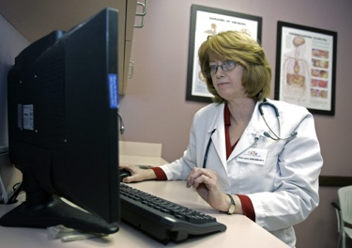
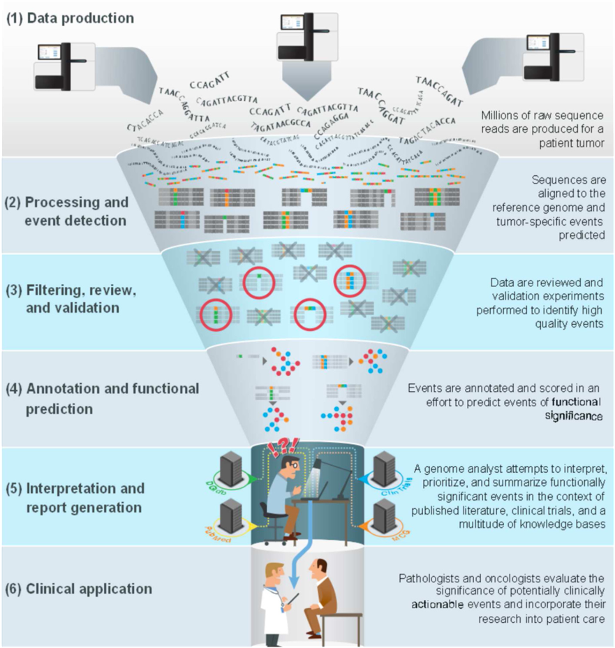



Phenotypes: Finding HPO terms is hidden time sink in the diagnostic process
+ hours, possibly days
12-48+ h
Manufacturing HPO descriptions
Requires Physician training
Time spent reviewing clinical notes
Subjective
Process and Quality hard to standardize
Must be repeated periodically for follow up analyses
HPO
Align
26-72h
Call Variants
2-8 h
>1 h
Annotate Variants
>1 h
Interpret Variants
12-48+ h
Clinical Report
3-6 h

Slide 14
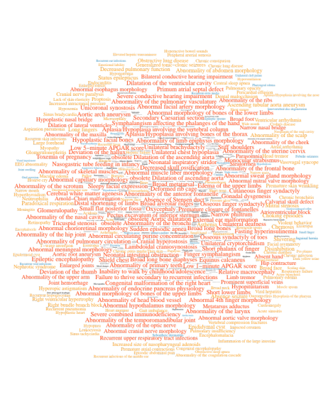
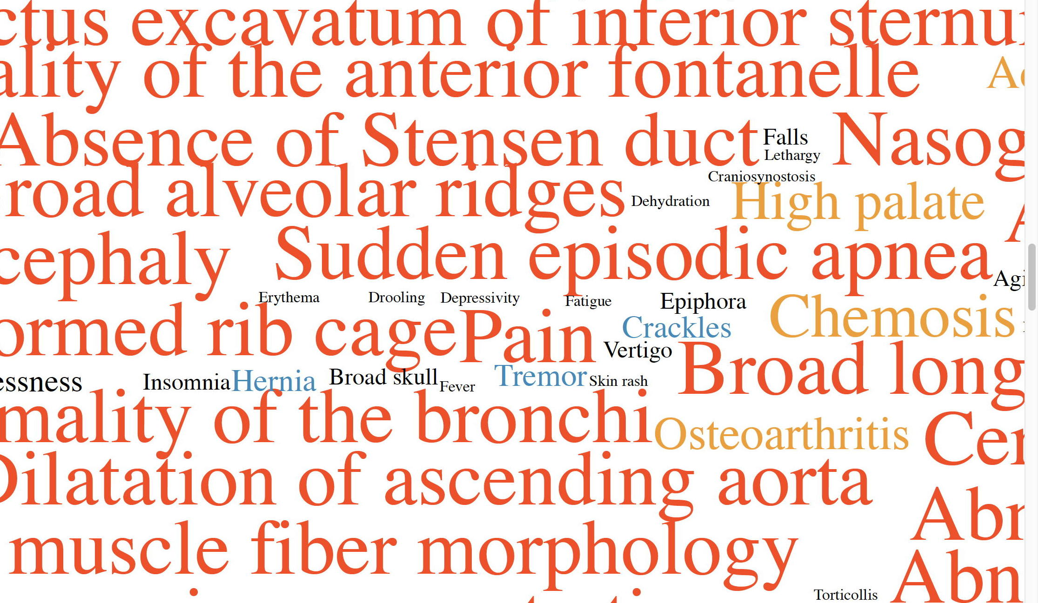
Phenotypes: Using automated descriptions
NLP pipeline
Proband’s clinic notes
HPO, SNOMED terms
Differences from manual, physician mediated process
Many, many, more terms
Error prone
Less specificity
Contradictory terms
Missing negations
Conflation of maternal with child terms
Not just a question of more terms, also a question of quality
Proband 245242
6-month Asian male
684 terms

Slide 15

GEM – Performance is best using NLP generated phenotype descriptions
Automatically generated phenotype descriptions
GEM
(Rady’scases)
98% in top 5
Phevor + VAAST
(Prior GeL cases)
Cumulative Causal Candidates (%)
VAAST
(Prior GeL cases)
Rank Order
© Copyright 2018 Fabric Genomics Inc.

Slide 16
GEM – resilient to misdiagnosis
GEM (RADY’s)
GEM (RADY’s)
100% in top 10
100% in top 15
Randomly permuted phenotype descriptions
Phevor + VAAST
Cumulative Causal Candidates (%)
VAAST
Rank Order
© Copyright 2018 Fabric Genomics Inc.

Slide 17
GEM – Rady’s undiagnosed cases
14 difficult cases with no definitive diagnosis
Included non-coding variants in analysis
Assuming parents (if available) are unaffected.
Leverage extended HPO descriptions to cast a wider net

Slide 18
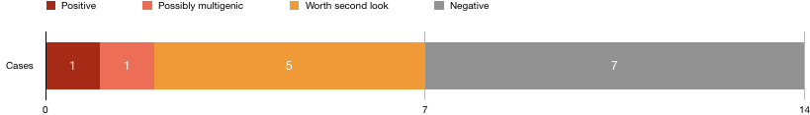
GEM – Rady’s undiagnosed cases
14 difficult cases with no definitive diagnosis
Included non-coding variants in analysis
Assuming parents (if available) are unaffected.
Leverage extended HPO descriptions to cast a wider net
GEM says No → less wasted time

Slide 19
Typical Turn Around Time
>26-72 h
Align
2-8 h
Call Variants
>1 h
Annotate Variants
>1 h
Interpret Variants
12-48+ h
Clinical Report
3-6 h
Adapted from: Good, B. M., Ainscough, B. J., McMichael, J. F., Su, A. I. & Griffith, O. L. Organizing knowledge to enable personalization of medicine in cancer. Genome Biology 15, 438 (2014).
Total: 2-5+ days

Slide 20
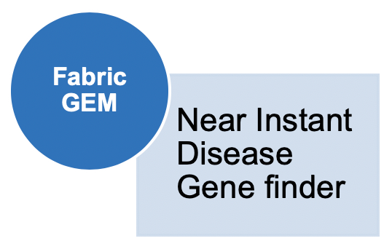
Future Turn Around Time
16-24 h
Rapid cycle
Align
~0.5 h
Hardware
acceleration
Call Variants
~0.25 h
Annotate Variants
<0.25 h
STAT Processing
Interpret Variants
<0.5 h
Clinical Report
<1 h
Adapted from: Good, B. M., Ainscough, B. J., McMichael, J. F., Su, A. I. & Griffith, O. L. Organizing knowledge to enable personalization of medicine in cancer. Genome Biology 15, 438 (2014).
Total: 18-26 hr

Slide 21


Francisco
De La Vega
Martin
Reese
Mark
Yandell
Barry
Moore
Shimul Chowdhury
Narayanan Veeraraghavan
Stephen F. Kingsmore

Slide 22
Challenges for benchmarking diagnosis methods
Synthetic spikes insufficient
  No negative spikes!
  Insufficient complexity (incomplete penetrance, phenotypes, background genetics)
Real patient cases needed:
  Genomes & Phenotypes
    Major privacy concerns
  100s of cases to cover:
    Pedigree
    Penetrance
    Inheritance
    Negative cases
Fabric Genomics is hiring

Slide 23


AI‑Driven Clinical Insights for Genomic Data

Slide 24
RCH undiagnosed analysis by GEM
Proband | Outcome | Incidental Findings | Consanguinity
243992 | Negative
240716 | Negative | yes
247963 | Negative | yes
245481 | WASL |  | yes
245237 | Positive |  | yes
245768 | Multiple Positives* |  | yes
244799 | WASL | yes
244949 END | Negative | yes
244750 | Negative
246385 | WASL | yes
247458 | WASL
248675 | Negative |  | yes
248893 | WASL
246158 | Negative
14 probands
1 Positive
1 Possible multigenic case
5 might be worth a 2nd look (WASL)
7 Decisively negative
GEM says No → less wasted time
*Consanguinity a complicating factor

Slide 25
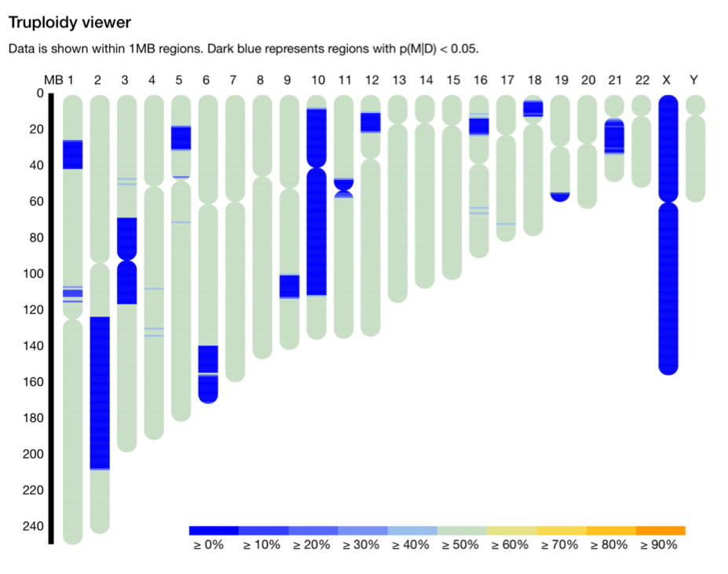
Consanguinity a complicating factor

Slide 26
Conclusions
GEM provides almost instant preliminary diagnosis of rare genetic disease
  Reduces TAT, resilient to misdiagnosis & artifacts, and can utilize automated NLP phenotypes
Reduction in interpretation has an immediate impact in overall cost
  Allows scalability of this approach to serve rare genetic disease patients (~5% of population)
These methods would allow rWGS will become routine standard of care for most acutely ill children in NICUs
  Speed and cost are paramount
Benchmarking and comparing AI-driven diagnostic methods present a number of challenges
  Synthetic spikes overly simplifies complexity (incomplete penetrance, phenotypes, background genetics)
  Need real patient genomes with phenotypes → privacy concerns

Slide 27
Rady Children Hospital rapid WGS cases
Retrospective analysis of ~100 cases from Rady’s rapid WGS Program
  Diagnosed and some undiagnosed
  Previously analyzed using VAAST+Phevor and other custom filters
Ongoing - Current analysis
  54 probands
  14 Undiagnosed probands
  Mixture of solos, duos, trios, and one quad.
  Variety of ancestries.
  Variety of mutation types, SNV, INDEL, SV
  Variety of inheritance patterns, AD, AR, XLD, XLR
  Variety of genotypes, dominant, de novo, simple recessive, compound heterozygotes
¹Farnaes L, Hildreth A, Sweeney NM, et al. Rapid whole-genome sequencing decreases infant morbidity and cost of hospitalization. NPJ Genom Med. 2018;3:10. Published 2018 Apr 4. doi:10.1038/s41525-018-0049-4

