Slide 1

CAGI slide pack guidelines
I agree to my slides being used according to the following terms: _______Kymberleigh Pagel_______
Authors: please include THIS slide at the beginning of your presentation to indicate that you agree with reuse of your slides in CAGI presentations, according to the terms below, and digitally sign by writing your name above.
To disseminate the CAGI results, I encourage all CAGI participants to remix these CAGI slides for inclusion in their oral and poster presentations
CAGI participants may use or publish any content of these slides only in compliance with the CAGI Data Use Agreement
CAGI participants may not cite or publish any content of these slides except with the written permission of the originating author or in the primary CAGI publications
CAGI participants must acknowledge the original authors of these slides and CAGI 2013. Include the acknowledgement banner across the bottom
CAGI participants must include the CAGI credits slide in their presentations
Slides with a red slash (no remix) may not be included in a presentation unless all attendees are registered CAGI participants who signed the data use agreement
Slides with a red X over the entire slide may not be used in any circumstances
Slides with a blue slash (embargoed) may not be used unless the embargo is explicitly lifted
Slides without slash or X may be tweeted unless flagged with the “No tweet” icon.
CAGI participants using these slides must explain the “No tweet” icon, which means that the slide content should not be disseminated outside the presenting conference hall. If the presentation venue permits pervasive tweeting, you may not include these slides in your talk
Note for slide authors: we expect all CAGI participants to abide by these restrictions, and will make best effort to ensure they are followed. However, but bear in mind that we have limited means of enforcing them, and therefore the restrictions cannot be guaranteed.

Slide 2
Challenge design and assessment in CAGI
Kymberleigh Pagel
Johns Hopkins University
Created for CAGI 2019
genomeinterpretation.org
Kymberleigh Pagel

Slide 3
Challenge design
Created for CAGI 2019
genomeinterpretation.org
Kymberleigh Pagel

Slide 4
Types of challenges in CAGI
For single variants
  protein activity using a variety of molecular and cellular phenotypes
  cell growth in cancer driver genes
  effect on RNA expression levels and splicing
For full exome and genome sequence
  assign complex traits phenotypes
  associate genome sequence and phenotypic traits
  identify causative variants in gene panel, exome, whole‐genome
No one-size-fits-all answers
Created for CAGI 2019
genomeinterpretation.org
Kymberleigh Pagel

Slide 5
A critical assessment of CAGI challenges
Most prediction methods are for designed for pathogenicity, but used for much more
  Have shown some ability to model aspects of underlying biology
CAGI challenges assess performance for specific tasks
Many discrete challenges, but repeated analyses (PGP, Crohn’s, etc.) allow self-improvement
Small sample sizes are an issue in both challenge types
Data quality
Created for CAGI 2019
genomeinterpretation.org
Kymberleigh Pagel

Slide 6
Ensuring data quality in CAGI Challenges
Continued high standards for challenge data, learn from past
  Experimental values are not exactly equivalent to ground truth
Q: How to overcome the limitations of experimental data?
Double-evaluate experimental data via additional (internal or external) validation of the experimental findings
If dedicated funds can be allocated to get the proper experimental data from a particular laboratory, then CAGI will have control over the data.
Created for CAGI 2019
genomeinterpretation.org
Kymberleigh Pagel

Slide 7
Maintaining the relevancy of CAGI Challenges
Larger data sets to develop more thorough and reliable methods
Longer prediction seasons for more extensive development
Simplified data access when possible -- restricts prediction season length
Novel challenges encourage developers to address new needs
  Noncoding elements, structural variation, multi-omics
Created for CAGI 2019
genomeinterpretation.org
Kymberleigh Pagel

Slide 8
Assessment
Created for CAGI 2019
genomeinterpretation.org
Kymberleigh Pagel

Slide 9
Rigorous assessment is important
Reliable ranking of predictors
Selective use of performance measures may give biased and misleading impression of tool capabilities
  Use several performance metrics
Each cycle has led to improved assessment
Assessors are providing an invaluable service
Created for CAGI 2019
genomeinterpretation.org
Kymberleigh Pagel

Slide 10
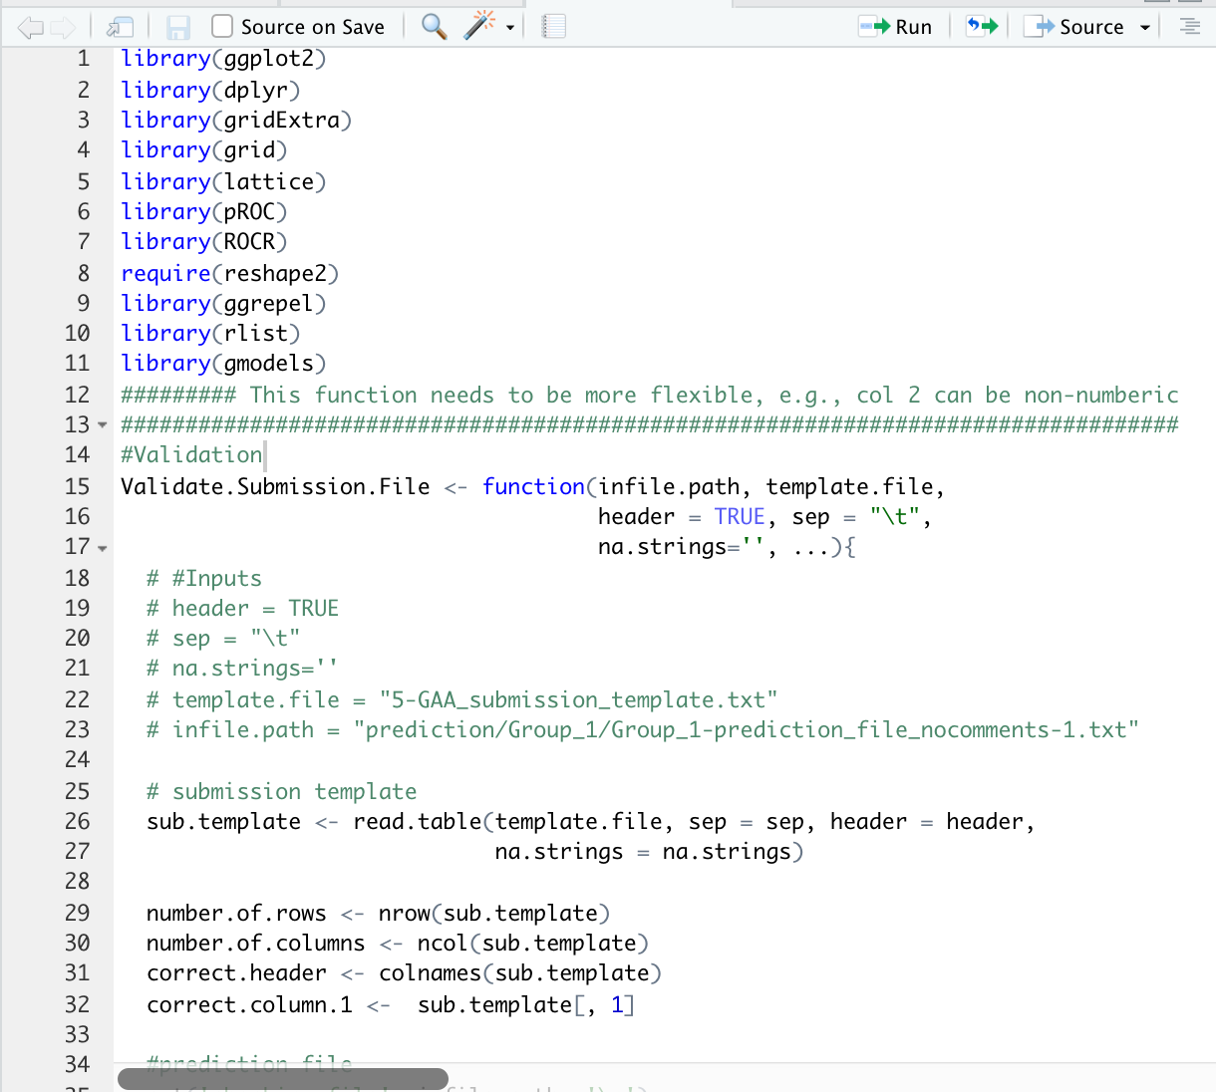
The R code
Was this R code actually used?
  Yes, for the missense challenges (e.g. GAA)
  For other challenges this code was given as a guidelines, but many assessors wrote their own scripts
~1200 lines of Rmd
Does not take into account standard baseline methods
GAA_EVAL.R
Created for CAGI 2019
genomeinterpretation.org
Kymberleigh Pagel

Slide 11
A critical assessment of CAGI assessment
Data availability – how/where to share standard assessment scripts, prediction values, methods details, and each assessor’s code/results
Q: Is there a way to house the submitted methods or require the submitters to make them available within a set time?
Many submissions reflect experimental or in-development methods,. How to set a minimum availability requirements?
  Subtle (and secret) tweaks may not want to be disclosed before results
Recommendation for version control, GitHub
Big delta between methods descriptions. Set 1-page minimum?
Created for CAGI 2019
genomeinterpretation.org
Kymberleigh Pagel

Slide 12
A critical assessment of CAGI assessment
Use of additional “baseline” methods in variant-level assessment
Q: What to do with non-participant methods?
Automatic inclusion in each relevant challenge, with a standard assessment of all (?) publicly available methods with uniform data manipulation
Necessity to inform and get involvement from developers
  Use “as is” may not be fair, tweaks and thresholds commonly used
Developers may not participate: i) the challenge is not appropriate for the method, ii) time constraints, and iii) potential for underperformance
Created for CAGI 2019
genomeinterpretation.org
Kymberleigh Pagel

Slide 13
A critical assessment of CAGI assessment
Polygenic risk scores as baseline for phenotype challenges
Q: What to do with polygenic risk scores; is there a role?
Polygenic risk scores can serve as baseline methods as well
Need existing implementations for assessment
  Or assessors can develop these in coordination with data providers
Linear sum of genotypes involved as baseline, inform predictors
Created for CAGI 2019
genomeinterpretation.org
Kymberleigh Pagel

Slide 14
A critical assessment of CAGI assessment
Need for implementation of standardized yet flexible assessment
Q: How to have more consistent assessment?
Standard evaluation toolkit that all can use - reduce assessor burden
  Minimal fixed set of measures will be used for the assessment
  Include CAGI-specific questions: Which cases were hardest to predict? How correlated were the predictors?
Informative, robust, and objective assessments is more important than consistency
Because of the fundamental differences in CAGI challenges, I cannot see a protocol that can apply to any challenge as is
Recruit the aid of statisticians or the data providers
Created for CAGI 2019
genomeinterpretation.org
Kymberleigh Pagel

Slide 15
Key Questions on Challenge
Design & Assessment
  How to overcome the limitations of experimental data?
  Is there a way to house the submitted methods or require the submitters to make them available within a set time?
  What to do with non-participant methods (baselines; new methods)?
  How to have more consistent assessment?
  What to do with polygenic risk scores; is there a role?
Created for CAGI 2019
genomeinterpretation.org
Kymberleigh Pagel

