Slide 1
Predicting Pathogenicity of Missense Variants with Weakly Supervised Regression
Yue Cao, Yuanfei Sun, Mostafa Karimi, Haoran Chen, Oluwaseyi Moronfoye and Yang Shen
Department of Electrical and Computer Engineering
Texas A&M University, College Station, TX 77843, United States.

Slide 2
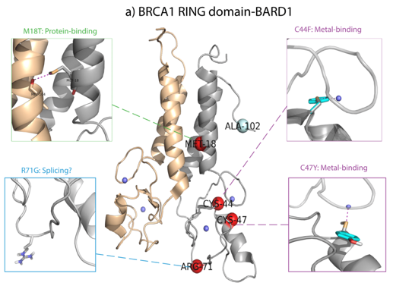
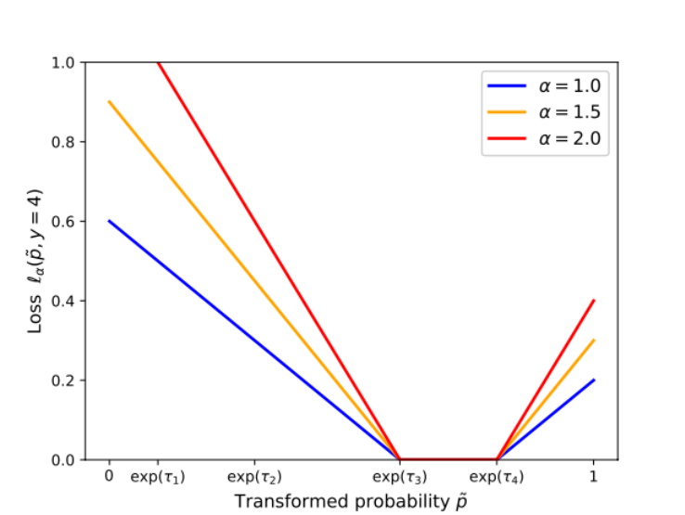
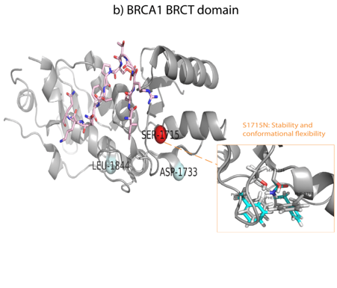
Predicting Pathogenicity of Missense Variants with Weakly Supervised Regression
Molecular-Impact Features from Mutpred2
Weakly Supervised Regression
Interpretation and Structural Modeling
Metal Binding,
Macromolecular binding,
Stability
…
Loss function

