Slide 1

CAGI slide pack guidelines
I agree to my slides being used according to the following terms: _______Author Name Here_______
Authors: please include THIS slide at the beginning of your presentation to indicate that you agree with reuse of your slides in CAGI presentations, according to the terms below, and digitally sign by writing your name above.
To disseminate the CAGI results, I encourage all CAGI participants to remix these CAGI slides for inclusion in their oral and poster presentations
CAGI participants may use or publish any content of these slides only in compliance with the CAGI Data Use Agreement
CAGI participants may not cite or publish any content of these slides except with the written permission of the originating author or in the primary CAGI publications
CAGI participants must acknowledge the original authors of these slides and CAGI 2013. Include the acknowledgement banner across the bottom
CAGI participants must include the CAGI credits slide in their presentations
Slides with a red slash (no remix) may not be included in a presentation unless all attendees are registered CAGI participants who signed the data use agreement
Slides with a red X over the entire slide may not be used in any circumstances
Slides with a blue slash (embargoed) may not be used unless the embargo is explicitly lifted
Slides without slash or X may be tweeted unless flagged with the “No tweet” icon.
CAGI participants using these slides must explain the “No tweet” icon, which means that the slide content should not be disseminated outside the presenting conference hall. If the presentation venue permits pervasive tweeting, you may not include these slides in your talk
Note for slide authors: we expect all CAGI participants to abide by these restrictions, and will make best effort to ensure they are followed. However, but bear in mind that we have limited means of enforcing them, and therefore the restrictions cannot be guaranteed.

Slide 2
What can cancer challenges teach us about genomic interpretation?
Melissa Cline
December 6, 2019
Created for CAGI 2019
genomeinterpretation.org
Melissa Cline

Slide 3
Goals of CAGI Cancer Experiments
Predict which variants increase the risk of cancer (Many Experiments)
Given mutated, inactivated p53, predict which mutations restore p53 function (CAGI2 p53)
Predict which breast cancer cell lines are responsive to which drugs (CAGI2 Pharmacogenomics)
Predict which pathogenic variants disrupt RNA splicing (CAGI3 TP53 splicing)
Created for CAGI 2019
genomeinterpretation.org
Melissa Cline

Slide 4
Goals of CAGI Cancer Experiments
Predict which variants increase the risk of cancer (Many Experiments)
Given mutated, inactivated p53, predict which mutations restore p53 function (CAGI2 p53)
Predict which breast cancer cell lines are responsive to which drugs (CAGI2 Pharmacogenomics)
Predict which pathogenic variants disrupt RNA splicing (CAGI3 TP53 splicing)
Created for CAGI 2019
genomeinterpretation.org
Melissa Cline

Slide 5
Goals of CAGI Cancer Experiments
Predict which variants increase the risk of cancer (Many Experiments)
Predict which variants impact protein function (CAGI3 p16)
Given variants observed in cancer cases and matched controls, predict which were observed in the cases (CAGI2 RAD50, CAGI5 CHEK2)
Predict the clinical significance of cancer variants (CAGI3 BRCA, CAGI5 ENIGMA)
Created for CAGI 2019
genomeinterpretation.org
Melissa Cline

Slide 6
Goals of CAGI Cancer Experiments
Predict which variants increase the risk of cancer (Many Experiments)
Predict which variants impact protein function (CAGI3 p16)
Given variants observed in cancer cases and matched controls, predict which were observed in the cases (CAGI2 RAD50, CAGI5 CHEK2)
Predict the clinical significance of cancer variants (CAGI3 BRCA, CAGI5 ENIGMA)
Created for CAGI 2019
genomeinterpretation.org
Melissa Cline

Slide 7
Embargoed
Created for CAGI 2013
genomeinterpretation.org
Silvio Tosatto

Slide 8
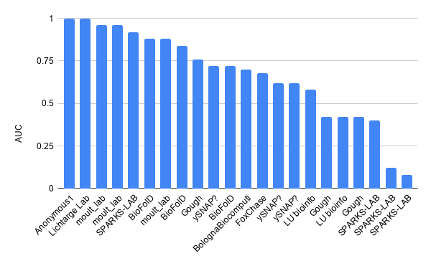
CAGI3 p16
Top methods featured a variety of approaches:
  SPARKS-LAB uses structure-based stability change
  Lichtarge Lab uses an evolutionary trace approach
  BioFolD uses SNPs&GO
Created for CAGI 2019
genomeinterpretation.org
Melissa Cline

Slide 9
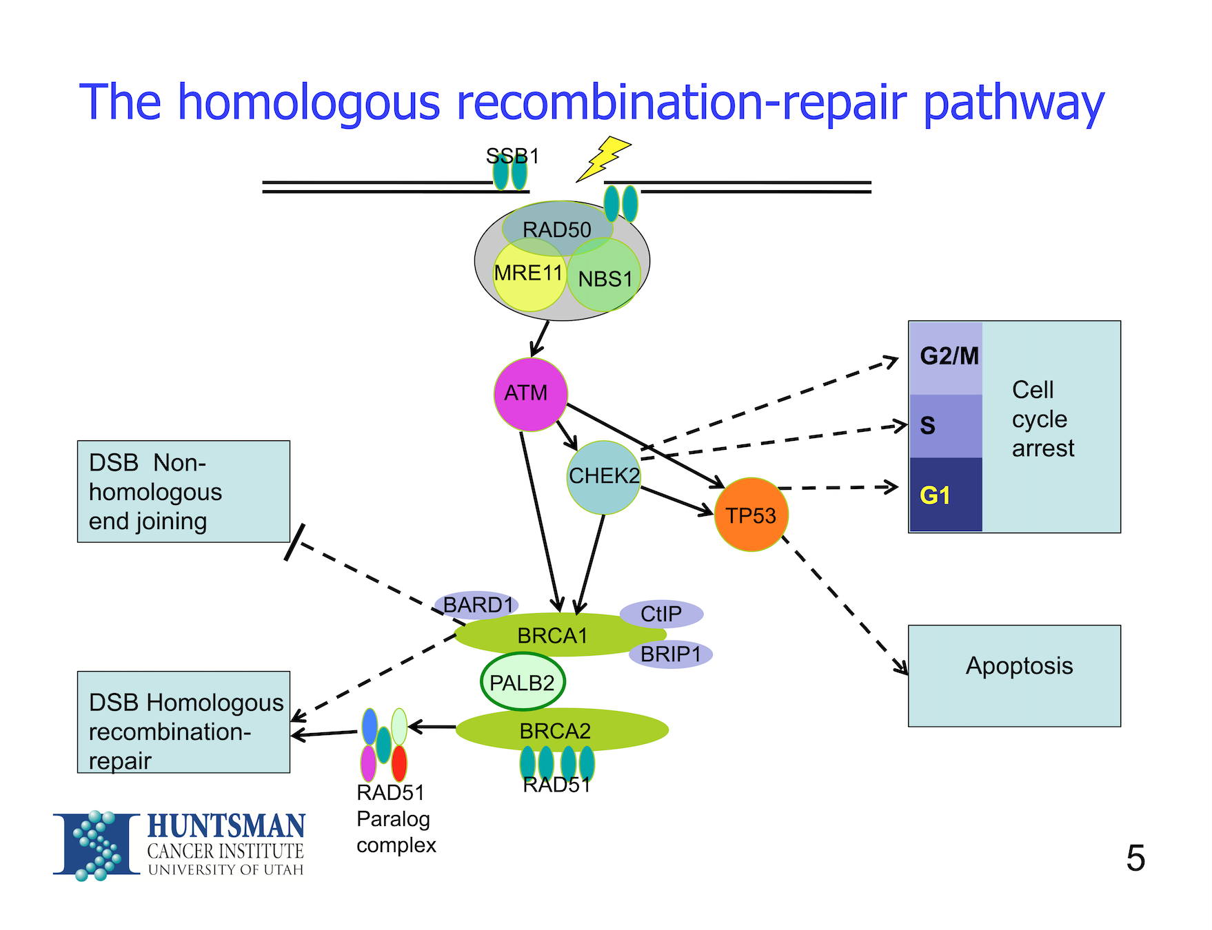
Predicting which variants came from cancer cases
Created for CAGI 2019
genomeinterpretation.org
Melissa Cline

Slide 10
Predicting which variants came from cancer cases
Created for CAGI 2019
genomeinterpretation.org
Melissa Cline

Slide 11
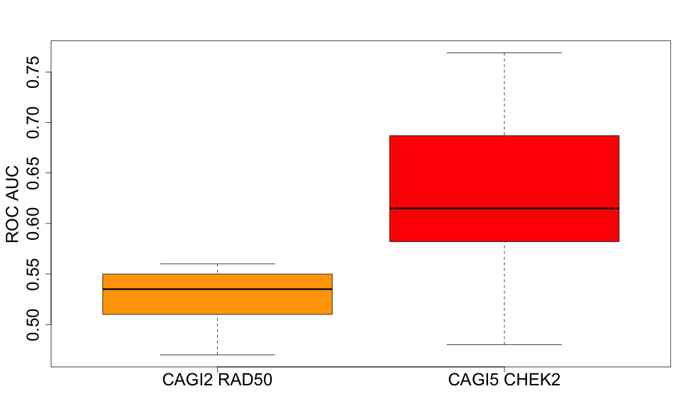
How are we faring?
Created for CAGI 2019
genomeinterpretation.org
Melissa Cline

Slide 12
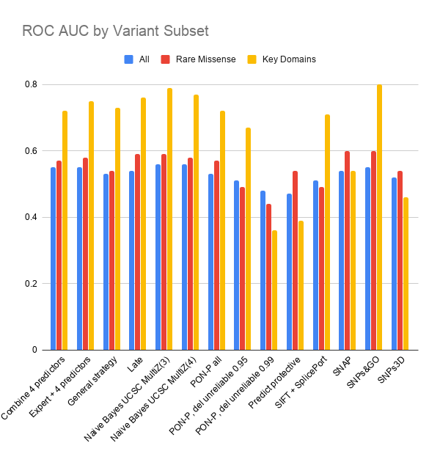
What is working well?
From the CAGI2 RAD50 assessment:
Shown: conservation offers a powerful signal
Not shown: few methods really ventured beyond missense variants.
Created for CAGI 2019
genomeinterpretation.org
Melissa Cline

Slide 13
Predicting Clinical Significance
Actual Clinical Significance is determined according to the ACMG Guidelines
Created for CAGI 2019
genomeinterpretation.org
Melissa Cline

Slide 14
Classes of Clinical Significance
By ACMG/AMP Guidelines
Pathogenic and Likely Pathogenic variants increase risk of cancer.
Benign and Likely Benign variants do not significantly affect cancer risk.
Variants of Uncertain Significance (VUS) have not yet been classified.
Created for CAGI 2019
genomeinterpretation.org
Melissa Cline

Slide 15
Assessing Clinical Significance
Reduce to two classes:
Group together Pathogenic and Likely Pathogenic
Group together Benign and Likely Benign
Omit VUS
Created for CAGI 2019
genomeinterpretation.org
Melissa Cline

Slide 16
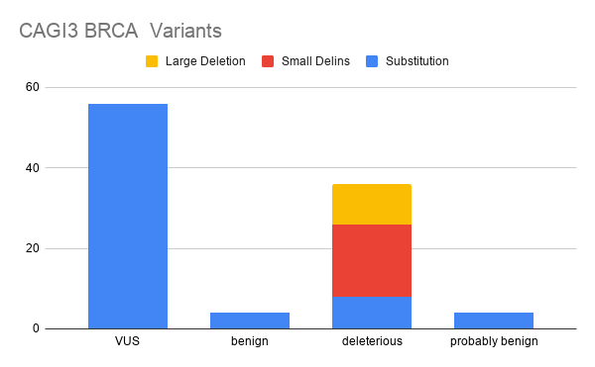
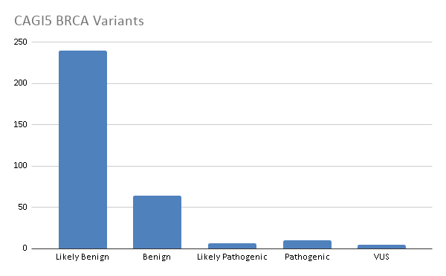
CAGI BRCA Variants
CAGI3: Most variants were either
VUS, which are not useful for assessment, or
Deletion/insertion variants, which received few predictions
CAGI5: Skewed to benign, but many more variants
Created for CAGI 2019
genomeinterpretation.org
Melissa Cline

Slide 17
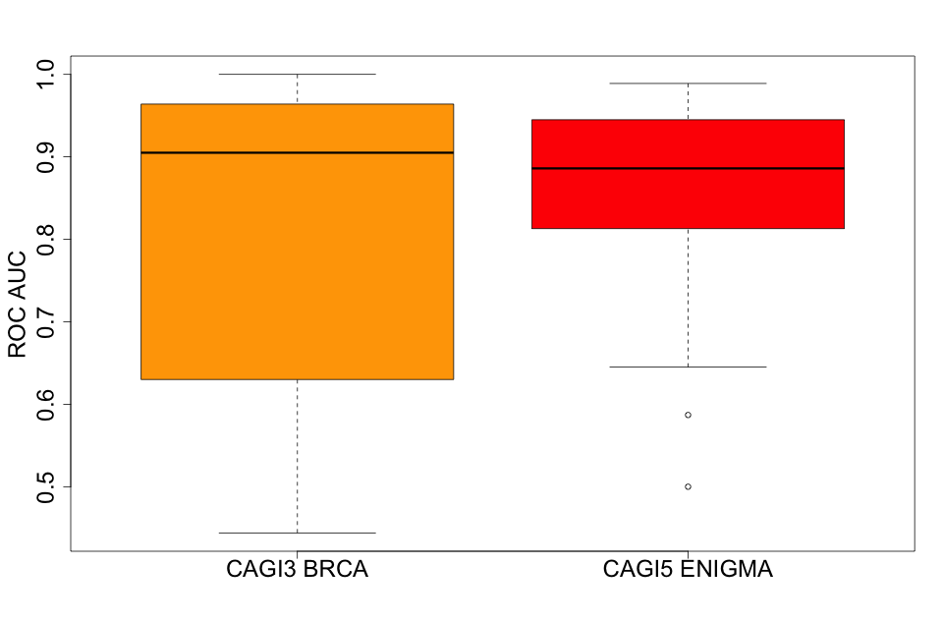
Predicting Clinical Significance
All Prediction Methods in Aggregate
Created for CAGI 2019
genomeinterpretation.org
Melissa Cline

Slide 18
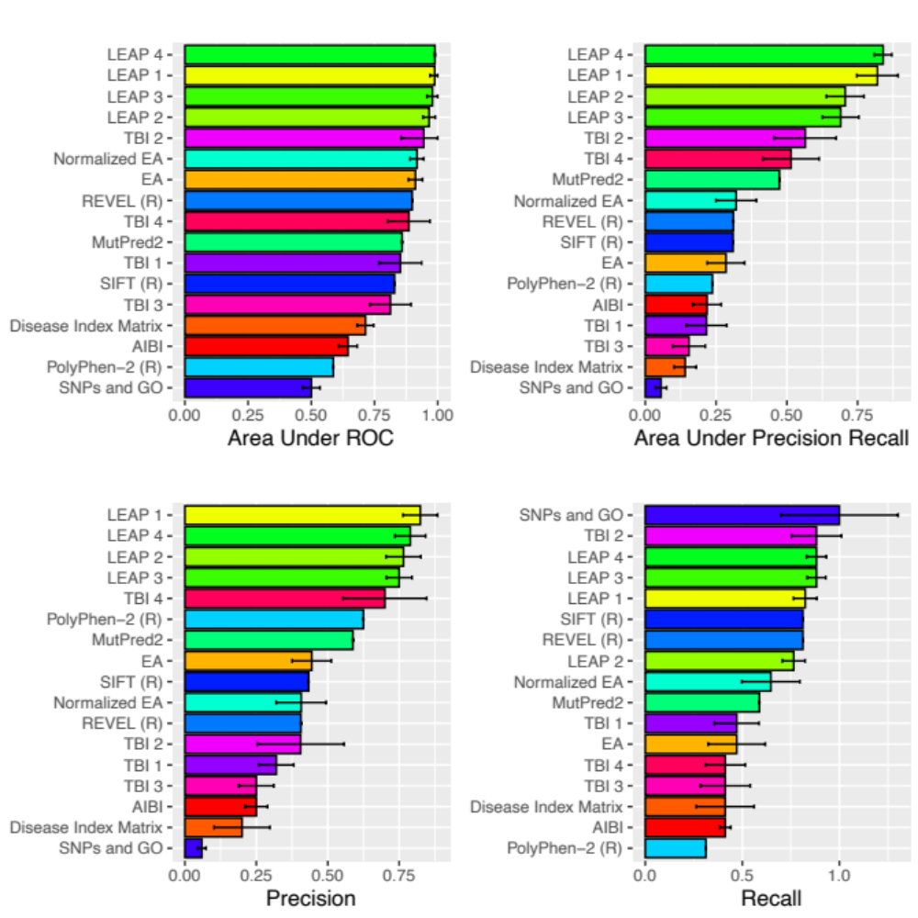
What worked well in CAGI5?
Cancer-specific methods (LEAP)
BRCA-specific methods (TBI)
Created for CAGI 2019
genomeinterpretation.org
Melissa Cline

Slide 19
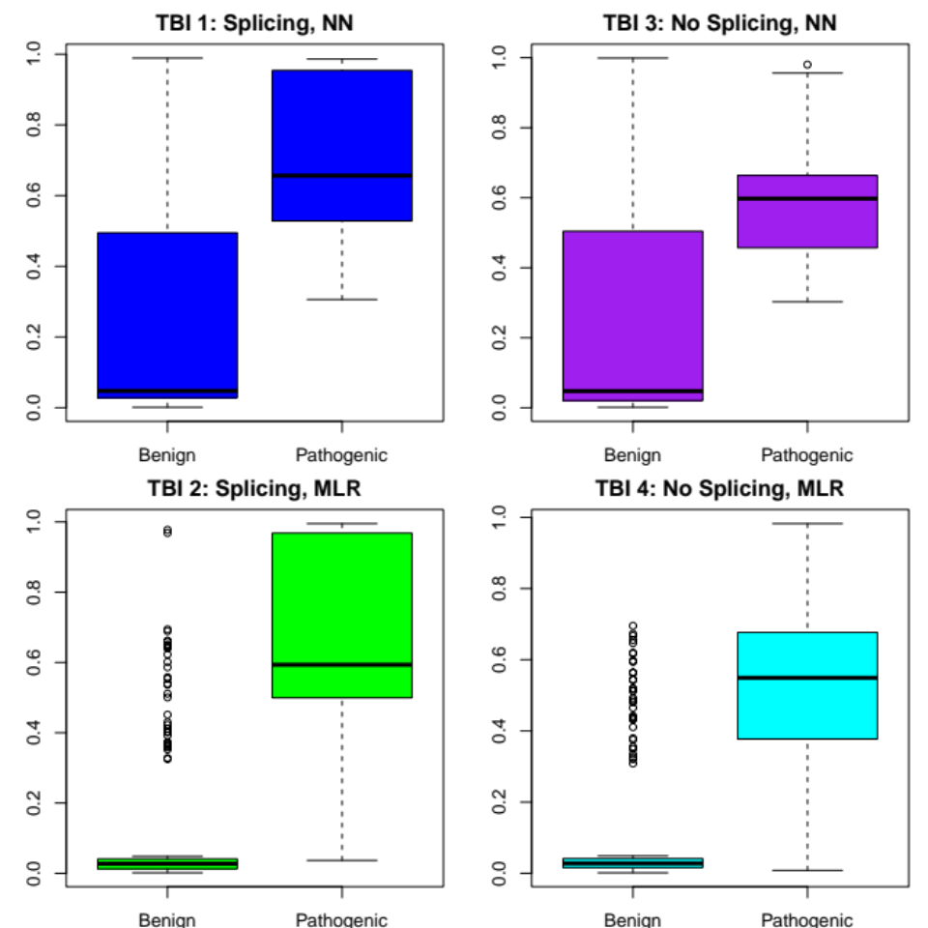
What else worked well in CAGI5?
Leveraging splicing information (TBI)
Created for CAGI 2019
genomeinterpretation.org
Melissa Cline

Slide 20
And what else helped in CAGI5?
Innovative and informative input features in LEAP:
Case-level data, especially variant co-occurrence data
Population frequency data
Literature data (HGMD)
Created for CAGI 2019
genomeinterpretation.org
Melissa Cline

Slide 21
Variant Co-occurrence
Created for CAGI 2019
genomeinterpretation.org
Melissa Cline

Slide 22
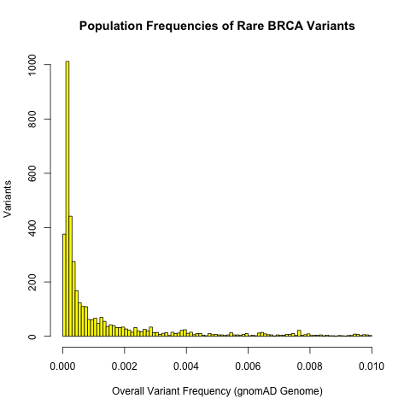
Population Frequency
Highly-rare variants are common
However, there are also many borderline-rare variants, which may be benign.
LEAP successfully leveraged such information to predict benign variants.
Created for CAGI 2019
genomeinterpretation.org
Melissa Cline

Slide 23
Scientific Literature
Few papers are written on benign variants
HGMD especially emphasizes BRCA variants
Created for CAGI 2019
genomeinterpretation.org
Melissa Cline

Slide 24
In Summary
Many methods are performing well on missense variants in conserved positions, but that’s not really addressing larger needs in variant interpretation.
Beyond conservation, there is valuable information in:
Predicted splicing impact
Co-occurring variants
Population frequency data
Indications of whether there are papers on the variant
Cancer-specific or locus-specific methods are faring especially well.
Created for CAGI 2019
genomeinterpretation.org
Melissa Cline

Slide 25
Acknowledgements
CAGI Organizers
Prediction teams, especially:
  LEAP developers, Color Genomics
  TransBioInf developers, Barcelona, Spain
Data Contributors, especially
  Amanda Spurdle, Michael Parsons, and the rest of the ENIGMA Consortium
BRCA Challenge Consortium
Created for CAGI 2019
genomeinterpretation.org
Melissa Cline

