Slide 1

CAGI slide pack guidelines
I agree to my slides being used according to the following terms: _______Lipika Ray Pal_______
Authors: please include THIS slide at the beginning of your presentation to indicate that you agree with reuse of your slides in CAGI presentations, according to the terms below, and digitally sign by writing your name above.
To disseminate the CAGI results, I encourage all CAGI participants to remix these CAGI slides for inclusion in their oral and poster presentations
CAGI participants may use or publish any content of these slides only in compliance with the CAGI Data Use Agreement
CAGI participants may not cite or publish any content of these slides except with the written permission of the originating author or in the primary CAGI publications
CAGI participants must acknowledge the original authors of these slides and CAGI 2013. Include the acknowledgement banner across the bottom
CAGI participants must include the CAGI credits slide in their presentations
Slides with a red slash (no remix) may not be included in a presentation unless all attendees are registered CAGI participants who signed the data use agreement
Slides with a red X over the entire slide may not be used in any circumstances
Slides with a blue slash (embargoed) may not be used unless the embargo is explicitly lifted
Slides without slash or X may be tweeted unless flagged with the “No tweet” icon.
CAGI participants using these slides must explain the “No tweet” icon, which means that the slide content should not be disseminated outside the presenting conference hall. If the presentation venue permits pervasive tweeting, you may not include these slides in your talk
Note for slide authors: we expect all CAGI participants to abide by these restrictions, and will make best effort to ensure they are followed. However, but bear in mind that we have limited means of enforcing them, and therefore the restrictions cannot be guaranteed.

Slide 2


CAGI Salon Topic:
Broadening Impact and Participation in CAGI
Lipika Ray Pal
Moult Group
Dec 6, 2019
Created for CAGI* 2019
genomeinterpretation.org
Lipika R. Pal

Slide 3
Broadening Impact of CAGI
Q.
How to have CAGI results be more broadly used?
Allow Predictors to submit predictions Off-season
Rolling Evaluation – continuous update of results on the site
CAGI as benchmarking standard
Consideration of security/privacy/embargo issues
Only applicable for single gene challenges at this moment
Created for CAGI* 2019
genomeinterpretation.org
Lipika R. Pal

Slide 4
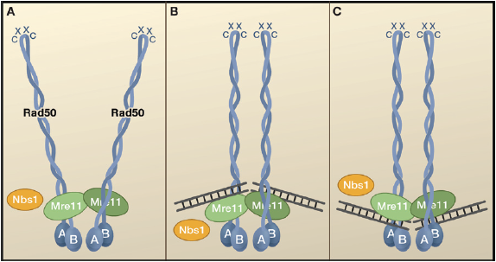
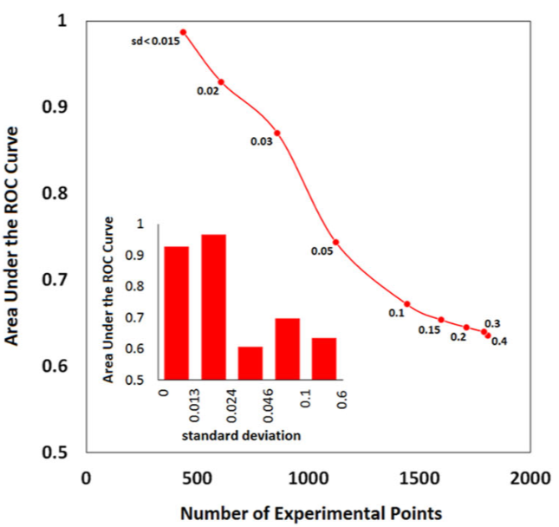
Broadening Impact of CAGI
Yin et al, 2017
Q.
How can we decrease the gap between our predictions and clinical usefulness?
CBS Challenge
Experimental data from model organism may not always match with the predictions based on human sequence
RAD50-MRN challenge
Gene specific or domain specific model is necessary
Katsonis et al, 2019
Created for CAGI* 2019
genomeinterpretation.org
Lipika R. Pal

Slide 5
Broadening Impact of CAGI
How do we make CAGI more visible in the user and predictor communities?
How to recognize participants (papers, letters of support etc.)?
Q.
CAGI4 Special issue
CAGI5 Special issue
Need CAGI FlagShip paper
Use of social media - Twitter
Literature survey
Created for CAGI* 2019
genomeinterpretation.org
Lipika R. Pal
5

Slide 6
Participation in CAGI
Q.
How to engage those who actually analyze exomes/whole genomes?
Challenges should be relevant
Artificially constructed challenges
Lack of appropriate set of data
Proper validation of the data
Created for CAGI* 2019
genomeinterpretation.org
Lipika R. Pal
6

Slide 7
Participation in CAGI
How to widen participation from the predictor community?
How can we facilitate the application of Deep Learning in genome interpretation?
Can we design the challenges in that line, or can we engage Deep Learning related persons in this endeavor?
Q.
Publications – advertisement in appropriate venues
Good assessment protocol – standard evaluation and rolling evaluation
Announcing ahead of time about the challenges to the appropriate research groups
Deep learning specific challenges
Provide larger training data
7
Created for CAGI* 2019
genomeinterpretation.org
Lipika R. Pal

Slide 8
Participation in CAGI
  Can we invite some leading companies and leading academic groups in the field and let them express their opinion about CAGI – how can we maximize participation from them?
Q.
Panel discussion from leading companies in the field
Industry people as data provider
Concern: Industry with larger resources
Created for CAGI* 2019
genomeinterpretation.org
Lipika R. Pal
8

Slide 9
Participation in CAGI
Q.
  How to better support non-PIs and career opportunities?
Job Board
Increase communications between groups
Created for CAGI* 2019
genomeinterpretation.org
Lipika R. Pal
9

Slide 10
Relevant Challenges & announcements ahead of time
Good Assessment
Protocol + CAGI Gold standard validation set
Publications & use of social media
Off-season submissions & Rolling evaluation
CAGI conferences + Job Board
Successful
CAGI
Created for CAGI* 2019
genomeinterpretation.org
Lipika R. Pal
10

