Slide 1

CAGI slide pack guidelines
I agree to my slides being used according to the following terms:
_______Justin Delano_______
Authors: please include THIS slide at the beginning of your presentation to indicate that you agree with reuse of your slides in CAGI presentations, according to the terms below, and digitally sign by writing your name above.
To disseminate the CAGI results, I encourage all CAGI participants to remix these CAGI slides for inclusion in their oral and poster presentations
CAGI participants may use or publish any content of these slides only in compliance with the CAGI Data Use Agreement
CAGI participants may not cite or publish any content of these slides except with the written permission of the originating author or in the primary CAGI publications
CAGI participants must acknowledge the original authors of these slides and CAGI 2013. Include the acknowledgement banner across the bottom
CAGI participants must include the CAGI credits slide in their presentations
Slides with a red slash (no remix) may not be included in a presentation unless all attendees are registered CAGI participants who signed the data use agreement
Slides with a red X over the entire slide may not be used in any circumstances
Slides with a blue slash (embargoed) may not be used unless the embargo is explicitly lifted
Slides without slash or X may be tweeted unless flagged with the “No tweet” icon.
CAGI participants using these slides must explain the “No tweet” icon, which means that the slide content should not be disseminated outside the presenting conference hall. If the presentation venue permits pervasive tweeting, you may not include these slides in your talk
Note for slide authors: we expect all CAGI participants to abide by these restrictions, and will make best effort to ensure they are followed. However, but bear in mind that we have limited means of enforcing them, and therefore the restrictions cannot be guaranteed.

Slide 2
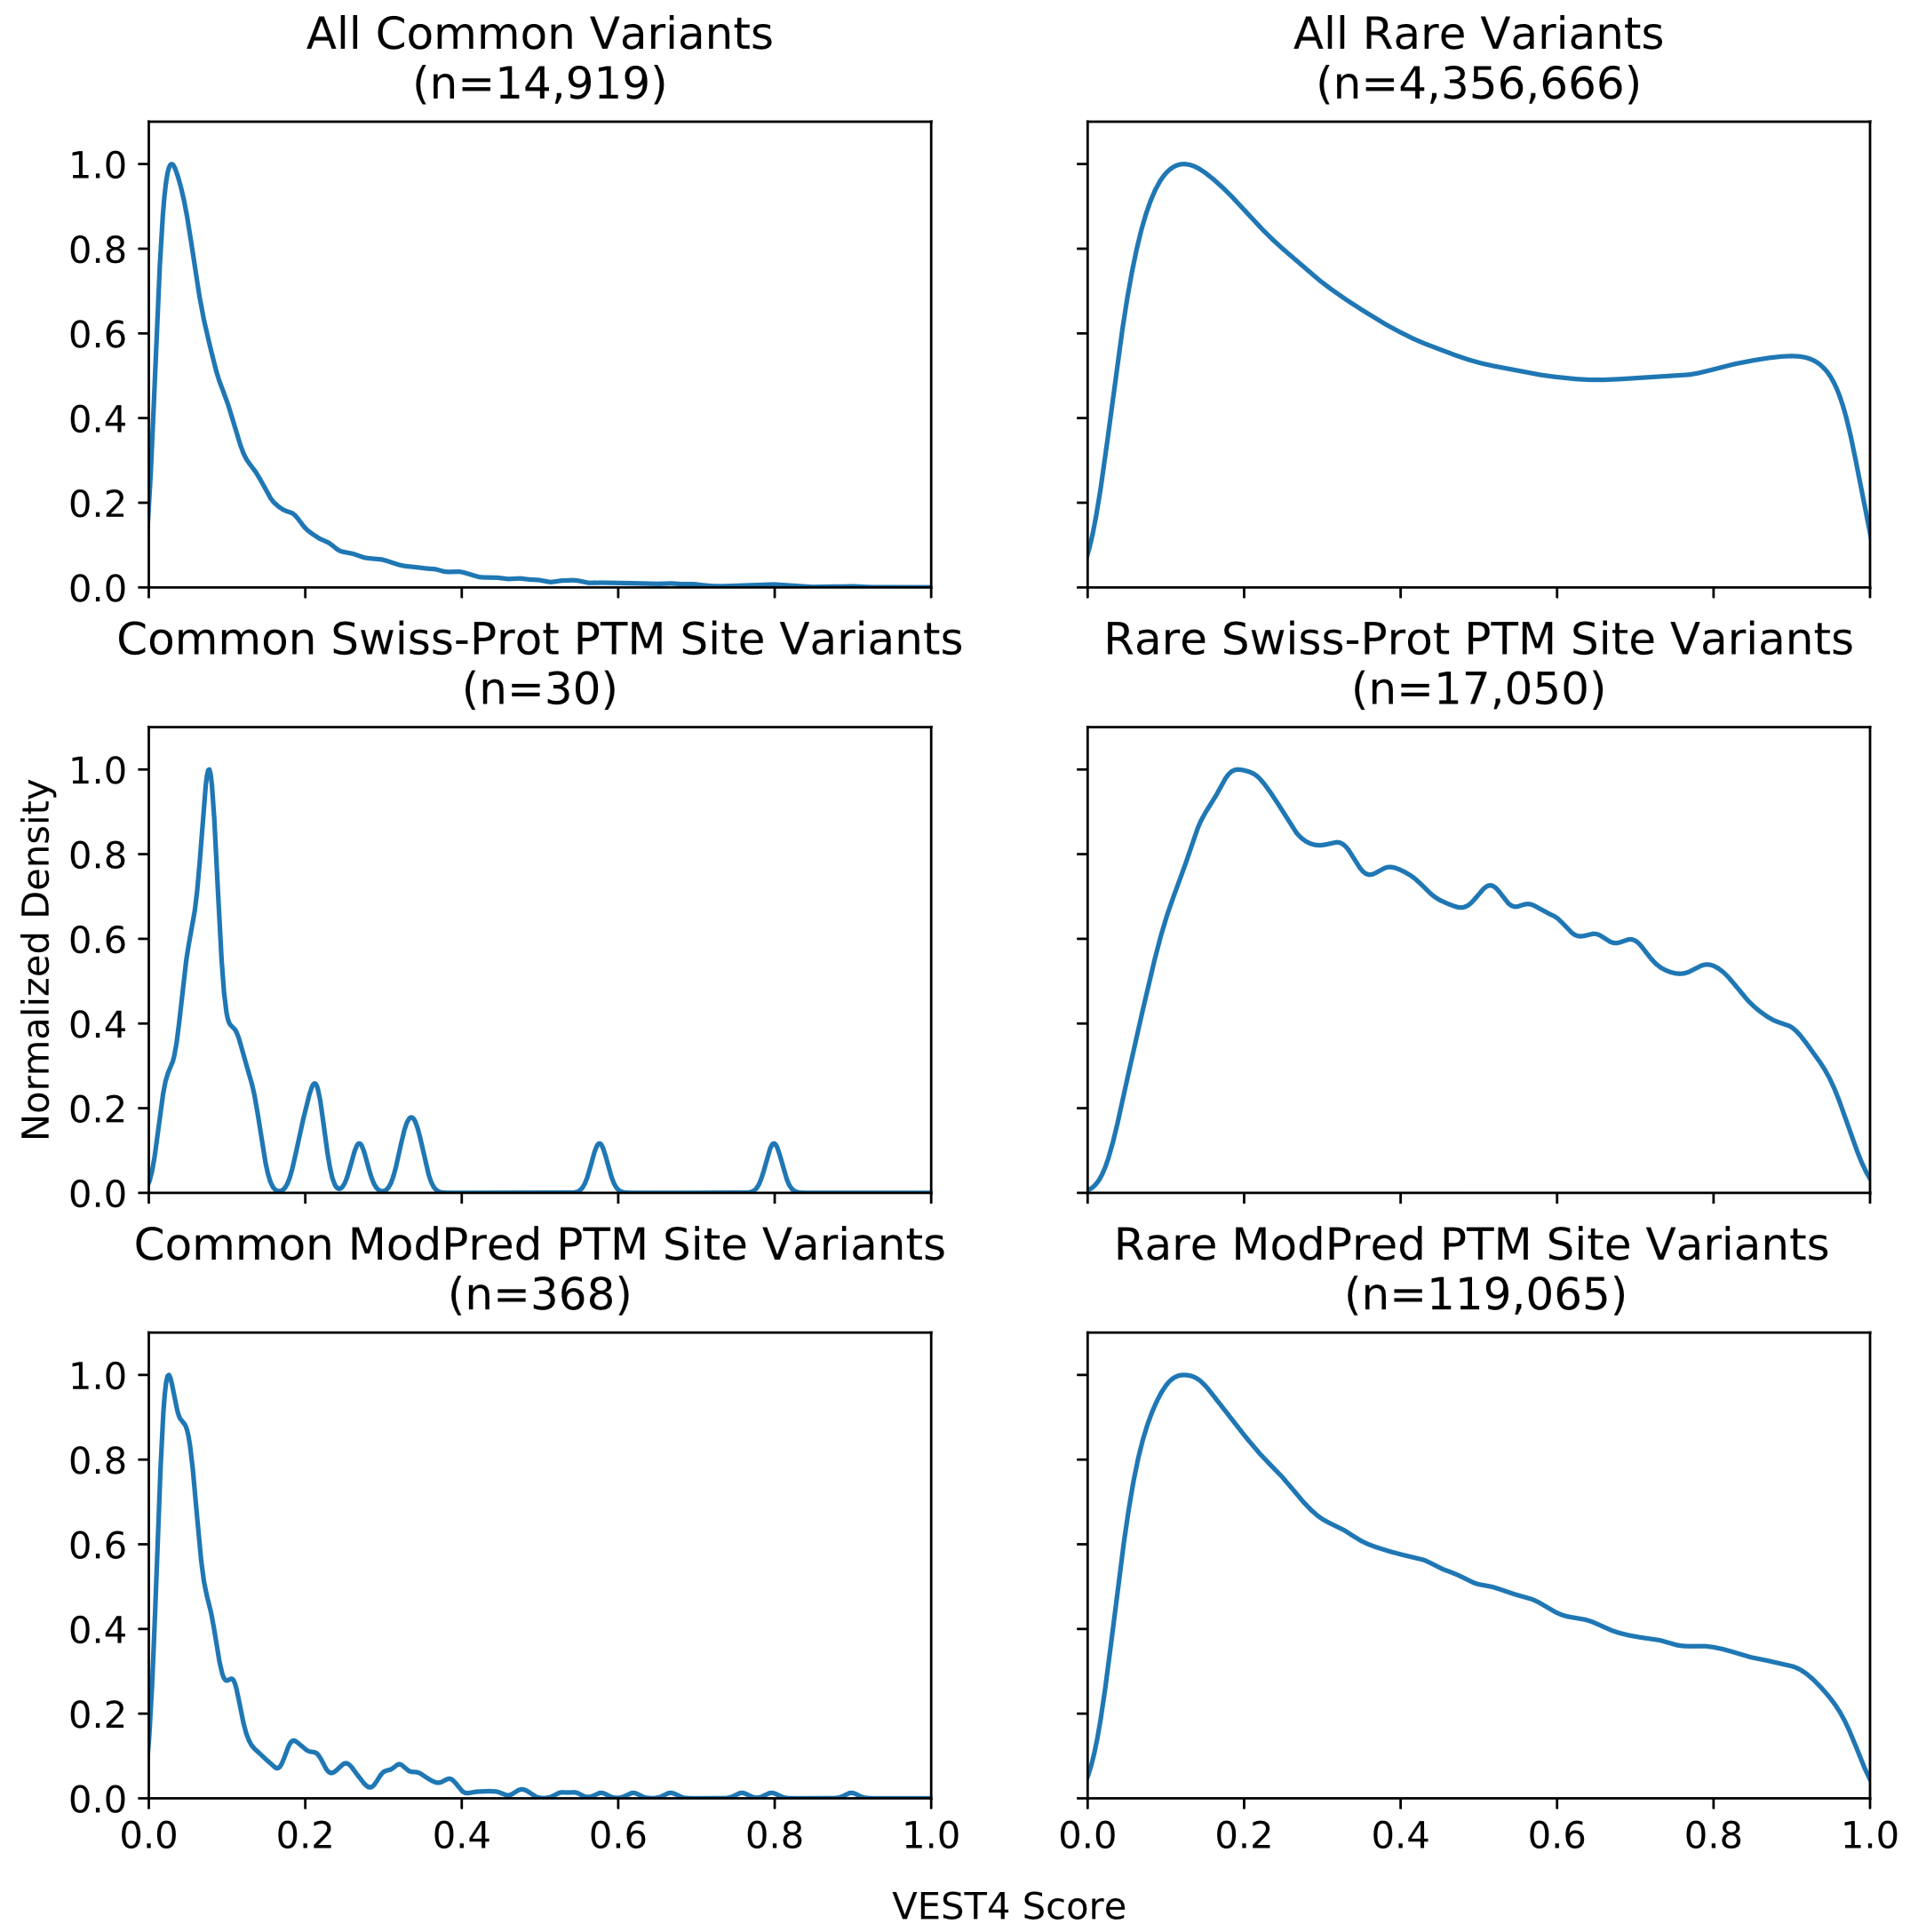
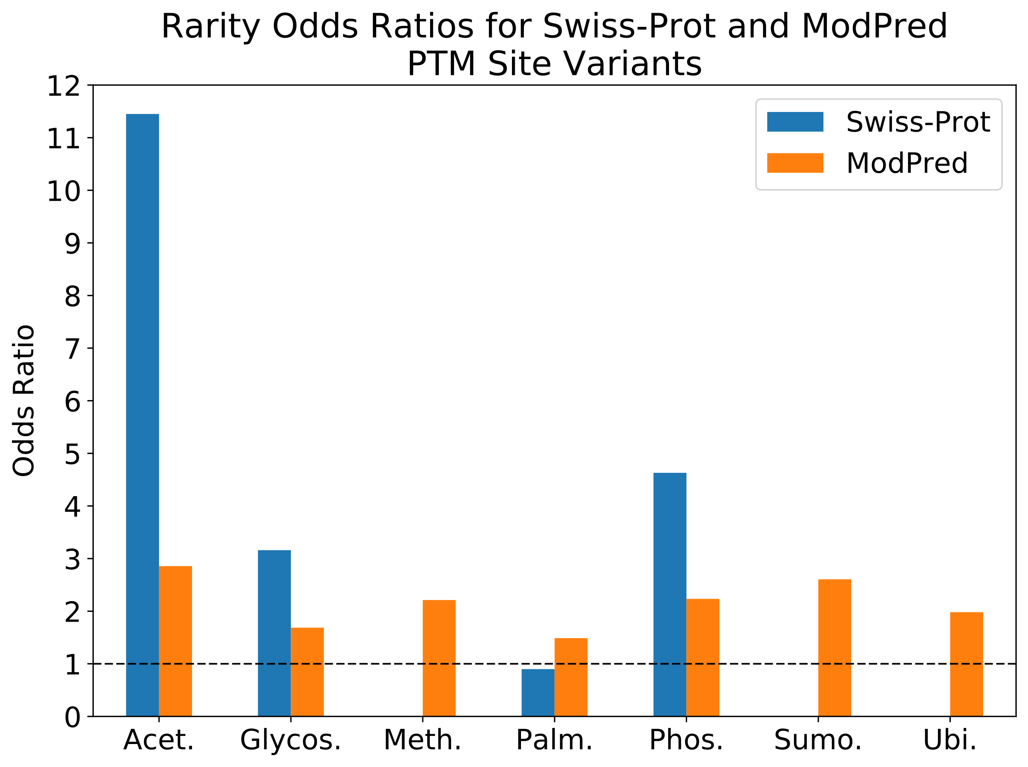
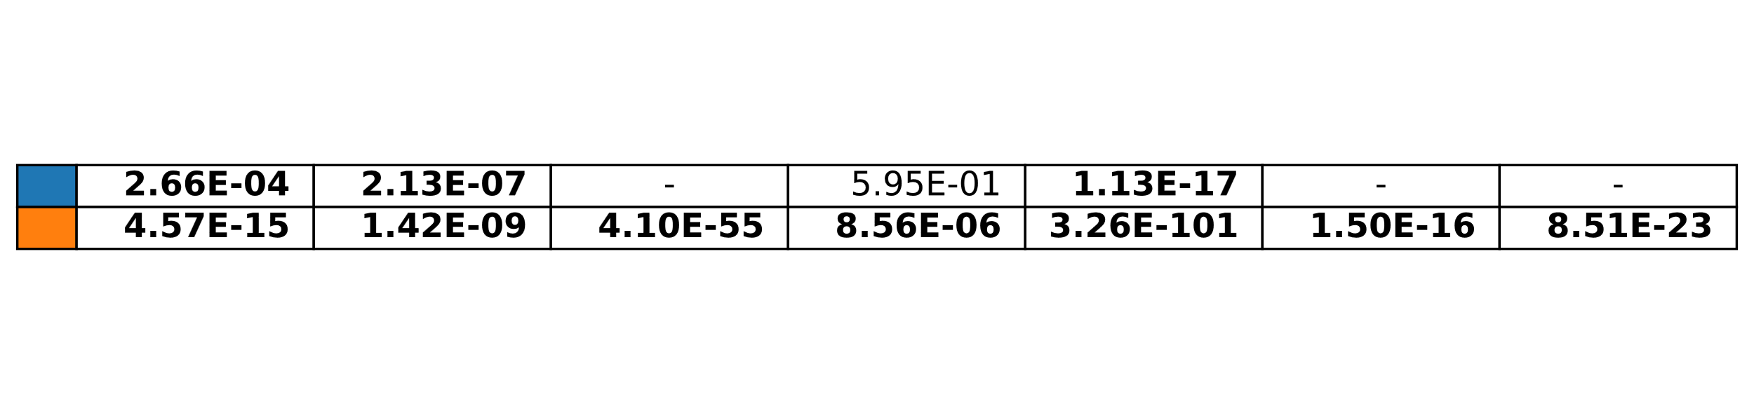
The impact of missense human variation on post-translational modifications in proteins
Justin Delano, Predrag Radivojac, Northeastern University, Boston, Massachusetts, U.S.A.
Objective: Understand molecular events impacted by genomic variation among healthy humans.
Data Sources: gnomAD, Swiss-Prot
Methods: Use computational tools to predict impact of variants and PTMs
Conclusions: PTM sites: Are preferentially impacted by rare variation.
Likely underlie phenotypic differences among healthy humans.
 | Common SNVs | Rare SNVs
Default Filtered gnomAD | 95,737 | 14,105,101
Depth Filtered gnomAD | 84,407 | 11,825,211
Depth Filtered and Swiss-Prot Annotated | 34 | 20,608
Depth Filtered and ModPred Annotated | 517 | 148,541
Depth Filtered, Swiss-Prot Annotated, and ModPred Annotated | 12 | 7,875

