Slide 1

CAGI slide pack guidelines
I agree to my slides being used according to the following terms: _______Lipika Ray Pal_______
Authors: please include THIS slide at the beginning of your presentation to indicate that you agree with reuse of your slides in CAGI presentations, according to the terms below, and digitally sign by writing your name above.
To disseminate the CAGI results, I encourage all CAGI participants to remix these CAGI slides for inclusion in their oral and poster presentations
CAGI participants may use or publish any content of these slides only in compliance with the CAGI Data Use Agreement
CAGI participants may not cite or publish any content of these slides except with the written permission of the originating author or in the primary CAGI publications
CAGI participants must acknowledge the original authors of these slides and CAGI 2013. Include the acknowledgement banner across the bottom
CAGI participants must include the CAGI credits slide in their presentations
Slides with a red slash (no remix) may not be included in a presentation unless all attendees are registered CAGI participants who signed the data use agreement
Slides with a red X over the entire slide may not be used in any circumstances
Slides with a blue slash (embargoed) may not be used unless the embargo is explicitly lifted
Slides without slash or X may be tweeted unless flagged with the “No tweet” icon.
CAGI participants using these slides must explain the “No tweet” icon, which means that the slide content should not be disseminated outside the presenting conference hall. If the presentation venue permits pervasive tweeting, you may not include these slides in your talk
Note for slide authors: we expect all CAGI participants to abide by these restrictions, and will make best effort to ensure they are followed. However, but bear in mind that we have limited means of enforcing them, and therefore the restrictions cannot be guaranteed.

Slide 2



Evolution of CAGI Over Four Rounds: Computational Challenges in
Analyzing Next Generation
Sequencing Data
Lipika Ray Pal
Moult Group
Dec 6, 2019
Created for CAGI* Workshop 2019
genomeinterpretation.org
Lipika R. Pal

Slide 3
Crohn’s Exome – 2011, 2013, 2016
Hopkins challenge &
Intellectual Disability panel
CAGI NGS Challenges
Gene Panel data: Mendelian and complex disorders
Whole Exome Sequencing data: Mendelian disorders
Whole Exome sequencing data: Complex disorders
Whole Genome Sequencing data: Rare Pediatric disease
Mouse Exome & FCH, HA challenge
SickKids4 & SickKids5
Created for CAGI* Workshop 2019
genomeinterpretation.org
Lipika R. Pal

Slide 4
Key Factors:
Data Quality
Methodology Used
Created for CAGI* Workshop 2019
genomeinterpretation.org
Lipika R. Pal

Slide 5
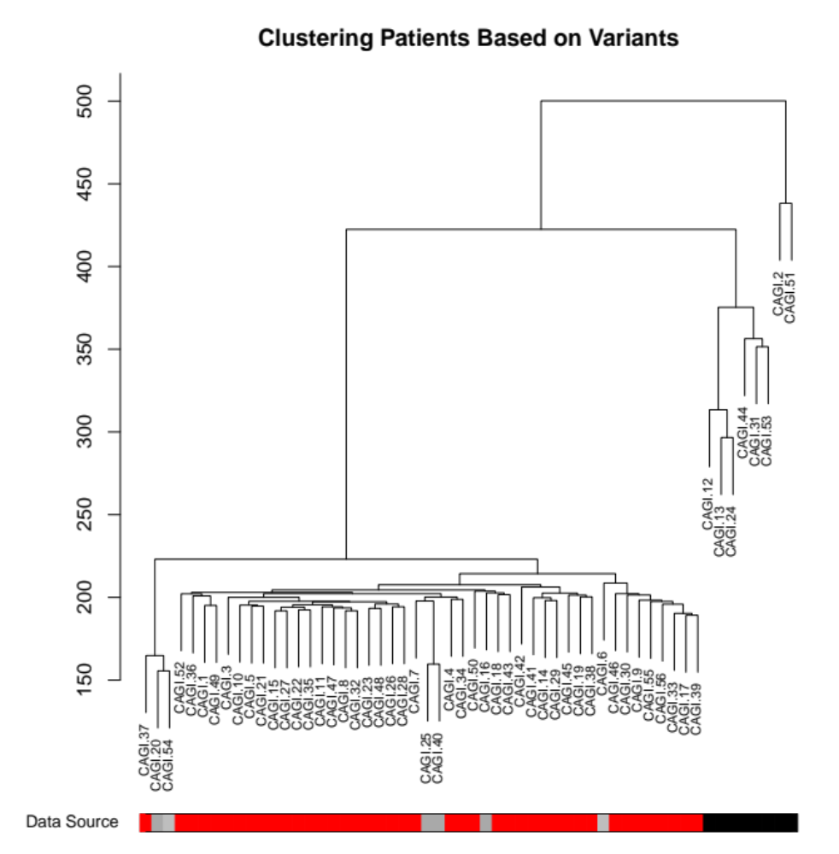
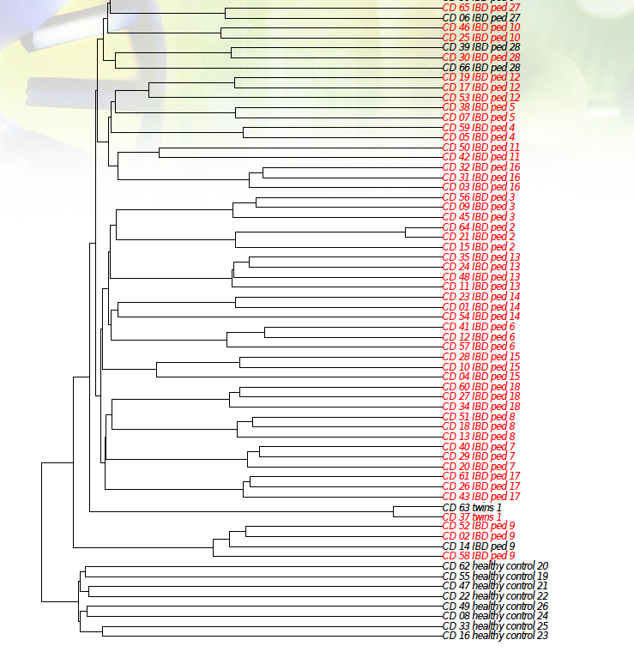
Identify Crohn’s disease patients from healthy individuals
Created for CAGI* Workshop 2019
genomeinterpretation.org
Lipika R. Pal

Slide 6
Comparison with 1000 genome novel SNVs in exonic region:
Population | Novel SNVs count
SickKids4 25 patients | 1800 (average) per individual
1000 genome EUR | 180 (maximum)
1000 genome AFR | 300 (maximum)
Created for CAGI* Workshop 2019
genomeinterpretation.org
Lipika R. Pal

Slide 7


Crohn’s exome challenge:
?
Data Provided by
Dr. Andre Franke,
Kiel, Germany
Created for CAGI* Workshop 2019
genomeinterpretation.org
Lipika R. Pal

Slide 8
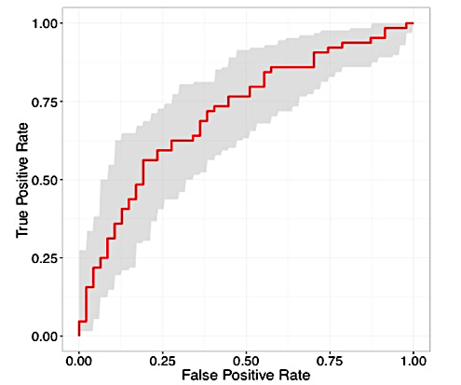
Methodology for Crohn’s challenges:
Linear Risk Scores based on impact variants in Exomes only
Exome Sequencing data
Imputation of GWAS markers
Naïve Bayes
Machine learning methods
Annotation by VARANT
Rare variants
ROC curve for the best performing CAGI4 Naïve Bayes model (conditional probability based) prediction with an AUC of 0.72. The shaded grey area shows the 95% confidence range.
140 loci
90 loci
140 loci
90 loci
90 loci
Created for CAGI* Workshop 2019
genomeinterpretation.org
Lipika R. Pal

Slide 9
Exome data: Mendelian disorders
Identify causative variants
OMIM
Coding region Mechanisms
Missense, Nonsense, Indel, Splicing
Match clinical profile with genotypic profile
Linear Risk Score
Disease Phenotype specific Selected gene list
Search for Impact variant in Coding region
Match with Pedigree, Inheritance pattern
Causative Variant(s)
Exome data
Variant Annotation
Quality Control
Consensus prediction for Missense variants
Created for CAGI* Workshop 2019
genomeinterpretation.org
Lipika R. Pal

Slide 10
SickKids Clinical challenge:
Data Provided by
Dr. Stephen Meyn,
SickKids Genome
Clinic, Toronto
Phenotypic profile
Genotypic profile
Causative variants for each individual
?
A
B
C
D
E
1001
1002
1003
1004
1005
?
Created for CAGI* Workshop 2019
genomeinterpretation.org
Lipika R. Pal

Slide 11
Whole Genome data: SickKids4
Identify causative variants for Rare Pediatric Disease
HPO, dbNSFP
Coding region Mechanisms
Clinical, Missense, Nonsense, Indel, Splicing
Match based on the degree of overlap of the OMIM disease description for the gene and patient’s phenotypes
Disease Phenotype specific Selected gene list
Search for Impact rare variants in whole genome
Match with Pedigree, Inheritance pattern, OMIM disease description
Causative Variant(s)
Whole Genome data
Variant Annotation
Quality Control
Consensus prediction for Missense variants
Created for CAGI* Workshop 2019
genomeinterpretation.org
Lipika R. Pal

Slide 12
Case Study 1: C2 Novel variant with Probable match with disease description
Genome_id | Gender | Phenotype_id | Chr:Pos:Ref:Alt | Gene | Inheritance pattern
1025 | F | H | 5:36985082:T:TA | NIPBL | AD
Clinical Symptoms of patient:
Decreased body weight, short stature, microcephaly, micrognathia, Brachycephaly, low posterior hairline, upslanted palpebral fissure, oculomotor apraxia; microtia, low-set ears,
speech apraxia, cutis marmorata, hypoplastic fifth toenail.
Mechanism | Frameshift Insert
OMIM disease | Cornelia de Lange syndrome 1
HP:0000248 | Brachycephaly
HP:0000965 | Cutis marmorata
HP:0002162 | Low posterior hairline
HP:0000369 | Low-set ears
HP:0000252 | Microcephaly
HP:0000347 | Micrognathia
HP:0004322 | Short stature
Phenotype agreement | short stature, dysmorphic features, microcephaly
Confidence | Probable match
✔
✔
✔
✔
✔
✔
✔
✔
✔
✔
“Cornelia de Lange syndrome is characterized by slow growth before and after birth leading to short stature; intellectual disability that is usually moderate to severe. This syndrome also have distinctive facial features, including arched eyebrows, low-set ears. Additional signs and symptoms of this syndrome can include an unusually small head (microcephaly), hearing loss.”
Ref: https://ghr.nlm.nih.gov/condition/cornelia-de-lange-syndrome
✔
✔
✔
✔
Created for CAGI* Workshop 2019
genomeinterpretation.org
Lipika R. Pal

Slide 13
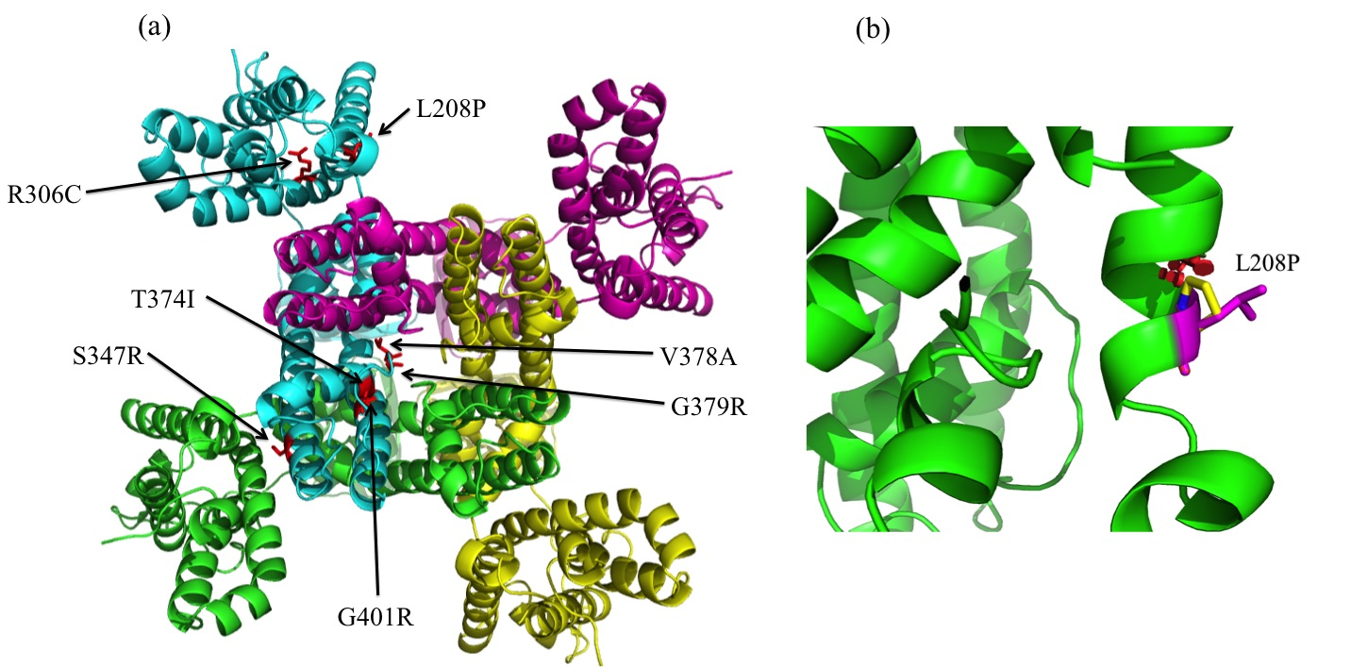
KCNB1 - potassium voltage-gated channel subfamily B member 1
Epileptic Encephalopathy
PDB model: 2R9R_B
Created for CAGI* Workshop 2019
genomeinterpretation.org
Lipika R. Pal

Slide 14
Whole Genome data: SickKids5
Identify Disease class and match paired profiles for 3 Rare Pediatric Diseases
+ Noncoding
HPO, dbNSFP, RetNet
Coding region Mechanisms
Clinical, Missense, Nonsense, Indel, Splicing
phenotype-gene matching algorithm using weighted HPO terms
Disease Phenotype specific Selected gene list
Search for Impact rare variants in whole genome
Match with Pedigree, Inheritance pattern, OMIM disease description
Causative Variant(s)
Whole Genome data
Variant Annotation
Quality Control
Consensus prediction for Missense variants
Coding & Noncoding
Identification of correct genome/clinical profile matches for 21% cases
Created for CAGI* Workshop 2019
genomeinterpretation.org
Lipika R. Pal

Slide 15
Take Home Message:
    Data quality checking is mandatory.
    Prediction of disease risk of Crohn’s disease only from exome sequencing data is not working. Can we get better clinical data or additional omics data, like microbiome data?
    We need a better predictive method for non-coding variants in whole genome sequencing data for rare pediatric diseases. Can CAGI eQTL and splicing methods be applicable here?
Created for CAGI* Workshop 2019
genomeinterpretation.org
Lipika R. Pal
Notes:
Clinical data and additional microbiome data

Slide 16
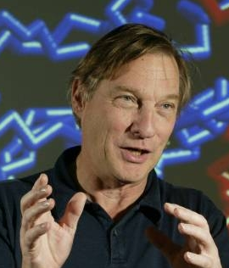
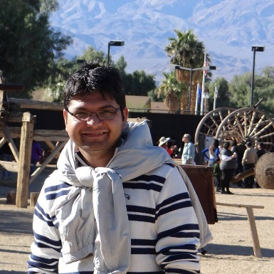
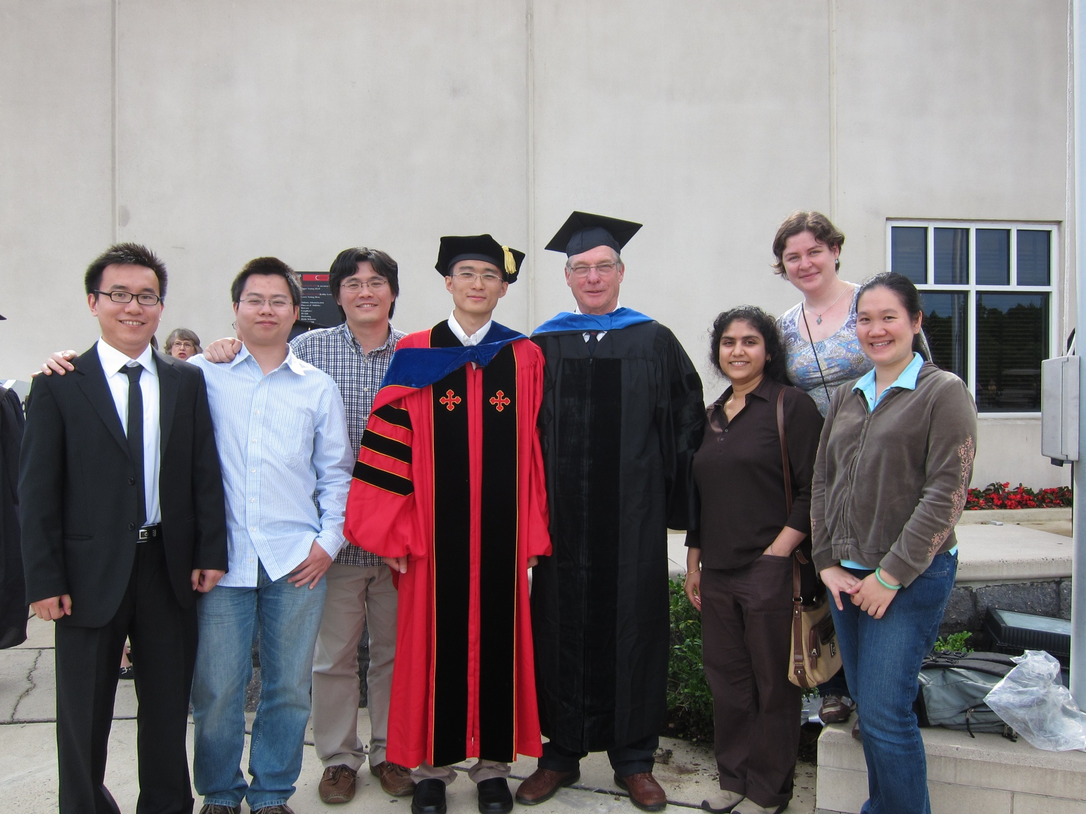
Acknowledgement
Moult Group
Prof. John Moult (PI)
Mr. Kunal Kundu
Dr. Yizhou Yin
Dr. Chen-Hsin Yu (Albert)
CAGI Organizers
CAGI Team
Challenge Data Providers
Funding:
NIH R01GM120364, R01GM104436,
R01GM102810
Created for CAGI* Workshop 2019
genomeinterpretation.org
Lipika R. Pal

Slide 17
Thank You !
Created for CAGI* Workshop 2019
genomeinterpretation.org
Lipika R. Pal

