Slide 1

CAGI slide pack guidelines
I agree to my slides being used according to the following terms:
______Tina Bakolitsa______
Authors: please include THIS slide at the beginning of your presentation to indicate that you agree with reuse of your slides in CAGI presentations, according to the terms below, and digitally sign by writing your name above.
To disseminate the CAGI results, I encourage all CAGI participants to remix these CAGI slides for inclusion in their oral and poster presentations
CAGI participants may use or publish any content of these slides only in compliance with the CAGI Data Use Agreement
CAGI participants may not cite or publish any content of these slides except with the written permission of the originating author or in the primary CAGI publications
CAGI participants must acknowledge the original authors of these slides and CAGI 2013. Include the acknowledgement banner across the bottom
CAGI participants must include the CAGI credits slide in their presentations
Slides with a red slash (no remix) may not be included in a presentation unless all attendees are registered CAGI participants who signed the data use agreement
Slides with a red X over the entire slide may not be used in any circumstances
Slides with a blue slash (embargoed) may not be used unless the embargo is explicitly lifted
Slides without slash or X may be tweeted unless flagged with the “No tweet” icon.
CAGI participants using these slides must explain the “No tweet” icon, which means that the slide content should not be disseminated outside the presenting conference hall. If the presentation venue permits pervasive tweeting, you may not include these slides in your talk
Note for slide authors: we expect all CAGI participants to abide by these restrictions, and will make best effort to ensure they are followed. However, but bear in mind that we have limited means of enforcing them, and therefore the restrictions cannot be guaranteed.

Slide 2
CAGI and clinical variants
Progress and missed opportunities
Tina Bakolitsa
Brenner lab
Notes:
Cell and structural biologist. Involved in CAGI & computational genetics less than a year. I have not assessed any of the challenges I’ll be talking about, although I was marginally involved with the SickKids challenge, looking at the structure and biochemistry of some of the more promising proposed variants. This to say, please step in and correct me if I’m wrong or misrepresenting something. I’m also happy that Lipika, Pedja and Sean are here who participated in these challenges. Also, John-Marc, the assessor of the John-Hopkins challenge, and Zhiqiang who oversaw the matching assessment of the SickKids challenge.
Ok, so. Many people have spoken in the past couple of days of the gap between where we are and where we’d like to be, in terms of performance. I think that was John. There were also repeated mentions of the need to follow up on the outcomes of CAGI challenges, the importance of challenge design, and how clinical labs don’t always agree on calling pathogenic variants. I’m going to be talking about three of these challenges that exemplify all these concerns.

Slide 3
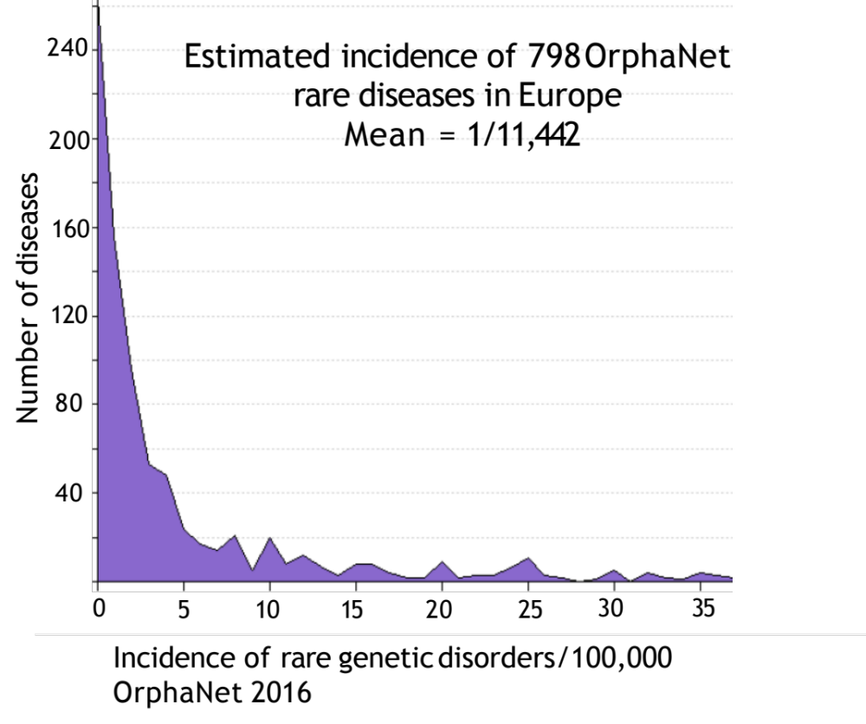
Diagnostic variants: challenges to validation
Phenotypic description may be information poor
Vast number of potential diagnoses, each rare
Case vs control comparison unclear (few cases, impurity of control datasets)
Segregation analyses not always possible
Disorders not always well characterized
Limited phenotypic description in databases
Functional validation rarely available
Notes:
Slide from Stephen Meyn, an outline of the problems involved in validating diagnostic variants. Clinical complexity, complex phenotypes.

Slide 4
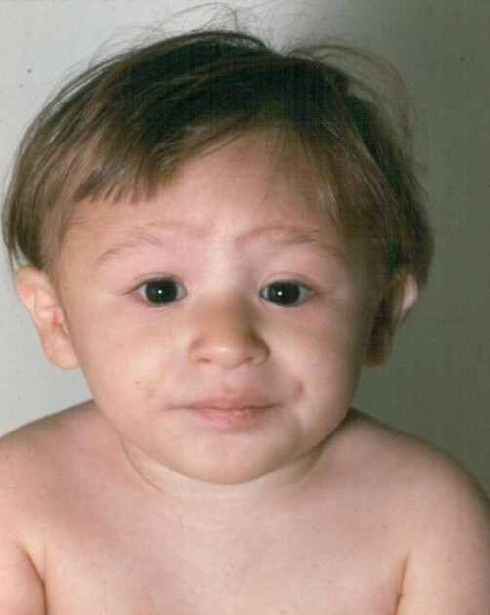
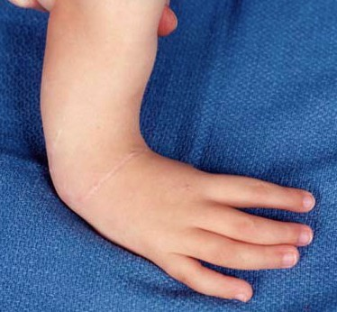
Fanconi anemia: 19 genes
OMIM Clinical Synopsis
33% - Radial aplasia
20% - Kidney malformation
30% - Cryptorchidism
10% - Low birth weight
10% - Mental retardation
50% - Pigmentary changes
10% - Congenital heart defect
25% - Microcephaly
20% - Strabismus, Microphthalmia
10% - Ear anomaly, Deafness
90% - Pancytopenia/Bone Marrow Failure
30% - Leukemia
30% - Risk of head/neck squamous cell carcinoma
25% of FA patients have no phenotype besides bone marrow failure
Notes:
Polygenic disorder with clinical heterogeneity.

Slide 5
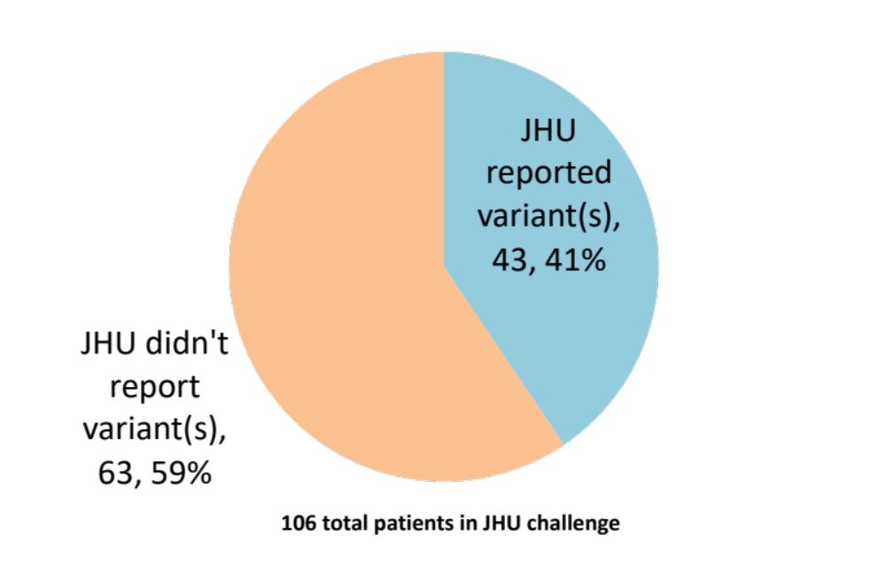
Johns Hopkins clinical panel challenge
106 patients, 83 genes, 14 disease classes (20 phenotypes + red herrings)
5 groups, 11 distinct submissions
Chandonia JM. et al. 2017. Hum Mutat. 40(9):1155-1168.
Notes:
Johns Hopkins DNA Diagnostic Laboratory offers testing for ~50 phenotypes and disorders. They offer NGS-based tests targeted for ~20 specific phenotypes. Only the requested genes are analyzed in each patient. Hopkins provided CAGI organizers with VCF files for the entire NGS panel for 106 patients with a range of clinical presentations. Genetic disorders were grouped into 14 disease classes (lung disorders, aneurysm, peroxisomal, craniofacial). The goal: match each patient to a disease class. Second challenge: predict the specific gene AND variant(s) that are the underlying cause of disease. Participants were instructed that every patient matched exactly one disease class.

Slide 6
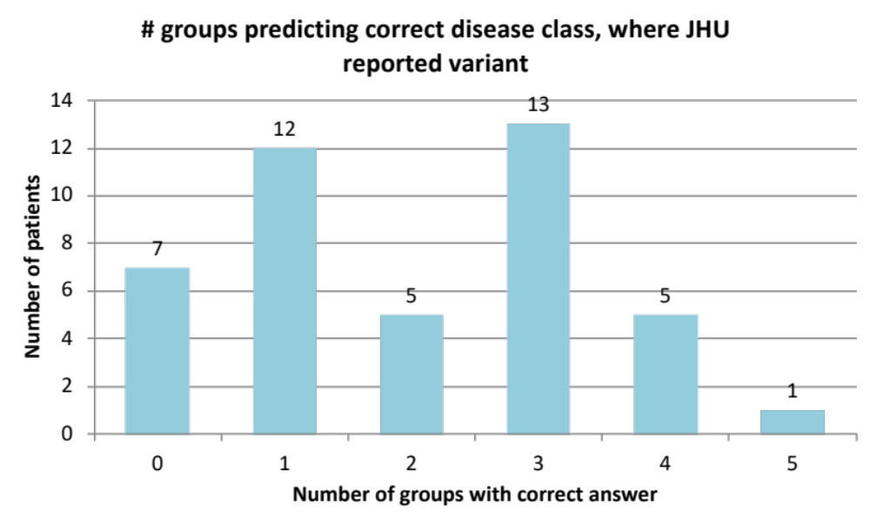
For the 43 cases where JHU reported a variant, one or more groups got the correct disease in 36 cases
Chandonia JM. et al. 2017. Hum Mutat. 40(9):1155-1168.
Notes:
Assessment was carried out by John-Marc, sitting right here, and looked at the number of correct predictions of disease class. Predicted disease class was the one assigned the highest probability among all 14 disease classes. The majority (36 out of 43 cases)

Slide 7
In most of those cases, predictors found the same variant(s) as JHU
Chandonia JM. et al. 2017. Hum Mutat. 40(9):1155-1168.
Notes:
Fewer groups correctly predicted both disease class and at least one of the variant or variants that Hopkins reported.

Slide 8
Even when JHU didn’t find a variant, at least one group predicted the disease class in majority of cases
Chandonia JM. et al. 2017. Hum Mutat. 40(9):1155-1168.
Notes:
They also predicted novel, causative variants in these genes. They also predicted a number of causal, diagnostic variants. What happened with those predictions?

Slide 9
Novel variants
IRB restrictions prevented JH from acting as assessor to this challenge or from providing detailed feedback on genes not analyzed
Specific novel variants could not be listed in the publication due to privacy restrictions
Major study limitation: true pathogenic variants (present in genes not analyzed) may have been missed => better assessment needed
Importance of ensuring appropriate consents and approvals in place to maximize use of clinical data
Importance of working closely with clinicians to eliminate possibility of unwanted incidental findings, ensure more in-depth discussion of challenge results
Notes:
The answer is, not much. As Lipica put it yesterday, there was no answer key provided for the larger section of this dataset. Why was that?
So in the paper, these are listed as a variant in FBN1, two variants in CFTR and so on.
Would like to talk with Malia, Barbara and the Ethics Forum to see if it’s legally/ethically possible to look at obtaining consent that might act retroactively, so we can revisit this part of the challenge with Johns Hopkins clinicians and get a more in-depth assessment of this challenge.

Slide 10
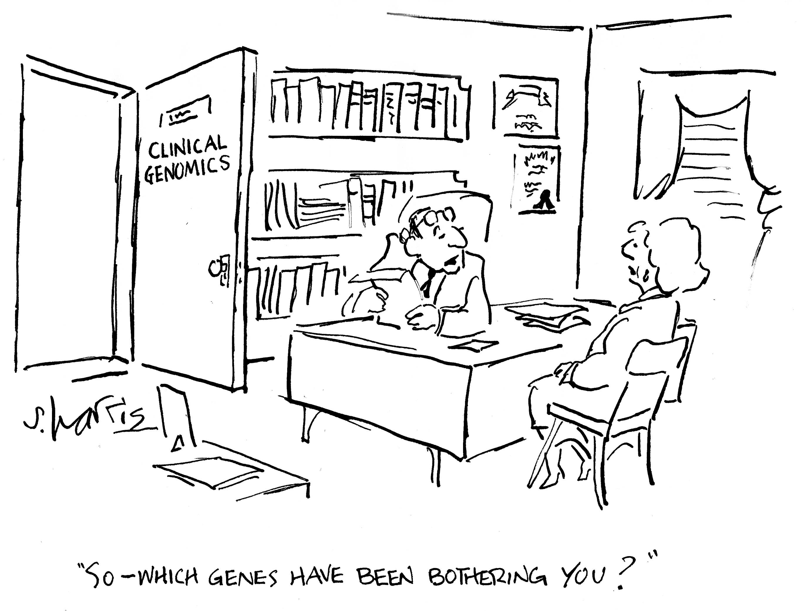

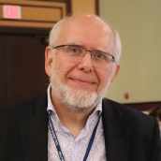






The SickKids Challenges
Genomes + phenotypic descriptions of undiagnosed children
.
Data provided by Stephen Meyn,
the Hospital for Sick Children, Toronto
Notes:
Now at Wisconsin. 25 out of 100 children undiagnosed (CAGI4), 25 out of 103 children undiagnosed (CAGI5). All patients in the CAGI cohorts consented for sharing of deidentified genomic and phenotypic data with external research projects. So this is already a better version of the JH challenge.

Slide 11
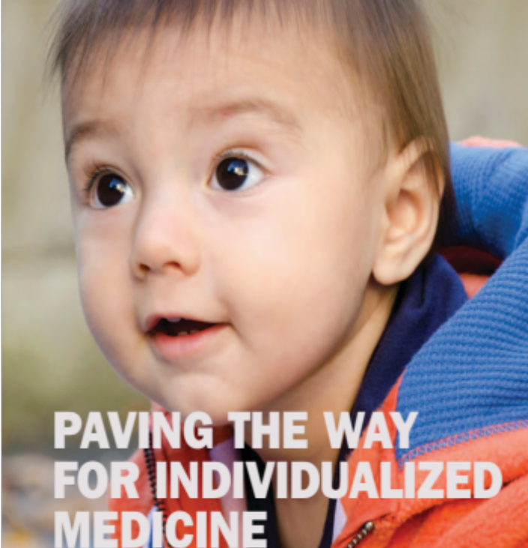
The SickKids Project
Pilot for practice of paediatric genomic medicine
Assess WGS as both diagnostic and predictive test
Develop and validate new bioinformatics tools for clinical genomics
Discover new disease genes
Develop new models of clinical care
Inclusion criteria:
<18 years of age, both parents alive
Child suspected of having a primary genetic disorder
Working diagnosis is polygenic with incomplete clinical test sensitivity
Bowdin SC. et al. 2014. Hum Mutat. 35(5):513-519.
Bowdin SC. et al. 2016. Clin Genet. 89(1):10-19.
Notes:
25 out of 100 children undiagnosed (CAGI4), 25 out of 103 children undiagnosed (CAGI5). All patients in the CAGI cohorts consented for sharing of deidentified genomic and phenotypic data with external research projects.

Slide 12

CAGI 4: solely variant prediction
Challenge: identify
causal variants
191 potential
diagnostic variants
proposed by predictors
125 related to phenotype,
10 proposed by more than one group
?
25 undiagnosed patients (linked HPO-based clinical descriptions & WGS)
Kasak L. et al. 2019. Hum Mutat. 40(9):1373-1391.
Notes:
WGS data and clinical phenotypic descriptions in the form of Phenotips annotations, based on HPO terms. Majority were variants for dominant disorders. No structural variants were proposed.
Of these, the assessor deemed 2/3 related to phenotype.
Some of these were taken further and validated with the clinician. For example a child with epilepsy was predicted by a CAGI participant to have a relevant mutation in KCNB1. This gene is known to be associated with a very specific type of seizures, and communication with the doctor confirmed that the patient did indeed have that type of seizure and the case was deemed solved, and the child now has a molecular diagnosis.
Similar results were achieved for another child, and more are promising.
Therefore, CAGI predictors were able to identify causal variants that were overlooked by a clinical laboratory.

Slide 13
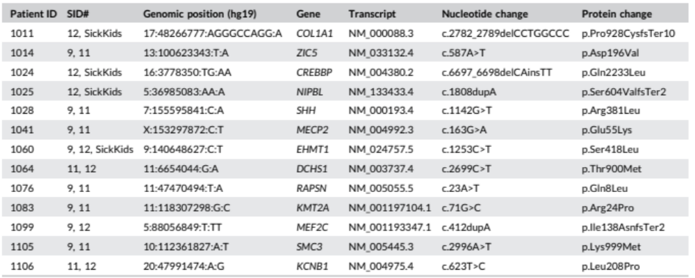
CAGI 4: potential diagnostic variants
New
Kasak L. et al. 2019. Hum Mutat. 40(9):1373-1391.
Notes:
This table shows the 10 variants predicted by more than one group. In 4 cases, the predictor’s candidate variant had also been classified as a candidate variant by the SickKids bioinformatics pipeline but discarded upon initial manual review by the SickKids Genome Clinic diagnostic team. Nomination by CAGI participants prompted reassessment. 1024 variant did not fit clinical phenotype, 1025 was a good phenotypic fit but didn’t validate by Sanger sequencing. 1011 and 1060 were located in genes that had partial overlap with clinical phenotype, and were successfully validated.

Slide 14
CAGI 4: new causal variants identified
KCNB1 c.T623C:p.L208P
SMC3 c.A29996T:K999M
Epileptic encephalopathy
(Babkinaa N. et al. 2016.
Eur J Med Genet. 59(2):70-4.)
Cornelia de Lange
(Bhuiyan ZA. et al. 2006.
J Med Genet. 43(7): 568–575.)
Kasak L. et al. 2019. Hum Mutat. 40(9):1373-1391.
Notes:
As Lipica said yesterday, KCNB1 is a potassium voltage-gated channel subfamily B member, epileptic encephalopathy. This gene is known to be associated with a very specific type of seizures, and communication with the doctor confirmed that the patient did indeed have that type of seizure and the case was deemed solved, and the child now has a molecular diagnosis.
SMC3 is a nuclear protein involved in chromosome maintenance. Mutations in this gene have been previously reported in Cornelia de Lange syndrome and affect binding in DNA. Clinically heterogeneous developmental disorder (facial dysmorphia, upper limb malformations, growth and cognitive retardation, GI abnormalities).

Slide 15
CAGI 5: phenotype-to-genotype matching
Challenge:
predict phenotype, identify
causal, secondary variants
3 broad phenotype categories
(6 eye, 7 neuro, 11 connective)
8 prediction teams
?
24 undiagnosed patients (unlinked HPO-based clinical descriptions & WGS)
Kasak L. et al. 2019. Hum Mutat. 40(9):1373-1391.

Slide 16
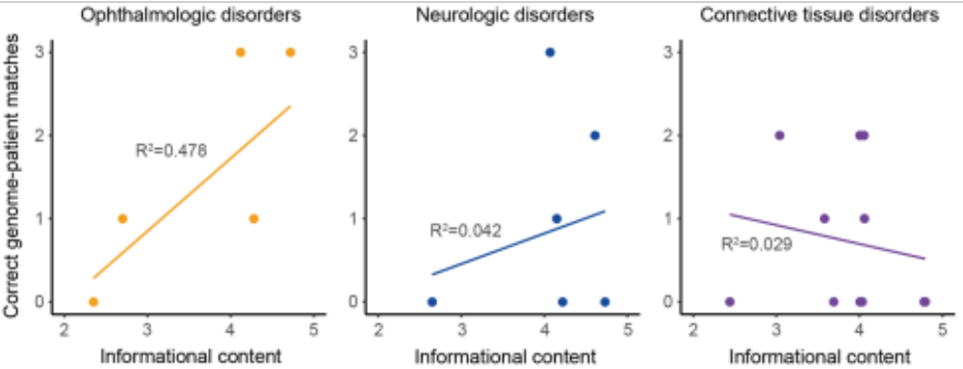
Richness of phenotypic description
does not correlate with improved accuracy
Correlation between the informational content of a patient’s clinical description and the number of correct genome-patient matches for all submissions
Kasak L. et al. 2019. Hum Mutat. 40(9):1373-1391.
Notes:
Assumption: the more detailed the clinical description, the more useful it is in aiding molecular diagnosis. Rich phenotypic descriptions may aid genome-patient matching for specific categories of disease.

Slide 17
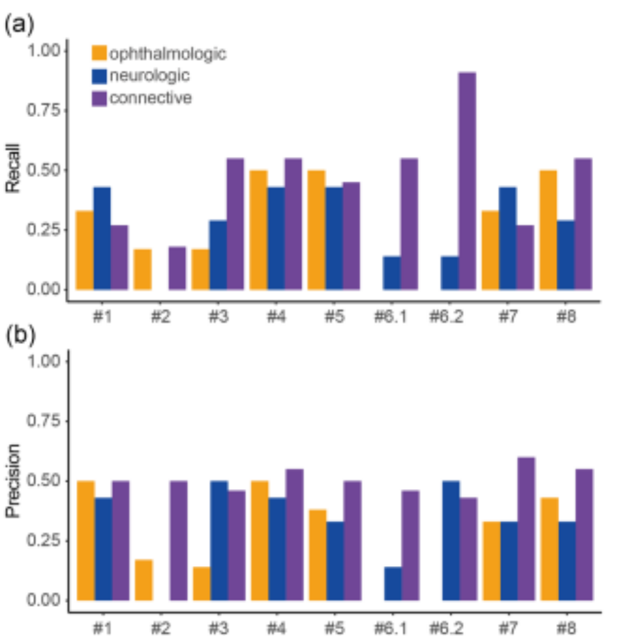
Recall and Precision
Kasak L. et al. 2019. Hum Mutat. 40(9):1373-1391.
Notes:
Most submissions achieved low positive rates and low positive predictive values in this part of the challenge, so in broad phenotype category matching. Average accuracy was 37%. It looks like #6.2 achieves a significantly better result by matching 10 out of 11 genomes correctly. with respect to predicting connective tissue. However, this represents 11 out of 24 genomes. This result would still rank lower than the random prediction where the highest probability would always be given to the connective tissue category (11 out of 24 genomes or 46%). And in terms of statistical significance, Zhiqiang and Changhua carried out bootstrapping simulations and found out that this was not better than random chance. Patient to genome matching did a bit better, with two groups performing better than chance. These were groups that included ethnic and sex information (not all methods used this information) and also methods that weighted HPO terms. I’ll come back to this later.

Slide 18
CAGI 5: candidates for phenotypic expansion
Potential variants identified in 13 out of 24 genomes
No overlap in variant or gene as disease-causing in the same genome
All proposed variants were heterozygous
No additional variants (excluding B and LB) nominated for same gene
LMNA
c.G887GT:p.R296L
EP300 c.A7028AG:Q2343R
Absent from gnomAD, literature
Predicted deleterious
LMNA associated with >10 genetic disorders affecting multiple organ systems
Potential new laminopathy
Unreported, rare, conserved
Conflicting predictions
Root-level HPO terms overlap with patient’s phenotype
New EP300-related syndrome
Kasak L. et al. 2019. Hum Mutat. 40(9):1373-1391.
Notes:
LMNA variant is located in a coiled-coil region of the molecule. Potential disruption of intra-helical ion pair formation, thereby leading to protein destabilization and aggregation (literature reports). Abnormal LMNA processing can cause mitochondrial dysfunction, which was the working clinical hypothesis for this patient, and is thought to contribute to the variety of disease phenotypes observed in laminopathies. LMNA is associated with at least 10, mostly dominant, genetic disorders affecting multiple organ systems. The patient has a complex phenotype.
EP300 is usually associated with Rubinstein-Taybi syndrome 1. Patient shares some root terms but lacks intellectual disability and distinctive dysmorphic features. This group also identified an intronic variant, MAF low enough to be plausibly pathogenic (0.0015% in gnomAD) but no additional info could be found for this variant. Insufficient evidence => VUS

Slide 19
CAGI 5: secondary variants
3 phenotype categories
8 prediction teams
?
24 undiagnosed patients (unlinked HPO-based clinical descriptions & WGS)
Challenge:
predict phenotype, identify
causal, secondary variants
Secondary variants
MSH2 c.942+2delT
35 distinct variants submitted
8 clinically classified as P, 4 LP, 16 VUS, 4 LB, 3 B
7 P variants associated with autosomal recessive disorders
1 P variant reported in a low penetrance gene
Splice alteration, classified LP
Absent from gnomAD
Sequencing artifact?
Potential risk variant for Lynch syndrome
Kasak L. et al. 2019. Hum Mutat. 40(9):1373-1391.
Notes:
Example of reportable clinical finding. If verified by confirmatory clinical sequencing, this alteration could confer a high risk of Lynch syndrome and its associated cancers.
The variant interpretation was exhaustive. Stephen Meyn’s group looked not only at highest probability predicted causal variants for all groups but also at secondary variants (an example here). And variants not matched to the correct patient that were identified in more than one submission for a given genome (only VUS or above were considered). ‘Not enough evidence’.

Slide 20
SickKids summary
A single phenotypic category does not provide enough information to distinguish a genome
Overlap of phenotypic categories a likely confounder in phenotype-genotype matching
Groups that performed best incorporated gender and reported ancestry information, and ranked HPO terms
Variant prediction might be improved by combining a variant-to-phenotype approach with gene prioritization

Slide 21
CAGI and clinical variants
Challenge design
Follow-up
  Further genetic testing (LMNA twin)
Consistent clinical evaluations
  Currently qualitative and varying between labs
Better method descriptions
More data
  Experimental assays
Notes:
Parents and similarly affected twin of patient predicted to have a causative LMNA mutation could be assessed to determine if the variant is de novo in the affected twins.

Slide 22
Acknowledgements
Stephen Meyn (data provider and clinical assessor)
Jesse Hunter and Rupa Udani (variant assessors)
Brenner lab (disease and genome matching assessors)
Laura Kasak
Zhiqiang Hu
Changhua Yu
CAGI organizers
CAGI participants
Notes:
This is the Sick Kids clinical genome challenge
Our collaborator Stephen Meyn in Toronto has performed WGS on undiagnosed children as part of both their clinical care and a research protocol. He shared with us the genomes and clinical description for 25 children with undiagnosed disease.
The aim of the challenge was to match the genome to clinical description, identify the possible causal variants, and any secondary findings.
The predictors identified 187 variants.
Of these, the assessor deemed 2/3 related to phenotype.
Some of these were taken further and validated with the clinician. For example a child with epilepsy was predicted by a CAGI participant to have a relevant mutation in KCNB1. This gene is known to be associated with a very specific type of seizures, and communication with the doctor confirmed that the patient did indeed have that type of seizure and the case was deemed solved, and the child now has a molecular diagnosis.
Similar results were achieved for another child, and more are promising.
Therefore, CAGI predictors were able to identify causal variants that were overlooked by a clinical laboratory.

Slide 23
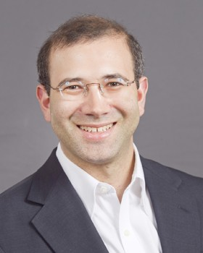
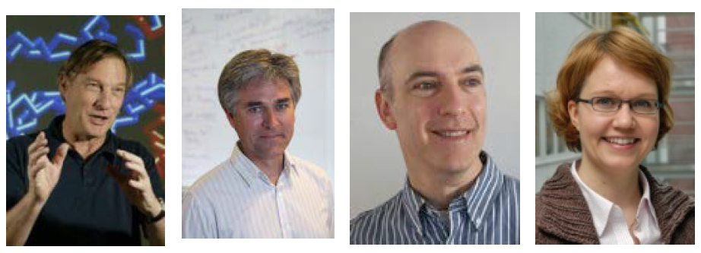
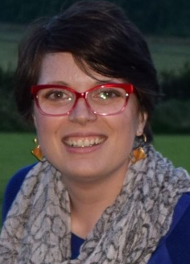

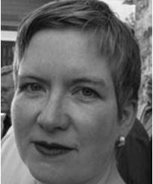

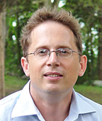
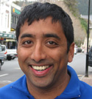
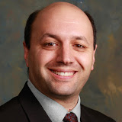
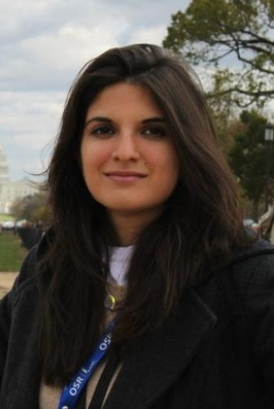
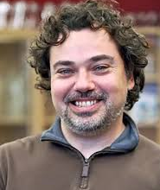

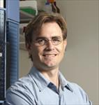
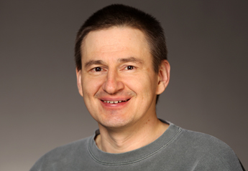
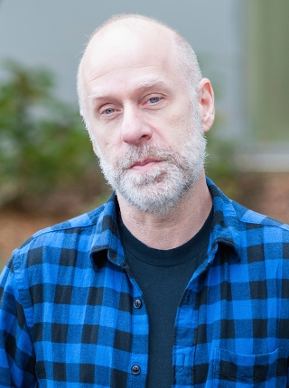
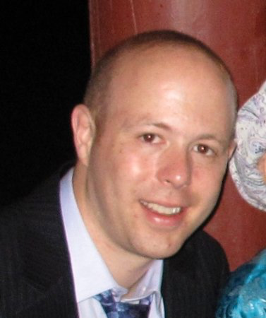
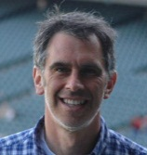
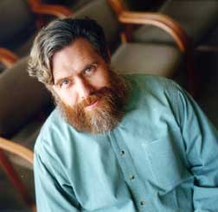

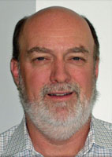

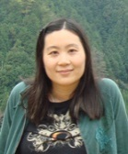
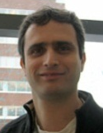
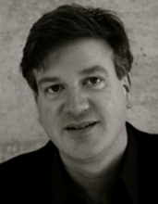
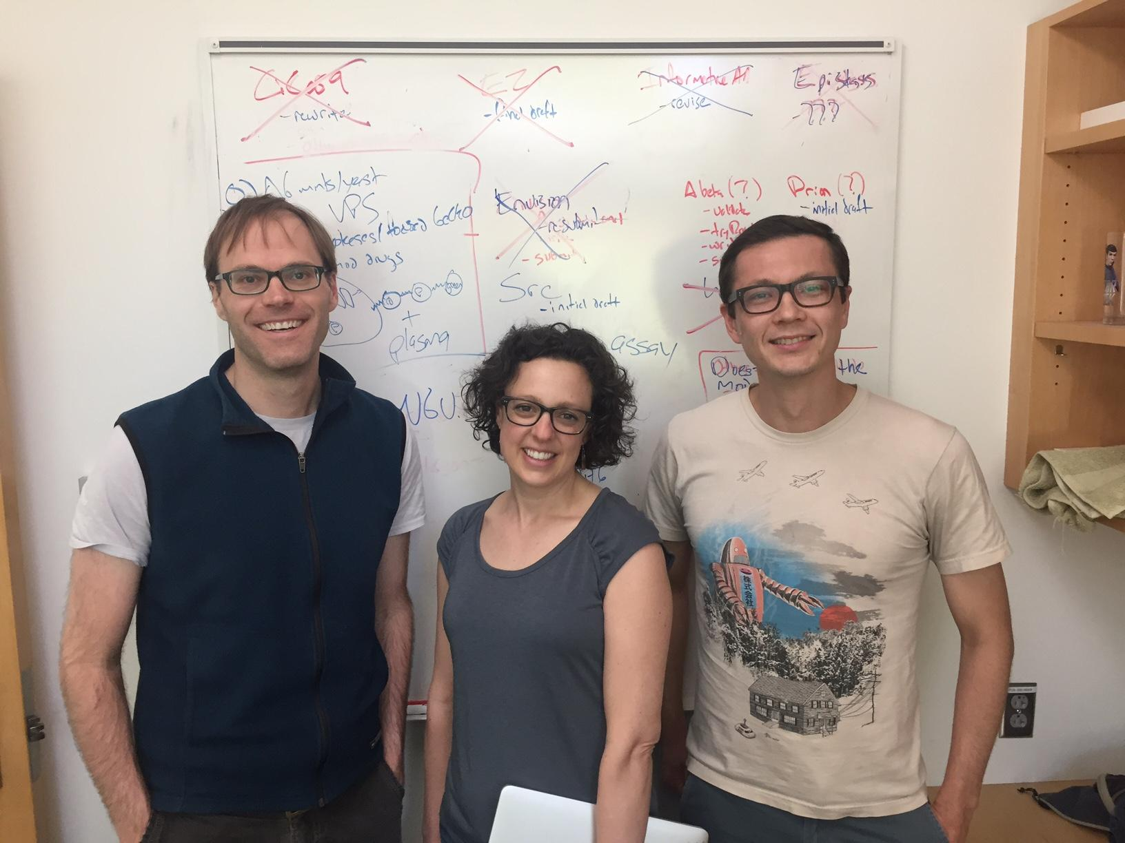
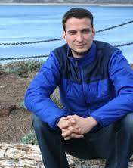
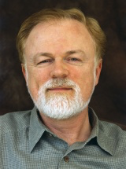
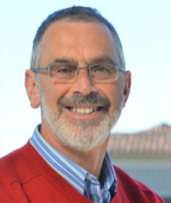

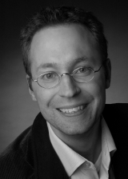
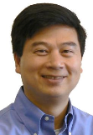

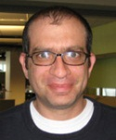
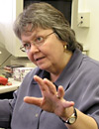
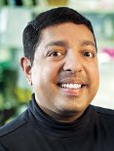

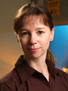

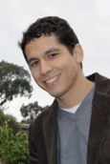
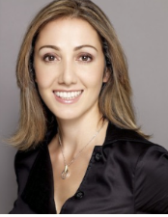
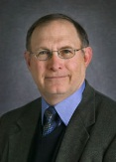
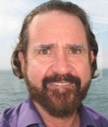
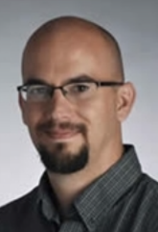
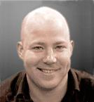



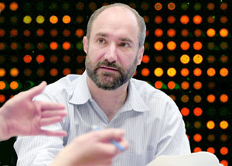
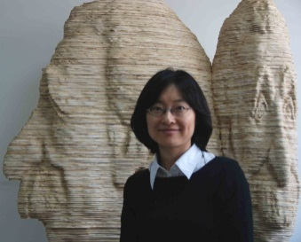
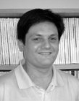
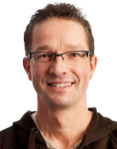











































CAGI Acknowledgements
Data Providers
Russ Altman
Adam P. Arkin
Madeleine P. Ball,
Jason Bobe,
Paolo Bonvini,
Bethany Buckley,
George Church,
Garry R. Cutting,
Emma D’Andrea,
Lisa Elefanti,
Aron W. Fenton,
Andre Franke,
Nina Gonzaludo,
Joe W. Gray,
Linnea Jannson,
John P. Kane,
Pui-Yan Kwok,
Rick Lathrop,
Jonathan H. LeBowitz,
Federica Lovisa,
Angel C. Y. Mak,
Mary J. Malloy,
Richard McCombie,
Chiara Menin,
M. Stephen Meyn,
John Moult,
Robert Nussbaum,
Mehdi Pirooznia,
James B. Potash,
Clive R. Pullinger,
Jasper Rine,
Frederick Roth,
Pardis Sabeti,
Jeremy Sanford,
Maria C. Scaini,
Nicole Schmitt,
Jay Shendure,
Molly Sheridan,
Michael Snyder,
Tim Sterne-Weiler,
Paul L. F. Tang,
Sean Tavtigian,
Ryan Tewhey,
Silvio C. E. Tosatto,
Jochen Weile,
G. Karen Yu,
Peter Zandi.
Assessors
Aashish Adhikari,
Marco Carraro,
John-Marc Chandonia,
Rui Chen,
Wyatt T. Clark,
Roxana Daneshjou,
Roland Dunbrack,
Iddo Friedberg,
Gad Getz,
Nick Grishin,
Rachel Karchin,
Anat Kreimer,
Stephen. Meyn,
Sean D. Mooney,
Alexander A. Morgan,
John Moult,
Robert Nussbaum,
Jeremy Sanford,
David B. Searls,
Artem Sokolov,
Josh Stuart,
Shamil Sunyaev,
Sean Tavtigian,
Silvio C. E. Tosatto,
Qifang Xu,
Nir Yosef
Data Providers
Organizers
Scientific Council
Patricia Babbitt,
Atul Butte,
Garry Cutting,
Laura Elnitski,
Reece Hart,
Ryan Hernandez,
Rachel Karchin,
Robert Nussbaum,
Michael Snyder,
Shamil Sunyaev,
Joris Veltman,
Liping Wei
Advisory Board & Scientific Council
Ethics Forum
Assessors
@CAGInews
Website Development
genomeinterpretation.org
Website Development
Sadhna Rana
Navya Dabbiru
Stephen Yee
Maya Zuhl,
Sri Jyothsna Yeleswarapu
Gaurav Pandey
Ethics Forum
Wylie Burke
Flavia Chen
Julie Harris-Wai
Kirsten Isgro
Barbara A. Koenig
Robert Nussbaum
Mark Yarborough
Predictors: Allison Abad, Ogun Adebali, Ivan Adzhubey, Talal Amin, Johnathan R. Azaria, Giulia Babbi, Eraan Bachar, Benjamin Bachman, Minkyung Baek, Greet De Baets, Michael Beer, Violeta Beleva-Guthrie, Bonnie Berger, Brady Bernard, Rajendra Bhat, Rohit Bhattacharya, Samuele Bovo, Marcus Breese, Aharon S. Brodie, Yana Bromberg, Binghuang Cai, Colin Campbell, Chen Cao, Emidio Capriotti, Marco Carraro, Rita Casadio, Billy H. W. Chang, Shann-Ching Chen, Yun-Ching Chen, Chien-Yuan Chen, Melissa Cline, Andrea Corredor, Carla Davis, Mark Diekhans, Rezarta I. Dogan, Christopher Douville, Ian Driver, Roland Dunbrack, Joost van Durme, Andrea Eakin, Matthew Edwards, Gokcen Eraslan, Hai Fang, Carlo Ferrari, Anna Flynn, Lukas Folkman, Colby T. Ford, Adam Frankish, Zaneta Franklin, Yao Fu, Alessandra Gasparini, Tom Gaunt, David Gifford, Manuel Giollo, Nina Gonzaludo, Valer Gotea, Julian Gough, Yuchun Guo, Jennifer Harrow, Marcia Hasenahuer, Lim Heo, Ramin Homayouni, Raghavendra Hosur, Cheng L. V. Huang, Peter Huwe, Sohyun Hwang, Tadashi Imanishi, Jules Jacobsen, Chan-Seok Jeong, Yuxiang Jiang, David T. Jones, Daniel Jordan, Beomchang Kang, Rachel Karchin, Panagiotis Katsonis, Sunduz Keles, Manolis Kellis, Nikki Kiga, Dongsup Kim, Eiru Kim, Jack F. Kirsch, Michael Kleyman, Andreas Kraemer, Anshul Kundaje, Kunal Kundu, Pui-Yan Kwok, Ernest Lam, Dae Lee, Gyu R. Lee, Insuk Lee, Pietro Di Lena, Emanuela Leonardi, Andy Li, Jun Li, Yue Li, Biao Li, Olivier Lichtarge, Chiao-Feng Lin, Rhonald C. Lua, Angel Mak, Pier L. Martelli, David Masica, Zev Medoff, Aziz M. Mezlini, Rahul Mohan, Alexander M. Monzon, Sean D. Mooney, Matthew Mort, John Moult, Steve Mount, Eliseos Mucaki, Jonathan Mudge, Nikola Mueller, Chris Mungall, Katsuhiko Murakami, Yoko Nagai, Noushin Niknafs, Abhishek Niroula, Conor M. L. Nodzak, Yanay Ofran, Ayodeji Olatubosun, Kymberleigh Pagel, Lipika R. Pal, Taeyong Park, Nathaniel Pearson, Vikas Pejaver, Jian Peng, Alexandra Piryatinska, Catherine Plotts, Predrag Radivojac, Aditya R. Rao, Aliz Rao, Graham Ritchie, Peter Rogan, Frederic Rousseau, Jana M. Schwarz, Joost Schymkowitz, Chaok Seok, George Shackelford, Sohela Shah, Maxim Shatsky, Ron Shigeta, Hashem A. Shihab, Jung E. Shim, Junha Shin, Sunyoung Shin, Ilya Shmulevich, Bradford R. Silver, Nasa Sinnott-Armstrong, Ben Smithers, Yesim A. Son, Mario Stanke, Nathan Stitziel, Andrew Su, Laksshman Sundaram, Paul Tang, Nuttinee Teerakulkittipong, Natalie Thurlby, Janita Thusberg, Kevin Tian, Collin Tokheim, Silvio C. E. Tosatto, Yemliha Tuncel, Tychele Turner, Ron S. Unger, Aneeta Uppal, Gurkan Ustunkar, Jouni Valiaho, Mauno Vihinen, Mary Wahl, Michael Wainberg, Meng Wang, Maggie Wang, Yanran Wang, Xinyuan Wang, Li-San Wang, Liping Wei, Qiong Wei, Rene Welch, Stephen Wilson, Chunlei Wu, Lijing Xu, Qifang Xu, Yuedong Yang, Christopher Yates, Yizhou Yin, Chen-Hsin Yu, Dejian Yuan, Jan Zaucha, Haoyang Zeng, Maya Zuhll
Advisory Board
Russ Altman,
George Church,
Tim Hubbard,
Scott Kahn,
Sean Mooney,
Pauline Ng,
Susanna Repo,
John Shon,
Join
CAGI 6!
Notes:
lkjsdkljrs

