Slide 1



The ClinGen Sequence Variant Interpretation Working Group:
Approach to the ACMG Classification Guidelines
Marc S. Greenblatt, M.D.
University of Vermont,
Larner College of Medicine

Slide 2


Slide 3
OVERVIEW
“Is this variant Pathogenic or Not”
ACMG Standards and Guidelines 2015
Refining the ACMG Computational Guidelines
Opportunities for Improvement
Examples from CAGI and Other
Data Sets and Methods

Slide 4
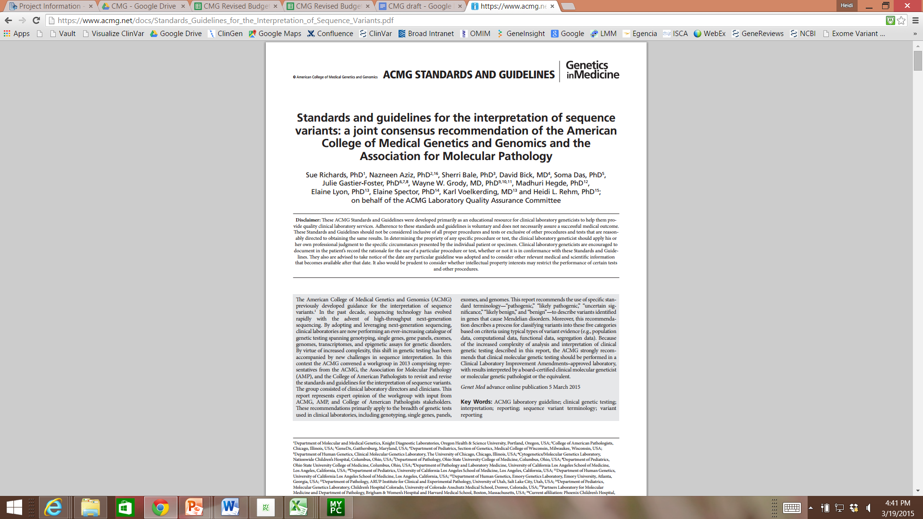
PMID: 25741868
Notes:
Introduce ACMG guidelines

Slide 5
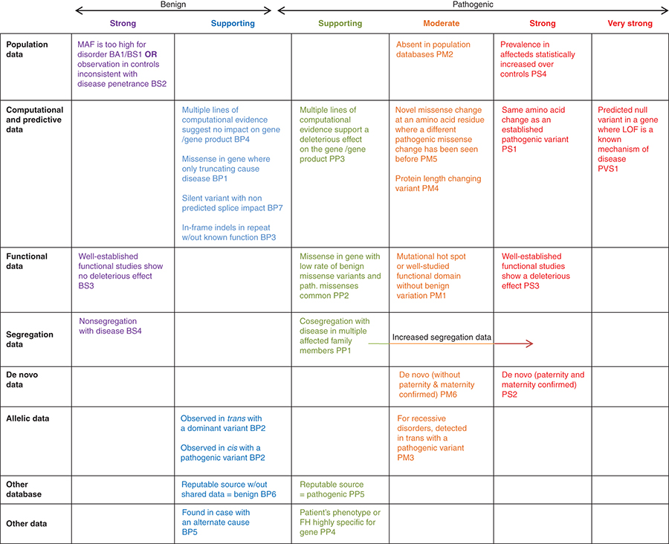
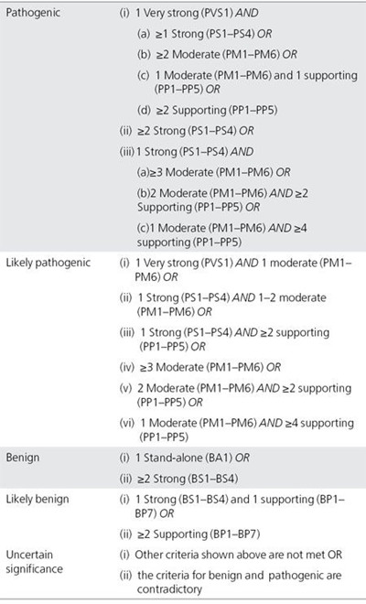
ACMG Guidelines for Interpreting Variants
Over 20 categories of evidence
“Supporting”, “Moderate”,
“Strong”, “Very Strong”
“Combining Rules”
Notes:
The guideline defines 28 criteria, each with an assigned code, that address types of variant evidence. Each criteria code is assigned a direction, benign (B) or pathogenic (P), and a level of strength: stand-alone (A), very strong (VS), strong (S), moderate (M), or supporting (P).

Slide 6
“…We expect that this variant classification approach will evolve as technology and knowledge improve…
those working in specific disease groups should continue to develop more focused guidance regarding the classification of variants …
the applicability and weight assigned to certain criteria may vary by gene and disease…”
Outside of ACMG, work proceeds on how to refine the standards
Notes:
The committee recognized that the guideline was a starting framework that would evolve over time.

Slide 7
ACMG Computational Evidence Standards
Defining Terms
B = Benign, P = Pathogenic
P = SuPporting Evidence, ~2.08:1 Odds Path in a Bayesian Model
M = Moderate Evidence, ~4.33:1 Odds Path
S = Strong Evidence, ~18.72:1 Odds Path
VS = Very Strong Evidence, ~350 Odds Path
Final Rules to Define Evidence Type and Strength:
BP1 = Rule 1, SuPporting Evidence for Benign
PS1 = Rule 1, Strong Evidence for Pathogenic
Richards Genet Med 2015, Tavtigian Genet Med 2019

Slide 8
Refinements Needed to the ACMG Computational Evidence Standards
BP4 Multiple lines of computational evidence suggest no impact BP4
Missense in gene where only truncating cause disease BP1
Silent variant with non predicted splice impact BP7
In-frame indels in repeat w/out known function BP3
What weight to assign in silico evidence
PP3 Multiple lines of computational evidence support a deleterious effect
Novel missense change at AA residue where a different pathogenic missense change has been seen before PM5
Protein length changing variant PM4
Same AA change as established pathogenic variant PS1
Predicted null variant in a gene where LOF is a Known mechanism of Disease PVS1

Slide 9
Refining ACMG Standards for
Variant Classification- Whose Task?
Individual Commercial and Research Labs
Disease-Focused Groups
  ENIGMA- Breast Cancer-associated variants
  InSiGHT- Colorectal
  Very well studied data sets may not generalize
ClinGen (“Clinical Genome Resource”)

Slide 10
ClinGen Background
ClinGen
  www.clinicalgenome.org
  NIH-funded (U-41) effort to improve patient care using genetic/genomic data
  Began in 2013
  Many centers collaborating to
    Build a central annotated resource
    Define the clinical relevance of genes and variants for use in precision medicine and research
Working Groups Relevant to CAGI Include:
  Gene Curation
  Sequence Variant Interpretation (SVI)

Slide 11
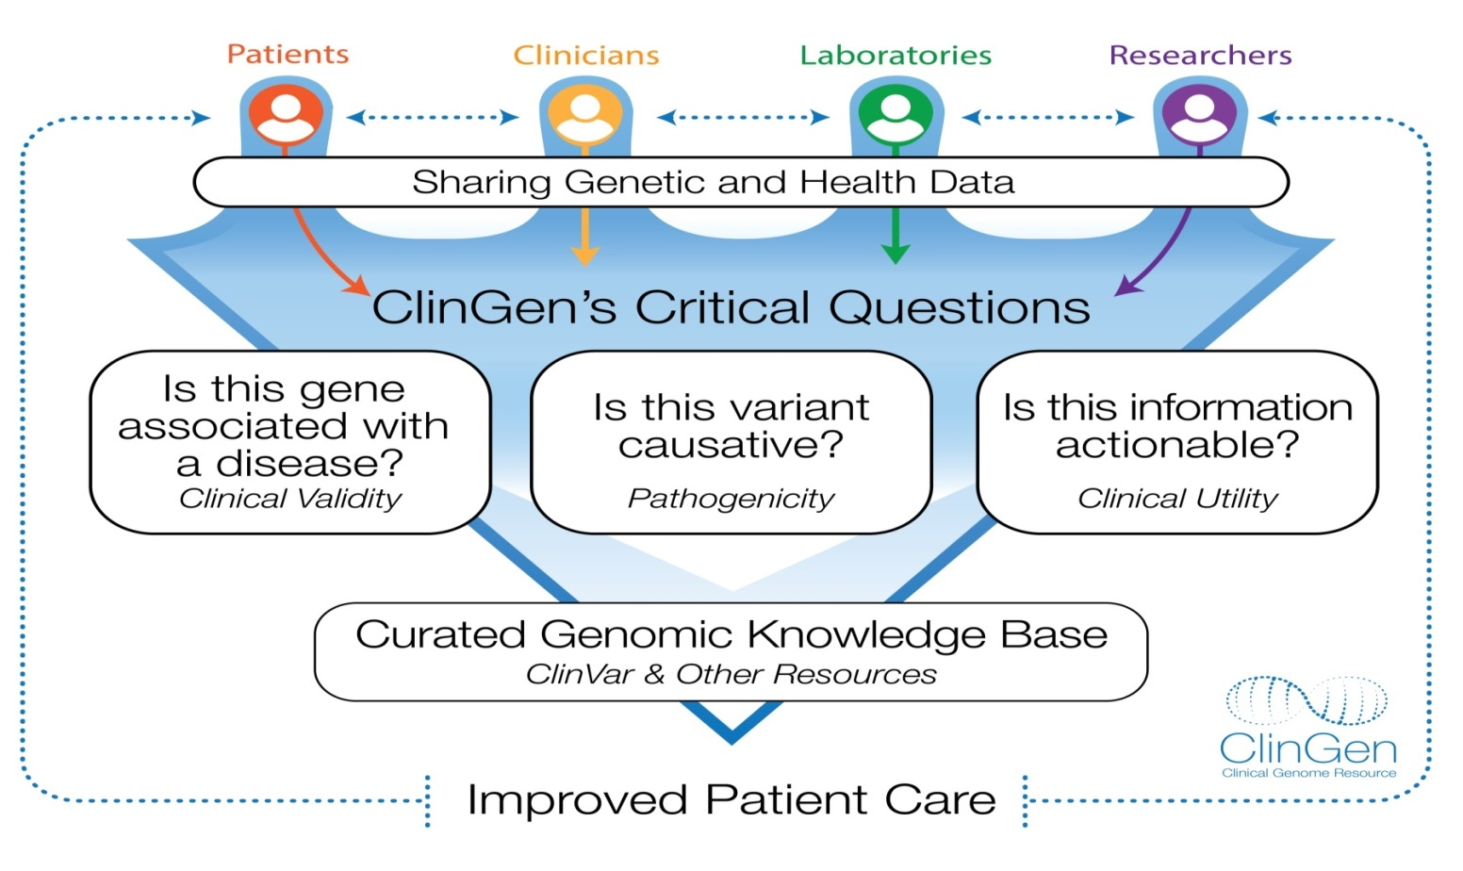
ClinGen: The Clinical Genome Resource
Purpose: - Create a central resource that defines the clinical relevance of genes and variants - improve patient care through precision medicine and research.
www.clinicalgenome.org
>400 people from >90 institutions
Notes:
Introduce ClinGen (briefly)

Slide 12
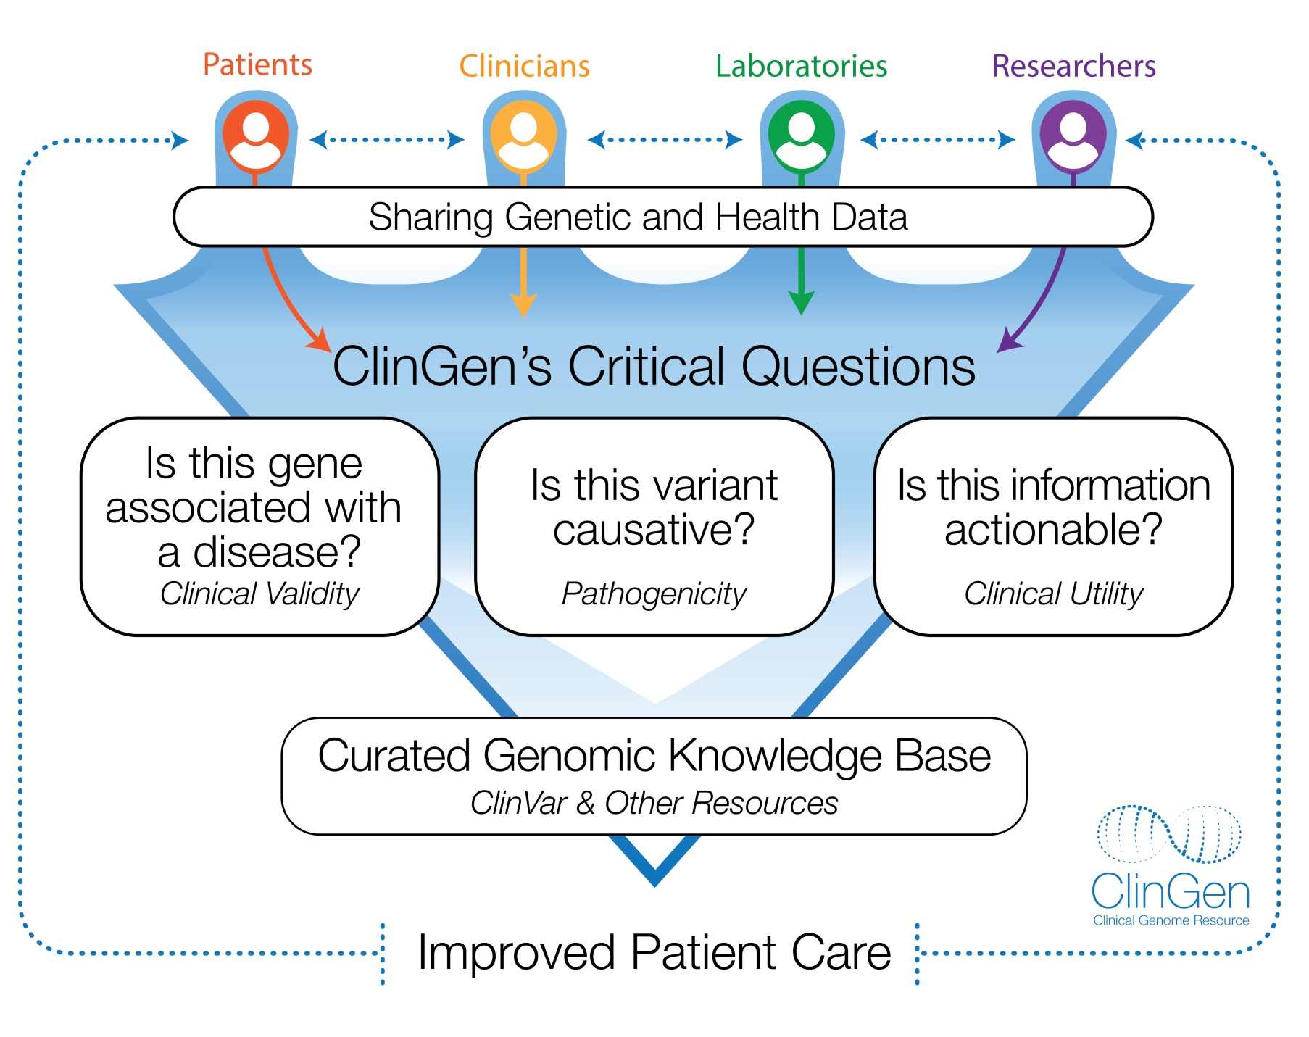
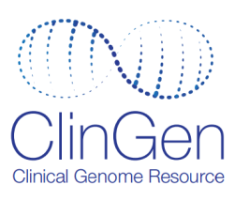
The Clinical Genome Resource
Notes:
Add in diversity of group here? Verbally describe the overall team involved in crc/polyposis group.

Slide 13
Refuted
Disputed
No
Reported
Evidence
Limited
Moderate
Strong
Definitive
Two Key Evidence Types
Genetic Evidence (probands)
  Case-level data (unrelated probands with convincing variants)
  Segregation of variants within families
  Case-control data
Experimental Evidence (functional studies)
  Function (expression, biochemical function, interactions)
  Functional alteration (patient cells, non-patient cells)
  Models and Rescue (animal models, rescues, cell culture models)
Points for each type of evidence according to ClinGen framework
Strande et al (2017) Am J Hum Genet

Slide 14
Choosing Data Sets- Gene Curation Brugada Syndrome (1)
Brugada Syndrome- Cardiac Arrhythmia
  Risk of sudden death
  Autosomal Dominant
  SCN5A is the most common gene
  Over 20 genes with reported association,
  Most had rare variants with functional studies showing sodium or potassium channel defect
What Data Set to use to test methods?

Slide 15
Choosing Data Sets- Gene Curation Brugada Syndrome (1)
What Data Set to use to test methods?
Comparison of 5 in silico methods to select the “best method” (Leong BMC Med Genet 2015)
  SCN5A, KCNH2, and KCNQ1 genes
Brugada Syndrome Gene Expert Panel used the ClinGen framework for assessing gene-phenotype association (Hosseini Circulation 2018)
  Only SCN5A classified as “Definitive” association
  20/21 genes “Disputed”, including KCNH2
  KCNQ1 clinical validity not assessed

Slide 16
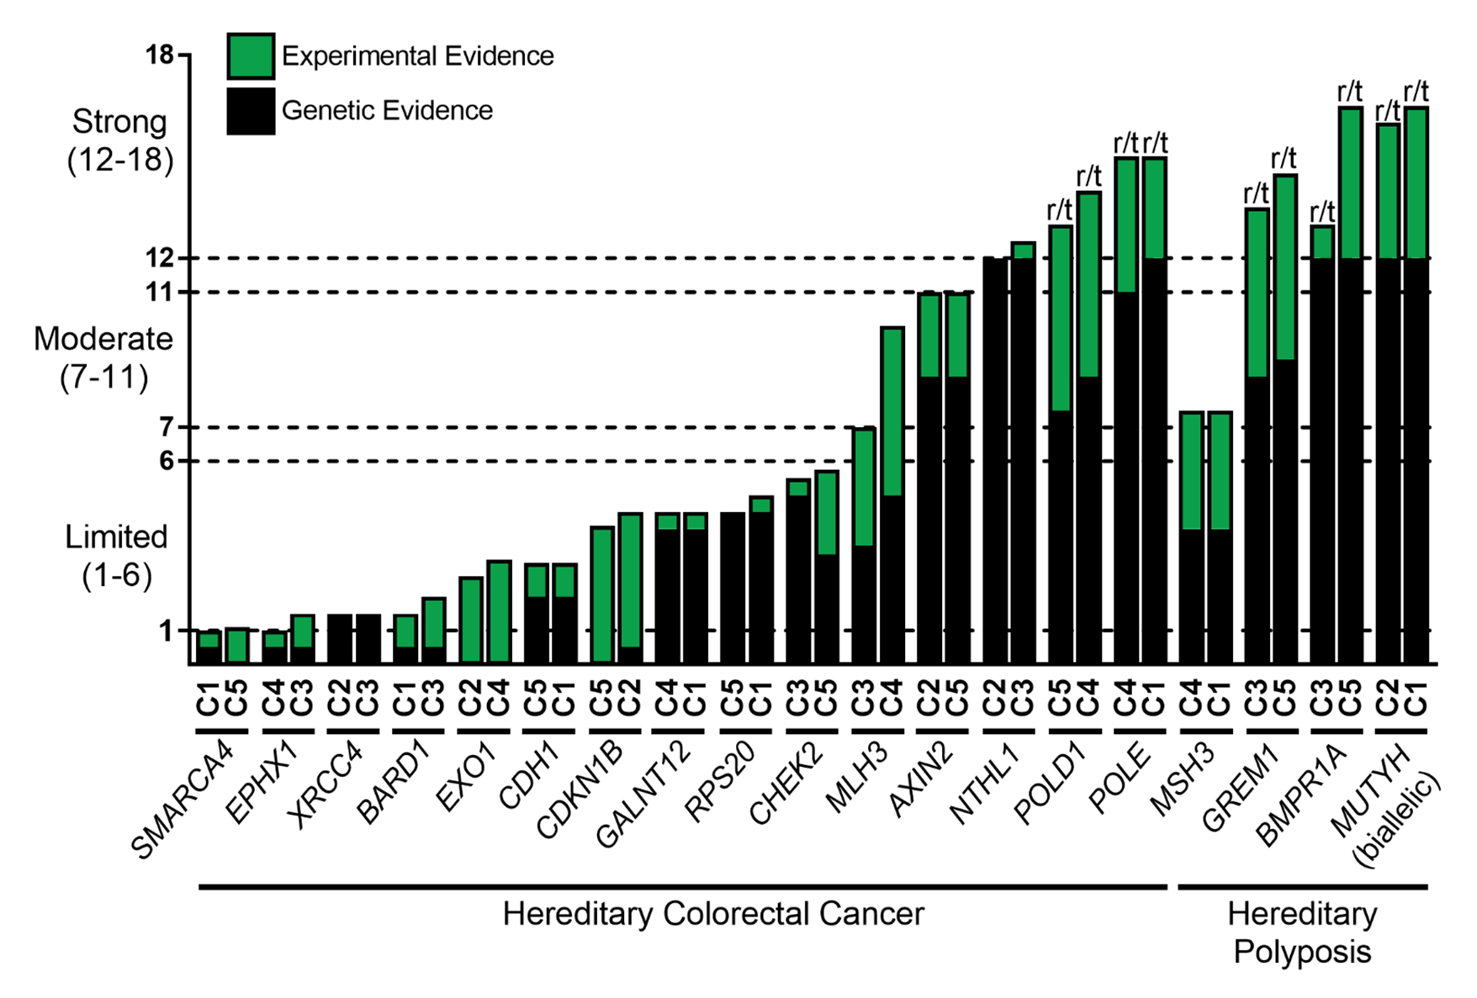
Hereditary Colon Cancer/Polyposis Genes
Clinical Validity Classifications
Check whether
the genes
being studied
have been
validated
Seifert Genet Med 2019

Slide 17
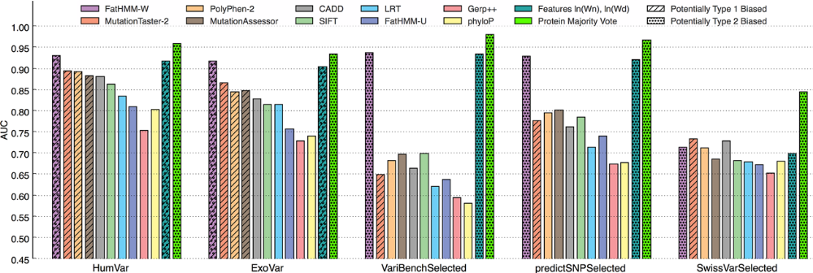
Choosing Data Sets-
Avoid Potential Circularity
Two types of circularity (described in Grimm Hum Mut 2015)
  Overlap in data set used for training & evaluation, leads to overfitting
  Training on a data set in which a gene contains all Path or all Neutral
Potentially biased sets (hatched, dotted) → better predictions

Slide 18
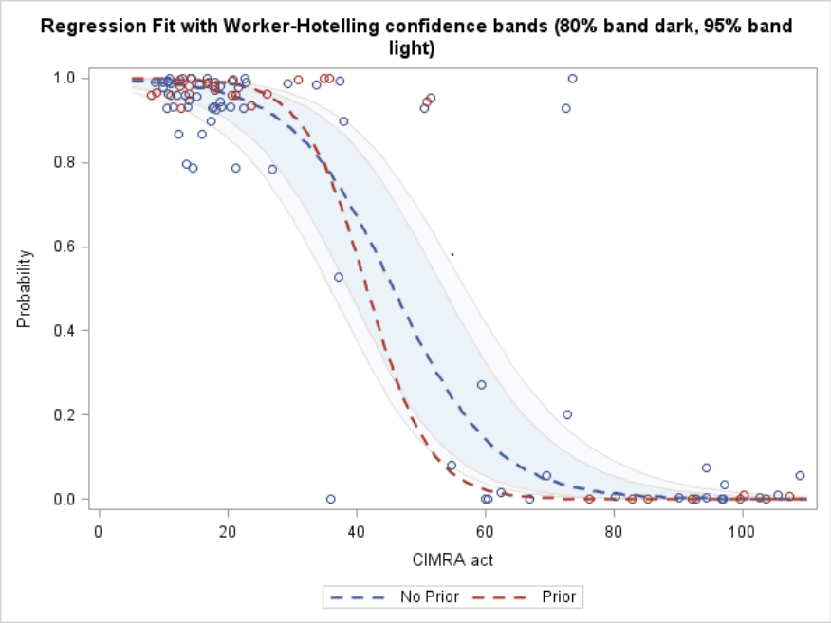
Circularity Because the “Gold Standard”
Was Classified Using the Same Data Type
MMR gene variants- New functional assay to classify Path v Benign for Lynch Synd
Blue curve: Variants not used to classify in silico tools (no prior fcn assays done)
Red curve: Variants used previously to classify in silico tools (prior fcn assays)-
potential for circularity and falsely high predictive value
Red curve violates the 80% and 95% CI
of the blue curve
Red curve has better discrimination due to
circularity, from prior use of a different
in vitro assay to classify the data set
Relevance to in silico algorithms-
Does the method use
population allele frequency?
If so, don’t use AF as a separate
predictor

Slide 19
The Clinical Genome Resource
Notes:
Add in diversity of group here? Verbally describe the overall team involved in crc/polyposis group.

Slide 20
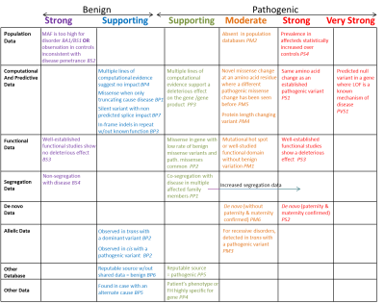
ACMG/AMP Guidelines
16% of discrepancies
in ClinVar due to
in silico data
ClinGen Disease WGs
Cardiovascular
Developmental Delay
Sequence Variant Interpretation WG
Harmonize recommendations for modifying ACMG guidelines
Hereditary Cancer
Metabolism
RASopathies
Gene/Disease Specific ACMG Guidelines
General recommendations to ACMG Guidelines

Slide 21
ClinGen SVI Progress
Weights of Evidence to Classify Variants
When combining data, how to weigh different types of evidence?
  ACMG proposed Qualitative “combining rules”
  SVI Goal is a more Quantitative method
Mathematical modeling (Tavtigian Hum Mut 2018)
  ACMG rules, with minor changes, accurately portray a Bayesian probability model
  Strength of each evidence level (P, M, S,VS) is exponential, ranging from strengths from 2.08:1 →350:1

Slide 22
Other Issues in
Classifying Variants
“Concordance of multiple methods” – BP4, PP3
In silico methods tend to correlate better with each other than with functional assay experimental data
  CAGI Examples (Clark et al NAGLU, Zhang CALM1 assay in yeast)
  Talk on this topic later today
  ACMG use of concordance is not appropriate- need a new rule

Slide 23
Other Issues in
Classifying Variants
Baseline “seq only” method may outperform specific methods
Genes with few or no known benign variants (PTEN)
  How to assess predictive values with no negative controls
  May not be able to assign accurate PVs
Easy versus Hard Variants
  CAGI examples Clark NAGLU, Kasak CBS
Remember, in a Bayesian model, each type of data does not need to be definitive.
If strength is below the threshold for Pathogenic or Benign, that’s OK. The rules to classify require multiple types of data anyway.

Slide 24
Suggested Refinements to the ACMG Computational Evidence Standards
Current ACMG Standard for Supporting Evidence
  BP4 Multiple lines of in silico evidence suggest no impact
  PP3 Multiple lines of in silico evidence support a deleterious effect
Proposed Improved Standard by SVI Computational Subgroup
  Choose one of an approved list of methods that have been validated for missense variants (see poster from Vikas, Sean, and Peja)
  Separate lists of methods for Pathogenic, Benign
  Apply to variants in a gene to generate scores
  80% PV = Odds Path of 4:1, Supporting = 2:1
  Score exceeds threshold of 0.8 PV → Apply BP4 or PP3
  Score does not reach threshold 0f 0.8 → Cannot apply BP4 or PP3

Slide 25
Acknowledgments
ClinGen Sequence Variation Interpretation Computational Subgroup
  Steven Brenner
  Bing Feng
  Rachel Karchin
  Ann O’Donnell Luria
  Predrag Radivojac
  Sean Tavtigian
ClinGen Sequence Variant Interpretation
  Les Biesecker
  Steven Harrison
  Marc Greenblatt
  Danielle Azzariti
  Rajarshi Ghosh
  Snehit Prabhu
  Natasha Strande
  Steven Brenner
  Peter Kang
  Chris Heinen
  Rachel Karchin
  Robert Nussbaum
  Matt Hurles
  Sean Tavtigian
  Garry Cutting
  Antonis Antoniou
  Fergus Couch
  Selina Dwight
  Matt Wright
  Sharon Plon
  Heidi Rehm
ClinGen U41-HG007437; U41 HG007436

Slide 26
ACMG-AMP evidence categories causing persistent interpretation differences
Notes:
While application has increased concordance, there are still differences in application/interpretation of the rules (even when looking at the same evidence)

Slide 27
ClinGen SVI Progress in
Classifying Variants
Goal is transparency and consistency in classification rules
Working with InSiGHT Variant Interpretation Committee and other disease-specific groups
SVI has refined and updated several ACMG rules
  Population frequency data to classify a variant Benign
  Segregation data to classify a variant Pathogenic
  Splicing, de novo, other rules
  16% of discrepancies in ClinVar from in silico data

