Slide 1
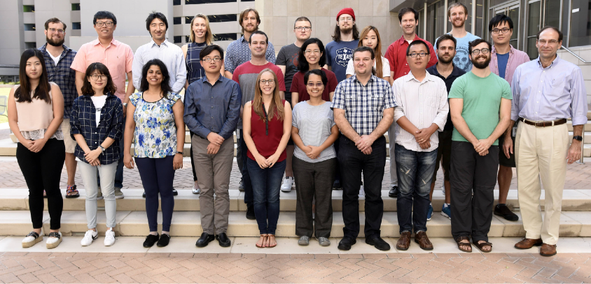
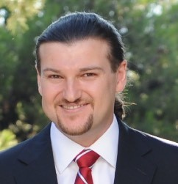
Predictors agree with each other more than with experiments
Dr. Panos Katsonis
Olivier Lichtarge M.D., Ph.D.
Molecular and Human Genetics © Baylor College of Medicine Houston, Texas

Slide 2

By the way…

Slide 3

CBS (2011)
Cystathionine β-Synthase
84 variants
2 assays
9 metrics

Slide 4
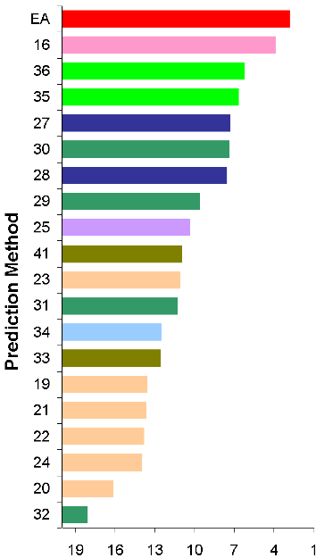
CBS (2011)
Cystathionine β-Synthase
84 variants
2 assays
9 metrics
Lichtarge lab (EA) Bromberg lab (SNAP)
Moult lab (SNPs3D)
Moult lab (SNPs3D) Vihinen lab (PON-P)
Brenner lab (SIFT) Vihinen lab (PON-P)
Brenner lab (R. Forest w SIFT) Switch lab (FoldX3.b4)
Mooney lab (MutPred)
Tosatto lab (K-Nearest neighbor)
Brenner lab (growth ratios)
Sunyaev lab (Polyphen2) Mooney lab (MutPred)
Tosatto lab (K-Nearest neighbor) Tosatto lab (novel metrics) Tosatto lab (K-Nearest neighbor)
Tosatto lab (D100 roll) Tosatto lab (K-Nearest neighbor)
Brenner lab (Random Forest w SIFT)
Worst
Assessor’s Overall rank
Best
Predict the effect of 84 variants in the function of CBS in high (400ng/ml) and in low (2ng/ml) co-factor (pyridoxine) concentration, measured in yeast complementation assay

Slide 5
CBS (2011)
Cystathionine β-Synthase
84 variants
2 assays
9 metrics
Lichtarge lab (EA) Bromberg lab (SNAP)
Moult lab (SNPs3D)
Moult lab (SNPs3D) Vihinen lab (PON-P)
Brenner lab (SIFT) Vihinen lab (PON-P)
Brenner lab (R. Forest w SIFT) Switch lab (FoldX3.b4)
Mooney lab (MutPred)
Tosatto lab (K-Nearest neighbor)
Brenner lab (growth ratios)
Sunyaev lab (Polyphen2) Mooney lab (MutPred)
Tosatto lab (K-Nearest neighbor) Tosatto lab (novel metrics) Tosatto lab (K-Nearest neighbor)
Tosatto lab (D100 roll) Tosatto lab (K-Nearest neighbor)
Brenner lab (Random Forest w SIFT)
1
PCC
against experimental data
0.8
0.6
0.4
0.2
0
0
0.2
0.4 0.6 0.8
1
average PCC
against other submissions
Worst
Assessor’s Overall rank
Best
Predict the effect of 84 variants in the function of CBS in high (400ng/ml) and in low (2ng/ml) co-factor (pyridoxine) concentration, measured in yeast complementation assay

Slide 6
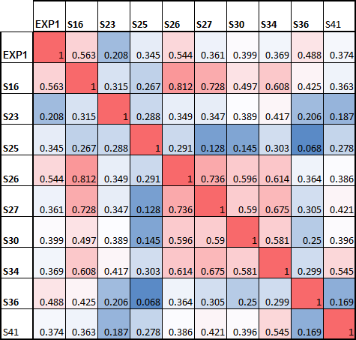
CBS (2011)
Cystathionine β-Synthase
84 variants
2 assays
9 metrics
Lichtarge lab (EA) Bromberg lab (SNAP)
Moult lab (SNPs3D)
Moult lab (SNPs3D) Vihinen lab (PON-P)
Brenner lab (SIFT) Vihinen lab (PON-P)
Brenner lab (R. Forest w SIFT) Switch lab (FoldX3.b4)
Mooney lab (MutPred)
Tosatto lab (K-Nearest neighbor)
Brenner lab (growth ratios)
Sunyaev lab (Polyphen2) Mooney lab (MutPred)
Tosatto lab (K-Nearest neighbor) Tosatto lab (novel metrics) Tosatto lab (K-Nearest neighbor)
Tosatto lab (D100 roll) Tosatto lab (K-Nearest neighbor)
Brenner lab (Random Forest w SIFT)
1
Lichta
PCC
against experimental data
0.8
0.6
0.4
0.2
EA phylogenomic approach
PON-P: random forest trained with variants of the PhenCode database using PhD-SNP, PolyPhen2, SIFT, SNAP, and DDG ENSEMBLE METHOD
PolyPhen2 (the authors) : naive Bayes trained on UniProt variants using features of amino-acid replacements, distance of the first deviation from the human wildtype, and whether the mutant originated at a hypermutable site
SIFT (not the authors): position specific substitution profile
0
0
0.2
0.4 0.6 0.8
1
average PCC
against other submissions
Worst Best
Assessor’s Overall rank
Predict the effect of 84 variants in the function of CBS in high (400ng/ml) and in low (2ng/ml) co-factor (pyridoxine) concentration, measured in yeast complementation assay

Slide 7

p16 (2013)
10 variants
1 assay
4 metrics

Slide 8
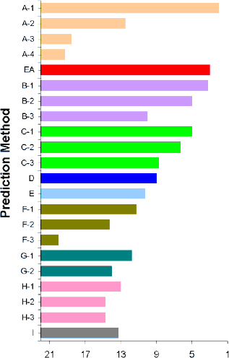
p16 (2013)
10 variants
1 assay
4 metrics
Yang & Zhou lab (SVM) Yang & Zhou lab (ddG)
Yang & Zhou lab (PSSM) Yang & Zhou lab (ddG)
Lichtarge lab (EA) Casadio lab (SNPs&GO)
Casadio lab (DrDancer) Casadio lab (Meta-SNP)
Moult lab (6 methods) Moult lab (6 methods)
Moult lab (6 methods) Anonymous (PSSM)
Dunbrack lab (SVM) Gaunt lab (FATHMM)
Gaunt lab (FATHMM) Gaunt lab (FATHMM)
Vihinen lab (PON-P) Vihinen lab (PON-P)
Bromberg lab (SNAP)
Bromberg lab (SNAP) Bromberg lab (SNAP)
Casadio lab (SNPs&GO)
Worst Assessor’s Overall rank Best
Evaluate how 10 variants of p16 protein impact its
ability to block cell proliferation.The proliferation rate
was set as 100% for mutation-like and 50% for wild- type cells

Slide 9
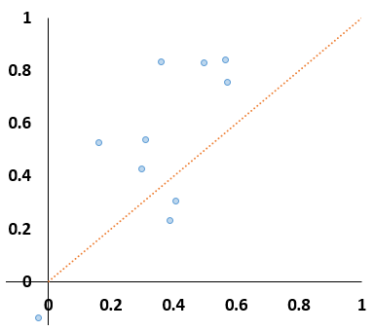
p16 (2013)
10 variants
1 assay
4 metrics
Yang & Zhou lab (SVM) Yang & Zhou lab (ddG)
Yang & Zhou lab (PSSM) Yang & Zhou lab (ddG)
Lichtarge lab (EA) Casadio lab (SNPs&GO)
Casadio lab (DrDancer) Casadio lab (Meta-SNP)
Moult lab (6 methods) Moult lab (6 methods)
Moult lab (6 methods) Anonymous (PSSM)
Dunbrack lab (SVM) Gaunt lab (FATHMM)
Gaunt lab (FATHMM) Gaunt lab (FATHMM)
Vihinen lab (PON-P) Vihinen lab (PON-P)
Bromberg lab (SNAP)
Bromberg lab (SNAP) Bromberg lab (SNAP)
Casadio lab (SNPs&GO)
Worst Assessor’s Overall rank Best
Evaluate how 10 variants of p16 protein impact its
PCC
against experimental data
average PCC
against other submissions
ability to block cell proliferation.The proliferation rate
was set as 100% for mutation-like and 50% for wild- type cells

Slide 10
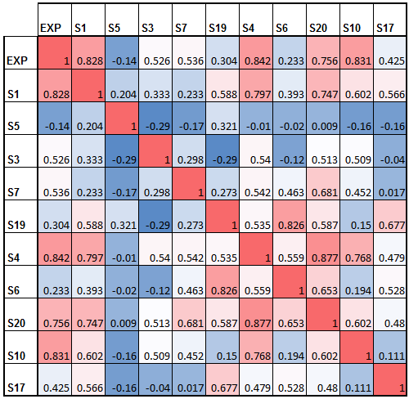
p16 (2013)
10 variants
1 assay
4 metrics
Yang & Zhou lab (SVM) Yang & Zhou lab (ddG)
Yang & Zhou lab (PSSM) Yang & Zhou lab (ddG)
Lichtarge lab (EA) Casadio lab (SNPs&GO)
Casadio lab (DrDancer) Casadio lab (Meta-SNP)
Moult lab (6 methods) Moult lab (6 methods)
Moult lab (6 methods) Anonymous (PSSM)
Dunbrack lab (SVM) Gaunt lab (FATHMM)
Gaunt lab (FATHMM) Gaunt lab (FATHMM)
Vihinen lab (PON-P) Vihinen lab (PON-P)
Bromberg lab (SNAP)
Bromberg lab (SNAP) Bromberg lab (SNAP)
Casadio lab (SNPs&GO)
Worst Assessor’s Overall rank Best
Evaluate how 10 variants of p16 protein impact its ability to block cell proliferation.The proliferation rate was set as 100% for mutation-like and 50% for wild- type cells
PCC
against experimental data
EA = S4
FATHMM: used protein domain annotation and calculated probability based on Hidden Markov Models that represent the alignment
PON-P: random forest trained with variants of the
PhenCode database using PhD-SNP, PolyPhen2, SIFT, SNAP, and DDG
2 linear models: trained with proliferation assay
data using SNPs3D stability, SNPs 3D sequence, PolyPhen2, SIFT, CHASM, and Condel
average PCC
against other submissions

Slide 11


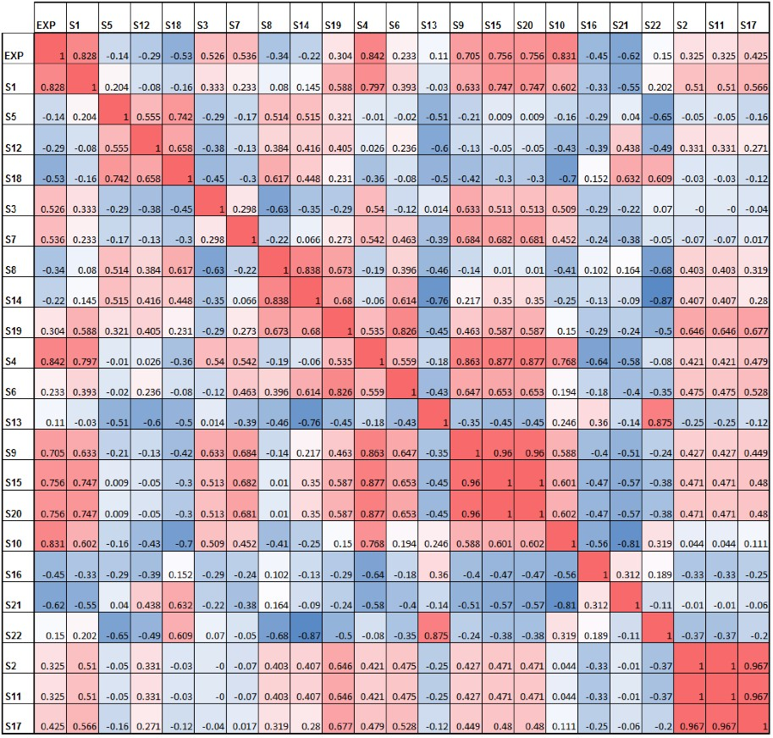
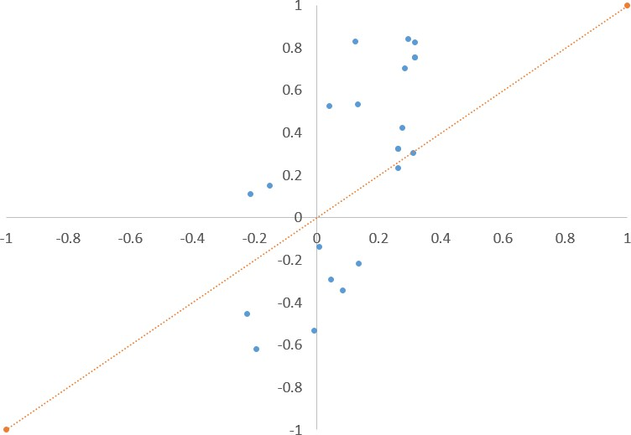
p16 all submissions (2013)
PCC
against experimental data
average PCC
against other submissions
EA = S4
The data points vary more on the y-axis than in the x-axis (which is an average). This suggests that the performance assessment is not robust for only 10 points.

Slide 12

SUMO Ligase (2016)
5,572 variants
1 assay
54 metrics!

Slide 13
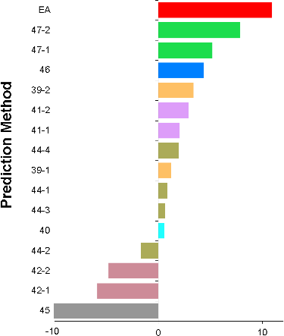
SUMO Ligase (2016)
5,572 variants
1 assay
54 metrics!
Lichtarge lab (EA) Moult lab (11 methods)
Moult lab (11 methods) Dunbrack lab (SVM)
Jones lab (Substitution frequency) Bromberg lab (SNAP)
Bromberg lab (SNAP) Mooney lab (MutPred2)
Jones lab (Substitution frequency)
Mooney lab (MutPred)
Mooney lab (MutPred2-beta) Zhuliny lab (SAVER)
Mooney lab (MutPred2-beta) Casadio lab (INPS)
Casadio lab (INPS)
Berkeley Biolabs (pipeline w Polyphen2)
Worst Best
Predict of the effect of 5,572 variants on competitive growth. The competitive growth was calculated as the ratio of the barcode read counts at the restrictive and at the
permissive temperature. This ratio was normalized to the ratio observed for the ‘wild- type’.

Slide 14
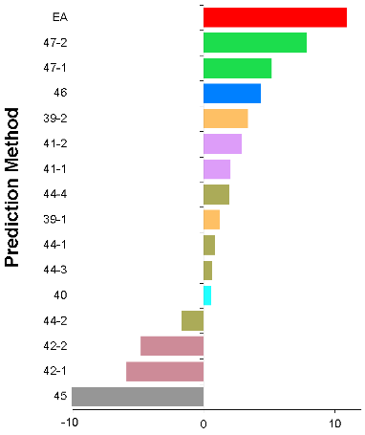
SUMO Ligase (2016)
5,572 variants
1 assay
54 metrics!
Lichtarge lab (EA) Moult lab (11 methods)
Moult lab (11 methods) Dunbrack lab (SVM)
Jones lab (Substitution frequency) Bromberg lab (SNAP)
Bromberg lab (SNAP) Mooney lab (MutPred2)
Jones lab (Substitution frequency)
Mooney lab (MutPred)
Mooney lab (MutPred2-beta) Zhuliny lab (SAVER)
Mooney lab (MutPred2-beta) Casadio lab (INPS)
Casadio lab (INPS)
Berkeley Biolabs (pipeline w Polyphen2)
1
PCC
against experimental data
0.75
0.5
0.25
Worst Best
Predict of the effect of 5,572 variants on competitive growth. The competitive growth was calculated as the ratio of the barcode read counts at the restrictive and at the
0
0
0.25 0.5 0.75
average PCC
against other submissions
1
permissive temperature. This ratio was normalized to the ratio observed for the ‘wild- type’.

Slide 15
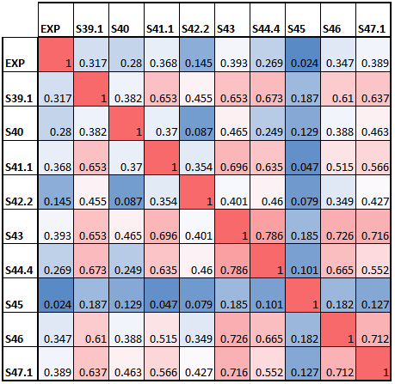
SUMO Ligase (2016)
5,572 variants
1 assay
54 metrics!
Lichtarge lab (EA) Moult lab (11 methods)
Moult lab (11 methods) Dunbrack lab (SVM)
Jones lab (Substitution frequency) Bromberg lab (SNAP)
Bromberg lab (SNAP) Mooney lab (MutPred2)
Jones lab (Substitution frequency)
Mooney lab (MutPred)
Mooney lab (MutPred2-beta) Zhuliny lab (SAVER)
Mooney lab (MutPred2-beta) Casadio lab (INPS)
Casadio lab (INPS)
Berkeley Biolabs (pipeline w Polyphen2)
1
PCC
against experimental data
0.75
0.5
0.25
Worst Best
Predict of the effect of 5,572 variants on competitive growth. The competitive growth was calculated as the ratio of the barcode read counts at the restrictive and at the permissive temperature. This ratio was normalized to the ratio observed for the ‘wild- type’.
EA = S43
MutPred2: machine learning trained on variants from HGMD, SwissVar, and dbSNP, using over 50 different protein properties
0
0
0.25 0.5 0.75
average PCC
against other submissions
1
Linear model of conservation, Get Area Server, a weighted contact score, and PolyPhen2
SVM trained on SwissVar variants using PSSM scores, conservation AL2CO, surface accessibility, three disorder predictor scores
SVM trained on PAH disease related variants using Polyphen-2, SIFT, SNPs3D sequence profile, CADD, Panther, PON-P2, SNAP2, Provean, LRT,VEST3, MutationTaster.

Slide 16

NAGLU (2016)
165 variants
1 assay
3 metrics

Slide 17
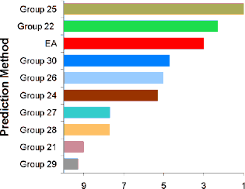
NAGLU (2016)
165 variants
1 assay
3 metrics
Mooney lab (MutPred2) Moult lab (11 methods)
Lichtarge lab (EA) Dunbrack lab (5 methods) Jones lab (Subst. freq.) (PSSM)
Wei lab (SVM on NAGLU data) Ford lab (Polyphen2)
Casadio lab (INPS) (SNPs&GO)
Bromberg lab (SNAP)
Yang & Zhou lab (EASE-MM)
Worst Best
Assessor’s Overall rank
Predict the effect of 165 variants on NAGLU enzymatic activity

Slide 18
NAGLU (2016)
165 variants
1 assay
3 metrics
1
PCC
against experimental data
0.75
Mooney lab (MutPred2) Moult lab (11 methods)
Lichtarge lab (EA) Dunbrack lab (5 methods) Jones lab (Subst. freq.) (PSSM)
Wei lab (SVM on NAGLU data) Ford lab (Polyphen2)
Casadio lab (INPS) (SNPs&GO)
Bromberg lab (SNAP)
Yang & Zhou lab (EASE-MM)
0.5
0.25
Worst Best
Assessor’s Overall rank
Predict the effect of 165 variants on NAGLU enzymatic activity
0
0.25 0.5 0.75
average PCC
against other submissions
0
1

Slide 19
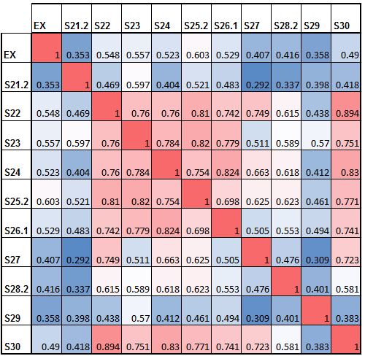
NAGLU (2016)
165 variants
1 assay
3 metrics
1
PCC
against experimental data
0.75
Mooney lab (MutPred2) Moult lab (11 methods)
Lichtarge lab (EA) Dunbrack lab (5 methods) Jones lab (Subst. freq.) (PSSM)
Wei lab (SVM on NAGLU data) Ford lab (Polyphen2)
Casadio lab (INPS) (SNPs&GO)
Bromberg lab (SNAP)
Yang & Zhou lab (EASE-MM)
0.5
0.25
Worst Best
Assessor’s Overall rank
Predict the effect of 165 variants on NAGLU enzymatic activity
SVM trained on NAGLU variants using Polyphen-2, SIFT, SNPs3D sequence profile, CADD, Panther, PON-P2, SNAP2, Provean, LRT, VEST3, MutationTaster.
EA = S23
5 SVM classifiers trained on NAGLU variants using Phylop conservation score, protetin sequence composition bias, CpG island, protein second structure, protein structure volume change, protein structure B factor and prediction scores from Polyphen2 and MutationAssessor
MutPred2: machine learning trained on variants from HGMD, SwissVar, and dbSNP, using over 50 different protein properties
Custom: contact map derived from the available 3-D structure and amino acid covariation
0
0.25 0.5 0.75
average PCC
against other submissions
0
1

Slide 20

Pyruvate Kinase (2016)
543 variants
1 assay
1 metrics

Slide 21
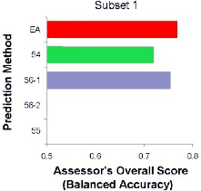
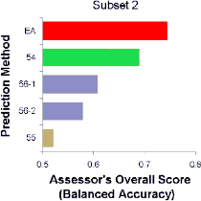
Pyruvate Kinase (2016)
543 variants
1 assay
1 metrics
Lichtarge lab (EA) Jones lab (Subst. freq.)
Seok lab (PSSM) Seok lab (ConSurf)
Casadio lab (active site annot.)
Predict the effect of 543 mutations on L-PYK enzyme activity.

Slide 22
Pyruvate Kinase (2016)
1
543 variants
1 assay
1 metrics
PCC
against experimental data
0.75
Lichtarge lab (EA) Jones lab (Subst. freq.)
Seok lab (PSSM) Seok lab (ConSurf)
Casadio lab (active site annot.)
Predict the effect of 543 mutations on L-PYK enzyme activity.
0.5
0.25
0
0.25 0.5 0.75
average PCC
against other submissions
0
1

Slide 23
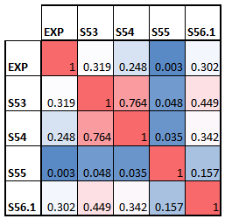
Pyruvate Kinase (2016)
1
543 variants
1 assay
1 metrics
PCC
against experimental data
0.75
Lichtarge lab (EA) Jones lab (Subst. freq.)
Seok lab (PSSM) Seok lab (ConSurf)
Casadio lab (active site annot.)
Predict the effect of 543 mutations on L-PYK enzyme activity.
0.5
0.25
EA = S53
0
MetaPSICOV : pairwise substitution frequencies with pseudocounts
0
0.25 0.5 0.75
average PCC
against other submissions
1

Slide 24

CALM1 (2018)
1813 variants
1 assay
16 metrics

Slide 25
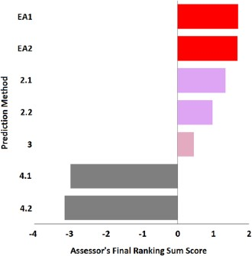
CALM1 (2018)
1813 variants
1 assay
16 metrics
Lichtarge lab (EA)
Lichtarge lab (EA) Capriotti lab (3 predictors)
PhD-SNP; PANTHER; SNPs&GO
Capriotti lab (SNPs&GO)
Casadio lab (INPS 3D)
Pal lab (Molecular Dynamics) Pal lab (Molecular Dynamics)
Worst Best
Predict the fitness effect of 1,813
variants of the human calmodulin
measured with a competitive growth
assay in yeast

Slide 26
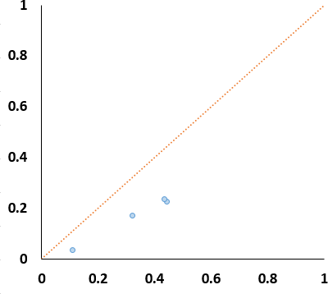
CALM1 (2018)
1813 variants
1 assay
16 metrics
PCC
against experimental data
Lichtarge lab (EA)
Lichtarge lab (EA) Capriotti lab (3 predictors)
PhD-SNP; PANTHER; SNPs&GO
Capriotti lab (SNPs&GO)
Casadio lab (INPS 3D)
Pal lab (Molecular Dynamics) Pal lab (Molecular Dynamics)
Worst Best
Predict the fitness effect of 1,813
average PCC
against other submissions
variants of the human calmodulin
measured with a competitive growth
assay in yeast

Slide 27
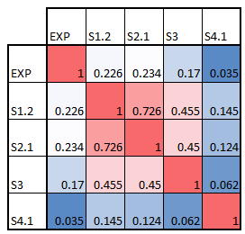
CALM1 (2018)
1813 variants
1 assay
16 metrics
PCC
against experimental data
Lichtarge lab (EA)
Lichtarge lab (EA) Capriotti lab (3 predictors)
PhD-SNP; PANTHER; SNPs&GO
Capriotti lab (SNPs&GO)
Casadio lab (INPS 3D)
Pal lab (Molecular Dynamics) Pal lab (Molecular Dynamics)
EA = S1.2
PhD-SNP + PANTHER + SNPs&GO
INPS 3D: Support Vector Regression trained on features extracted from the protein primary sequence and features
Worst
Best
Predict the fitness effect of 1,813
extracted from the protein 3D structure
average PCC
against other submissions
variants of the human calmodulin
measured with a competitive growth
assay in yeast

Slide 28

GAA (2018)
357 variants
1 assay
1 metric

Slide 29
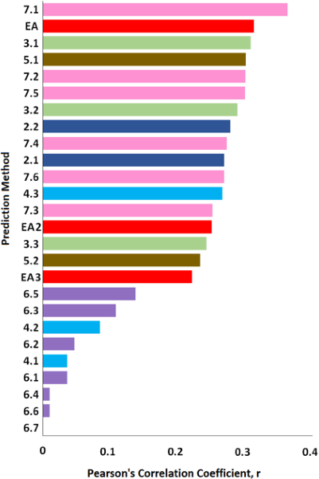
GAA (2018)
357 variants
1 assay
1 metric
Bromberg lab (SNAP) Lichtarge lab (EA)
(dbNSFP)
Mooney lab (MutPred2)* Bromberg lab (SNAP) Bromberg lab (SNAP)
(dbNSFP)
Capriotti lab (SNPs&GO)
Bromberg lab (SNAP) Capriotti lab (SNPs&GO) Bromberg lab (SNAP) Kim lab (ELASPIC)
Bromberg lab (SNAP) Lichtarge lab (u50 align)
(dbNSFP)
Mooney lab (MutPred2)* Lichtarge lab (prET)
Casadio lab (PhDSNP + SIFT + SNAP) Casadio lab (PhDSNP)
Kim lab (ELASPIC)
Casadio lab (SNPs&GO + PhDSNP)
Kim lab (ELASPIC) Casadio lab (SNPs&GO)
Casadio lab (MetaSNP) Casadio lab (PhDSNPg)
Casadio lab (SNPsGO + PhDSNPg)
Worst Best
Predict the enzymatic activity of 357
EA = S1.1
variants of the human acid alpha-
glucosidase.
*some variants were not scored

Slide 30
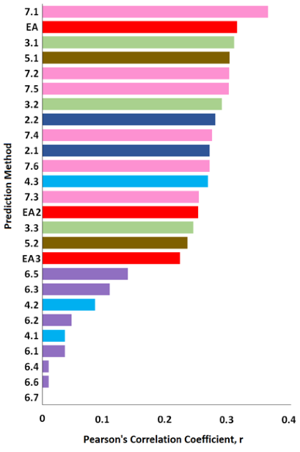
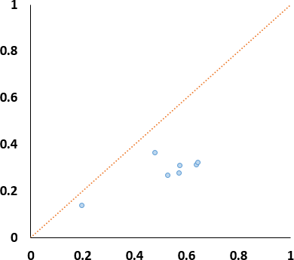
GAA (2018)
357 variants
1 assay
1 metric
Bromberg lab (SNAP) Lichtarge lab (EA)
(dbNSFP)
Mooney lab (MutPred2)* Bromberg lab (SNAP) Bromberg lab (SNAP)
(dbNSFP)
Capriotti lab (SNPs&GO)
Bromberg lab (SNAP) Capriotti lab (SNPs&GO) Bromberg lab (SNAP) Kim lab (ELASPIC)
Bromberg lab (SNAP) Lichtarge lab (u50 align)
(dbNSFP)
Mooney lab (MutPred2)* Lichtarge lab (prET)
Casadio lab (PhDSNP + SIFT + SNAP) Casadio lab (PhDSNP)
Kim lab (ELASPIC)
Casadio lab (SNPs&GO + PhDSNP)
Kim lab (ELASPIC) Casadio lab (SNPs&GO)
Casadio lab (MetaSNP) Casadio lab (PhDSNPg)
Casadio lab (SNPsGO + PhDSNPg)
Worst Best
Predict the enzymatic activity of 357
PCC
against experimental data
average PCC
against other submissions
variants of the human acid alpha-
glucosidase.
*some variants were not scored

Slide 31
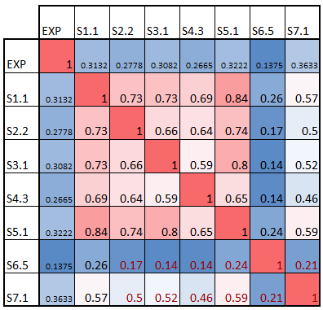
GAA (2018)
357 variants
1 assay
1 metric
Bromberg lab (SNAP) Lichtarge lab (EA)
(dbNSFP)
Mooney lab (MutPred2)* Bromberg lab (SNAP) Bromberg lab (SNAP)
(dbNSFP)
Capriotti lab (SNPs&GO)
Bromberg lab (SNAP) Capriotti lab (SNPs&GO) Bromberg lab (SNAP) Kim lab (ELASPIC)
Bromberg lab (SNAP) Lichtarge lab (u50 align)
(dbNSFP)
Mooney lab (MutPred2)* Lichtarge lab (prET)
Casadio lab (PhDSNP + SIFT + SNAP) Casadio lab (PhDSNP)
Kim lab (ELASPIC)
Casadio lab (SNPs&GO + PhDSNP)
Kim lab (ELASPIC) Casadio lab (SNPs&GO)
Casadio lab (MetaSNP) Casadio lab (PhDSNPg)
Casadio lab (SNPsGO + PhDSNPg)
Worst Best
PCC
against experimental data
EA = S1.1
SNPs&GO: SVM trained on Swiss-Prot data and using: the local sequence environment of the mutation at hand, features derived from sequence alignment, prediction data provided by the PANTHER classification system and a functional based log-odds score calculated considering the GO classification
dbNSFP: prediction scores from 29 prediction algorithms
ELASPIC: constructs homology models of domains and domain-domain interactions, and uses those models, together with sequential and other features, to predict the energetic impact of a mutation on the stability of a single domain or the affinity between two domains
MutPred2: machine learning trained on variants from HGMD, SwissVar, and dbSNP, using over 50 different protein properties
average PCC
against other submissions
Predict the enzymatic activity of 357
variants of the human acid alpha-
glucosidase.
*some variants were not scored

Slide 32
TPMT & PTEN (2018) – Folding stability
4,002 PTEN
3,952 TPMT
1 assay
1 metrics!

Slide 33
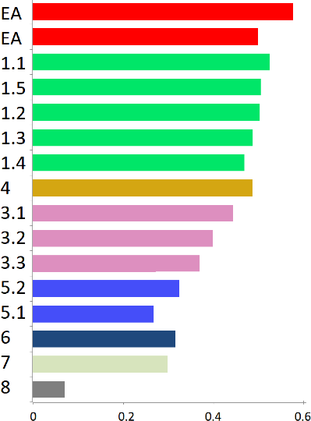
TPMT & PTEN (2018) – Folding stability
4,002 PTEN
3,952 TPMT
1 assay
1 metrics!
Lichtarge lab (EA w acc) Lichtarge lab (EA)
Moult lab (7 methods)
Moult lab (8 methods) Moult lab (Rosetta)
Moult lab (8 methods) Moult lab (8 methods)
Zhou lab (EASE-MM) Casadio lab (INPS 3D)
Casadio lab (INPS 3D) Casadio lab (INPS 3D)
Dunbrack lab (FoldX) Dunbrack lab (FoldX)
Vihinen lab (PON-P) (SVM)
Pal lab (Molecular Dynamics)
Prediction Method
Worst
Pearson Correlation Coefficient
Best
Predict the effect of 4,002 PTEN and 3,952 TPMT variants on protein stability (fluorescent reporter assay)

Slide 34
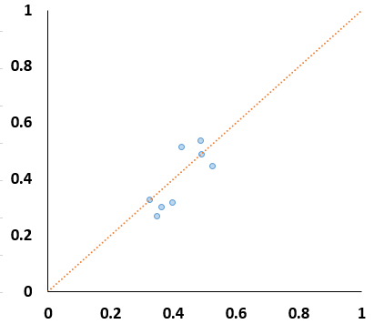
TPMT & PTEN (2018) – Folding stability
4,002 PTEN
3,952 TPMT
1 assay
1 metrics!
a
t
a d
l
a
t
n
e
m
i
r e
xp e
t
s
n i
ga
a
Lichtarge lab (EA w acc) Lichtarge lab (EA)
Moult lab (7 methods)
Moult lab (8 methods) Moult lab (Rosetta)
Moult lab (8 methods) Moult lab (8 methods)
Zhou lab (EASE-MM) Casadio lab (INPS 3D)
Casadio lab (INPS 3D) Casadio lab (INPS 3D)
Dunbrack lab (FoldX) Dunbrack lab (FoldX)
Vihinen lab (PON-P) (SVM)
Pal lab (Molecular Dynamics)
PCC
Prediction Method
average PCC
against other submissions
Worst
Pearson Correlation Coefficient
Best
Predict the effect of 4,002 PTEN and 3,952 TPMT variants on protein stability (fluorescent reporter assay)

Slide 35
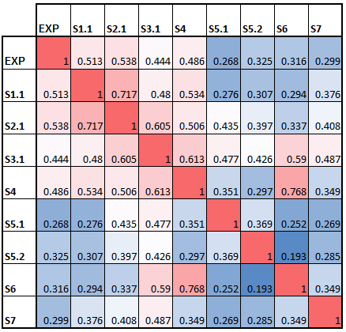
TPMT & PTEN (2018) – Folding stability
4,002 PTEN
3,952 TPMT
1 assay
1 metrics!
a
t
a d
l
a
t
n
e
m
i
r e
xp e
t
s
n i
ga
a
Lichtarge lab (EA w acc) Lichtarge lab (EA)
Moult lab (7 methods)
Moult lab (8 methods) Moult lab (Rosetta)
Moult lab (8 methods) Moult lab (8 methods)
Zhou lab (EASE-MM) Casadio lab (INPS 3D)
Casadio lab (INPS 3D) Casadio lab (INPS 3D)
Dunbrack lab (FoldX) Dunbrack lab (FoldX)
Vihinen lab (PON-P) (SVM)
Pal lab (Molecular Dynamics)
PCC
Prediction Method
average PCC
against other submissions
SVR ensemble (PolyPhen2, SIFT, SNPs3D Profile, PON-P2, PROVEAN, VEST3, SNAP2)
INPS 3D: Stability Predictor Support Vector Regression trained on features extracted from the protein primary sequence and features extracted from the protein 3D structure
Worst Best
Pearson Correlation Coefficient
Predict the effect of 4,002 PTEN and 3,952 TPMT variants on protein stability (fluorescent reporter assay)
EASE-MM: DDG predictor of 5 SVM models trained on features from evolutionary conservation, amino acid parameters, and predicted structural properties.
EA = S2.1

Slide 36
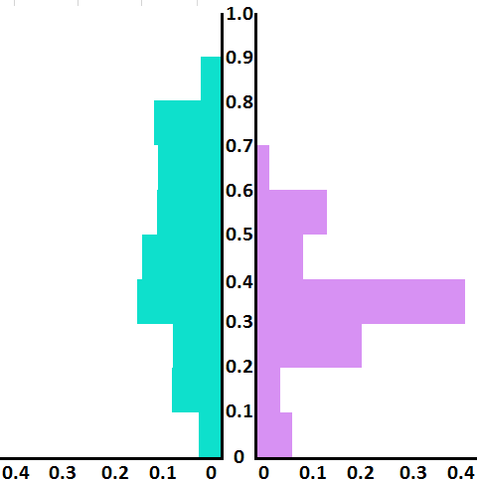
These data show…
PREDICTORS AGREE BETTER WITH EACH OTHER THAN WITH TO EXPERIMENTAL DATA
Agreement of predictions with predictions or experimental data
Pearson's correlation coefficient, r
average
average
0.46
0.34
fraction
based on CBS, NAGLU, SUMO, Pyruvate
Kinase, GAA, and CALM1 challenges

Slide 37
These data show…
PREDICTORS AGREE BETTER WITH EACH OTHER THAN WITH TO EXPERIMENTAL DATA
WHY?
Agreement of predictions with predictions or experimental data
Predictors at fault
Experiment at fault
Pearson's correlation coefficient, r
average
average
0.46
0.34
fraction
based on CBS, NAGLU, SUMO, Pyruvate
Kinase, GAA, and CALM1 challenges

Slide 38
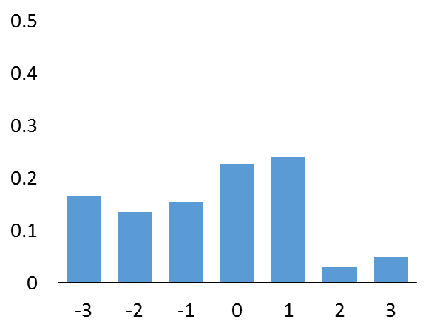
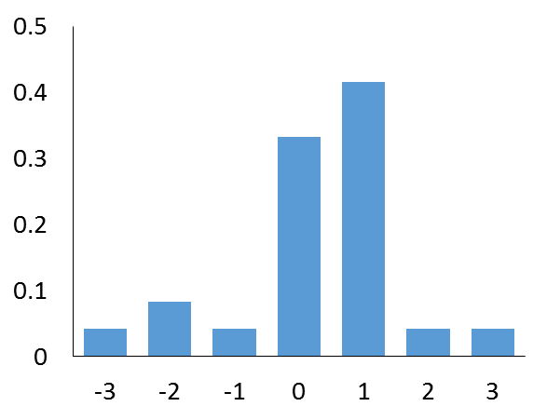

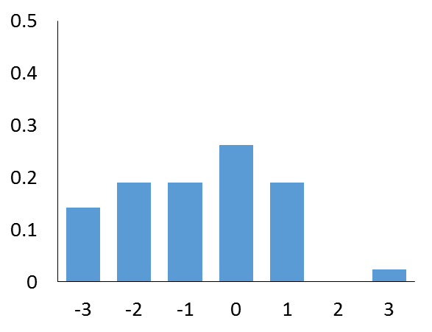
Predictors at fault: Are substitution odds misleading?
Underestimated impact
Av(Pred) - Exp > 0.33
All NAGLU variants
Fraction
Fraction
NAGLU (2018)
BLOSUM62 log-odds
BLOSUM62 log-odds Overestimated impact Exp - Av(Pred) > 0.33
0.5
Good impact estimation
|Exp – Av(Pred)| < 0.1
Fraction
0.4
Fraction
0.3
0.1
0
-3 -2 -1 0 1 2 3
BLOSUM62 log-odds
BLOSUM62 log-odds

Slide 39
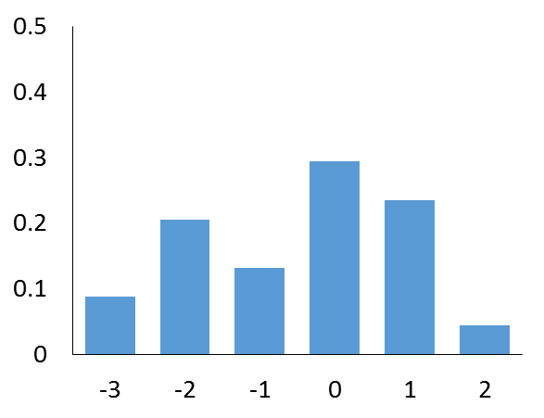
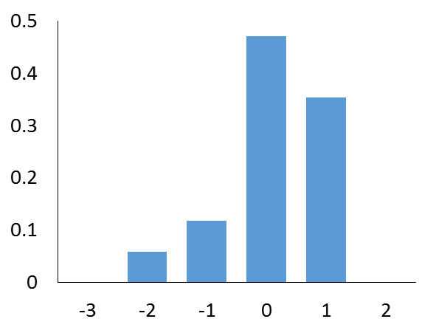
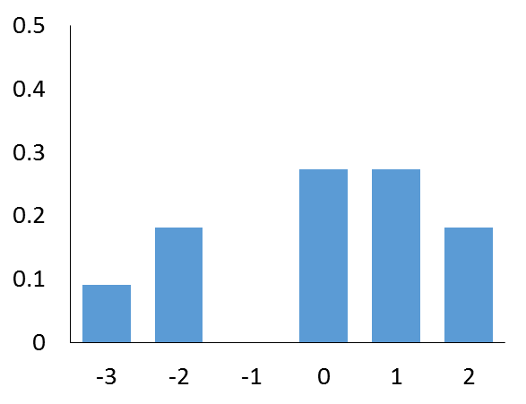
Predictors at fault: Are substitution odds misleading?
Underestimated impact
Av(Pred) - Exp > 0.33
All CBS variants
Fraction
Fraction
BLOSUM62 log-odds
BLOSUM62 log-odds Overestimated impact Exp - Av(Pred) > 0.33
Fraction
CBS (2011)
84 variants
2 assays
9 metrics
BLOSUM62 log-odds

Slide 40
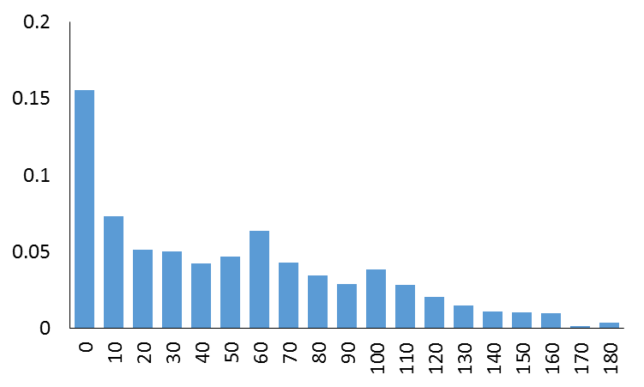
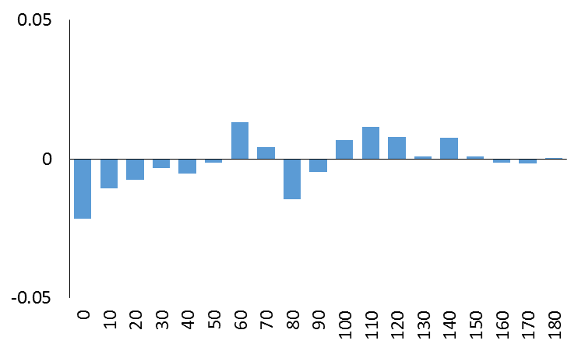

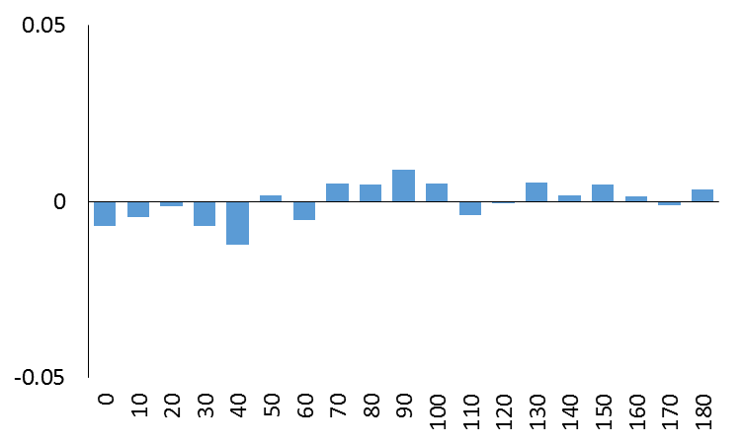
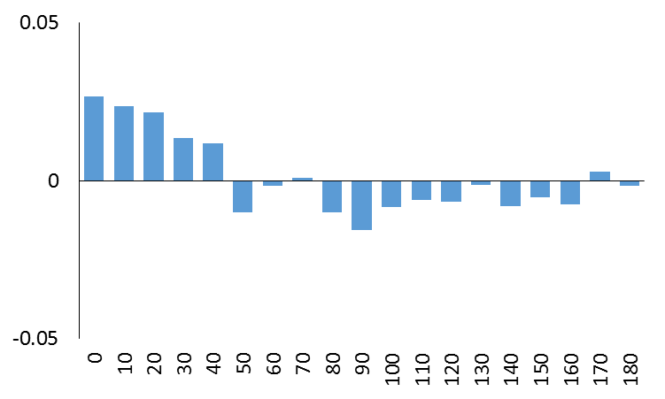
Folding stability: Is solvent access misleading?
Fraction difference
from all variant distribution
Underestimated impact
Av(Pred) - Exp > 0.33
All variants
Fraction
TPMT & PTEN (2018)
Solvent Accessibility
Solvent Accessibility
Overestimated impact
Exp - Av(Pred) > 0.33
Fraction difference
from all variant distribution
Good impact estimation
|Exp – Av(Pred)| < 0.1
Fraction difference
from all variant distribution
Solvent Accessibility
Solvent Accessibility

Slide 41
Some sources of predictor error?
Predictors agree better with each other than with to experimental data
Agreement of predictions with predictions or experimental data
WHY?
Predictors at fault
Amino acids (dis)similarity is not fully understood
Protein stability is not fully understood
Pearson's correlation coefficient, r
average
average
0.46
0.34
Experiment at fault
fraction
based on CBS, NAGLU, SUMO, Pyruvate
Kinase, GAA, and CALM1 challenges

Slide 42
Some sources of predictor error?
Predictors agree better with each other than with to experimental data
Agreement of predictions with predictions or experimental data
WHY?
Predictors at fault
Amino acids (dis)similarity is not fully understood
Protein stability is not fully understood
Pearson's correlation coefficient, r
average
average
0.46
0.34
Experiment at fault
fraction
based on CBS, NAGLU, SUMO, Pyruvate
Kinase, GAA, and CALM1 challenges

Slide 43
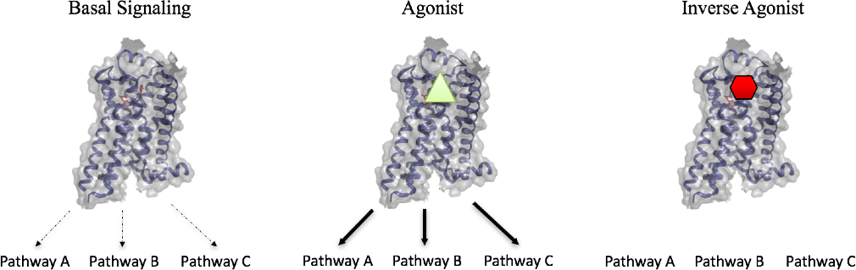
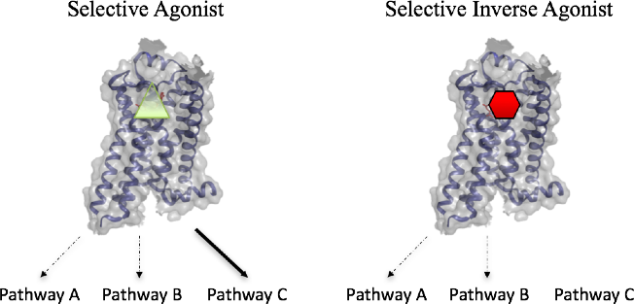
Protein are complex computers: GPCRs
Many layers of complexity:
A GPCR may respond to multiple ligands
Each ligand may activate distinct combinations of signaling pathways
GPCRs must have mechanisms to adopt many different structural conformations that, in response to various ligands, signal through diverse pathways
What are the determinants of signaling and bias

Slide 44
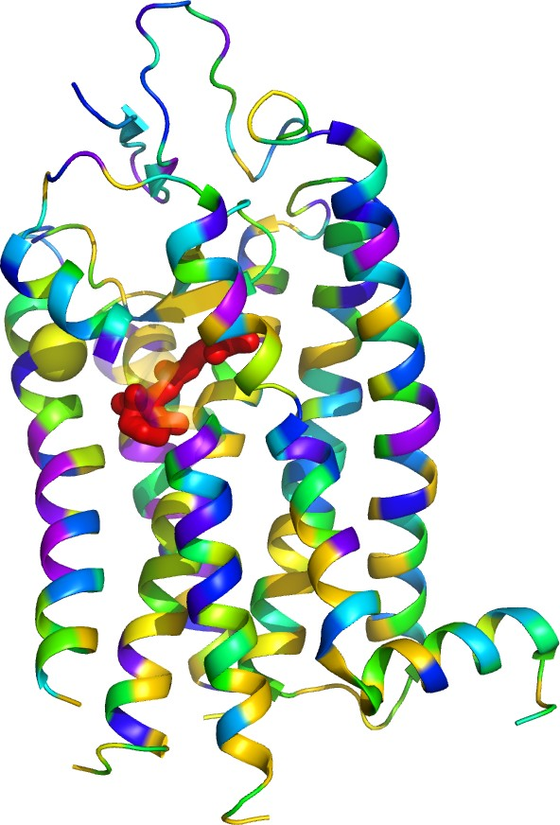

Need multiple assays to measure what mutations do
Residue Weight
Rhodopsin
W175A/C/H TM4
Decrease ligand binding
HEAVY
Impaired retinal binding
100
LIGHT
80
60
40
20
0
WT L79A L79S W175A W175C W175H
% Rhodopsin Regeneration
Madabushi JBC 2004
Wensel Lab

Slide 45
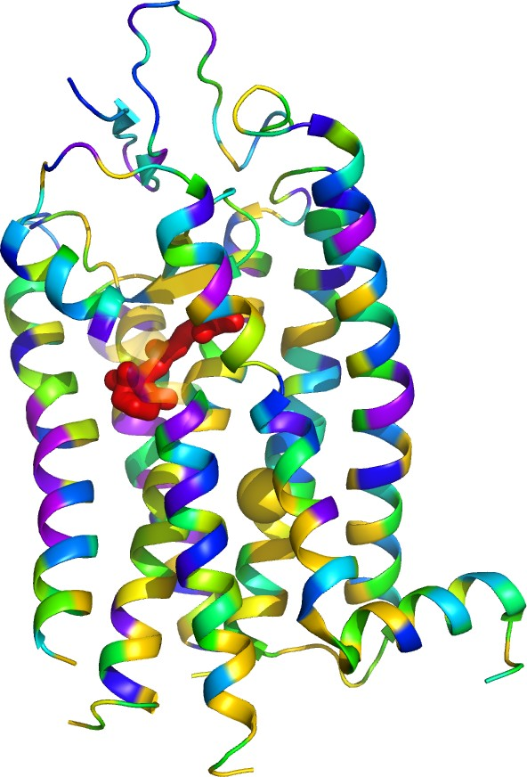
Need multiple assays to measure what mutations do
Residue Weight
Decrease retinal binding
Design constitutive activity
Rhodopsin
HEAVY
Impaired retinal binding
Constitutive activation (mild but pathological)
100
LIGHT
80
3
L79A TM2
3
2
1
hν
60
2
hν
40
0
0 4 8 12
20
1
0
0
WT L79A L79S W175A W175C W175H
% Rhodopsin Regeneration
0 4 8 12
GTPγS bound (pmoles)
Madabushi JBC 2004
Wensel Lab

Slide 46
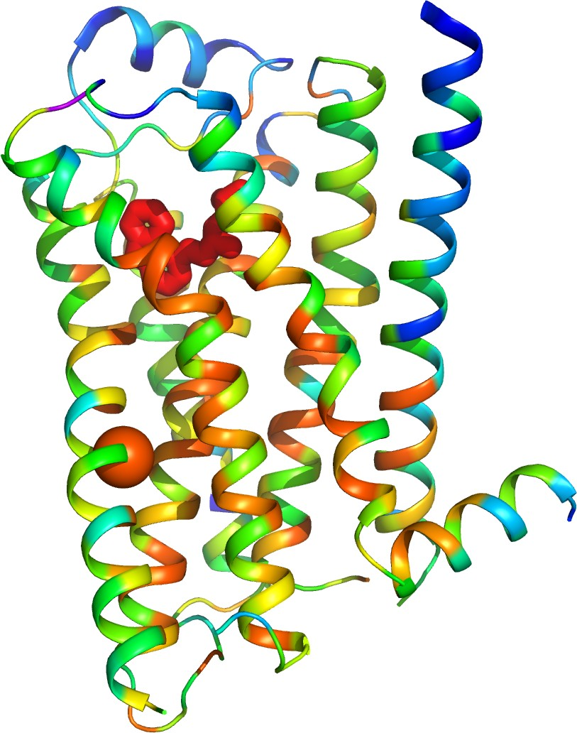

Slide 47
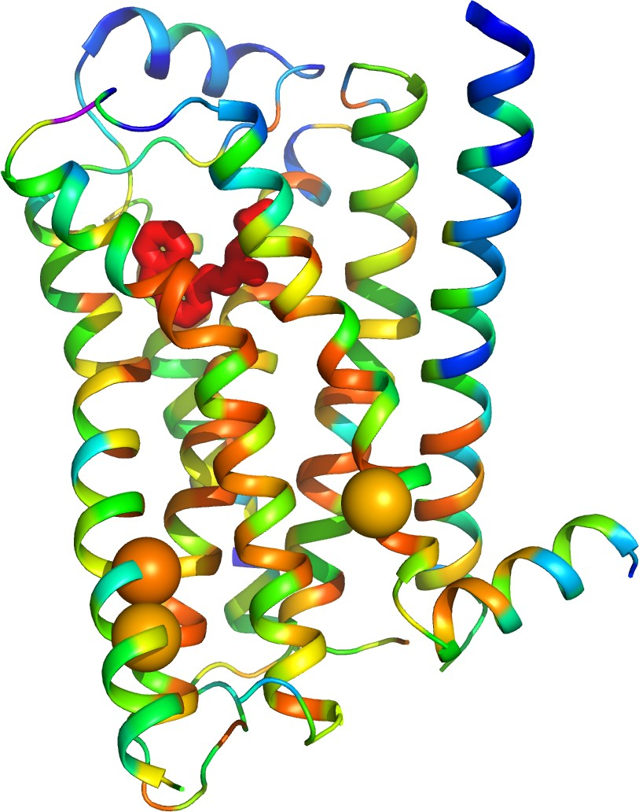

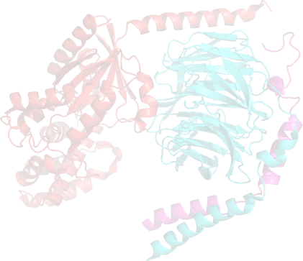
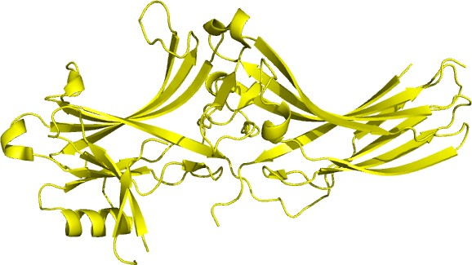
Need multiple assays to measure what mutations do
Residue Weight
Decrease retinal binding
Yield constitutive activity
HEAVY
Reprogram allosteric specificity
Separate efferent pathways
YT68H TM2
Y219G TM5
Uncouple efferent pathways
G protein not activated GPCR Internalized
Y132H TM3
20
15
LIGHT
40
30
20
10
0
WT
10
5
Mutant
- controls
0
NS -12 -11 -10 -9 -8 -7 -6 -5
log[iso]
WT M3
Percent Sequestration β₂-AR mutant
cAMP accumulation HEK-293 (pMoles)
β-arrestin
G Protein
Shenoy et al JBC 2006 Lefkowitz Lab

Slide 48
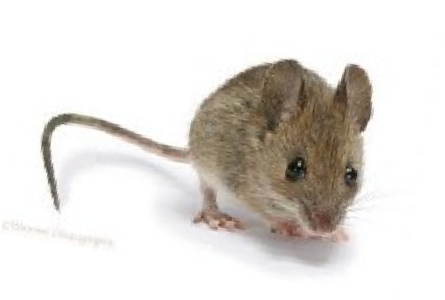
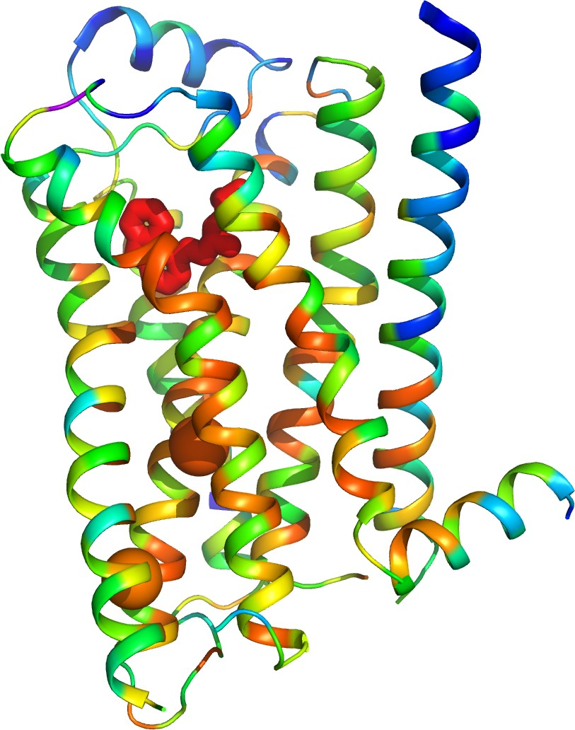
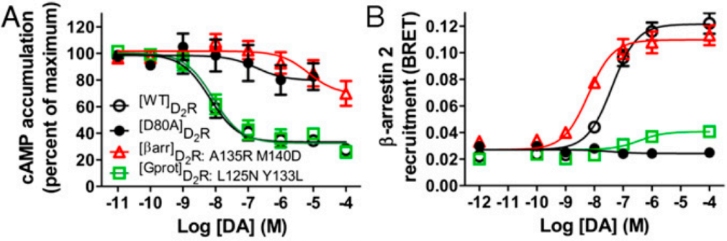
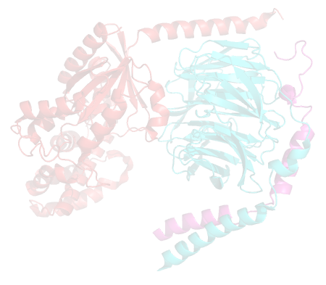


Need multiple assays to measure what mutations do
Residue Weight
Decrease retinal binding
Yield constitutive activity
HEAVY
Reprogram allosteric specificity
Separate efferent pathways
- in vivo
L125N TM3
Y133L TM3
LIGHT
β-arrestin
G Protein
Peterson et al PNAS 2015
Caron Lab

Slide 49





Need multiple assays to measure what mutations do
Residue Weight
Decrease retinal binding
Yield constitutive activity
HEAVY
Reprogram allosteric specificity
Separate efferent pathways
  in vivo
  either way
L125N TM3
Y133L TM3
LIGHT
β-arrestin
G Protein
Peterson et al PNAS 2015
Caron Lab

Slide 50









Decode the switches that bias receptor signaling
Residue Weight
HEAVY
Decrease retinal binding
Yield constitutive activity
Reprogram allosteric specificity
V86
Separate efferent pathways
Map functional bias modules
A78
I278
L124 I127
R328
K273 A271
R333
LIGHT
Schonegge et al NSMB 2017
Bouvier Lab

Slide 51



Example of complexity revealed by multiple assays: Experimentally impact across 5 pathways
Characterize mutational impact across 5 major signaling pathways
Generates a signaling profile for each mutation
Schonegge and Gallion 2016

Slide 52

Multiple parameters characterize the dose-response curve
Maximal signaling
EC50 concentration
Basal signaling
Dose response curves display receptor activity (for a specific signaling response) as a function of ligand concentration.

Slide 53


Signaling bias can be titrated at each position
V86->I(26),
A(53),
Y(73),
D(90)
Increasing the mutational pressure on a single position eventually leads to a strong, biased perturbation on GPCR signaling.
Schonegge and Gallion 2016

Slide 54

Cluster together mutations with similar impact across pathways
Schonegge and Gallion 2016

Slide 55

The mutations form three clusters
each with a different and specific signaling bias
Schonegge and Gallion 2016

Slide 56






Mutations in the same cluster have structurally related neighbors which are different between cluster
Schonegge and Gallion 2016

Slide 57



Mutations in the same cluster have structurally related neighbors and also affect the conserved motifs
Schonegge and Gallion 2016

Slide 58


These data show…
ET and EA present a computational way to guide site directed mutagenesis thereby drastically reducing experimental time.
Using designed mutations we can induce biased signaling and separate G protein and Arrestin dependent signaling.
These biased receptors represent ways to understand structural control of signaling specificity and implicate functional motifs (DRY, PIF, NPxxY) in signaling selectivity.
Mutations in the TM region near functional motifs can rewire GPCR signaling in many ways

Slide 59


How many assays?
ADRb2
Correlation between predicted SNV impact (Evolutionary Action [EA]) and overall experimentally assessed impact for 26 variants in ADRB2, quantified using 29 measures across five biological assays.
Correlation (R2) between EA scores and 29 phenotypic measures for ADRB2 variants. Each phenotypic measure individually (1), all phenotypic measures integrated as a whole (All), and different combinations of the 29 measures (2–28) are represented on the x-axis. For combinations of six measures through combinations of 23 measures, a random sample of 300,000 possibilities was assessed. The performance of all phenotypic measures integrated as a whole is also represented as a solid line at y = 0.73.
Gallion Hum Mutat. 2017

Slide 60


The more assays the better predictions correlate with experiments
MLH1
Relationship between alignment depth and variant prioritization accuracy for a set of 28 SNVs in MLH1. We randomly sampled the original MLH1 alignment to generate different alignments of between 1 and 100 homologs. For each alignment depth, 50 alignments were created by randomly selecting without replacement from the set of MLH1 homologs with E-values between 0 and 0.5. Variant EA scores were derived from each alignment and variants rankings were assessed using the experimental “overall interpretation of impact” as a gold standard and quantified using the area under the receiver operating curve (AUROC). For each box plot, the center line indicates the median, the box indicates quartiles, and the whiskers indicate the range. Alignment depths were compared statistically using a Kruskal-Wallis test.
Assessment of MLH1 variants using multiple assays. MLH1 mutational data were adapted from Raevaara et al. (2005), in which 28 SNVs were measured for performance on five separate assays of protein function. The ability of EA to rank the
functional impact of the variants within each individual assay is displayed in gray, whereas the ability of EA to prioritize “overall” variant effect is displayed in black

Slide 61
Some sources of experimental incompleteness?
Predictors agree better with each other than
WHY?
with to experimental data
Agreement of predictions with predictions or experimental data
Predictors at fault
Amino acids (dis)similarity is not fully understood
Pearson's correlation coefficient, r
average
Protein stability is not fully understood
average
0.46
0.34
Experiment at fault
Experimental error/uncertainty
fraction
May need multiple assays to measure protean functions
based on CBS, NAGLU, SUMO, Pyruvate Kinase, GAA, and CALM1 challenges

Slide 62
Some sources of experimental incompleteness?
Predictors agree better with each other than
WHY?
with to experimental data
Agreement of predictions with predictions or experimental data
Predictors at fault
Amino acids (dis)similarity is not fully understood
Pearson's correlation coefficient, r
average
Protein stability is not fully understood
average
0.46
0.34
Experiment at fault
Experimental error/uncertainty
fraction
May need multiple assays to measure protean functions
based on CBS, NAGLU, SUMO, Pyruvate Kinase, GAA, and CALM1 challenges
Anything else?

Slide 63


One more thing…
Genotype
Fitness

Slide 64






Life depends on a multiscale series of emergent phenomena
Protein
Pathway
So it is diﬃcult to know at which level a mutation makes an impact
Genotype
Network
System
Fitness
Organ
Cell

Slide 65


Protean and cryptic functional effects of variants in PROKR2 and DRD2
PROKR2 mutational data adapted from Sbai et al. (2014), testing functional effects of 21 total variants. Initial assessment of cell surface expression left 10 variants with wild-type phenotype; five additional assays revealed a spectrum of affected function for the remaining variants.
DRD2 mutational data adapted from Peterson et al. (2015). All SNVs with high predicted impact (defined as top 20% of all possible DRD2 variants, EA>80) were assessed for phenotypic impact. Axes represent log(mutant function/WT function) values for G protein (x axis) and þ-arrestin (y axis) signaling. Signaling was considered to be affected if there was at least a 50% decrease in signaling function for the mutant DRD2 compared with wild type (dotted lines)
Gallion Hum Mutat. 2017

Slide 66
Some sources of experimental incompleteness?
Predictors agree better with each other than
WHY?
with to experimental data
Agreement of predictions with predictions or experimental data
Predictors at fault
Amino acids (dis)similarity is not fully understood
Pearson's correlation coefficient, r
average
Protein stability is not fully understood
average
0.46
Experiment at fault
0.34
Experimental error/uncertainty
fraction
May need multiple assays to measure protean functions
Especially given the multi scale structure of life
based on CBS, NAGLU, SUMO, Pyruvate Kinase, GAA, and CALM1 challenges

Slide 67






Forward…
No transparent unified, multiscale emergence theory
No solution to the genotype-phenotype problem
—Intractable—
Fitness
How to proceed?

Slide 68
Forward…
A. Lump
—> Machine Learning (ML)
Fitness

Slide 69
Forward…
A. Lump
—> Machine Learning (ML)
B. Evolutionary Action theory
f (γ ) = ϕ
∫ f ′(γ ) ⋅ dγ
Fitness
f ′(γ ) ⋅ dγ = dϕ

Slide 70


The mutations form three clusters
each with a different and specific signaling bias
Schonegge and Gallion 2016

Slide 71
Join us!

Slide 72


Dr. Panos Katsonis
Benu
Ted Wensel Lab
Yun Min Sung
Hye Jin Kang
Huda Zoghbi Lab Steve Baker
Christophe Herman Lab
MD Anderson Jeff Myers Lab
David Neskey
Curtis Pickering
Mitch Fredricks
Duke
Bob Lefkowitz Marc Caron
Stanford
Jure Leskovec
NIH NSF CPRIT
Monica Montoya Greg Ira Lab
Larry Donehower Lab Susan Rosenberg Lab
McNair Foundation Oskar Fischer Foundation
DARPA
U. De Montréal
Tajhal Dayaram Neha Parikh
Juan Botas Lab Ismael Al-Ramahi
Nancy Perrier Lab Michel Bouvier
Purdue
IARPA
David Gleich

Slide 74






























































































CAGI Acknowledgements
Data Providers
Russ Altman
Adam P. Arkin
Madeleine P. Ball,
Jason Bobe,
Paolo Bonvini,
Bethany Buckley,
George Church,
Garry R. Cutting,
Emma D’Andrea,
Lisa Elefanti,
Aron W. Fenton,
Andre Franke,
Nina Gonzaludo,
Joe W. Gray,
Linnea Jannson,
John P. Kane,
Pui-Yan Kwok,
Rick Lathrop,
Jonathan H. LeBowitz,
Federica Lovisa,
Angel C. Y. Mak,
Mary J. Malloy,
Richard McCombie,
Chiara Menin,
M. Stephen Meyn,
John Moult,
Robert Nussbaum,
Mehdi Pirooznia,
James B. Potash,
Clive R. Pullinger,
Jasper Rine,
Frederick Roth,
Pardis Sabeti,
Jeremy Sanford,
Maria C. Scaini,
Nicole Schmitt,
Jay Shendure,
Molly Sheridan,
Michael Snyder,
Tim Sterne-Weiler,
Paul L. F. Tang,
Sean Tavtigian,
Ryan Tewhey,
Silvio C. E. Tosatto,
Jochen Weile,
G. Karen Yu,
Peter Zandi.
Assessors
Aashish Adhikari,
Marco Carraro,
John-Marc Chandonia,
Rui Chen,
Wyatt T. Clark,
Roxana Daneshjou,
Roland Dunbrack,
Iddo Friedberg,
Gad Getz,
Nick Grishin,
Rachel Karchin,
Anat Kreimer,
Stephen. Meyn,
Sean D. Mooney,
Alexander A. Morgan,
John Moult,
Robert Nussbaum,
Jeremy Sanford,
David B. Searls,
Artem Sokolov,
Josh Stuart,
Shamil Sunyaev,
Sean Tavtigian,
Silvio C. E. Tosatto,
Qifang Xu,
Nir Yosef
Data Providers
Organizers
Scientific Council
Patricia Babbitt,
Atul Butte,
Garry Cutting,
Laura Elnitski,
Reece Hart,
Ryan Hernandez,
Rachel Karchin,
Robert Nussbaum,
Michael Snyder,
Shamil Sunyaev,
Joris Veltman,
Liping Wei
Advisory Board & Scientific Council
Ethics Forum
Assessors
@CAGInews
Website Development
genomeinterpretation.org
Website Development
Sadhna Rana
Navya Dabbiru
Stephen Yee
Maya Zuhl,
Sri Jyothsna Yeleswarapu
Gaurav Pandey
Ethics Forum
Wylie Burke
Flavia Chen
Julie Harris-Wai
Kirsten Isgro
Barbara A. Koenig
Robert Nussbaum
Mark Yarborough
Predictors: Allison Abad, Ogun Adebali, Ivan Adzhubey, Talal Amin, Johnathan R. Azaria, Giulia Babbi, Eraan Bachar, Benjamin Bachman, Minkyung Baek, Greet De Baets, Michael Beer, Violeta Beleva-Guthrie, Bonnie Berger, Brady Bernard, Rajendra Bhat, Rohit Bhattacharya, Samuele Bovo, Marcus Breese, Aharon S. Brodie, Yana Bromberg, Binghuang Cai, Colin Campbell, Chen Cao, Emidio Capriotti, Marco Carraro, Rita Casadio, Billy H. W. Chang, Shann-Ching Chen, Yun-Ching Chen, Chien-Yuan Chen, Melissa Cline, Andrea Corredor, Carla Davis, Mark Diekhans, Rezarta I. Dogan, Christopher Douville, Ian Driver, Roland Dunbrack, Joost van Durme, Andrea Eakin, Matthew Edwards, Gokcen Eraslan, Hai Fang, Carlo Ferrari, Anna Flynn, Lukas Folkman, Colby T. Ford, Adam Frankish, Zaneta Franklin, Yao Fu, Alessandra Gasparini, Tom Gaunt, David Gifford, Manuel Giollo, Nina Gonzaludo, Valer Gotea, Julian Gough, Yuchun Guo, Jennifer Harrow, Marcia Hasenahuer, Lim Heo, Ramin Homayouni, Raghavendra Hosur, Cheng L. V. Huang, Peter Huwe, Sohyun Hwang, Tadashi Imanishi, Jules Jacobsen, Chan-Seok Jeong, Yuxiang Jiang, David T. Jones, Daniel Jordan, Beomchang Kang, Rachel Karchin, Panagiotis Katsonis, Sunduz Keles, Manolis Kellis, Nikki Kiga, Dongsup Kim, Eiru Kim, Jack F. Kirsch, Michael Kleyman, Andreas Kraemer, Anshul Kundaje, Kunal Kundu, Pui-Yan Kwok, Ernest Lam, Dae Lee, Gyu R. Lee, Insuk Lee, Pietro Di Lena, Emanuela Leonardi, Andy Li, Jun Li, Yue Li, Biao Li, Olivier Lichtarge, Chiao-Feng Lin, Rhonald C. Lua, Angel Mak, Pier L. Martelli, David Masica, Zev Medoff, Aziz M. Mezlini, Rahul Mohan, Alexander M. Monzon, Sean D. Mooney, Matthew Mort, John Moult, Steve Mount, Eliseos Mucaki, Jonathan Mudge, Nikola Mueller, Chris Mungall, Katsuhiko Murakami, Yoko Nagai, Noushin Niknafs, Abhishek Niroula, Conor M. L. Nodzak, Yanay Ofran, Ayodeji Olatubosun, Kymberleigh Pagel, Lipika R. Pal, Taeyong Park, Nathaniel Pearson, Vikas Pejaver, Jian Peng, Alexandra Piryatinska, Catherine Plotts, Predrag Radivojac, Aditya R. Rao, Aliz Rao, Graham Ritchie, Peter Rogan, Frederic Rousseau, Jana M. Schwarz, Joost Schymkowitz, Chaok Seok, George Shackelford, Sohela Shah, Maxim Shatsky, Ron Shigeta, Hashem A. Shihab, Jung E. Shim, Junha Shin, Sunyoung Shin, Ilya Shmulevich, Bradford R. Silver, Nasa Sinnott-Armstrong, Ben Smithers, Yesim A. Son, Mario Stanke, Nathan Stitziel, Andrew Su, Laksshman Sundaram, Paul Tang, Nuttinee Teerakulkittipong, Natalie Thurlby, Janita Thusberg, Kevin Tian, Collin Tokheim, Silvio C. E. Tosatto, Yemliha Tuncel, Tychele Turner, Ron S. Unger, Aneeta Uppal, Gurkan Ustunkar, Jouni Valiaho, Mauno Vihinen, Mary Wahl, Michael Wainberg, Meng Wang, Maggie Wang, Yanran Wang, Xinyuan Wang, Li-San Wang, Liping Wei, Qiong Wei, Rene Welch, Stephen Wilson, Chunlei Wu, Lijing Xu, Qifang Xu, Yuedong Yang, Christopher Yates, Yizhou Yin, Chen-Hsin Yu, Dejian Yuan, Jan Zaucha, Haoyang Zeng, Maya Zuhll
Advisory Board
Russ Altman,
George Church,
Tim Hubbard,
Scott Kahn,
Sean Mooney,
Pauline Ng,
Susanna Repo,
John Shon,
Join
CAGI 6!
Notes:
lkjsdkljrs

