Slide 1

Biological discovery and consumer genomics activate latent privacy risk in omics data
Zhiqiang Hu, Ph.D.
Brenner Research Group
Dec 6, 2019
Notes:
We have discovered, that many types of biological data routinely shared have incredibly invasive privacy risks. These data were safe to share at the time they were created. But today they have risk of re-identification. This would reveal private information from research participants who thought their data were protected.

Slide 2
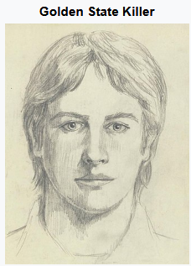
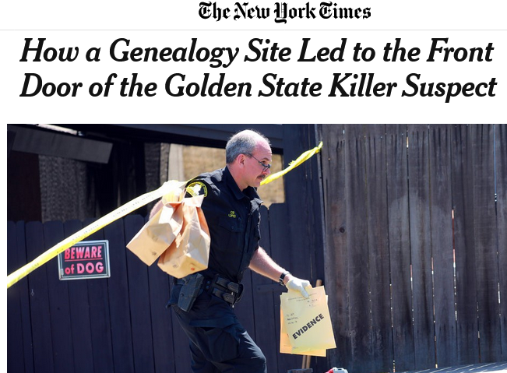
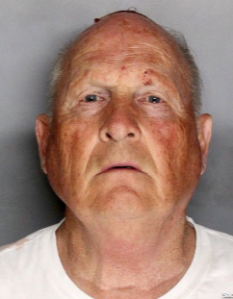
26 Apr 2018
Committed at least 13 murders, more than 50 rapes, and over 100 burglaries in Northern California from 1974 to 1986
72 years old
https://www.nytimes.com/2018/04/26/us/golden-state-killer.html
Notes:
Let me start with a story happened last year. Many of you may already hear about it. The well known golden state killer, who committed over a hundred violent crimes in 1970s-1980s, and stopped committing crimes after the next 30 years. He was finally arrested last year. How could the police find him after such a long time?

Slide 3
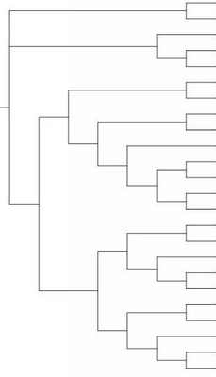
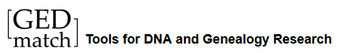
Finding the Golden State Killer
DNA from crime scenes
(1980s)
GEDmatch (2018)
Genotype 1
name 1
criminal
quasi-identifiers
age?
Genotype
Genotype 2
name 2
Ancestor
locations
Genotype 3
name 3
Genotype 4
name 4
Descendants
… … … …
age,loc
name a
age,loc
name b
age,loc
name c
age,loc
name d
… …
… …
… …
https://www.gedmatch.com
Notes:
The police collected DNA from the crime scene of1980s. The DNA DID not match any data in existing dna db. Last year, they did a search through the GEDmatch database. GEDmatch contains consumer genetics data, like 23andme and Ancenstry DNA. People upload their own genotype data to find potential relatives. The police did a similar thing. The search led to the identification of about 20 distant relatives, at a third-cousin level, inferring a common ancestor who lived 200 ys ago. They worked with a professional genealogist to reconstruct the family history and try to match the criminal information with current family members. The information is estimated age and locations. We call these features quasi-identifiers. They are not able to identify a person alone but contain considerable information. Combining the genetics with the quasi-identifiers led to the identification of two candidate suspects.
They collected their DNA and matched to the criminal DNA them again, finally found the Golden State Killer.

Slide 4
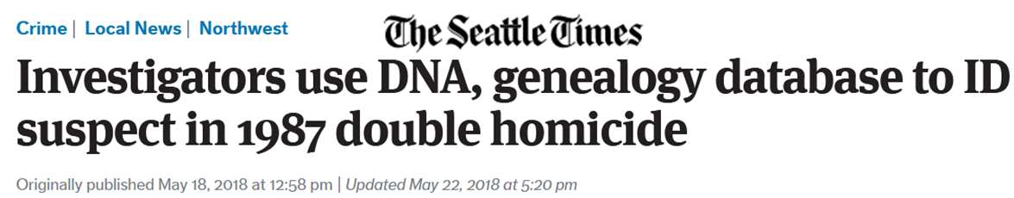
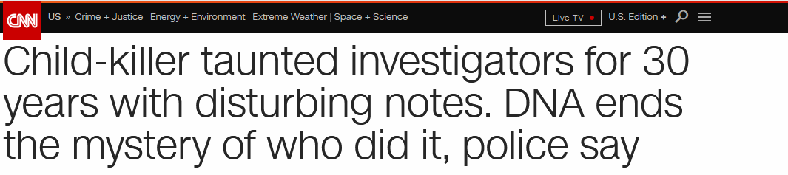
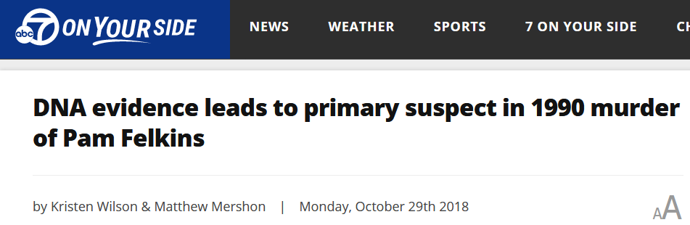
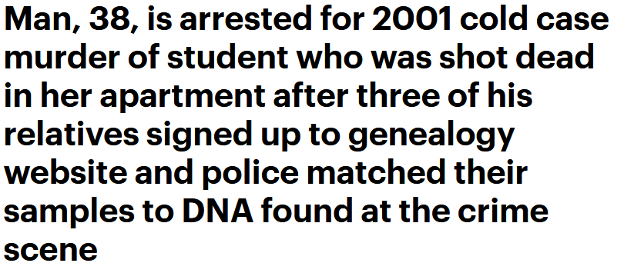
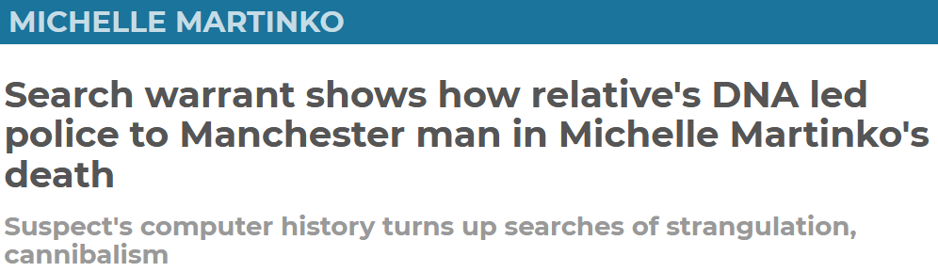
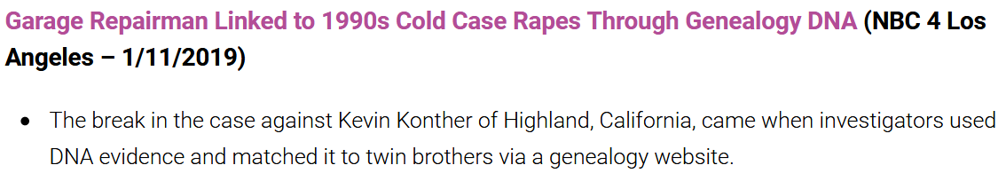

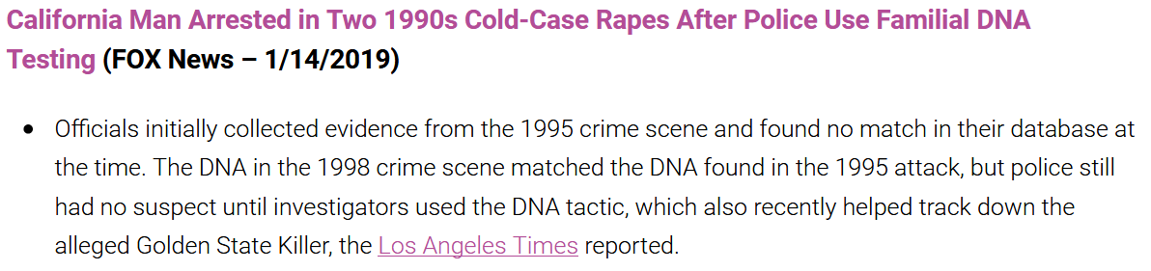
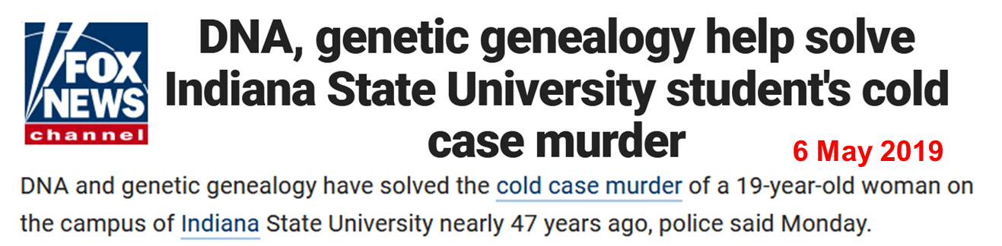
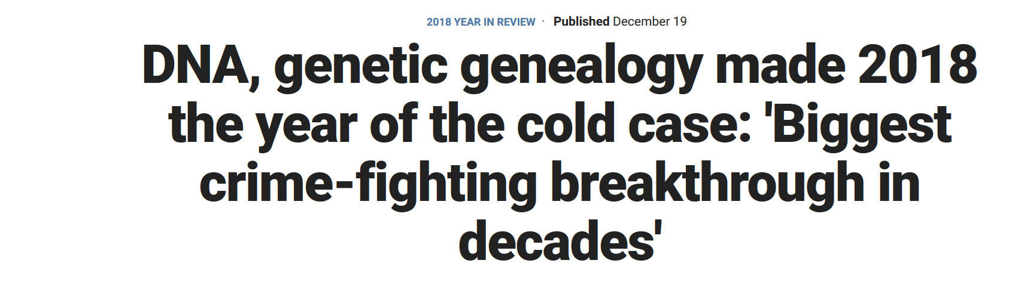
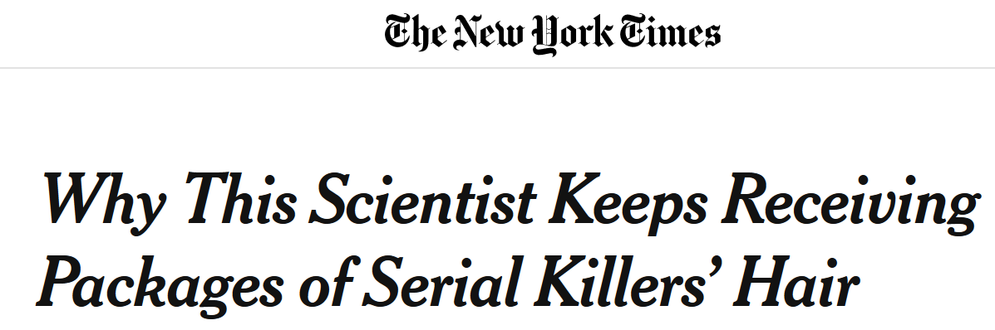
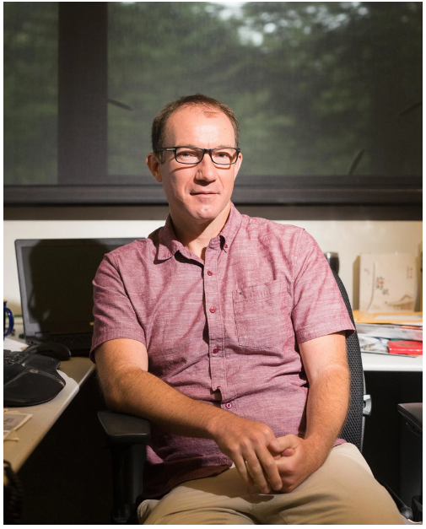
18 May 2018
17 Jul 2018
29 Oct 2018
11 Jan 2019
19 Dec 2018
14 Jan 2019
6 Nov 2018
16 Sep 2019
Lab alumnus Ed Green
Notes:
This is not a unique case. Many cold cases have been solved since then.
One person involved has been Ed Green, a former Berkeley student from the Brenner lab.

Slide 5
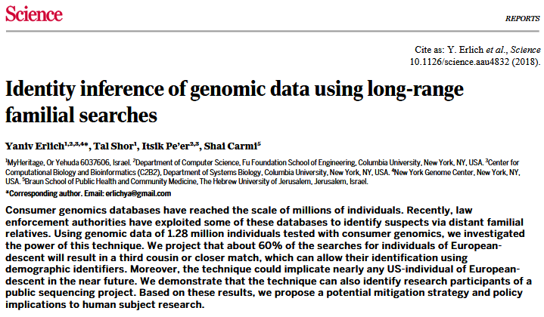
Identifying a person via familial searches
… about 60% of the searches for individuals of European-descent will result in a third cousin or closer match.
Notes:
A recent research suggests that this kind of re-identification could be common.
60%of European descent search will results in a third cousin or closer match, and the data are still increasing.

Slide 6
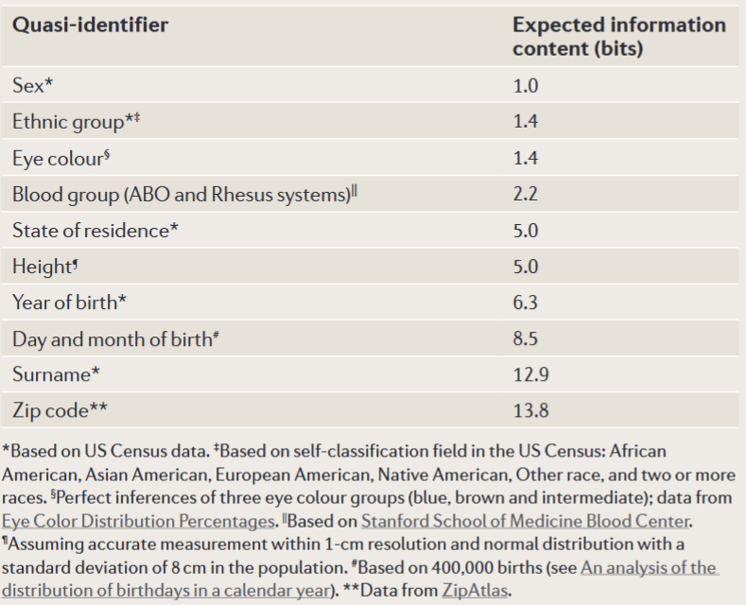

Bits of information in common identifiers
US population
(327 million)
28.28 bits
$$2^{28.28}=3.27×{10}^{8}$$
13.8+8.5+6.3=28.6
Erlich Y and Narayanan A. 2014. Nature Review Genetics. 15:409-421. doi:10.1038/nrg3723
Notes:
Cannot find UK zipcode information content easily

Slide 7
How do other types of data breach personal privacy?
(linking attack)
GEDmatch
PGP
Bob
Genotype 1
Genotype A
HNPCC
alcohol intolerance
alcoholism
hepatitis B
stomach ulcer
cirrhosis
PKU
Alice
Genotype 2
Genotype B
depression
John
Genotype 3
Genotype C
bipolar disorder
Tom
Genotype 4
Genotype D
myocardial infarction
… … … …
… … … …
GEDmatch
GEO/SRA
Bob
Genotype 1
genomic variants
RNA-seq reads
manic syndrome
Alice
Genotype 2
genomic variants
RNA-seq reads
bulimia
John
Genotype 3
genomic variants
RNA-seq reads
trimethylaminuria
Tom
Genotype 4
genomic variants
RNA-seq reads
erectile dysfunction
… … … …
… … … …
Notes:
Then how can other types of data, like rna-seq, also breach personal privacy?
Linking attack is a computer science term which describes how an attacker gains access to information by linking data in two independent dababases. I will show you an example. Here the attacker is a life insurance company or your X significant other. GEDmatch database contains genotype data, names and location. Personal genome database contains consumer genetics data. People upload their own genotype to PGP to help research. It may contain phenotypes, such as disease. Once the attacker know genotype 1 from GEDmatch db and genotype C fro PGP are from the same person, the attacker will be aware that Bob has bipolar disorder.
For non-genomics data, I will show an example with RNA-seq, which are readily used for medical research. RNA-seq data set can also be linked to genomes, since the RNA-seq reads contain genetic variants. Once the attacker know genotype 4 and the second RNA-seq dataset are from the same person, the attacker will be aware that Tom has bulimia.
******** can also match relatives **************

Slide 8
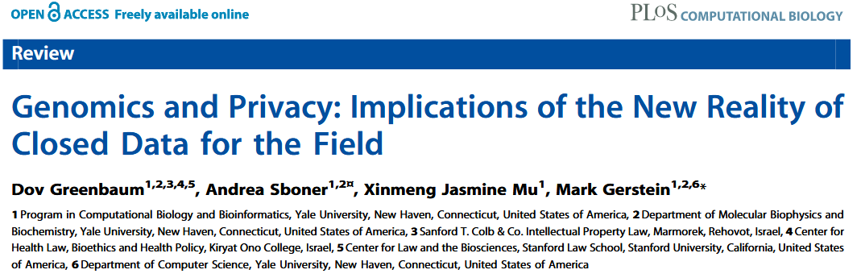
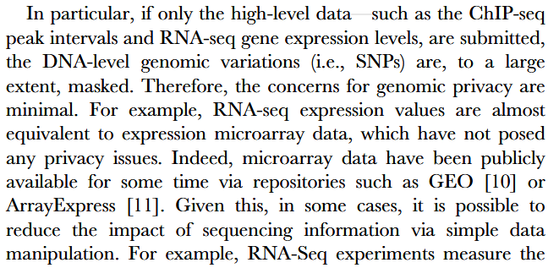
2011

Slide 9

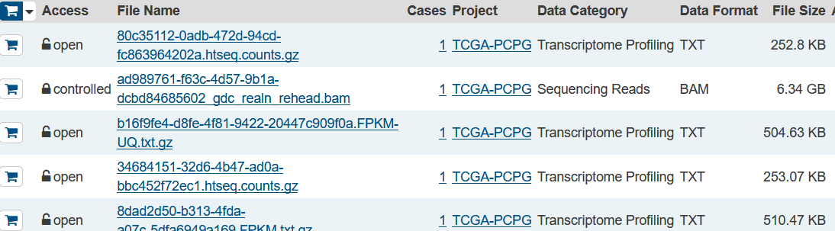
Summary data are often shared
Summary RNA-seq data
  Gene expression (TPM)
  Transcript expression (TPM)
  Exon read count
  Exon-exon junction read count
  Signals
Gene read count - Public
Reads - Controlled Access

Slide 10
Genotype can be inferred from gene expression via expression quantitative trait loci (eQTLs)
Expression QTL (eQTL)
Common SNP
Gene
G/G
G/G
G/G
High expression
A/G
A/G
Intermediate expression
A/A
A/A
Low expression
Gene expression
Harmanci A, et al. 2016. Nature Methods. 13:251-256. doi:10.1038/nmeth.3746
Schadt E, et al. 2012. Nature Genetics. 44:603-608. doi:10.1038/ng.2248
Notes:
However, recent studies suggested gene expresiion data are not that safe. Genotypes can be inferred via so-called eQTLs. ….

Slide 11


Linking expression data to genotypes
23andMe (2019)
Genotype data
Inferred genotype
GEDmatch
Bob
genotype
zip code
Notes:
Imagine a person who took part in a depression project in 2010, where the researcher released his gene expression data, with attached information which are important for reseach…..
By matching the inferred genotype and the genetic data, the attackter can tell the two datasets are from the same person. ……
*************In some cases, surname shpuld be inferred from Y chr strs. ******************

Slide 12
Linking expression data to genotypes
Inferred genotype
GEDmatch
relatives
Notes:
Imagine a person who took part in a depression project in 2010, where the researcher released his gene expression data, with attached information which are important for reseach…..
By matching the inferred genotype and the genetic data, the attackter can tell the two datasets are from the same person. ……
*************In some cases, surname shpuld be inferred from Y chr strs. ******************

Slide 13
Linking expression data to genotypes
Inferred genotype
male, birth:1985, ethnicity, relatives, ZIP code, hair color, surname, eye color, etc.
depression
Bob
Notes:
Imagine a person who took part in a depression project in 2010, where the researcher released his gene expression data, with attached information which are important for reseach…..
By matching the inferred genotype and the genetic data, the attackter can tell the two datasets are from the same person. ……
*************In some cases, surname shpuld be inferred from Y chr strs. ******************

Slide 14
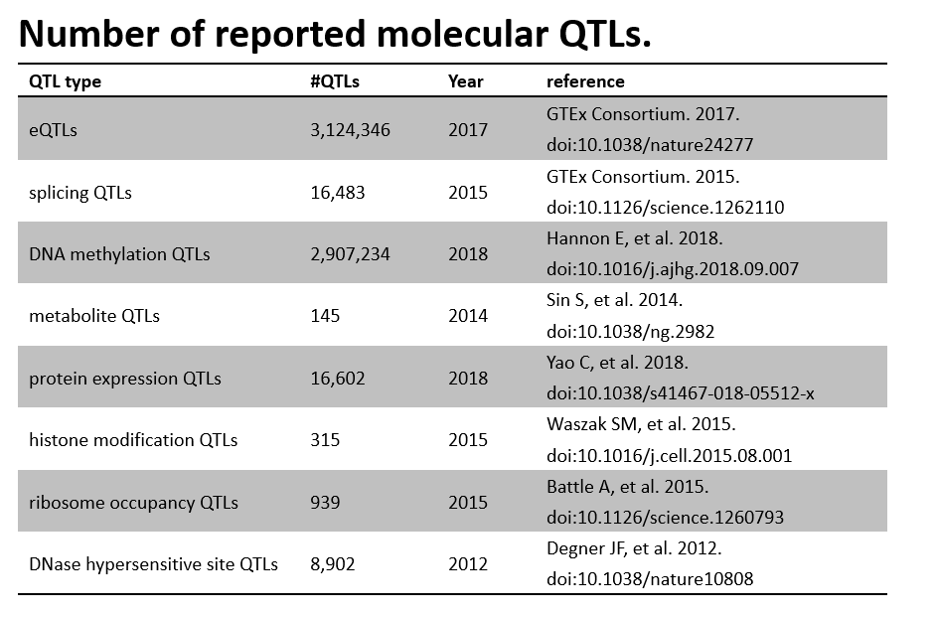
Can other types of data be linked to genomes?
Notes:
Here we want to ask a question: can other type of large scale functional datasets may allow you to infer genetic variants?
Many kinds of molecular QTLs have been reported.

Slide 15
Many types of omics data have numerous QTL usable for re-identification
Notes:
The problem is defind as - given a dataset, such as gene expression profile, public QTLs, and a pool of genomes containing the corresponding genome of the dataset, can the attacker uniquely identify the corresponding genome out of the genome pool?
We use a Bayesian framework and information theory to estimate the linking power. I also bring a poster where I put some technical details. If you want to see how we did this, come to me later.
Here we showed that, for example, ……………………………purple.
Dnase is quite stable across tissues. Both Dnase and gene exp have the ability to be linked to a genome from the world population. Splicing data can be identified from a pool of hundred thousands of genomes.
sQTLs are not powerful today but could be more powerful in the future
Note:

Slide 16
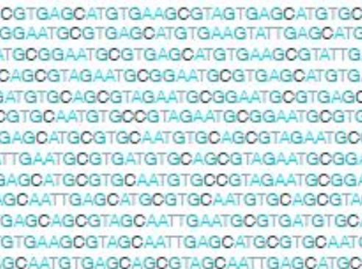
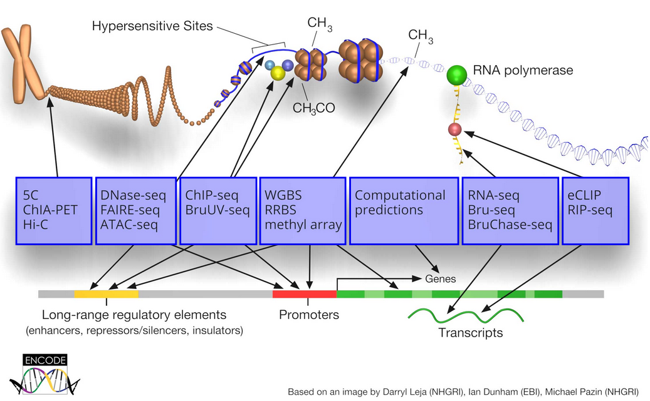
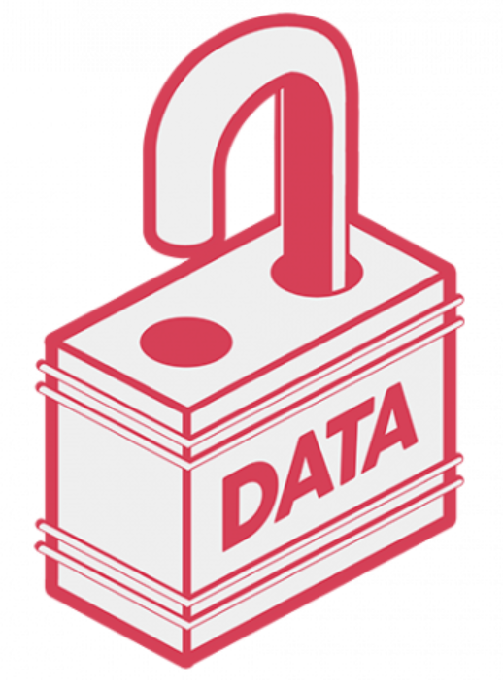
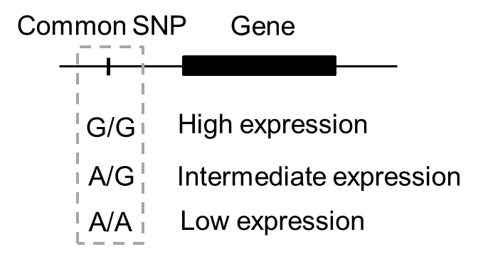
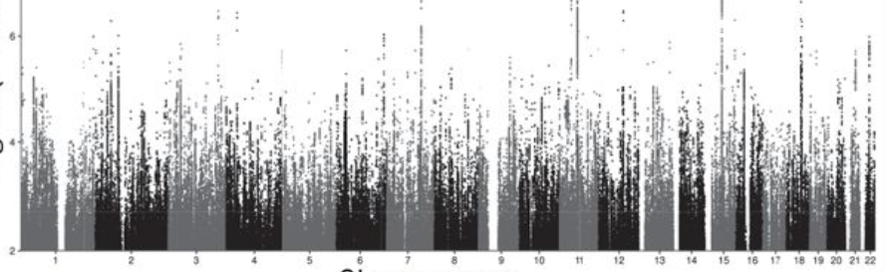
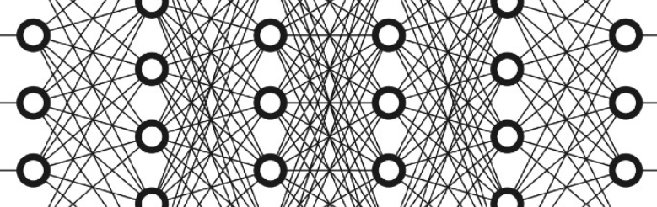
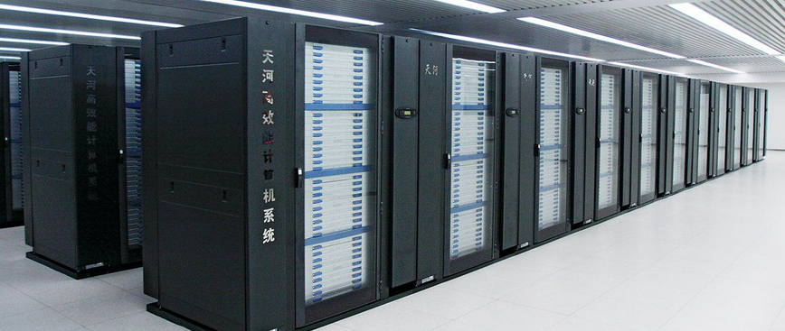
Hidden challenges of personal privacy in omics data are revealed over time
More data
More types of data
More public data
More molecular QTLs
More knowledge of genotype-phenotype mapping
Disease risks
Appearance
Behaviors
… …
Improved algorithms
More powerful computation
Notes:
Why dataset that were safe 5 years ago breach privacy today?
First, we have more amount of certain type of data and even more data types. Also, more people release their data, especially genotypes.
Second, we may have more QTLs. And, more phenotype will be predicted with more accuracy..
Third, more powerful attacking strategy can be used.
Data type: encode
DNA lock: https://www.sociam.org/open-data
GWAS: Large-scale GWAS reveals insights into the genetic architecture of same-sex sexual behavior. Science journal.

Slide 17
Latent risk in omics data manifests over time
Notes:
Data previously considered safe were not safe today. For example, people generally believe genomic data are okay at the time of human genome project. Later when the sequencing cost become low, due to NGS, we found we can sequence individual genomes, there is a concern about the privacy. Before 2010, there are only several individual genomes, but later the number expands and it is a serious concern. Last year advances in forensics genetics demonstrate it is a real private issue to share personal genotypes.
Here we demonstrate splicing data and gene exp, dnase data are not that safe. For example, when RNA-seq is ready for clinical use and in the near future, the number of people with personal rna-seq will be similar as the number of people who has genome data today.
For HiC data, we cannot do it yet but may be possible in the future

Slide 18
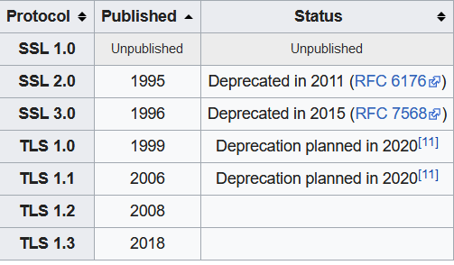
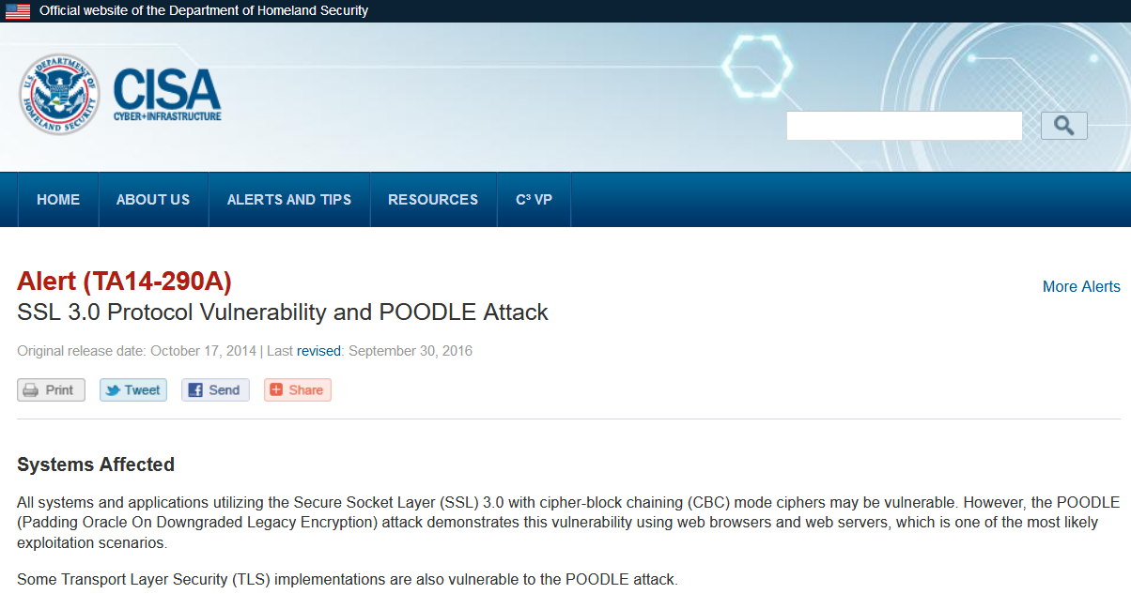
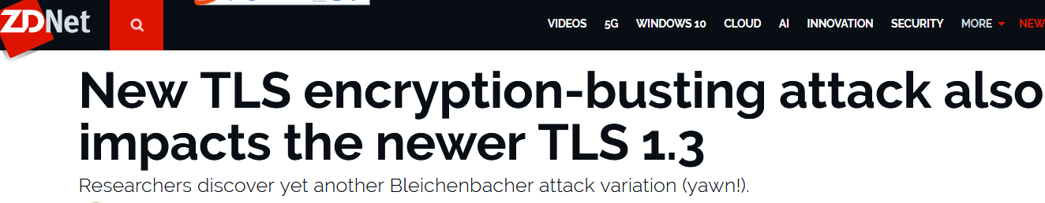
Security is expected to degrade over time
Genome privacy: lifetime…
and possibly beyond for descendants, relatives
Notes:
Having thought about it, it is not surprise that data become dangerous over time. As security degrades in all fields,. For example, the Internet connection technich has evolved multiple times. While, you don’t care yor ………

Slide 19
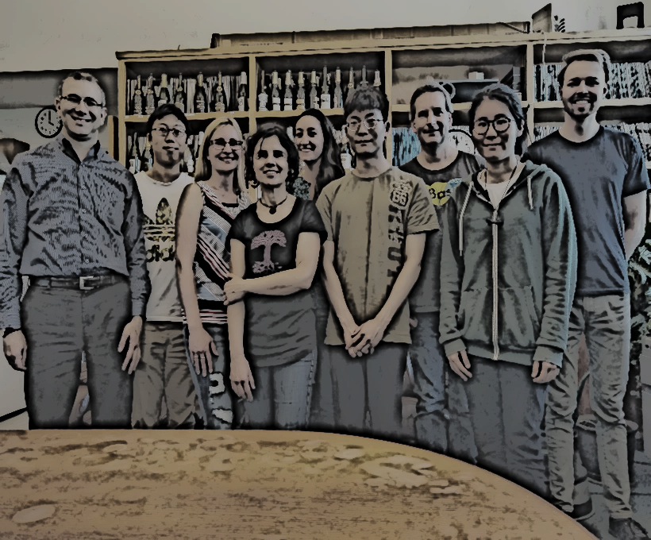


Acknowledgements
Brenner Lab
Brenner Research Group
Yale University
Mark B. Gerstein
Gamze Gursoy

Slide 20
DNA upload sites for additional analysis on raw consumer genetics DNA file (23andMe, AncestryDNA, MyHeritage)
Contribute to Science
Personal genome project
Luna DNA
DNA Land
Ancestry test
GEDmatch (free)
Lamily Tree DNA (free)
MyHeritage (free)
LivingDNA (free)
Nutrition & Fitness
Genopalate
Athletigen
Vitagene
Fitness Genes
DNA fit
More traits
Genomelink (free)
LIFE NOME
Promethease
And more!
Dot one
DNA Romance
Sequence.com
Summarized at https://blog.genomelink.io/posts/the-17-best-dna-upload-sites-for-additional-analysis-on-raw-dna-data-file-in-2019-including-free-ones-for-23andme-ancestrydna-myheritage-users

Slide 21
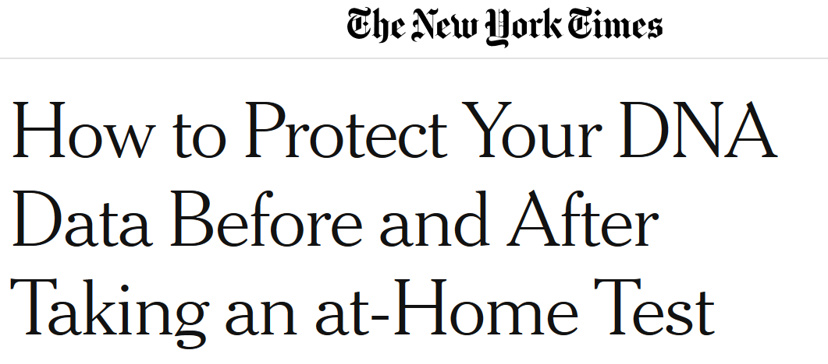
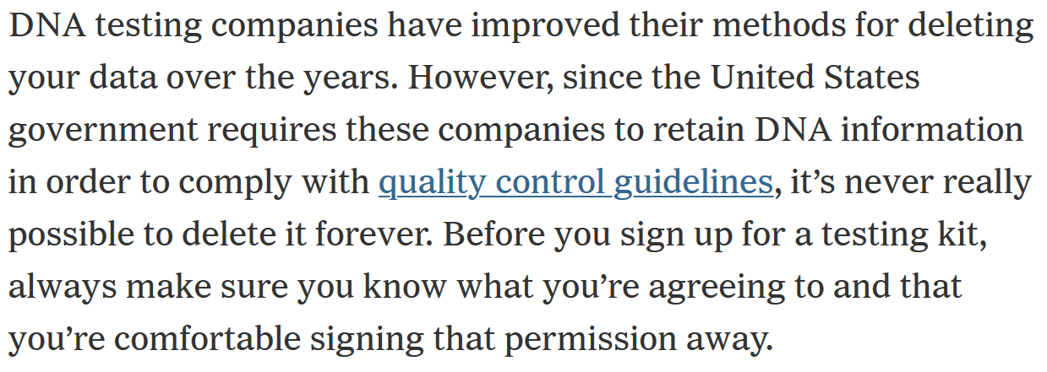

Slide 22
