Slide 1
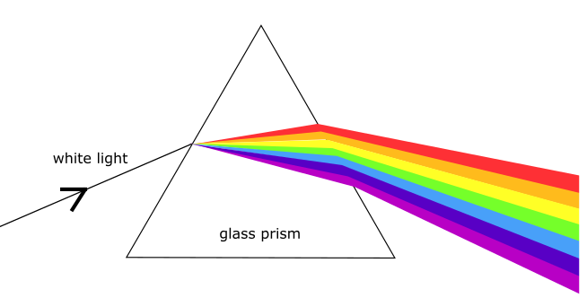
MLD Bootcamp Lecture 9: using computational biology in industry
Wyatt Clark
Heterogeneous
Disease
Disease Severity
Severe
Genetics
Mild

Slide 2
Computational biology impacts all stages of drug development
Indication Selection
Clinical/Post Approval
Target ID/Validation
IND Enabling

Slide 3
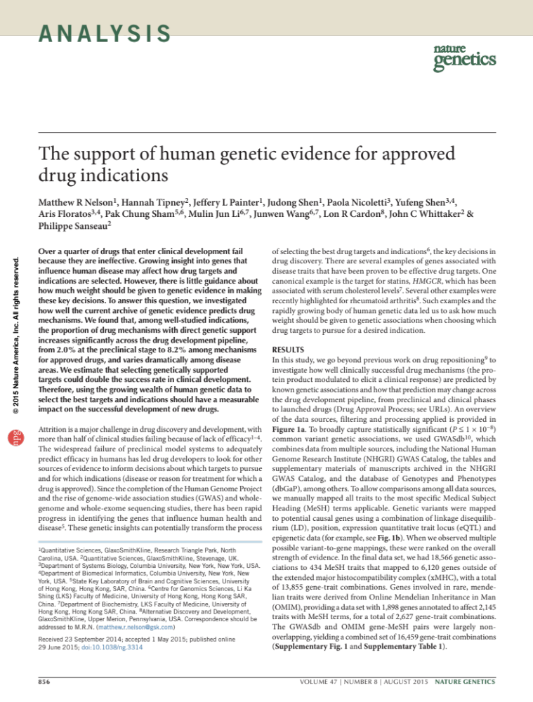
Genetically defined drug targets are more likely to succeed
Indication Selection

Slide 4
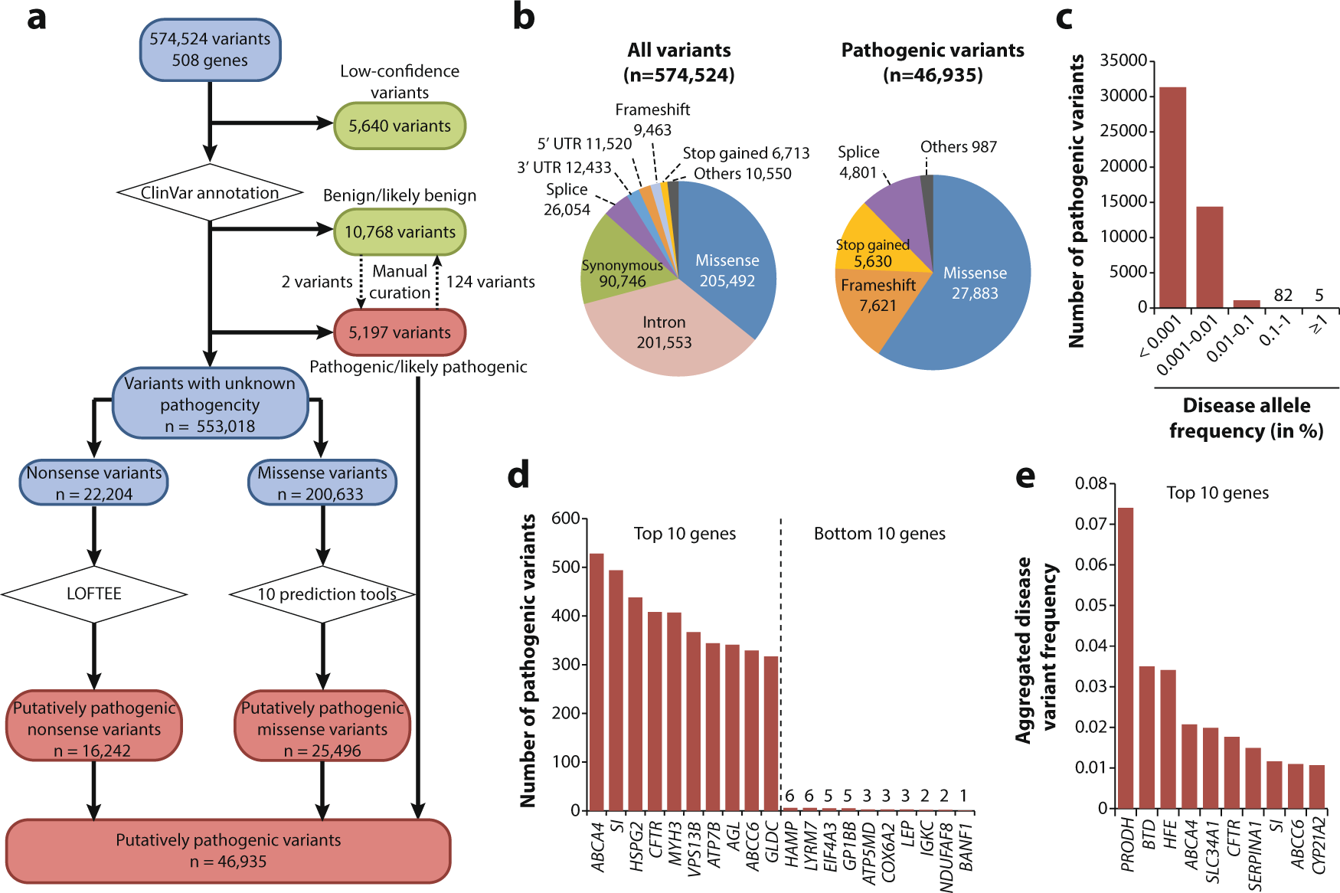
Missense, frameshift, and stop gained mutations are the most common consequence of mutations associated with recessive disease
Notes:
https://www.nature.com/articles/s41525-021-00203-x

Slide 5
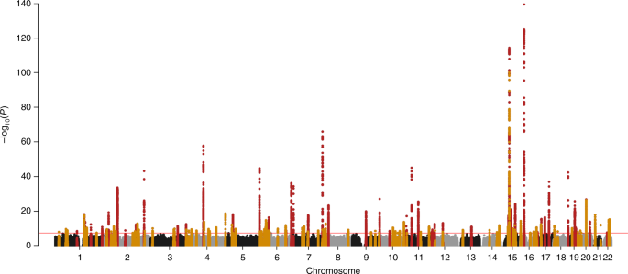
The results of Genome Wide Association Studies (GWAS) show that common non-coding mutations can have significant associations with human phenotypes
Manhattan plot of single nucleotide point mutation association with eGFR (kidney function).
Notes:
https://www.nature.com/articles/s41467-019-11704-w

Slide 6
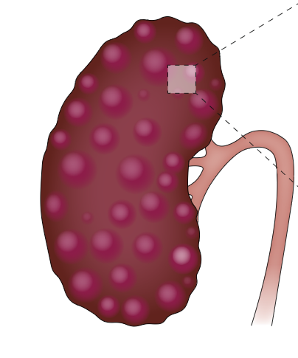
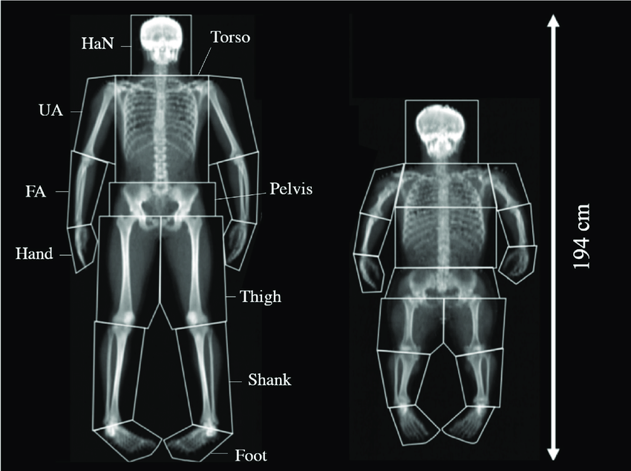
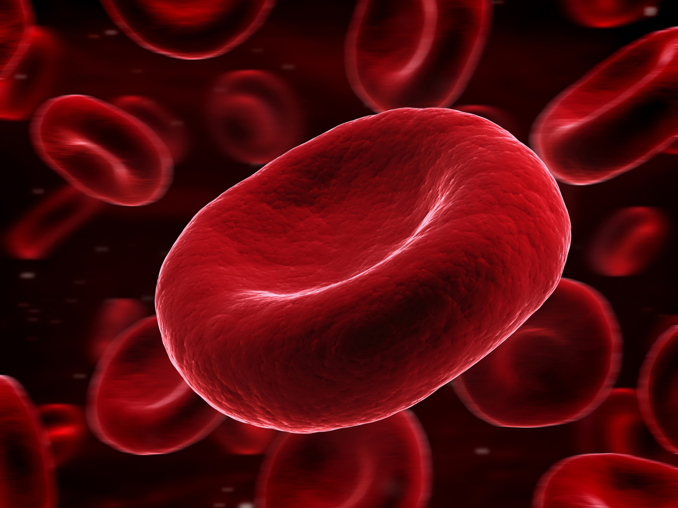
The Human genetic disease landscape is shaped by population genetics
Mendelian, highly penetrant, rare
Somatic mutations are unique: can be common, but have large effect size
Common disease,
moderate penetrance
Effect Size
Genetic modifiers and polygenic disease
Frequency of mutation
Notes:
LEP
NROB2

Slide 7
This landscape impacts several important dimensions of the drug development process
Highly likely to recapitulate disease
Mouse models
Deviation from, or no phenotype
Effect Size
Nonexistent
Frequency of mutation

Slide 8
This landscape impacts several important dimensions of the drug development process
Difficult
Ability to show impact on disease
Really difficult
Effect Size
Really really really difficult
Frequency of mutation

Slide 9
The therapeutic modality must match the disease
Mendelian, highly penetrant, rare
Common disease,
moderate penetrance
Disease Severity
Genetic modifiers and polygenic disease
Frequency of mutation

Slide 10
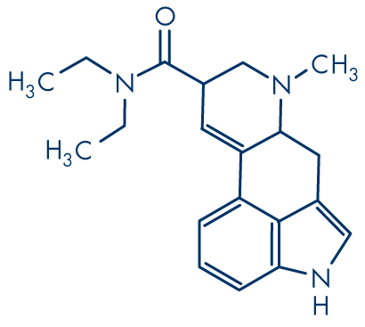
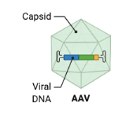
The therapeutic modality must match the disease
Gene Therapy is not a realistic therapeutic for a common disease with low medical unmet need.
Targeting a single gene *may* have little impact on polygenic disease
A small molecule with a marginal impact on disease progression will not have a meaningful impact on a disease with high medical unmet need
Disease Severity
Engineered vector genome
Frequency of mutation

Slide 11
Different mutations in the same gene will cause a spectrum of disease
25%
Even for a recessive, severe disease like MLD we need to understand the patient breakdown
55%
Disease Severity
20%
Frequency of mutation

Slide 12
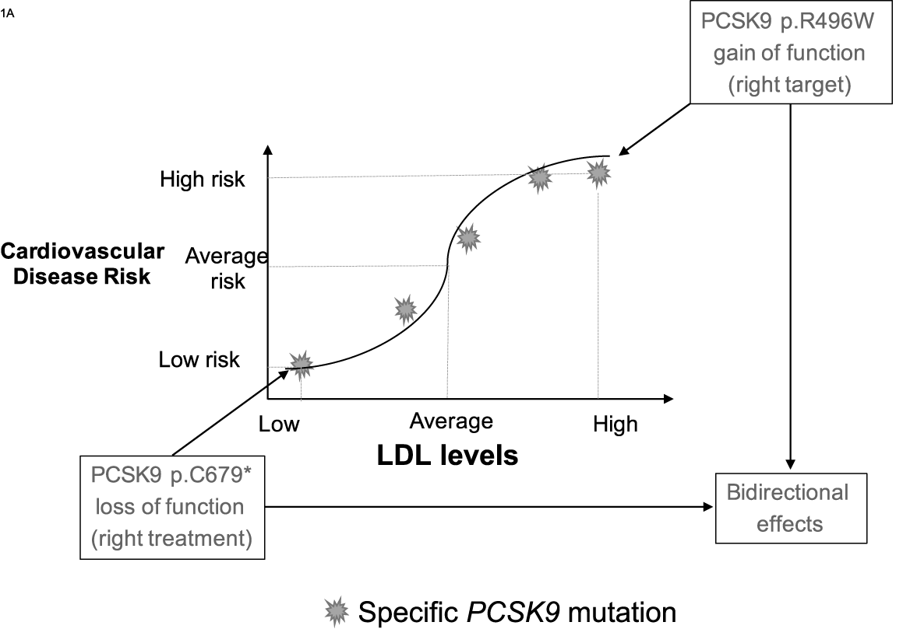
Bidirectional genes can have the ability to impact a phenotype in individuals without a mutation in that gene

Slide 13
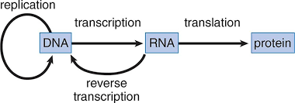
More modalities directly target steps in the “Central Dogma”
Target ID/Validation
Enzyme Replacement Therapy
AAV/Lentiviral Gene Therapy
CRISPR
mRNA delivery (LNP)
Anti-sense Oligonucleotides

Slide 14
“Central Dogma” modalities require central dogma science
Target ID/Validation
Capsid engineering
Vector genome design
Genome editing optimization
Isoform detection
Target sequence identification
Structure prediction

Slide 15
Investigational New Drug
IND
Packaging consistency
Potential off target sequences
Structural stability

Slide 16
Passing patients through the “Genetic Prism” increases clinical trial success
Clinical/Post Approval
Faster, smaller, more successful trial
Expensive, large N, long running clinical trial
Disease Subtypes
Severe
Genetics
Mild
Explaining variability in response by understanding genetic /phenotypic variability in trail population

Slide 17
Conclusions
Indication Selection
Clinical/Post Approval
Target ID/Validation
IND Enabling
Drugs with genetically defined targets are more likely to succeed
Computational and genomic tools are not just nice to have, but are required to develop “Central Dogma Modality” drugs
Regulator scrutiny of genotoxicity of these modalities will put an even greater emphasis on genomic methods
Understanding the genotype/phenotype relationship helps in running efficient and successful clinical trials and finding expansion opportunities.

