Slide 1

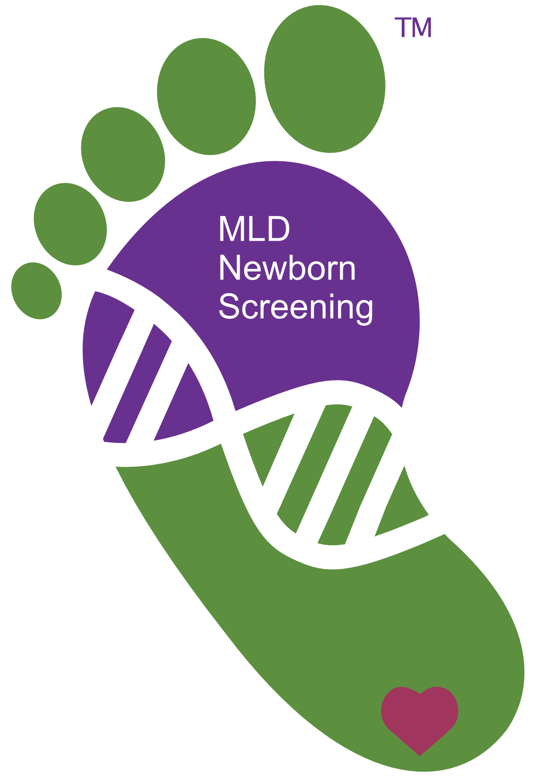
Biomarin Bootcamp
Dean Suhr, President & co-Founder
MLD Foundation
August 31st, 2022
21345 Miles Drive • West Linn, OR 97068-2878 USA
1+ 503-656-4808 • dean@MLDfoundation.org
www.MLDfoundation.org

Slide 2
Our Goals for Today
Introduce you to rare metabolic disease
Help bridge medical science and technology … and inspire you to apply your skills in the rare disease field
Answer your questions and be helpful/collaborative
      and have some fun while doing so!

Slide 3
Background
Dean
  Electrical engineer, rare disease dad … three girls with MLD … strong business operations, marketing, and technology (web, analysis, & databases)
MLD Foundation
  1999 … World’s 1st MLD Family™ conference … very early days of the Internet
  2001 … Received 501c3 … now in our 21st year
  Global MLD-focused foundation with extensive family contact and strong research & policy initiatives …
    clinical trials, therapy approvals, basic science, newborn screening, gene therapy, access & reimbursement

Slide 4
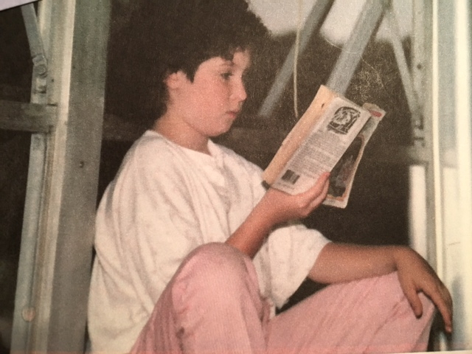
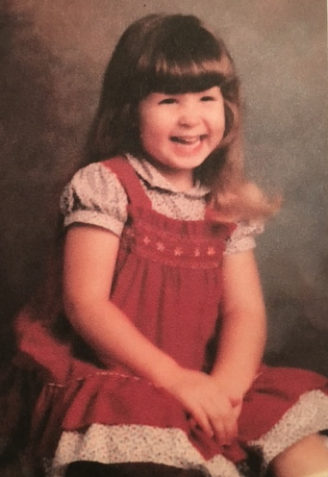
Our Story – Lindy
Our oldest …
  3rd grade … first symptoms
  diagnosed at 14 in 1995
  6-year diagnostic odyssey
  textbooks said she’d live to 20’s
  turning 42 next month

Slide 5
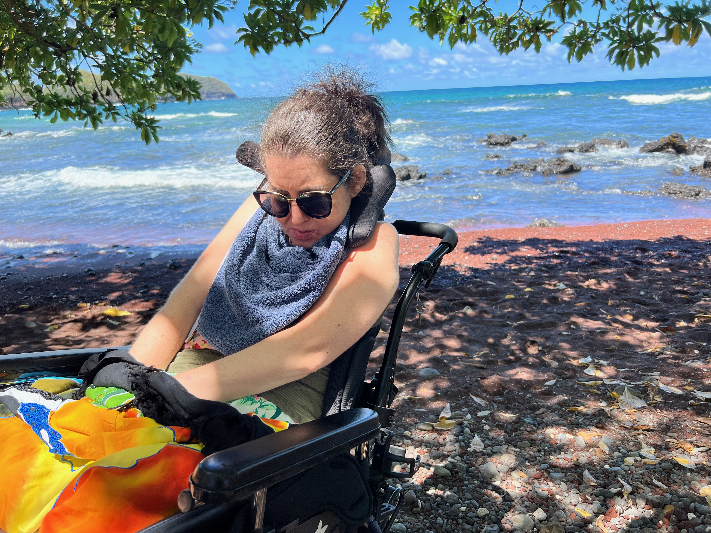
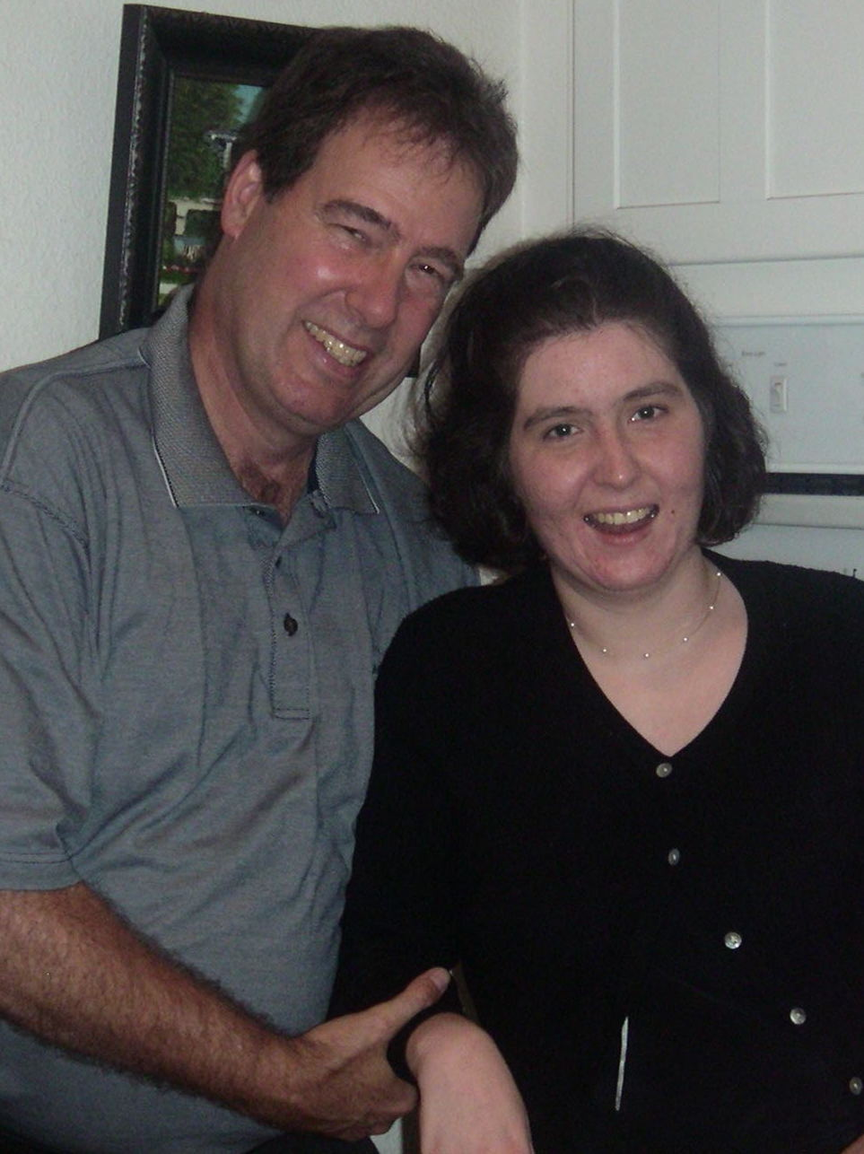
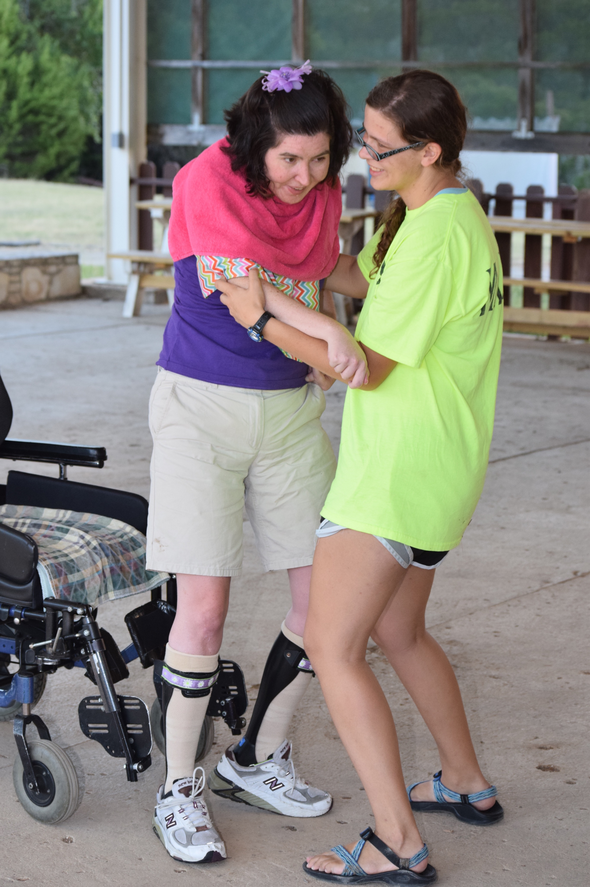
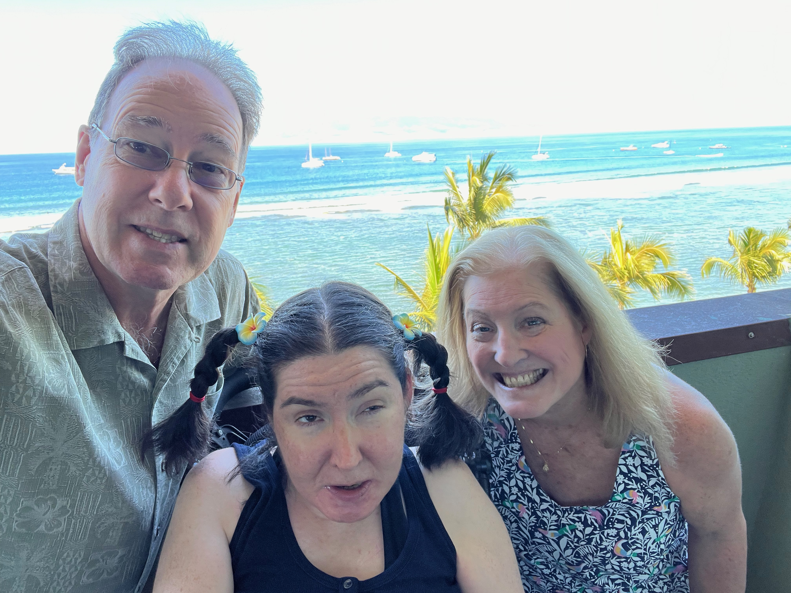
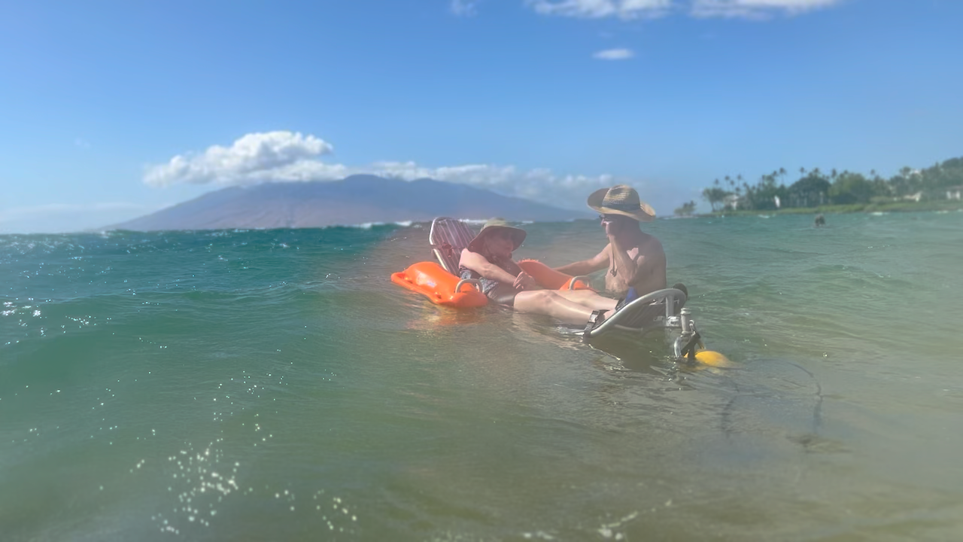
Our Story – Lindy
  Diagnosis – Juvenile MLD … too advanced for therapy
age 41
which is >> 20!

Slide 6
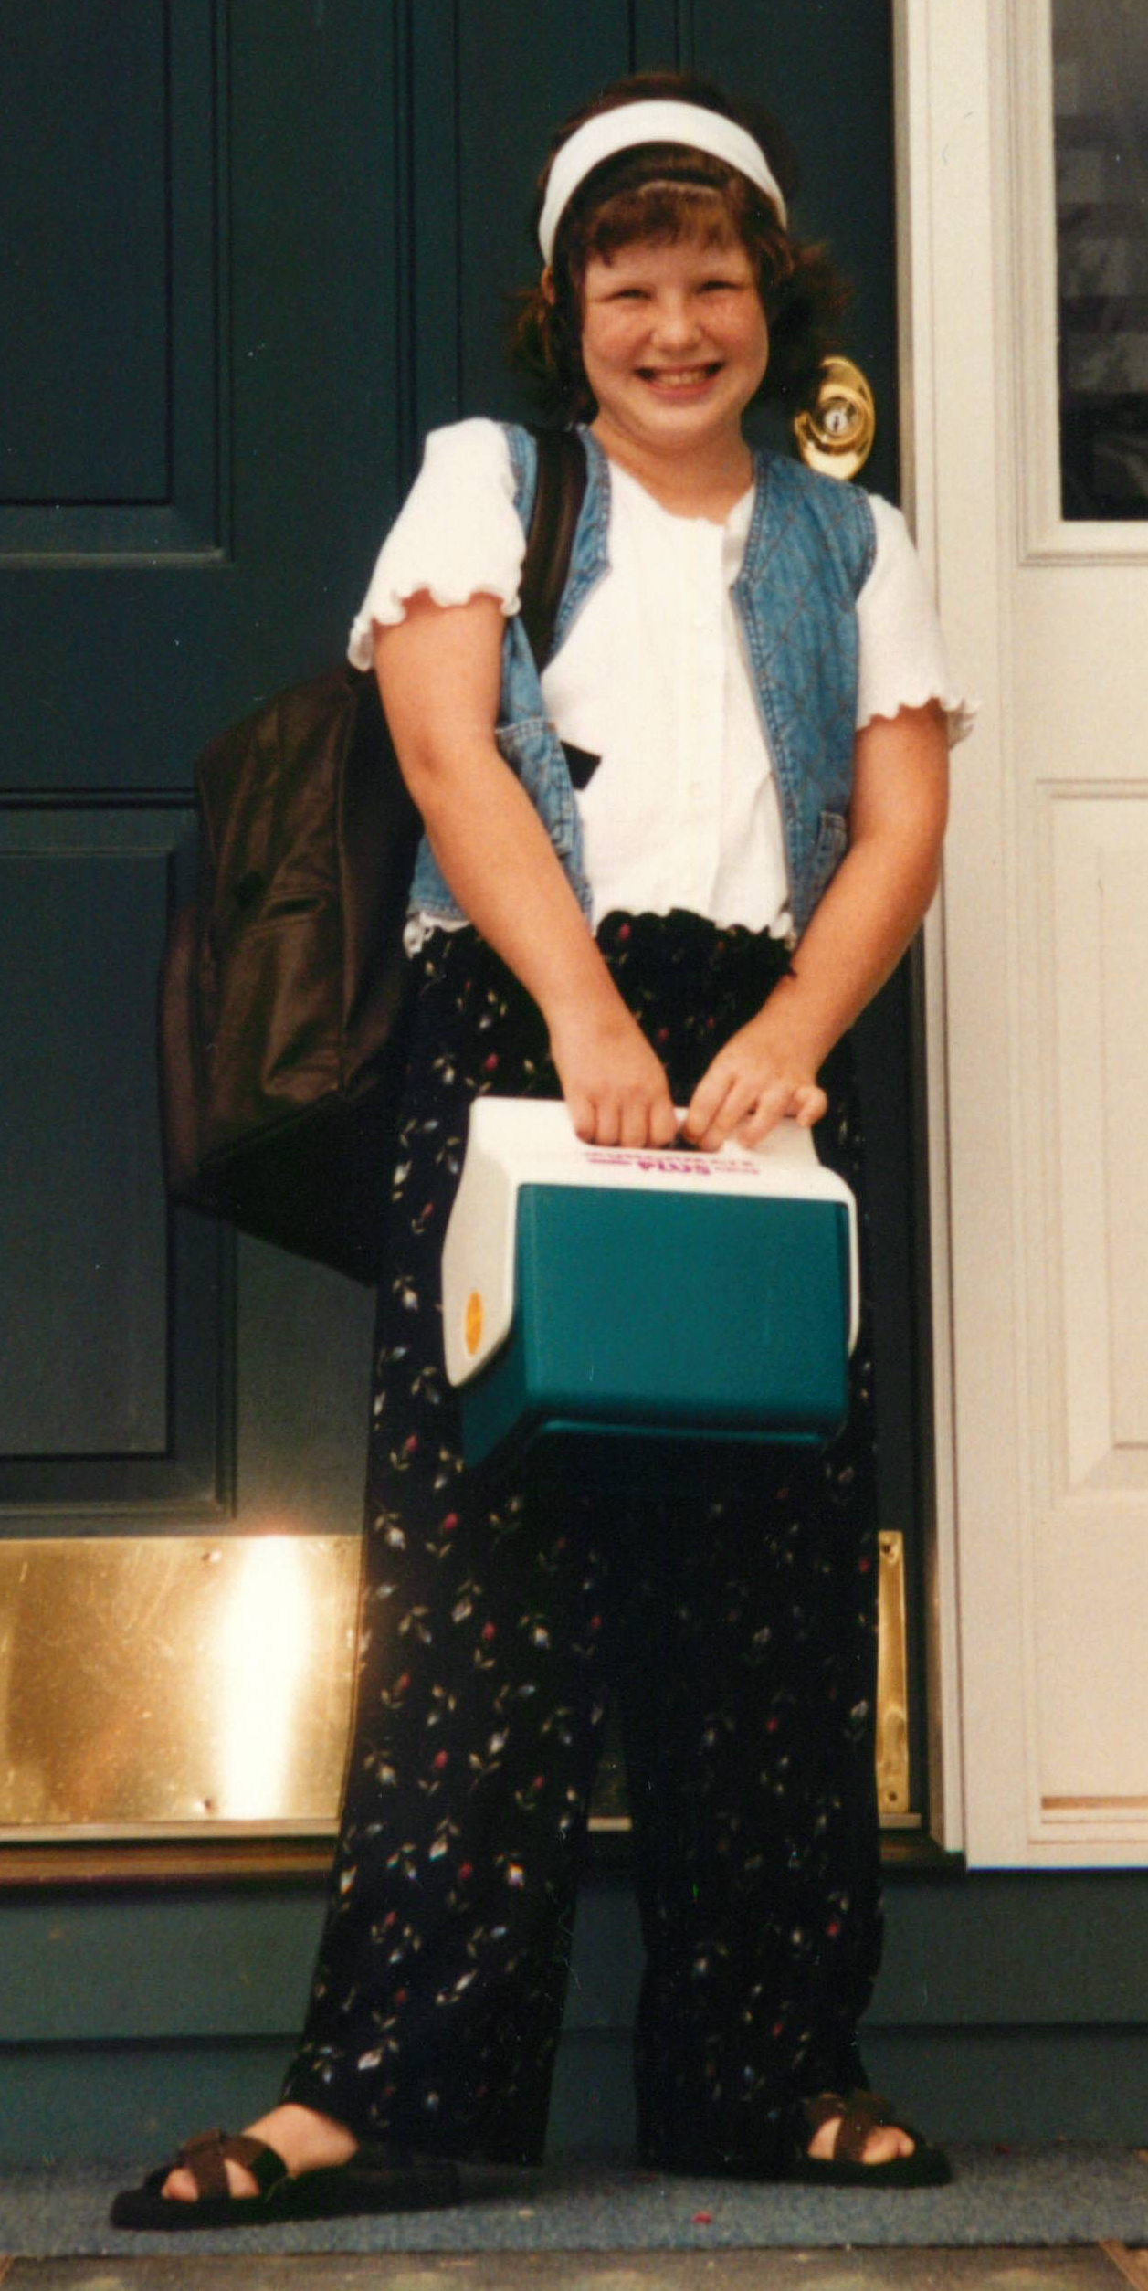
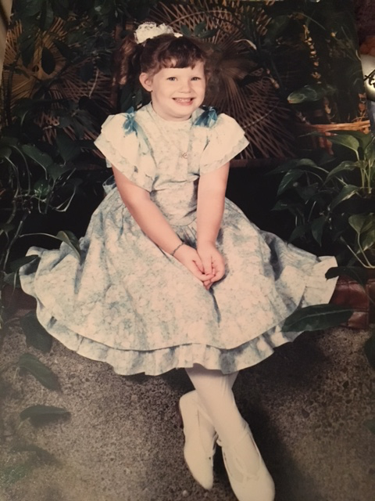
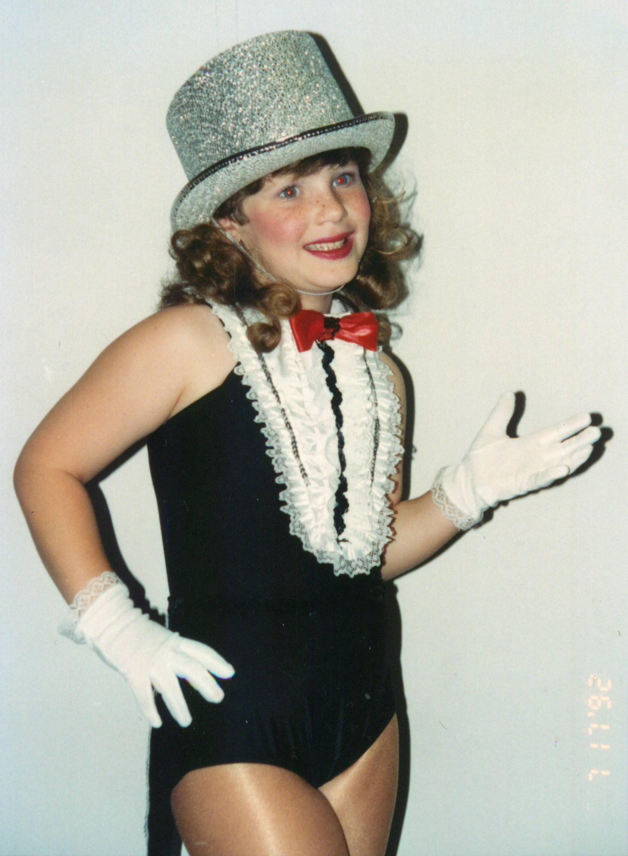
Our Story – Darcee
  Dr. Krivit, Univ. of Minnesota
  Bone Marrow Transplant @ age 10 (1995)
  Engrafted
  GVHD/Complications

Slide 7
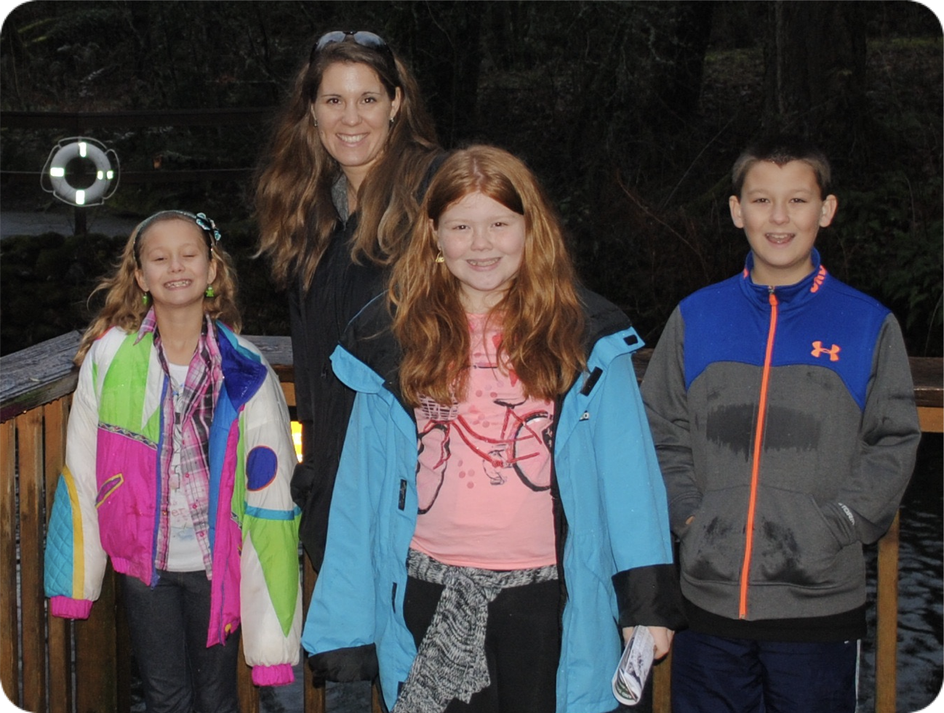

Our Story – Jclynn
Jclynn, our middle daughter
Darcee’s donor @ age 12 (now 40)
Not a carrier, free of MLD
MLD is stopped in this branch of our family tree
Note: While someone may not have the disease, not be a carrier, and not be medically affected, there are no family members that are emotionally “unaffected”

Slide 8


We C.A.R.E.®

Slide 9
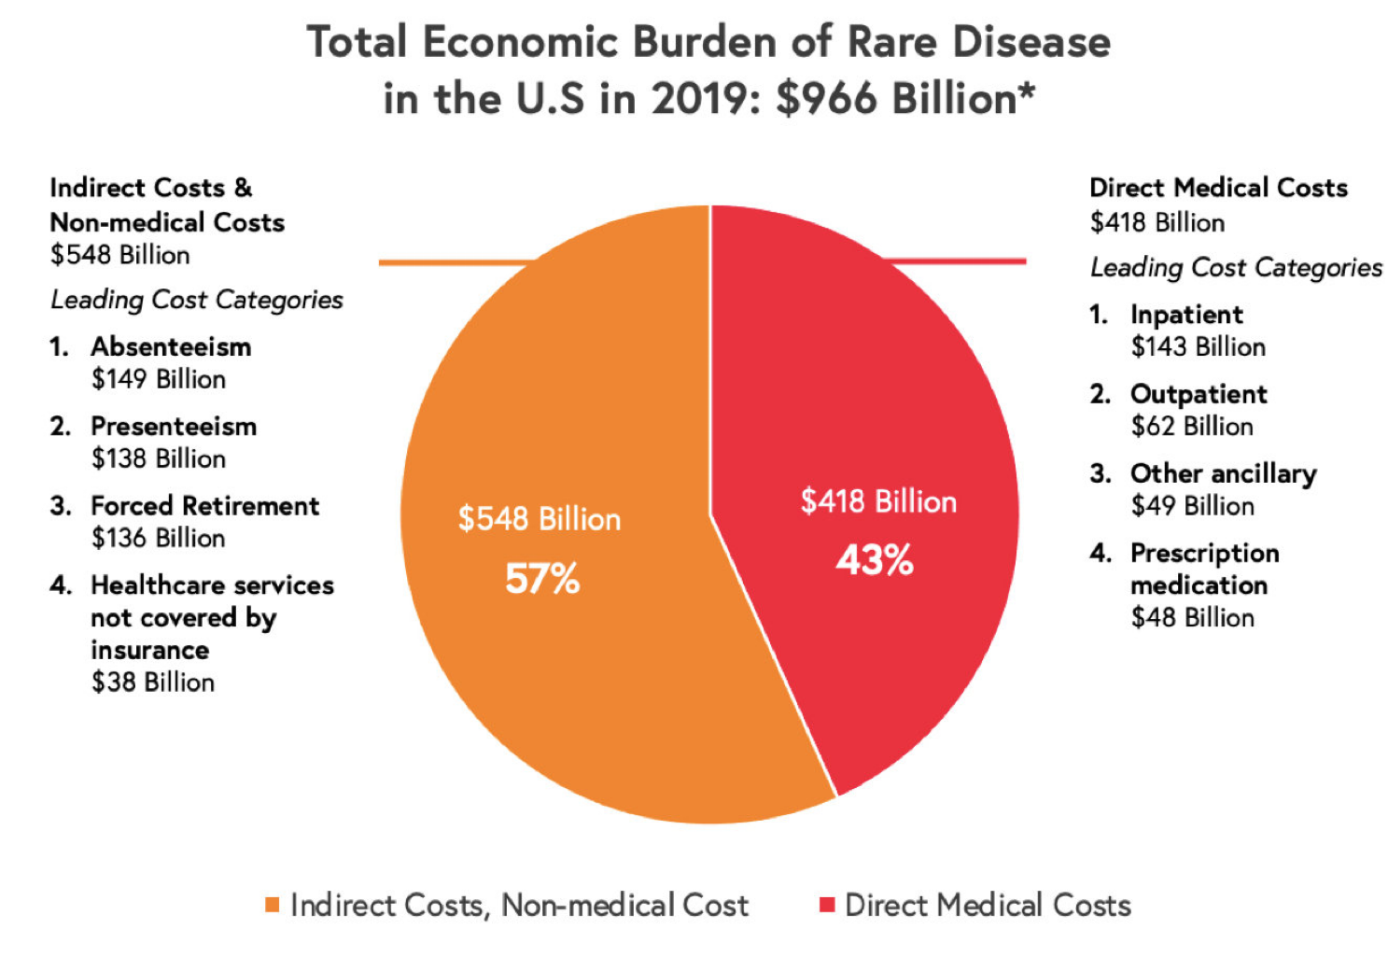
Rare Disease Facts
Source: Global Genes Rare Disease Facts https://globalgenes.org/rare-diseases-facts-statistics/
EveryLife Foundation Burden study https://everylifefoundation.org/burden-study/

Slide 10
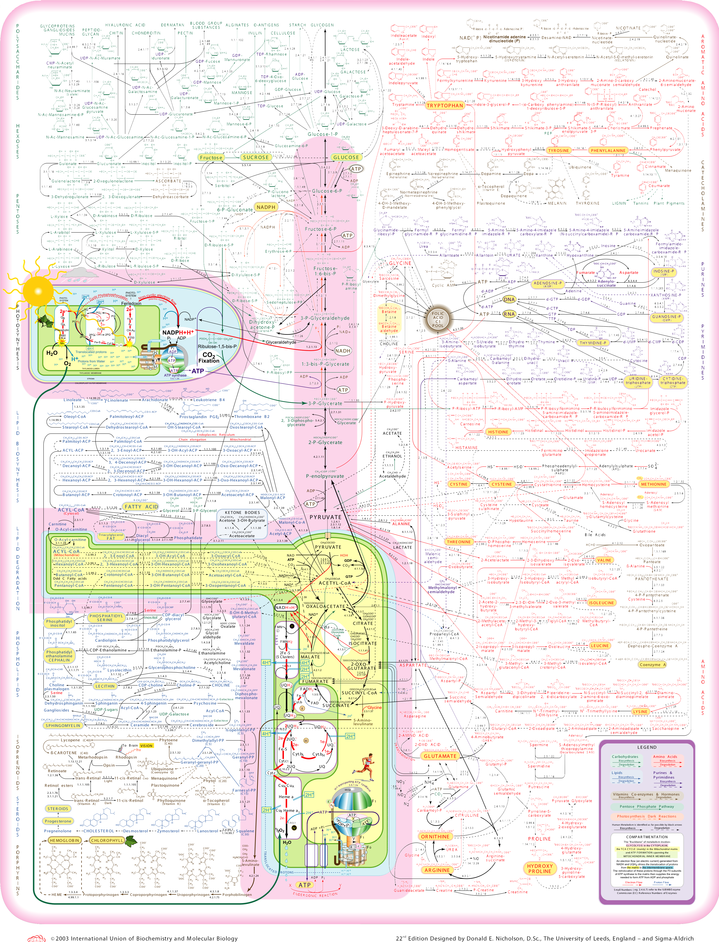
Human Metabolic Pathways
Oh my!

Slide 11
Chemistry of
Sphingolipids
…
G_{M1} ganglioside β-galactosidase
NAcgal-gal-glc-cer
|
NANA
||
G_{M1}
||
G_{M2} ganglioside β-hexosaminidase A
Tay Sachs - GM2
NAcgal-^{β}-gal-^{α}-gal-^{β}-glc-^{β}-cer
globoside
gal-glc-cer
|
NANA
β-hexosaminidase A and B
||
||
ganglioside neuraminidase
Sandhoff Disease
GM3
Αlpha-galactosidase A
gal-gal-glc-cer
trihexosylceramide
||
gal-glc-cer
Fabry
||
lactosylceramide β-galctosidase
PC-cer
||
glc-cer
sphingomyelinase
glucosylceramide β-glucosidase
||
Niemann-Pick
Gaucher
Arylsulfatase - A
sulfatide
sulfatase
galactosylceramide
β-galactosidase
SO4
|3
gal-^{β}-cer
ceramidase
||
gal-cer
||
ceramide
||
Sphingosine + fatty acid
MLD
Krabbe
Farber
gal=galactose, cer=ceramide, NAcgal=N-acetylgalactosamine, glc=glucose, NANA=N-acetylneuraminic acid slide courtesy: David Wenger

Slide 12


London
Metro
X
some pathways are more critical than others
X
X

Slide 13
Cell Structure
Nucleus
  Houses and maintains DNA
Cytoplasm
Mitochondrion
  The energy source for the cell
Golgi and Endoplasmic Reticulum
  Cellular factor - makes the tools
Lysosome
  Recycling system
Licensed under a Creative Commons Attribution No-Derivative-Works Non-Commercial 3.0 License https://dbscience4.wikispaces.com/

Slide 14
Nerves
Neuron
Axon
Myelin
Synapsis
Myelin Sheath insulates and
speeds signals down the axons
Neuron
Axon

Slide 15
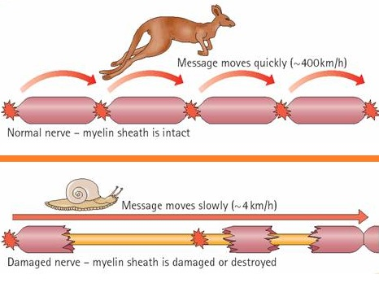
Role of Myelin

Slide 16
Metachromatic Leukodystrophy
Rare terminal neuro-metabolic genetic disorder
  Both a lysosomal disease and a leukodystrophy
  Missing or very low ARSA enzyme
    missing enzyme —> sulfatide buildup —> irreversible myelin damage
  chromosome 23
    over 300 known gene variants (mutations) = 90,000 genotypes
Forms
  late infantile, early juvenile, late juvenile, adult

Slide 17
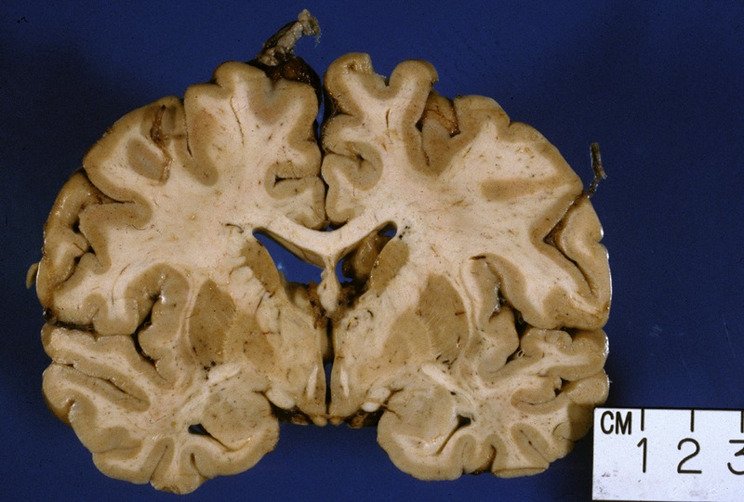
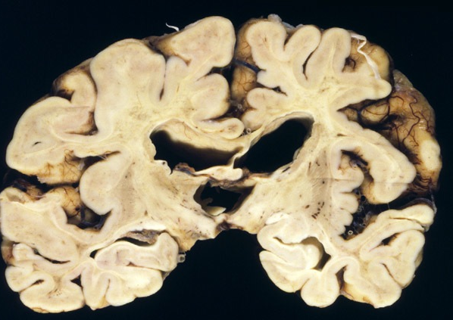
Normal White Matter Loss of White Matter
http://cclcm.ccf.org/vm/VM_cases/neuro/neuro_case1_gross1.jpg
http://www.neuropathologyweb.org/test6/6testimages/6p22G-XALD.jpg
Notes:
jsakjahsadasjkh

Slide 18
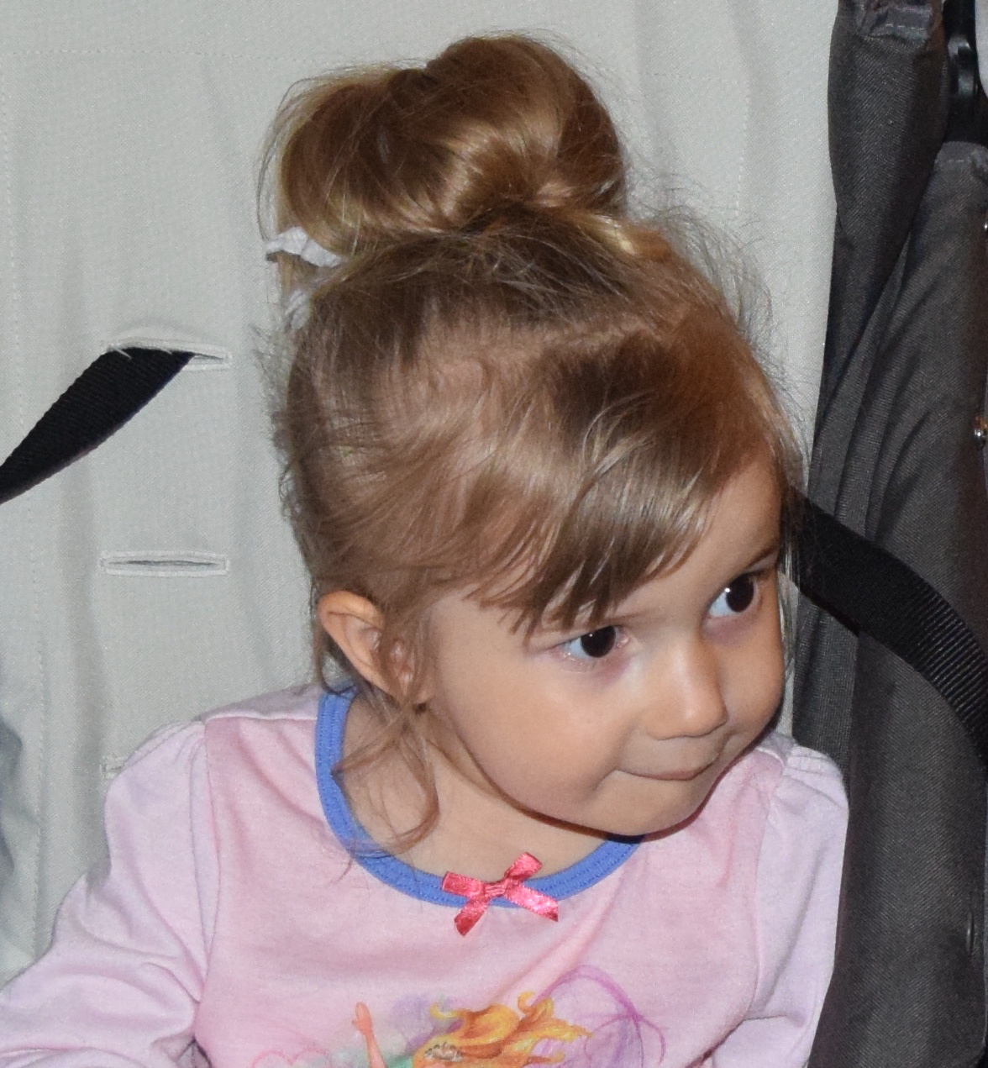
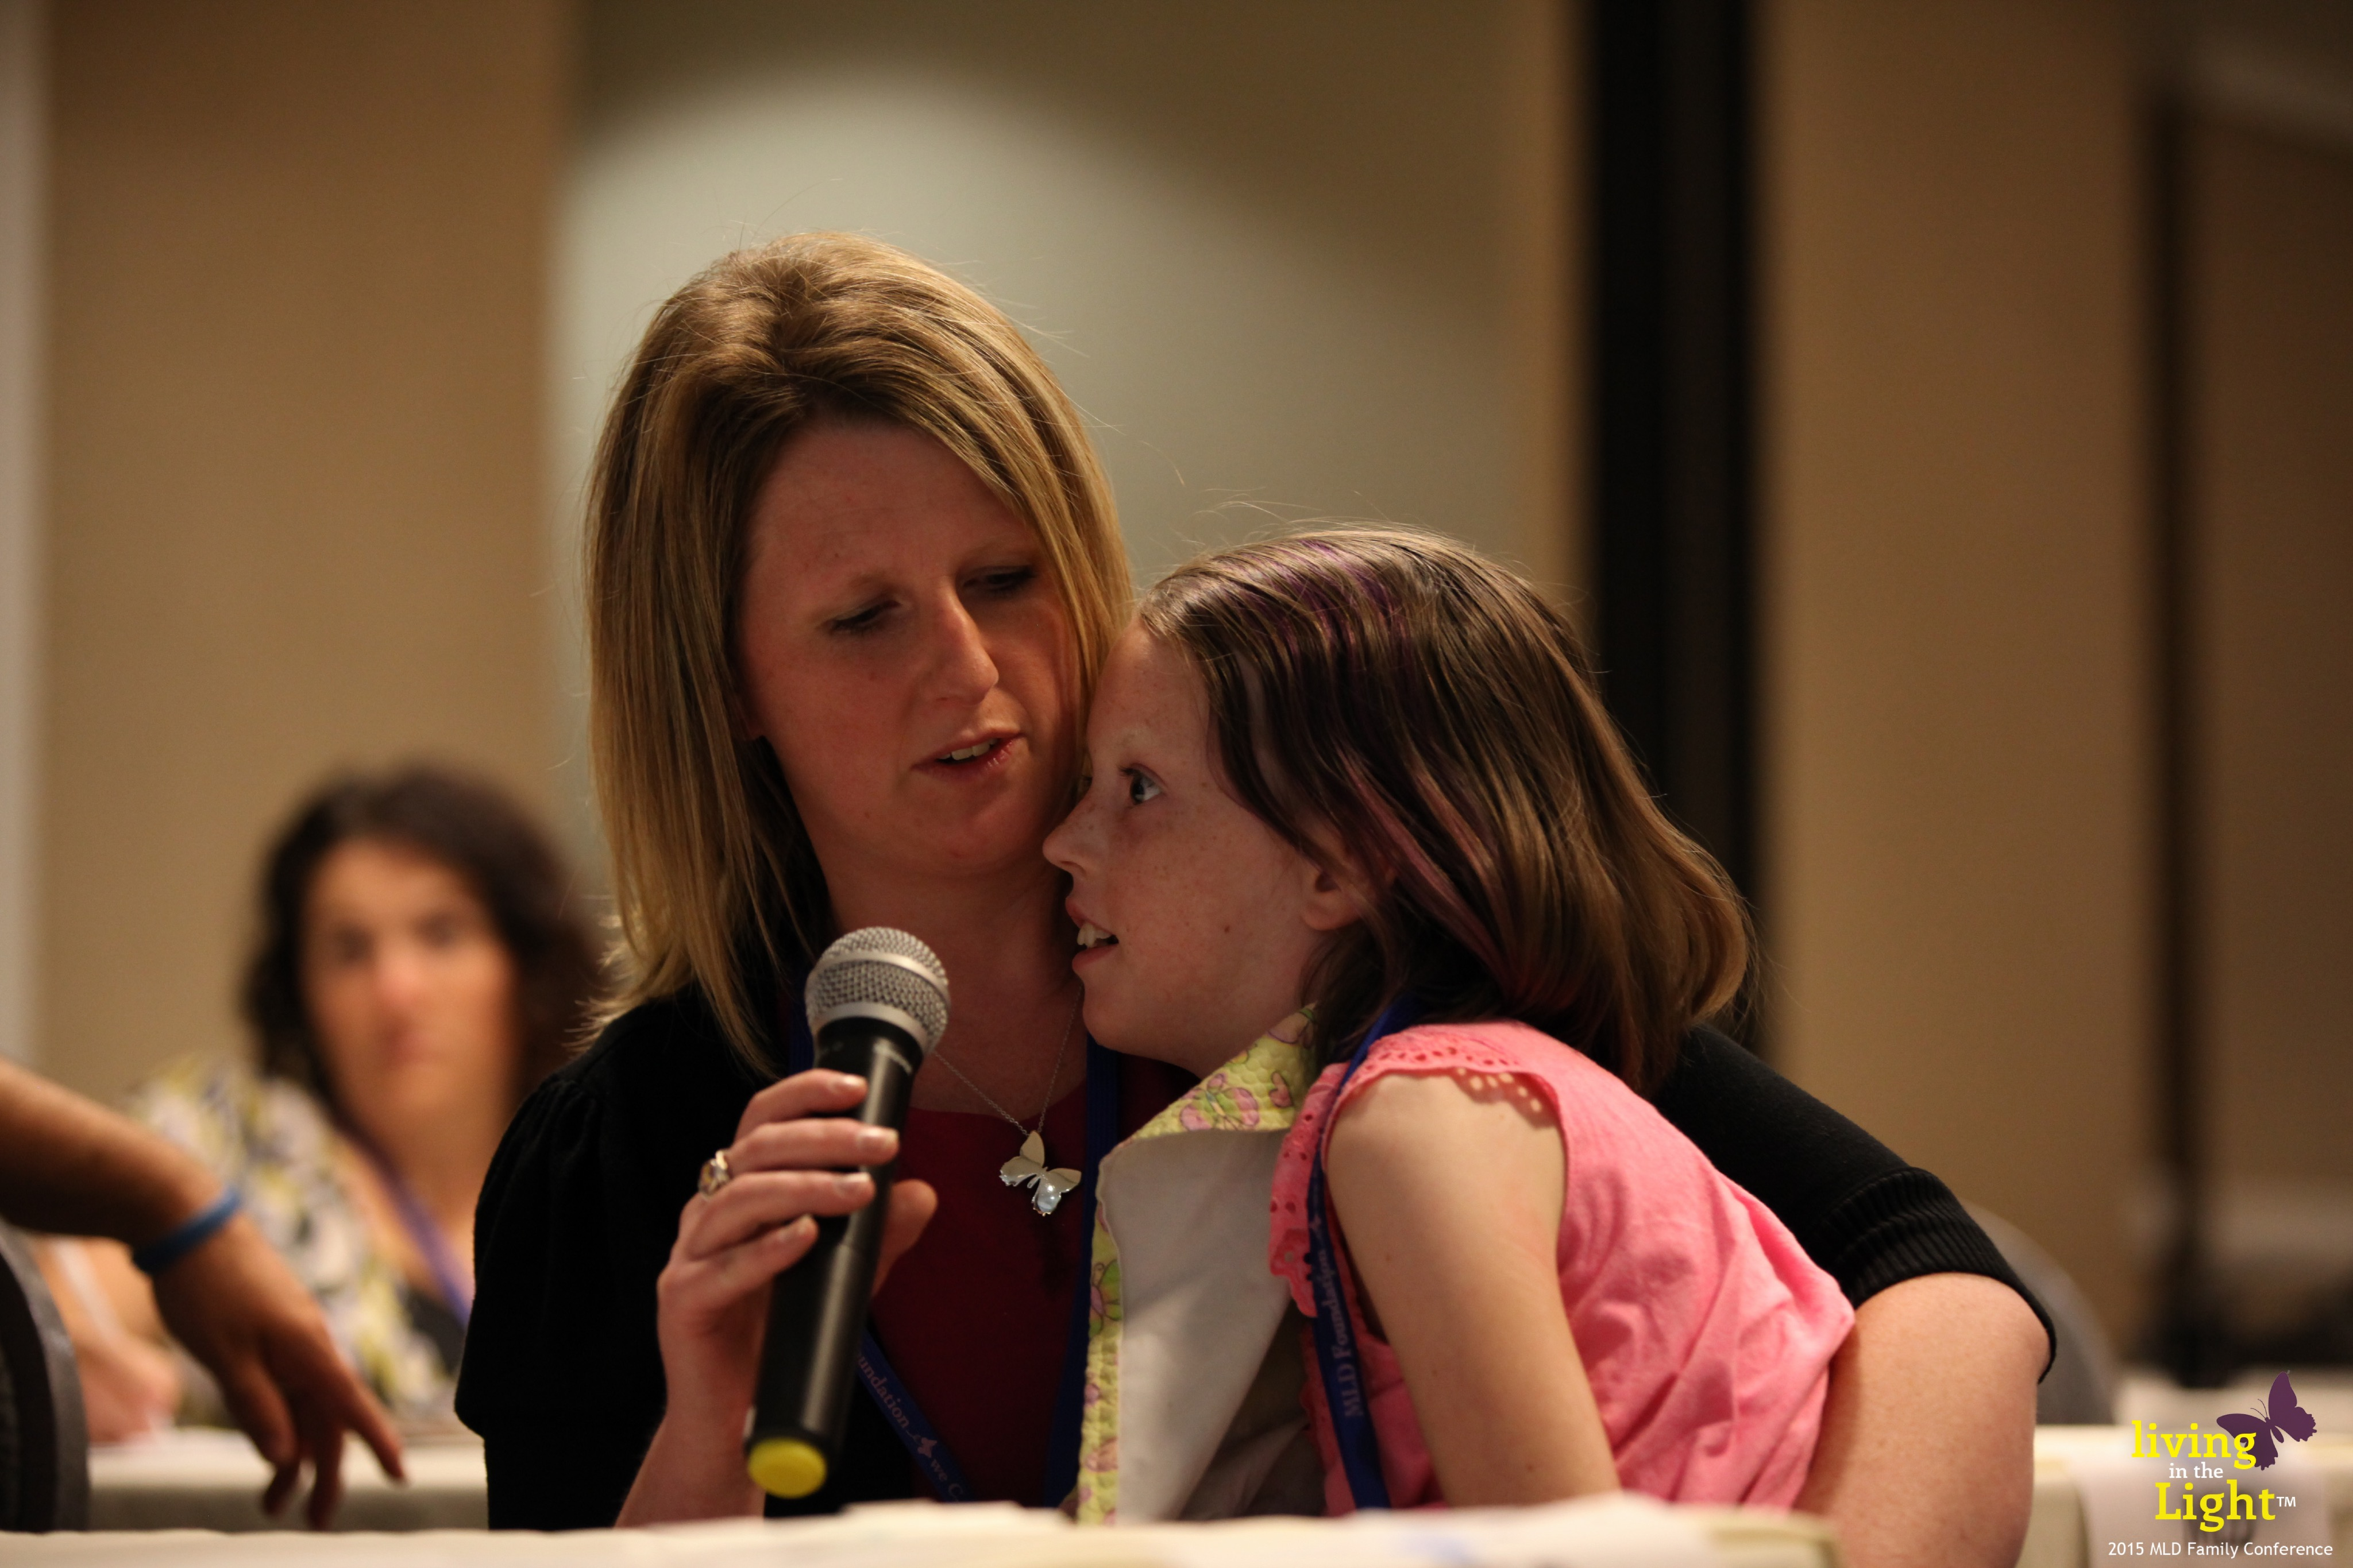
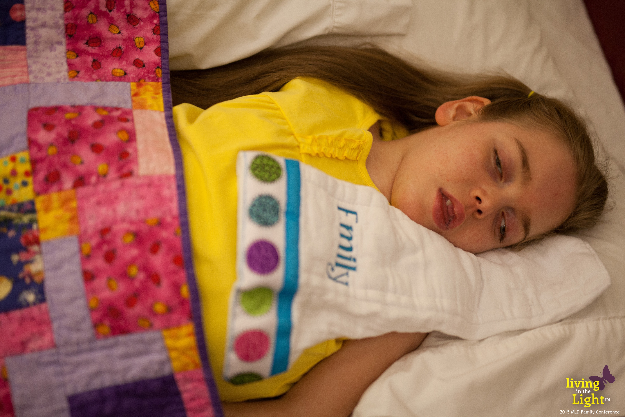
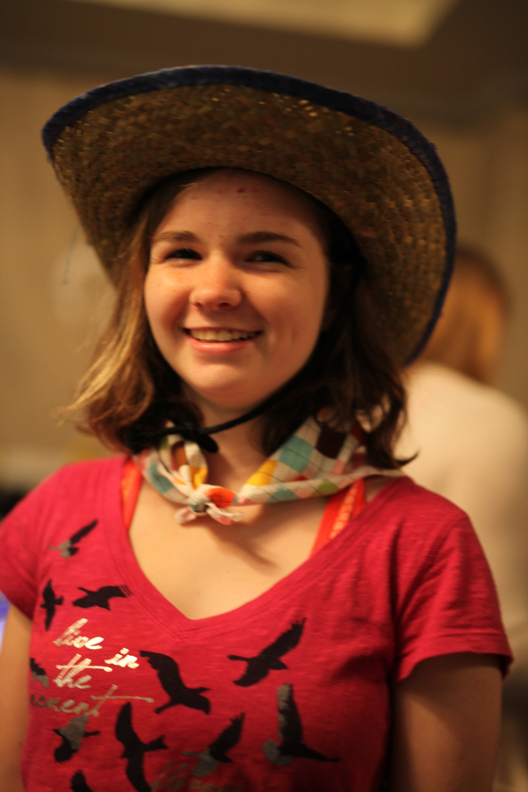
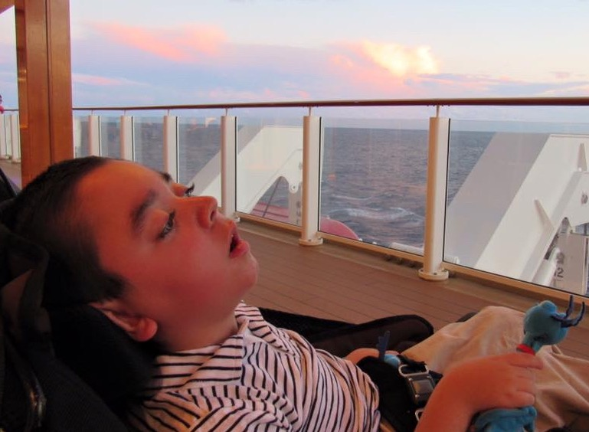
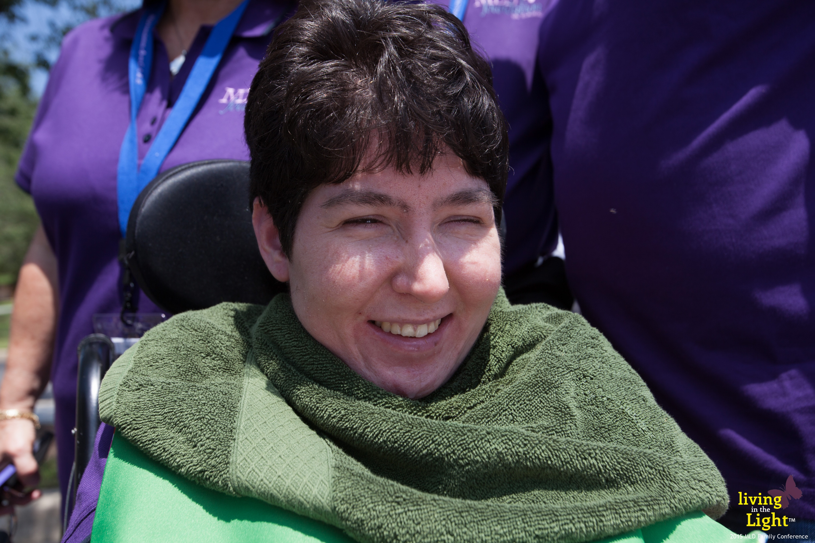
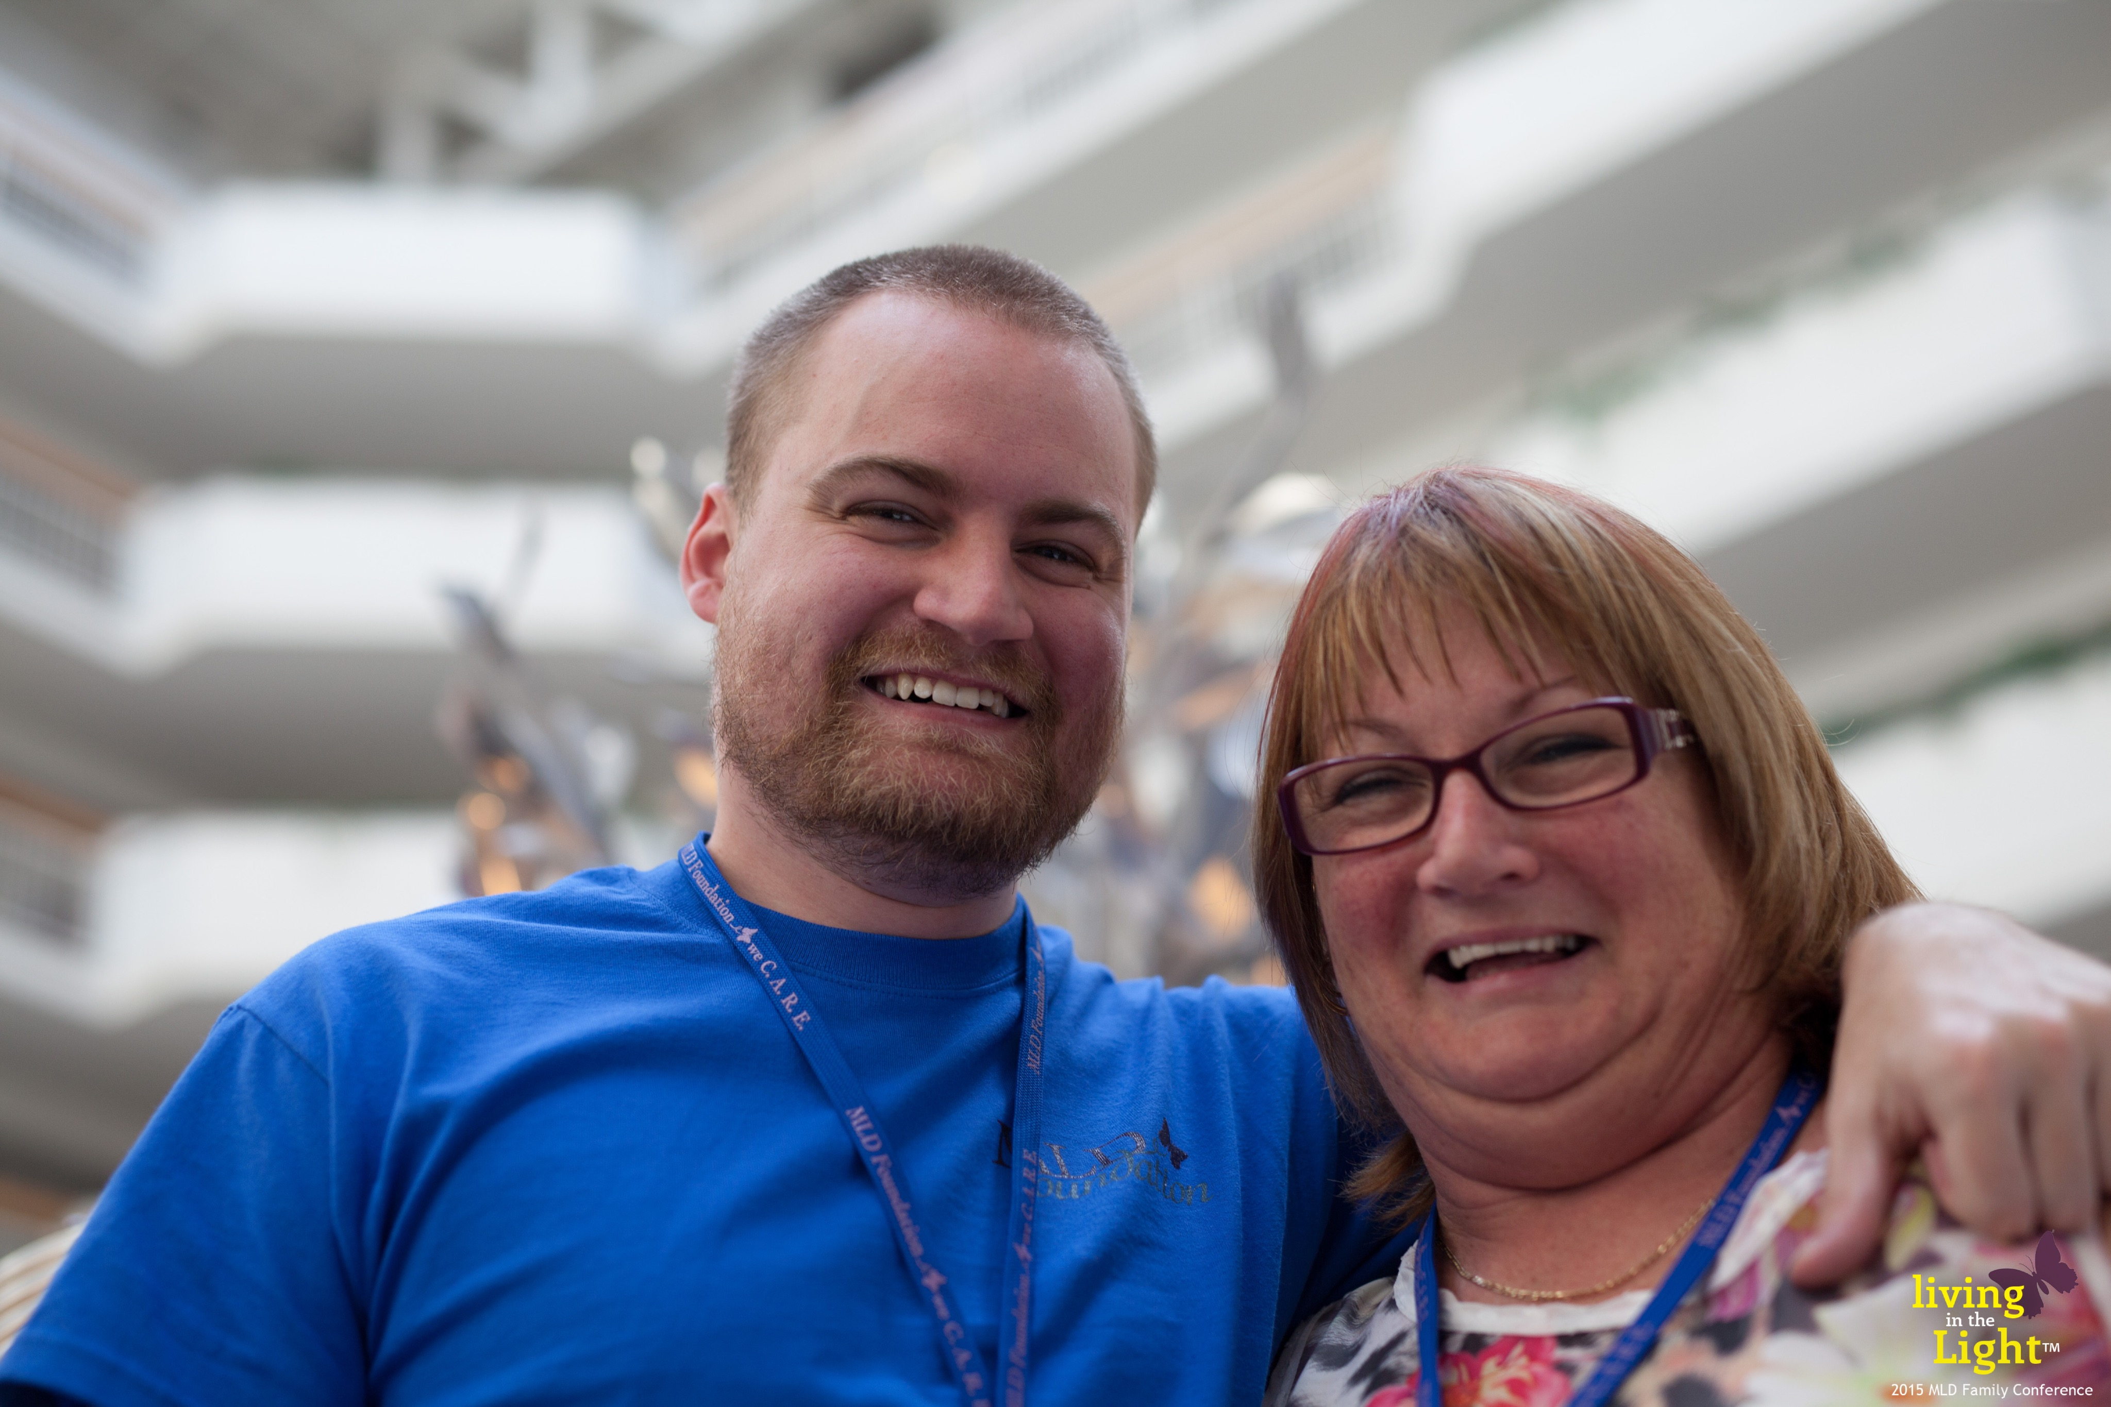
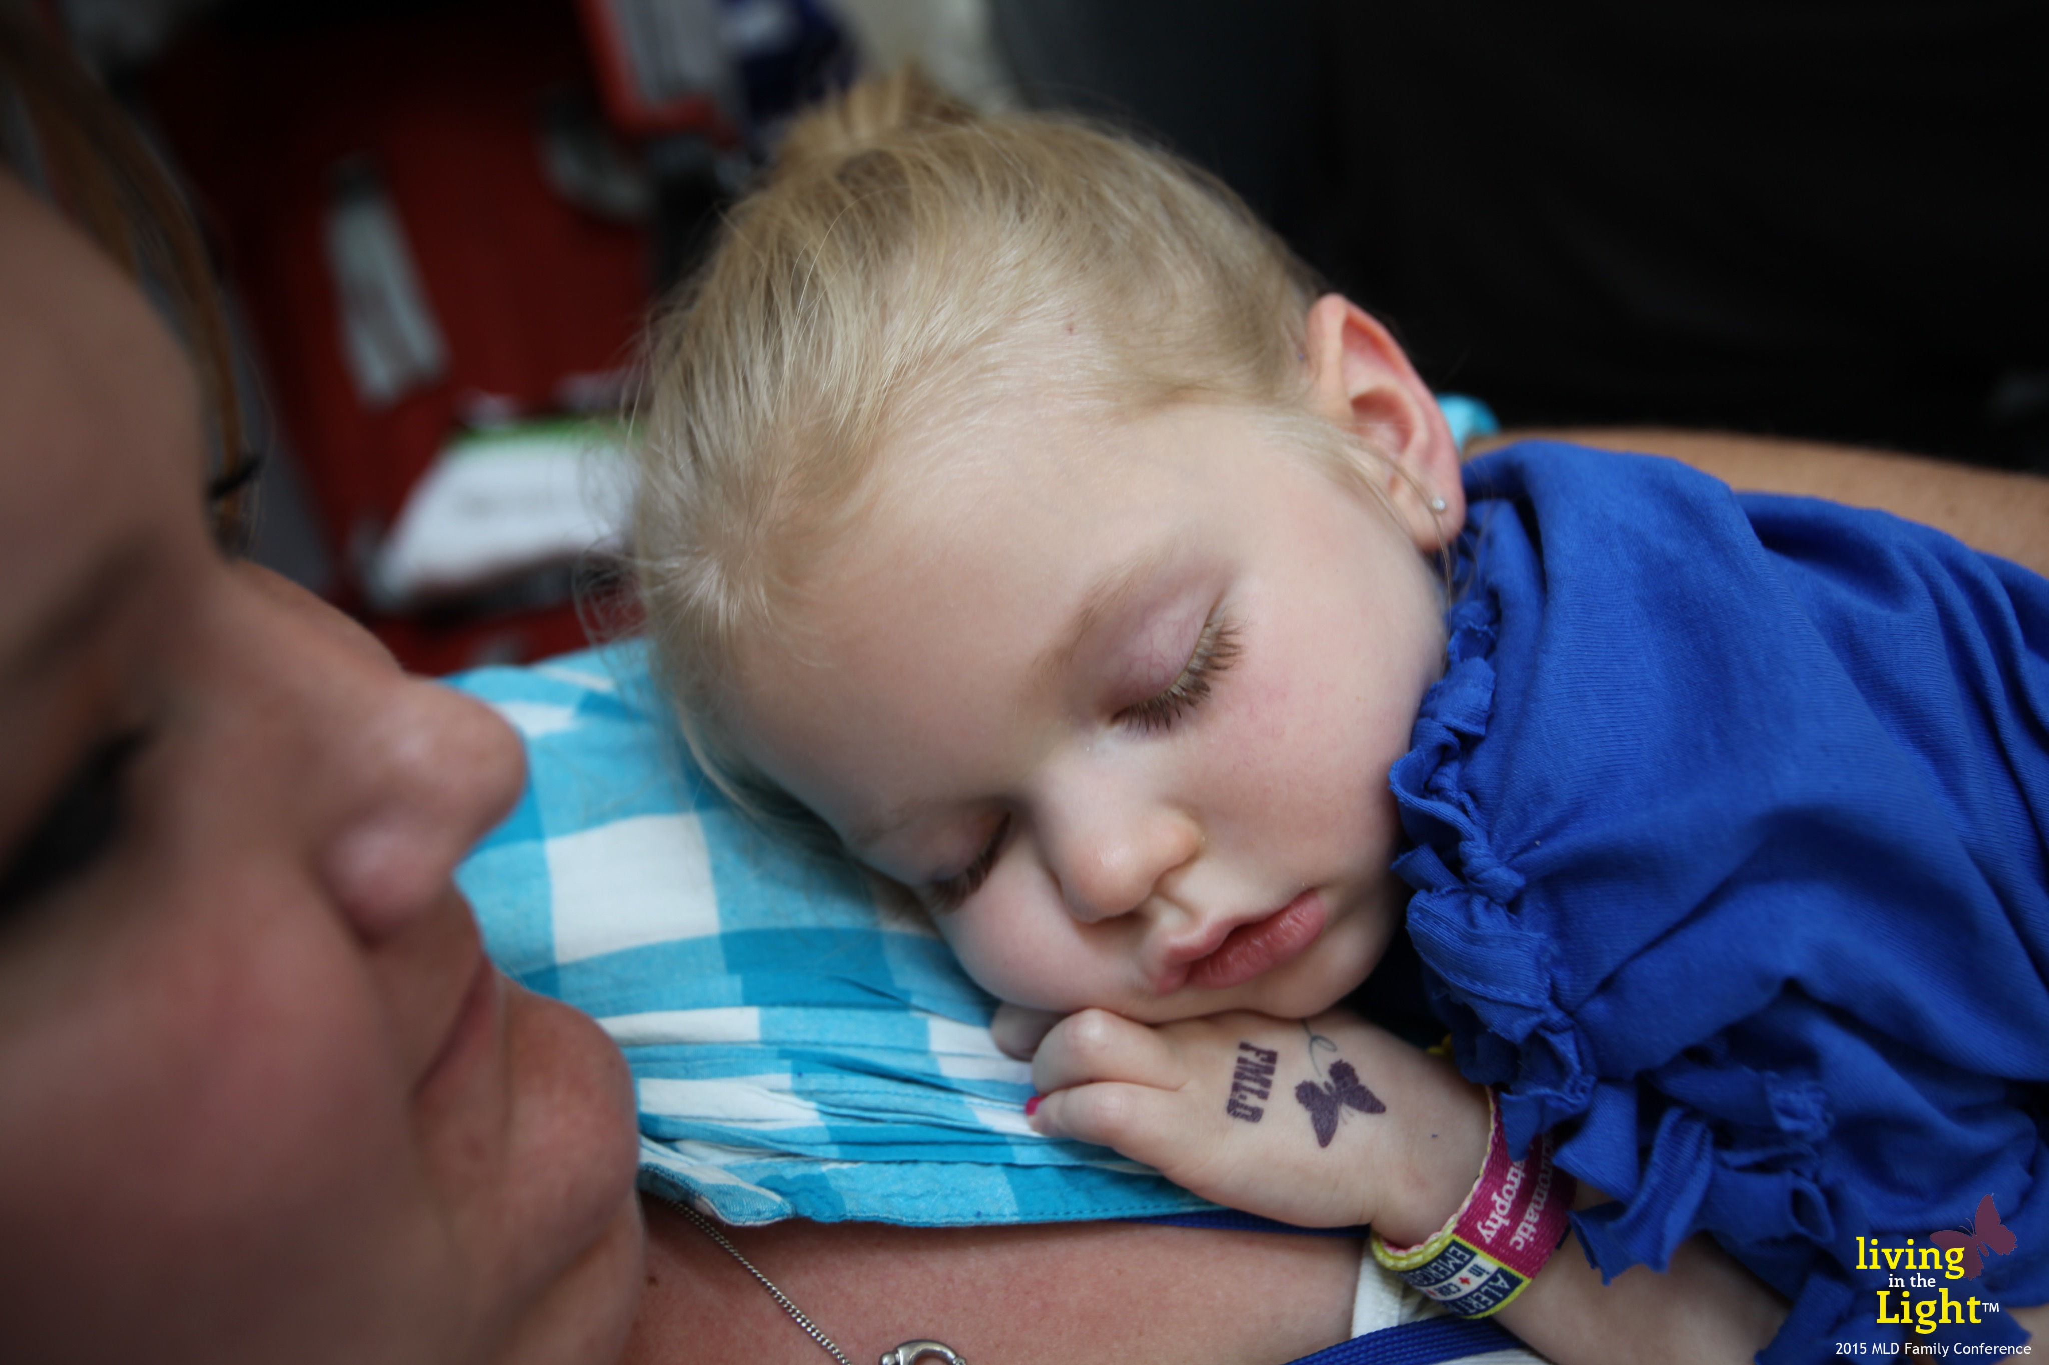
Forms of MLD
Juvenile – 20-25% of cases
  onset between 4 and late teens
  motor or cognitive forms
  lifespan … 10 years, sometimes longer
Late Infantile – 50-60% of cases
  onset between 12 & 24 months
  loss of motor skills are first symptoms
  lifespan … until 7 or 8, sometimes 12-13 yrs old
Adult – 15-20% of cases
  onset 4th or 5th decade
  cognitive loss is first symptom
  probably very under diagnosed
* All pictures used with permission
Notes:
MLD is really a continuum but has been broken down into three categories based on onset of symptoms. As research continues, we might see that perhaps MLD could be classified as three different disease entities requiring different approaches.

Slide 19
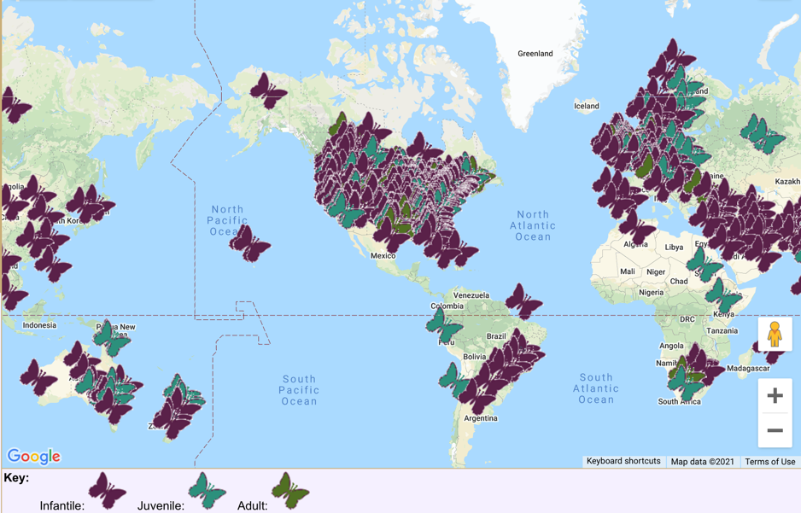
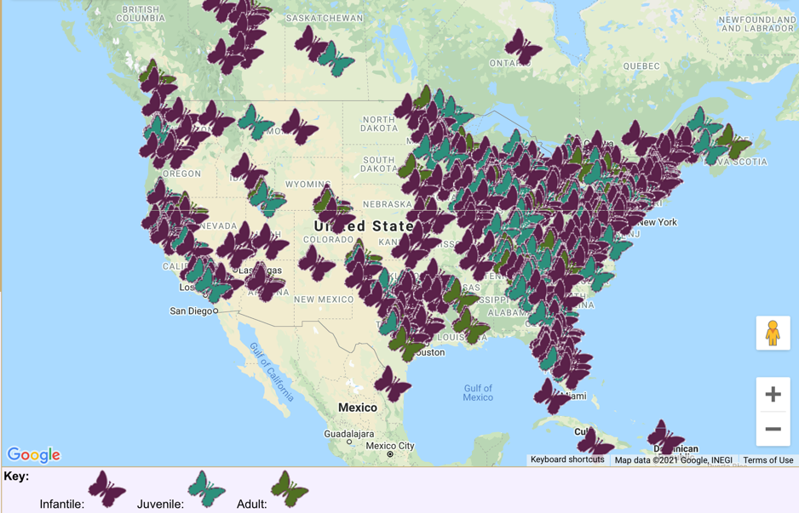
The MLD Family™
MLDfoundation.org/mldmap.php

Slide 20
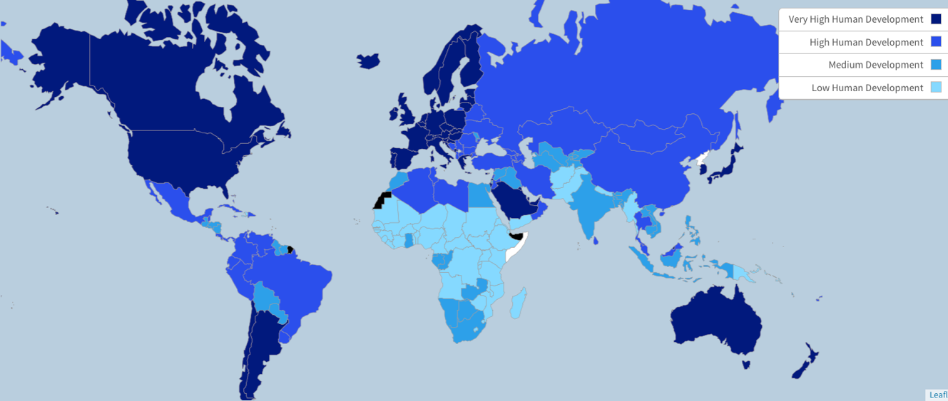
Demographics … What is 1st World?
1st World: United Nations … Human Development Index > 0.8 = VHHD

Slide 21
Incidence & Prevalence
 | BIRTHS – Incidence* |  |  | ALIVE – Prevalence
 | USA | 1st World | Global | USA | 1st World | Global
Late Infantile | 60 | 170 | 1,897 | 240 | 682 | 7,587
Juvenile | 27 | 77 | 862 | 519 | 1,472 | 3,449
Adults | 22 | 62 | 690 | 1,071 | 3,036 | 33,799
* Assuming incidence of 1 in 40,000 births
© 2022 MLD Foundation – All assumptions driving this table are available from MLD Foundation

Slide 22
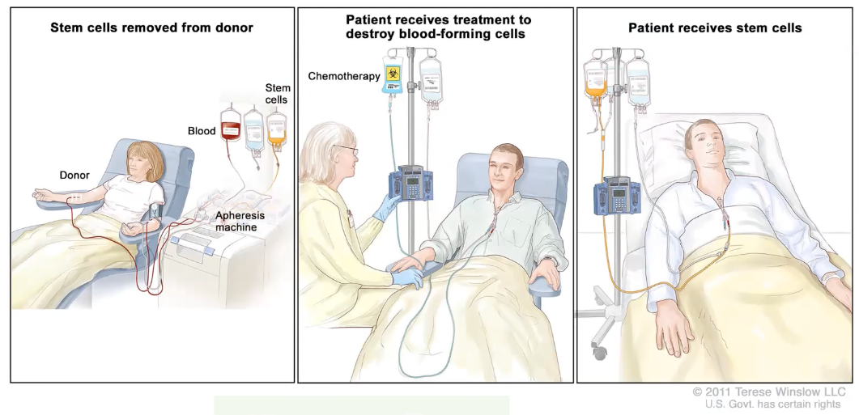
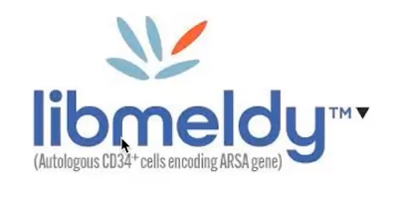
MLD Research & Clinical Trials
Stem cell transplant (academic/institutional) –
slows disease but typically does not halt progression
Gene therapy … 2005 large animals, EU approved
Libmeldy late 2020, FDA filings expected late 2022
ERT in clinical trial – globally
FDA …Panelist for FDA initiated IEM PFDD,
co-Organizing MLD PFDD
Natural history and MLD Patient Powered Registry™
4 other active biopharma projects plus another on a roadmap

Slide 23
We C.A.R.E.®

Slide 24
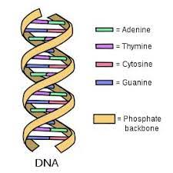
Genomics
23 chromosomes
20-25k genes built from 3 billion DNA base pairs

Slide 25
Genomics
AUTOSOMAL DOMINANT
Need only one copy of the abnormal gene to be affected.
Affected parent has
  50% chance of an affected child by passing on the abnormal gene
  50% chance of an unaffected child by passing on the normal copy of the gene
AUTOSOMAL RECESSIVE
Both parents must be carriers.
Affected: two abnormal genes – one from each parent (25%)
Carrier inherits one good gene and one abnormal gene (50%)
Disease free and not a carrier – two good genes = disease free, (25%)

Slide 26
Genomics
X-Linked Recessive
Carrier mother:
  50% chance of affected son
  50% chance of carrier daughter
Affected father:
  50% chance of carrier daughter
  all sons healthy
X-Linked Dominant
Affected mother:
  50% chance of affected child
  50% chance of carrier child
Affected father:
  50% chance of affected daughter
  all sons healthy
Females have two X chromosomes, while males only have one

Slide 27
Genomics - comments
There are other inheritance patterns
Stats are per pregnancy
Carriers may be affected by a milder or different form of disease
Variations can be spontaneous, i.e., not inherited
Not everything is a single gene mutation, nor is everything genetic
  Multi-gene, microbiome, environmental, etc.
  And/or combinations of all of the above

Slide 28
Genomic - comments
Getting your genome sequenced …
    will show your variants – most variants are benign
    is not absolute … sequencing itself is pretty accurate, but not all variants (genotypes) have been correlated to phenotypes, i.e. a VoUS
Improving genotype-phenotype correlation leads to …
    better/more accurate diagnostics
    guides proper therapy and timing recommendations
    improved quality of life – with or without therapy
Sequencing is becoming part of newborn screening … (for some disorders)

Slide 29
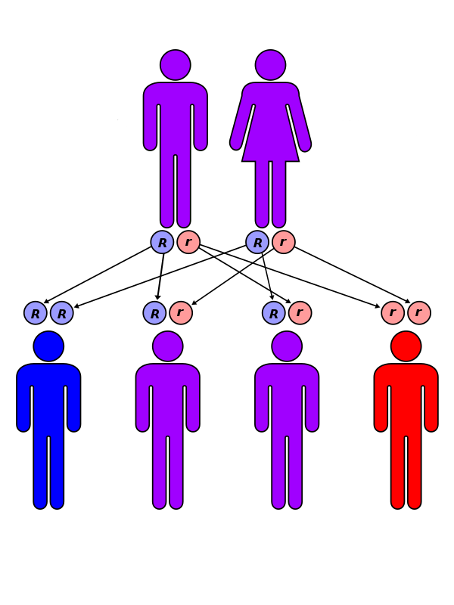
MLD – Genomics
Autosomal Recessive
    need carrier mother and carrier father
    1 in 4 chance of an affected child
Incidence … 1 in 40,000 births
MLD affects all people groups … globally
1 in 100 is a carrier
    100 x 100 x 4 = 40,000

Slide 30
We C.A.R.E.®

Slide 31
NBS Facts
Newborn screening has been around for 67 years
    MA passed the first law – PKU
    Dr. Robert Guthrie has been deemed the “Father of Newborn Screening” – PKU niece
About 4 million US babies are screened each year.
12,000 are identified with a NBS disorder each year (1 in 333)
    With treatment, many of these babies will have healthy lives.
The CDC recognized newborn screening as 1 of the 10 most important public health achievements of the last century.
Newborn screening is the most equitable program in the USA!

Slide 32
NBS – the Best Diagnostic Start
Good diagnostics improve clinical/therapeutic decision-making and help us to understand the disease
    Identify before visible symptoms and before irreversible damage
    Requires ever-improving genotype-phenotype correlation
Equity & efficiency … 99%+ of all US babies are screened
NBS is public health, not research, but blood spots contain a wealth of research information about Population Health

Slide 33
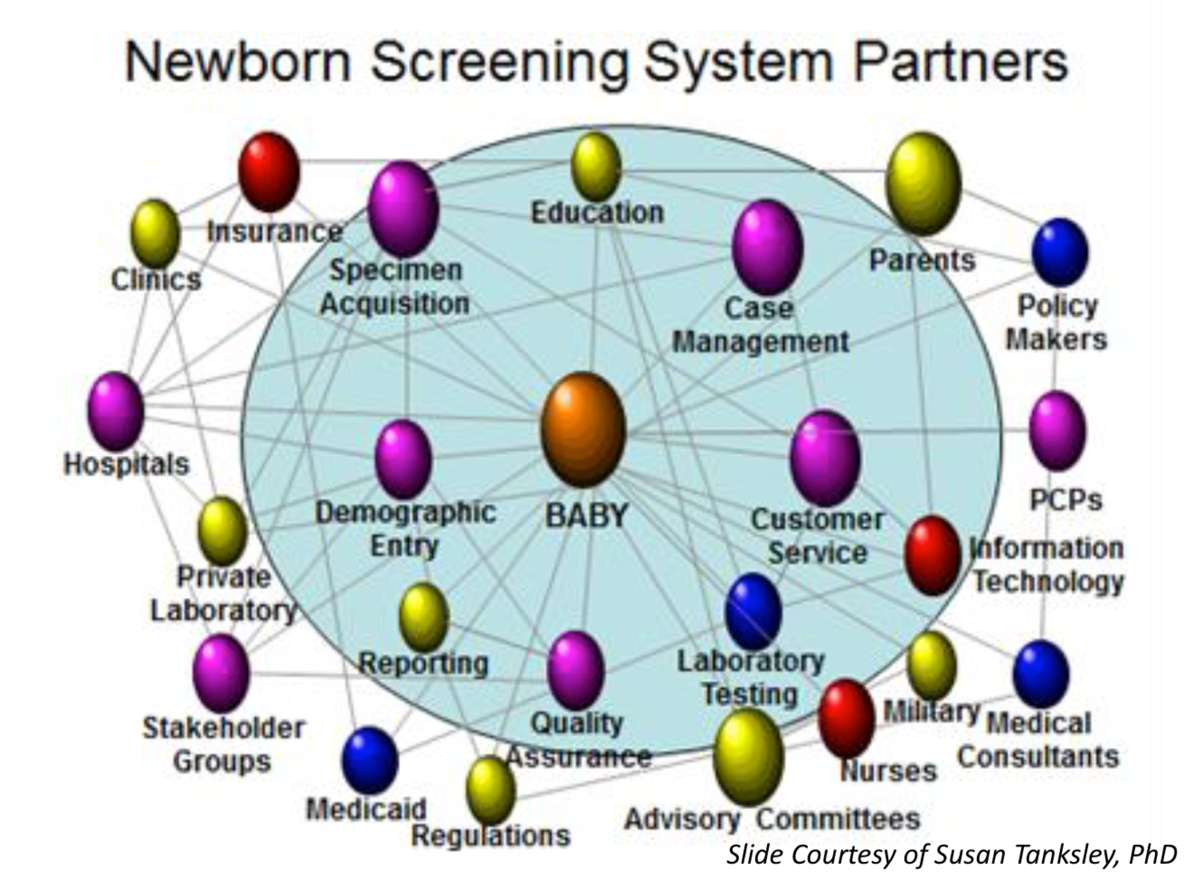
The NBS Ecosystem is Complicated
NBS is much more than just a heel prick and a lab test!

Slide 34
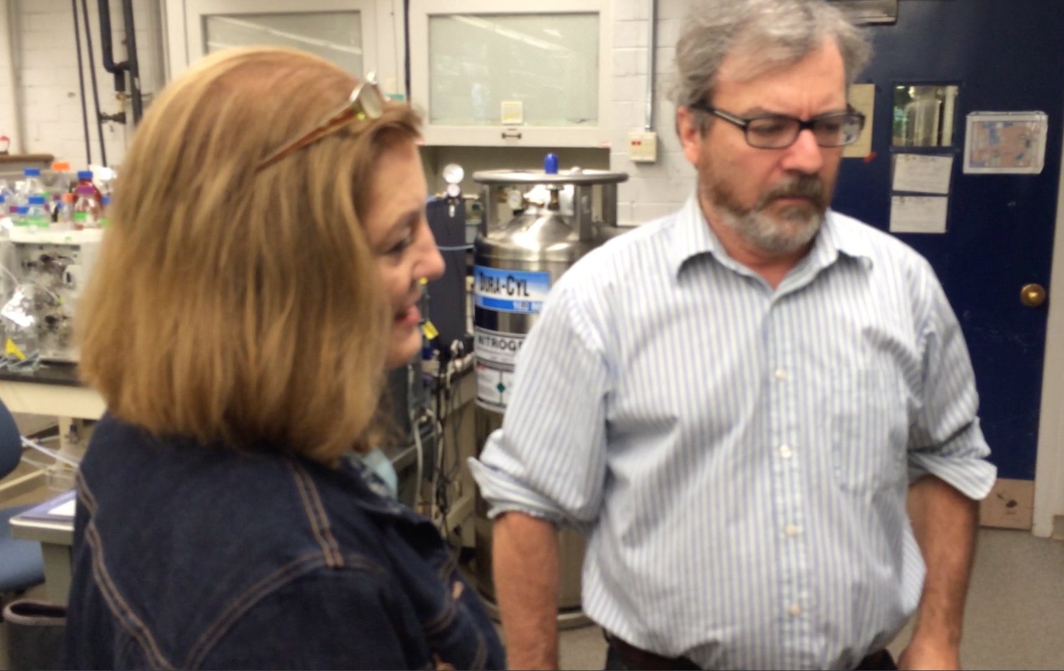

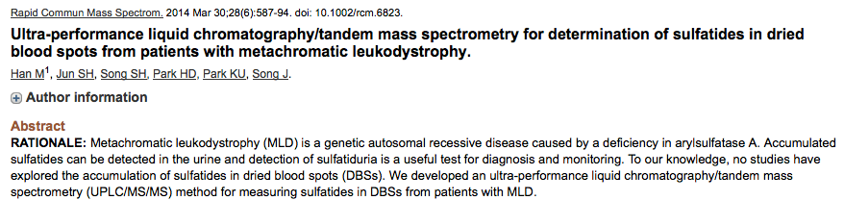
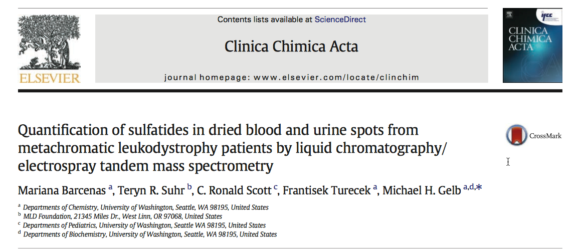
Working With the Gelb Lab
Started collaboration in 2012
Co-identified a new screening strategy when
traditional enzyme level testing didn’t work (2016)
MLD Foundation provided the blood spots
for lab validation
Built state public health relationships and provided support for WA deidentified pilot study to validate the lab work
    Sequencing is the current false positive reduction approach
WA … >100k spots over 3+ years … 3 hits: including 1 positive, 1 VoUS … but all deidentified

Slide 35
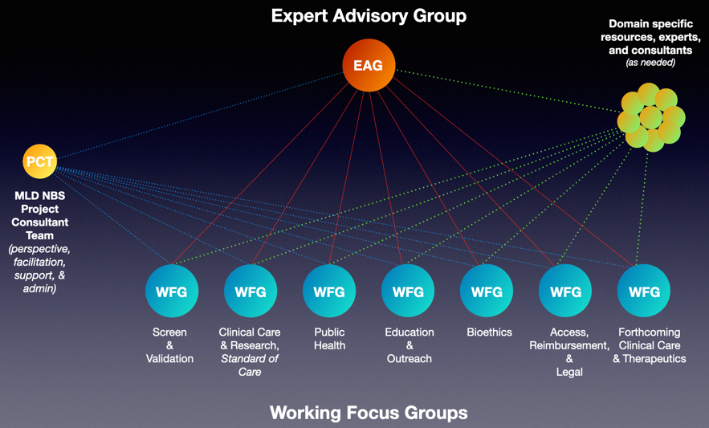

MLD Newborn Screening
2012 Gelb lab started development work on MLD NBS assay
2017 – Hosted 1st MLD NBS Summit
2020
    Launched MLD NBS Expert Advisory Group
    Launched RANSIP for RUSP nomination
    German NBS pilot launches
2021 ScreenPlus and
German pilots launch

Slide 36
MLD NBS Flow
MS/MS … sulfatides in DBS
MS/MS … ARSA enzyme level in DBS (to avoid pseudo issues)
Targeted sequencing
Goal
  Confirm MLD
  Identify age of onset … form of MLD
    expect over 50% of results to indicate onset/form

Slide 37
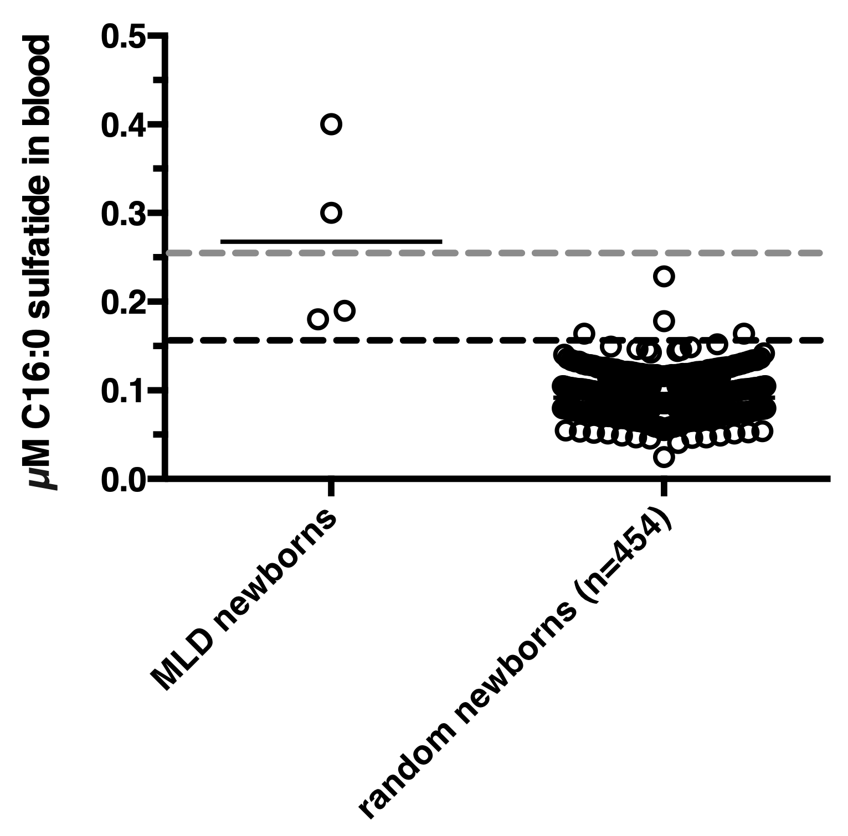
WA Pilot Study Results
Over 100,000 babies screened
over 3+ years
Continual refinement …
cutoffs have been adjusted
several times

Slide 38
WA Pilot Study Results
2 potential positives
    high confidence in confirmation
    and elimination of false positives –
    sequencing VoUS
    New confirmation technique being developed
Screen looks very good and is working
  confidence in no false negatives
  efficient, looks to be transferrable
  potential for late infantile and juvenile
  distinction, not sure if will discern adults

Slide 39
We C.A.R.E.®

Slide 40
Initiatives: Genotype/Phenotype
Every new diagnosis needs a solid genotype-phenotype-biochemical correlation to optimize therapy and clinical care
Gelb Lab & Biomarin
  Measured ARSA enzymatic activity of ≈300 variants … covers all common variants
  Segmented into Severe, Moderate, Mild, and Benign variants
  <2% 2-4% 4-13% >13% of “normal” (wild type) level
  78% predictive accuracy for published phenotypes
    78% is awesome, but leaves room for refinement and improvement
Combine with other patient-specific diagnostic processes

Slide 41
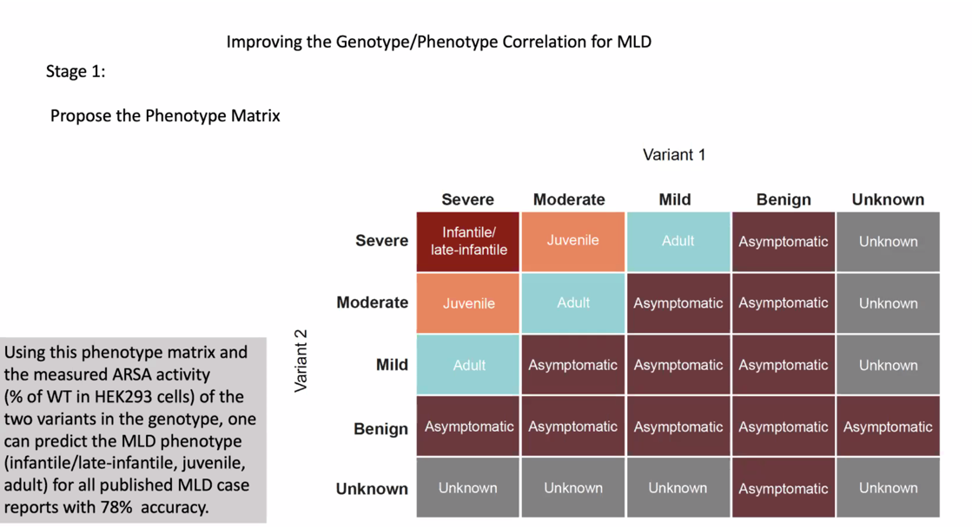
Initiatives: Genotype/Phenotype

Slide 42
Initiatives: Genotype/Phenotype
Improving the genotype-phenotype correlation for better outcomes
  Identify and gather ARSA enzymatic activity on other variants
MLD Foundation will be expanding phenotype contributions
Review, and as necessary, adjust segmenting process and cutoffs
  Severe, Moderate, Mild, and Benign variants
  <2% 2-4% 4-13% >13% of “normal” (wild type) level

Slide 43
Questions & Discussion
Dean Suhr … dean@MLDFoundation.org

Slide 44
We C.A.R.E.®

