Slide 1
Introduction to variant annotation and data sources
Vikas Pejaver
Assistant Professor, Institute for Genomic Health & Dept. of Genetics and Genomic Sciences
Icahn School of Medicine at Mount Sinai, New York City
August 29, 2022

Slide 2
Outline
What is variant annotation?
Variant annotation databases and tools
  ClinVar
  dbNSFP
dbNSFP deep dive
The prediction task and data sets

Slide 3
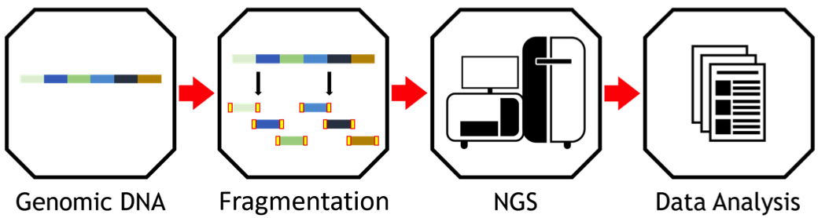
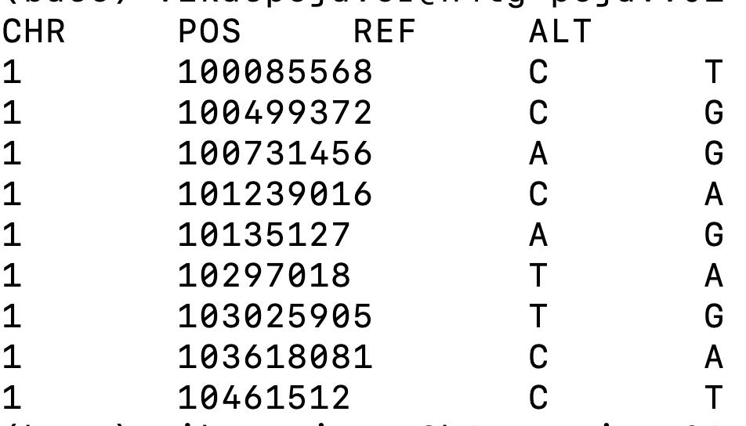
What is variant annotation?

Slide 4
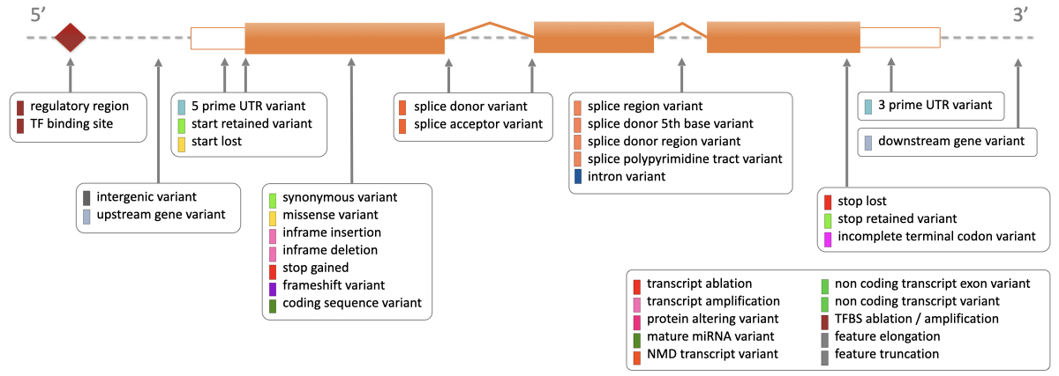
What is variant annotation?

Slide 5
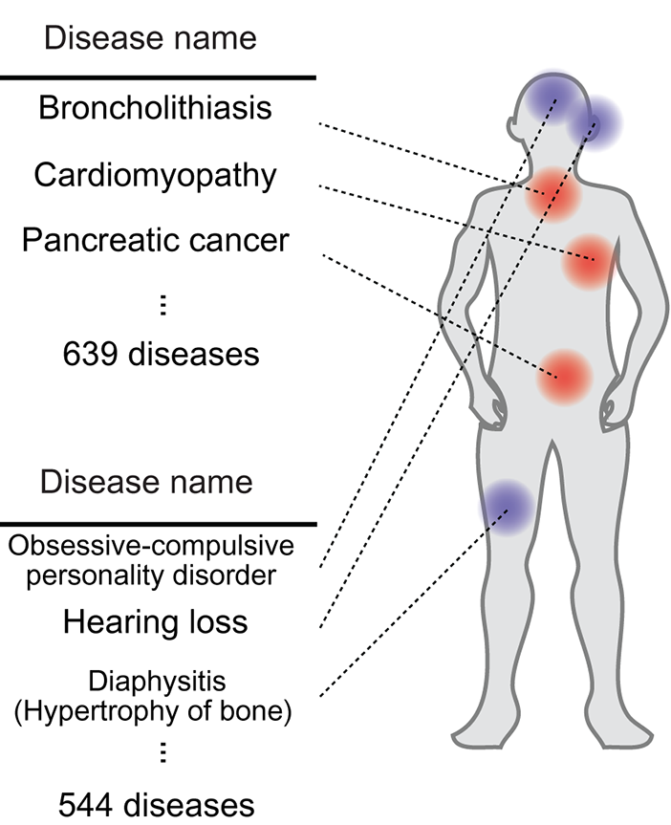
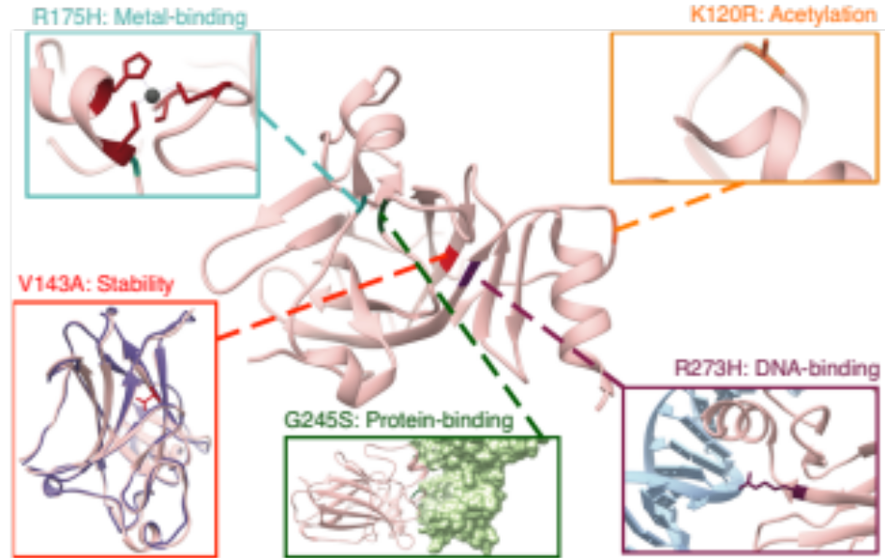
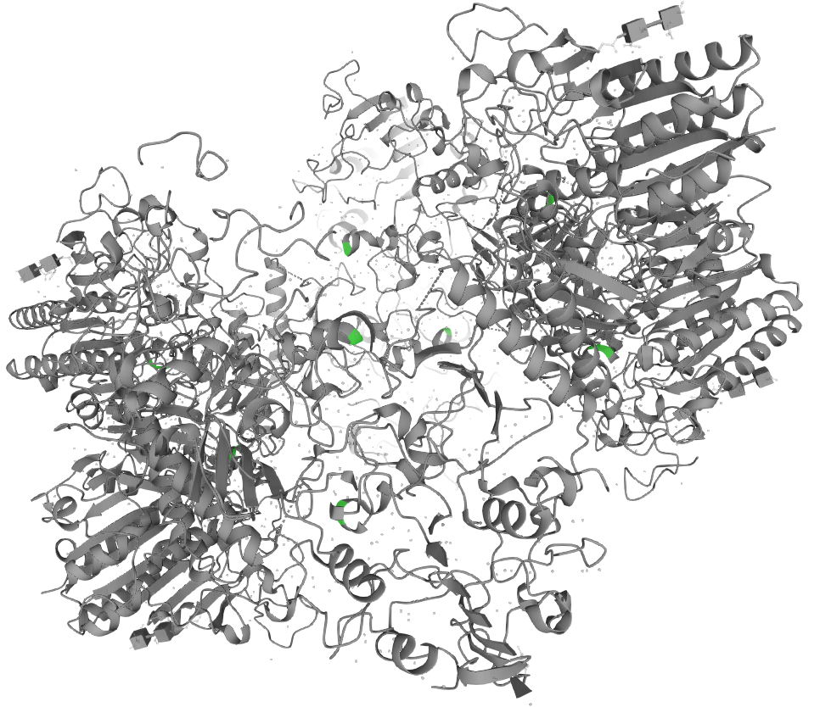
What is variant annotation?
Protein structure
Protein function
Disease and traits

Slide 6
What is variant annotation?
The process of linking genetic variants to information
about their consequences and impacts at
different levels of a biological system

Slide 7
Outline
What is variant annotation?
Variant annotation databases and tools
  ClinVar
  dbNSFP
dbNSFP deep dive
The prediction task and data sets

Slide 8
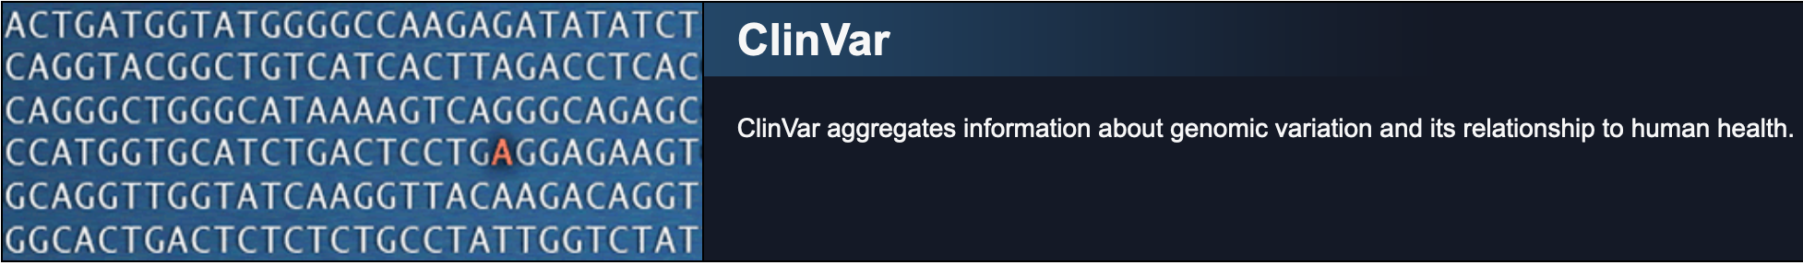
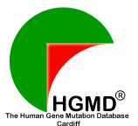




Variant annotation databases

Slide 9
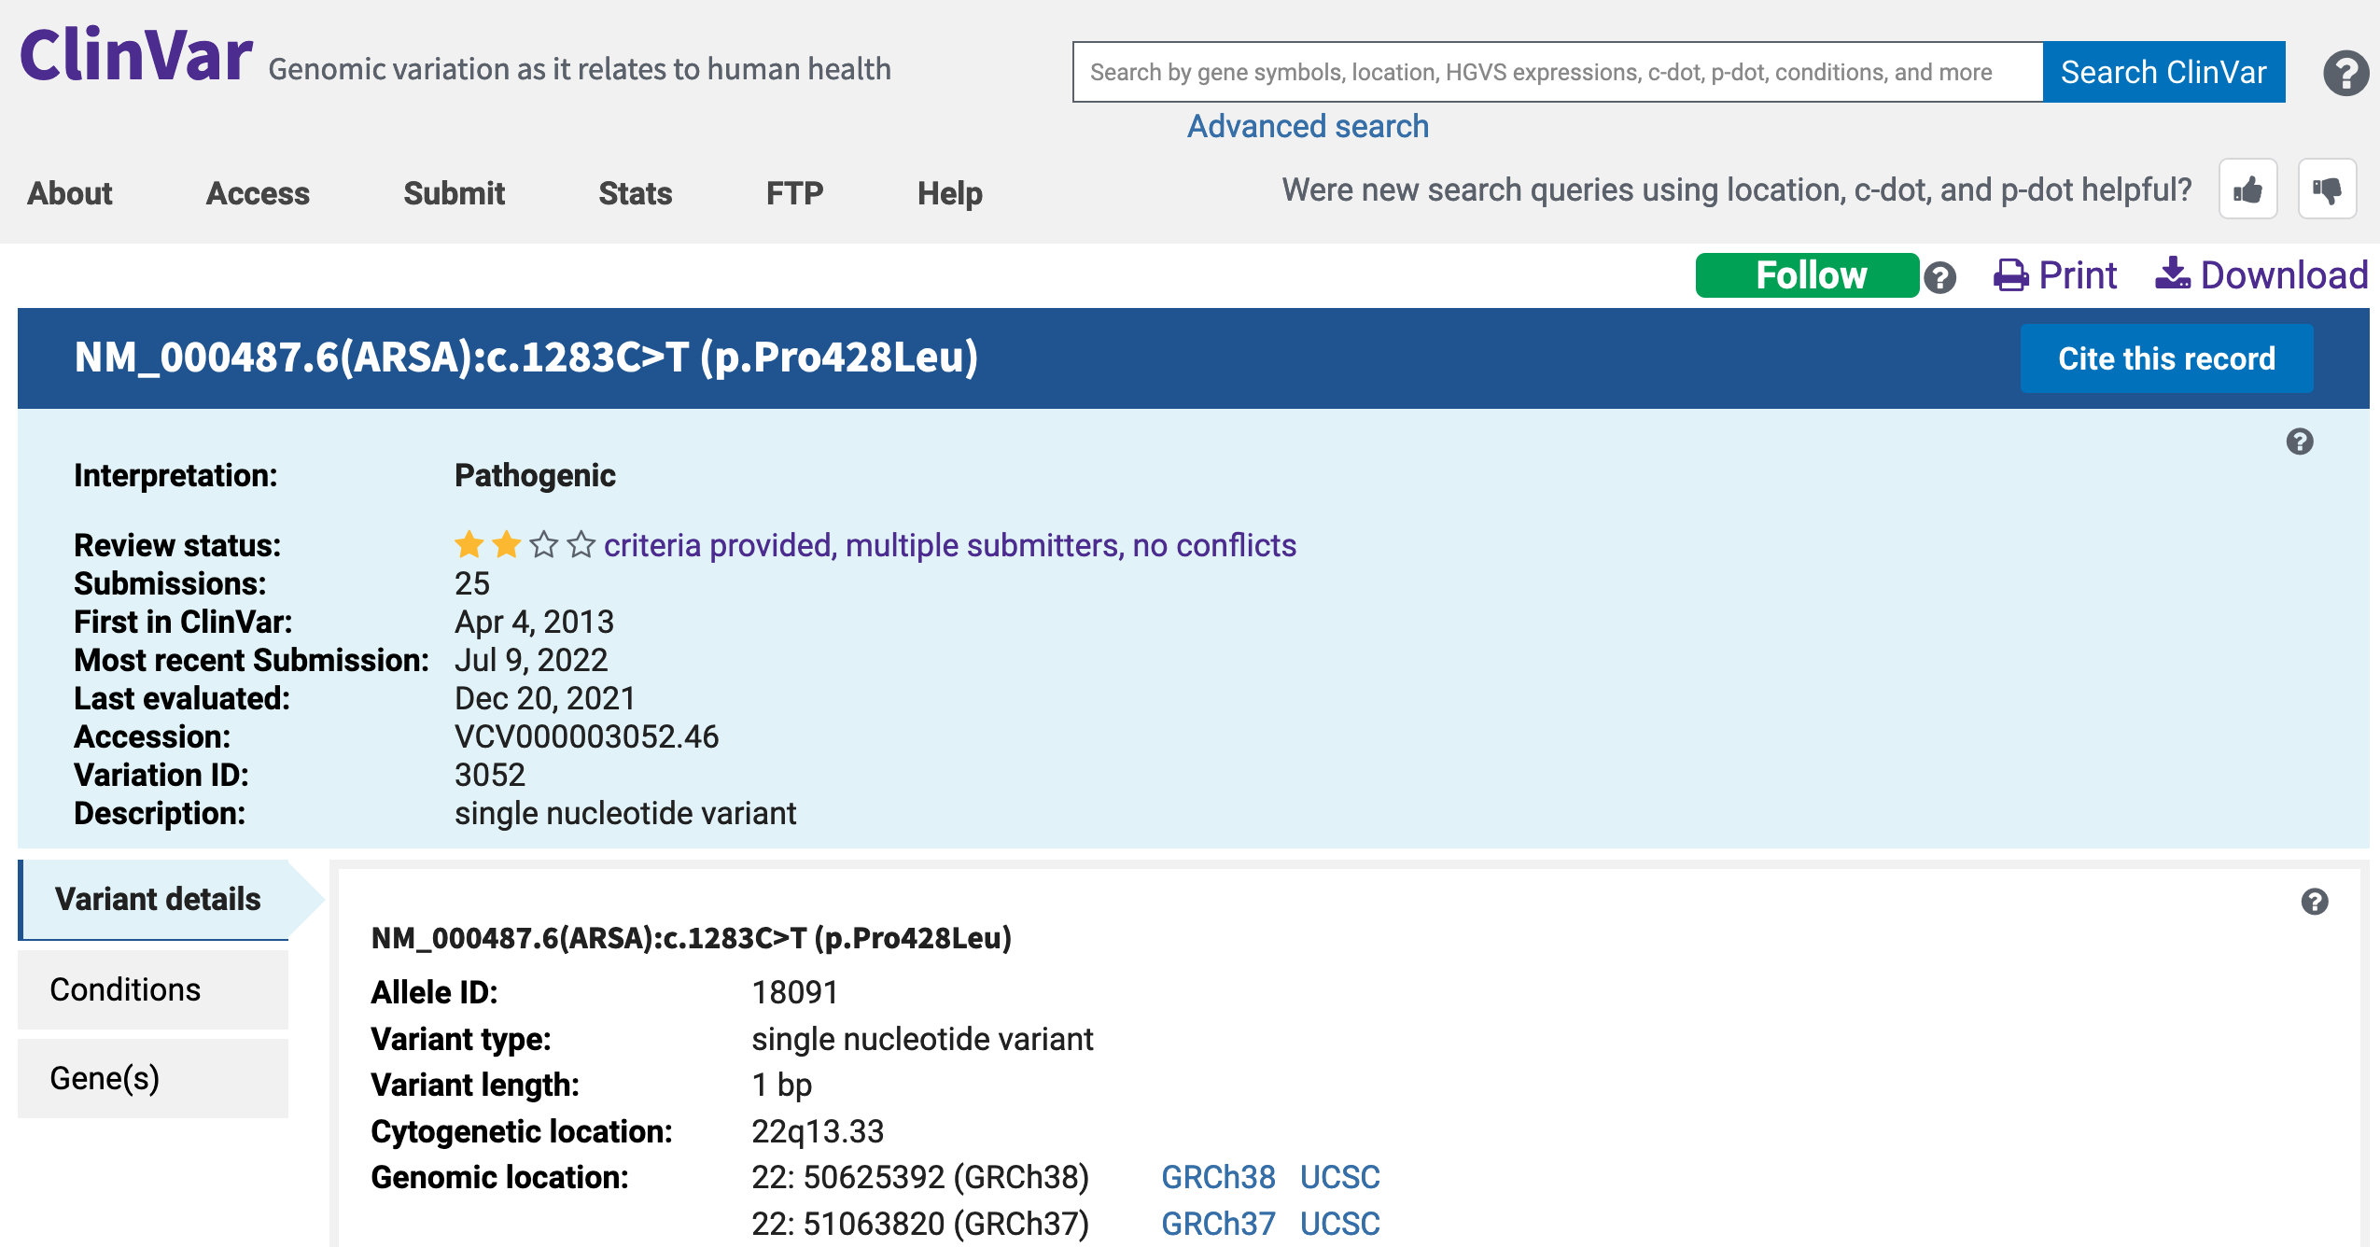
ClinVar

Slide 10
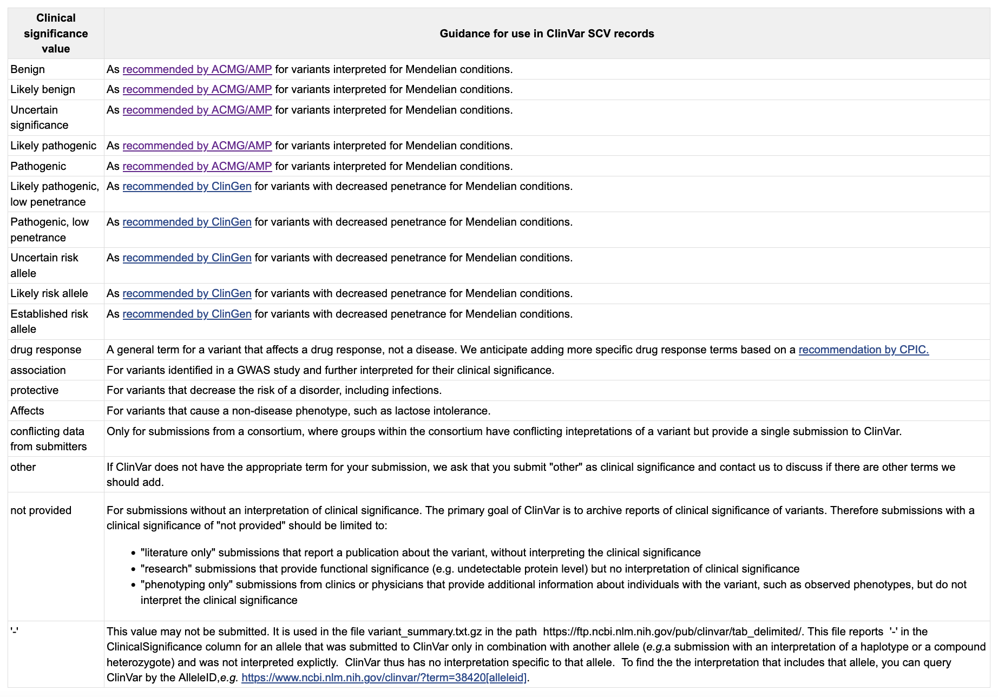
ClinVar

Slide 11
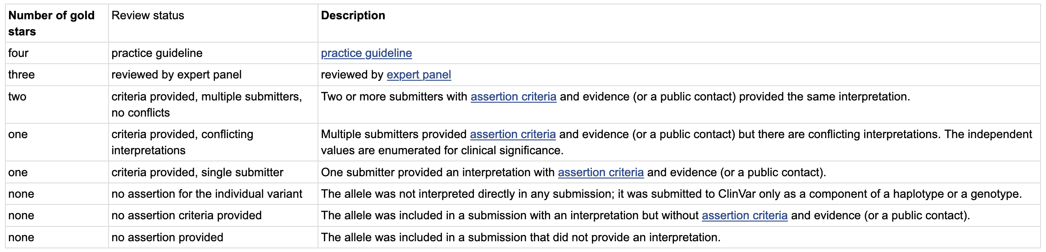
ClinVar

Slide 12




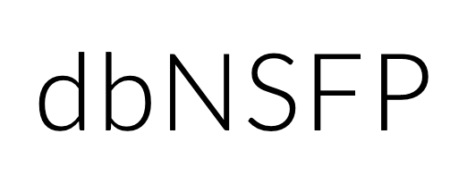
Variant annotators

Slide 13
dbNSFP: overview
A database and tool that contains annotations
from multiple resources for all potential
non-synonymous single-nucleotide
variants in the human genome
Reference: … C A G C T A G C T A G T T A G …
Alternate 1: … A C A A A C A A A C A A A C A …
Alternate 2: … G G C G C G C G C G C C C G C …
Alternate 3: … T T T T G T T T G T T G G T T …
84,013,490 variants!

Slide 14
Outline
What is variant annotation?
Variant annotation databases and tools
  ClinVar
  dbNSFP
dbNSFP deep dive
The prediction task and data sets

Slide 15
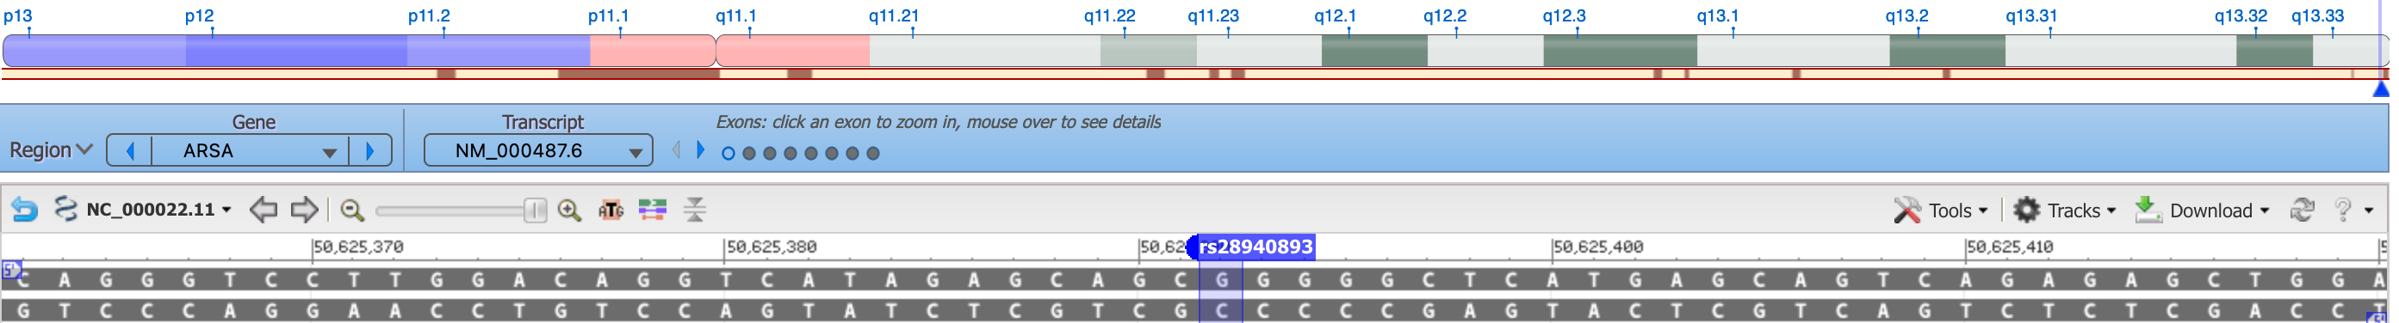
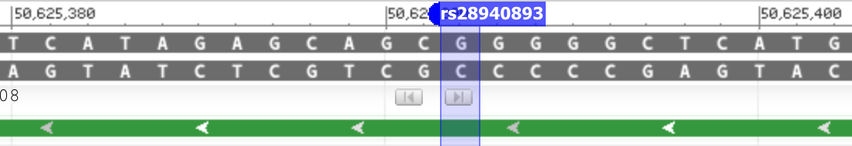
dbNSFP: chromosomal coordinates
22 50625392 G A

Slide 16
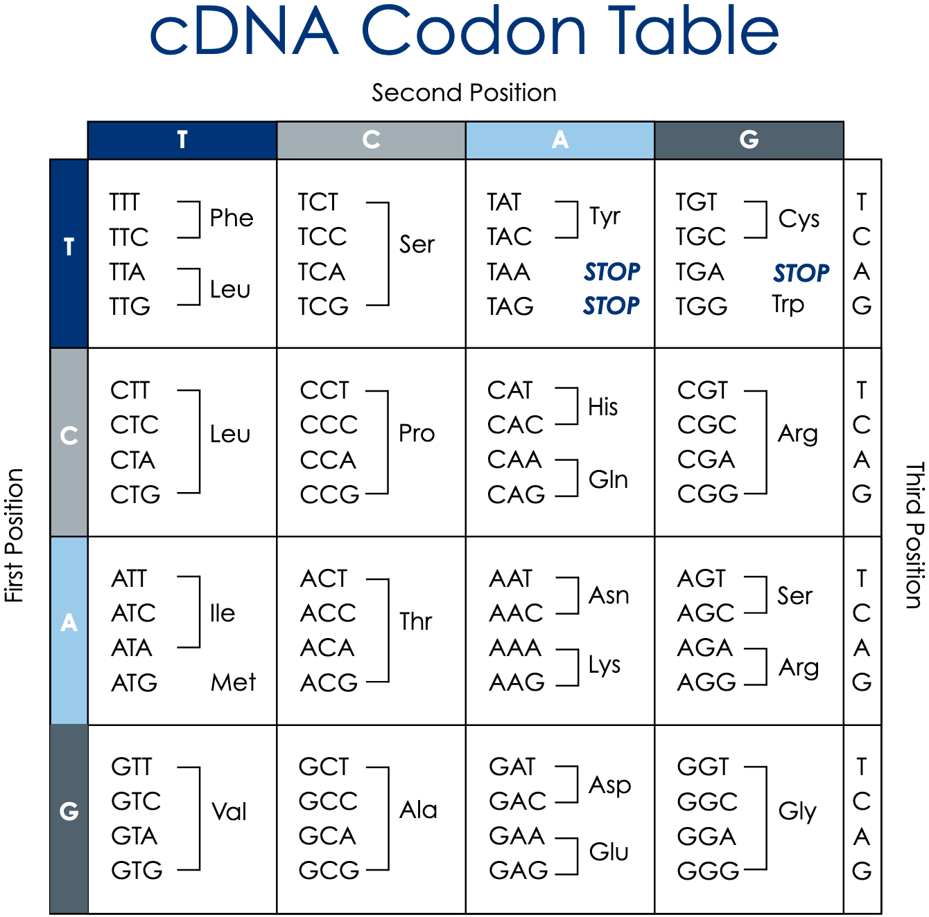
dbNSFP: amino acid change
G -> A
Reverse complement: C -> T
CCG -> CTG
Pro -> Leu (Proline to Leucine)

Slide 17
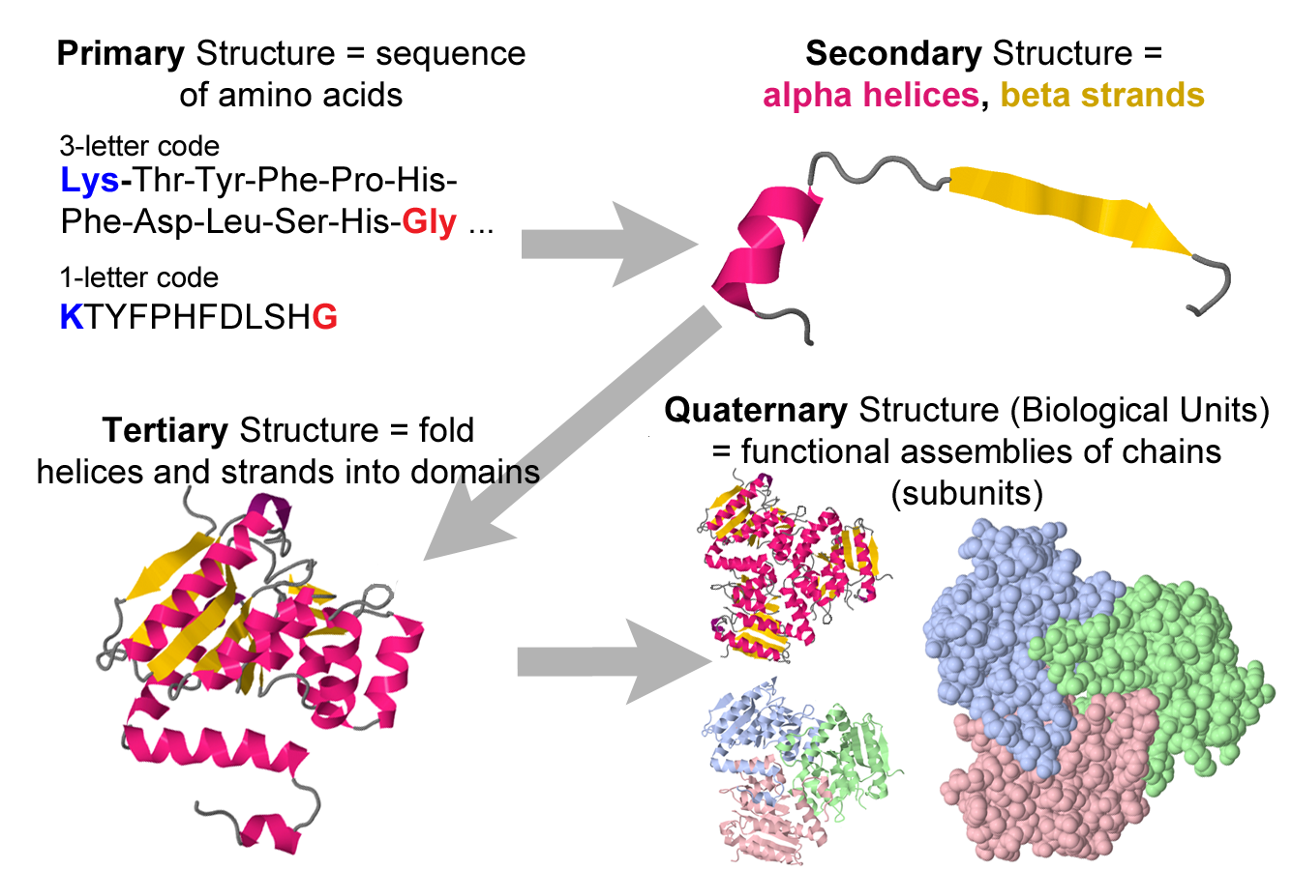
dbNSFP: amino acid change
p.Pro428Leu
P428L
22 50625392 G A P428L

Slide 18
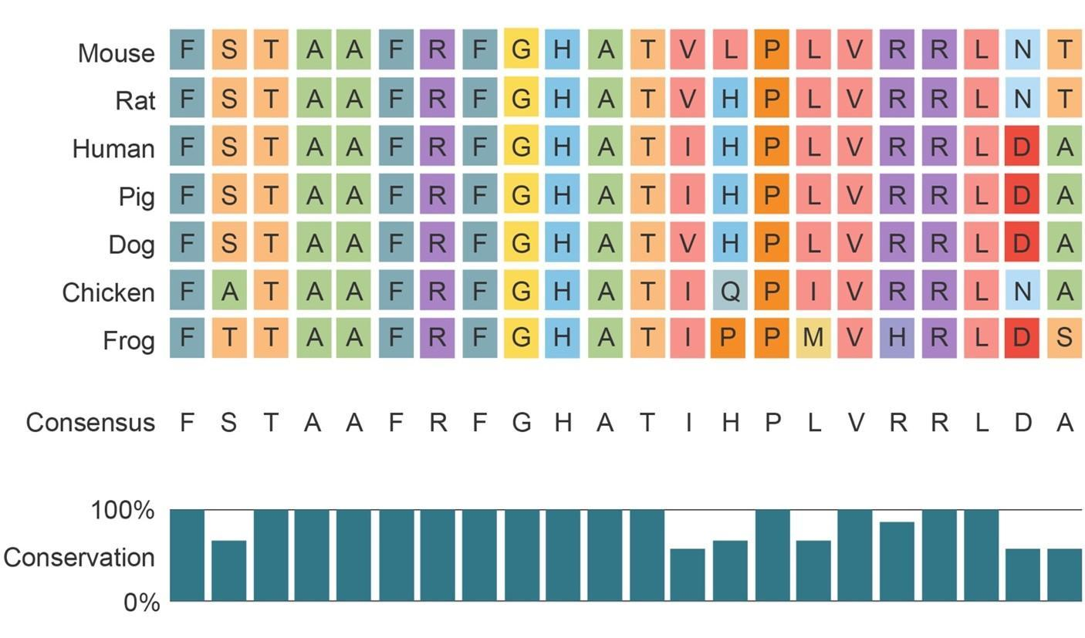
dbNSFP: conservation scores
Higher conservation -> more likely to be functionally important and even
pathogenic
Different ways to calculate scores

Slide 19
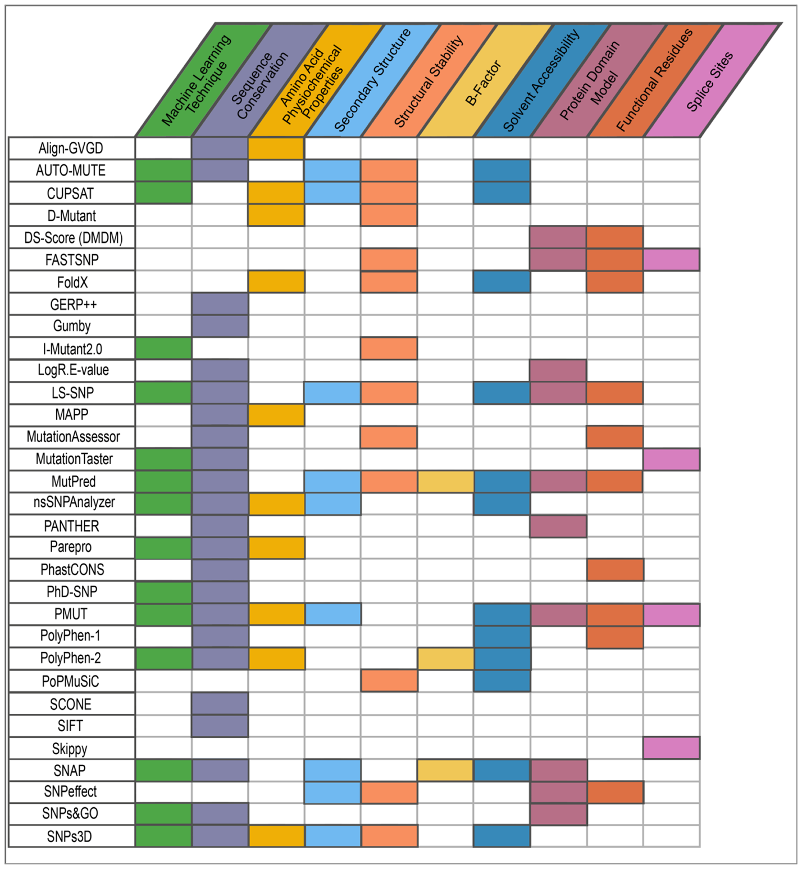
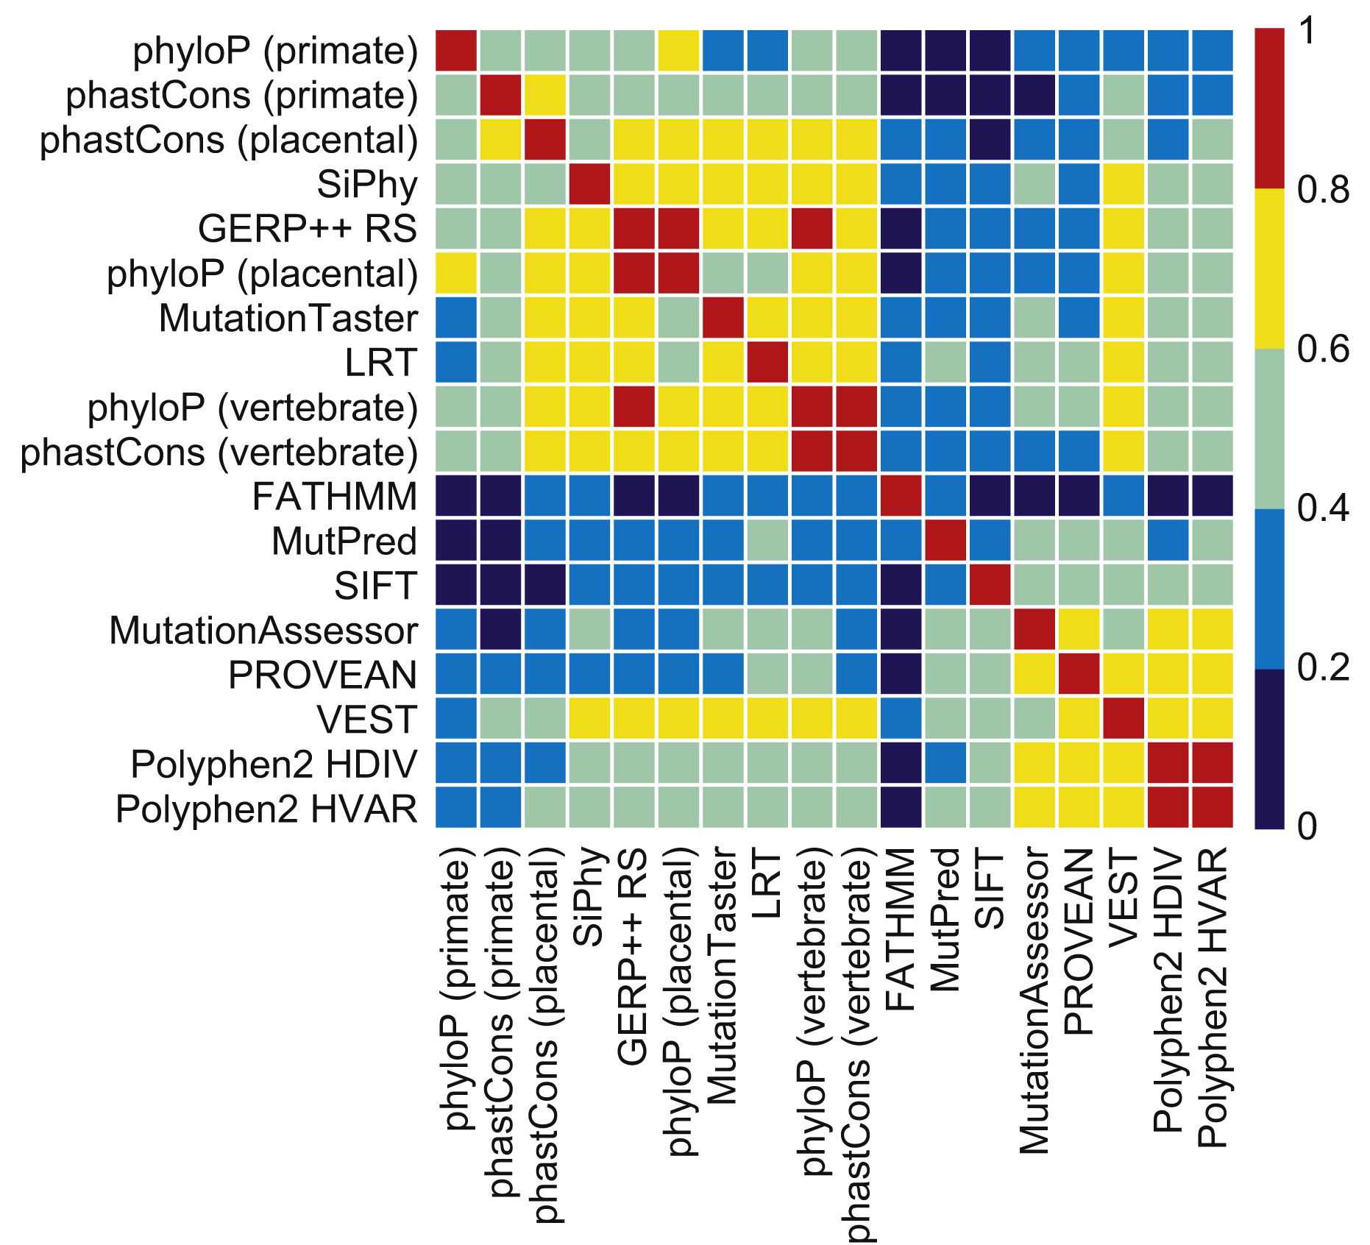
dbNSFP: variant impact predictor scores
Variant impact predictors integrate different genomic and protein features to classify variants as disease-associated or neutral
Predictor outputs can often be correlated with each other

Slide 20
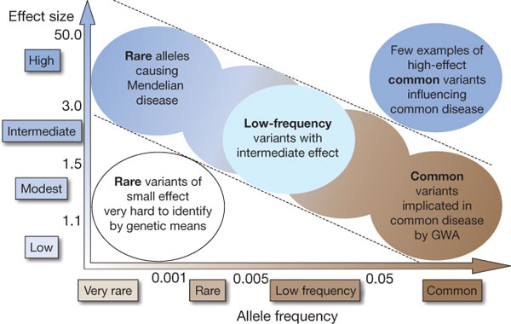
dbNSFP: allelic information
Allele frequency
Allele history
ANCESTRAL
G
Human
Common
ancestor
G
G
Chimpanzee
G
Gorilla
DERIVED – more likely to be benign
G
Human
Common
ancestor
A
A
Chimpanzee
Minor (alternate) alleles with lower frequency are more likely to be pathogenic
A
Gorilla

Slide 21
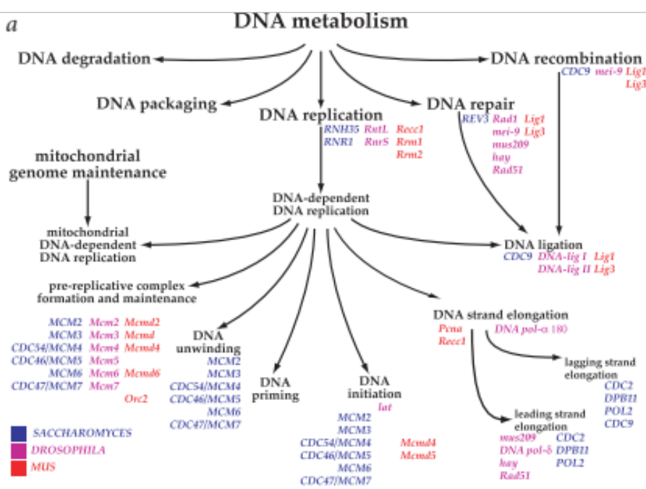
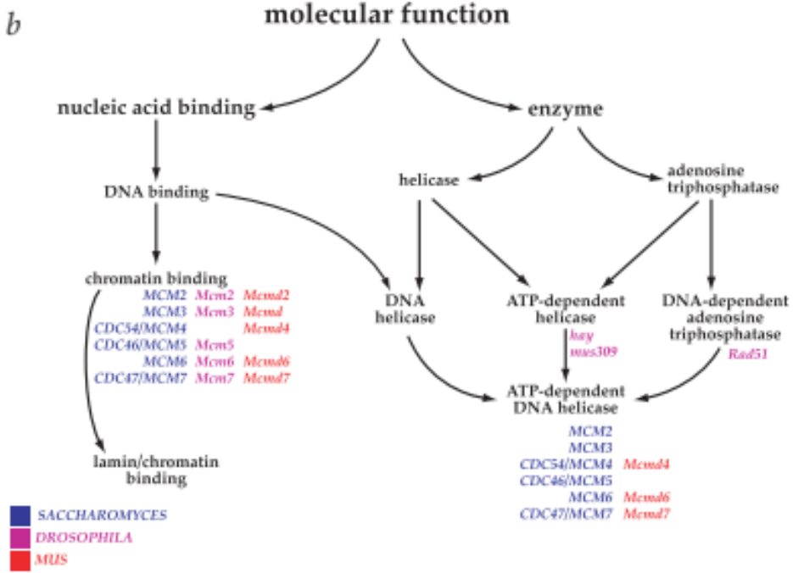
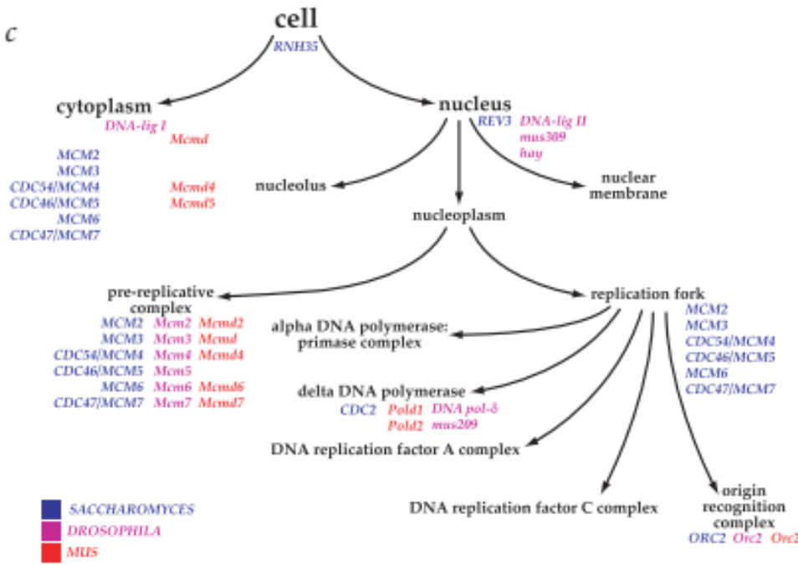
dbNSFP: gene-level features
Information about the gene that a variant is found in:
What is the gene/protein’s molecular function?
What biological processes does the gene/protein play a role in?
Which parts of the cell does the resulting gene/protein carry out its function?

Slide 22
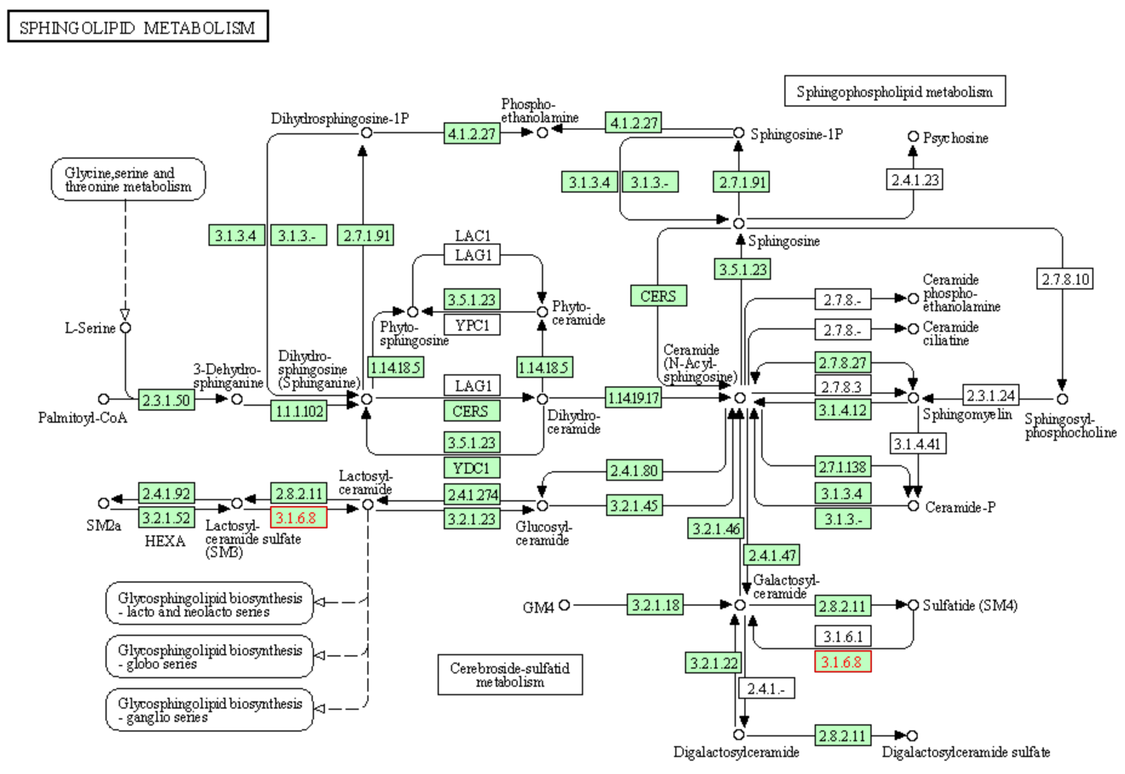
dbNSFP: gene-level features
Information about the gene that a variant is found in:
What pathways does the gene/protein participate in?

Slide 23
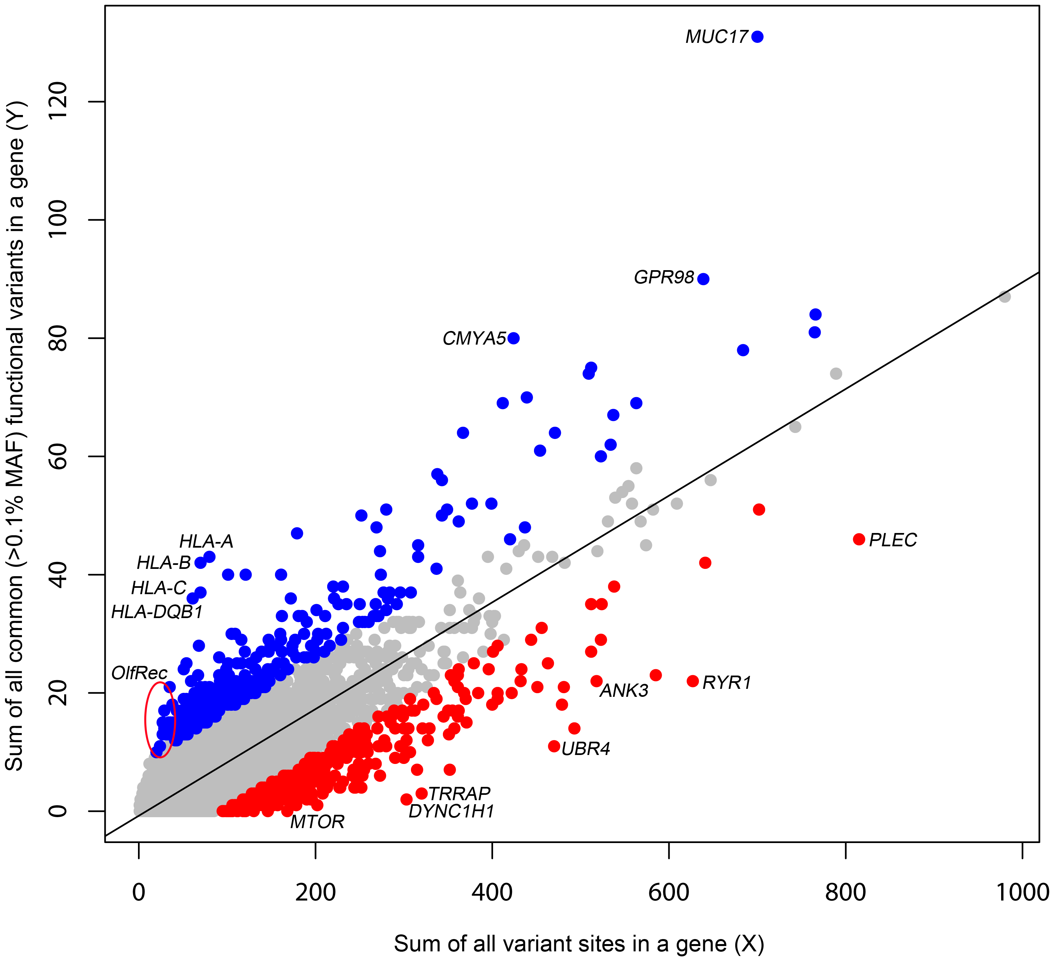
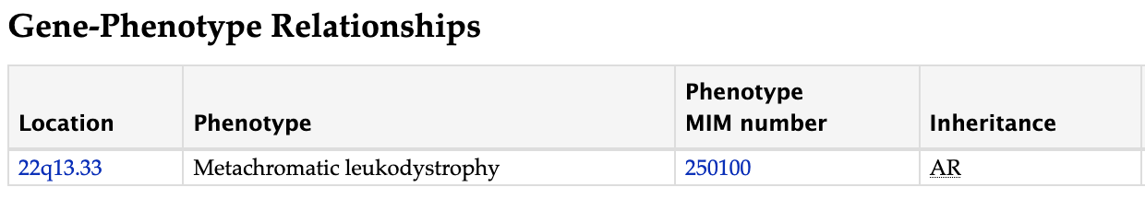
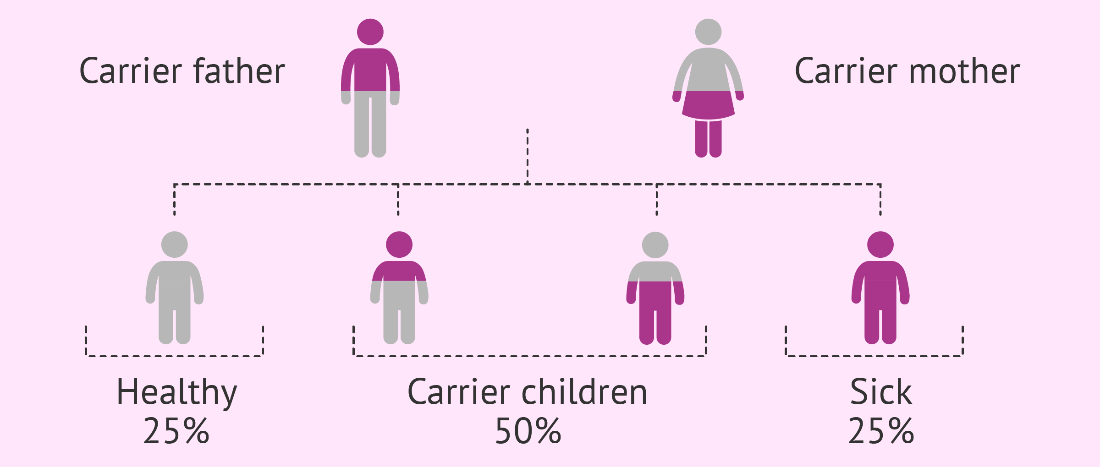
dbNSFP: gene-level features
Information about the gene that a variant is found in:
What diseases/traits does the gene participate in?
Is the gene likely to be involved in recessively inherited diseases?
Is the gene generally intolerant to variation?

Slide 24
Outline
What is variant annotation?
Variant annotation databases and tools
  ClinVar
  dbNSFP
dbNSFP deep dive
The prediction task and data sets

Slide 25
Overview of data sets provided
ARSA challenge data set
Prediction set
277 variants (only ARSA)
  No labels – only features
47 columns
dbNSFP
Training set 1
13,369 variants (from all genes)
  1,300 pathogenic
  12,069 benign
49 columns
ClinVar (after August 2017)
Training set 2
28,857 variants (from all genes)
  1,301 pathogenic
  3,775 likely pathogenic
  76 pathogenic/likely pathogenic
  12,069 benign
  11,149 likely benign
  487 benign/likely benign
49 columns

Slide 26
Overview of data sets provided
Column name | Brief description | Column name | Brief description
CHR | Chromosomal coordinates | Polyphen2_HVAR_score | Variant impact predictor scores
POS |  | REVEL_score
REF |  | SIFT_score
ALT |  | SiPhy_29way_logOdds
Clinical_significance | Label information from ClinVar | VEST3_score
Y |  | fathmm_MKL_coding_score
Review_status |  | integrated_fitCons_score | Conservation scores
CADD_raw | Variant impact predictor scores | phastCons100way_vertebrate
DANN_score |  | phastCons20way_mammalian
Eigen_PC_raw |  | phyloP100way_vertebrate
Eigen_raw |  | phyloP20way_mammalian
FATHMM_score |  | Ancestral_allele | Allele history
GERP___RS | Conservation scores | Ensembl_geneid | Gene ID
GM12878_fitCons_score |  | gnomAD_exomes_AF | Allele frequency
GenoCanyon_score | Variant impact predictor scores | Pathway_ConsensusPathDB_ | Gene function
H1_hESC_fitCons_score | Conservation scores | Pathway_KEGG__full
HUVEC_fitCons_score |  | Function_description
LRT_score | Variant impact predictor scores | MIM_phenotype_id
M_CAP_score |  | Trait_association_GWAS_
MetaLR_score |  | GO_biological_process
MetaSVM_score |  | GO_cellular_component
MutationAssessor_score |  | GO_molecular_function
MutationTaster_score |  | P_rec_ | Gene pathogenicity scores
PROVEAN_score |  | RVIS_EVS
Polyphen2_HDIV_score
Training sets

Slide 27
Overview of data sets provided
Column name | Brief description | Column name | Brief description
ProteinChange | Amino acid change | REVEL_score | Variant impact predictor scores
CHR | Chromosomal coordinates | SIFT_score
POS |  | SiPhy_29way_logOdds
REF |  | VEST3_score
ALT |  | fathmm_MKL_coding_score
CADD_raw | Variant impact predictor scores | integrated_fitCons_score | Conservation scores
DANN_score |  | phastCons100way_vertebrate
Eigen_PC_raw | Variant impact predictor scores | phastCons20way_mammalian
Eigen_raw |  | phyloP100way_vertebrate
FATHMM_score |  | phyloP20way_mammalian
GERP___RS | Conservation scores | Ancestral_allele | Allele history
GM12878_fitCons_score |  | Ensembl_geneid | Gene ID
GenoCanyon_score | Variant impact predictor scores | gnomAD_exomes_AF | Allele frequency
H1_hESC_fitCons_score | Conservation scores | Pathway_ConsensusPathDB_ | Gene function
HUVEC_fitCons_score |  | Pathway_KEGG__full
LRT_score | Variant impact predictor scores | Function_description
M_CAP_score |  | MIM_phenotype_id
MetaLR_score | Variant impact predictor scores | Trait_association_GWAS_
MetaSVM_score |  | GO_biological_process
MutationAssessor_score |  | GO_cellular_component
MutationTaster_score |  | GO_molecular_function
PROVEAN_score |  | P_rec_ | Gene pathogenicity scores
Polyphen2_HDIV_score |  | RVIS_EVS
Polyphen2_HVAR_score
Prediction set

Slide 28
Some more information about the data files
Each row is a variant
Files are in the comma-separated values (CSV) format
  Each column is separated by a comma
Columns may have missing values
  Denoted by “NaN”
Even within a single feature type, values can be on different scales
  E.g. variant impact predictor scores
For the ARSA prediction set, the variants are ordered in the same manner as the expected output file

Slide 29
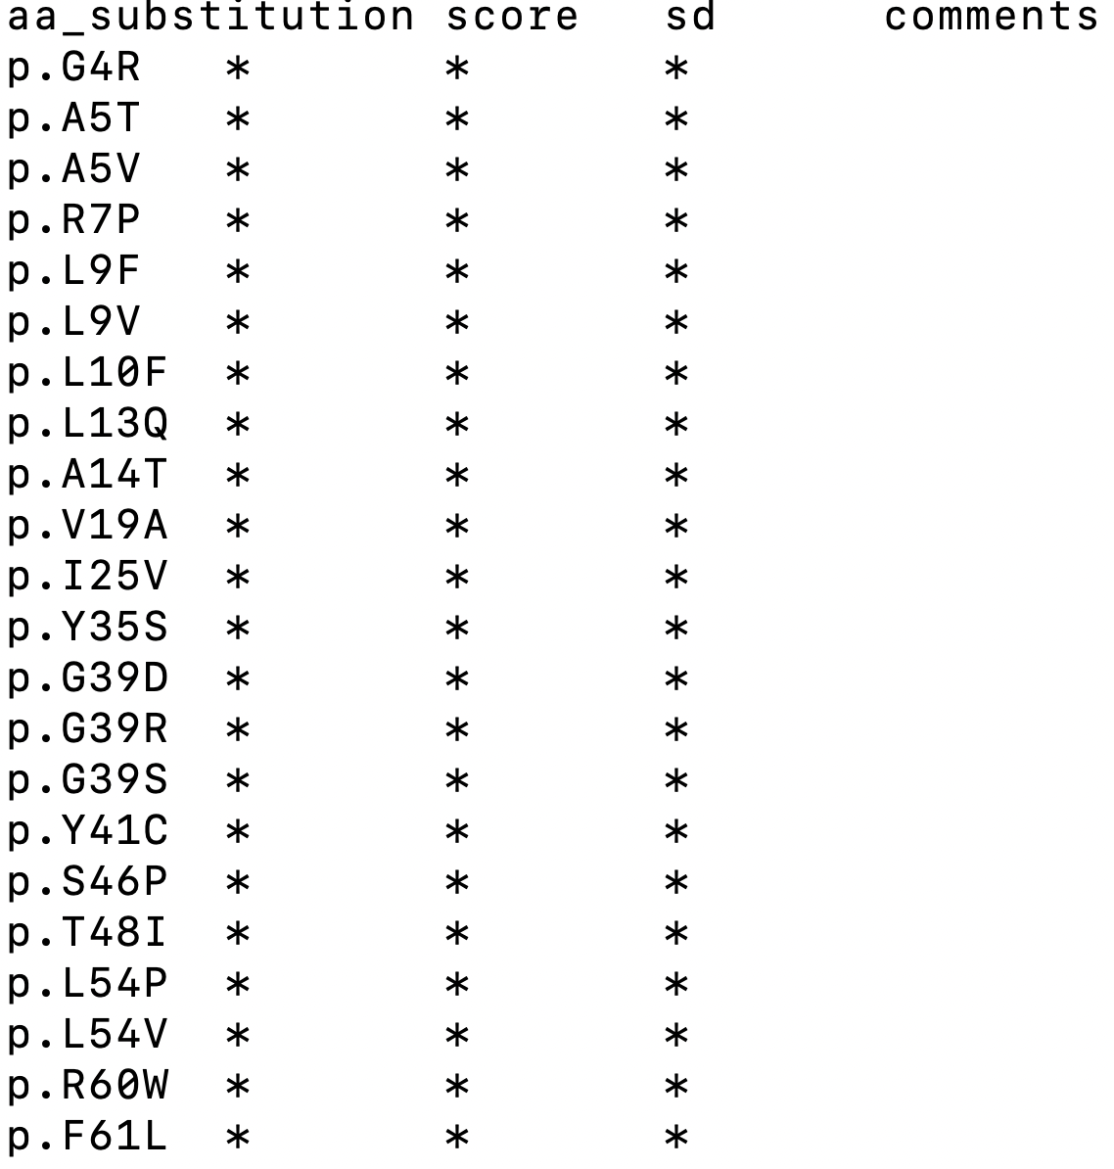
Expected output file format
Each row is a variant
Files are in the comma-separated values (TSV) format
  Each column is separated by a “tab”
Replace ‘ * ‘ with your predictions
  score : your prediction score
  sd : standard deviation (you can
  set to some arbitrary number)
  comments : qualitative remarks, if any

Slide 30
Some tips and hints
Missing scores will have to be handled
You do not have to use all the features provided
  May not even be necessary
Not all variants that impact protein function are pathogenic
  Training sets will not be perfect for this task
Conservation is a strong predictor of pathogenicity
  Used as a feature in most variant impact predictors already
  Again, pathogenicity ≠ function-altering
Gene-level information will be the same for all variants in a single gene:
  May not help that much here for prediction
  But can be used to specifically select variants for training
    E.g., genes with similar functions as ARSA or involved in similar diseases

Slide 31
Questions?
Good luck!
My lab is looking for students and postdocs
Email: vikas.pejaver@mssm.edu
Twitter: @vikaspejaver

