Slide 1
Intro to Machine Learning
MLD Bootcamp 2022

Slide 2
OUTLINE
Supervised and Unsupervised Learning
Classification and Regression
Framework for Machine Learning Projects
Data Collection and Preprocessing
Model Training
Model Tuning and Evaluation
Supervised Models
Linear Models: Linear Regression, Logistic Regression
Tree-Based Models: Decision Trees, Random Forests, Gradient Boosted
Unsupervised Models
Clustering: Hierarchical, K-Means
Dimensionality Reduction: PCA, SVD
Neural Nets: CNN
Model Evaluation
Metrics: Accuracy, Recall, Precision, F1-Score
Cross-Validation
ML Overview
Types of Data
Definitions
Bayesian: Naïve Bayes
Perceptron
ROC-AUC
SVM
KNN
Feature scaling and normalization
Convert categorical variables
Validate data
Model optimization

Slide 3
Machine Learning Overview

Slide 4
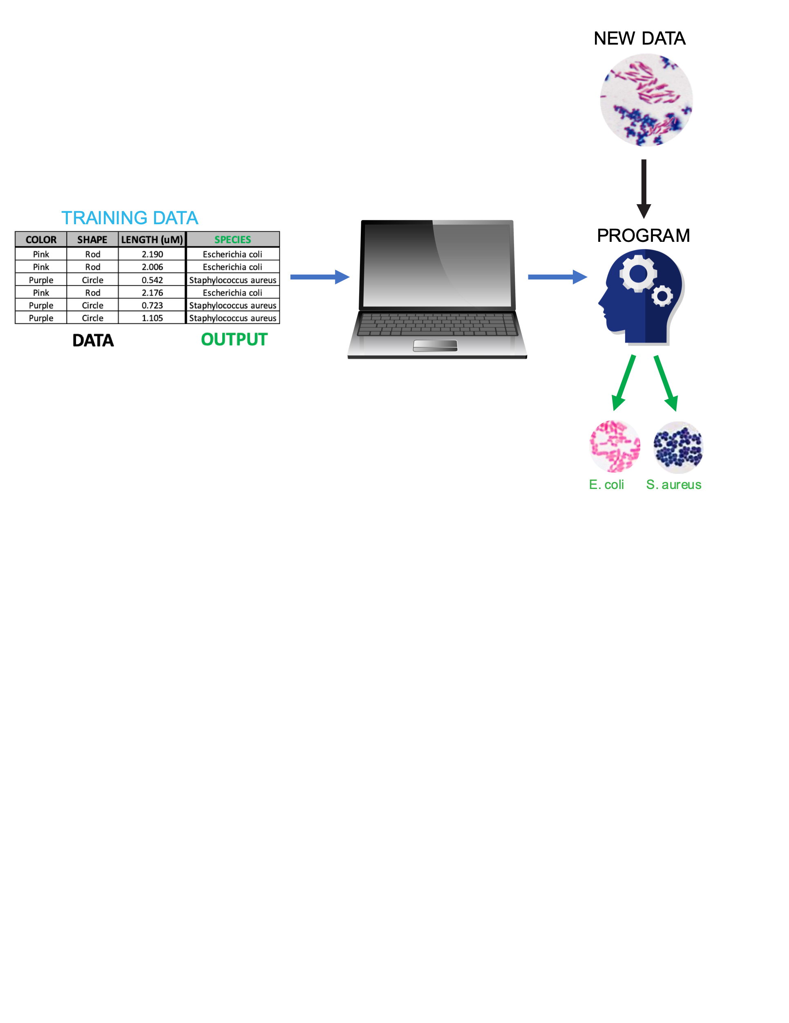
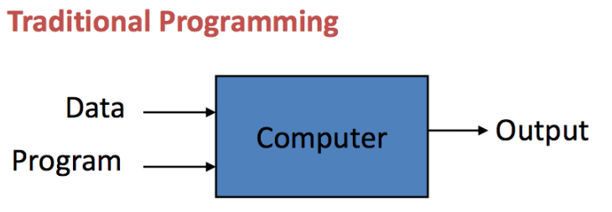
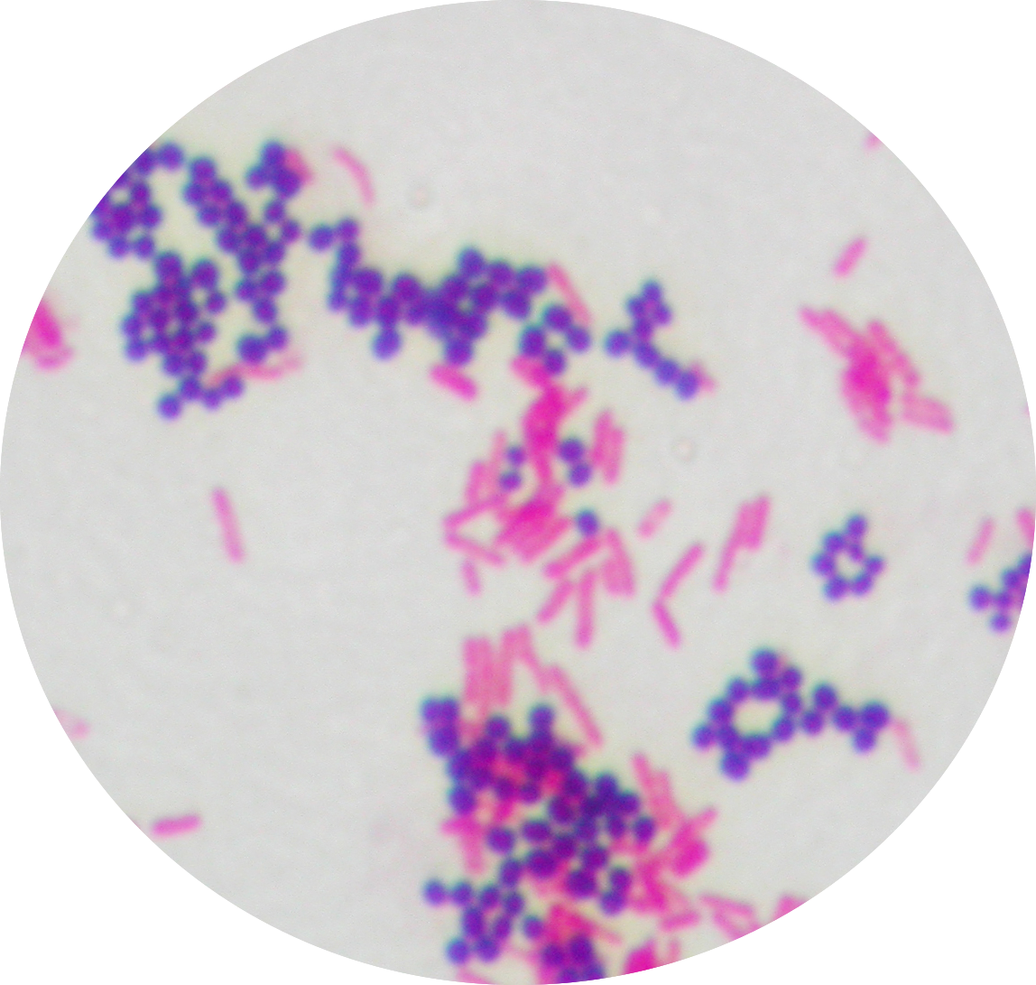
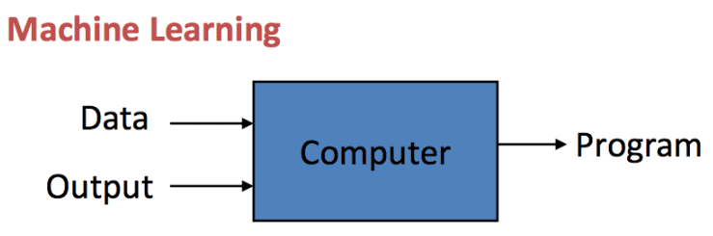
WHAT IS MACHINE-LEARNING?
Machine learning is the act of programming computers to learn from data autonomously.
Machine learning algorithms find patterns in sample data (aka. Training Data) in order to make predictions or decisions about new data without being explicitly programmed to do so.
How is this different from traditional computer programming?
EXAMPLE: Categorize Staphylococcus aureus and Escherichia coli
OUTPUT
OUTPUT
Notes:
S. Aureus (cocci: purple/Gram+, round, small area), E. coli (bacilli: pink/Gram-, oblong, larger area)

Slide 5
Types of Data
DATA
NUMERICAL
Comprised of numbers
CATEGORICAL
Comprised of words or classes
CONTINUOUS
Infinite options
DISCRETE
Finite Options
NOMINAL
Data has no order
ORDINAL
Ordered Categories
Time (hrs): 2.3, 6.11, 8.001
Mass (g): 28.35, 20,
Temp (F): 273.15, 98.6
Number of patients in clinical trial
Number of genes in database
Eye color
Species
Blood type: O, A, B, AB
Pain ranking: Mild/Moderate/Severe
Cancer Stages: I-IV
Coffee: Tall/Grande/Venti
Notes:
Continuous: If you can measure it
Discrete: If you can count it
Nominal: If you can name it
Ordinal: If you can rank if

Slide 6
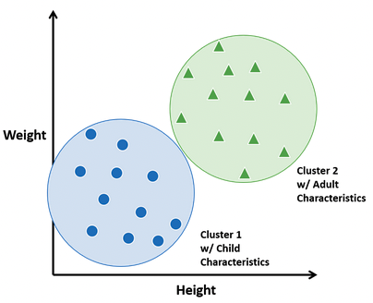
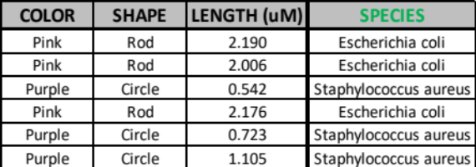
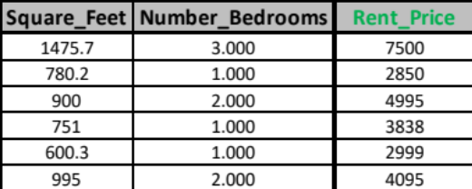
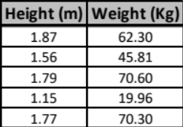
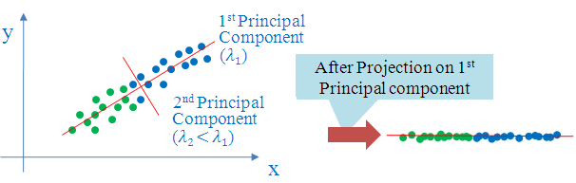
Types of Machine Learning
Machine Learning
Identifies patterns or groups within a dataset without the guidance of output labels
Labelled training data is used to create a model
SUPERVISED
UNSUPERVISED
Classification
Predicts a categorical variable
Algorithms:
Logistic Regression, Decision Trees, Support Vector Machines, K-Nearest Neighbors
Regression
Predicts a numeric variable
Algorithms: Linear Regression, Regression trees
Clustering
Identifies patterns and groups of similar objects
Algorithms: K-Means Clustering, Hierarchical Clustering
Dimensionality Reduction
Converts high-dimensional data into lesser dimensions
Algorithms: Principal-Component Analysis, t-stochastic Neighbor Embedding

Slide 7
FRAMEWORK FOR MACHINE LEARNING PROJECTS

Slide 8
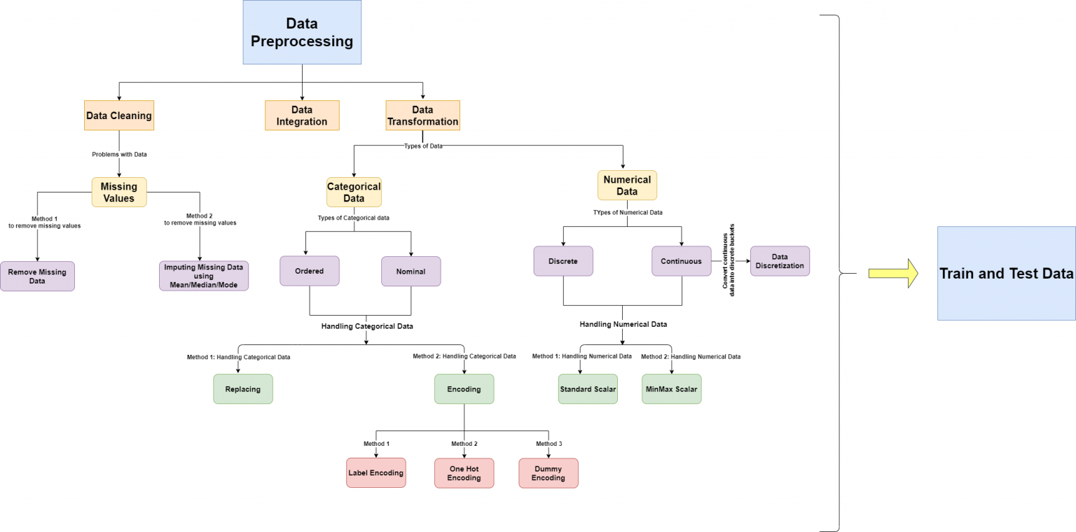
FRAMEWORK FOR ML PROJECTS
Model Tuning
Model Training
Train/Test Split
Training Data
Data Collection & Cleaning
Test Data
Model Evaluation
Notes:
Clean Data: Drop duplicates, drop/fill missing values, standardize capitalization or nomenclature for categorical variables, etc.
Train/Test Split: Divide data to training set to teach model, then test set to later evaluate it’s performance
Train Model: Teach your model with the training set
Model Evaluation: quantify performance (we’ll discuss metrics later) using the reserved/novel test data
Model Tuning: Update model (tweak hyperparameters) until satisfactory

Slide 9
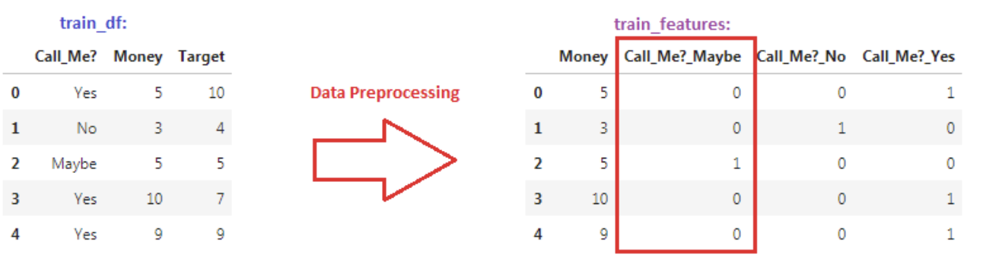
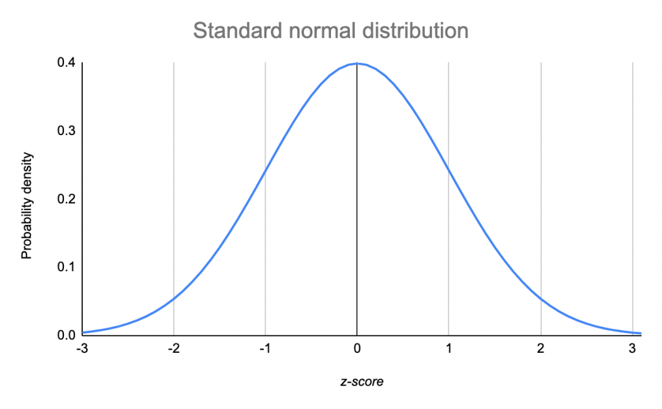
Data Preprocessing
General Cleaning: remove duplicates, typos, outliers, etc.
Clean missing values:
  Remove: df.dropna()
  Impute or fill with a new value: df.fillna(), sklearn.impute.SimpleImputer, sklearn.impute.KNNImputer
Convert categorical variables to binary features:
  sklearn.preprocessing.OneHotEncoder, pd.get_dummies
Feature scaling: put numeric variables on the same scale to avoid features with bigger values from dominating the model
  Standardization: convert feature distributions to the standard normal distribution (N(0,1))
  Min-Max Normalization: sklearn.preprocessing.MinMaxScaler
Feature engineering: select variables for input into the model, prioritizing features that are “associated” with the output variable
  sklearn.feature_selection.SelectKBest, Recursive feature selection (sklearn.feature_selection.RFECV)
Notes:
Features with large values/magnitudes can result in a models with large weights and dominate models
Select K-Best: use Chi2, ANOVA/F-Value

Slide 10

Model Tuning and Optimization
Model Tuning
Model tuning involves iterative rounds of training a model with new features, better data and/or hyperparameters.
Hyperparameters are variables that finetune model training and affect accuracy.
Feature engineering can also improve model performance.
Remember, quality data is essential for training accurate models…
Train/Test Split
Model Training
Training Data
Data Collection & Cleaning
Test Data
Model Evaluation

Slide 11
SUPERVISED MODELS

Slide 12
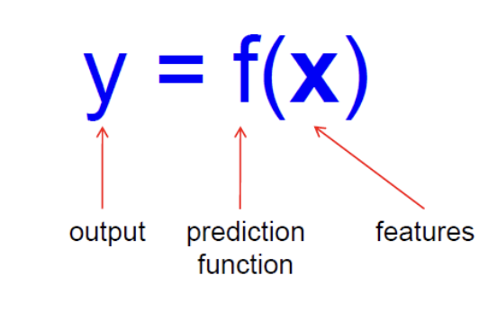
Terminology Review: Titanic Example
The goal of machine learning is to find patterns in sample data (aka. Training Data) to create a function that makes predictions about new data
Y: the output we wish to predict
  In code lab, the desired output we want to predict is “Survival” (Binary feature: 0/1)
X: set of input features or data used for training
  Age, Fare, Sex, etc. in the Titanic
F: Prediction function that maps features to outputs
x_train: the training dataset, or set of features used to train the function
y_train: the output (survival labels) for each item in the training dataset
x_test: novel data with known output labels (not used to train model) used to assess the accuracy of model
Y_test/y_true: true (correct) labels for the testing dataset
y_pred (ŷ): predictions generated by the model using data

Slide 13
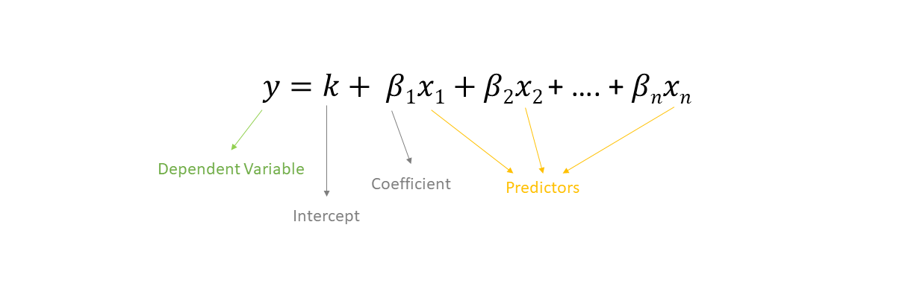
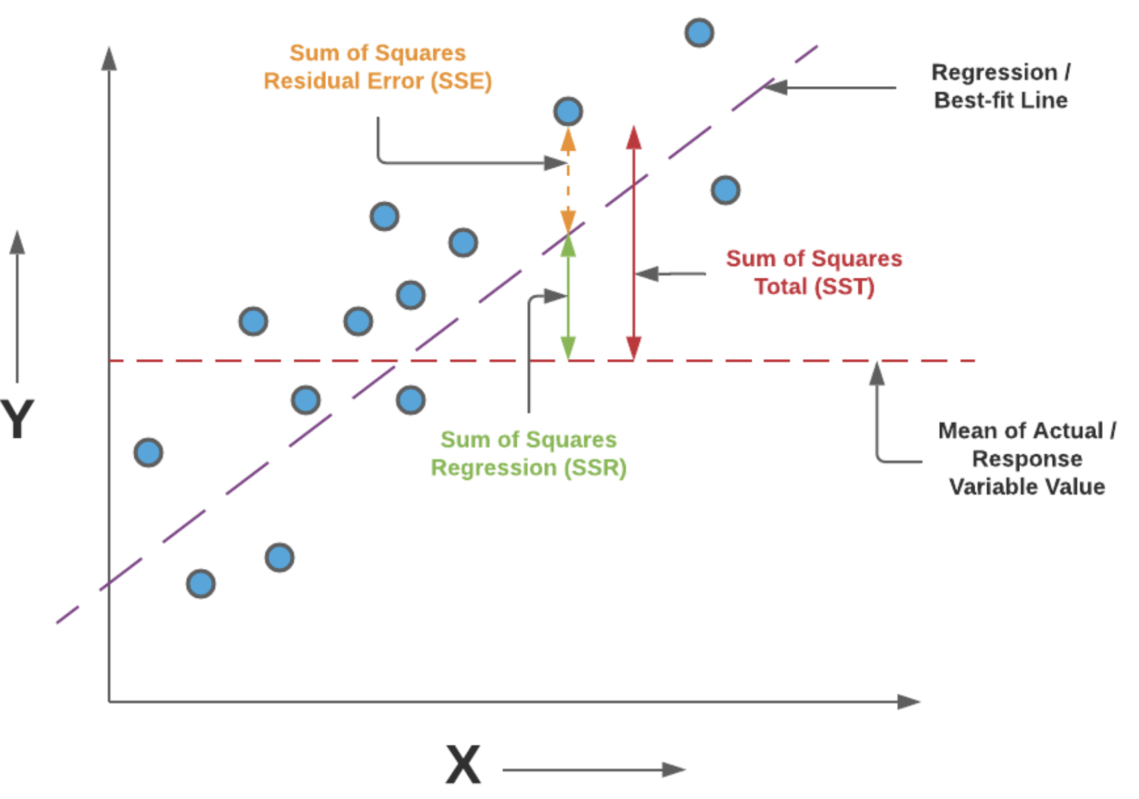
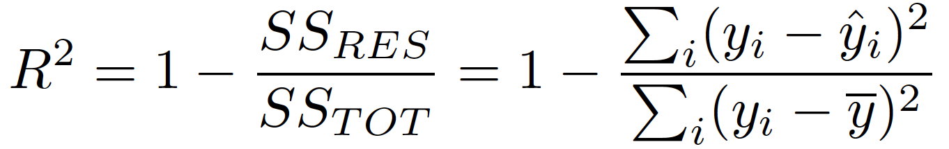
LINEAR REGRESSION
DESCRIPTION
USE CASES
Linear regression defines a line that best describes how different levels of an input/independent variable affect the value of the output/dependent variable. It can be used to predict continuous variables and determine the correlation (R²) between input features and output labels.
Predicting continuous target variable:
  Predict cost of eggs over time
  Model the relationship between BMI and LDL cholesterol levels
  Predict housing price from number of bedrooms
ALGORITHM
ADVANTAGES
DISADVANTAGES
Intuitive algorithm is easy to explain
Output coefficients/weights are easy to interpret
Quick and easy to train
Assumes linearity between inputs and output variables
Prone to underfitting with small, high-dimensional data
Vulnerable to outliers
EXAMPLE CODE
from sklearn.linear_model import LinearRegression
reg = LinearRegression()
reg.fit(X_train, y_train)
y_pred = reg.predict(X_test)
Notes:
Slide Anatomy:
Descriptions, Use Cases, Advantages/Disadvantages panels demonstrate when/where model
“Example Code” for code lab
“Algorithm” is hyperlink to extended description
Optimization: Find the line that minimizes the sum of the squares of the “Residual” (difference)

Slide 14
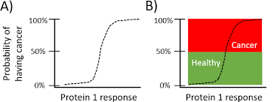
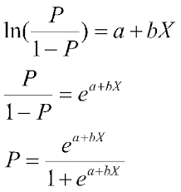
LOGISTIC REGRESSION
DESCRIPTION
USE CASES
Logistics regression uses a sigmoid function to return the probability of a label. It is commonly used for binary classification tasks.
Binary classification: Yes/No, 0/1
  Spam Detection: Spam/Not-Spam email
  Credit Card fraud: True/Fraudulent purchase
ALGORITHM
ADVANTAGES
DISADVANTAGES
Log Odds
Intercept
Intuitive and easy to explain
Less prone to overfitting when using regularization
Applicable for multi-class predictions
Assumes linearity between inputs and outputs
Prone to overfitting with small training datasets, with high-dimensionality (i.e. Lots of features/variables)
Slope
Threshold
Feature
EXAMPLE CODE
from sklearn.linear_model import import LogisticRegression
reg = LogisticRegression()
reg.fit(X_train, y_train)
y_pred = reg.predict(X_test)
- - - - - -
++++++
Hyperparameters: penalty, max_iter, C, solver

Slide 15
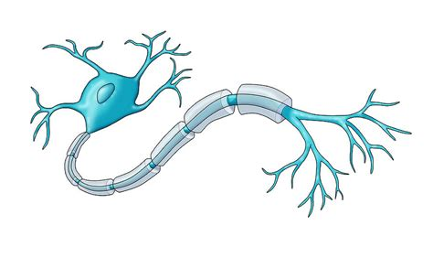
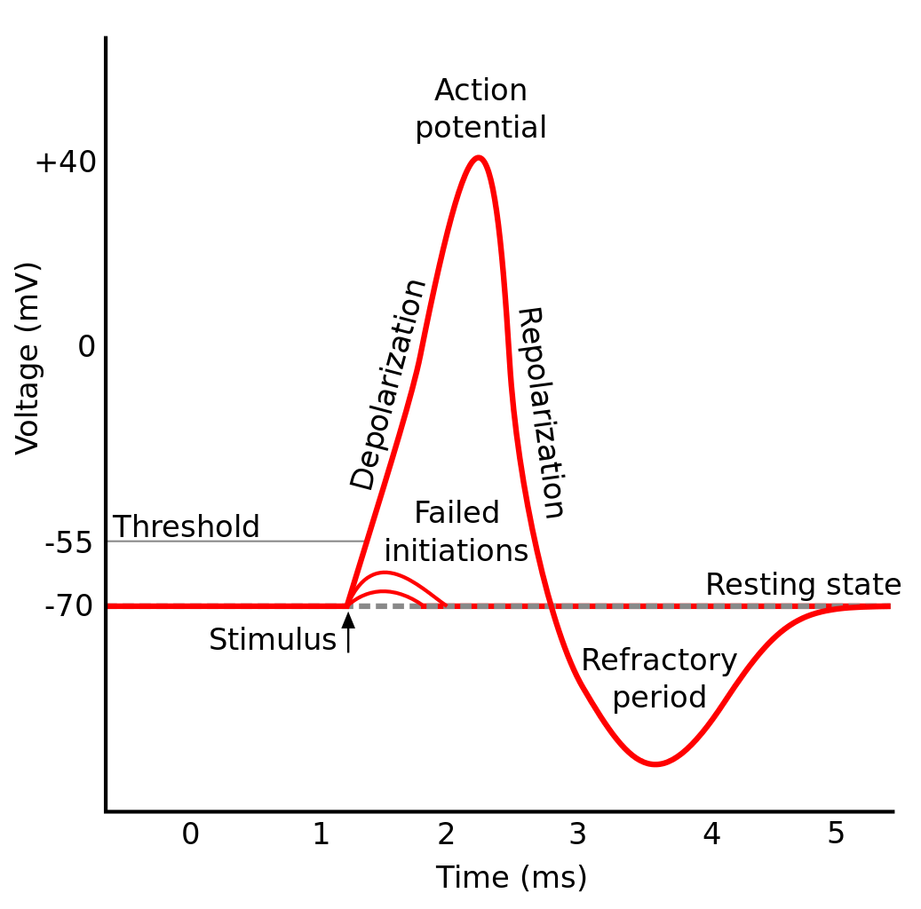
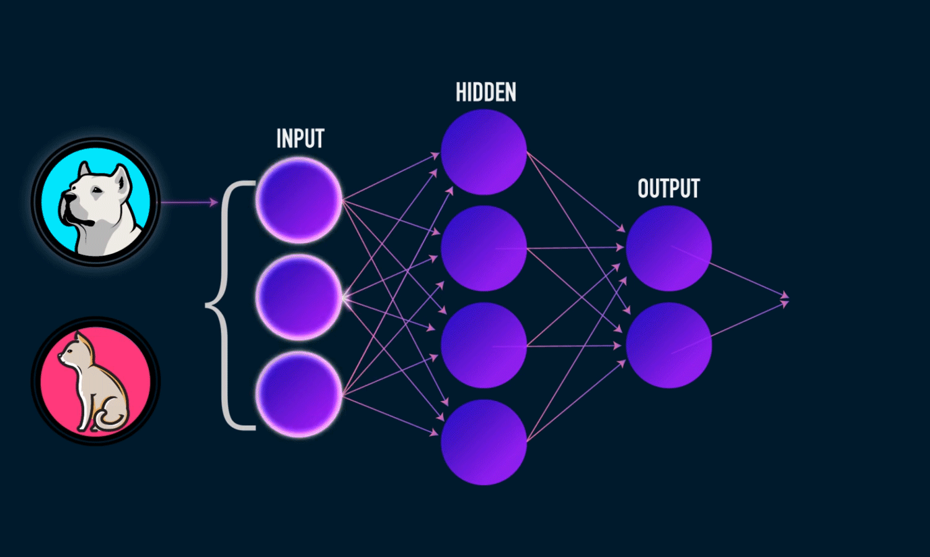
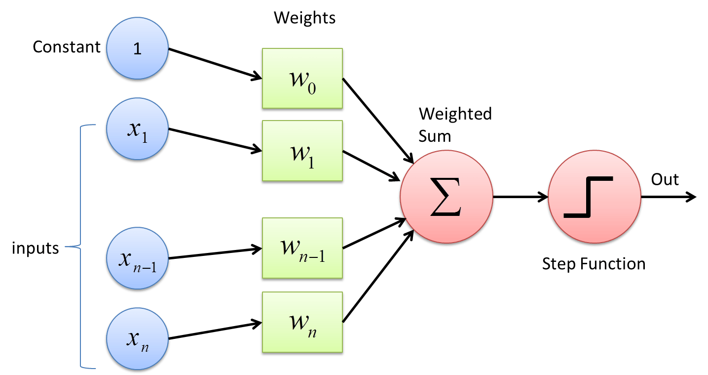
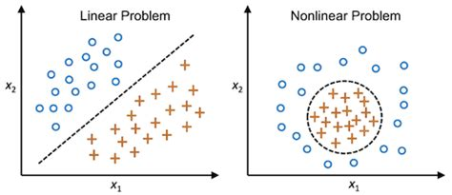


PERCEPTRON
DESCRIPTION
USE CASES
Perceptrons are classifiers that accept a series of inputs with assigned weights, then feeds their weighted sum to an activation function that determine if a threshold is met for the input item to be classified. Perceptrons are the building block of neural nets!
Classification (binary or multiclass)
  Identifying plant or animal species
  Predicting gene severity (Pathogenic/Benign)
ALGORITHM
Rosenblatt 1957
ADVANTAGES
DISADVANTAGES
Conceptually clear
Results easy to interpret
Easy to implement from scratch
Classes must be linearly separable
height
EXAMPLE CODE
mass
from sklearn.linear_model import Perceptron
pc = Perceptron()
pc.fit(X_train, y_train)
y_pred = pc.predict(X_test)
n_teeth
Hyperparameters: penalty, max_iter, fit_intercept, shuffle, tol
Notes:
Description
Use Cases
Cat vs Dog classifier to demo algo

Slide 16
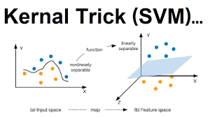
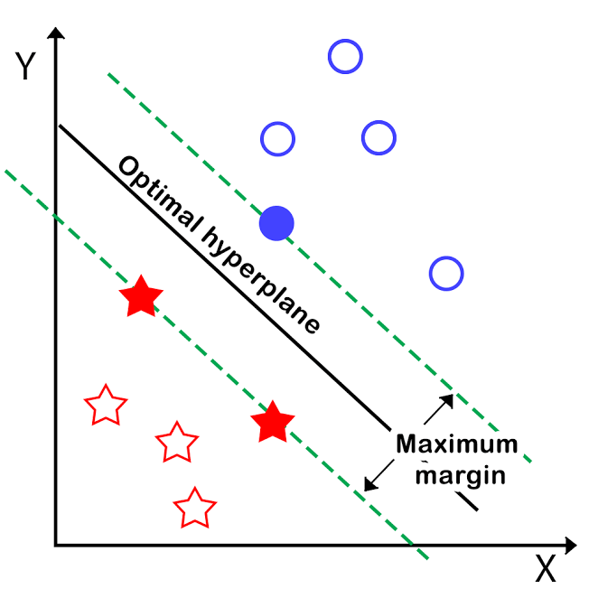
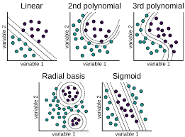
SUPPORT VECTOR MACHINES
DESCRIPTION
USE CASES
SVM determines the best way to classify data based on its position in relation to a border between the “positive” class and “negative” class. This border is called a hyperplane which maximizes the distance between data from different classes.
Classification (binary or multiclass) or regression
  Classify facial expressions: Happy/Sad
  Radiology (image analysis): Cancerous/Benign
ALGORITHM
ADVANTAGES
DISADVANTAGES
Performs well even with limited training data
Method has many applications with different Kernel
Struggles with outliers and not always ideal for multiclass problems
Computationally expensive and slow to train (O(n²))
EXAMPLE CODE
from sklearn import SVC
svc = SVC()
svc.fit(X_train, y_train)
y_pred = svc.predict(X_test)
Hyperparameters: c, kernel, gamma

Slide 17
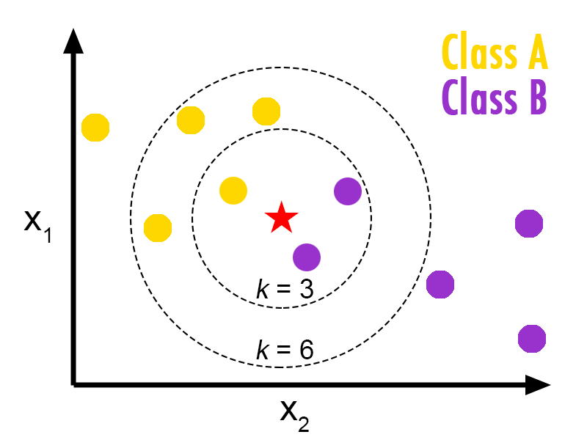
K-NEAREST NEIGHBORS
DESCRIPTION
USE CASES
KNN is a classification algorithm that works by finding the most similar data points in the training set, graphed in n-dimensional space (n = number of features).
Classification or regression
  Movie Recommendation systems: Watch/Don’t
  Text mining
  Stock forecasting
ALGORITHM
ADVANTAGES
DISADVANTAGES
Easy to understand and explain
No training phase
Can capture complex patterns in high-dimensional data
Predictions are computationally expensive (O(nd)) and require significant storage (must retain training set)
Selecting the optimal “K” can be challenging
Struggles with noisy data and outliers
Doesn’t tolerate missing data
EXAMPLE CODE
from sklearn.neighbors import KNeighborsClassifier
knn = KNeighborsClassifier()
knn.fit(X_train, y_train)
y_pred = knn.predict(X_test)
Hyperparameters: n_neighbors, weights, leaf_size, p
Notes:
“Majority voting”
Distance metrics: Euclidean Distance, Hamming, Minkowsky

Slide 18
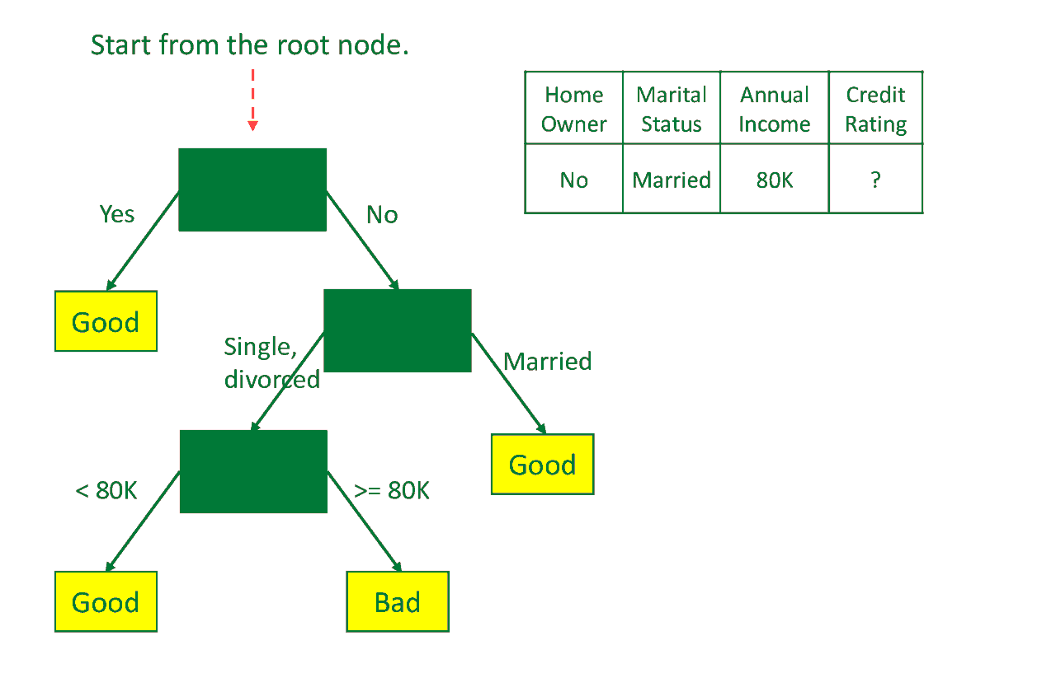
DECISION TREE
DESCRIPTION
USE CASES
Decision trees are classification algorithms that combine a series of yes/no questions in a hierarchical fashion to maximize accuracy of categorization.
Classification or regression
  Credit score modeling
  Disease prediction: Sick/Healthy
ALGORITHM
ADVANTAGES
DISADVANTAGES
Interpretable results and rules
Fast training and testing time (O(depth))
Can handle large number of features that include irrelevant attributes
Prone to overfitting
Sensitive to outliers
Unstable and model can vary widely based on training data
EXAMPLE CODE
from sklearn.tree import DecisionTreeClassifier
dtc = DecisionTreeClassifier()
dtc.fit(X_train, y_train)
y_pred = dtc.predict(X_test)
Hyperparameters: criterion, max_depth, min_samples_split, min_samples_leaf; max_features

Slide 19
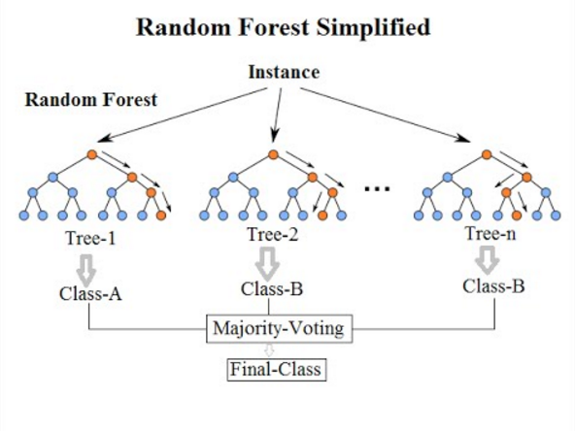
RANDOM FOREST
DESCRIPTION
USE CASES
Random forests are ensemble models, comprised of multiple decision trees. Random forests utilize a technique called bagging, where each tree in the forest is trained on a random sampling of the original dataset, then takes the majority vote across the trees.
Classification or regression
  Predicting sales revenue
  Predict age of onset for disease
ALGORITHM
ADVANTAGES
DISADVANTAGES
Robust against outliers
Highly accurate and less prone to overfitting
Difficult to interpret
Training is slow for high-dimensional data
Hyperparameters not easy to select
EXAMPLE CODE
from sklearn.ensemble import RandomForestClassifier
rfc = RandomForestClassifier()
rfc.fit(X_train, y_train)
y_pred = rfc.predict(X_test)
Hyperparameters: n_estimators, max_features, max_depth, min_samples_split, min_samples_leaf, boostrap
Notes:
Takes a random sample of data and builds in ongoing sersies of trees on different subsets

Slide 20
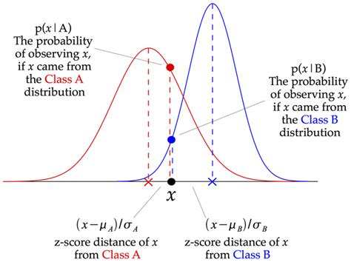
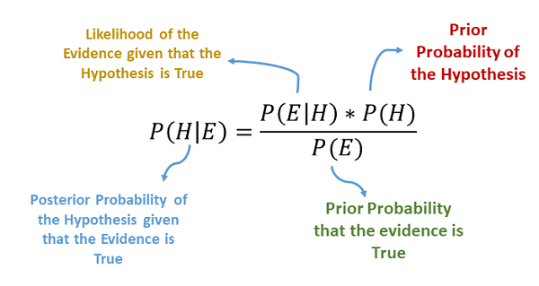
NAÏVE BAYES
DESCRIPTION
USE CASES
Naïve Bayes is a classification algorithm that calculates conditional probabilities (Bayes Theorem) based on prior knowledge and the naïve assumption that features are independent.
Classification
  Anomaly detection
  Multiclass classification: classify different varietals of iris
ALGORITHM
ADVANTAGES
DISADVANTAGES
Easy to implement from scratch
Decent performance from small datasets
Amenable to multiclass classification
Fast performance on high-dimensional data
Requires conditional independence of variables (features must be independent of each other given output class)
EXAMPLE CODE
from sklearn.naive_bayes import GaussianNB
gnb = GaussianNB()
gnb.fit(X_train, y_train)
y_pred = gnb.predict(X_test)
Hyperparameters: priors, var_smoothing
Notes:
Conditional probability distributions for each input feature (frequency/likelihood of each feature given the class)
Starts with a guess for P(Pos_Class) and P(Neg_Class), as priors

Slide 21
UNSUPERVISED MODELS

Slide 22
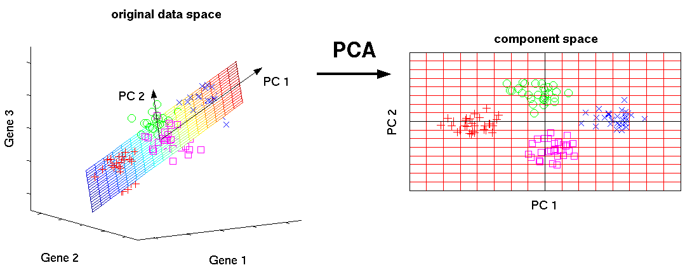
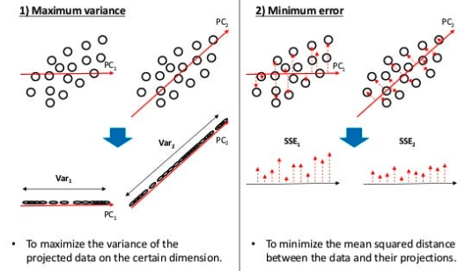
PRINCIPAL COMPONENT ANALYSIS
DESCRIPTION
USE CASES
PCA is an algorithm that can be used to understand data in high-dimensional space, by representing or projecting the data onto lower-dimensional space.
Data visualization and exploratory analysis: understanding cellular heterogeneity in a tissue from RNA-sequencing
Feature selection
ALGORITHM
ADVANTAGES
DISADVANTAGES
Removes correlated features
Can be used to reduce the number of features fed to another algorithm, improving model performance
Requires data pre-processing (standardization)
Standard PCA can only detect linear relationships
Computationally intensive for large and high-dimensional data
EXAMPLE CODE
from sklearn.decomposition import PCA
pca = PCA()
pca.fit(X_train, y_train)
y_pred = pca.predict(X_test)
Hyperparameters: n_components, tol, svd_solver
Notes:
Four main parts: feature covariance, eigen decomposition, principal component transformation, and choosing components in terms of explained variance
Uses the correlation structure of the original variables to reduce the dimensionality of the data

Slide 23
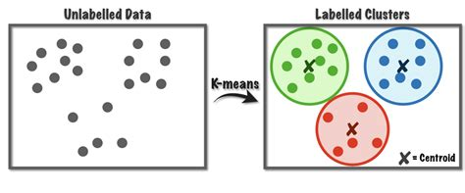
K-Means Clustering
DESCRIPTION
USE CASES
K-means clustering divides data into “k” groups. It partitions data by randomly assigning centroids to datapoints and repeats the centroid generation-assignment process until cluster memberships within data no longer change.
Grouping like objects
  Image segmentation/compression
  Identify subgroups and patterns genetic data
  Feature selection
ALGORITHM
ADVANTAGES
DISADVANTAGES
Simple and easy to interpret
Optimal K is often unclear
Computationally and memory intensive
EXAMPLE CODE
from sklearn.cluster import KMeans
km = KMeans()
km.fit(X_train, y_train)
y_pred = km.predict(X_test)
Hyperparameters: n_clusters, max_iter, init, n_init

Slide 24
MODEL EVALUATION

Slide 25
Model Evaluation
To evaluate a model, test the model’s performance on a data not utilized during training OR tuning.
A best practice is to reserve a third subset of the original data “train-test-validation split”
Model Tuning
Split
Model Training
Training Data
Data Collection & Cleaning
Test Data
Model Evaluation
Validation Data
Final Evaluation

Slide 26
MODEL EVALUATION:
Classification

Slide 27
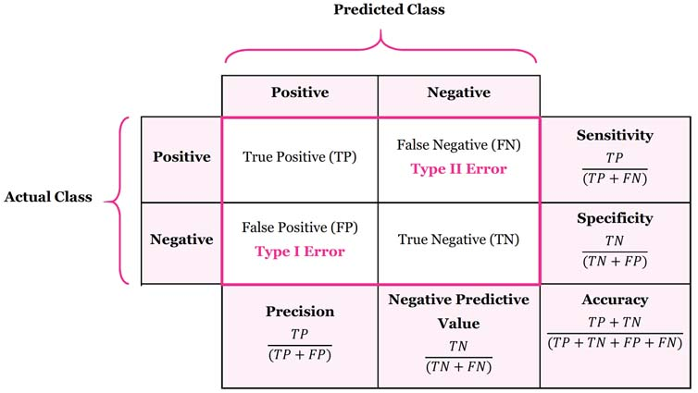
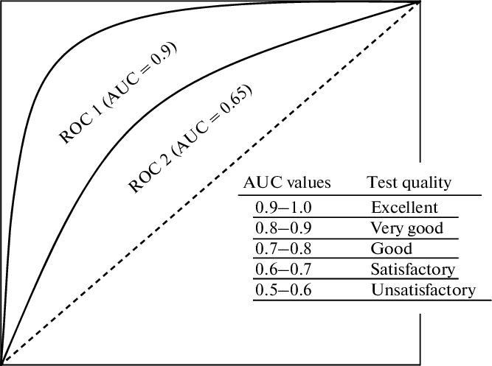
BINARY CLASSIFICATION: Evaluation Metrics
CONFUSION MATRIX
ROC-AUC
Receiver-Operator Characteristic,
Area-Under-the-Curve

Slide 28
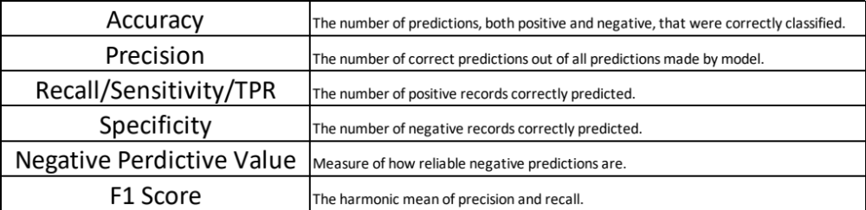

BINARY CLASSIFICATION: CONFUSION MATRICES
Positive Class: “Yes” category for a binary target variable
  ”Survived” in the Titanic dataset (1)
Negative Class: “No” category for a binary target variable
  “Didn’t Survive” in the Titanic dataset (0)
True Positive: Items that the model correctly predicted as positive
  Passenger was predicted to survive and survived in real life
True Negative: Items the model correctly predicted as negative
  Passenger was predicted to die and died in real life
False Positive: Item model incorrectly predicted as positive
  Passenger was predicted to survive but died in real life
False Negative: Item model incorrectly predicted as negative
  Passenger was predicted to die but survived in real life

Slide 29
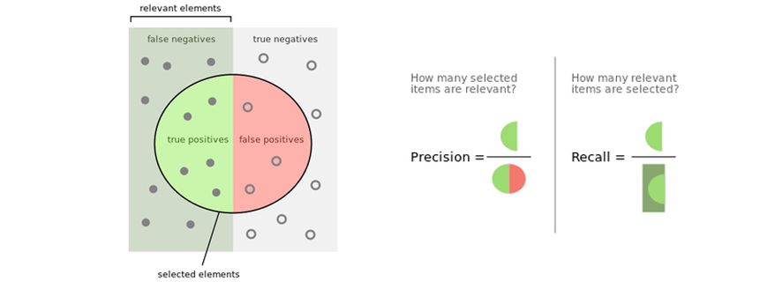
Confusion Matrices Continued

Slide 30
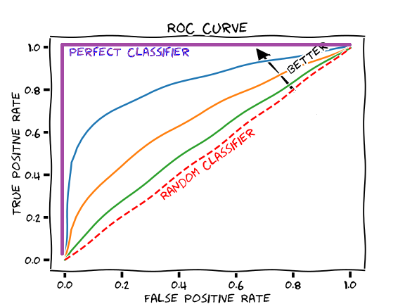
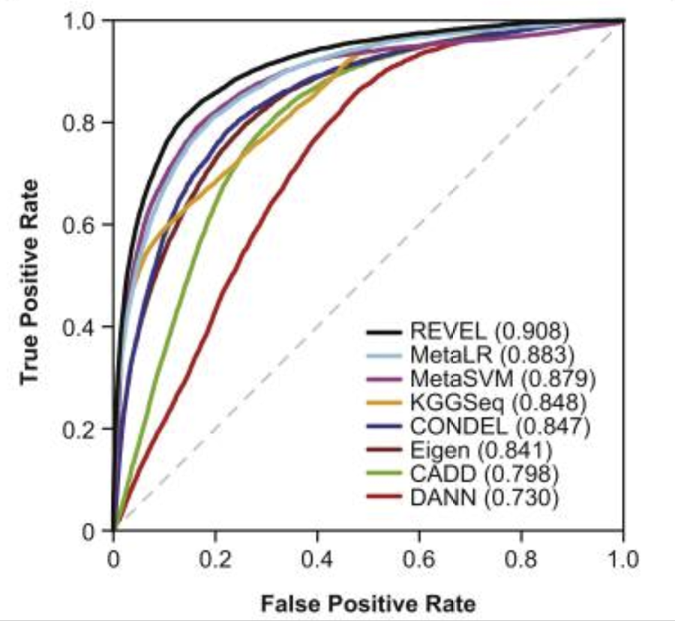
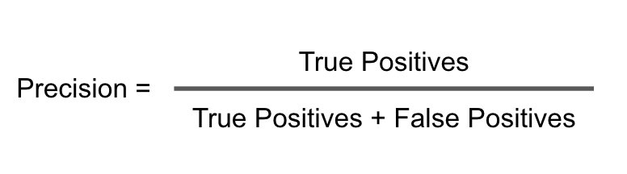
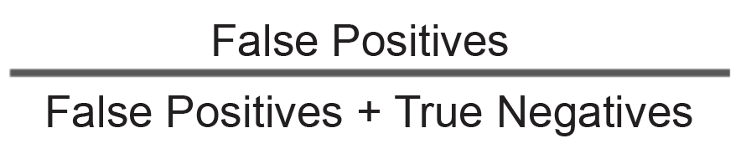
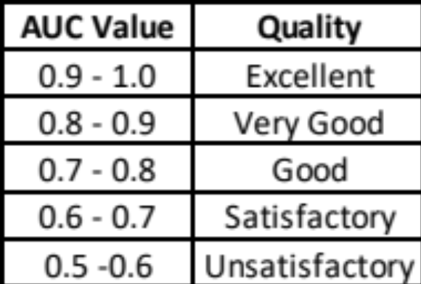
ROC-AUC
ROC-AUC (Receiver-Operator Area-Under-the-Curve) curves are a common way to report the performance of binary classifiers.
True Positive Rate:
False Positive Rate:
TPR
FPR =

Slide 31
Multiclass Classification: Evaluation
Multiclass classification involves building a classifier that predicts more than 2 classes:
  Examples:
    Classifier that predicts if a mutation is Severe, Moderate or Mild
    Classifier for blood types (A, B, AB, O)
How do you evaluate a model that predicts a categorical variable with more than 2 categories?
Perform ROC-AUC, but adapt the multiple classes into a binary comparisons:
  One vs Rest: OvR
    Select one class as the “Positive” class, then assign and combine the others (the rest) as the “Negative” class.
  One vs One: OvO
    Compare all possible two-class combinations of the dataset and create an ROC-AUC for each combination

Slide 32
MODEL EVALUATION:
Regression

Slide 33
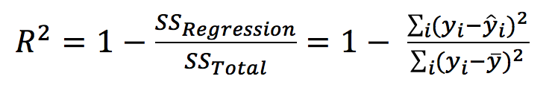
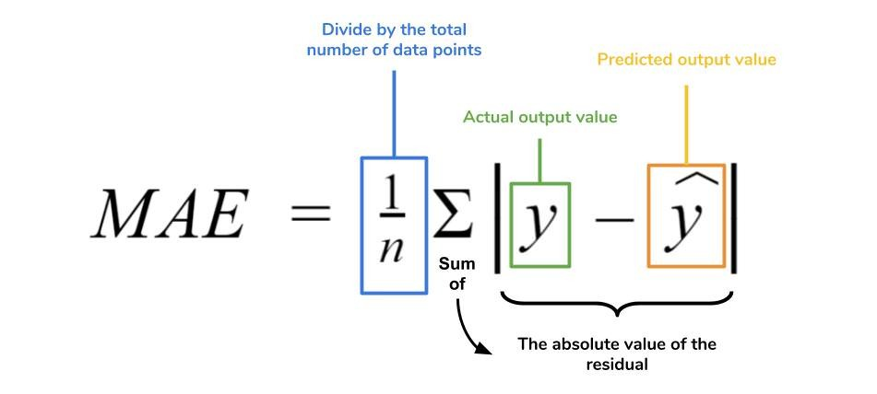
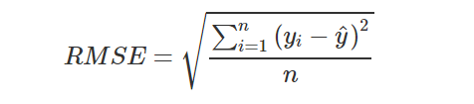
REGRESSION: Evaluation Metrics
from sklearn.metrics import r2_score
r2_score(Actual, Predicted)
R² of 1 is ideal
(Range: [-inf, 1], larger the better)
MEAN ABSOLUTE ERORR
from sklearn.metrics import mean_absolute_error
mean_absolute_error(Y_test, Y_predicted)
Smaller the better
ROOT MEAN SQUARED ERORR
from sklearn.metrics import mean_squared_error
mse = mean_squared_error(Y_test, Y_predicted)
rmse = (mse)**0.5
Notes:
No hard and fast cut-offs for good MAE/RMSE, though you want it to be minimized

Slide 34
EVALUATION
TECHNIQUES

Slide 35
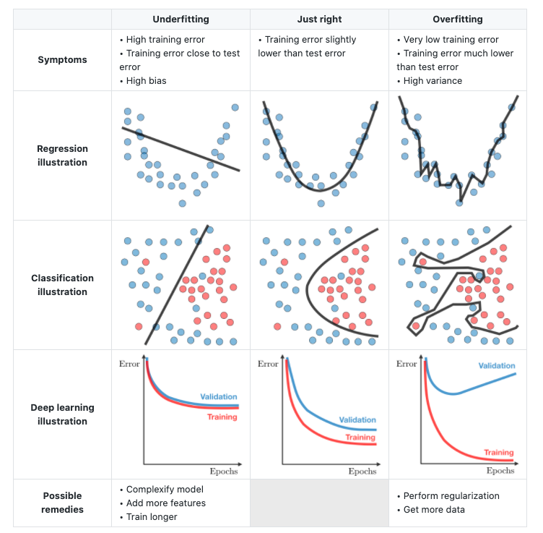
MODEL PERFROMANCE
Recall, test data is typically reserved to assess a final model’s performance.
OVERFITTING:
  When the model performs better on the training data, than the test data.
  Solutions:
    Acquire a larger training dataset or use a data-augmentation algorithm
    Feature engineering: remove a feature(s) from the model or consider dimensionality reduction
UNDERFITTING:
  When the model performs equally poorly on the test and training datasets.
    Add more features to your dataset to increase model complexity
    Test alternate algorithm(s)
    Increase training time
    Check data for outliers

Slide 36
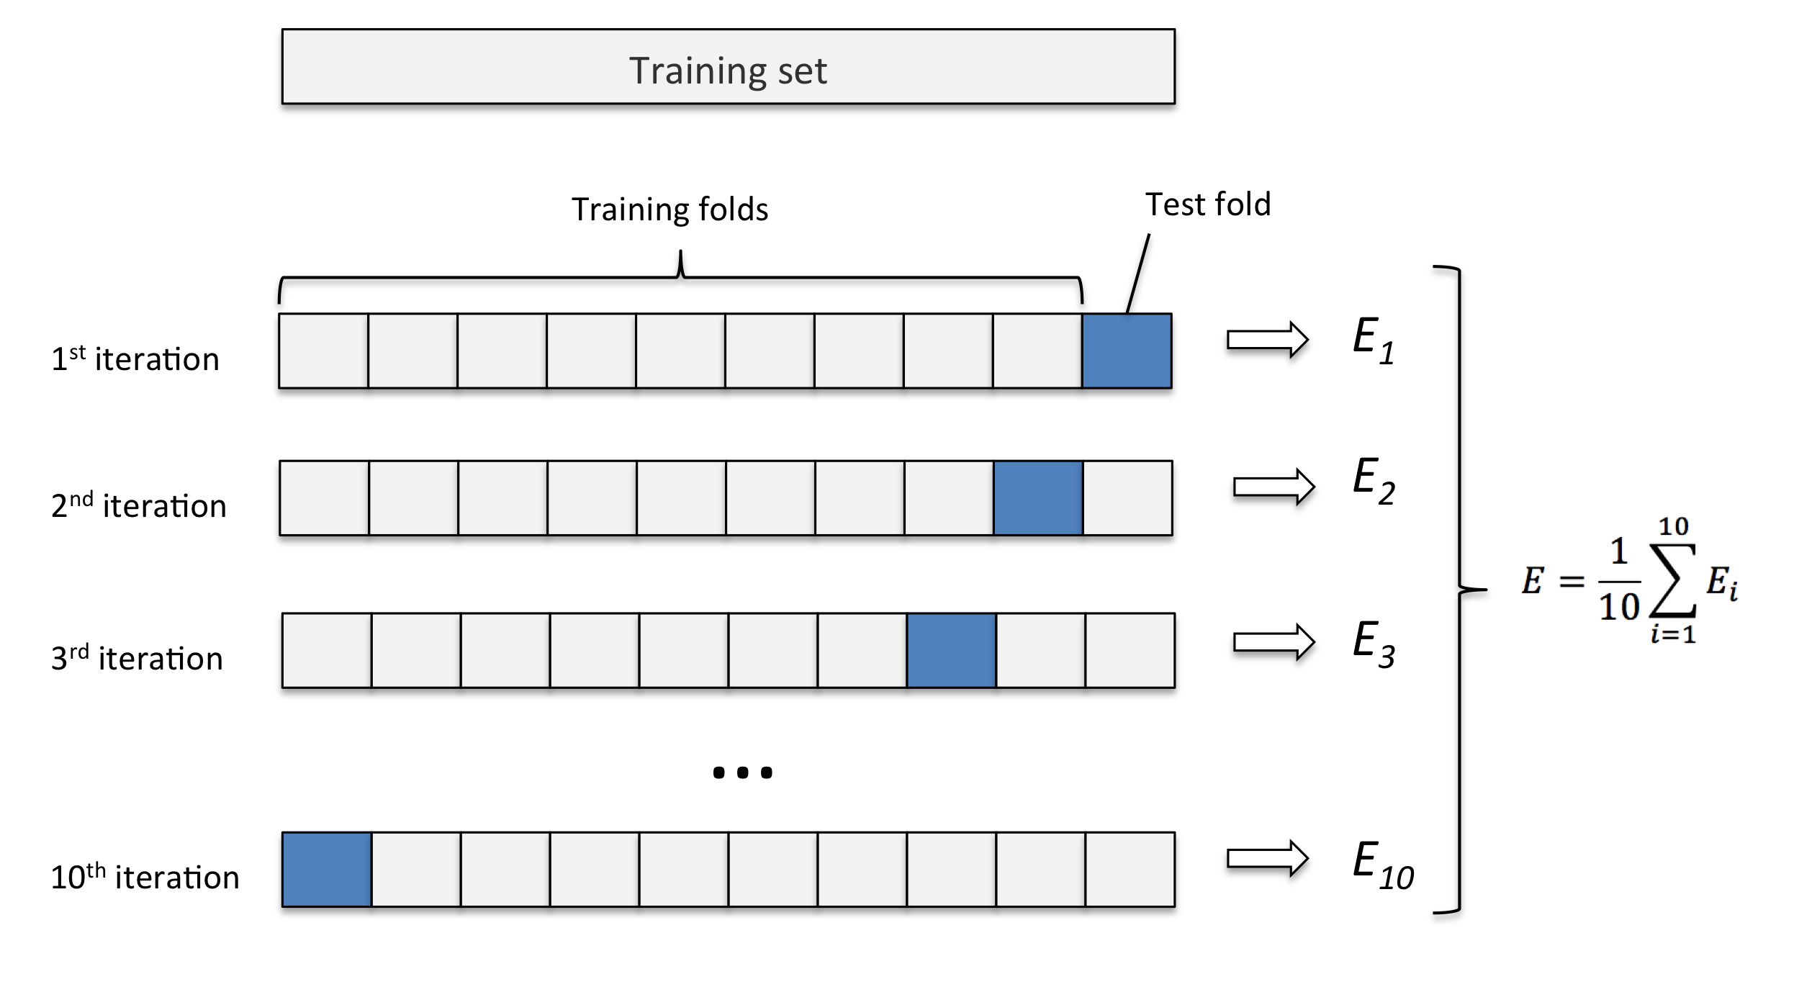
CROSS-VALIDATION
Cross Validation is the process of training a model multiple times on different subsets of your data, to improve confidence in the model’s accuracy and evaluation metrics.
Cross validation indicates how well your model will generalize and perform on new data.
Cross validation is also useful for model selection and optimization.
from sklearn.model_selection import cross_validate
from sklearn.linear_model import LinearRegression
from sklearn import datasets
diabetes = datasets.load_diabetes()
X = diabetes.data[:150]
y = diabetes.target[:150]
reg = LinearRegression()
cv_results = cross_validate(reg, X, y, cv=3)
print(cv_results['test_score’])

Slide 37
MODEL OPTIMIZATION

Slide 38
Optimization Techniques
from sklearn.impute import SimpleImputer
from sklearn.preprocessing import OneHotEncoder, StandardScaler
from sklearn.compose import ColumnTransformer
from sklearn.pipeline import Pipeline
from sklearn import metrics
target = 'Survived'
X_train, X_test, y_train, y_test = train_test_split(train_df.drop(columns=target),
train_df[target], test_size=0.2, random_state=123)
categorical_features = [x for x in train_df.select_dtypes(exclude=['number']).columns.values if x != "Name"]
numeric_features = [x for x in train_df.select_dtypes(include=['number']).columns.values if x!= target]
num_pipeline = Pipeline([ ('imputer', SimpleImputer(strategy="median")), ('std_scaler', StandardScaler())])
cat_transformer = Pipeline(steps = [('imputer', SimpleImputer(strategy='constant', fill_value='missing’)), ('onehot', OneHotEncoder(handle_unknown='ignore'))])
num_transformer= Pipeline(steps = [('imputer', SimpleImputer(strategy="most_frequent")), ('cat', OneHotEncoder(handle_unknown='ignore'))])
preprocessor = ColumnTransformer(transformers=[('num', num_transformer, numeric_features), ('cat', cat_transformer, categorical_features)])
pipe = Pipeline(steps = [('preprocessor', preprocessor),
('classifier', RandomForestClassifier(random_state=1))])
param_grid = {'preprocessor__num__imputer__strategy' : ['mean', 'median’],
classifier__max_depth' : range(10, 200),
'classifier__max_features' : [0.1,1],
'classifier__n_estimators' : range(50, 500),
'classifier__criterion' : ["gini", "entropy"]
}
grid_search = GridSearchCV(pipe, param_grid=param_grid, cv=10, scoring = 'roc_auc', n_jobs = 4)
Improve model performance through iterative rounds of training, adjusting model hyperparameters, performing feature-engineering and/or cleaning the training dataset each time.
Hyperparameters can be optimized randomly (sklearn.model_selection.RandomizedSearchCV), by testing a collection of guesses (sklearn.model_selection.GridSearchCV) or using advanced techniques like Bayesian hyperparameter optimization (hyperopt)
Feature engineering: Select variables for input into the model, prioritizing features that are “associated” with the output variable. “Good” features are difficult to predict
  sklearn.feature_selection.SelectKBest, Recursive feature selection (sklearn.feature_selection.RFECV)
Models can also be optimized from end-to-end, including the preprocessing step:

