Slide 1
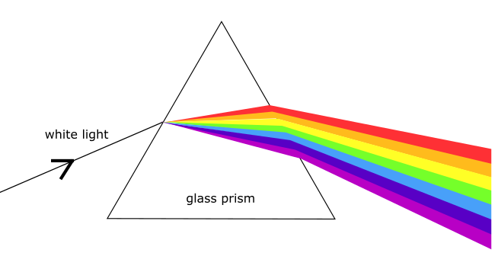
MLD Bootcamp Lecture 1: Course Overview, Genetics Pt 2
Wyatt Clark
Heterogeneous
Disease
Disease Severity
Severe
Genetics
Mild

Slide 2
Overview
A very brief introduction to GWAS and PGS (5 minutes)
Understanding the genotype/phenotype relationship in MLD (20 minutes)
The big picture of the human disease landscape (5 minutes)
Different mutation types (15 minutes)
Modes of inheritance (5 minutes)
DNA damage repair (5 minutes)

Slide 3
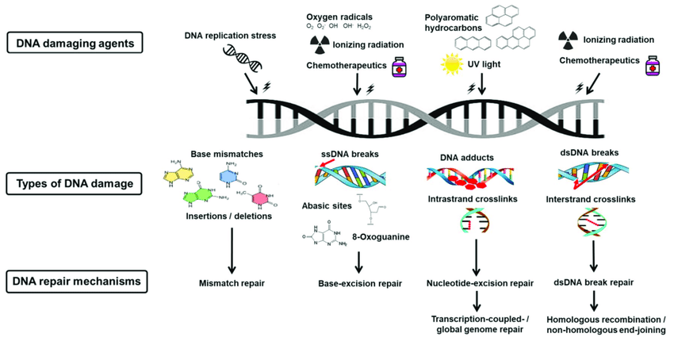
Several DNA damage repair pathways have evolved to ensure the fidelity of DNA
https://youtu.be/sX6LncNjTFU?t=342
Notes:
https://pubmed.ncbi.nlm.nih.gov/29641431/

Slide 4
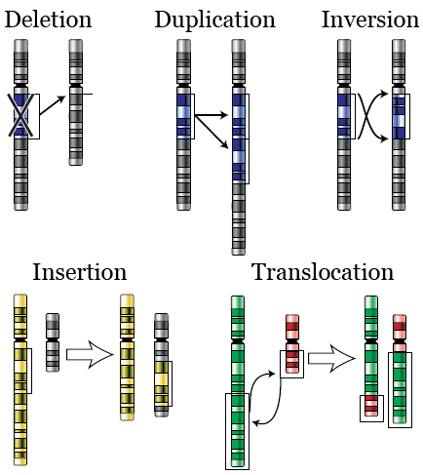
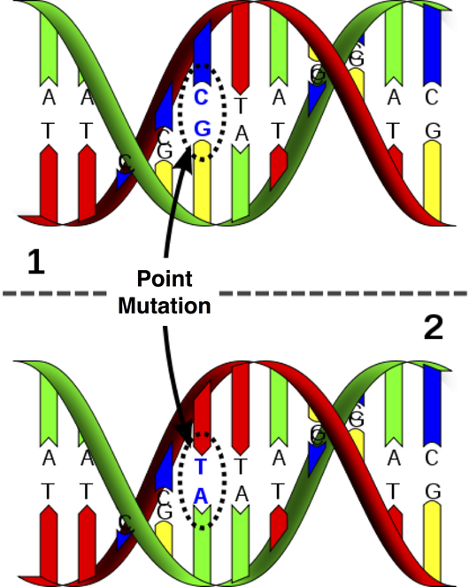
Mutations can be large rearrangements in your DNA, or just changes to single nucleotides in the DNA sequence

Slide 5
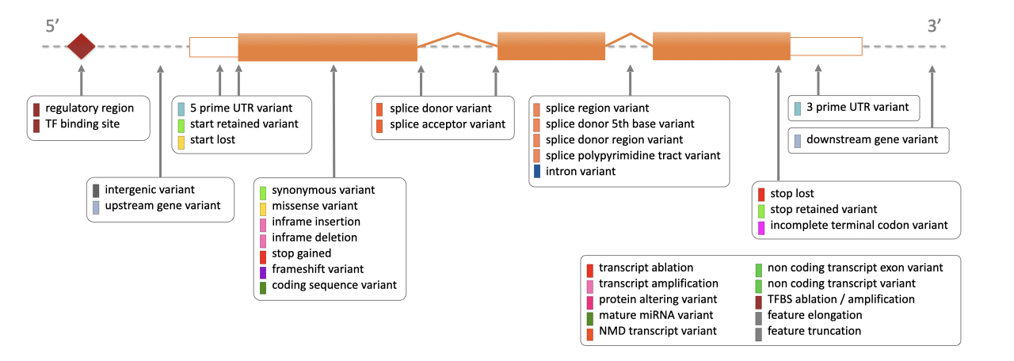
Mutations can impact a wide variety of RNA and protein features
Notes:
https://uswest.ensembl.org/info/genome/variation/prediction/predicted_data.html

Slide 6
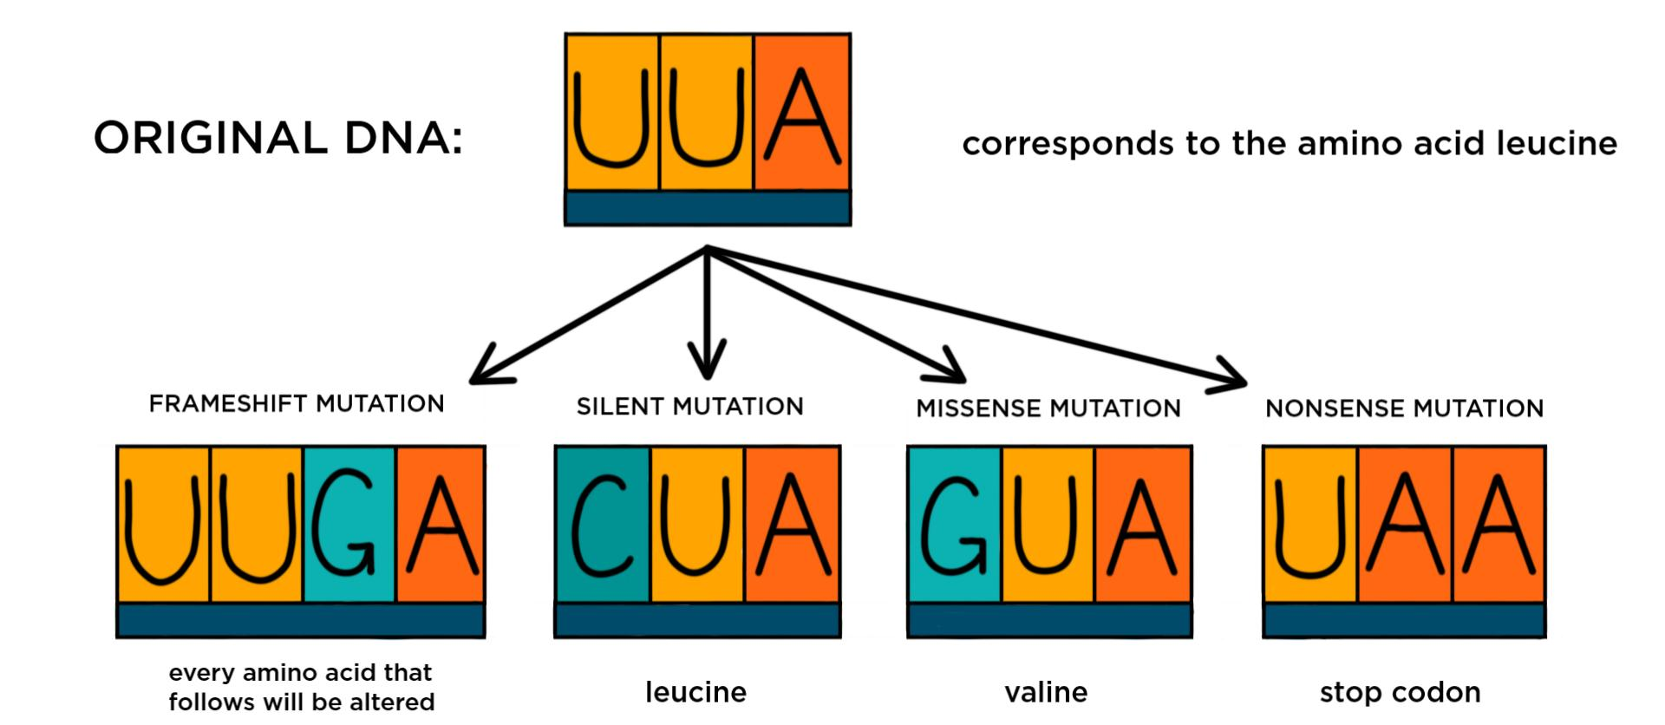
We will mainly be working with point mutations that change the amino acid sequence of a protein

Slide 7
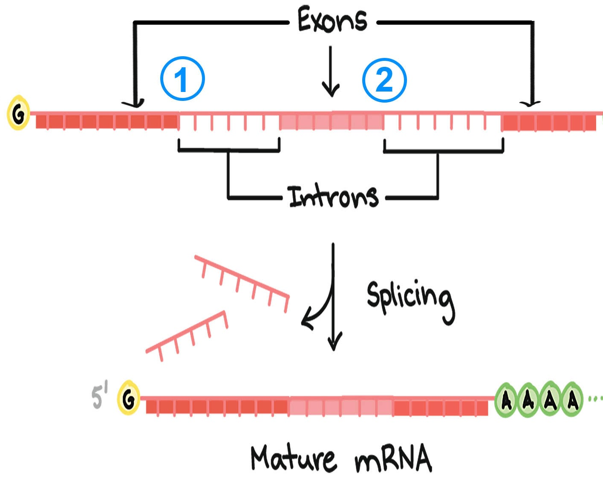
Some mutations can even disrupt the splicing process, leading to dysfunctional proteins
Point mutation at splice site

Slide 8
Representation of mutations is standardized using HGVS nomenclature
Genomic DNA
Coding DNA (RNA)
Protein Change
g.chr1:155205634:T>C
ENST00000327247.5:c.1226A>G
GBA:p.Asn409Ser
ENST00000327247.5:c.465+1G>A
Chromosome:position:ref:alt
Transcript/Gene:position:ref:alt
Protein/Gene:position:ref:alt
Can use single letter or three letter abbreviations for amino acids

Slide 9
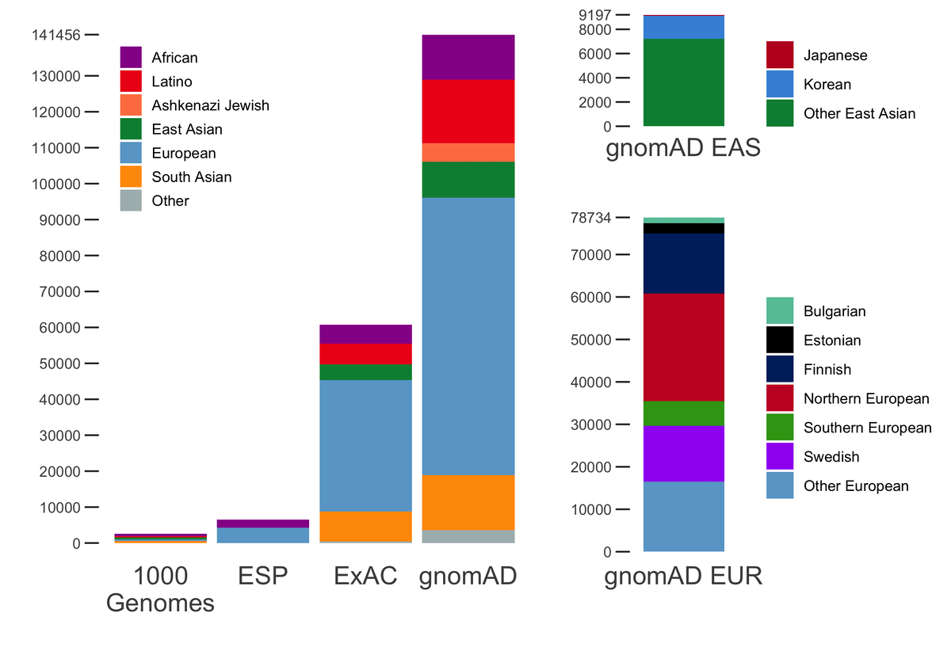
The Genome Aggregation Database (GnomAD) is a great resource for looking for mutations identified in the human population
https://gnomad.broadinstitute.org/

Slide 10
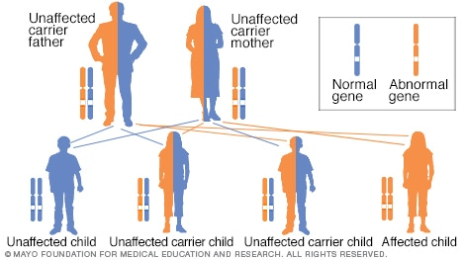
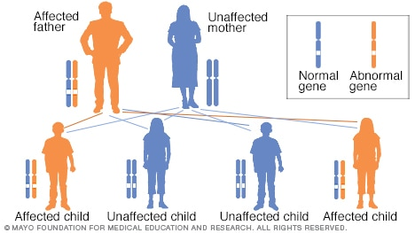
MLD is a recessive disease
Recessive
Dominant
?
?
A recessive disease requires mutations in both copies of a gene
A dominant disease only requires a mutation in one copy
Notes:
Image source: https://www.mayoclinic.org/autosomal-dominant-inheritance-pattern/img-20006210

Slide 11
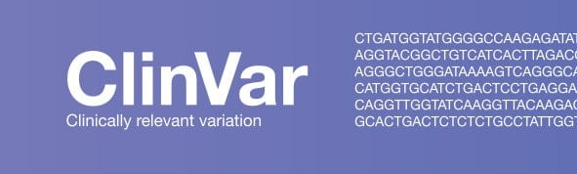
ClinVar is a database of curated disease associated mutations
https://www.ncbi.nlm.nih.gov/clinvar/

Slide 12
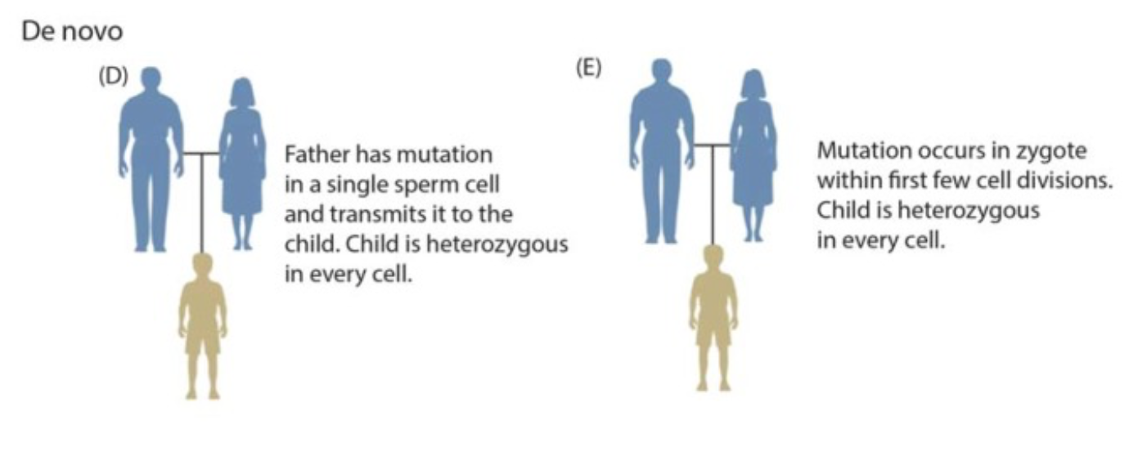
Most severe dominant diseases are caused by de novo mutations
Notes:
Why? If a mutation leads to a phenotype that is so severe that it impacts fitness (the ability to have children and pass on your genetic material), then that pathogenic allele will be removed from the population after one generation

Slide 13
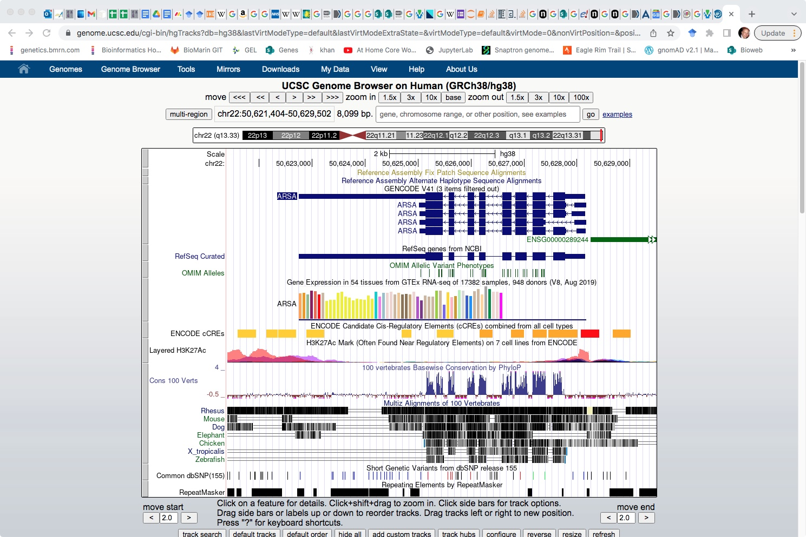
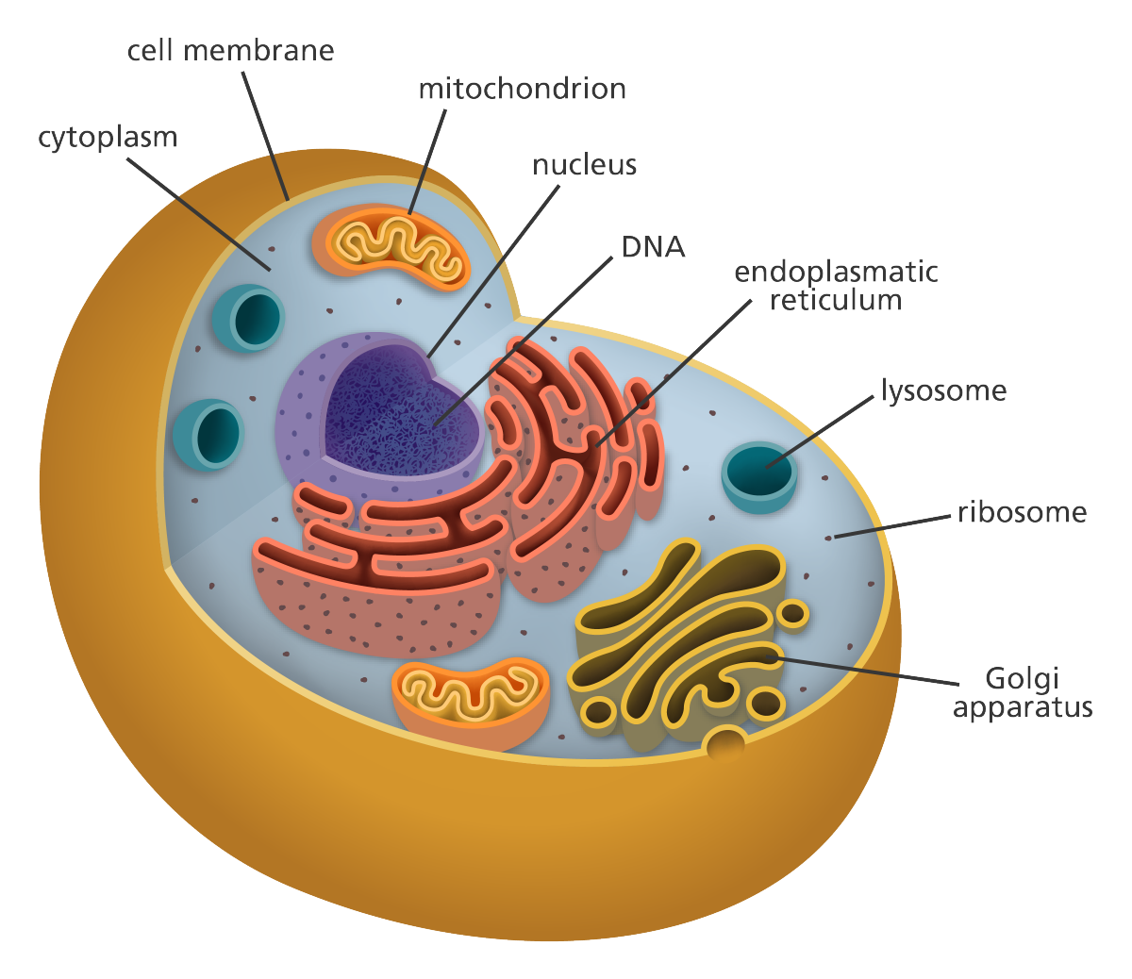
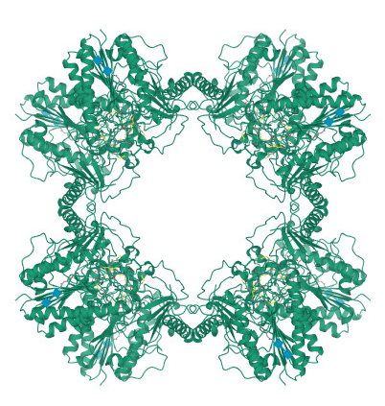
ARSA helps break sulfatides down in the lysosome. Mutation in ARSA cause MLD
https://genome.ucsc.edu/cgi-bin/hgGateway
https://www.rcsb.org/structure/1AUK

Slide 14
MLD is a recessive disease with a spectrum of severity/age of onset
Subtype | Age of Onset | Disease Duration
Late-Infantile | 6 mo-2 yr (60%) | ~3.5 years after onset
Juvenile | 3-16 yr (25%) | ~6-9 years
Adult | > 16 yr (15%) | ~5-14 years *Minimal published data on adult onset prognosis

Slide 15
We can used genetics to understand the variability in MLD age of onset
Heterogeneous
Disease
Disease Severity
Severe
Genetics
Mild

Slide 16
We can start the two most common mutations to try to understand the genotype/phenotype relationship
Variant 1 | Variant 2 | Phenotypes
c.465+1G>A | c.465+1G>A | 24 Late Infantile
c.465+1G>A | p.P428L | 17 Juvenile
p.P428L | p.P428L | 8 Adult, 11 Juvenile
p.465+1G>A | p.I181S | Adult
c.465+1G>A | p.C491G | Adult
c.465+1G>A | p.P96A | Adult
c.465+1G>A | p.R290H | Adult
Variant 1 | Variant 2 | Phenotype
We can tell c.465+1G>A is more severe than p.P428L
p.I181S, p.C491G, p.P96A, p.R290H, p.I181S, p.R290H
only occur in patients with “severe” variants
not found in combination with each other
not found in Late Infantile patients (mostly in Adult Patients)
Notes:
Change these to reflect current data

Slide 17
After looking at the patients in their entirety, it seems three levels of variant severity are needed
We can tell from these patients there are three levels of variant severity
Severe
  465+1G>A
Moderate
  P428L
Mild
  I181S, C491G, P96A, R290H
Variant 1 | Variant 2 | Phenotypes
465+1G>A | 465+1G>A | 24 Late Infantile
461+1G>A | P428L | 17 Juvenile
P428L | P428L | 8 Adult, 11 Juvenile
461+1G>A | I181S | Adult
461+1G>A | C491G | Adult
461+1G>A | P96A | Adult
461+1G>A | R290H | Adult
We also have a pretty good idea what the phenotype matrix will look like
 | Severe | Moderate | Mild
Severe | Infantile | Juvenile | Adult
Moderate | Juvenile | Adult | Asymptomatic
Mild | Adult | Asymptomatic | Asymptomatic
Little confidence an individual would be symptomatic with two of these mutations
Notes:
Yes we are making a judgment call in setting cut-offs for patient severity as well as variant severity. Although enzymatic activity is a continuous variable, we are dealing with a finite number of mutations; and even combinations of variants found in patients. Any disease has variation, but with enough patients you could essentially sort the mutations according to severity. Change these to reflect current data. 1 patient with 461+1G>A/461+1G>A
is presymptomatic. This brings the number that are late infantile to 24 (out of 25 pts with that genotype)?

Slide 18
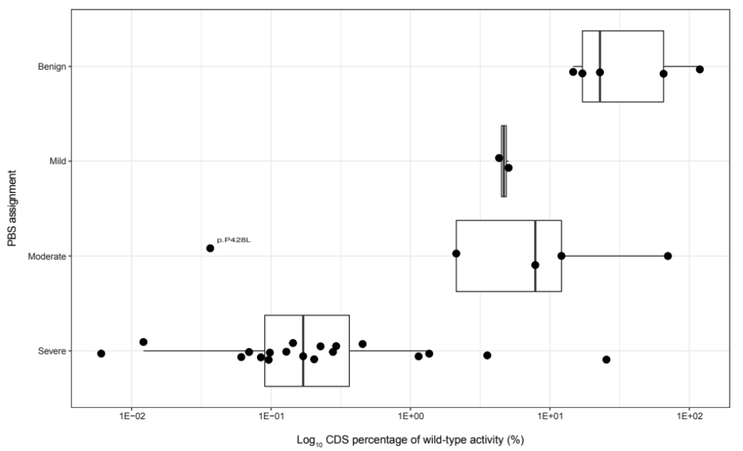
Enzymatic activity values correlated with patient-based severity assignments

Slide 19
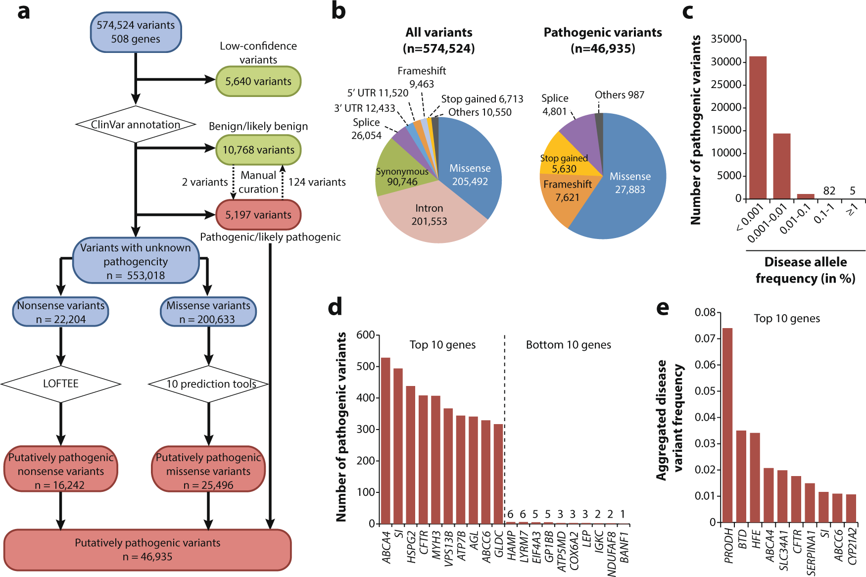
Missense, frameshift, and stop gained mutations are the most common consequence of mutations associated with recessive disease
Notes:
https://www.nature.com/articles/s41525-021-00203-x

Slide 20
Most missense variants in ARSA have never been observed in patients and their contribution to disease is unknown
A VUS is a Variant of Unknown Significance

Slide 21
Mutations can impact a wide variety of RNA and protein features
Notes:
https://uswest.ensembl.org/info/genome/variation/prediction/predicted_data.html

Slide 22
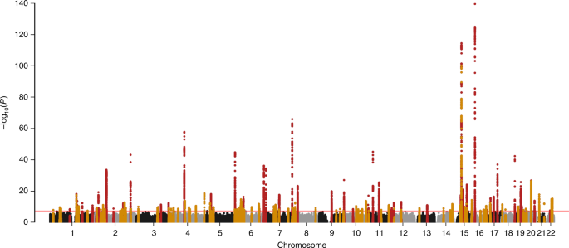
The results of Genome Wide Association Studies (GWAS) show that common non-coding mutations can have significant associations with human phenotypes
Manhattan plot of single nucleotide point mutation association with eGFR (kidney function).
Notes:
https://www.nature.com/articles/s41467-019-11704-w

Slide 23
Polygenic models combine the impact of multiple mutations to predict a phenotype
Polygenic Score

Slide 24
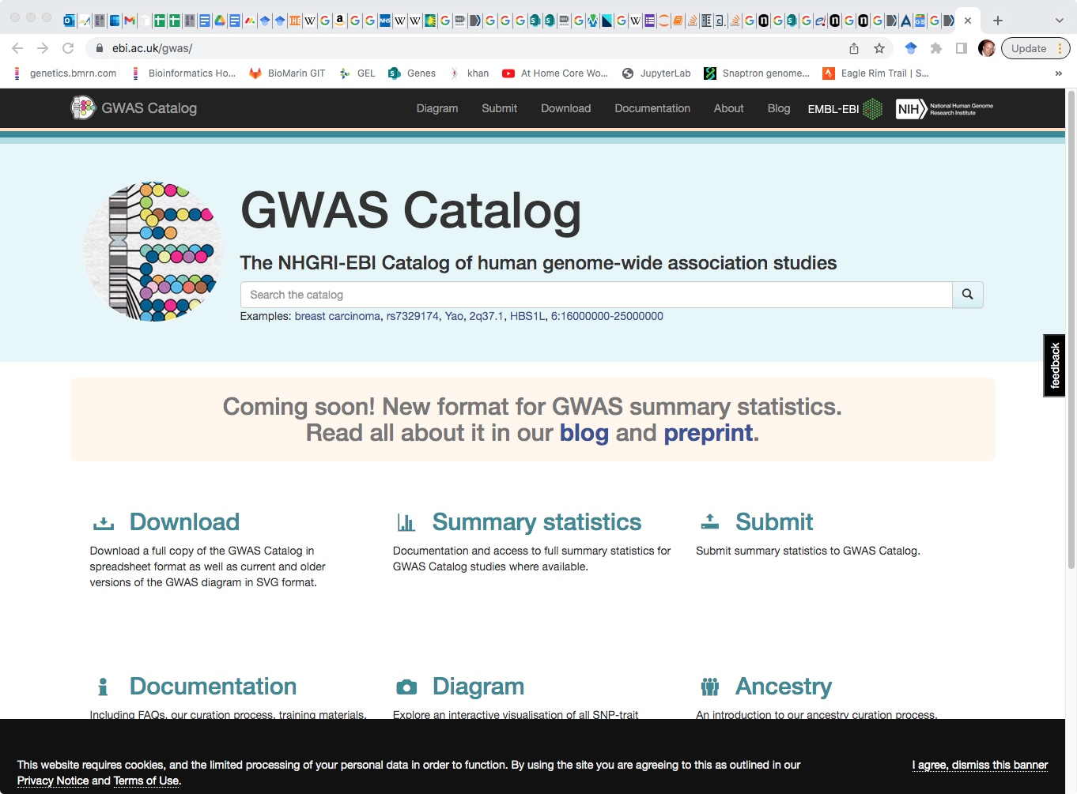
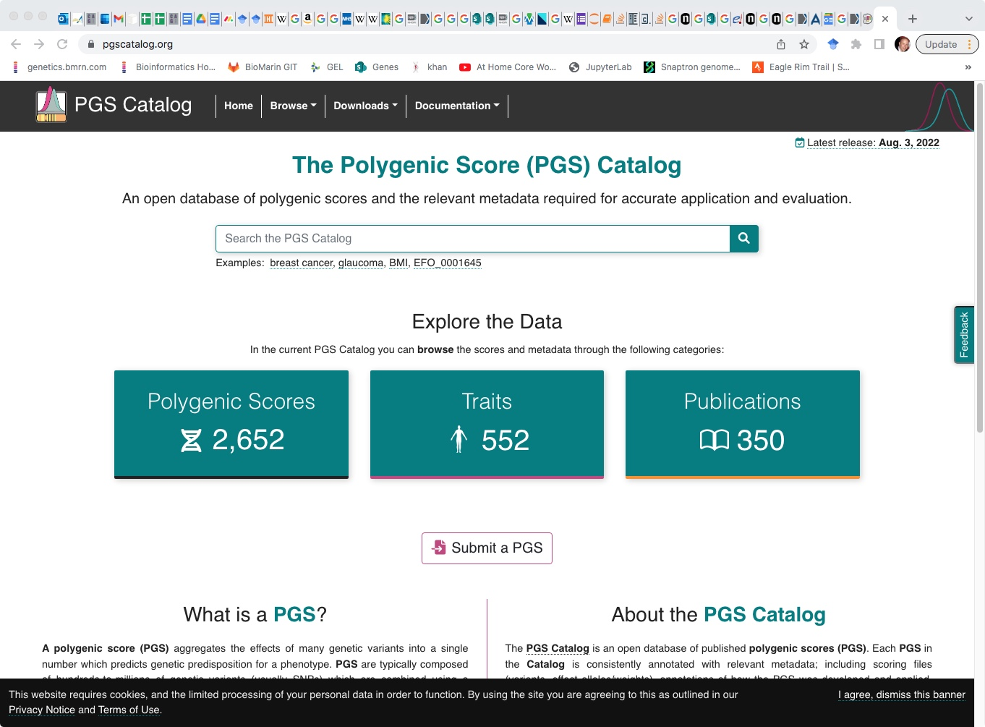
https://www.ebi.ac.uk/gwas/
https://www.pgscatalog.org/

Slide 25
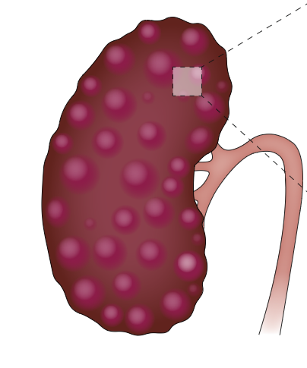
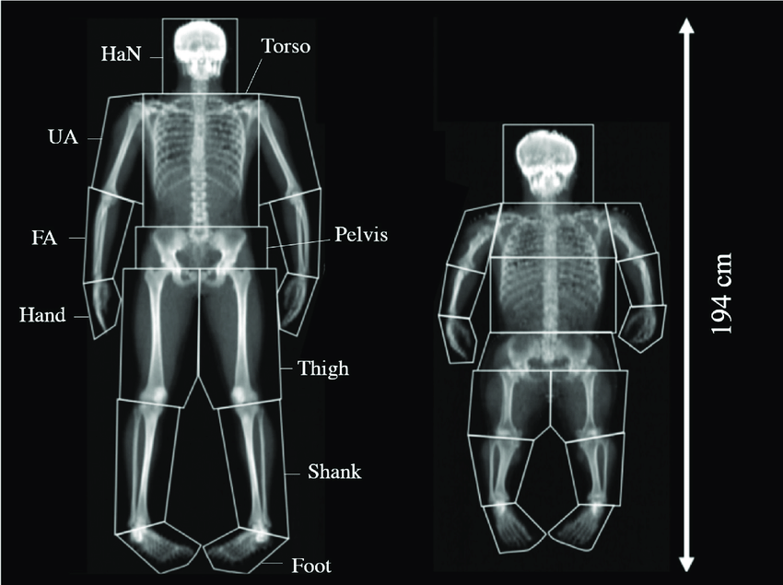
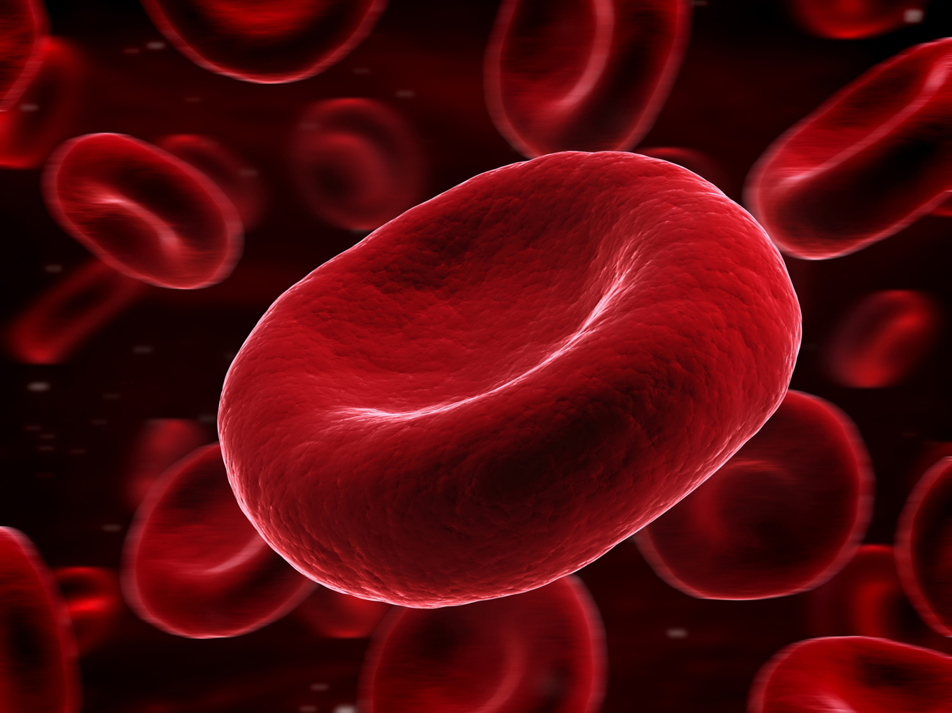
The Human genetic disease landscape is shaped by population genetics
Mendelian, highly penetrant, rare
Somatic mutations are unique: can be common, but have large effect size
Common disease,
moderate penetrance
Effect Size
Genetic modifiers and polygenic disease
Frequency of mutation

Slide 26
Thank You!

