Slide 1
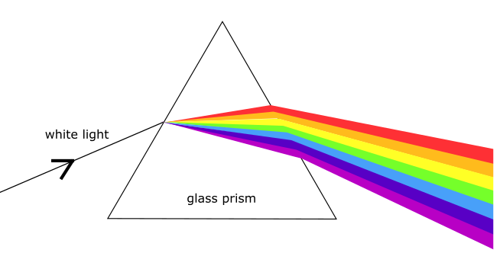
MLD Bootcamp Lecture 1: Course Overview, Genetics Pt 1
Wyatt Clark
Heterogeneous
Disease
Disease Severity
Severe
Genetics
Mild

Slide 2
Overview
Introduction (5 minutes)
Bootcamp goals (5 minutes)
Acknowledgements (5 minutes)
Bootcamp Schedule (10 minutes)
Genetics Basics (30 minutes)
Quick Roll-call/sound check (5 minutes)

Slide 3
Please email your institutional email to
cagi@genomeinterpretation.org

Slide 4
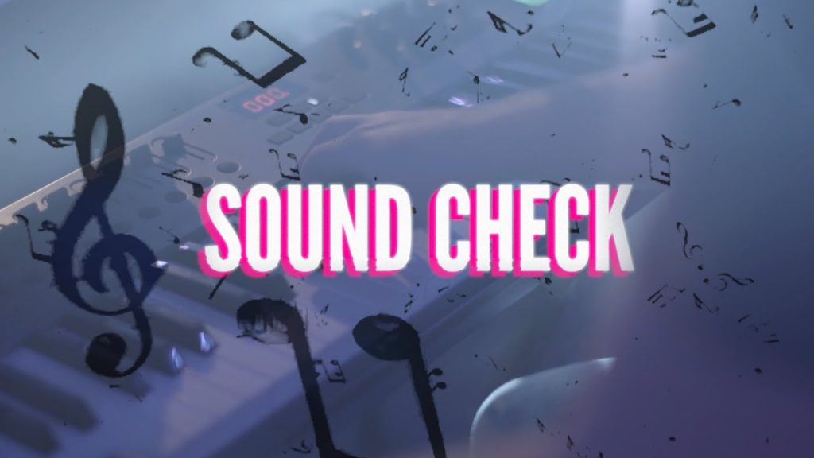

Slide 5
Bootcamp Goals
Goal 1: Introduce participants to basic concepts in genetics
Focus on rare disease genetics
Use Metachromatic Leukodystrophy (MLD) as an example
Goal 2: Help participants become more comfortable programming
Using the Python programming language
Goal 3: Engauge participants with Machine Learning concepts
Using what they learn about genetics and programming in python

Slide 6
Acknowledgements
Organizers
Courtney Astore, Constantina Bakolitsa, Steven Brenner, Wyatt Clark, Shantanu Jain, Akash Kamandula, Vikas Pejaver, Predrag Radivojac, Rashika Ramola, Marena Trinidad, Michelle Velyunskiy, Daniel Zeiberg.
Guest Speakers
Jenny Goldstein (University of North Carolina), Dean Suhr (MLD Foundation).
MLD Data Generators
Marena Trinidad, Xinying Hong, Michael Gelb, Steven Froelich, Wyatt Clark

Slide 7
Bootcamp Schedule
The bootcamp will take place Monday through Friday
Starting: August 22nd, 2022 until
Ending: September 2nd, 2022
Lectures will occur from 4:00PM till 5:00PM EDT
Code Lab will run from 5:30PM till 6:30PM EDT

Slide 8
Lecture Schedule: Week One
Monday August 22nd: Introduction to Genetics Pt. 1
Lecturer: Wyatt Clark
Tuesday August 23rd: Introduction to Genetics Pt. 2
Lecturer: Wyatt Clark
Wednesday August 24th: Introduction to Machine Learning Pt. 1
Lecturer: Marena Trinidad
Thursday August 25th: Introduction to Machine Learning Pt. 2
Lecturer: Marena Trinidad
Friday August 25th: Genetics refresh, Critical Assessment of Genome Interpretation (CAGI)
Lecturer: Steven Brenner

Slide 9
Lecture Schedule: Week Two
Monday August 29th: Data sources for genomics research, meta-predictor development
Lecturer: Vikas Pejaver
Tuesday August 30th: ClinGen, biocuration, and genetic testing
Lecturer: Jenny Goldstein
Wednesday August 31st: MLD Foundation and new-born screening
Lecturer: Dean Suhr
Thursday September 1st: Real-world application and impact of genetics research
Lecturer: Wyatt Clark
Friday September 2nd: Predictor performance evaluation, discussion, concluding ceremony
Lecturer: Shantanu Jain

Slide 10
Code Lab: Week One
Monday August 22nd: Python introduction, installing Anaconda, Jupyter notebooks
Lecturer: Marena Trinidad
Tuesday August 23rd: Loading, parsing, and exploring data
Lecturer: Daniel Zeiberg
Wednesday August 24th: Exploring data and model building
Lecturer: Rashika Ramola
Thursday August 25th: Model building and evaluation
Lecturer: Daniel Zeiberg
Friday August 25th: Forming prediction teams, handling MLD/ARSA CAGI challenge datasets
Lecturer: Wyatt Clark

Slide 11
Code Lab: Week Two
Monday August 29th: Teams work on predictions in breakout rooms
Tuesday August 30^{th:} Teams work on predictions in breakout rooms
Wednesday August 31st : Teams work on predictions in breakout rooms
Thursday September 1st :Teams submit predictions for the ARSA challenge

Slide 12
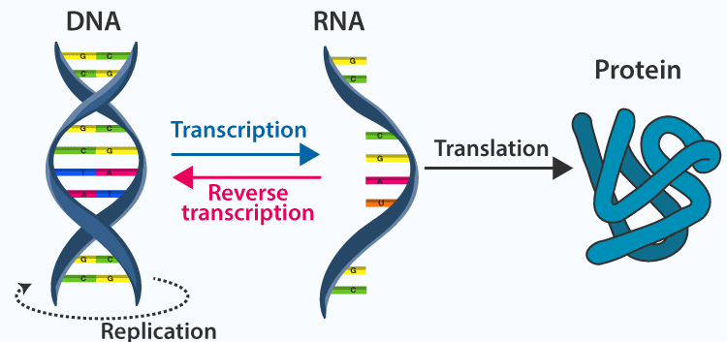
The Central Dogma of Molecular Biology: DNA to RNA to Protein
Notes:
https://byjus.com/biology/central-dogma-inheritance-mechanism/

Slide 13
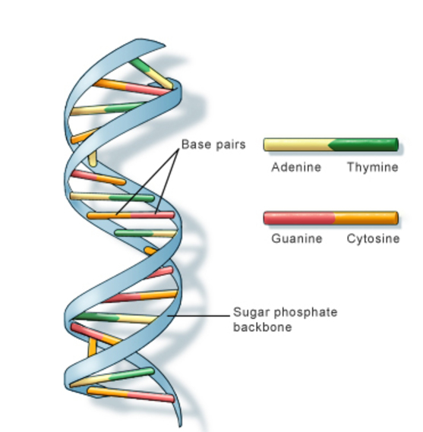
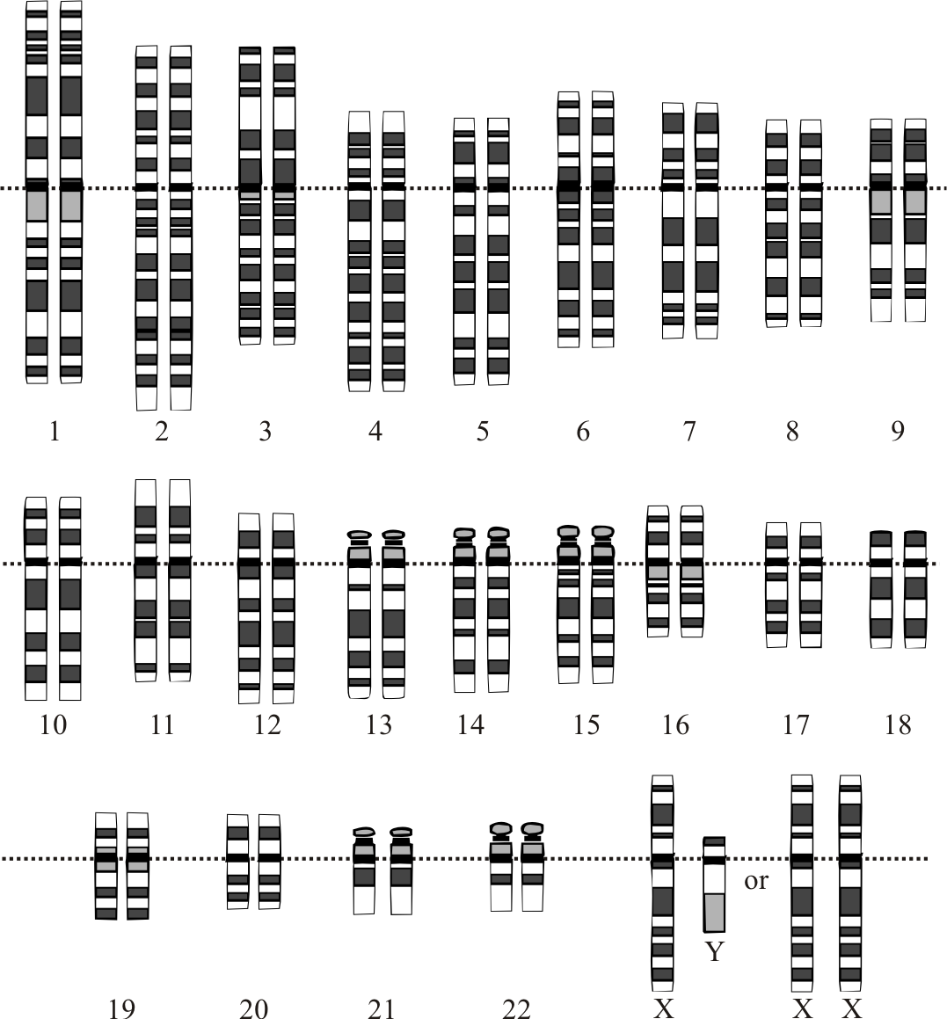
DNA Basics
Your DNA is organized into linear chromosomes
There are 23 "pairs" of chromosomes
You get one copy from your mom, and one from your dad (diploid)
This means you have two copies of every gene
Except on the X and Y chromosome in boys (heterogametic)
It is double stranded, and A and T are always paired, and so are G and C
Some organisms, such as bacteria, have circular genomes
DNA is made up of 4 nucleotides: A, T, G, C

Slide 14
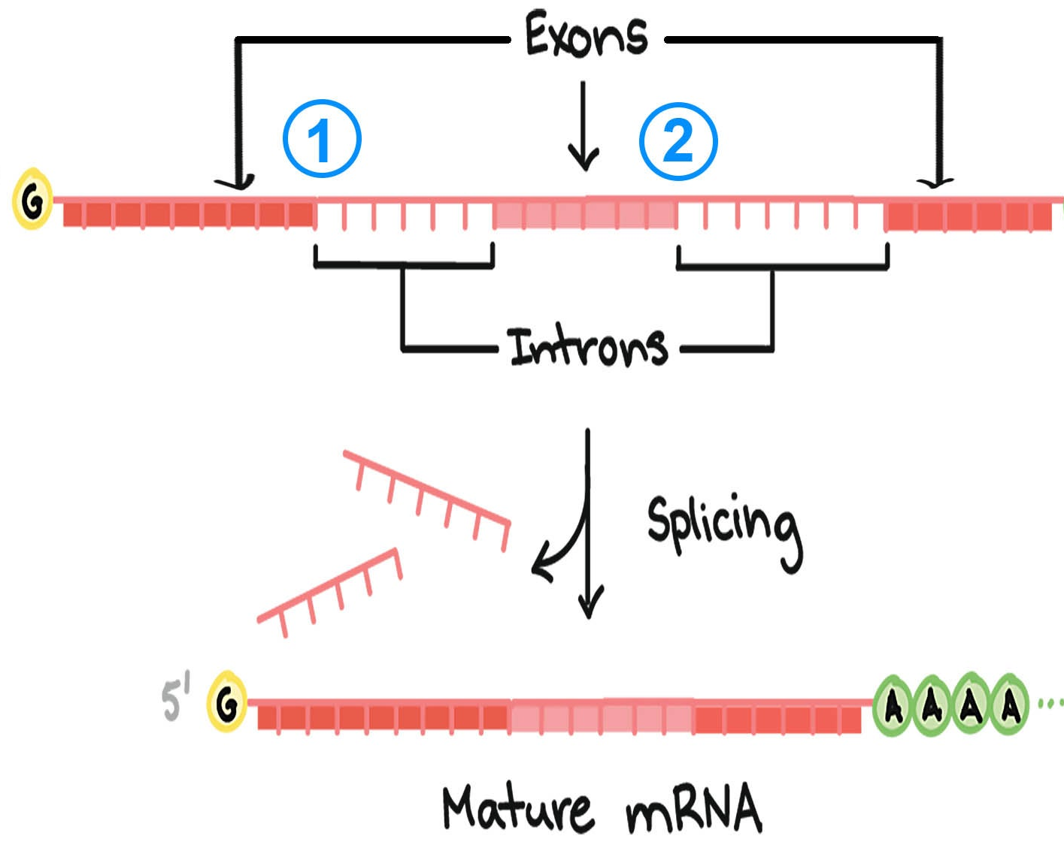
For a gene’s recipe to be ready, introns must first be removed from the RNA message
Genes are first “expressed“ as a RNA sequence
Almost all eukaryotic genes contain introns
Introns are pieces of RNA that get spliced out, or removed, before making the final recipe for a protein
DNA is not directly translated into a protein sequence
Some genes are only expressed in certain tissue or cell types
RNA is an intermediary between DNA and proteins
RNA is then translated into a protein sequence
Generally, the number of transcripts, or RNA sequences for a gene, correlates with the amount of protein produced

Slide 15
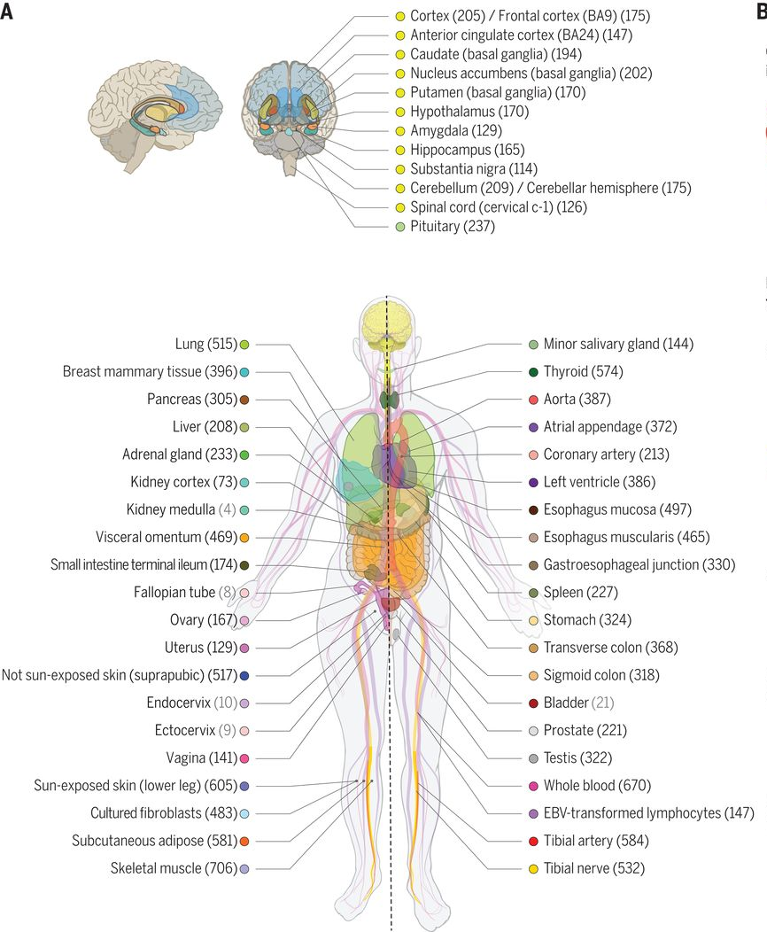
The Genotype-Tissue Expression (GTEx) Portal is a great resource for looking at where a gene of interest is expressed
https://gtexportal.org/home/

Slide 16
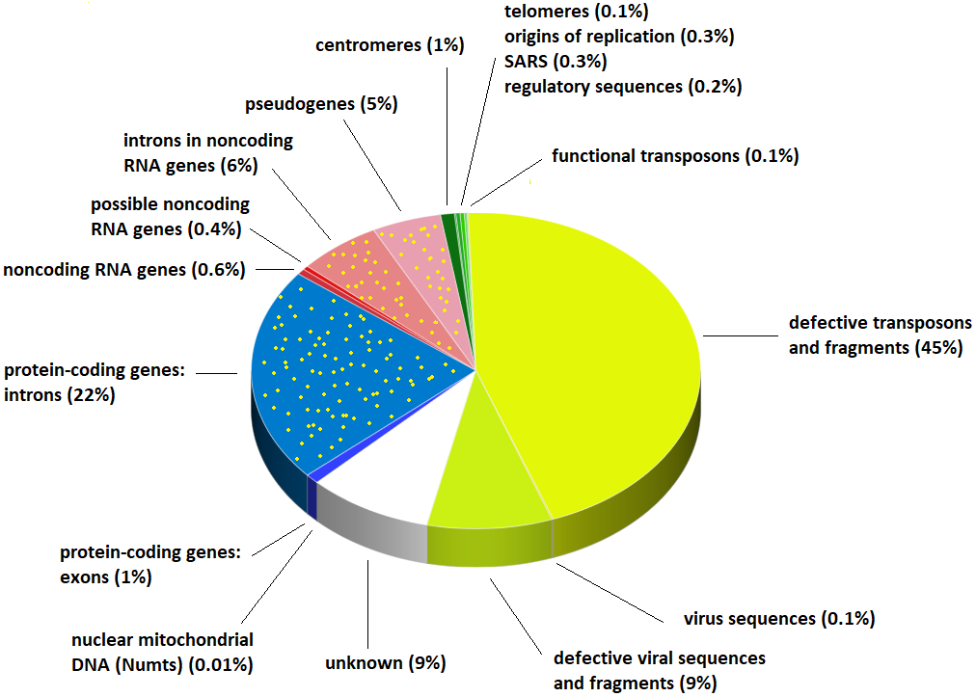
Genes aren’t the only thing in your genome!
Notes:
Image Source:
https://sandwalk.blogspot.com/2018/03/whats-in-your-genome-pie-chart.html

Slide 17
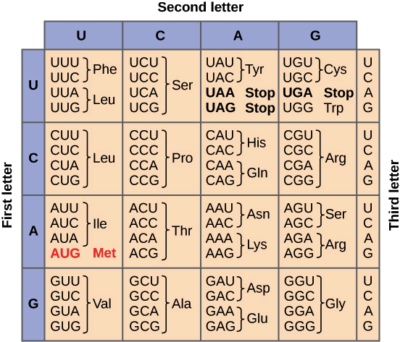
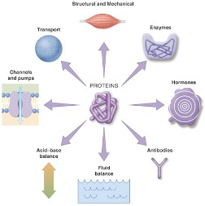
Proteins are the workhorses of your cells
Although proteins have a linear sequence, most fold into a globular 3D structure
Proteins carry out a wide range of complex functions
Proteins do almost everything in your body; from transporting different molecules to where they are needed, to helping translate other proteins
Each sequence of three nucleotides, or a codon, codes for a specific amino acid
This structure can change as they perform different functions. Some proteins are even unstructured, or disordered
mRNA is translated into a linear sequence of amino acids
Mutations in your DNA can impact protein function
Even a change in a single amino acid can completely disrupt a proteins ability to function

Slide 18
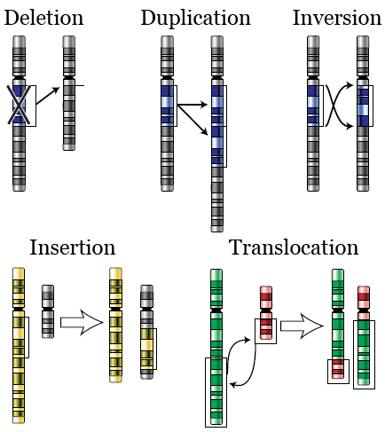
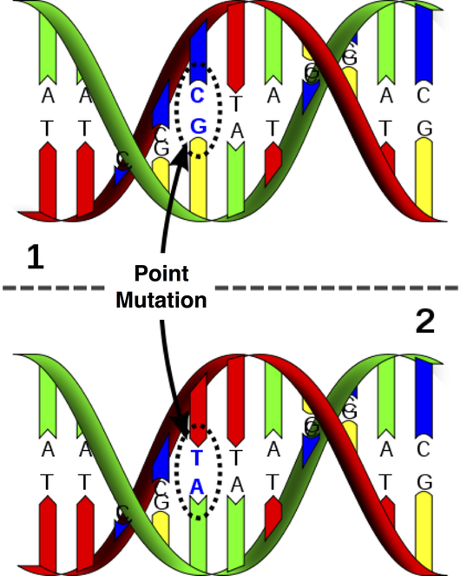
Mutations can be large rearrangements in your DNA, or changes to single nucleotides in the DNA sequence

Slide 19
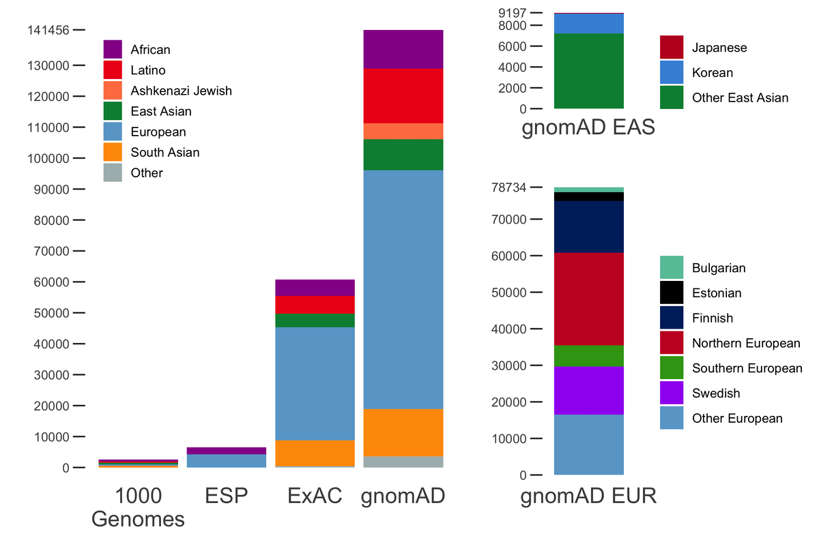
The Genome Aggregation Database (GnomAD) is a great resource for looking for mutations identified in the human population
https://gnomad.broadinstitute.org/

Slide 20
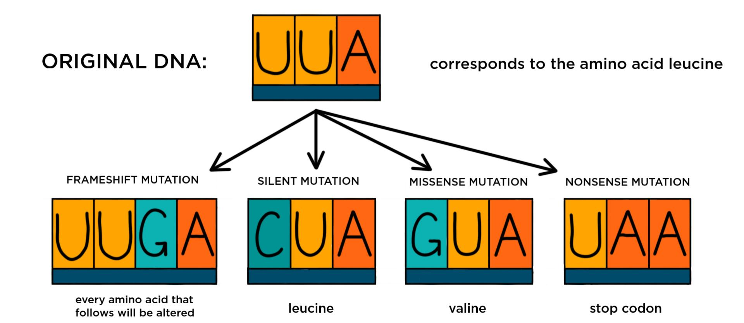
We will mainly be working with point mutations that change the amino acid sequence of a protein

Slide 21
Representation of mutations is standardized using HGVS nomenclature
Genomic DNA
Coding DNA (RNA)
Protein Change
g.chr1:155205634:T>C
ENST00000327247.5:c.1226A>G
GBA:p.Asn409Ser
Chromosome:position:ref:alt
Transcript/Gene:position:ref:alt
Protein/Gene:position:ref:alt
Can use single letter or three letter abbreviations for amino acids

Slide 22
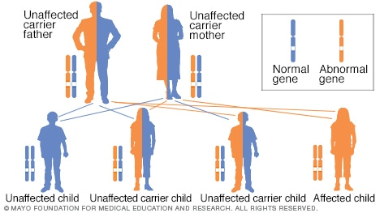
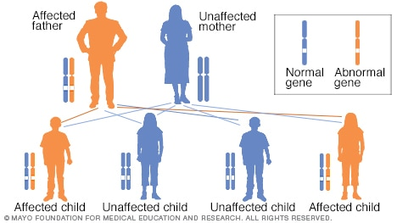
Diseases can be inherited in a dominant or recessive fashion
Recessive
Dominant
?
?
A recessive disease requires mutations in both copies of a gene
A dominant disease only requires a mutation in one copy
Notes:
Image source: https://www.mayoclinic.org/autosomal-dominant-inheritance-pattern/img-20006210

Slide 23
MLD is a recessive disease with a spectrum of severity
Subtype | Age of Onset | Disease Duration | Average Life Expectancy
Late-Infantile | 6 mo-2 yr (60%) | ~3.5 years after onset | 5-6 years → 5.5 years
Juvenile | 3-16 yr (25%) | ~6-9 years | 9-25 years → 17 years
Adult | > 16 yr (15%) | ~5-14 years *Minimal published data on adult onset prognosis | ~25-45 years → 35 years *Estimation difficult due to wide range of disease onset

Slide 24
Next time I will show you how we can used genetics to help understand variation in disease severity
Heterogeneous
Disease
Disease Severity
Severe
Genetics
Mild

Slide 25
Thank You!

