Slide 1

CAGI7 slide pack guidelines
I agree to my slides being used according to the following terms:
__Shaopei Ye__
Authors: please include THIS slide at the beginning of your presentation to indicate that you agree with reuse of your slides in CAGI presentations, according to the terms below, and digitally sign by writing your name above.
To disseminate the CAGI results, I encourage all CAGI participants to remix these CAGI slides for inclusion in their oral and poster presentations.
CAGI participants may use or publish any content of these slides only in compliance with the CAGI Data Use Agreement.
CAGI participants may not cite or publish any content of these slides except with the written permission of the originating author or in the primary CAGI publications.
CAGI participants must acknowledge the original authors of these slides and CAGI7. Include the acknowledgement banner across the bottom.
CAGI participants must include the CAGI credits slide in their presentations.
Slides with a red slash (no remix) may not be included in a presentation unless all attendees are registered CAGI participants who signed the data use agreement.
Slides with a red X over the entire slide may not be used in any circumstances.
Slides with a blue slash (embargoed) may not be used unless the embargo is explicitly lifted.
Slides without slash or X may be tweeted unless flagged with the “No tweet” icon.
CAGI participants using these slides must explain the “No tweet” icon, which means that the slide content should not be disseminated outside the presenting conference hall. If the presentation venue permits pervasive tweeting, you may not include these slides in your talk.
Note for slide authors: we expect all CAGI participants to abide by these restrictions and will make best effort to ensure they are followed. However, bear in mind that we have limited means of enforcing them, and therefore the restrictions cannot be guaranteed.
Notes:
At CAGI7, use of this slide pack is only required for CAGI dataset providers, assessors, and predictors, but all are encouraged to use the annotations for materials they do not want shared publicly.

Slide 2


Variant Impact Prediction via QAFI family
LPL Challenge
CLINTRABI* TEAM – Shaopei Ye
Vall d’Hebron Institute of Research (VHIR)
*Clinical and Translational Bioinformatics Group, VHIR, Barcelona, Spain
Notes:
Good afternoon everyone.
My name is Shaopei Ye, and I’m a PhD student in the CLINTRABI team, supervised by Xavier de la Cruz at the Vall d’Hebron Institute of Research in Spain.
I’m very grateful to the CAGI7 organizers for the invitation to be here and share our work with you today. I’ll present our work on variant impact prediction using the QAFI family models.

Slide 3
CLINTRABI Research Focus
Goal: prediction of the functional impact of missense variants
Family of Models: QAFI (Quantitative Assessment of Functional Impact)
  Fundamental: QAFI 2.0, QAFIsplit 1.0-3.0, QAFIclas
  Metapredictors: QAFImeta
LPL Challenge: six distinct models
Notes:
So before I get into the details of the model, let me give you an overview of our work.
Our main goal is to predict the functional impact of missense variants.
To do this, we developed a family of models called QAFI, which stands for Quantitative Assessment of Functional Impact.
Within this family, we have three fundamental methods — including QAFI 2.0, the QAFIsplit series, and QAFIclass — each approaching the prediction problem from a slightly different angle.
On top of these, we also built a metapredictor called QAFImeta, which brings together our QAFI models along with five other in-silico predictors.
For the LPL challenge, we submitted the results of six of these models.

Slide 4


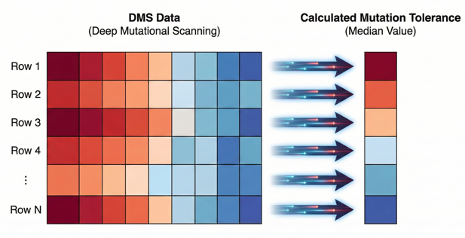


QAFI family: QAFI2.0, QAFIsplit
Central Prediction Strategy: Ensemble Approach
  Base predictors: 60 Protein-Specific Predictors (PSPs)
  Integration strategy: median-based, weighted-correlation
Novel Feature: Mutation Tolerance
  Source: linear predictor
Notes:
Now let me explain the core idea behind the QAFI2.0 and QAFIsplit framework.
Our prediction strategy is built around an ensemble approach.
In this approach, our base predictors are sixty protein-specific models trained on DMS data.
And then we use two integration strategies to combine them: one is a simple median-based method, and the other is a weighted-correlation approach.
As an important feature-level improvement, we now incorporate mutation tolerance.
Let me explain this feature. If you look at the figure on the right, the large square represents a DMS experiment, where each cell corresponds to a mutant value. The vertical numbers correspond to the protein sequence.
Mutation tolerance is defined, for each sequence position, as the median effect across all mutations at that position.
In our framework, mutation tolerance is obtained using a previously trained linear predictor.
Now, I am going to describe the main predictors in our family: QAFI 2.0 and QAFIsplit 3.0

Slide 5
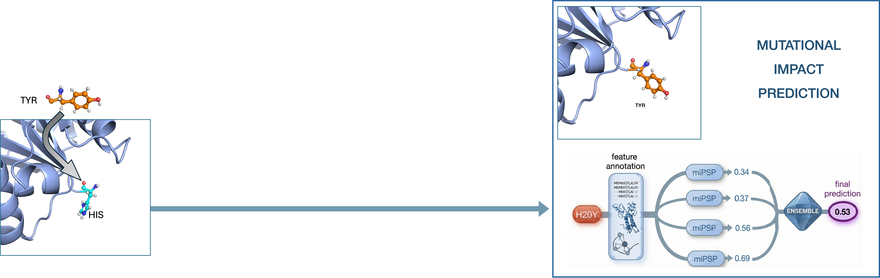
Fundamental: QAFI 2.0
CAGI PROTEINS
Ozkan et al. (2025), Hum Genet 144, 191–208.
Notes:
Here is how QAFI 2.0 makes a prediction for a new mutation.
For example, let’s consider a Tyrosine-to-Histidine substitution in one of the CAGI proteins, we first annotate the mutation using structural and sequence features.
These features serve as input to 60 protein-specific predictors, each producing an estimate of the mutation’s impact; the final prediction corresponds to the median of these estimates.

Slide 6
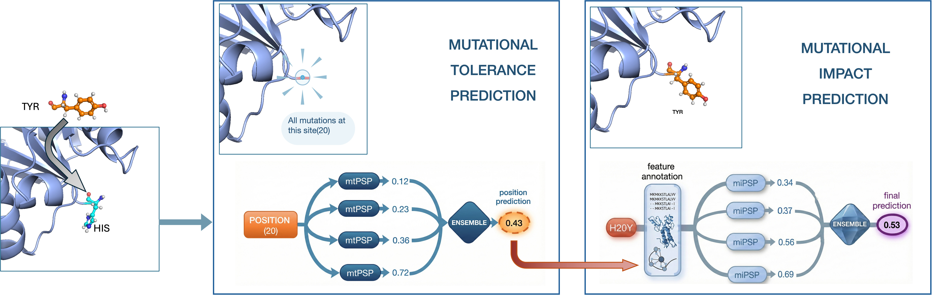
Fundamental: QAFIsplit
CAGI PROTEINS
Notes:
We now turn to QAFIsplit. It works very similarly to QAFI 2.0, but with one important additional step. Let us focus on the middle plot.
In this part, we predict mutation tolerance at the variant location using a set of 60 protein-specific linear predictors. The resulting value is then included as an additional feature when predicting the impact of the variant.
From here, the second step proceeds as in QAFI 2.0.

Slide 7
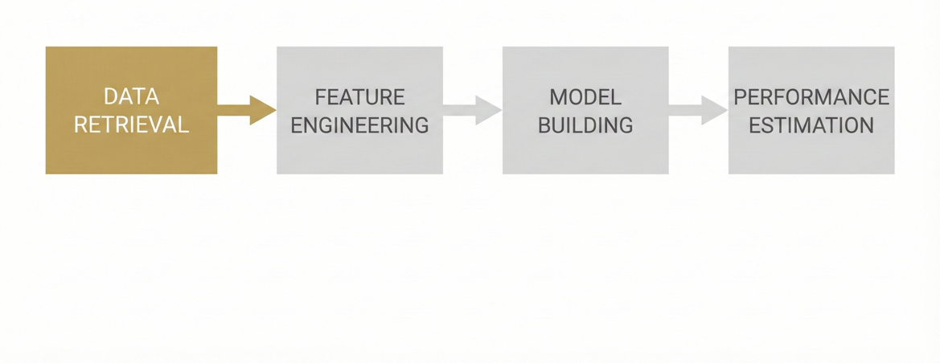
QAFI Fundamental: Development Framework
DATA RETRIEVAL
Primary Source: DMS experiments from ProteinGym¹ database
Data Processing: Normalization² and Scaling to standardize exper. values
¹Notin et al. (2023), NeurIPS 36, 64331–64379.
²Gray et al. (2018), Cell Syst 6, 116–124.
Notes:
Now let us look at how the models are trained.
We follow a simple four-step pipeline, and the first step is data retrieval.
Our main source of training data comes from DMS experiments in the ProteinGym database.
Before using these data for training, we normalize and scale the experimental values — following the approach in Gray and collaborators.

Slide 8
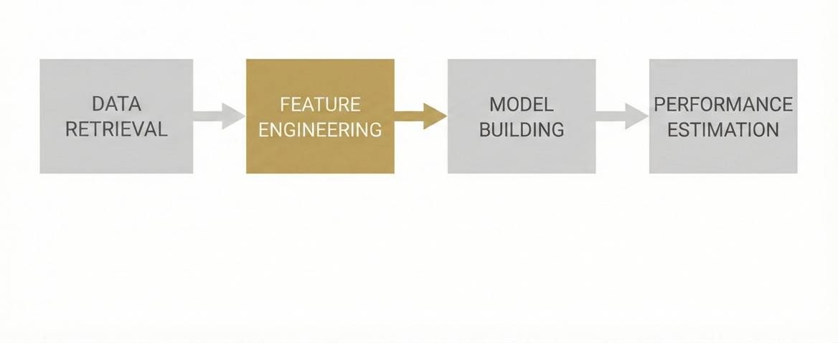
QAFI Fundamental: Development Framework
FEATURE ENGINEERING (28+1 FEATURES)
Sequence-based
Conservation (Entropy, PSSM), Blosum62 , Neighbor Compatibility, etc.
Structure-based - AlphaFold models
Confidence (pLDDT), Packing Density, Res.-Res. Potential (Miyaz. & Jernig.), etc.
Only in QAFIsplit
Mutation Tolerance
Notes:
After preparing the data, the next step is feature engineering.
We extract a total of 28 features, plus one additional feature which is only used in QAFIsplit.
These include sequence-based features such as conservation scores —like entropy, PSSM — Blosum62 , and neighbor-compatibility metrics.
In addition, we use structure-based features derived from AlphaFold models, including pLDDT confidence, packing density, and residue–residue interaction potentials.

Slide 9
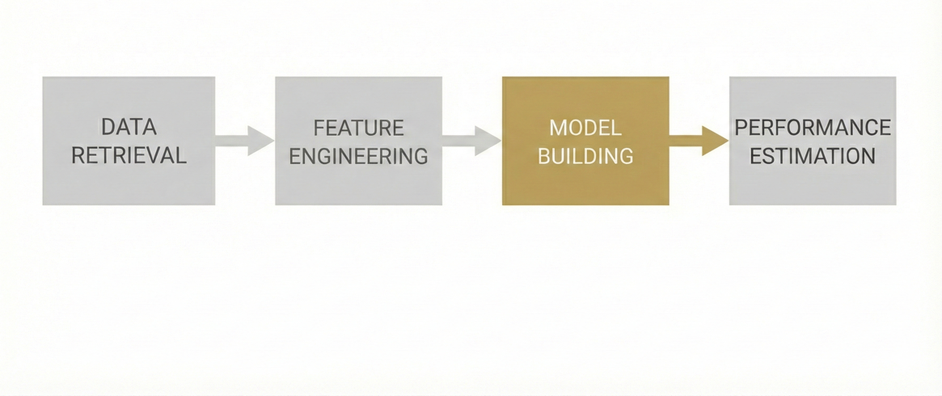
QAFI Fundamental: Development Framework
MODEL BUILDING
PSPs
  Mutation tolerance: Position-level features + Linear regression
  Variant impact: All features + XGBoost
Ensemble Strategies
  QAFI 2.0: Median-based consensus
  QAFIsplit 3.0: Weighted-correlation ensemble
Notes:
We now move to the model building step.
For PSPs, we use two types of models, depending on the task.
For mutation tolerance (used in QAFIsplit), we train a linear regression model on the position-level features to produce a tolerance score for each site.
For variant impact, we use the full set of features and train our protein-specific predictors with XGBoost.
For the ensemble strategies,
To combine the scores of the resulting protein-specific predictors, we use two options:
In QAFI 2.0, a median-based method.
In QAFIsplit 3.0, a weighted-correlation method.

Slide 10
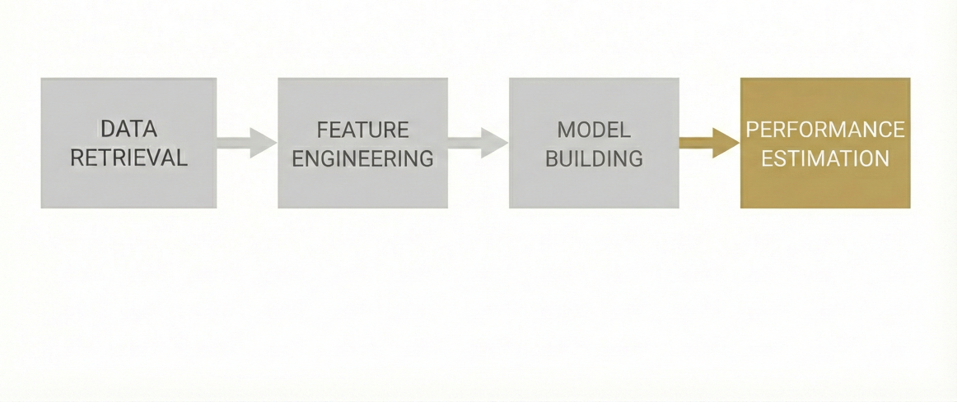
QAFI Fundamental: Development Framework
PERFORMANCE ESTIMATION
Leave-One-Protein-Out Cross-Validation (60 proteins)
Independent Validation: Beltran et al.¹ Dataset
  402 proteins, over 500,000 variants
  Benchmarked against 12 external models
¹Beltran et al. (2025). Nature, 637, 885-894.
Notes:
To estimate performance, we used a standard LOPO cross-validation on the 60 proteins in our dataset and an external dataset published by Beltran and colleagues in 2025. This second dataset includes 402 proteins and over 500,000 variants. For benchmarking purposes, we also used the performance results provided in Beltran and colleagues for 12 external models, all evaluated on the same dataset.

Slide 11
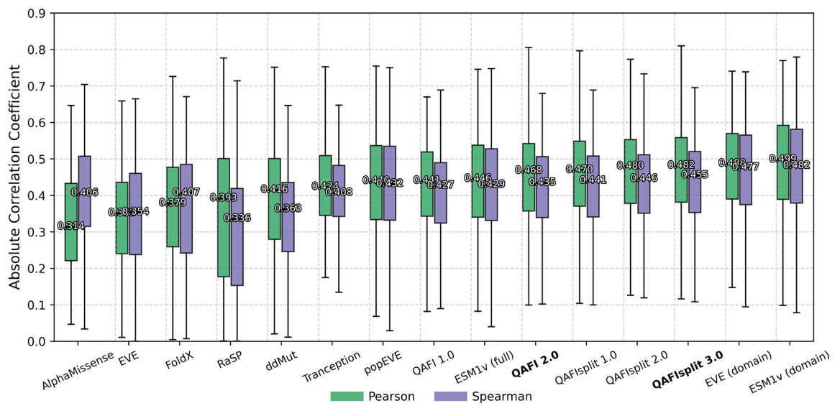
Validation Results - Beltran et al.(2025) Dataset
Notes:
Due to time constraints, I will focus only on the results from the independent validation on the Beltran dataset.
Here you can see how the QAFI models perform on this dataset, using the predictions we generated before the CAGI7 challenge. QAFI 2.0 and QAFIsplit 3.0 in particular are consistently among the top approaches across hundreds of proteins.
At the same time, we observed that the external models from other groups capture complementary aspects of variant effects.
That is why, in addition to the QAFI family, we also explored a metapredictor that integrates QAFI with several of these external models.

Slide 12
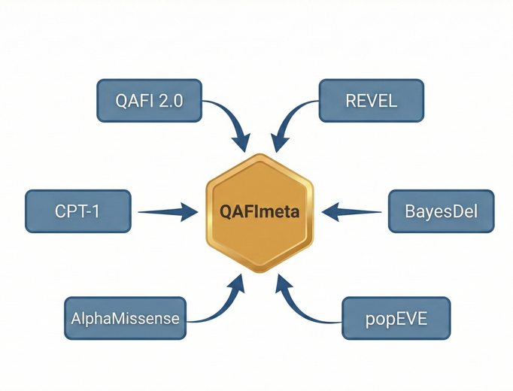
QAFI Metapredictors: QAFImeta
INPUT: QAFI, REVEL, BayesDel, popEVE, AlphaMissense, and CPT-1
INTEGRATION
  Rescaling of external tools
OUTPUT
  Median Consensus
Notes:
More precisely, the inputs in our metapredictor include QAFI 2.0, as well as REVEL, BayesDel, popEVE, AlphaMissense, and CPT-1.
Because these models use different scales, we first rescale their outputs to make them comparable, and then we simply take the median.

Slide 13
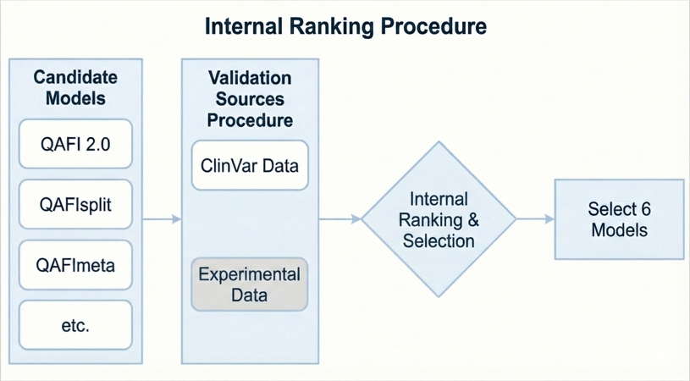
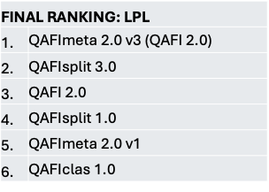
Selecting models for CAGI7 challenges
Notes:
Finally, I would like to walk you through the model selection process we used for the CAGI7 challenges.
As a starting point, we had the models in the QAFI family, including QAFI 2.0, QAFIsplit 3.0, and the QAFImeta metapredictor.
From there, we followed a three-step process:
First, we used the best available data to estimate performance — typically ClinVar or DMS data for most challenges.
Second, we evaluated all candidate models on these datasets and ranked them according to their performance.
Third, we selected the top six models to generate our final submissions to CAGI7.
For the LPL challenge, however, the situation was more constrained because only about 100 ClinVar variants were available for internal validation. Using this smaller dataset, we applied the same process and selected the six models shown on the right.
This completes the selection process for the LPL task. The final performance of the QAFI approach in the LPL challenge — and in the other three challenges — has been kindly presented by the corresponding CAGI assessors.

Slide 14
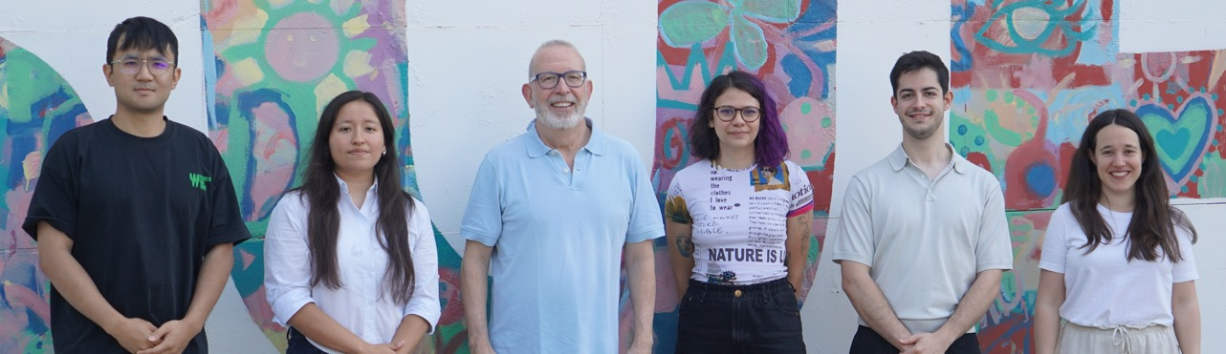




Shaopei Ye
Aitana Díaz
Xavier de la Cruz
Selen Özkan
Javier Guerrero
Natàlia Padilla
CAGI Organization (National Institutes of Health award U24 HG007346)
China Scholarship Council (CSC)
THANK YOU!!
CLINICAL AND TRANSLATIONAL BIOINFORMATICS
Notes:
To finish my presentation, I would like to acknowledge the members of the CLINTRABI team----- with whom we have prepared the CAGI participation — my thanks to all of them.(first selen)
I also want to thank once again the CAGI7 organizers for their kind invitation and for all the work involved in running this challenge.
The organization of CAGI7 has been generously supported by an NIH grant, which we gratefully acknowledge.
The clinical and translational bioinformatics group gratefully acknowledges support from the Spanish Ministry of Science and Innovation, the EU NextGeneration programme, and ICREA.
And finally, I would like to thank the China Scholarship Council for supporting my PhD.

Slide 15
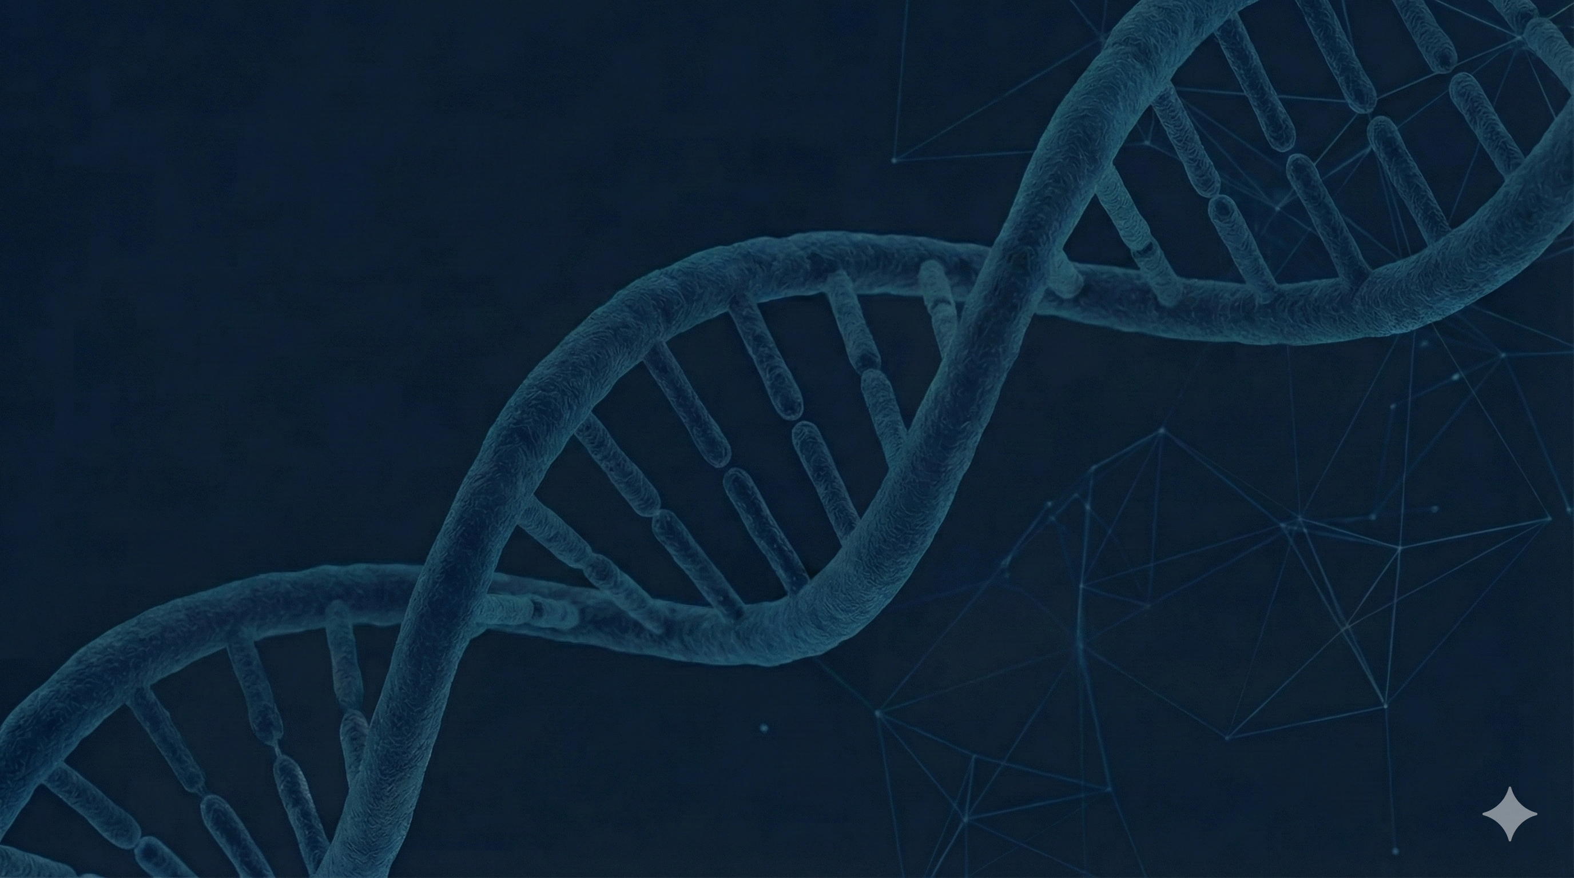
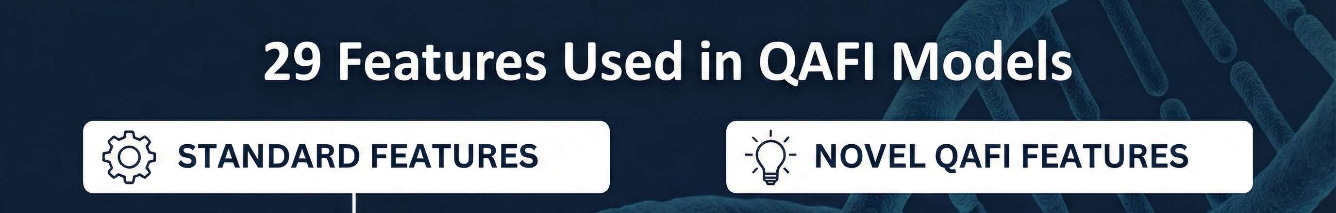
Sequence-based (from MSA)
Shannon’s Entropy
PSSM
Blosum62
Hybrid Sequence–Structure Features
PDFF Transformations Probabilistic shifts in feature distributions (e.g., pLDDT_pdff, PSSM_pdff)
Neighbor Compatibility (neco)
fraction cons. 3D neighbor
Normalized Contact Energy of the Native Residue
access.dependent vol.
Likelihood of the pLDDT Bin for Amino Acid Replacement
Structure-based (from Alphafold)
M.J. potential
pLDDT bin
pLDDT
Notes:
QAFI paper, most of the feature detail in the paper and other will come in another….

Slide 16
ALL METHOD IN CAGI7
FINAL RANKING: TSC2
1. | QAFImeta 2.0 v3 (QAFI 2.0)
2. | QAFI 2.0
3. | QAFIsplit 1.0
4. | QAFIsplit 3.0
5. | QAFImeta 2.0 v1
6. | QAFIclas 1.0
FINAL RANKING: ATP7B
1. | QAFImeta 2.0 v1
2. | QAFI 2.0
3. | QAFIsplit 1.0
4. | QAFImeta 2.0 v3 (QAFI 2.0)
5. | QAFIsplit 3.0
6. | QAFIclas 1.0
FINAL RANKING: LPL
1. | QAFImeta 2.0 v3 (QAFI 2.0)
2. | QAFIsplit 3.0
3. | QAFI 2.0
4. | QAFIsplit 1.0
5. | QAFImeta 2.0 v1
6. | QAFIclas 1.0
FINAL RANKING: ARSA
1. | QAFIsplit 3.0
2. | QAFIclas 1
3. | QAFIsplit 1.0
4. | QAFImeta 2.0 v4 (QAFIsplit 3.0)
5. | QAFImeta 2.0 v1
6. | QAFI 2.0

Slide 17
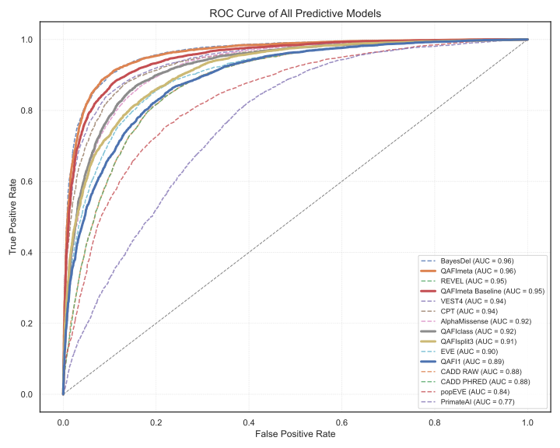
QAFIMETA
ROC Analysis
Notes:
Dataset

