Slide 1

CAGI 7 slide pack guidelines
I agree to my slides being used according to the following terms:
_______Joe Marsh_______
Authors: please include THIS slide at the beginning of your presentation to indicate that you agree with reuse of your slides in CAGI presentations, according to the terms below, and digitally sign by writing your name above.
At CAGI 7, use of this slide pack is only required for CAGI dataset providers, assessors, and predictors, but all are encouraged to use the annotations for materials they do not want shared publicly.
To disseminate the CAGI results, I encourage all CAGI participants to remix these CAGI slides for inclusion in their oral and poster presentations
CAGI participants may use or publish any content of these slides only in compliance with the CAGI Data Use Agreement
CAGI participants may not cite or publish any content of these slides except with the written permission of the originating author or in the primary CAGI publications
CAGI participants must acknowledge the original authors of these slides and CAGI 7. Include the acknowledgement banner across the bottom
CAGI participants must include the CAGI credits slide in their presentations
Slides with a red slash (no remix) may not be included in a presentation unless all attendees are registered CAGI participants who signed the data use agreement
Slides with a red X over the entire slide may not be used in any circumstances
Slides with a blue slash (embargoed) may not be used unless the embargo is explicitly lifted
Slides without slash or X may be tweeted, tooted, posted, X’d unless flagged with “No tweet” icon
CAGI participants using these slides must explain the “No tweet” icon, which means that the slide content should not be disseminated outside the presenting conference hall. If the presentation venue permits pervasive tweeting, you may not include these slides in your talk
Note for slide authors: we expect all CAGI participants to abide by these restrictions, and will make best effort to ensure they are followed. However, but bear in mind that we have limited means of enforcing them, and therefore the restrictions cannot be guaranteed.

Slide 2



Assessing predictor performance on abundance-impacting variants in lipoprotein lipase
Ben Livesey & Joe Marsh
MRC Human Genetics Unit
Institute of Genetics and Cancer
University of Edinburgh
Created for CAGI 7
genomeinterpretation.org

Slide 3
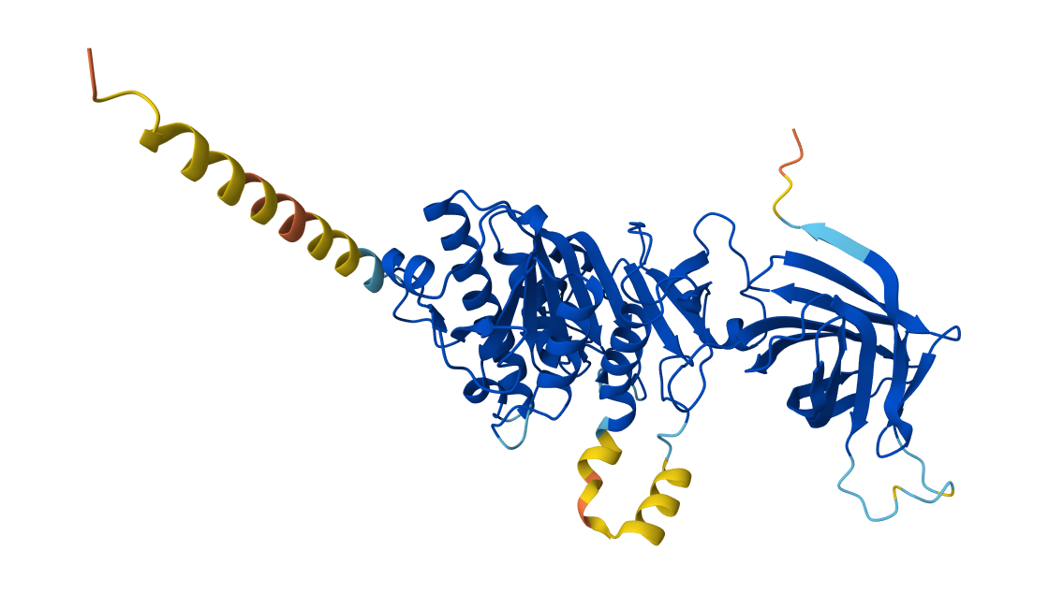
The challenge
Task: Predict the effect of variants in human LPL on cell-surface abundance, as measured by a saturation mutagenesis MAVE.
  8292 single amino acid substitutions
  442 stop gain variants
  366 synonymous variants
Created for CAGI 7
genomeinterpretation.org
Joe Marsh

Slide 4
The models
Group | Number | Summary
3billion | 6 | Complex deep learning model (ClearVariant)
3BIOBXL | 6 | RSALOR + training on DMS data
AIBI | 6 | -
Alpha2Abundance | 1 | Transformed AlphaMissense
bat | 6 | Models based on physicochemical properties / conservation.
Biofold | 2 | -
BolognaBiocomputing | 4 | E-SNPs&GO + DDGmb
CLINTRABI | 6 | Variants of QAFI + meta-predictors
DMIIP | 4 | PLM embeddings + consensus predictor
Group | Number | Summary
Evocoders | 1 (0)* | -
Evolutionary Action | 4 | EA + MetaEA
INLAB_BBSR | 6 | MLP trained on hydrolase variants
Pejaverlab | 4 | Variants of MutPred2 refined on VKORC1 DMS
PRESCOTT | 4 | PRESCOTT + iGEMME
Structguy-Dev | 2 | -
UXFactory | 6 | EvoStructCLIP framework variants
VespaG | 2 | -
Total of 70 models from 17 groups
Created for CAGI 7
genomeinterpretation.org
Joe Marsh

Slide 5
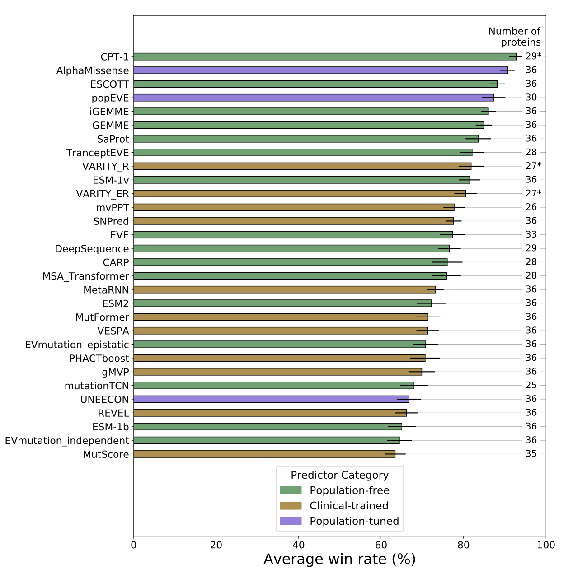

Other publicly available models
30 additional models chosen for comparison, mostly out of 97 from our recent paper
  Only those with ‘full’ amino acid substitution coverage
Created for CAGI 7
genomeinterpretation.org
Joe Marsh

Slide 6
Stop gain and synonymous variants
Strategies:
Don’t provide a value.
Provide a single value for all
Provide a dynamic value
30 models provided dynamic stop gain predictions, of which 6 were significantly correlated with the MAVE data after multiple testing correction.
Model | Spearman’s Correlation | Pval Adj
3billion_6 | 0.208 | 3.05E-4
3BIOBXL_1 - _6 | 0.182 | 3.56E-3
Only 7 models produced dynamic predictions for synonymous variants.
None of which were significantly correlated with the LPL MAVE data after multiple testing correction.
(Not surprising, given that nucleotide sequences weren’t provided)
Created for CAGI 7
genomeinterpretation.org
Joe Marsh

Slide 7
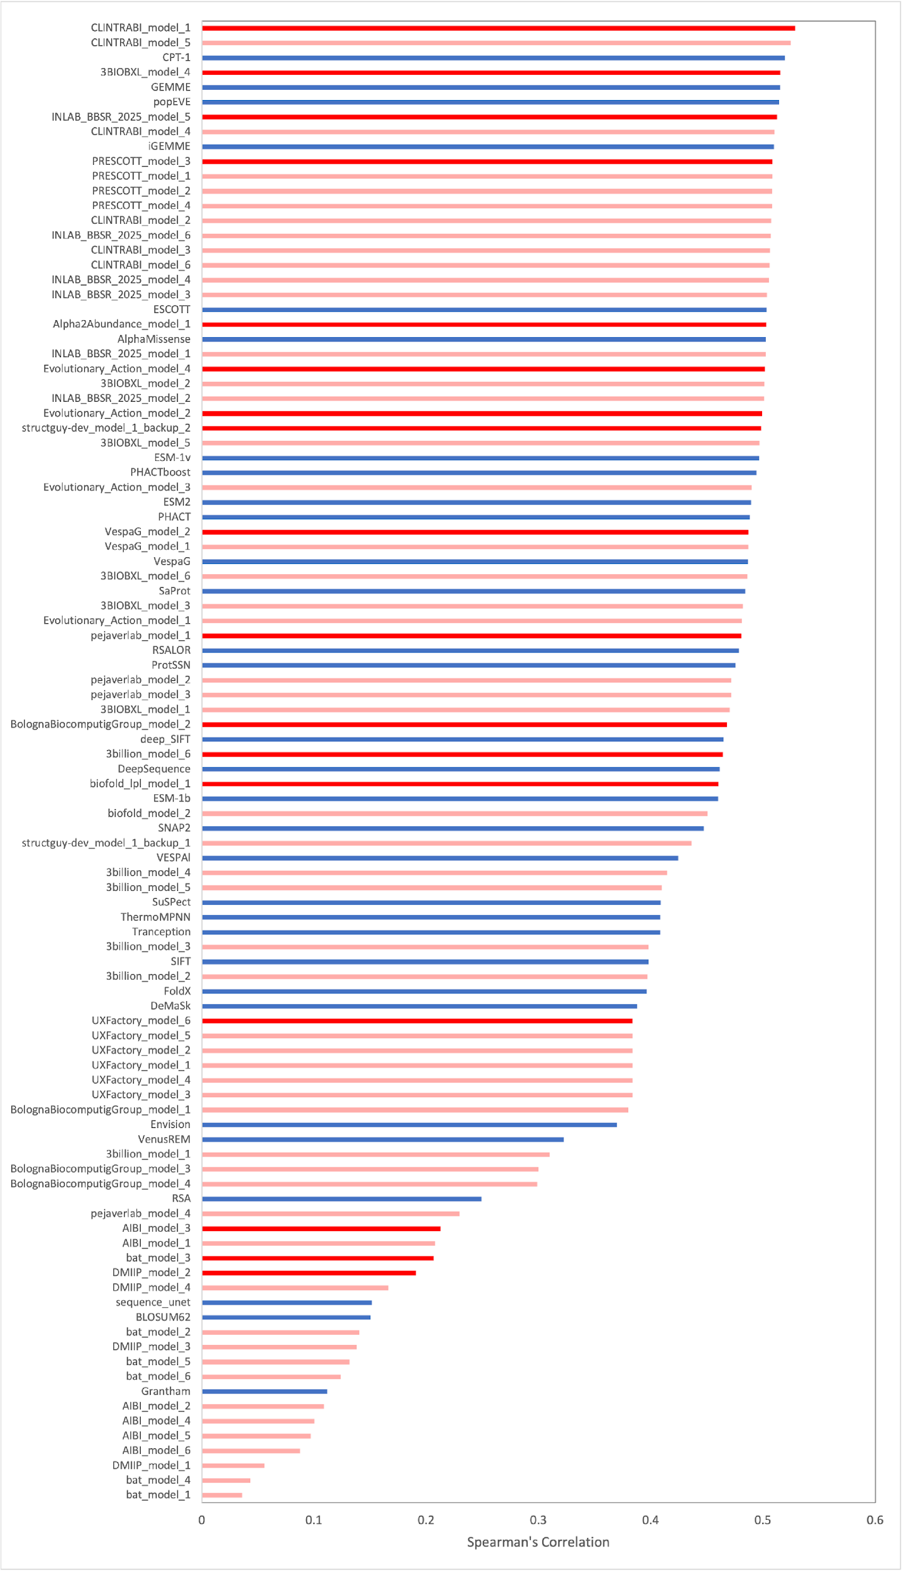
Single amino acid substitutions: full rankings
Created for CAGI 7
genomeinterpretation.org
Joe Marsh

Slide 8
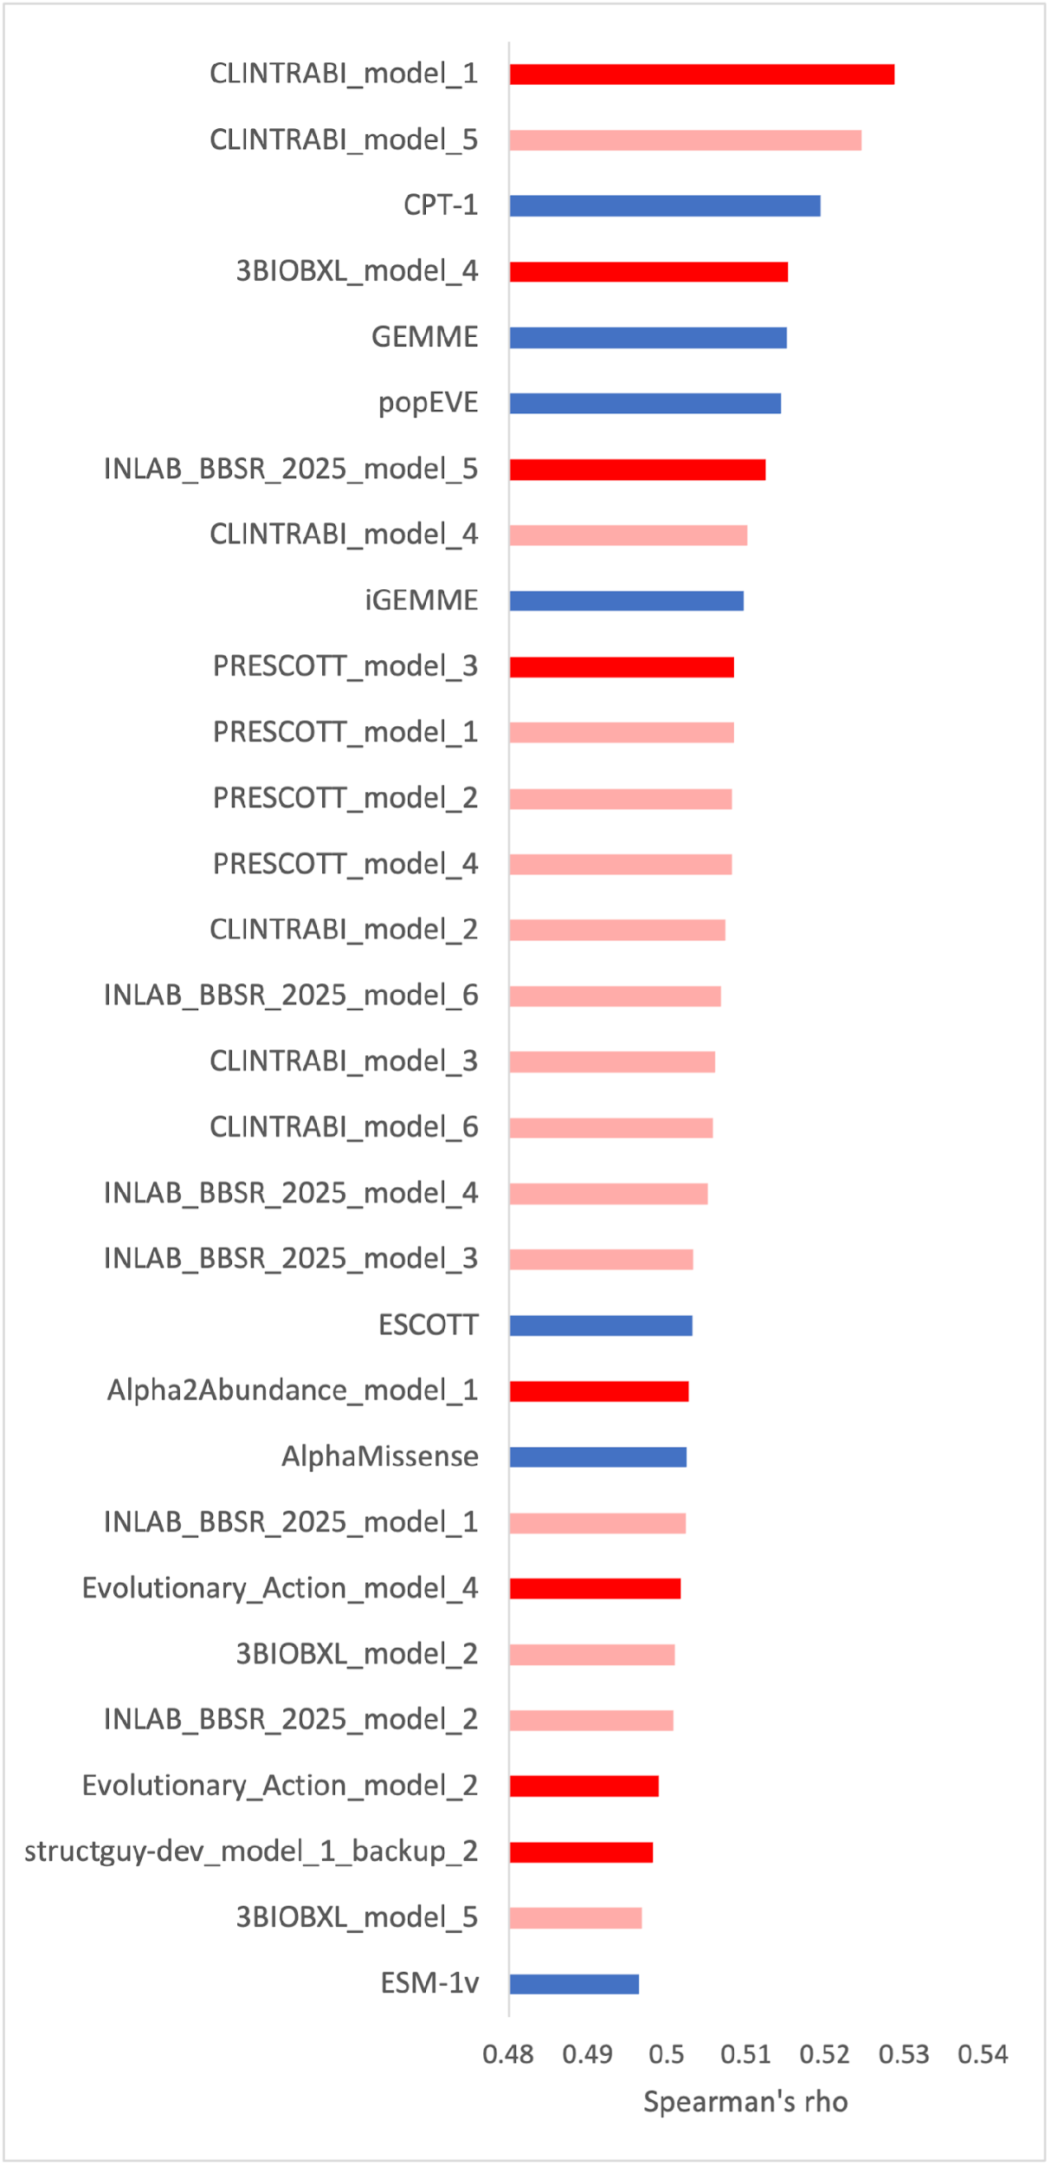
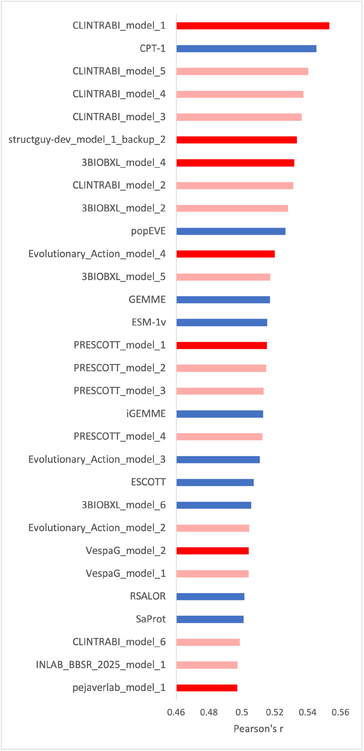
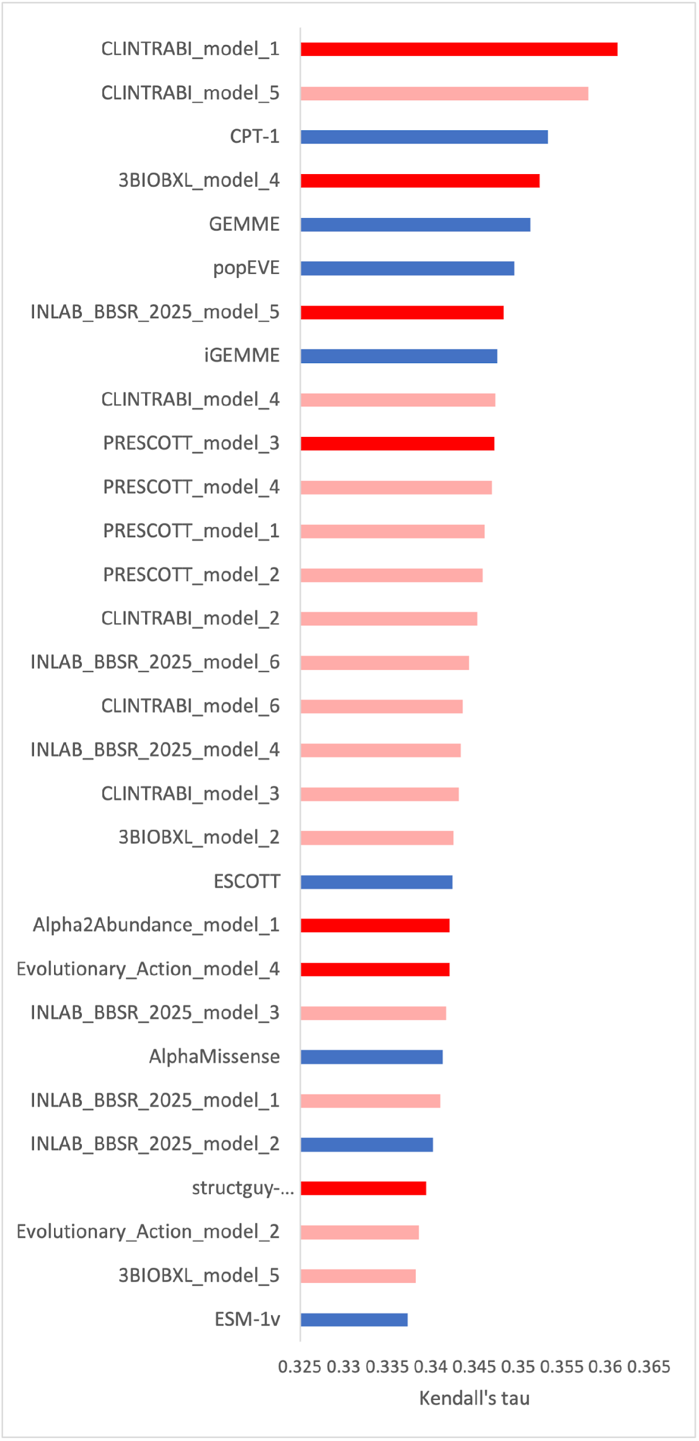
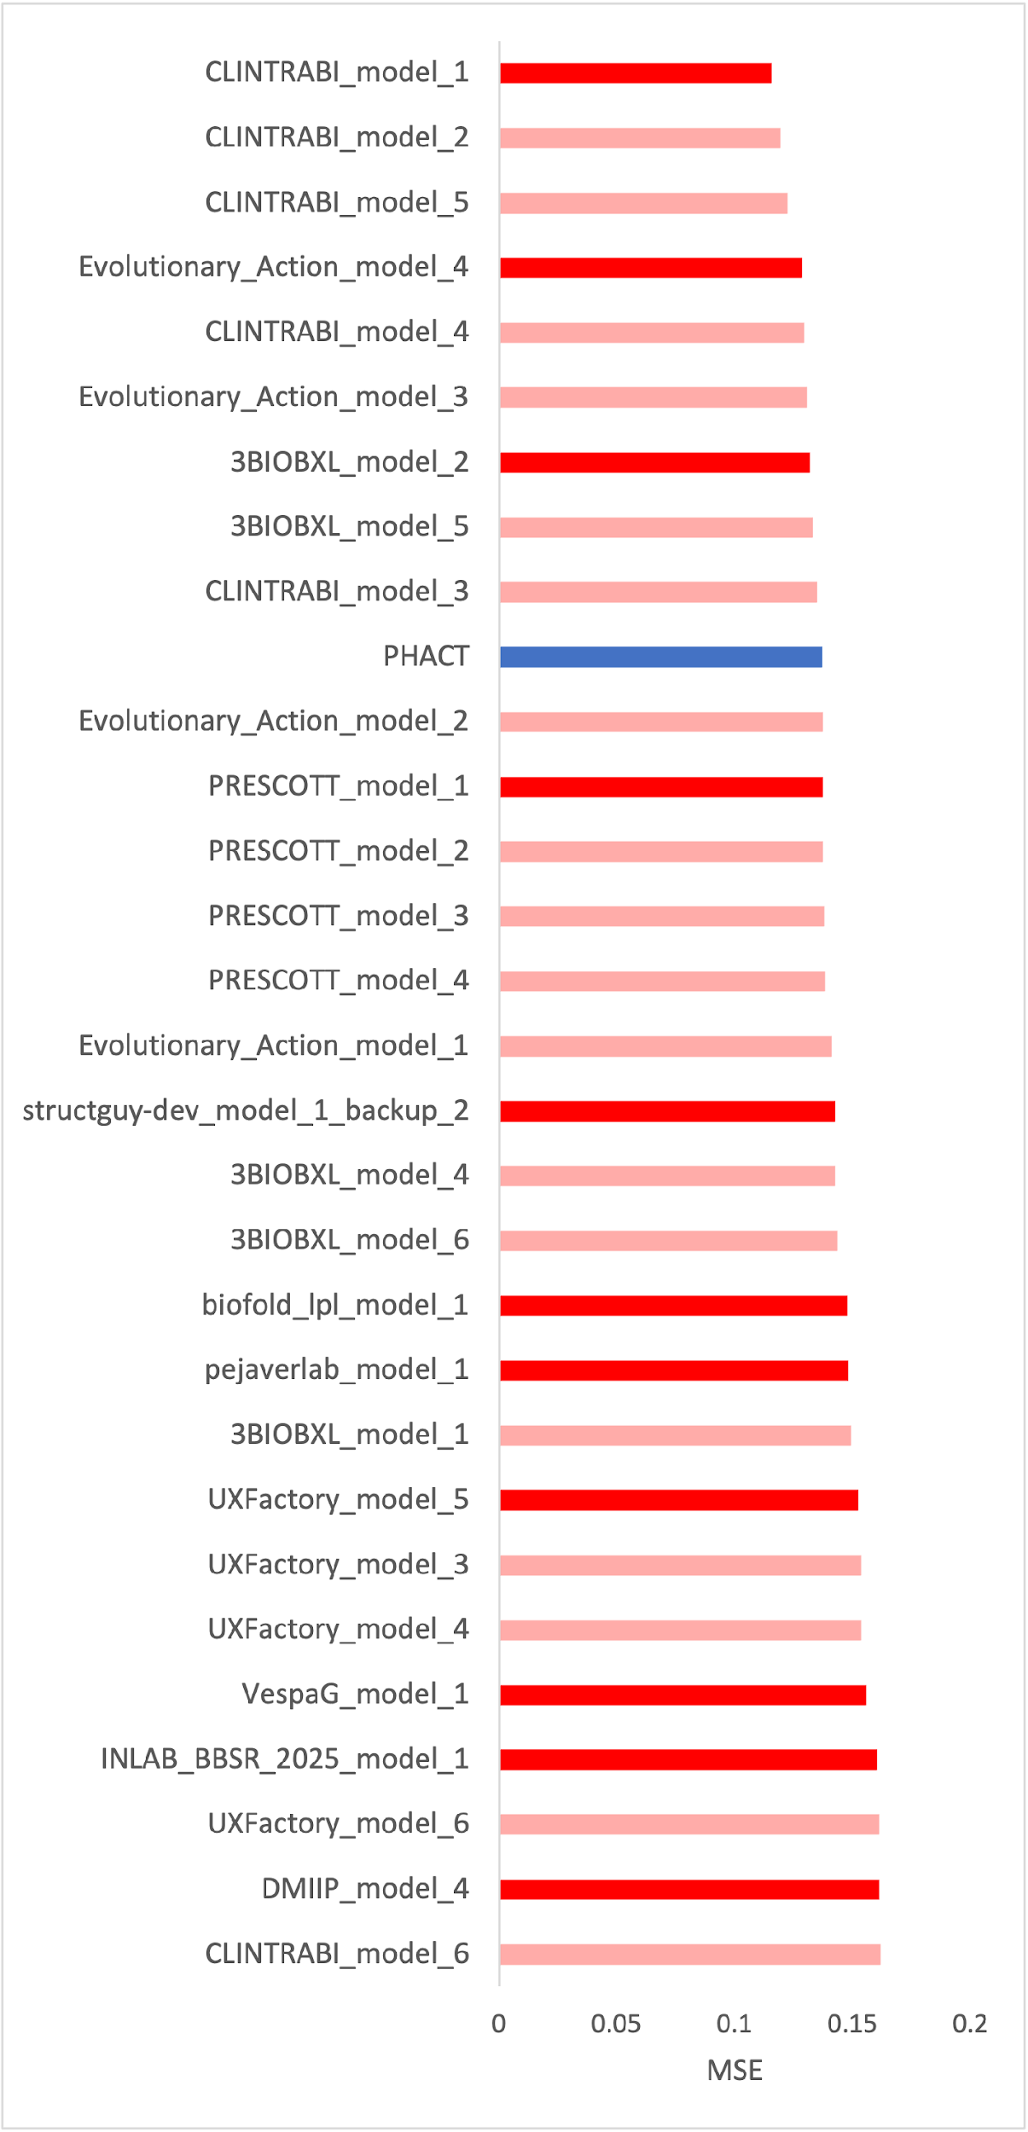
Top-ranking 30 models
Created for CAGI 7
genomeinterpretation.org
Joe Marsh

Slide 9
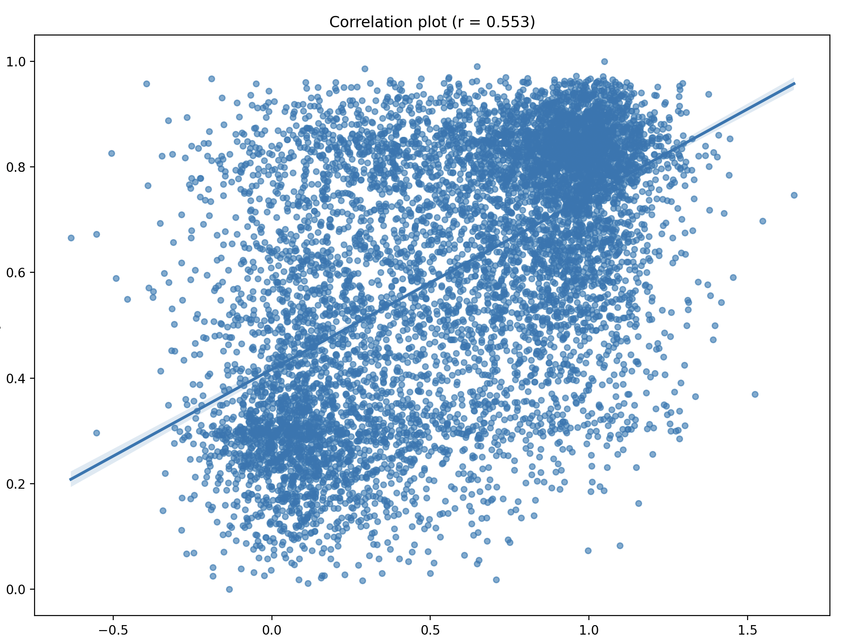
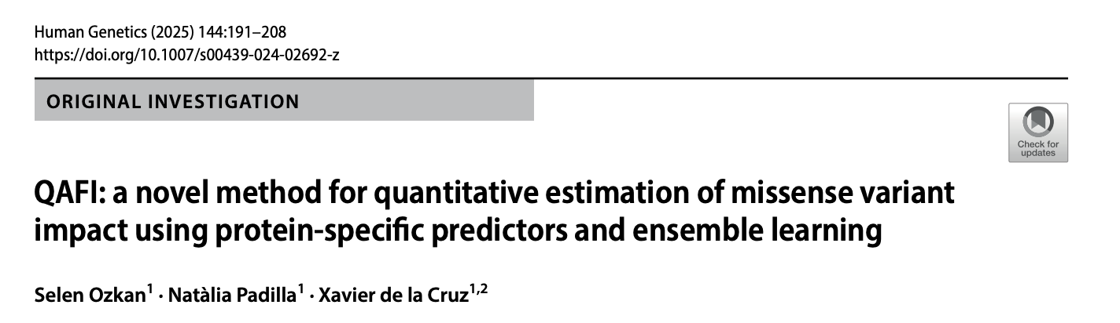
Top model: CLINTRABI_1
CLINTRABI_1 = QAFIMeta 2.0 v3
  QuAntitative estimation of the Functional Impact (QAFI)
  Combines own MAVE-trained QAFI with several rescaled SOTA models (REVEL, BayesDel, popEVE, AlphaMissense, CPT-1)
CLINTRABI_6 is the model not trained on MAVE data, and it does the worst (17th ρ)
CLINTRABI_1
MAVE
Created for CAGI 7
genomeinterpretation.org
Joe Marsh

Slide 10
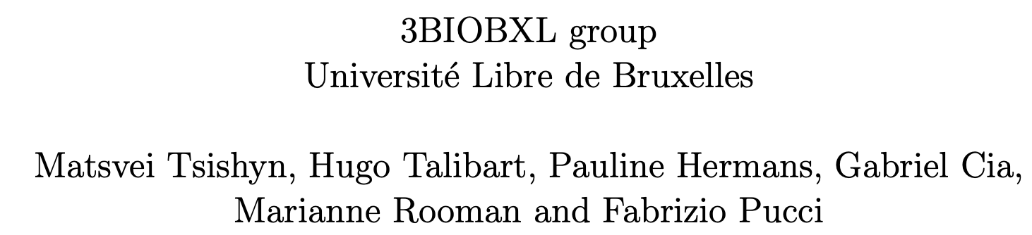
Other notable models
3BIOBXL_4 (4th ρ, 7th r)
  Meta-predictor composed of a linear combination of SaProt (ranked 39th ρ), StructureDCA (a direct couplings analysis method), relative solvent accessibility (RSA) and statistical potentials from PoPMuSiC, and trained on Roth-lab MAVE datasets
  3BIOBXL_3: same approach but trained on Fowler-lab MAVE datasets, ranks much lower (40th ρ, 32nd r)
Created for CAGI 7
genomeinterpretation.org
Joe Marsh

Slide 11
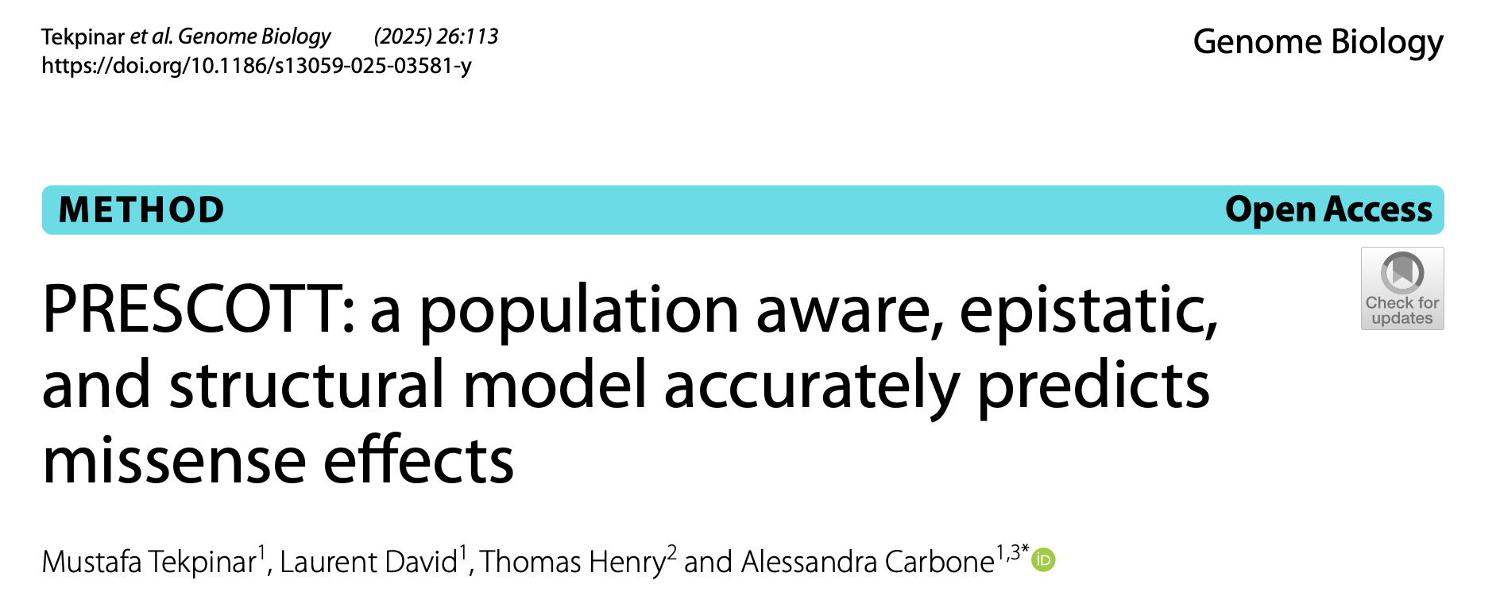
Other notable models
INLAB_BBSR_5 (7th ρ, 33rd r)
  multi-layer perceptron with 4 layers trained on pathogenic + benign variants from hydrolase-family proteins (inc. LPL). Uses a combination of embeddings from ESM2 (ranked 33rd) along with further added structural context to make predictions.
PRESCOTT_3 (10th ρ, 17th r)
  iGEMME, modified GEMME (ranked 5th ρ), is purely sequence alignment-based
  Outperforms other PRESCOTT models that include structural information and/or population variants
Created for CAGI 7
genomeinterpretation.org
Joe Marsh

Slide 12

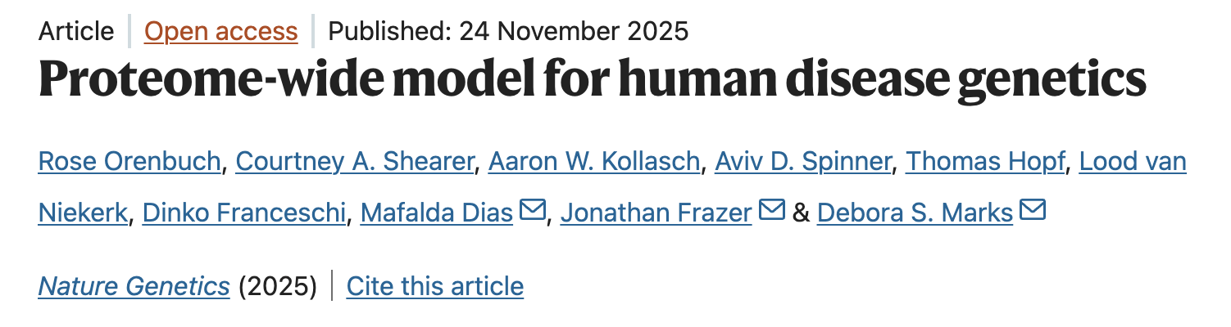
Models from outside the competition
CPT-1 (3rd ρ, 2nd r)
  Cross-protein transfer model trained on 5 MAVE datasets, plus EVE, ESM-1v, structural descriptors, vertebrate-focused alignments
popEVE(6th ρ, 10th r)
  Combines EVE and ESM-1v, with gene-level scaling based on human population variants
Created for CAGI 7
genomeinterpretation.org
Joe Marsh

Slide 13
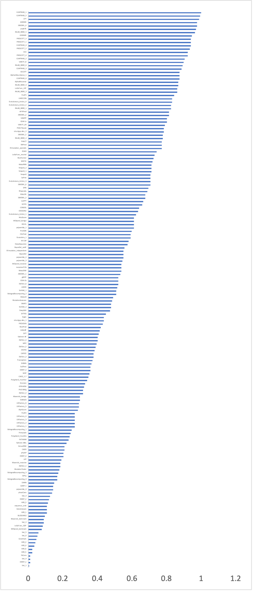
Pairwise competition allows us to include more models with incomplete coverage
EVE
VARITY_R
70 further models with ‘incomplete’ coverage
  Mostly SNVs only
  Mostly clinical-trained pathogenicity predictors
Only two ‘new’ models in the top 25:
  EVE 13th
  VARITY_R 16th
Created for CAGI 7
genomeinterpretation.org
Joe Marsh

Slide 14
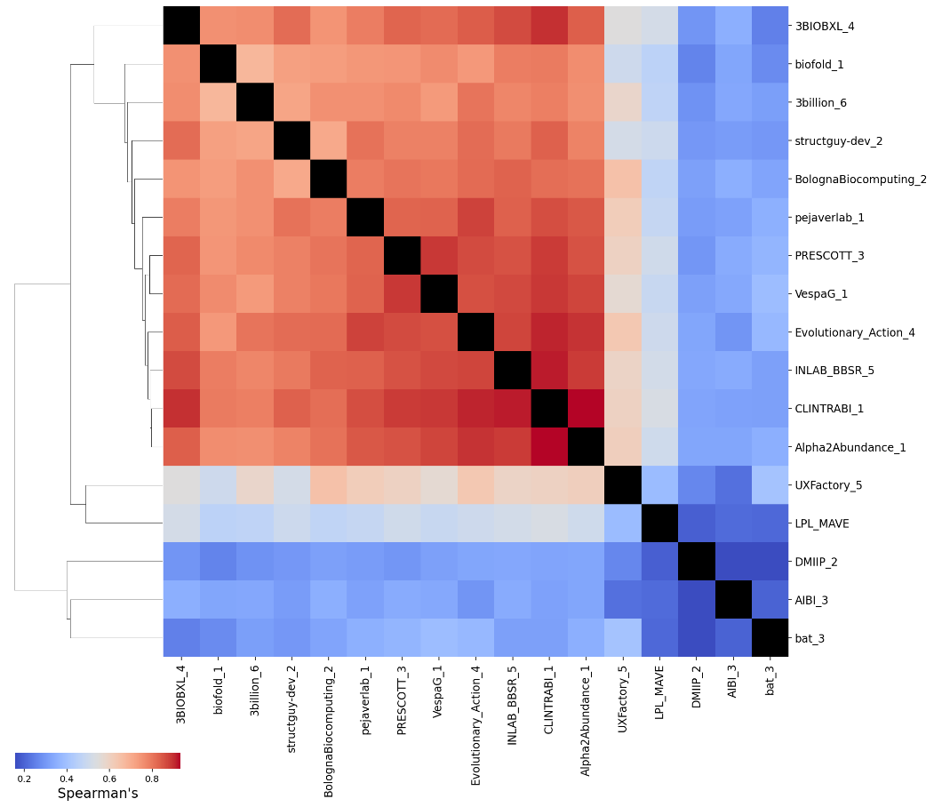
Top models are highly correlated with each other
Created for CAGI 7
genomeinterpretation.org
Joe Marsh

Slide 15
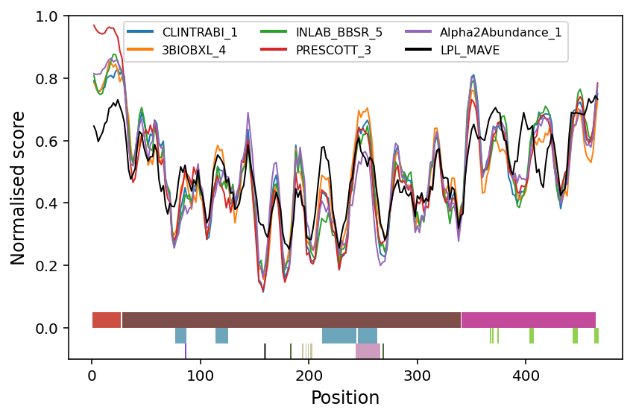
MAVE vs predictor (dis)agreement
Antibody binding
GPIHBP1 interface
Hydrolase domain
PLAT domain
APO C-II interface
Catalytic triad
Created for CAGI 7
genomeinterpretation.org
Joe Marsh
Notes:
Another thing you can see from this is that residue average level correlations are pretty good tho, pick up residue level effects pretty good, but not specific variation. How much is experimental noise, how much different problem

Slide 16
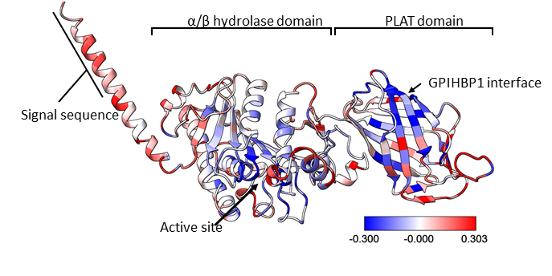
Structural context of disagreements
Antibody binding
VEP damaging
MAVE damaging
Created for CAGI 7
genomeinterpretation.org
Joe Marsh

Slide 17
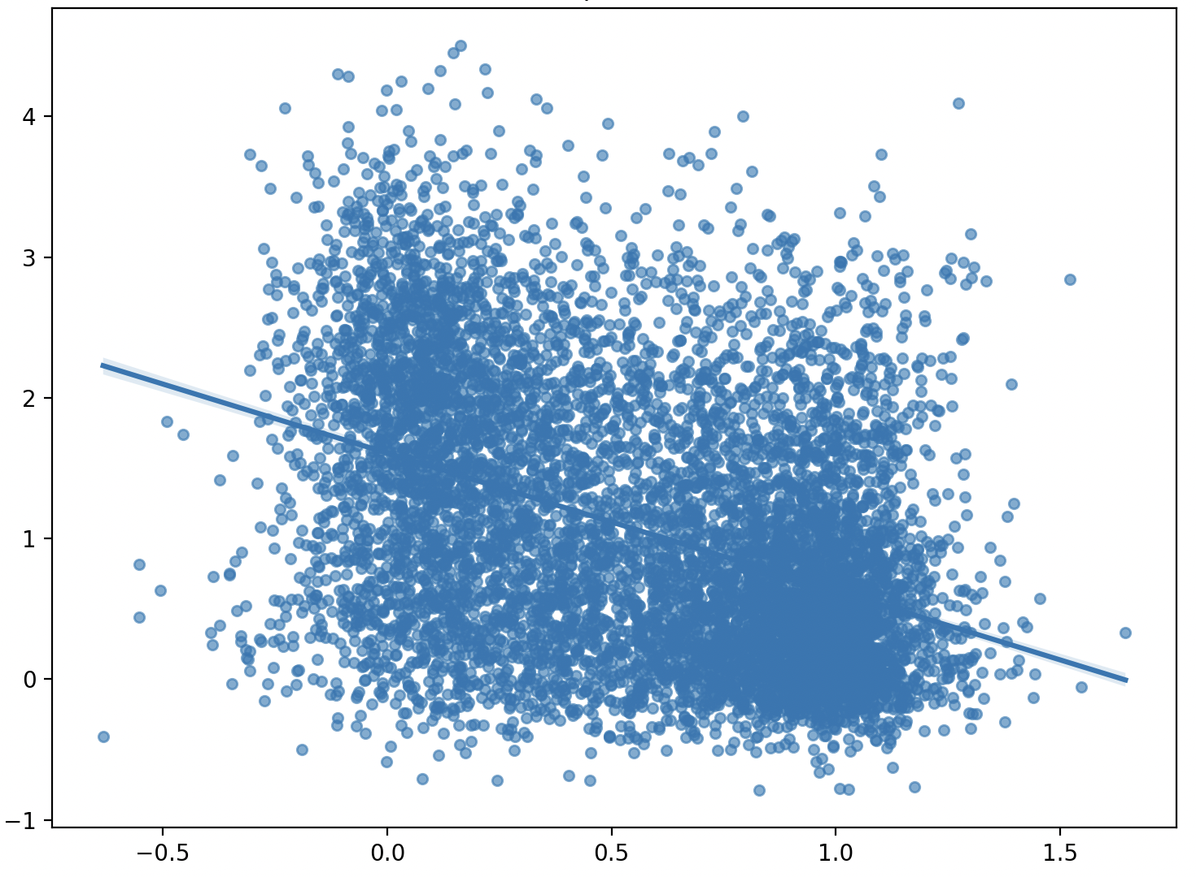
Performance of stability predictors
ρ = 0.409
ThermoMPNN ranks 61st in Spearman (0.409), FoldX 66th (0.396), using AF2 model
Using experimental crystal structures is actually a little worse (full complex or monomer) in ranked competition
Slightly lower correlations with FoldX than typically observed for other abundance MAVE datasets (Gerasimavicius et al, Prot Sci 2023)
ThermoMPNN ΔΔG (kcal/mol)
MAVE
Created for CAGI 7
genomeinterpretation.org
Joe Marsh

Slide 18
What have we learned?
There are common features of most top models
  Meta-predictors
  Trained using MAVE data
  ‘Functional’ rather than pathogenicity predictors
  Predictors submitted for this challenge are in general performed better than other publicly available models
But, the best purely sequence-alignment based methods (GEMME/iGEMME) do really well
All top predictors are over-predicting functional important sites not related to the assay due to conservation
  but stability predictors are still worse
Created for CAGI 7
genomeinterpretation.org
Joe Marsh

Slide 19
What would an ideal predictor look like?
Evolution is necessary but not sufficient
  Evolution encodes many relevant constraints related to folding, secretion, dimerization, etc.
  But also reflects things that are invisible to this assay, like catalytic activity and binding
What the predictor really needs to learn
  Extract only the evolutionary and structural signal relevant to ER folding, secretion, surface delivery, and antibody detection
  In other words, predict “reaches the surface and is recognised”, not “general functional importance”
This is probably much much harder than predicting pathogenicity! No ’generic’ model is ever going to be able to do it
Created for CAGI 7
genomeinterpretation.org
Joe Marsh

Slide 20
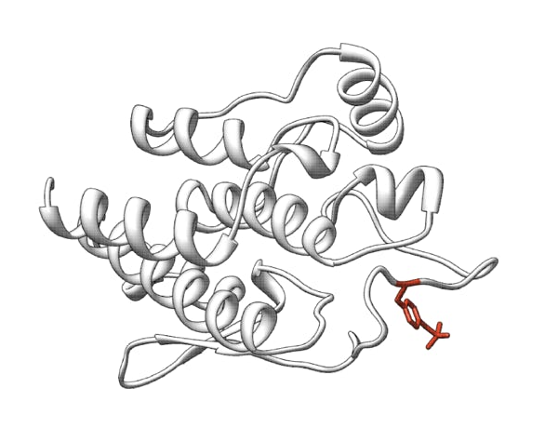
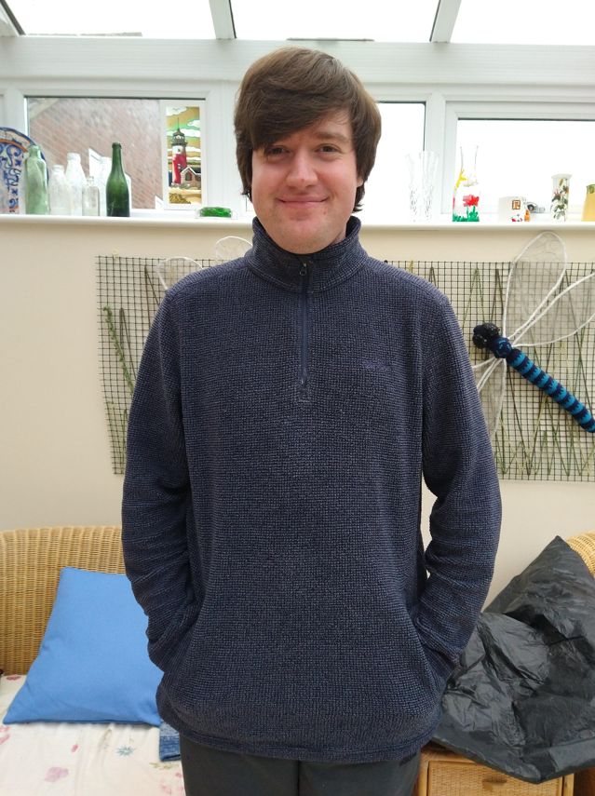

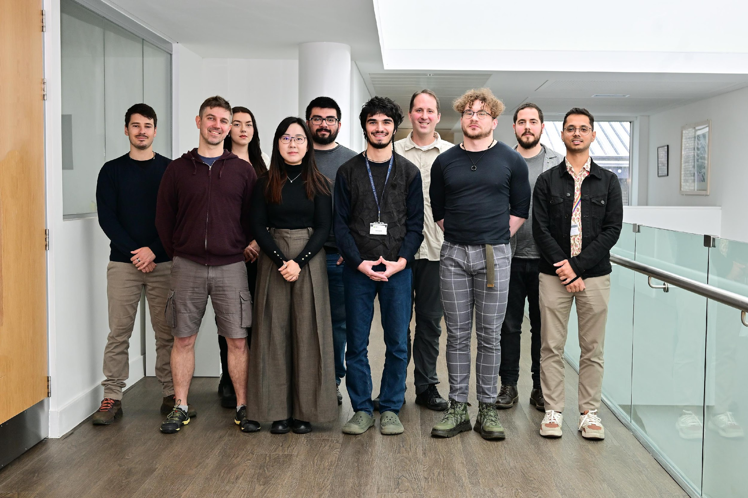
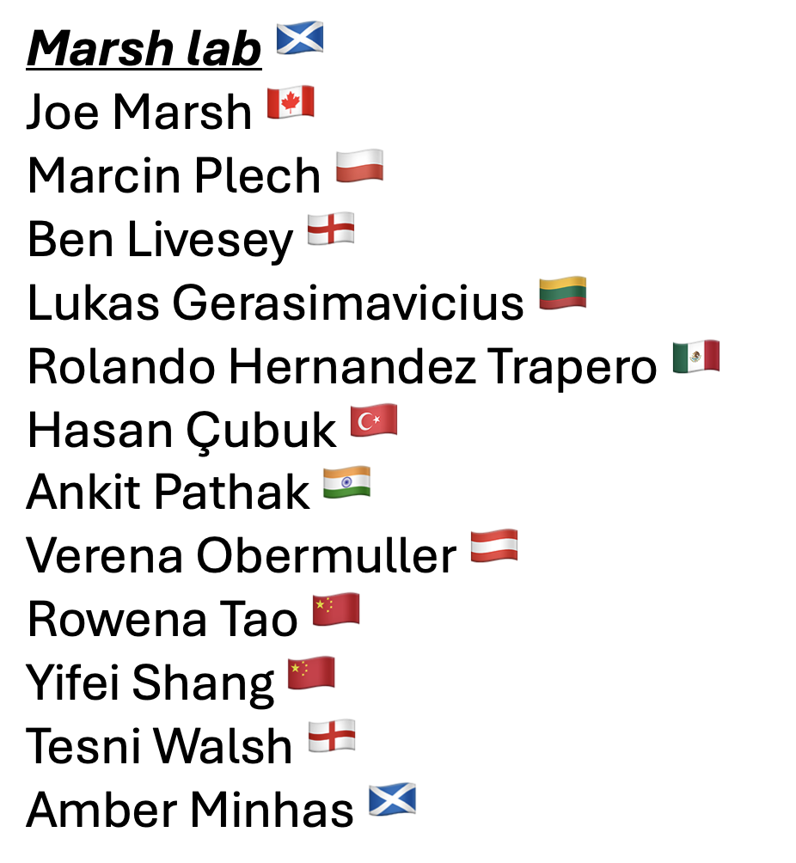
Acknowledgments
CAGI 7
Fritz Roth and Daniel Tabet
All the entrants
Ben Livesey
Created for CAGI 7
genomeinterpretation.org
Joe Marsh

