Slide 1
CAGI 7 slide pack guidelines
I agree to my slides being used according to the following terms:
_______Daniel Tabet_______
Authors: please include THIS slide at the beginning of your presentation to indicate that you agree with reuse of your slides in CAGI presentations, according to the terms below, and digitally sign by writing your name above.
At CAGI 7, use of this slide pack is only required for CAGI dataset providers, assessors, and predictors, but all are encouraged to use the annotations for materials they do not want shared publicly.
To disseminate the CAGI results, I encourage all CAGI participants to remix these CAGI slides for inclusion in their oral and poster presentations
CAGI participants may use or publish any content of these slides only in compliance with the CAGI Data Use Agreement
CAGI participants may not cite or publish any content of these slides except with the written permission of the originating author or in the primary CAGI publications
CAGI participants must acknowledge the original authors of these slides and CAGI 7. Include the acknowledgement banner across the bottom
CAGI participants must include the CAGI credits slide in their presentations
Slides with a red slash (no remix) may not be included in a presentation unless all attendees are registered CAGI participants who signed the data use agreement
Slides with a red X over the entire slide may not be used in any circumstances
Slides with a blue slash (embargoed) may not be used unless the embargo is explicitly lifted
Slides without slash or X may be tweeted, tooted, posted, X’d unless flagged with “No tweet” icon
CAGI participants using these slides must explain the “No tweet” icon, which means that the slide content should not be disseminated outside the presenting conference hall. If the presentation venue permits pervasive tweeting, you may not include these slides in your talk
Note for slide authors: we expect all CAGI participants to abide by these restrictions, and will make best effort to ensure they are followed. However, but bear in mind that we have limited means of enforcing them, and therefore the restrictions cannot be guaranteed.

Slide 2



Measuring Lipoprotein Lipase (LPL) missense variants effects at scale
Daniel R Tabet
with Frederick P Roth

Slide 3
Outline
Lipoprotein Lipase (LPL) as a disease gene
A sequence–function study of Lipoprotein Lipase (LPL)
  Experimental overview
  Sequence-structure-function insights into LPL
  Potential for variant (re)classification
Created for CAGI 7; genomeinterpretation.org

Slide 4
Outline
Lipoprotein Lipase (LPL) as a disease gene
A sequence–function study of Lipoprotein Lipase (LPL)
  Experimental overview
  Sequence-structure-function insights into LPL
  Potential for variant (re)classification
Created for CAGI 7; genomeinterpretation.org

Slide 5
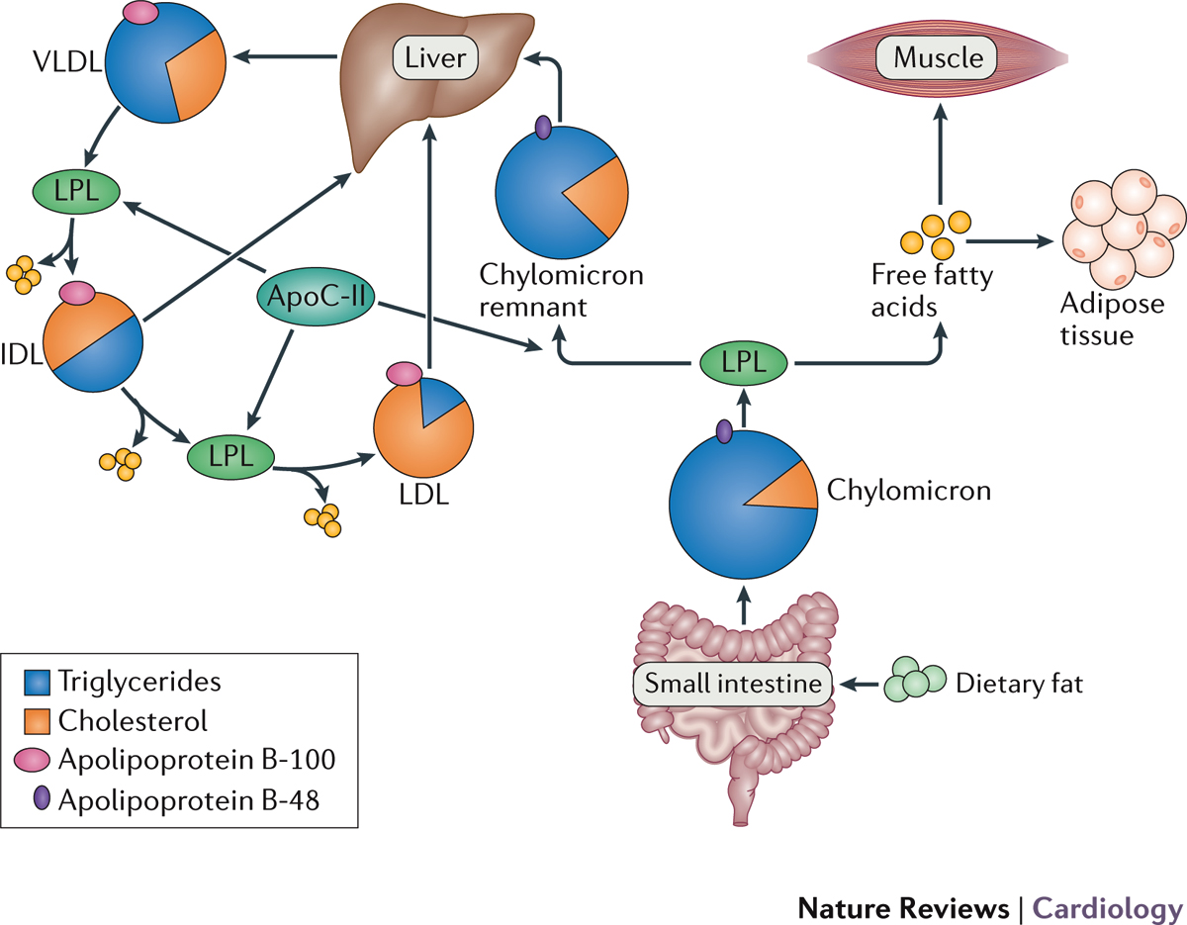
Hydrolysis of triglycerides is important for lipoprotein maturation
Reiner, Z. (2017)
Notes:
As a means of moving lipids through our bloodstream, our bodies produce these large lipoproteins.
Start off as triglyceride-rich, and are processed by LPL releasing triglycerides as free fatty acids.
This provides free fatty acids for surrounding tissue to be used as energy either used or stored, and through this lipoproteins mature and gradually shrink.
___
Metabolism of triglycerides. | Chylomicrons are formed in the small intestine from dietary fat, and contain triglycerides and apolipoprotein B-48. Chylomicrons enter the circulation, where they are hydrolysed by lipoprotein lipase (LPL), which is activated by apolipoprotein C-II (apoC-II). Free fatty acids, which are produced by hydrolysis of triglycerides, are either used in muscle cells as a source of energy or resynthesized into triglycerides and stored in adipose cells. Chylomicron remnant particles, also rich in triglycerides, are removed from the circulation in the liver. Triglycerides are also synthesized in liver cells and, together with apolipoprotein B-100, form very low-density lipoprotein (VLDL) particles, which are secreted in blood. VLDL particles are also hydrolysed by LPL, and are transformed into intermediate-density lipoprotein (IDL) particles. IDL particles are either catabolized in the liver or transformed into low-density lipoprotein (LDL) particles by LPL.

Slide 6
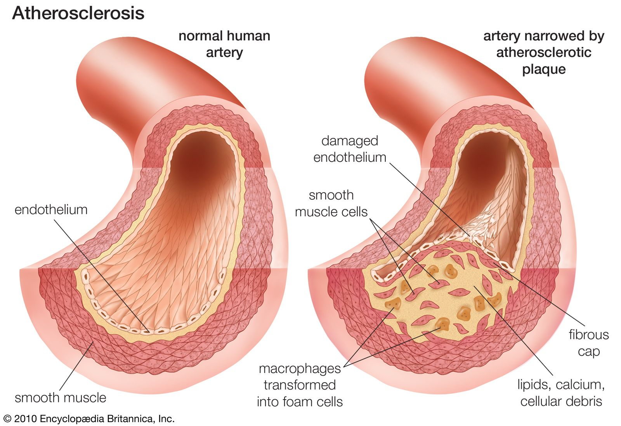
Dysfunction in LPL causes hypertriglyceridemia
Het. LoF predisposes to CAD
Homo. LoF causes hyperchylomicronemia
—
Lipoproteins in artery walls → plaque formation
(i.e., atherosclerosis)
—
~ 70% of ClinVar missense variants are VUS
“Atherosclerosis”. Encyclopaedia Britannica. (2024)
Created for CAGI 7; genomeinterpretation.org
Notes:
Disruption of LPL causes hypertriglyceridemia, but interestingly, disease takes on two forms here depending on your genotype.

Slide 7
Outline
Lipoprotein Lipase (LPL) as a disease gene
A sequence–function study of Lipoprotein Lipase (LPL)
  Experimental overview
  Sequence-structure-function insights into LPL
  Potential for variant (re)classification
Created for CAGI 7; genomeinterpretation.org

Slide 8
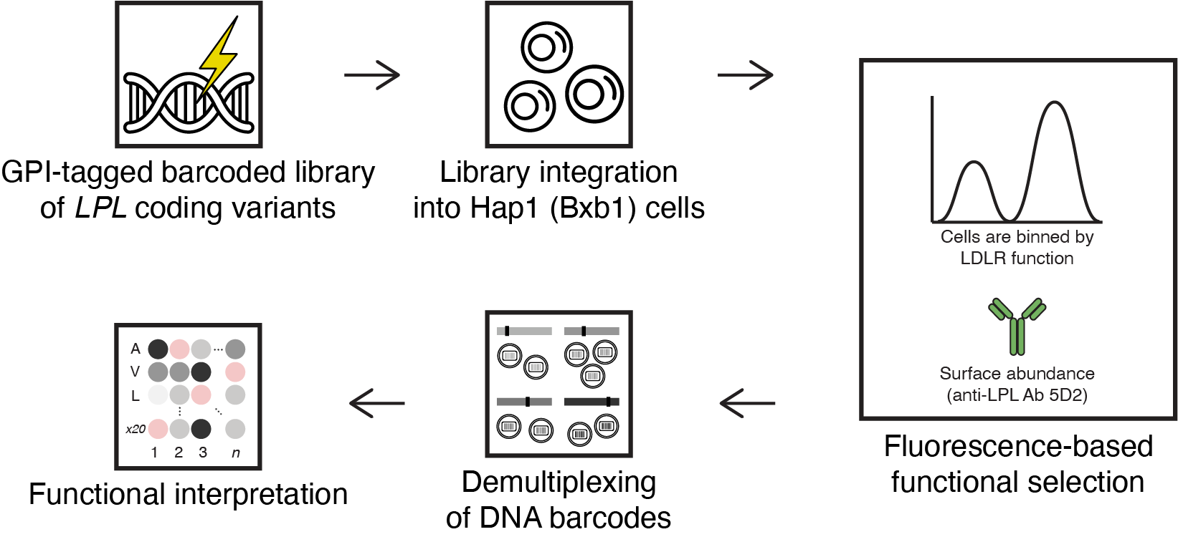
Measuring the effects of
LPL missense variants at scale
Cells are binned by
LPL abundance
Surface abundance
(anti-LPL Ab 5D2)

Slide 9
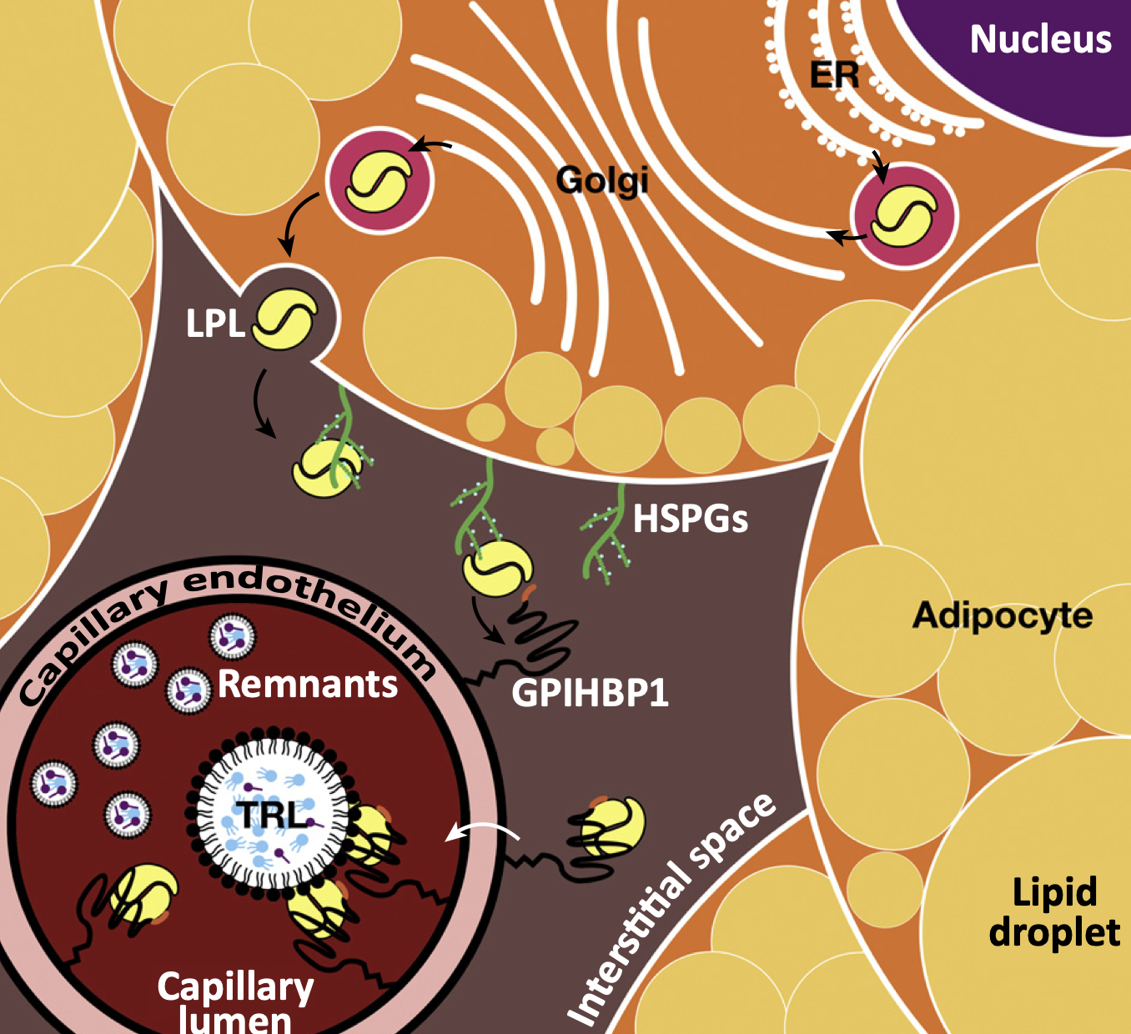
LPL is secreted and remains membrane bound only through interactions with other partners
Synthesized in the parenchyma
and trafficked to the capillary lumen
—
No transmembrane domain
—
Interacts with HSPGs & GPIHBP1
on the cell surface
Reiner Z. Nat Rev Cardiol. (2017)
Created for CAGI 7; genomeinterpretation.org

Slide 10
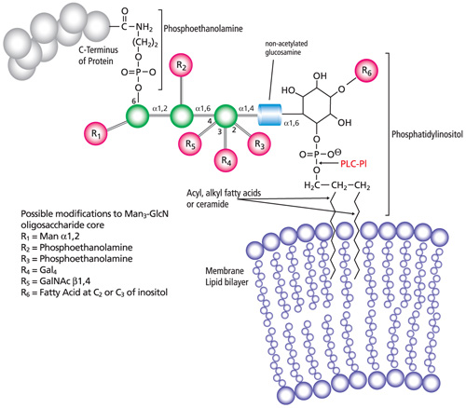
Addition of a C-terminal GPI anchor tethers LPL to the cell surface
Lipid anchors used by many
cell-surface proteins
—
Added as a covalent
post-translational modification
Created for CAGI 7; genomeinterpretation.org
Notes:
Amide bonded to the C-terminus
**signals addition of GPI anchor

Slide 11
Measuring the effects of
LPL missense variants at scale
Cells are binned by
LPL abundance
Surface abundance
(anti-LPL Ab 5D2)
Adapted from Tabet D., …, Roth FP., Claussnitzer M. Annu Rev Genet. (2022).

Slide 12
A complete sequence-function map of LPL based on surface abundance

Slide 13
A complete sequence-function map of LPL based on surface abundance
Amino acid substitution
Amino acid position
Created for CAGI 7; genomeinterpretation.org
Notes:
Much data, can we make sense of this in the context of the structure of LPL.

Slide 14
Outline
Lipoprotein Lipase (LPL) as a disease gene
A sequence–function study of Lipoprotein Lipase (LPL)
  Experimental overview
  Sequence-structure-function insights into LPL
  Potential for variant (re)classification
Created for CAGI 7; genomeinterpretation.org

Slide 15
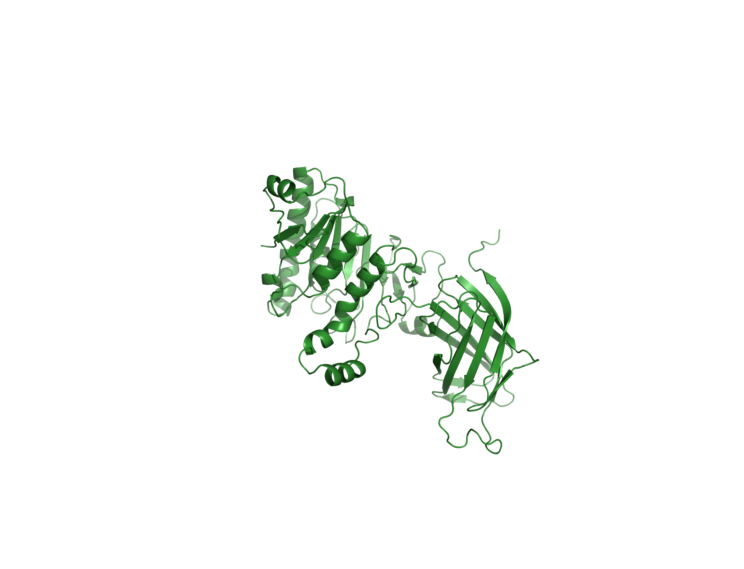
The (AlphaFold) structure of LPL
Triglyceride hydrolysis
& regulation
—
Stability &
trafficking
—
N-terminal ɑ/β-hydrolase domain
C-terminal β-barrel domain
Created for CAGI 7; genomeinterpretation.org

Slide 16
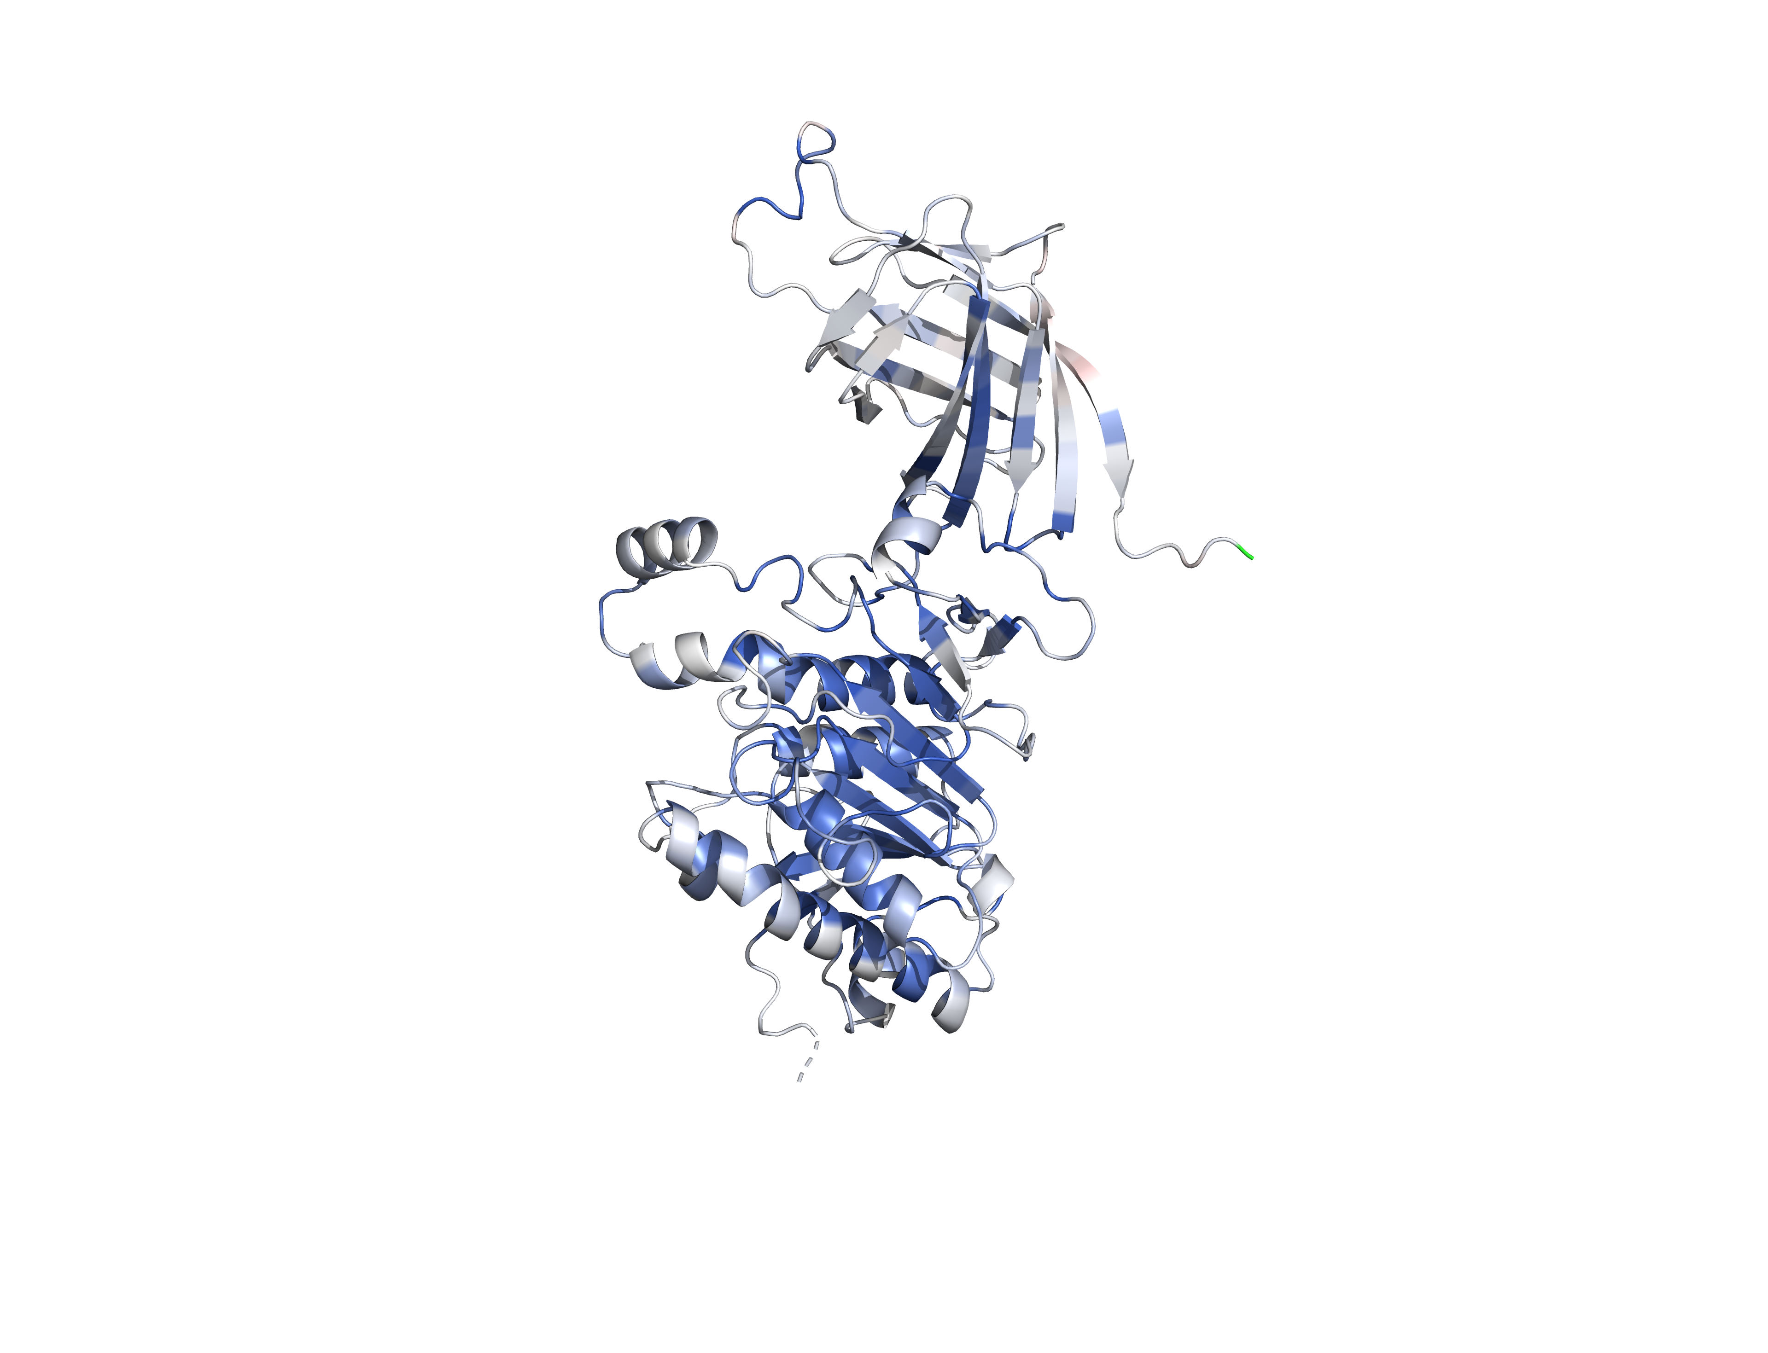
The ɑ/β-hydrolase (catalytic) domain is highly unstable and shows a broad intolerance to substitution
N-terminal ɑ/β-hydrolase domain
C-terminal β-barrel domain
Created for CAGI 7; genomeinterpretation.org
Notes:
The overwhelming majority of the N-terminal domain is intolerant to substitution—largely because LPL is so unstable.
_____
LPL crystal structure solved as a head-to-tail homodimer bound to partial GPIHBP1—dimer aspect makes it a little annoying so showing AF instead
N-terminus: holds the catalytic triad and a lid segment which controls substrate accessibility
C-terminus: Flattened b-barrel, or b-sandwich made up of two four-strand b-sheets, common to membrane or lipid associated proteins
Also has a W-rich loop important for lipid and lipoprotein binding

Slide 17
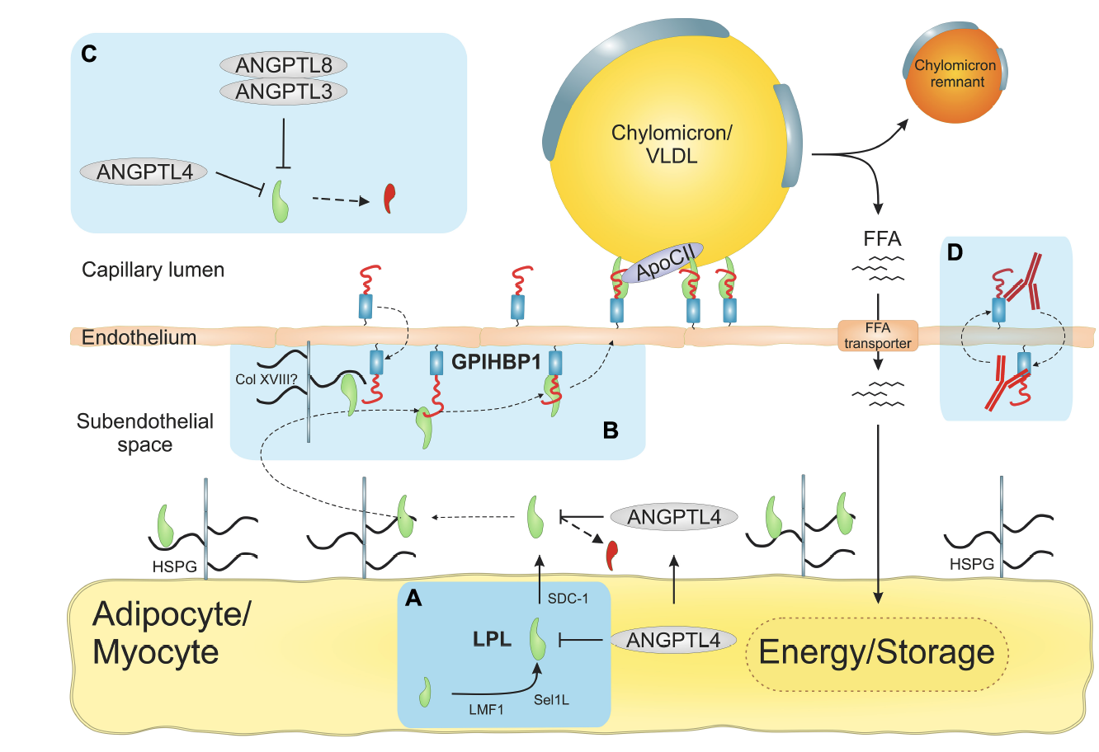
LPL interacts with multiple proteins that are critical to stabilizing its N-terminal domain
LPL is highly unstable
and must always be ‘chaperoned’
—
This instability is the central mechanism
by which LPL levels are regulated
Kristensen et al. Cell Dev Bio. (2021)
Notes:
LPL is effectively always on the edge of unfolding (Tm of 34.8C)…
This instability plays a big part in how LPL is regulated: there are all these chaperones, and activators, and inhibitors that are part of the biology of LPL, and a major part of what these are doing is acting through either stabilizing or destabilizing the protein…
_____
LPL is initially chaperoned by LMF1 and Sel1-L in the ER—ensures proper folding (S-S) and secretion
LoF in LMF1 (lipase maturation factor 1) → hypertriglyceridemia
Sel1L is an adaptor protein for an E3 ligase in the ER-associated degradation pathway. In Sel1L deficiency, LPL is trapped in the ER in unfolded aggregates and degraded by autophagy
LPL is processed in the Golgi before exiting via the secretory pathway where it interacts with SCD-1 (a HSPG)—obligate sorting receptor for LPL
Binding to SDC1 stabilizes the protein and limits flexibility between the two domains
Negative charges on heparan sulfates bind positively charged heparan binding motif in LPL
Once it interacts with SDC1 it enters the sphingomyelin-enriched vesicular sorting pathway for secretion
Interesting! W-rich loop in LPL is needed for secretion, probably interacts with secretory vesicle membrane
Newly synthesized LPL remains attached to the cell surface on HSPGs
Without GPIHBP1 it accumulates in the sub-endothelial space bound to HSPGs in the abluminal surface of the capillary endothelium
LPL is flowing against the flow of capillary fluid extrusion (cool!), probably diffusing across a charge gradient based on either density or degree of sulfation of HSPGs in the sub-endothelial space
Probably ends up on collagen XVIII (most prominent HSPG on the basement membrane
Cool that a common phenotype of collage XVIII deficiency (Knobloch’s syndrome) is moderate hypertriglyceridemia and reduced plasma LPL levels
GPIHBP1 is an obligate partner of LPL (identified in 2007 by Stephen Young’s group, UCLA)
N-terminal domain of GPIHBP1 draws out LPL from collagen XVIII and then its LU domain can interact with LPL and improve stability (Tm bound to GPIHBP1 is 57C)
GPIHBP1 lacking the n-terminal domain is able to bind LPL but not able to draw it from HSPGs
GPIHBP1 is only expressed in the capillary endothelium, absent from larger vessles (GPIHBP1 and LPL expressed in same tissue, except lungs where GPIHBP1 only is expressed by not known why)
Due to its GPI anchor (probably), GPIHBP1 clusters in sphingomyelin-rich microdomains on the cell surface, facilitates TRL margination
In the capillary lumen, many LPL-GPIHBP1 complexes bind to chylomicrons (and others), have to overcome sheer stress from flow
ANGPTL4 and ANGPTL3/8 inhibit LPL by catalyzing the irreversible unfolding of its hydrolase domain
Regulation
In fasting/exercise: TRLs are directed away from storage and toward oxidative tissues—inhibit LPL in WAT
Upon refeeding: ANGPTL3/8 is upregulated in oxidative tissue which inhibits LPL, ANGPTL4 is downregulated in WAT

Slide 18
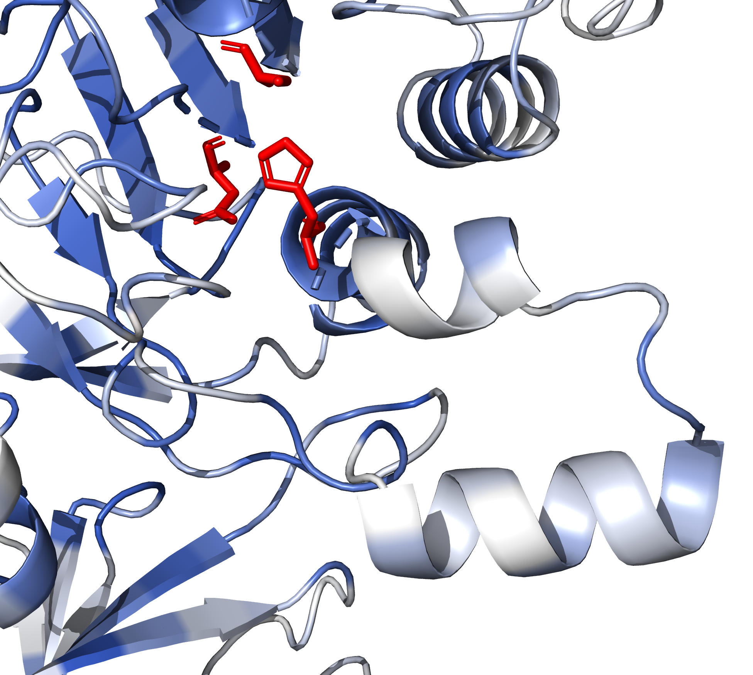
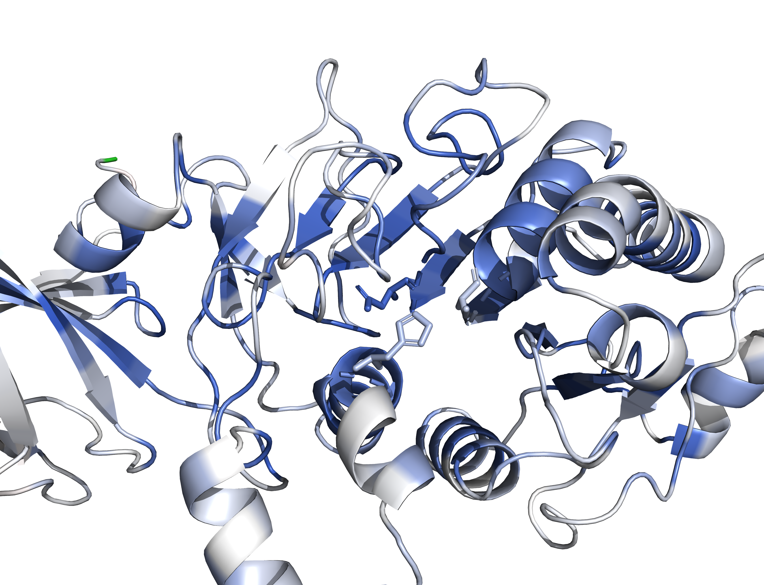
The ɑ/β-hydrolase (catalytic) domain is highly unstable and shows a broad intolerance to substitution
lid-domain
active site
Created for CAGI 7; genomeinterpretation.org
Notes:
E.g., of how this works well: if we zoom in on the active site, although our assay does nothing to measure LPL activity, we find all of these active site residues to impact stability.
We miss a couple of the residues in the catalytic triad, but that’s to be expected, and fine we know what those do anyways.
Compare this to the lid-domain, which is this flexible region that confers substrate specificity, where most residues are tolerated.
_____
Catalytic triad | An acid-base-nucleophile is the most common for generating a nucleophilic residue for covalent catalysis. It works as a charge relay system, polarizing the nucleophile, which attacks the substrate, forming an intermediate that is hydrolyzed releasing the product. In the case of LPL, the nucleophile is Ser159, the acid is Asp183 and the base is His 268. This is the same triad as in chymotrypsin. In this triad, the acid is hydrogen bonded to the base, which polarises and activates the nucleophile. First, the polarized nucleophile attacks the carbonyl carbon, forcing the carbonyl oxygen to accept an electron, forming a tetrahedral intermediate. This intermediate then collapses back to a carbonyl with the nucleophile, ejecting the other half of the substrate, which is aided by the addition of a proton by the base. In a hydrolysis reaction, the acyl-enzyme intermediate is then attacked by a water molecule, resulting in the release of the second half of the product.

Slide 19
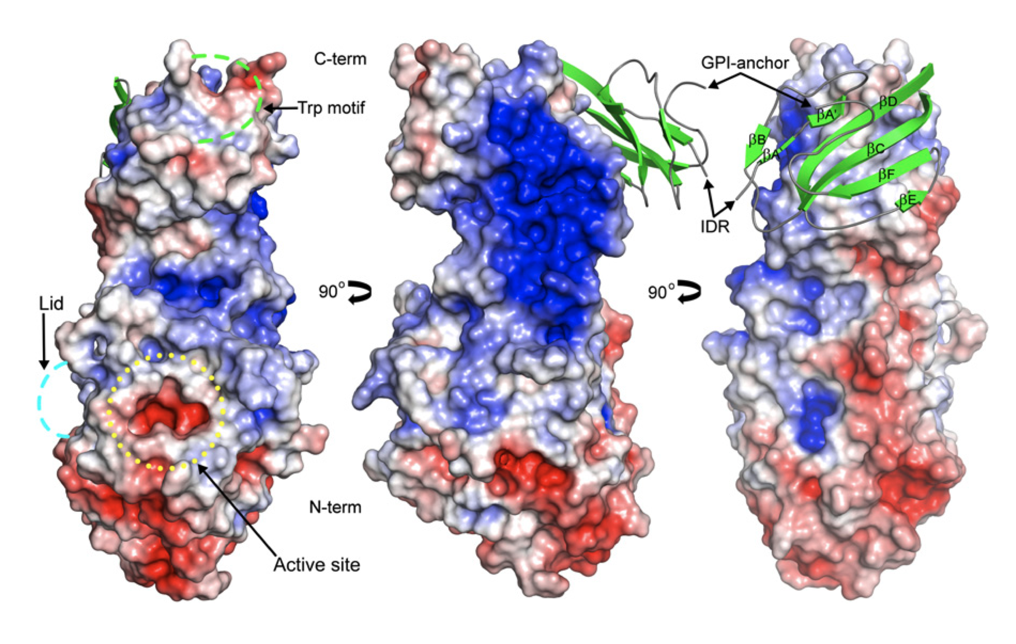
A large basic patch is critical for interaction-mediated stability & localization
*Coloured by electrostatic potential—not abundance score*
Birrane G et al. PNAS. (2018)
Created for CAGI 7; genomeinterpretation.org
Notes:
The heparin-binding motif of LPL forms a large basic patch that spans both domains, stabilizing the protein, and driving fast, transient electrostatic interactions with HSPGs (facilitate the protein moving up a gradient).
_____
Not the actual structure of LPL, inferred from PL, but largely close
The stability of monomeric LPL is quite low (largely due to the a/b hydrolase domain), its Tm is 35C
Even binding of small heparin fragments raises the Tm to 42C
Interestingly, to show that LPL is active as a monomer, prevented LPL from forming homodimers by adding antibody 5D2 (which binds the Trp-rich loop of LPL’s C-terminal PLAT domain and prevents the formation of the head-to-tail homodimers)
Two distinct interactions between LPL and GPIHBP1
A fast and transient electrostatic interaction between the disordered acid domain of GPIHBP1 and the heparin binding site of LPL
A slow and stable interaction between the LU domain and the PLAT domain of LPL
These combine to a very fast association rate and a slow dissociation rate
RIGHT: GPIHBP1 LU domain forms a concave hydrophobic surface that interacts with the hydrophobic surface of the c-terminal domain of LPL
MIDDLE: In blue is the large basic patch (~2400A²) in LPL spanning the c-terminal, hinge and n-terminal. The n-terminal of the acidic domain of GPIHBP1 would interact here (not crystalized, this is the acidic intrinsically disordered domain (IDR)) and stabilize the hydrolase domain
LEFT: On the other face of the protein, the W-rich loop would interact with lipids, lid domain and active site.
About GoF: The S474* variant terminates the protein with Lys-Lys close to the large basic patch (instead of Ser-Gly), so this could allow for a stronger electrostatic interaction with the acidic binding domain of GPIHBP1 OR with HSPGs—this one probably makes more sense since we pick it up in the cell culture model.
*Cool that apparently it is well known that intrinsic protein disorder often underlies fast association rates by increasing the capture radius for these electrostatic interactions and lack of orientation constraints

Slide 20
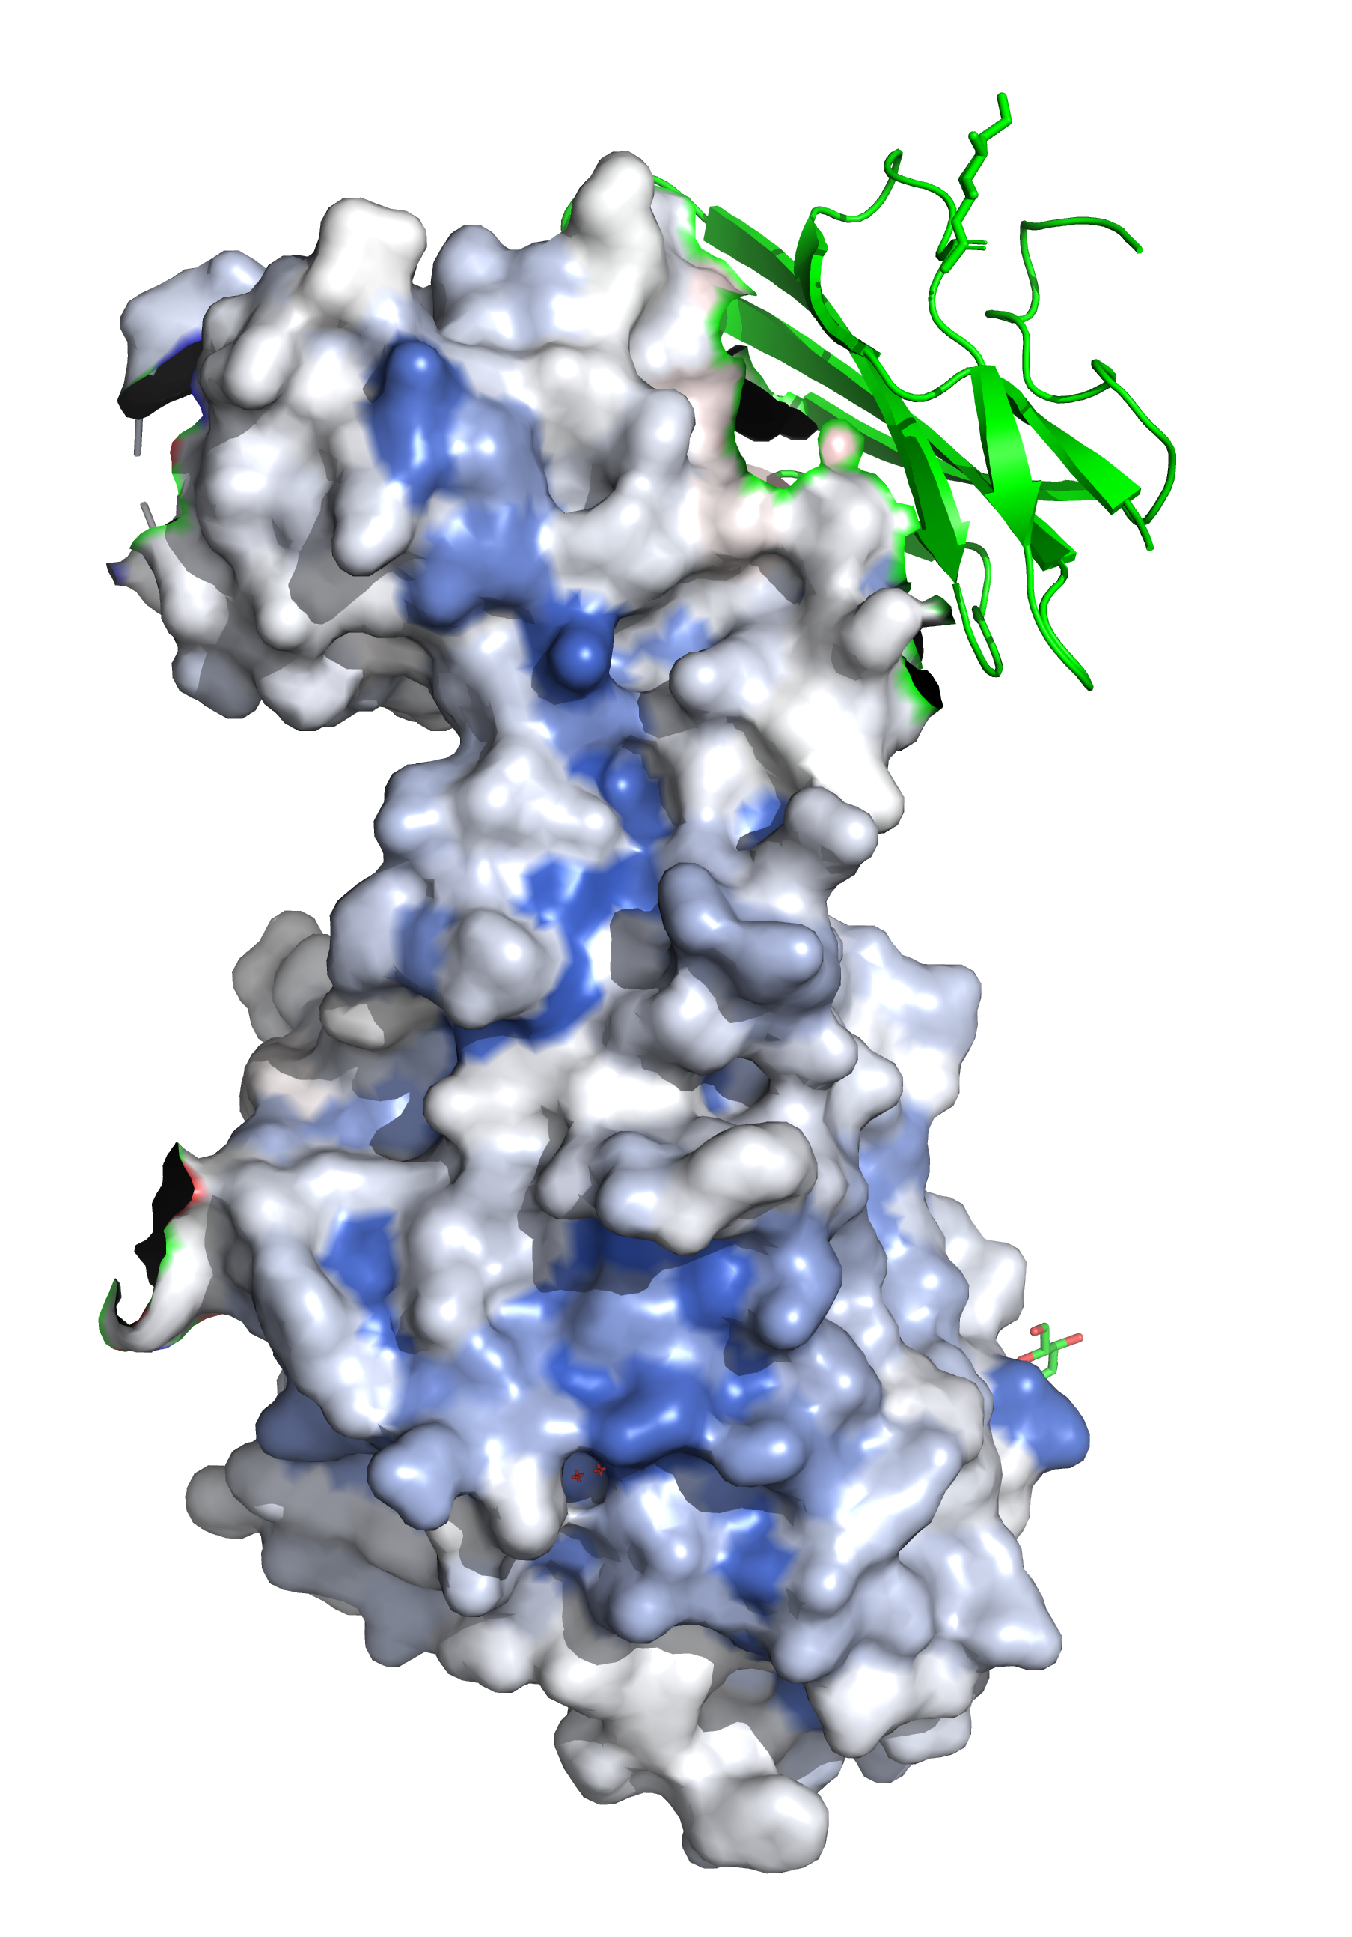
The HSPG-binding patch is important for protein stability
A large basic patch spans the
N- and C-terminal domains
—
Residues in this region do not
tolerate substitution
Notes:
Here, in the absence of HSPG binding is that LPL is not stabilized and unfolds.

Slide 21
Outline
Lipoprotein Lipase (LPL) as a disease gene
A sequence–function study of Lipoprotein Lipase (LPL)
  Experimental overview
  Sequence-structure insights into LPL
  Potential for variant (re)classification
Created for CAGI 7; genomeinterpretation.org

Slide 22
Sequence variants are interpreted based on a combination of evidence types
Population data
  (i.e., is a variant so common that it must be benign)
Segregation data
  (i.e., does a genetic variant co-segregate with disease)
Computational prediction
  (e.g., supervised machine learning models)
Functional evidence
  (i.e., experimental assessment in a model system)
Richards S., at al. Genet Med. (2015)

Slide 23
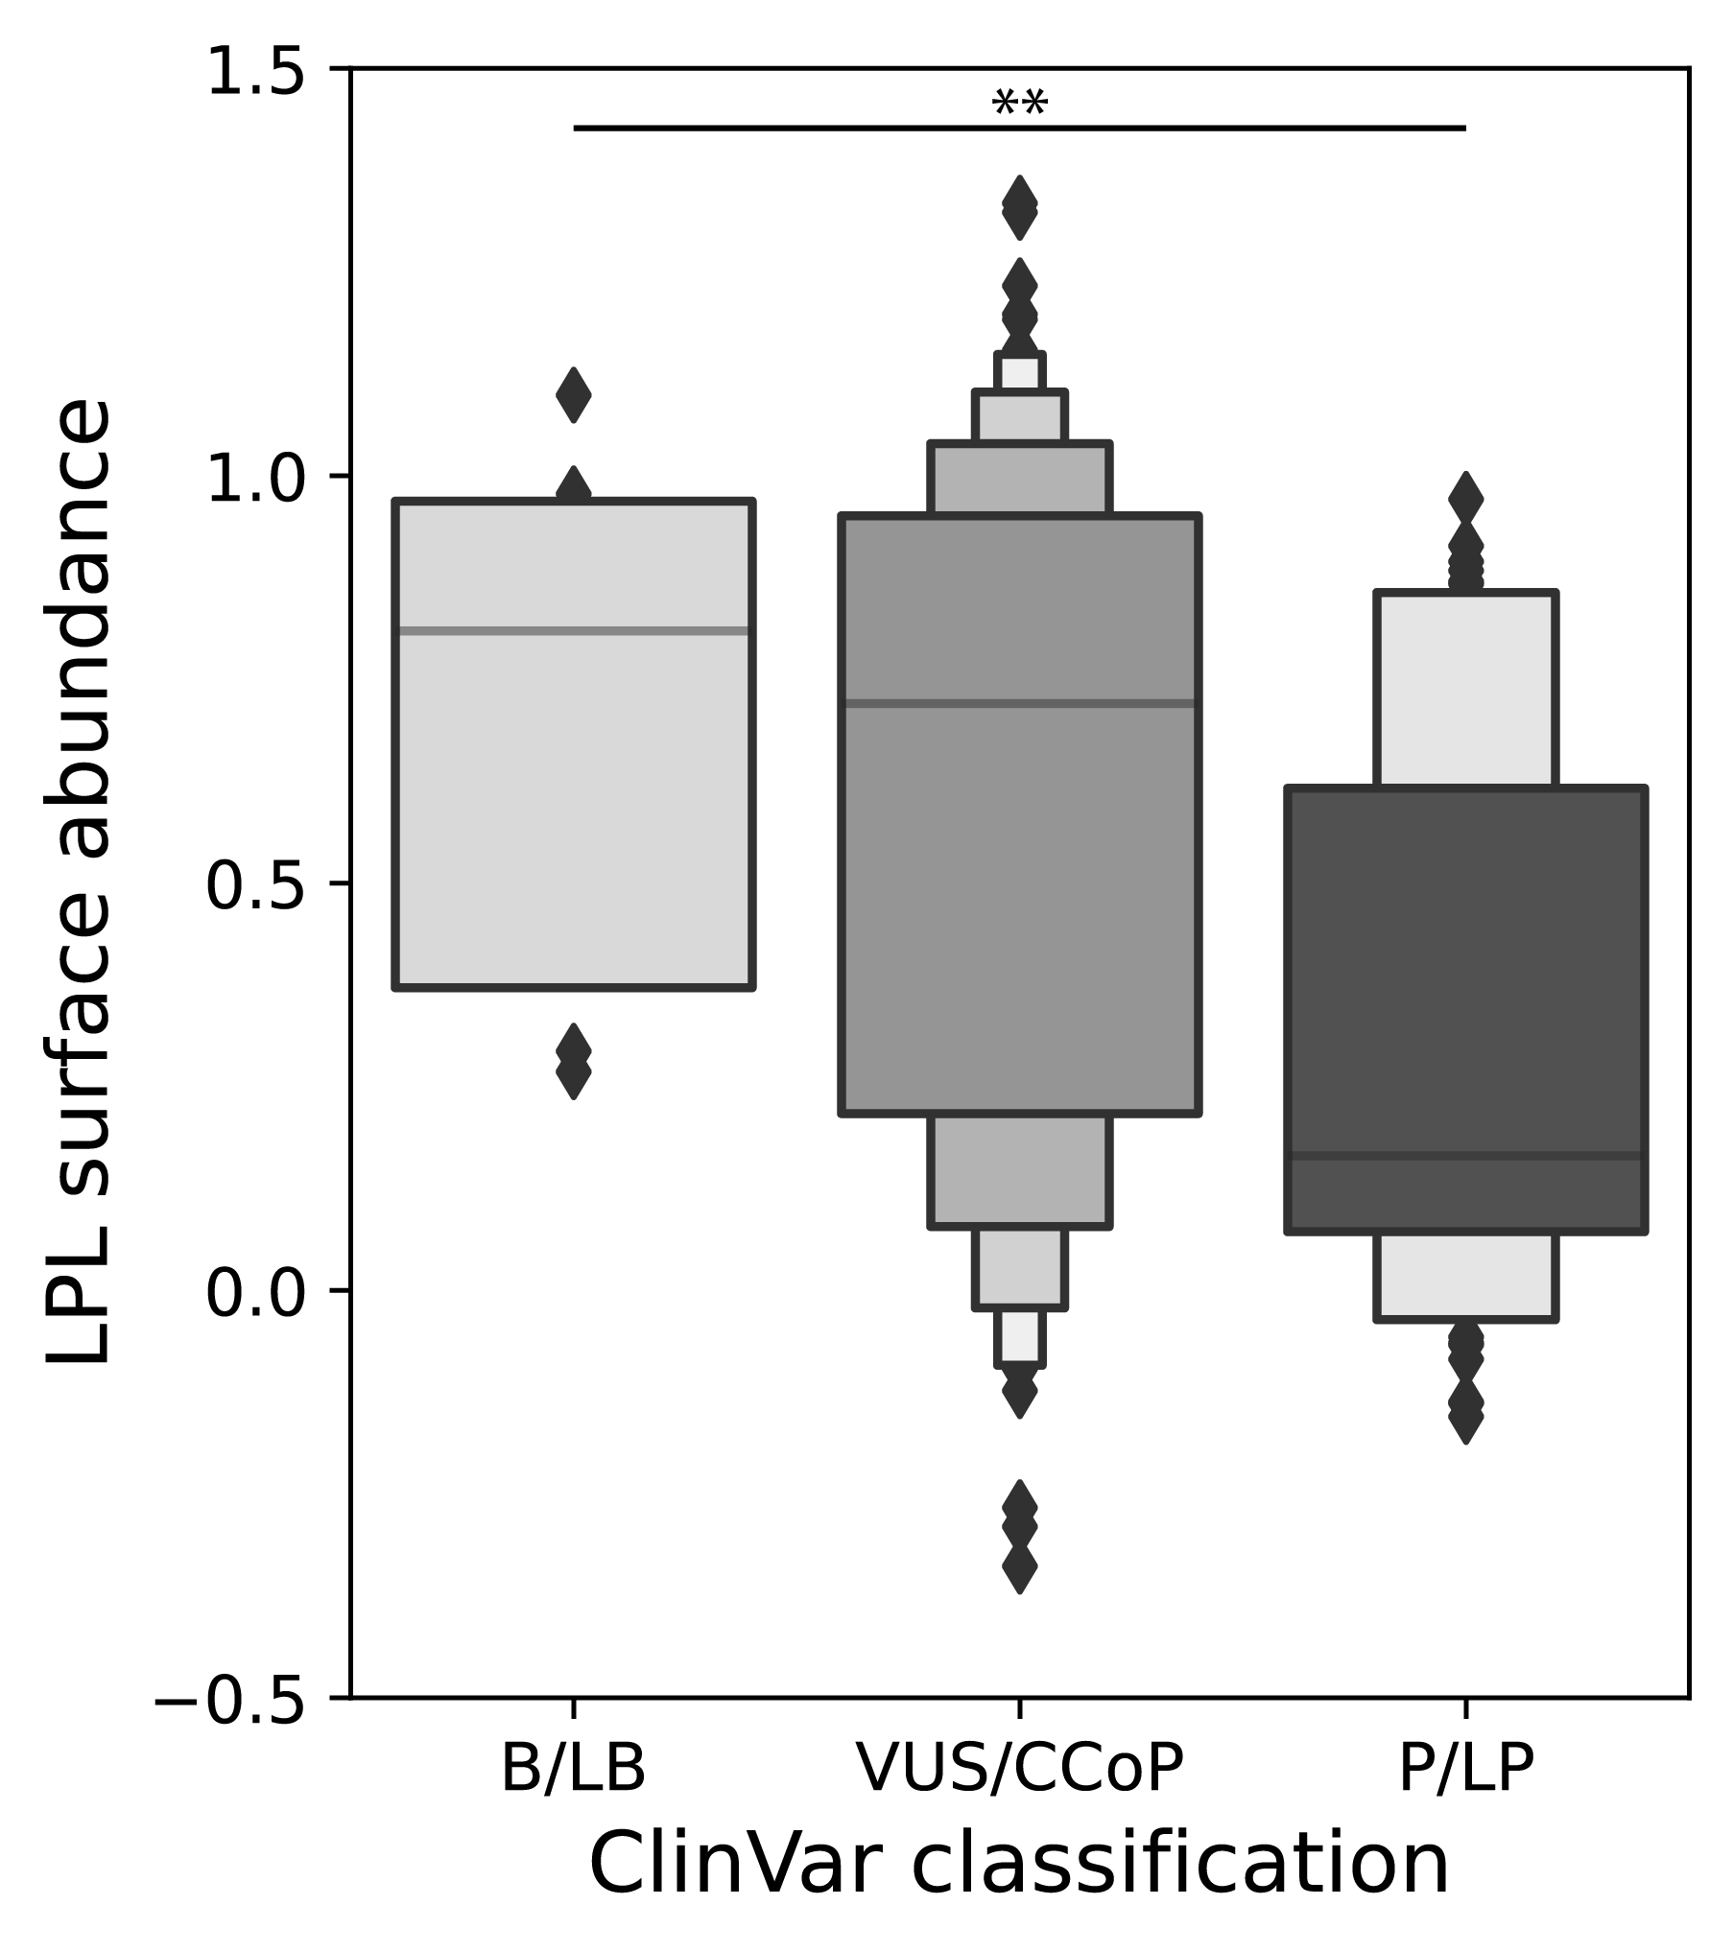
Functional scores correlate with variant consequence and clinical classification
Notes:
~ ClinVar #s as a December 2025: 9 B/LB; 53 P/LP; and183 VUS.
**: Mann-Whitney U < 0.01

Slide 24
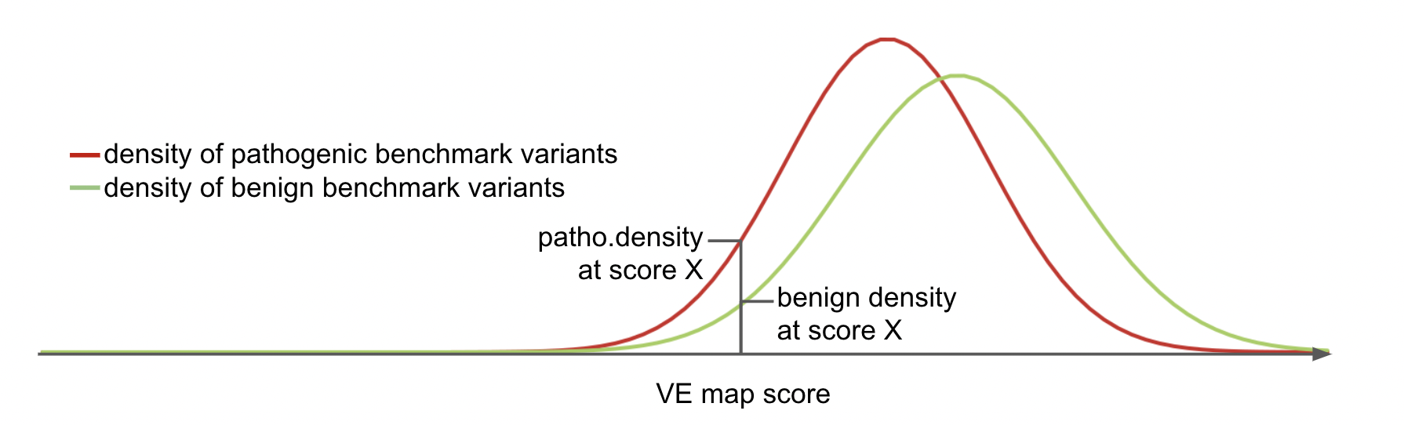
Calculating score-specific evidence strengths
—
We can derive a score-specific likelihood of pathogenicity
based on observed clinical variants
Jochen Weile

Slide 25
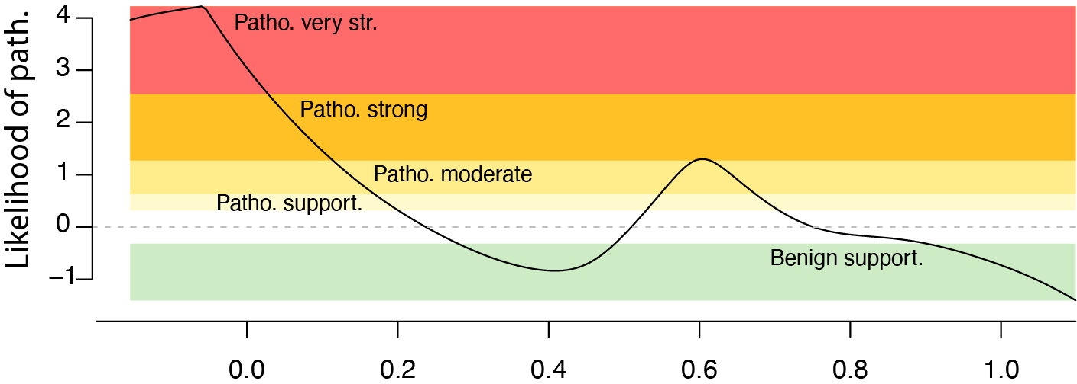
Functional scores provide evidence for clinical variant classification at scale
LPL abundance score
Created for CAGI 7; genomeinterpretation.org

Slide 26
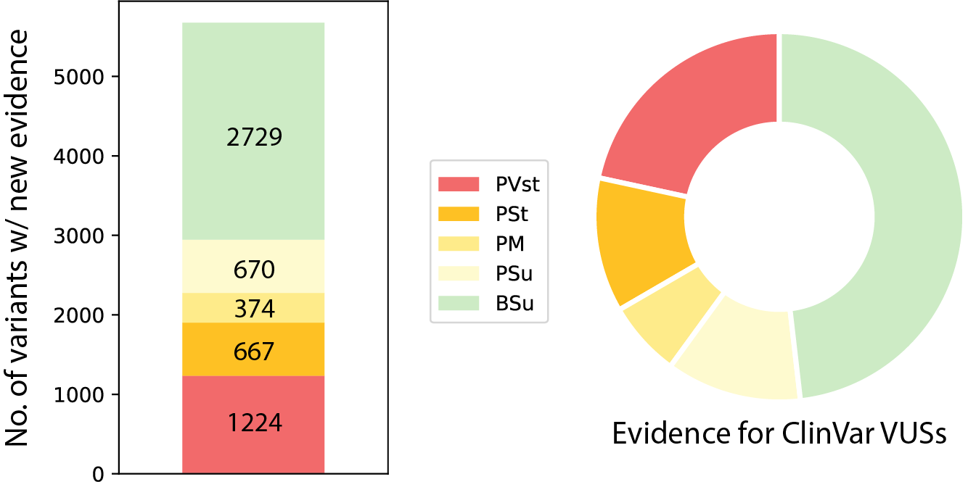
Functional scores provide evidence for clinical variant classification at scale
108 VUSs
—
New functional evidence for ~ 5500 LPL missense variants
Notes:
108 VUSs is ~ 60% of the current VUSs in ClinVar (December 2025).

Slide 27
Summary
Generated a full-length sequence-function map of LPL
Abundance is an effective readout for capturing LPL function(s)
Providing new evidence for variant classification for 5500
variants including > 60% of current VUSs

Slide 28
Future directions…
Measuring LPL catalytic activity at scale
Resolving variant effects in the context of LPL chaperones,
activators, and inhibitors (e.g., GPIHBP1, ANGPTL4)
Extending functional scores to disease prediction in human cohorts
Notes:
- Do PRCs and LLRs and maybe Invitae?

Slide 29




Thank you!
Roth lab
Fritz Roth
Atina Coté
Jochen Weile
Ashyad Rayhan
Iosifina Fotiadou
Roujia Li
Nishka Kishore
Carmela Serio Carrero
Kevin Kuang
Anna Axakova
CardioVar Consortium
Dan Roden
Calum MacRae
Megan Lancaster
Euan Ashley
Victoria Parikh
Andrew Glazier
Brett Kroncke
Western University
Robert Hegele

