Slide 1

CAGI7 slide pack guidelines
I agree to my slides being used according to the following terms:
__Sirui Zhang, Zefeng Wang__
Authors: please include THIS slide at the beginning of your presentation to indicate that you agree with reuse of your slides in CAGI presentations, according to the terms below, and digitally sign by writing your name above.
To disseminate the CAGI results, I encourage all CAGI participants to remix these CAGI slides for inclusion in their oral and poster presentations.
CAGI participants may use or publish any content of these slides only in compliance with the CAGI Data Use Agreement.
CAGI participants may not cite or publish any content of these slides except with the written permission of the originating author or in the primary CAGI publications.
CAGI participants must acknowledge the original authors of these slides and CAGI7. Include the acknowledgement banner across the bottom.
CAGI participants must include the CAGI credits slide in their presentations.
Slides with a red slash (no remix) may not be included in a presentation unless all attendees are registered CAGI participants who signed the data use agreement.
Slides with a red X over the entire slide may not be used in any circumstances.
Slides with a blue slash (embargoed) may not be used unless the embargo is explicitly lifted.
Slides without slash or X may be tweeted unless flagged with the “No tweet” icon.
CAGI participants using these slides must explain the “No tweet” icon, which means that the slide content should not be disseminated outside the presenting conference hall. If the presentation venue permits pervasive tweeting, you may not include these slides in your talk.
Note for slide authors: we expect all CAGI participants to abide by these restrictions and will make best effort to ensure they are followed. However, bear in mind that we have limited means of enforcing them, and therefore the restrictions cannot be guaranteed.
Notes:
At CAGI7, use of this slide pack is only required for CAGI dataset providers, assessors, and predictors, but all are encouraged to use the annotations for materials they do not want shared publicly.

Slide 2



Evaluation of Predictors in the CAGI7 Splicing Challenge
Sirui Zhang & Zefeng Wang
Created for CAGI7
genomeinterpretation.org
Sirui Zhang
Notes:
“Hello everyone,
It is my great honour to be here and present our evaluation of predictors submitted to the CAGI7 Splicing Challenge.
My name is Sirui Zhang, and this work was done together with Dr. Zefeng Wang in SOUTHERN UNIVERSITY of science and techenoligy in China, who is my phd suopervisor.

Slide 3
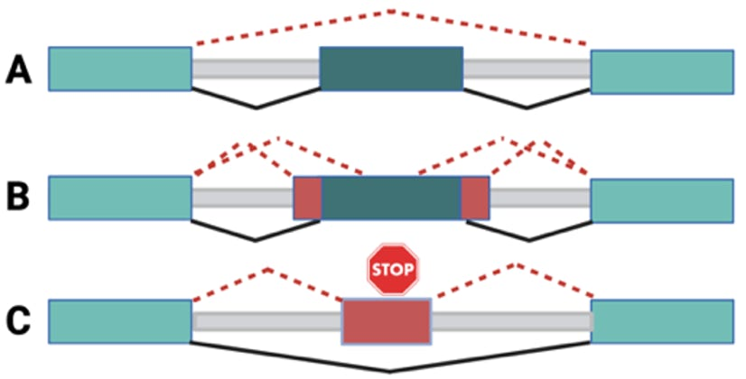
Overview of Splicing Challenge
Predict aberrant splicing for peri-exonic and deep intronic variants
Figure 1. Aberrant splicing events to be studied by a high-throughput splicing assay (HTSA) using a splicing reporter containing 270 nt around the variants.
(A) Peri-exonic variant leads to exon skipping. (B) Peri-exonic variant leads to a change in 3’ or 5’ splice site. (C) Deep-intronic variant leads to a cryptic exon inclusion. Normal splicing is presented with black lines, and abnormal splicing with red dotted lines.
Created for CAGI7
genomeinterpretation.org
Sirui Zhang
Notes:
I would like to briefly inturduce this challenge. This challenge focuses on predicting aberrant splicing caused by two major classes of variants: peri-exonic variants, which lie close to splice junctions, and deep intronic variants, which can activate cryptic splice sites.
The experimental assay (as KNIGA imntroduces) , used a high-throughput mini-gene reporter that includes 270 nucleotides surrounding each tested variant. This allows us to quantify how each mutation alters the splicing outcome.
Our goal in this challenge is to predict the degree of aberrant splicing induced by each variant,
as measured experimentally by the ΔAbS scor
3 types of splicing changing variants

Slide 4
Why This Challenge Matters
Splicing disruption is a major cause of genetic disease
Many impactful variants lie outside canonical splice sites
Essential for clinical genome interpretation
Enables therapeutic development
Critical for understanding disease mechanisms
Created for CAGI7
genomeinterpretation.org
Sirui Zhang
Notes:
Why This Challenge Matters
**“Splicing disruption is one of the major contributors to human genetic disease, but many disease-causing variants occur outside canonical splice sites, where prediction becomes extremely challenging.
Accurately predicting these effects is essential for clinical genome interpretation — to determine whether a patient's variant is benign or pathogenic. /ˌpæθə'dʒɛnɪk/
These predictions also guide therapeutic development, such as antisense oligonucleotides that correct splicing defects.
Finally, understanding how variants alter splicing helps us uncover fundamental disease mechanisms.
That’s why this challenge is both scientifically important and clinically meaningful.”**
30–50% of pathogenic variants act by altering RNA splicing.
Includes exon skipping, cryptic splice-site activation, and intron retention.
Deep intronic and regulatory variants are hard to detect without computational tools.
Models help reveal “hidden” splice-altering mutations.
Each genome contains millions of variants; experimental validation is impossible at scale.
Computational prediction prioritizes variants for diagnosis and functional testing.
Splicing-modifying therapies (e.g., antisense oligos) require knowing which variants disrupt splicing.
Predictors guide target selection.
Abnormal splicing contributes to cancer, neurodegeneration, and immune disorders.
Prediction models reveal regulatory networks affected by variants.

Slide 5
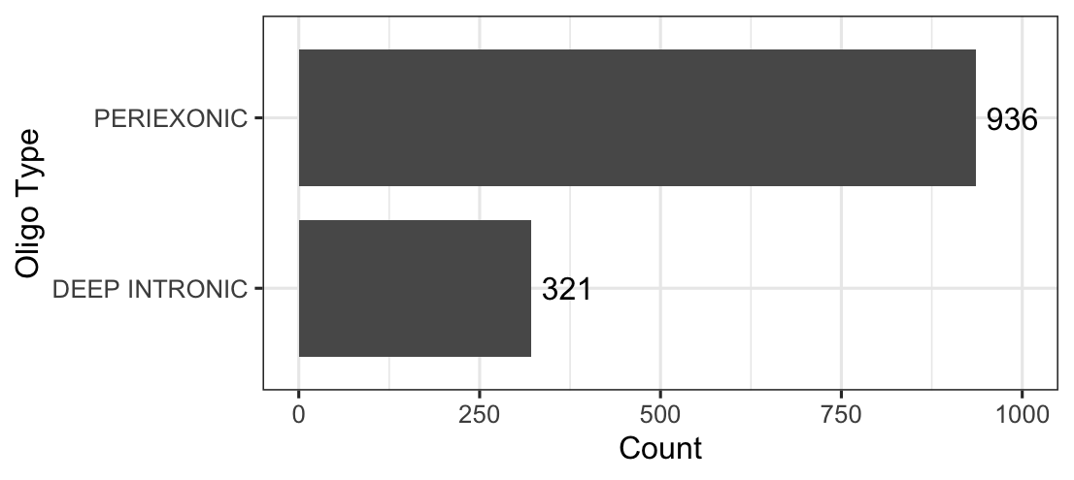
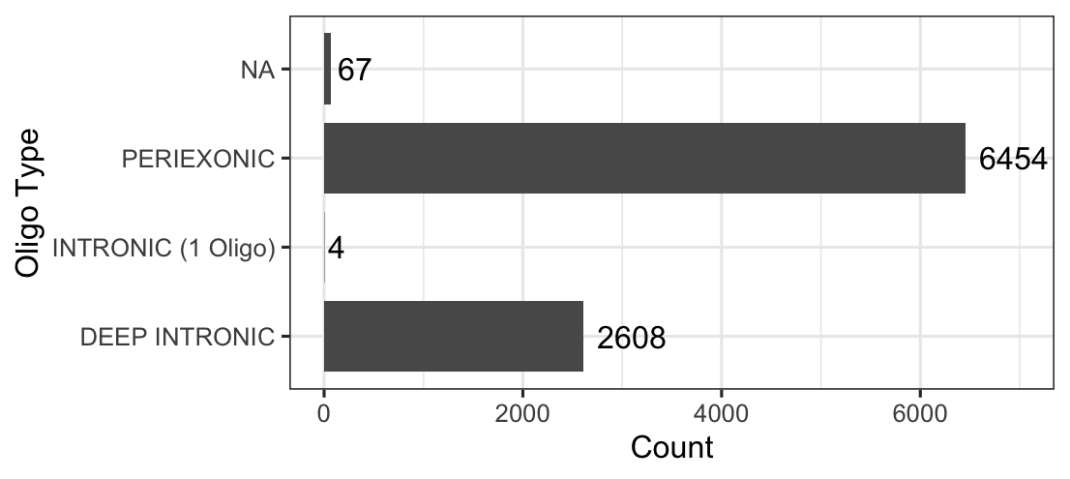
Training vs. Testing Dataset Overview
Training Dataset:
Testing Dataset:
Total: 1257
Total: 9133
Created for CAGI7
genomeinterpretation.org
Sirui Zhang
Notes:
The training dataset contains two main categories of variants: roughly /ˈrʌfli/ 900 peri-exonic variants and about 300 deep-intronic variants.
The testing dataset is larger and includes more than 6,400 peri-exonic variants, about 2,600 deep-intronic variants,

Slide 6
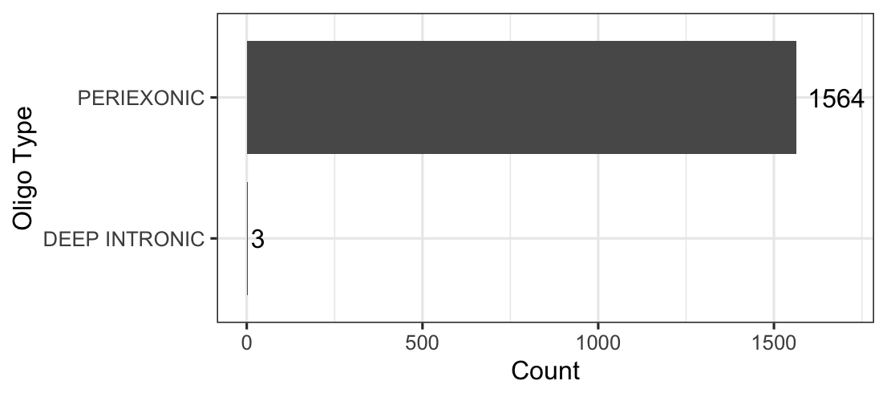
Training vs. Testing Dataset Overview
Testing Dataset
(experiment batch 1):
Training Dataset:
Total: 1257
Total:1567
Created for CAGI7
genomeinterpretation.org
Sirui Zhang
Notes:
However, In the first experimental batch of the testing dataset, we currently have 1,567 variants with measured splicing change( ΔAbS values). Almost all of these are peri-exonic, and only three are deep-intronic variants.
“So at this stage, the available ground truth is dominated by peri-exonic variants, meaning that today’s results primarily /praɪˈmerəli/ reflect each predictor’s performance on peri-exonic variant prediction.

Slide 7
Overview
7 groups
28 predictions
Team | Methods
3billion_cagi7 | 6
AIBIA_bioinfo-ufpr | 5
Evolutionary_Action | 6
FrankStarling | 1*
INLAB_BBSR_2025 | 6
UMSplicing | 1*
Zhliu | 3
( *: no supporting document)
Created for CAGI7
genomeinterpretation.org
Sirui Zhang
Notes:
An Overview of Submitted Predictions
“We received a total of 28 predictions from 7 participating groups.
The number of methods submitted by each team varies, ranging from single-model entries to teams contributing five or six different predictors.
And I will summarizes the full set of predictors evaluated in today’s analysis.”

Slide 8
Key Modeling Frameworks and Ideas
3billion_cagi7 : Unified splicing‐prediction framework combining a nucleotide-transformer backbone with specialized peri-exonic and deep-intronic variant-scoring models
AIBIA_bioinfo-ufpr : Sequence-derived features with large neural-network ensembles (Models 1–3) or by using genomic annotation features with gradient-boosting regressors to estimate PSI/PRES changes (Models 5–6).
Evolutionary_Action : Heuristically combining SpliceAI, CADD, and FATHMM-XF predictions,
INLAB_BBSR_2025 : Use SpliceTransformer delSplice scores and MMSplice Δlogit-PSI and pathogenicity scores as features, trains multiple machine-learning regressors
Zhliu : Extracting SpliceAI-derived sequence features, training stacked XGBoost regression models, and improving accuracy through teacher-model–based denoising of the training data.
Notes:
“Here is an overview of the main modeling strategies used by the participating teams.
Some teams built sequence-based models using large neural architectures—such as transformer backbones, neural-network ensembles, or SpliceAI-derived features.
Others integrated multiple existing predictors, combining tools like SpliceAI, CADD, FATHMM-XF, or MMSplice to produce ensemble or feature-based scores.
We also saw gradient-boosting and stacked regression models incorporating genomic annotations or denoised PSI labels.
Overall, the submitted methods span a wide spectrum /ˈspektrəm/—from deep learning architectures to ensemble meta-predictors to traditional machine-learning regressors.”
And I will summarizes the full set of predictors evaluated in today’s analysis.”

Slide 9
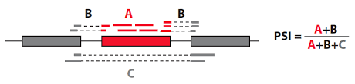
Predictor Performance Measured by Correlation with ΔPSI
∆PSI = PSI_{Var} - PSI_{Ref}
Test set with experiment ground truth: 1567
Six groups submit ∆PSI predictions
Created for CAGI7
genomeinterpretation.org
Sirui Zhang
Notes:
Firstly, let’s compare the delta PSI values prediction
defined as the PSI of the variant minus the PSI of the reference. \
For the current test set, we have experimental ground truth for 1,567 variants.
Among all participating teams, six groups submitted ΔPSI predictions, which allows us to directly measure model.

Slide 10
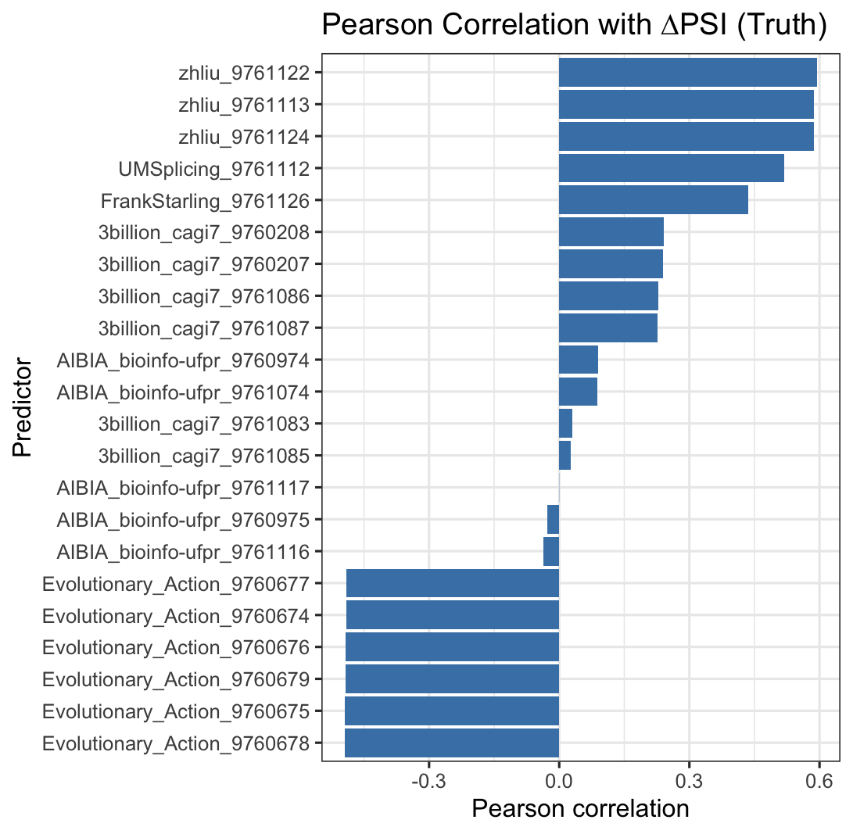
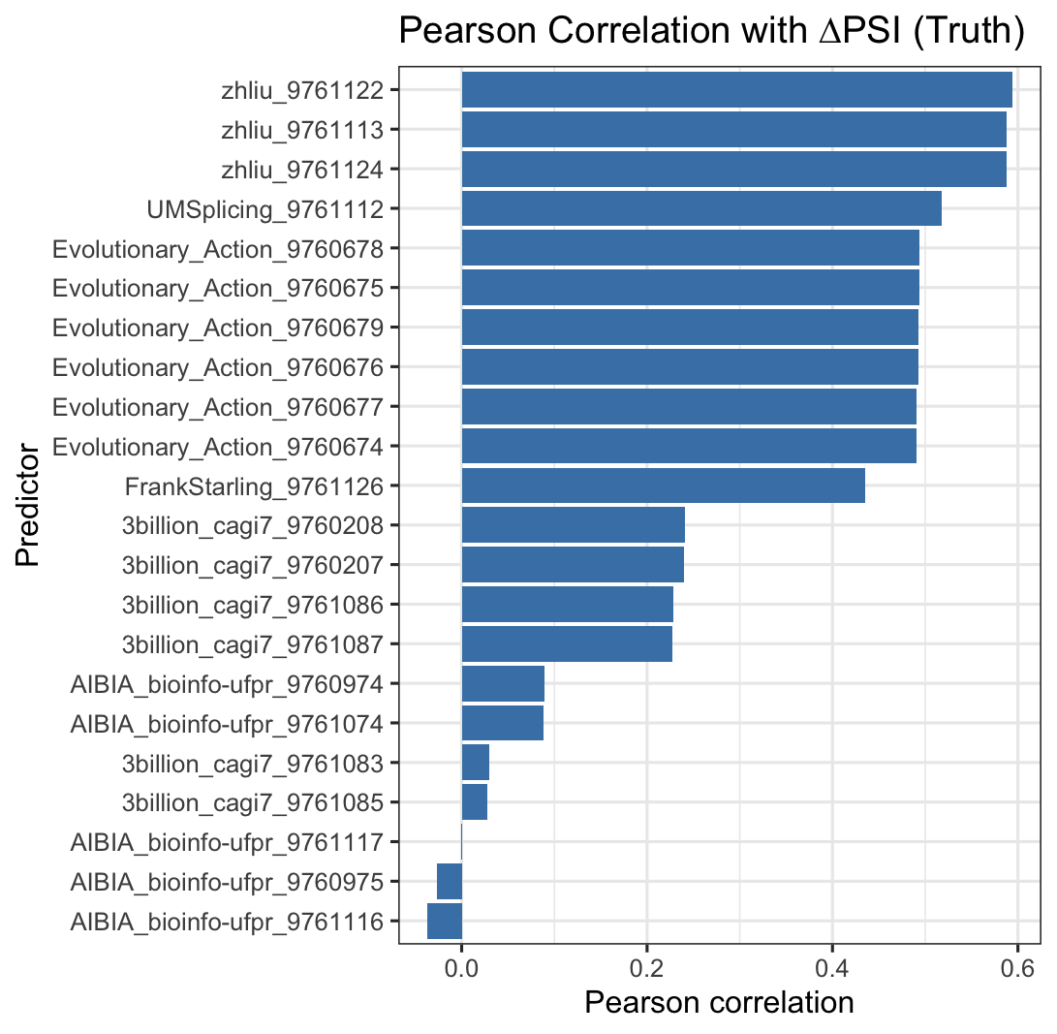
Predictor Performance Measured by Correlation with ΔPSI
Correct the technical mistakes by team E-A
Created for CAGI7
genomeinterpretation.org
Sirui Zhang
Notes:
The plot on the left shows the results from our initial evaluation.
You can see that most predictors fall into reasonable ranges, but the submissions from the Evolutionary_Action team displayed strong negative correlations, which was unexpected. And we re-examine the technical details. We found that they reversed the two terms when computing ΔPSI.
Awe corrected ΔPSI values.
The updated results — shown in the plot on the right —
Overall, after this correction, the predictors from the Zhiu team remain the strongest, followed by Evolutionary_Action, UMSplicing, and others.

Slide 11
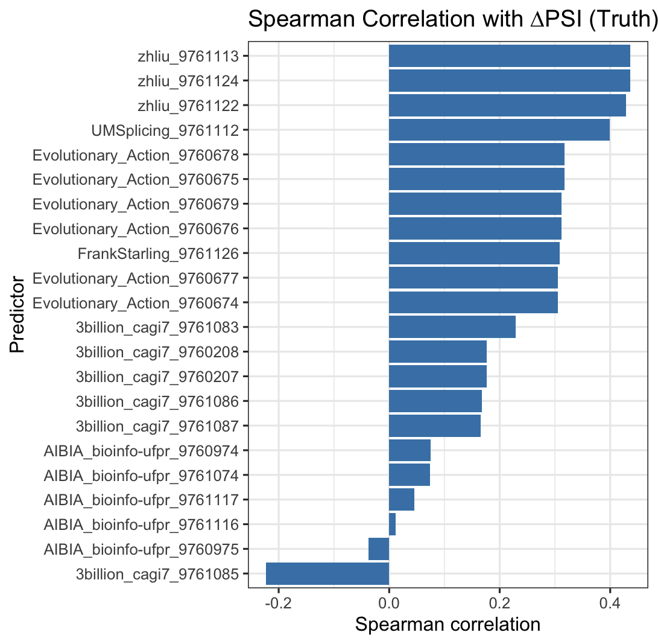
Predictor Performance Measured by Correlation with ΔPSI
Created for CAGI7
genomeinterpretation.org
Sirui Zhang
Notes:
And this is the results shows spearman correlations between each predictors and experimental ground truth
the predictors from the Zhliu team remain the strongest, followed, UMSplicing, by Evolutionary_Action and others.
These correlations provide a clear benchmark for each method’s ability to estimate ΔPSI changes.
This is the result of the accuracy of delt_PSI value

Slide 12
Predictor Performance Measured by Correlation with ΔAbs
PSIRef | percent spliced in for references
PSIVar | percent spliced in for variants
∆PSI | PSIVar - PSIRef
PRESRef | Percent reference exon splicing in a reference sample
PRESVar | Percent reference exon splicing in a variant sample
∆PRES | PRESVar – PRESRef
AbSRef | AbSRef = 1 – PSIRef ⋅ PRESRef
AbSVar | AbSVar = 1 – PSIVar ⋅ PRESVar
∆AbS | AbSVar – AbSRef
∆AbS = overall aberrant splicing score, a score between 0 and 1, where 0 indicates no aberrant splicing, 1 indicates maximal aberrant splicing.
Test set with experiment ground truth: 1567
All groups submit ∆PSI predictions
Created for CAGI7
genomeinterpretation.org
Sirui Zhang
Notes:
Then, we exaimed the more imoprtant value, overall aberrant splicing score, a score between 0 and 1, where 0 indicates no aberrant splicing, 1 indicates maximal aberrant splicing
we have 1,567 experimentally measured variants with ground-truth ΔAbS values.

Slide 13
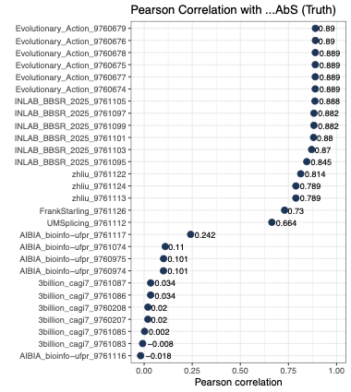
Predictor Performance Measured by Correlation with ΔAbs
Pearson Correlation with ∆AbS (Truth)
Test set: 1567
Created for CAGI7
genomeinterpretation.org
Sirui Zhang
Notes:
“Here, we evaluate predictor performance using correlation with ΔAbS, the overall aberrant-splicing score.
Each point on this plot represents one submitted predictor.
A few key observations:
Evolutionary_Action models show the strongest performance,, indicating very high consistency with the experimental measurements.
The INLAB_BBSR_2025 models also perform very well, with correlations
The Zhilu predictors follow next,

Slide 14
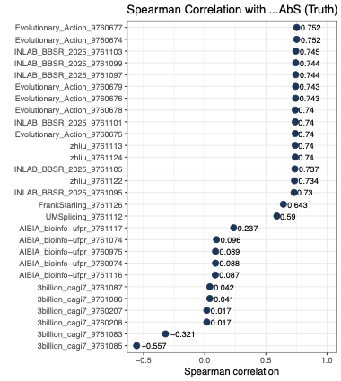
Predictor Performance Measured by Correlation with ΔAbs
Spearman Correlation with ∆AbS (Truth)
Test set: 1567
Created for CAGI7
genomeinterpretation.org
Sirui Zhang
Notes:
For the Spearman correlation, the resulkts are similar
Evolutionary_Action models and INLAB_BBSR models again perform the best, with Spearman correlations around 0.74–0.75.and Zhilu predictors follow closely,

Slide 15
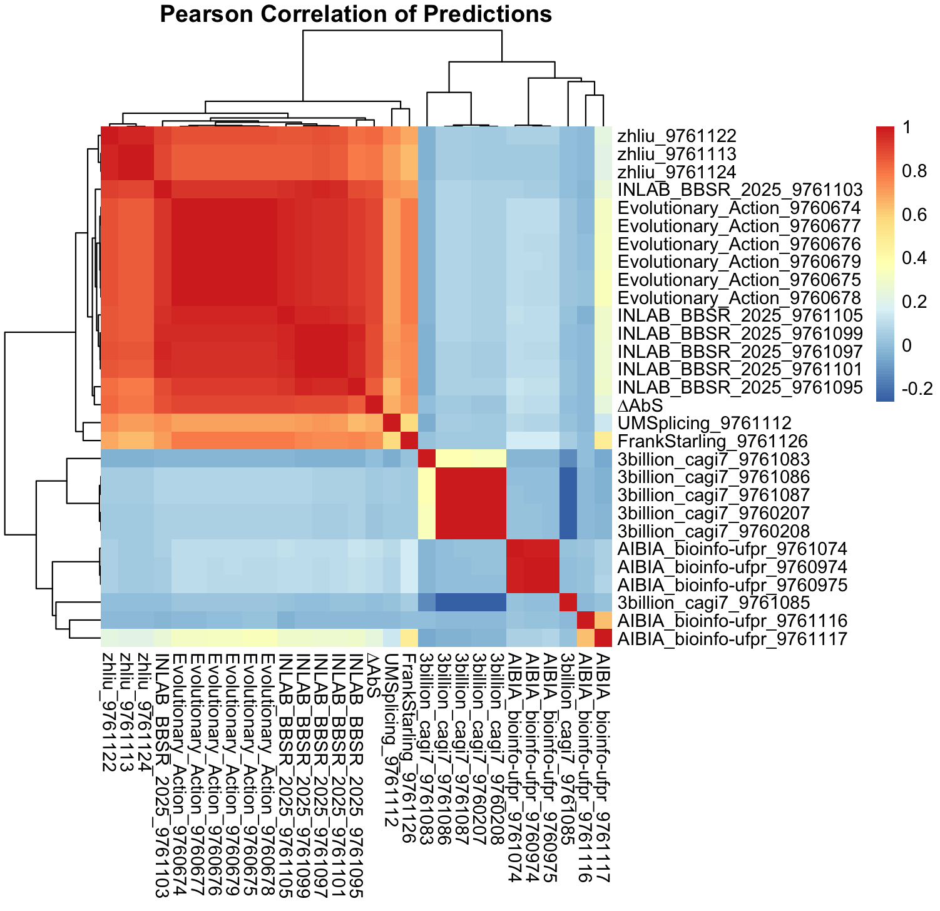
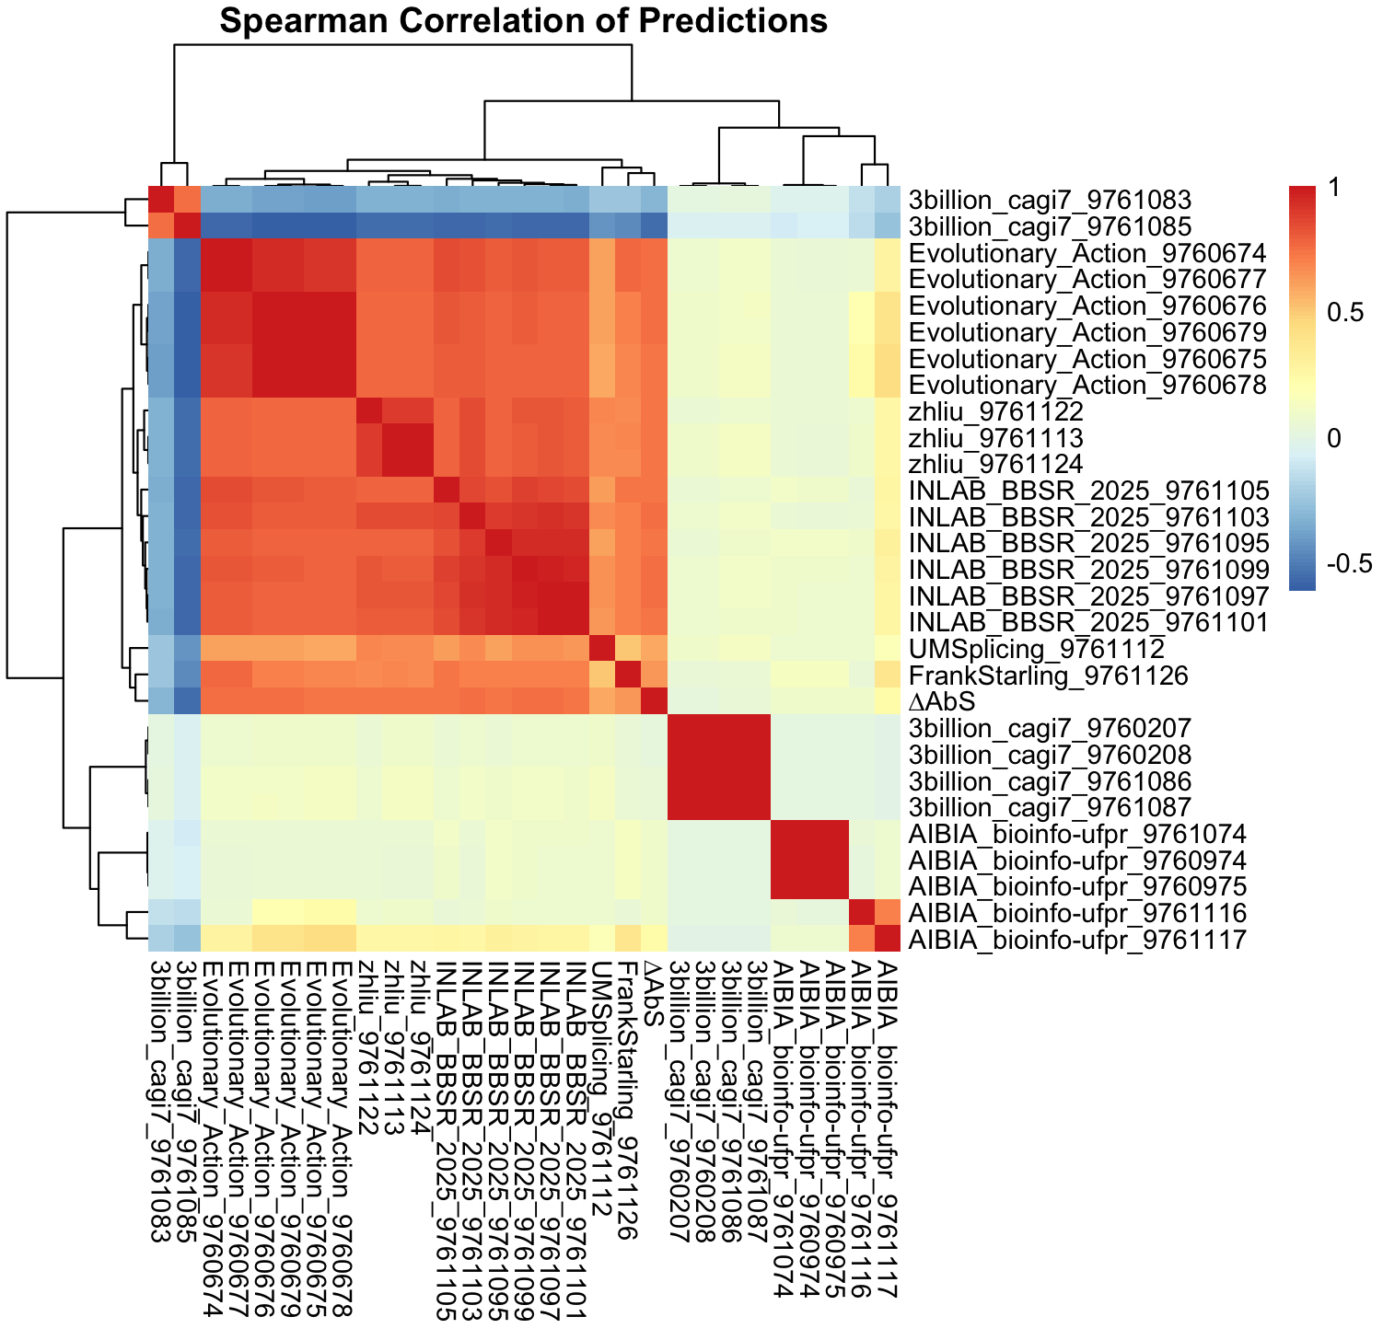
Correlations among predictors & ground truth
Test set: 1567
Created for CAGI7
genomeinterpretation.org
Sirui Zhang
Notes:
If we look at the clustering of correlations between predictors and the ground truth, we can see that predictors from several teams consistently cluster together with the ground truth, as indicated by the red arrows. These teams including INLAB, evolutionary)action, zhliu, UMSplicing and Frankstarlling
Based on these results, we can see that several predictors show very strong consistency with the experimental measurements. It also becomes clear that a few groups demonstrate particularly strong predictive performance.

Slide 16

How These Tools Perform Compared to Recruited Predictors ?
Recruited Predictors: SpliceAI, Pangolin
Created for CAGI7
genomeinterpretation.org
Sirui Zhang
Notes:
Now the next question is:
How do these tools compare with established baseline predictors, such as SpliceAI and Pangolin?

Slide 17
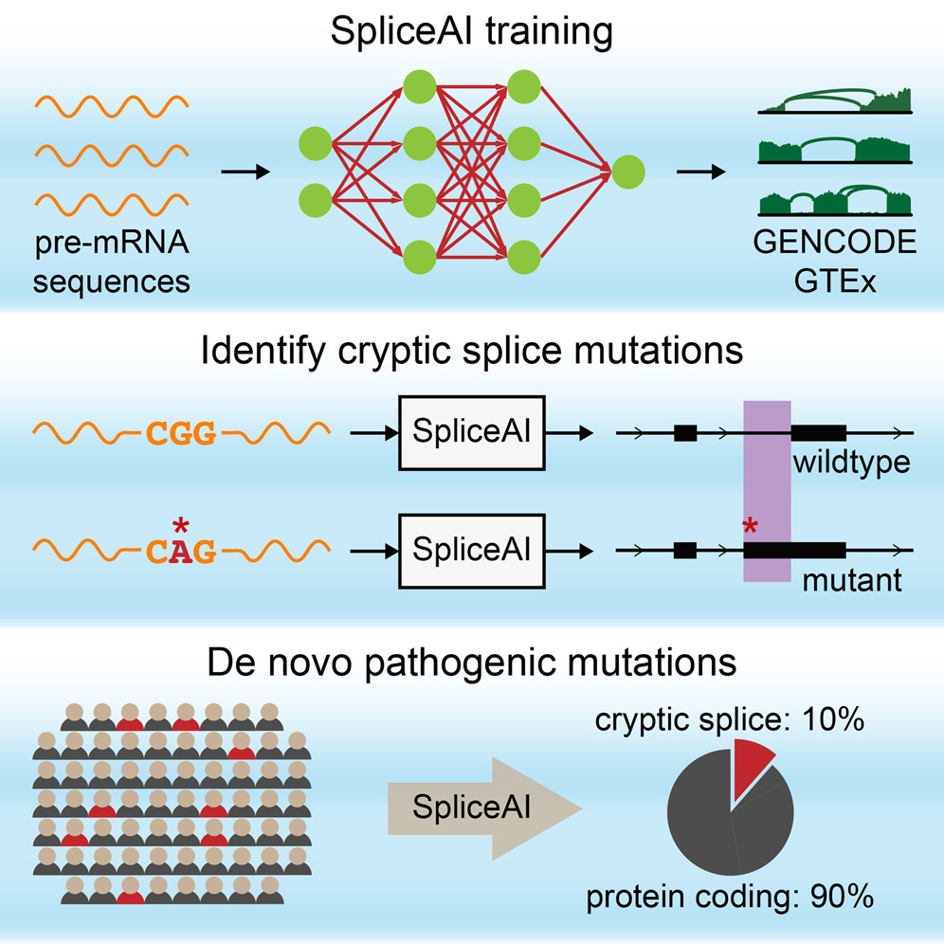
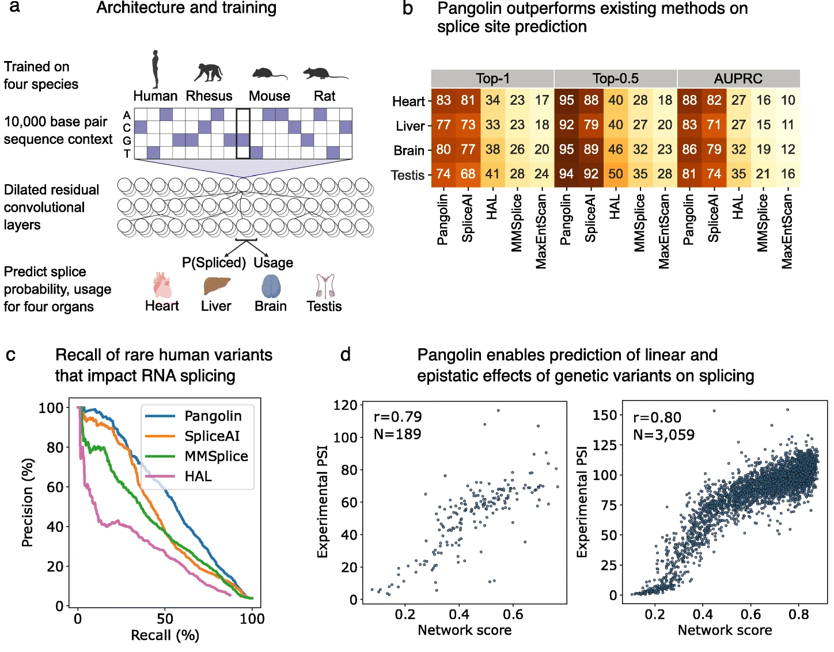
SpliceAI
Pangolin
(Jaganathan et. al, 2019, Cell)
(Zeng et. al, 2022, Genome Biology)
Created for CAGI7
genomeinterpretation.org
Sirui Zhang
Notes:
SpliceAI is a deep neural-network model trained on large genomic datasets (GENCODE, GTEx) to predict how sequence variants alter splice sites.
#It is particularly effective at detecting cryptic splice sites and annotating potentially pathogenic splicing mutations.
Pangolin
Pangolin uses dilated /daɪˈletɪd/ convolutional networks trained across multiple species to predict splice probabilities and tissue-specific splice usage.
#It outperforms many existing splicing predictors and accurately models both linear and epistatic effects of genetic variants on splicing.
These are widely used splicing prediction models, so they serve as helpful reference points for evaluating whether the submitted approaches provide additional value or improvements.
•
SpliceAI, a 32-layer deep neural network, predicts splicing from a pre-mRNA sequence
•
75% of predicted cryptic splice variants validate on RNA-seq
•
Cryptic splicing may yield ∼10% of pathogenic variants in neurodevelopmental disorders
•
Cryptic splice variants frequently give rise to alternative splicing
Predicting RNA splicing from DNA sequence using Pangolin

Slide 18
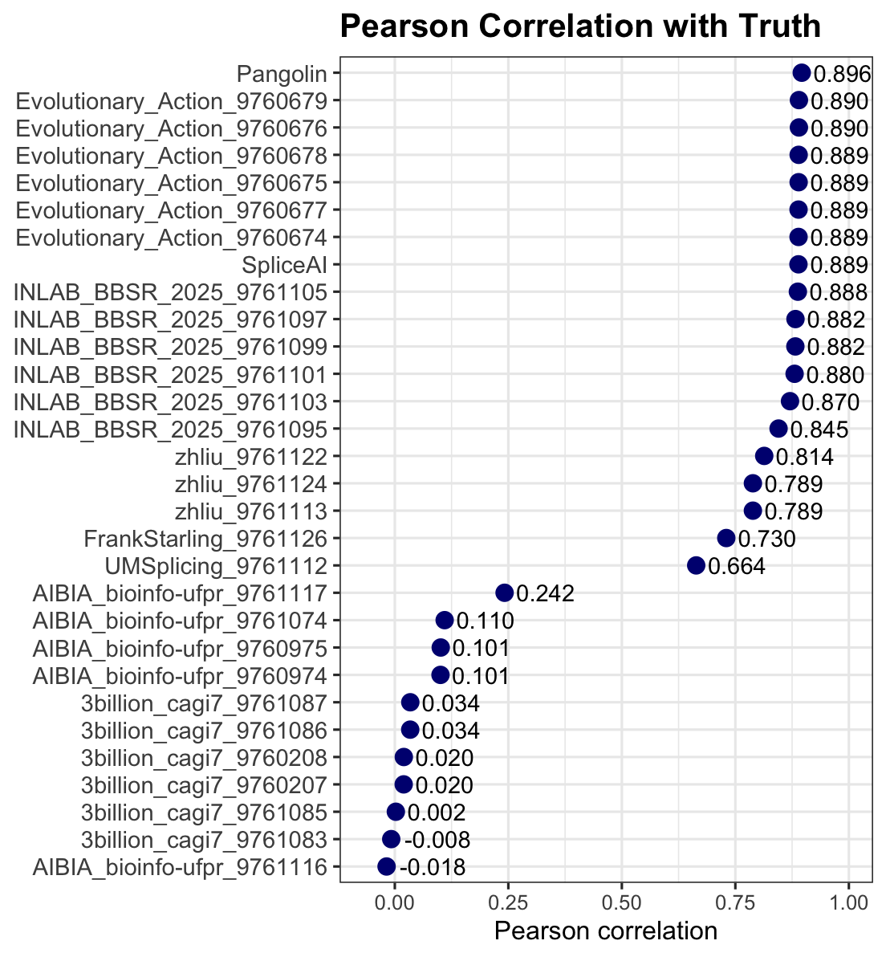
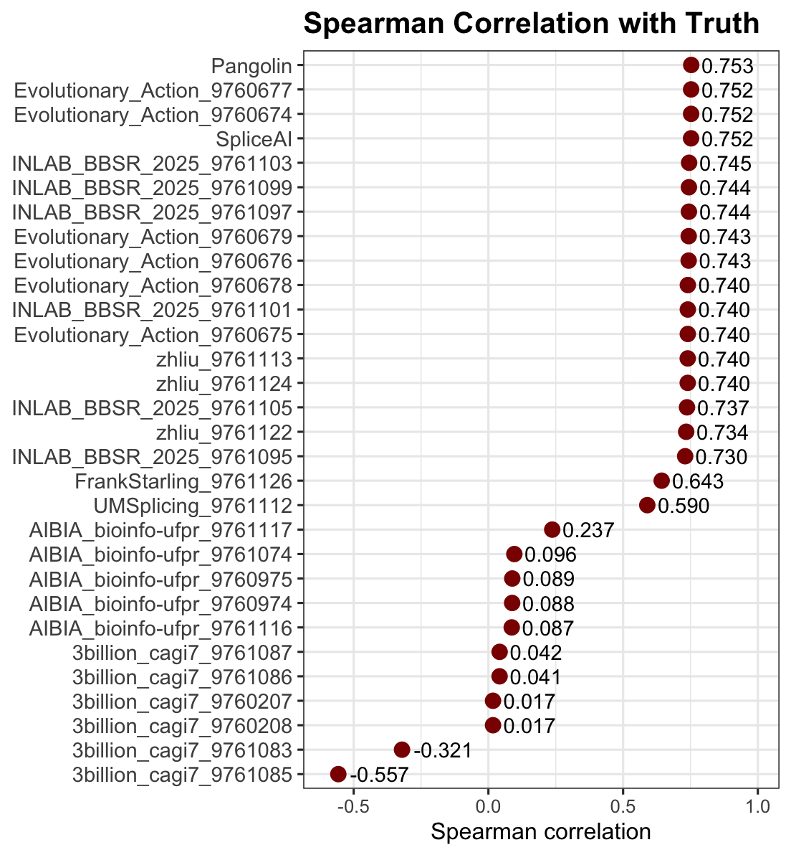
Created for CAGI7
genomeinterpretation.org
Sirui Zhang
Notes:
Here we compare all submitted predictors against the experimental ground truth using both Pearson and Spearman correlations.
On both metrics, Pangolin and Evolutionary_Action are consistently the top performers, showing the strongest agreement with the real abrrent splicing measurements.
SpliceAI also performs well, ranking right below the top tier.
Other models show moderate to low correlation, with some methods producing near-zero or even negative correlations, suggesting limited predictive power under the current test set.
Overall, these two plots provide a clear performance ranking that is consistent across correlation measures.”

Slide 19
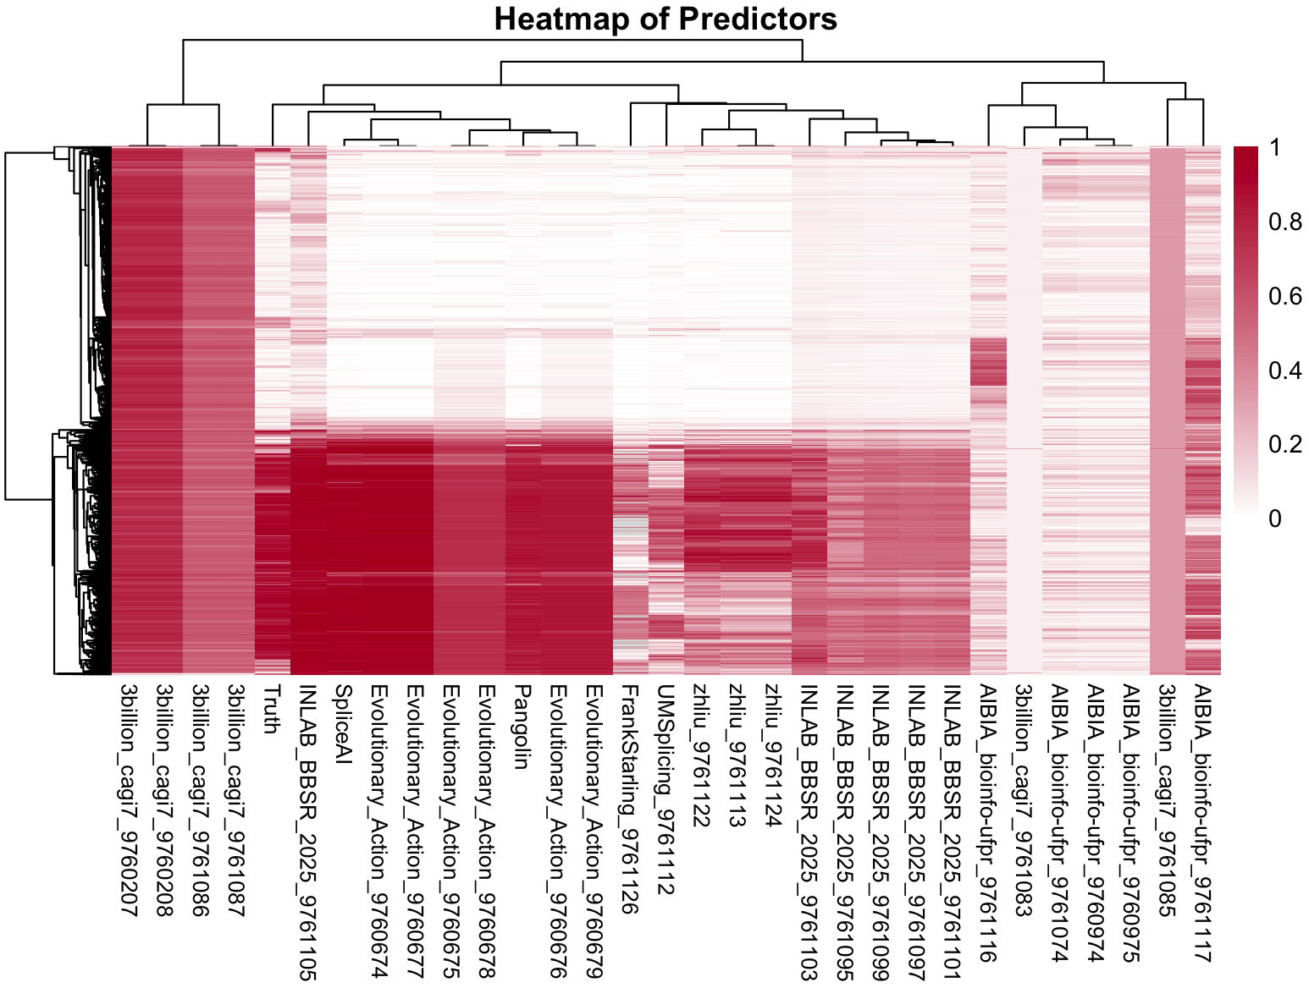
∆AbS
Test set: 1567
Created for CAGI7
genomeinterpretation.org
Sirui Zhang
Notes:
This heatmap visualizes all predictor outputs across the 1,567 variants in the test set, with hierarchical/ˌhaɪə'rɑrkɪkl/ clustering applied to both predictors and variants.
We can see a clear block structure:
Predictors that correlate well with the experimental truth (such as Evolutionary_Action, INLAB, SpliceAI, and Pangolin) cluster together and show strong, consistent signal patterns.
#In contrast, predictors from 3billion and some AIBIA models form separate clusters with much weaker or inconsistent signals, which matches their lower correlation scores.
Overall, this heatmap provides a global view of predictor similarity and highlights which methods capture meaningful splicing patterns.”

Slide 20

What Drives Strong Performance in Splicing Predictors?
Predictors: Evolutionary_Action, INLAB_BBSR, Zhliu
Created for CAGI7
genomeinterpretation.org
Sirui Zhang
Notes:
“At this point, a natural question is: what actually makes a splicing predictor perform well in this challenge?
From our benchmark, three predictors clearly stand out: Evolutionary_Action, INLAB_BBSR, and Zhliu.
In the next few slides, I’ll take a closer look at how each of these methods is built and what common design choices might be driving their strong performance.”**

Slide 21
Evolutionary_Action
Combined three variant-effect prediction tools:
SpliceAI – primary predictor of splicing impact
CADD – general functional impact scoring
FATHMM-XF – regulatory/functional effect predictor
A heuristic ensemble approach was used to integrate these scores into a single composite OASS value.
Model 1
SpliceAI-only (Serves as the baseline model, leveraging the most splicing-specific predictor.)
Models 2–3: Weighted Ensembles
Combine SpliceAI + (CADD + FATHMM-XF)
Weighting schemes:
  Model 2: 2:1 (SpliceAI : CADD+FATHMM-XF)
  Model 3: 4:1
Designed to test how additional functional scores refine SpliceAI-based predictions.
Models 4–6: Neighbor-Aware Extensions
Extend Models 1–3 by incorporating sequence-context adjustments, especially for indels.
Variant effects are influenced by nearby genomic positions to better capture local splicing perturbations.
Created for CAGI7
genomeinterpretation.org
Sirui Zhang
Notes:
“Evolutionary_Action achieves strong performance by integrating three different variant-effect predictors:
#SpliceAI for splicing impact, CADD for general functional effects, and FATHMM-XF for regulatory impact.
These scores are combined using heuristic /hjʊ'rɪstɪk/ ensemble to produce one composite OASS value.
The team tested several model variants.
Model 1 uses SpliceAI alone as the baseline.
Models 2 and 3 add CADD and FATHMM-XF with different weighting schemes, allowing them to evaluate how much these additional functional scores improve SpliceAI-based predictions.
Models 4–6 extend these approaches further by incorporating sequence-context or neighbor-aware adjustments, which help capture local genomic influences, especially in cases like indels.
Overall, the method performs well because it blends splicing-specific, functional, and regulatory information, while also accounting for local sequence context.”
OASS provides a unified metric for capturing predicted splicing impact.
Six heuristic models allow systematic comparison of different tools, weightings, and neighbor-aware adjustments.
This framework helps identify which combination of predictors best approximates experimental splicing outcomes.

Slide 22
INLAB_BBSR_2025
Across all six models, the team followed a shared overall framework for predicting aberrant splicing in peri-exonic and deep-intronic variants. All models:
Used SpliceTransformer delSplice scores and MMSplice delta_logit_psi + pathogenicity scores as the core feature set.
Leveraged these scores because changes in PSI and predicted pathogenicity are both indicative of splicing disruption.
Treated the experimental AbS (aberrant splicing) values as regression labels.
Split the provided CAGI dataset into training, validation, and test sets.
Built regression-based predictors to estimate splicing effects.
The primary differences between the six models involve which regression method was used and how the individual model predictions were combined (meta-learning, weighted averaging, simple averaging, single-model prediction, or neural network).
Created for CAGI7
genomeinterpretation.org
Sirui Zhang
Notes:
“INLAB_BBSR_2025 followed a unified framework across all six of their models.
They started by using a set of strong splicing-related features—primarily the SpliceTransformer delSplice scores, MMSplice delta logit PSI, and several pathogenicity /ˌpæθədʒi'nisiti/ scores.
For supervision, they treated the experimental AbS values as regression labels and split the CAGI dataset into training, validation, and test sets.
Each of the six models is a regression-based approach that estimates the magnitude of aberrant splicing.
#The key differences among the six models lie in the regression method used and in how predictions were combined—ranging from simple averaging to weighted ensembles, meta-learning, and a neural network strategy.
Overall, their strong performance comes from using rich splicing features together with multiple ensemble formulations.”

Slide 23
Zhliu
Extract SpliceAI donor/acceptor probability profiles (AG, AL, DG, DL) from genomic sequence
Engineer sequence features (regional averages, softmax-weighted windows, positional summaries)
Train multiple XGBoost regression models on these SpliceAI-derived features
Use ridge regression stacking to combine XGBoost outputs into a final predictor
Train teacher models on an external dataset (Scott et al.) to obtain clean PSI estimates
Remove samples with large discrepancies between teacher predictions and experimental measurements
Retrain ensemble on the denoised dataset to improve generalization
Predict PSI/PRES and compute ΔAbS as the final output
Created for CAGI7
genomeinterpretation.org
Sirui Zhang
Notes:
ZhliU’s method builds heavily on SpliceAI-derived information.
They first extract SpliceAI donor and acceptor probability profiles and engineer a rich set of sequence features
Using these features, they train multiple XGBoost regression models and then apply ridge-regression stacking to combine them into a final ensemble predictor.
A teacher–student framework is used to obtain cleaner PSI estimates:
The final model is then retrained on this denoised dataset for improved generalization
“After reviewing the methods used by the top-performing predictors, I’d also like to raise one more question for discussion:”

Slide 24
Why a Large Language Model Showed Limited Performance: Case Study of 3billion?
Created for CAGI7
genomeinterpretation.org
Sirui Zhang
Notes:
“After reviewing the methods used by the top-performing predictors, I’d also like to raise one more question for discussion:”

Slide 25
3billion
IssaSplice Backbone
Built on the Nucleotide Transformer, selected for strong performance on 270bp local sequence windows.
Predicts both splice-site class (acceptor / donor / neither) and PSI regression values.
Trained using balanced splice-site labels derived from GENCODE v49, with soft boundary labeling.
PSI supervision comes from GTEx, applying Gaussian weighting to reflect read distributions.
Optimized with focal loss + weighted MSE and a cosine learning-rate schedule.
Variant Scoring Models
Two specialized modules: DeepIntronicPredictor for deep intronic variants and PeriExonicPredictor for exon-proximal variants.
Models operate on REF and ALT sequences, predicting PSI/PRES for each allele to compute splicing impact.
Deep intronic predictor uses six sequence patterns per variant to capture long-range effects; peri-exonic uses paired windows around junctions.
Aggregation uses either Pooling + MLP or Self-attention with CLS token to combine contextual signals.
Supports optional gnomAD allele-frequency features via RBF embedding to model variant rarity.
Data Handling & Calibration
Missing or inconsistent oligotypes trigger a hierarchical fallback between peri-exonic and deep-intronic extraction strategies.
Ambiguous strand or incomplete annotations default to a standardized positive-strand windowing scheme.
Created for CAGI7
genomeinterpretation.org
Sirui Zhang
Notes:
“3billion’s method is built on the IssaSplice backbone, using a Nucleotide Transformer model trained on 270-bp local windows. It predicts both splice-site class and PSI, with supervision from GENCODE and GTEx. For variant scoring, they use two modules—one for deep-intronic variants and one for peri-exonic variants
The method seems resonable, one likely reason for its relatively weaker performance is the limited 270-bp context window. Splicing regulation often depends on long-range sequence context, and models like SpliceAI use much larger input windows, which may capture regulatory signals that this shorter-window model misses.”

Slide 26
Future Directions for Improving Splicing Prediction
Integrate complementary predictors to leverage different model strengths.
Expand sequence context in training and experiments (beyond 270 bp) to capture broader regulatory signals.
Incorporate richer biological information (e.g., upstream/downstream context, multi-source features) to enhance generalization.
Created for CAGI7
genomeinterpretation.org
Sirui Zhang
Notes:
“Overall, these results highlight both how far splicing predictors have come and where they still fall short. As we think about what could move the field forward, combining models might be a very promising direction, and future training frameworks will probably benefit from using richer information—like longer upstream and downstream sequence context. It’s also worth asking whether experimental designs could capture longer regulatory regions so the models have better support.”
These are just my own thoughts, and I’d really love to hear others’ suggestions or even counter-arguments

Slide 27
Future Plan
A more comprehensive analysis will be performed once the full test set results become available.
Expand the analysis to include more predictors, including SpliceTransformer, MMSplice, and others.
Created for CAGI7
genomeinterpretation.org
Sirui Zhang
Notes:
“For the next steps, we have two main directions.
First, we will perform a more comprehensive analysis once the complete test-set results are released. This will allow us to evaluate the predictors more thoroughly and refine our comparisons.
Second, we plan to expand the analysis by including additional splicing predictors, such as SpliceTransformer, MMSplice, and several others. Incorporating a broader set of models will help us better understand the strengths and limitations of different methodological approaches.”
这是为了捕捉：
远程剪接增强子/抑制子（ESE/ESS/ISE/ISS）
branch point
长距离 RNA secondary structure 影响
cryptic splice site activation
deep intronic regulatory elements

Slide 28


Acknowledgement
Zefeng Wang
Chair Professor,
Southern University of Science and Technology
CAGI7
Steven E. Brenner
Predrag Radivojac
Kinga Bujakowska
Created for CAGI7
genomeinterpretation.org
Sirui Zhang
Notes:
At last, I really thank zefeng, who works together with this assessment, and thank steven, predrag, and kinga for the discussion

Slide 30
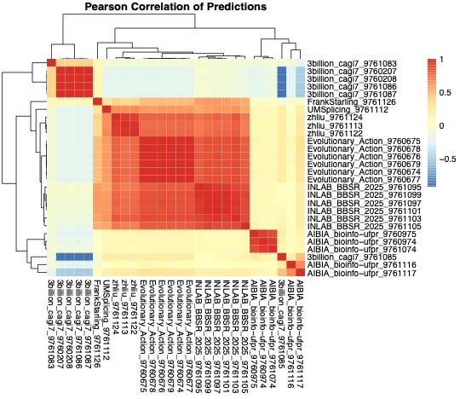
Test set: 9133
Created for CAGI7
genomeinterpretation.org
Sirui Zhang

Slide 31
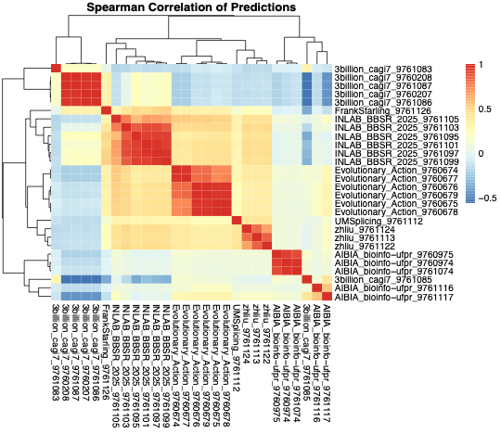
Test set: 9133
Created for CAGI7
genomeinterpretation.org
Sirui Zhang

Slide 32
Predictor | Core Idea | Key Inputs / Features | Modeling Strategy | Why It Works Well
Evolutionary_Action | Ensemble integrates splicing + functional impact scores | SpliceAI, CADD, FATHMM-XF + neighbor-aware context | Weighted ensembles (2:1, 4:1), sequence-context extensions | Captures both splicing-specific and regulatory/functional disruption; robust across variant types
INLAB_BBSR_2025 | Meta-learning framework using multiple splicing predictors | SpliceTransformer delSplice, MMSplice Δlogit(psi), pathogenicity scores | Regression models + different ensembling schemes; trained on CAGI dataset | Leverages complementary splicing features; flexible ensemble improves generalization
Zhliu | SpliceAI probability tracks + feature engineering + XGBoost | SpliceAI AG/AL/DG/DL probability profiles + engineered sequence windows | Multiple XGBoost models + ridge stacking + teacher–student denoising | Uses rich local probability profiles + denoising to better capture subtle splicing effects

Slide 33
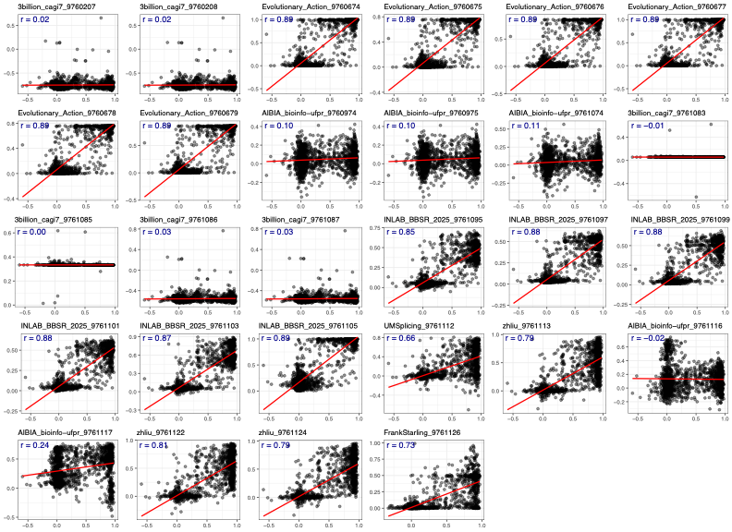
predictions
Ground truth

Slide 34
Training vs. Testing Dataset Overview
PSIRef | percent spliced in for references
PSIVar | percent spliced in for variants
∆PSI | PSIVar - PSIRef
PRESRef | Percent reference exon splicing in a reference sample
PRESVar | Percent reference exon splicing in a variant sample
∆PRES | PRESVar – PRESRef
AbSRef | AbSRef = 1 – PSIRef ⋅ PRESRef
AbSVar | AbSVar = 1 – PSIVar ⋅ PRESVar
∆AbS | AbSVar – AbSRef

Slide 35
Initial dataset []
Compare Delta_PSI
Add SpliceAI & Pangolin & Splicetransformer
Deep intron~(few)

Slide 36
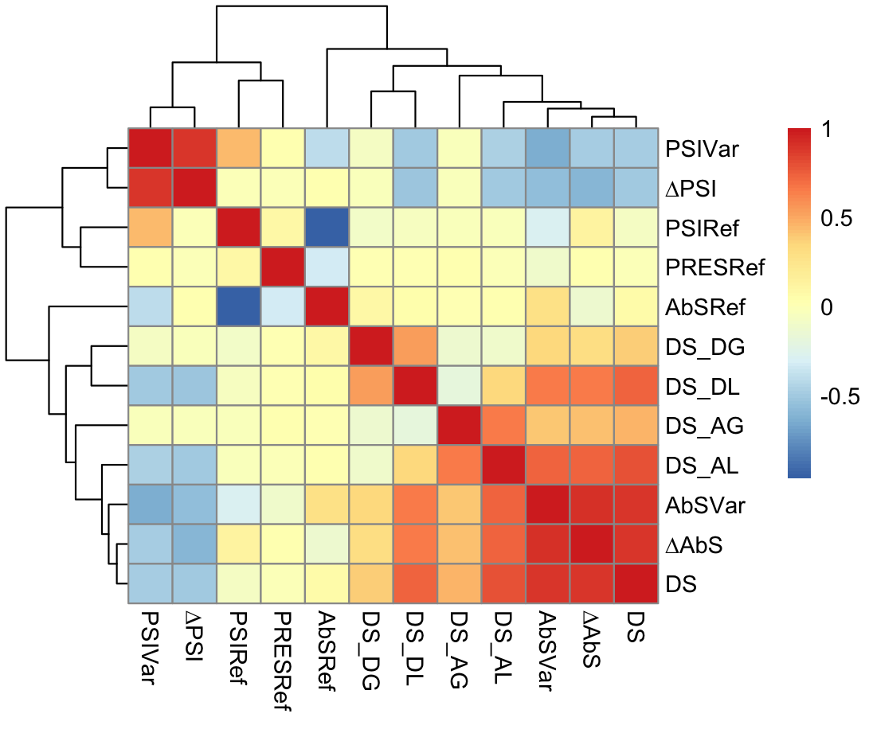

Slide 37
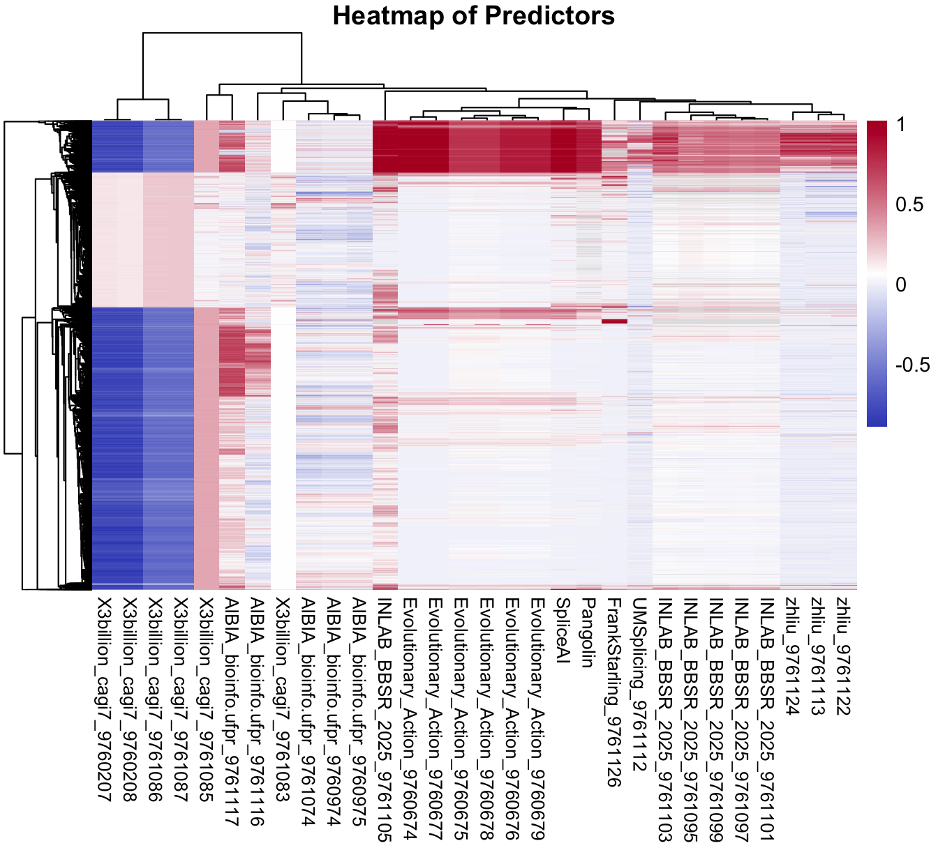
Test set: 9133

Slide 38
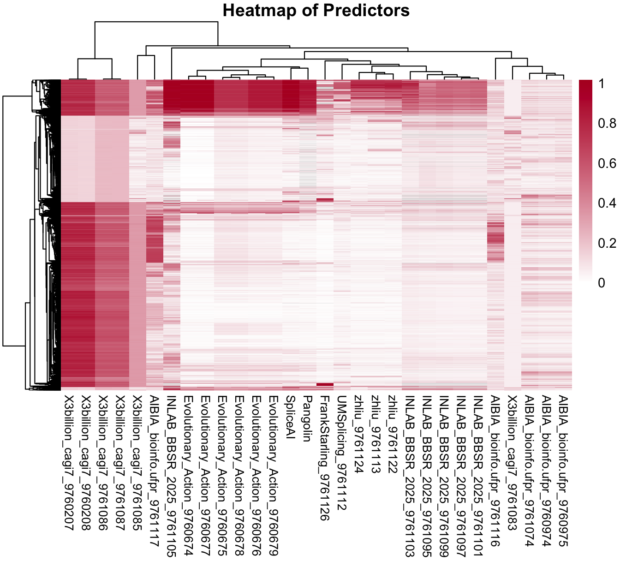
Test set: 9133
Absolute

