Slide 1

CAGI7 slide pack guidelines
I agree to my slides being used according to the following terms:
__Kinga Bujakowska__
Authors: please include THIS slide at the beginning of your presentation to indicate that you agree with reuse of your slides in CAGI presentations, according to the terms below, and digitally sign by writing your name above.
To disseminate the CAGI results, I encourage all CAGI participants to remix these CAGI slides for inclusion in their oral and poster presentations.
CAGI participants may use or publish any content of these slides only in compliance with the CAGI Data Use Agreement.
CAGI participants may not cite or publish any content of these slides except with the written permission of the originating author or in the primary CAGI publications.
CAGI participants must acknowledge the original authors of these slides and CAGI7. Include the acknowledgement banner across the bottom.
CAGI participants must include the CAGI credits slide in their presentations.
Slides with a red slash (no remix) may not be included in a presentation unless all attendees are registered CAGI participants who signed the data use agreement.
Slides with a red X over the entire slide may not be used in any circumstances.
Slides with a blue slash (embargoed) may not be used unless the embargo is explicitly lifted.
Slides without slash or X may be tweeted unless flagged with the “No tweet” icon.
CAGI participants using these slides must explain the “No tweet” icon, which means that the slide content should not be disseminated outside the presenting conference hall. If the presentation venue permits pervasive tweeting, you may not include these slides in your talk.
Note for slide authors: we expect all CAGI participants to abide by these restrictions and will make best effort to ensure they are followed. However, bear in mind that we have limited means of enforcing them, and therefore the restrictions cannot be guaranteed.
Notes:
At CAGI7, use of this slide pack is only required for CAGI dataset providers, assessors, and predictors, but all are encouraged to use the annotations for materials they do not want shared publicly.

Slide 2

Predict aberrant splicing for peri-exonic and deep intronic variants
Kinga M. Bujakowska
CAGI7 Conference
Boston, 2025-12-08

Slide 3
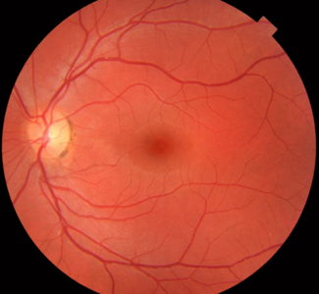
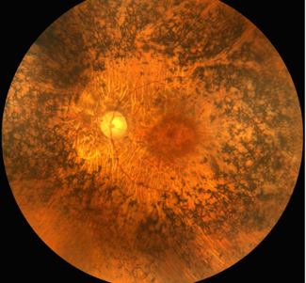
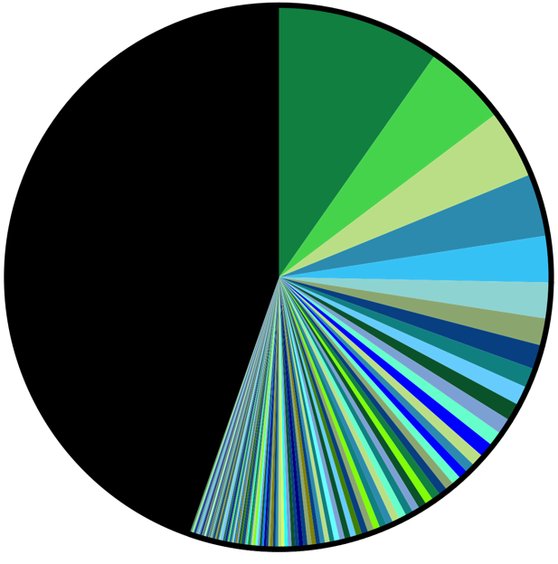
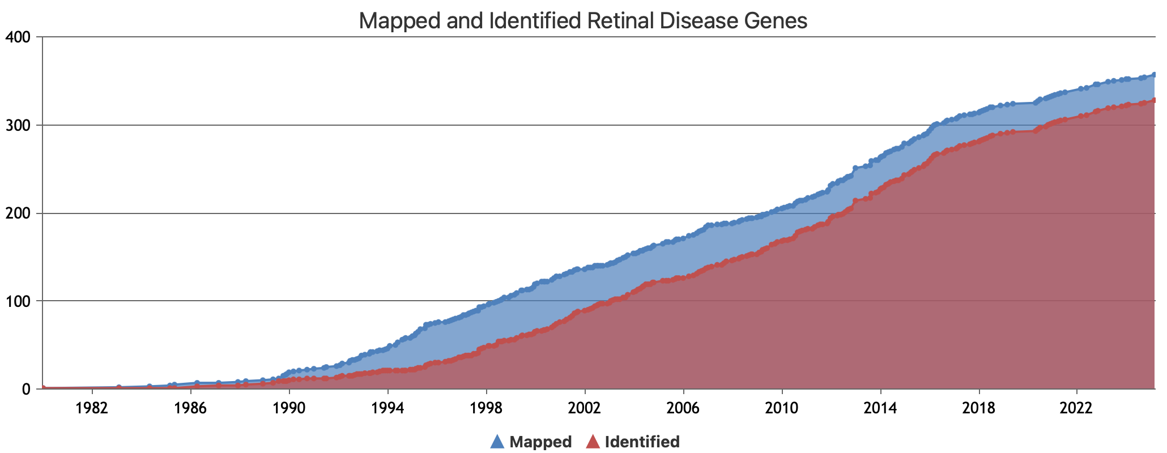
Study Motivation
Rod-Cone
Degeneration (RP)
Confident Genetic Diagnoses: 56%
Normal Retina
VUSs or no genetic lead
44%
328 identified genes
Illustration by Hilary Scott
RetNet April 7, 2025
CAGI7 Conference

Slide 4
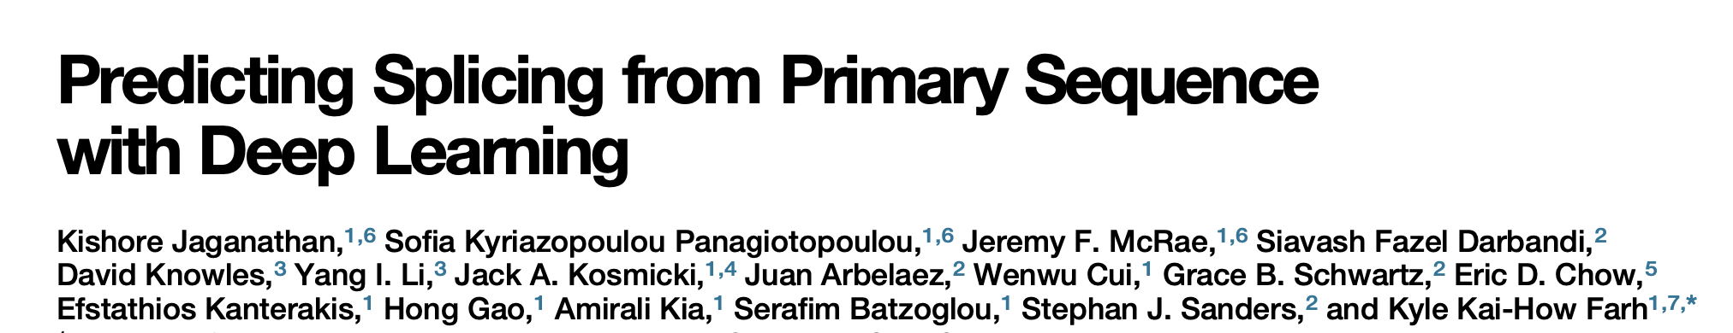
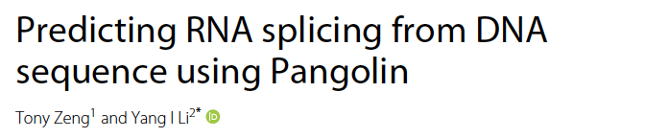
Study Motivation
Rod-Cone
Degeneration (RP)
Confident Genetic Diagnoses: 56%
Normal Retina
VUSs or no genetic lead
44%
328 identified genes
Can a substantial number of VUSs affect splicing?
Illustration by Hilary Scott
RetNet April 7, 2025
CAGI7 Conference

Slide 5
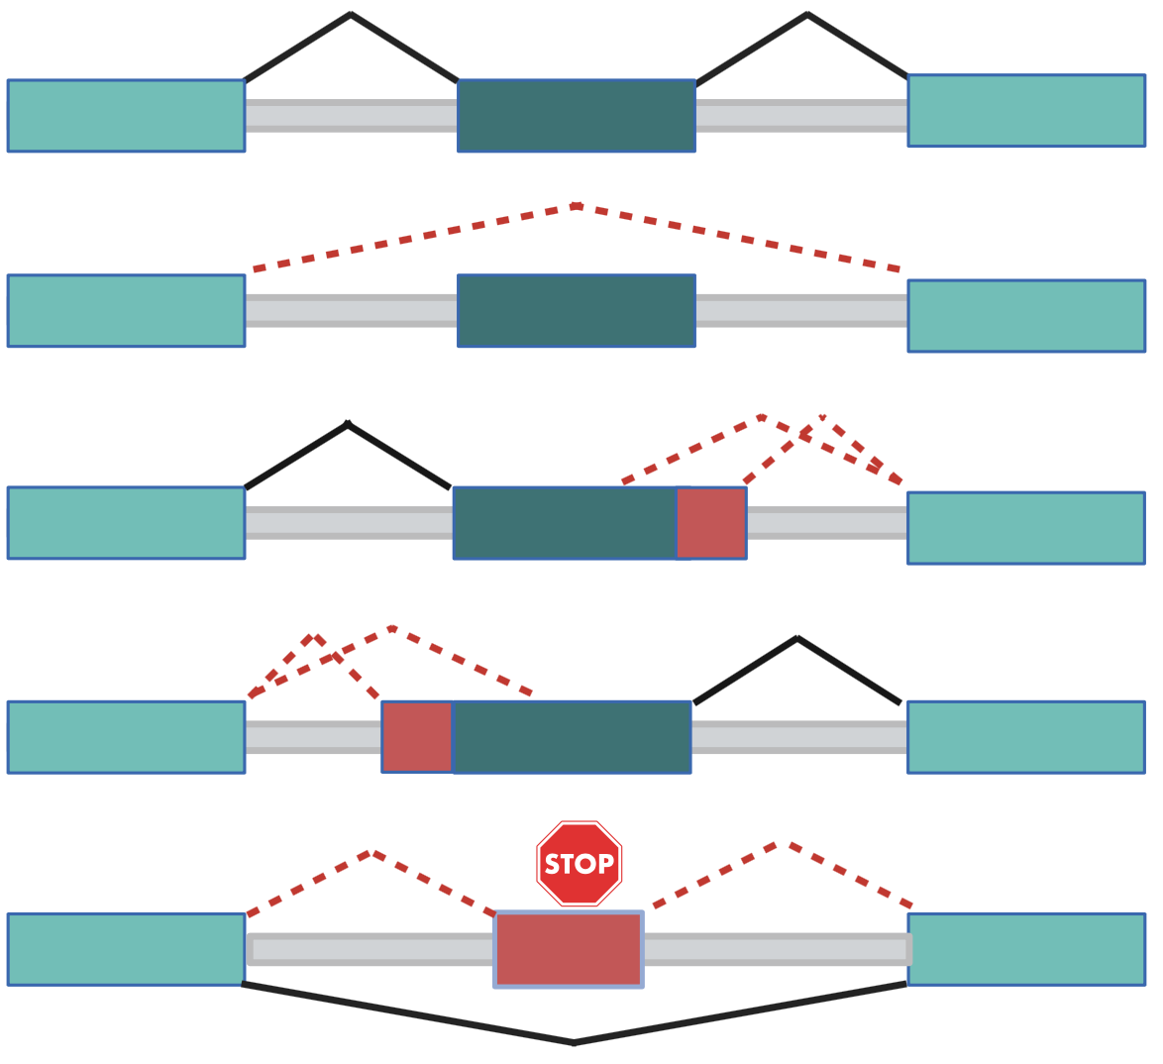
Aberrant Splicing events
Reference Splicing
Exon Skipping
Aberrant 3’ Splice Site
Aberrant 5’ Splice Site
Cryptic Exon Inclusion
CAGI7 Conference

Slide 6
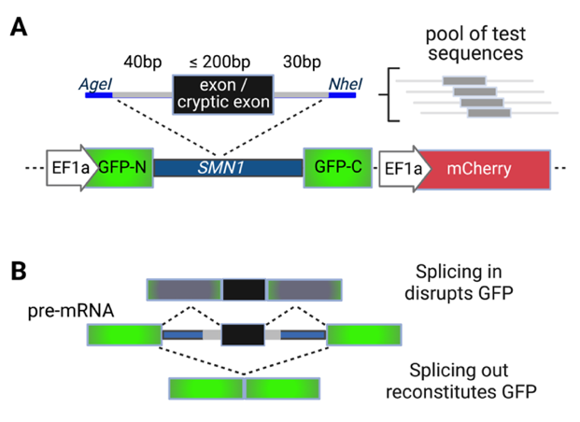
High throughput splicing assay (HTSA)
Scott et al 2023
Adapted from Cheung et al 2019
CAGI7 Conference
Notes:
each cell 1 mutation but each variant at least 100 cells…

Slide 7
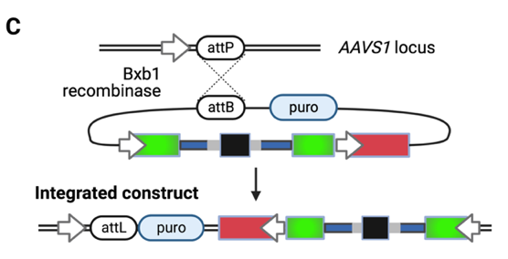
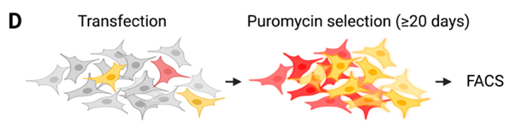
High throughput splicing assay (HTSA)
HEK293 cells
Scott et al 2023
Adapted from Cheung et al 2019
CAGI7 Conference
Notes:
each cell 1 mutation but each variant at least 100 cells…

Slide 8
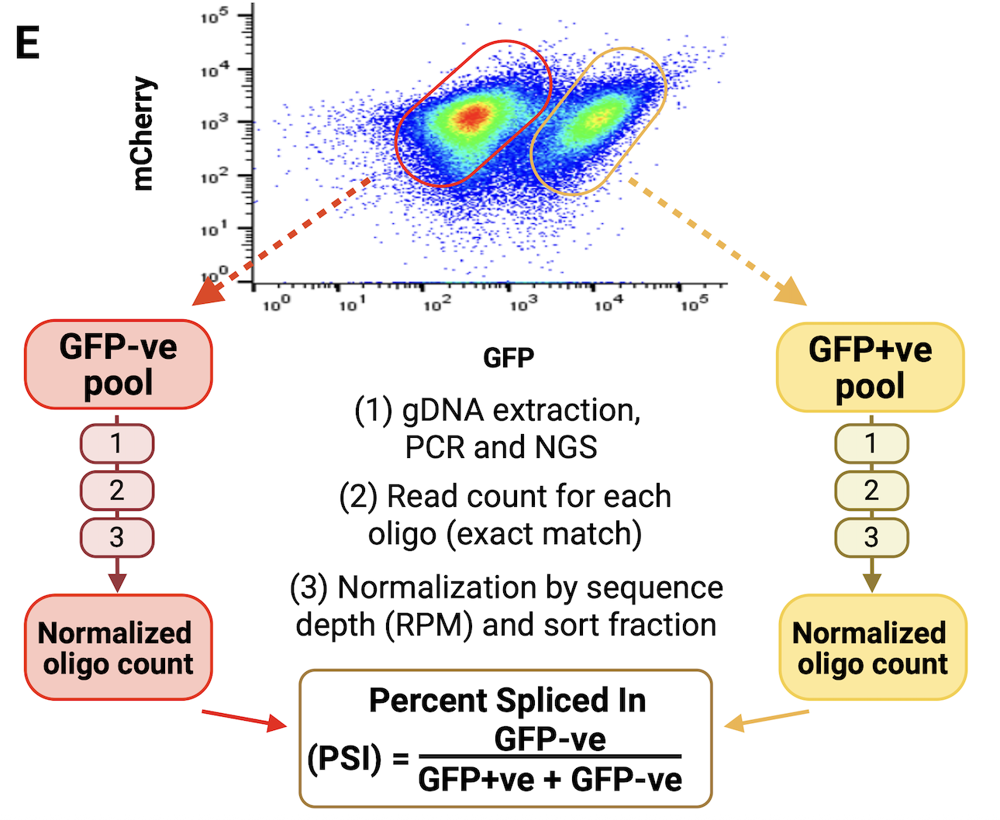

FACS
Exon inclusion
Exon skipping
The fraction of minigene transcripts with the test exon included
CAGI7 Conference
Notes:
EII box / text in red, bigger

Slide 9
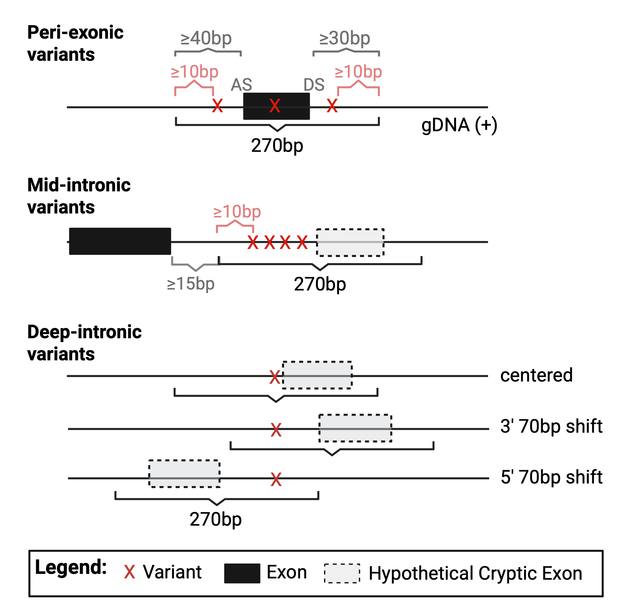
Oligo Design
2152 exons
864 intronic oligos
835 AS/DS controls
2950 Variants
CAGI7 Conference

Slide 10
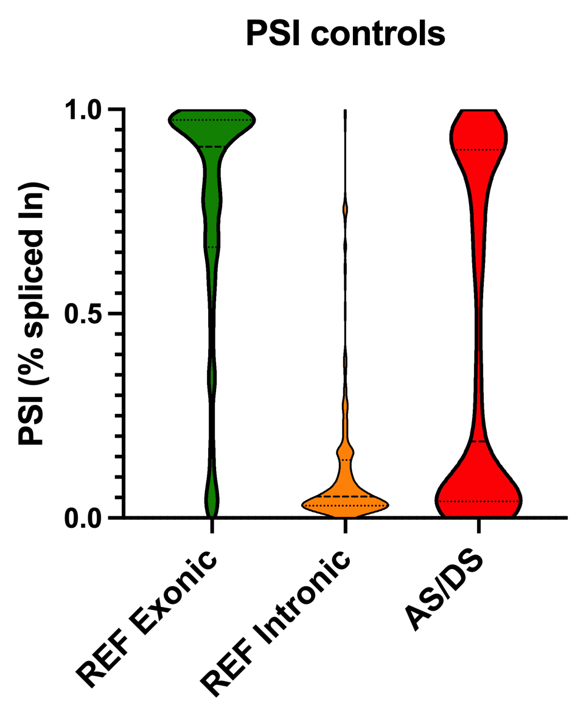
PSI Controls
CAGI7 Conference

Slide 11
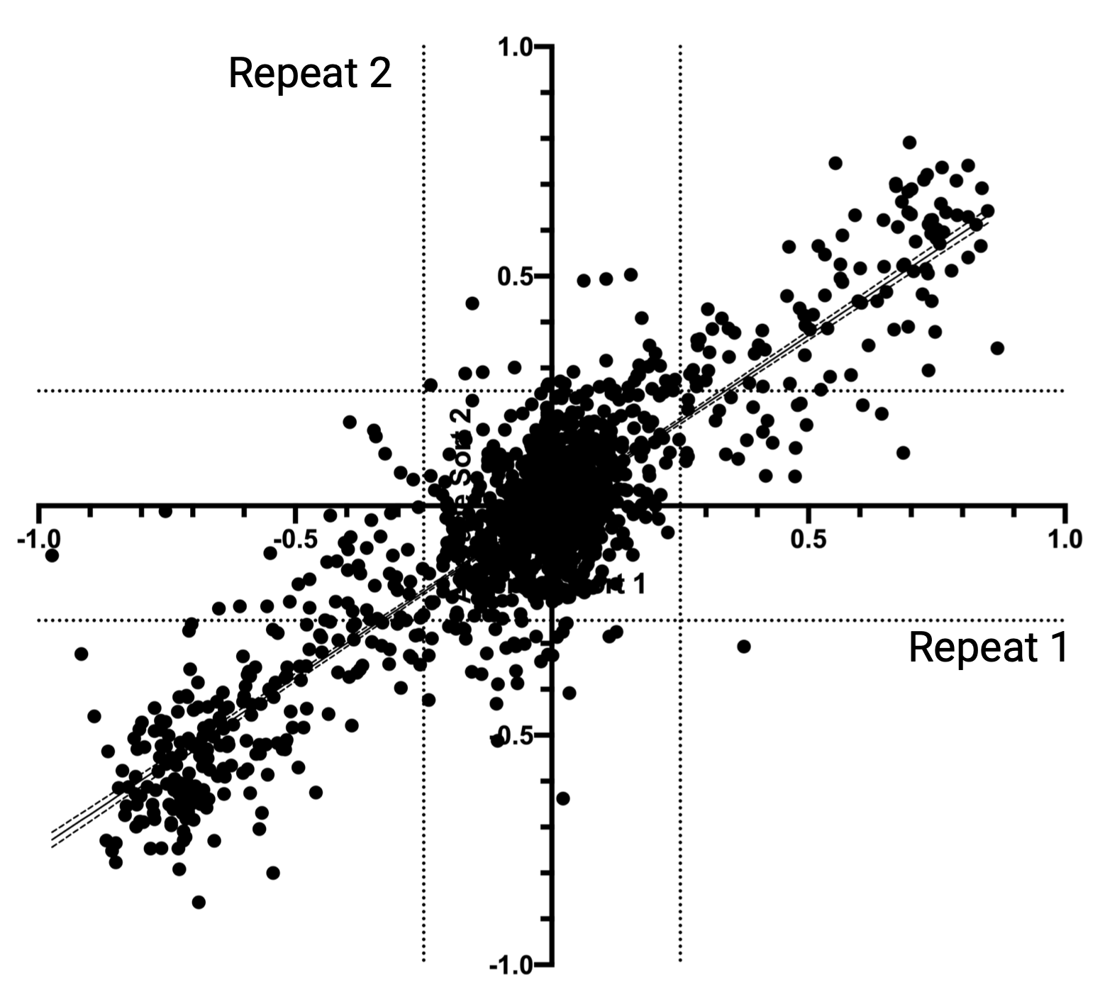
Reproducibility of the Assay
ΔPSI = PSI_{Var} - PSI_{Ref}
y = 0.75x - 0.0017
r² = 0.78 p <0.0001
CAGI7 Conference

Slide 12
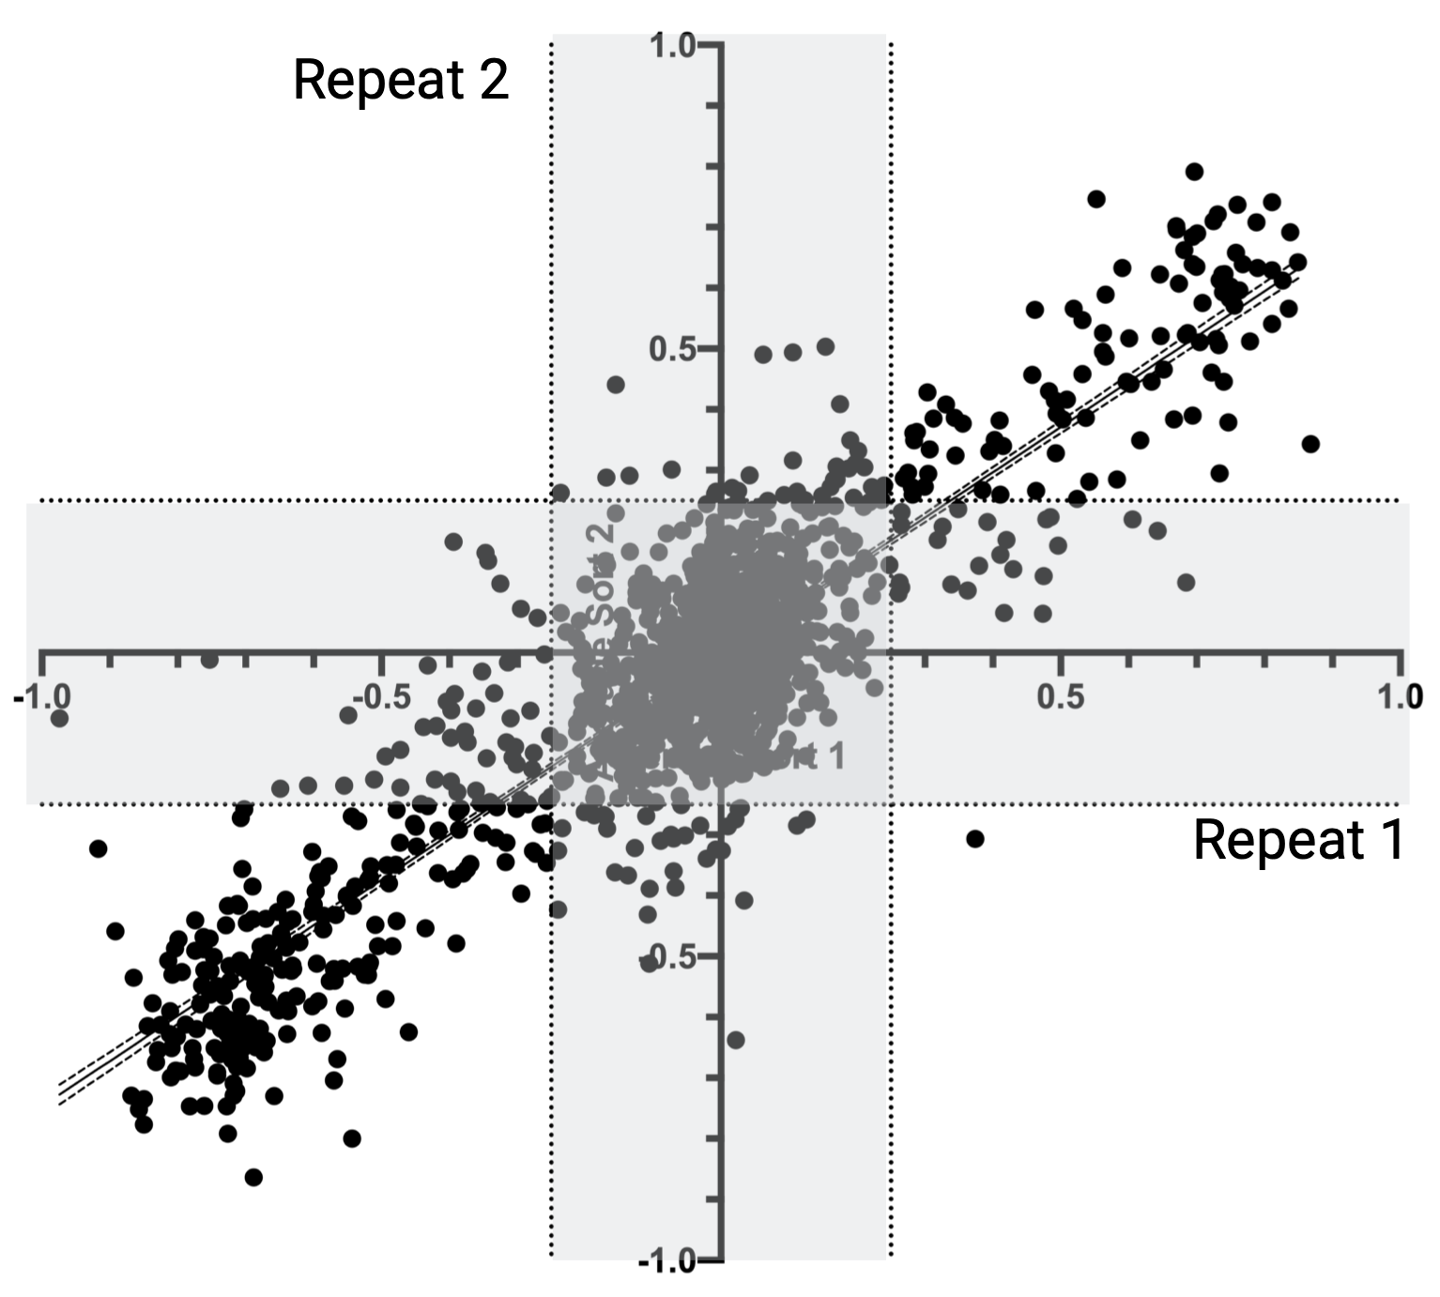
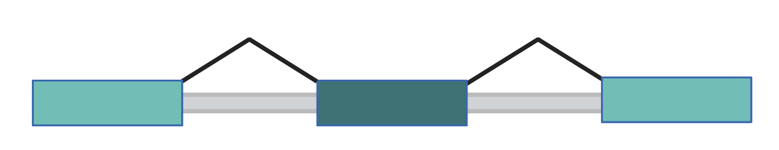
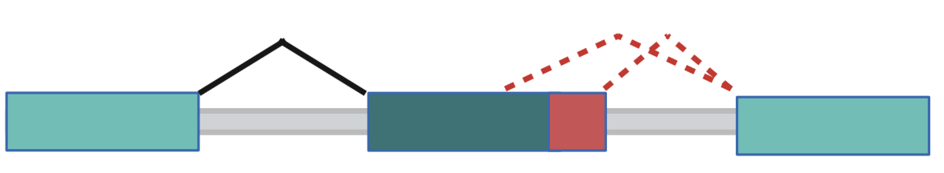
Reproducibility of the Assay
ΔPSI = PSI_{Var} - PSI_{Ref}
No effect on exon inclusion
y = 0.75x - 0.0017
r² = 0.78 p <0.0001
CAGI7 Conference

Slide 13
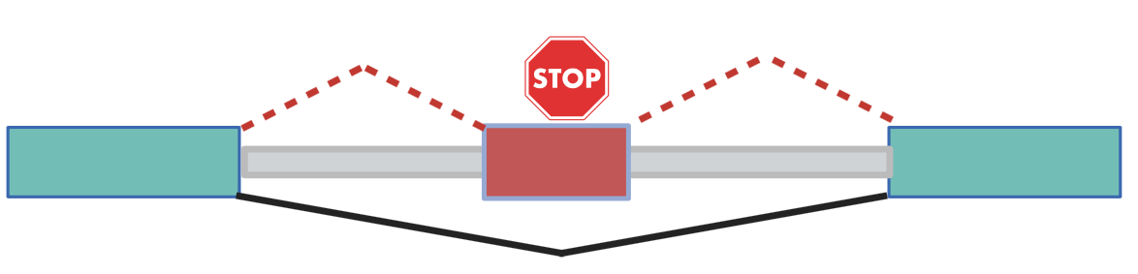
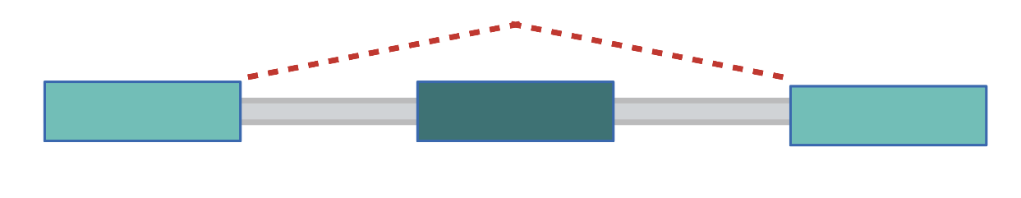
Reproducibility of the Assay
ΔPSI = PSI_{Var} - PSI_{Ref}
Cryptic exon inclusion
No effect on exon inclusion
Exon skipping
y = 0.75x - 0.0017
r² = 0.78 p <0.0001
CAGI7 Conference

Slide 14
HTSA vs Different Splicing Events
Reference Splicing
Exon Skipping
Aberrant 3’ Splice Site
Aberrant 5’ Splice Site
Cryptic Exon Inclusion
CAGI7 Conference

Slide 15
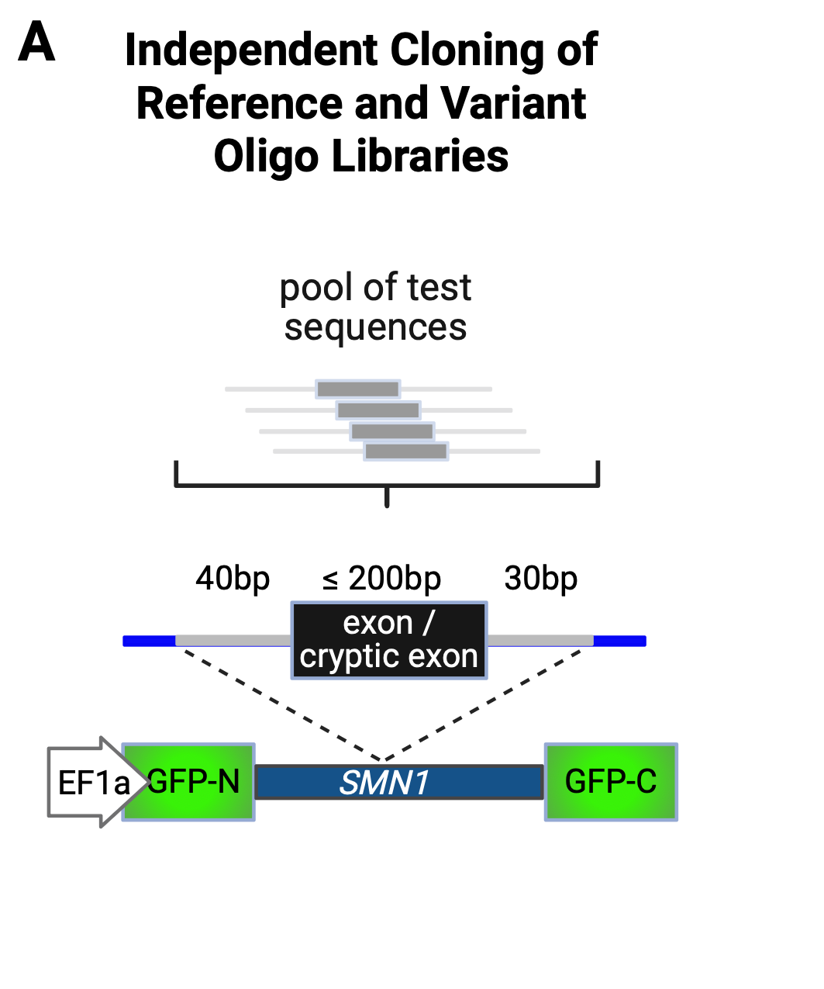
Experiment 2: HTSA RT-PCR
CAGI7 Conference

Slide 16
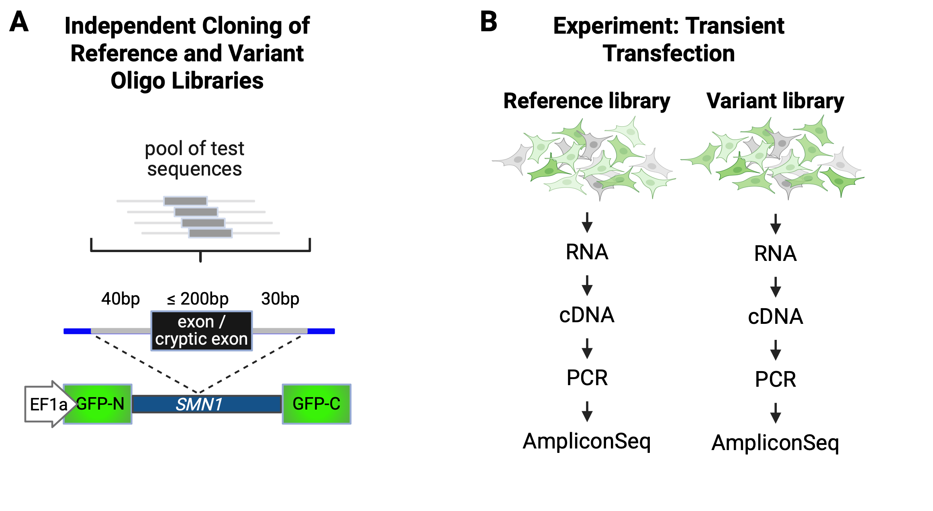
Experiment 2: HTSA RT-PCR
CAGI7 Conference

Slide 17
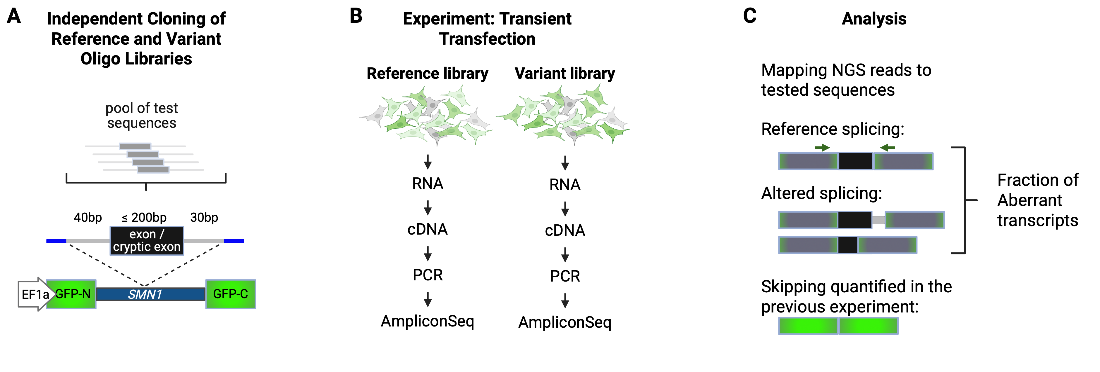
Experiment 2: HTSA RT-PCR
CAGI7 Conference

Slide 18
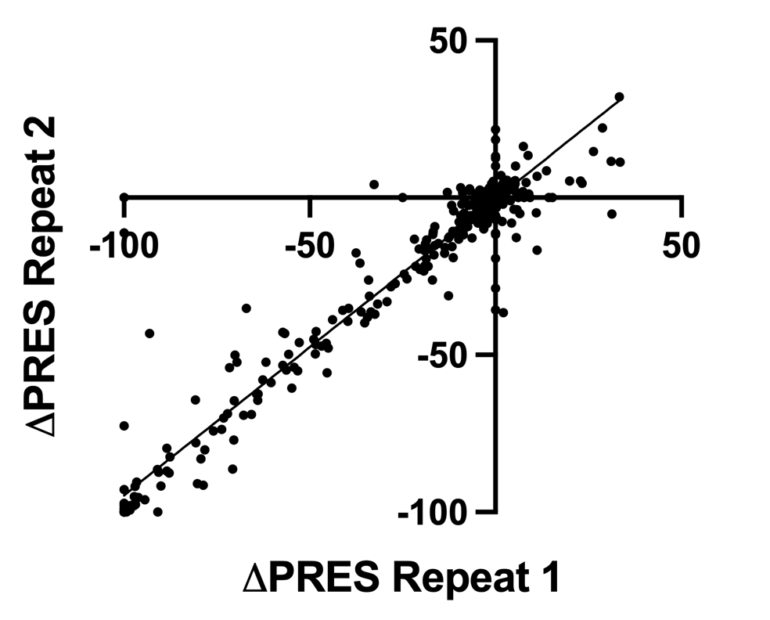
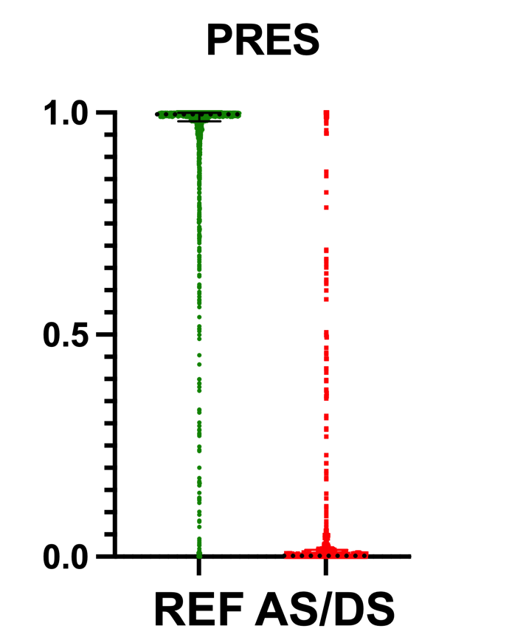
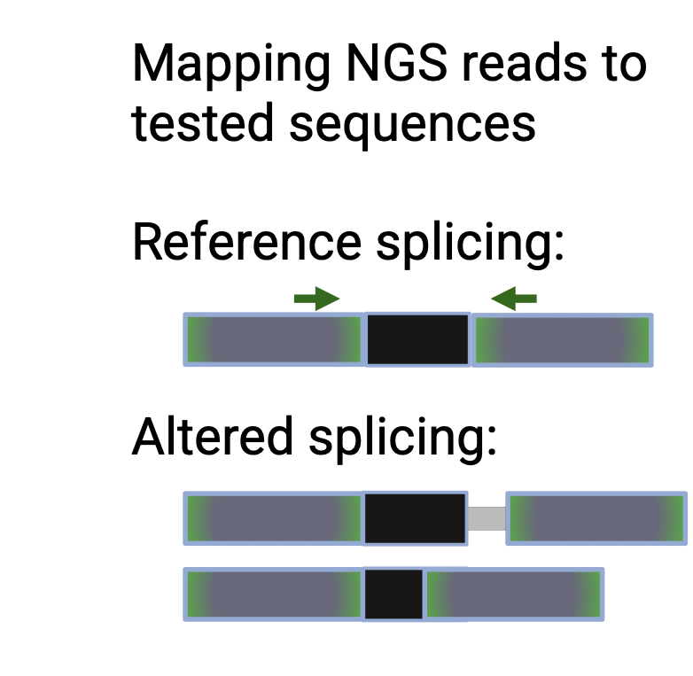
PRES: Percent Reference Exon Splicing
y = 0.94x - 0.43
r² = 0.94 p <0.0001
CAGI7 Conference

Slide 19
Overall Aberrant Splicing Score
  If peri-exonic variant leads to 50% exon skipping with a perfect reference:
  PSI_{Var} = 0.5 and PSI_{Ref} = 1 then ∆PSI = -0.5
  If 30% of spliced-in transcripts show reference exon splicing:
  PRES_{Var} = 0.3 and PRES_{Ref} = 1 then ∆PRES = -0.7
  Then:
  Aberrant Splicing Score of the variant (AbS_{Var}) and the reference (AbS_{Ref}):
  AbS_{Var} = 1 – PSI_{Var} ⋅ PRES_{Var} = 1 – 0.5 ⋅ 0.3 = 1 – 0.15 = 0.85
  AbS_{Ref} = 1 – PSI_{Ref} ⋅ PRES_{Ref} = 1 – 1 ⋅ 1 = 0
  ∆AbS = AbS_{Var} – AbS_{Ref} = 0.85 - 0
CAGI7 Conference

Slide 20
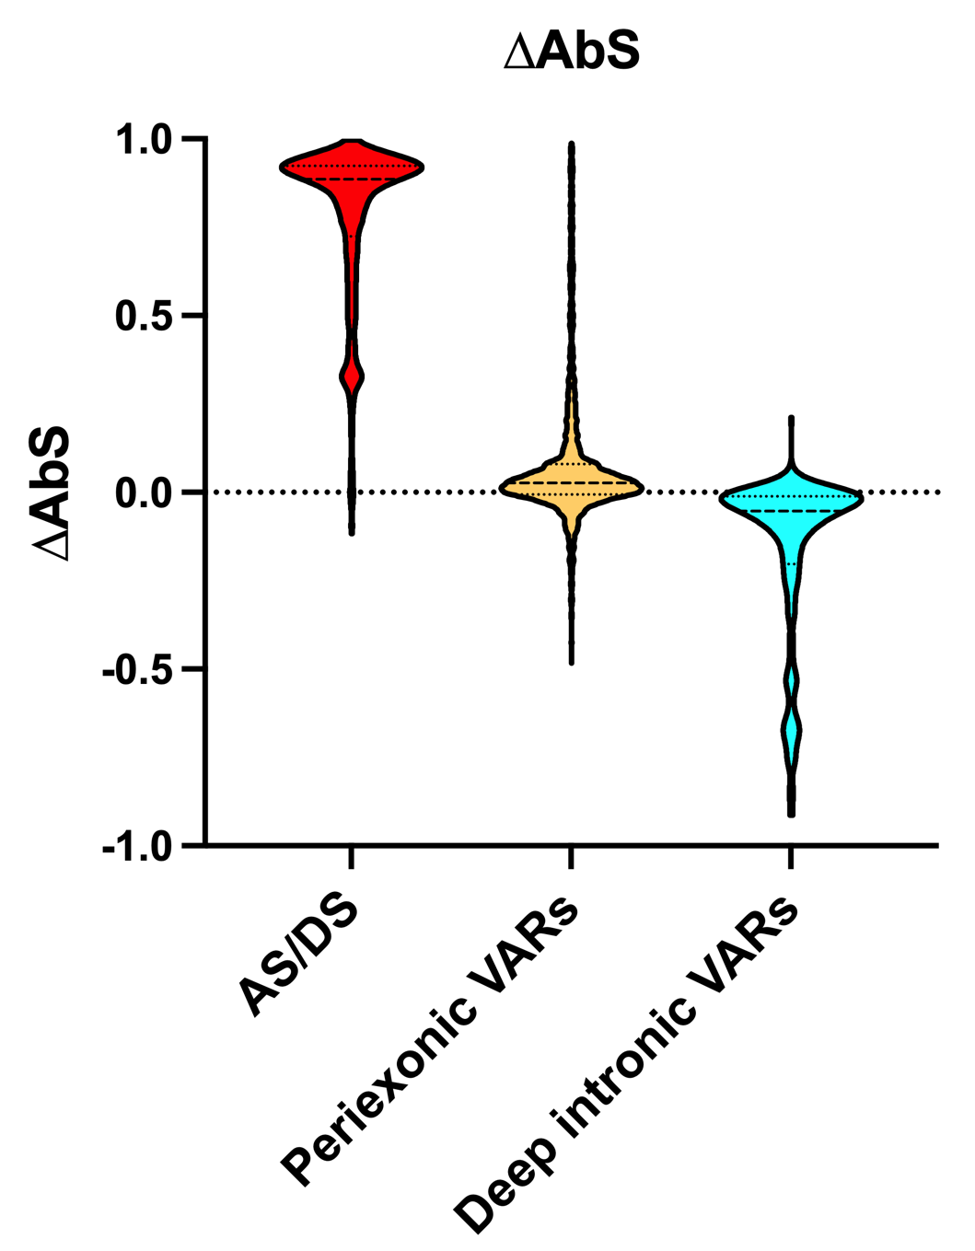
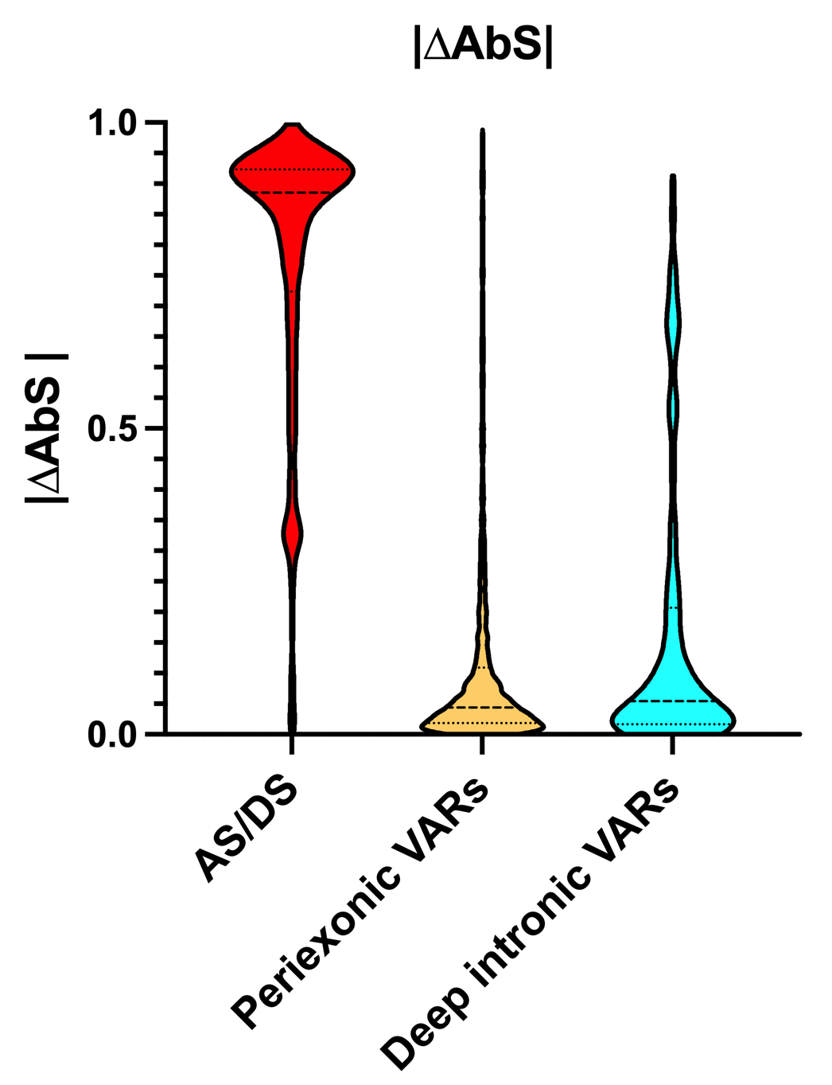
∆AbS values
Absolute ∆AbS values
CAGI7 Conference

Slide 21
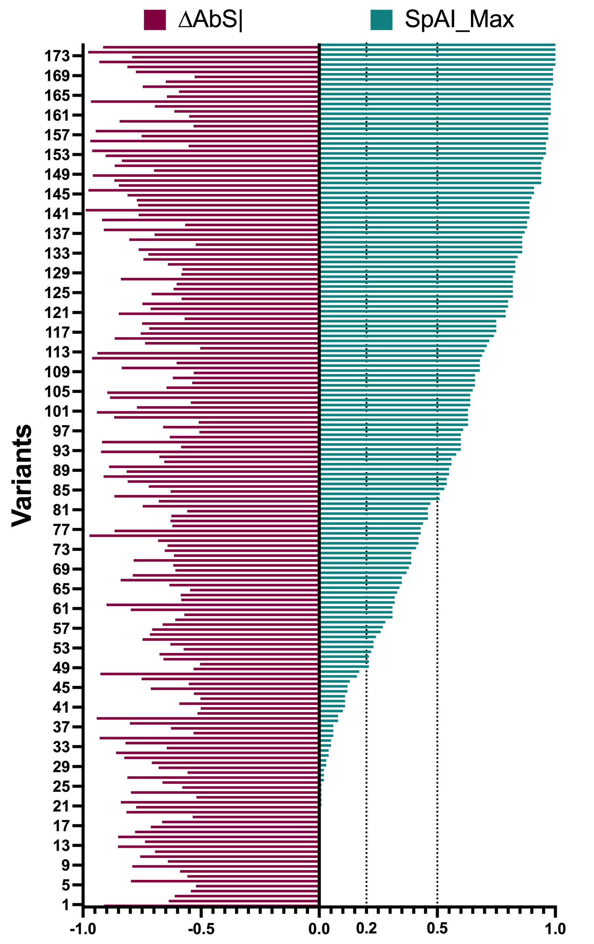
Overall results: 175/2950 variants (∆AbS ≥ 0.5)
HTSA vs SpAI
2 deep intronic variants
SpAI<0.5 (82 hits)
3 deep intronic variants
SpAI<0.2 (48 hits)
SpAI=0 (20 hits)
CAGI7 Conference

Slide 22
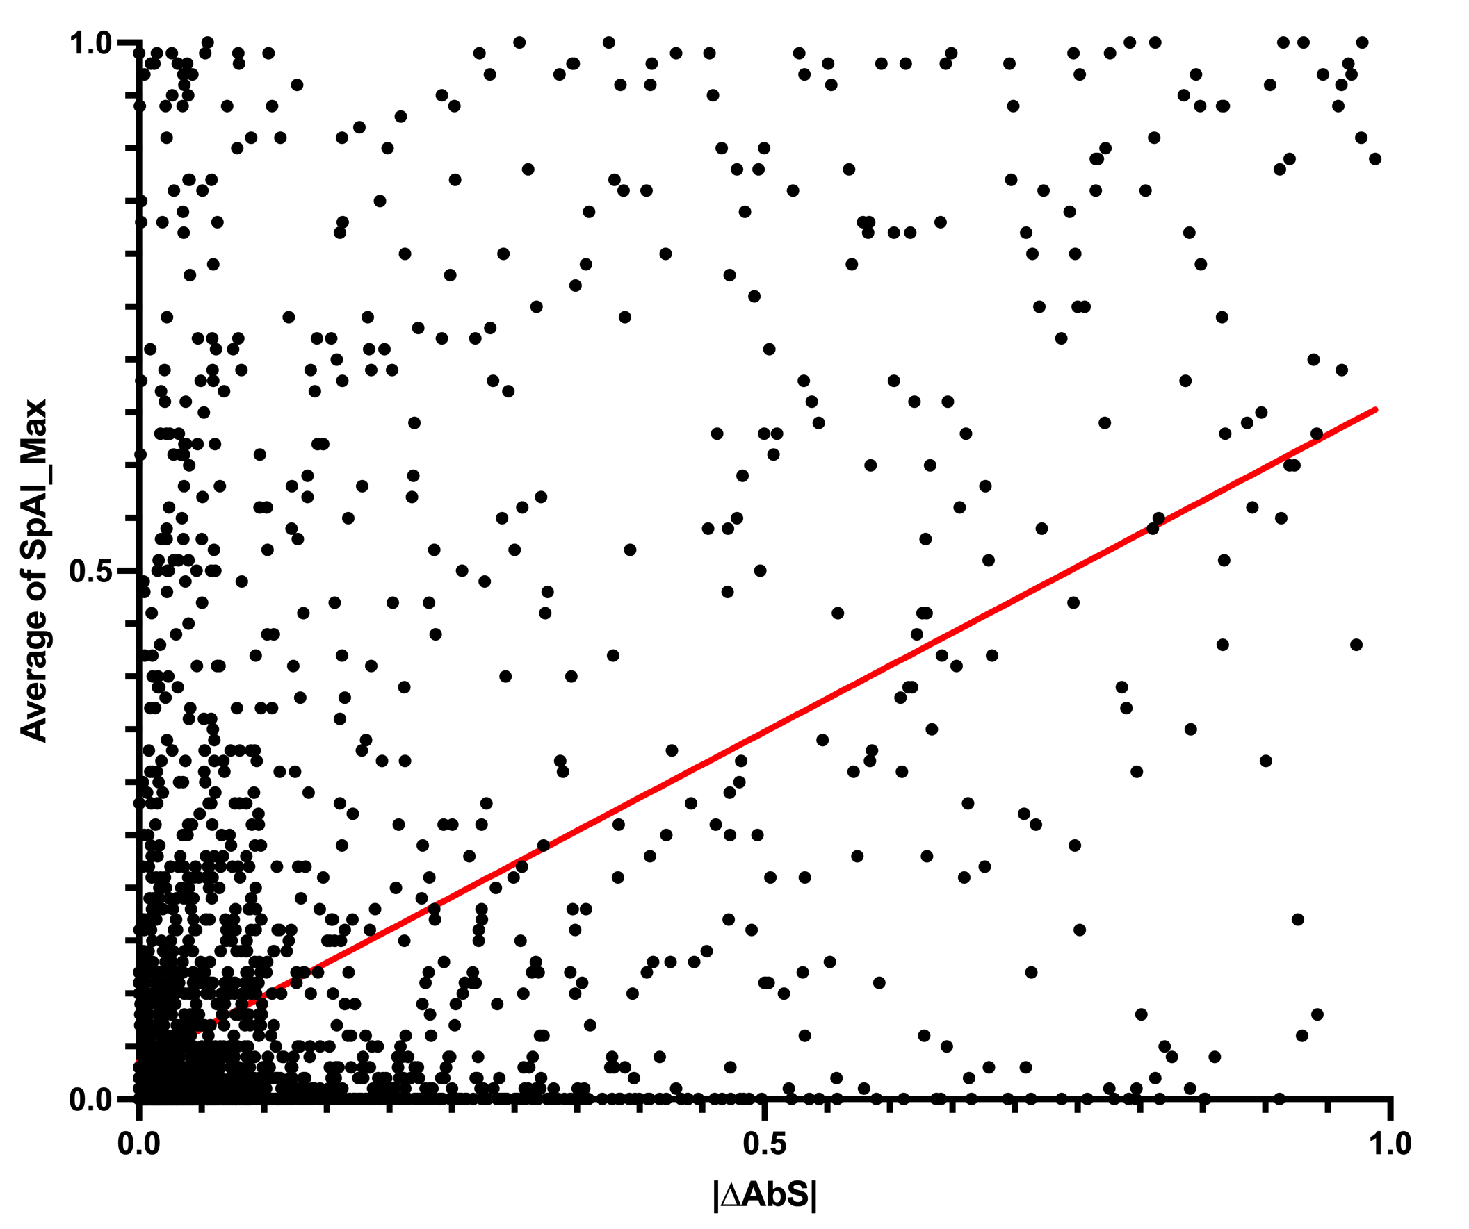
Overall results: 175/2950 variants (∆AbS ≥ 0.5)
HTSA vs SpAI
2 deep intronic variants
2950 Variants
SpAI<0.5 (82 hits)
3 deep intronic variants
SpAI<0.2 (48 hits)
SpAI=0 (20 hits)
y = 0.625x + 0.035, r²= 0.238
CAGI7 Conference

Slide 23
HTSA Future Directions
Major critiques of HTSA:
  Mini-gene approach lacks genomic context
  HEK293 cells don’t recapitulate the cell-specific splicing
  About 10% of the references show poor performance
Future directions
  Prime-editing based multiplexed mutagenesis
  Different cell types or iPSC-derived retinal cells
CAGI7 Conference

Slide 24
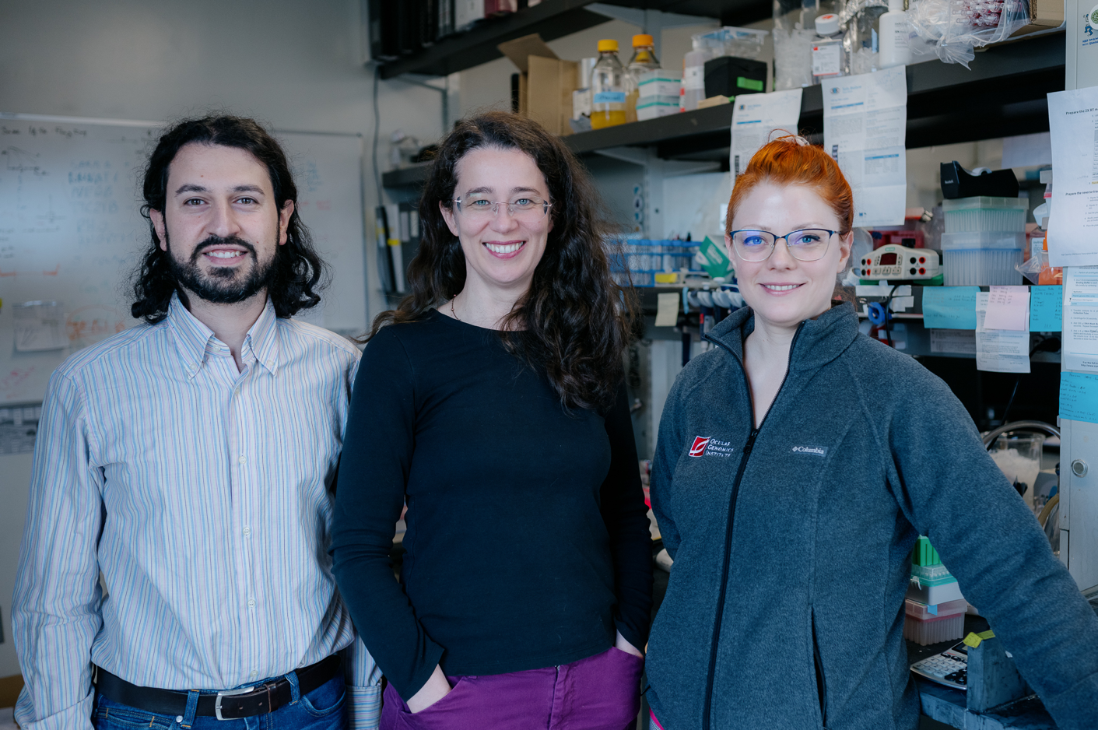
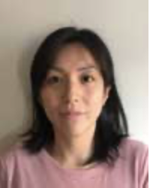






Thank you
CAGI7
Predrag Radivojac
Nilah Monnier Ioannidis
Steven Brenner
Sirui Zhang
Zefeng Wang
Ocular Genomics Institute
Eric Pierce
Jason Commander
Marcela Garita-Hernandez
Rachel Huckfeldt
Janey Wiggs
Ayellet Segre
Lizzy Rossin
Qin Liu
Shisong Rong
Carol Weigel-DiFranco
Anna Larson
Marianna Weener
Hilary Scott
Genetic Counseling
Emily Place
Kate O’Connell
John Borchert
Netra Bellur-Modur
Bujakowska Lab
Riccardo Sangermano
Egle Galdikaite-Braziene
Mihoko Leon
Jatniel Rodriguez
Bioinformatics
Sudeep Mehrotra
Daniel Navarro-Gomez
Mihoko
Collaborators
Anne O’Donnell-Luria Heidi Rehm
Daniel Calame
GREGoR
Riccardo
Egle

