Slide 1

CAGI 7 slides – Steve Mount
I agree to my slides being used according to the following terms:
_______Steve Mount_______
Authors: please include THIS slide at the beginning of your presentation to indicate that you agree with reuse of your slides in CAGI presentations, according to the terms below, and digitally sign by writing your name above.
At CAGI 7, use of this slide pack is only required for CAGI dataset providers, assessors, and predictors, but all are encouraged to use the annotations for materials they do not want shared publicly.
All slides in this talk may be shared publicly.
To disseminate the CAGI results, I encourage all CAGI participants to remix these CAGI slides for inclusion in their oral and poster presentations
CAGI participants may use or publish any content of these slides only in compliance with the CAGI Data Use Agreement
CAGI participants may not cite or publish any content of these slides except with the written permission of the originating author or in the primary CAGI publications
CAGI participants must acknowledge the original authors of these slides and CAGI 7. Include the acknowledgement banner across the bottom
CAGI participants must include the CAGI credits slide in their presentations
Slides with a red slash (no remix) may not be included in a presentation unless all attendees are registered CAGI participants who signed the data use agreement
Slides with a red X over the entire slide may not be used in any circumstances
Slides with a blue slash (embargoed) may not be used unless the embargo is explicitly lifted
Slides without slash or X may be tweeted, tooted, posted, X’d unless flagged with “No tweet” icon
CAGI participants using these slides must explain the “No tweet” icon, which means that the slide content should not be disseminated outside the presenting conference hall. If the presentation venue permits pervasive tweeting, you may not include these slides in your talk
Note for slide authors: we expect all CAGI participants to abide by these restrictions, and will make best effort to ensure they are followed. However, but bear in mind that we have limited means of enforcing them, and therefore the restrictions cannot be guaranteed.

Slide 2

Splicing Variant Impact Prediction:
The state of the art and some issues
Steve Mount
University of Maryland, College Park
CAGI 7
Dec. 8, 2025
Created for CAGI 7
Splicing Variant Impact Prediction
a review by Steve Mount
genomeinterpretation.org

Slide 3
Splicing Variant Impact Prediction:
The state of the art and some issues
The problem can be broken down into three:
1) Does the variant alter splicing?
2) How does the variant alter splicing?
What isoforms are affected and what alternative isoforms result?
3) What is the function of altered isoforms?
Created for CAGI 7
Splicing Variant Impact Prediction
a review by Steve Mount
genomeinterpretation.org

Slide 4
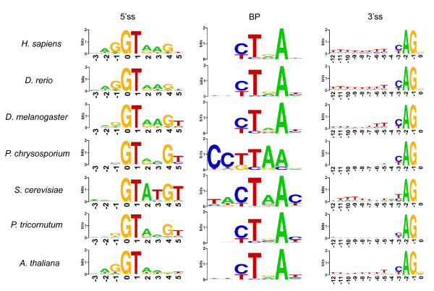
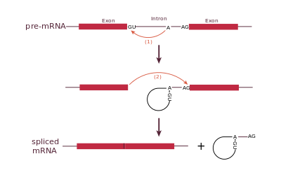
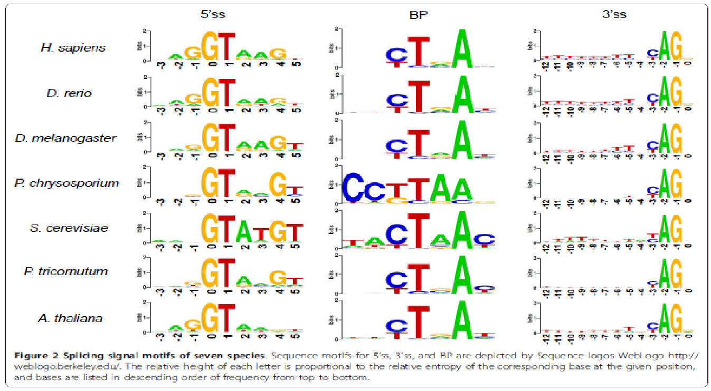
Does the variant alter splicing?
Core splicing signals:
GT and AG
MaxEnt
Created for CAGI 7
Splicing Variant Impact Prediction
a review by Steve Mount
genomeinterpretation.org

Slide 5
Does the variant alter splicing?
pyrimidine tract
AG exclusion zone
branch site
...
Created for CAGI 7
Splicing Variant Impact Prediction
a review by Steve Mount
genomeinterpretation.org

Slide 6
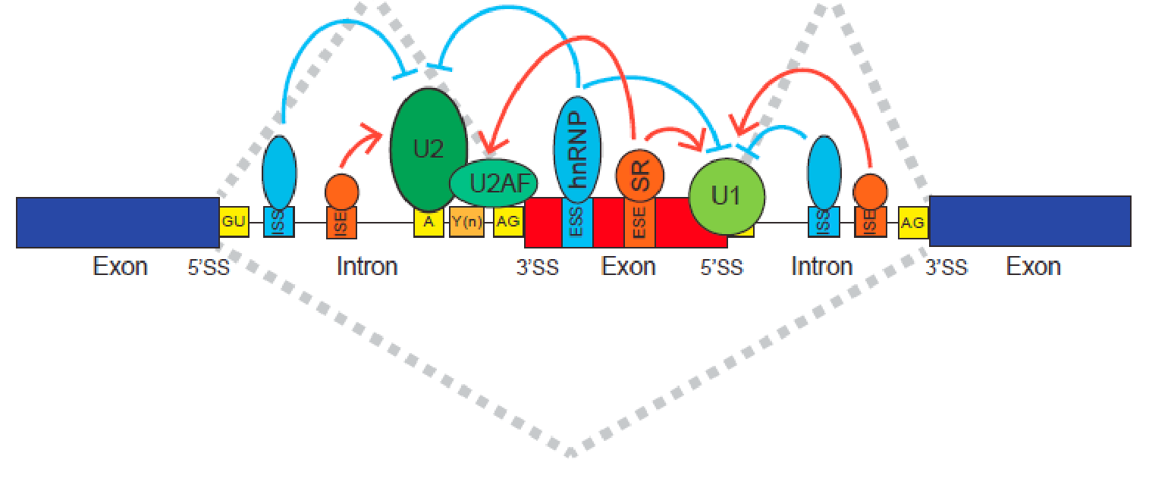
Does the variant alter splicing?
Auxiliary splicing signals:
ESE: exonic splicing enhancer
ESS: exonic splicing silencer
ISE: intronic splicing enhancer
ISS: intronic splicing silencer
From The Expanding Landscape of Alternative Splicing Variation in Human Populations.
by: Eddie Park, Zhicheng Pan, Zijun Zhang, Lan Lin, Yi Xing
American journal of human genetics, Vol. 102, No. 1. (04 January 2018), pp. 11-26
Created for CAGI 7
Splicing Variant Impact Prediction
a review by Steve Mount
genomeinterpretation.org

Slide 7
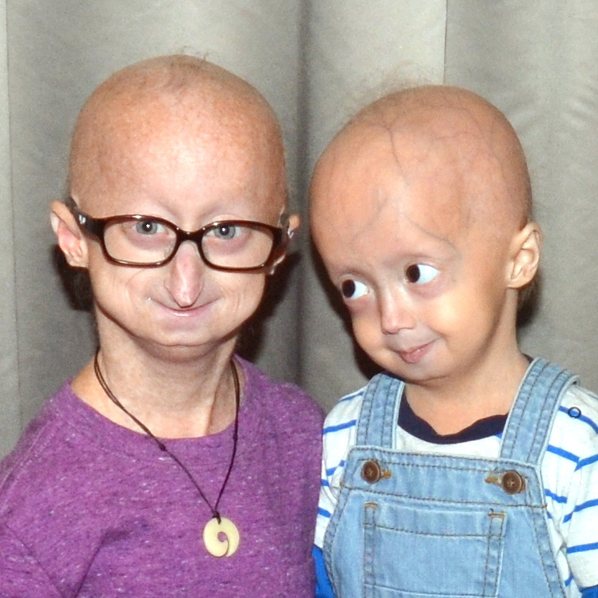
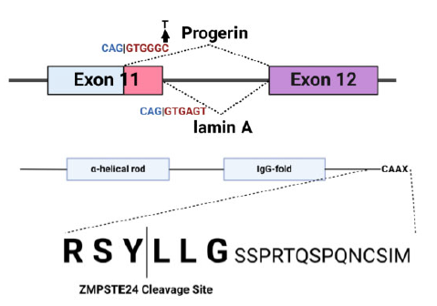
Does the variant alter splicing?
Splice site gain: cryptic splice sites.
Created for CAGI 7
Splicing Variant Impact Prediction
a review by Steve Mount
genomeinterpretation.org

Slide 8
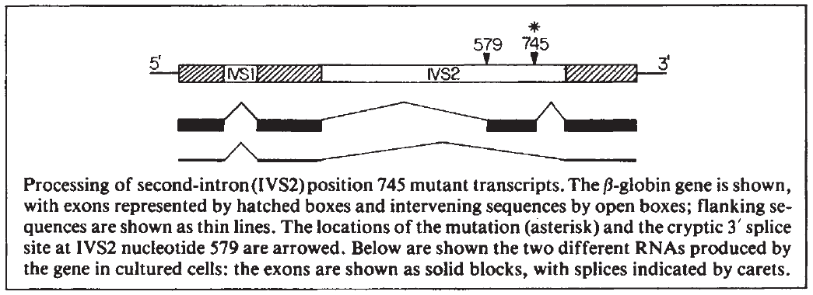
Does the variant alter splicing?
Splice site gain: cryptic exon activation.
from: Mount and Steitz 1983. “Lessons from Mutant Globins” Nature 303:380
2025: Three Clinvar pathogenic variants activate cryptic exons in paring with the same cryptic 3’ SS
579: TCTCTTTCTTTCAG|GGC
654: AAG|GCAATA
AAG|GTAATA
cons: MAG|GTRAGT
705: GAT|GTAAGG
GAG|GTAAGG
cons: MAG|GTRAGT
745: CAG|CTACAA
: CAG|GTACAA
cons: MAG|GTRAGT
Created for CAGI 7
Splicing Variant Impact Prediction
a review by Steve Mount
genomeinterpretation.org

Slide 9
Does the variant alter splicing?
Computational methods:
SpliceAI (Illumina 2019. 32 layer convolutional neural network)
- still the gold standard
- CI-SpliceAI (Strauch et al. 2022;
- OpenSpliceAI (Chao et al. 2025; Pertea JHU)
Pangolin (Zeng et al. 2022)
- introduces tissue-specificity
SpTransformer (You et al. 2024)
- transformer based. 15 tissues.
Transformer-45k (Jonsson et al. 2024)
- transformer based. DeCode 45k context
Splicing Variant Impact Prediction
a review by Steve Mount
genomeinterpretation.org

Slide 10
Does the variant alter splicing?
Minigene reporter assays (a sparse sample):
Singh and Cooper 2006 “Minigene reporter for identification and analysis of cis elements and trans factors affecting pre-mRNA splicing” Biotechniques
Vex-seq (Adamson et al. 2018. Graveley. CAGI5)
- sequencing assay with barcode in downstream exon, UMI.
MaPSY (Soemedi et al. 2017)
- exonic variant inclusion assayed by sequencing
SeqSplice (Canson et al. 2025)
- barcoded with sequencing assay
HTSA (Cheung et al. 2019; CAGI7 - Bujakowska)
- landing pad and FACS
Splicing Variant Impact Prediction
a review by Steve Mount
genomeinterpretation.org

Slide 11
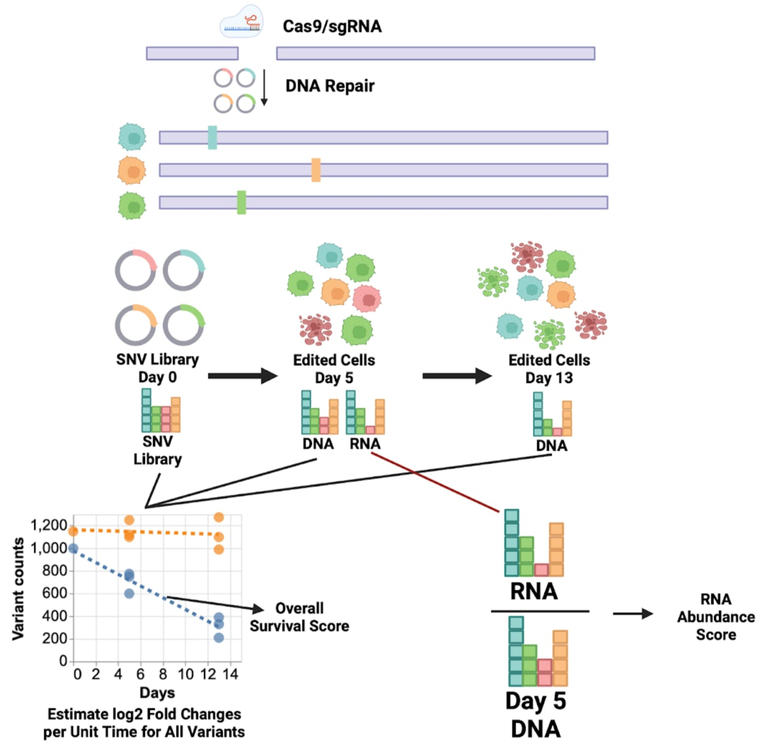
Does the variant alter splicing?
Direct examination of spliced RNA from the variant in its genomic context (patient or CRISPR):
Wai et al. 2020 (D. Baralle)
“Blood RNA analysis can increase clinical diagnostic rate and resolve variants of uncertain significance”
CAGI6
Findlay et al. 2014 (Shendure)
“Saturation editing of genomic regions by multiplex homology-directed repair”
CAGI7 BARD1 challenge
“Predict the effect of BARD1 single nucleotide variants on RNA abundance”
Splicing Variant Impact Prediction
a review by Steve Mount
genomeinterpretation.org

Slide 12
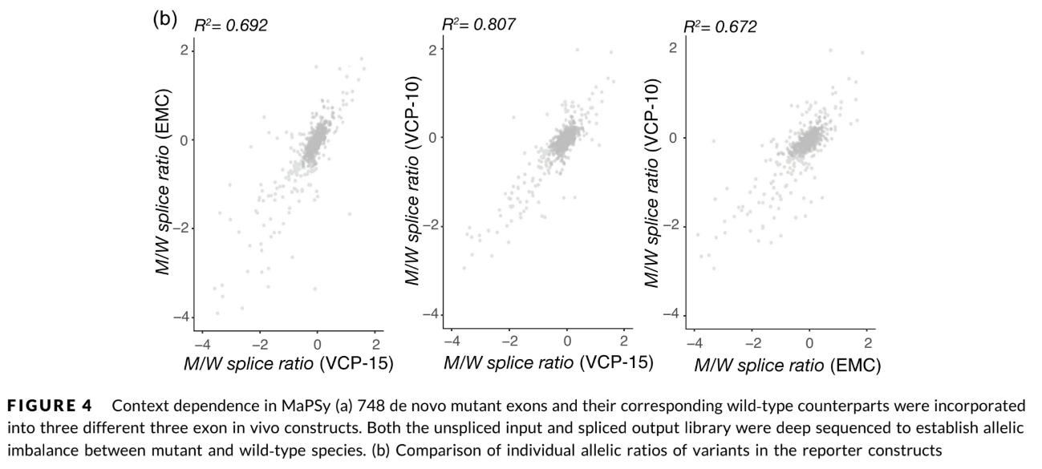
Does the variant alter splicing?
The importance of context
Data from Rhine et al. CAGI5 "Future directions for high-throughput splicing assays in precision medicine."
Splicing Variant Impact Prediction
a review by Steve Mount
genomeinterpretation.org

Slide 13
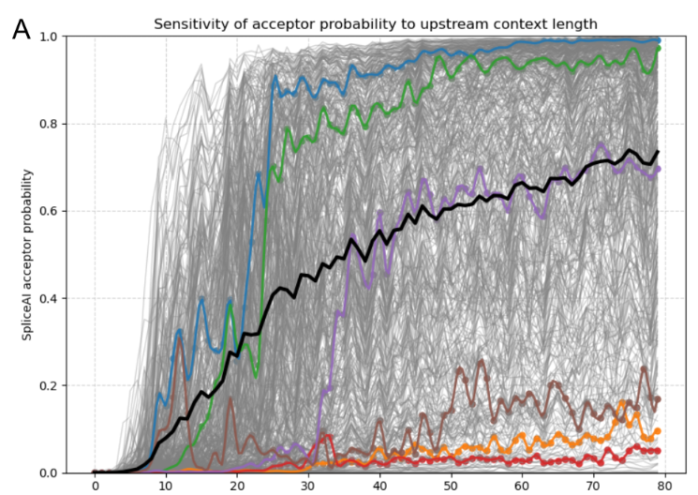
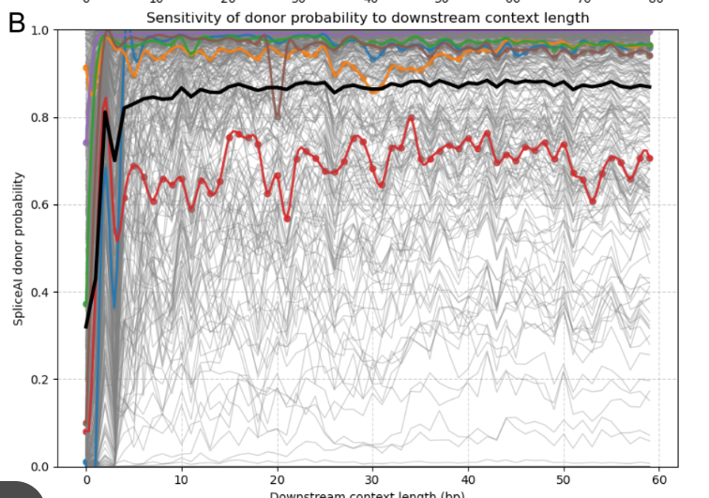
Does the variant alter splicing?
The importance of context
(Wanru Lin)
The average acceptor strength improves up to 80 bp.. Individual sites show a sharp increase at 20 to 50 bp.
Splicing Variant Impact Prediction
a review by Steve Mount
genomeinterpretation.org

Slide 14
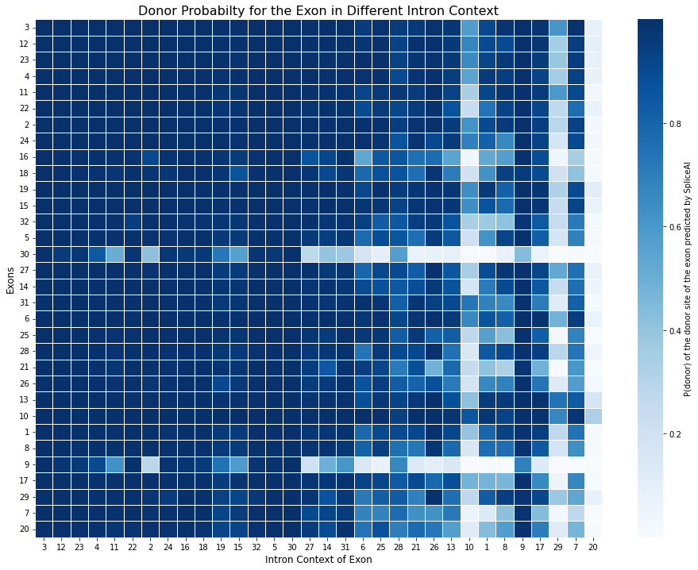
Does the variant alter splicing?
(Wanru Lin)
The importance of context
SpliceAI donor probability for 32 exons (from -40 to +3) in their natural, or other contexts (flanking intons plus 50 bp.).
rows: exons
columns: context
Splicing Variant Impact Prediction
a review by Steve Mount
genomeinterpretation.org

Slide 15
How does the variant alter splicing?
Intron retention
Exon skipping
Cryptic site activation (or choice)
or
Splicing Variant Impact Prediction
a review by Steve Mount
genomeinterpretation.org

Slide 16
What is the function of altered isoforms?
Are they predicted to be coding?
Are they regulatory?
poison exons can be essential
- potassium channels (seizure)
- SR protein poison exons
Do novel isoforms have novel functions?
- p53 exon 6 truncating “separation of function”
- SR protein poison exons
- oncogenic activation of MET by exon 14 skipping
non-small cell lung cancer.
Splicing Variant Impact Prediction
a review by Steve Mount
genomeinterpretation.org

Slide 17


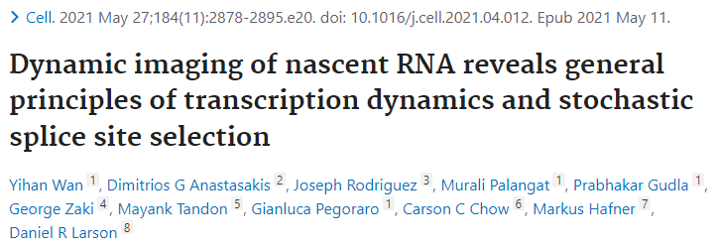
What is the function of altered isoforms?
(Are they noise?)
Problem: a lot of alternative splicing is just noise
Splicing Variant Impact Prediction
a review by Steve Mount
genomeinterpretation.org

Slide 18
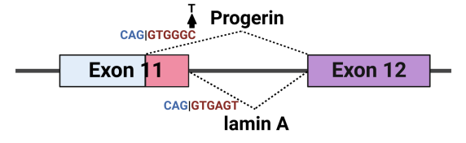
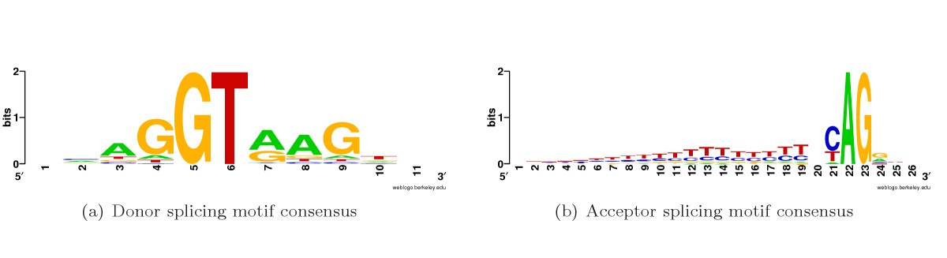
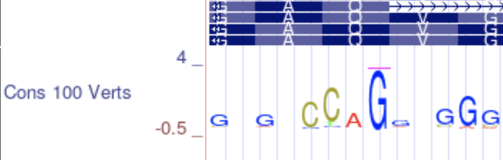
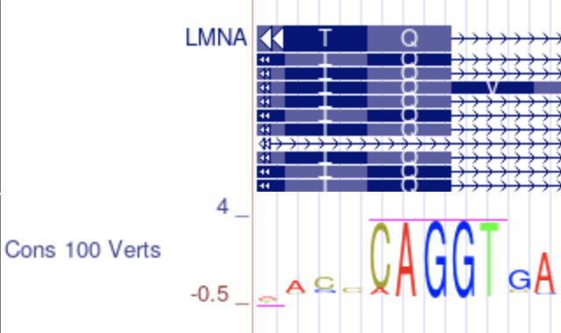
What is the function of altered isoforms?
Annotated sites can be nonfunctional – e.g. progerin
Progerin transcript
splice site
(Yu et al., 2023)
Transcript | Sequence in 5’ splice sites | MaxEnt score | Species
Progerin | CAGgtgggc | 8.07 | Human
Lamin A | CAGgtgagt | 10.67 | Human
Progerin | GGGgctggt | -7.44 | Opossum
Lamin A | CAGgtaagt | 10.86 | Opossum
Progerin | CAGaacgcc | -16.09 | Zebra finch
Lamin A | CAGgtcagt | 8.94 | Zebra finch
Lamin A transcript
splice site
Splicing Variant Impact Prediction
a review by Steve Mount
genomeinterpretation.org

Slide 19
What is the function of altered isoforms?
Annotated sites can be nonfunctional – e.g. progerin
SpliceCons
Wanru Lin in my lab developed a binary classifier to distinguish between functional and nonfunctional splice sites based on the MaxEnt scores across species
MANE transcript splice sites were used as true positives and non-annotated sites with high MaxEnt score were used as true negatives.
Features were MaxEnt scores across species; the list of species was varied to optimize performance.
Transcript | Sequence in 5’ splice sites | MaxEnt score | Species
Progerin | CAGgtgggc | 8.07 | Human
Lamin A | CAGgtgagt | 10.67 | Human
Progerin | GGGgctggt | -7.44 | Opossum
Lamin A | CAGgtaagt | 10.86 | Opossum
Progerin | CAGaacgcc | -16.09 | Zebra finch
Lamin A | CAGgtcagt | 8.94 | Zebra finch
Splicing Variant Impact Prediction
a review by Steve Mount
genomeinterpretation.org

Slide 20
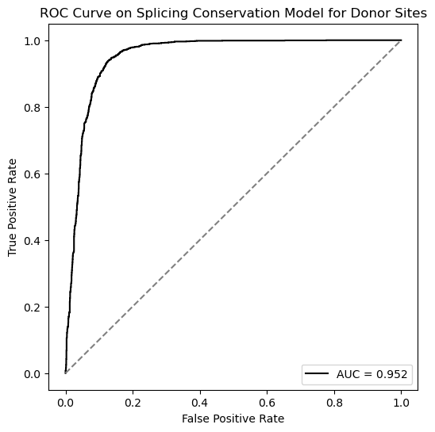
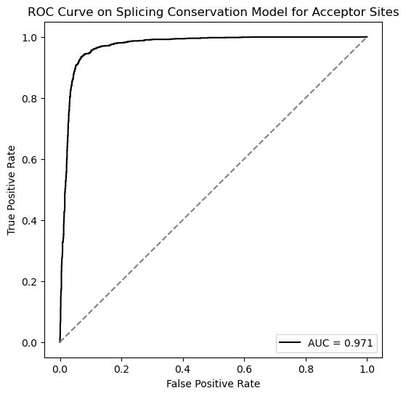
What is the function of altered isoforms?
Annotated sites can be nonfunctional – e.g. progerin
MANE transcript splice sites were used as true positives and non-annotated sites with high MaxEnt score were used as true negatives. Features were MaxEnt scores across species; the list of species was varied to optimize performance.
Splicing Variant Impact Prediction
a review by Steve Mount
genomeinterpretation.org

Slide 21
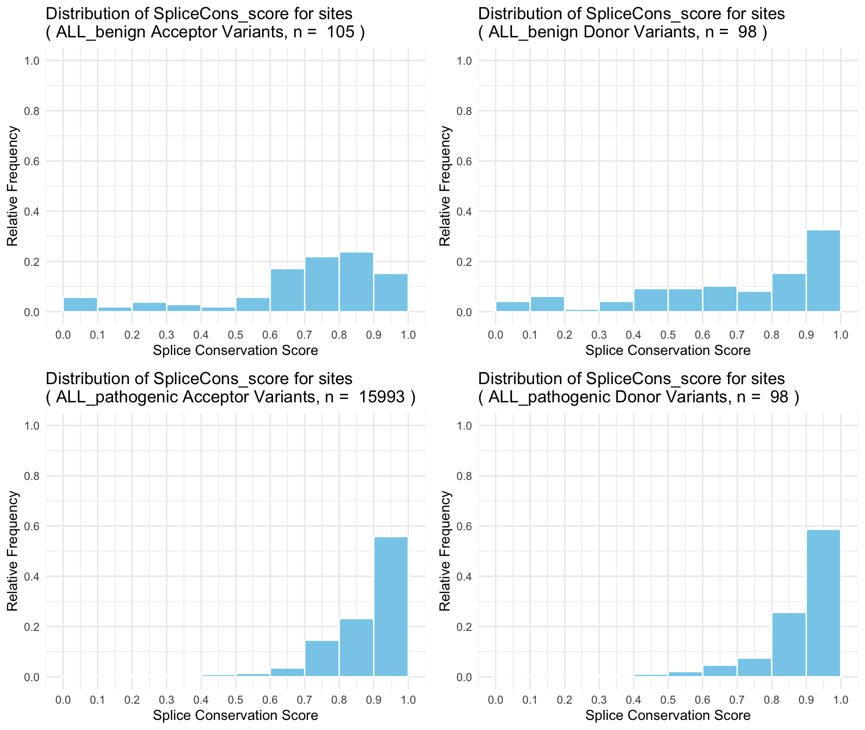
What is the function of altered isoforms?
SpliceCons is predictive of pathogenicity in ClinVar
The distribution of conservation scores for pathogenic splice site dinucleotide variants
Splicing Variant Impact Prediction
a review by Steve Mount
genomeinterpretation.org

Slide 22
What is the function of altered isoforms?
SpliceCons is predictive of pathogenicity in ClinVar
The distribution of conservation scores for pathogenic splice site dinucleotide variants
The distribution of conservation scores for benign splice site dinucleotide variants
Splicing Variant Impact Prediction
a review by Steve Mount
genomeinterpretation.org

Slide 23
Splicing Variant Impact Prediction:
Summary and direction
Does the variant alter splicing?
- High throughput minigene assays are good.
- Computational methods are almost as good and improving
- CRISPR in relevant cell lines is likely to become the gold standard
- Computational methods for tissue-specificity and alternative splicing
Created for CAGI 7
Splicing Variant Impact Prediction
a review by Steve Mount
genomeinterpretation.org

Slide 24
Splicing Variant Impact Prediction:
Summary and direction
Does the variant alter splicing?
- Minigene assays.
- Computational methods
- CRISPR in relevant cell lines
How does the variant alter splicing?
What is the function of altered isoforms?
- Predicting noise
- Gene-specific
- Protein structure (splicing variant as indel or truncation alleles)
Created for CAGI 7
Splicing Variant Impact Prediction
a review by Steve Mount
genomeinterpretation.org

