Slide 1


Analysis of de novo structural variants in rare disease patients
Laura Covill, PhD
O’Donnell-Luria lab
Broad Institute of MIT and Harvard
Boston Children’s Hospital

Slide 2
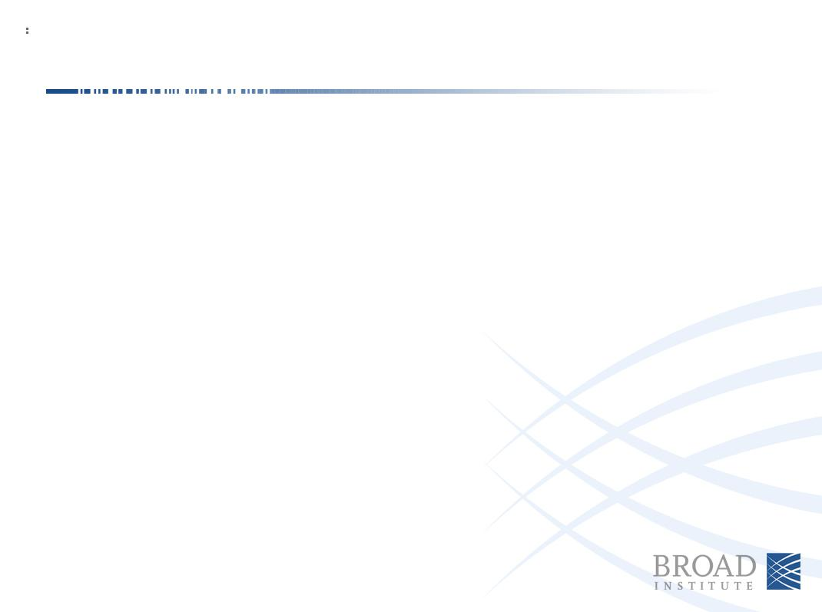
Introduction
Non-coding variation is voluminous and the effects can be extremely varied
De novo variation is a frequent cause of Mendelian disease
Few de novo structural variants per patient = easy to screen
Notes:
De novo variation is a frequent cause of Mendelian disease

Slide 3




>870 unsolved srGS trios
>300 unsolved lrGS trios
De novo non-coding variants
Rare (<0.001 MAF)
Cell-type specific annotations
Predicted intronic/regulatory proximal to
disease gene or dosage-sensitive gene
Constraint, conservation scoring
Notes:
j

Slide 4
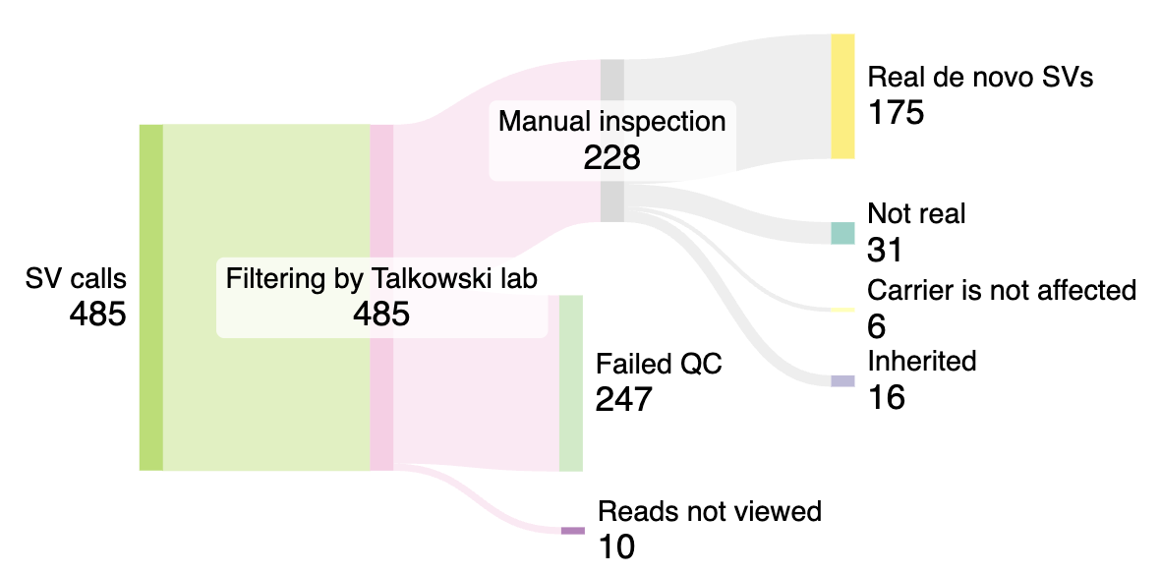
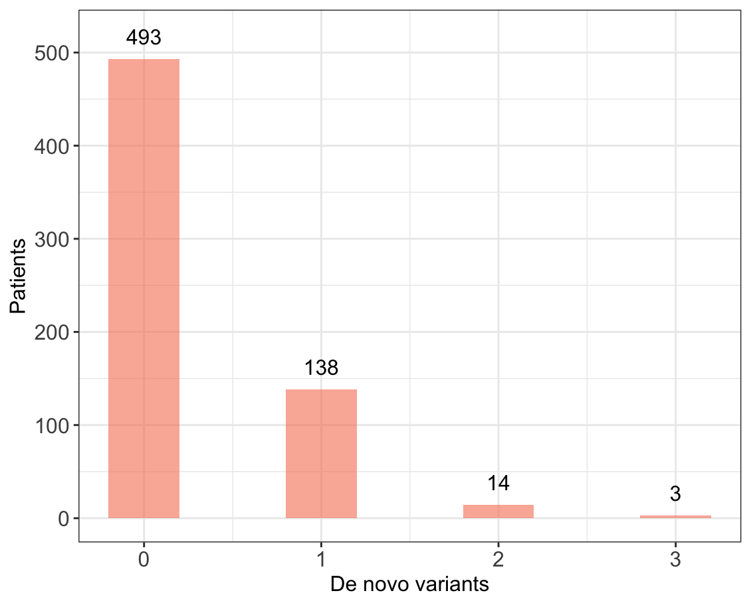
Generating a dataset of de novo SVs
Notes:
17 patients have more than one SV

Slide 5
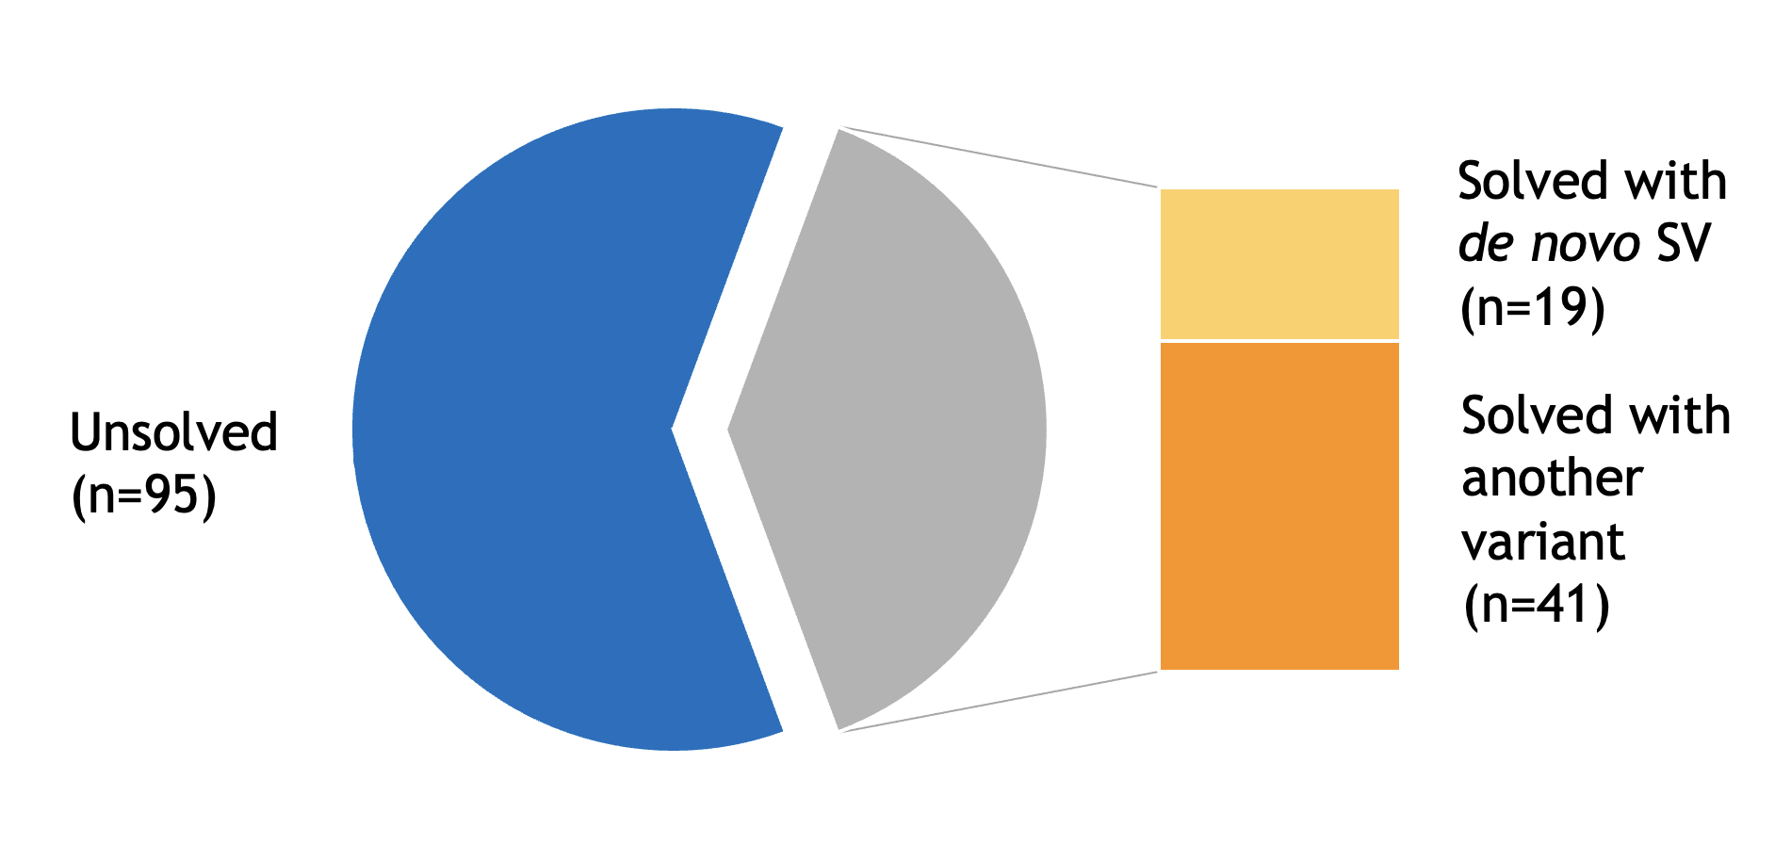
Solves in 155 patients carrying a de novo SV
Notes:
Out of previous solves, 2 were non-coding, compared to 129/175 – 10% compared to 72%. 10% is actually a 2.5-fold increase compared to solves including at least one non-coding SNV.

Slide 6
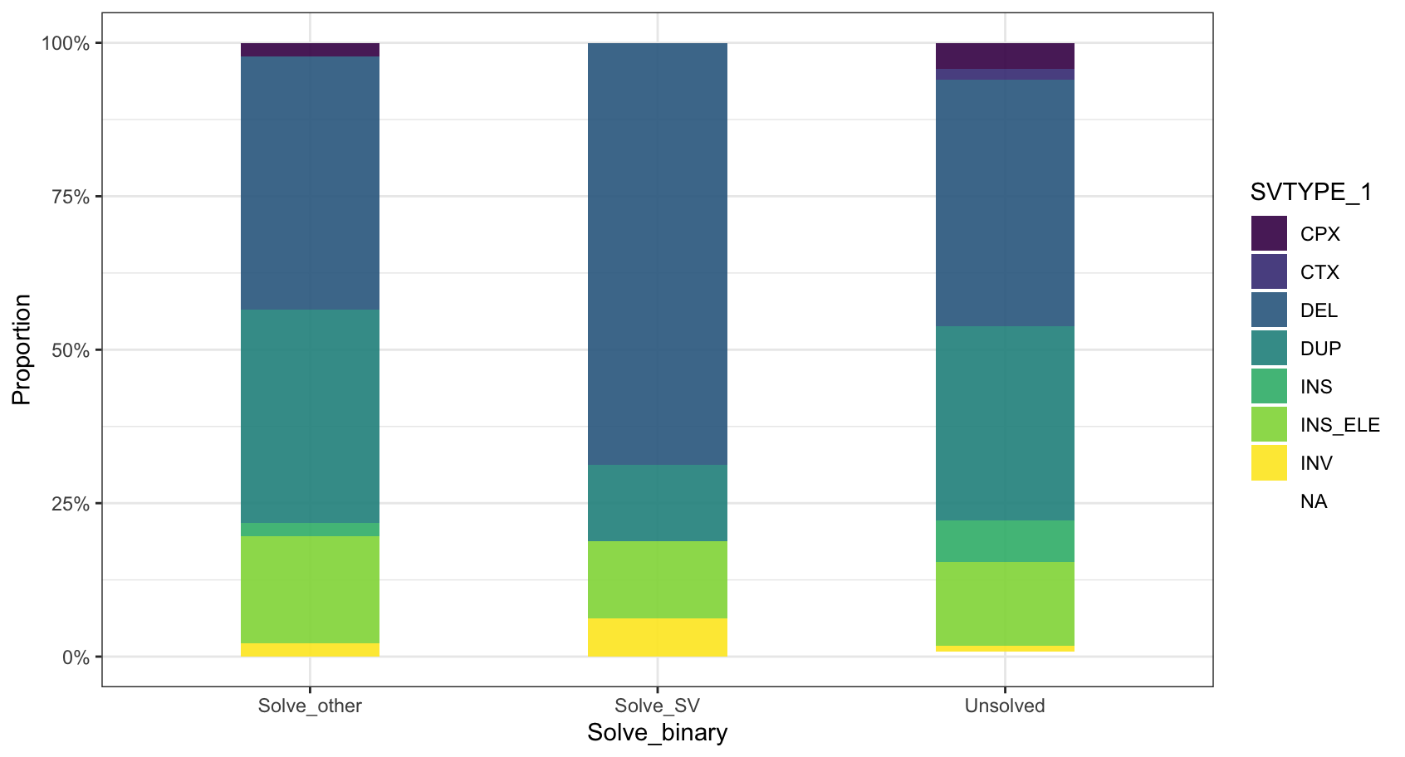
Solves typically come from the most interpretable classes of variant
Notes:
De novo variation is a frequent cause of Mendelian disease

Slide 7
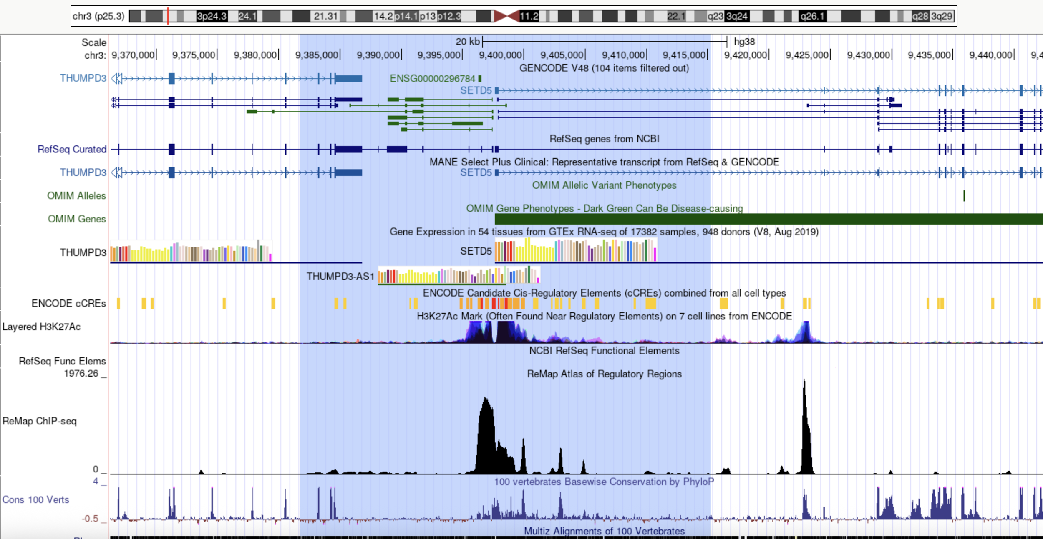
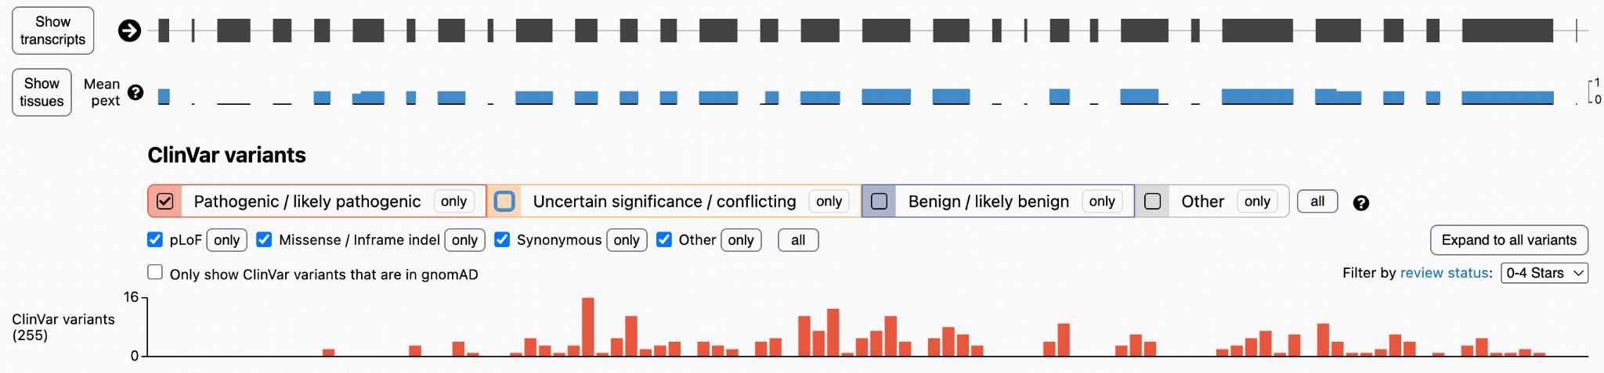
Patient 1
Male presenting from birth with borderline microcephaly, severe/moderate ID, hypertonia, limb spasticity
38.5kb deletion including first exon of SETD5
Notes:
De novo variation is a frequent cause of Mendelian disease

Slide 8
Patient 1
Male presenting from birth with borderline microcephaly, severe/moderate ID, hypertonia, limb spasticity
38.5kb deletion including promoter, 5’UTR and coding first exon of SETD5
Good phenotypic match for previous patients.
Notes:
De novo variation is a frequent cause of Mendelian disease

Slide 9
Patient 2
Female presenting from birth with syndromic overgrowth
Notes:
De novo variation is a frequent cause of Mendelian disease

Slide 10
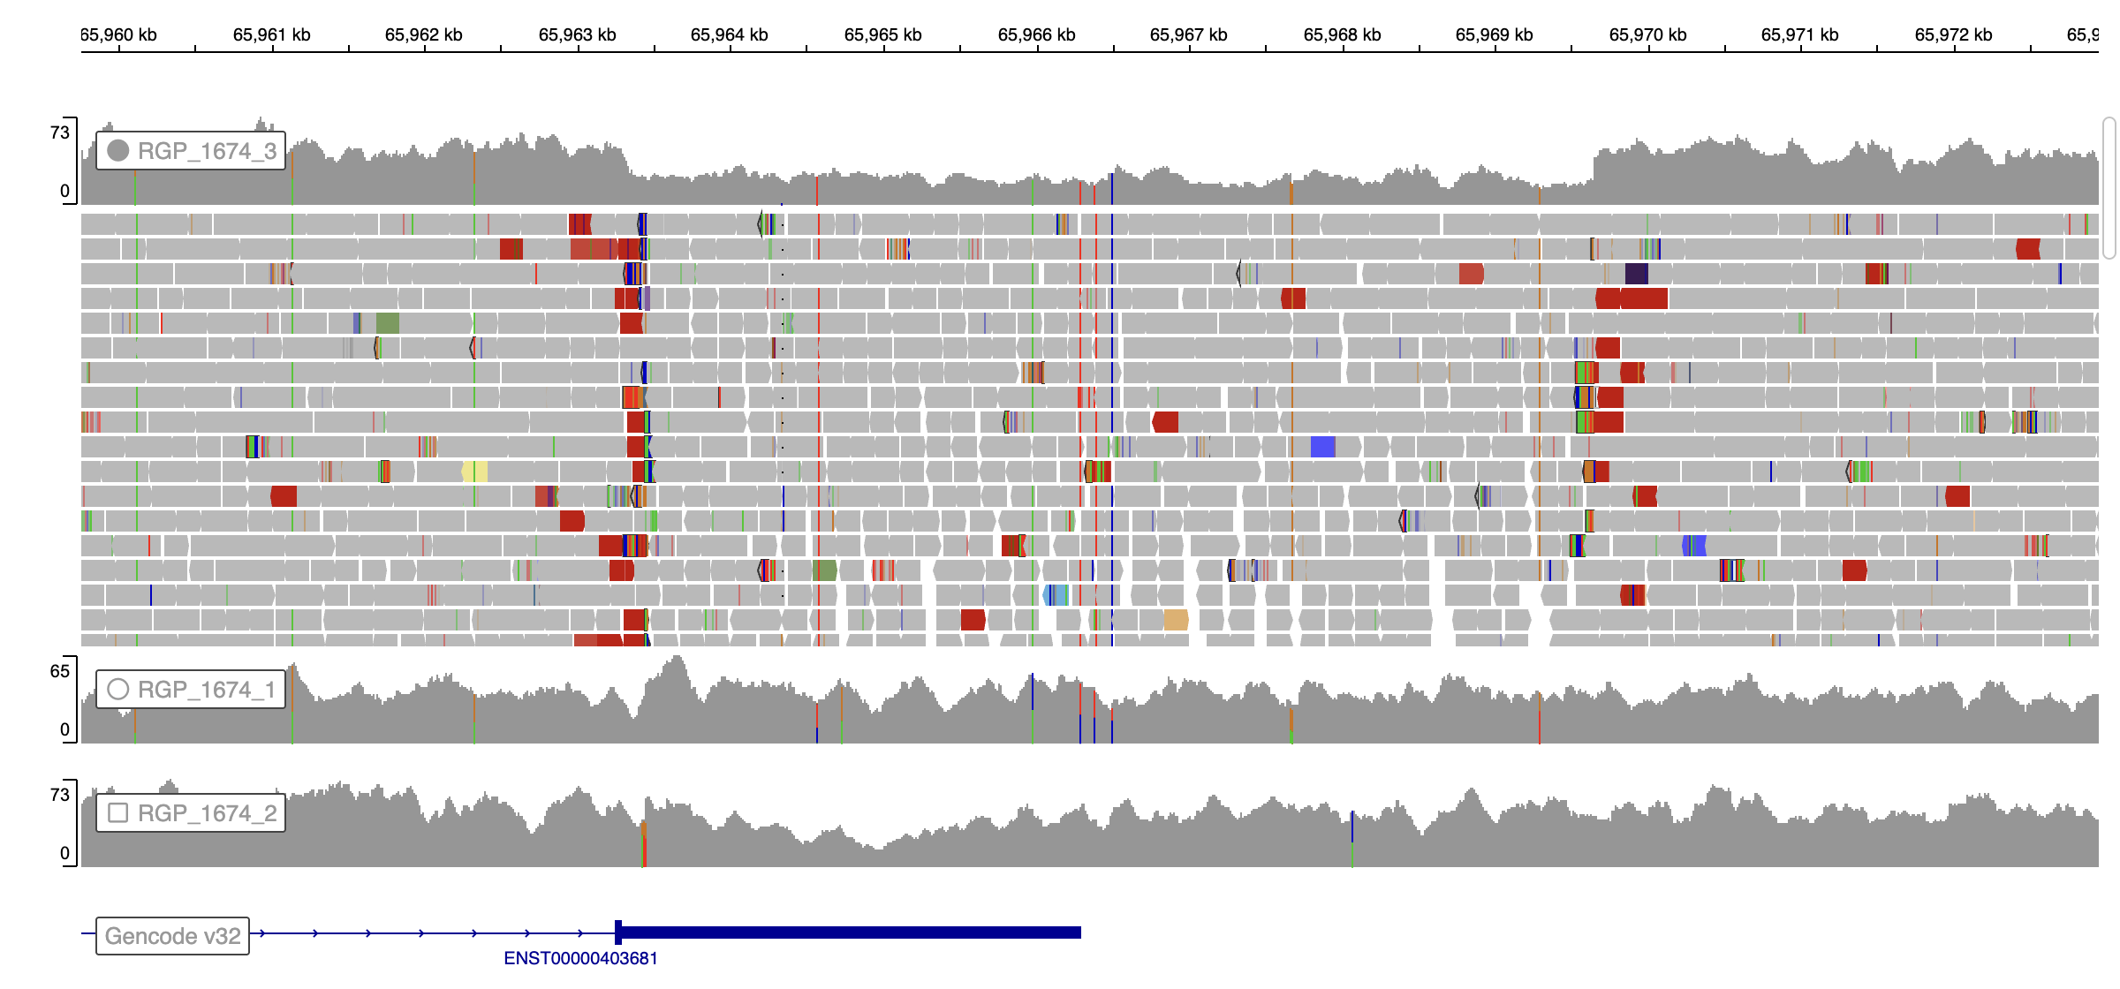
Patient 2
Female presenting from birth with syndromic overgrowth
Patient
Mother
Father
HMGA2
6.6kb deletion including most of the 3’UTR
Previous patients reported with undergrowth
Notes:
De novo variation is a frequent cause of Mendelian disease

Slide 11
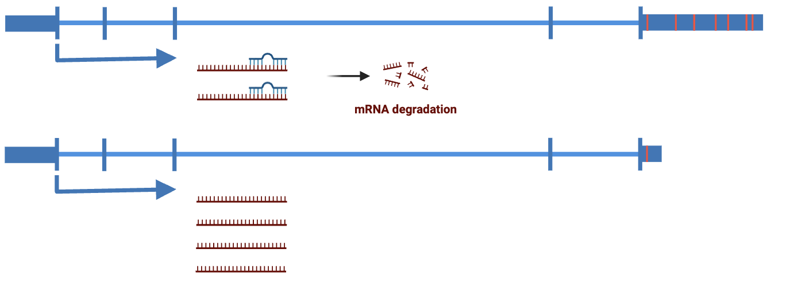
Patient 2
Female presenting from birth with syndromic overgrowth
Let-7 binding sites
HMGA2
wildtype
HMGA2
3’UTR deletion
Notes:
De novo variation is a frequent cause of Mendelian disease

Slide 12
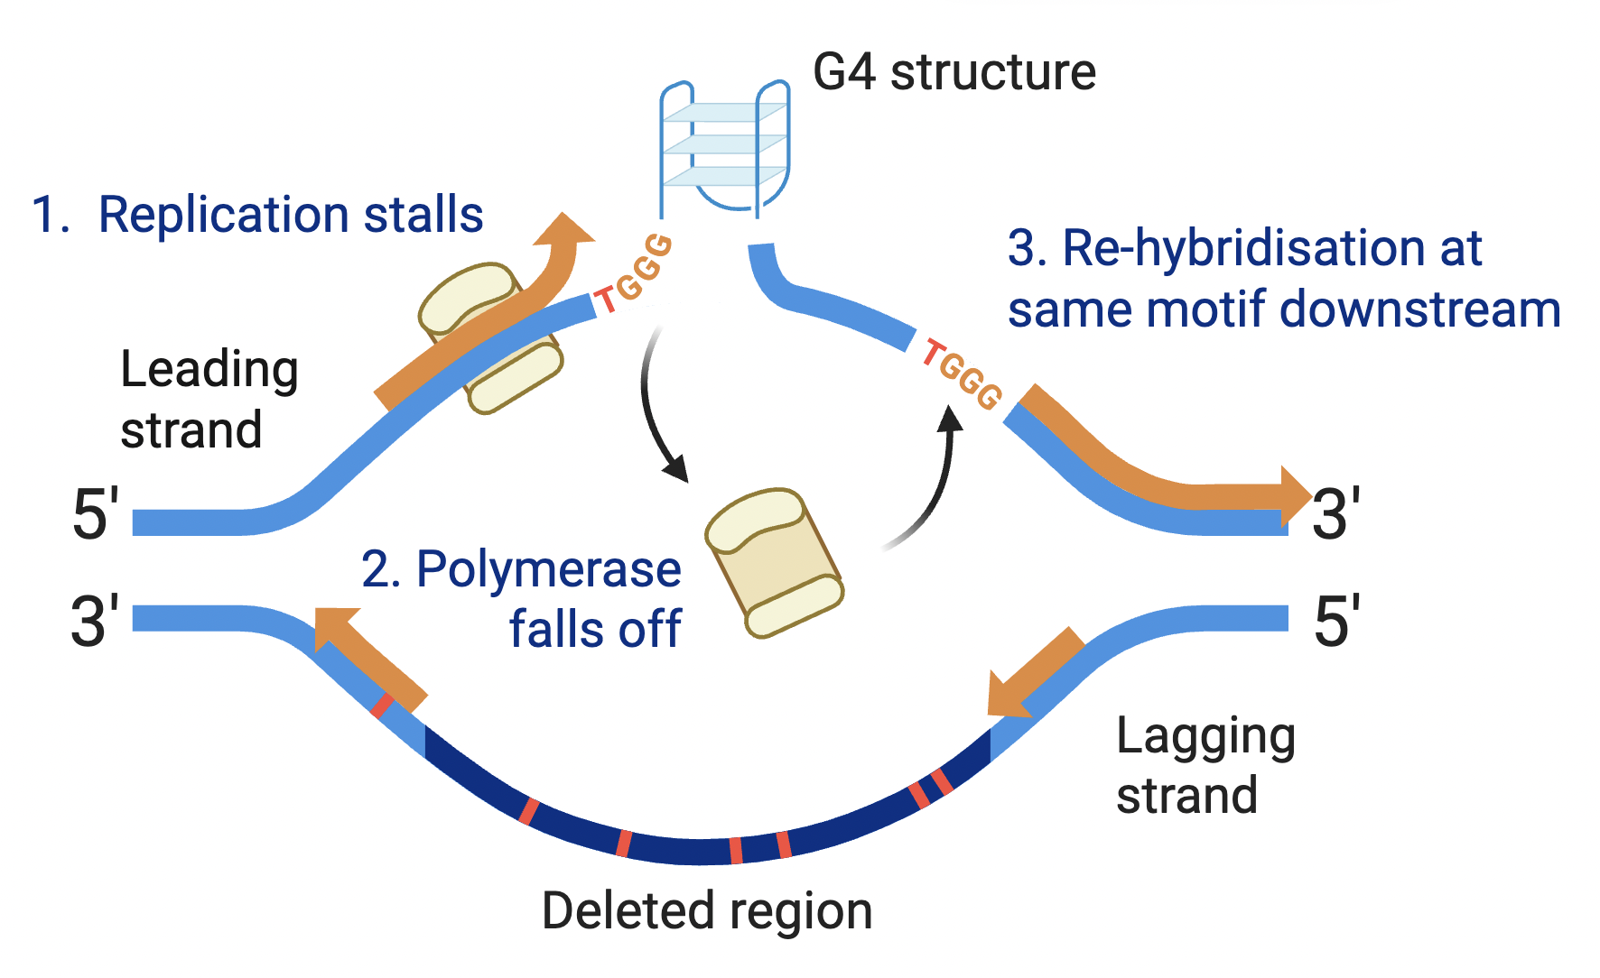
Patient 2
Female presenting from birth with syndromic overgrowth
Notes:
De novo variation is a frequent cause of Mendelian disease

Slide 13
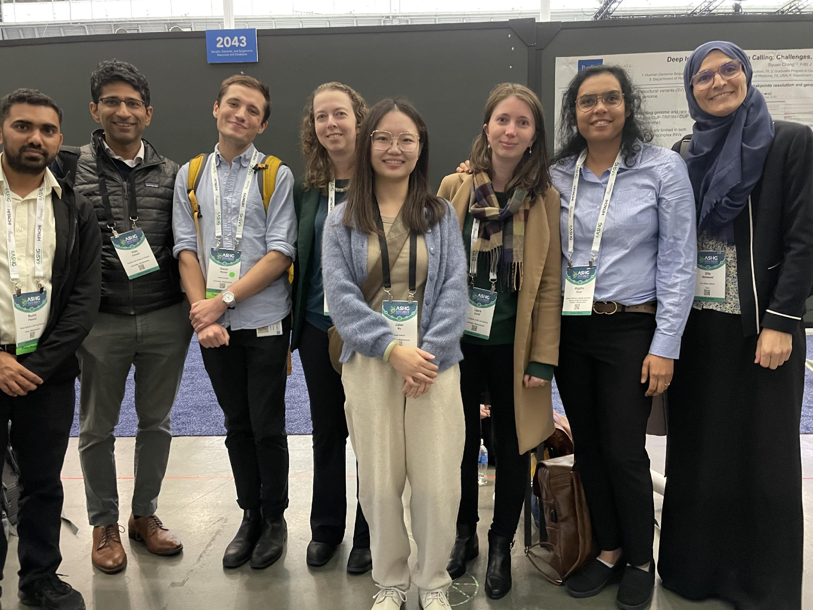
Acknowledgements
O’Donnell-Luria lab
Vijay Ganesh
Jialan Ma
Daniel Marten
Olfa Messaoud
Anne O’Donnell-Luria
Briana O’Leary
Lindsay Romo
Mugdha Singh
Translational Genomics Group, Broad Institute
Emily O’Heir
Talkowski lab, Broad Institute
Nehir Kurtas
Arthur Lee
Alba Sanchis-Juan
Manton Center for Orphan Disease Research

