Slide 1

CAGI7 slide pack guidelines
I agree to my slides being used according to the following terms:
__Ryan Hernandez__
Authors: please include THIS slide at the beginning of your presentation to indicate that you agree with reuse of your slides in CAGI presentations, according to the terms below, and digitally sign by writing your name above.
To disseminate the CAGI results, I encourage all CAGI participants to remix these CAGI slides for inclusion in their oral and poster presentations.
CAGI participants may use or publish any content of these slides only in compliance with the CAGI Data Use Agreement.
CAGI participants may not cite or publish any content of these slides except with the written permission of the originating author or in the primary CAGI publications.
CAGI participants must acknowledge the original authors of these slides and CAGI7. Include the acknowledgement banner across the bottom.
CAGI participants must include the CAGI credits slide in their presentations.
Slides with a red slash (no remix) may not be included in a presentation unless all attendees are registered CAGI participants who signed the data use agreement.
Slides with a red X over the entire slide may not be used in any circumstances.
Slides with a blue slash (embargoed) may not be used unless the embargo is explicitly lifted.
Slides without slash or X may be tweeted unless flagged with the “No tweet” icon.
CAGI participants using these slides must explain the “No tweet” icon, which means that the slide content should not be disseminated outside the presenting conference hall. If the presentation venue permits pervasive tweeting, you may not include these slides in your talk.
Note for slide authors: we expect all CAGI participants to abide by these restrictions and will make best effort to ensure they are followed. However, bear in mind that we have limited means of enforcing them, and therefore the restrictions cannot be guaranteed.
Notes:
At CAGI7, use of this slide pack is only required for CAGI dataset providers, assessors, and predictors, but all are encouraged to use the annotations for materials they do not want shared publicly.

Slide 2
From Learning to Leading: Cultivating Resilience through Community
Ryan Hernandez, PhD
Created for CAGI7
genomeinterpretation.org
Ryan Hernandez

Slide 3

Apologies for the expletives
Terms banned under the Trump administration:
Diversity
Equity
Inclusion
Accessibility
Belonging
Created for CAGI7
genomeinterpretation.org
Ryan Hernandez

Slide 4

Apologies for the expletives
Created for CAGI7
genomeinterpretation.org
Ryan Hernandez

Slide 5

Apologies for the expletives
Created for CAGI7
genomeinterpretation.org
Ryan Hernandez

Slide 6

Apologies for the expletives
Created for CAGI7
genomeinterpretation.org
Ryan Hernandez

Slide 7

Apologies for the expletives
Terms banned under the Trump administration:
Created for CAGI7
genomeinterpretation.org
Ryan Hernandez

Slide 8
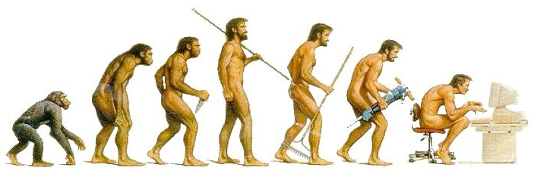


From Learning to Leading: Cultivating Resilience through Community
Ryan D. Hernandez
ryan.hernandez@ucsf.edu
    Professor in Bioengineering and Therapeutic Sciences at UCSF
    co-Associate Dean for Diversity, Equity, Inclusion
    co-Director of the Biological and Medical Informatics (BMI) graduate program
    co-Director of the Post-baccalaureate Research Opportunities to Promote Equity in Learning (PROPEL)
    co-Director of the Post-baccalaureate Research Education Program (PREP)
    co-Director of Advancing Research Careers of Historically Excluded Scholars (ARCHES)
    Director Genentech-UCSF School of Pharmacy PhD Diversity Fellowship Program
Created for CAGI7
genomeinterpretation.org
Ryan Hernandez

Slide 9
From Learning to Leading: Cultivating Resilience through Community
Ryan D. Hernandez
ryan.hernandez@ucsf.edu
    Professor in Bioengineering and Therapeutic Sciences at UCSF
    co-Associate Dean for Diversity, Equity, Inclusion
    co-Director of the Biological and Medical Informatics (BMI) graduate program
    co-Director of the Post-baccalaureate Research Opportunities to Promote Equity in Learning (PROPEL)
    co-Director of the Post-baccalaureate Research Education Program (PREP)
    co-Director of Advancing Research Careers of Historically Excluded Scholars (ARCHES)
    Director Genentech-UCSF School of Pharmacy PhD Diversity Fellowship Program
Created for CAGI7
genomeinterpretation.org
Ryan Hernandez

Slide 10
From Learning to Leading: Cultivating Resilience through Community
Ryan D. Hernandez
ryan.hernandez@ucsf.edu
    Professor in Bioengineering and Therapeutic Sciences at UCSF
    co-Director of the Biological and Medical Informatics (BMI) graduate program
    co-Director of the Post-baccalaureate Research Opportunities to Promote Equity in Learning (PROPEL)
    co-Director of the Post-baccalaureate Research Education Program (PREP)
    co-Director of Advancing Research Careers of Historically Excluded Scholars (ARCHES)
    Director Genentech-UCSF School of Pharmacy PhD Diversity Fellowship Program
Created for CAGI7
genomeinterpretation.org
Ryan Hernandez

Slide 11
From Learning to Leading: Cultivating Resilience through Community
Ryan D. Hernandez
ryan.hernandez@ucsf.edu
    Professor in Bioengineering and Therapeutic Sciences at UCSF
    co-Director of the Biological and Medical Informatics (BMI) graduate program
    co-Director of the PROPEL Post-baccalaureate Training Program
    co-Director of the Post-baccalaureate Research Education Program (PREP)
    co-Director of Advancing Research Careers of Historically Excluded Scholars (ARCHES)
    Director Genentech-UCSF School of Pharmacy PhD Diversity Fellowship Program
Created for CAGI7
genomeinterpretation.org
Ryan Hernandez

Slide 12
From Learning to Leading: Cultivating Resilience through Community
Ryan D. Hernandez
ryan.hernandez@ucsf.edu
    Professor in Bioengineering and Therapeutic Sciences at UCSF
    co-Director of the Biological and Medical Informatics (BMI) graduate program
    co-Director of the PROPEL & PREP Post-baccalaureate Training Programs
    co-Director of Advancing Research Careers of Historically Excluded Scholars (ARCHES)
    Director Genentech-UCSF School of Pharmacy PhD Diversity Fellowship Program
Created for CAGI7
genomeinterpretation.org
Ryan Hernandez

Slide 13
From Learning to Leading: Cultivating Resilience through Community
Ryan D. Hernandez
ryan.hernandez@ucsf.edu
    Professor in Bioengineering and Therapeutic Sciences at UCSF
    co-Director of the Biological and Medical Informatics (BMI) graduate program
    co-Director of the PROPEL Post-baccalaureate Training Program
    co-Director of ARCHES: Building bridges to connect and support research faculty
    Director Genentech-UCSF School of Pharmacy PhD Diversity Fellowship Program
Created for CAGI7
genomeinterpretation.org
Ryan Hernandez

Slide 14
From Learning to Leading: Cultivating Resilience through Community
Ryan D. Hernandez
ryan.hernandez@ucsf.edu
    Professor in Bioengineering and Therapeutic Sciences at UCSF
    co-Director of the Biological and Medical Informatics (BMI) graduate program
    co-Director of the PROPEL Post-baccalaureate Training Program
    co-Director of ARCHES: Building bridges to connect and support research faculty
    Director Genentech-UCSF School of Pharmacy PhD Fellowship Program
Created for CAGI7
genomeinterpretation.org
Ryan Hernandez

Slide 15
From Learning to Leading: Cultivating Resilience through Community
Ryan D. Hernandez
ryan.hernandez@ucsf.edu
    Professor in Bioengineering and Therapeutic Sciences at UCSF
    co-Director of the Biological and Medical Informatics (BMI) graduate program
    co-Director of the PROPEL Post-baccalaureate Training Program
    co-Director of ARCHES: Building bridges to connect and support research faculty
    Director Genentech-UCSF School of Pharmacy PhD Fellowship Program
    co-Director of the Center for Diversity in Genomics and Precision Health (CDGPH)
Created for CAGI7
genomeinterpretation.org
Ryan Hernandez

Slide 16
From Learning to Leading: Cultivating Resilience through Community
Ryan D. Hernandez
ryan.hernandez@ucsf.edu
    Professor in Bioengineering and Therapeutic Sciences at UCSF
    co-Director of the Biological and Medical Informatics (BMI) graduate program
    co-Director of the PROPEL Post-baccalaureate Training Program
    co-Director of ARCHES: Building bridges to connect and support research faculty
    co-Director of the Center for Diversity in Genomics and Precision Health (CDGPH)
Created for CAGI7
genomeinterpretation.org
Ryan Hernandez

Slide 17

“Life is like juggling too many balls. At least one will always be falling. Just make sure you are not always dropping the same ball”
Michael Purugganan
RESEARCH
LIFE
PROPEL
BMI
CDPH
ARCHES
Other things
Created for CAGI7
genomeinterpretation.org
Ryan Hernandez

Slide 18
Collaboration to overcome challenges
Many campuses pride themselves for collaboration, but it often stops at
co-corresponding authors.
Overcoming resistance to new ideas can be tough, especially on your own.
Efforts to improve are frequently met with “NO.”
Partnering makes tasks more enjoyable and effective.
Created for CAGI7
genomeinterpretation.org
Ryan Hernandez

Slide 19

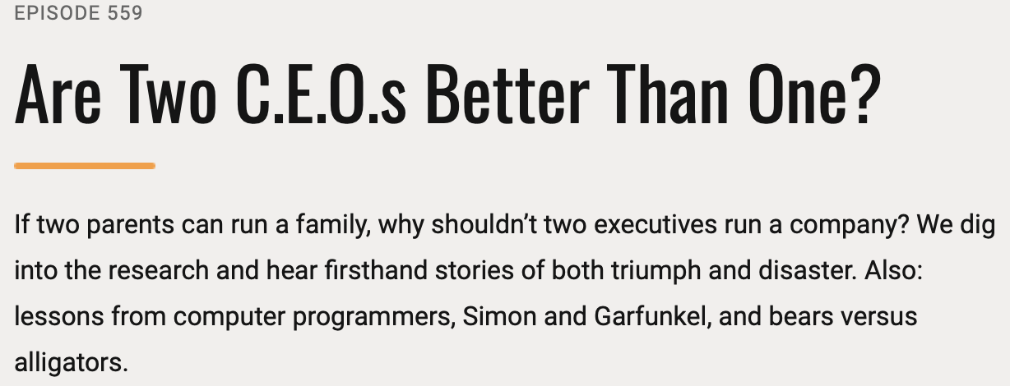

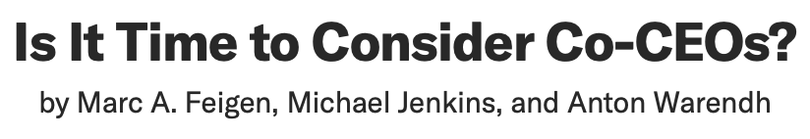
I cannot do ANY of this alone…
https://freakonomics.com/podcast/are-two-c-e-o-s-better-than-one/
Created for CAGI7
genomeinterpretation.org
Ryan Hernandez

Slide 20
Keys to successful “co”-ing:
Willing Participants
Complementary Skill Sets
Clear Responsibilities and Decision Rights
Mechanisms for Conflict Resolution
An Appearance of Unity
Fully Shared Accountability
Shared Values
Created for CAGI7
genomeinterpretation.org
Ryan Hernandez

Slide 21
From Learning to Leading: Cultivating Resilience through Community
Ryan D. Hernandez
ryan.hernandez@ucsf.edu
    Professor in Bioengineering and Therapeutic Sciences at UCSF
    co-Director of the Biological and Medical Informatics (BMI) graduate program
    co-Director of the PROPEL Post-baccalaureate Training Program
    co-Director of ARCHES: Building bridges to connect and support research faculty
    co-Director of the Center for Diversity in Genomics and Precision Health (CDGPH)
Created for CAGI7
genomeinterpretation.org
Ryan Hernandez

Slide 22
First step: Identify a problem
Engaging in DEI work is personal endeavor.
What matters to you?
Created for CAGI7
genomeinterpretation.org
Ryan Hernandez

Slide 23
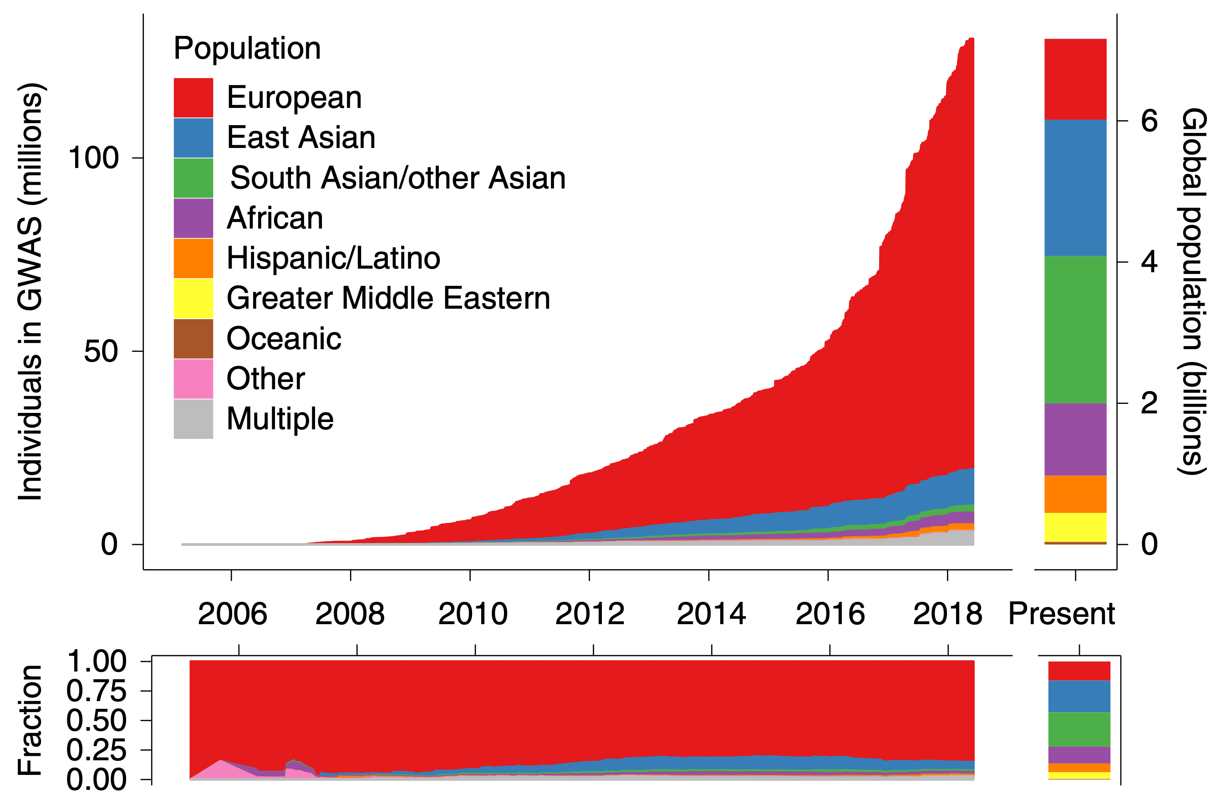
DEI work is personal
and scientific
11%
21%
25%
17%
9%
10%
Created for CAGI7
genomeinterpretation.org
Martin et al (2019)
Ryan Hernandez

Slide 24
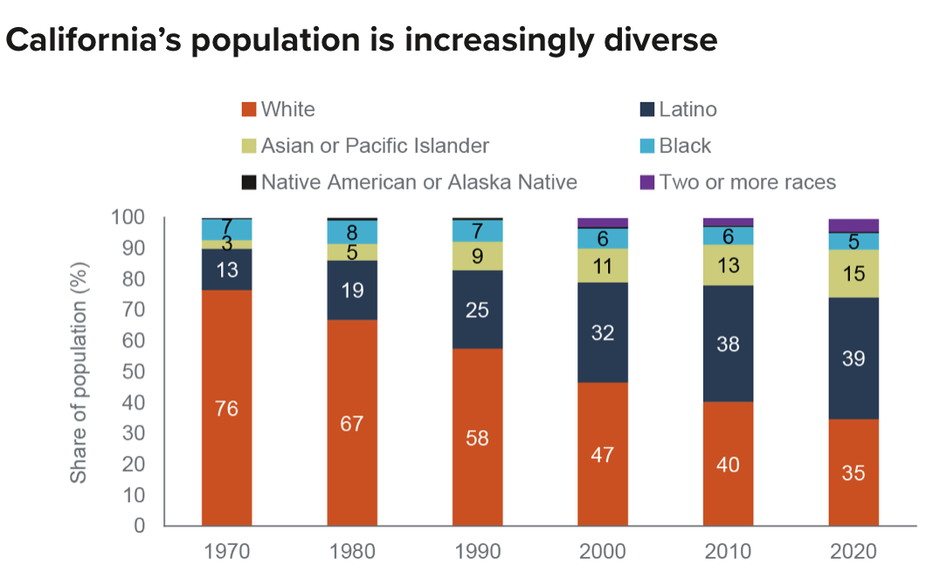
https://www.ppic.org/publication/californias-population/
Created for CAGI7
genomeinterpretation.org
Ryan Hernandez

Slide 25
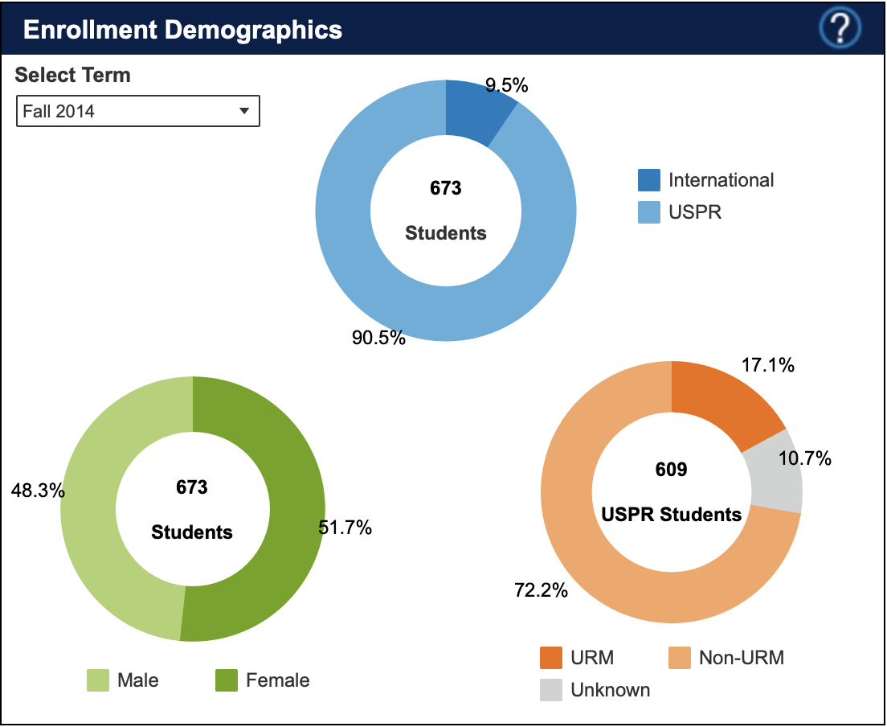
Created for CAGI7
genomeinterpretation.org
Ryan Hernandez

Slide 26
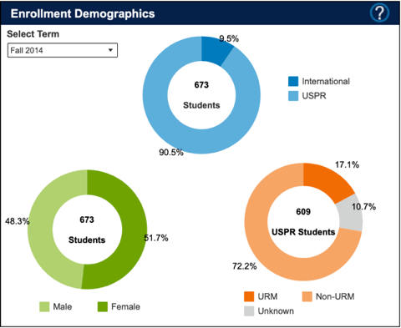
Created for CAGI7
genomeinterpretation.org
Ryan Hernandez

Slide 27
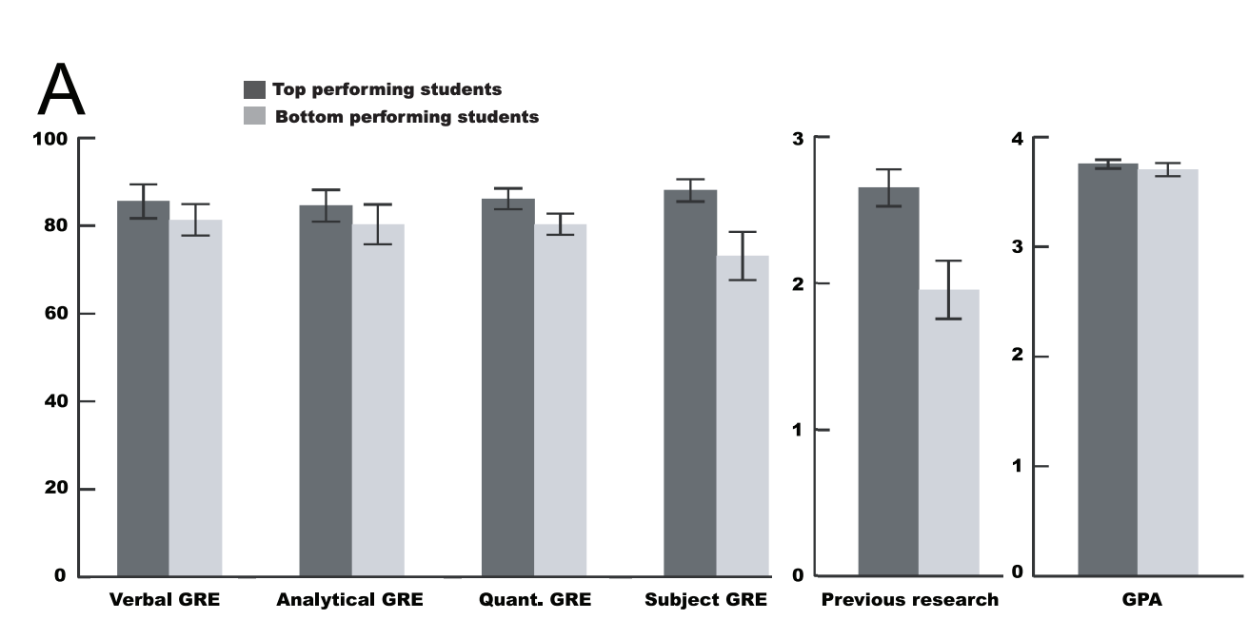
What factors correlate with grad student “success”?
Applicants with hands-on research experience nearly 4 times as likely gain acceptance.
Students from lower socioeconomic statuses have limited or no access to research experiences.
Research experience programs do not have enough capacity.
Weiner, 2013
Rahbar, et al, 2022
Created for CAGI7
genomeinterpretation.org
Ryan Hernandez
Notes:
Several sources have looked at barriers to graduate school entry and success. One common theme appears to be previous research experience. Weiner in 2013 identified research experience as the best predictor of grad school success, and applicants with research experience are 4 times more likely to gain an acceptance than those without. This is troubling for those from lower socioeconomic statuses as they often have limited or no access to research experiences. Programs exist to offer those, but they are often limited in capacity and, now they are largely under threat and disappearing. It was frustration with this capacity limit that led to the formation of PROPEL.

Slide 28
Motivation
Beyond research experience: developing confidence, community, and sense of scientific identity are critical for becoming a scientific leader.
Created for CAGI7
genomeinterpretation.org
Ryan Hernandez

Slide 29
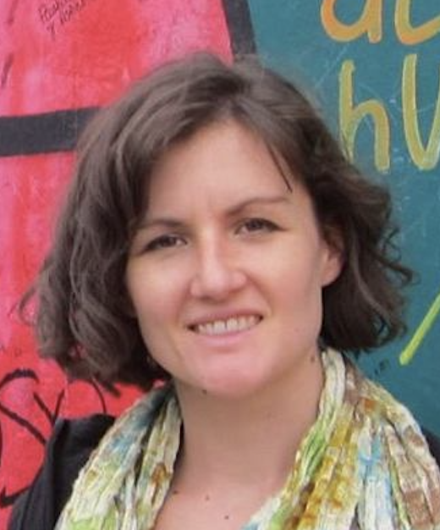
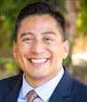
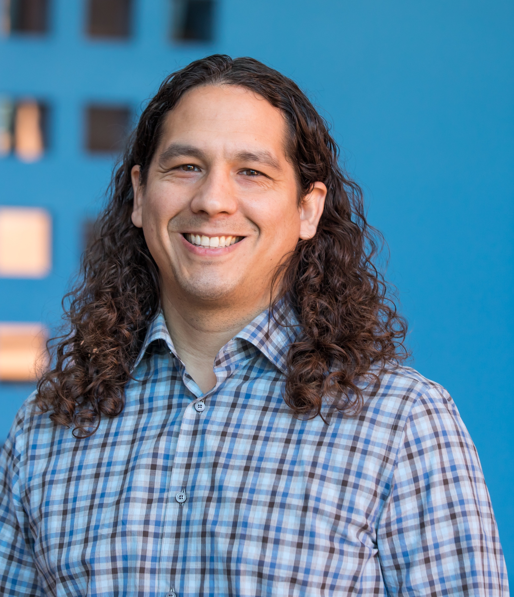
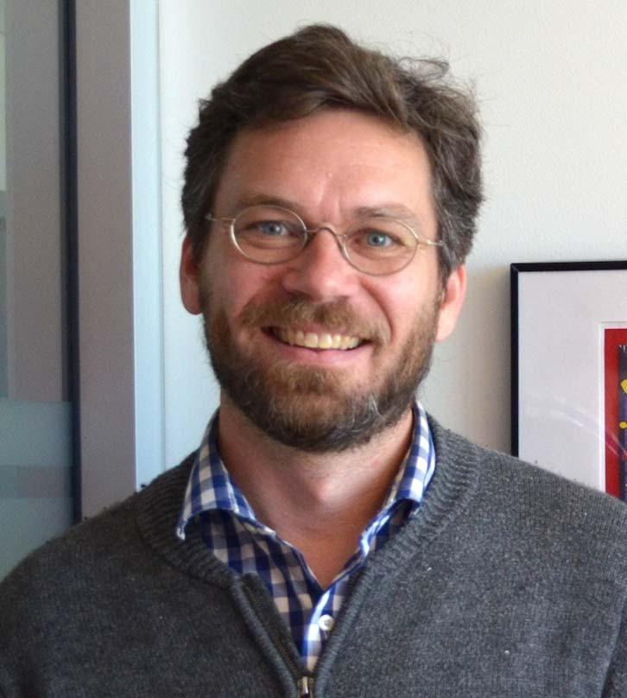
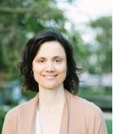
Matchmaking Team
Jessica Allen, PhD
Angel Max Guerrero
Ryan Hernandez, PhD
Todd Nystul, PhD
Jennifer Seuferer
Created for CAGI7
genomeinterpretation.org
Ryan Hernandez

Slide 30





Scholars Find Positions at Matchmaking Event or UCSF Job Board
Scholar Recruitment
Hiring
Apply
Matchmaking Event
(NIH Diversity Supplements)
Scholar and new faculty mentor both apply to PROPEL
Scholars find a full-time position at in two ways
UCSF Job Boards
(junior specialist or SRA)
Created for CAGI7
genomeinterpretation.org
Ryan Hernandez
Notes:
This is very different from how traditional postbac programs are run.

Slide 31
The matching process: recruitment
Faculty and scholars are invited to sign up through our Matchmaking Event Website: justice.ucsf.edu
  We advertise to scholars through our professional/social media networks
  We advertise to faculty using information about qualifying NIH grants and UCSF email lists
2021: 95 applicants and 116 faculty
2022: 94 applicants and 113 faculty
2023: 55 applicants and 77 faculty
2024: 101 applicants and 98 faculty
Created for CAGI7
genomeinterpretation.org
Ryan Hernandez

Slide 32
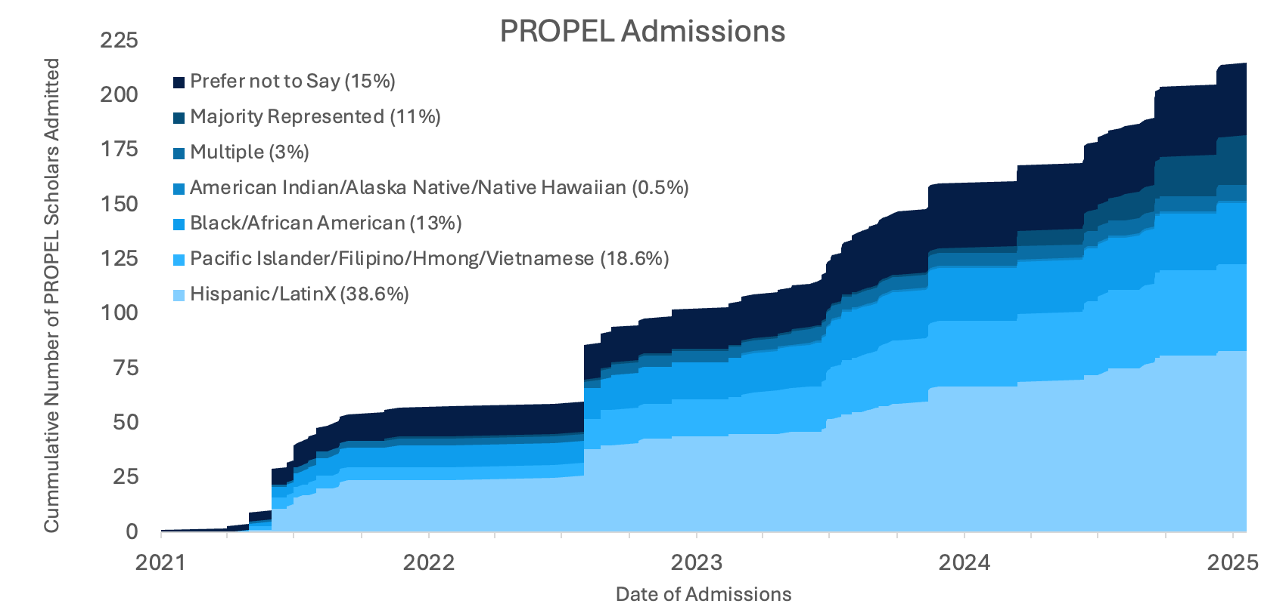
Explosive Growth of PROPEL Over 4 years
Created for CAGI7
genomeinterpretation.org
Ryan Hernandez

Slide 33
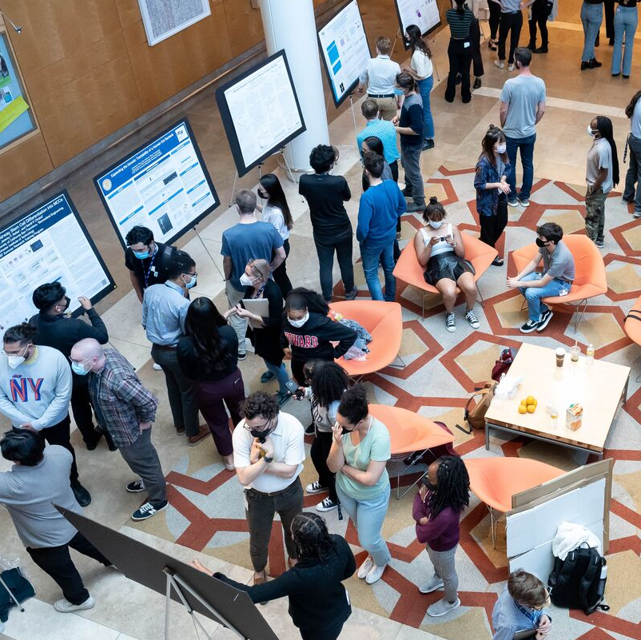
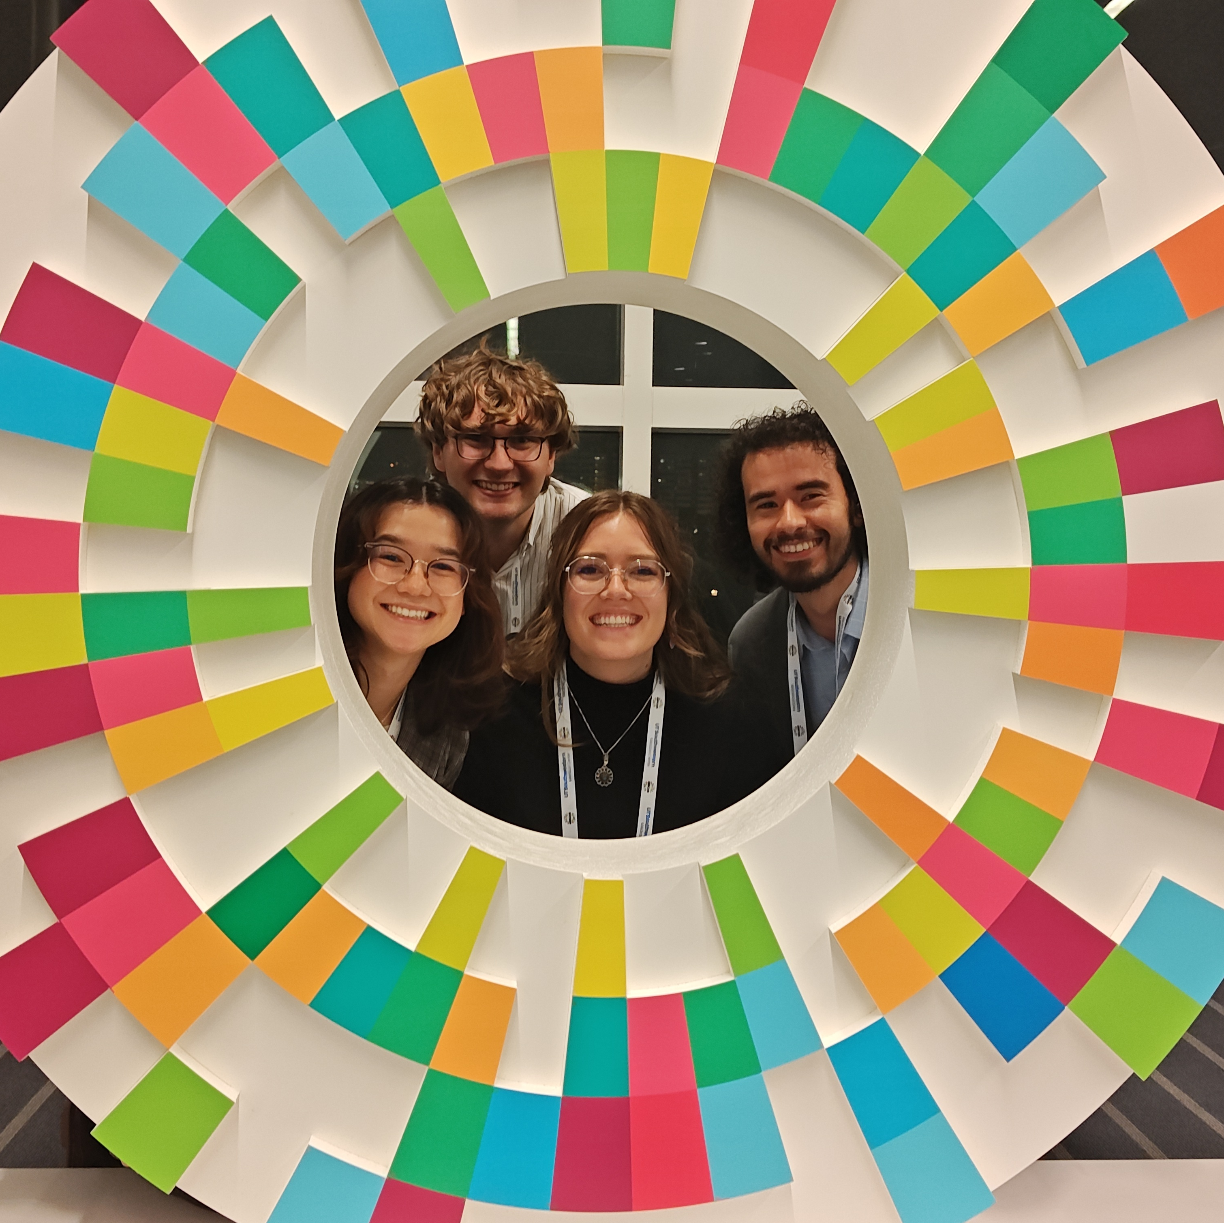
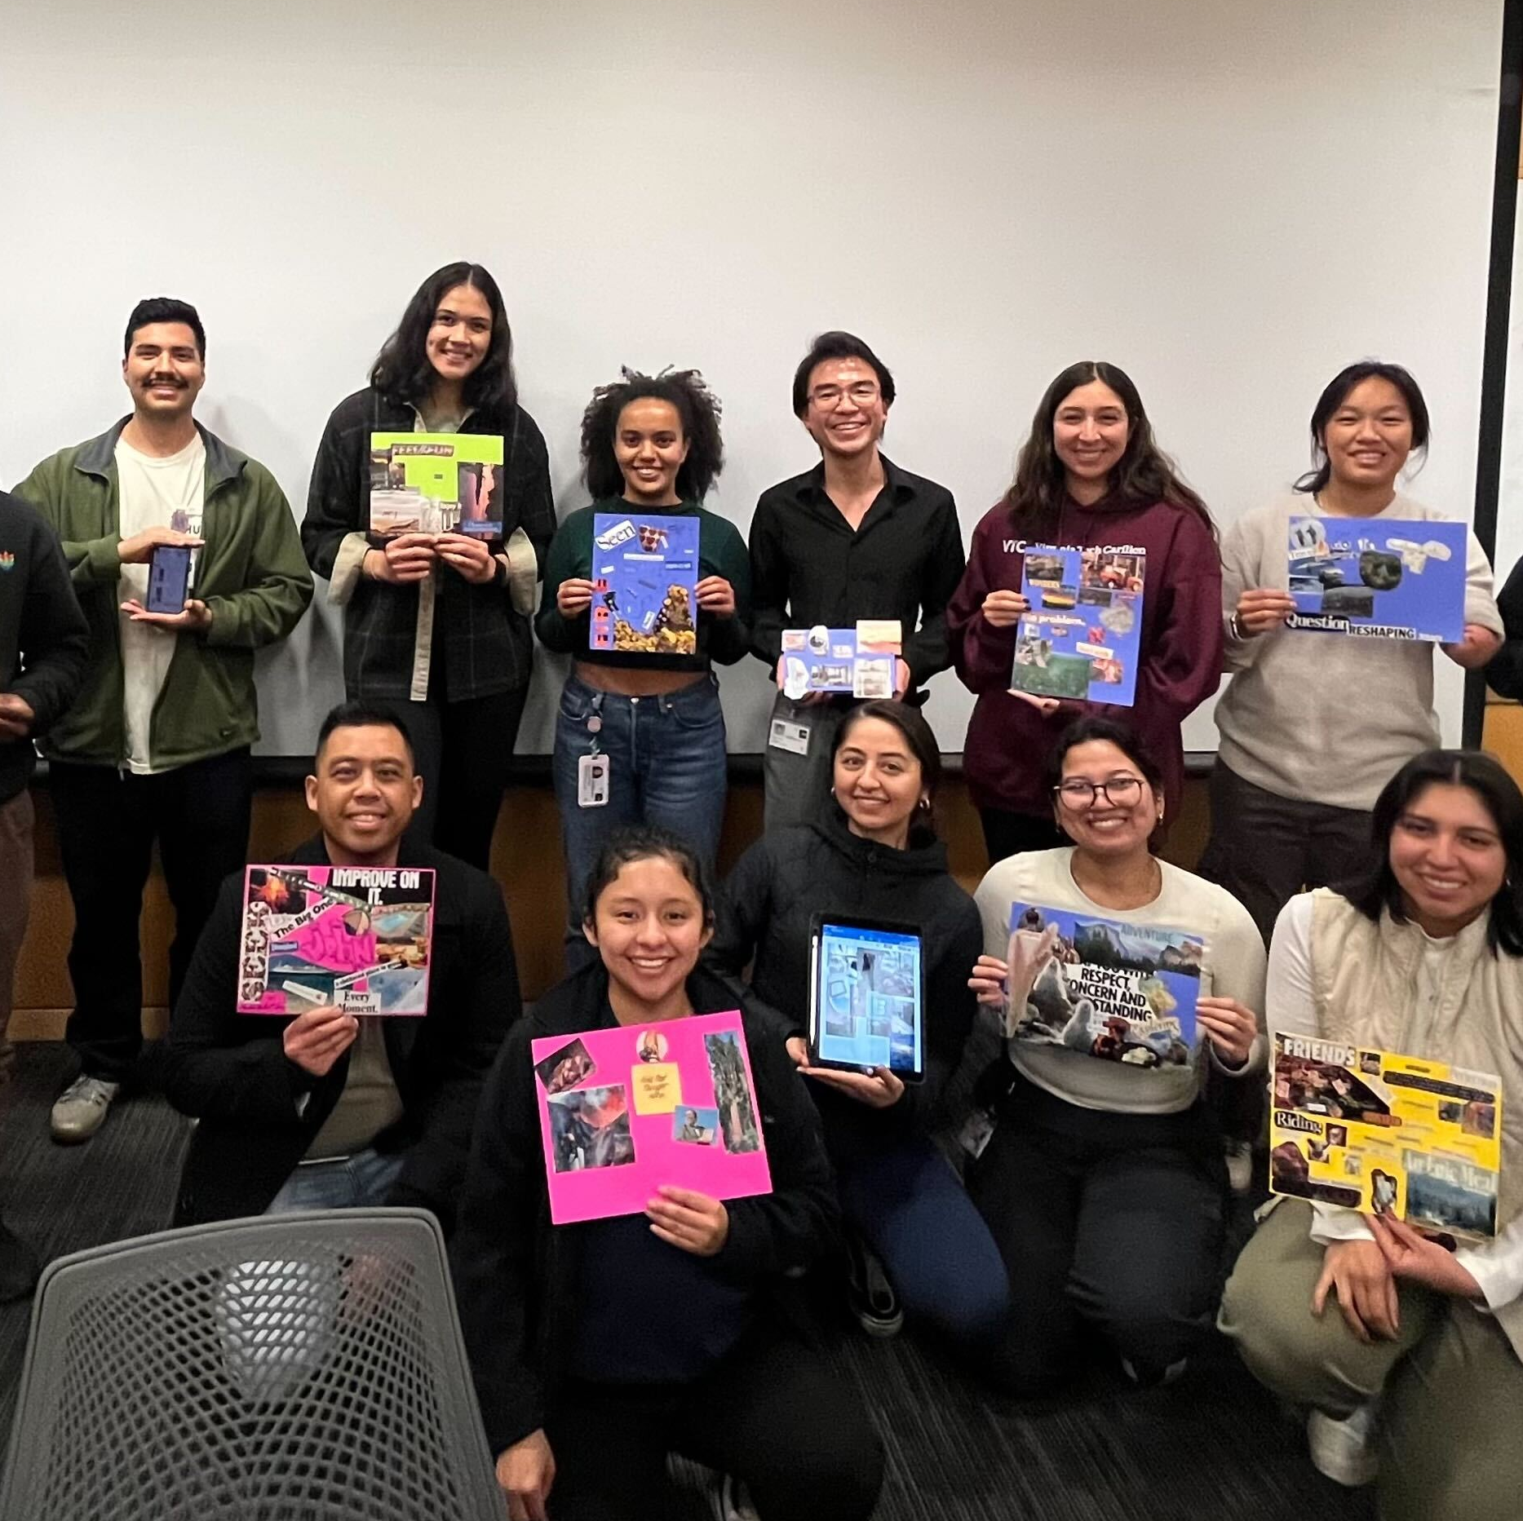
“Critical Mass” Offers Programmatic Benefits
Annual Symposium honoring and showcasing scholar science
PREP@UCSF fully integrated into PROPEL enriching both program
Campus presence connects PROPEL with campus organizations and volunteer networks
Created for CAGI7
genomeinterpretation.org
Ryan Hernandez

Slide 34
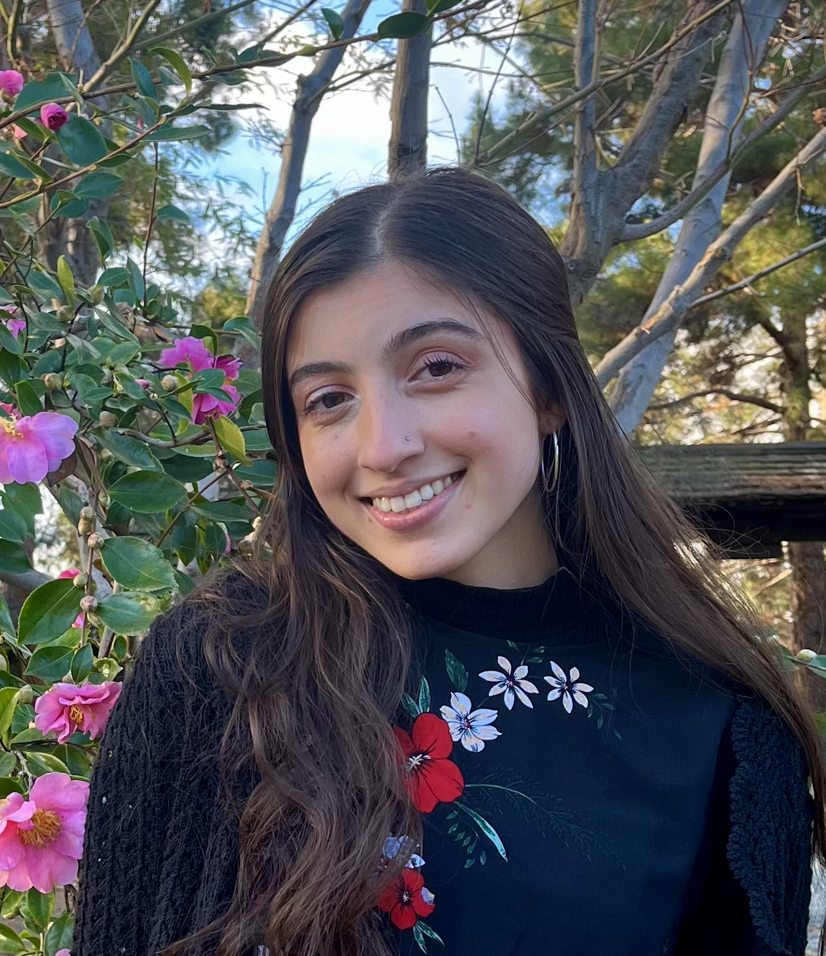
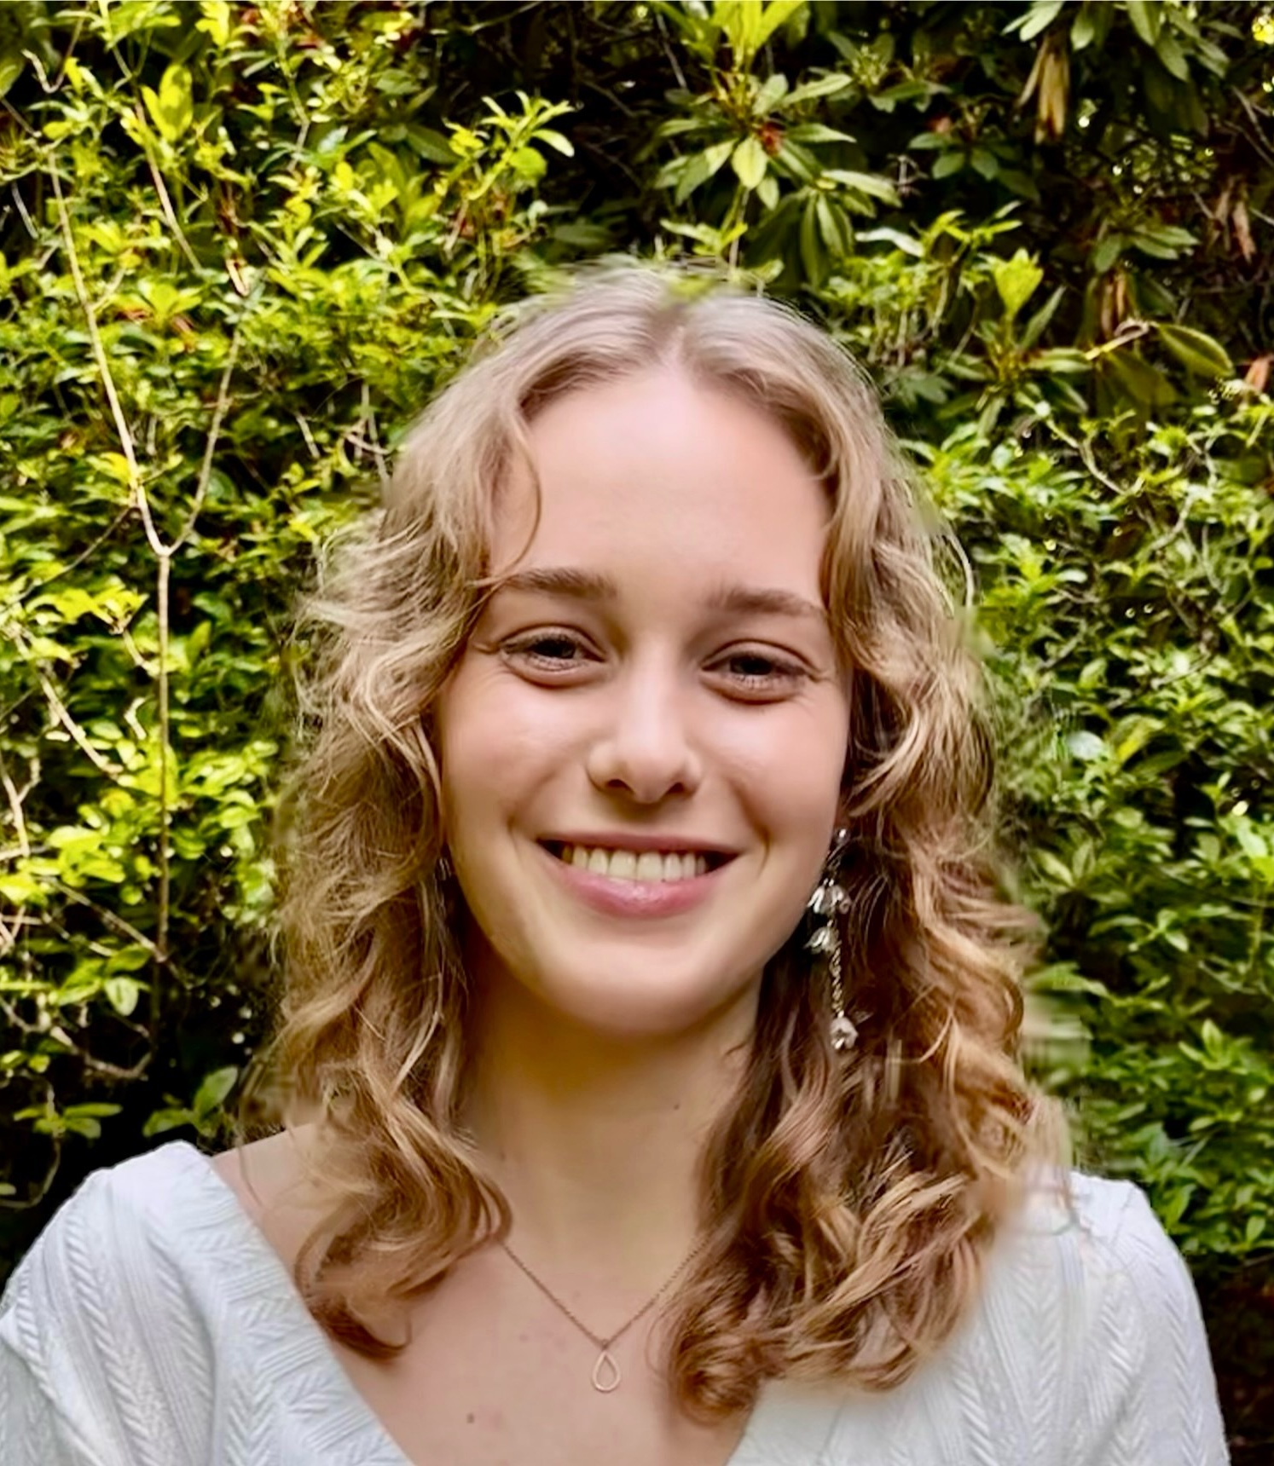
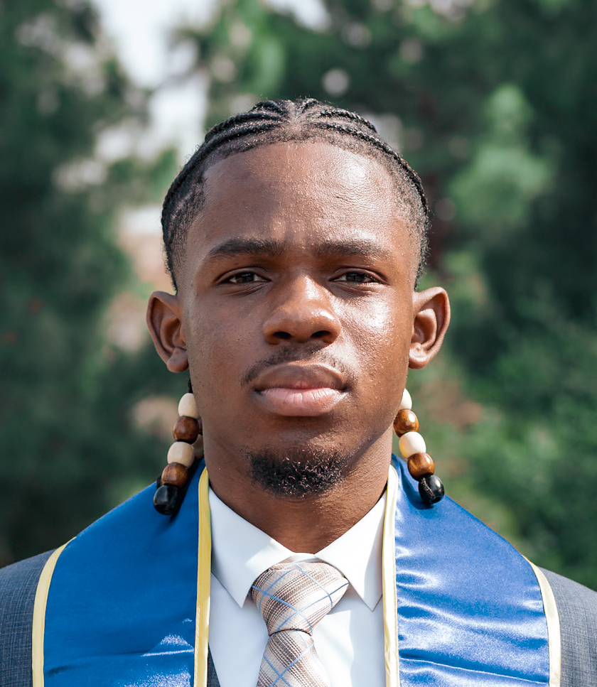
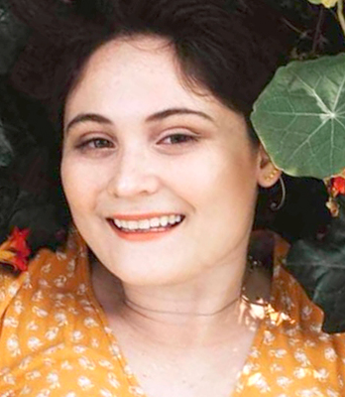
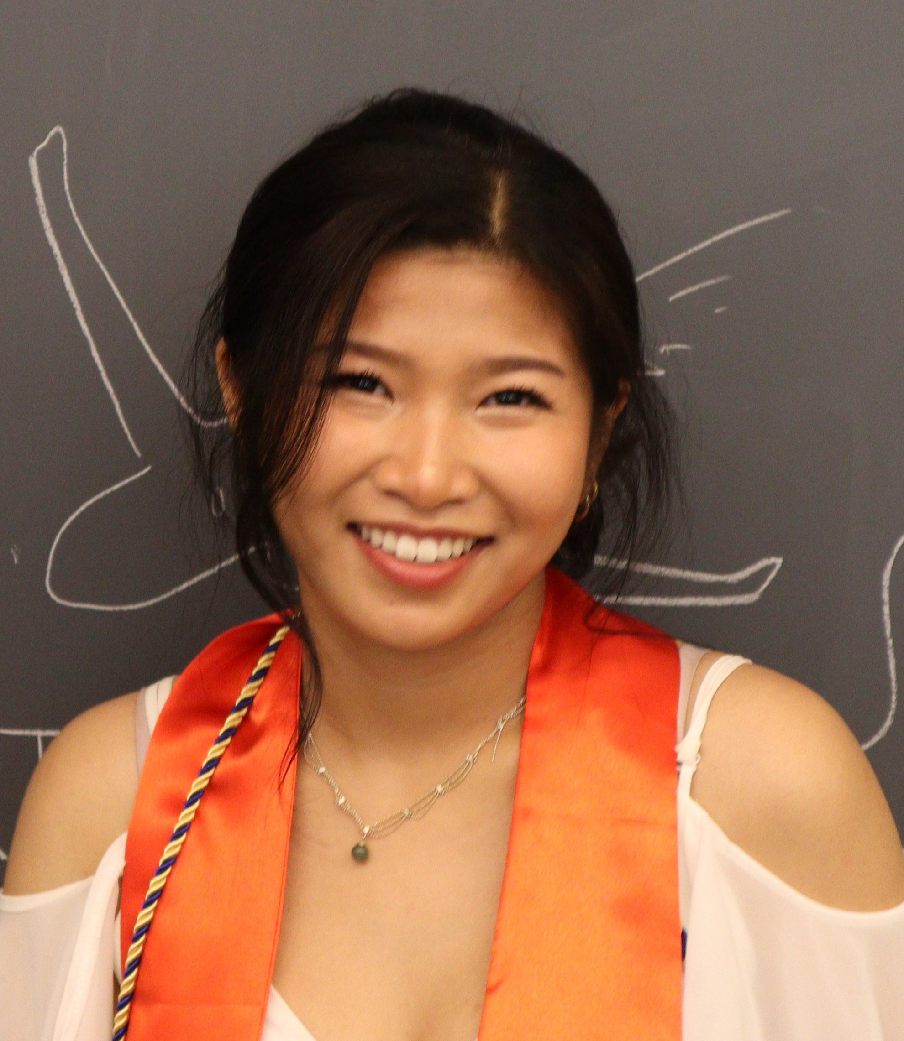
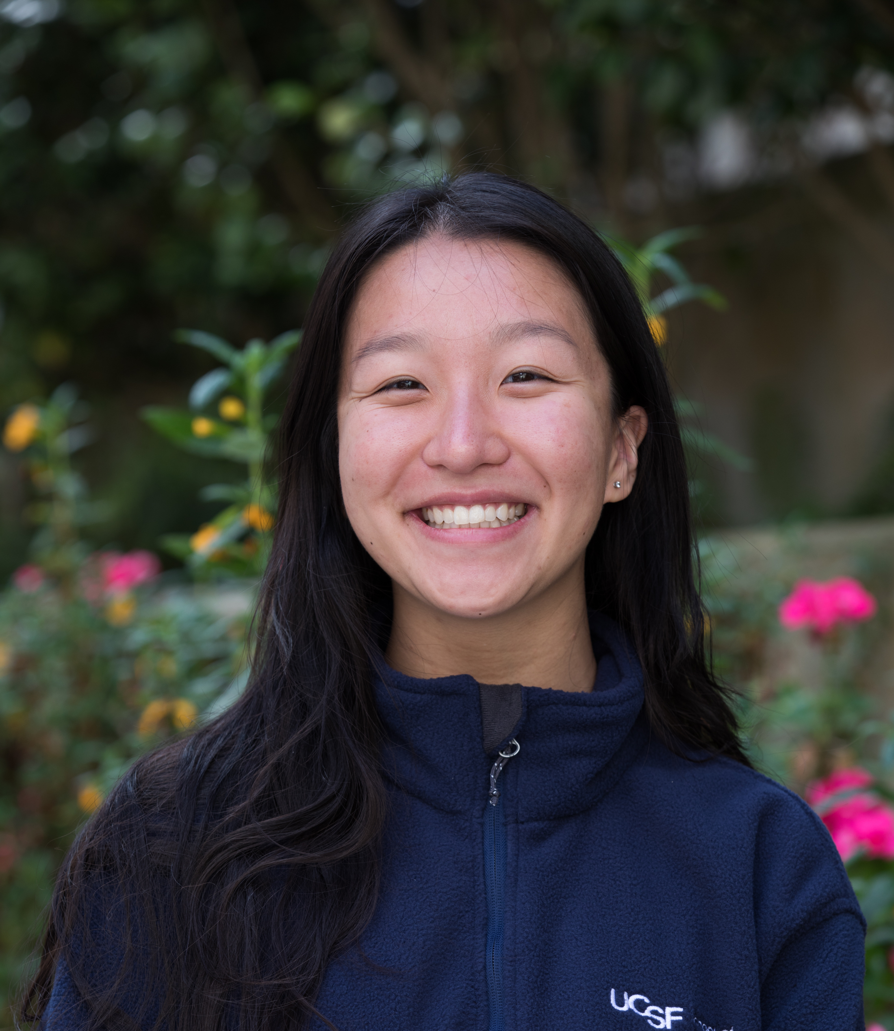
Scholar-Selected Council:
A Driver of Programmatic Improvements
2024-25 PROPEL Scholars Council
Council-led Initiatives:
MD-PhD AMCAS application support
MCAT Bootcamp
Social Media Committee/Monthly Newsletter
Faculty mentorship panel series
Peer mentorship program
UCSC Undergrad Mentorship Program
Created for CAGI7
genomeinterpretation.org
Ryan Hernandez

Slide 35
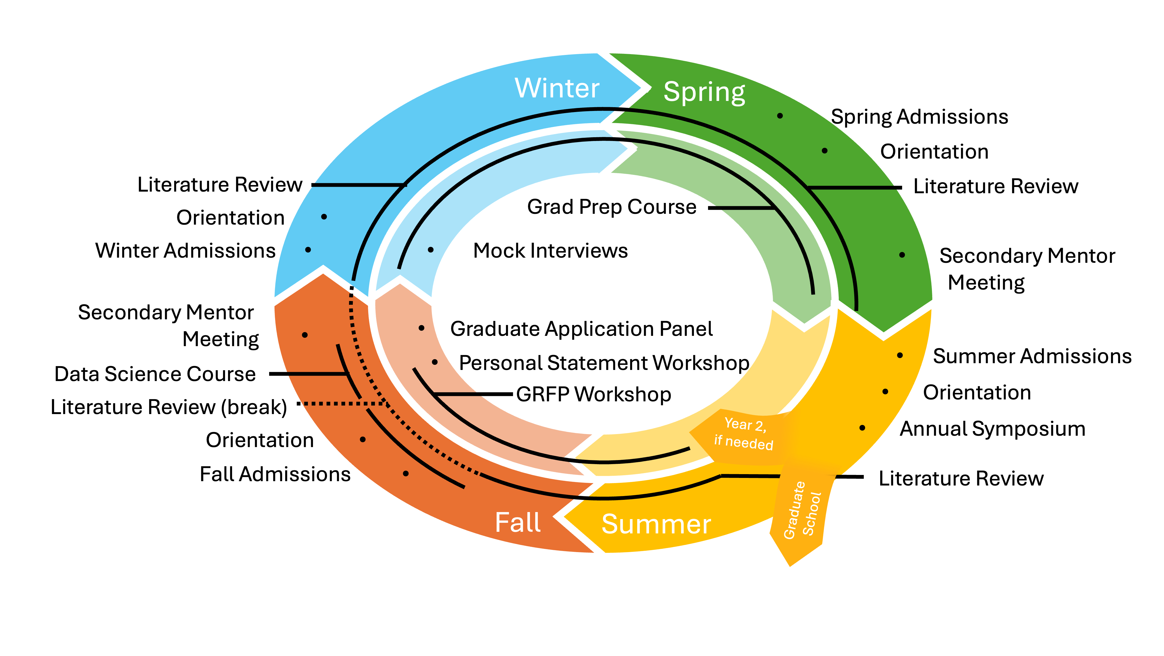
Curriculum Supports Scientific Development to Ultimately Support Grad School Readiness
Course objectives:
  Support scientific development
  Prepare them for grad school
Limit time away from bench
Flexible for either 1 or 2-year tracks
  Majority of scholars stay 2 years
Created for CAGI7
genomeinterpretation.org
Ryan Hernandez

Slide 36










Other Universities Adopt PROPEL Model
REACH
PROPEL NW
ICARE
120
active scholars
Created for CAGI7
genomeinterpretation.org
Ryan Hernandez

Slide 37





Matchmaking Team
Jessica Allen, PhD
Angel Max Guerrero
Ryan Hernandez, PhD
Todd Nystul, PhD
Jennifer Seuferer
National Partners: https://propelscholars.org
Created for CAGI7
genomeinterpretation.org
Ryan Hernandez

Slide 38
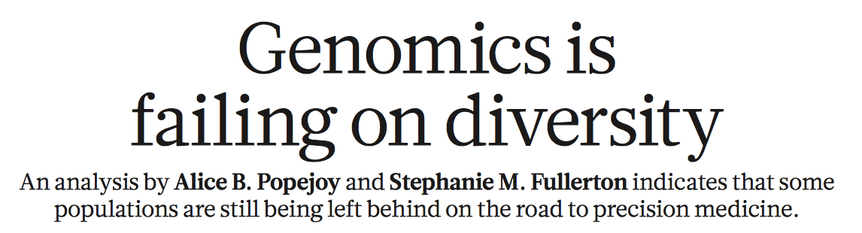
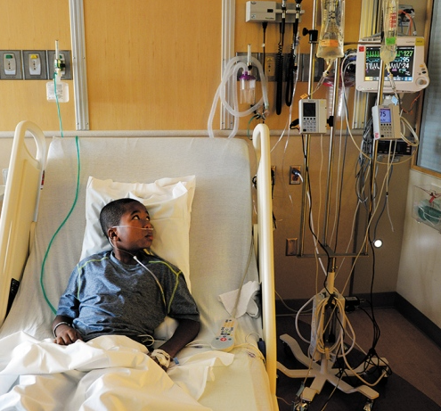
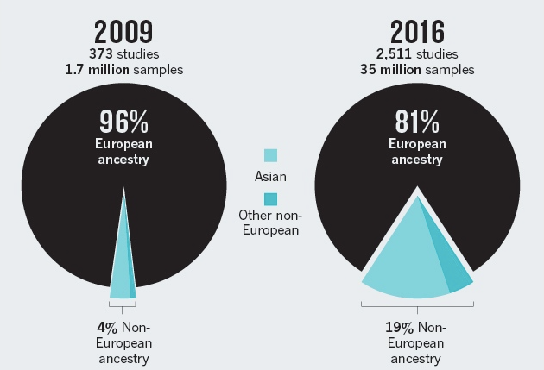
Created for CAGI7
genomeinterpretation.org
Ryan Hernandez

Slide 39
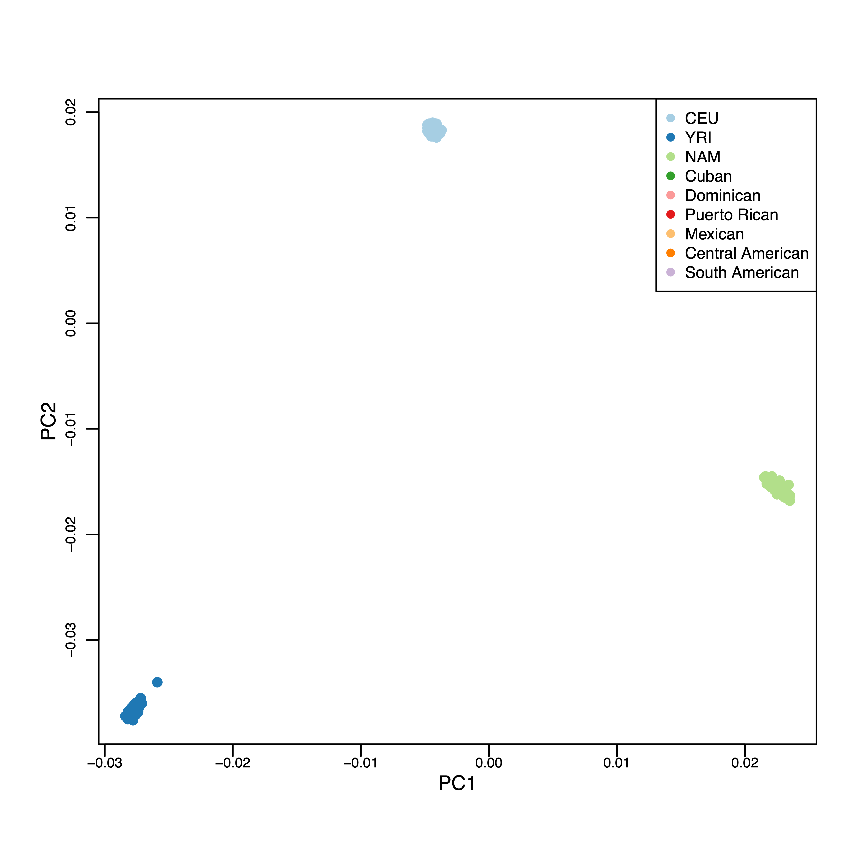
Henn, et al (2012)
Created for CAGI7
genomeinterpretation.org
Ryan Hernandez

Slide 40
Clustering genomic data
European
Principle Component Analysis: PCA
Amerindigenous
African
Created for CAGI7
genomeinterpretation.org
Ryan Hernandez

Slide 41
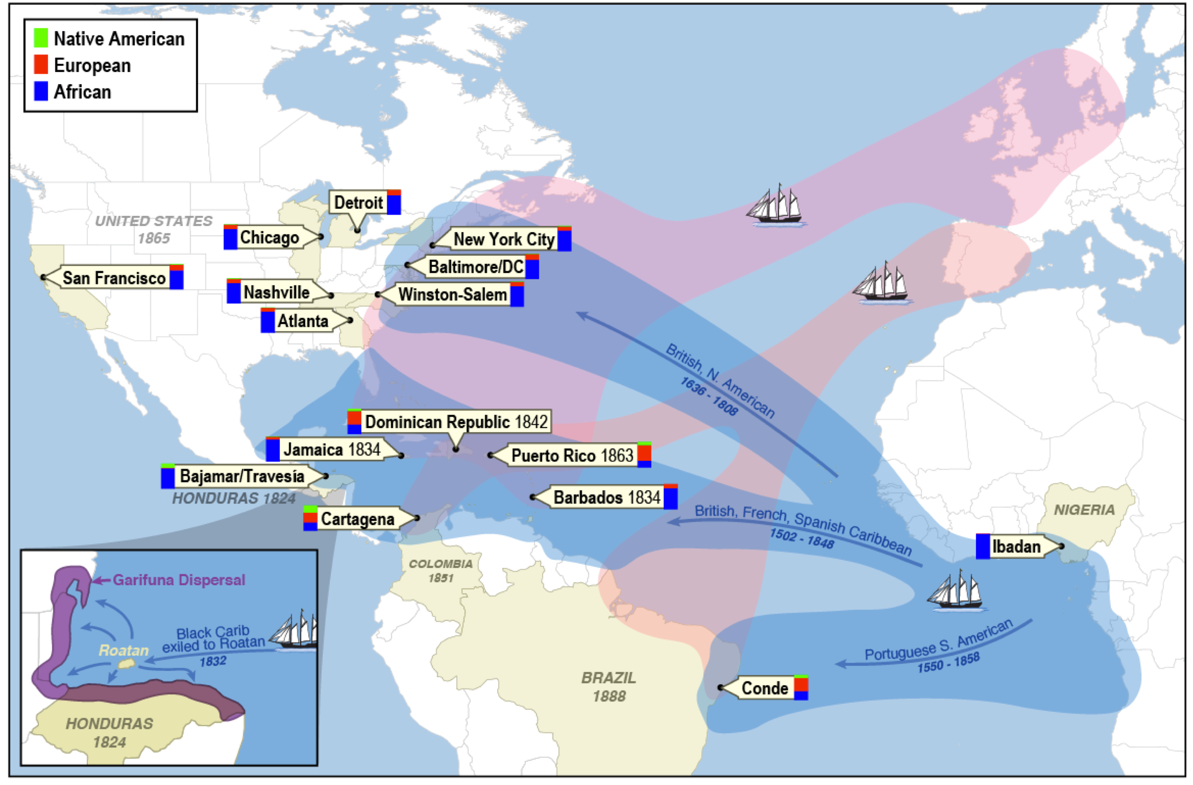
Recolonization & Forced Migration: Admixture
Mathias et al. (2016)
Created for CAGI7
genomeinterpretation.org
Ryan Hernandez

Slide 42
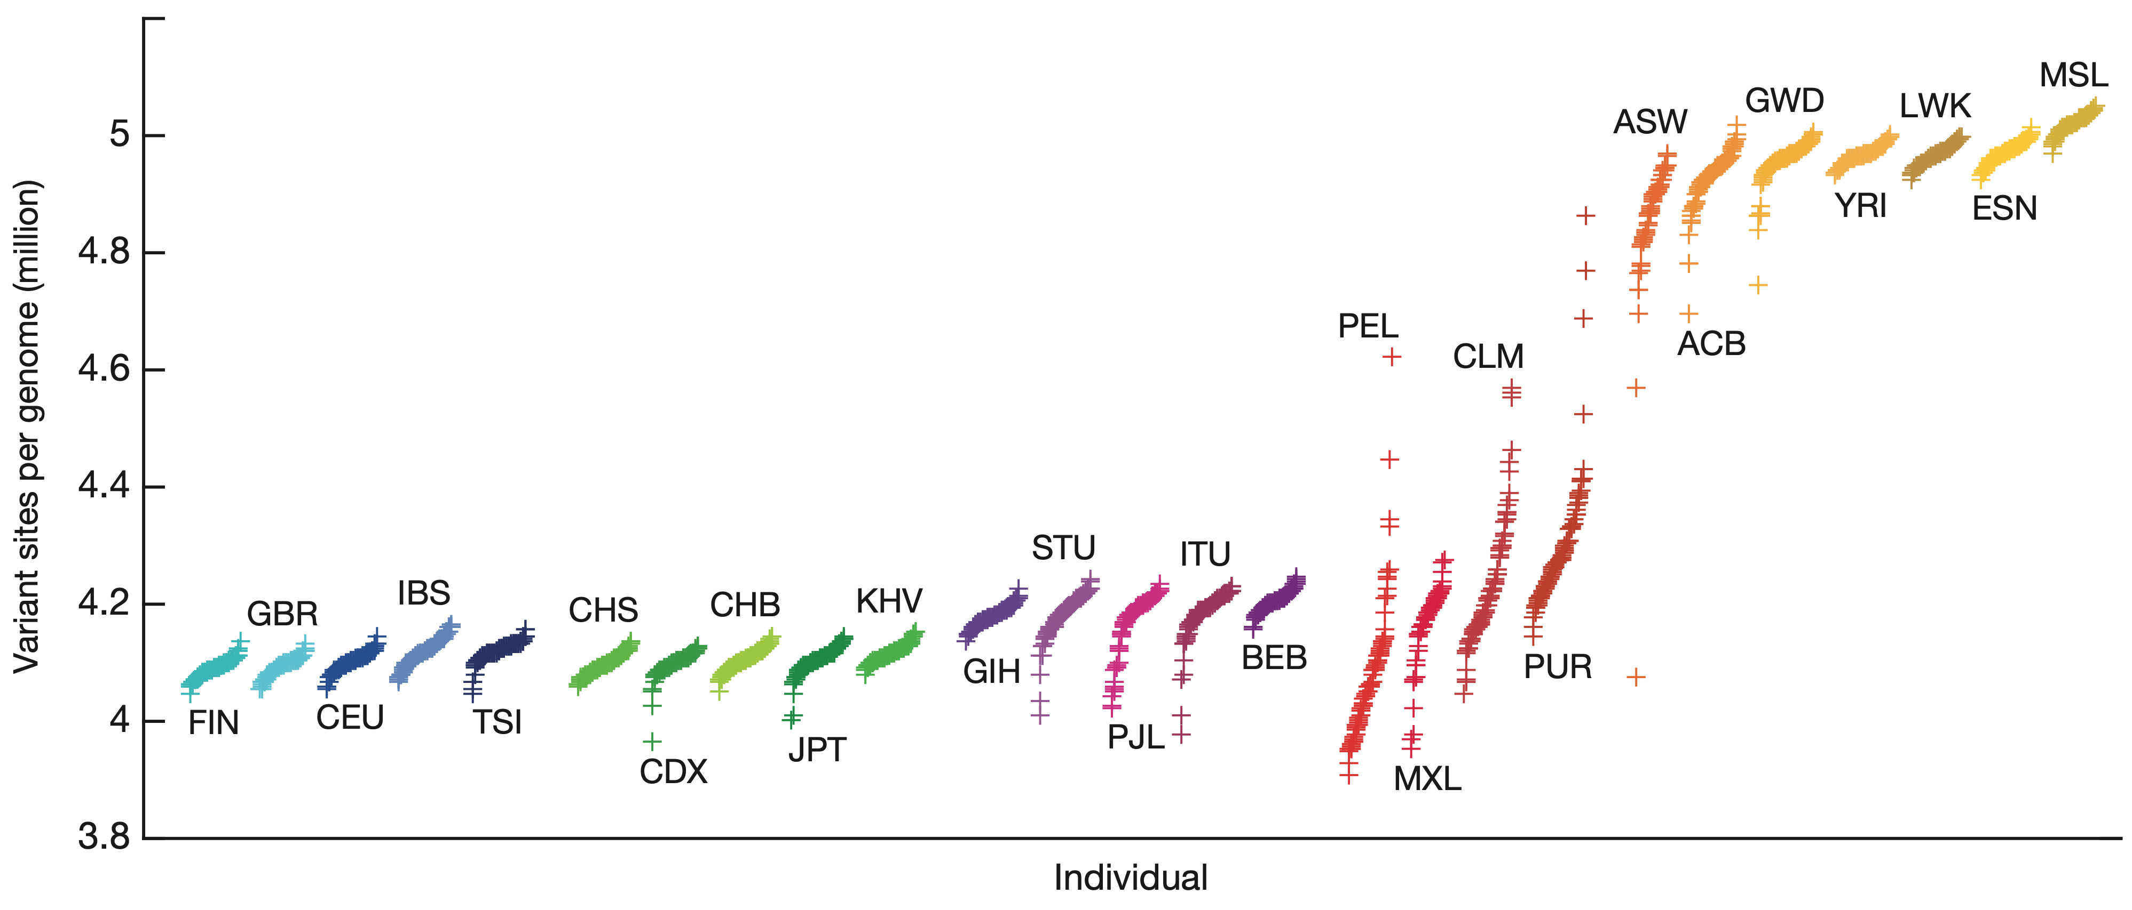
Serial bottlenecks and the colonization of the world
Americas
Africa
South Asia
Europe
East Asia
1000 Genomes Project (2015)
Created for CAGI7
genomeinterpretation.org
Ryan Hernandez

Slide 43
Admixture results in a mosaic genomes
Pop 1
x
Pop 2
F1
F2
F3
...
Fn
Created for CAGI7
genomeinterpretation.org
Ryan Hernandez

Slide 44
Hernandez (1981)
Created for CAGI7
genomeinterpretation.org
Ryan Hernandez

Slide 45
“Distinct groups” are not actually distinct
In the United States, admixture produces a continuum of populations
European
Amerindigenous
African
Spear et al (2020)
Created for CAGI7
genomeinterpretation.org
Ryan Hernandez

Slide 46
“Distinct groups” are not actually distinct
In the United States, admixture produces a continuum of populations
White
Hispanic/Latine
Black/African American
Spear et al (2020)
Created for CAGI7
genomeinterpretation.org
Ryan Hernandez

Slide 47
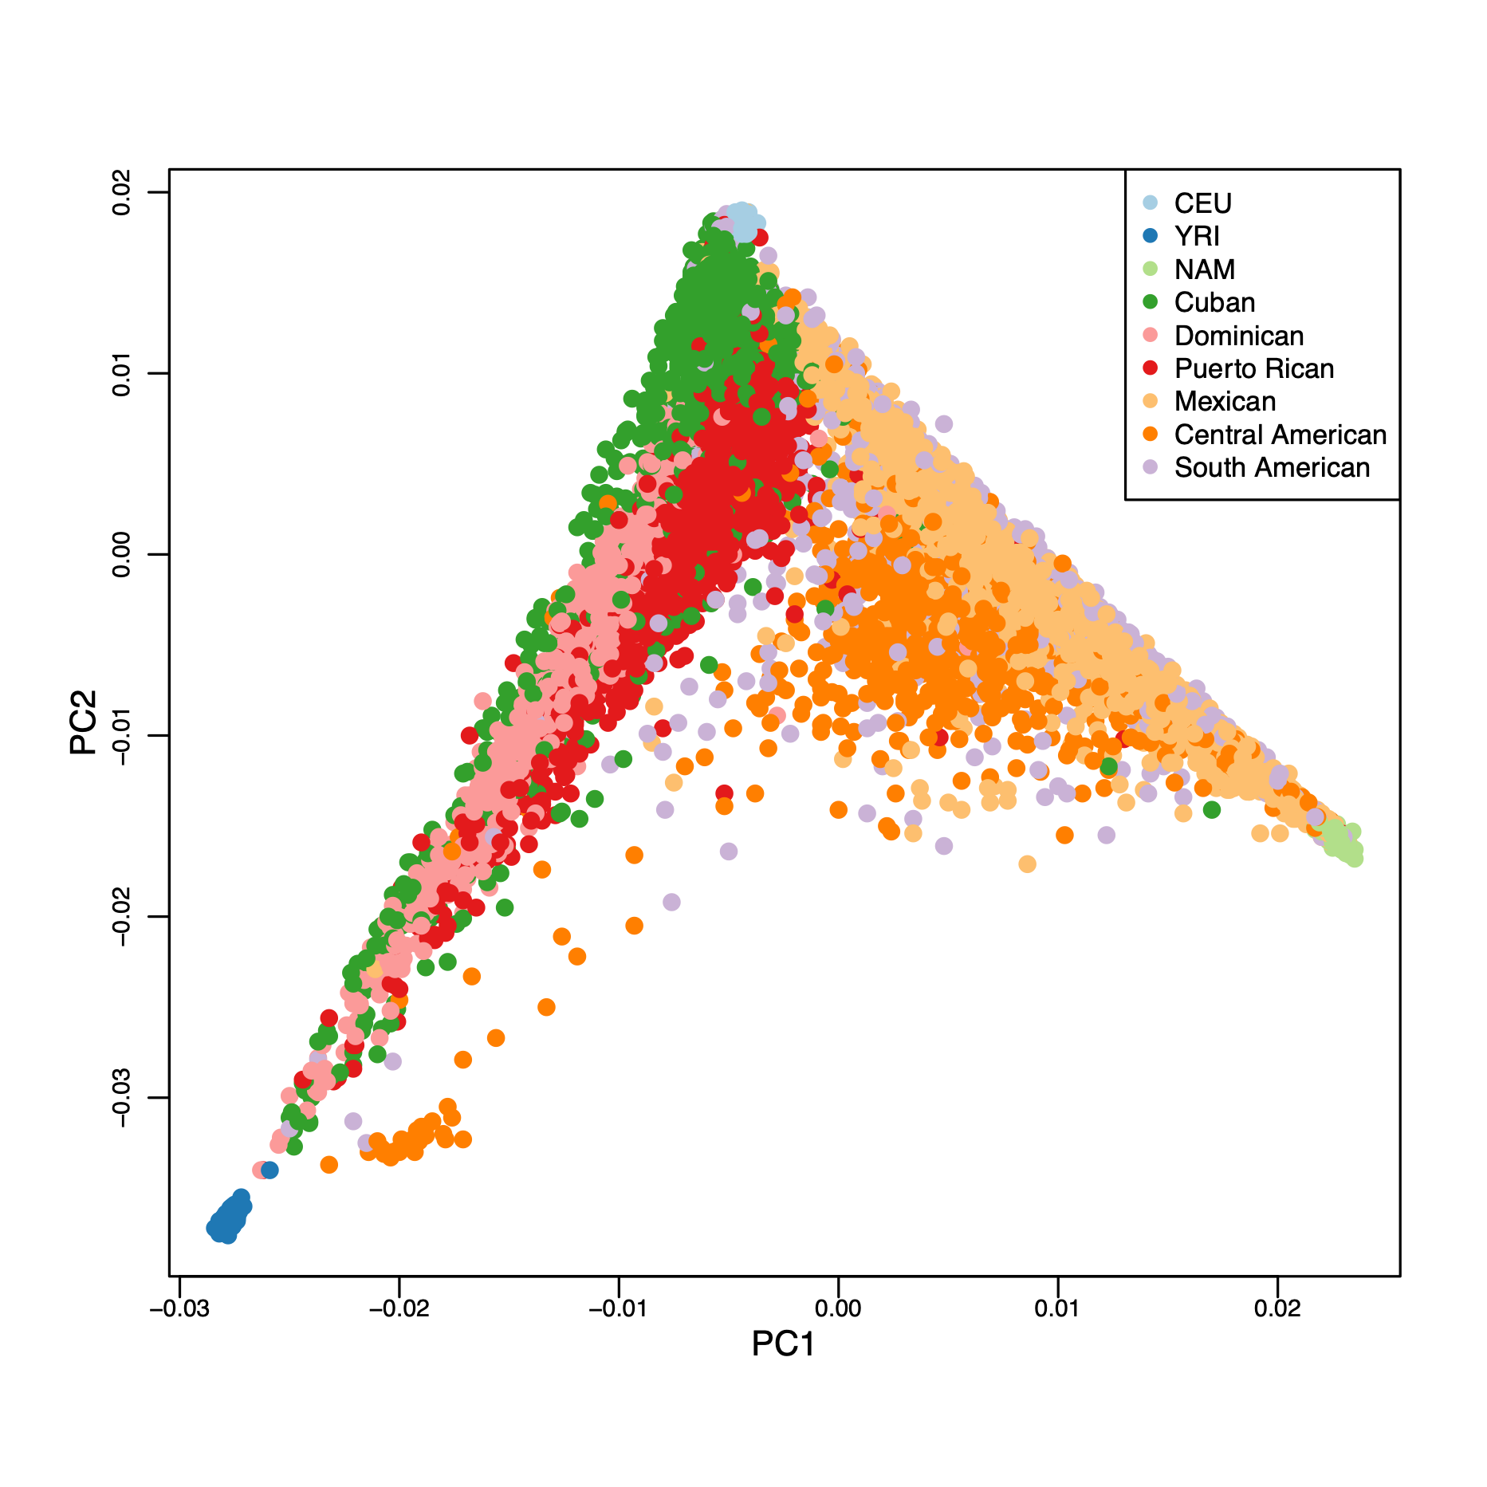
“Distinct groups” are not actually distinct
In the United States, admixture produces a continuum of populations
Spear et al (2020)
Created for CAGI7
genomeinterpretation.org
Ryan Hernandez

Slide 48
Race, ethnicity, and genetic ancestry
White
In the United States, admixture produces a continuum of populations
Race and ethnicity are imperfect partitions of a continuum
More information is needed on family history to overcome systemic underrepresentation of historically excluded groups
Hispanic/ Latine
Black/African American
Spear et al (2020)
Created for CAGI7
genomeinterpretation.org
Ryan Hernandez

Slide 49
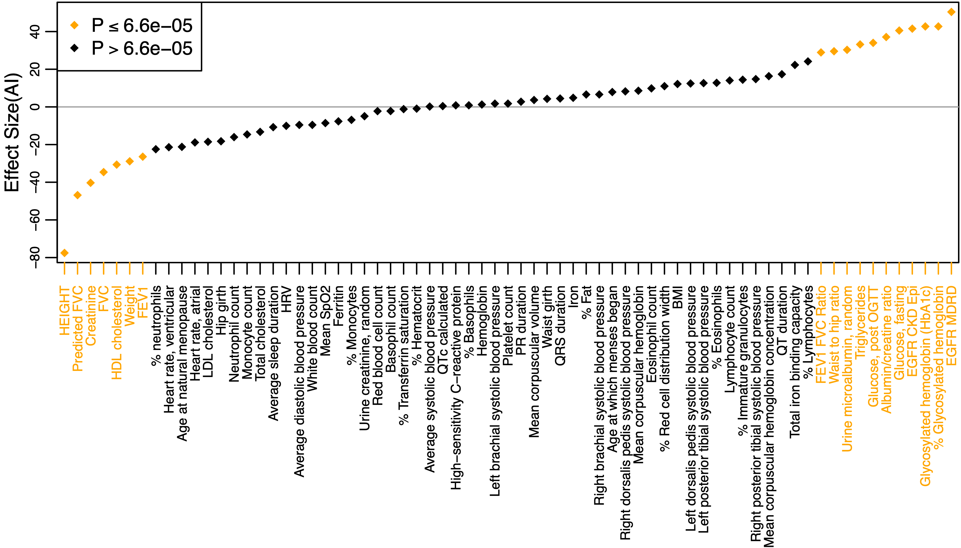
Ancestry is correlated with many biomedical traits
Spear et al (2020)
Created for CAGI7
genomeinterpretation.org
Ryan Hernandez

Slide 50
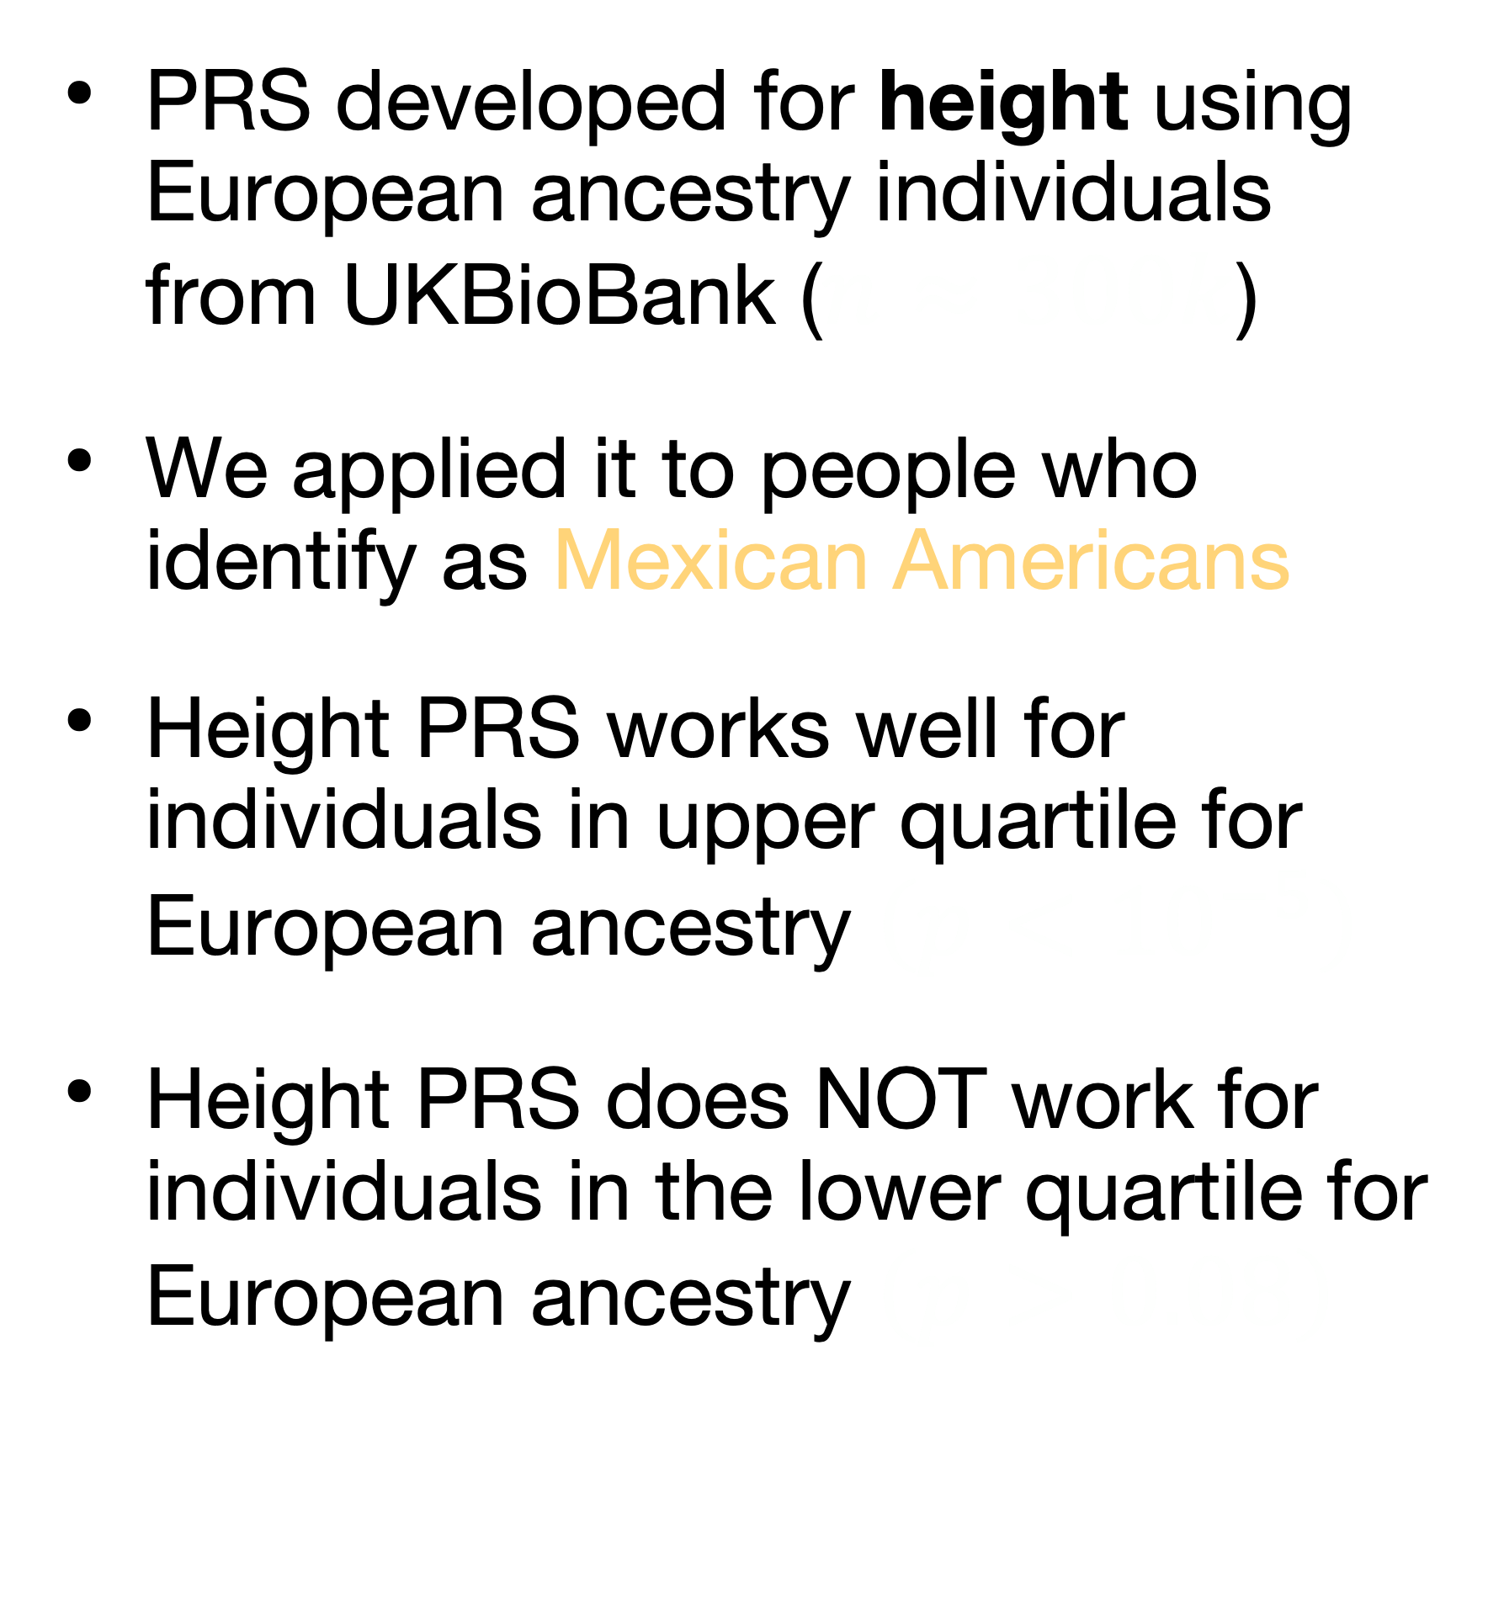



Precision medicine for some
Design PRS from European ancestry
$$\}$$
PRS developed for height using European ancestry individuals from UKBioBank ($n≈300k$)
We applied it to people who identify as Mexican Americans
Height PRS works well for individuals in upper quartile for European ancestry $\left(p<{10}^{−5}\right)$
Height PRS does NOT work for individuals in the lower quartile for European ancestry $\left(p>0.08\right)$
$$\}$$
$$\}$$
Spear et al (2020)
Created for CAGI7
genomeinterpretation.org
Ryan Hernandez

Slide 51
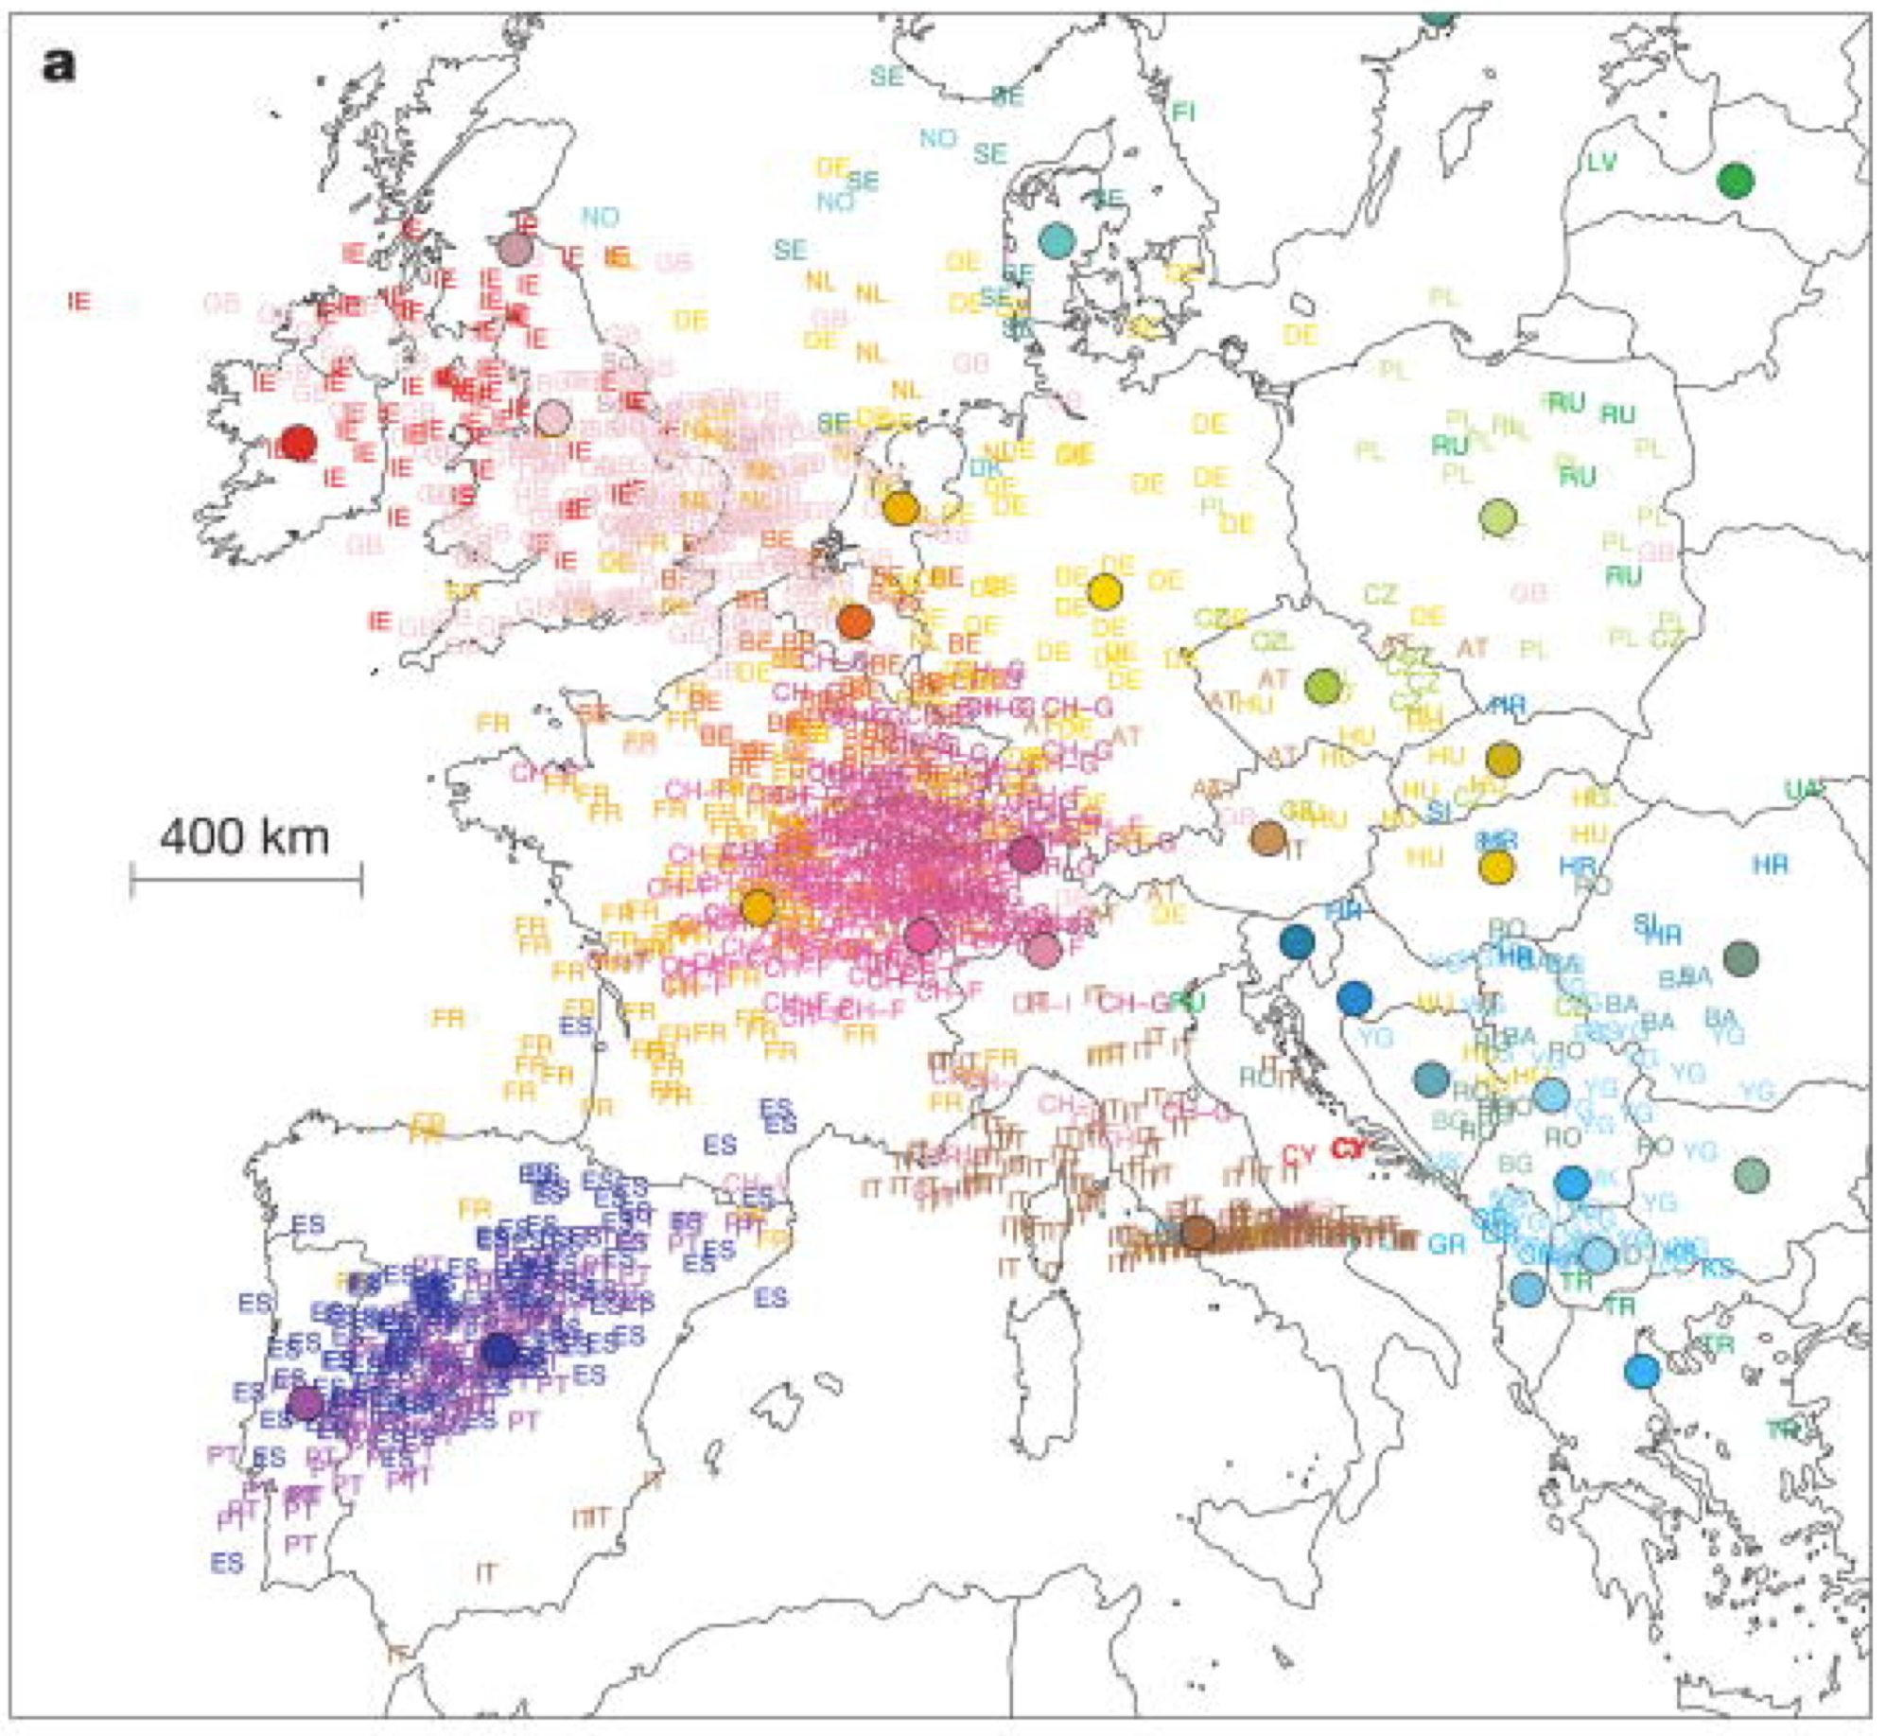
“Ancestry”?
What is European ancestry?
“Genes mirror geography”
Novembre et al (2008)
Created for CAGI7
genomeinterpretation.org
Ryan Hernandez

Slide 52

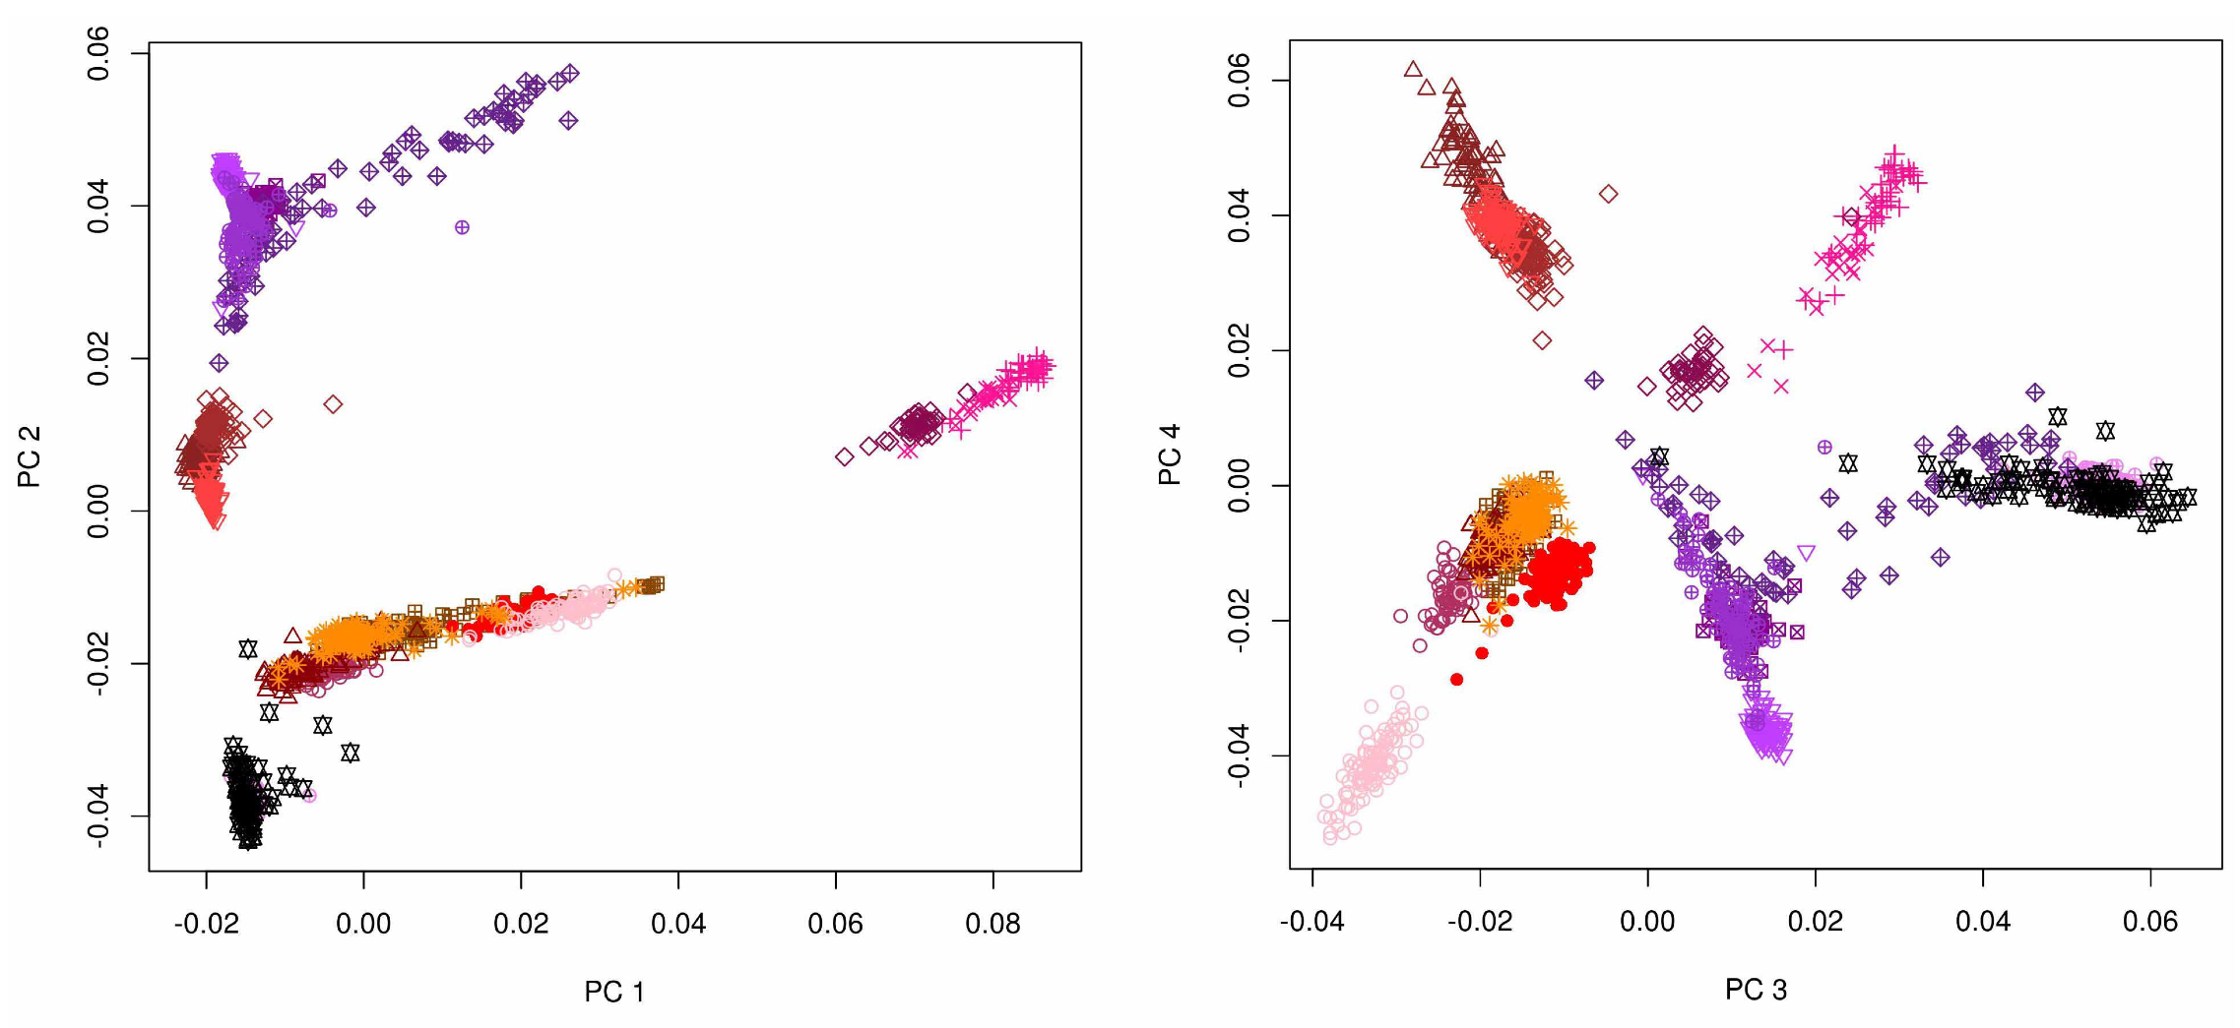
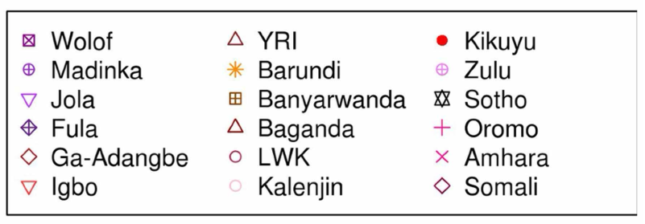
“Ancestry”?
What is African ancestry?
Substantial variation among indigenous groups
Created for CAGI7
genomeinterpretation.org
Ryan Hernandez

Slide 53
“Ancestry”?
What is Amerindigenous ancestry?
Individuals who identify as Central and South American have a range of Amerindigenous ancestry
Individuals who identify as Mexican American have a range of Amerindigenous ancestry
But they cluster with different groups!
Created for CAGI7
genomeinterpretation.org
Ryan Hernandez

Slide 54
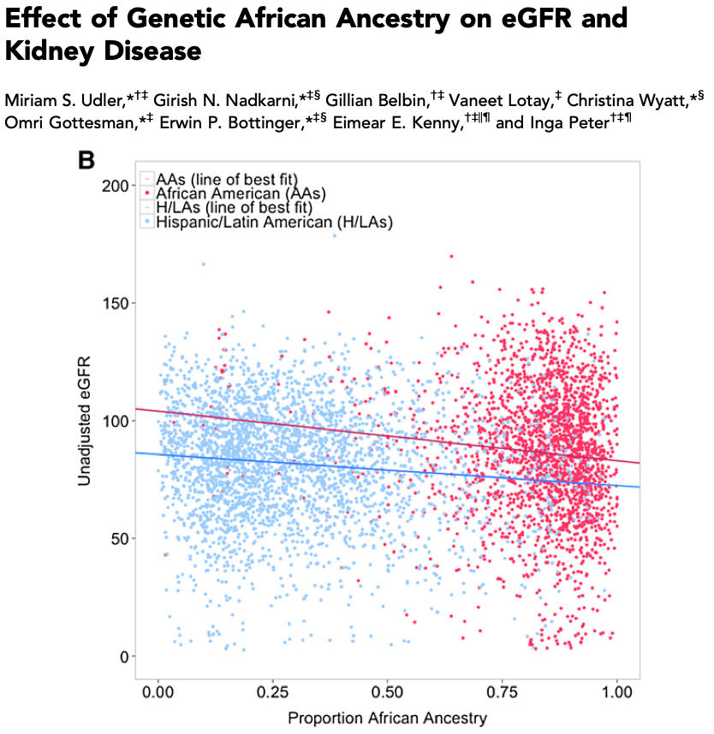
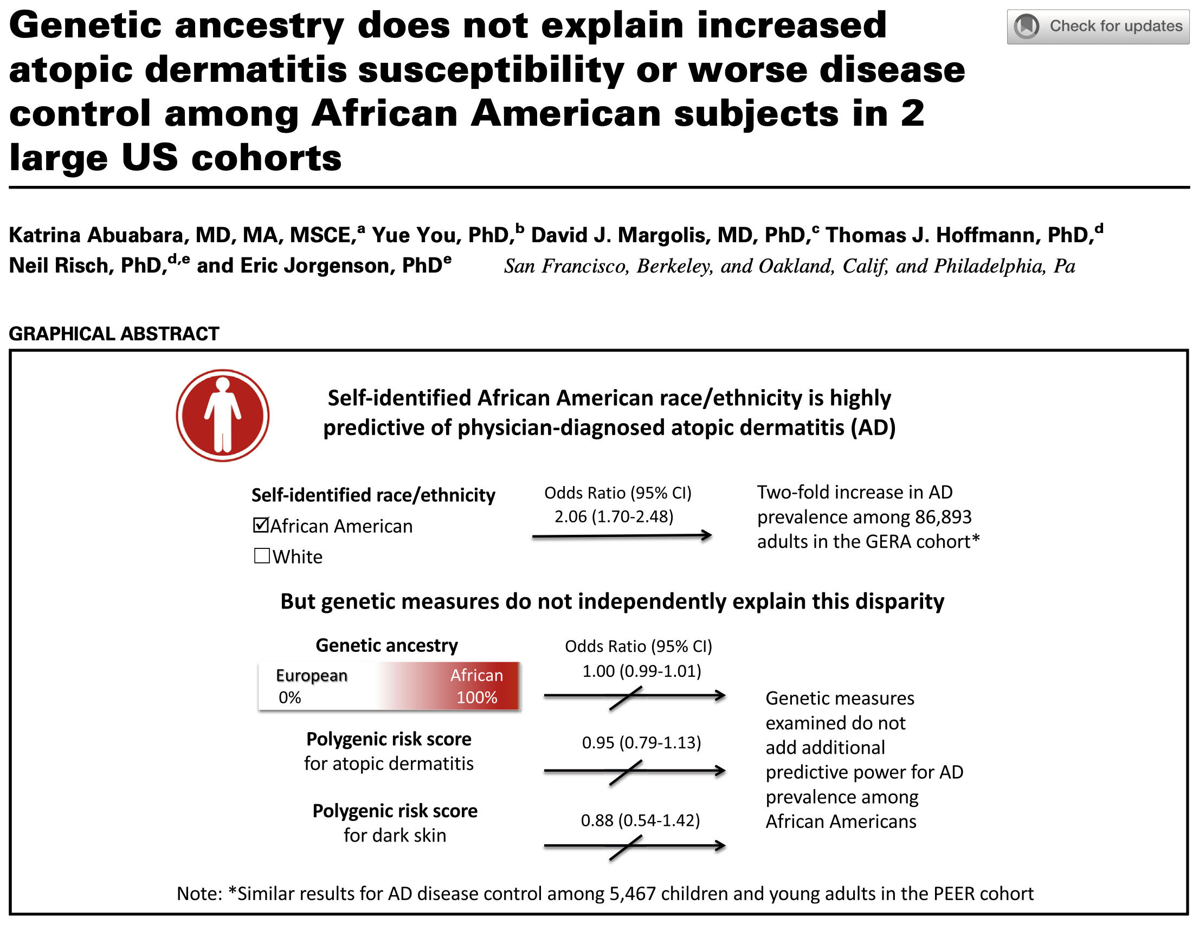
Race, ethnicity, and ancestry as information
Created for CAGI7
genomeinterpretation.org
Ryan Hernandez

Slide 55
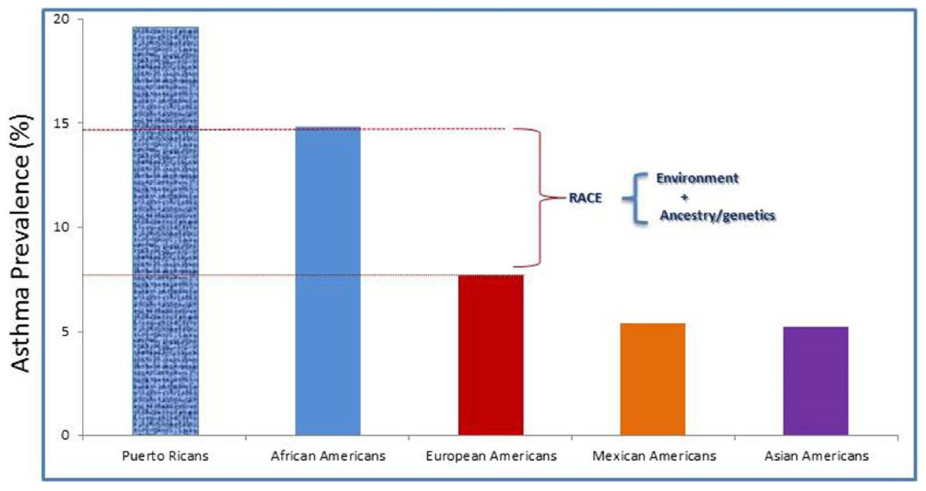
Race, ethnicity, and ancestry as information
Mersha (2015)
Created for CAGI7
genomeinterpretation.org
Ryan Hernandez

Slide 56
Race, ethnicity, and ancestry as information
Mersha (2015)
Created for CAGI7
genomeinterpretation.org
Ryan Hernandez

Slide 57
Content Warning
The following material contains descriptions and depictions of violence, death, and discrimination. I’m including this content in order to clearly describe how research is misused and ways that we as a scientific community can do better.
Created for CAGI7
genomeinterpretation.org
Ryan Hernandez

Slide 58
May 14, 2022
10 Black people were murdered by an 18 year old White man.
The accused wrote a manifesto describing himself as an ethno-nationalist and a supporter of white supremacy who was motivated to commit acts of political violence.
Carlson, et al. (2022)
Created for CAGI7
genomeinterpretation.org
Ryan Hernandez

Slide 59

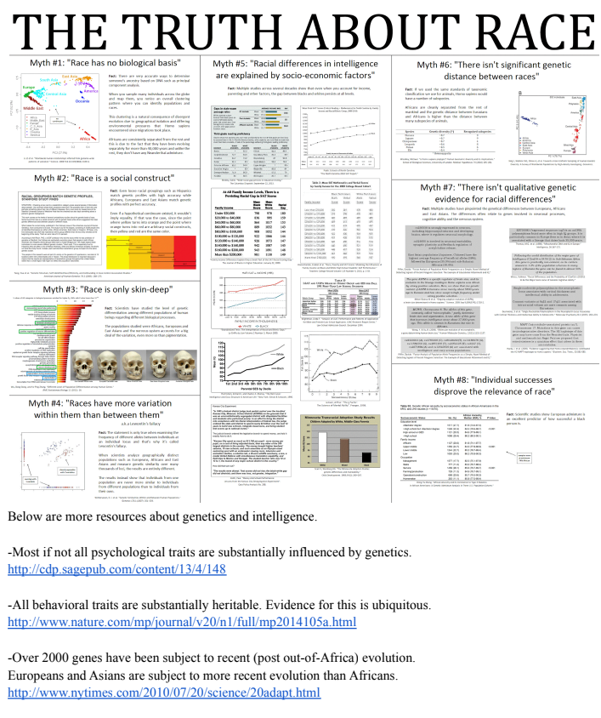
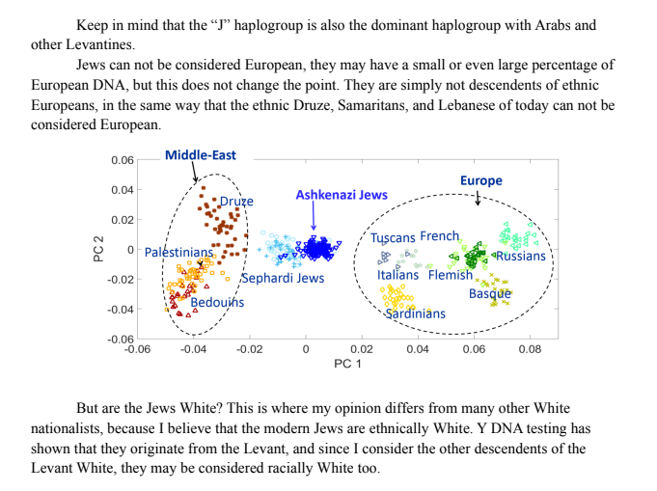
Catastrophic misuse of genetics
Carlson, et al. (2022)
Created for CAGI7
genomeinterpretation.org
Ryan Hernandez

Slide 60
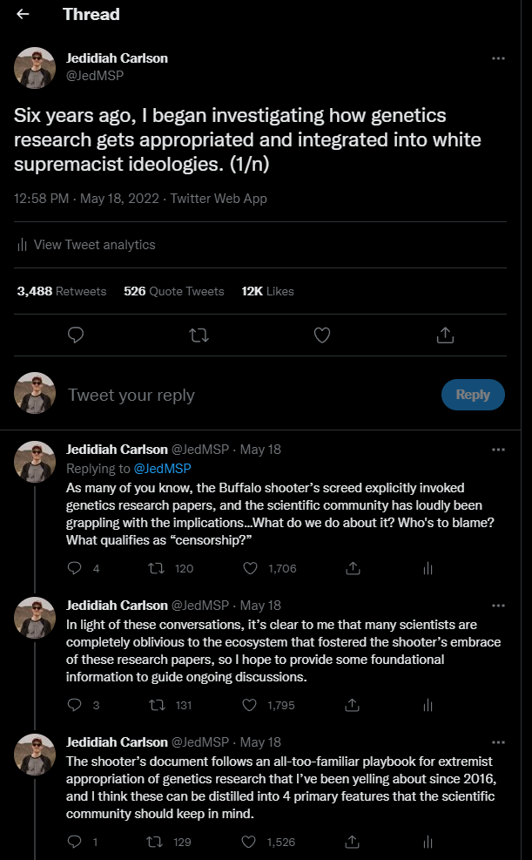
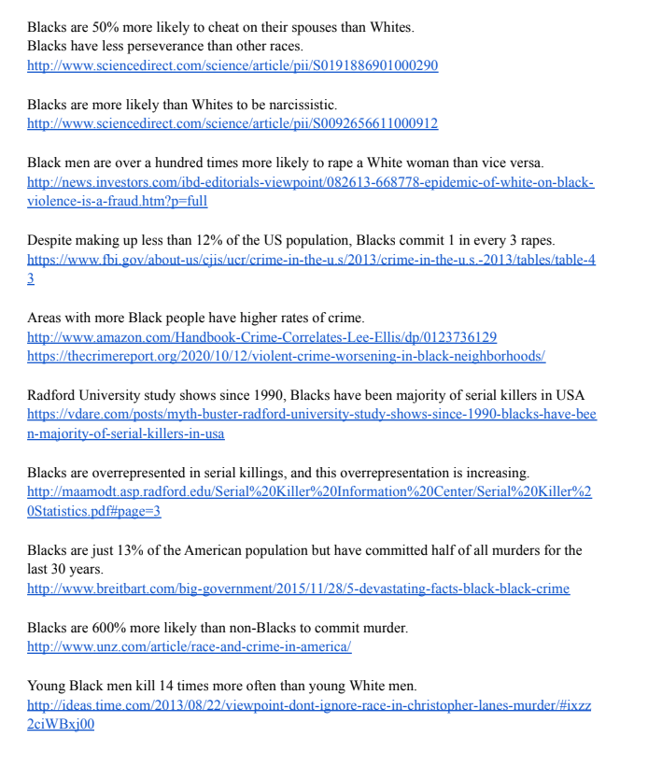
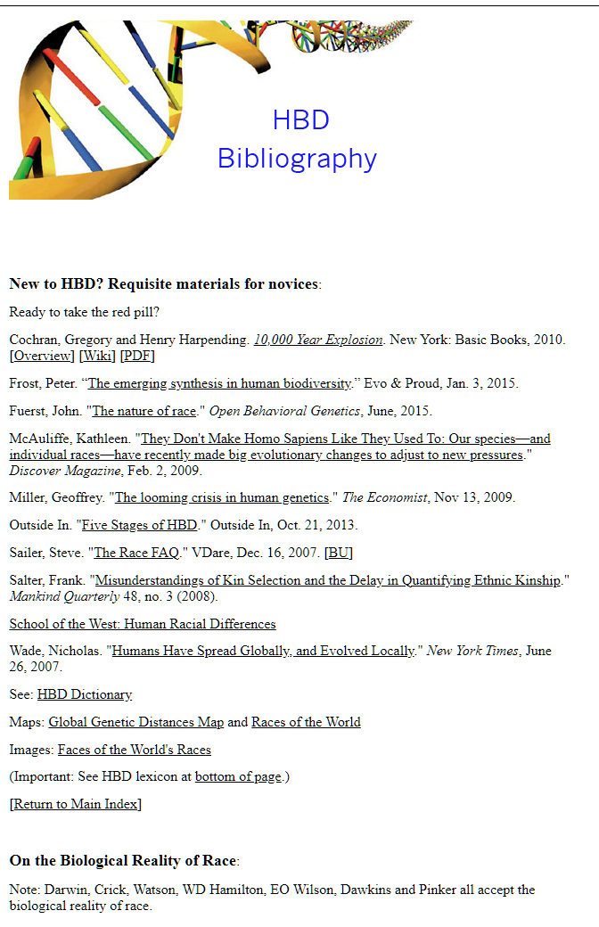
Far-Right Journal Clubs
Carlson, et al. (2022)
Created for CAGI7
genomeinterpretation.org
Ryan Hernandez

Slide 61
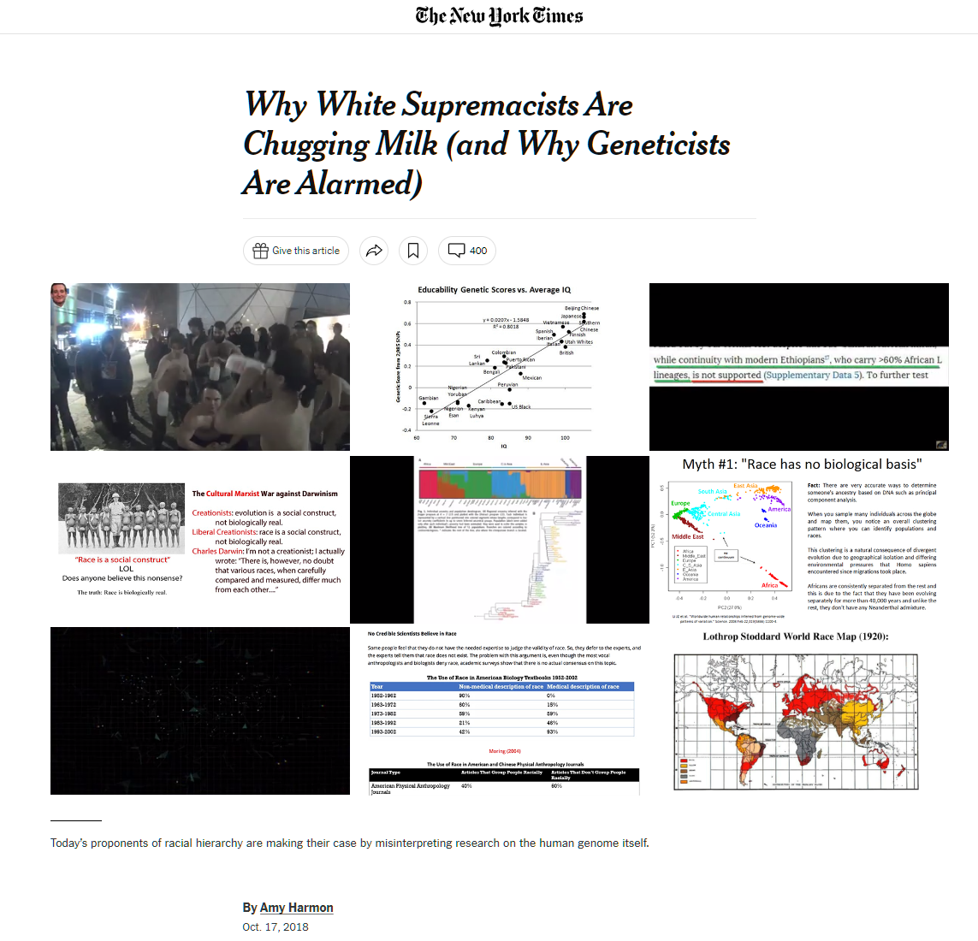
Carlson, et al. (2022)
Created for CAGI7
genomeinterpretation.org
Ryan Hernandez

Slide 62
Catastrophic history
Eugenics is the scientifically erroneous and immoral theory of “racial improvement” and “planned breeding,” which gained popularity during the early 20th century. Eugenicists worldwide believed that they could perfect human beings and eliminate so-called social ills through genetics and heredity. They believed the use of methods such as involuntary sterilization, segregation and social exclusion would rid society of individuals deemed by them to be unfit.
American eugenicists from a variety of disciplines declared certain individuals unfit, “feebleminded” or anti-social, which resulted in the involuntary sterilization of at least 60,000 people through 30 states’ laws by the 1970s.
These eugenicists disproportionately targeted Latine, Native Americans, African Americans, poor whites and people with disabilities during the entirety of the 20th century.
https://www.genome.gov/about-genomics/fact-sheets/Eugenics-and-Scientific-Racism
Created for CAGI7
genomeinterpretation.org
Ryan Hernandez

Slide 63


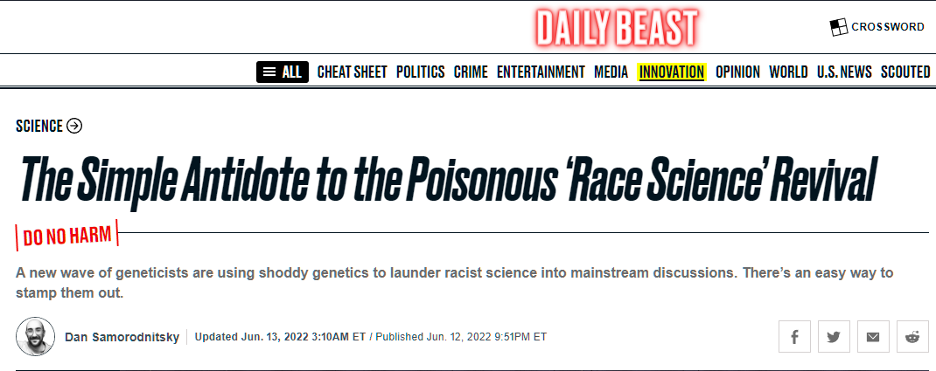
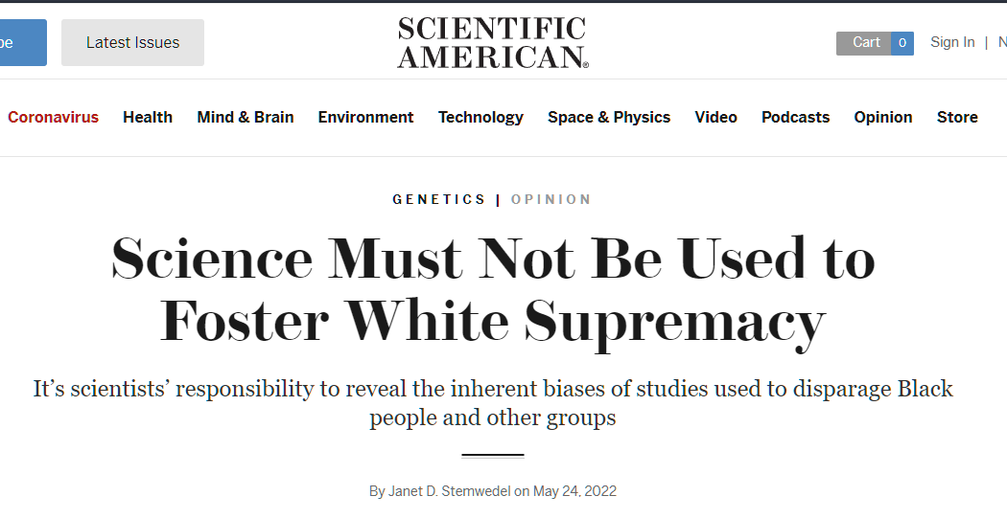


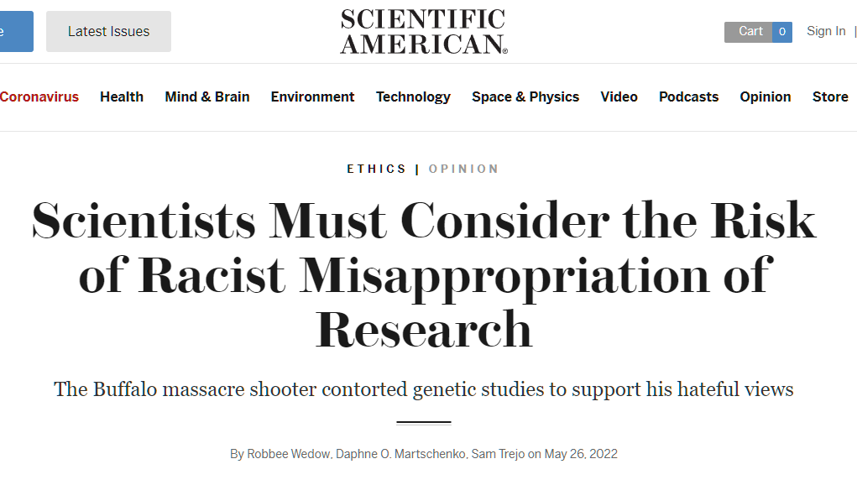
What can be done?
Current approach is the “Repudiation Cycle”
Carlson, et al. (2022)
Created for CAGI7
genomeinterpretation.org
Ryan Hernandez

Slide 64
Recommendations
Race, ethnicity, and ancestry are different sources of information and their use is inherently complex and multidisciplinary.
    None of these categories are particularly good at capturing social determinants of health
Multidisciplinary teams of clinicians, geneticists, epidemiologists/statisticians, bioethicists, social scientists, and other scientists who have expertise on the collection and use of patient information on race, ethnicity, nationality, and ancestry should be included in the process of creating and/or modifying data collection tools.
These teams should also provide input on how this information is stored, categorized, and accessed. This is especially important if/when genetic information is also collected and included.
Created for CAGI7
genomeinterpretation.org
Ryan Hernandez

Slide 65
Reassess your research
Scientists are highly incentivized to speculate about potential positive impacts
We must also consider the potential negative impacts
Must expect that work will be misappropriated
Contend with implicit biases embedded in our data, methodology, and inference
Expand the scope of your research toward inclusivity
Scientists cannot solve the problems of racism, but we can and must leverage our expertise and prestige to reduce its impacts and actively build a just, equitable society
Jedidiah Carlson
Created for CAGI7
genomeinterpretation.org
Ryan Hernandez

Slide 66
Conclusions
DEI is often a personal endeavor. You have to care.
Identifying key challenges is the first step to creating impactful solutions.
Overcoming resistance to new ideas is easier with a supportive community.
Research experience, confidence, and scientific identity are key for scientific success.
Cultivating mentorship, sponsorship, and support networks enhances personal and professional growth.
Building a diverse scientific community fosters resilience and drives innovation.
Created for CAGI7
genomeinterpretation.org
Ryan Hernandez

