Slide 1
CAGI 6 and 7
Polygenic Risk Prediction challenge
Sung Chun
Boston Children’s Hospital
Harvard Medical School

Slide 2

CAGI 7 slide pack guidelines
I agree to my slides being used according to the following terms:
_______Sung Chun_______
Authors: please include THIS slide at the beginning of your presentation to indicate that you agree with reuse of your slides in CAGI presentations, according to the terms below, and digitally sign by writing your name above.
At CAGI 7, use of this slide pack is only required for CAGI dataset providers, assessors, and predictors, but all are encouraged to use the annotations for materials they do not want shared publicly.
To disseminate the CAGI results, I encourage all CAGI participants to remix these CAGI slides for inclusion in their oral and poster presentations
CAGI participants may use or publish any content of these slides only in compliance with the CAGI Data Use Agreement
CAGI participants may not cite or publish any content of these slides except with the written permission of the originating author or in the primary CAGI publications
CAGI participants must acknowledge the original authors of these slides and CAGI 7. Include the acknowledgement banner across the bottom
CAGI participants must include the CAGI credits slide in their presentations
Slides with a red slash (no remix) may not be included in a presentation unless all attendees are registered CAGI participants who signed the data use agreement
Slides with a red X over the entire slide may not be used in any circumstances
Slides with a blue slash (embargoed) may not be used unless the embargo is explicitly lifted
Slides without slash or X may be tweeted, tooted, posted, X’d unless flagged with “No tweet” icon
CAGI participants using these slides must explain the “No tweet” icon, which means that the slide content should not be disseminated outside the presenting conference hall. If the presentation venue permits pervasive tweeting, you may not include these slides in your talk
Note for slide authors: we expect all CAGI participants to abide by these restrictions, and will make best effort to ensure they are followed. However, but bear in mind that we have limited means of enforcing them, and therefore the restrictions cannot be guaranteed.

Slide 3
Overview of the PRS CAGI 6 and 7 Challenge
New area for CAGI
Evaluates the accuracy of statistical methods
Massive protected patient data for training/validation cohort
Synthetic data to augment real data challenge
Created for CAGI 7
genomeinterpretation.org
Chun & Sunyaev

Slide 4
Challenge phenotypes
4 real phenotypes for which screening or early intervention is available
  Breast Cancer
  Early-onset Coronary Artery Disease
  Inflammatory Bowel Disease
  Type 2 Diabetes
30 simulated phenotypes to investigate the characteristics of statistical model (optional)
Created for CAGI 7
genomeinterpretation.org
Chun & Sunyaev

Slide 5
Datasets: Simulated phenotypes
Inputs:
GWAS
summary statistics
N=100,000
Training cohort:
N=2,500/2,500
individual genotypes
disease outcomes
Validation cohort:
N=50,000
individual genotypes
Predict
Validation cohort:
disease outcomes
Data source: Chun & Imakaev et al. AJHG 2020
Created for CAGI 7
genomeinterpretation.org
Chun & Sunyaev

Slide 6
Datasets: Real phenotypes
Inputs:
GWAS
summary statistics
(public)
N=~35,000 - 330,000
New to CAGI7:
Challenge participants can use any proprietary or public data. However, we strongly
request for additional prediction models trained on legacy GWAS data from CAGI 6.
Created for CAGI 7
genomeinterpretation.org
Chun & Sunyaev

Slide 7
Datasets: Real phenotypes
Inputs:
Training cohort from UK Biobank
Training cohort:
UK Biobank
Case
Control
GWAS
summary statistics
(public)
N=~35,000 - 330,000
Breast cancer
3,956
3,956
IBD
2,483
2,483
Covariates:
age, sex,
3 genetic PCs
CAD
2,000
2,000
Available SNPs
T2 Diabetes
7,298
7,298
Training on UK Biobank data was handled centrally via software submission.
UK Biobank data are not directly shared with participants.
Created for CAGI 7
genomeinterpretation.org
Chun & Sunyaev

Slide 8
Datasets: Real phenotypes
Validation cohort:
MGB Biobank
N=~7,800-16,000
Inputs:
GWAS
summary statistics
(public)
N=~35,000 - 330,000
Training cohort:
UK Biobank
Available SNP info
PRS model /
Software
Predict
Covariates:
age, sex,
3 genetic PCs
Available SNPs
Validation cohort:
disease outcomes
No individual-level data are released to challenge participants.
Created for CAGI 7
genomeinterpretation.org
Chun & Sunyaev

Slide 9
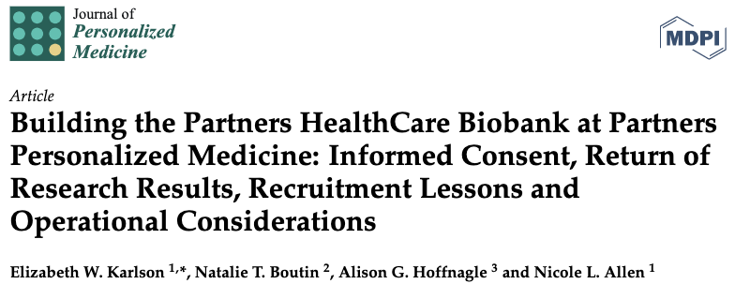
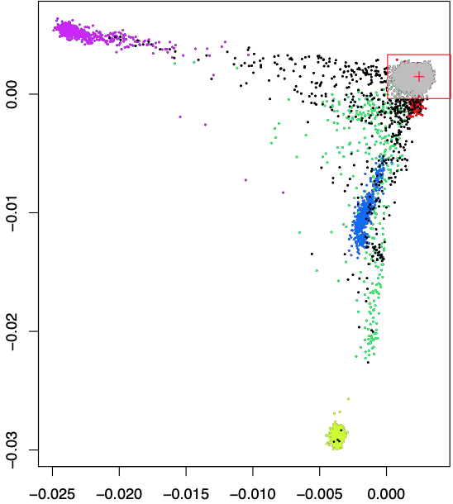
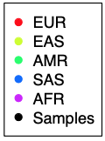
Validation Cohort:
MGB Biobank (formerly, Partners Biobank)
White-only subset by questionnaire
and genetic ancestry PCA
Genetic ancestry PC2
Genetic ancestry PC1
Created for CAGI 7
genomeinterpretation.org
Chun & Sunyaev

Slide 10
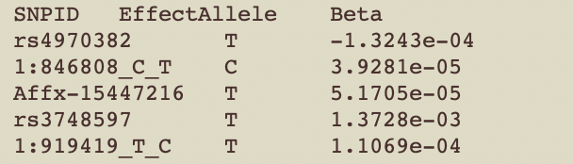
Two challenge submission options
Additive PRS model
  Effect allele and weight for each select SNP
Submit a prediction pipeline
  No internet
  Detailed instruction required
  Containerization is preferred but not required
  Rarely runs out of box (some adjustment to data are typically needed)
Created for CAGI 7
genomeinterpretation.org
Chun & Sunyaev

Slide 11
Challenge participants for CAGI 6
  Applied an AI technique
  Incorporate covariates directly into the model
  Mega PRS
  Integrate functional annotation into heritability model
  LD Pruning + Thresholding informed by various
  variant annotations
  Sparse lasso regression
  Multiple published PRS methods
  Incorporate pleiotropy and functional annotation
Software
(pre-trained)
Team 1
Team 2
SNP effects
*
Team 3
Software
(training requested)
Team 4
Software
(pre-trained)
Team 5
SNP effects
*
Submitted predictions for simulated datasets as well
Created for CAGI 7
genomeinterpretation.org
Chun & Sunyaev

Slide 12
Challenge participants for CAGI 7
  Dr. Doug Speed will present their approach
  Method not described
  Method not described
  Random Forest accounting for nonlinear effects
  Ensemble of logistic regression models
  Neural Net model
  Method not described
  Linearly combine with PRS for related conditions
  Applied multiple published PRS methods
  Best performing model was selected with OpenSNP
SNP effects
LDAK
GeneForecaster
SNP effects
*
GenoHackers
SNP effects
Software
(pre-trained & training requested)
GENGI
InnoThyroGen
SNP effects
Toonsiss
SNP effects
SNP effects
UQ BioSig
*
*
Submitted predictions for simulated datasets as well
Created for CAGI 7
genomeinterpretation.org
Chun & Sunyaev

Slide 13
Invited methods
4 published methods trained on legacy GWAS data
for CAGI 6
  LD Pruning + Thresholding (P+T)
  LDPred v1
  PRS-cs
  NPS
Created for CAGI 7
genomeinterpretation.org
Chun & Sunyaev

Slide 14
Evaluation metrics
Baseline model (covariates only, no PRS):
$$y \sim age+sex+PC1+PC2+PC3+…+PC10$$
Logistic regression of:
$$y \sim age+sex+PC1+PC2+PC3+…+PC10+PRS$$
AUC of the full model including PRS and covariates
R²_{nagelkerke} : the likelihood of data under the full model compared to the likelihood under the null model
5% Tail Odds Ratio (OR): The odd at top 5% of the score relative to the odd of the rest of distribution (covariates included)
$$\frac{\#\left\{y=1\bigwedge{\hat{y}}> q_{0.95}\right\}}{\#\left\{y=0 ⋀ \hat{y}{ >q}_{0.95}\right\}}/\frac{\#\left\{y=1\bigwedge{\hat{y}}< q_{0.95}\right\}}{\#\left\{y=0 ⋀ \hat{y}{ < q}_{0.95}\right\}}$$
Created for CAGI 7
genomeinterpretation.org
Chun & Sunyaev

Slide 15
Evaluation metrics
Baseline model (covariates only, no PRS):
$$y \sim age+sex+PC1+PC2+PC3+…+PC10$$
Logistic regression of:
$$y \sim age+sex+PC1+PC2+PC3+…+PC10+PRS$$
AUC of the full model including PRS and covariates
R²_{nagelkerke} : the likelihood of data under the full model compared to the likelihood under the null model
5% Tail Odds Ratio (OR): The odd at top 5% of the score relative to the odd of the rest of distribution (covariates included)
$$\frac{\#\left\{y=1\bigwedge{\hat{y}}> q_{0.95}\right\}}{\#\left\{y=0 ⋀ \hat{y}{ >q}_{0.95}\right\}}/\frac{\#\left\{y=1\bigwedge{\hat{y}}< q_{0.95}\right\}}{\#\left\{y=0 ⋀ \hat{y}{ < q}_{0.95}\right\}}$$
Created for CAGI 7
genomeinterpretation.org
Chun & Sunyaev

Slide 16
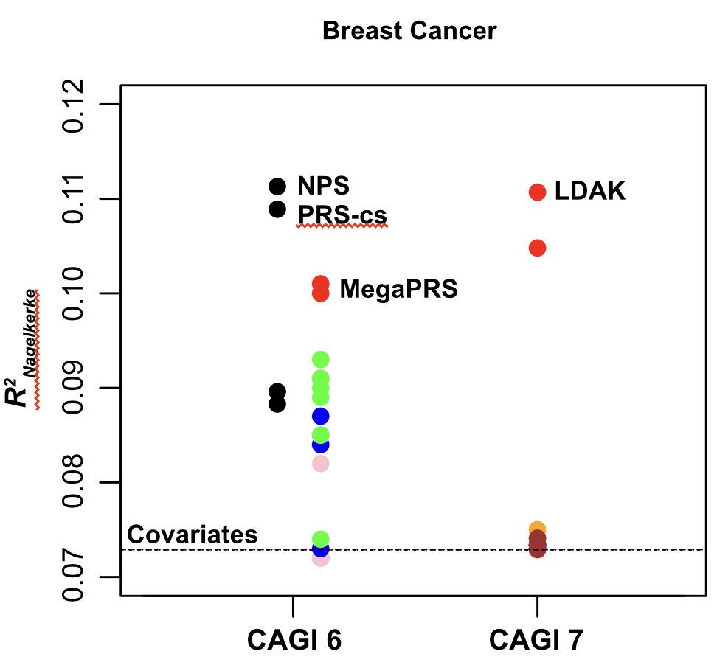
Created for CAGI 7
genomeinterpretation.org
Chun & Sunyaev

Slide 17
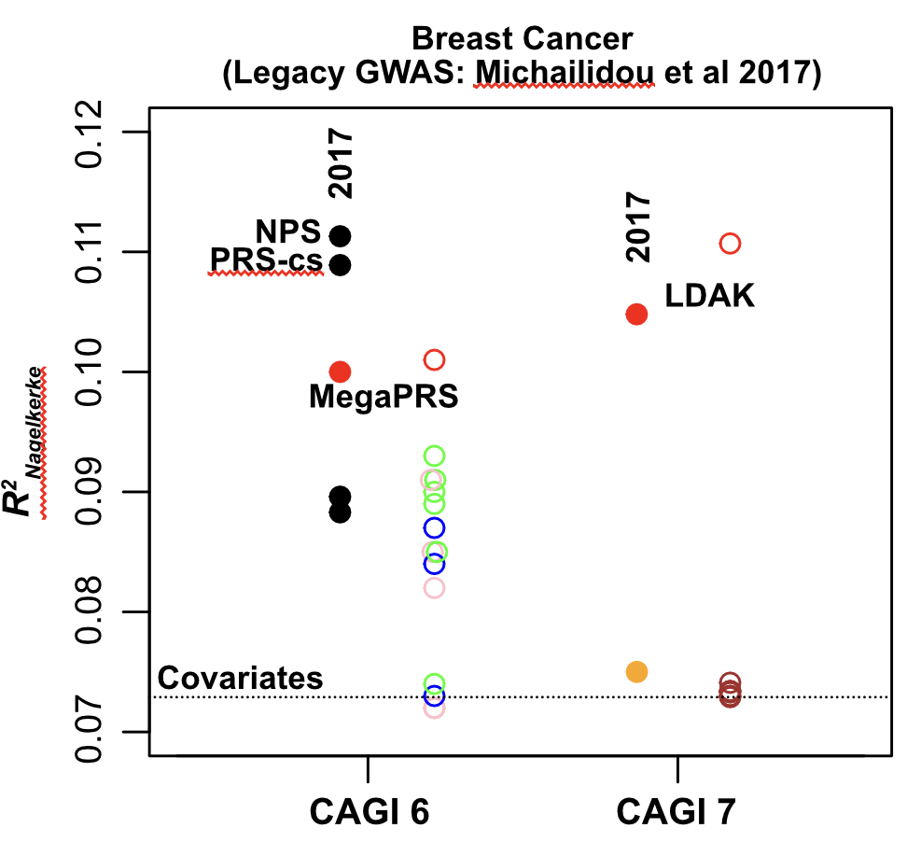
Created for CAGI 7
genomeinterpretation.org
Chun & Sunyaev

Slide 18
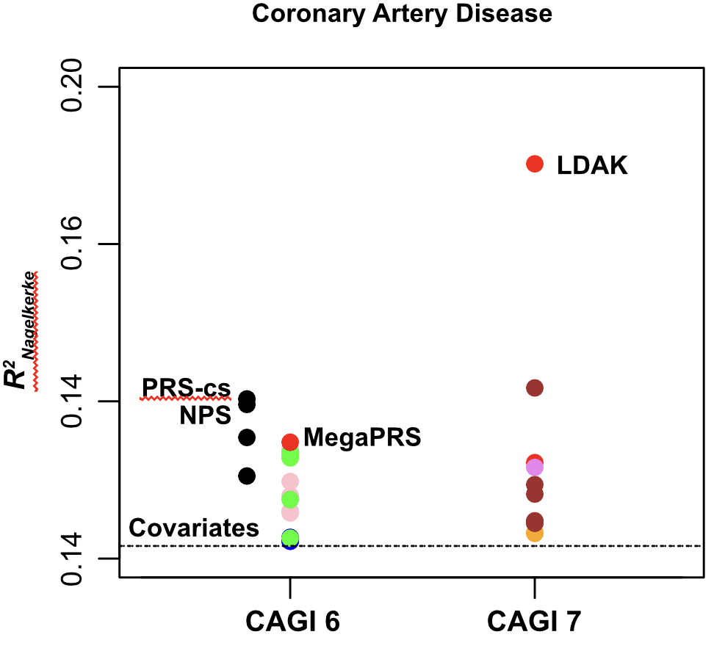
Created for CAGI 7
genomeinterpretation.org
Chun & Sunyaev

Slide 19
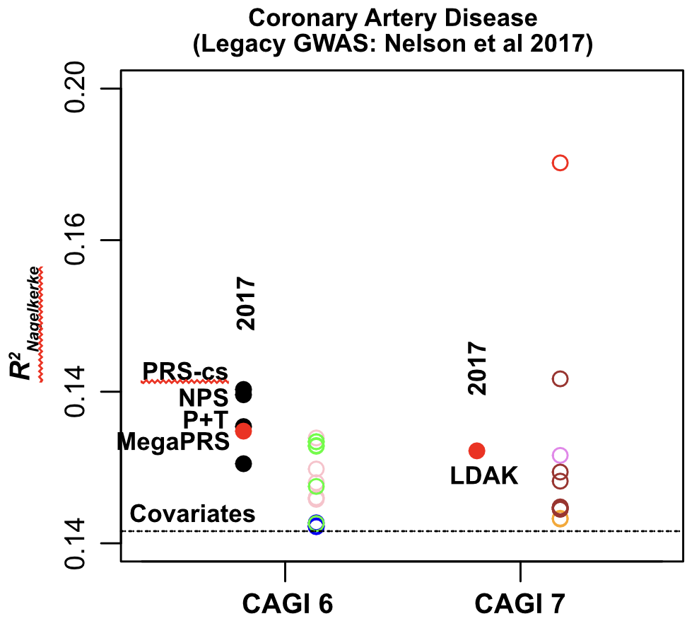
Created for CAGI 7
genomeinterpretation.org
Chun & Sunyaev

Slide 20
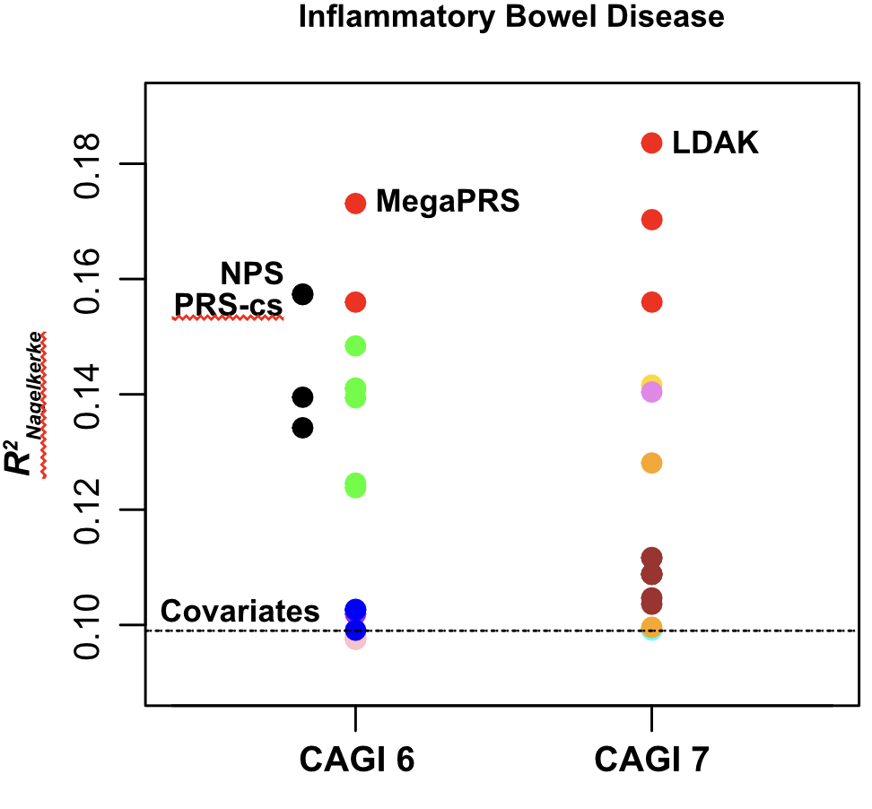
Created for CAGI 7
genomeinterpretation.org
Chun & Sunyaev

Slide 21
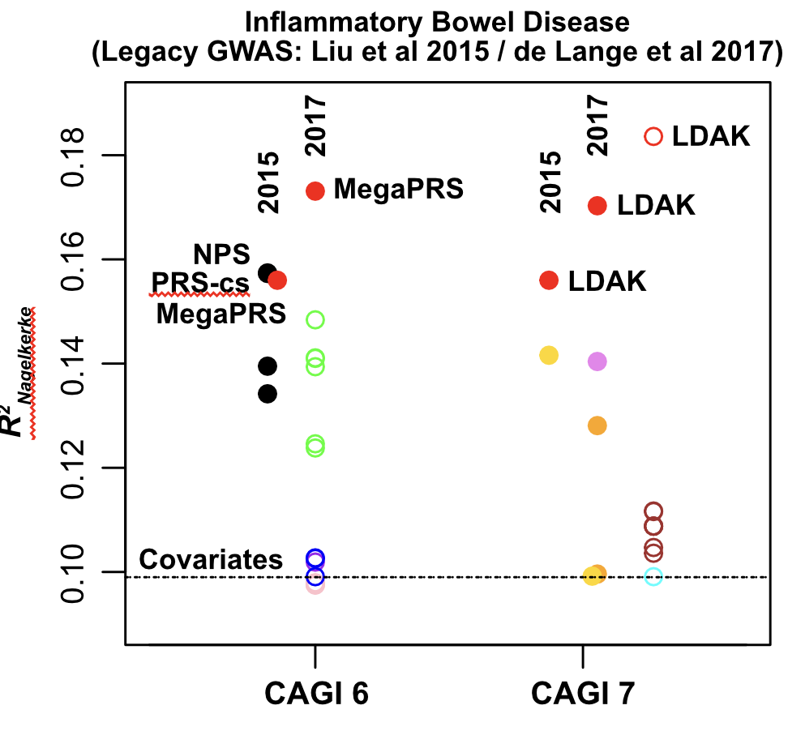
Created for CAGI 7
genomeinterpretation.org
Chun & Sunyaev

Slide 22
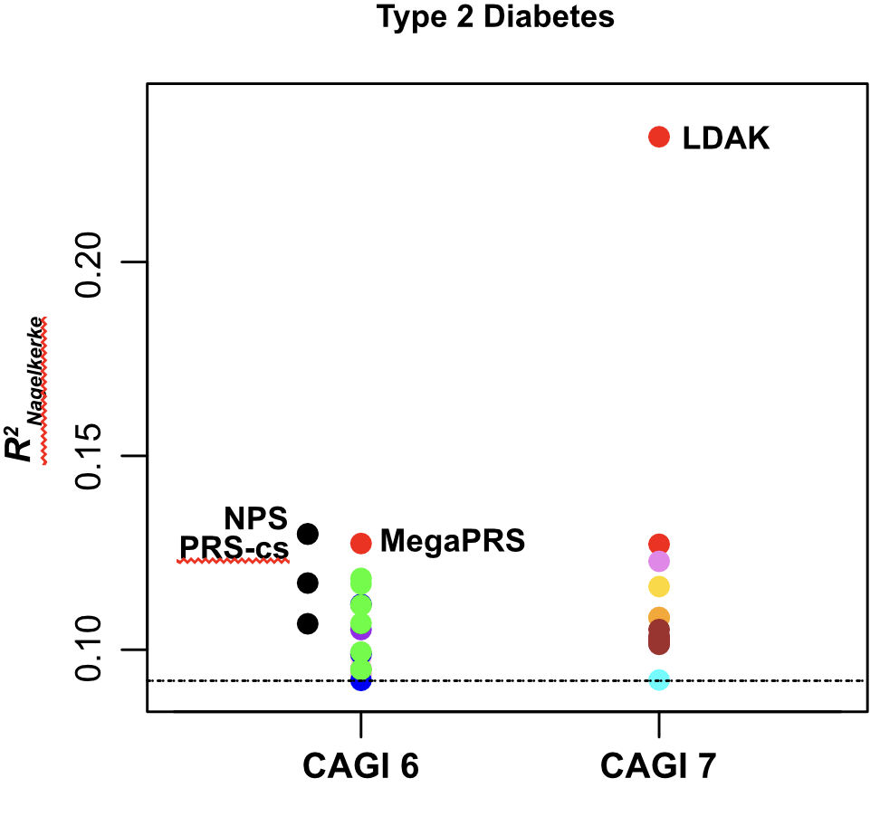
Created for CAGI 7
genomeinterpretation.org
Chun & Sunyaev

Slide 23
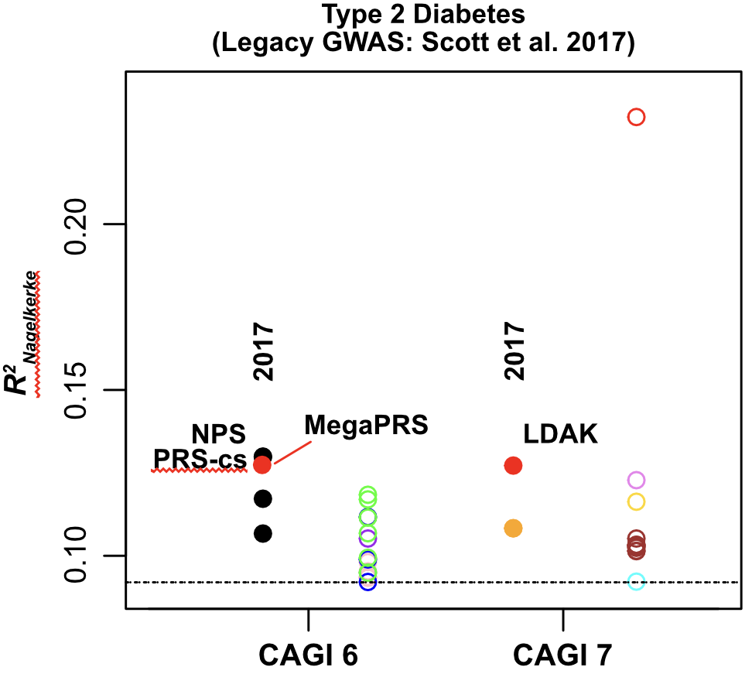
Created for CAGI 7
genomeinterpretation.org
Chun & Sunyaev

Slide 24
Conclusions
Team LDAK performed the best overall and outperformed all other methods in 3 phenotypes.
The improvement in accuracy seems to be correlated with higher statistical power of recent GWAS data.
Machine learning-based prediction models did not perform well. The current challenge may not be structured to evaluate the full potential of these approaches.
Need a mechanism to share training cohorts more easily and make more covariates available.
Future PRS challenges will greatly benefit from inclusion of more diverse ancestry.
Created for CAGI 7
genomeinterpretation.org
Chun & Sunyaev

Slide 25
Acknowledgement
Nikolaos Patsopoulos (HMS)
Benjamin Neale (HMS)
Constantina Bakolitsa (UC Berkeley)
Predrag Radivojac (Northeastern)
Michael Cho (HMS)
We would like thank all participants!
This research has been conducted using the UK Biobank Resource under Application Number 31063.
Created for CAGI 7
genomeinterpretation.org
Chun & Sunyaev

