Slide 1





CAGI7 lentiMPRA Prediction Challenge: MPAC
John Butts
Tewhey Lab
The Jackson Laboratory and University of Maine

Slide 2
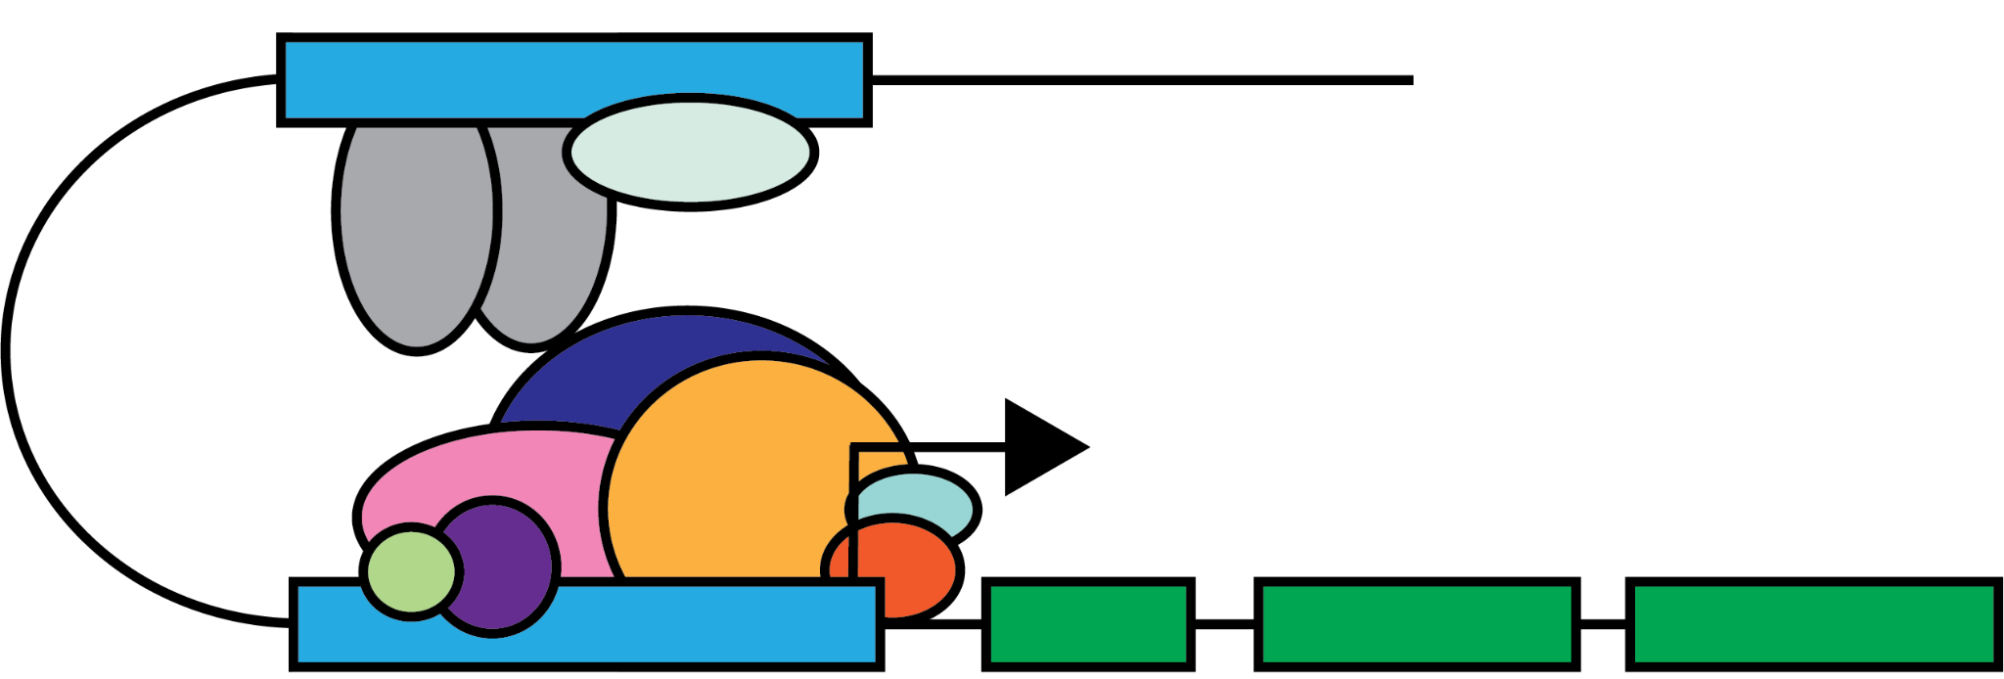
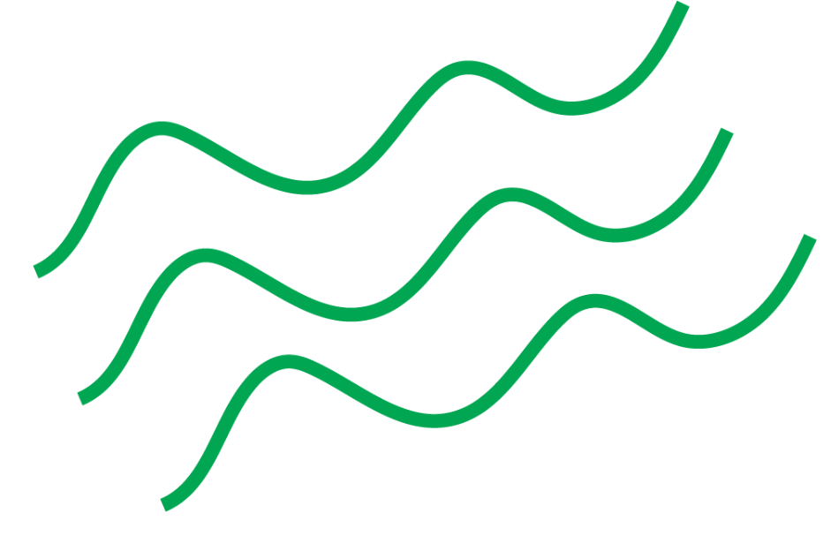
cis-Regulatory Elements (CREs) precisely regulate transcription

Slide 3
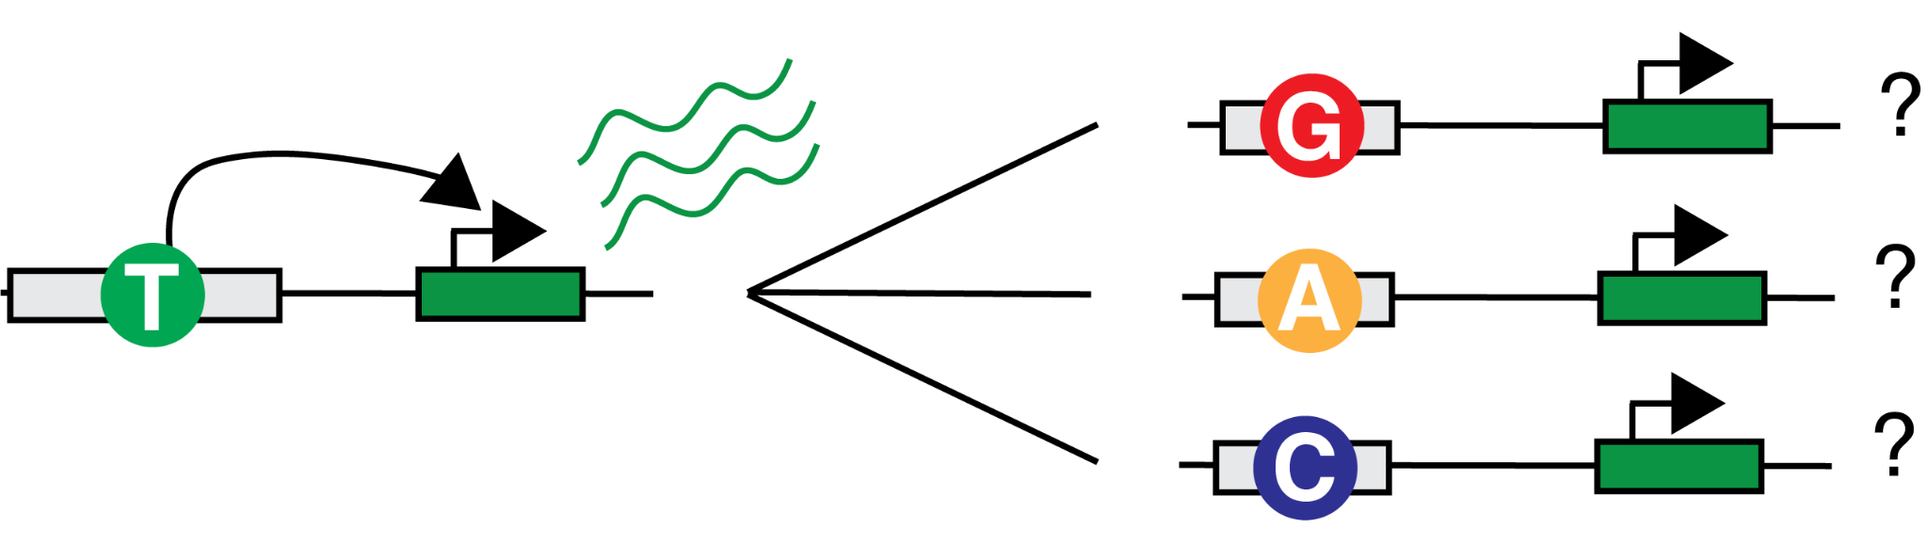
Assessing the impact of non-coding variation requires functional validation

Slide 4
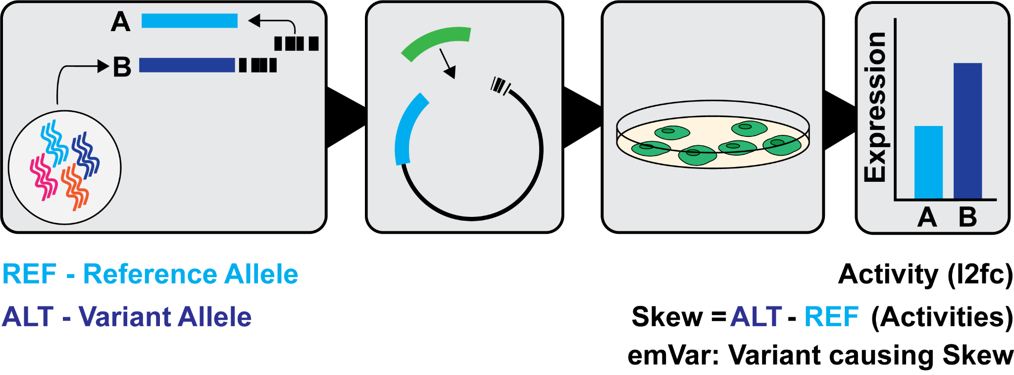
Massively Parallel Reporter Assays (MPRAs) can capture activity differences between variants
Notes:
MPRA allows us to test thousands of variants in a single experiment
Enables high-throughput testing of sequences allowing for:
Activity measurements of numerous sequences - validating candidate CREs
Measuring the impact of SNVs on Activit

Slide 5
Definitions of MPRA terminologies
Notes:
Define emVar for audience here

Slide 6
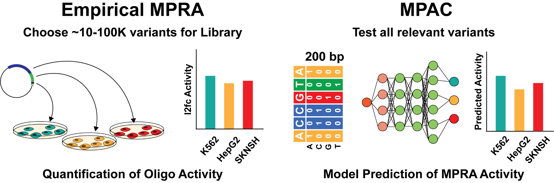
Experimental MPRA requires rational variant selection
Siraj 2024

Slide 7
Malinois with Parallel Aggregated Cross-validation (MPAC) for comprehensive variant testing

Slide 8
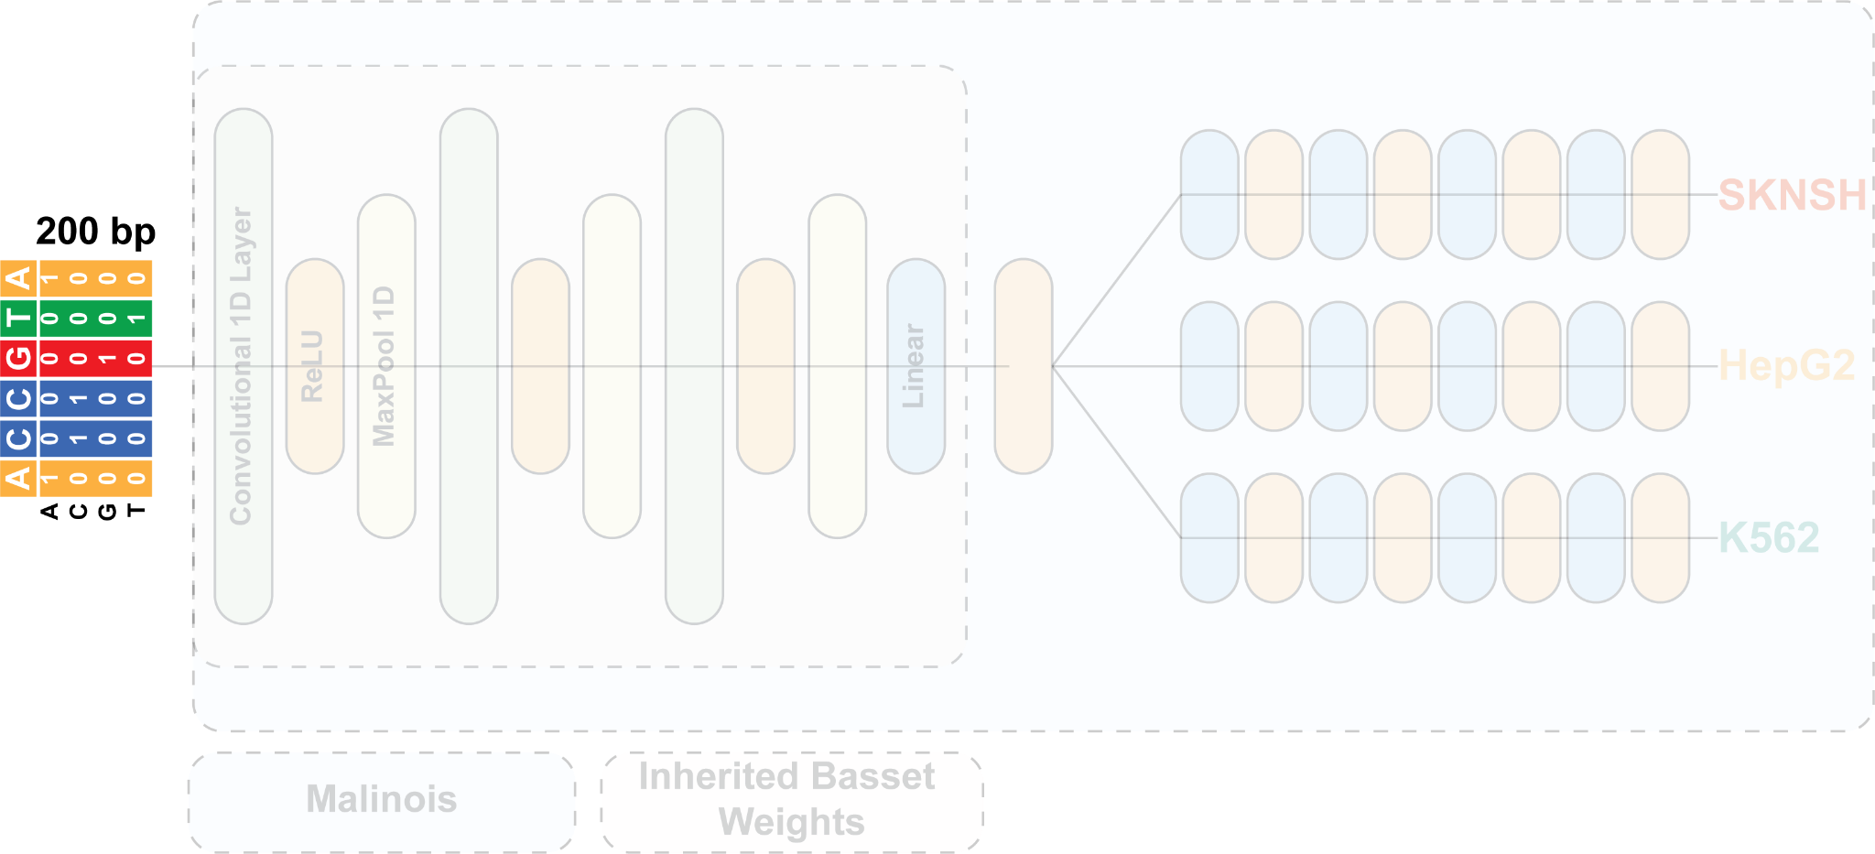
Malinois takes a 200 bp one hot encoded sequence as input

Slide 9
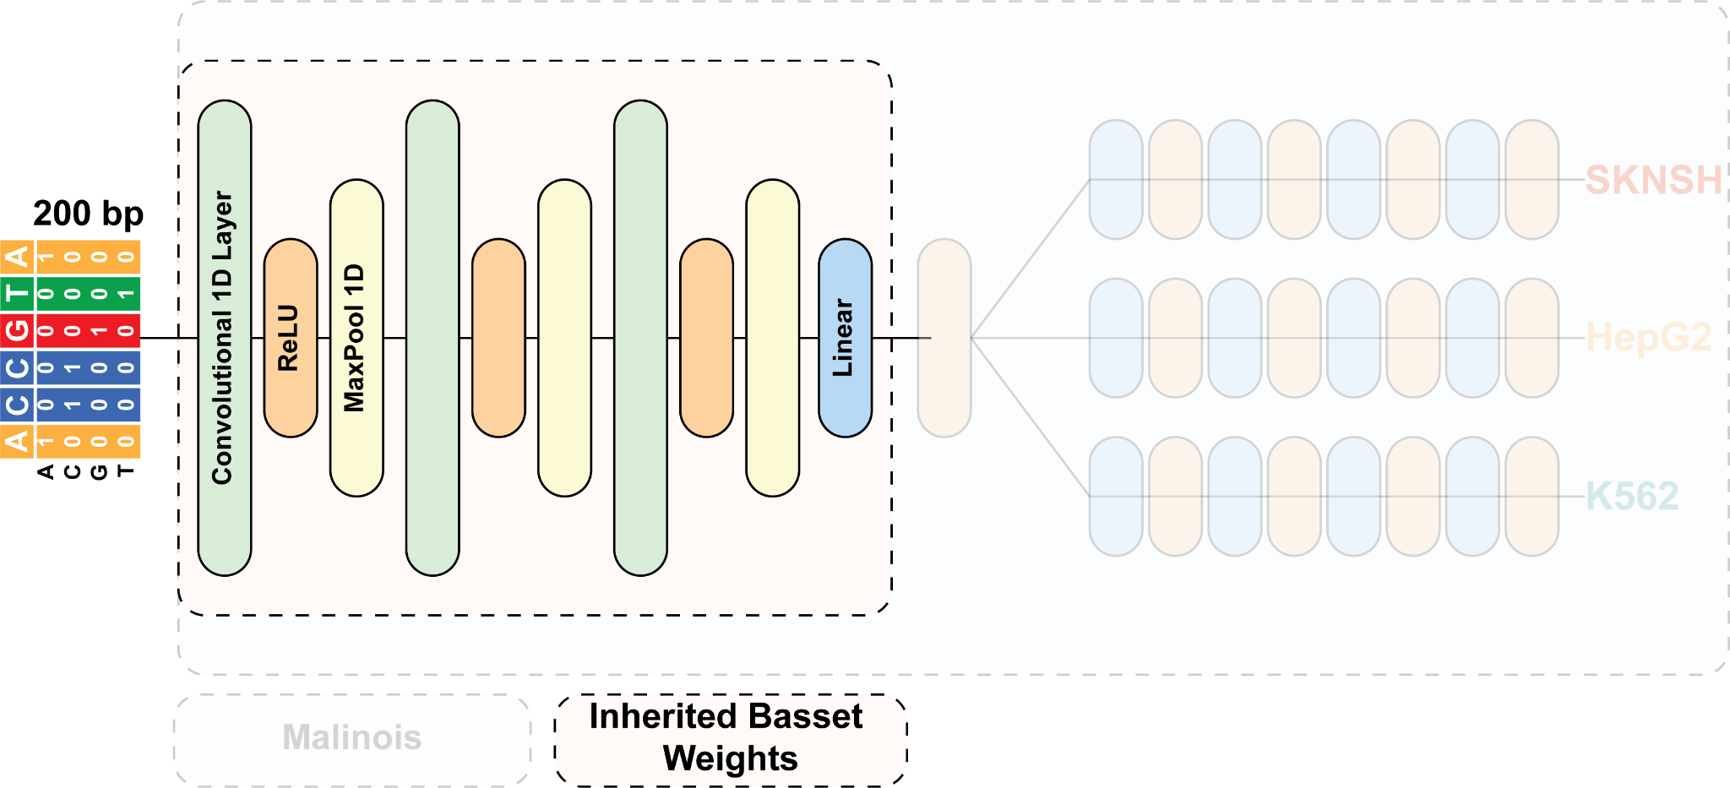
Malinois ‘trunk’ consists of 3 convolutional layers initialized with Basset weights
Kelley 2016

Slide 10
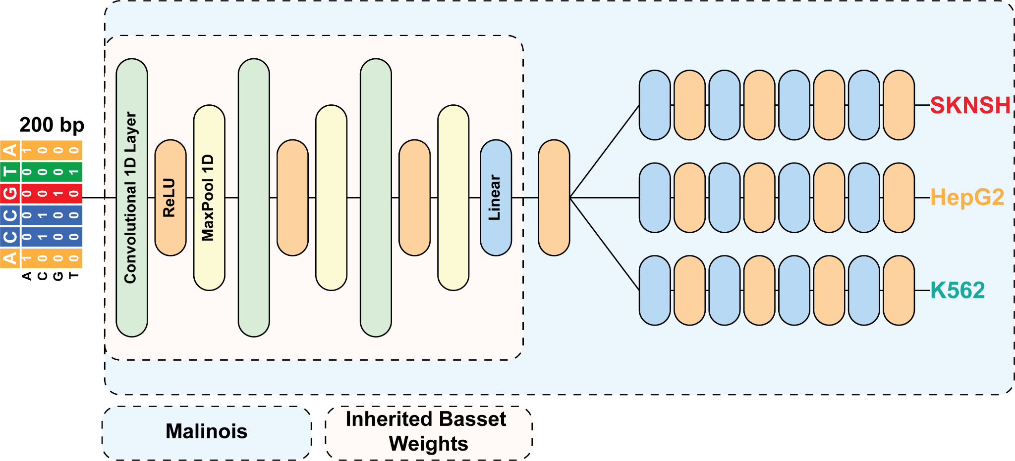
Malinois ‘branches’ predict MPRA activity for three cell types
Gosai and Castro et al 2024

Slide 11
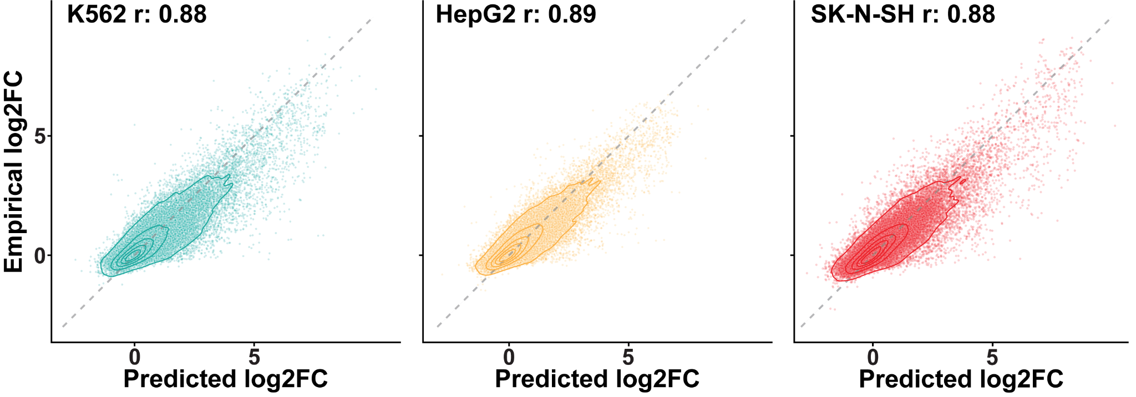
Malinois is a highly accurate model of MPRA activity
Gosai and Castro et al 2024

Slide 12
Malinois is a highly accurate model of MPRA activity
Test set for Malinois contains sequences from chromosomes 7 and 13
How can we expand on this base for variant effect prediction?

Slide 13
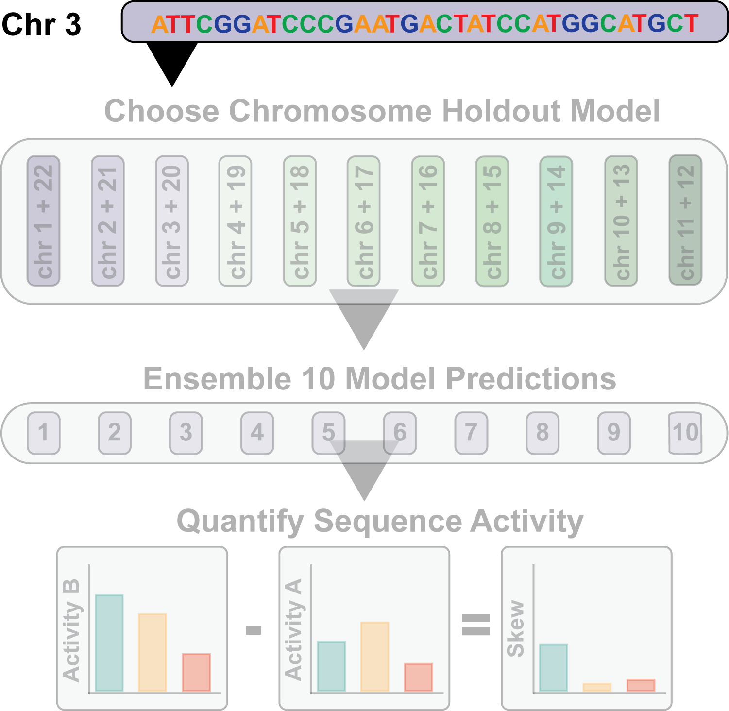
MPAC is a ‘pack’ of 110 Malinois models capable of unbiased predictions for any autosome

Slide 14
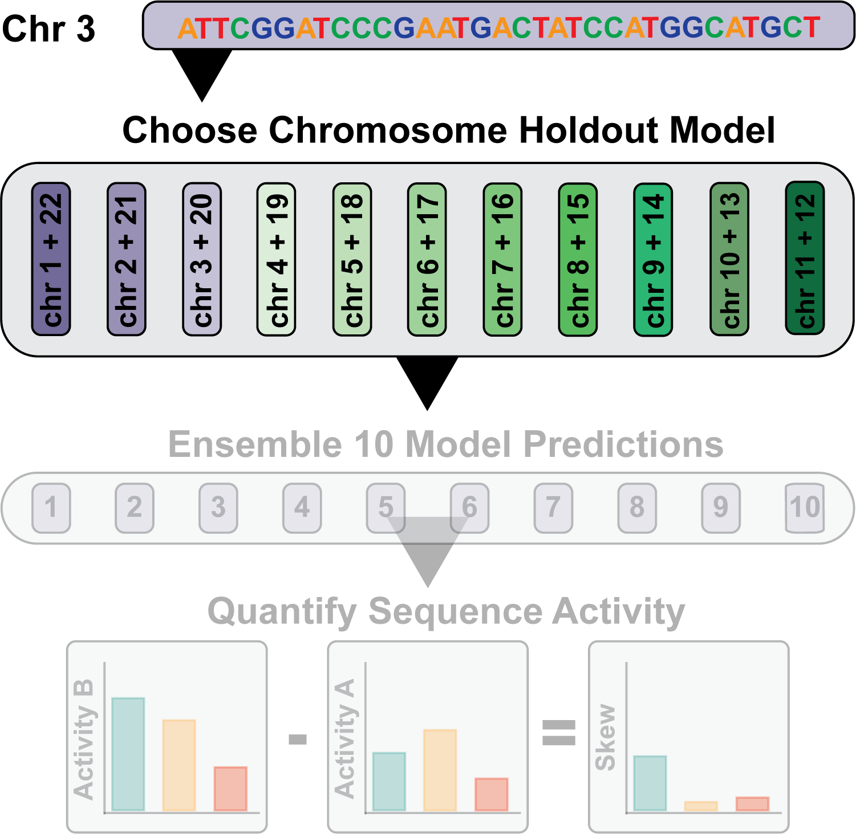
MPAC can generate predictions for any autosomal sequence

Slide 15
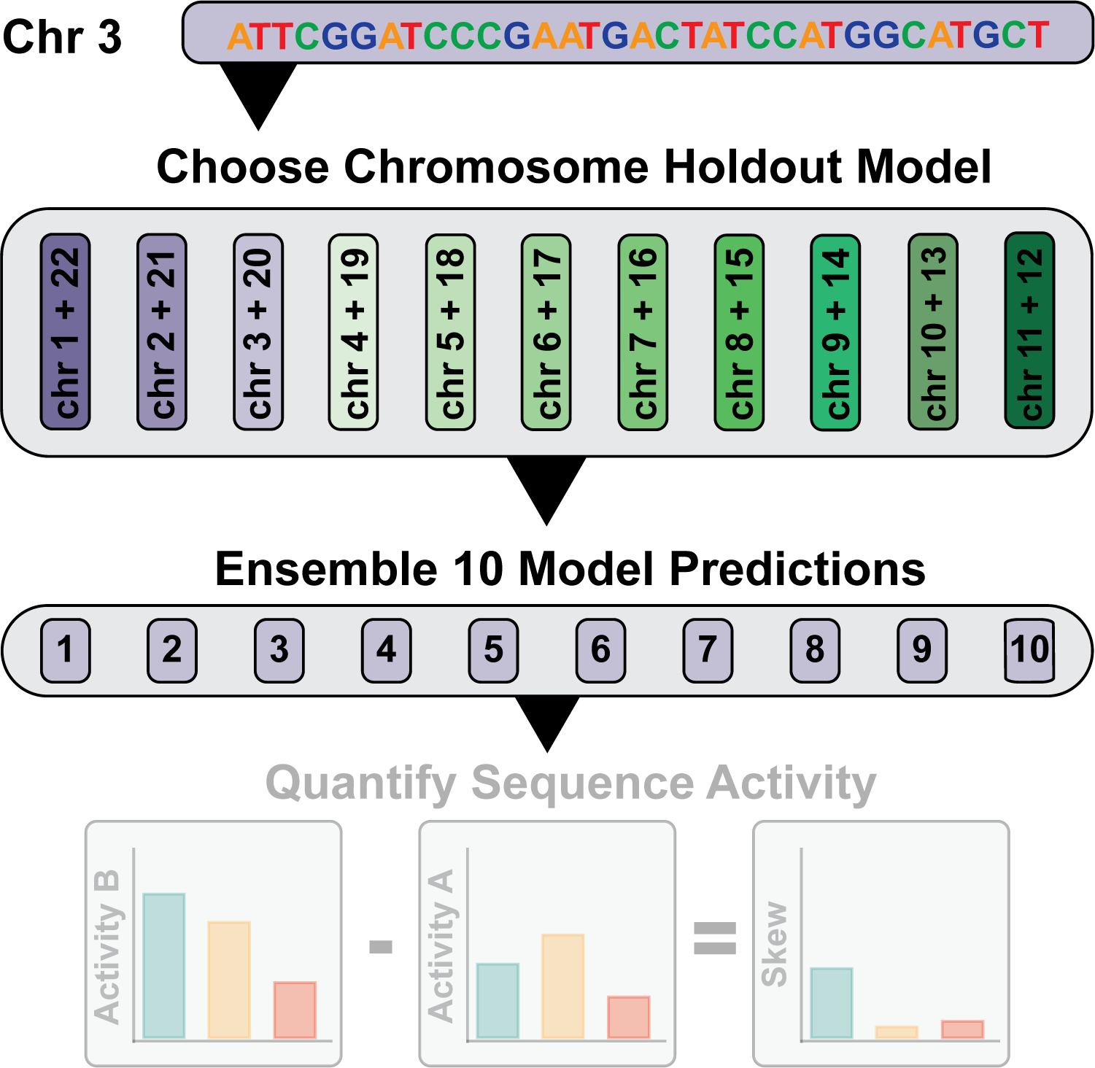
Each sequence activity is then predicted by ten models

Slide 16
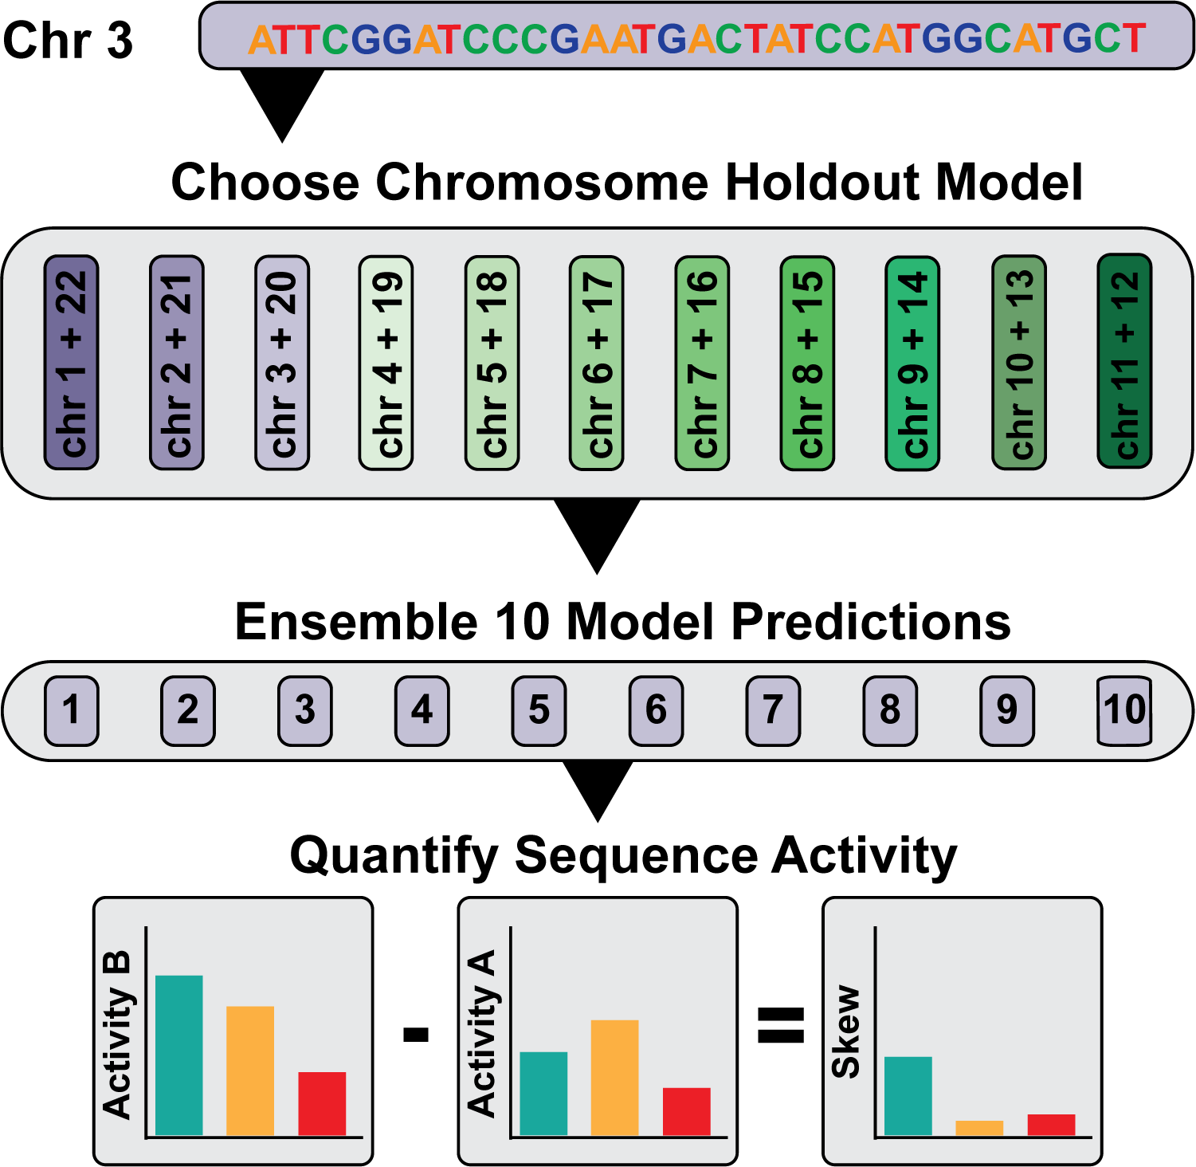
10 model predictions are averaged for a final activity prediction

Slide 17
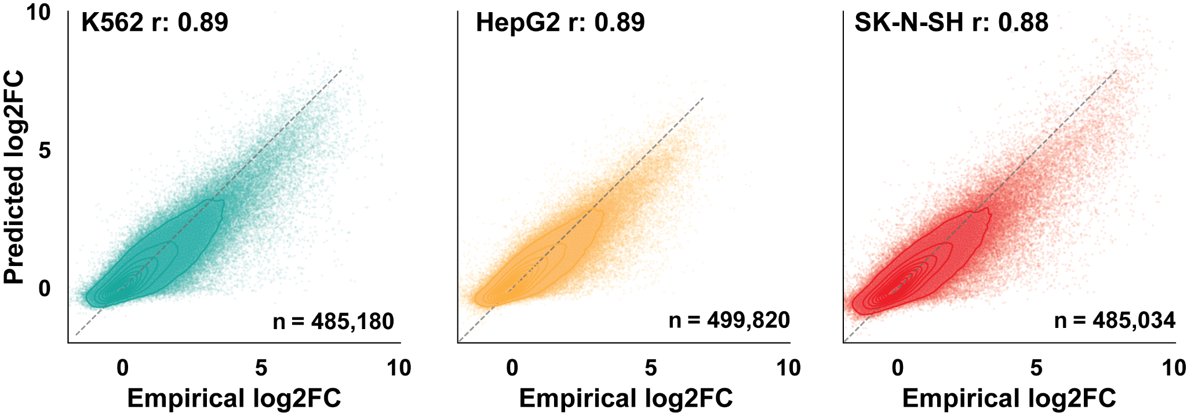
Genome-wide predictions from MPAC maintain accuracy of Malinois
Butts and Rong et al 2025, in Revision
Notes:
K562: 495,180 sequences
HepG2: 499,820 sequences
SK-N-SH: 485,034 sequences

Slide 18
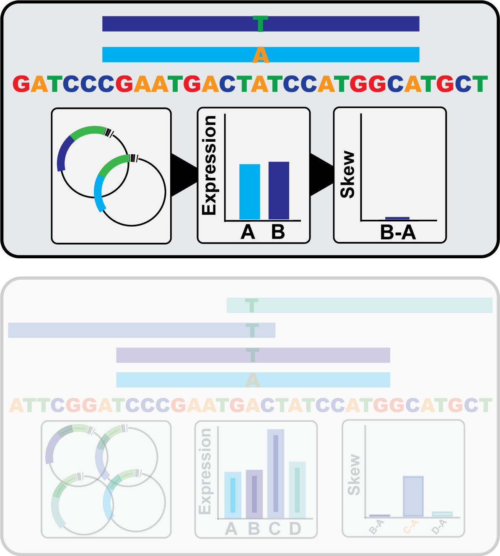
Testing variants only in the center of the sequence may miss emVars
Notes:
K562: 495,180 sequences
HepG2: 499,820 sequences
SK-N-SH: 485,034 sequences

Slide 19
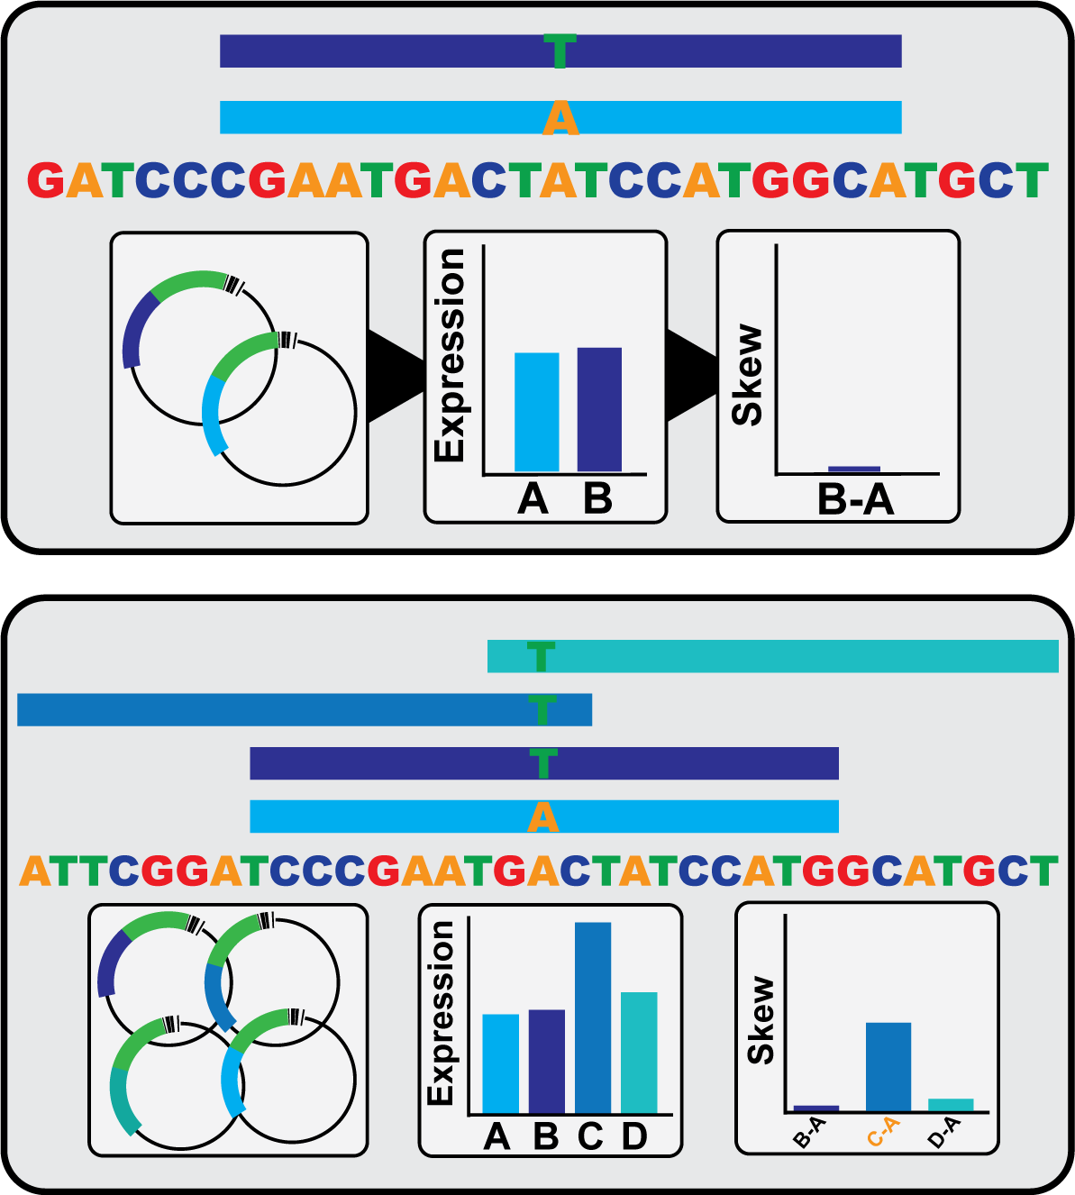
‘Windowing’ position of the variant can increase the recovery of emVars
Notes:
K562: 495,180 sequences
HepG2: 499,820 sequences
SK-N-SH: 485,034 sequences

Slide 20
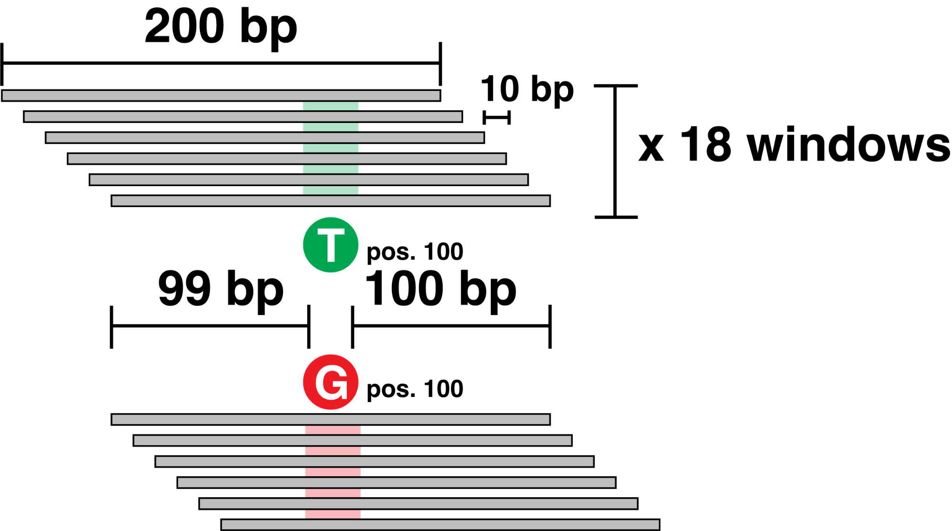
For MPAC 18 predictions are generated, sliding the variant in 10bp increments
Notes:
K562: 495,180 sequences
HepG2: 499,820 sequences
SK-N-SH: 485,034 sequences

Slide 21
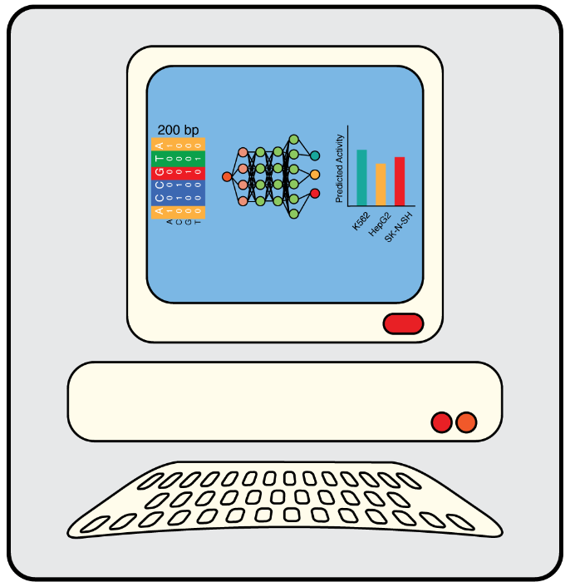
Prediction submission 1: Variant Windowed
Models per prediction: 10
n predictions: 18
Strand: avg(fwd, rev)
Variant Position: 9,19,29,...179
Effect threshold: >= abs(l2fc(0.5))
lenti normalization: None

Slide 22
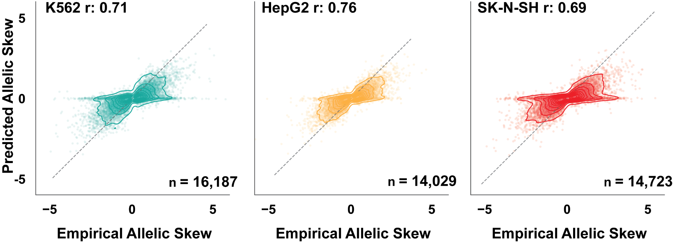
MPAC skew predictions show high correlation to empirical emVars
Butts and Rong et al 2025, in Revision
Notes:
Points represent an empirical emVar in that cell type:
n K562: 16,187 ref/alt pairs
n HepG2: 14,029 ref/alt pairs
n SKNSH: 14,723 ref/alt pairs

Slide 23
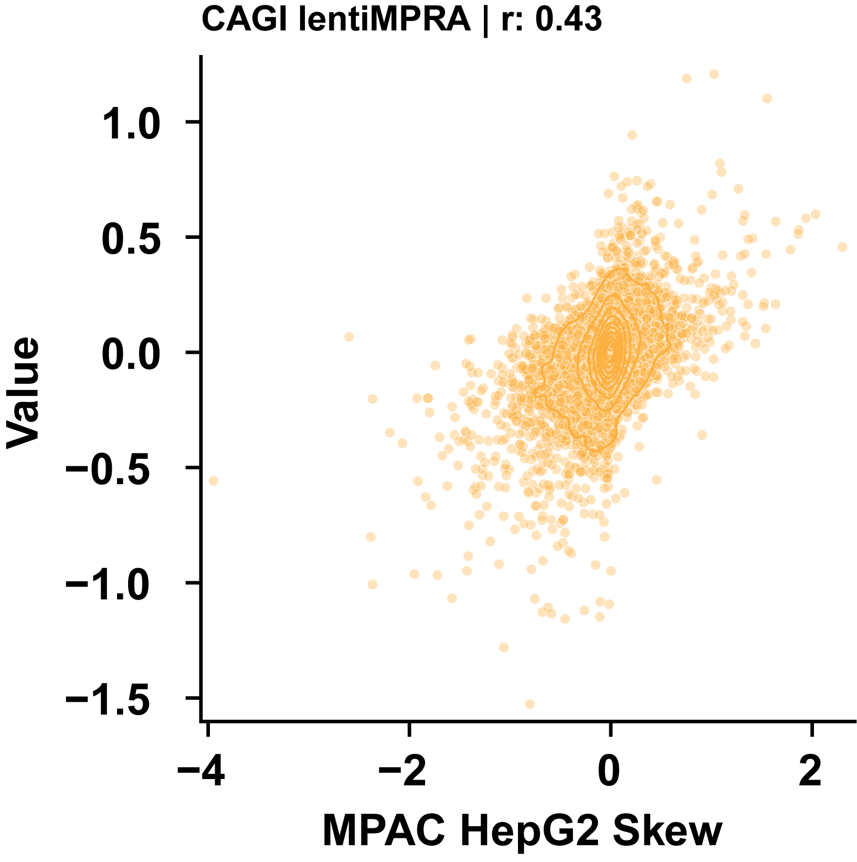
Unmodified MPAC correlates comparably to lentiMPRA for all variants
Notes:
Points represent an empirical emVar in that cell type:
n K562: 16,187 ref/alt pairs
n HepG2: 14,029 ref/alt pairs
n SKNSH: 14,723 ref/alt pairs

Slide 24
Prediction submission 2: Variant centered
Models per prediction: 10
n predictions: 1
Strand: avg(fwd, rev)
Variant Position: 100
Effect threshold: >= abs(l2fc(0.5))
lenti normalization: None

Slide 25
Prediction submission 3: Strand specific windowing
Models per prediction: 10
n predictions: 18
Strand: fwd | rev based on lentiMPRA
Variant Position: 9,19,29,...179
Effect threshold: >= abs(l2fc(0.5))
lenti normalization: None

Slide 26
Prediction submission 4: MPAC + linear regression
Models per prediction: 10
n predictions: 18
Strand: avg(fwd, rev)
Variant Position: 9,19,29,...179
Effect threshold: >= abs(l2fc(0.13))
lenti normalization: Linear regression

Slide 27
Prediction submission 5: Malinois + lentiMPRA
Models per prediction: 1
n predictions: 3
Strand: avg(fwd, rev)
Variant Position: 100
Effect threshold: >= abs(l2fc(0.2))
lenti normalization: Fine-tuning on Agarwal 2025 HepG2 lentiMPRA data

Slide 28
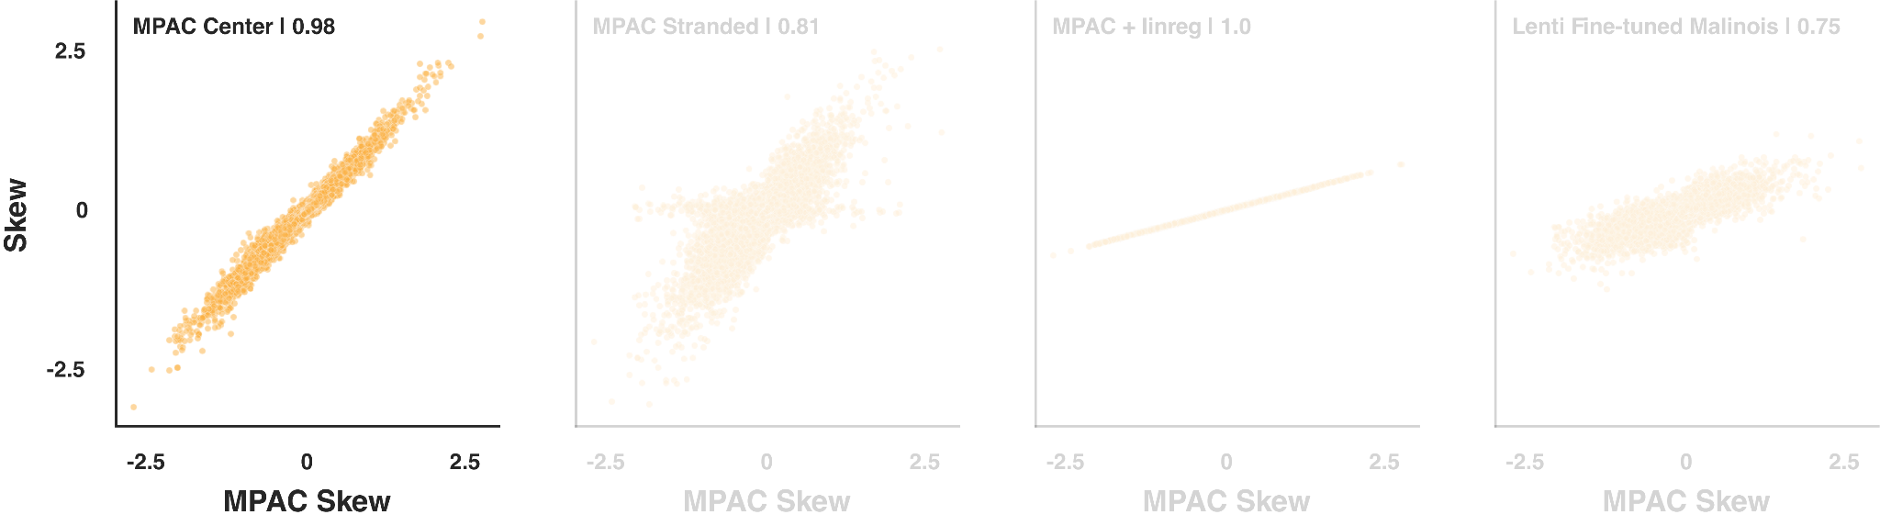
Center only predictions are highly correlated with MPAC

Slide 29
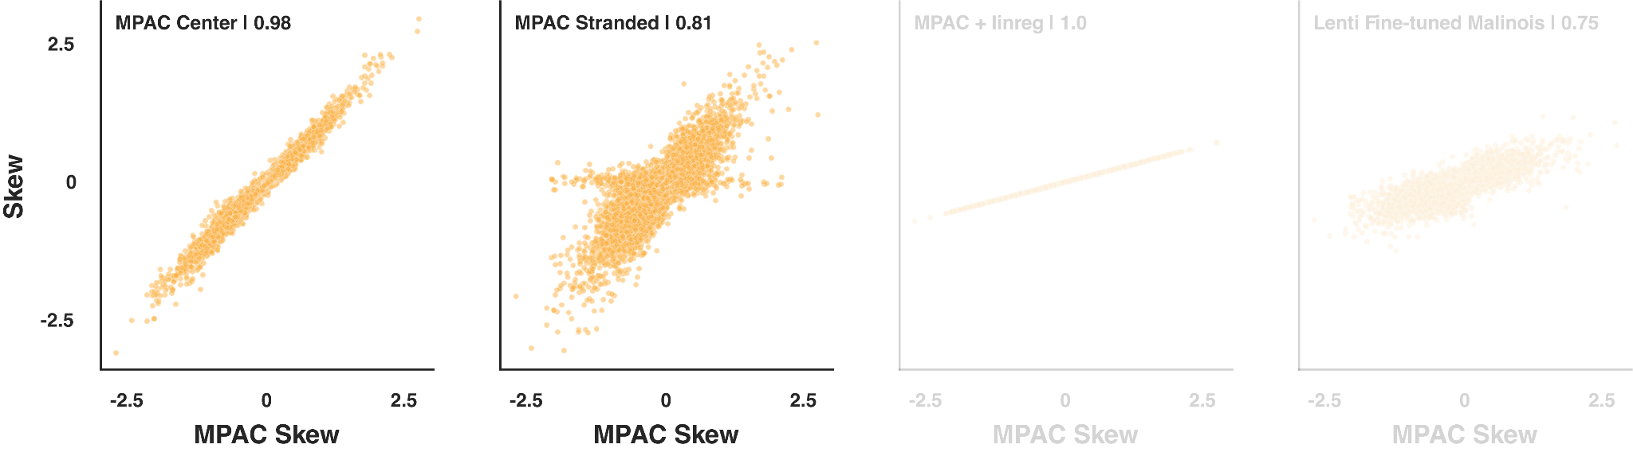
Accounting for DNA strand impacts variant effect prediction

Slide 30
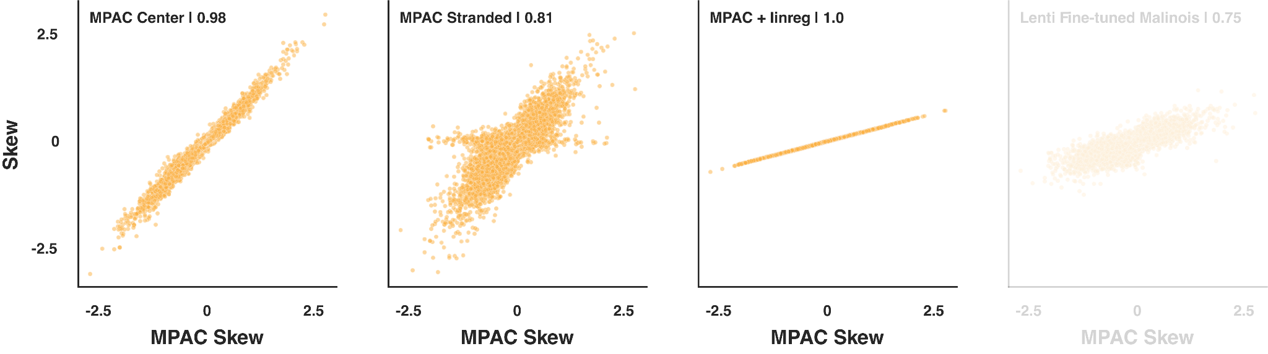
Linear regression of MPAC predictions reduces the range of skew predictions

Slide 31
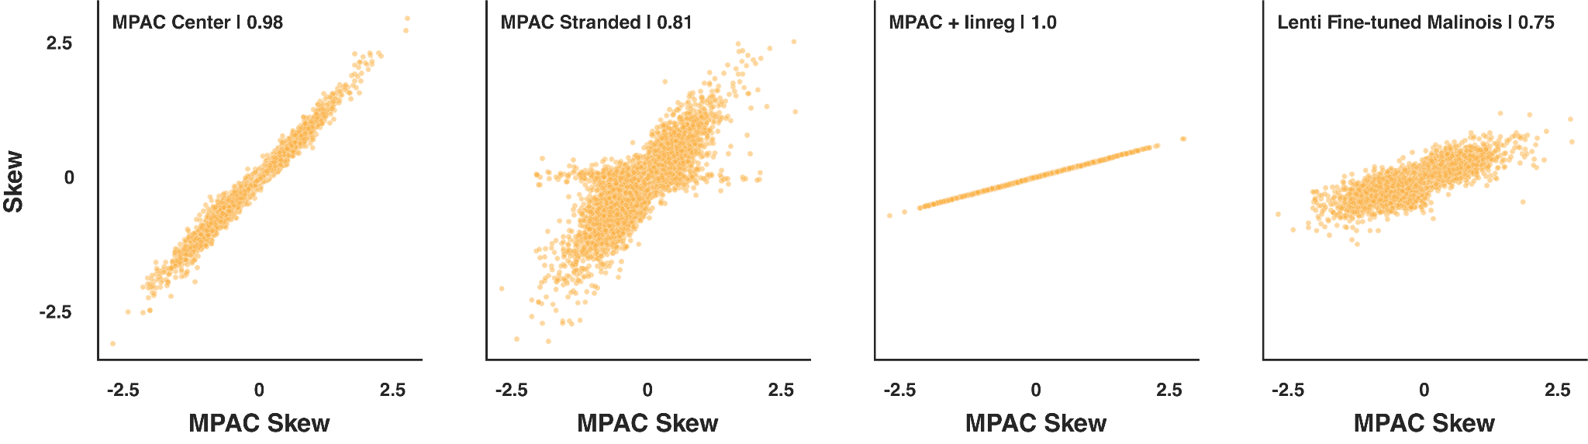
Fine tuned Malinois shows lower skews but direction of effects are consistent

Slide 32
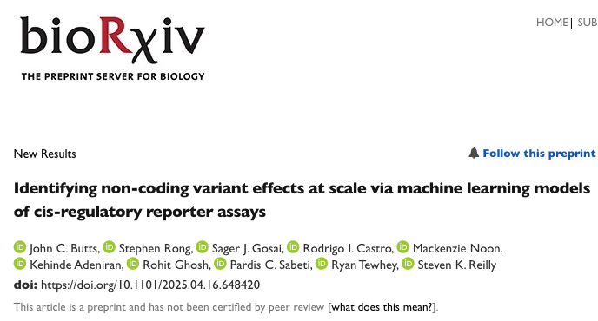
Please see my preprint and poster for more info and applications of MPAC!

Slide 33





Thank You!
Tewhey Lab
Rodrigo Castro
Kousuke Mouri
Susan Kales
Niketa Nerurkar
Takeshi Iwasaki
Kehinde Adeniran
Zoe Mattingly
Lila Lyons
Reilly Lab
Stephen Rong
Mackenzie Noon
Steve Reilly
Funding
UM1HG009435, R00HG008179, R00HG010669, R01HG012872, R35HG011329
Sabeti Lab
Sagar Gosai
Pardis Sabeti

