Slide 1

CAGI7 slide pack guidelines
I agree to my slides being used according to the following terms:
Arif A. Rather
Authors: please include THIS slide at the beginning of your presentation to indicate that you agree with reuse of your slides in CAGI presentations, according to the terms below, and digitally sign by writing your name above.
To disseminate the CAGI results, I encourage all CAGI participants to remix these CAGI slides for inclusion in their oral and poster presentations.
CAGI participants may use or publish any content of these slides only in compliance with the CAGI Data Use Agreement.
CAGI participants may not cite or publish any content of these slides except with the written permission of the originating author or in the primary CAGI publications.
CAGI participants must acknowledge the original authors of these slides and CAGI7. Include the acknowledgement banner across the bottom.
CAGI participants must include the CAGI credits slide in their presentations.
Slides with a red slash (no remix) may not be included in a presentation unless all attendees are registered CAGI participants who signed the data use agreement.
Slides with a red X over the entire slide may not be used in any circumstances.
Slides with a blue slash (embargoed) may not be used unless the embargo is explicitly lifted.
Slides without slash or X may be tweeted unless flagged with the “No tweet” icon.
CAGI participants using these slides must explain the “No tweet” icon, which means that the slide content should not be disseminated outside the presenting conference hall. If the presentation venue permits pervasive tweeting, you may not include these slides in your talk.
Note for slide authors: we expect all CAGI participants to abide by these restrictions and will make best effort to ensure they are followed. However, bear in mind that we have limited means of enforcing them, and therefore the restrictions cannot be guaranteed.
Notes:
At CAGI7, use of this slide pack is only required for CAGI dataset providers, assessors, and predictors, but all are encouraged to use the annotations for materials they do not want shared publicly.

Slide 2
Extending MPRALegNet for Predicting Regulatory Variant Effects in the CAGI 7 Challenge
Arif A. Rather
CAGI7 conference
Dec-07-2025
Lee Lab
Boston Children’s Hospital
Harvard Medical School
Broad Institute

Slide 3
Sequence to function models (existing)
Model | Output Format | Input-seq | Output
Sei | Multi-task classification | 4096 bp | 1 x 21907
Enformer | Multi-task regression | 196608 bp | 896 x 5313
Borzoi | Multi-task regression | 524288 bp | 6144 x 7611
Flashzoi | Multi-task regression | 524288 bp | 6144 x 7611
MPRALegNet | Single-task regression | 230 bp | 1
Created for CAGI7
genomeinterpretation.org
Arif A. Rather

Slide 4
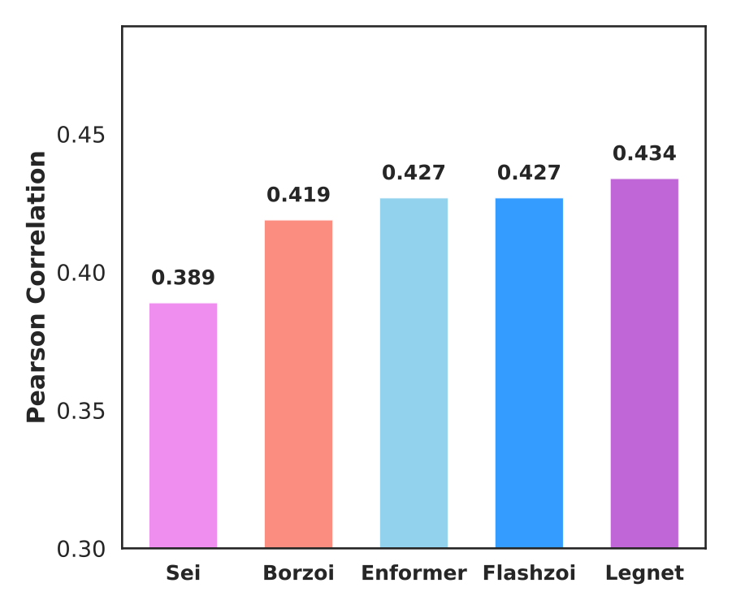
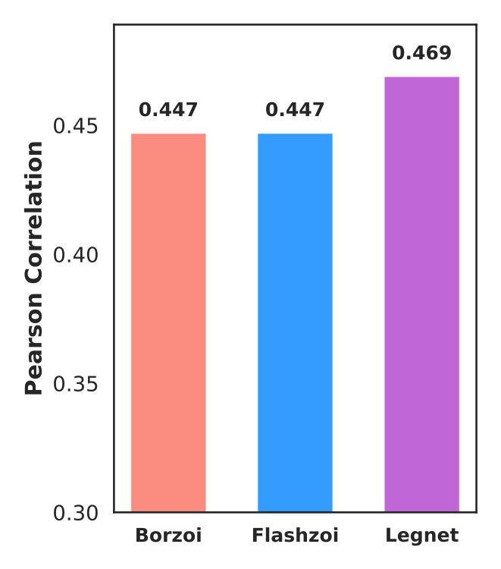
Performance evaluation
Single Replicate
Ensemble
Used central 4096 bp to score variants with enformer, Borzoi and Flashzoi
Avg predictions across forward and reverse strand, shift sequences by 1 bp whenever possible
*4 kbp from the variant position
Created for CAGI7
genomeinterpretation.org
Arif A. Rather

Slide 5
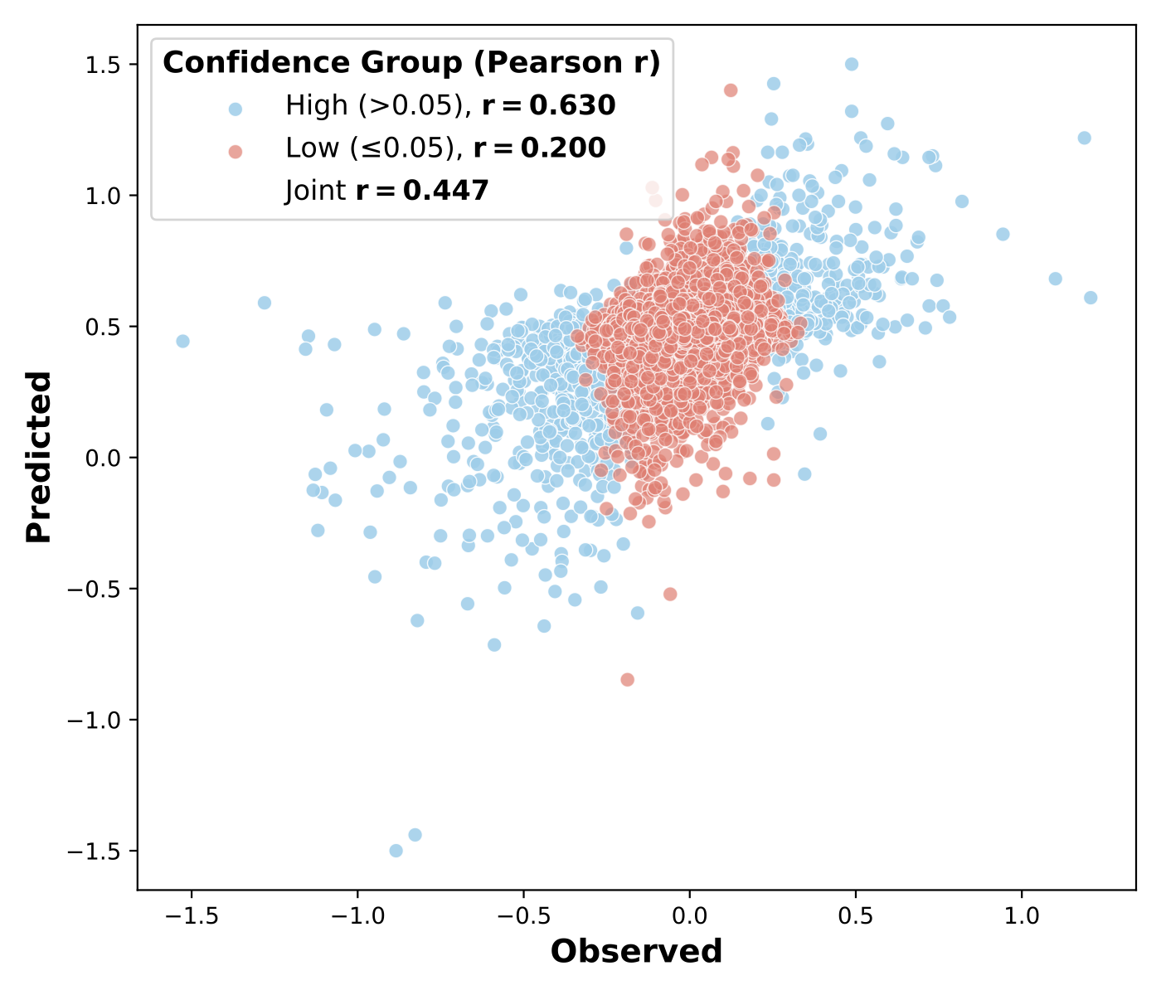
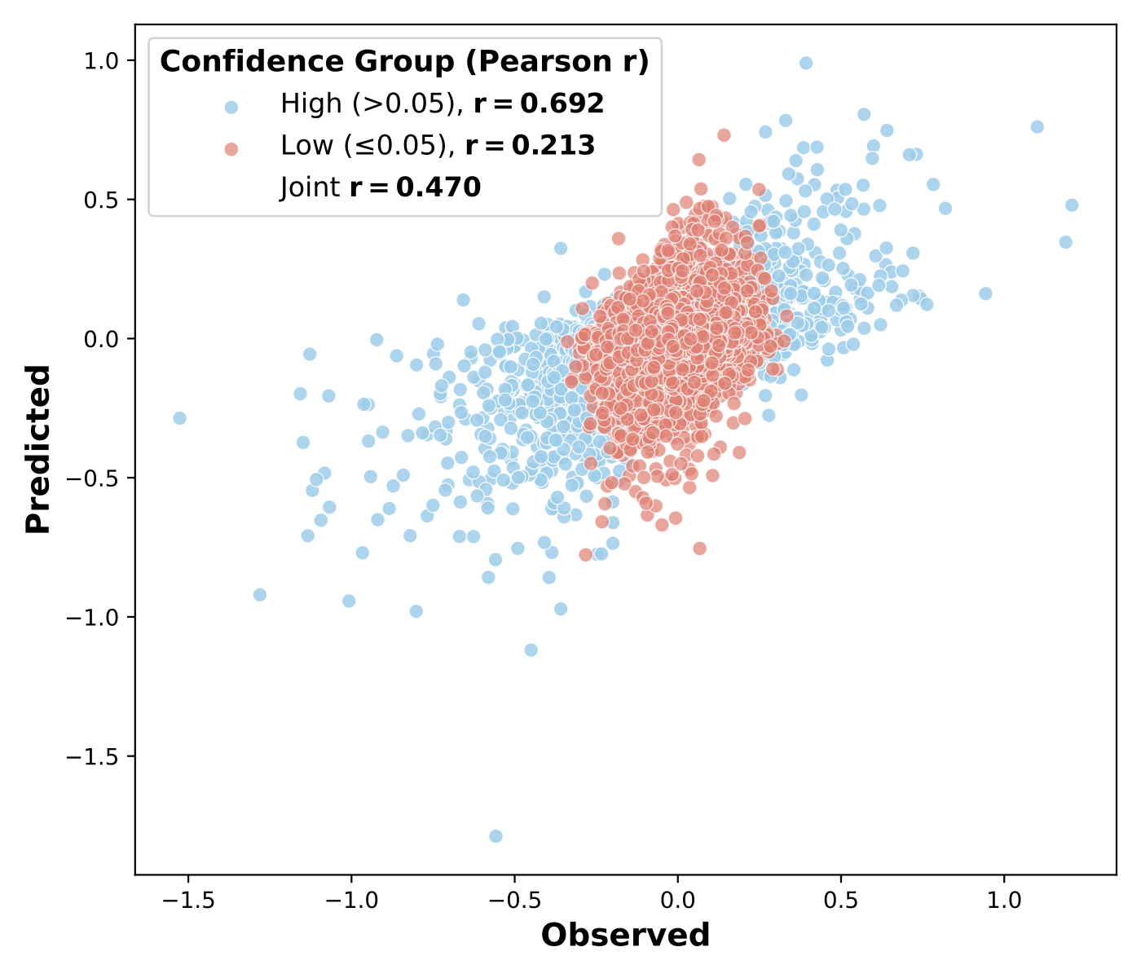
Distribution based on confidence
Borzoi ensemble
MPRALegNet ensemble
Created for CAGI7
genomeinterpretation.org
Arif A. Rather

Slide 6
Method 1
Using lentiMPRA training data to fine-tune MPRALegNet for variant effect size prediction
  Optimize models to predict effect sizes by fitting alternative – reference (alt-ref) scores to observed effect sizes in the training data
  Data Preparation:
      Partitioned data into 4 folds (2:1:1 ratio)
      G1: chr19, chr21, G2: chr13, chr15, G3: chr20, chr22, G4: chr14, chr18
      15 bp Constant followed by 200bp Genomic sequence centered at variant followed by 15bp Constant
  Fine-tuned 90 MPRAlegNet base models using lentiMPRA variant effect data to model alt-ref
  Each base model yielded 12 configurations
Created for CAGI7
genomeinterpretation.org
Arif A. Rather

Slide 7
Method 1
  Training parameters
    Optimizer: AdamW (decay=0.01)
    Loss = MSE + 0.3 × (1 − R)
    weight decay = 0.01
    Learning Rate: 1e-5
    Batch Size: 1024
    Scheduler: Cosine Annealing
    Early Stop:Patience=20
    Max Epochs: 200
  Final variant effect scores generated by averaging predictions across all 1,080 fine-tuned models
Created for CAGI7
genomeinterpretation.org
Arif A. Rather

Slide 8
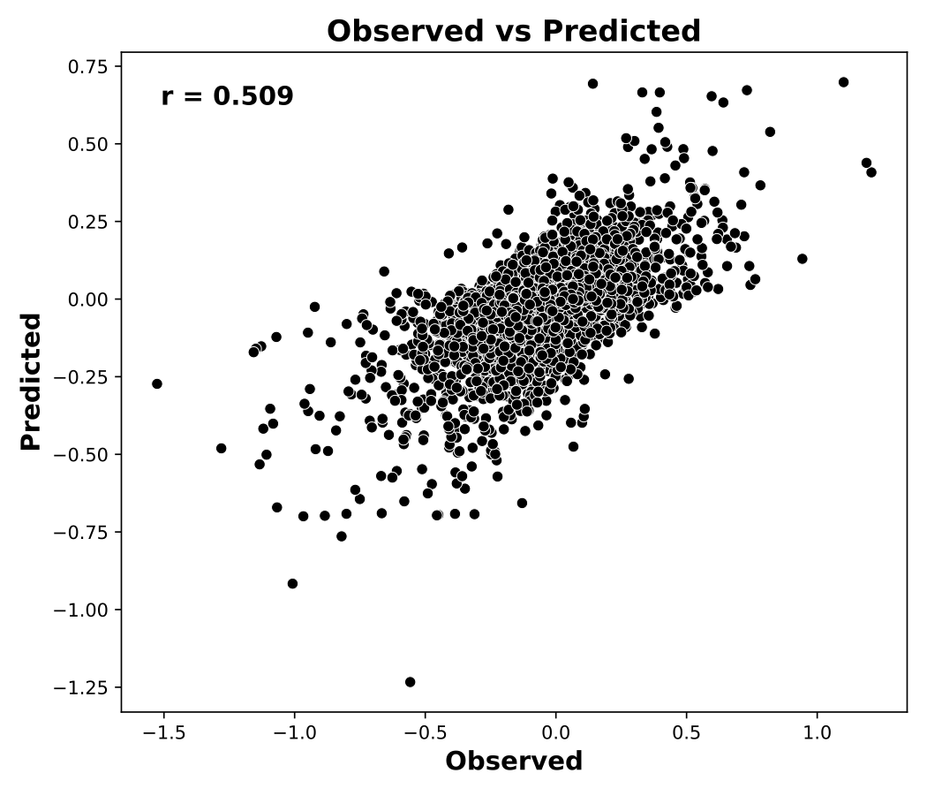
Evaluation
Created for CAGI7
genomeinterpretation.org
Arif A. Rather

Slide 9
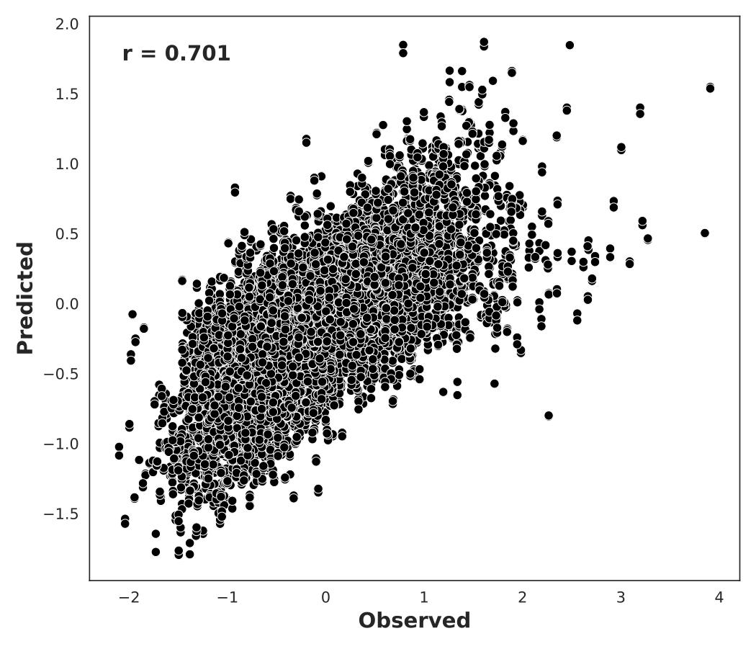
Method 2
Hypothesis: improving the base model performance could improve performance on the variant effect prediction
Data augmentation
  Incorporated additional ~30k sequences constructs with low barcode counts which were previously excluded from the training
  Train SVR model on the original MPRA data to learn sequence-activity relationships using gapped k-mer features
      Score the entire genome to identify:
                Low-activity regions (SVR score < -1): ~1.9 million regions
                High-activity regions (SVR score > 1): ~3,000 regions
  This data was exclusively used for Training
Performance on the test set
Created for CAGI7
genomeinterpretation.org
Arif A. Rather

Slide 10
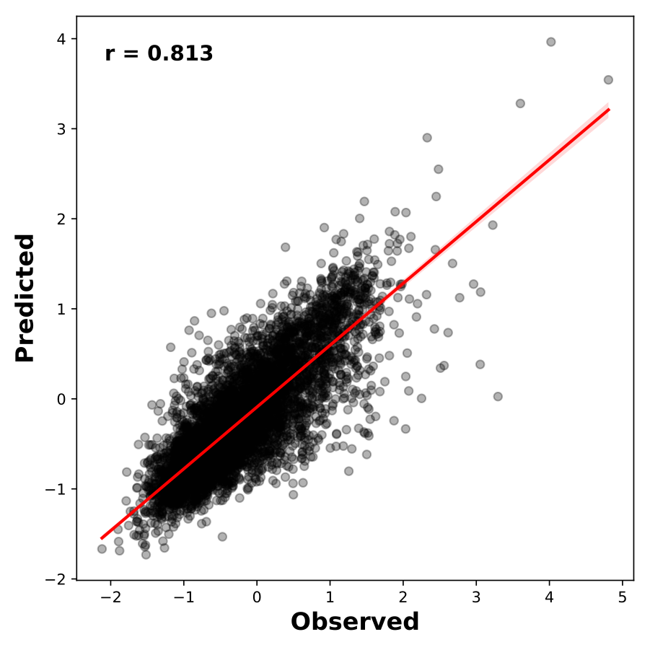
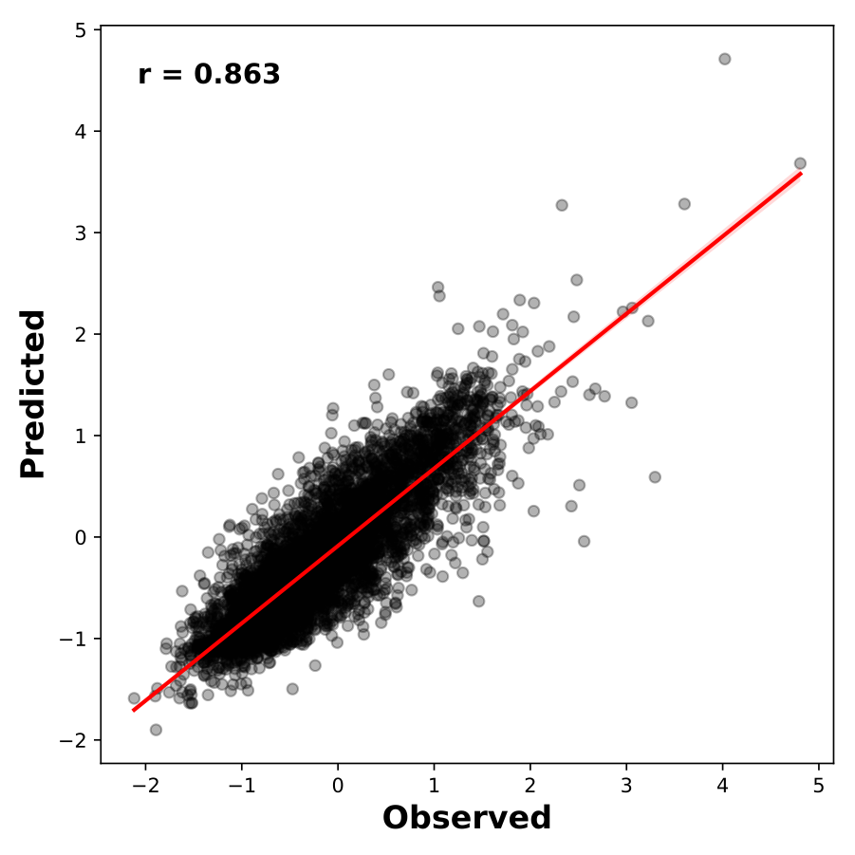
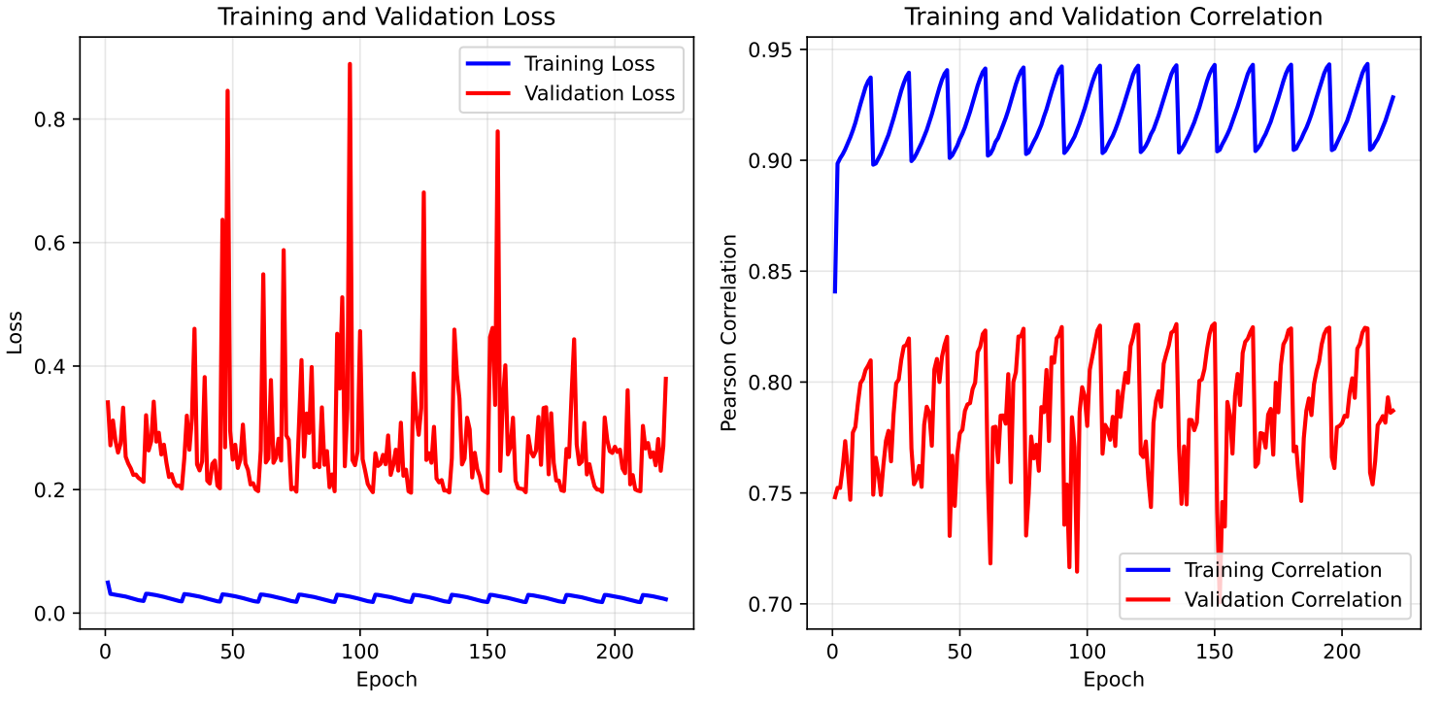
Retraining
We selected the top 10 models (out of 90) based on their ability to accurately predict effect sizes in the training dataset.
Training was performed for 200 epochs using a cosine learning rate decay schedule with warm-up restarts.
Performance on the test set single replicate
Base model
Re-trained
Created for CAGI7
genomeinterpretation.org
Arif A. Rather

Slide 11
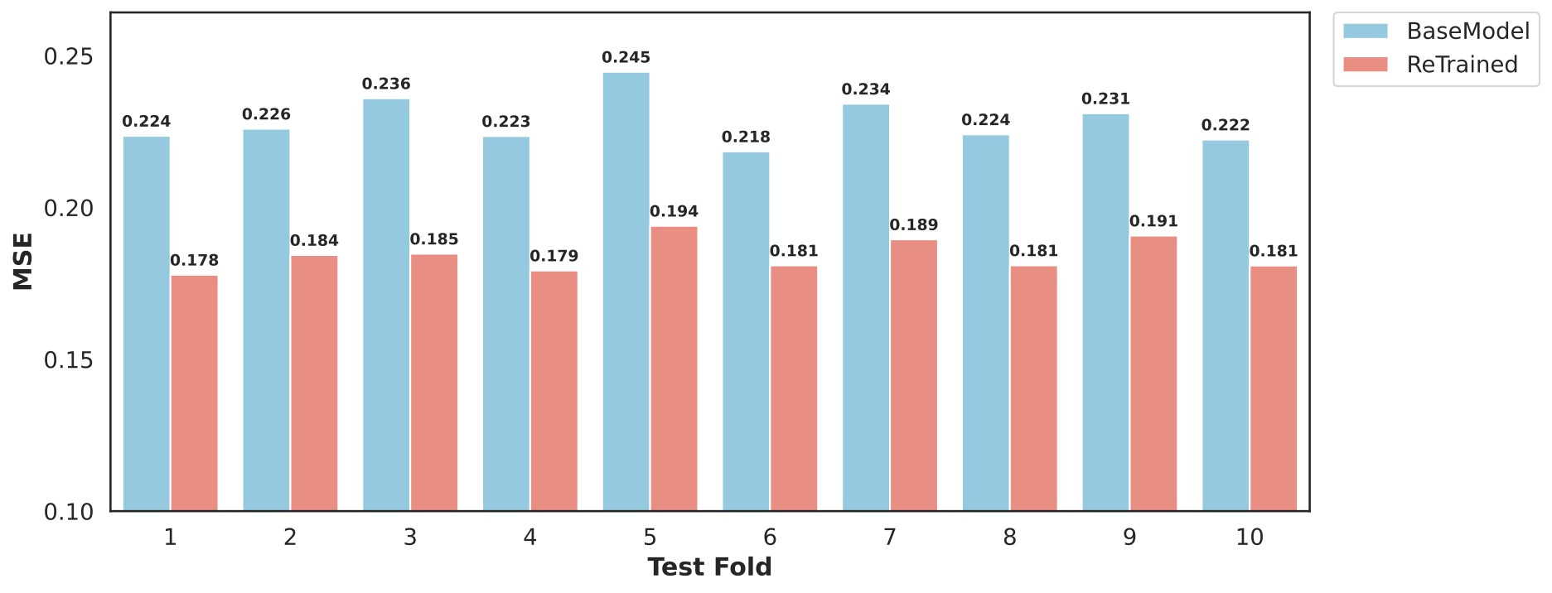
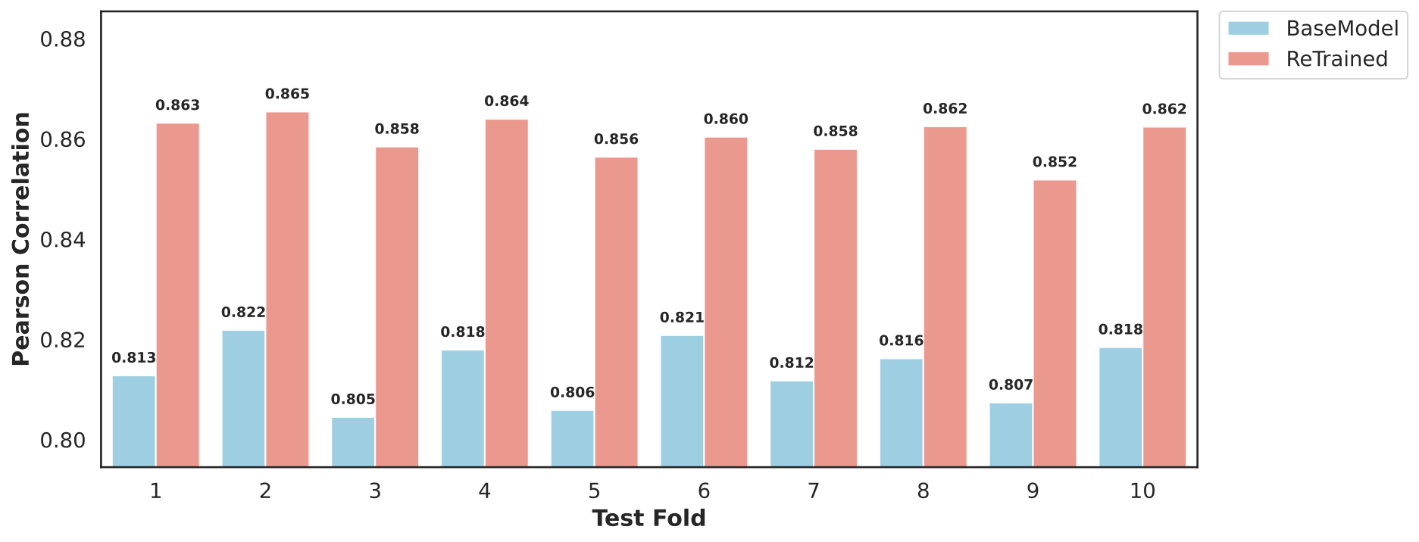
Test set evaluation
Created for CAGI7
genomeinterpretation.org
Arif A. Rather

Slide 12
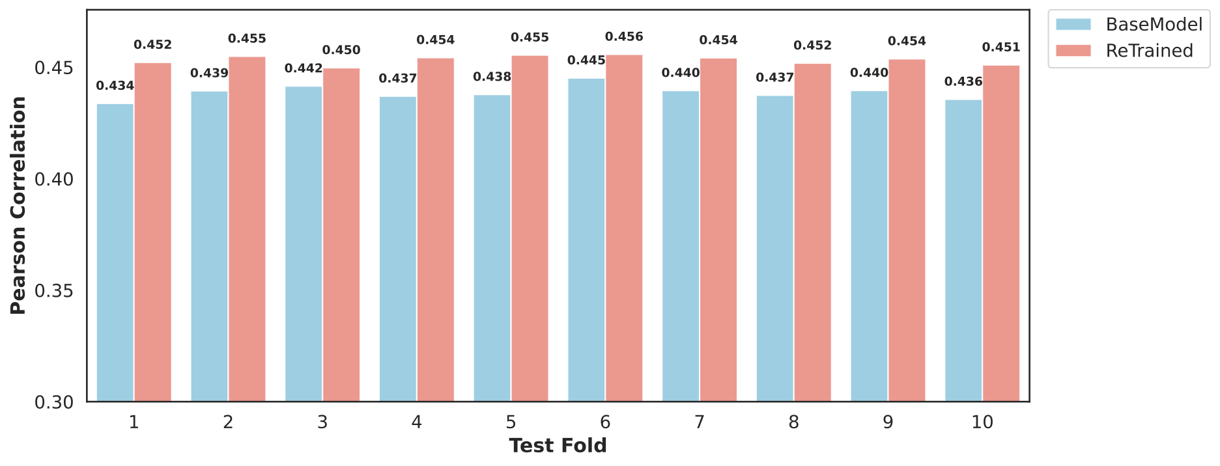
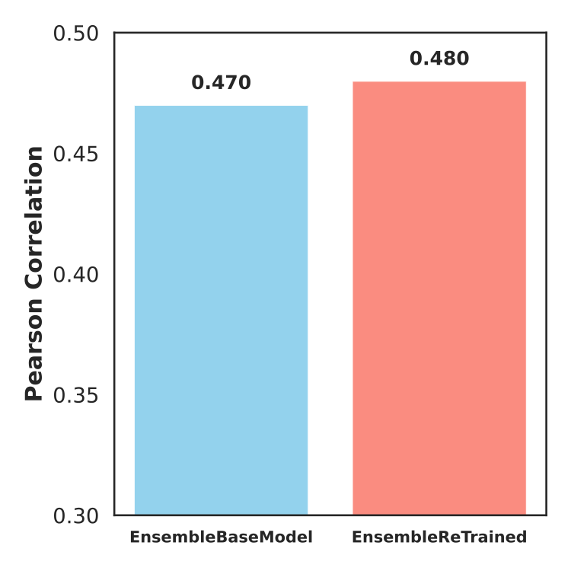
Effect size evaluation
Individual
Ensemble
Created for CAGI7
genomeinterpretation.org
Arif A. Rather

Slide 13
Method 3
Combining Method 1 and Method 2
  Models trained on augmented data were fine-tuned to model the effect size using the training data
  Only 10 models were re-trained and subsequently fine-tuned by fitting alternative – reference (alt-ref) scores to observed effect sizes in the training data.
  We made only one finetuned model for each test/validation fold pairs, resulting in 10 fine-tuned models. Final predictions were made by averaging scores across all fine-tuned models.
Created for CAGI7
genomeinterpretation.org
Arif A. Rather

Slide 14
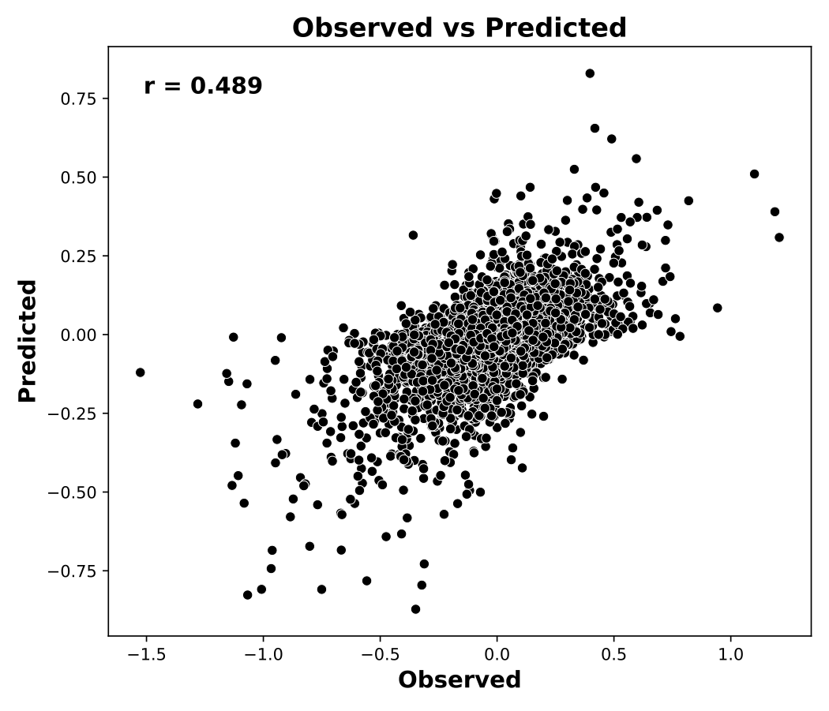
Evaluation
Created for CAGI7
genomeinterpretation.org
Arif A. Rather

Slide 15
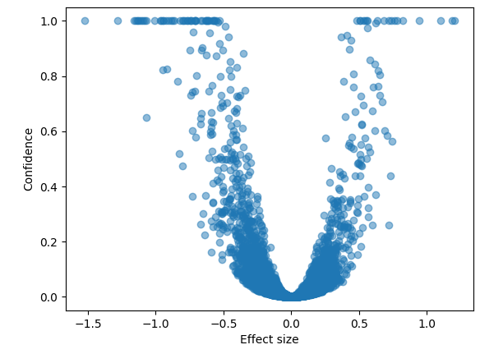
Inferring other parameters
We observe:
Symmetric V-shaped pattern between Effect Size and Confidence
Low Confidence when Effect Size is near zero
Higher Confidence for large positive or negative Effect Sizes (|Effect Size| ≈ 1)
We model the confidence as:
$f=\frac{1}{1+exp(\frac{a-|x|}{b})}$
Created for CAGI7
genomeinterpretation.org
Arif A. Rather

Slide 16
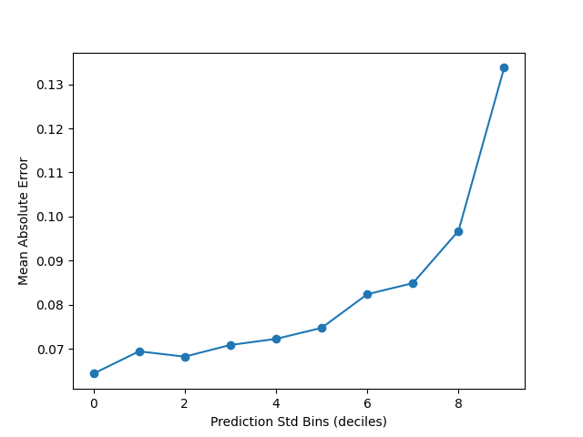
Use prediction std to weight points
We convert prediction standard deviation into weight:
$\min_{a,b}\overset{N}{\underset{i=1}{∑}}{\left(\frac{y_{i}-f(x_{i};a,b)}{σ_{i}+ϵ}\right)}^{2}$($σ_{i}$: uncertainty (prediction_std), $ϵ$: to avoid zero division)
Lower prediction std → higher weight → stronger impact on sigmoid parameters
Use SciPy curve_fit to perform weighted nonlinear least squares
$$confidence_{pred}=g(x_{i};a,b)$$
Created for CAGI7
genomeinterpretation.org
Arif A. Rather

Slide 17
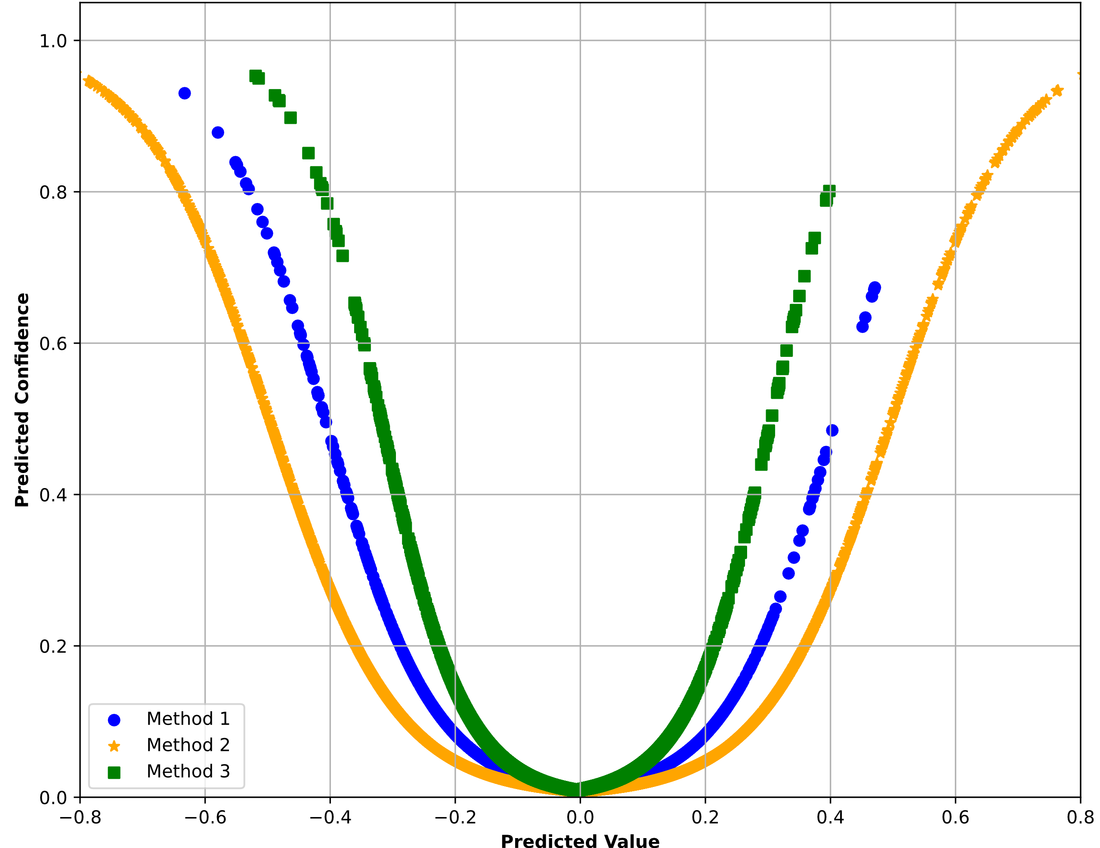
Results
Created for CAGI7
genomeinterpretation.org
Arif A. Rather

Slide 18
Effect & Direction Assignment
Effect: Effect = 1 if Confidence ≥ 0.05, else 0
Direction: If Effect = 1 → Direction = sign(Value); else Direction = 0
Probability Scoring
P_Effect: Confidence × normalized Value (Effect Size)
P_Direction: grows with Confidence and normalized Value, capped to [0.5–1] to reflect directional certainty
$normalized_Value=\frac{|x|}{max(|X|)}$
where x is single variant’s value and X is the dataset containing all value.
Created for CAGI7
genomeinterpretation.org
Arif A. Rather

Slide 19
Summary
Single-task deep learning MPRA model performs better than multi-task general purpose models, but the improvement is modest.
Including variant-level data during training improves variant-effect prediction.
More variant-level data could further improve model performance.
Exploring new data-augmentation methods may improve generalization across diverse genomic datasets.
Created for CAGI7
genomeinterpretation.org
Arif A. Rather

Slide 20
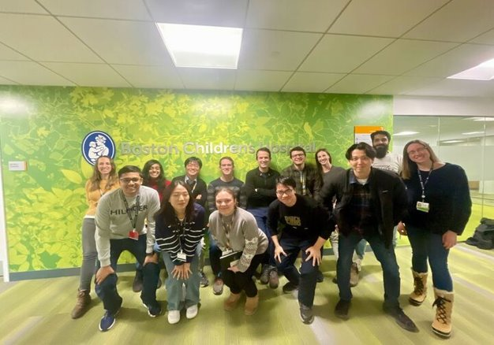
Thank you
  Dongwon Lee
  Yangyang Lin
  Jeerthi Kannan
  All other members of the lab
…and to CAGI Organizers, Data Providers and Assessors
Created for CAGI7
genomeinterpretation.org
Arif A. Rather

