Slide 1

CAGI7 slide pack guidelines
I agree to my slides being used according to the following terms:
__Ryan Hernandez__
Authors: please include THIS slide at the beginning of your presentation to indicate that you agree with reuse of your slides in CAGI presentations, according to the terms below, and digitally sign by writing your name above.
To disseminate the CAGI results, I encourage all CAGI participants to remix these CAGI slides for inclusion in their oral and poster presentations.
CAGI participants may use or publish any content of these slides only in compliance with the CAGI Data Use Agreement.
CAGI participants may not cite or publish any content of these slides except with the written permission of the originating author or in the primary CAGI publications.
CAGI participants must acknowledge the original authors of these slides and CAGI7. Include the acknowledgement banner across the bottom.
CAGI participants must include the CAGI credits slide in their presentations.
Slides with a red slash (no remix) may not be included in a presentation unless all attendees are registered CAGI participants who signed the data use agreement.
Slides with a red X over the entire slide may not be used in any circumstances.
Slides with a blue slash (embargoed) may not be used unless the embargo is explicitly lifted.
Slides without slash or X may be tweeted unless flagged with the “No tweet” icon.
CAGI participants using these slides must explain the “No tweet” icon, which means that the slide content should not be disseminated outside the presenting conference hall. If the presentation venue permits pervasive tweeting, you may not include these slides in your talk.
Note for slide authors: we expect all CAGI participants to abide by these restrictions and will make best effort to ensure they are followed. However, bear in mind that we have limited means of enforcing them, and therefore the restrictions cannot be guaranteed.
Notes:
At CAGI7, use of this slide pack is only required for CAGI dataset providers, assessors, and predictors, but all are encouraged to use the annotations for materials they do not want shared publicly.

Slide 2
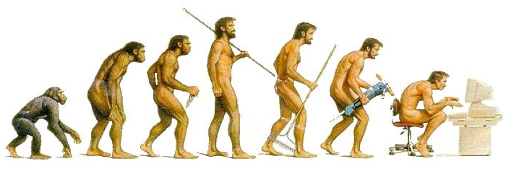


Evolutionary Forces Shape the Genetic Architecture of Complex Traits
Ryan D. Hernandez
ryan.hernandez@ucsf.edu
    Professor in Bioengineering and Therapeutic Sciences at UCSF
    co-Director of the Biological and Medical Informatics (BMI) graduate program
    co-Director of the PROPEL Post-baccalaureate Training Program
    co-Director of ARCHES: Building bridges to connect and support research faculty
    co-Director of the Center for Diversity in Genomics and Precision Health (CDGPH)
‹#›
Created for CAGI7
genomeinterpretation.org
Ryan Hernandez

Slide 3
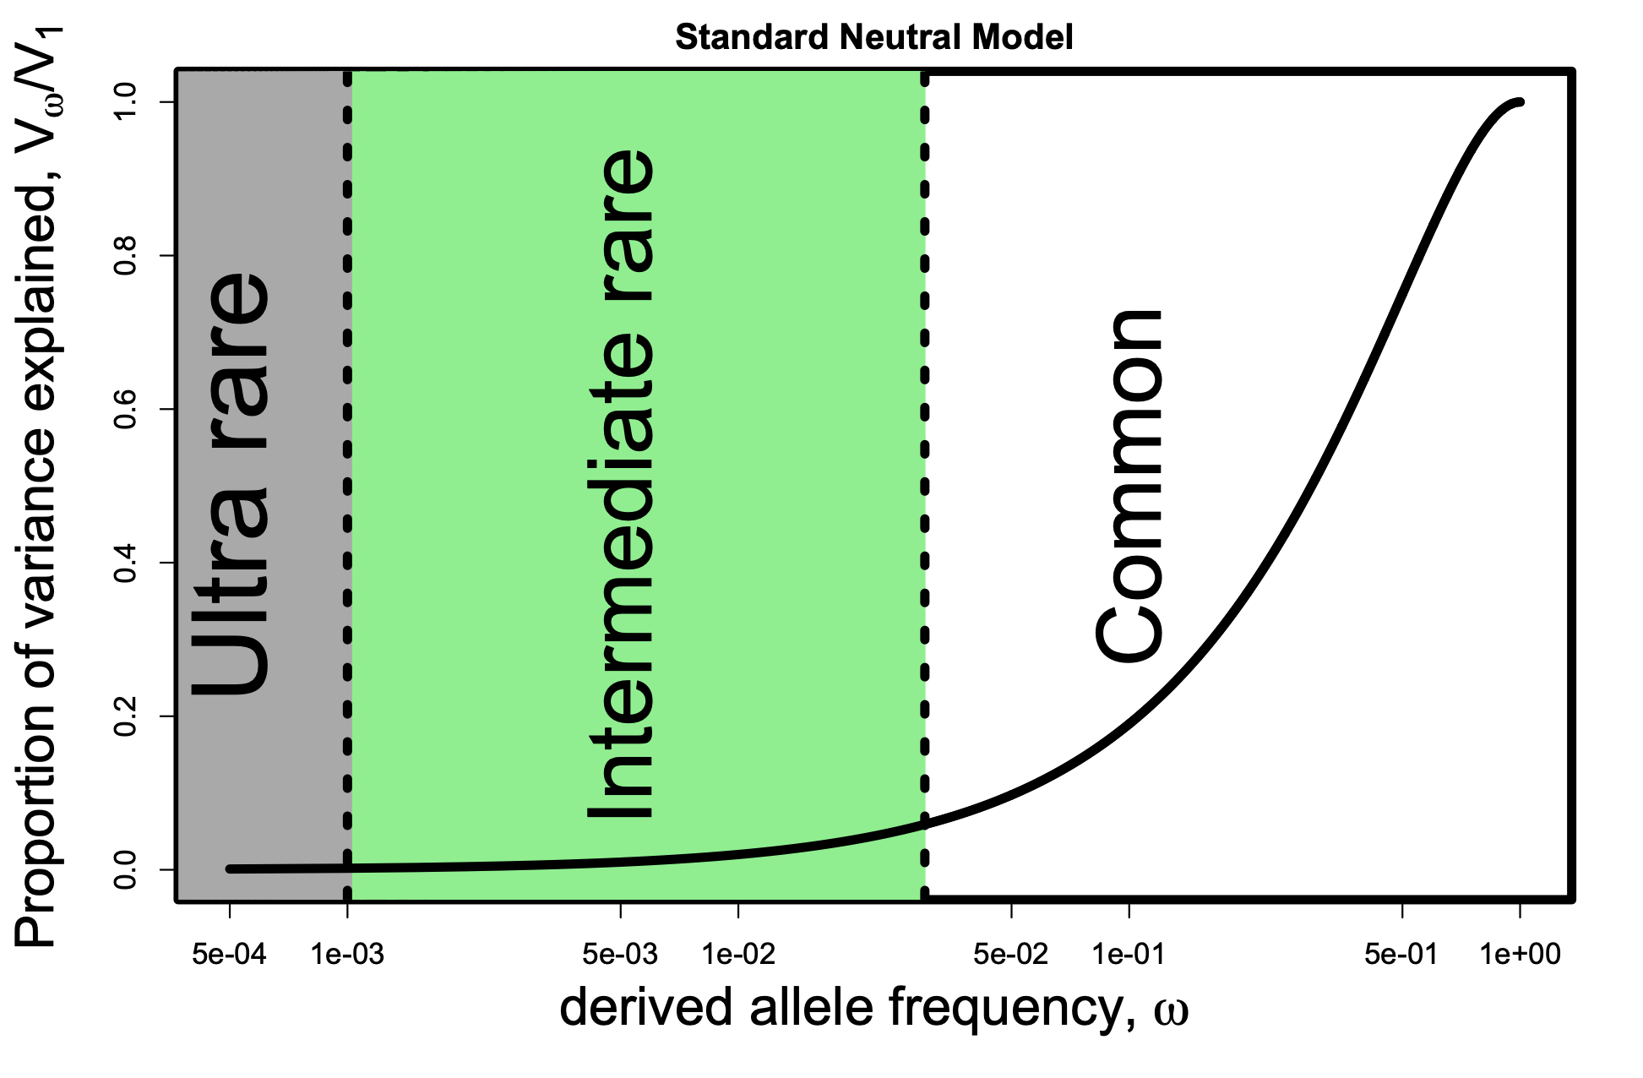
Neutral model: most variance explained by common alleles
Proportion of h² explained
by alleles with freq ≤ ω
Created for CAGI7
genomeinterpretation.org
Ryan Hernandez

Slide 4
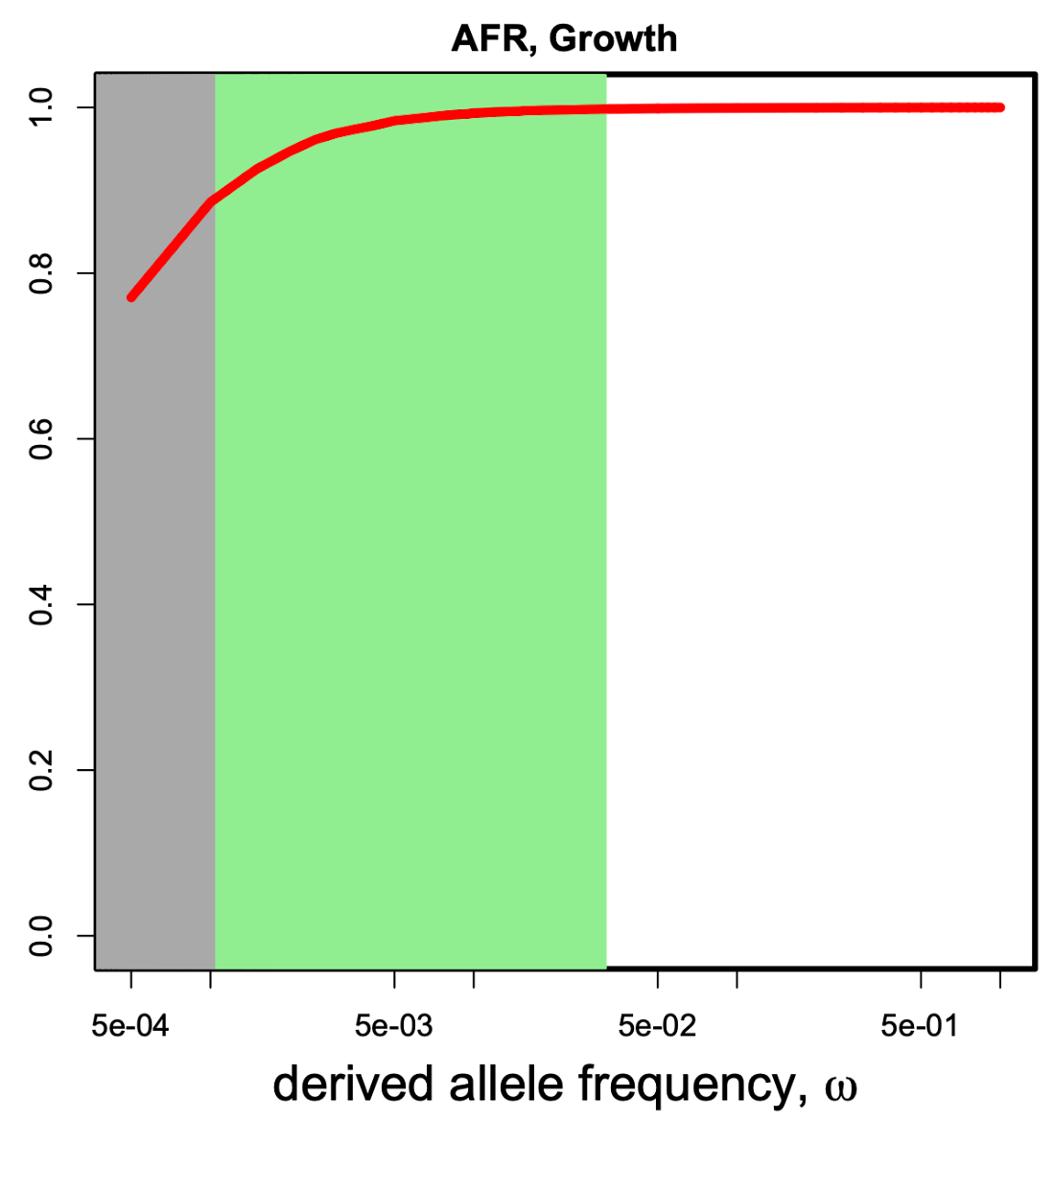
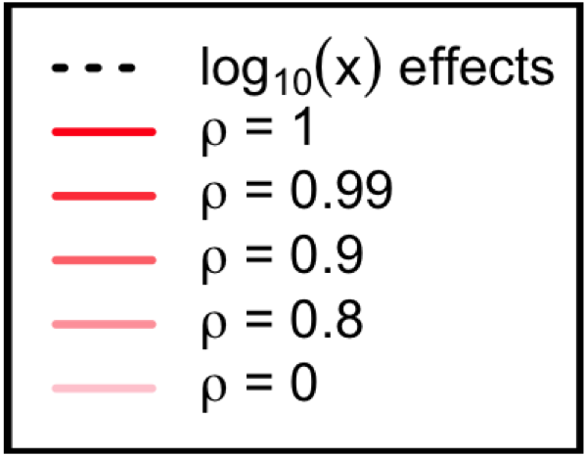
Evolutionary Model: Most Variance explained by Ultra Rare Alleles
Proportion of h² explained
by alleles with freq ≤ ω
Created for CAGI7
genomeinterpretation.org
Ryan Hernandez

Slide 5
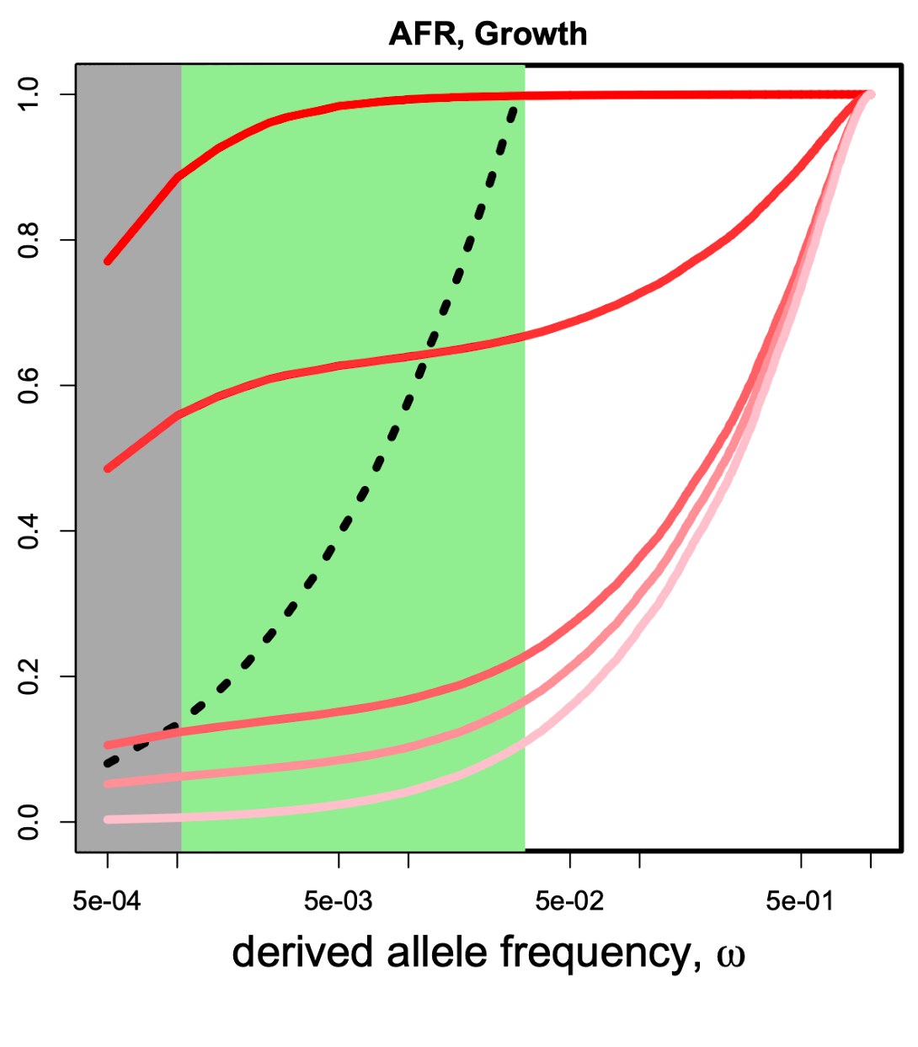
Evolutionary Model: Most Variance explained by Ultra Rare Alleles or common alleles…
Proportion of h² explained
by alleles with freq ≤ ω
Created for CAGI7
genomeinterpretation.org
Ryan Hernandez

Slide 6
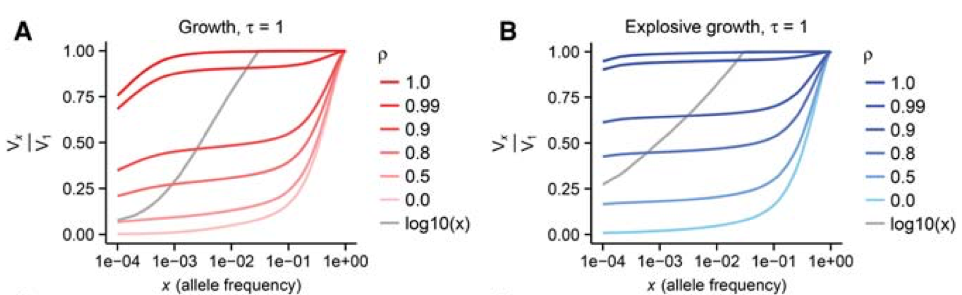
Evolutionary Model: Most Variance explained by Ultra Rare Alleles or common alleles…
Genetic Architecture
Proportion of variance explained
by alleles with freq ≤ x
Proportion of variance explained
by alleles with freq ≤ x
  Key finding:
    Rare variants are a major contributor ONLY when causal variants are deleterious.
Created for CAGI7
genomeinterpretation.org
Ryan Hernandez

Slide 7

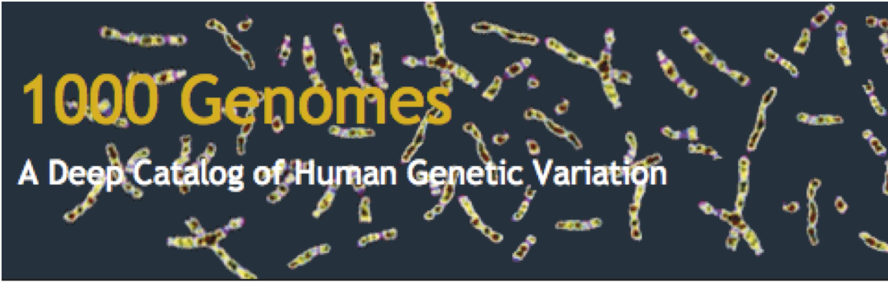
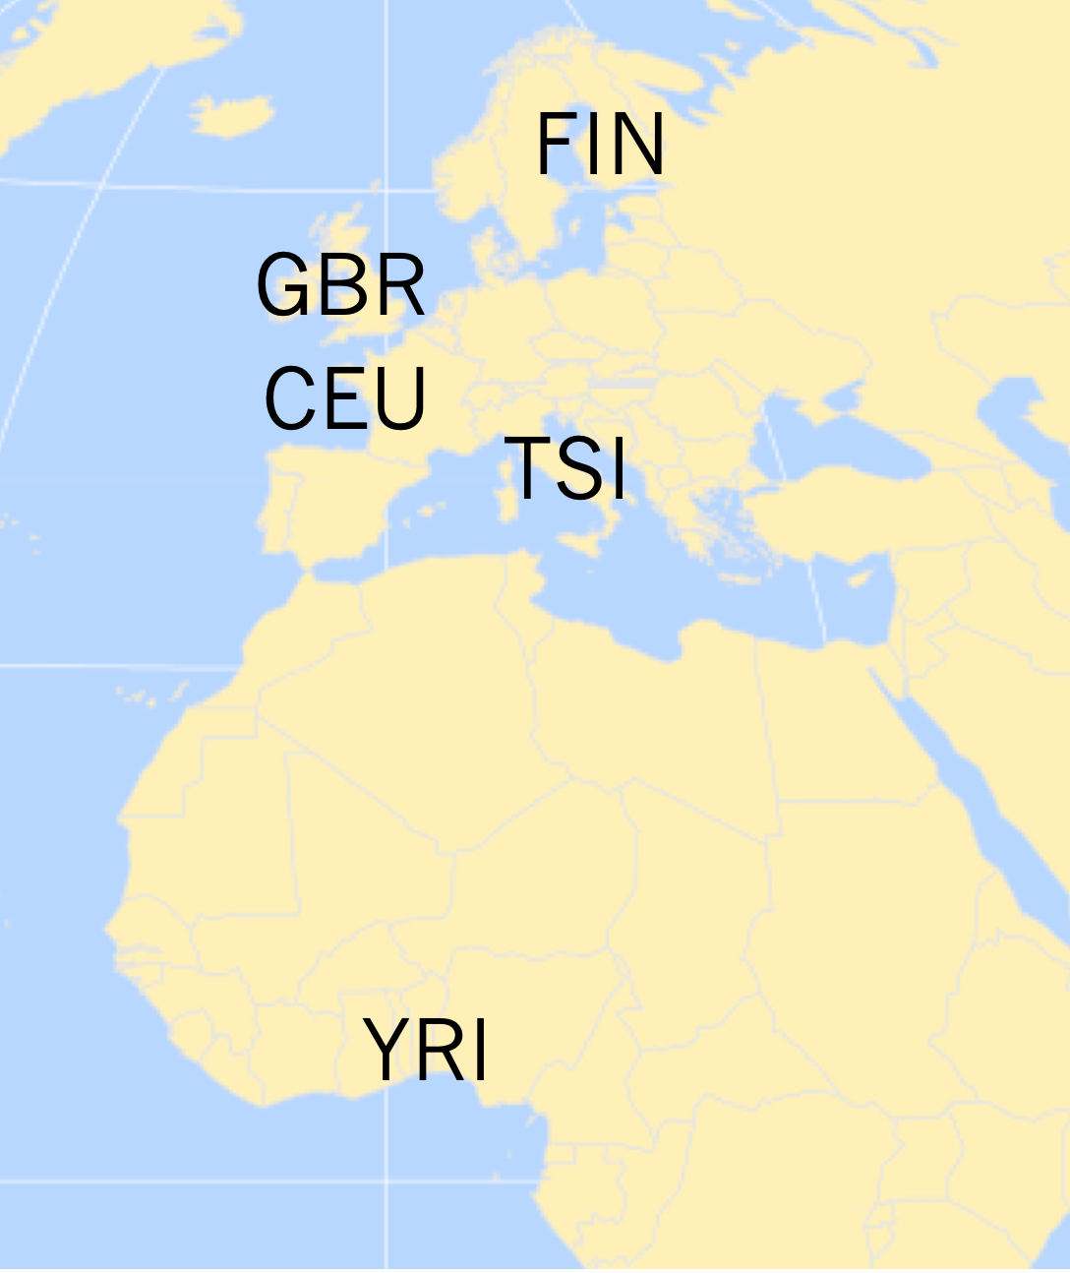

  Large-scale RNA sequencing + WGS
    4 European populations
    360 individuals
    low coverage WGS + high coverage exome: Phase 3.
    RNA-seq: median depth 58.3M reads
      Gene expression:
      log2 transformed, median centered, and quantile normalized.
      10,077 unique genes.
Hernandez et al. (2019)
Noah Zaitlen
Created for CAGI7
genomeinterpretation.org
Ryan Hernandez

Slide 8
  Large-scale RNA sequencing + WGS
    4 European populations
    360 individuals
    low coverage WGS + high coverage exome: Phase 3.
    RNA-seq: median depth 58.3M reads
      Gene expression:
      log2 transformed, median centered, and quantile normalized.
      10,077 unique genes.
  Our sample size is small, but can we learn anything about the genetic basis of complex traits from these 10k genes?
  Let’s analyze heritability of gene expression due to cis variation (within 1Mb of gene)
Hernandez et al. (2019)
Created for CAGI7
genomeinterpretation.org
Ryan Hernandez

Slide 9
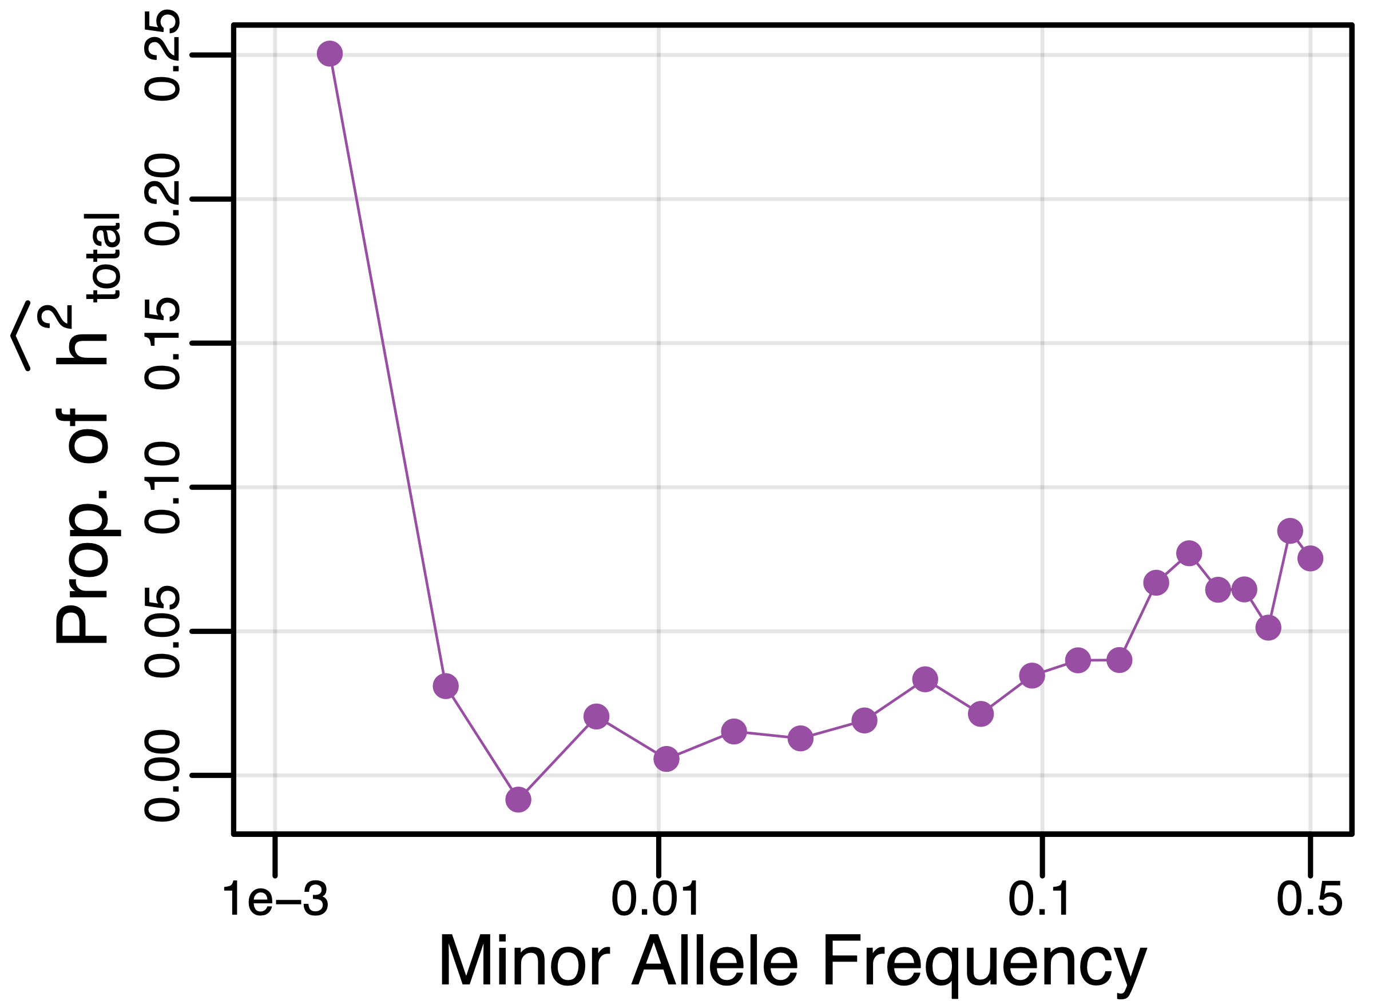
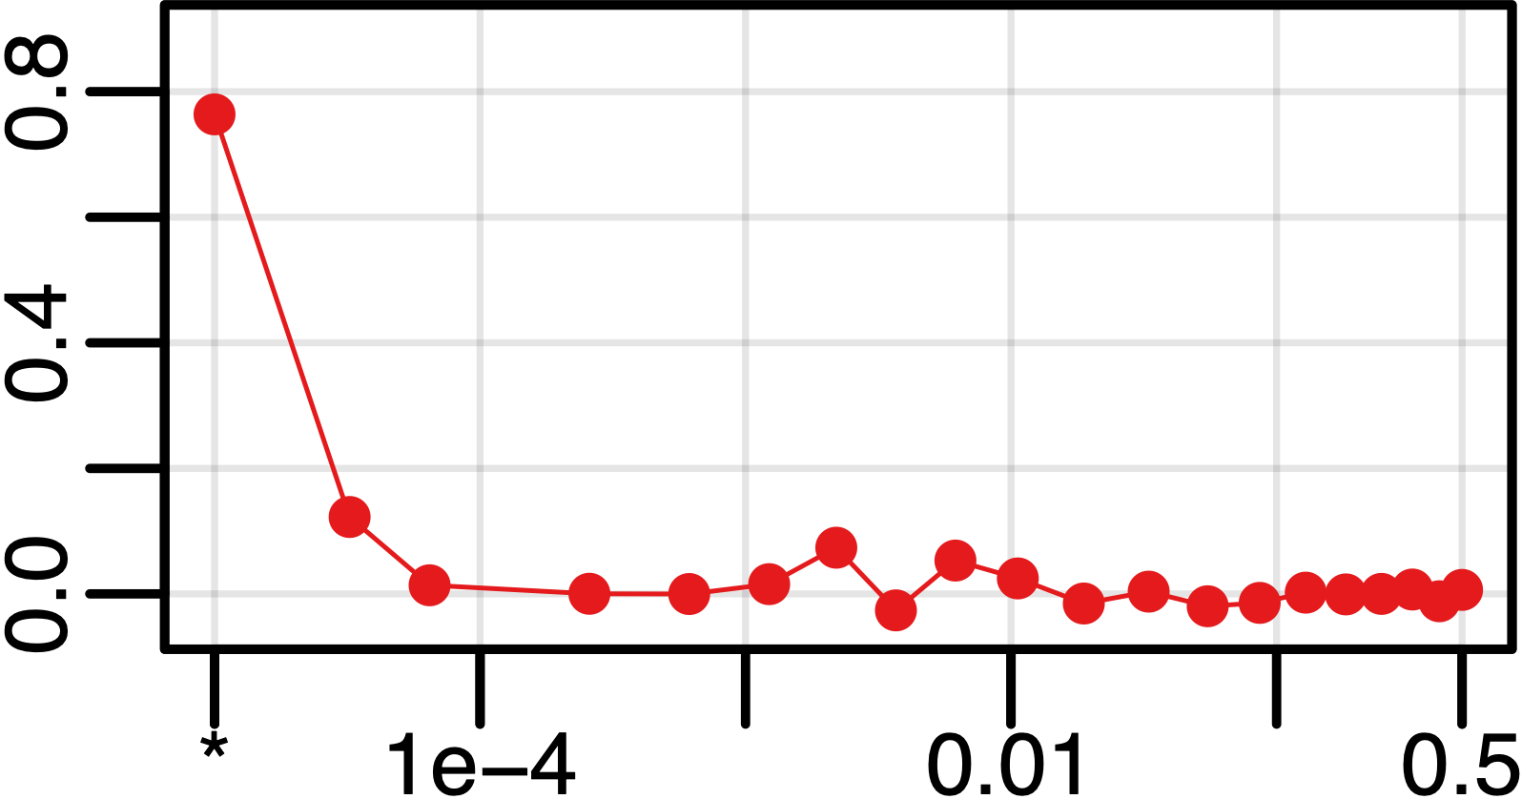
Rare variant heritability
Partition singletons by gnomAD MAF (n>15,000)
>90% of singleton heritability is due to EXTREMELY rare variants (MAF<10⁻⁴).
Fraction of heritability
Hernandez et al. (2019)
Created for CAGI7
genomeinterpretation.org
Ryan Hernandez

Slide 10
  Validating rare variants’ role in the genetic architecture of human gene expression
We will use a Massively Parallel Reporter Assay (MPRA)
  Identify variants
  Synthesize 200bp surrounding DNA with REF and ALT alleles at variant
  Link them minimal promoter (mP) and a barcode (BC) gene
  Transfect cells with lentivirus & grow
  Solve world’s problems by SEQUENCING….
Created for CAGI7
genomeinterpretation.org
Ryan Hernandez

Slide 11
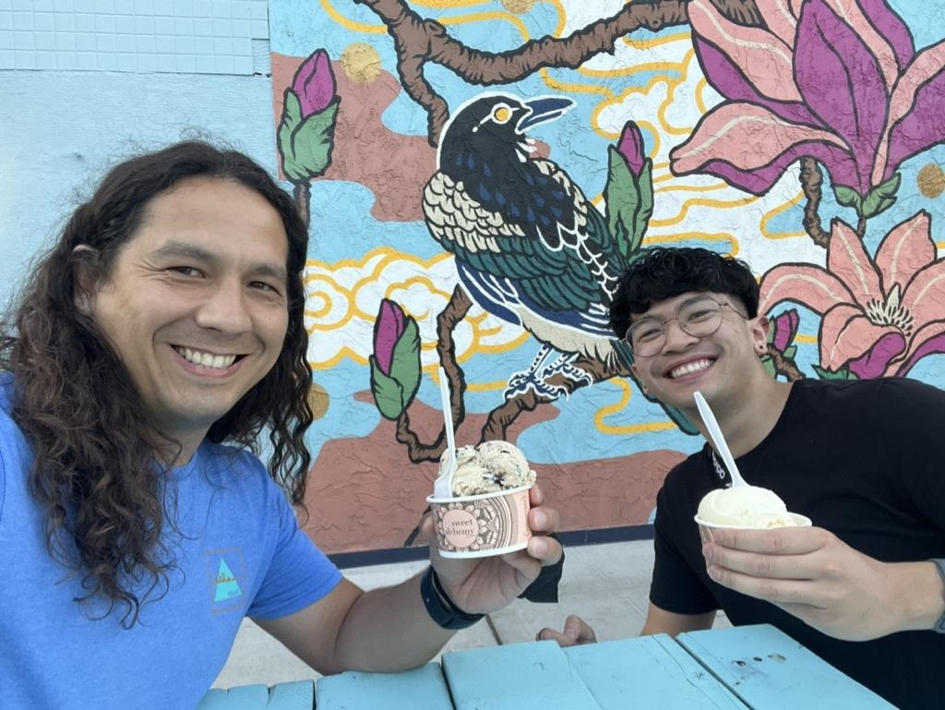
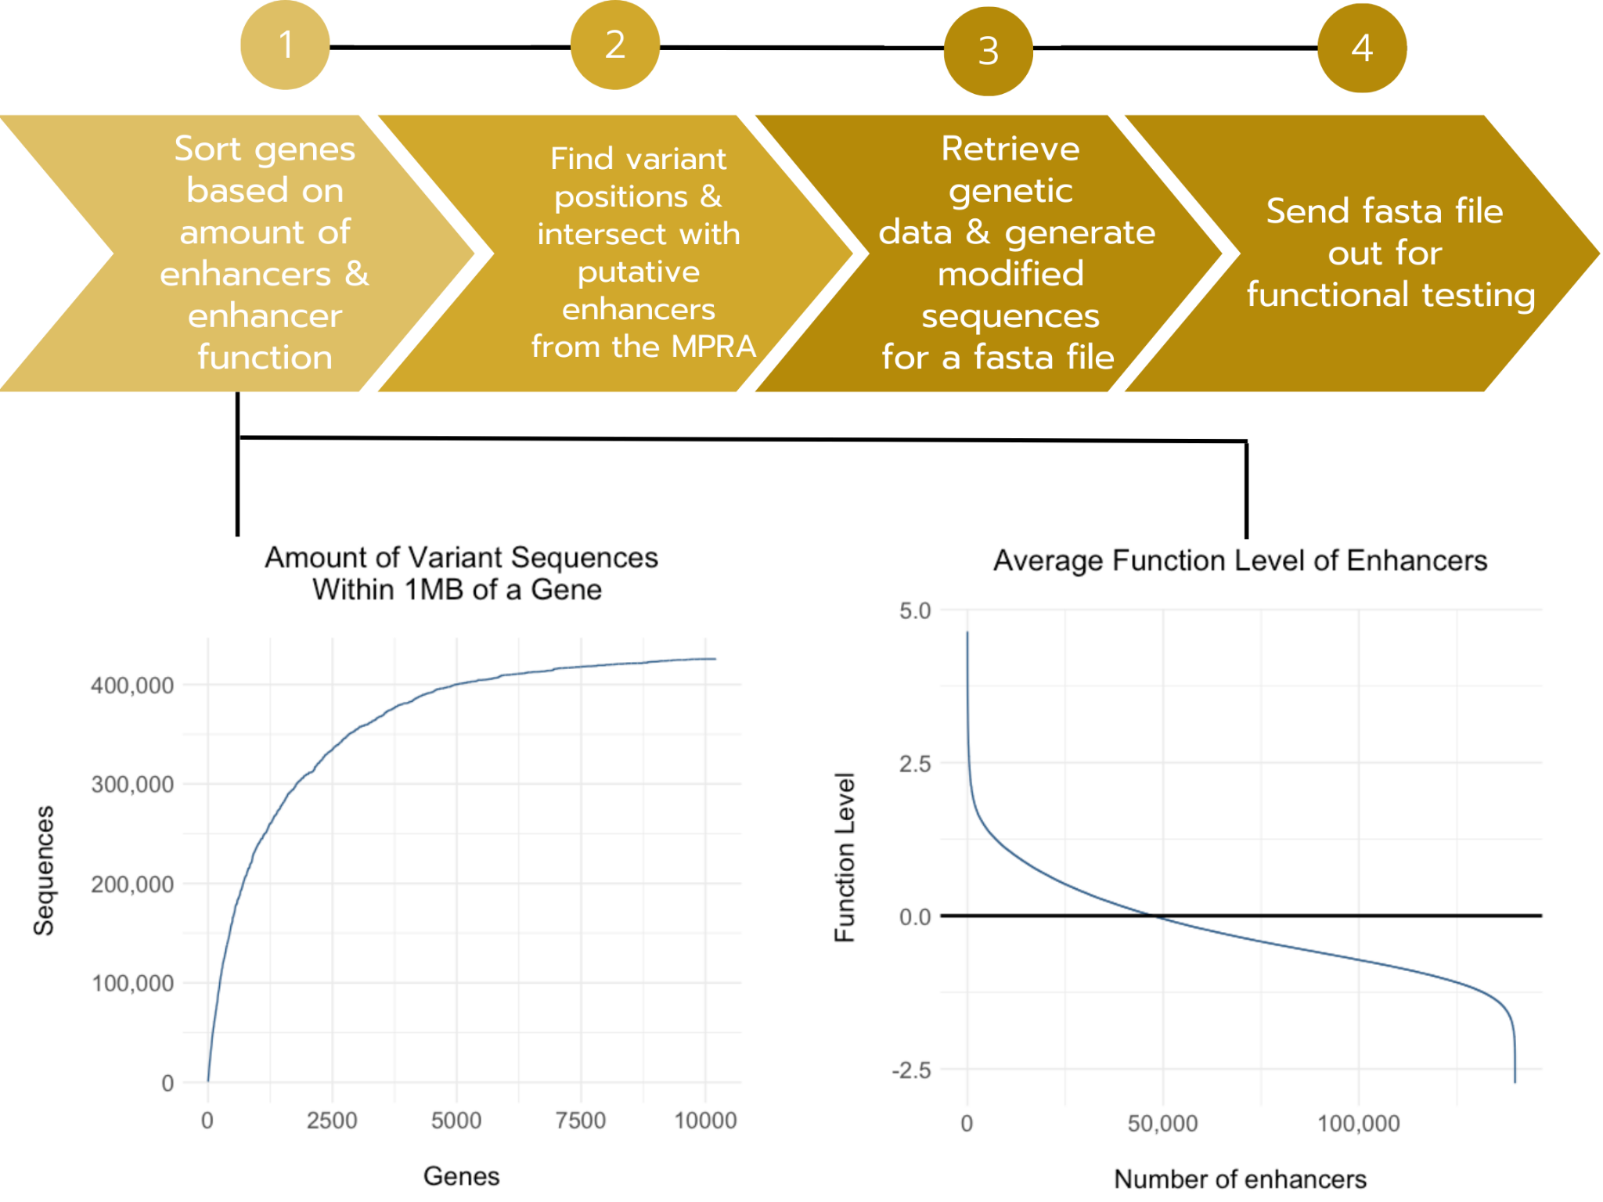
Step 1: Identify variants
289,319 unique, enhancer-variant pairs
425,612 modified sequences
Variant selection team: Matt Suntay
Created for CAGI7
genomeinterpretation.org
Ryan Hernandez

Slide 12
Step 1: Identify variants
Filtered out:
Enhancers with low transcriptional activity measurement
Structural variants
Result:
51k enhancer sequences
  Originally 127k enhancers
86k variants
120k oligos
  Originally 298k oligos
Created for CAGI7
genomeinterpretation.org
Ryan Hernandez

Slide 13
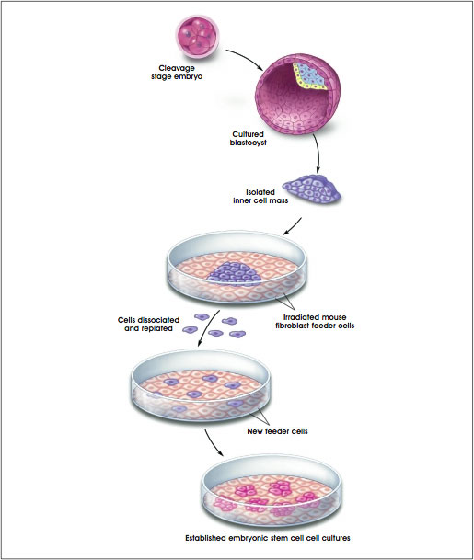
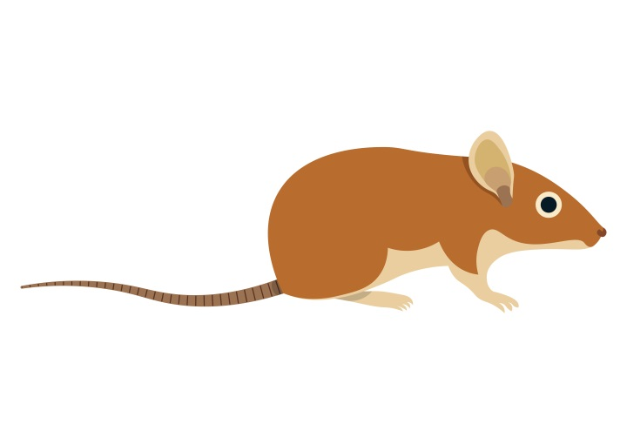
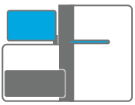
Massively parallel reporter assays (MPRAs)
Enhancer?
Minimal Promoter
Reporter gene
Enhancer?
“
“
Enhancer?
“
“
Enhancer?
“
“
RNA-seq
DNA-seq
Patwardhan Nature Biotech 2012
Smith Nature Genetics 2013
Birnbaum PLoS Genetics 2014
Inoue Genome Research 2017
Kircher Nature Communications 2019
Inoue Cell Stem Cell 2019
Gordon Nature Protocols 2020
Klein Nature Methods 2020
Weiss eLife 2021
Georgakopoulos-Soares Cell Genomics 2022
Kreimer Nature Communications 2022
Deng Science 2024
Agarwal Nature 2025
Activity (RNA/DNA)
Enhancer
Created for CAGI7
genomeinterpretation.org
Ryan Hernandez

Slide 14
Massively parallel reporter assays (MPRAs)
Enhancer
Minimal Promoter
Reporter gene
Enhancer
“
“
Enhancer
“
“
Enhancer
“
“
RNA-seq
DNA-seq
Data generation team: Chengyu Deng (Nadav Ahituv lab)
Activity (RNA/DNA)
Enhancer
Created for CAGI7
genomeinterpretation.org
Ryan Hernandez

Slide 15
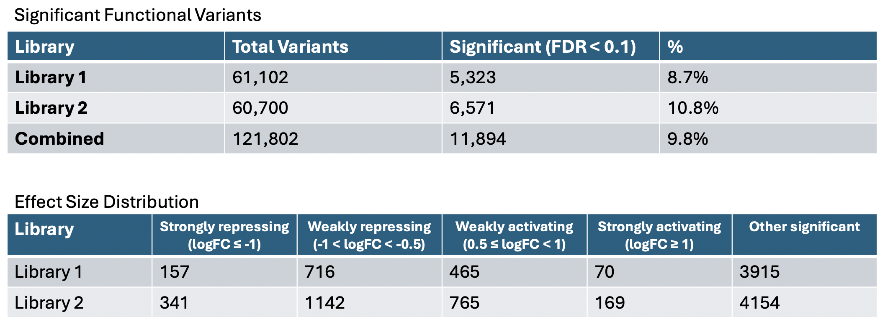
Analysis team: Mustafa Helal (Martin Kircher lab)
Created for CAGI7
genomeinterpretation.org
Ryan Hernandez

Slide 16
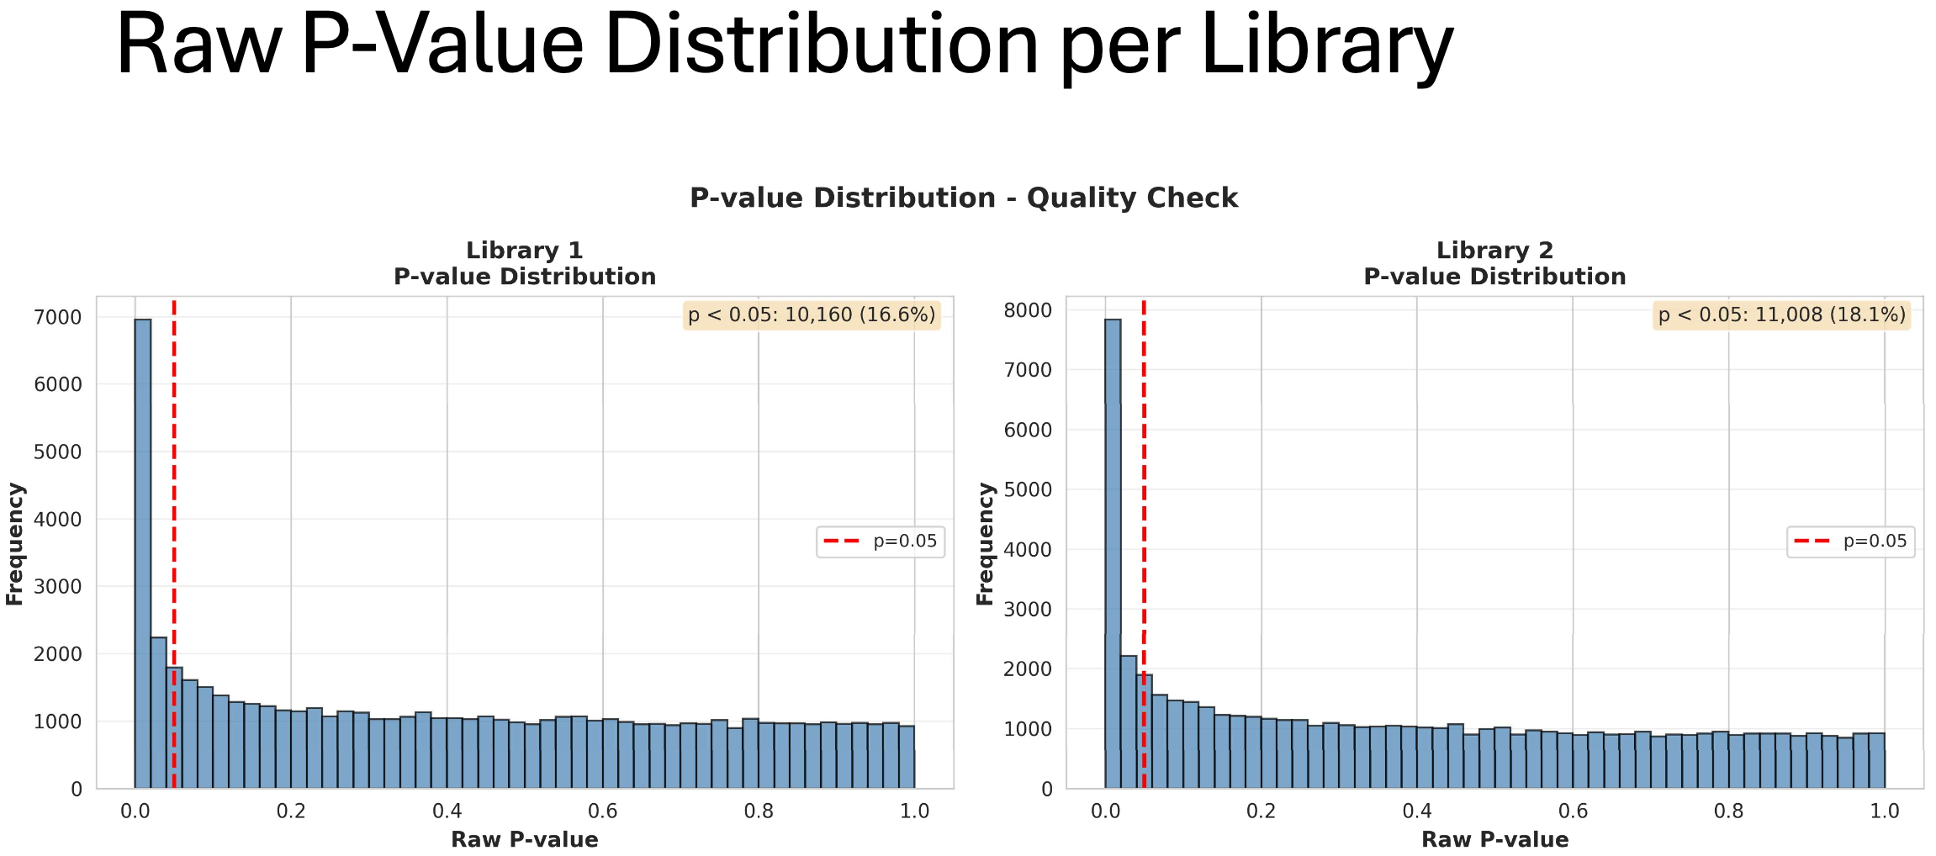
Created for CAGI7
genomeinterpretation.org
Ryan Hernandez

Slide 17
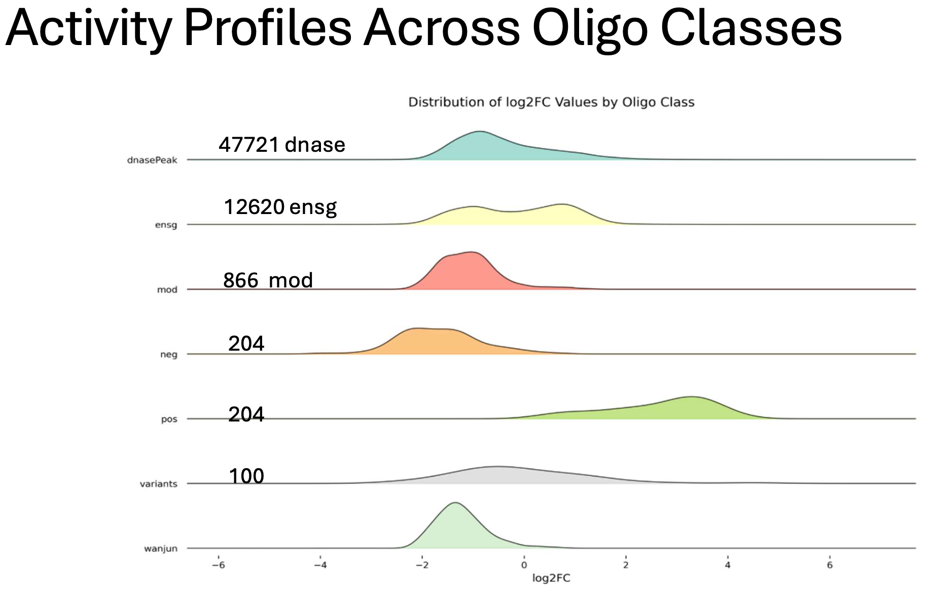
Created for CAGI7
genomeinterpretation.org
Ryan Hernandez

Slide 18
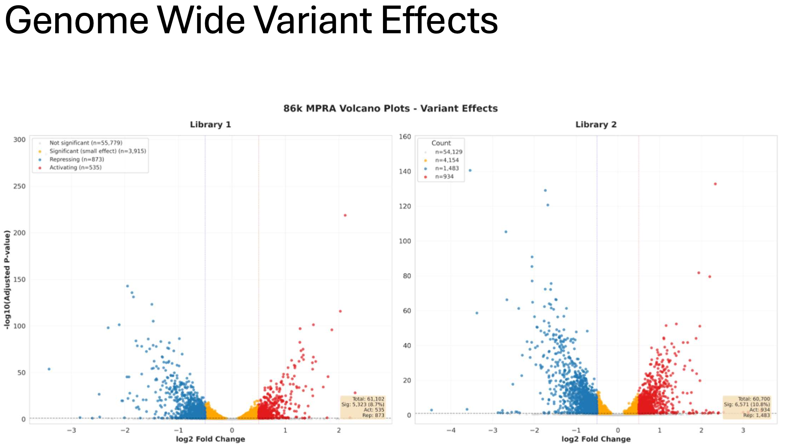
Created for CAGI7
genomeinterpretation.org
Ryan Hernandez

Slide 19

Do ultrarare variants contribute more to the genetic architecture of gene expression than common variants?
Do globally rare singletons contribute more to gene expression differences among people than singletons that are not globally rare?
Are outlier expression patterns typically driven by functional enhancer variants?
Now what??
Created for CAGI7
genomeinterpretation.org
Ryan Hernandez

Slide 20
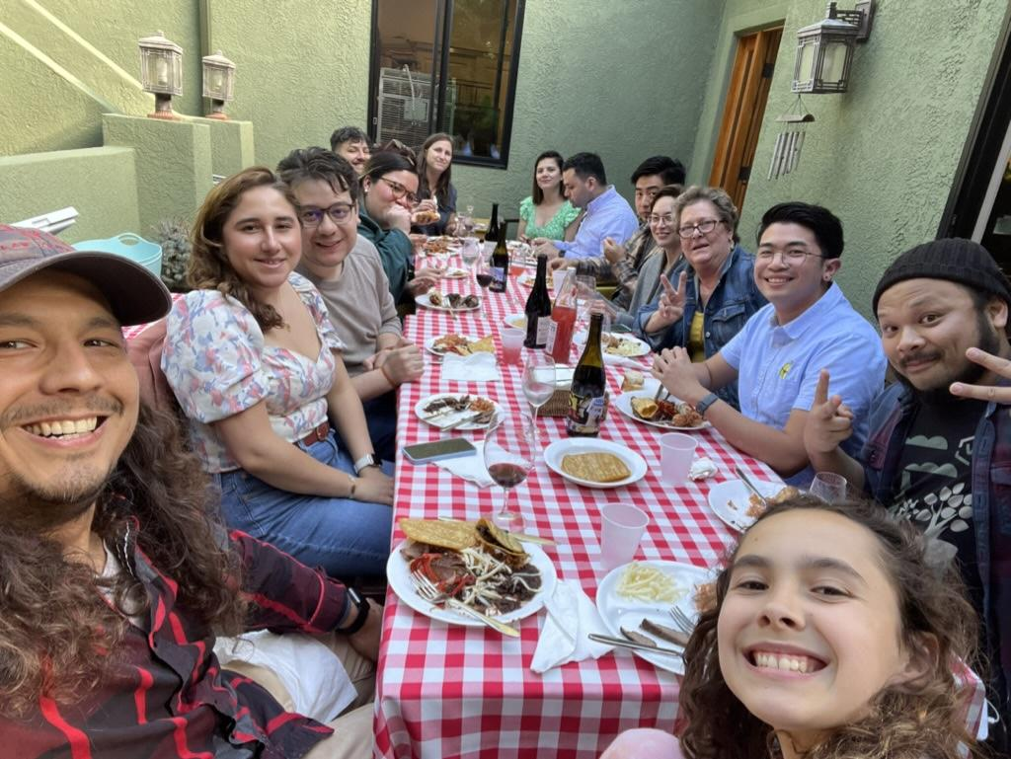

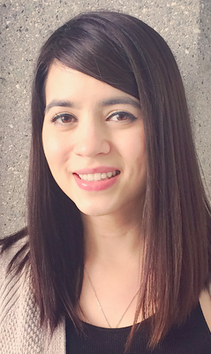
Thanks!
Funding: R01GM142112
Created for CAGI7
Ryan Hernandez

Slide 21
Thank you!
Created for CAGI7
genomeinterpretation.org
Ryan Hernandez

