Slide 1

CAGI 7 slide pack guidelines
I agree to my slides being used according to the following terms:
Dmitry Penzar
Authors: please include THIS slide at the beginning of your presentation to indicate that you agree with reuse of your slides in CAGI presentations, according to the terms below, and digitally sign by writing your name above.
At CAGI 7, use of this slide pack is only required for CAGI dataset providers, assessors, and predictors, but all are encouraged to use the annotations for materials they do not want shared publicly.
To disseminate the CAGI results, I encourage all CAGI participants to remix these CAGI slides for inclusion in their oral and poster presentations
CAGI participants may use or publish any content of these slides only in compliance with the CAGI Data Use Agreement
CAGI participants may not cite or publish any content of these slides except with the written permission of the originating author or in the primary CAGI publications
CAGI participants must acknowledge the original authors of these slides and CAGI 7. Include the acknowledgement banner across the bottom
CAGI participants must include the CAGI credits slide in their presentations
Slides with a red slash (no remix) may not be included in a presentation unless all attendees are registered CAGI participants who signed the data use agreement
Slides with a red X over the entire slide may not be used in any circumstances
Slides with a blue slash (embargoed) may not be used unless the embargo is explicitly lifted
Slides without slash or X may be tweeted, tooted, posted, X’d unless flagged with “No tweet” icon
CAGI participants using these slides must explain the “No tweet” icon, which means that the slide content should not be disseminated outside the presenting conference hall. If the presentation venue permits pervasive tweeting, you may not include these slides in your talk
Note for slide authors: we expect all CAGI participants to abide by these restrictions, and will make best effort to ensure they are followed. However, but bear in mind that we have limited means of enforcing them, and therefore the restrictions cannot be guaranteed.

Slide 2
CAGI7
LentiMPRA challenge
MLRG MSU solution
Asha Uses All: Ensembling Multimodal Models and Extensive Test-Time Augmentation Lead to Superior Performance
D. Penzar
Faculty of bioengineering and bioinformatics, Lomonosov Moscow State University, Moscow, Russia
Vavilov Institute of General Genetics, Russian Academy of Science, Moscow, Russia

Slide 3
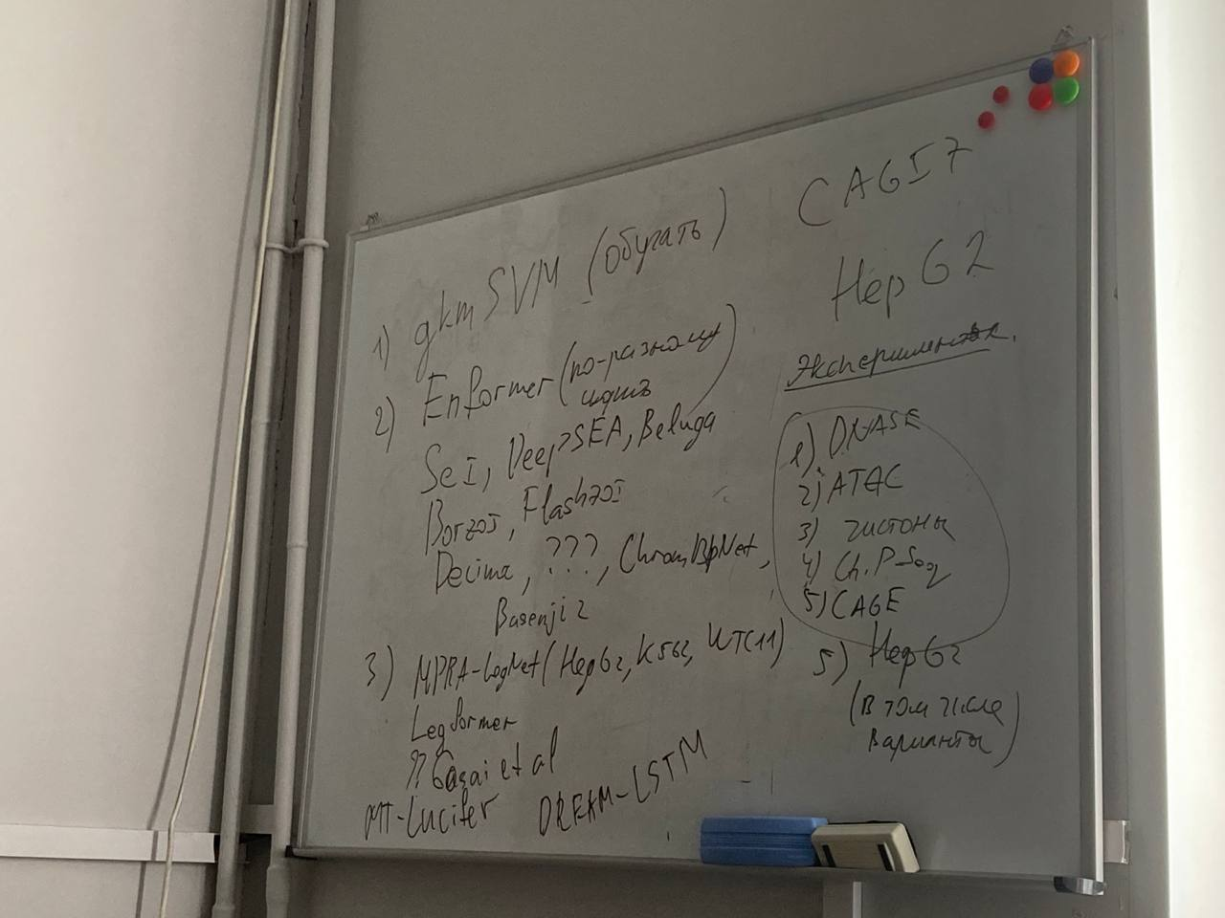

Find the difference

Slide 4
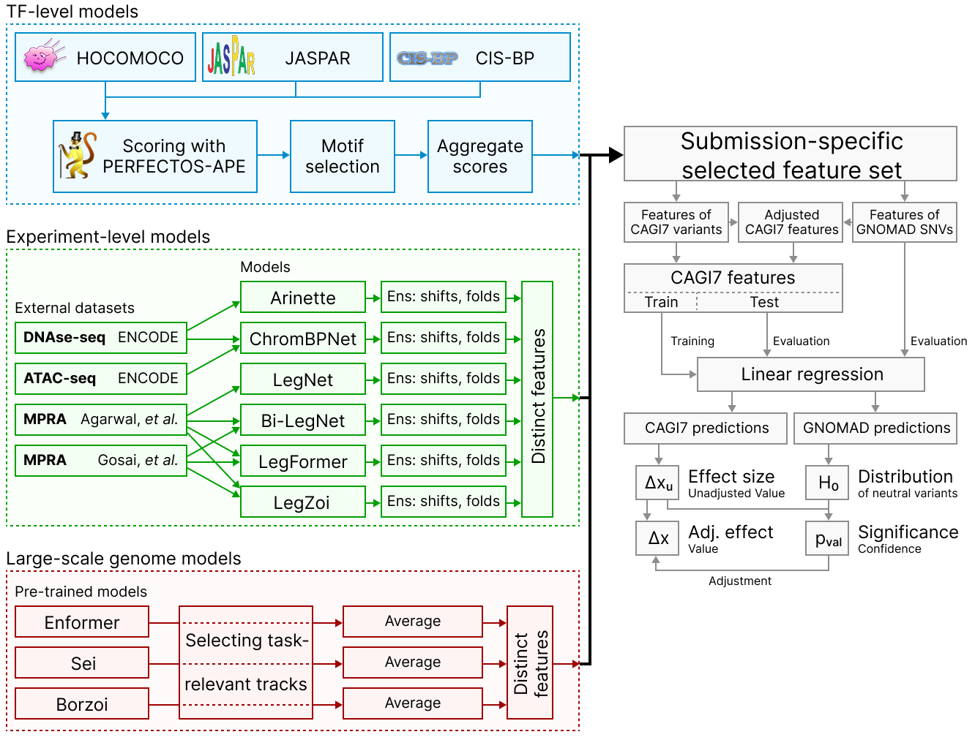
Final Asha scheme

Slide 5
Data separation
1) We used the following cross-validation scheme during competition
1. chr19
2. chr14
3. chr20
4. chr15
5. chr13, chr21
6. chr18, chr22
2) Additionally, we calculated metrics for high-confidence intervals (Confidence >0.05)

Slide 6
No motifs

Slide 7
Linear regression

Slide 8
Large-scale genome models

Slide 9
How to score MPRA experiment with a genomic model?
Fragment from the experiment (with ref or alt allelel)
Known flanks, inserted in genome

Slide 10
How to score MPRA experiment with a genomic model?
Fragment from the experiment (with ref or alt allelel)
Genomic context
Pad fragment with Ns
… NNNNNNNNNNNNNNNN
NNNNNNNNNNNNNNNN….
In-silico insert fragment into lentiMPRA construct and pad rest with Ns
… NNNNNNNNNNNNNNNN
NNNNNNNNNNNNNNNN….
Which way is better?

Slide 11
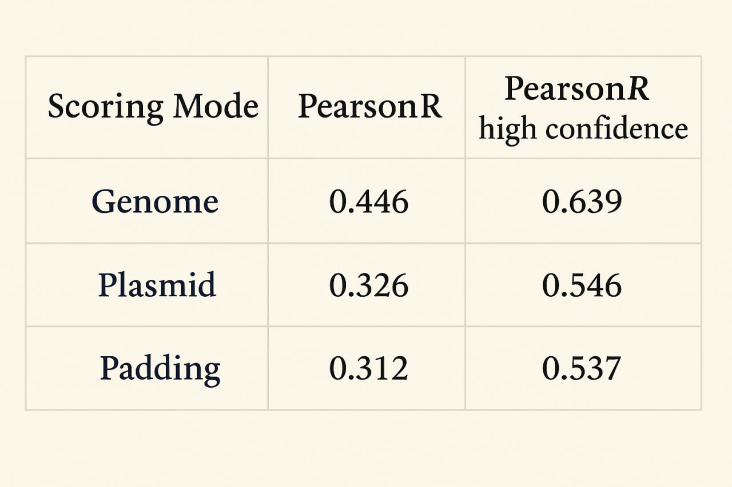
How to score MPRA experiment with a genomic model? (zero-shot performance)
Interestingly, all three features are important for final models

Slide 12
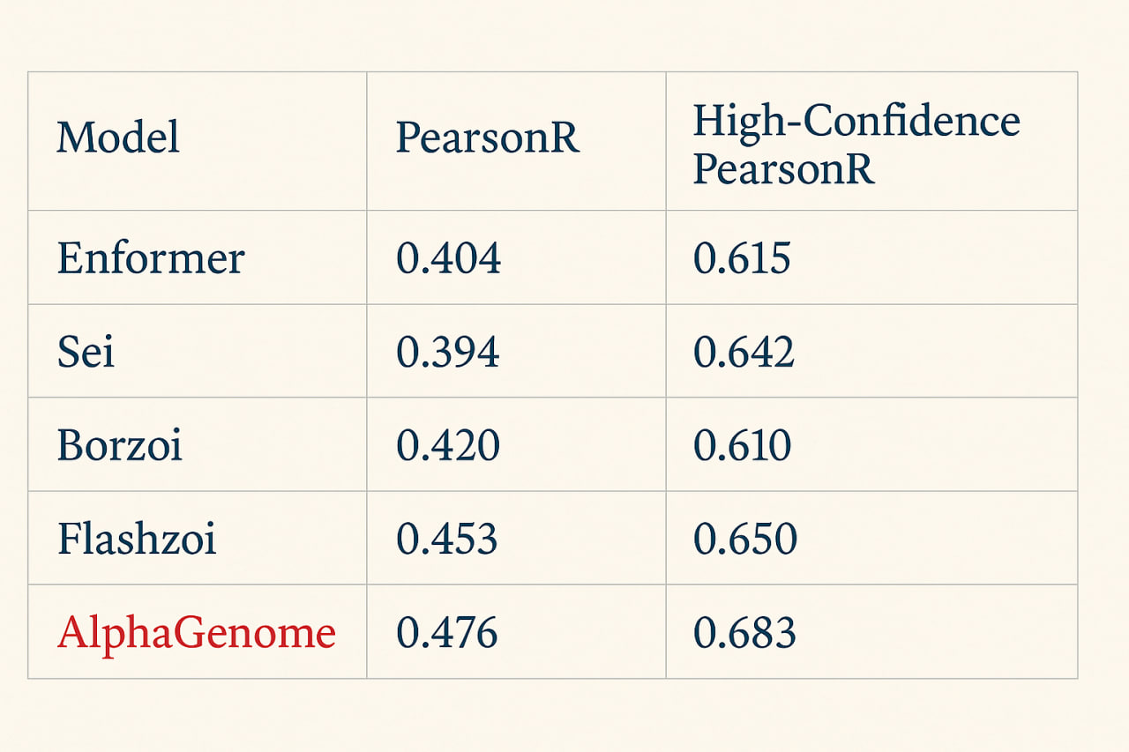
Large-scale deep learning seq2activity models (zero-shot performance)

Slide 13
Single-experiment models

Slide 14
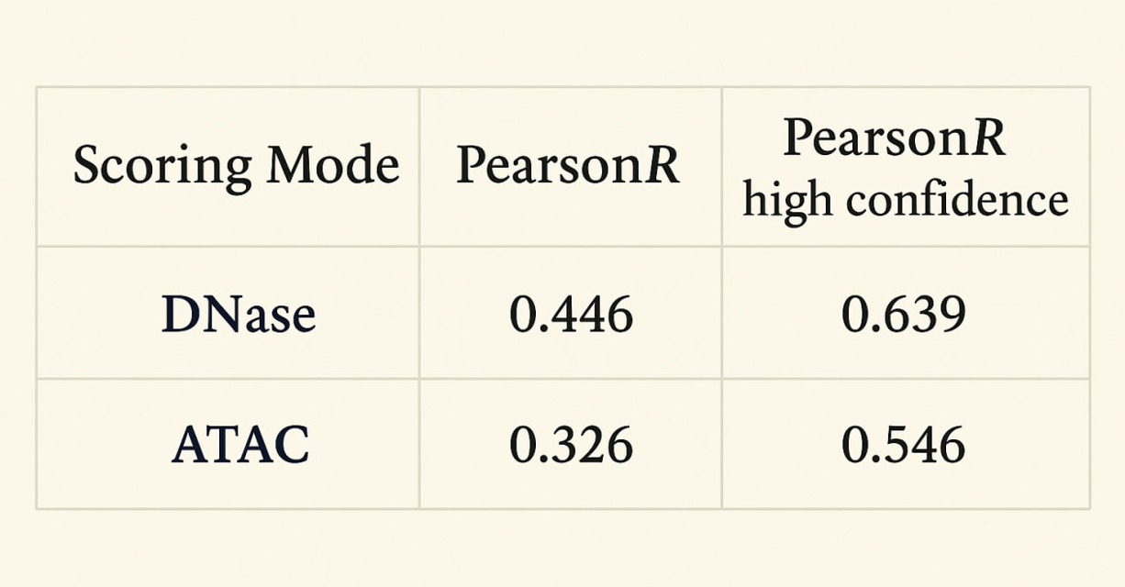
ChromBPNet (zero-shot)

Slide 15
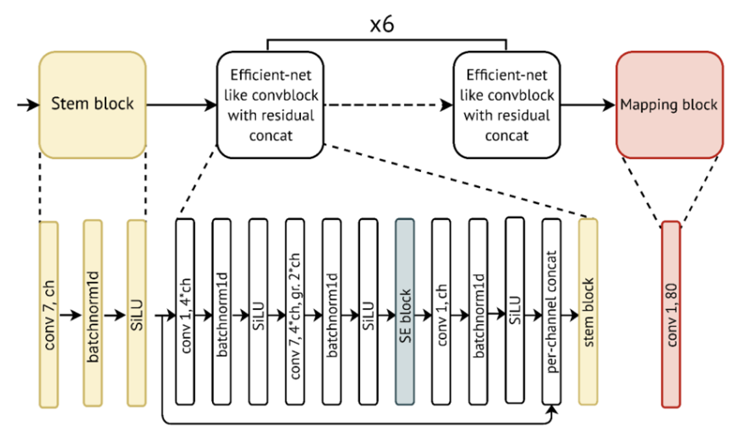
MPRA-LegNet

Slide 16
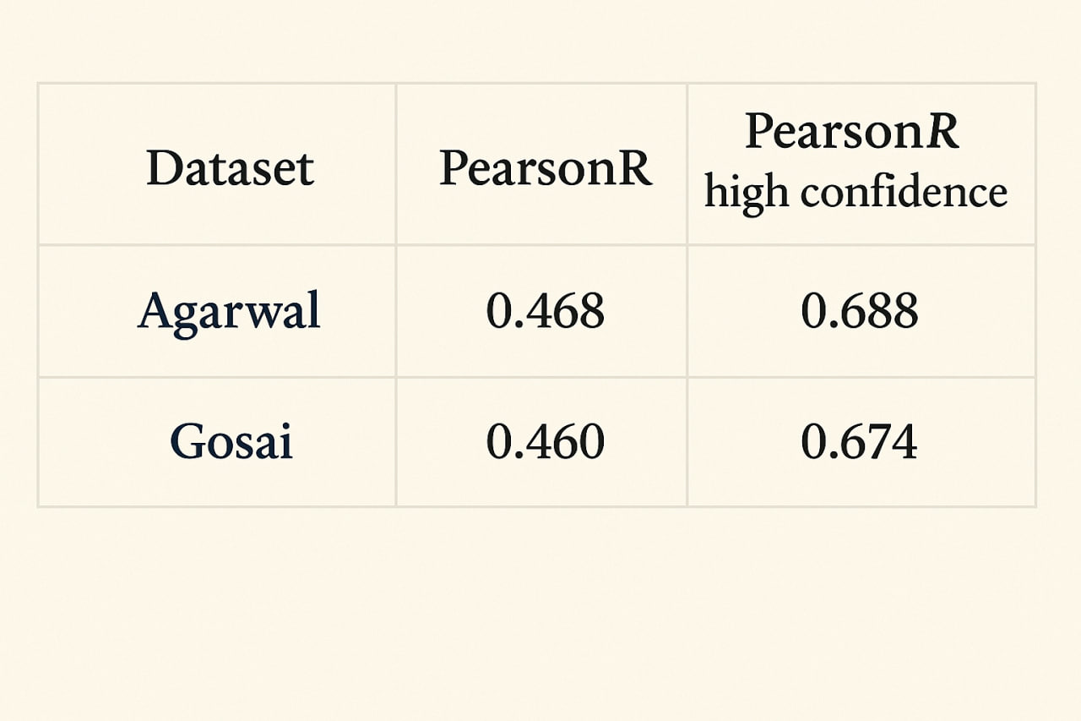
MPRA-LegNet (zero-shot)
Best scores – to use only HepG2 data

Slide 17
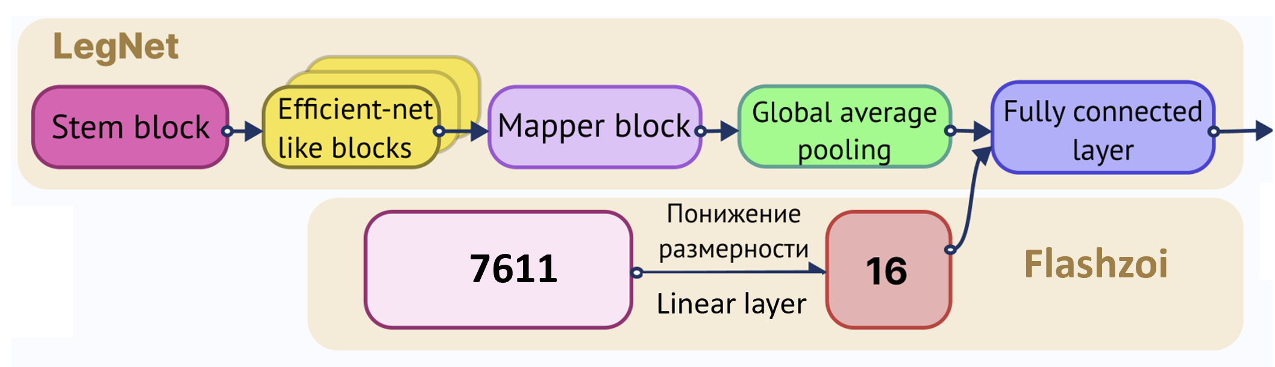
Legformer/Legzoi

Slide 18
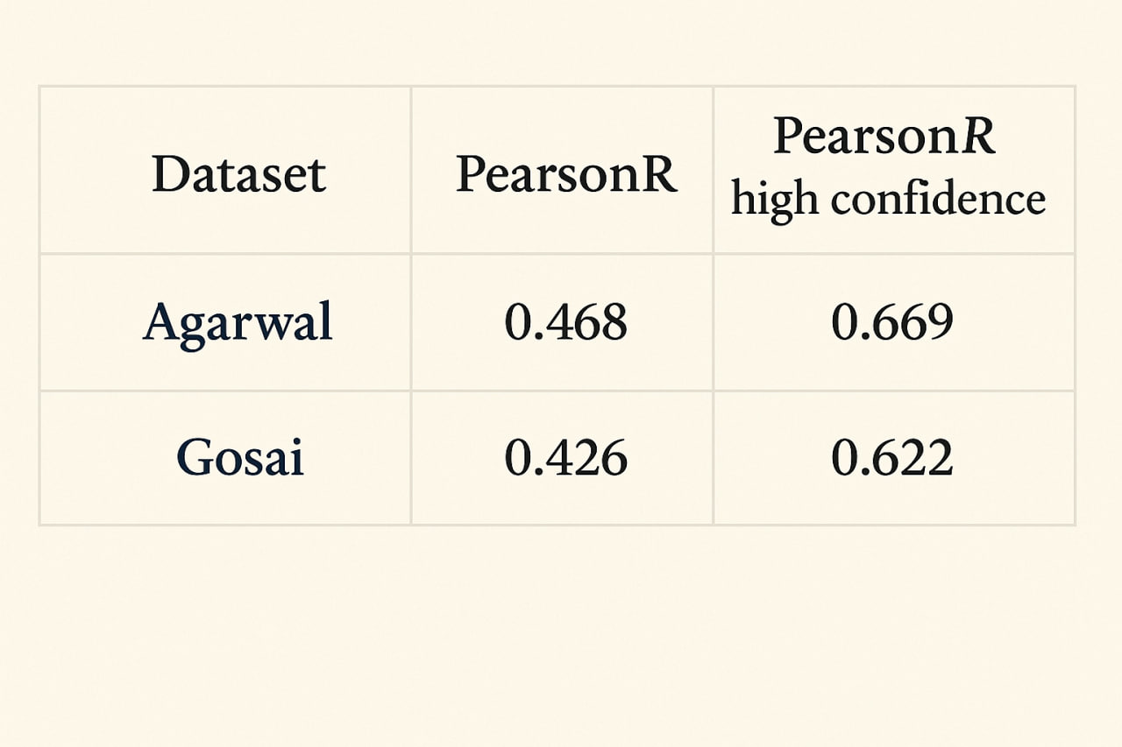
Legformer (zero-shot)
Worse than LegNet, but good as an additional feature

Slide 19
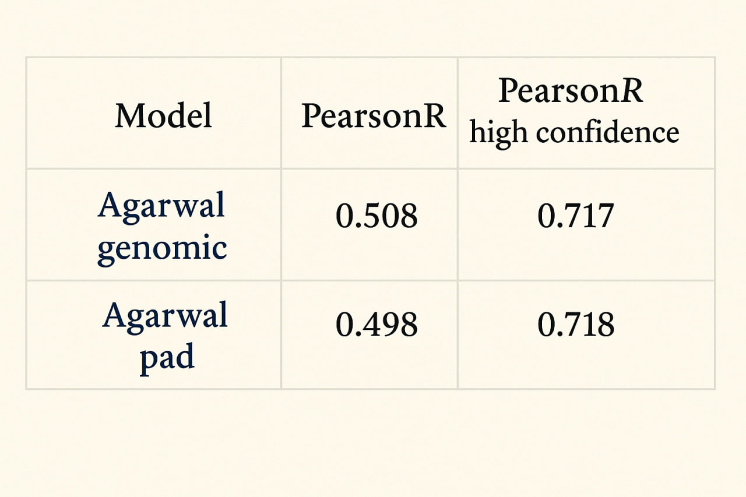
Legzoi (zero-shot)

Slide 20
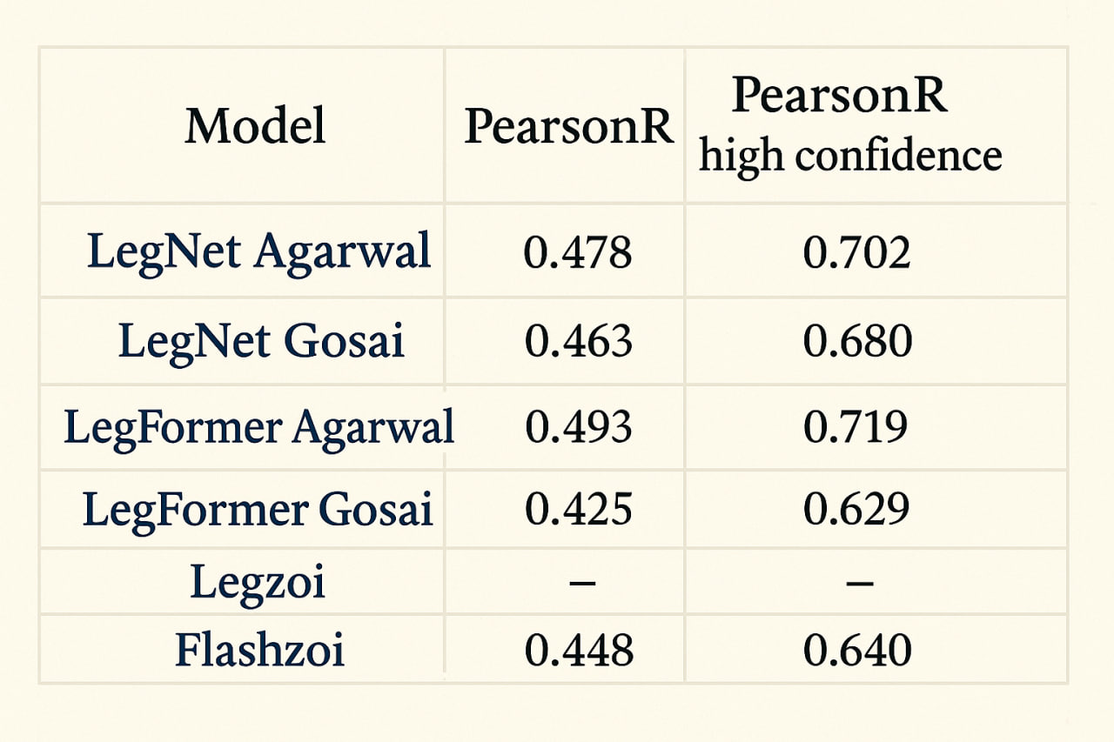
Shifting prediction window slightly (zero-shot)

Slide 21
Additional variants datasets
1. PromoterAI variants (Jaganathan et al)
2. CAGI5 (Kircher et al)
3. Griesemer et al
4. Patwardhan et al (CAGI5 small analogue)
5. Steensel et al
6. GNOMAD variants (chr 22, MAF > 0.01)

Slide 22
Additional variants datasets
1. PromoterAI variants (Jaganathan et al)
2. CAGI5 (Kircher et al)
3. Griesemer et al
4. Patwardhan et al (CAGI5 small analogue)
5. Steensel et al
6. GNOMAD variants (chr 22, MAF > 0.01)
Using none of them result in improved performance…
But GNOMAD scored with all models allows for a cool trick

Slide 23
Adjusting features

Slide 24
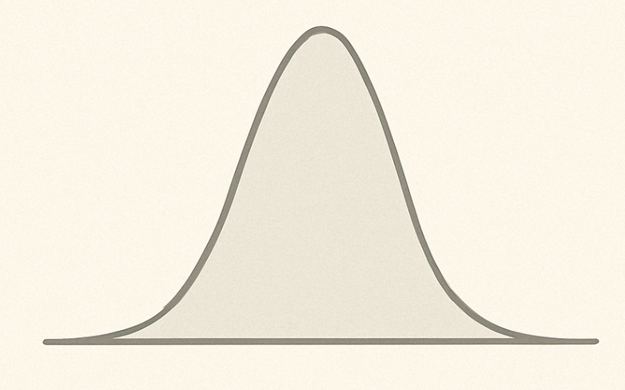
P-values for features
GNOMAD variants were selected in a way they should be neutral. So, for each feature we have distribution of the feature under H0 hypothesis. We can calculate p-value for each feature
0
Mutation feature
Feature distribution for GNOMAD mutation = H0 (no effect)

Slide 25
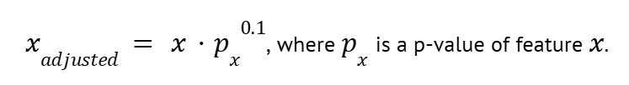
Adjusted features
It turns out that for high-confidence features the following transformation makes predictions (for high confidence values) better:

Slide 26
Accessing the confidence of predictions

Slide 27
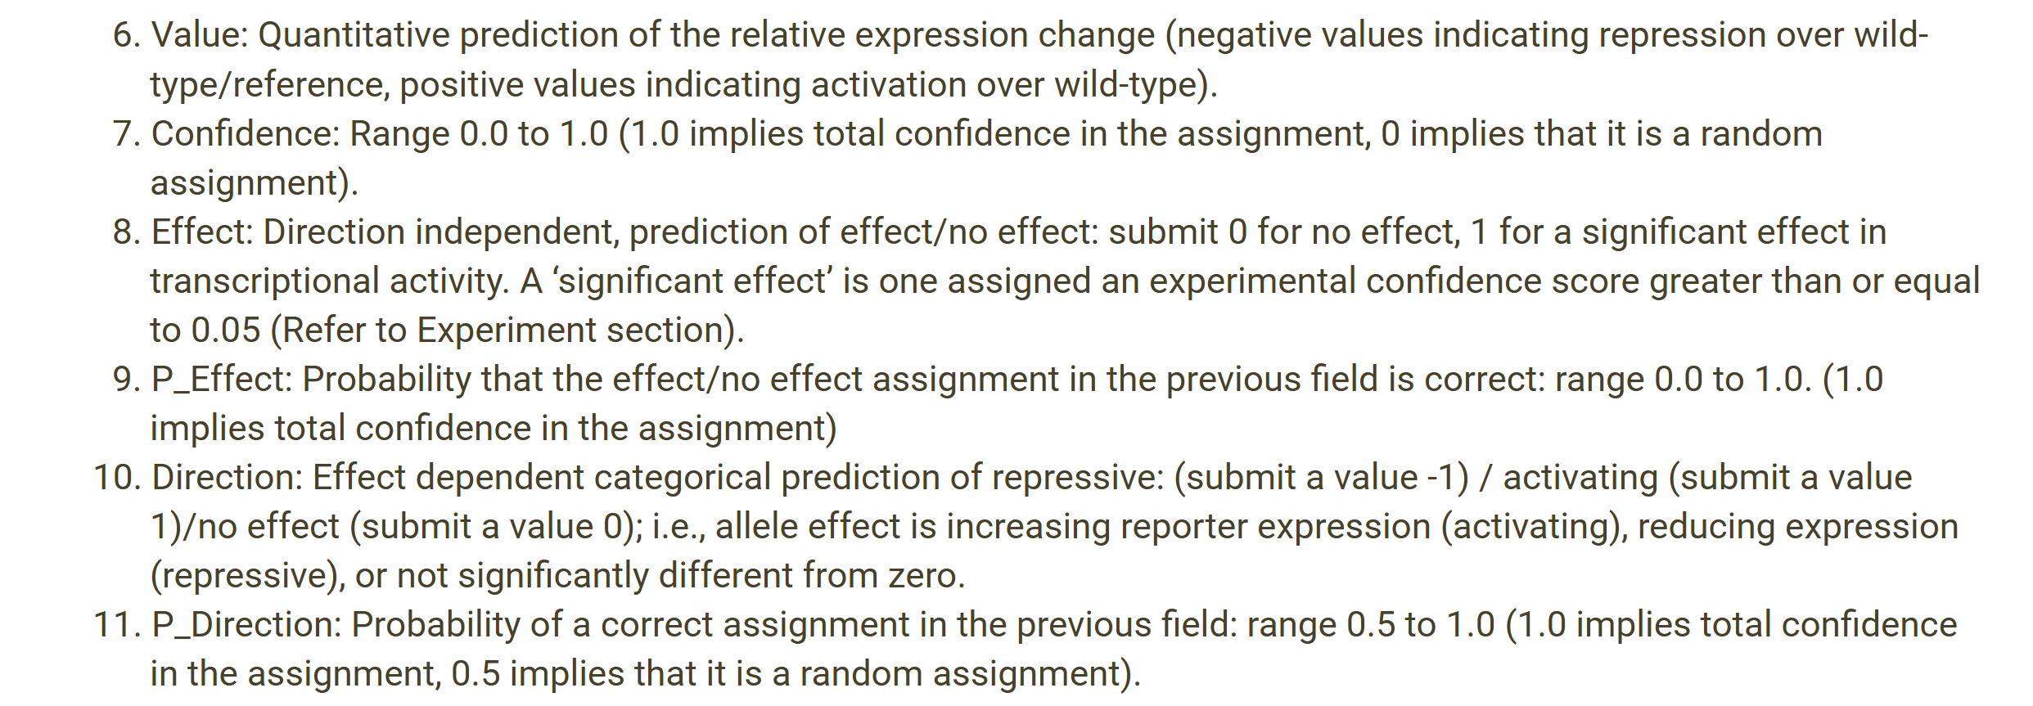
We asked not only to predict the effect of mutation, but
Classification works badly – there is no true positive/negative classes in the dataset,
only determined by Confidence

Slide 28
We asked not only to predict the effect of mutation, but
Is it possible to calculate the significance of mutation in other way?

Slide 29
P-values for final model predictions
GNOMAD variants were selected in a way they should be neutral. So, for each feature we have distribution of the feature under H0 hypothesis. We can predict for them using our final models and use these predictions as H0-distribution. After that, we just need to select thresholds for p-values.
0
Mutation effect
Linear model predictions distribution for GNOMAD mutation = H0 (no effect)

Slide 30
Conclusions
MPRA-based models perform better at assessing the effects of mutations in the challenge.
Genome-wide models also show strong performance on the same task.
Hybrid models that use MPRA data and whole-genome model embeddings as inputs could win the competition in a zero-shot fashion. It’s quite possible that than properly tuned, hybrid model like Legzoi will alone produce top-1 predictions
A linear combination of predictions from models trained on different data sources, combined with test-time augmentation, achieves the best performance.
Neither finetuning nor training neural networks or boosting models from scratch on the challenge data leads to any performance improvement.
Although the Asha model incorporates many features, it still permits rapid scoring of variant effects.

Slide 31
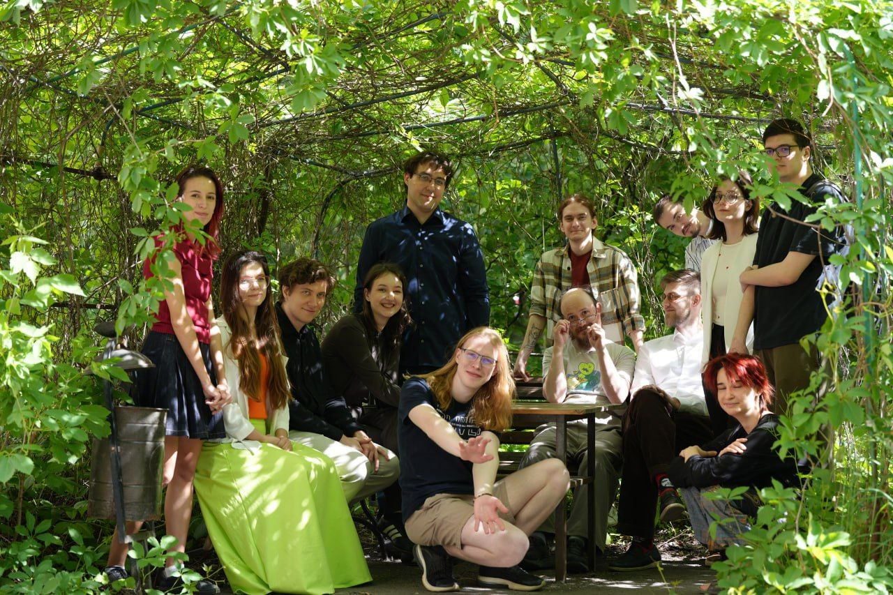




Computational Regulatory Genomics Lab (FBB MSU)
Alexei Vasilenko*
Eva
Zubova*
Nikita Gryzunov
Arsenii Zinkevich

Slide 32
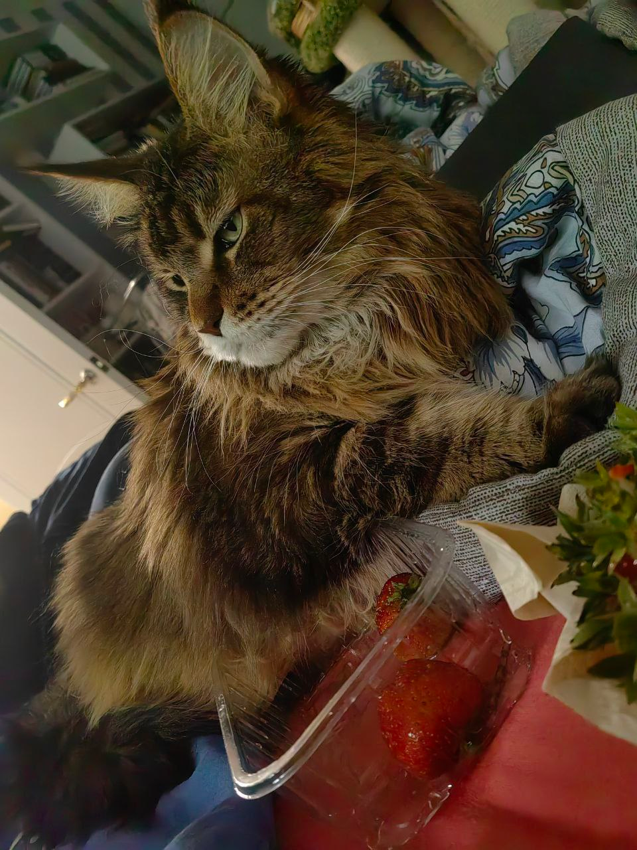

Two unregistered participants (they can’t, they have paws)

Slide 33
Additional slides

Slide 34
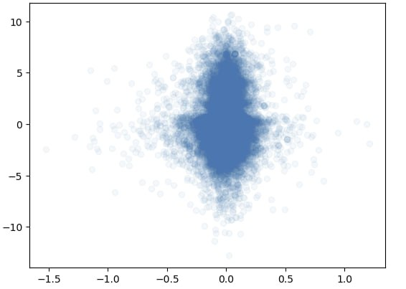
DNA-LM are still just a very expansive piece of garbage
Evo-2
GPN-STAR
….

