Slide 1

CAGI 7 slide pack guidelines
I agree to my slides being used according to the following terms:
_______Michael A Beer_______
Authors: please include THIS slide at the beginning of your presentation to indicate that you agree with reuse of your slides in CAGI presentations, according to the terms below, and digitally sign by writing your name above.
At CAGI 7, use of this slide pack is only required for CAGI dataset providers, assessors, and predictors, but all are encouraged to use the annotations for materials they do not want shared publicly.
To disseminate the CAGI results, I encourage all CAGI participants to remix these CAGI slides for inclusion in their oral and poster presentations
CAGI participants may use or publish any content of these slides only in compliance with the CAGI Data Use Agreement
CAGI participants may not cite or publish any content of these slides except with the written permission of the originating author or in the primary CAGI publications
CAGI participants must acknowledge the original authors of these slides and CAGI 7. Include the acknowledgement banner across the bottom
CAGI participants must include the CAGI credits slide in their presentations
Slides with a red slash (no remix) may not be included in a presentation unless all attendees are registered CAGI participants who signed the data use agreement
Slides with a red X over the entire slide may not be used in any circumstances
Slides with a blue slash (embargoed) may not be used unless the embargo is explicitly lifted
Slides without slash or X may be tweeted, tooted, posted, X’d unless flagged with “No tweet” icon
CAGI participants using these slides must explain the “No tweet” icon, which means that the slide content should not be disseminated outside the presenting conference hall. If the presentation venue permits pervasive tweeting, you may not include these slides in your talk
Note for slide authors: we expect all CAGI participants to abide by these restrictions, and will make best effort to ensure they are followed. However, but bear in mind that we have limited means of enforcing them, and therefore the restrictions cannot be guaranteed.

Slide 2
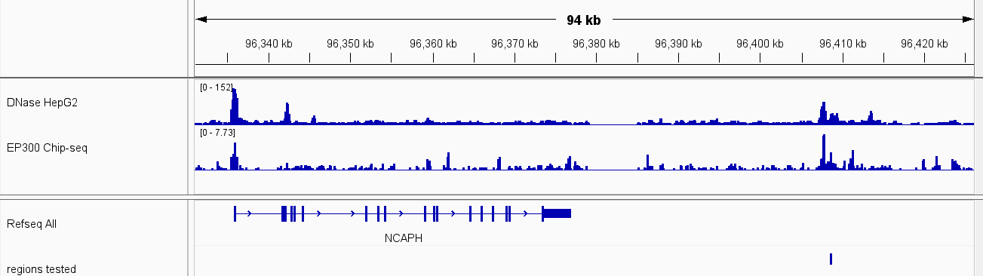
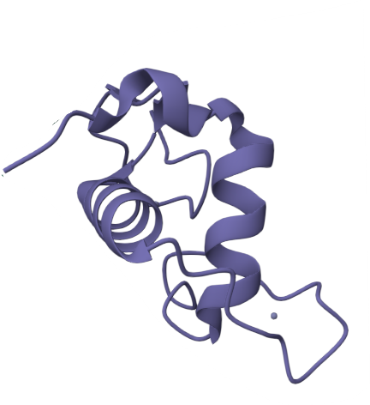
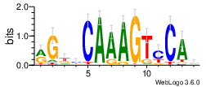

Goal: Predict Variants which Disrupt Enhancer Activity and Change Expression
chr2
HepG2 Dnase-seq
HepG2 p300
TF: HNF4A
…CAGCAAGGAGACAGGAGGCACAGCTCAAACTTCTCTCTCCAATTTGGGGTGTGGG… Ref
…CAGCAAGGAGACAGGAGGCACAGCTCAAAGTTCTCTCTCCAATTTGGGGTGTGGG… Alt
P(Ref)=0
P(Alt)=0.928
Created for CAGI 7
genomeinterpretation.org
Michael Beer

Slide 3
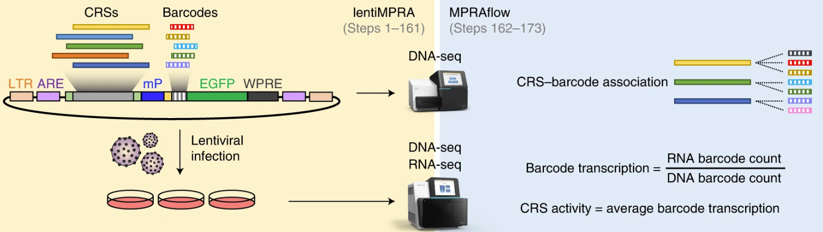
CAGI7 lentiMPRA Challenge Description and Model Evaluation Metrics Overview
Goal: predict the effect of genetic variants as measured using lentiMPRA. 90k SNVs were selected from the 1000 Genomes Project and flanking 200bp were tested in 3 HepG2 replicates. Each group was then given 25% of the data (variants on chromosomes 13,14,15,18,19,20,21,22) to train models on. Models were evaluated using the remaining 75% of the data.
3 predicted labels (Value = change in RNA/DNA induced by the SNV, Effect = binarized label, and Direction).
We used the following metrics to evaluate each group’s models:
Value: total Pearson R, total RMSE, Pearson R of top 1k variants by either experiment or prediction,
RMSE of top 1k variants by experiment/prediction
Effect (binary): Precision and recall
Effect/Direction from Value: auPRC
Nat Prot. 2020
Kircher Shendure Ahituv et al
Created for CAGI 7
genomeinterpretation.org
Michael Beer

Slide 4
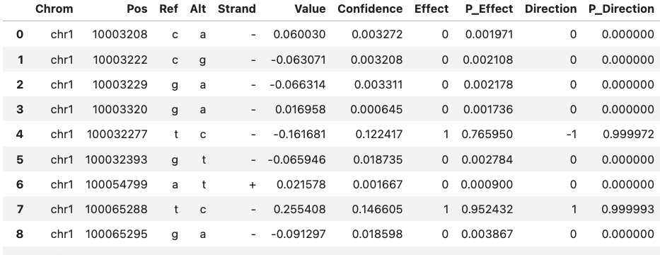
Challenge Description and Model Evaluation Metrics Overview
Predict effect of variants measured using lentiMPRA in HepG2
90,417 variants tested in MPRA on 200bp constructs
Participants given 20,162 training variants on chromosomes 13-15,18-22
Evaluation on remaining 70,255 variants
Predicted confidence fields (Confidence, P_Effect and P_Direction) were omitted from evaluation due to lack of consistent interpretations and descriptions
Evaluation Overview
Pearson R on test set variants (all or stratified by Value or predicted value)
RMSE on test set variants (all or stratified by Value or predicted value)
Precision-Recall auPRC of predicted Effect
Created for CAGI 7
genomeinterpretation.org
Michael Beer

Slide 5
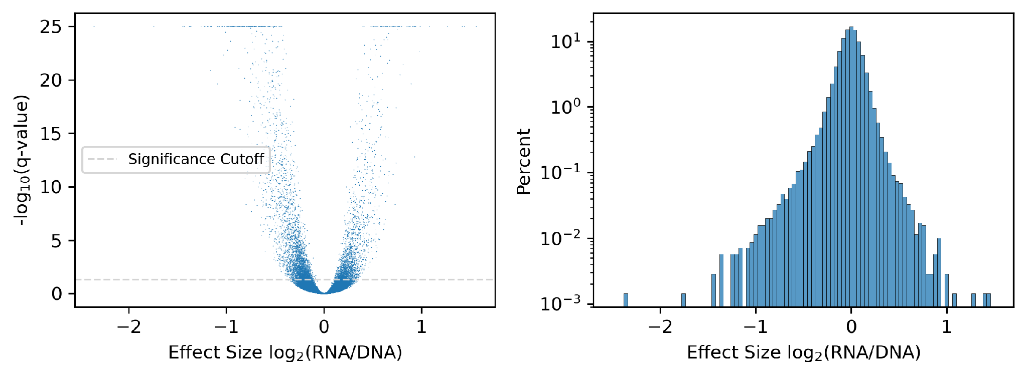
Reported Significance Cutoff
Effect Size = change in log2(RNA/DNA) Alt vs Ref
70,255 total test-set variants total
5904 variants have Effect = 1 (exceed experimental cutoff)
Most variants fall just above threshold and have very low expression change, but from data provided it is impossible to quantify the expression change
Created for CAGI 7
genomeinterpretation.org
Michael Beer

Slide 6
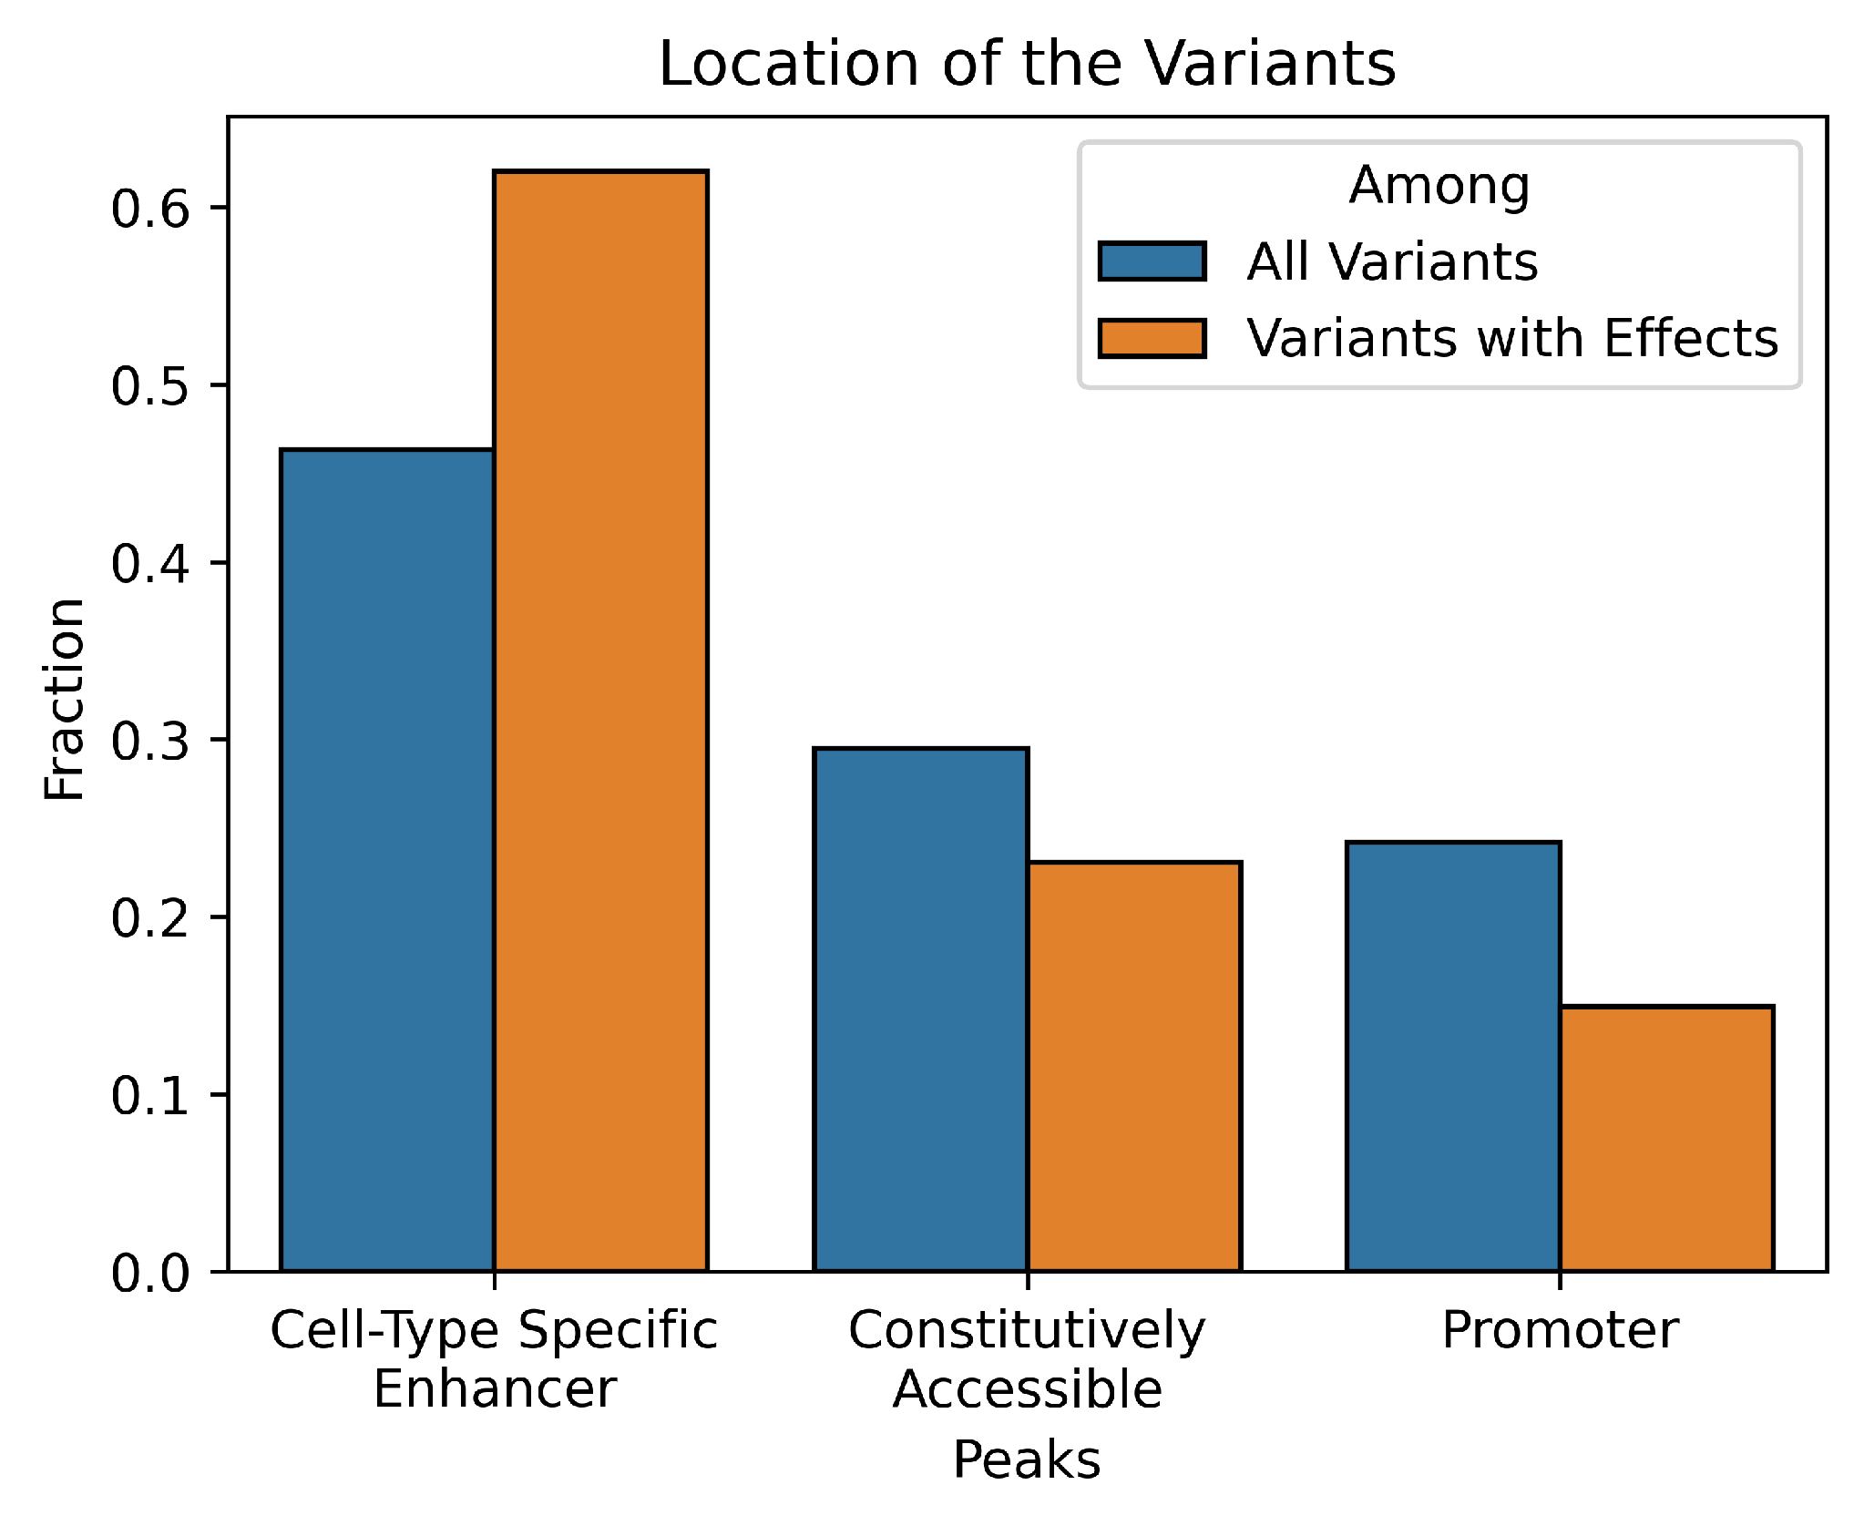
Majority of Variants with Effects are in Enhancers
Tested regions from DNase-seq HepG2 peaks
Most of 70,255 test-set SNVs in enhancers.
Some in constitutive peaks (CTCF) and promoters
Variants with measured effects enriched more strongly in enhancers
Depleted in constitutive peaks and promoters
Created for CAGI 7
genomeinterpretation.org
Michael Beer

Slide 7
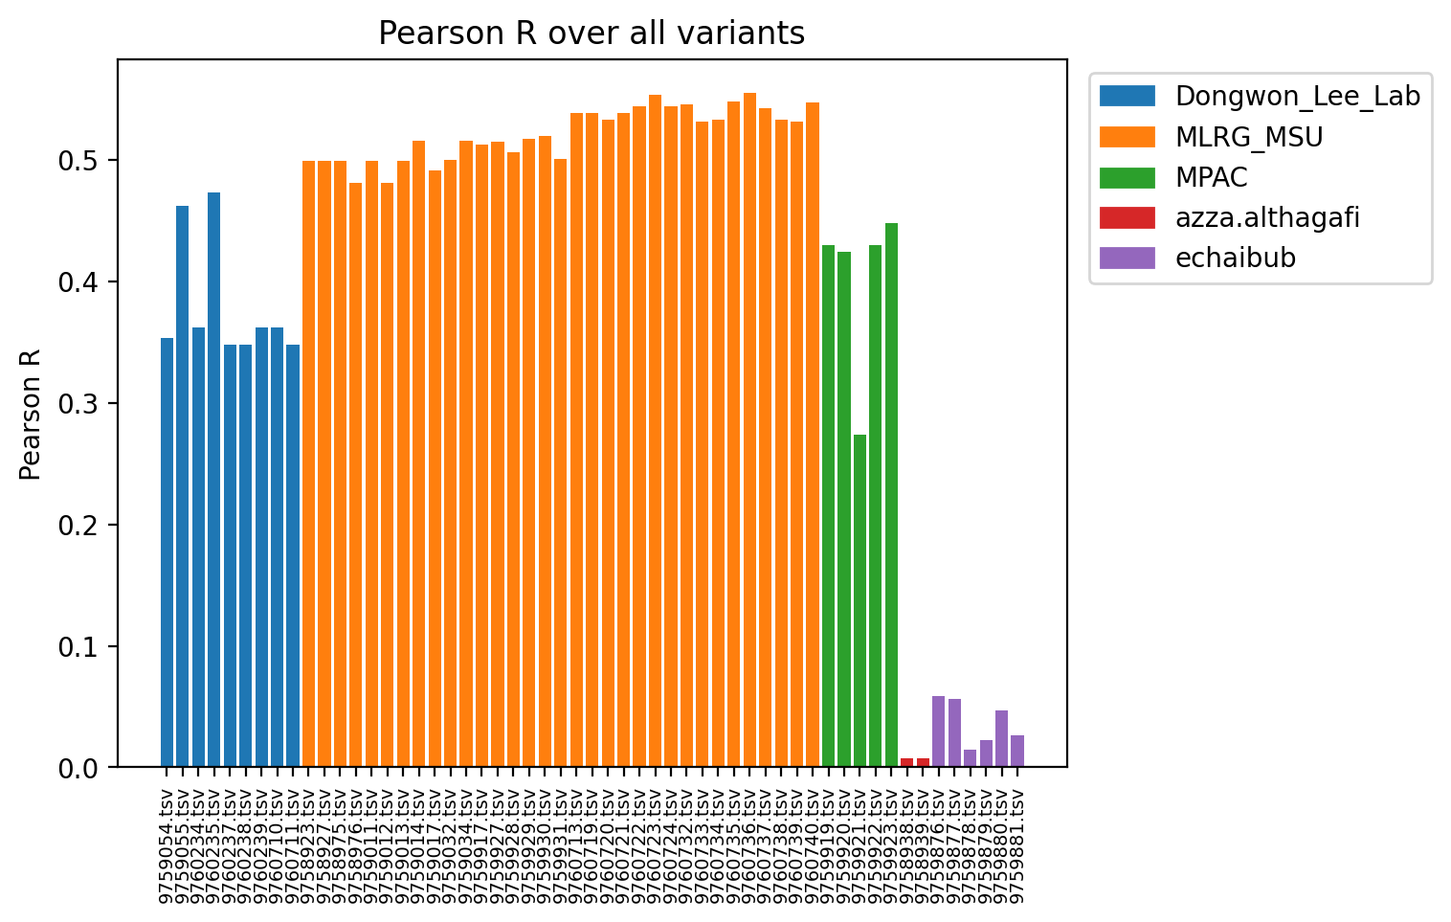
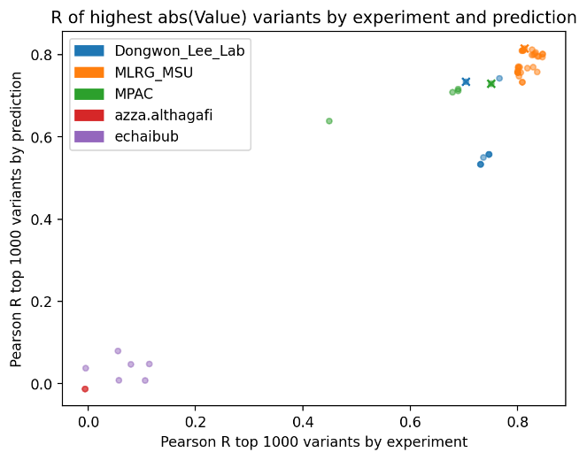
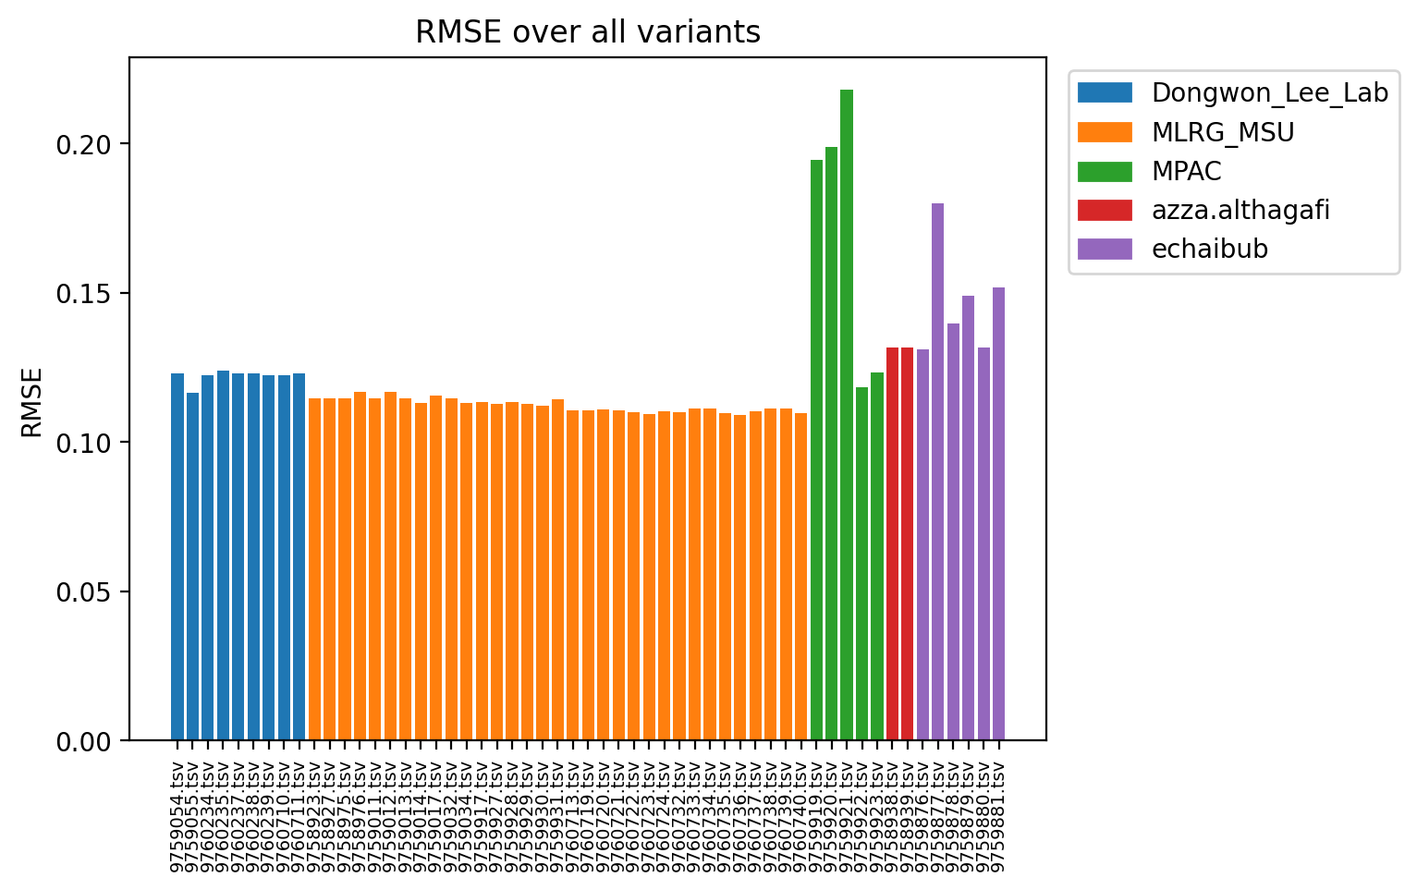
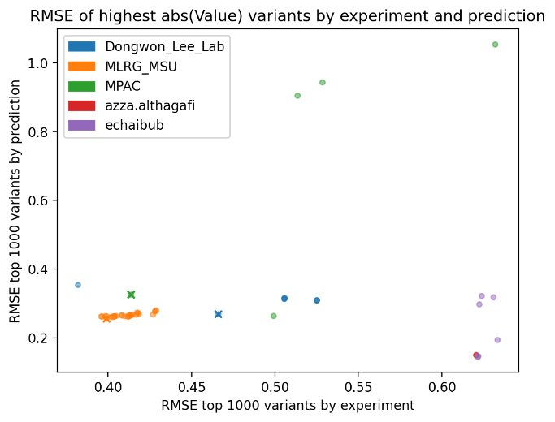
Evaluation on Variant Effect Value Prediction
Created for CAGI 7
genomeinterpretation.org
Michael Beer

Slide 8
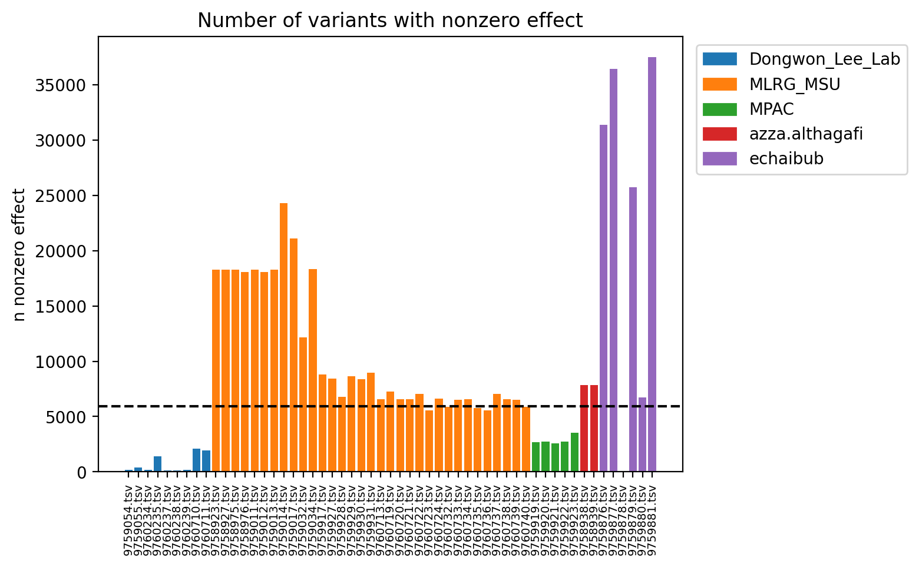
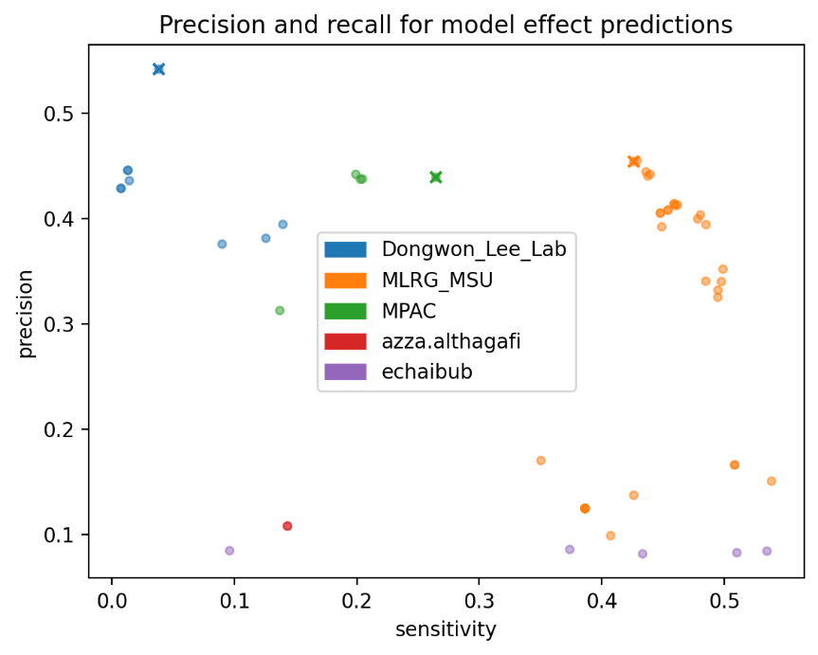
Evaluation on Variant Boolean Effect Prediction
Black dashed line is experimental threshold for number of variants with Effect=1
Models predicted varying number of positive binary effect variants (more and less conservative models)
The effect prediction (0 or 1 for each variant) was evaluated for precision and recall
MSU lab models had the best combination of precision and sensitivity, although Lee and MPAC labs were able to identify a small subset of high effect variants with high precision
Created for CAGI 7
genomeinterpretation.org
Michael Beer

Slide 9
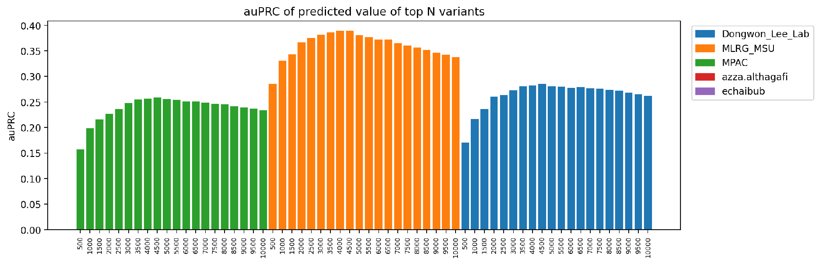
Changing Effect=1 Threshold of Measured Signal and Calculating auPRC
(right) normalized auPRC (auPRC-baseline) / (1-baseline) peaks at around 4500 and decreases as baseline increases
Peak performance at N=4500 somewhat below experimental choice of N=5891
Although reported recall for these 3 groups is quite different, auPRC over baseline is much more similar: 0.25-0.38
Created for CAGI 7
genomeinterpretation.org
Michael Beer

Slide 10
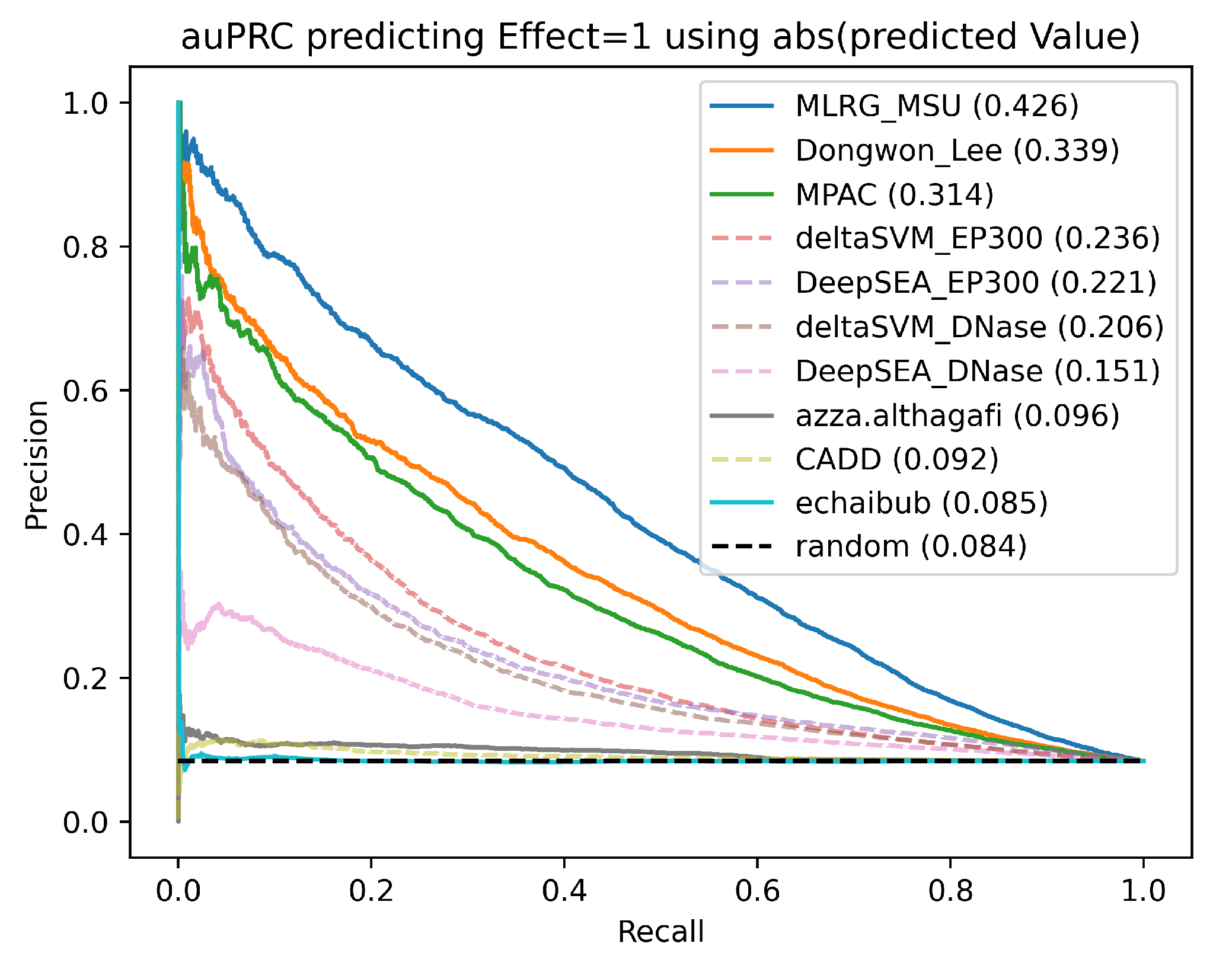
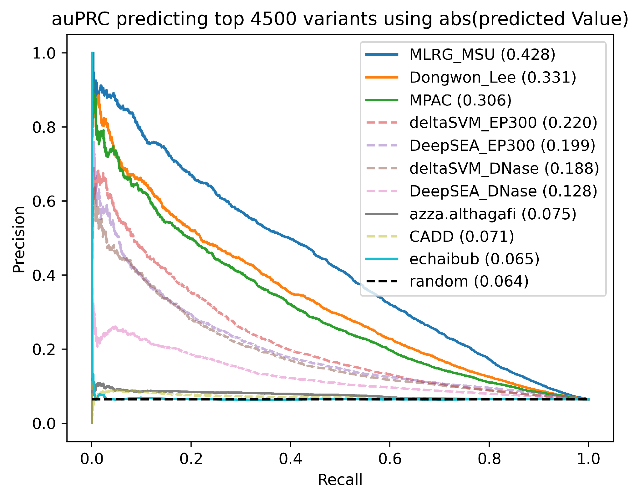
Variant Effect Predictions Significantly Outperform Benchmark Methods
3 of 5 models outperform best benchmarks
N=5904
N=4500
Benchmark ML models (DeepSEA, gkm-SVM) trained on P300, DHS, ATAC outperform CADD
Performance comparable to CAGI 5, but these are common (much weaker) variants
Are we learning new biology or learning the assay?
Created for CAGI 7
genomeinterpretation.org
Michael Beer

Slide 11
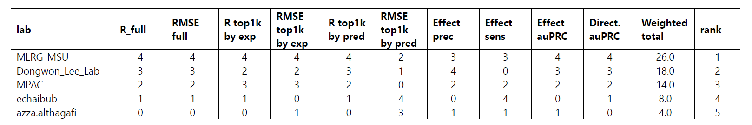
Prediction Ranking
Rank groups by each metric (4-best, 0-worst)
Weighted metrics by importance. R_full, RMSE_full, effect_auPRC and direction auPRC (wt 1), other metrics (wt 0.5)
Calculated weighted score for the best model from each group.
Rankings don’t change with equal weighting of each metric
Clear gap between top 3 and other 2
Ranking is: 1. MLRG_MSU, 2. Dongwon_Lee_Lab, 3. MPAC, 4. echaibub, 5. azza.althagafi
Created for CAGI 7
genomeinterpretation.org
Michael Beer

Slide 12
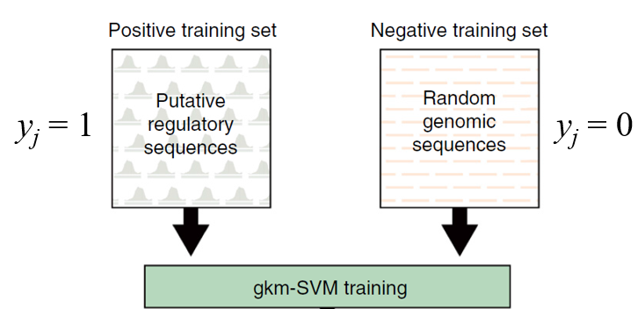
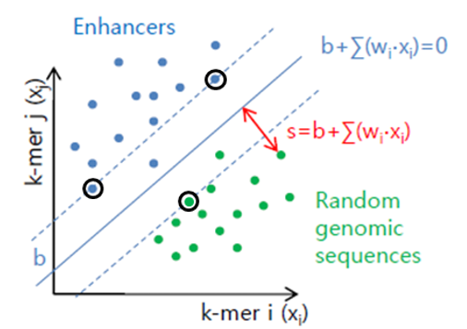
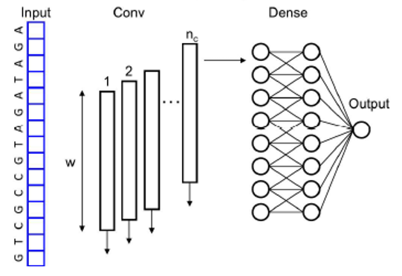
Using Baseline Methods to Evaluate Features Learned by each Model
DeepSea and gkm-SVM train on cell-type specific chromatin state or TF bound peaks
DeepSea:
Both train models to predict each cell-specific set of peaks:
DHS in HepG2
p300 binding HepG2
gkm-SVM 2014, DeepSEA 2015
Created for CAGI 7
genomeinterpretation.org
Michael Beer

Slide 13
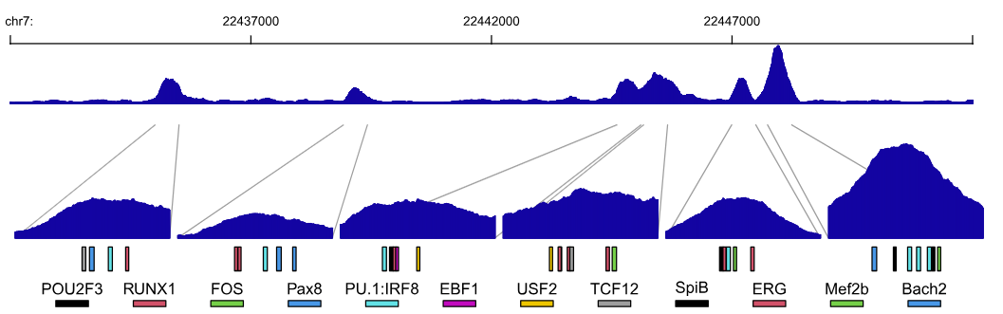
Beer Lab ENCODE 4 Trained Models
gkm-SVM models identified regulatory programs from ENCODE DHS/ATAC/TF ChIP-seq datasets
All 4720 models made public on ENCODE portal Sept 2021: www.encodeproject.org
ATAC/DHS trained models reveal general regulatory principles, making very few assumptions
Consistently high predictive power (AUROC>0.9) and consistent regulatory complexity (5-10 core TFs / cell-tissue) Similar cell types activate TFs and identify similar TF features
very few novel TFs (TFBS database coverage pretty good), but refinements of TF models quantitatively important
3 classes of TF vocabulary:
  promoter, CTCF, distal enhancer (many types ~200)
Predict binding sites to interpret CRISPR and MPRA
Created for CAGI 7
genomeinterpretation.org
Michael Beer

Slide 14
Using Baseline Methods to Evaluate Features Learned by each Model
p300 gkm-SVM
p300 DeepSEA
DNase-seq gkm-SVM
DNase-seq DeepSEA
Best baseline models trained on different peaks and learn slightly different features
Created for CAGI 7
genomeinterpretation.org
Michael Beer

Slide 15
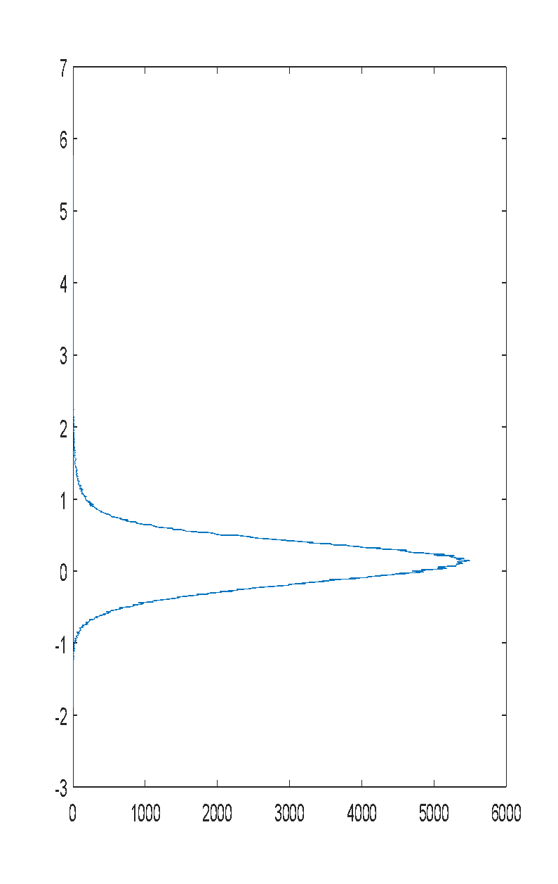
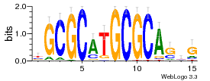
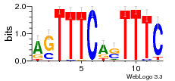
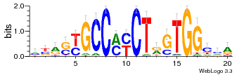
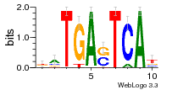
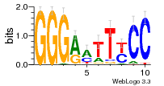
gkm-SVM/DeepSEA Weights Encode Co-factor TFs Required to Predict Cell-specific Binding
lymphoblasts:
positive regulatory activity
gapped kmer rev comp weight
---TGA-TCA TGA-TCA--- 3.9077
--TGA-TCA- -TGA-TCA-- 3.8894
CA--AG--GG CC--CT--TG 3.1542
C--CT--TGG CCA--AG--G 3.0112
CC-C--G-GG CC-C--G-GG 2.8744
CC---AG-GG CC-CT---GG 2.7722
GGG----CCC GGG----CCC 2.6648
--ATGA-T-A T-A-TCAT-- 2.5223
-ATGA-T-A- -T-A-TCAT- 2.4859
--T-A-TCAT ATGA-T-A-- 2.4789
GG--A--CCC GGG--T--CC 2.4532
GG---TT-CC GG-AA---CC 2.4359
CAC--G--GG CC--C--GTG 2.3986
GG-A---CCC GGG---T-CC 2.3864
...
...
CC-C--CC-C G-GG--G-GG -1.7710
CC---GCC-C G-GGC---GG -1.8183
CCC-C--C-C G-G--G-GGG -1.8376
CCCCC----C G----GGGGG -1.9243
CC-C---CCC GGG---G-GG -1.9663
negative regulatory activity
NRF1
IRF2
CTCF
BATF
NFκB
Distribution of ~ 1,000,000 gapped kmer weights
Created for CAGI 7
genomeinterpretation.org
Michael Beer

Slide 16
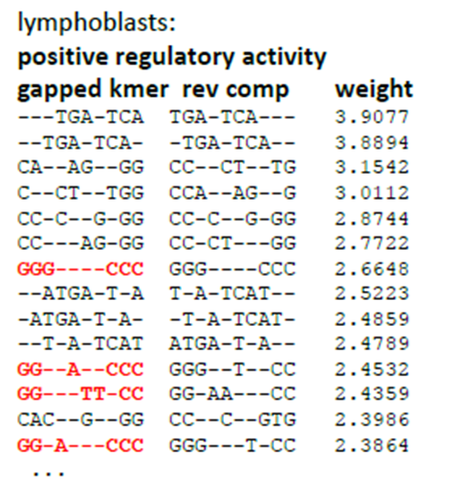
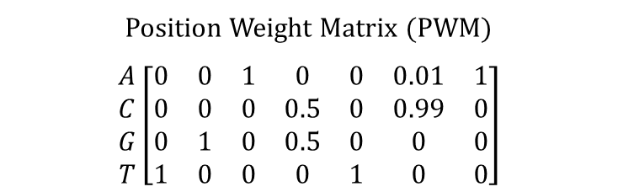

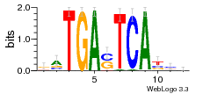
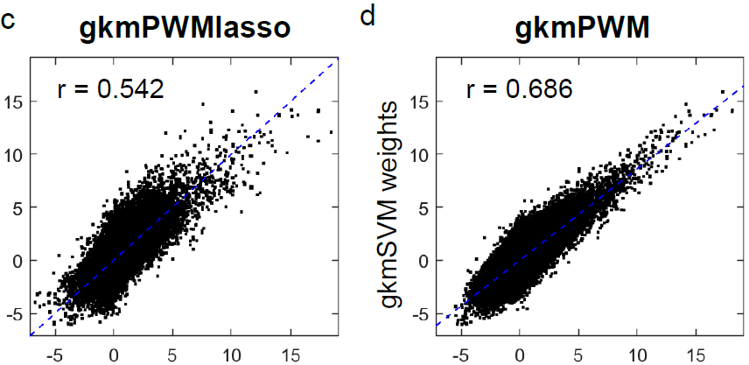
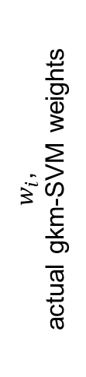
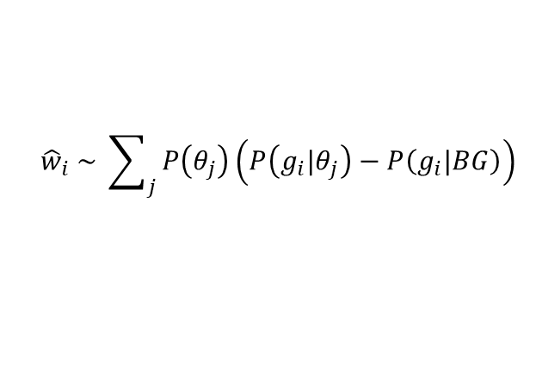
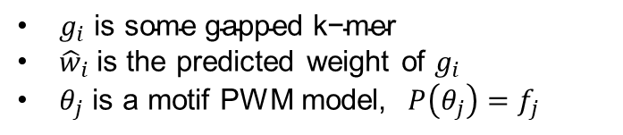

gkmPWM Method to Extract TFBS from Weight Distribution
~2,000,000 gapped kmers
D. Shigaki
Use pre-existing PWMs to extract --or-- generate de novo motifs minimizing error
Created for CAGI 7
genomeinterpretation.org
Michael Beer

Slide 17
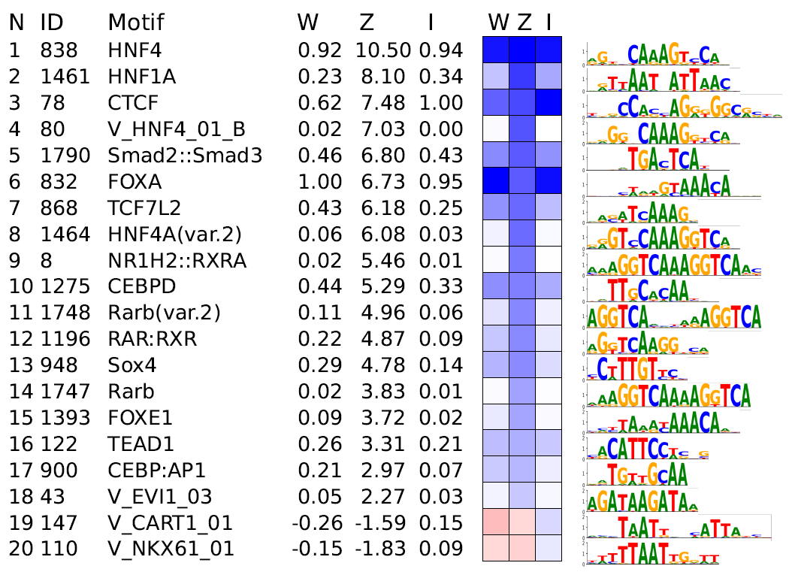
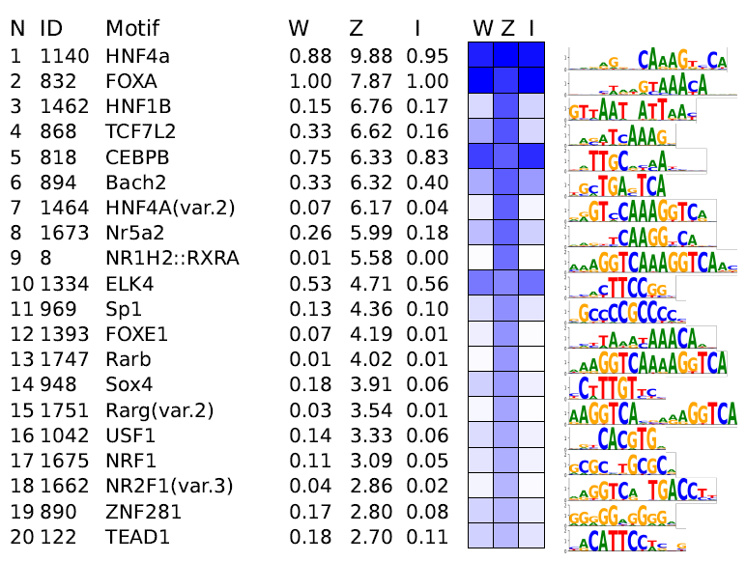
Motifs Learned from Models Trained on HepG2 DHS and EP300
Motifs from DNase-seq gkm-SVM
Motifs from EP300 ChIP-seq gkm-SVM
All with known activity in HepG2 (liver)
CTCF and SP1 most notable differences between DNase and p300
Created for CAGI 7
genomeinterpretation.org
Michael Beer

Slide 18
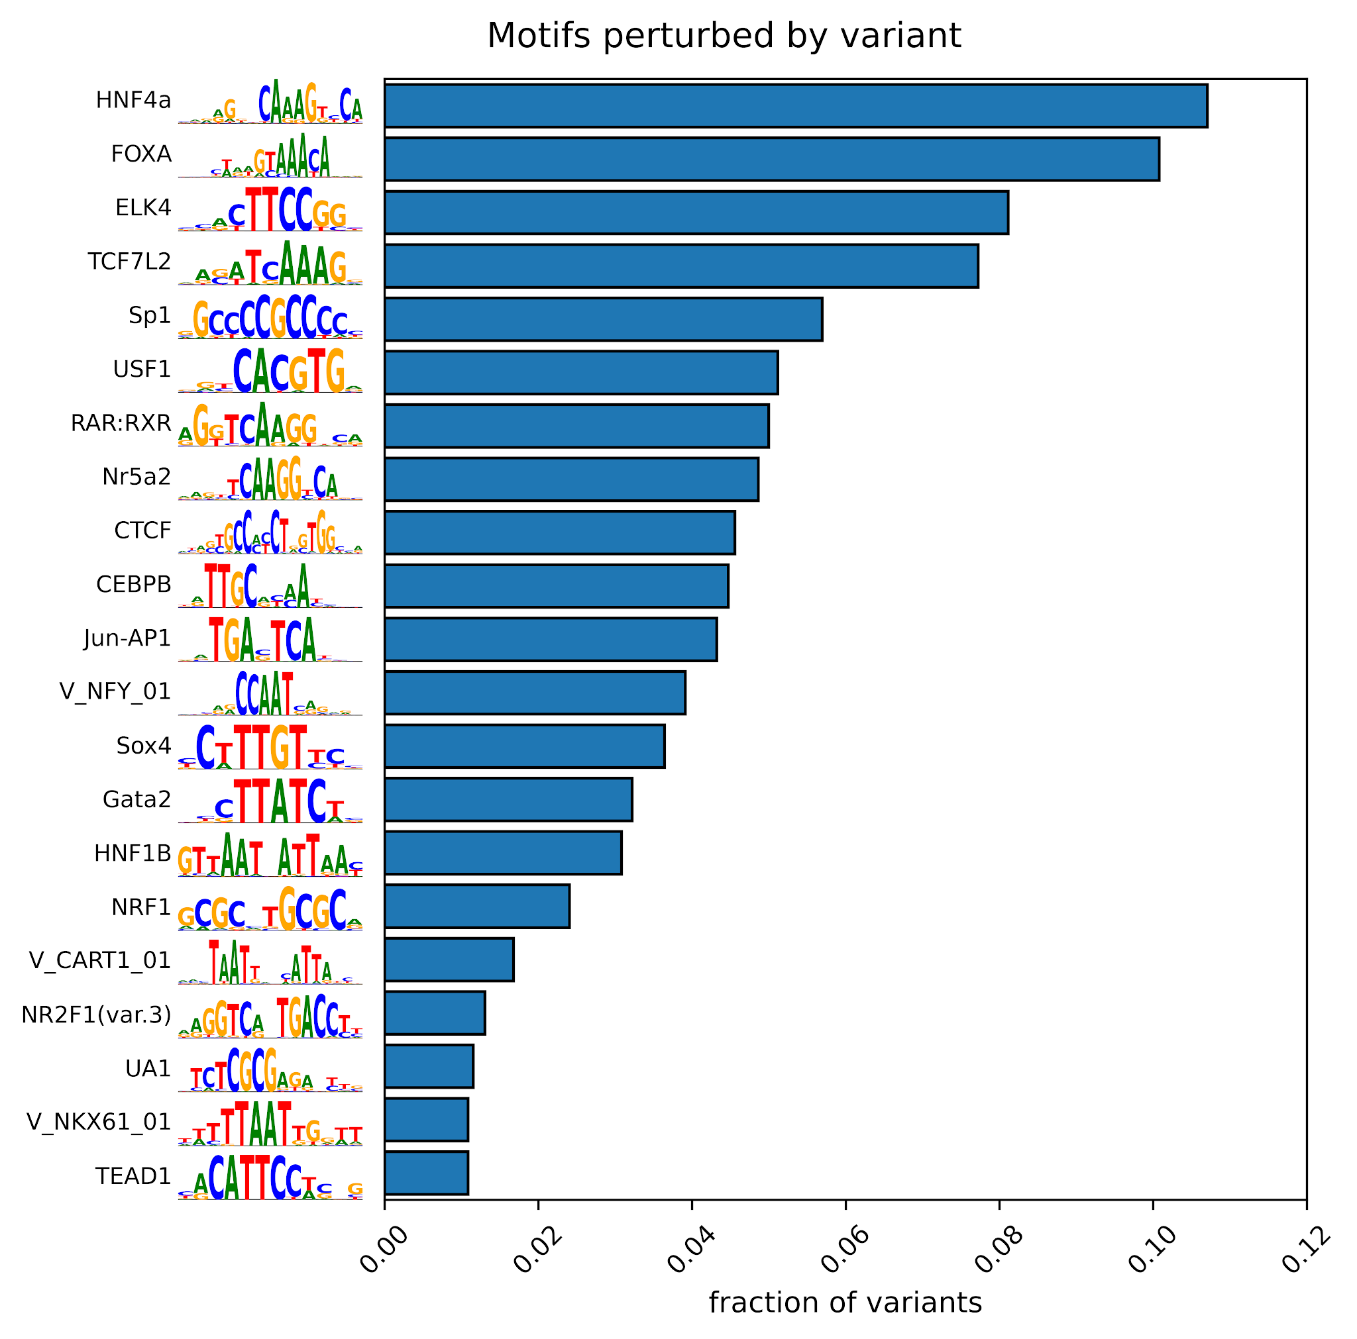
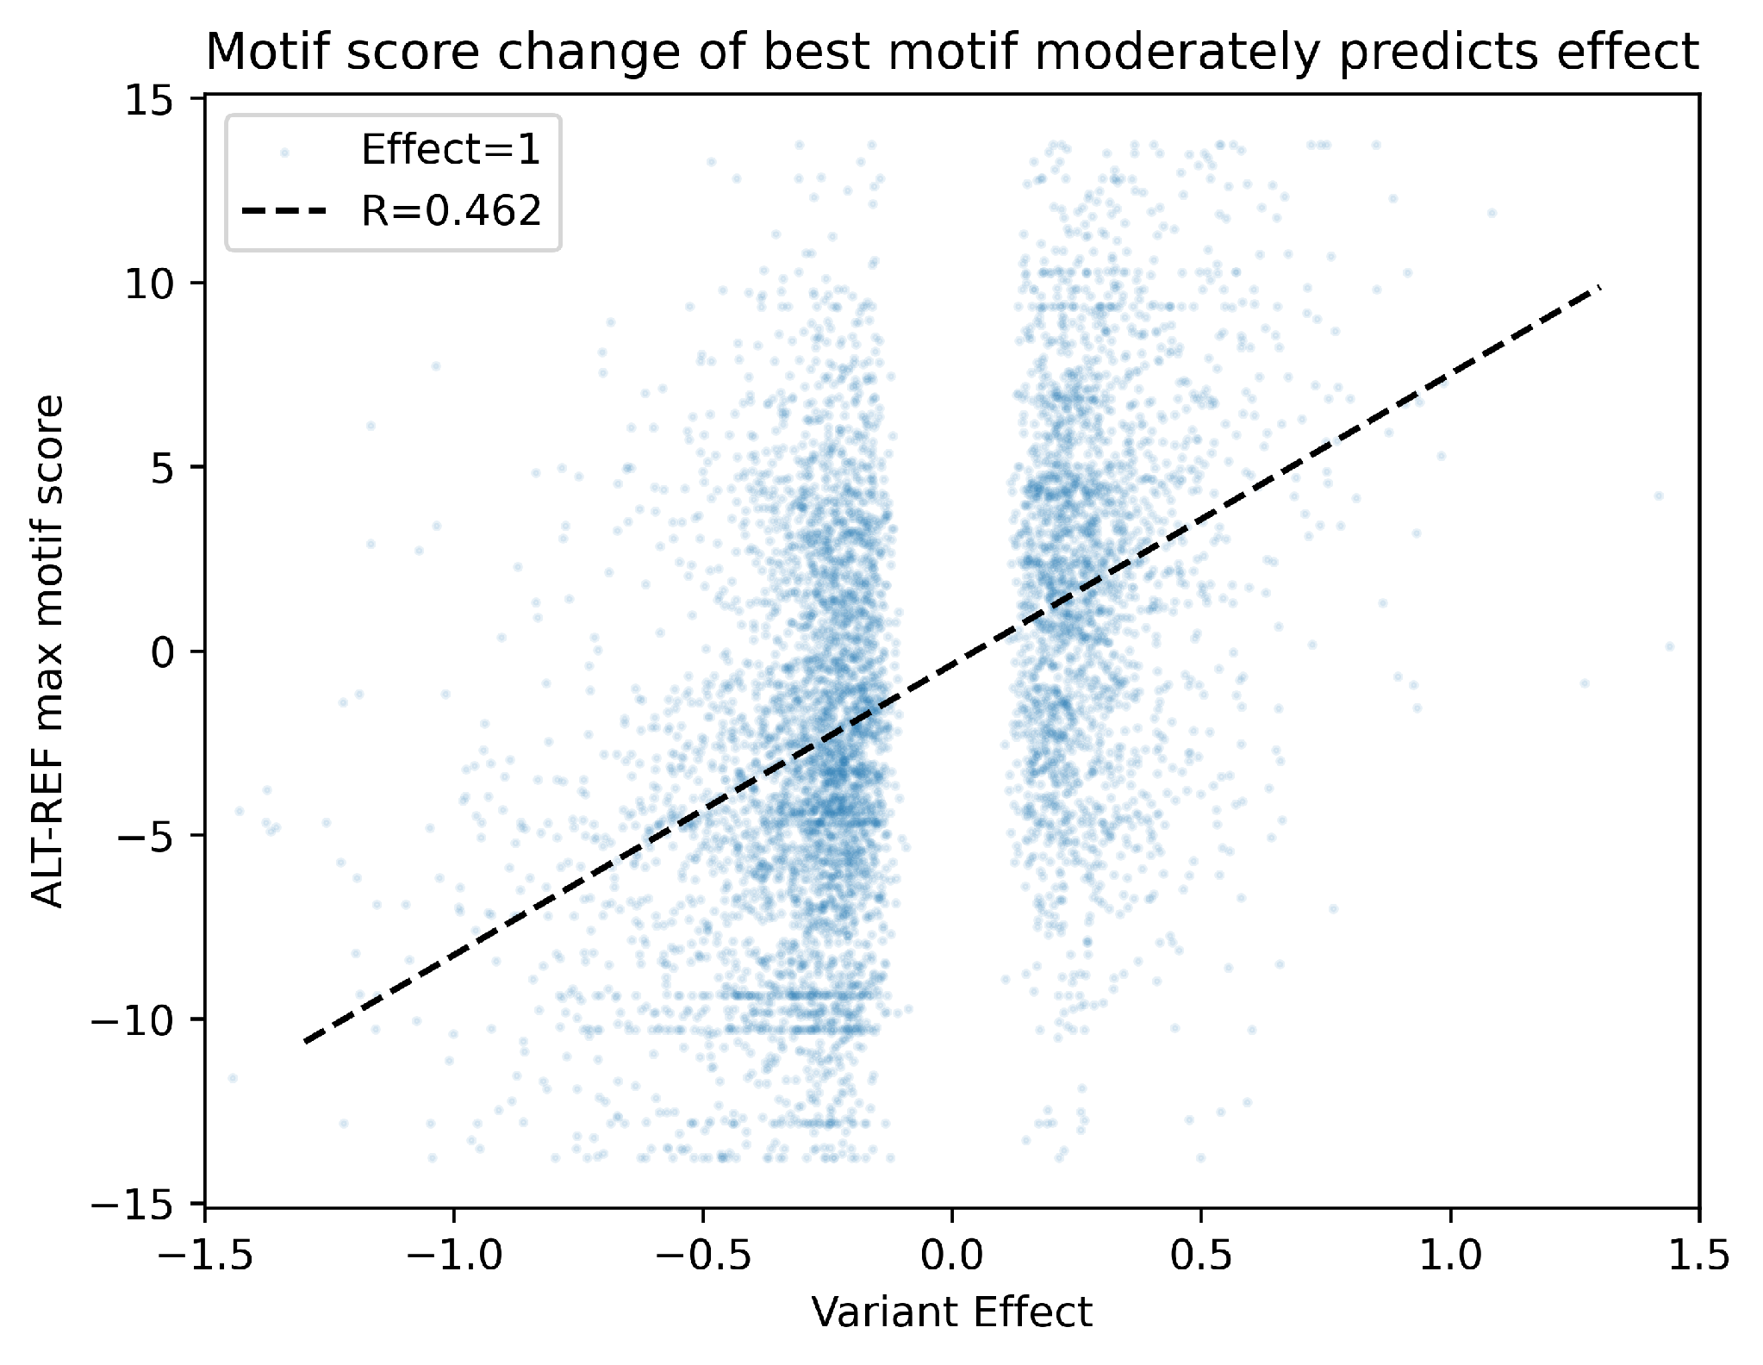
Single Motif Disruption Correlates With Variant Effect
Most Variants disrupt TFBS motifs learned gkm-SVM
Change in motif score induced by the variant correlates somewhat with Effect (Corr=0.462)
Created for CAGI 7
genomeinterpretation.org
Michael Beer

Slide 19
Modeling Strategies shared Amongst Different Teams
 |  | MLRG_MSU | Dongwon_Lee_Lab | MPAC | echaibub | azza.althagafi
METHODOLOGIES | Convolutional Neural Network
 | Random Forest
 | 1-hot encoded DNA
 | 200 bp window
 | Ensembling
 | Data augmentation
 | Transfer learning
ADDITIONAL FEATURES | External MPRA (LegNet)
 | DNase/ATAC-seq
 | ChIP-seq
 | Motif scanning
 | Genomic location
Created for CAGI 7
genomeinterpretation.org
Michael Beer

Slide 20
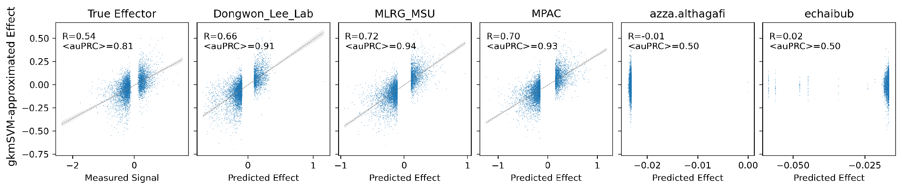
gkmSVM can Well-Approximate Other Models’ Predicted Effects
Trained linear gkmSVM to approximate the measured signals or scores predicted by models
The positive peak set consists of the allele with the higher MPRA readout.
The models were ensembles of 5-fold chromosomal split, and the shown approximated effect were calculated from when variants fall in test folds
gkmSVM’s predicted score are highly correlated with submitted models’ scores
Created for CAGI 7
genomeinterpretation.org
Michael Beer

Slide 21
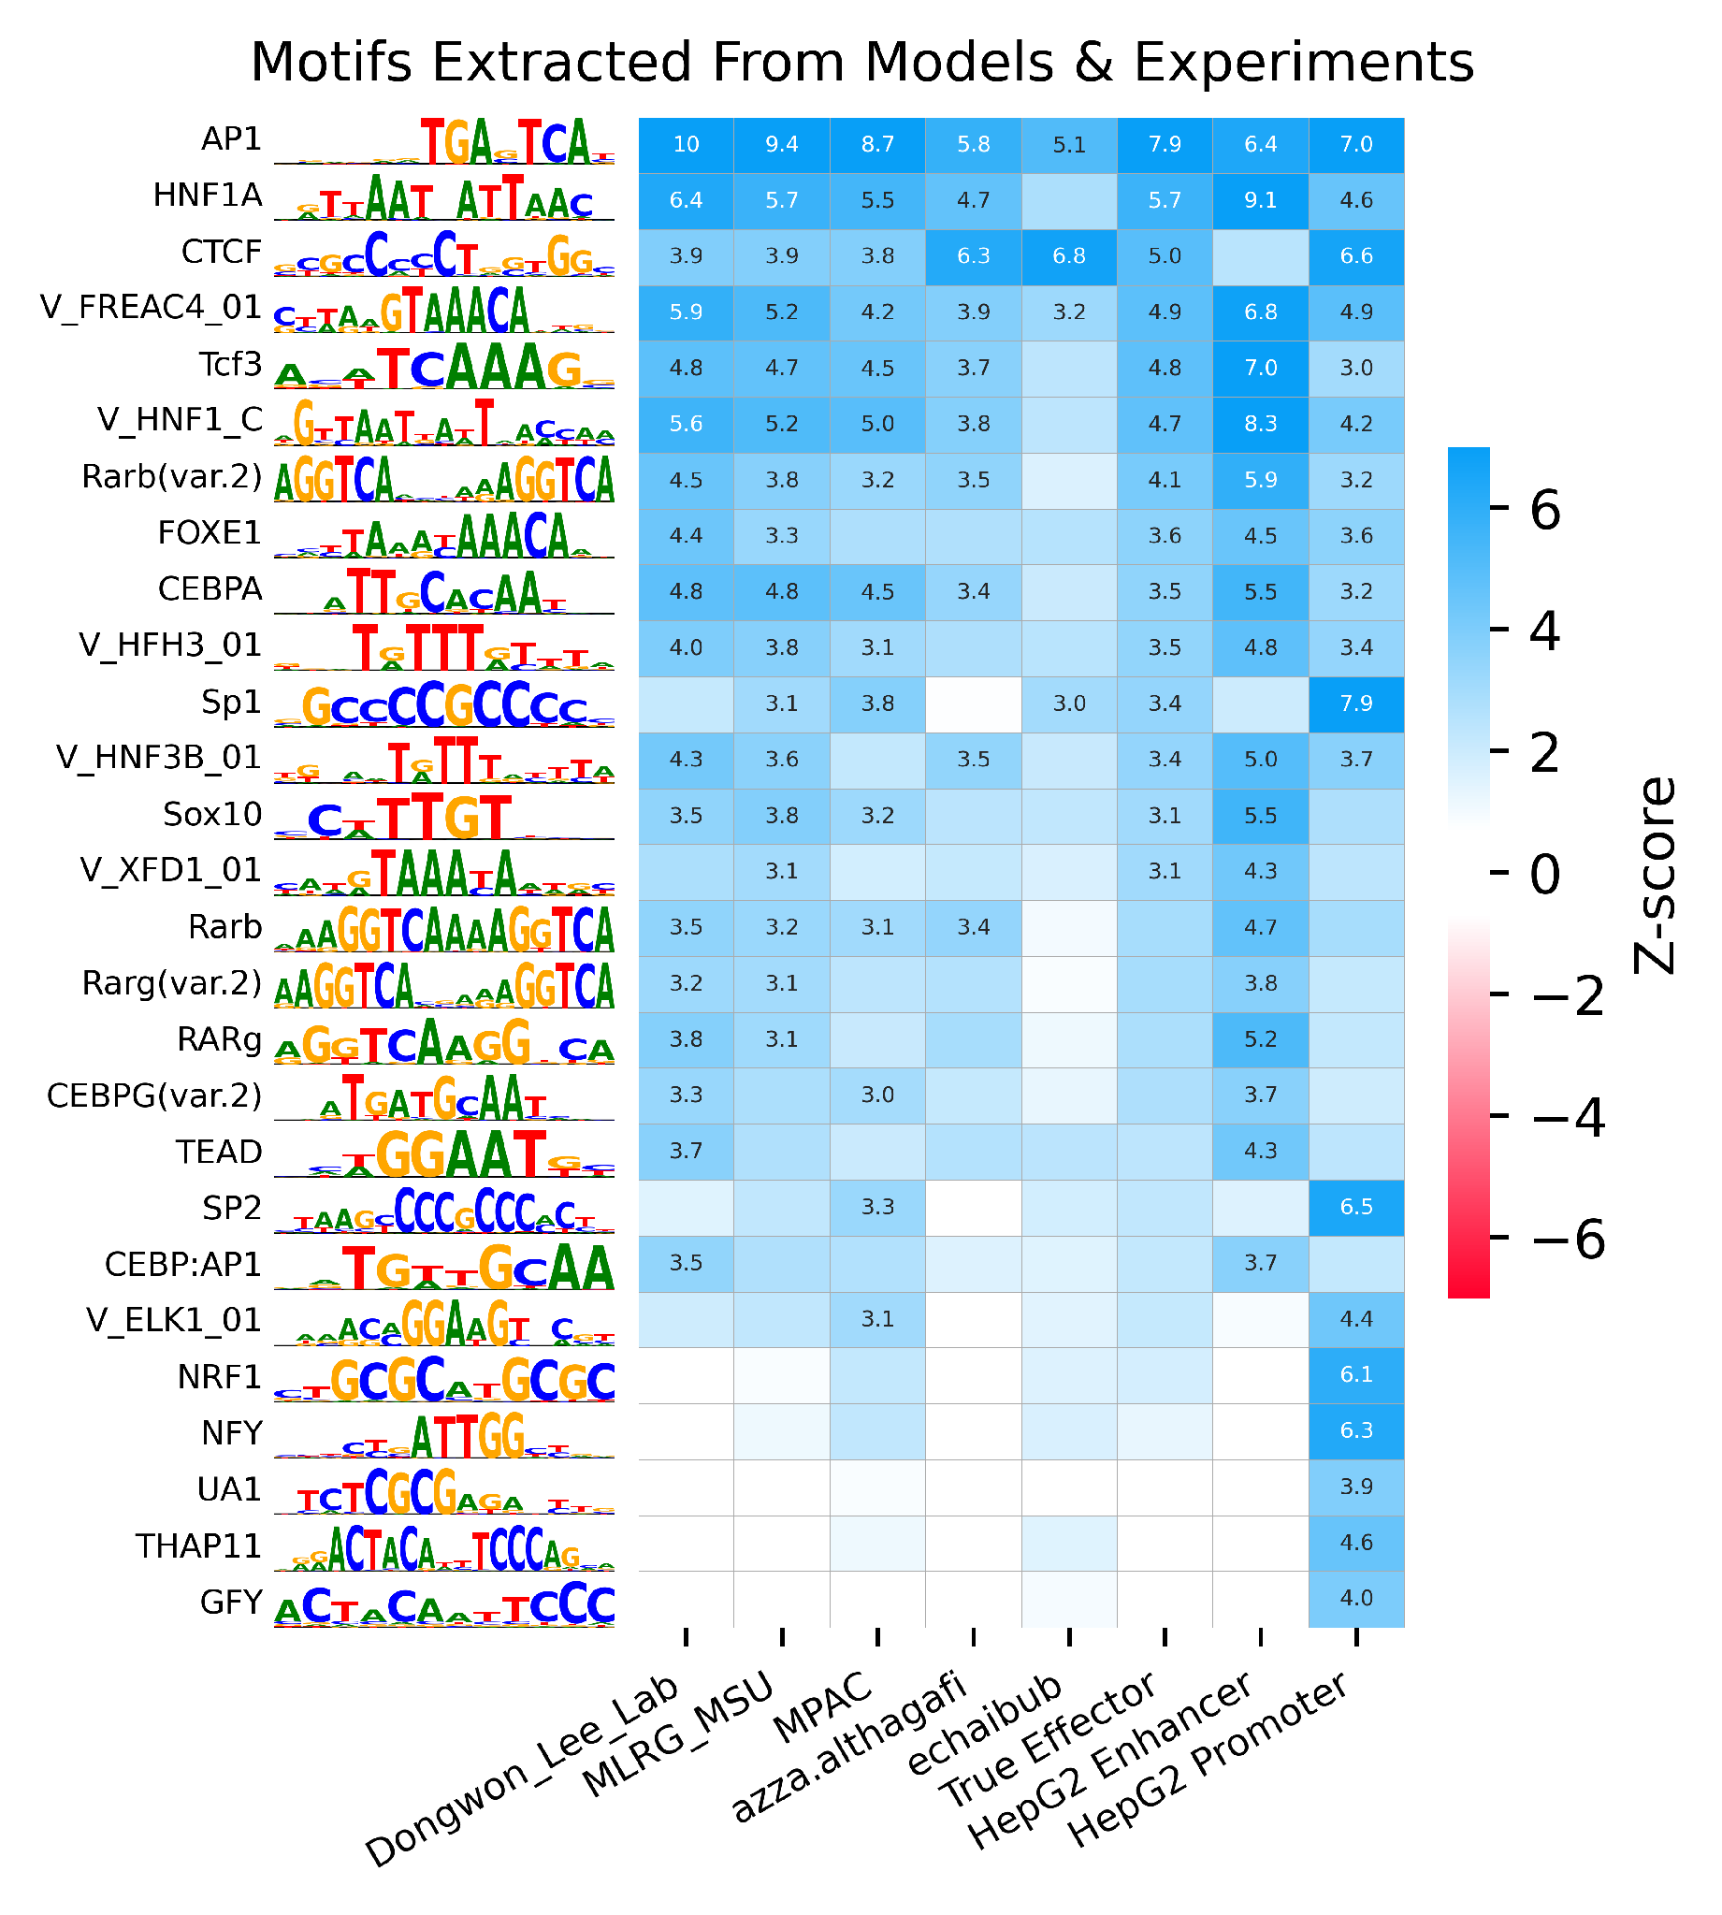
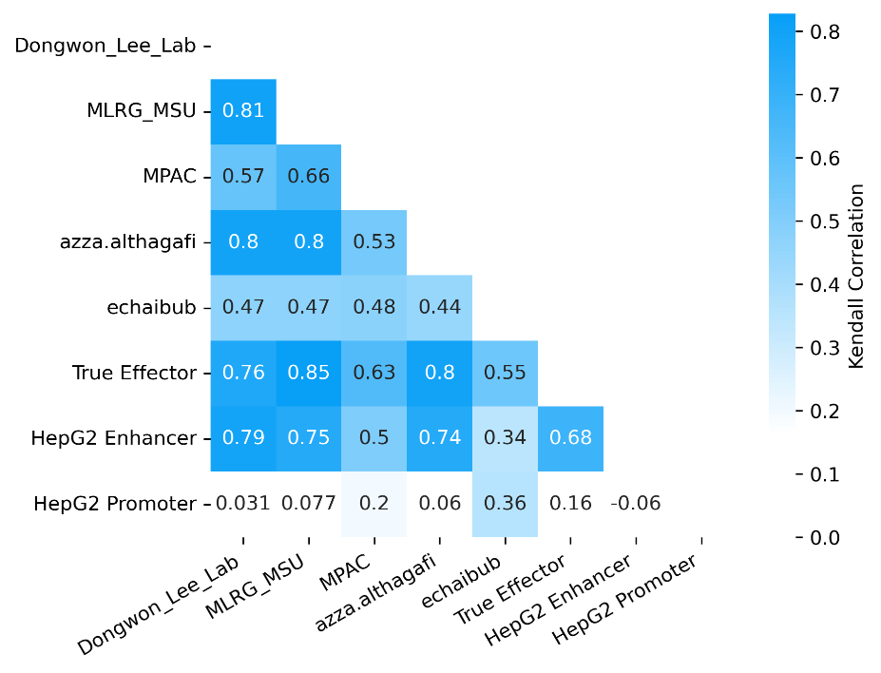
Motifs Extracted From Predictors
Motifs extracted from submitted models, MPRA (Effect=1), and HepG2 peaks
Agreement of motifs extracted from models, effectors, and CREs
Created for CAGI 7
genomeinterpretation.org
Michael Beer

Slide 22
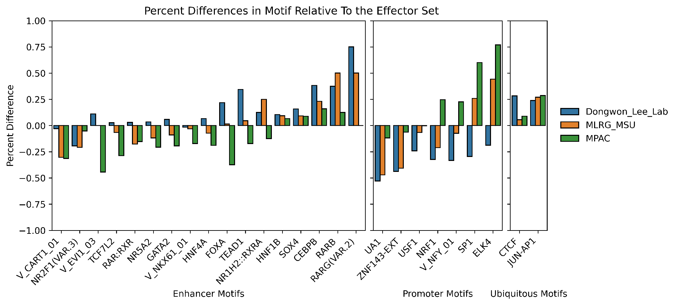
Distribution of Variant Motif Disruption of Prediction Models
Each variant assigned to TFBS motif it most strongly disrupts
Compare which TFBS disrupted by variants predicted by each model
Lee_Lab’s model more sensitively detects HepG2 enhancer motifs
MPAC’s model more sensitively detects promoter motifs
All three models detect CTCF and AP1 motifs.
Percent Differences in Disrupted Motif relative to MPRA Effect variants
Created for CAGI 7
genomeinterpretation.org
Michael Beer

Slide 23
Conclusions
Overall predictive accuracy exceeds baseline models
Top methods seem to be mostly learning known HepG2 TFBS
Unclear what is driving performance improvement over baseline models
  Refinement of known TFBS motifs?
  Learning other features or features specific to the assay?
Improved data quality and prediction performance relative to CAGI5, even though task got more difficult
Thanks to Gary Yang and Andrew Rojnuckarin
Created for CAGI 7
genomeinterpretation.org
Michael Beer

