Slide 1

CAGI 7 slide pack guidelines
I agree to my slides being used according to the following terms:
_______Steven E. Brenner_______
Authors: please include THIS slide at the beginning of your presentation to indicate that you agree with reuse of your slides in CAGI presentations, according to the terms below, and digitally sign by writing your name above.
At CAGI 7, use of this slide pack is only required for CAGI dataset providers, assessors, and predictors, but all are encouraged to use the annotations for materials they do not want shared publicly.
To disseminate the CAGI results, I encourage all CAGI participants to remix these CAGI slides for inclusion in their oral and poster presentations
CAGI participants may use or publish any content of these slides only in compliance with the CAGI Data Use Agreement
CAGI participants may not cite or publish any content of these slides except with the written permission of the originating author or in the primary CAGI publications
CAGI participants must acknowledge the original authors of these slides and CAGI 7. Include the acknowledgement banner across the bottom
CAGI participants must include the CAGI credits slide in their presentations
Slides with a red slash (no remix) may not be included in a presentation unless all attendees are registered CAGI participants who signed the data use agreement
Slides with a red X over the entire slide may not be used in any circumstances
Slides with a blue slash (embargoed) may not be used unless the embargo is explicitly lifted
Slides without slash or X may be tweeted, tooted, posted, X’d unless flagged with “No tweet” icon
CAGI participants using these slides must explain the “No tweet” icon, which means that the slide content should not be disseminated outside the presenting conference hall. If the presentation venue permits pervasive tweeting, you may not include these slides in your talk
Note for slide authors: we expect all CAGI participants to abide by these restrictions, and will make best effort to ensure they are followed. However, but bear in mind that we have limited means of enforcing them, and therefore the restrictions cannot be guaranteed.

Slide 2
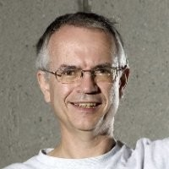
Amos Bairoch
1957 – 2025
ID ARSA$HUMAN STANDARD; PRT; 507 AA.
AC P15289;
DT 01-APR-1990 (REL. 14, CREATED)
DT 01-APR-1990 (REL. 14, LAST SEQUENCE UPDATE)
DT 01-APR-1990 (REL. 14, LAST ANNOTATION UPDATE)
DE ARYLSULFATASE A PRECURSOR (EC 3.1.6.1) (ASA) (GENE NAME: ARSA).
OS HUMAN (HOMO SAPIENS).
OC EUKARYOTA; METAZOA; CHORDATA; VERTEBRATA; TETRAPODA; MAMMALIA;
OC EUTHERIA; PRIMATES.
RN [1] (SEQUENCE FROM N.A.)
RA STEIN C., GIESELMANN V., KREYSING J., SCHMIDT B., POHLMANN R.,
RA WAHEED A., MEYER H.E., O'BRIEN J.S., VON FIGURA K.;
RL J. BIOL. CHEM. 264:1252-1259(1989).
CC -!- FUNCTION: HYDROLYSES CEREBROSIDE SULFATE.
CC -!- CATALYTIC ACTIVITY: A + PHENOL SULFATE + H(2)O = A PHENOL +
CC SULFATE.
CC -!- SUBCELLULAR LOCATION: LYSOSOMAL.
CC -!- DISEASE: COMPLETE OR PARTIAL DEFICIENCY LEADS TO METACHROMATIC
CC LEUCODYSTROPHY (INTRALYSOSOMAL STORAGE OF CEREBROSIDE SULFATE).
CC -!- SIMILARITY: TO OTHER SULFATASES.
DR EMBL; J04593; HSASFA.
DR PROSITE; PS00149; SULFATASE.
KW HYDROLASE; SIGNAL; GLYCOPROTEIN; LYSOSOME.
FT SIGNAL 1 18 PROBABLE.
FT CHAIN 19 505 ARYLSULFATASE A.
FT ACT_SITE 125 125 PUTATIVE.
FT CARBOHYD 158 158 POTENTIAL.
FT CARBOHYD 184 184 POTENTIAL.
FT CARBOHYD 350 350 POTENTIAL.
SQ SEQUENCE 507 AA; 53394 MW; 1252623 CN;
MGAPRSLLLA LAAGLAVARP PNIVLIFADD LGYGDLGCYG HPSSTTPNLD QLAAGGLRFT
DFYVPVSLCT PSRAALLTGR LPVRMGMYPG VLVPSSRGGL PLEEVTVAEV LAARGYLTGM
AGKWHLGVGP EGAFLPPHQG FHRFLGIPYS HDQGPCQNLT CFPPATPCDG GCDQGLVPIP
LLANLSVEAQ PPWLPGLEAR YMAFAHDLMA DAQRQDRPFF LYYASHHTHY PQFSGQSFAE
RSGRGPFGDS LMELDAAVGT LMTAIGDLGL LEETLVIFTA DNGPETMRMS RGGCSGLLRC
GKGTTYEGGV REPALAFWPG HIAPGVTHEL ASSLDLLPTL AALAGAPLPN VTLDGFDLRP
PAAGHRQEPS AVSLLLPVLP RRGPWGFCCA DWKVQGSLLH PGSAHSDTTA DPACHASSSL
TAHEPPLLYD LSKDPGENYN LLGGVAGATP EVLQALKQLQ LLKAQLDAAV TFGPSQVARG
EDPALQICCH PGCTPRPACC HCPDPHA
//
Created for CAGI 7
genomeinterpretation.org
Steven E. Brenner

Slide 3
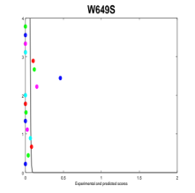
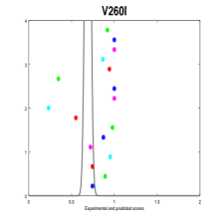
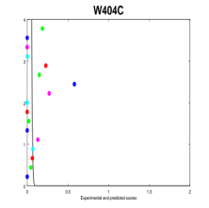
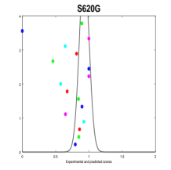
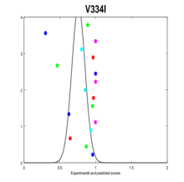
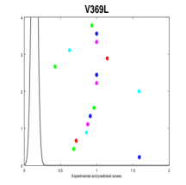
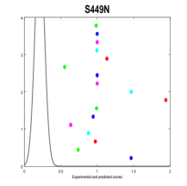
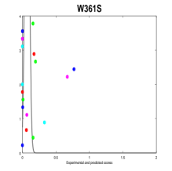
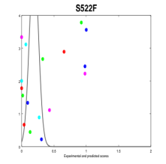
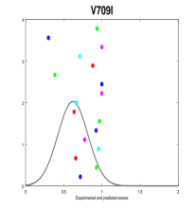
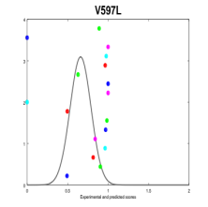
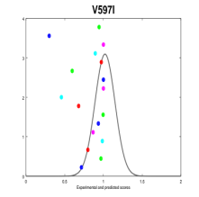
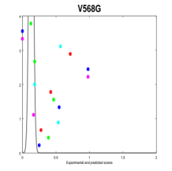
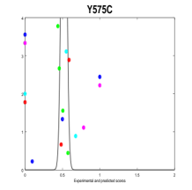
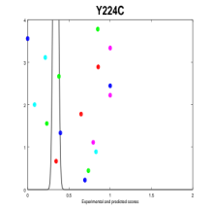
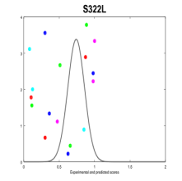
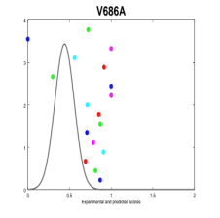
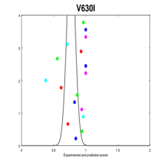
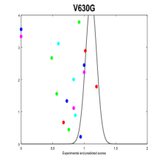
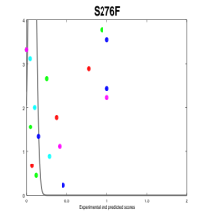

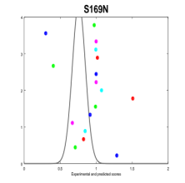
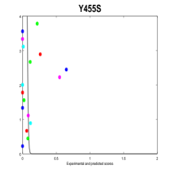
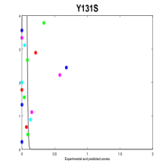
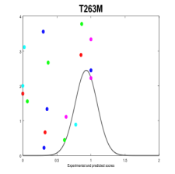
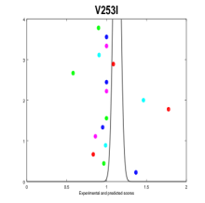
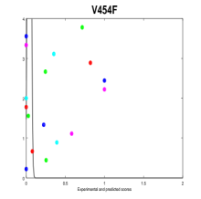
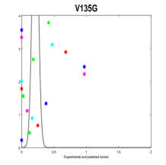
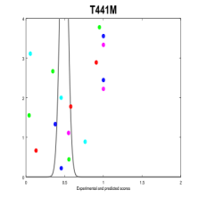
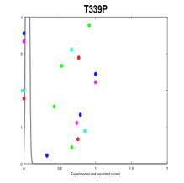
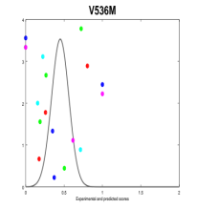
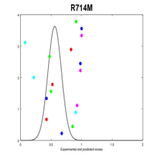
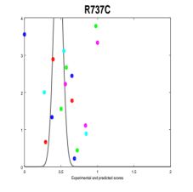
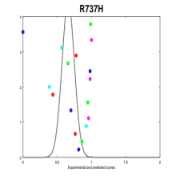
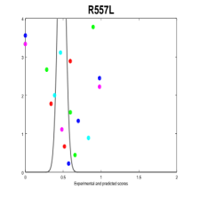
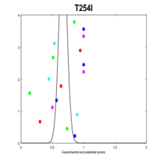
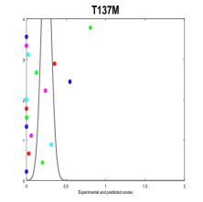
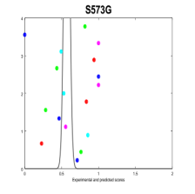
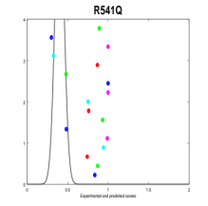
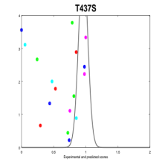
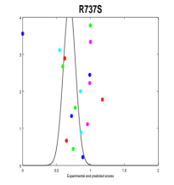
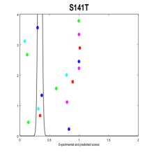
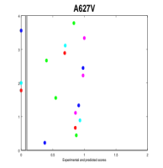
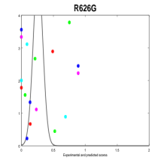
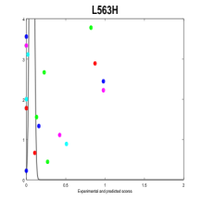
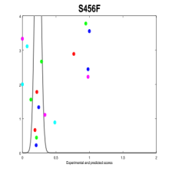
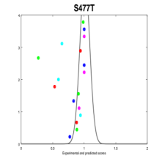
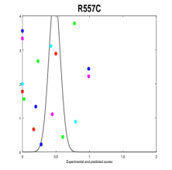
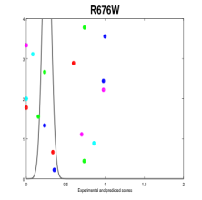
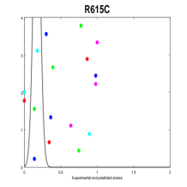











Gaurav Pandey
Probability of observing the experimental value
Created for CAGI 7
genomeinterpretation.org
Steven E. Brenner

