Slide 1

CAGI 7 slide pack guidelines
I agree to my slides being used according to the following terms:
_______Flavia Chen_______
Authors: please include THIS slide at the beginning of your presentation to indicate that you agree with reuse of your slides in CAGI presentations, according to the terms below, and digitally sign by writing your name above.
At CAGI 7, use of this slide pack is only required for CAGI dataset providers, assessors, and predictors, but all are encouraged to use the annotations for materials they do not want shared publicly.
To disseminate the CAGI results, I encourage all CAGI participants to remix these CAGI slides for inclusion in their oral and poster presentations
CAGI participants may use or publish any content of these slides only in compliance with the CAGI Data Use Agreement
CAGI participants may not cite or publish any content of these slides except with the written permission of the originating author or in the primary CAGI publications
CAGI participants must acknowledge the original authors of these slides and CAGI 7. Include the acknowledgement banner across the bottom
CAGI participants must include the CAGI credits slide in their presentations
Slides with a red slash (no remix) may not be included in a presentation unless all attendees are registered CAGI participants who signed the data use agreement
Slides with a red X over the entire slide may not be used in any circumstances
Slides with a blue slash (embargoed) may not be used unless the embargo is explicitly lifted
Slides without slash or X may be tweeted, tooted, posted, X’d unless flagged with “No tweet” icon
CAGI participants using these slides must explain the “No tweet” icon, which means that the slide content should not be disseminated outside the presenting conference hall. If the presentation venue permits pervasive tweeting, you may not include these slides in your talk
Note for slide authors: we expect all CAGI participants to abide by these restrictions, and will make best effort to ensure they are followed. However, but bear in mind that we have limited means of enforcing them, and therefore the restrictions cannot be guaranteed.

Slide 2
The CAGI Ethics Forum
Flavia Chen, MPH
Created for CAGI 7
genomeinterpretation.org
Chen

Slide 3
Origins of the CAGI Ethics Forum
  Launched in 2015, the CAGI Ethics Forum was created to afford responsive attention to the evolving technical, scientific, regulatory, and policy environment in areas relevant to CAGI, including data sharing, security, privacy, human research protection, and the social and ethical implications of translational genomics.
Created for CAGI 7
genomeinterpretation.org
Chen

Slide 4
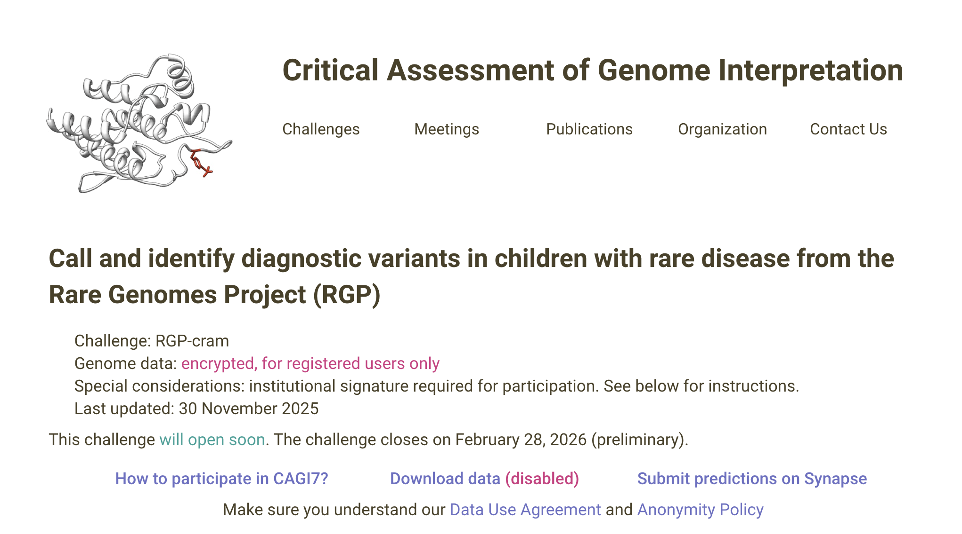
Created for CAGI 7
genomeinterpretation.org
Chen

Slide 5
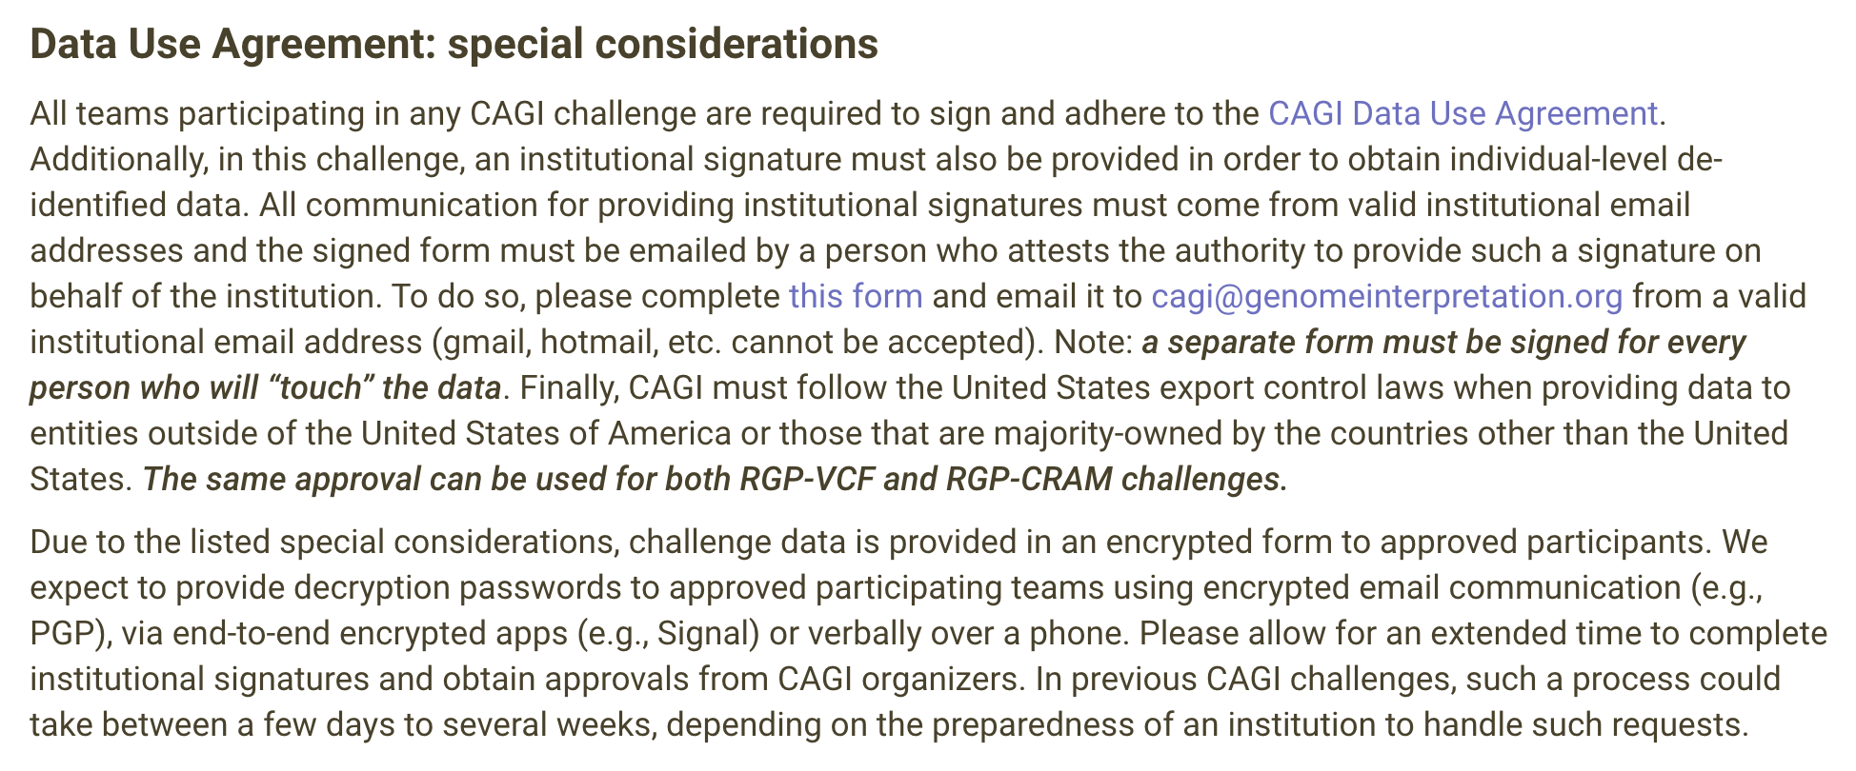
Created for CAGI 7
genomeinterpretation.org
Chen

Slide 6
Core Work of CAGI Ethics Forum
Informing novel governance mechanisms
Developing specific practices
Providing structured review of CAGI challenges
Created for CAGI 7
genomeinterpretation.org
Chen

Slide 7
Areas of Reflections
Addressing the interests of data providers
Addressing the interests of patient-participants
Weighing trade-offs in data access models
Created for CAGI 7
genomeinterpretation.org
Chen

Slide 8
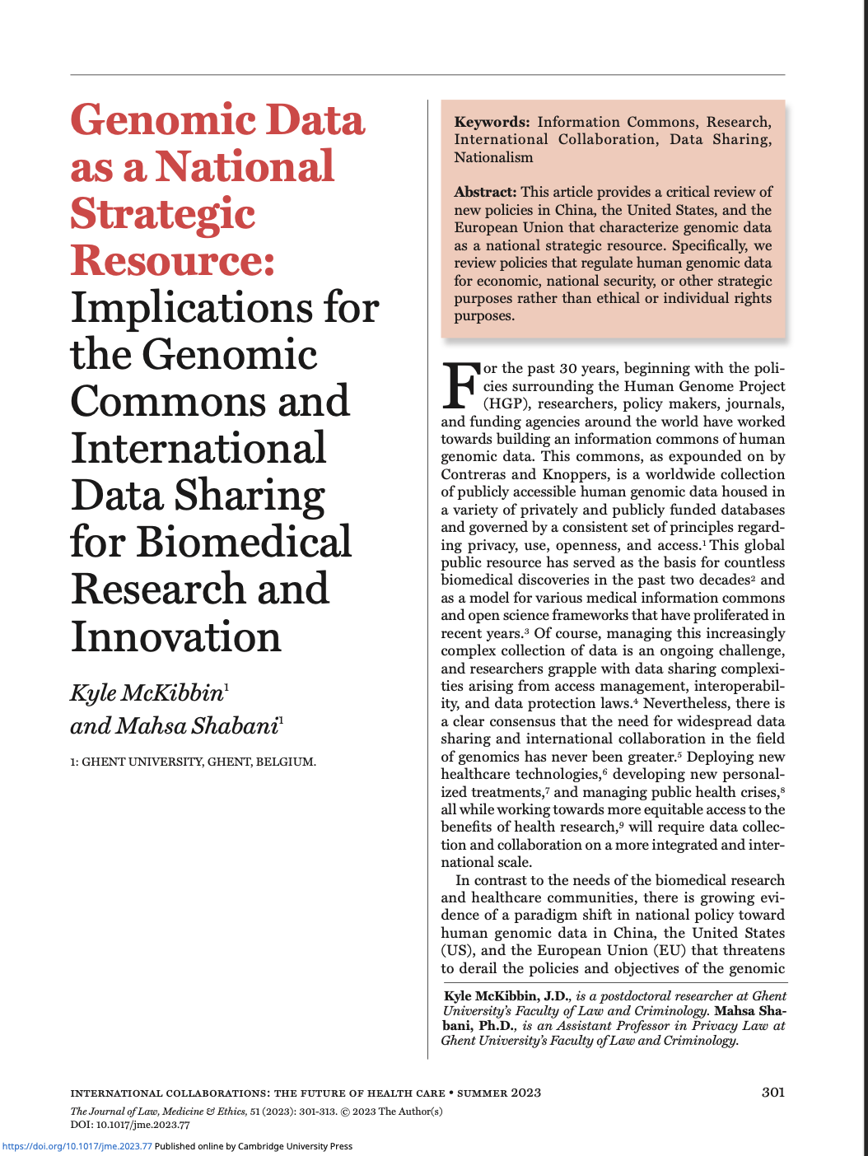
DOI: 10.1017/jme.2023.77
Created for CAGI 7
genomeinterpretation.org
Chen

Slide 9
NSR Policies
“NSR Policies… are markedly different than policies that have supported the creation of the commons over the past several decades. First, NSR policies primarily serve a strategic purpose rather than a purpose in support of human rights or values. Second, NSR policies serve to protect, acquire, or restrict the use of genomic data as a collective resource rather than as a vested personal privacy or data protection right. That is to say data protection or privacy are not the exclusive objective of these policies even if there may be some benefits to data protection or privacy. Third, NSR policies tend to treat control over genomic data as a competition or zero-sum game rather than a cooperative endeavor based on reciprocity, like the commons. As such NSR policies are those that tend to dispose of the benefits of global cooperative biomedical research and innovation in favor of strategic benefits, the interests of a limited set of countries, or explicitly national interests. States may accomplish this by restricting access or granting preferential access to certain categories of data, specific data sources, or data infrastructure.” -McKibben & Shabani, 2023

Slide 10
Areas of Reflections (Revisited)
Addressing the interests of data providers/
Addressing the interests of patient-participants
Weighing trade-offs in data access models
Created for CAGI 7
genomeinterpretation.org
Chen

Slide 11
Acknowledgements
Dr. Malia Fullerton, CAGI Ethics Forum Chair
Current and Former CAGI Ethics Forum Members
Dr. Steven Brenner, ex officio CAGI Ethics
Dr. Pedja Radivojac, ex officio CAGI Ethics
Created for CAGI 7
genomeinterpretation.org
Chen

Slide 12
Thank You!
Created for CAGI 7
genomeinterpretation.org
Chen

