Slide 1

CAGI7 slide pack guidelines
I agree to my slides being used according to the following terms:
_______Brynja Matthiasardottir_______
Authors: please include THIS slide at the beginning of your presentation to indicate that you agree with reuse of your slides in CAGI presentations, according to the terms below, and digitally sign by writing your name above.
At CAGI7, use of this slide pack is only required for CAGI dataset providers, assessors, and predictors, but all are encouraged to use the annotations for materials they do not want shared publicly.
To disseminate the CAGI results, I encourage all CAGI participants to remix these CAGI slides for inclusion in their oral and poster presentations
CAGI participants may use or publish any content of these slides only in compliance with the CAGI Data Use Agreement
CAGI participants may not cite or publish any content of these slides except with the written permission of the originating author or in the primary CAGI publications
CAGI participants must acknowledge the original authors of these slides and CAGI7. Include the acknowledgement banner across the bottom
CAGI participants must include the CAGI credits slide in their presentations
Slides with a red slash (no remix) may not be included in a presentation unless all attendees are registered CAGI participants who signed the data use agreement
Slides with a red X over the entire slide may not be used in any circumstances
Slides with a blue slash (embargoed) may not be used unless the embargo is explicitly lifted
Slides without slash or X may be tweeted, tooted, posted, X’d unless flagged with “No tweet” icon
CAGI participants using these slides must explain the “No tweet” icon, which means that the slide content should not be disseminated outside the presenting conference hall. If the presentation venue permits pervasive tweeting, you may not include these slides in your talk
Note for slide authors: we expect all CAGI participants to abide by these restrictions, and will make best effort to ensure they are followed. However, but bear in mind that we have limited means of enforcing them, and therefore the restrictions cannot be guaranteed.

Slide 2
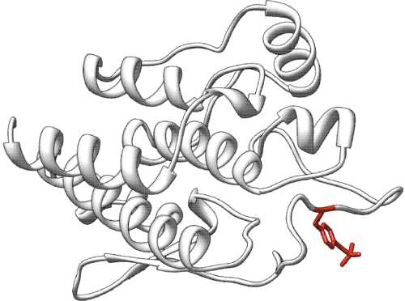


Predict the effect of BARD1 single nucleotide variants on RNA abundance and cell survival
CAGI7 – BARD1 challenge
Brynja Matthiasardottir
Mount lab (UMD) and Kastner lab (NHGRI)
UMSplicing

Slide 3
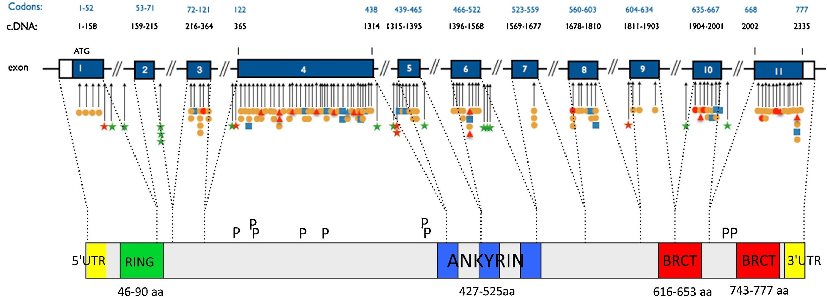
BARD1 Background
BARD1 (BRCA1 Associated RING domain 1) encodes a RING E3 ub ligase that forms a heterodimer with BRCA1
Together, this complex is essential for maintaining genomic stability through double-strand break repair and targeted ubiquitination of DNA-repair proteins
11 exons and 3 major functional domains
Germline variants associated with hereditary breast and ovarian cancer
Required for ubiquitin ligase activity
Mediates protein-protein interactions, tumor suppression
Participate in DNA repair and mRNA processing
Irminger-Finger et al., 2016

Slide 4
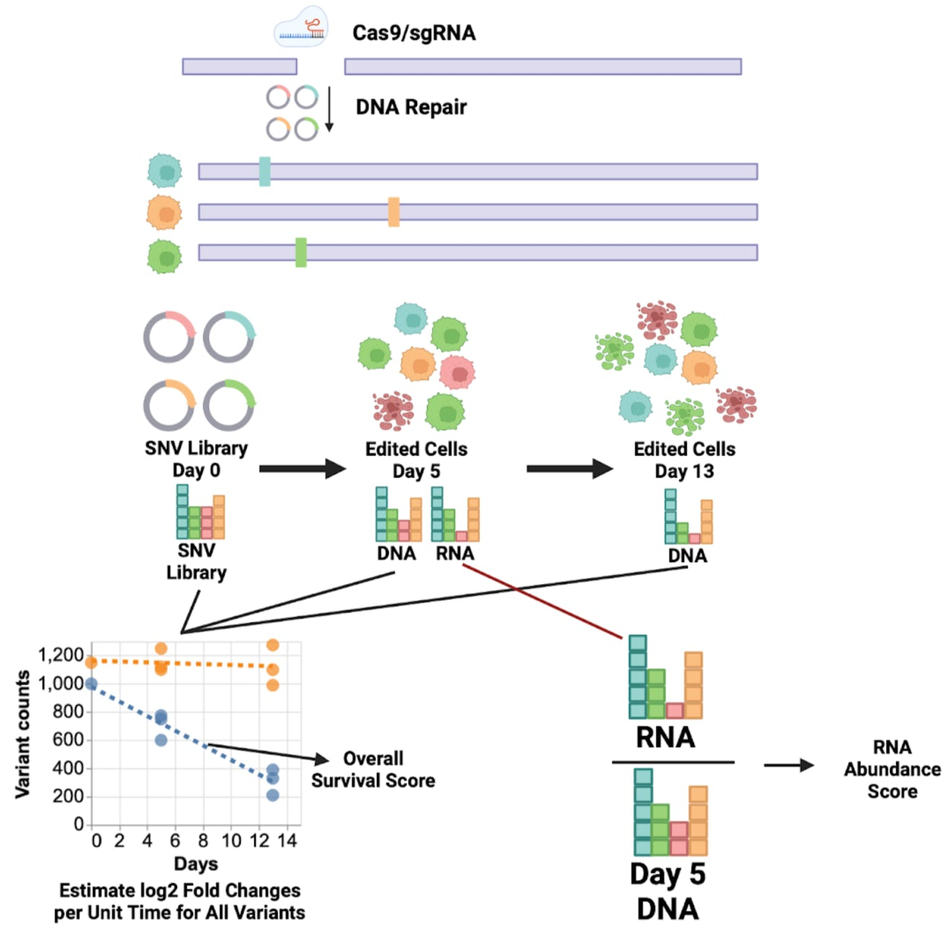
BARD1 Challenge
Saturation Genome Editing performed in HAP1 cells to test over 9000 SNVs in BARD1
Functional read outs:
RNA abundance and cell survival
Variants were scored such that the score of 0 is considered to be functional for this assay, whereas the scores below zero 0 are non-functional
Predictors needed to predict:
RNA abundance (RA) and it’s uncertainty (SDRA)
Survival score (SS) and its uncertainty (SDSS)
Figure from CAGI7 challenge

Slide 5
BARD1 – Models submitted
2 models submitted for the CAGI7 BARD1 challenge
  RNA Abundance Model (RA / SDRA) – two different approaches
  Survival Score Model (SS / SDSS) – same model for both submissions
Goal to see how well we would perform by recalibrating existing variant-impact prediction tools for a specific gene, and to test which optimization strategy works best

Slide 6
BARD1 – Models submitted
2 models submitted for the CAGI7 BARD1 challenge
  RNA Abundance Model (RA / SDRA) – two different approaches
  Survival Score Model (SS / SDSS) – same model for both submissions

Slide 7
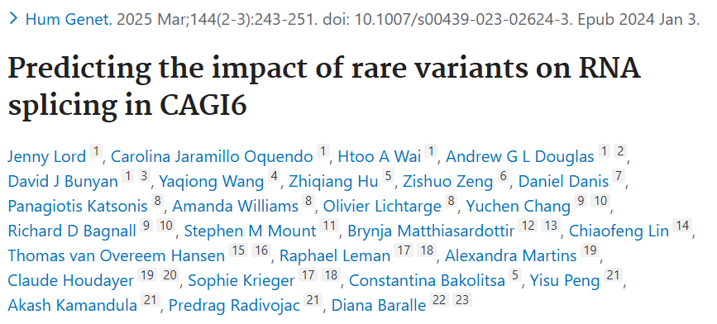
BARD1 RNA Abundance Model – Training data
Assume that variants affecting splicing should strongly impact RNA abundance
SpliceAI
To calibrate the model, we used training data from CAGI6 Splicing VUS challenge (N=257)

Slide 8
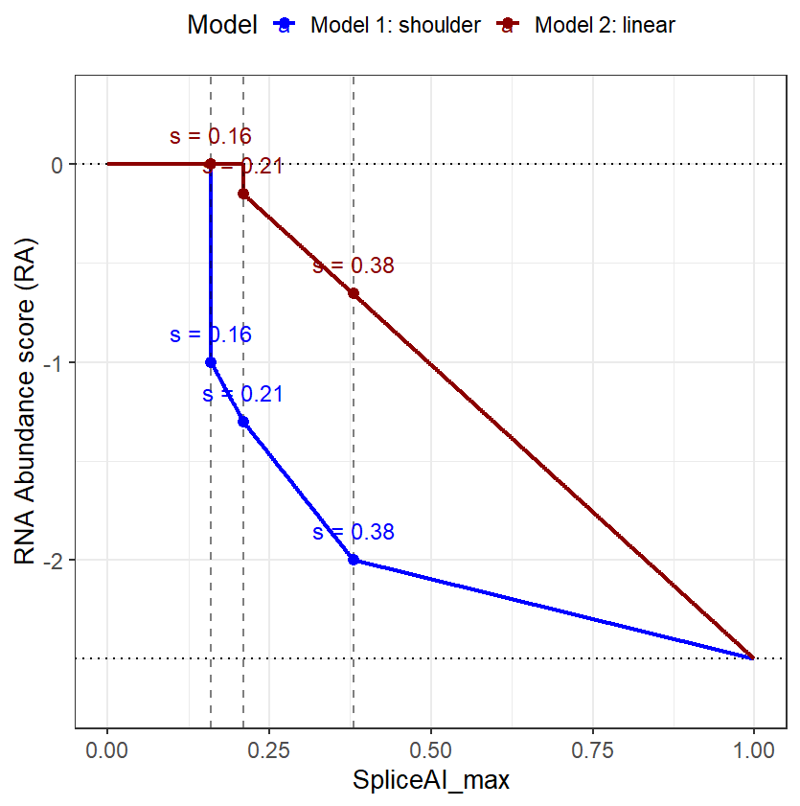
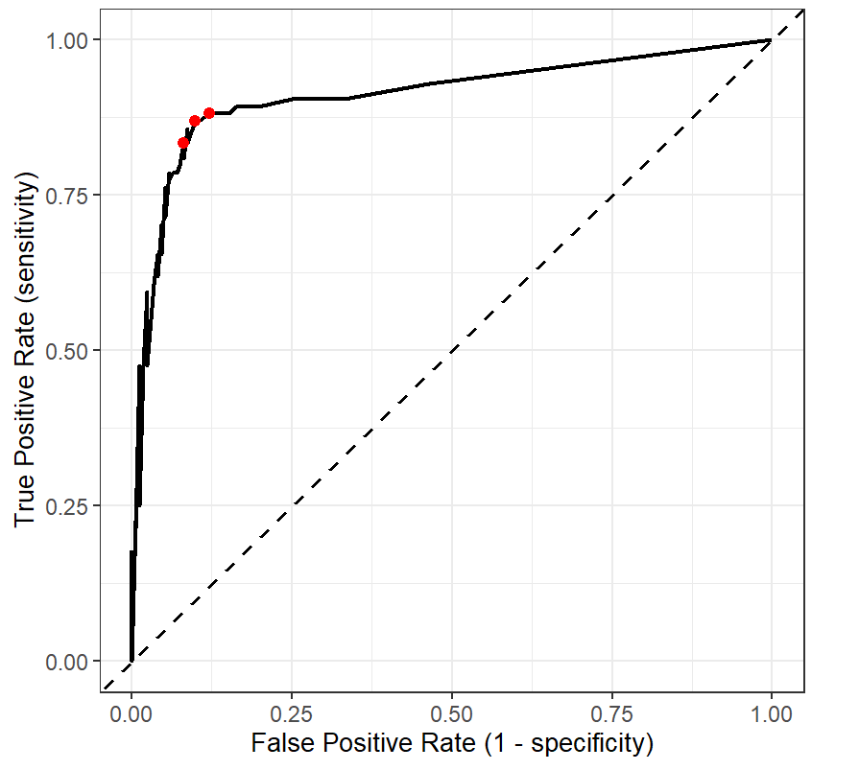
BARD1 RNA Abundance Model – Performance evaluation of SpliceAI on Training data
ROC curve for SpliceAI predictions on SplicingVUS CAGI6 challenge Training data
0.16
0.21
0.38
AUC = 0.88
Should we model RNA abundance based on one threshold, or should we use the entire ROC shoulder, which might better capture a biologically meaningful transition zone

Slide 9
BARD1 Models submitted
2 models submitted for the CAGI7 BARD1 challenge
  RNA Abundance Model (RA / SDRA) – two different approaches
  Survival Score Model (SS / SDSS) – same model for both submissions

Slide 10
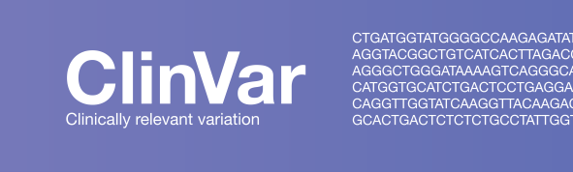
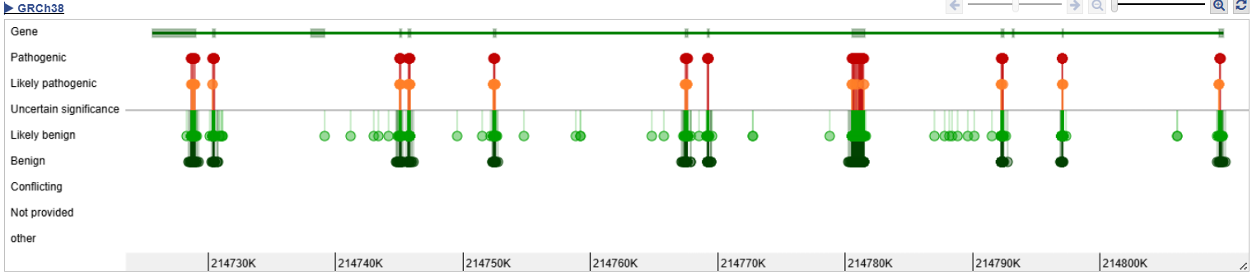
BARD1 Survival Score Model – Training data
ClinVar BARD1 variants used for training:
    N_total = 1465
      Benign / Likely Benign = 1263
    Pathogenic / Likely Pathogenic = 202
45 Variant Impact Prediction tools used to annotate ClinVar variants
CADD the only tool to annotate all variants and therefore used as a primary feature for survival modeling
4 models developed, only one submitted

Slide 11
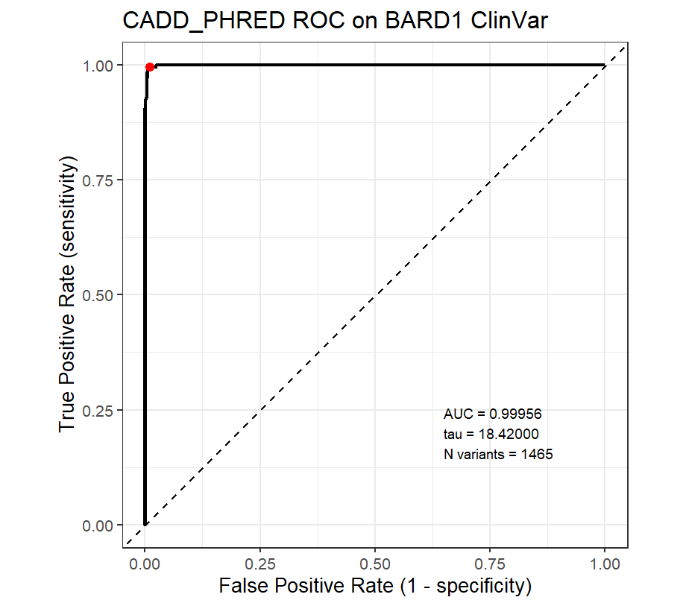
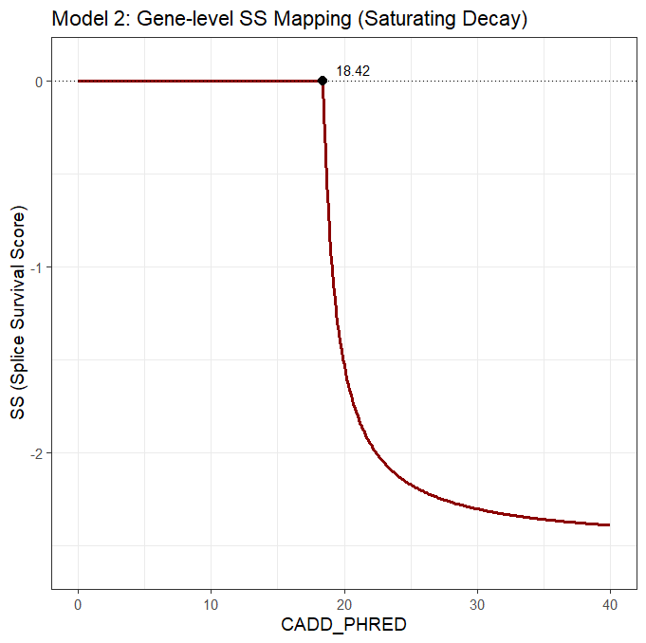
BARD1 – Survival Score Model 1
How well does a simple gene level threshold perform on the ClinVar dataset?
Model 1 – Gene level SS Mapping (Saturating Decay)
Out of 1465 ClinVar variants, 13 variants were FP and 1 was FN
Saturating decay function used for Model 1 as CADD is PHRED scaled – the scale is logarithmic

Slide 12
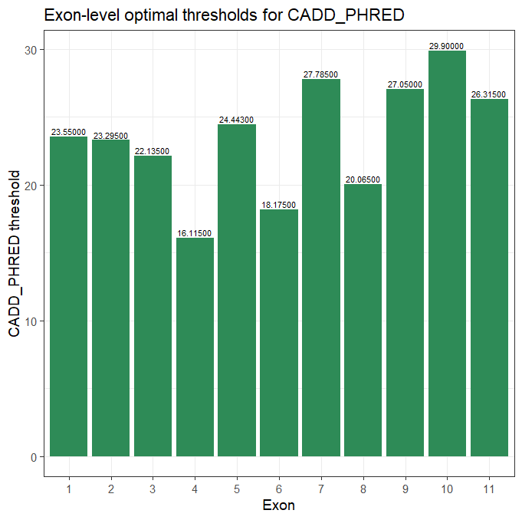
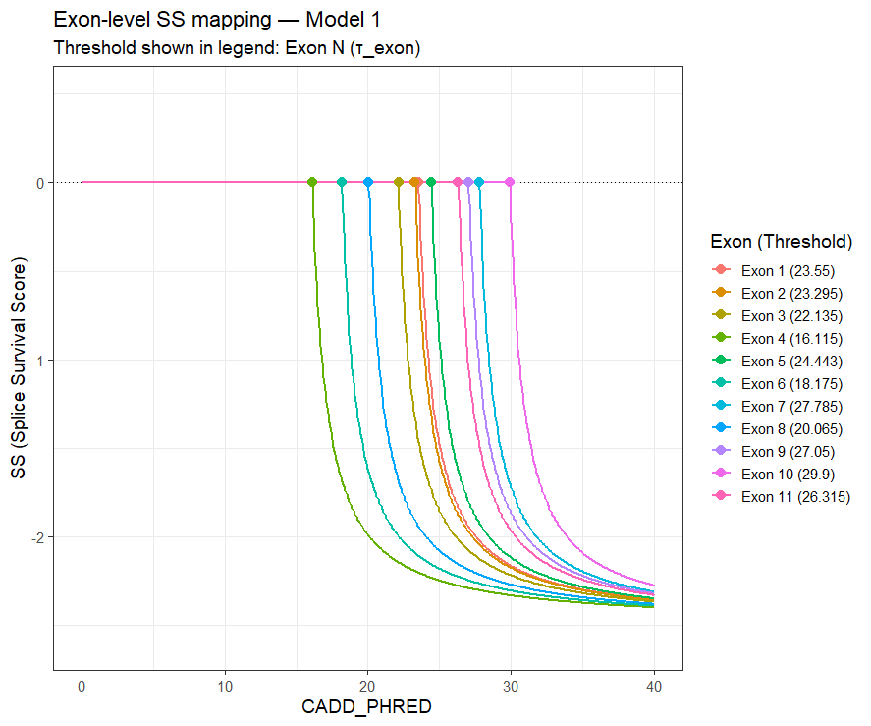
BARD1 – Survival Score Model 2
Can the performance of CADD be improved by using exon-specific thresholds rather than a single gene-wide cutoff?
Model 2 – Exon level SS Mapping (Saturating Decay)
Out of 1465 ClinVar variants, 10 variants were FP
Exon specific thresholds varied substantially (from ~16 to ~30)

Slide 13
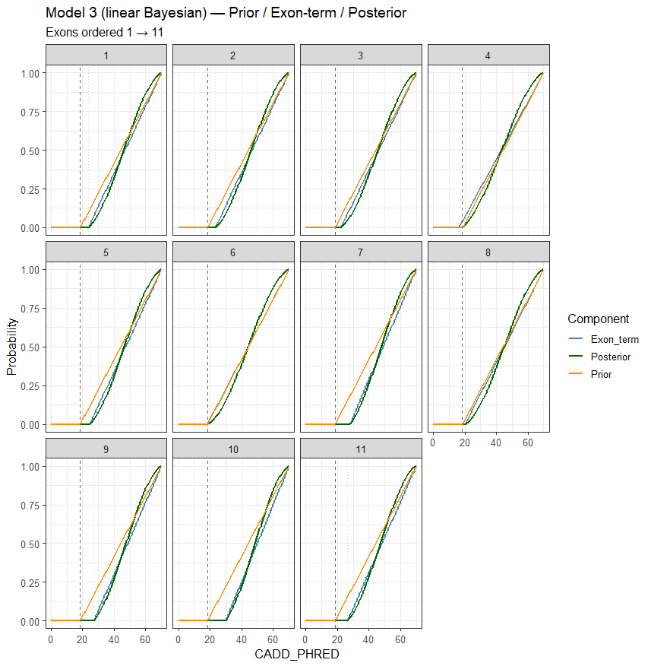
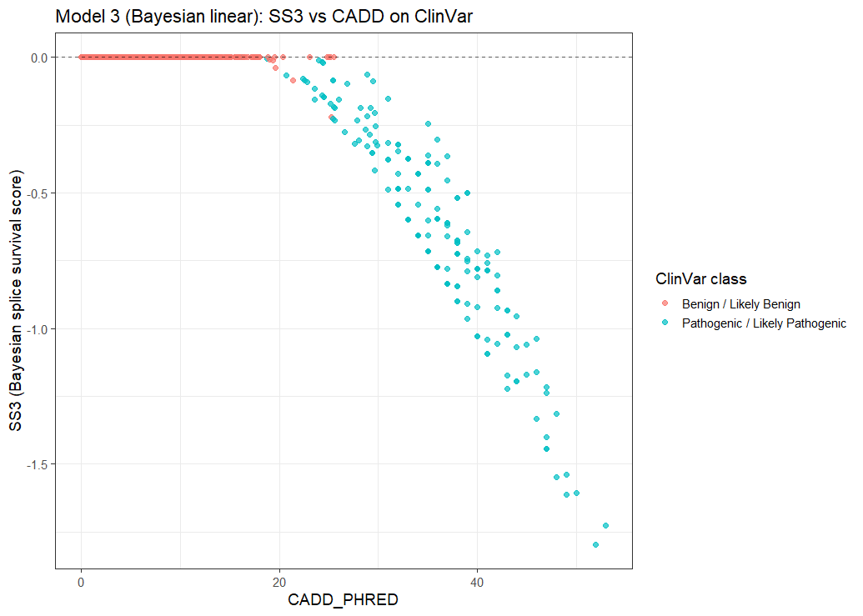
BARD1 – Survival Score Model 3
Can we combine gene- and exon- level information in a principled way?
A Bayesian linear model combines a gene-level prior with exon-level likelihoods to generate an exon-specific posterior probability
Out of 1465 ClinVar variants, 8 variants were FP

Slide 14
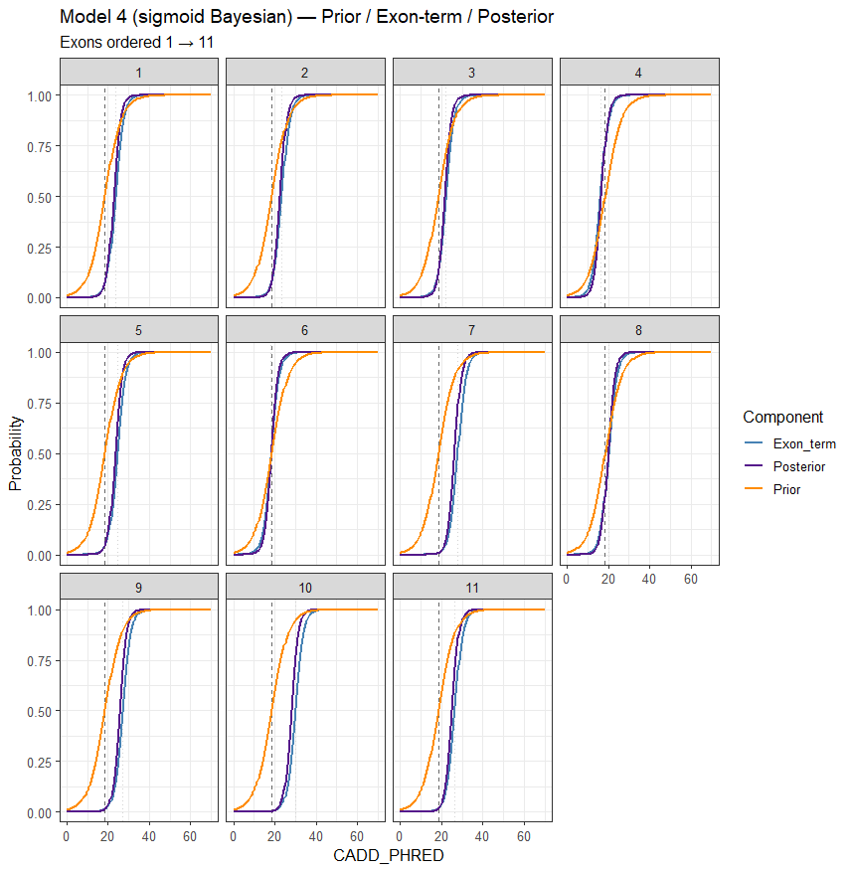
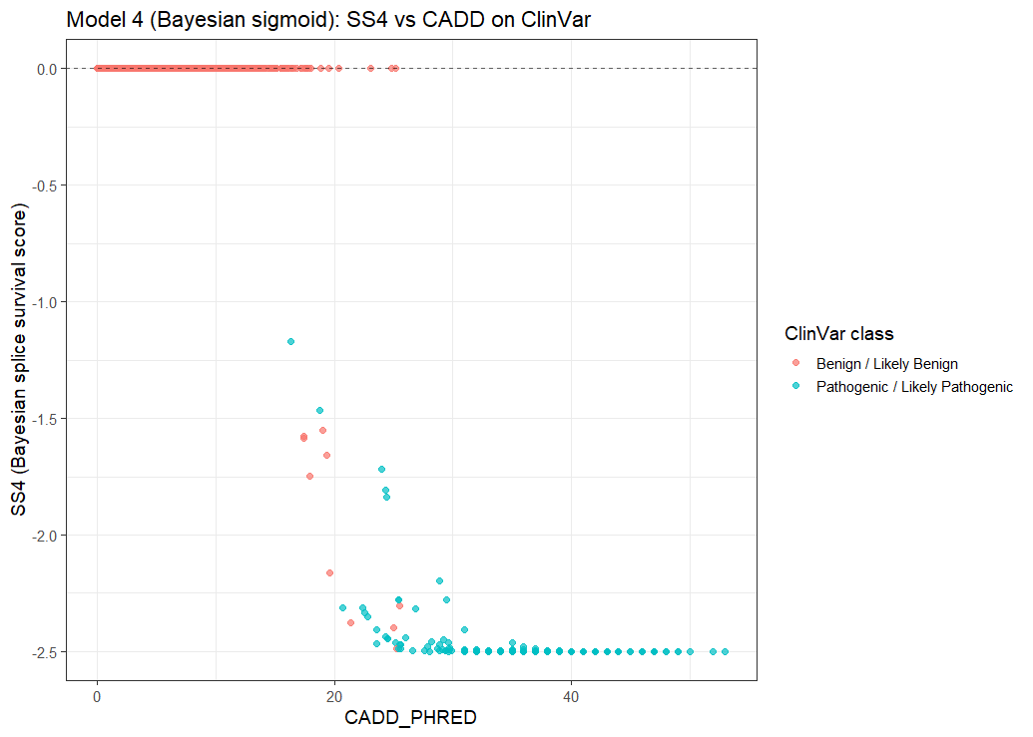
BARD1 – Survival Score Model 4
Can we combine gene- and exon- level information in a principled way?
A Bayesian sigmoid model combines a gene-level prior with exon-level likelihoods but applies a sigmoid mapping to generate an exon-specific posterior probability
Test whether a sharper transition would improve binary separation of variants
Out of 1465 ClinVar variants, 10 variants were FP

Slide 15
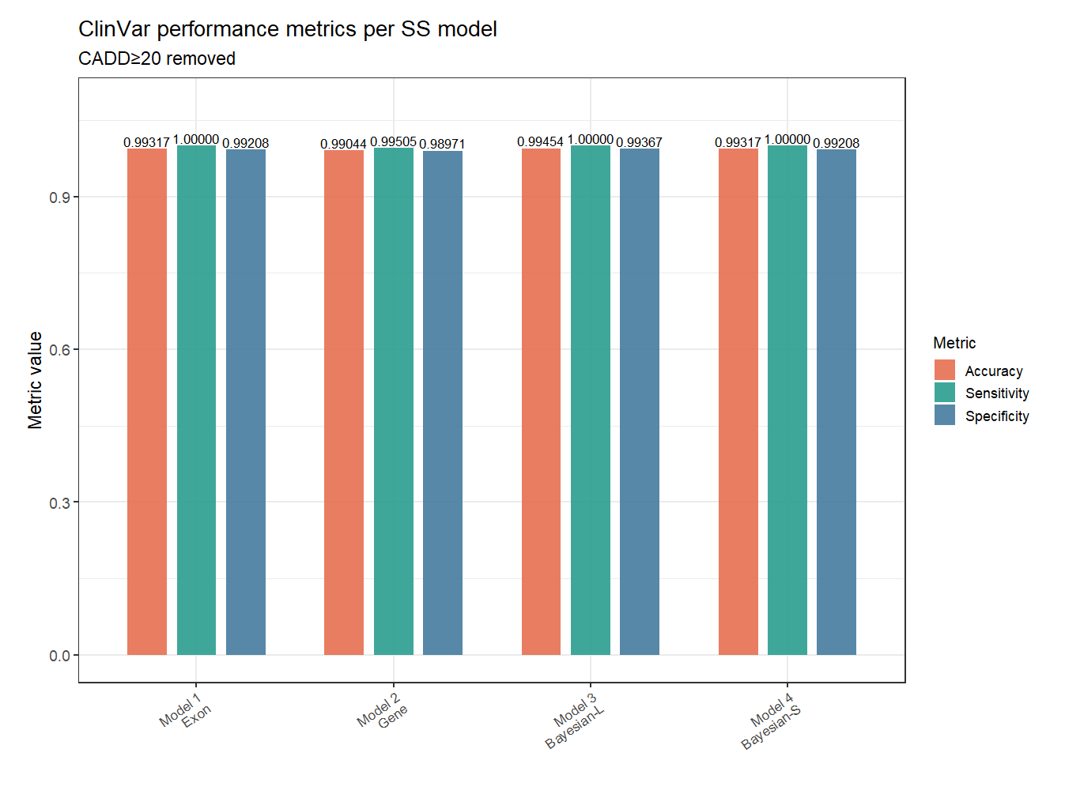
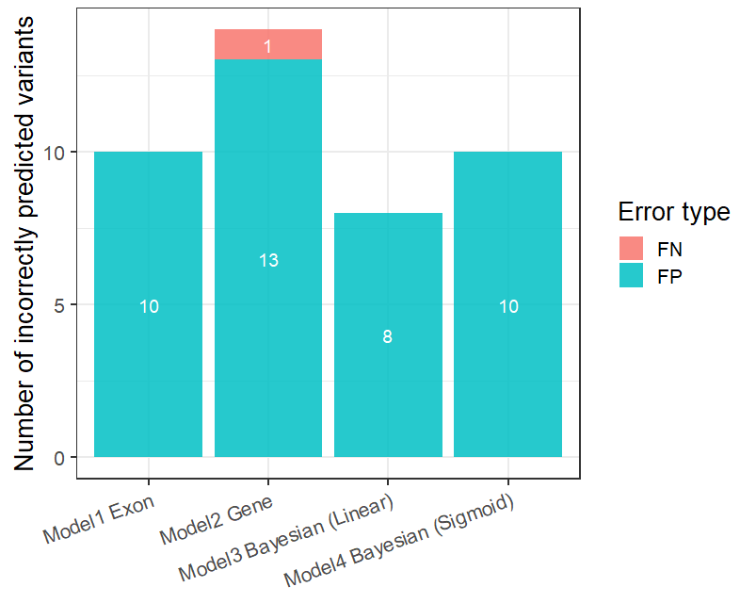
BARD1 Survival Score Models – Performance evaluation
Model 3 (Bayesian linear) showed the best performance and therefore used for challenge submission

Slide 16
BARD1 – Models submitted
Model 1:
  RA Shoulder
  SS Bayesian linear
Model 2:
  RA Linear
  SS Bayesian linear

Slide 17
Acknowledgements
CAGI7
University of Maryland
Stephen M. Mount
Wanru Lin
NHGRI
Daniel L. Kastner
CAGI organizers
Thank you!
Questions?

