Slide 1


Saturation genome editing of BARD1 resolves VUS and provides insight into BRCA1-BARD1 tumor suppression
Lea Starita PhD

Slide 2
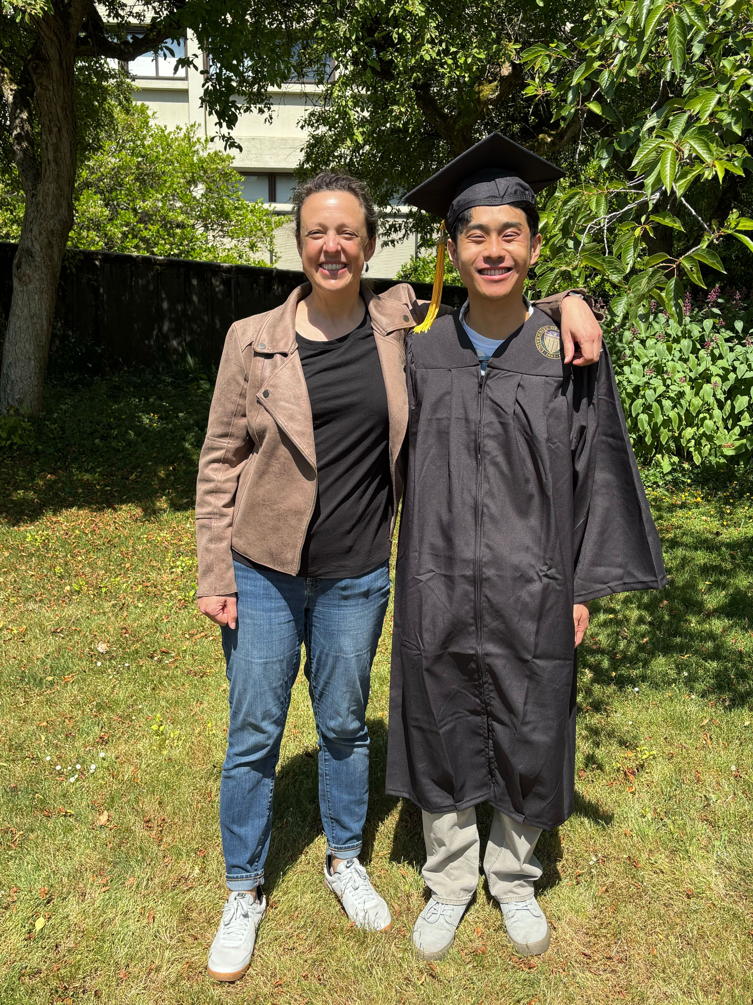

Woo, Casadei, Synder et al.
Ivan Woo,
UW undergraduate

Slide 3
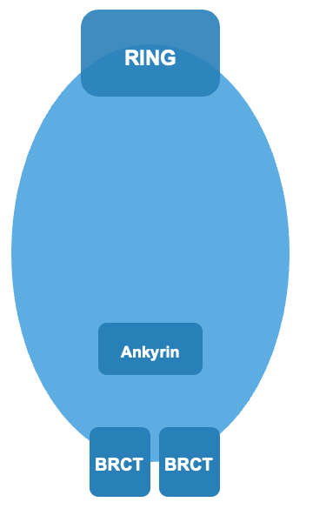
BARD1

Slide 4
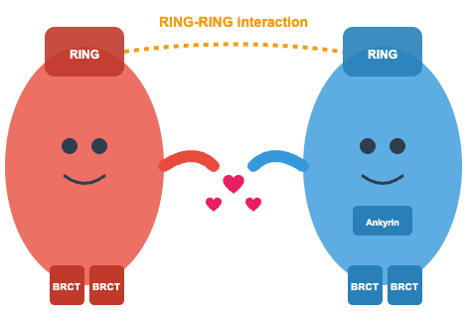
BARD1; BRCA1-Associated RING Domain 1
BRCA1
BARD1

Slide 5
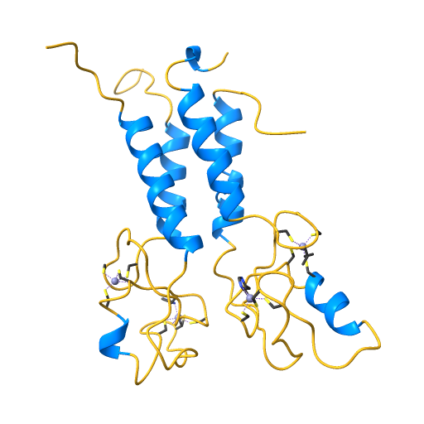
BARD1; BRCA1-Associated RING Domain 1
BRCA1
BARD1
Ubiquitin ligase activity
Required for double strand DNA repair
Tumor suppressor
Risk genes for breast and ovarian cancer
BARD1 is associated with neuroblastoma

Slide 6

A MAVE for BARD1
BARD1 is essential in haploid HAP1 cells
Notes:
Growth assays are a very simple type of MAVE. If a gene is essential and you express only a damaging variant, that cell will grow slower than those expressing variants with WT-like activity. And we can track the change in abundance of those variants by sequencing.
Here, we take advantage of a HAPloid human cell line, where there is a only one copy of the genome + install variants using CRISPR Cas9.

Slide 7
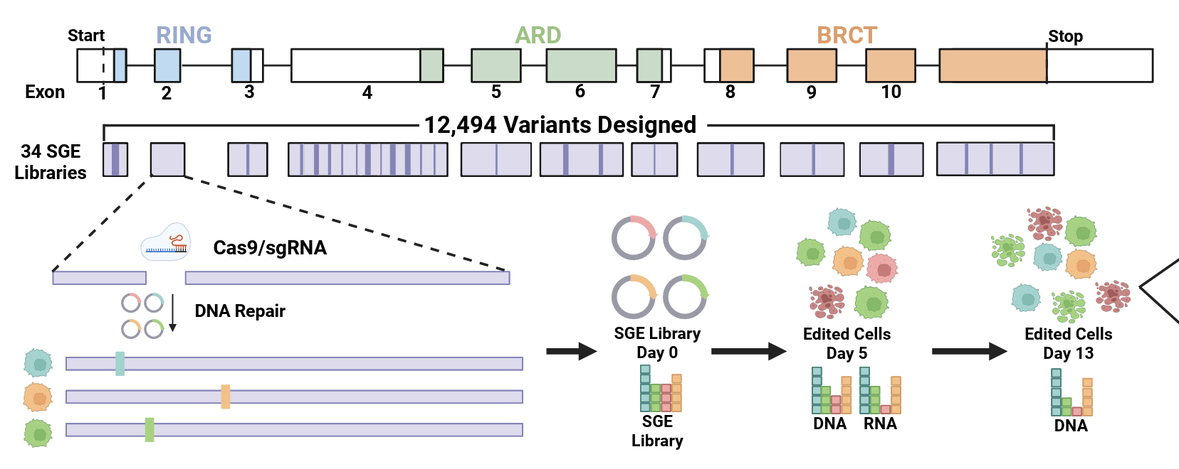
Saturation genome editing of BARD1

Slide 8
Saturation genome editing of BARD1
All SNVs in exons and ~20 bp of proximal introns
All possible 3-bp deletions

Slide 9
Saturation genome editing of BARD1

Slide 10
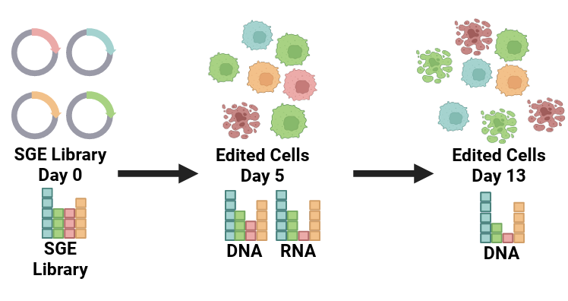
Scoring BARD1 variants for functional effects

Slide 11
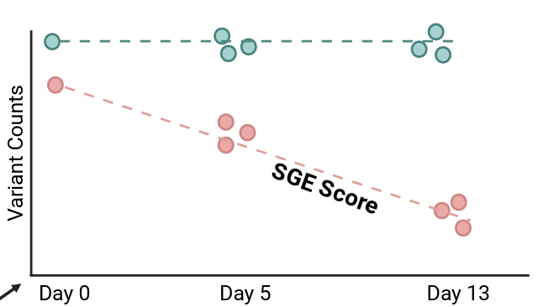
Scoring BARD1 variants for functional effects
Functional scores
Notes:
log₂ fold change in relative variant abundance per day

Slide 12
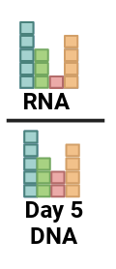
Scoring BARD1 variants for functional effects
Functional scores
RNA scores

Slide 13
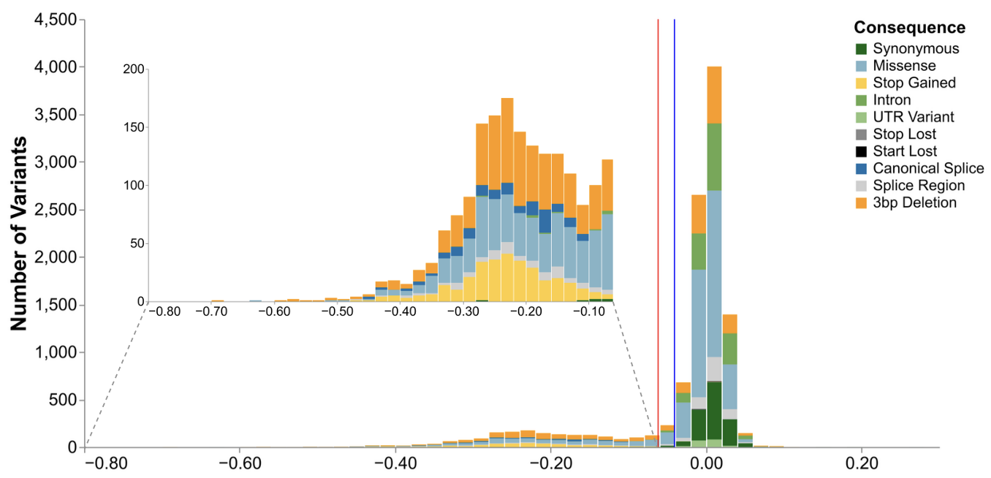
10,915 function scores for BARD1 SNVs and 3-bp deletions
Functional scores

Slide 14
10,915 function scores for BARD1 SNVs and 3-bp deletions
Functional scores

Slide 15
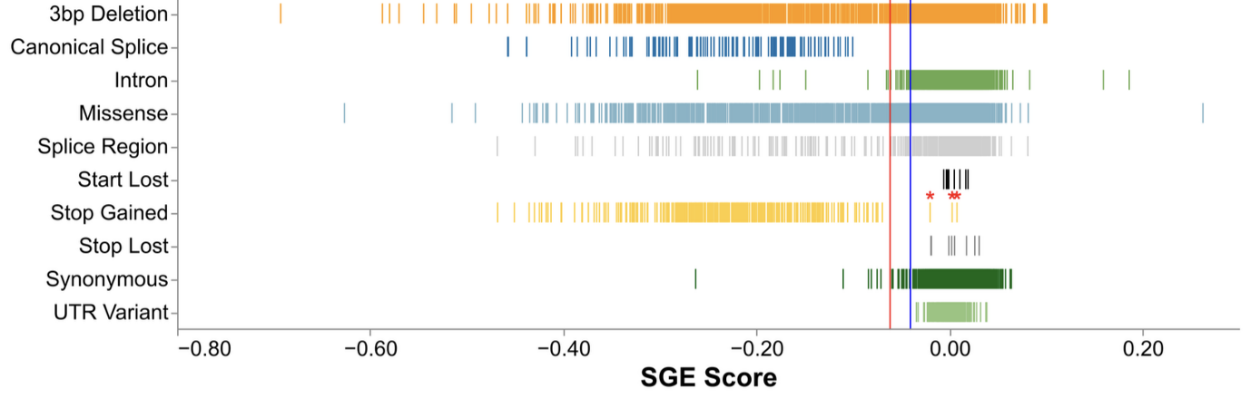
10,915 function scores for BARD1 SNVs and 3-bp deletions
Functional scores

Slide 16
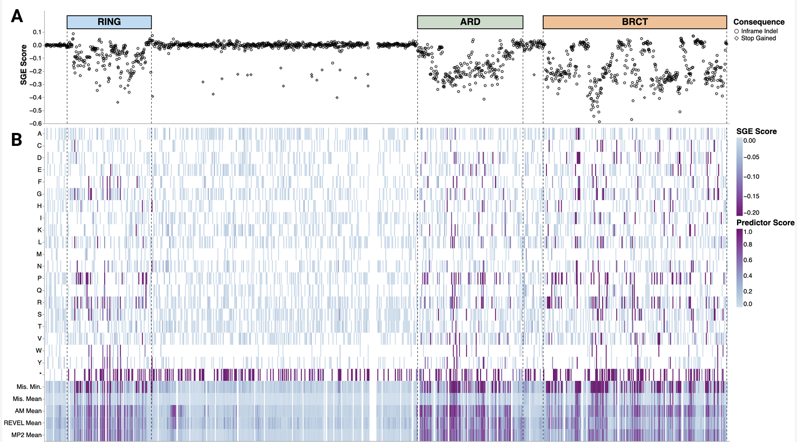
LOF variants enriched 36X in the folded domains
deletions

Slide 17
LOF variants enriched 36X in the folded domains
deletions
missense
stop

Slide 18
Current VEPs over predict damage
min missense
mean missense
AlphaMissense
REVEL
MutPred-2

Slide 19
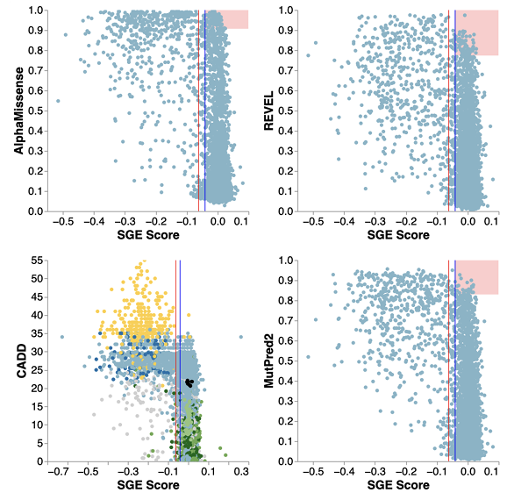
Current VEPs over predict damage
min missense
mean missense
AlphaMissense
REVEL
MutPred-2
AlphaMissense
REVEL
MutPred-2
CADD

Slide 20
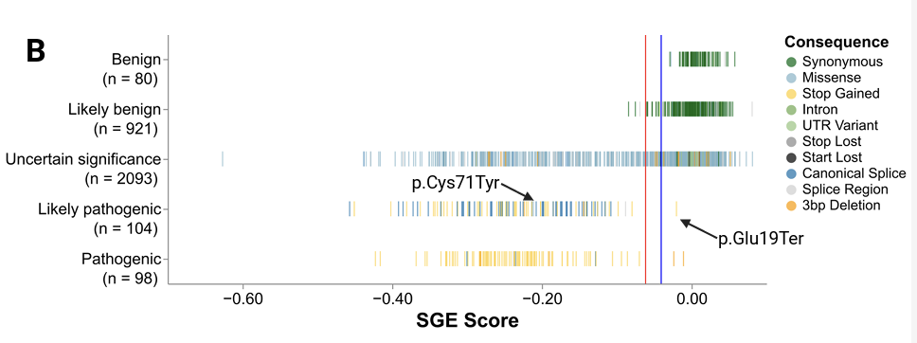
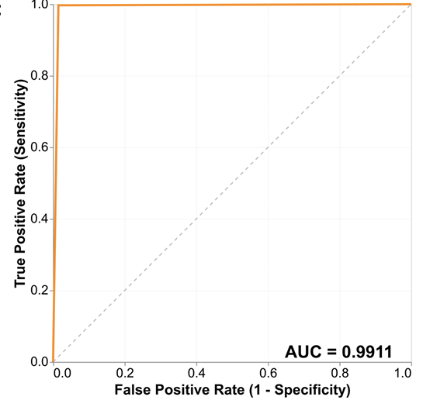
BARD1 accurately predict clinical consequence
Functional scores

Slide 21
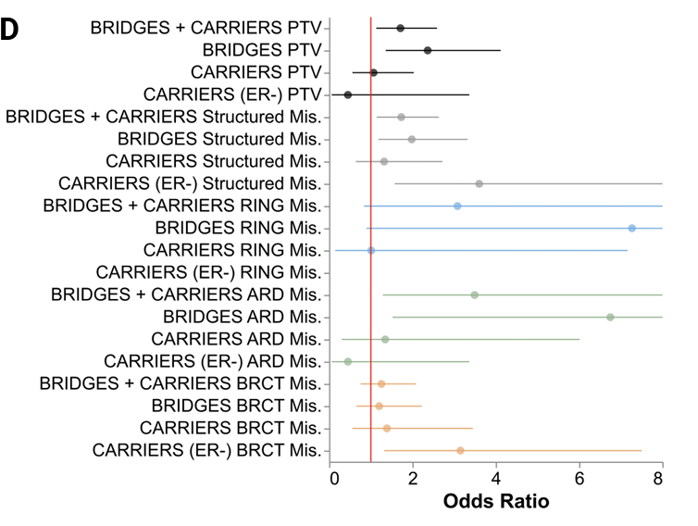
LOF BARD1 variants are enriched in breast cancer cases vs. controls

Slide 22
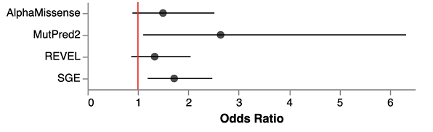
LOF BARD1 variants are enriched in breast cancer cases vs. controls

Slide 23
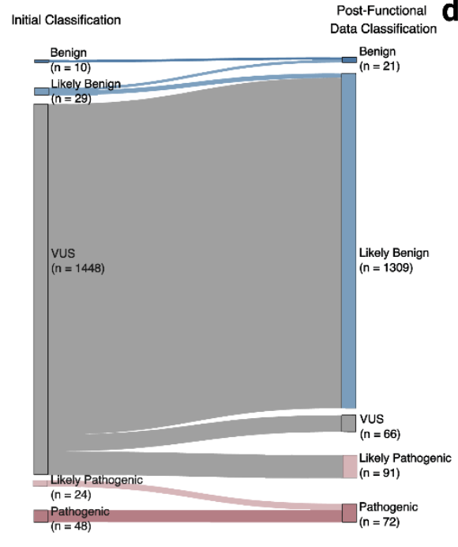
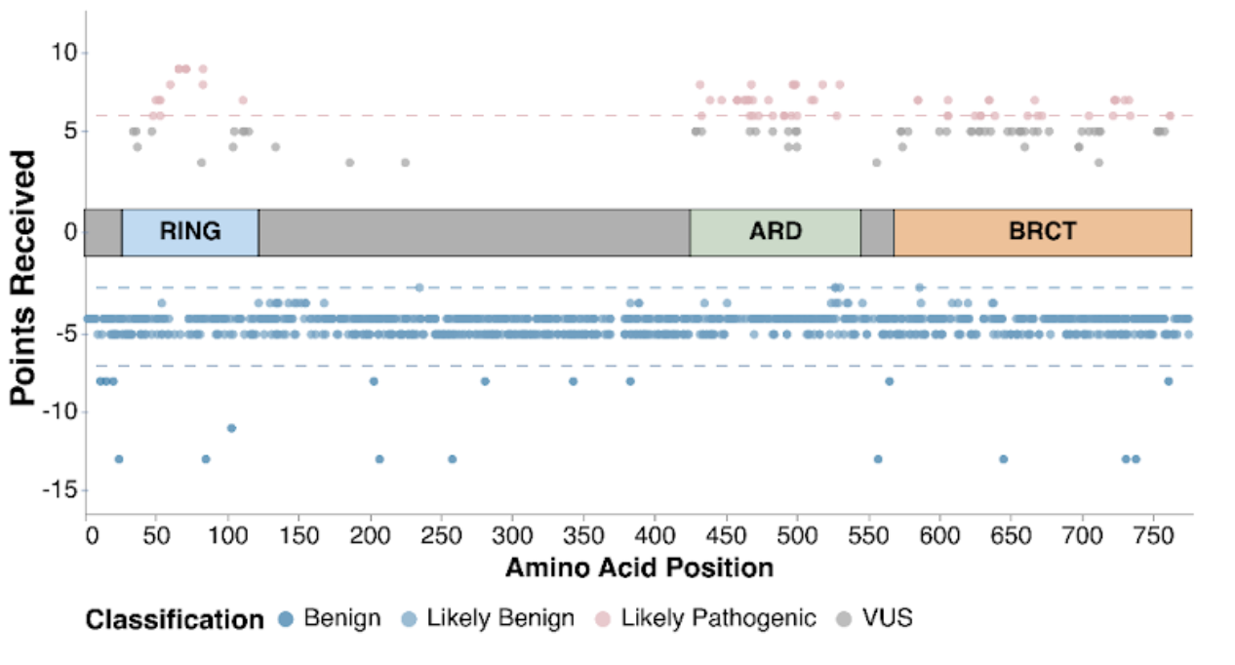
Accuracy of SGE data provides strong evidence for variant classification

Slide 24
What’s going on with the variants with unexpected scores?
Functional scores

Slide 25
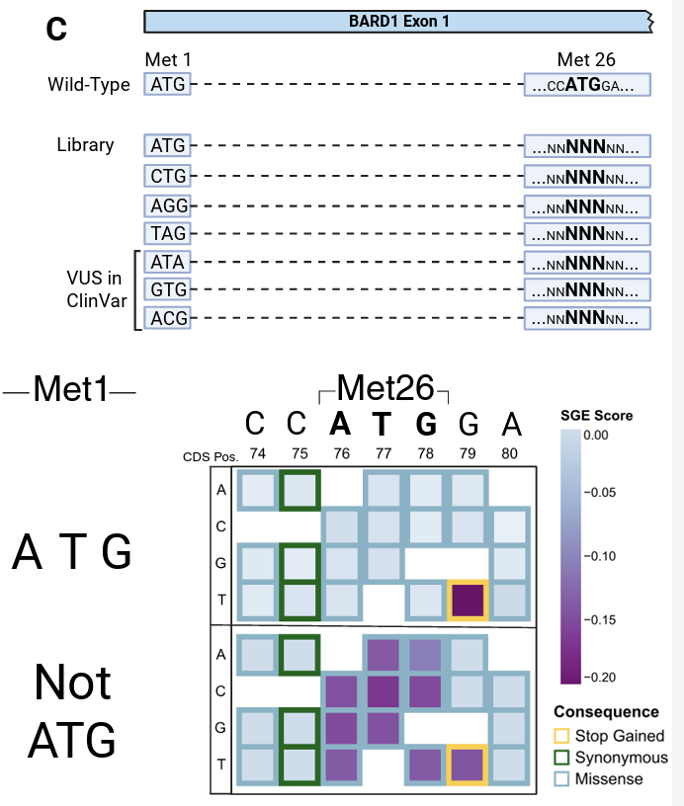
BARD1 has an alternative start codon

Slide 26
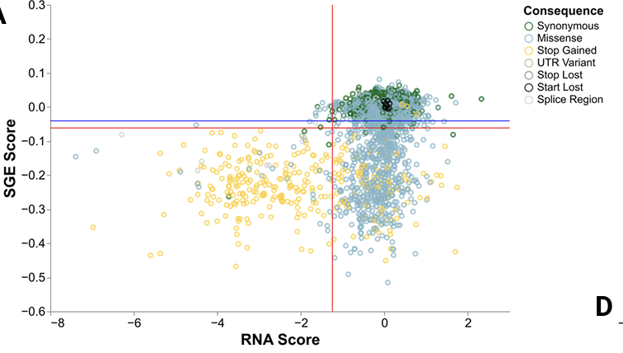
RNA scores reveals variants that cause splice effects

Slide 27
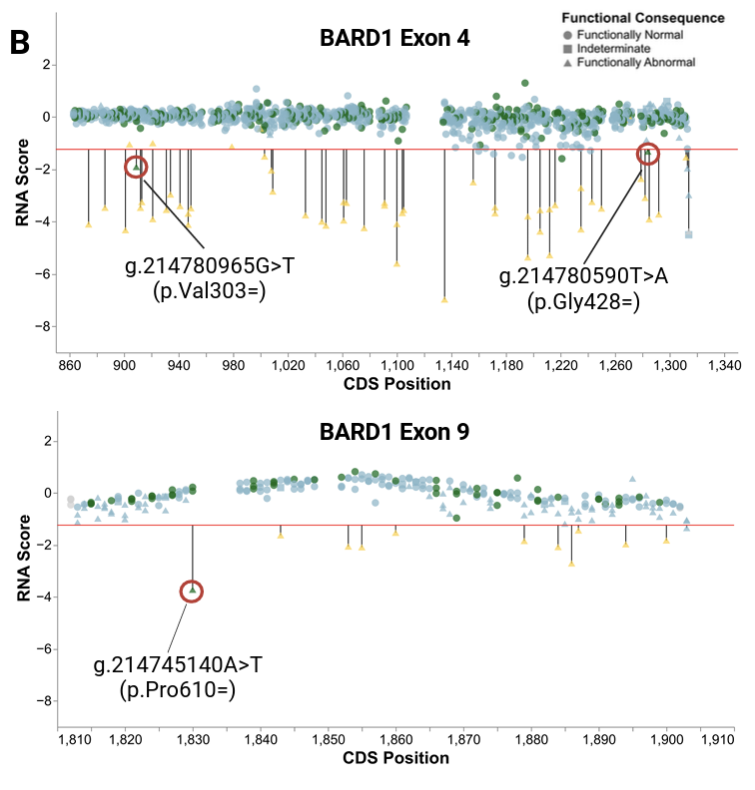
RNA scores reveals variants that cause splice effects
Functional scores

Slide 28
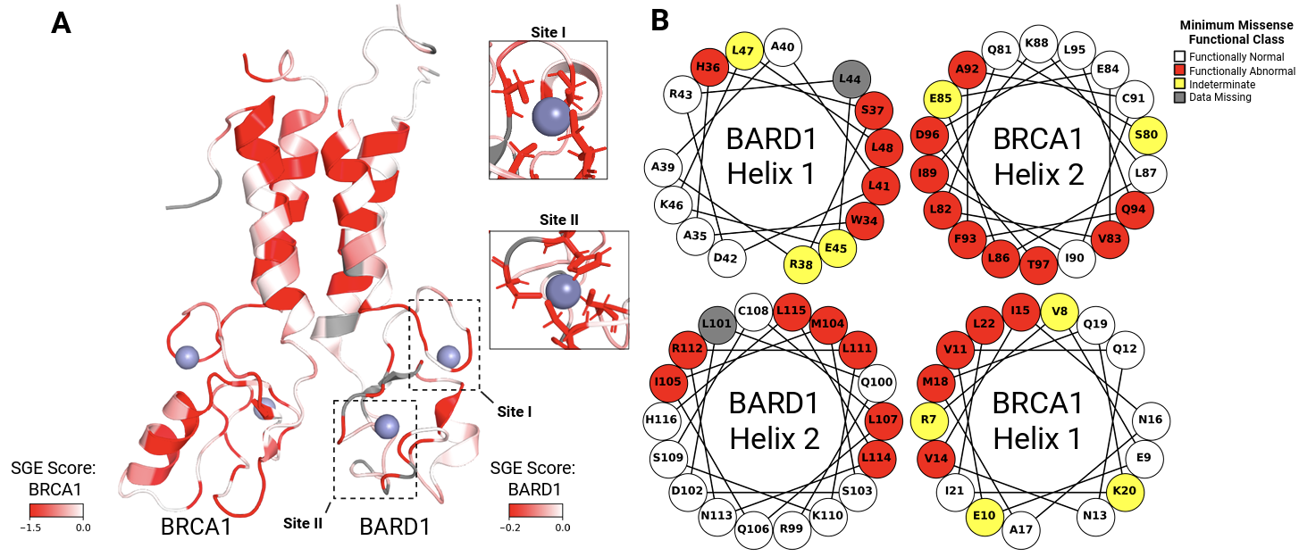
Reciprocal SGE experiments highlight critical features of the BRCA1 and BARD1 RING domains

Slide 29
Reciprocal SGE experiments highlight critical features of the BRCA1 and BARD1 RING domains

Slide 30
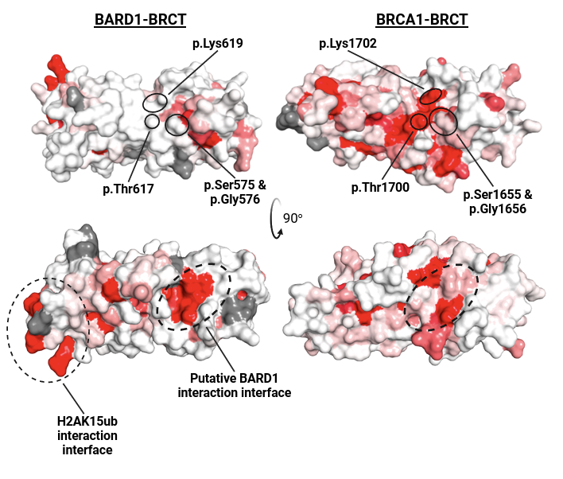
Reciprocal SGE experiments highlight differential missense sensitivity in BRCA1 and BARD1 BRCT domains

Slide 31
Reciprocal SGE experiments highlight differential missense sensitivity in BRCA1 and BARD1 BRCT domains

Slide 32

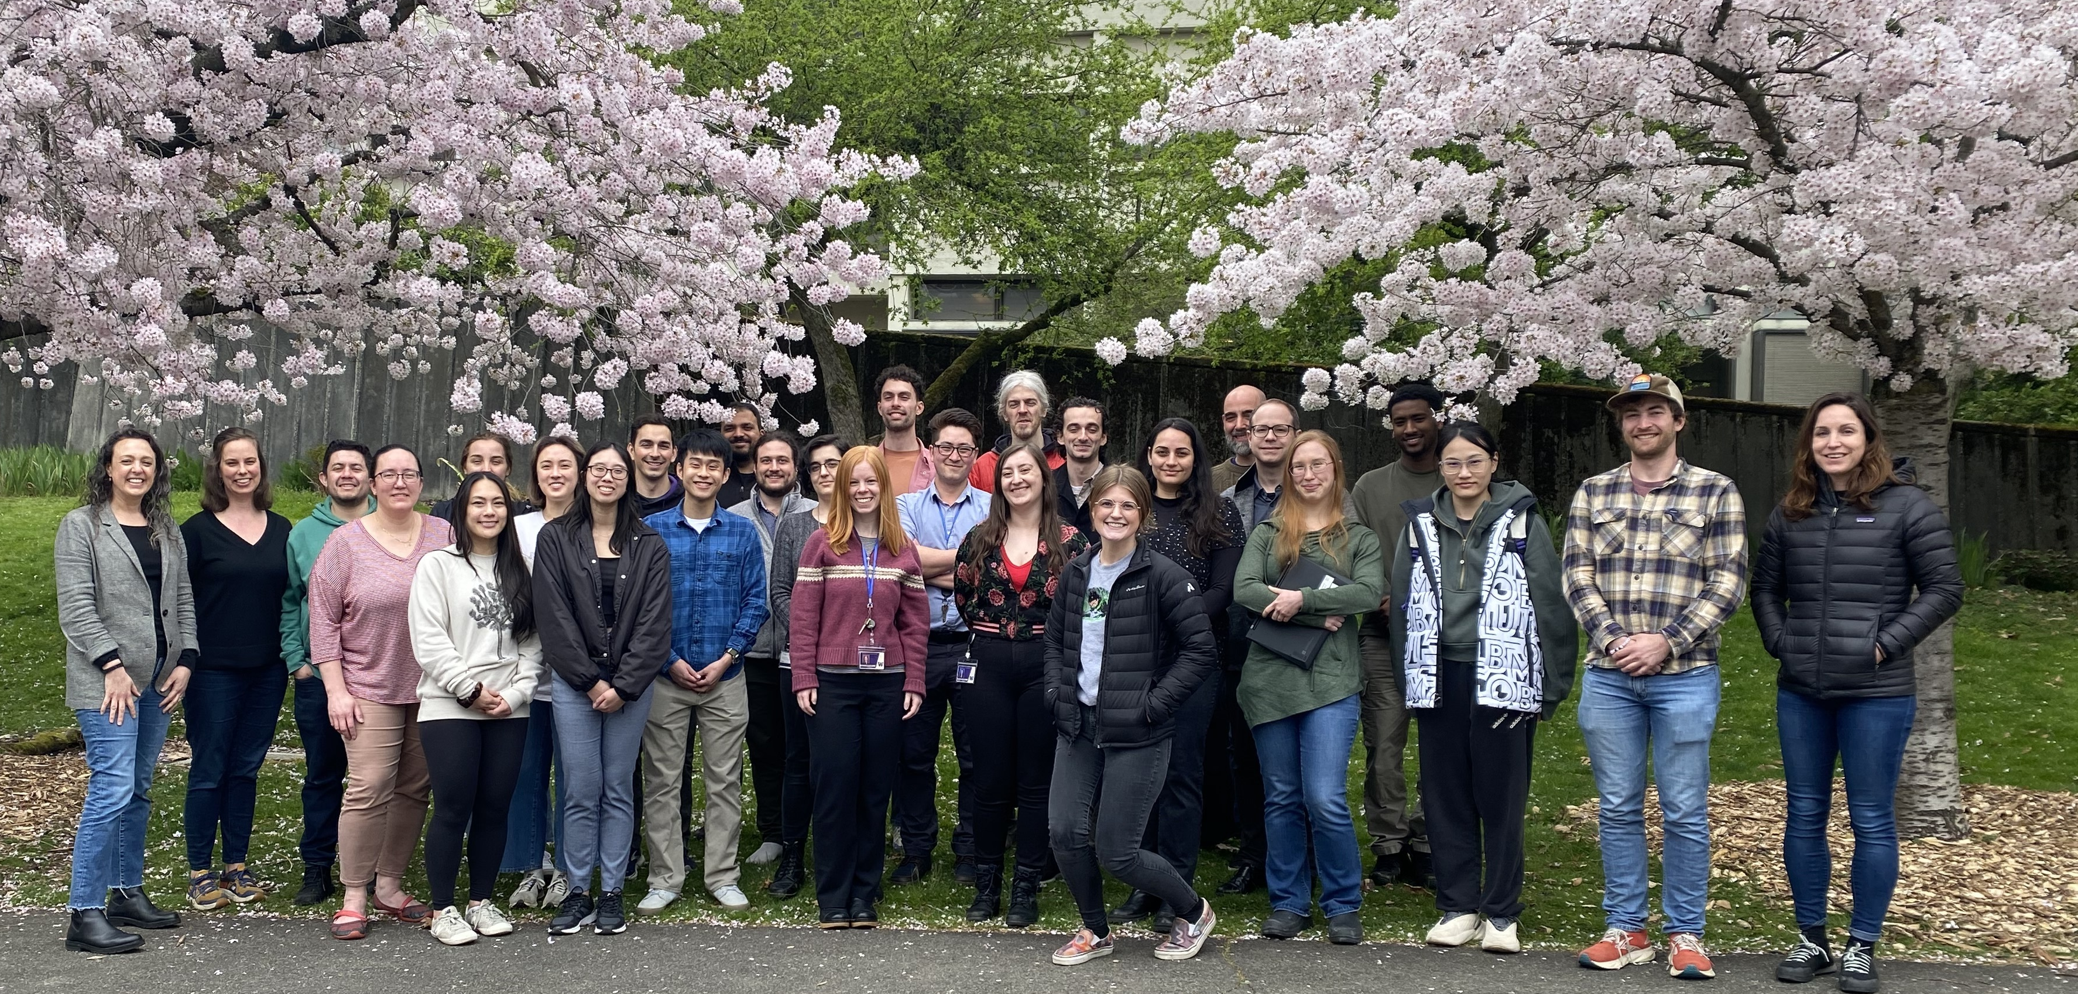


Many people to thank --
Starita lab
v v
v v
BBI Advanced Technology Lab
v v
Program
management
Cardio project
sci BATs
Mutant BATs
Shawn Fayer
Nahum Smith
Riddhiman Garge
Silvia Casadei
Malvika Tejura
Ben Mallory
Sophie Gibson
Christine Lin
Yile Chen
Mariam Benazouz
Min Seon Park
Doug Fowler
Daniel Yang
Clayton Friedman
Shawn Fayer
Mary O’Neill
Diana O’Day
Brent Ewing
Katherine Barker
Luis Gamboa
Nahum Smith
Silvia Casadei
Sabrina Best
Ivan Woo
Audrey Hamm
Sarah Heidl
Melinda Wheelock
Raining Wang
Jordan Ospahl
Leslie Rodriguez Salas
Obsa Seid
Cameron Wenman
Dan Holmes
Matthew Snyder
Airi Hosokai
Alicia Wu
Nola Klemfuss
Jasmine Duong
Lara Muffley
Sarah Heidl
Kristina Hyman
Peggie Lee
v v
CMAP PIs
v v
Doug Fowler
Judit Villen
Christine Queitsch
Jay Shendure
Cole Trapnell
Fritz Roth
Software team
Jeremy Stone
Dave Reinhart
Ben Capodano
Sally Grindstaff
v v
UW Variant Effects PIs
Doug Fowler
Andrew Stergachis
Alan Rubin
Richard James

