Slide 1

CAGI7 slide pack guidelines
I agree to my slides being used according to the following terms:
Fritz Roth
Authors: please include THIS slide at the beginning of your presentation to indicate that you agree with reuse of your slides in CAGI presentations, according to the terms below, and digitally sign by writing your name above.
To disseminate the CAGI results, I encourage all CAGI participants to remix these CAGI slides for inclusion in their oral and poster presentations.
CAGI participants may use or publish any content of these slides only in compliance with the CAGI Data Use Agreement.
CAGI participants may not cite or publish any content of these slides except with the written permission of the originating author or in the primary CAGI publications.
CAGI participants must acknowledge the original authors of these slides and CAGI7. Include the acknowledgement banner across the bottom.
CAGI participants must include the CAGI credits slide in their presentations.
Slides with a red slash (no remix) may not be included in a presentation unless all attendees are registered CAGI participants who signed the data use agreement.
Slides with a red X over the entire slide may not be used in any circumstances.
Slides with a blue slash (embargoed) may not be used unless the embargo is explicitly lifted.
Slides without slash or X may be tweeted unless flagged with the “No tweet” icon.
CAGI participants using these slides must explain the “No tweet” icon, which means that the slide content should not be disseminated outside the presenting conference hall. If the presentation venue permits pervasive tweeting, you may not include these slides in your talk.
Note for slide authors: we expect all CAGI participants to abide by these restrictions and will make best effort to ensure they are followed. However, bear in mind that we have limited means of enforcing them, and therefore the restrictions cannot be guaranteed.
Notes:
At CAGI7, use of this slide pack is only required for CAGI dataset providers, assessors, and predictors, but all are encouraged to use the annotations for materials they do not want shared publicly.

Slide 2
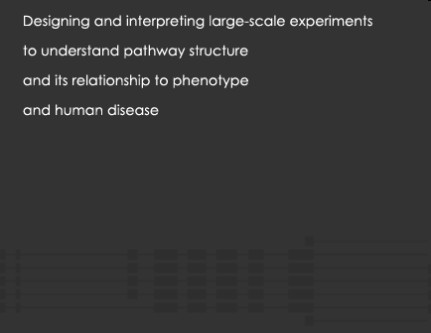

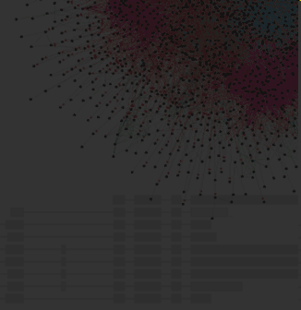
Proactive missense variant effect analysis for Wilson’s Disease
Fritz Roth
Department of Computational and Systems Biology
University of Pittsburgh School of Medicine
Critical Assessment of Genome Interpretation 7
Boston, MA
December 7, 2025
Potential conflicts
SAB member and/or shareholder: SeqWell, Ranomics, Constantiam
Previous research support from: Deep Genomics, Biogen, Beam Therapeutics, Alnylam

Slide 3
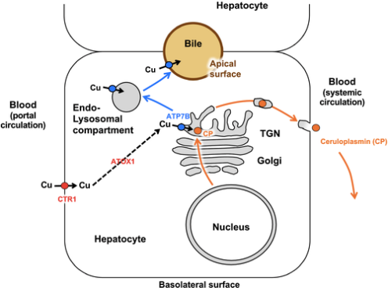
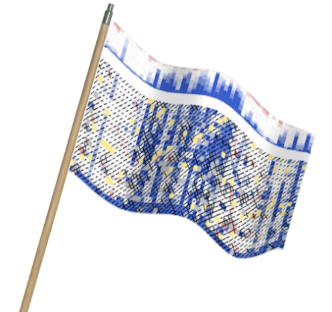
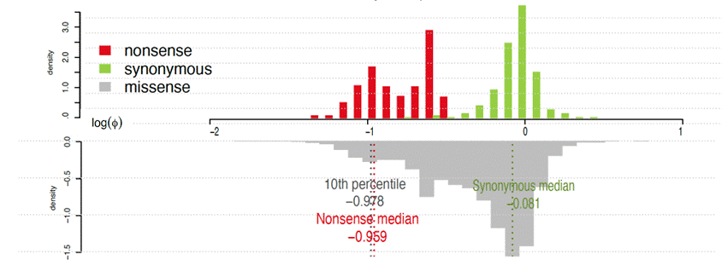
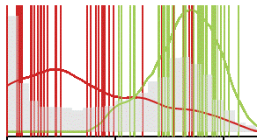
Outline
  Wilson’s Disease and its VUS Problem
  Assay and small-scale validation
  Variant effect mapping
  Reality checks
  Clinical evidence calibration
3

Slide 4
ATP7B and Wilson’s Disease
ATP7B encodes a transmembrane copper-transporting ATPase
ATP7B variants can cause Wilson’s disease, a rare autosomal recessive disorder of copper metabolism
Wilson’s Disease is characterised by diverse kidney, liver, neurological and other symptoms
4
Polishchuk and Polishchuk (2019)
https://ghr.nlm.nih.gov/condition/wilson-disease

Slide 5
Most ATP7B clinical missense variants have weak classifications
When we proposed this project in 2020:
  52% of ClinVar ATP7B missense variants were variants of uncertain significance (VUS)
Now the problem is worse (Dec 2025):
  71% VUS
5

Slide 6
Outline
  Wilson’s Disease and its VUS Problem
  Assay and small-scale validation
  Variant effect mapping
  Reality checks
  Clinical evidence calibration
6

Slide 7
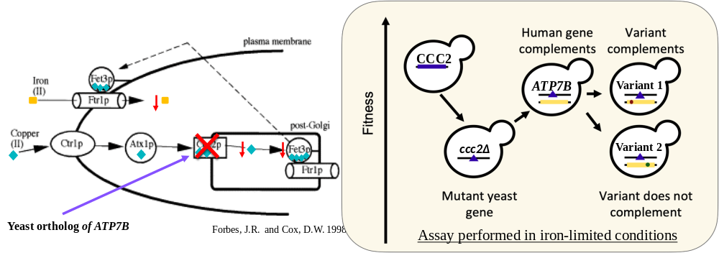
Yeast based functional complementation assay for ATP7B
Basic Idea:
Yeast with KO of ccc2 (ATP7B ortholog) cannot grow on iron-limited medium
Expressing (normally-functioning) ATP7B in yeast rescues growth
7
Modified from Forbes, J.R. and Cox, D.W. 1998
7

Slide 8
ATP7B: Domain structure and missense mutations
1
1
1
1
1
1
8
6
MBD1
MBD2
MBD3
MBD4
MBD5
MBD6
630
65
1
3
4
2
18
17
22
12
23
2
5
5
TMA
TMB
TM1
TM2
A domain
TM3
TM4
648
790
908
1003
55
47
15
14
12
1465
P
N domain
P domain
TM5
TM6
4
1004
1306
1373
MBD – metal binding domain(s); TMD – transmembrane domains; A domain - actuator domain; P domain – phosphorylation domain; N domain – nucleotide binding domain
In blue circles: Number of annotated-pathogenic missense variants in each segment (Wilson’s disease database)
8
Modified from Yu et al., 2018
8

Slide 9
Small-scale validation of the ATP7B yeast complementation assay
Iron sufficient
media
Iron limited
media
Agrees with
Expectation?
ccc2△ wt ATP7B
✓
ccc2△ empty vector
✓
G710S
✓
We achieved 70% recall
at 100% precision
*Pathogenic/Likely Pathogenic
Benign/Likely Benign variants
M769V
✕
G85V
✓
R969Q
✕
N41S
✕
P992L
✓
H1069Q
✓
P840L
✓
Precision: fraction of predicted pathogenic variants that are annotated pathogenic
Recall: fraction of all annotated pathogenic variants that were correctly predicted
G1266R
✓
P1273L
✓
R725K
✓
K832R
✓
A14D
✓
V456L
✓
H1034R
✓
V1140A
✓
H1207R
✓
9
(Kishore et al, in preparation)
Kishore, N. et. al., in prep

Slide 10
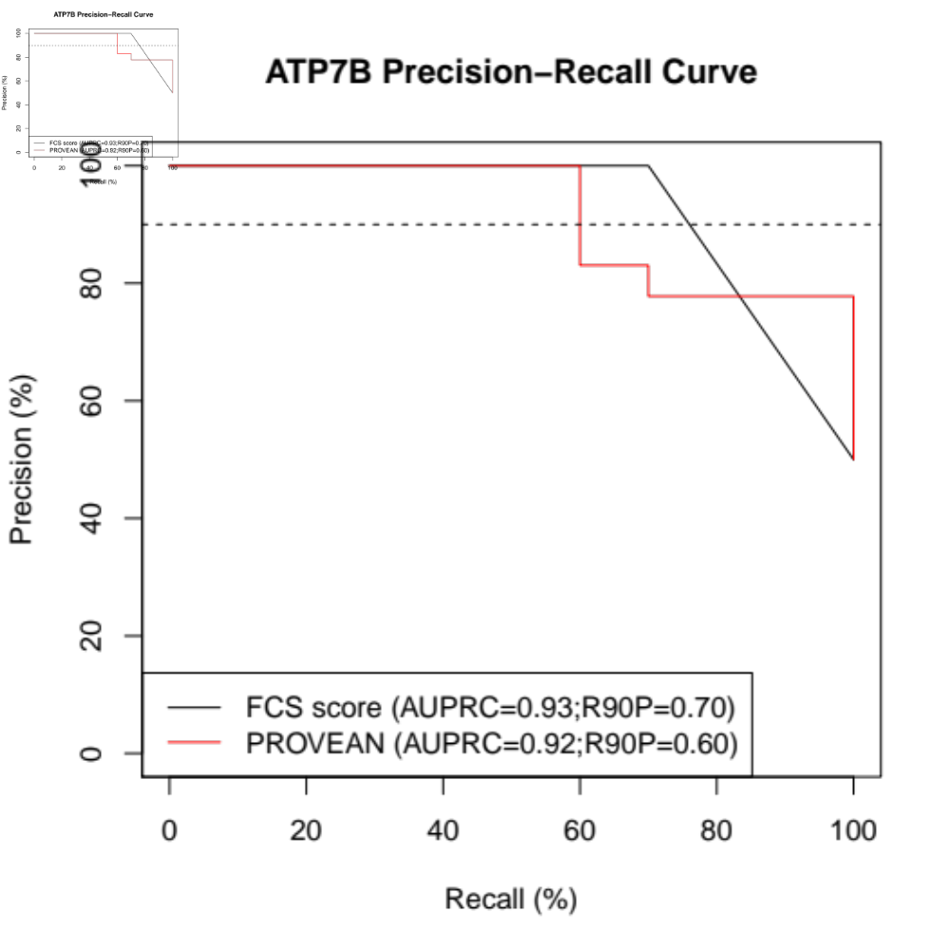
Small-scale validation of the ATP7B yeast complementation assay
Metal binding
domains 1- 6
TM
A, B,1,2
A
domain
TM
3-4
P
N
P
TMD
5-6
NH₂
COOH
Region 1
Region 2
Region 3
Region 4
Region 5
Region 6
Region 7
Region 8
Region 9
We achieved 70% recall
at 100% precision
Precision: fraction of predicted pathogenic variants that are annotated pathogenic
Recall: fraction of all annotated pathogenic variants that were correctly predicted
10
(Kishore et al, in preparation)
10

Slide 11
Outline
  Wilson’s Disease and its VUS Problem
  Assay and small-scale validation
  Variant effect mapping
  Reality checks
  Clinical evidence calibration
11

Slide 12
ATP7B: It’s really big
ATP7B : Length 1465 amino acids
Context: Longest protein with a complete and published map from our group is
LDLR with length 860 a.a. (Tabet et al 2025)
12
12

Slide 13
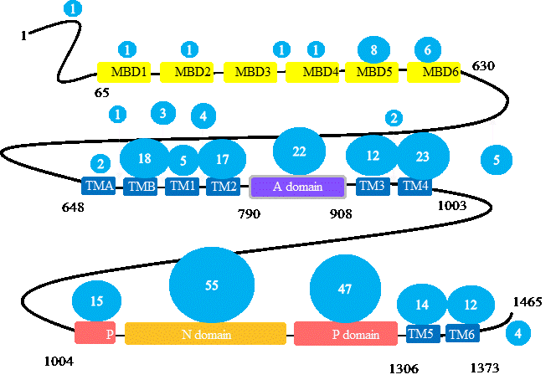
ATP7B: Nine mutagenesis target regions, we focused on C-terminal five
Regions of interest | Amino acid range
Region 5 | 706 - 879
Region 6 | 880 – 1028
Region 7 | 1029 – 1207
Region 8 | 1208 - 1350
Region 9 | 1351 - 1465
Metal binding
domains 1- 6
TM
A, B,1,2
A
domain
TM
3-4
P
N
P
TMD
5-6
NH₂
COOH
Region 1
Region 2
Region 3
Region 4
Region 5
Region 6
Region 7
Region 8
Region 9
Identified nine target ‘regions’ for mutagenesis, of which we are currently focusing on the C-terminal 5 regions because majority of known disease-causing missense mutations are C-terminal
13
Images modified from Yu et al., 2018
13

Slide 14
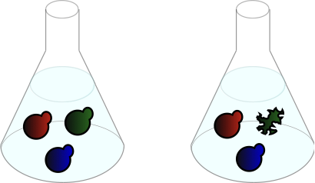
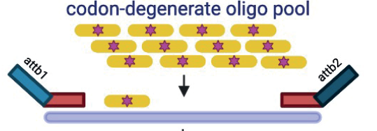
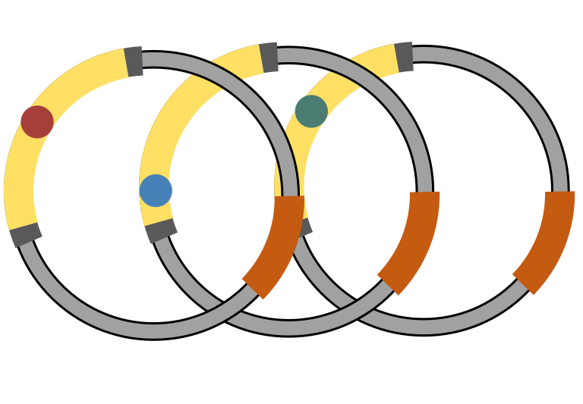
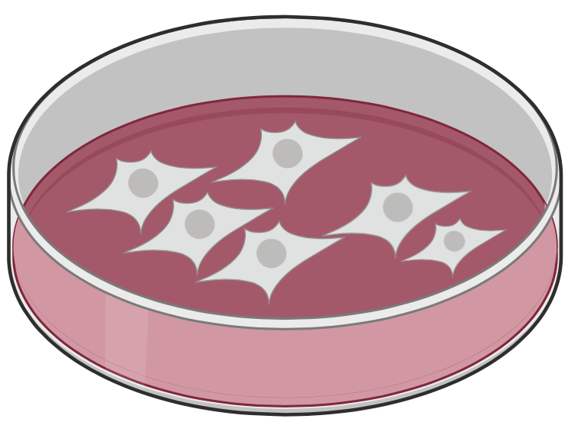
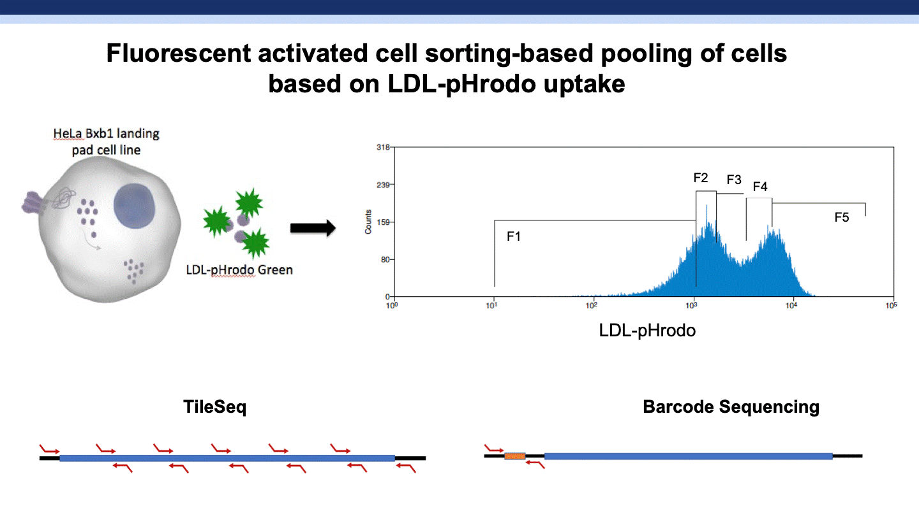

Framework for variant effect mapping
Mutagenesis
Library generation
Functional selection
x
x
Pre-
Selection
Post-Selection
Readout
Deriving fitness scores
Variant effect map
TileSeq
?
BarSeq
14

Slide 15
Analysis for subset of ATP7B variant effect map (amino acids 706 – 1028)
706 1028
Metal binding
domains 1- 6
TM
A, B,1,2
A
domain
TM
3-4
P
N
P
TMD
7-8
NH₂
COOH
Region 1
Region 2
Region 3
Region 4
Region 5
Region 6
Region 7
Region 8
Region 9
15
15

Slide 16
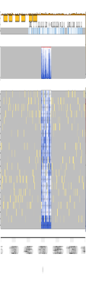
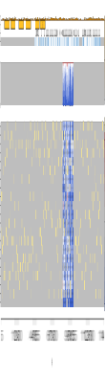
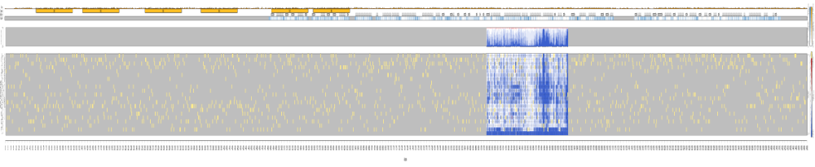
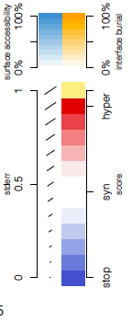
ATP7B variant effect map for amino acids 706 – 1028
723
731
754
764
784
786
TMD - MB
TMD – M1
TMD – M2
A domain
917
946
970
982
987
1004
A domain
TMD – M3
TMD – M4A
TMD – M4B
P domain (1st half)
16
(Kishore et al, in preparation)

Slide 17
Outline
  Wilson’s Disease and its VUS Problem
  Assay and small-scale validation
  Variant effect mapping
  Reality checks
  Clinical evidence calibration
17

Slide 18
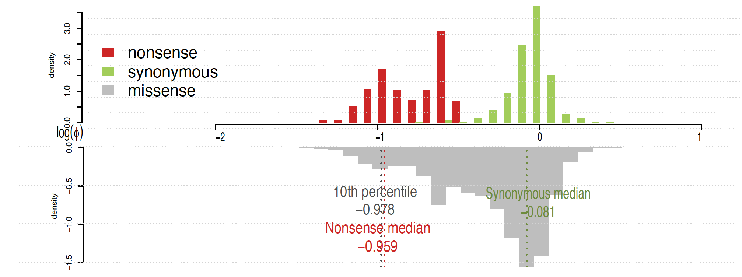

Distributions of maps scores for nonsense, synonymous and missense
Distribution of scores suggests good separation between nonsense and synonymous variants
Coverage: 99.9% of all amino acid substitutions and 100% of all SNV-reachable missense variants were captured
18
(Kishore et al, in preparation)

Slide 19
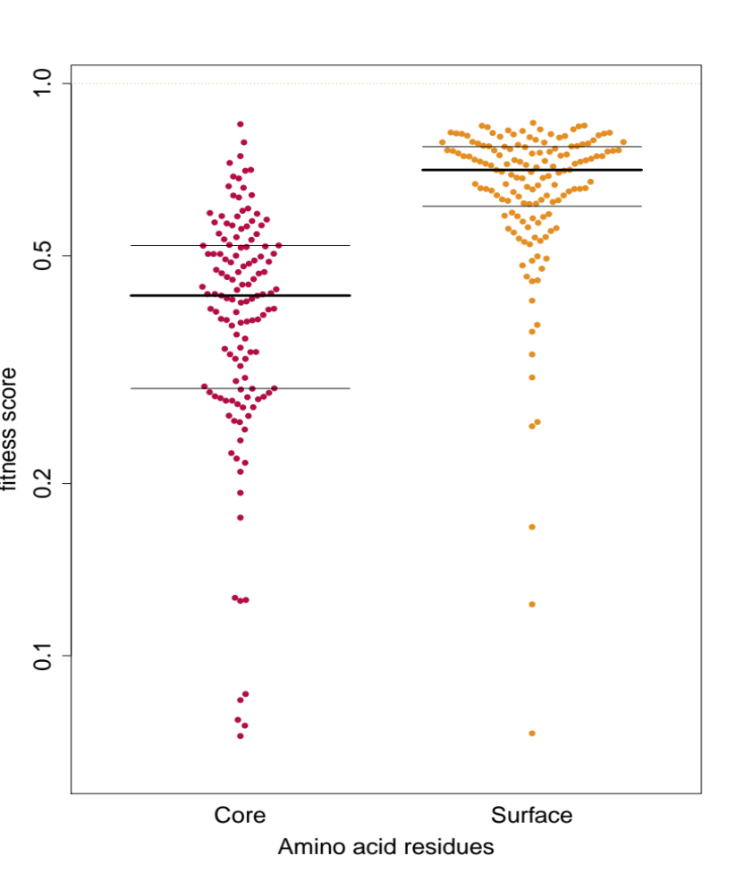
Reality check: More damaging scores for buried/core residues
△ median = -0.26; p-value < 2.2e-16
Core (ASA<20%) residues have a lower median fitness score than surface (ASA>35%) residues
Fitness Score
ASA = accessible surface area
Core
Surface
Amino acid residue
19
(Kishore et al, in preparation)

Slide 20
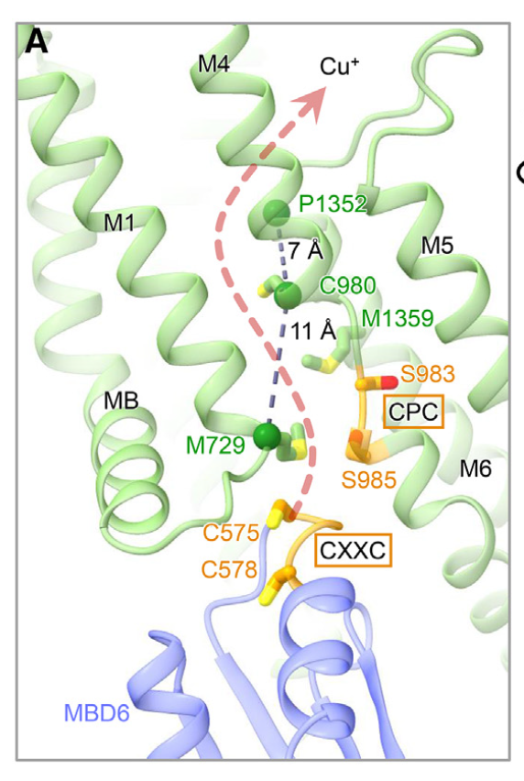
ATP7B variant effect map for amino acids 706 – 1028)
Important for copper binding
R778 seals the cytoplasmic side of the Cu⁺ entryway
Putative transmembrane Cu⁺ pathway of ATP7B with residues lining the Cu+ entryway labelled
M729
723
731
754
764
784
786
TMD - MB
TMD – M1
TMD – M2
A domain
TGE
Important phospho sites
C983
917
946
970
982
987
1004
CPC
A domain
TMD – M3
M4A
M4B
P domain (1st half)
C985
DKTG
CPC
Important for copper binding
20
(Kishore et al, in preparation)
Structure image modified from Yang, et. al. 2023
Notes:
CPC domain or the C983 and 985 that line the copper entryway and directly bind copper
Met729 lines the Cu entryway as well.
R778 an important residue of the Cu entryway; Lue at this position is the most common substitution seen in the Wilsons disease East Asian population at an allele frequency of 14-49%.

Slide 21
Outline
  Wilson’s Disease and its VUS Problem
  Assay and small-scale validation
  Variant effect mapping
  Reality checks
  Clinical evidence calibration
21

Slide 22
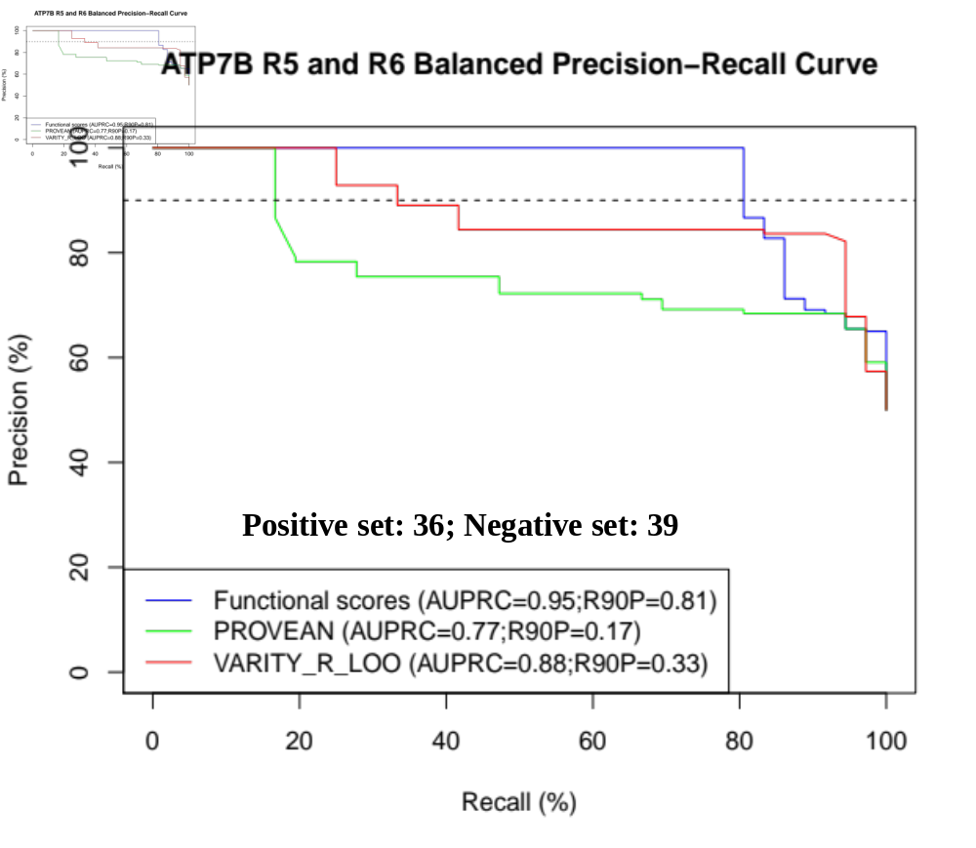
ATP7B map discriminates pathogenic from benign variants
Reference Set contains: ClinVar variants (2 quality stars and up); GnomAD variants (limited to ‘control only’ set; minor allele frequency set to < 0.00001)
Map regions 5-6 achieved
81% recall
at 90% precision
Precision: fraction of predicted pathogenic variants that are annotated pathogenic
Recall: fraction of all annotated pathogenic variants that were correctly predicted
22
(Kishore et al, in preparation)

Slide 23
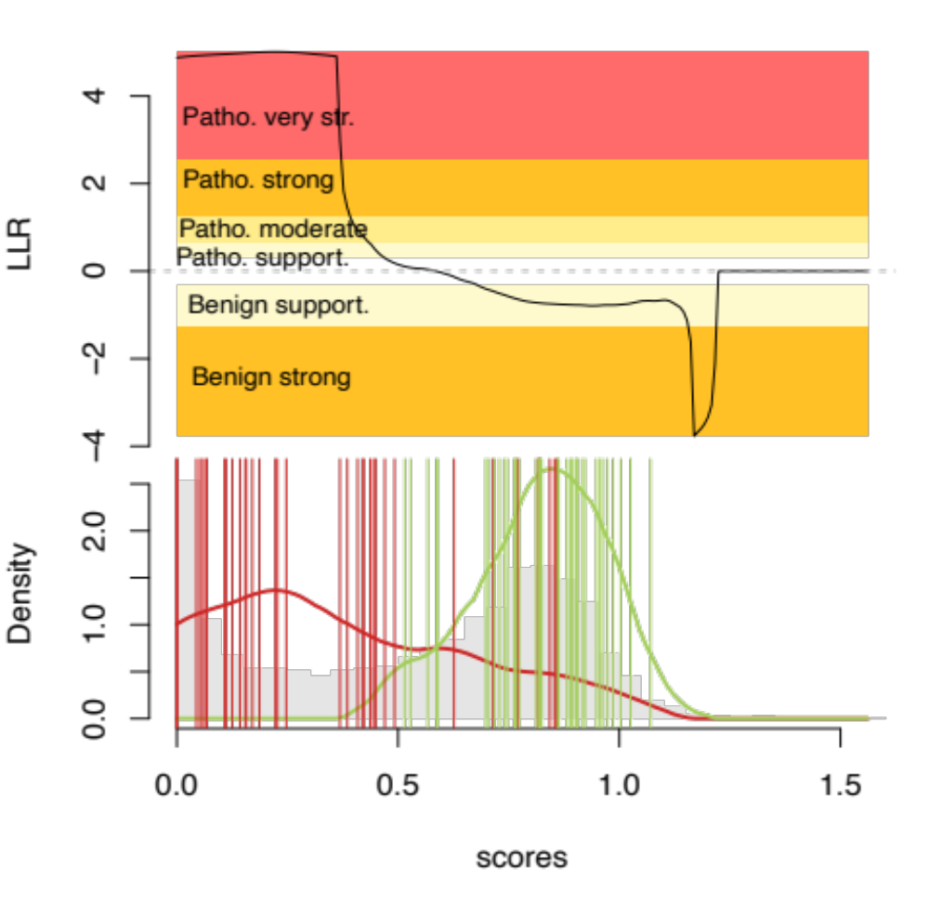
ATP7B map yields new evidence for 92% of ClinVar missense VUSs
Log Likelihood ratio
Suggested Evidence Strength | Fraction of VUS
Pathogenic very strong | 13%
Pathogenic strong | 1%
Pathogenic moderate | 2%
Pathogenic supporting | 8%
Benign supporting | 59%
Benign strong | 9%
Likely Benign/Benign
Density
Likely pathogenic/Pathogenic
CAVEAT: This calibration was reviewed or approved by ClinGen VCEP or other clinical decision-maker!
23
(Kishore et al, in preparation)

Slide 24
Summary and future directions
Summary:
Variant effect map for C-terminal half of the 1465-amino-acid ATP7B protein
After analyzing only regions 5 and 6…
  Scores distinguish pathogenic from benign variants
  Functional evidence for 92% of missense VUSs
To Do:
Similarly analyze regions 7-9!
Relate map scores to age of onset, severity, or other features of Wilson’s disease
Publish map for C-terminal half of ATP7B
Seek funding for N-terminal half of ATP7B.
24
(Kishore et al, in preparation)

Slide 25
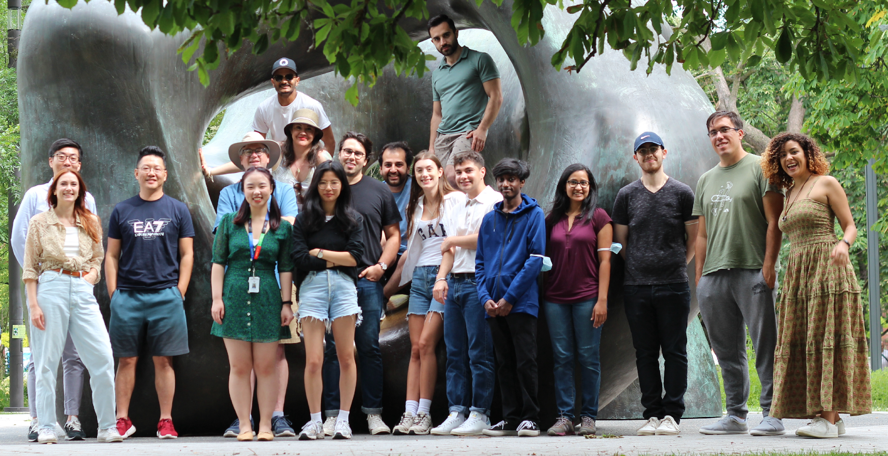
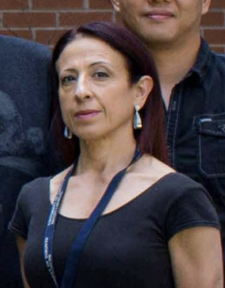


Acknowledgements
Roth Lab
Nishka Kishore
Marinella Gebbia
Warren van Loggerenberg
Anna Axakova
Sam Douville
Jochen Weile
Deep Genomics
Carl Spickett
Daniele Merico
Tehmina Masud
Support
Deep Genomics
NIH/NHGRI CEGS Program
Canada Excellence Research Chair
CIHR Foundation Grant
Canada Foundation for Innovation
Work mostly happened in Toronto:
Continuing at U Pittsburgh

Slide 26
THANK YOU!

