Slide 1

CAGI7 slide pack guidelines
I agree to my slides being used according to the following terms:
__Yihong Yang__
Authors: please include THIS slide at the beginning of your presentation to indicate that you agree with reuse of your slides in CAGI presentations, according to the terms below, and digitally sign by writing your name above.
To disseminate the CAGI results, I encourage all CAGI participants to remix these CAGI slides for inclusion in their oral and poster presentations.
CAGI participants may use or publish any content of these slides only in compliance with the CAGI Data Use Agreement.
CAGI participants may not cite or publish any content of these slides except with the written permission of the originating author or in the primary CAGI publications.
CAGI participants must acknowledge the original authors of these slides and CAGI7. Include the acknowledgement banner across the bottom.
CAGI participants must include the CAGI credits slide in their presentations.
Slides with a red slash (no remix) may not be included in a presentation unless all attendees are registered CAGI participants who signed the data use agreement.
Slides with a red X over the entire slide may not be used in any circumstances.
Slides with a blue slash (embargoed) may not be used unless the embargo is explicitly lifted.
Slides without slash or X may be tweeted unless flagged with the “No tweet” icon.
CAGI participants using these slides must explain the “No tweet” icon, which means that the slide content should not be disseminated outside the presenting conference hall. If the presentation venue permits pervasive tweeting, you may not include these slides in your talk.
Note for slide authors: we expect all CAGI participants to abide by these restrictions and will make best effort to ensure they are followed. However, bear in mind that we have limited means of enforcing them, and therefore the restrictions cannot be guaranteed.
Notes:
At CAGI7, use of this slide pack is only required for CAGI dataset providers, assessors, and predictors, but all are encouraged to use the annotations for materials they do not want shared publicly.

Slide 2
Beyond Sequence: How Structure and Multimodal Contexts Improve Variant Effect Prediction
Yuxuan Liu, Yihong Yang, Rujie Yin, Hao Zheng, Orlando Haye, Joshua Park, Kevin Nguyen, and Yang Shen*
Departments of Electrical & Computer Engineering and Computer Science & Engineering, Texas A&M University
Created for CAGI7
genomeinterpretation.org
Yihong Yang
Notes:
Hi everyone. I'm Yihong Yang from Texas A&M University. It is my great honor to be here to share our group's work. My presentation topic is: 'Beyond Sequence: How Structural and Multi-modal Contexts Improve Variant Effect Prediction.'"

Slide 3
Overview
Variant Effects and Contexts
Protein Language Models (PLM)
Incorporating Structural Contexts into PLM
Incorporating Functional Contexts
From Context-Specific VEP to Design
    Our Structure-Informed PLM
                SaProt
                Integrated Embeddings Approach
Created for CAGI7
genomeinterpretation.org
Yihong Yang
Notes:
Here is a quick overview of today's talk. Let's dive straight into the background.

Slide 4
Overview
Variant Effects and Contexts
Protein Language Models (PLM)
Incorporating Structural Contexts into PLM
Incorporating Functional Contexts
From Context-Specific VEP to Design
    Our Structure-Informed PLM
                SaProt
                Integrated Embeddings Approach
Created for CAGI7
genomeinterpretation.org
Yihong Yang
Notes:
Here is a quick overview of today's talk. Let's dive straight into the background.

Slide 5
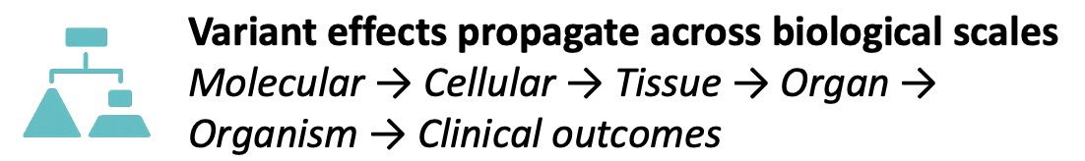
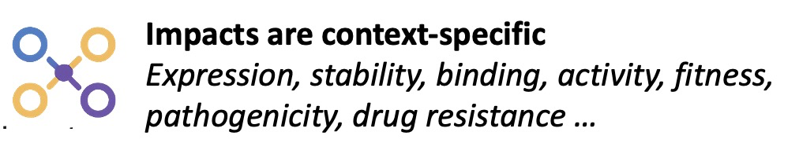
Variant Effects Are Context Specific
Effects vary by level: Molecular (expression, stability, binding, activity), Cellular (fitness), Tissue/Organ/Organism (phenotype).
Not all mutations are created equal. Their impacts manifest along a functional causal hierarchy. Predictions that ignore these specific contexts—treating all mutations as just sequence changes risk oversimplification.
Created for CAGI7
genomeinterpretation.org
Yihong Yang
Notes:
When we talk about Variant Effect Prediction (VEP), we must recognize that variant effects are context-specific. They propagate across biological scales:
Starting at the Molecular level, affecting gene expression and protein stability.
This influences binding and activity, leading to Cellular fitness consequences.
Finally, manifesting as Phenotypes at the tissue, oragn or organism level.
Not all mutations are created equal; their impacts manifest along a functional causal hierarchy. Predictions that ignore these contexts—treating all mutations simply as sequence seems to be too sipmle.

Slide 6
Overview
Variant Effects and Contexts
Protein Language Models (PLM)
Incorporating Structural Contexts into PLM
Incorporating Functional Contexts
From Context-Specific VEP to Design
    Our Structure-Informed PLM
                SaProt
                Integrated Embeddings Approach
Created for CAGI7
genomeinterpretation.org
Yihong Yang

Slide 7
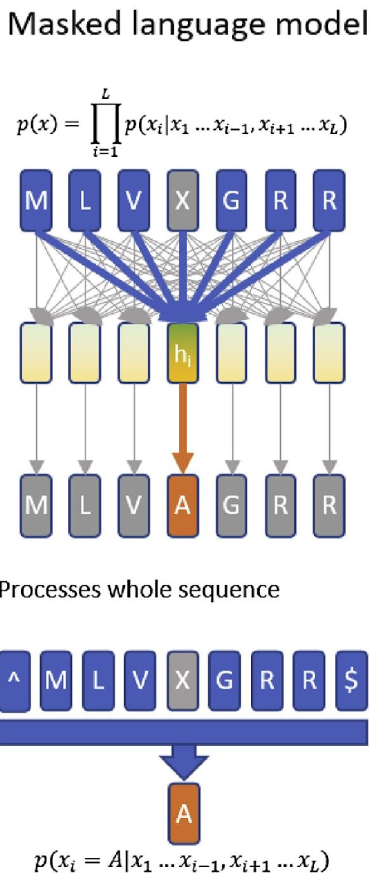
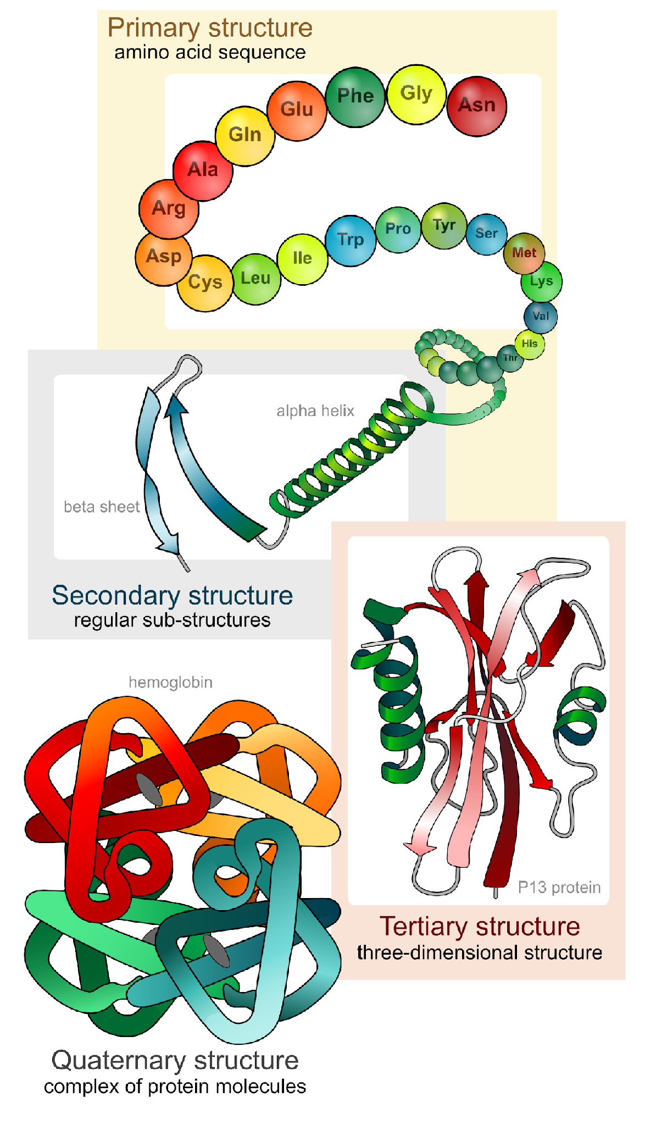

Protein Language Model for VEP
Developments in natural language processing, especially Transformers since 2018, have rippled into modeling “the protein language”
Function
reflect
Evolution
…
Protein Sequences
(Bepler and Berger 2021)
Created for CAGI7
genomeinterpretation.org
Yihong Yang
Notes:
Development in natural language processing, especially transformers have ripple into modeling the protein language. Masked Language Models use sequence inputs to reflect structure, function and evolution.

Slide 8
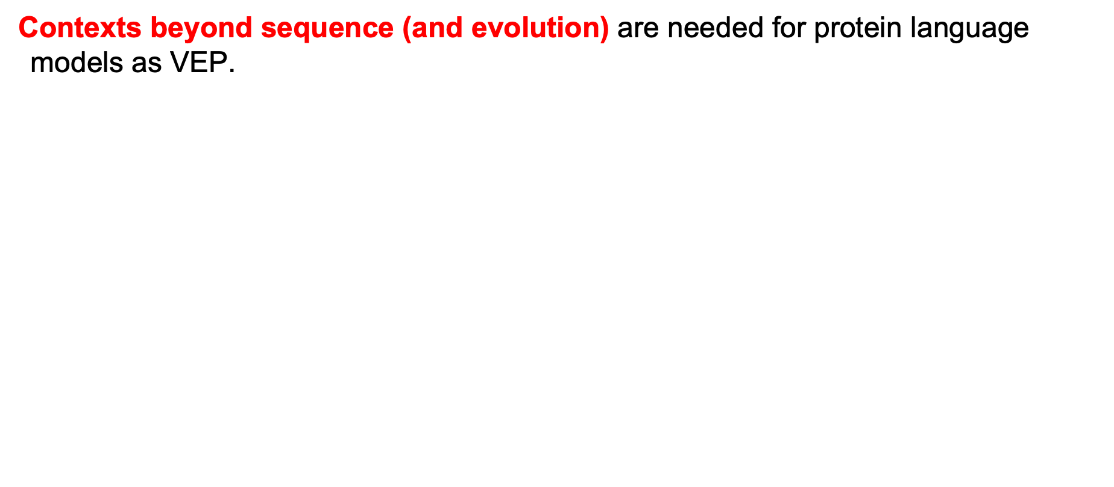
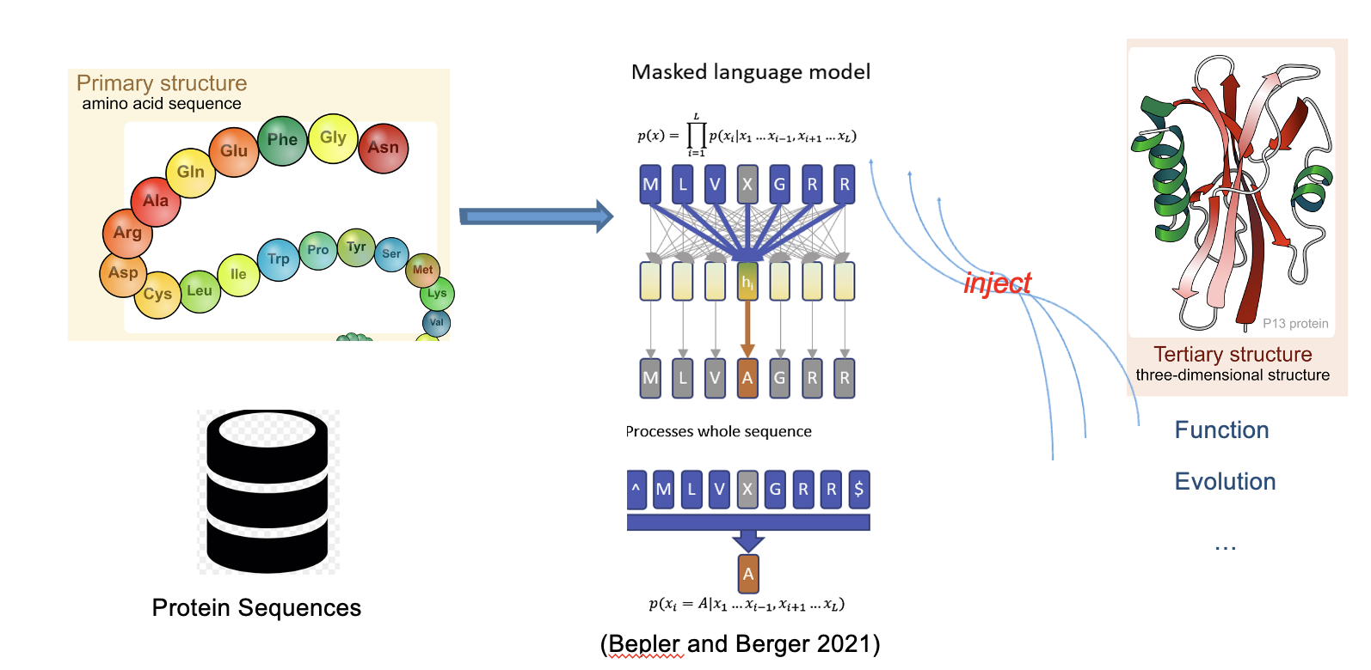
Protein Language Model for VEP
Created for CAGI7
genomeinterpretation.org
Yihong Yang
Notes:
After that, people are thinking about how these information can be injected back into the input to guide our protein language model to do variant effect prediction. Proteins are sequences but much more than sequences. They are sequences folded into 2D/3D structures. So it is a quite intuitive idea that we consider structural context when we doing variant effect prediction.

Slide 9
Overview
Variant Effects and Contexts
Protein Language Models (PLM)
Incorporating Structural Contexts into PLM
Incorporating Functional Contexts
From Context-Specific VEP to Design
    Our Structure-Informed PLM
                SaProt
                Integrated Embeddings Approach
Created for CAGI7
genomeinterpretation.org
Yihong Yang
Notes:
We all agree that structural contexts are helpful in all kinds of protein tasks. The key question is: When and how do these structural contexts help? To approach the answer, we consider two strategies to incorporate structural contexts into protein language models.

Slide 10
Overview
Variant Effects and Contexts
Protein Language Models (PLM)
Incorporating Structural Contexts into PLM
Incorporating Functional Contexts
From Context-Specific VEP to Design
    Our Structure-Informed PLM
                SaProt
                Integrated Embeddings Approach
Created for CAGI7
genomeinterpretation.org
Yihong Yang
Notes:
Strategy 1: What if structure is unknown during inference? We can utilize structure during training to imbue the model with context-specific knowledge. This is our SIP-LM (Structure-Informed Protein Language Model).

Slide 11
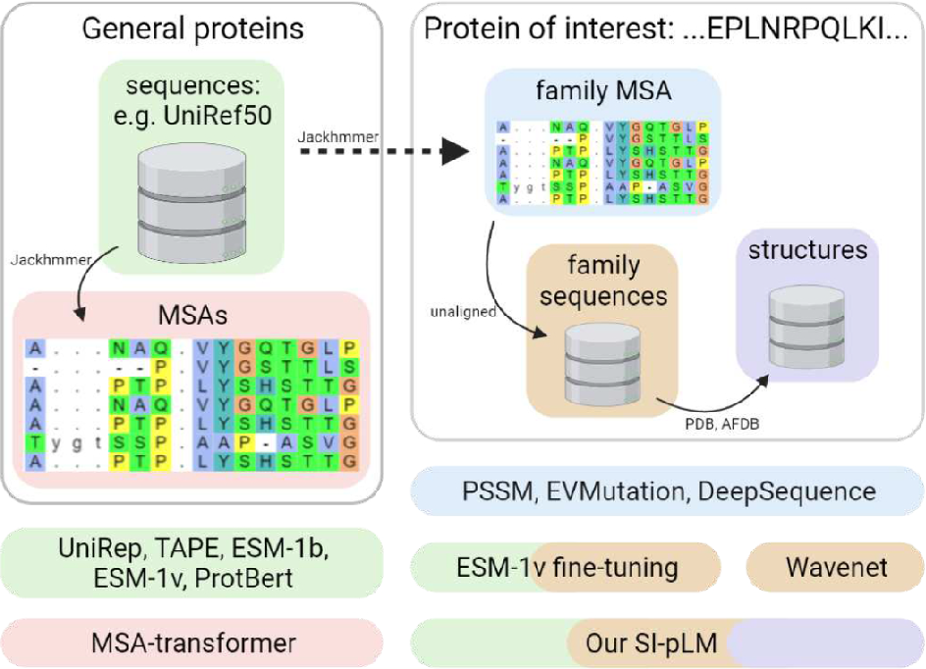
Our Structure-Informed Protein Language Models
No Structure is needed during model inference!
Sun and Shen, Human Genetics, 2025
Created for CAGI7
genomeinterpretation.org
Yihong Yang
Notes:
The SI-pLM architecture enhances standard protein language models by training them with a cross-modality denoising objective that incorporates 3D structural information strictly as a training regularizer, allowing the model to capture structural context while still requiring only sequence inputs for prediction. It incorporates structural context during training, but requires no structure during inference.

Slide 12
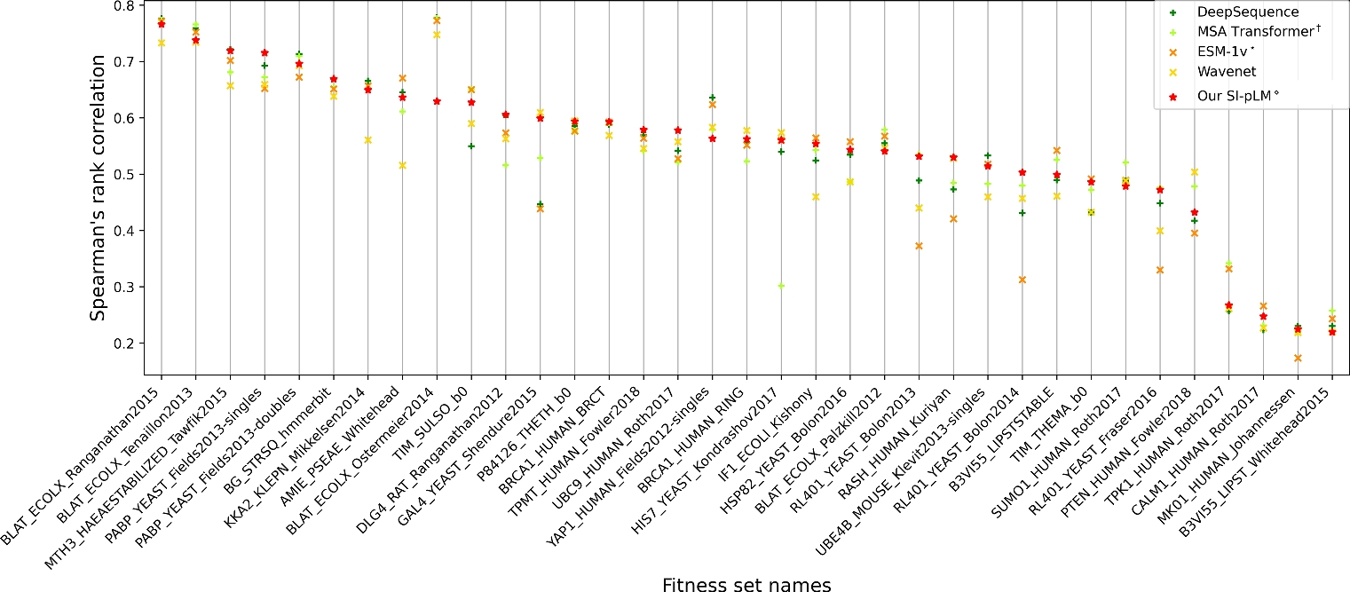
SI-PLMs are Robust for Zero-Shot VEP
(Top 1/2 in 20/35 DMS Tasks)
Created for CAGI7
genomeinterpretation.org
Yihong Yang
Notes:
Our results show SIP-LM is robust for zero-shot prediction, but when and how structural contexts help.

Slide 13
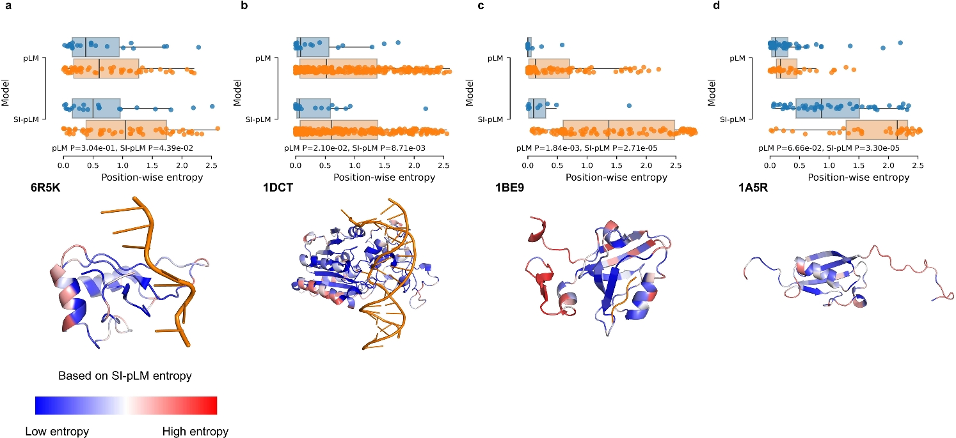
Why Structure-Contextualized Sequence Embeddings Are Better Sequence Embeddings for Few-Shot VEP
Learned amino-acid distributions of functionally and evolutionarily conserved residues can be of much lower entropy
Created for CAGI7
genomeinterpretation.org
Yihong Yang
Notes:
This figure illustrates that SIP-LM identifies critical regions better than prior models.
The box plot demonstrates that SIP-LM yields significantly lower p-values, indicating a sharper statistical distinction between conserved and non-conserved residues.
The 3D visualization reveals that SIP-LM accurately assigns low entropy (conserved) to essential areas like DNA binding interfaces, while assigning high entropy to flexible, disordered loops. This confirms that structural information helps the model capture conserved residues."

Slide 14
Overview
Variant Effects and Contexts
Protein Language Models (PLM)
Incorporating Structural Contexts into PLM
Incorporating Functional Contexts
From Context-Specific VEP to Design
    Our Structure-Informed PLM
                SaProt
                Integrated Embeddings Approach
Created for CAGI7
genomeinterpretation.org
Yihong Yang
Notes:
As for the second strategies, we can utilize structural context during inferences. With tools like AlphaFold2, structure is becoming accessible.

Slide 15
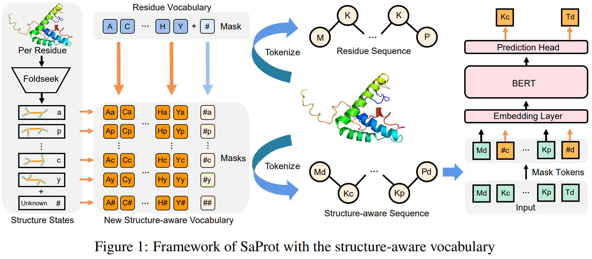
Sequence + Structure Bilingual Models
SaProt
https://www.biorxiv.org/content/10.1101/2023.10.01.560349v5
Created for CAGI7
genomeinterpretation.org
Yihong Yang
Notes:
Models like SaProt establish a 'structure-aware' vocabulary by combining amino acid residues with Foldseek-derived structural states.

Slide 16
Overview
Variant Effects and Contexts
Protein Language Models (PLM)
Incorporating Structural Contexts into PLM
Incorporating Functional Contexts
From Context-Specific VEP to Design
    Our Structure-Informed PLM
                SaProt
                Integrated Embeddings Approach
Created for CAGI7
genomeinterpretation.org
Yihong Yang

Slide 17
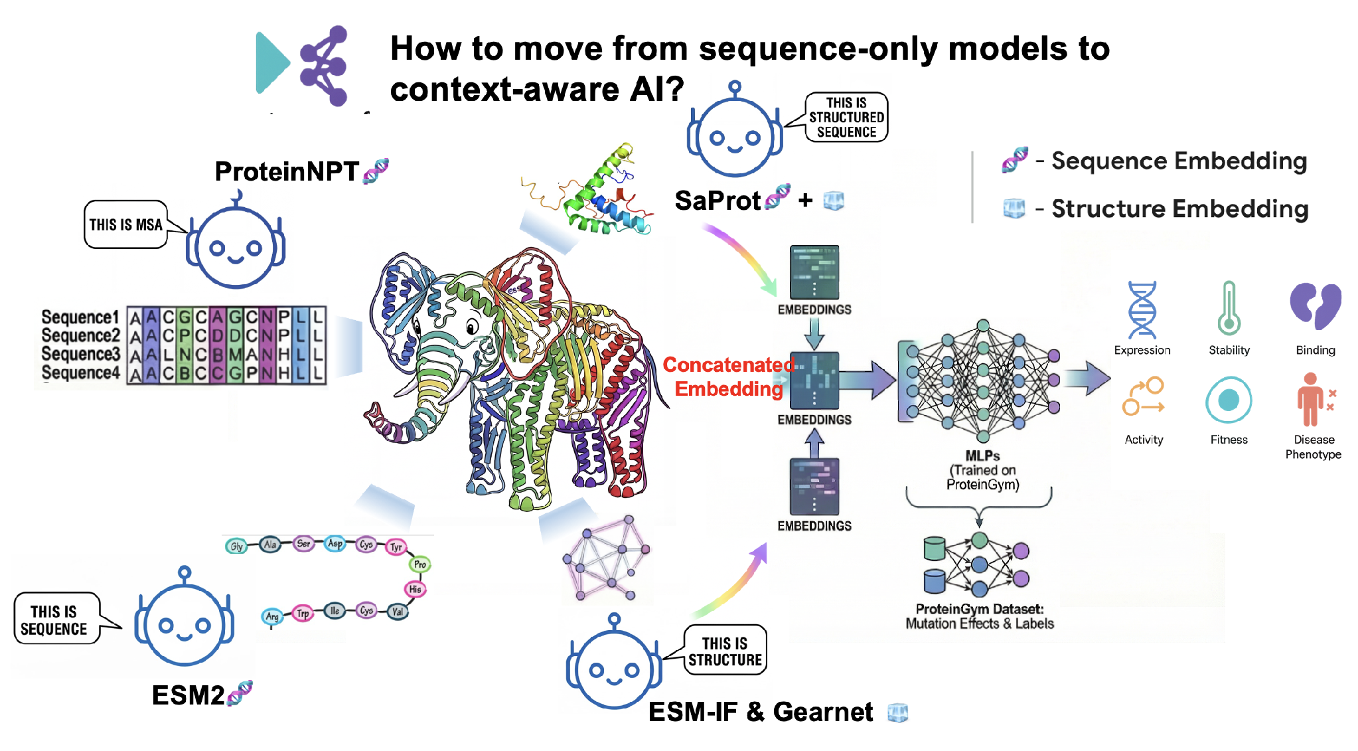
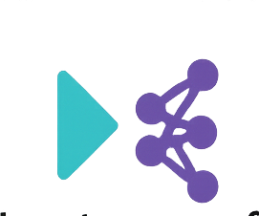
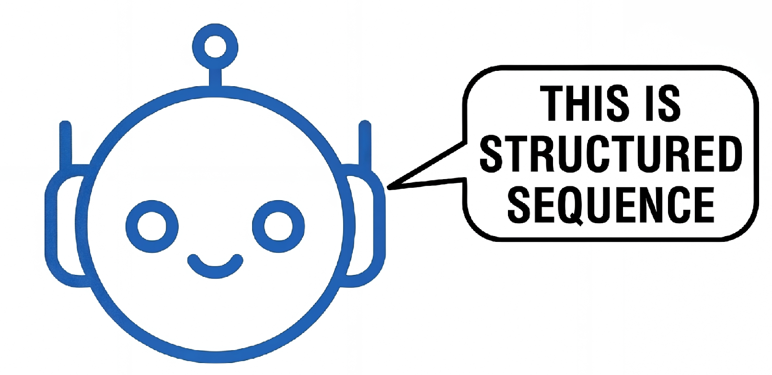
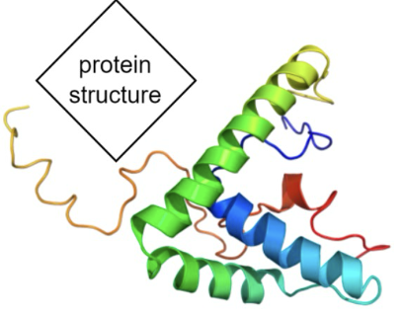


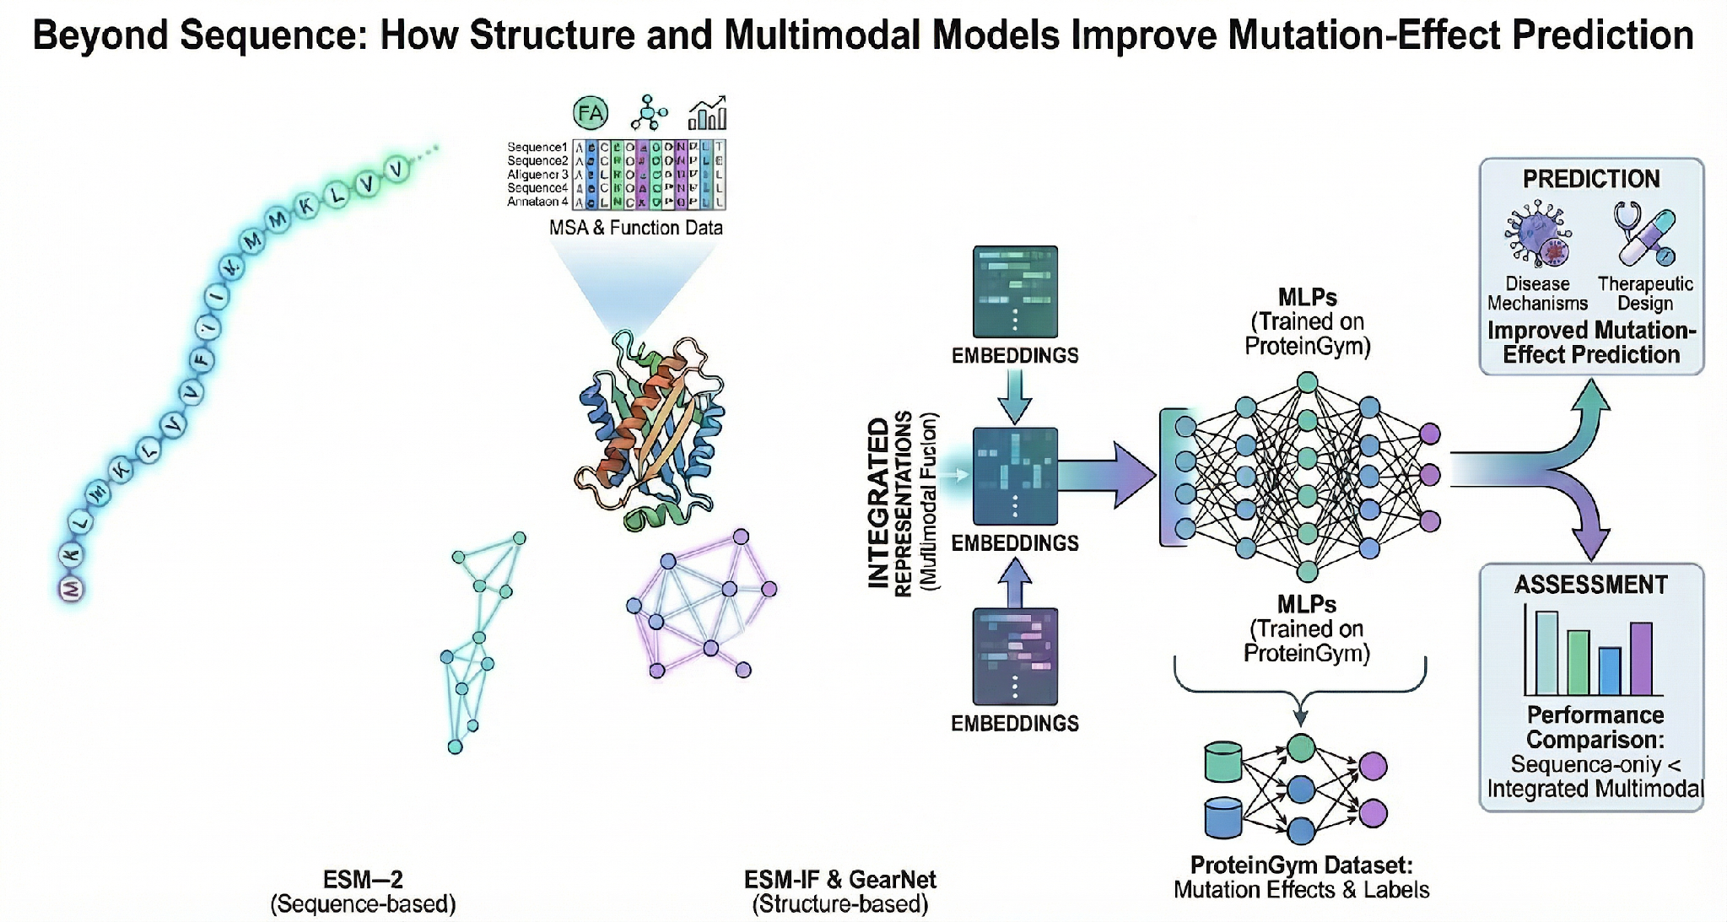
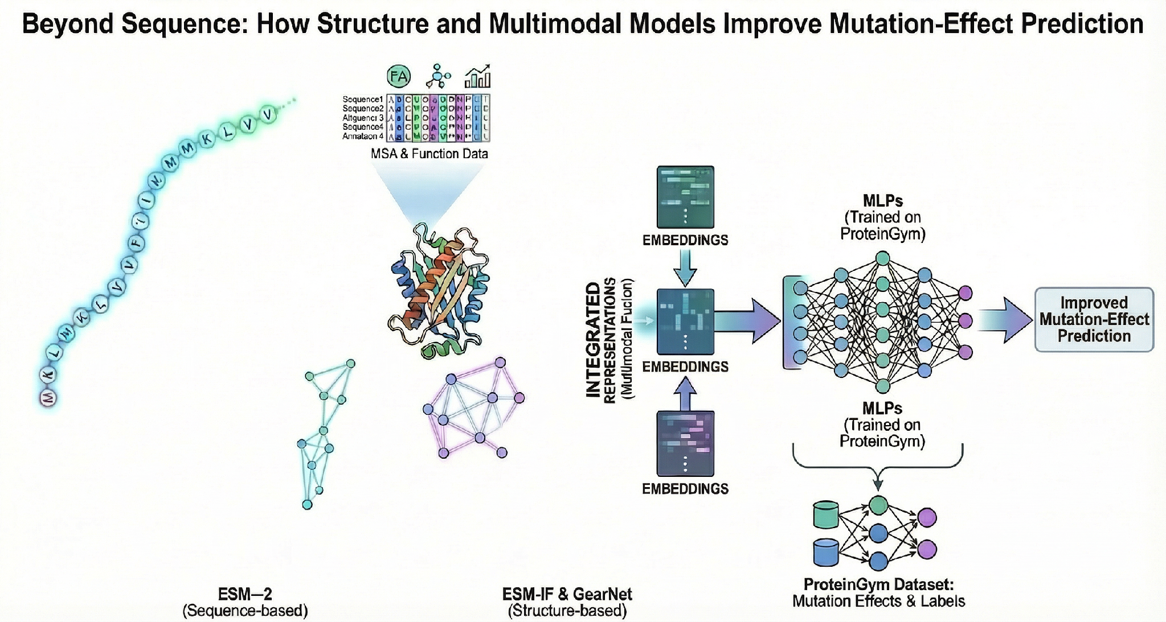


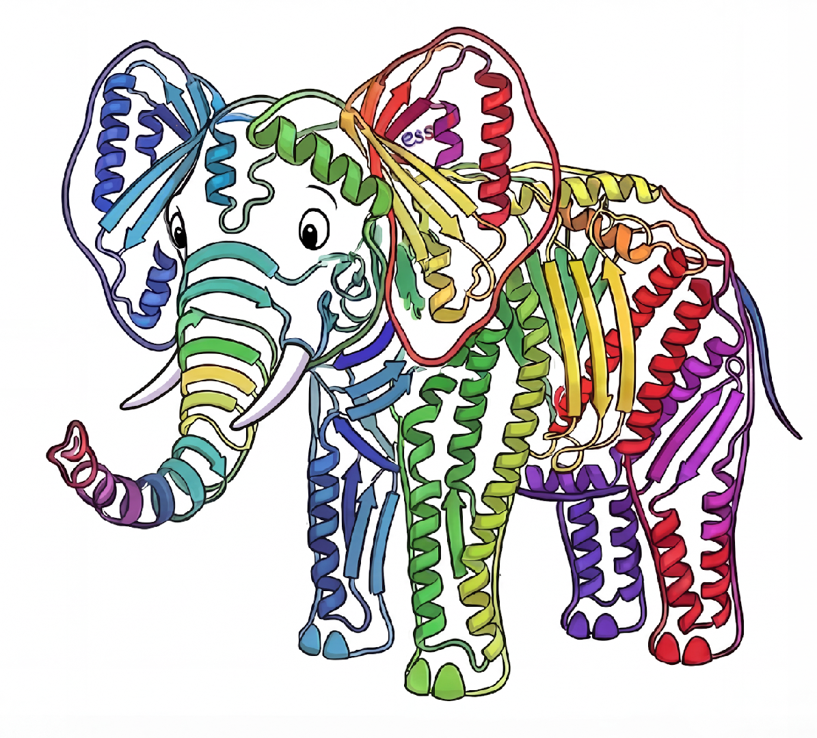

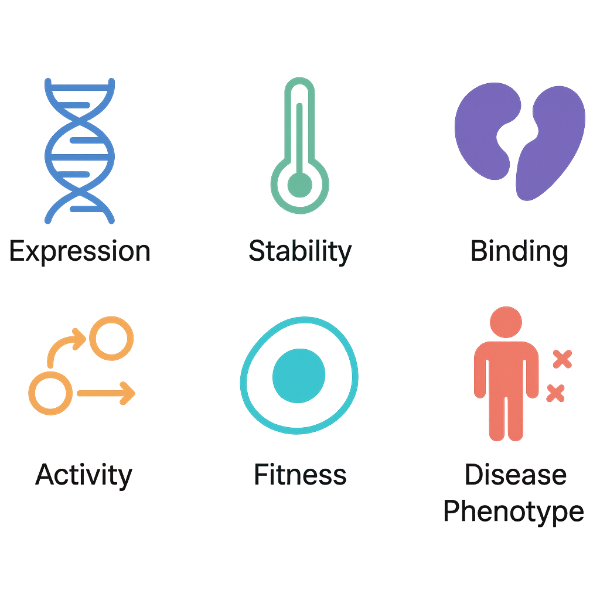
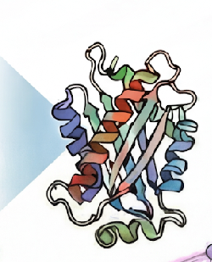
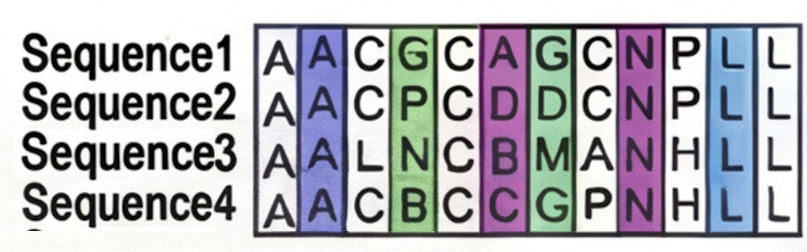
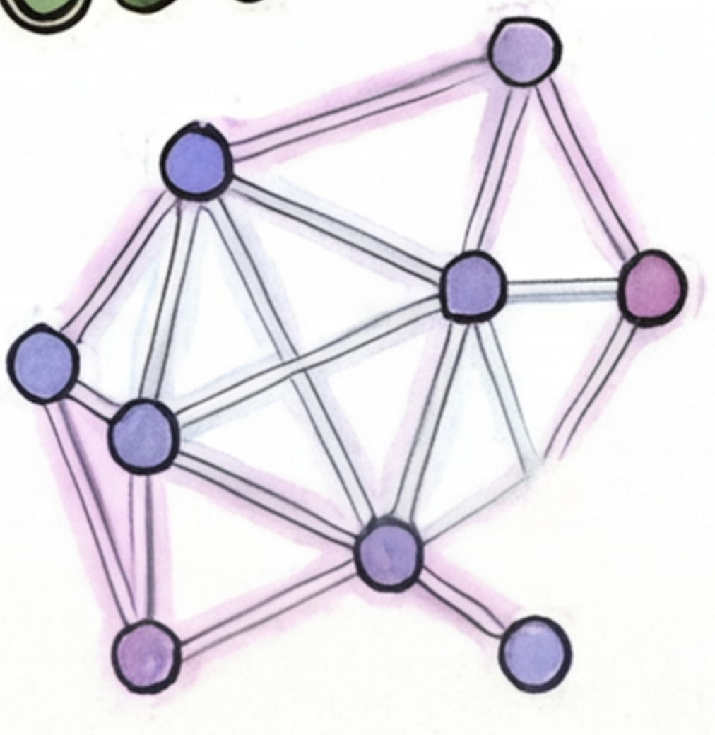
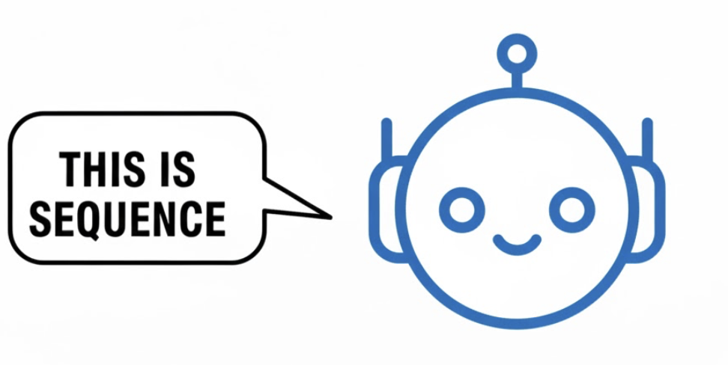
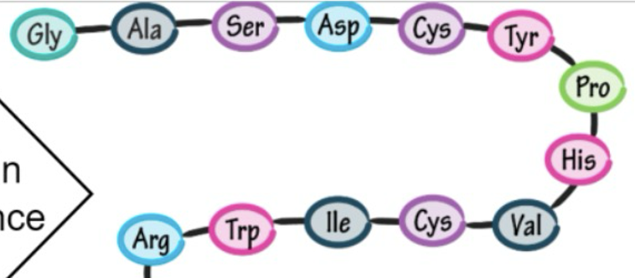



Our CAGI7 Approach: Integrating Multimodal Embeddings
How to move from sequence-only models to context-aware AI?
ProteinNPT
🧬
SaProt +
🧬
🧊
Concatenated
Embedding
ESM2
🧬
ESM-IF & Gearnet
🧊
Created for CAGI7
genomeinterpretation.org
Yihong Yang
Notes:
This multi modal embeddings motivate our integrated embedding approach. We start from a very ancient Chinese story, called “blind man and the elephant”. The protein world is like the elephant. It is so large that our models, which is just like the blind man, can only touch to feel how this world is like, for example, for ProteinNPT, oh, this is multiple sequence alignment for the ESM2, you say, oh, I see 1D structure. And for ESM-IF and Gearnet, they say wow, I touch the structure and SaProt may say oh no, it is no sequence, it is no structure. It is structured sequence. Our idea is intuitive: The more we touch, the better we understand. Therefore, our Integrated Embeddings Approach concatenates these different views to form a complete picture.

Slide 18
CAGI Strategy & Method
Embedding Configs
  Sequence-only: ESM-2;
  Structure-only: ESM-IF, GearNet
  Sequence + Structure: SaProt;
  Integrated: ESM-2/SaProt + ESM-IF + GearNet;
Data: ProteinGym DMS data; 5-fold CV, random splits; test split for reporting.
Models: 3-layer MLP trained on concatenated embeddings.
  Ensemble Predictors: average across four configs; protein-specific checkpoint selection guided by ClinVar pathogenicity when applicable.
  Zero-shot Predictor: SI-PLM (Model 6)
ARSA challenge:
  Additional model uses dbNSFP features and aggregates features for MNV via max over SNV components.
Created for CAGI7
genomeinterpretation.org
Yihong Yang
Notes:
So let‘s put it more specifically in our CAGI strategy and method, we have four different kind of embedding conflgs sequence only we have is ESM2. Structure only we have ESM-IF and Gearnet. For sequence plus structure, we have SaProt. And our integrated embeddings approach is ESM2 or SaProt plus ESM-IF plus Gearnet. Our data is from ProteinGym DMS data which is similar to CAGI7 challenge with five-fold cross validation and random splits. For the supervised model, we used three multi-layer perceptions trained on concatenated embeddings. Our ensemble predictors are based on the average across these four different conflgs and protein-specific checkpoint selection is guided by CleanVar pathogenicity dataset when available. We also utilize our zero-shot predictor SI-PLM as our sixth model. Specifically, for ARSA challenge challenge, we added a more machine learning model that utilize DPNSFP features and aggregate features for MMV max over SMV components

Slide 19
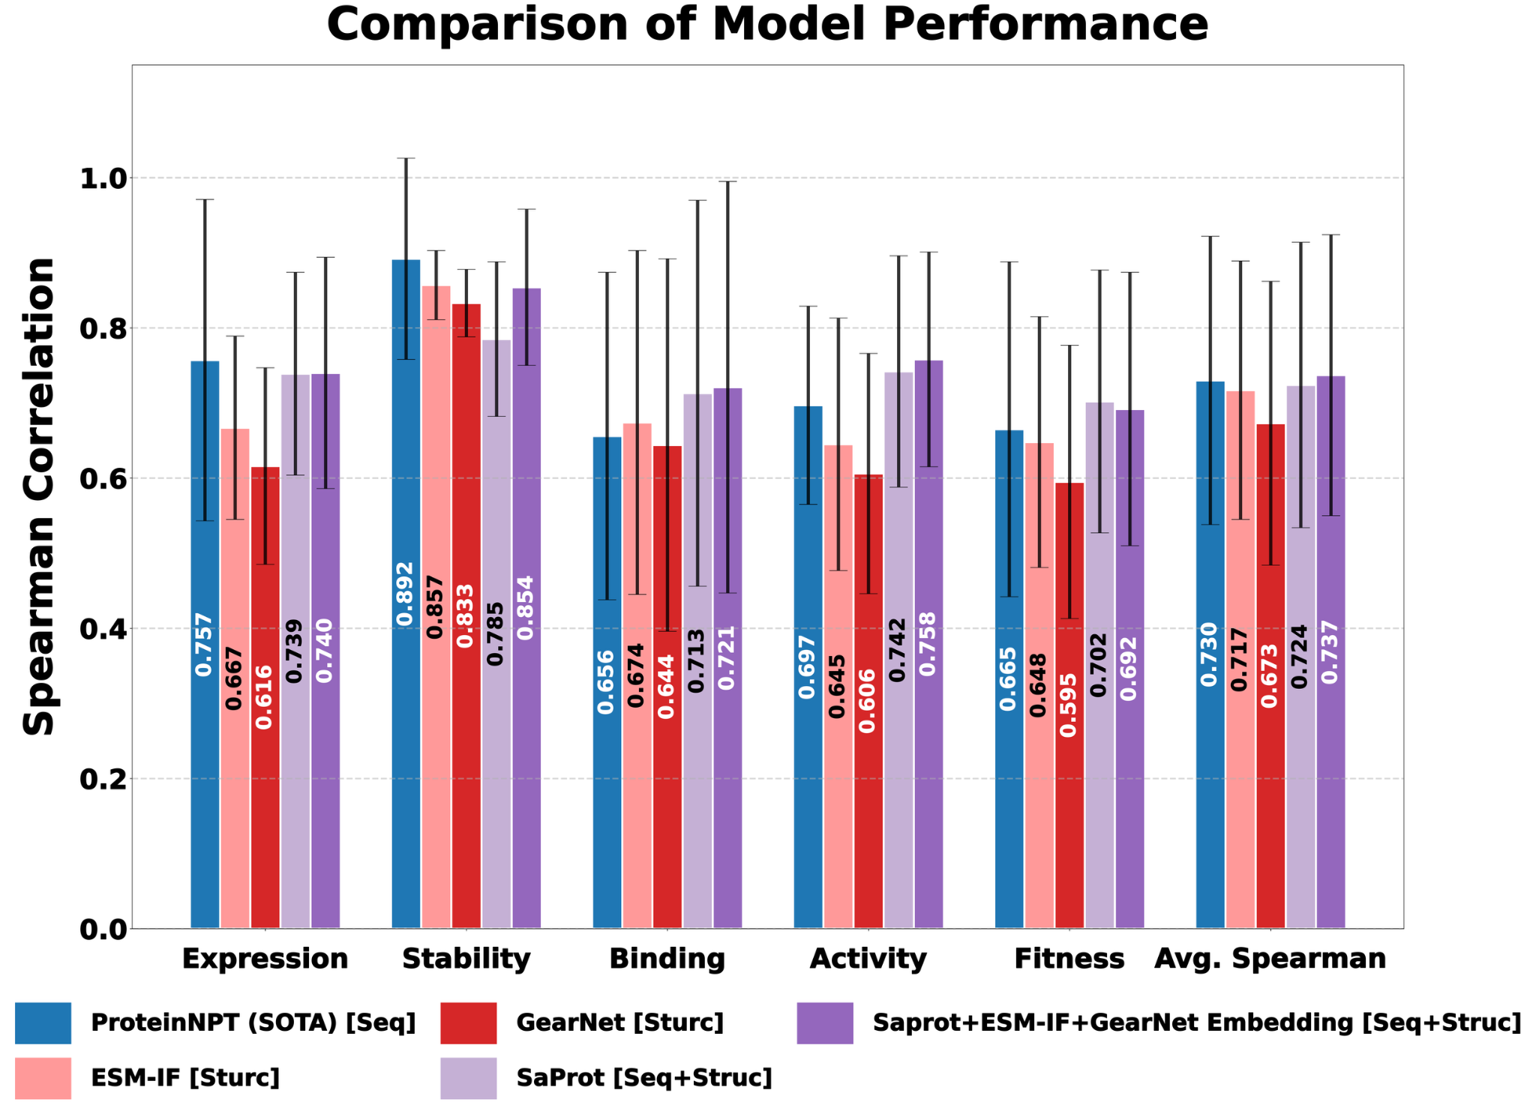
ProteinGym Result: When and How Structures Help
Sequence-only models excel in predicting “upstream” effects such as expression and stability.
Including structure provides critical advantage for predicting higher-order “downstream” effects.
Our multimodal embedding approach robustly outperforms across diverse contexts
Created for CAGI7
genomeinterpretation.org
Yihong Yang
Notes:
Since CAGI 7 results are pending, we evaluated on ProteinGym. Notably, we excluded MSA embeddings to strictly test if 'Structure' can beat or match 'MSA-based' performance. The results are clear:
Sequence-only models excel at predicting 'Upstream' effects (Expression, Stability).
However, including Structure provides a critical advantage for 'Downstream' effects (Binding, Activity, Fitness).
Our Multimodal Integrated Approach (the Red bars) robustly outperforms across diverse contexts."

Slide 20
Overview
Variant Effects and Contexts
Protein Language Models (PLM)
Incorporating Structural Contexts into PLM
Incorporating Functional Contexts
From Context-Specific VEP to Design
    Our Structure-Informed PLM
                SaProt
                Integrated Embeddings Approach
Created for CAGI7
genomeinterpretation.org
Yihong Yang

Slide 21
Overview
Variant Effects and Contexts
Protein Language Models (PLM)
Incorporating Structural Contexts into PLM
Incorporating Functional Contexts
From Context-Specific VEP to Design
    Our Structure-Informed PLM
                SaProt
                Integrated Embeddings Approach
Created for CAGI7
genomeinterpretation.org
Yihong Yang
Notes:
This has led us to expand our goal: From Prediction to Design.

Slide 22
Future Work
Incorporating additional modalities (e.g., MSA and GO) to improve variant effect prediction and protein design.
Adopting Protein-level splits to test generalization across, contrasting with ProteinGym's sequence-level splits.
Created for CAGI7
genomeinterpretation.org
Yihong Yang

Slide 23

Acknowledgement
Created for CAGI7
genomeinterpretation.org
Yihong Yang
Notes:
I would like to acknowledge the support from NSF, NIH, and Texas A&M. Finally, our group has openings for PhD students and Postdocs—you are very welcome to join us.

Slide 24
Thank you!
Created for CAGI7
genomeinterpretation.org
Yihong Yang

