Slide 1

CAGI 7 slide pack guidelines
I agree to my slides being used according to the following terms:
_______Hoyin Chu_______
Authors: please include THIS slide at the beginning of your presentation to indicate that you agree with reuse of your slides in CAGI presentations, according to the terms below, and digitally sign by writing your name above.
At CAGI 7, use of this slide pack is only required for CAGI dataset providers, assessors, and predictors, but all are encouraged to use the annotations for materials they do not want shared publicly.
To disseminate the CAGI results, I encourage all CAGI participants to remix these CAGI slides for inclusion in their oral and poster presentations
CAGI participants may use or publish any content of these slides only in compliance with the CAGI Data Use Agreement
CAGI participants may not cite or publish any content of these slides except with the written permission of the originating author or in the primary CAGI publications
CAGI participants must acknowledge the original authors of these slides and CAGI 7. Include the acknowledgement banner across the bottom
CAGI participants must include the CAGI credits slide in their presentations
Slides with a red slash (no remix) may not be included in a presentation unless all attendees are registered CAGI participants who signed the data use agreement
Slides with a red X over the entire slide may not be used in any circumstances
Slides with a blue slash (embargoed) may not be used unless the embargo is explicitly lifted
Slides without slash or X may be tweeted, tooted, posted, X’d unless flagged with “No tweet” icon
CAGI participants using these slides must explain the “No tweet” icon, which means that the slide content should not be disseminated outside the presenting conference hall. If the presentation venue permits pervasive tweeting, you may not include these slides in your talk
Note for slide authors: we expect all CAGI participants to abide by these restrictions, and will make best effort to ensure they are followed. However, but bear in mind that we have limited means of enforcing them, and therefore the restrictions cannot be guaranteed.

Slide 2
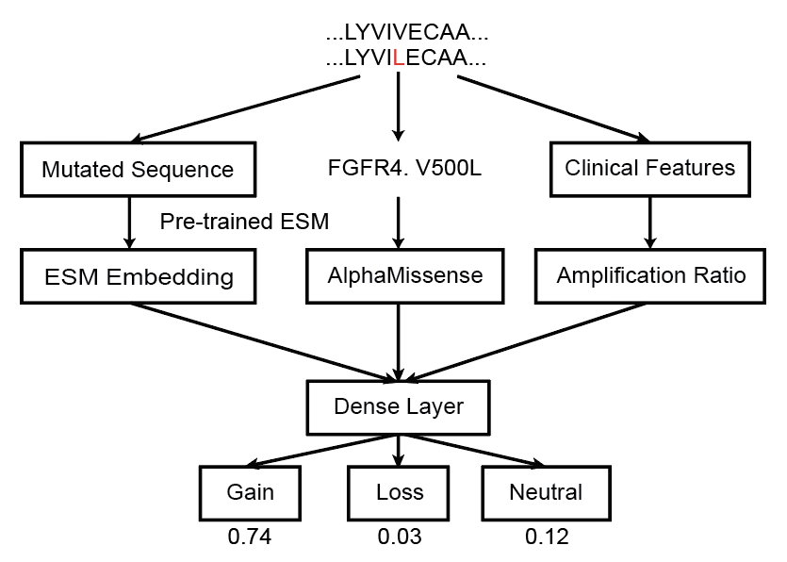
Combining Protein LM with Cancer Genomics to predict Gain-of-Function Somatic Mutations
Created for CAGI 7
genomeinterpretation.org
Hoyin Chu

Slide 3
The Cancer Genome is enriched for GoF
Missense mutations can be broadly classified as loss-of-function (LoF), neutral, or gain-of-function (GoF)
While GoF variants are much rarer than LoF variants in inherited genetic diseases, GoF mutations are much more common in cancer
Understanding whether a pathogenic variant is LoF or GoF could elucidate disease biology and inform therapeutic strategy

Slide 4
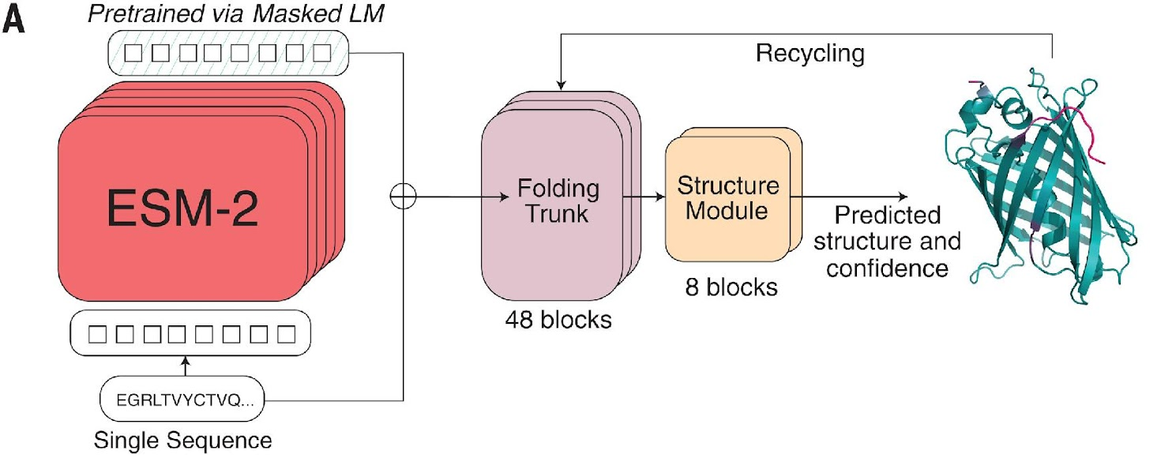
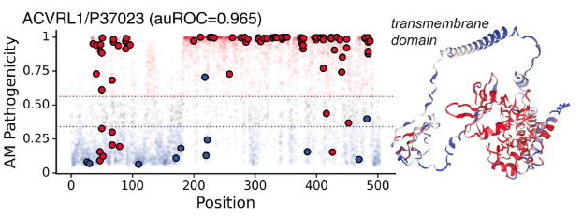
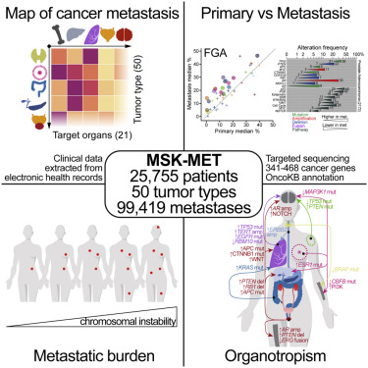

Prediction Strategy
Protein Representation
  ESM2 Embedding
Mutation Pathogenicity
  AlphaMissense score
Mutation Frequency
  MetTropism
Label
  OncoKB
Zeming Lin et al., Science 2024
Jun Cheng et al., Science 2023
Bastien Nguyen et al., Cell 2021
Debyani Chakravarty et al., JCO 2017

Slide 5
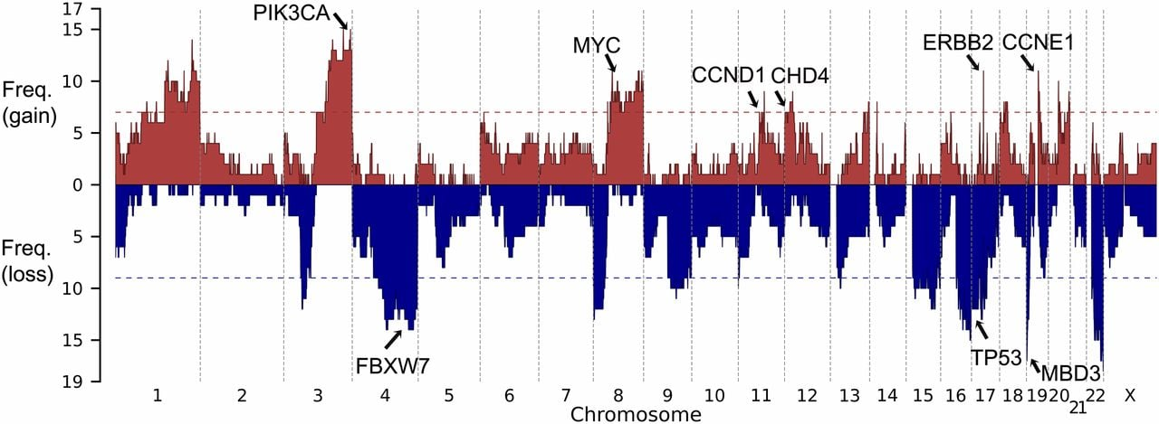
Engineering beyond Simple Frequency
Some genes are more likely to have GoF mutations than others
Cancer genome segments frequently get amplified / deleted
Siming Zhao et al., PNAS 2013
Amplification Ratio = (# Amplification / # Deletion)
  Assumption: Amplified genes are more likely to have GoF mutations
Is amplified = Variant ever seen appear in amplified segment
  Assumption: Amplified variants are more likely to be GoF

Slide 6
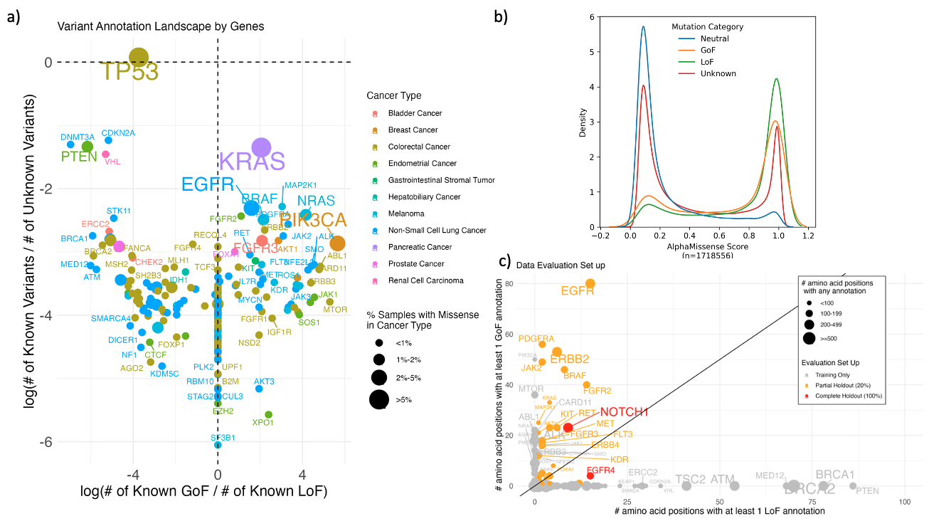
Feature Sanity Checks
OncoKB annotations recapitulates existing knowledge
AlphaMissense Separates GoF/LoF Mutations from Neutral mutations
The Neutral category is augmented with variants found in gnomAD with ≥10% population frequency

Slide 7
Model Training Data Sanity Check
Input: 39704 mutations from MetTropism
20% of mutations are held out from well annotated genes
For 2 well-annotated genes with more balanced LoF/GoF, all mutations are held out

Slide 8

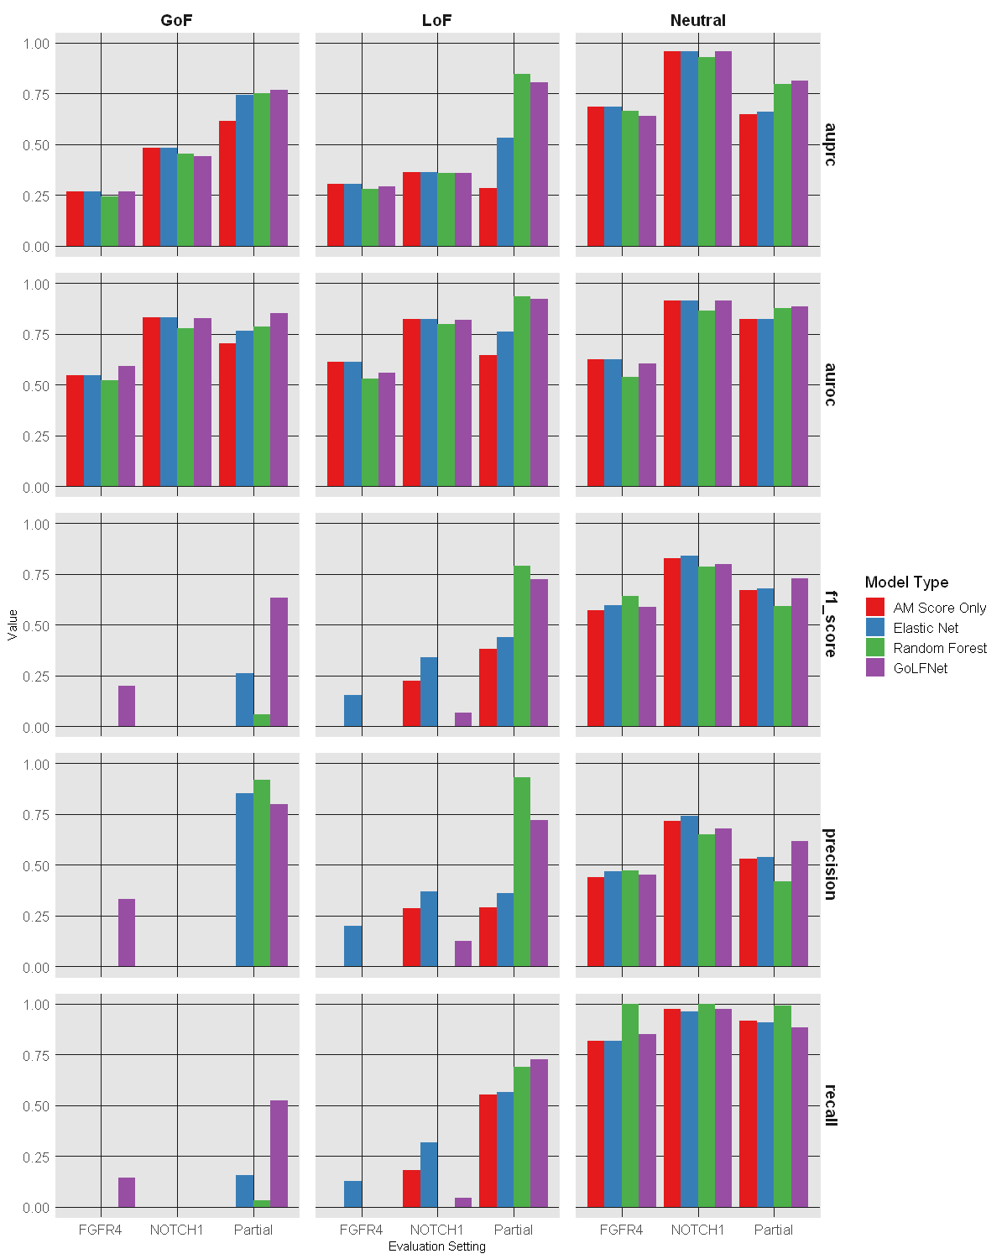
GoLFNet Model & Performance
(Gain-or-Loss of Function Network)
Precision
AUPRC
Recall
“Winner-takes-all” recall / precision

Slide 9
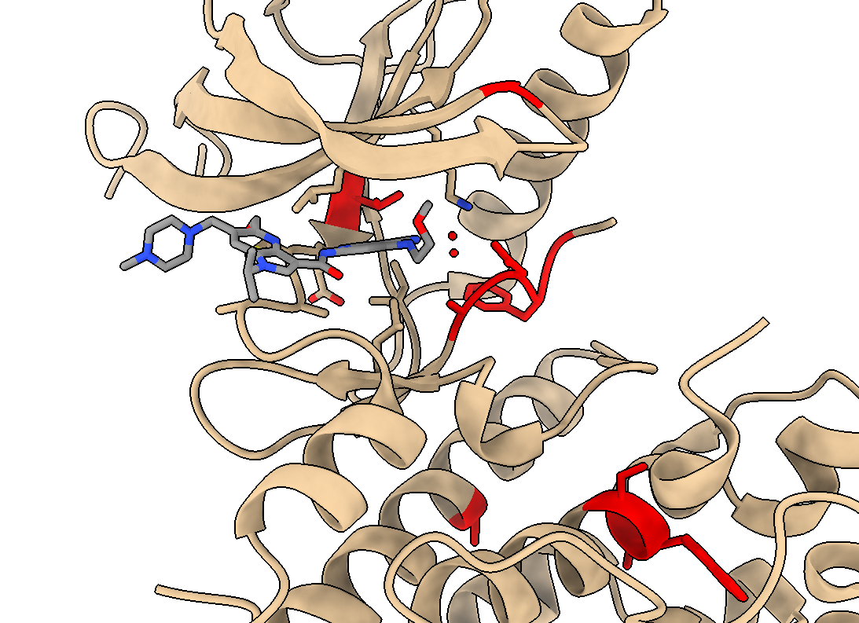
Applying the GoLFNet to Unannotated Somatic Missense Mutations
Location of top 20 Predicted GoF Variants in FGFR4
PDB ID: 8W5C

Slide 10
Summary
Cancer datasets are enriched for pathogenic GoF mutations and LoF mutations that may not be commonly seen in other datasets
Features based on cancer chromosomal imbalances improve GoF/LoF stratification
Application of predictive models could prioritize experimental screening of gain of function variants

Slide 11
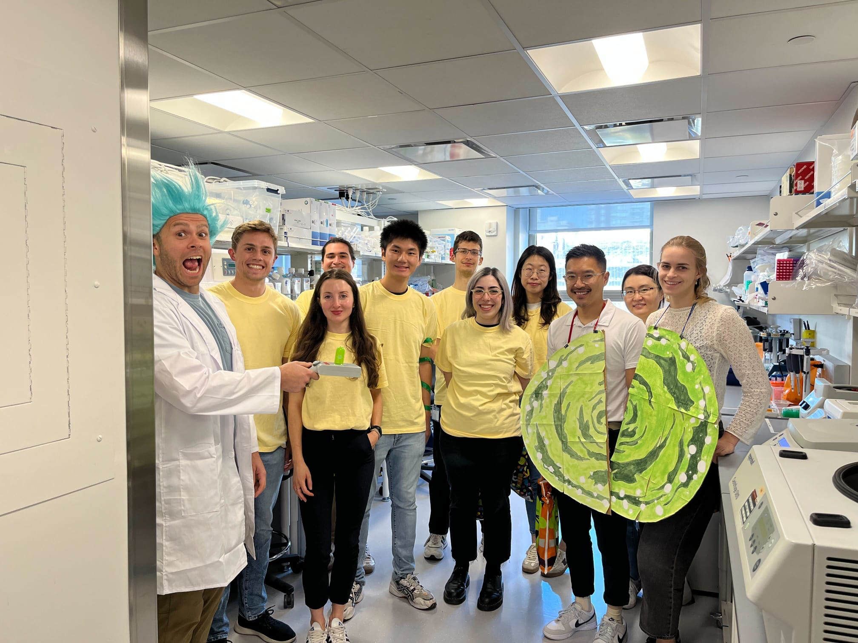
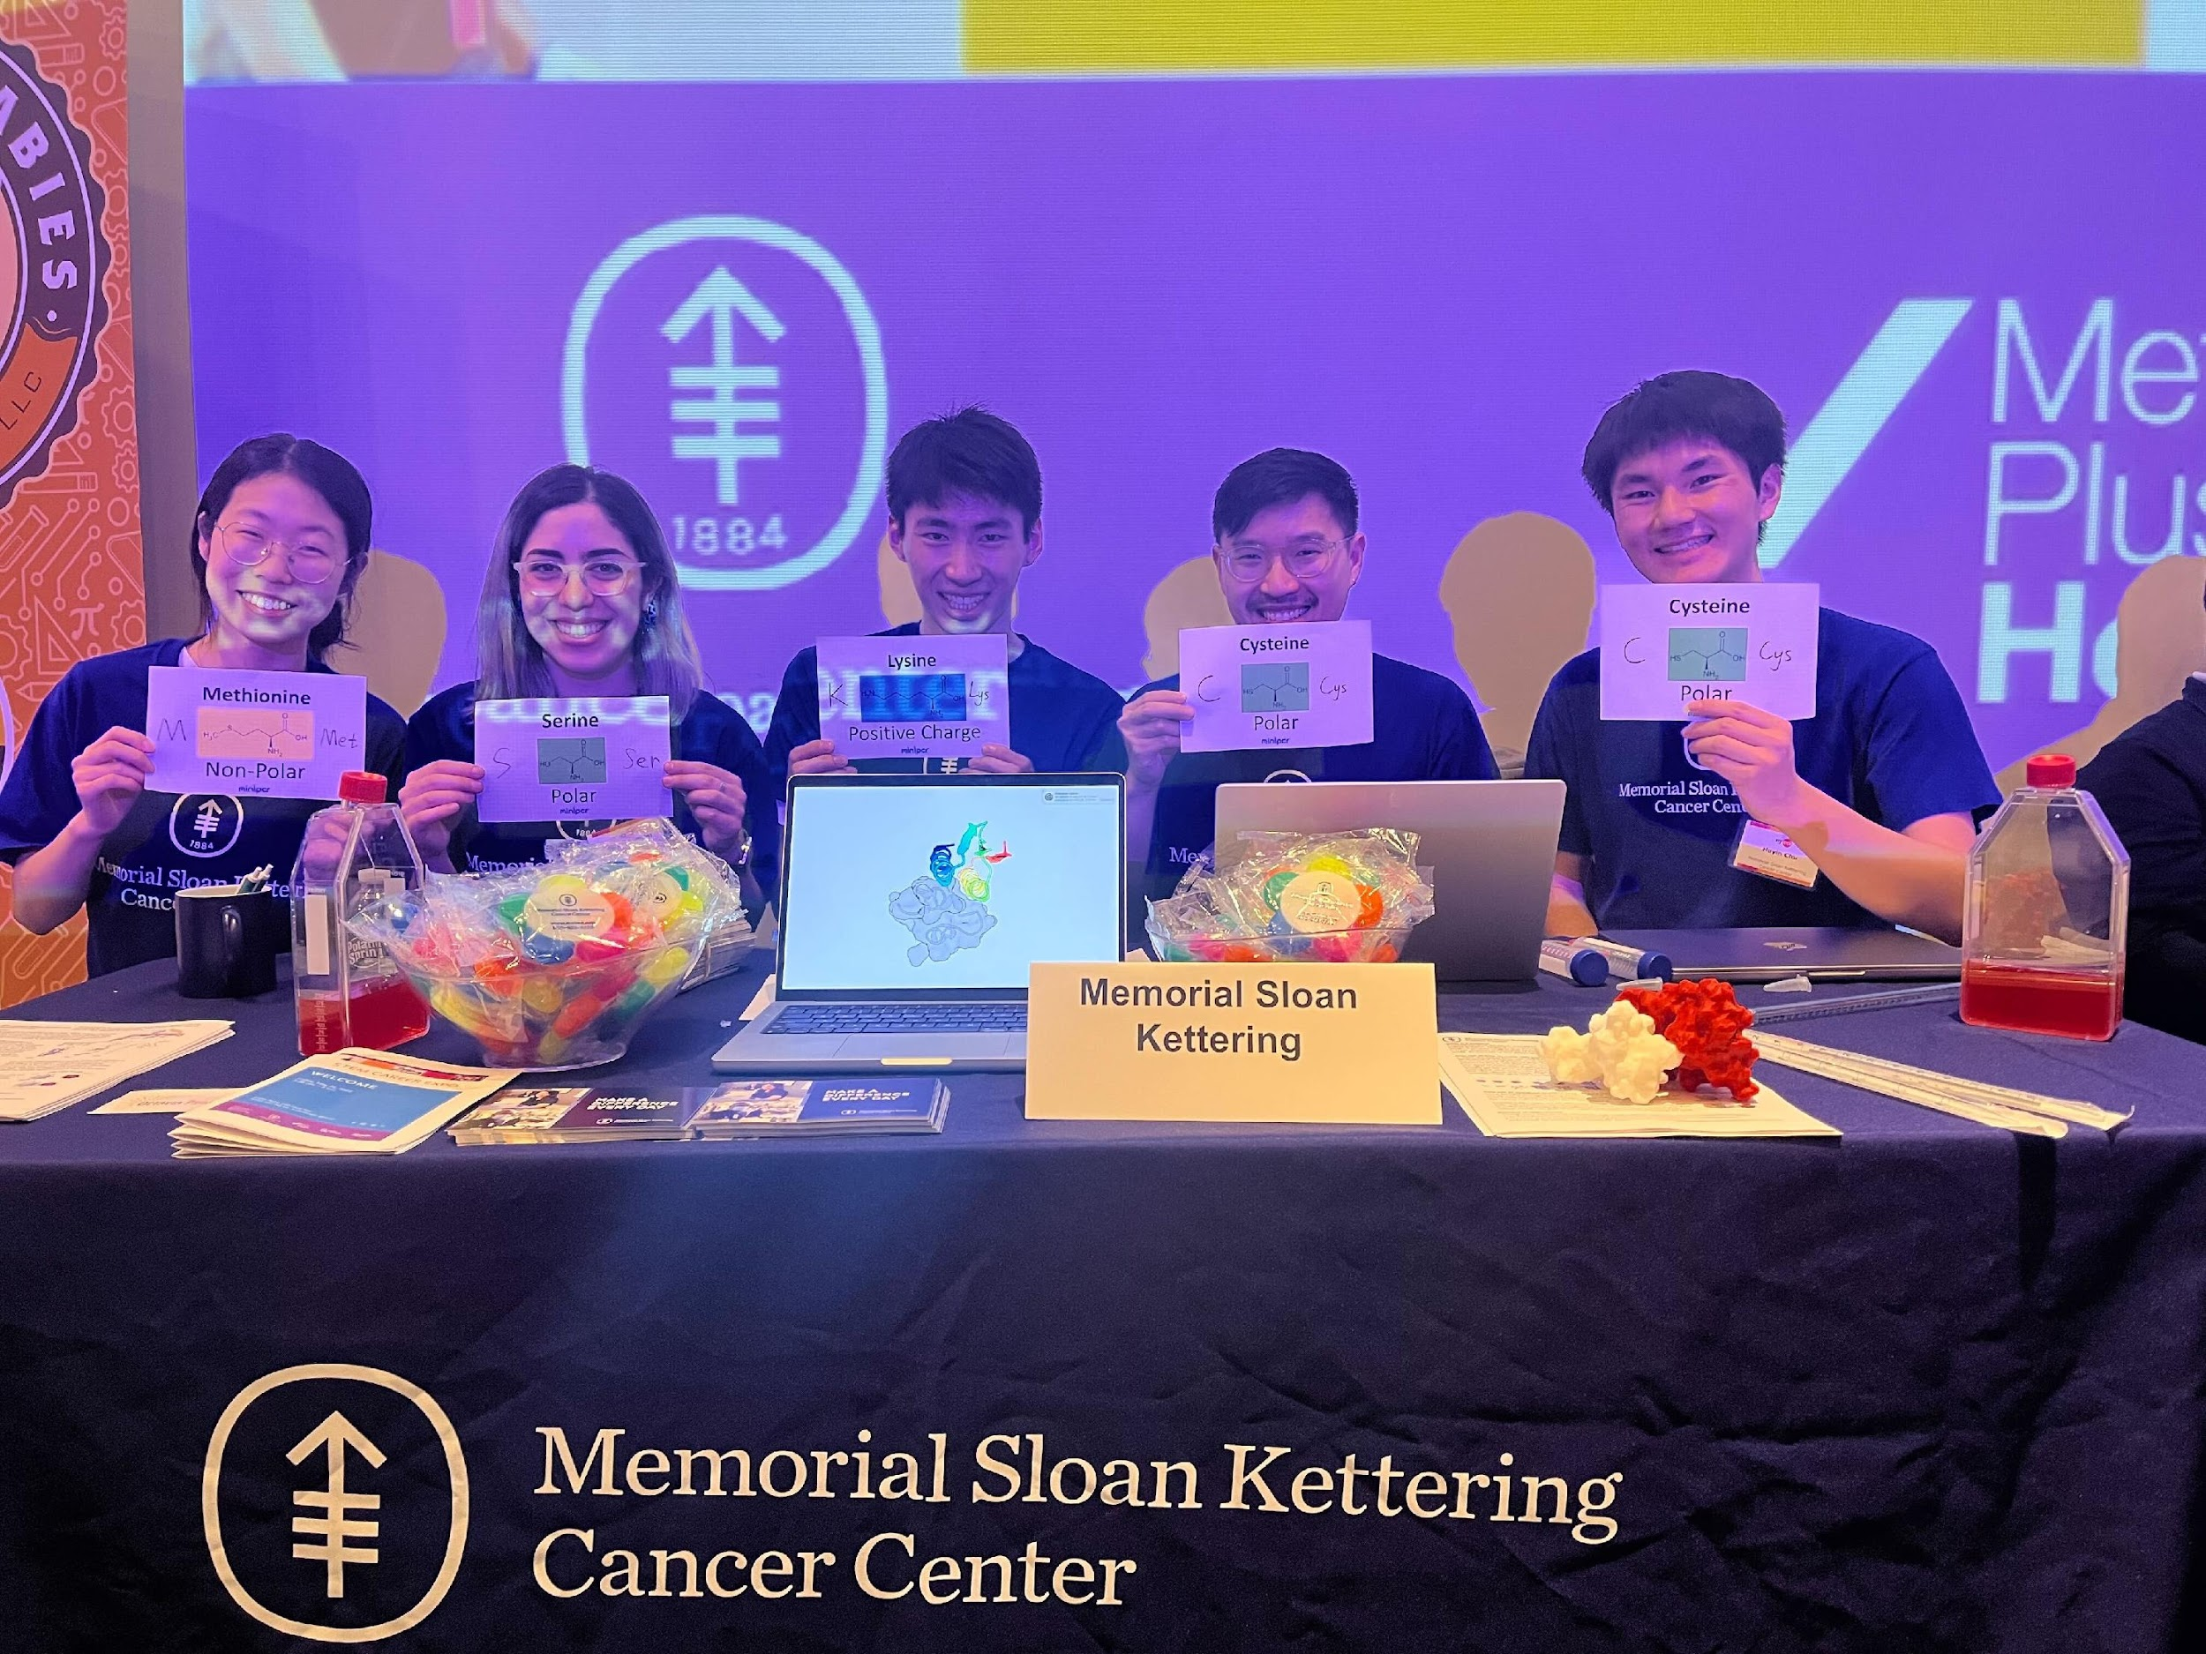
Thank You!
Lareau Lab
Arthur Chow
Betty Li
Benan Nalbant
Abi Dozic
Laura Kida
Jacob Gutierrez
Cole Honeycutt
William Lin
Zeyu Tang
Austin Varela
Sherry Nyeo
Thahmina Ali
Ayush Deep
Christian Figueroa-Espada
Erica Sun
Erin Cumming
Joseph Palmeri
Meghana Pagadala
Utsav Mesvani
Shekinah Scott

