Slide 1


StructGuy
Data leakage free prediction of functional effects of genetic variants
Alexander Gress
Helmholtz Institute for Pharmaceutical Research Saarland (HIPS)
CAGI7 - 6 December 2025
Notes:
Welcome, today I am going to present you our prediction model StructGuy that aims to predict the effects of genetic variants on protein function. Having such an expert-level audience I thought I could skip the usual introduction and background parts, and immediately jump into the model.

Slide 2
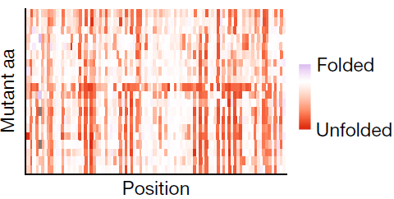
StructGuy simplified
StructGuy
train
predict
Central idea of StructGuy:
Supervised variant effect prediction that generalizes to proteins not seen during training
Notes:
Structguy is a supervised model that is trained on MAVE data and also aims to predict the same type of effects. But unlike most supervised functional effect predicts the goal is not to reproduce the values on the same MAVE, but to train on many different MAVEs and then predict the functional effects on proteins that are not covered in the training data. So the central idea of structguy is to have a supervised variant effect predictor that is able to generalize between proteins. This is actually a rather rare model type, most generalizers are unsupervised models.

Slide 3
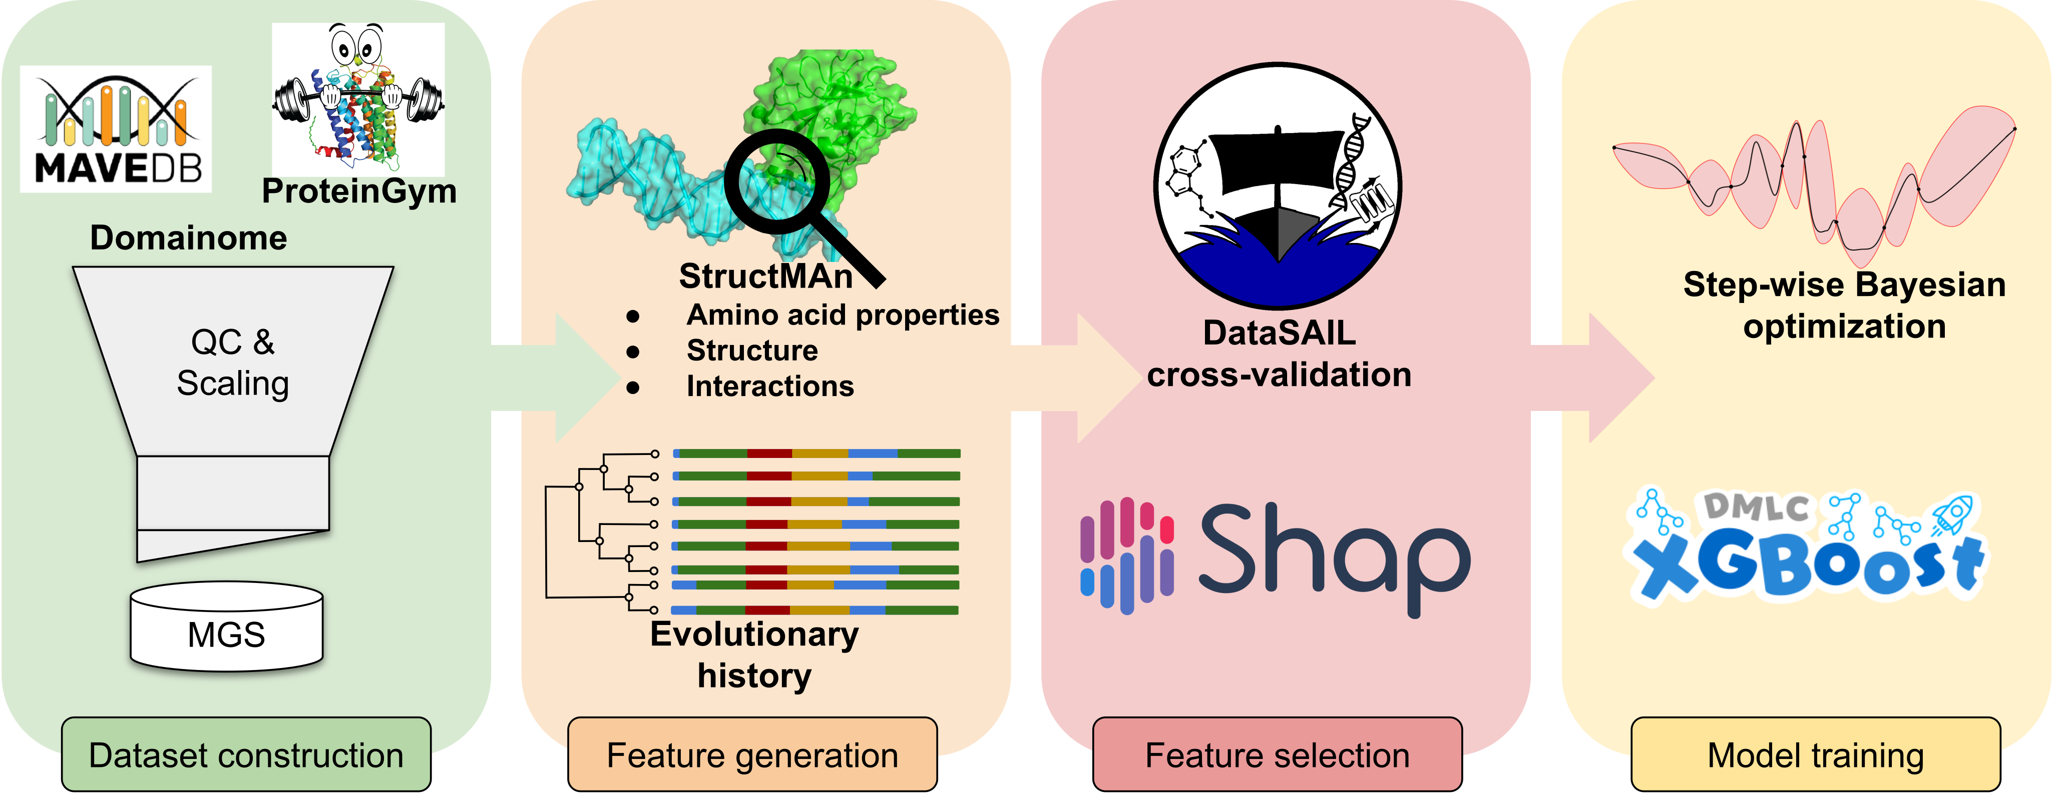
StructGuy at a glance
Notes:
The training process of StructGuy has a typical structure for a supervised machine learning model. It consists of four steps, the construction of the training dataset, the generation of descriptive features, which as most functional effect prediction methods contains features based on protein 3D structure and features derived from the evolutionary history of the target protein. Then feature selection and hyperparameter optimization, followed by the training of a xgboost gradient boosting model. I can’t go into detail on every part of the process today, so I want to focus a bit more on the unique features of structguy, beginning with the structural features.

Slide 4

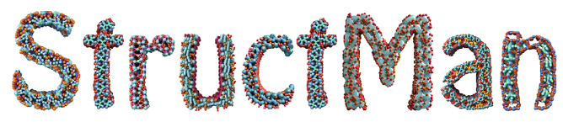
High-quality protein structure-based features
Annotates wild type position to 3D structures
Generates biologically meaningful features
Takes into account:
  Tertiary structure
  Interacting molecules
  Conservation of local interactions
  Variance of structural features across homologs
tools.helmholtz-hips.de/structman/
Yurtseven et al.: “StructMAn 2.0 Web: a web server for structural annotation of protein sequences and mutations”, Nucleic Acids Research 2025
Notes:
The structural features of structguy are computed by our inhouse structural annotation pipeline structman. The main idea of structman is to map any protein sequence to as much as possible protein structures, coming from the PDB and from alphafold. Structman annotates all those structures on the resiude level and provides amino acid specific structural analysis, which is what we need as features for our machine learning model. Structman considers the tertiary structures, leading to features like solvent access of a residue or the non-covalent bonds inside the protein chain. Tertiary features are features that could be computed just taking models from alphafold. But going beyond that, structman also looks into interacting molecules, so other protein chains, nucleic acids, ligands, everything that is co-resolved in a PDB entry. Further, by looking into multiple structures, structman can also determine the structural conservation of local interactions around any resiude, as well as calculate the variance of structural features across homologs. For example, the single most strongest feature in structguy is based on how consistent the solvent access is for a residue mapped into multiple structures.

Slide 5
StructGuy at a glance
Notes:
The generalizability of structguy is achieved in parts by its hyperparameter optimization setup, and by the way we split training data and usage of shap values for the selecting the most descriptive features. Assuming the hyperparameter optimization done, lets have a look into the core training setup of structguy.

Slide 6
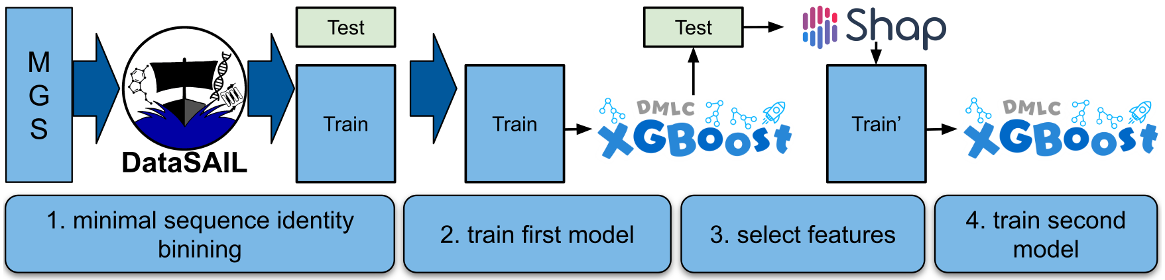
Training pipeline
Notes:
The first step is to split the training data in a way to simulate unseen proteins by minimizing the sequence identity of all proteins in the test split to all proteins in the train split. In other words, the proteins in the test split should be as much as possible different from the proteins in the train split. Then, on this training split, we train a xgboost model. We use it to predict the samples in the test split, and calculate the tree shap values for all features for all samples in the test set. Together with the known true effects, we can estimate which features work best in the prediction of variants in unseen proteins. Those features are now used to train a second xgboost model, which is has distinct set of hyperparameters compared to the first one. This model acts then as the final model for prediction.

Slide 7
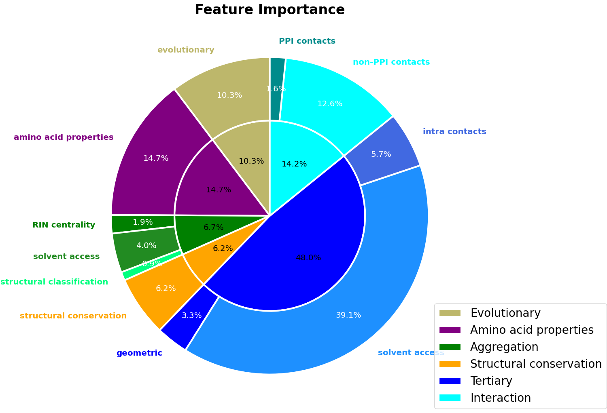
StructGuy favors features derived from protein 3D structure
Notes:
When we look at the distribution of feature importance values for different categories of features, we can see the with three quarters the structural features dominate in structguy. Only a quarter is based on statistical and evolutionary features. The most important structural features are based on the solvent access of the mutated residue, but also many other structural features are incorporated into the model.

Slide 8
Evaluation – ProteinGym benchmark
Comparison of supervised model to unsupervised models
Split proteins from ProteinGym based on sequence similarity to proteins in MGS
95-100%
Same proteins
Data leakage free evaluation
50-95%
Close homologs
35-50%
Distant homologs
0-35%
Unrelated proteins
Notes:
Now, to the usual question of how well the model actually performs. Our evaluation needed to show the ability to generalize, and since there is nothing really comparable, we went to proteingym to compare out supervised model to unsupervised models in the zero-shot benchmark. But of course, we cannot directly set our supervised model against unsupervised models, first we need to take care to remove any type of data leakage from the evaluation. For that, we calculated the sequence identity of all proteins in our training data to all proteins in proteingym. Based on that, we binned the proteins from proteingym into four categories. Same or highly similar proteins went into the above 95% sequence identity bin. Then, we have two bins for homologous proteins, which turned out to be comparably small. And lastly, there is the most important bin, the bin with unrelated proteins with a sequence identity below 35%. In this bin, we claim to be able to make a fair data leakage-free evaluation of our supervised model against unsupervised models.

Slide 9
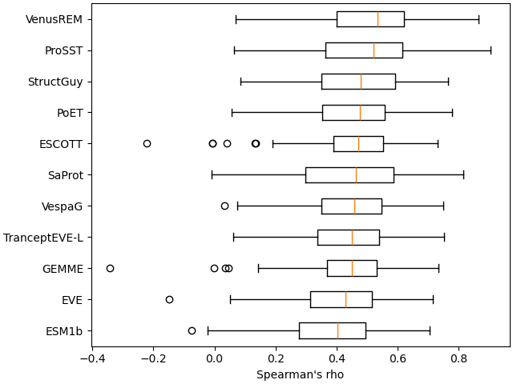
Evaluation against unsupervised models on ProteinGym
Notes:
In this plot, we can see selected state-of-the-art models that are listed in proteingym against structguy. On the x-axis we have the four bins, on the y-axis, we have the mean rho, simply speaking, the higher the better. Again, the most important bin is the left-most. For which, we can have a closer look. Here, structguy ranks among the top models showing the generalizability of our model on the level of a unsupervised model, which are generalizer by design. Now, the greatest advantage of our model is that is fully explainable. I will demonstrate that by looking into two mutations in FGFR3.

Slide 10
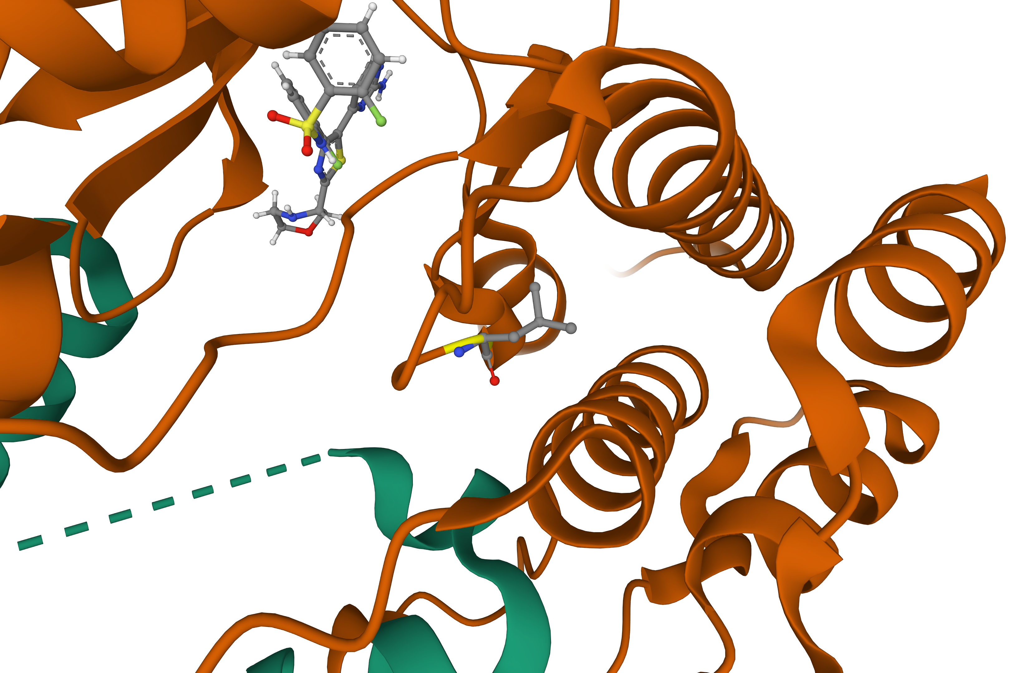
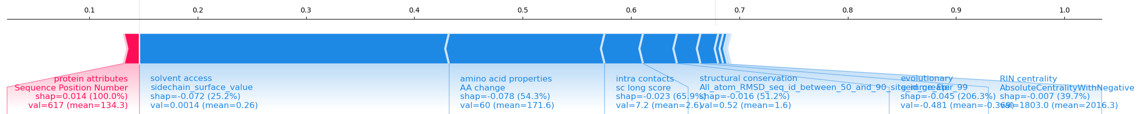
Case study – FGFR3 L618R
StructGuy: 0.146 (loss of function)
Core residue
Facilitates many intra chain interactions
PDB entry 7P3V
Red: neutral/beneficial – Blue: functionally detrimental
Notes:
In the case of an arginine replacing the leucine at position 618, StructGuy predicted a strong detrimental effect or loss of function. When we look at the structural environment of the leucine, we can see that is a core residue that facilities many interactions that stabilizes this bundle of alpha helices, which in turn are involded in the interaction with the green protein chain and the ligand binding pocket of the active site.
Now, when we ask what StructGuy thinks of this prediction, it tells us a similar story. Most importantly for structguy is that the residue has no solvent access, it also takes into account that the residue has many intra chain interactions and is structurally and evolutionary conserved.

Slide 11
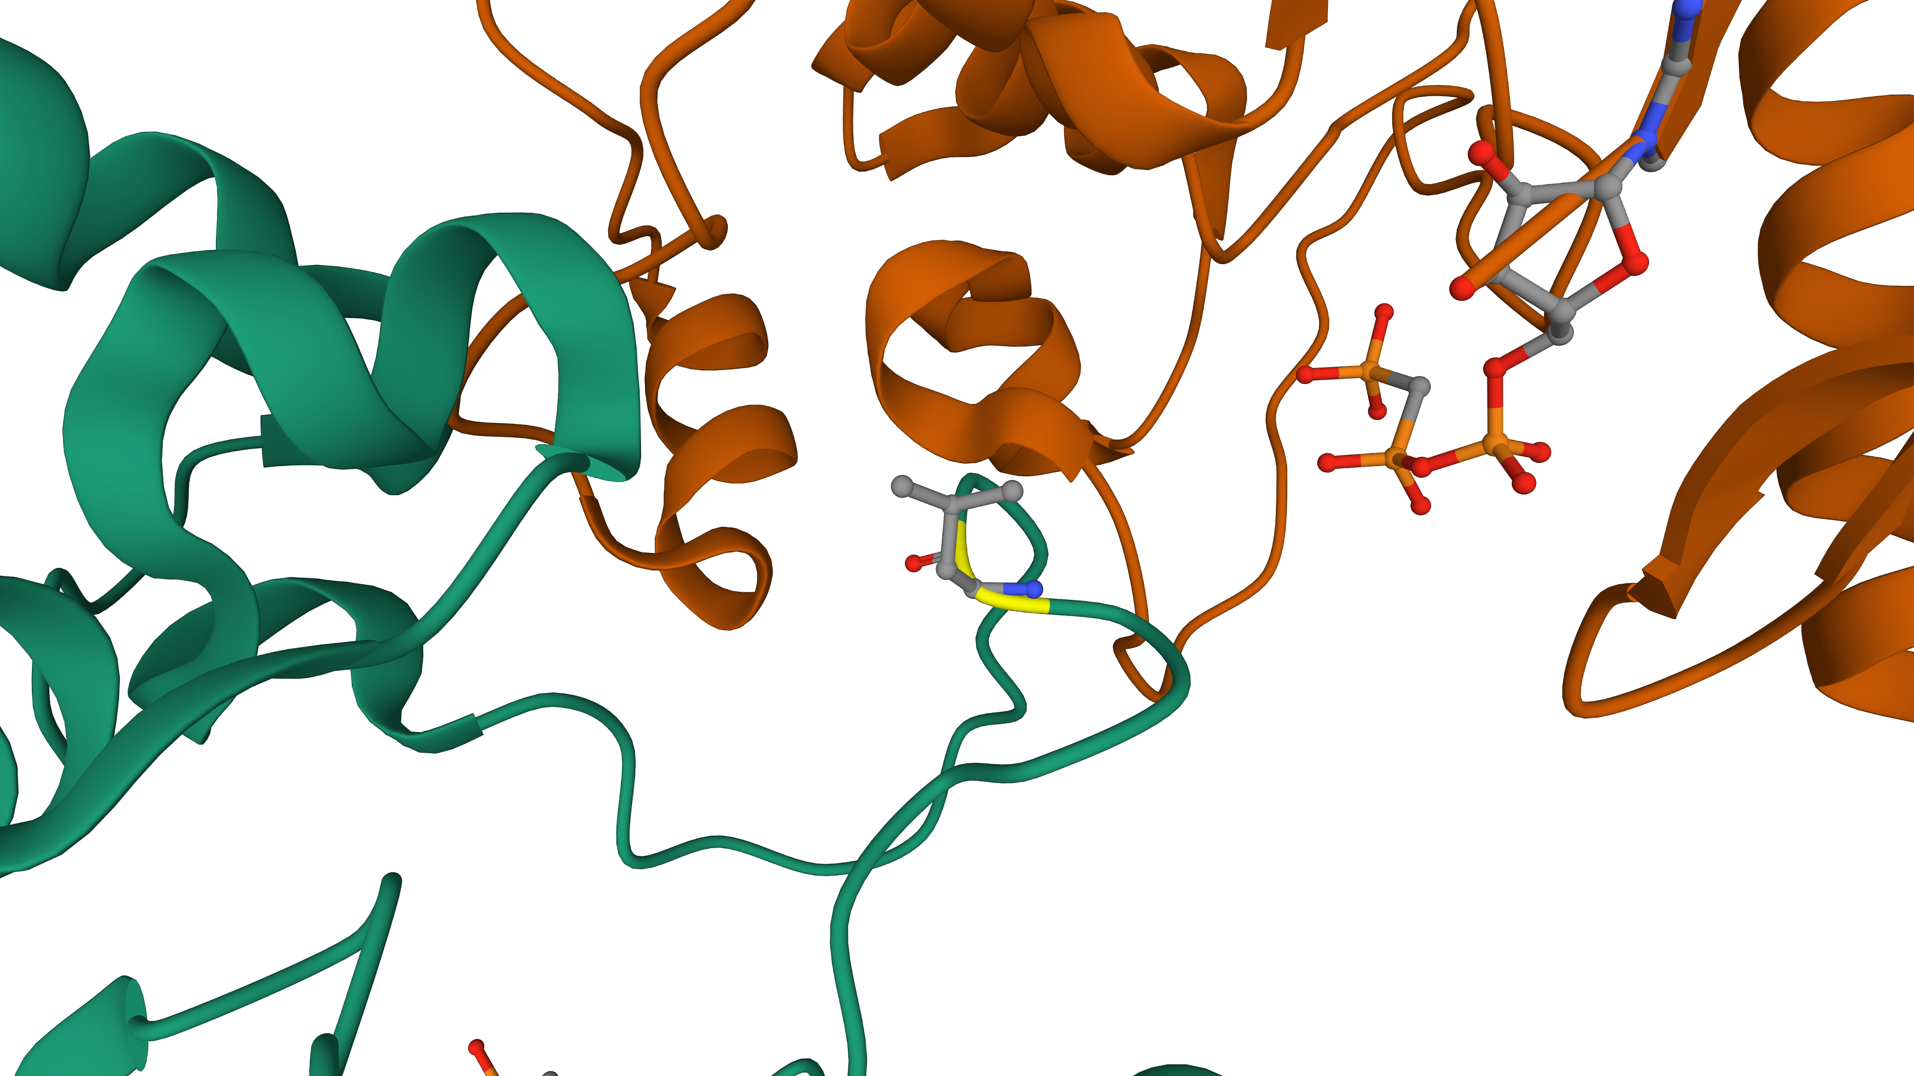
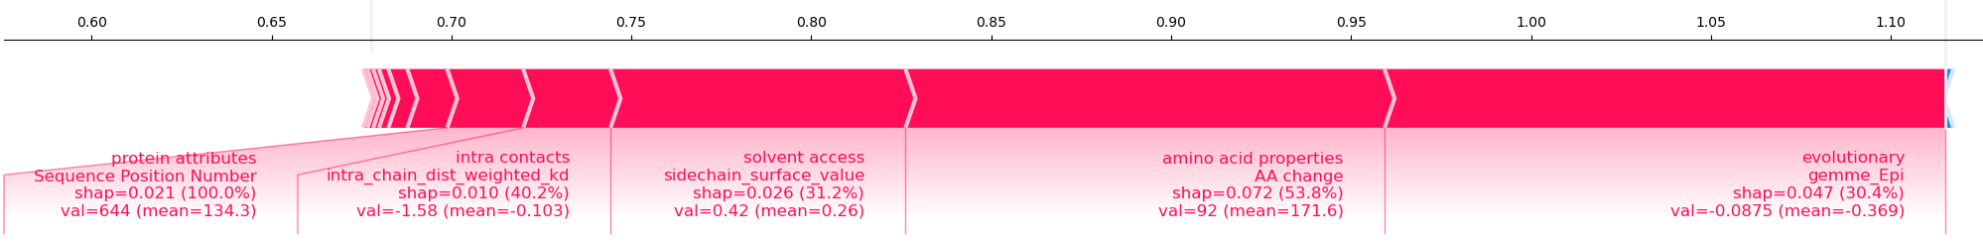
Case study – FGFR3 L645I
StructGuy: 1.115 (neutral or slightly beneficial)
Surface residue
Facilitates no important interactions
PDB entry 6PNX
Red: neutral/beneficial – Blue: functionally detrimental
Notes:
Another leucine on position 645 is replaced by a similar isoleucine. In this case, structugy predicts a neutral or even slightly benign effect. From the structure we can see a surface residue that doesn’t participate in any important interactions.

Slide 12
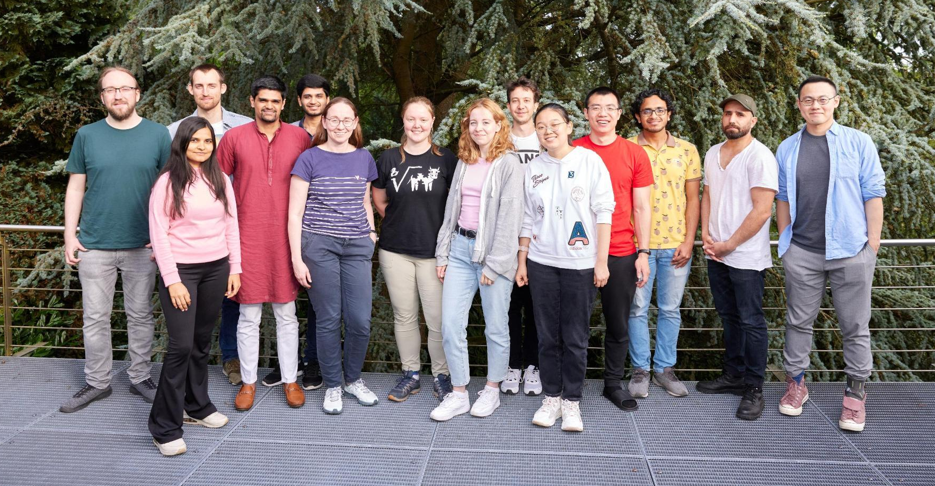
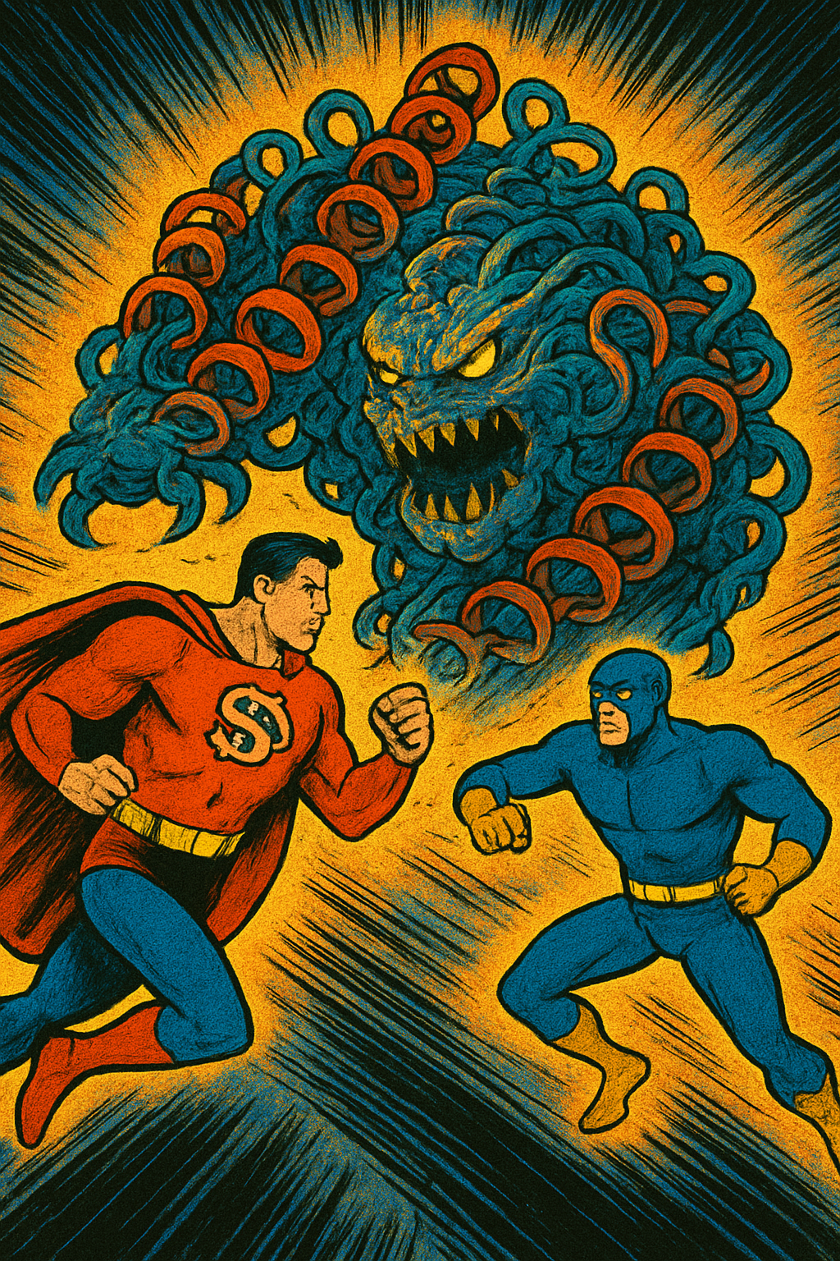


Take home messages
StructGuy…
… is supervised and generalizes
… will improve with future MAVEs
… explains its predictions using protein structure
Many thanks to
StructMAn/Guy team:
Olga Kalinina
Sebastian Keller
Alper Yurtseven
Roman Joeres
Johanna Becher
Sanjay Srikakulam
Carène Benasolo
Pascal Hirsch
For fruitful discussions:
Vasily Ramensky
Anastasia Kolchina
Amay Agrawal
Chen Guangyi
DrugSiderAI
biorxiv.org/content/10.64898/2025.12.01.691563v1

Slide 13
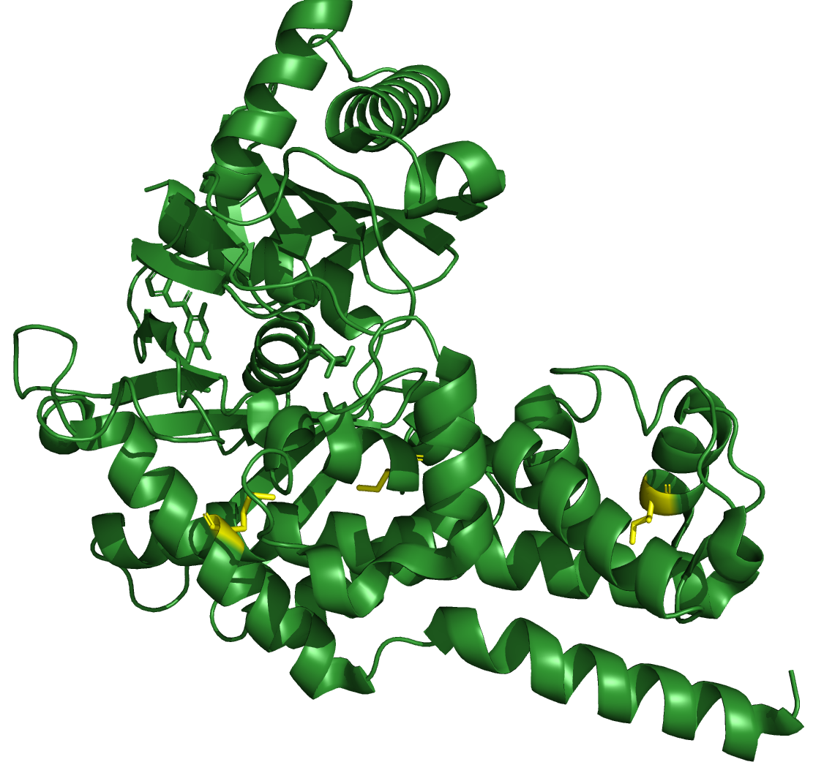
Case study – Hexokinase-4
part of unrelated proteins split
catalyzes the phosphorylation of hexose
MAVE measures the catalytic activity
5 examples only correctly predicted by StructGuy
PDB entry 3F9M

Slide 14
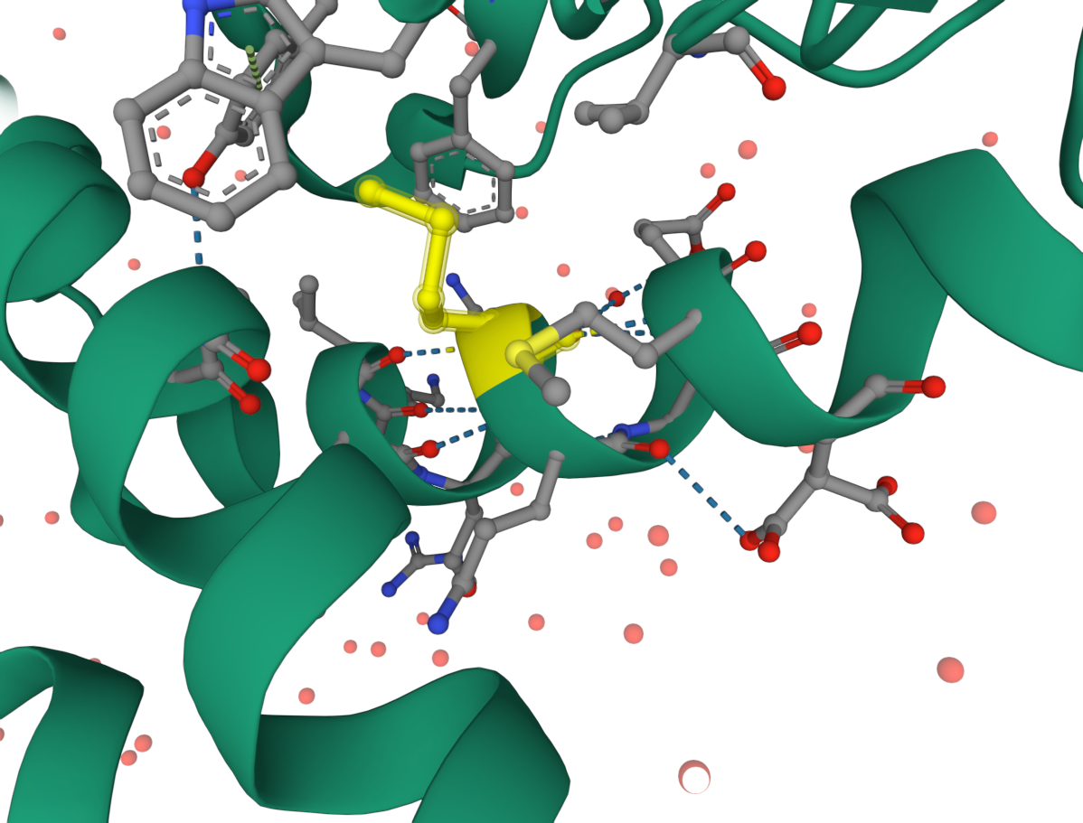
Case study – Hexokinase-4 position 37
Methionine → Tryptophan
activity lost

Slide 15
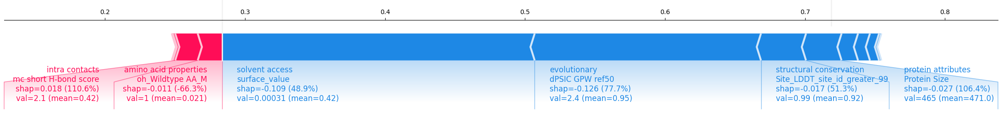
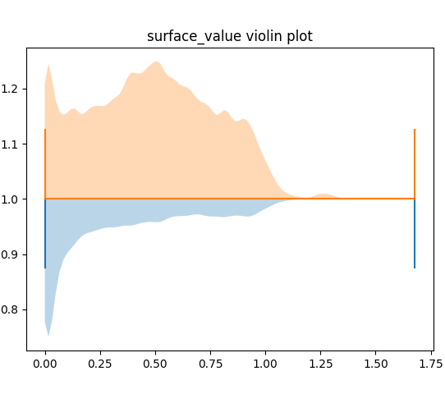
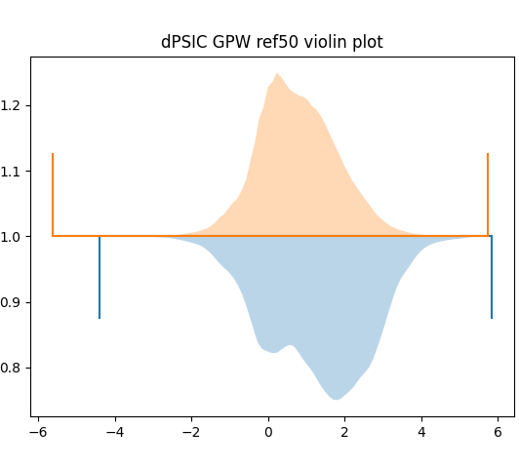
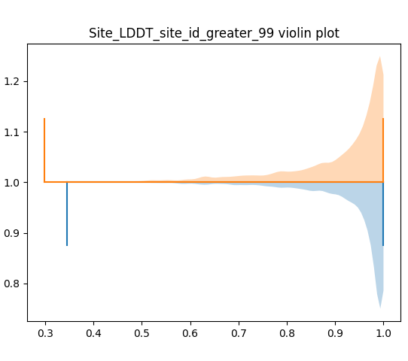
Case study – Hexokinase-4 position 37

Slide 16
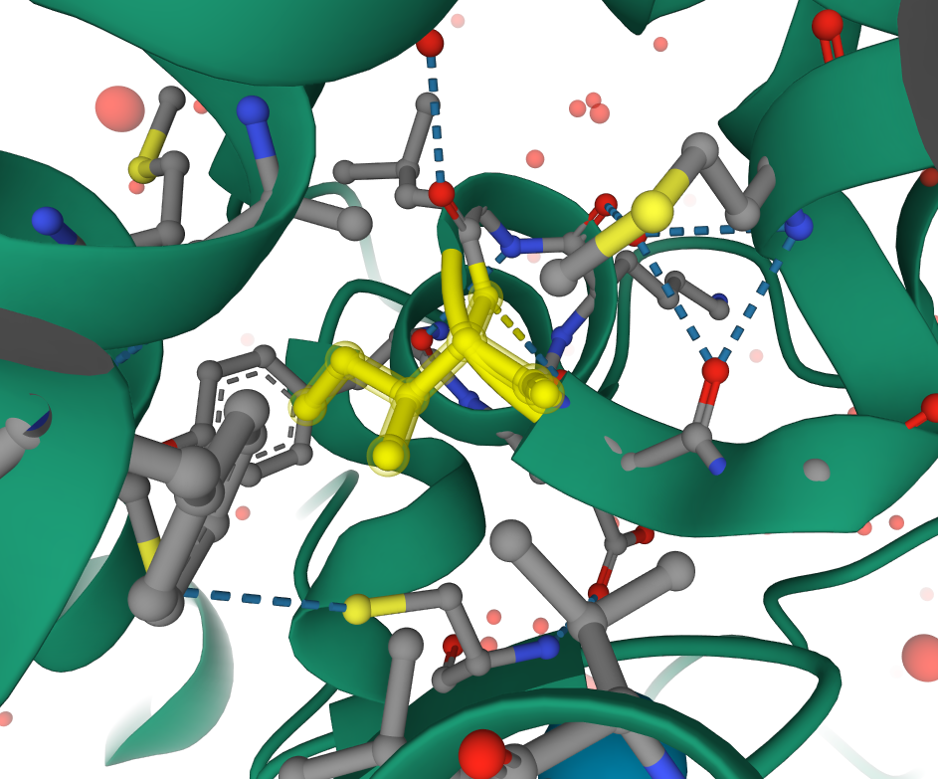
Case study – Hexokinase-4 position 293
Isoleucine → Serine/Alanine
both negatively effects activity
Serine worse than Alanine

Slide 17
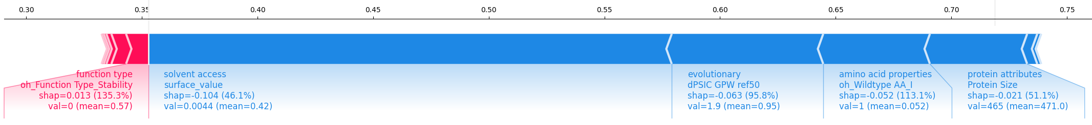
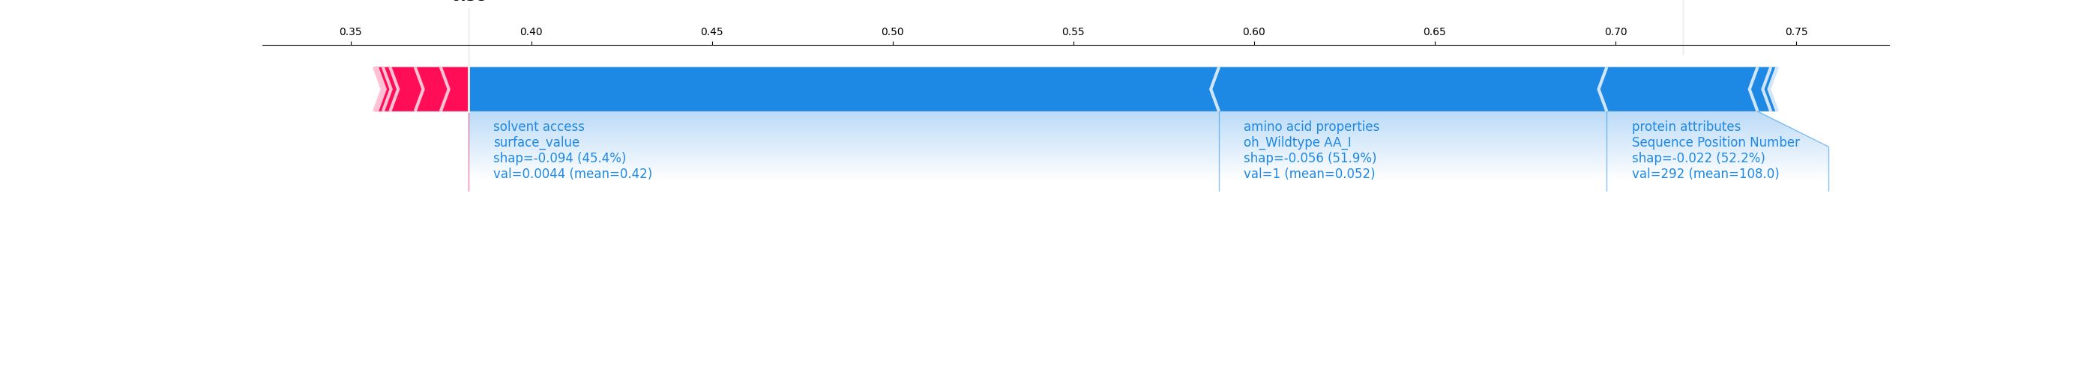
Case study – Hexokinase-4 position 293
Isoleucine → Serine
Isoleucine → Alanine

Slide 18
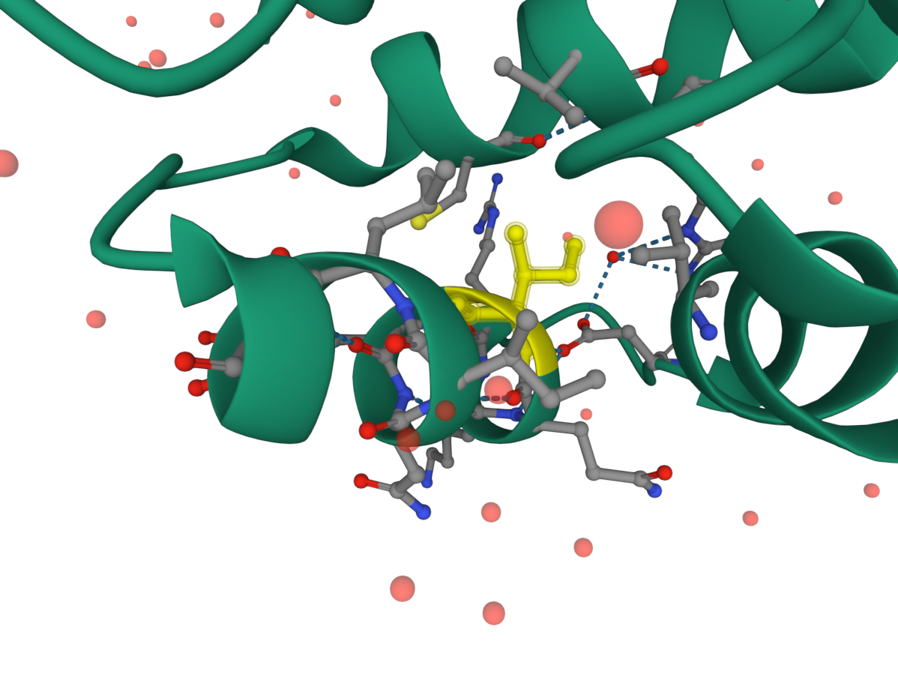
Case study – Hexokinase-4 position 348
Isoleucine → Serine/Alanine
some change in activity for both
Serine more than Alanine

Slide 19
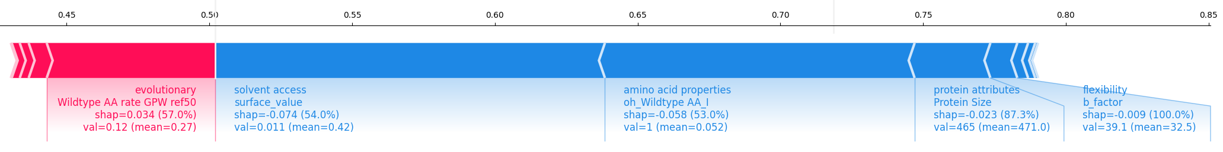
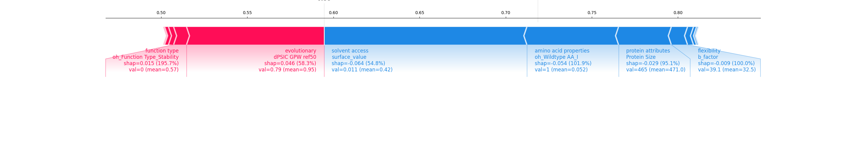
Case study – Hexokinase-4 position 348
Isoleucine → Serine
Isoleucine → Alanine

Slide 20

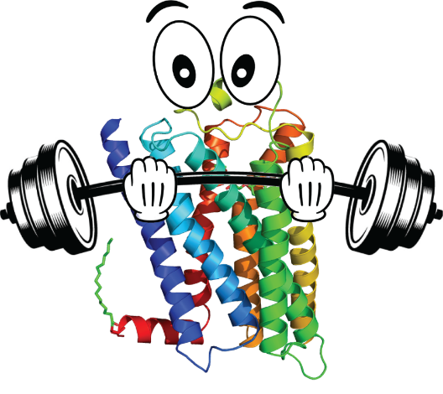
Multiplexed assay of variant effect (MAVE)
collection of raw MAVE data
1,240 entries
3,325 score sets
ProteinGym
manually curated
217 MAVEs
used for evaluation of prediction models
[1] Rubin et al.: “MaveDB 2024: a curated community database with over seven million variant effects from multiplexed functional assays”, Genome Biology 2025
[2] Notin et al.: “ProteinGym: Large-Scale Benchmarks for Protein Fitness Prediction and Design”, NeurIPS 2023
Notes:
… multiplexed assays of variant effect. I will not cover the technical details of those so called MAVEs, but would like to give an emphasis on the type of data they produce: experimental measurements of effects of virtually every possible amino acid variant in an individual protein, that’s exactly that what our model aims to predict.
There are some resources that collect the results of MAVE experiments, the largest of them is the MAVEDB, which currently holds the data of over

Slide 21
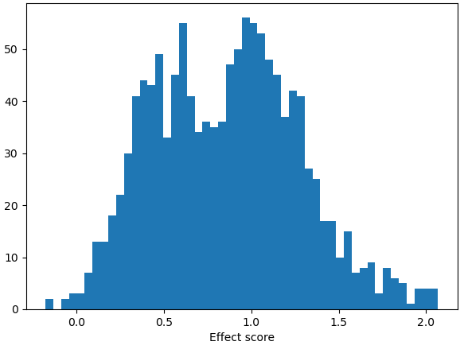
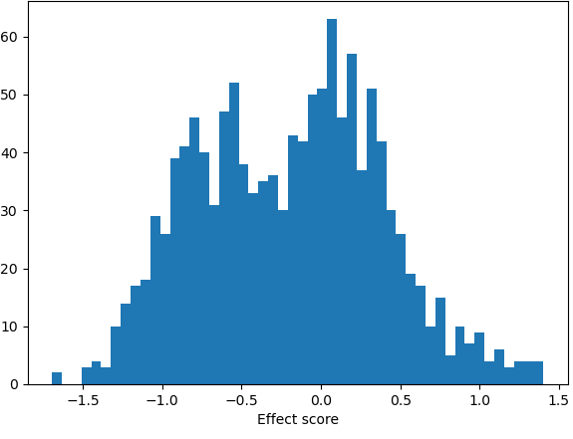
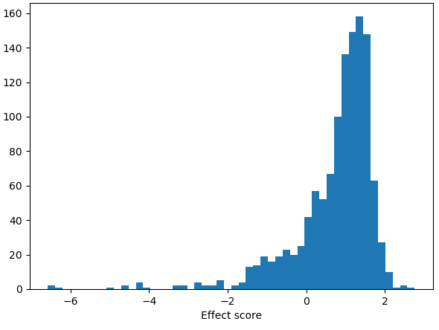
Construction of the MAVE gold standard (MGS) dataset
ProteinGym
Scores
nicely distributed
Quality control & rescaling
Goal: generalizability to other proteins
Score variance too low
similar distributions
coverage
protein length
Notes:
We start the construction of our training dataset, which we called mave gold standard dataset, with the all MAVEs from the two formerly mentioned resources.
Here we have the issue is that we cannot simply use all the data for supervised training, many of the MAVE measure different types of functional effects and also measure them on a different scale, further many MAVEs are not looking the whole protein and so on. Therefor we apply various filtering steps all with the goal to generate a training dataset with high quality and similar MAVE score distributions.
For example, have a look at those two example score distributions …

Slide 22
Unsupervised versus supervised models
More training data
Individual data less valuable
MAVE data just for evaluation
Generalization by design
Training data is scarce
MAVE data very valuable
Potentially biased towards proteins seen in training
Currently: training and prediction on same protein
Unsupervised
Supervised
Central idea of StructGuy:
Supervised variant effect prediction that generalizes to proteins not seen during training
Notes:
Bringing me to the topic, where are difference of those models are in this particular subfield. Generally,

