Slide 1

CAGI 7 slide pack guidelines
I agree to my slides being used according to the following terms:
_______Yaqi Su_______
Authors: please include THIS slide at the beginning of your presentation to indicate that you agree with reuse of your slides in CAGI presentations, according to the terms below, and digitally sign by writing your name above.
At CAGI 7, use of this slide pack is only required for CAGI dataset providers, assessors, and predictors, but all are encouraged to use the annotations for materials they do not want shared publicly.
To disseminate the CAGI results, I encourage all CAGI participants to remix these CAGI slides for inclusion in their oral and poster presentations
CAGI participants may use or publish any content of these slides only in compliance with the CAGI Data Use Agreement
CAGI participants may not cite or publish any content of these slides except with the written permission of the originating author or in the primary CAGI publications
CAGI participants must acknowledge the original authors of these slides and CAGI 7. Include the acknowledgement banner across the bottom
CAGI participants must include the CAGI credits slide in their presentations
Slides with a red slash (no remix) may not be included in a presentation unless all attendees are registered CAGI participants who signed the data use agreement
Slides with a red X over the entire slide may not be used in any circumstances
Slides with a blue slash (embargoed) may not be used unless the embargo is explicitly lifted
Slides without slash or X may be tweeted, tooted, posted, X’d unless flagged with “No tweet” icon
CAGI participants using these slides must explain the “No tweet” icon, which means that the slide content should not be disseminated outside the presenting conference hall. If the presentation venue permits pervasive tweeting, you may not include these slides in your talk
Note for slide authors: we expect all CAGI participants to abide by these restrictions, and will make best effort to ensure they are followed. However, but bear in mind that we have limited means of enforcing them, and therefore the restrictions cannot be guaranteed.

Slide 2
Loss of Function
Nonsense & Frameshift
Annotation Accumulation Accuracy Assessment
Challenge
Yaqi Su
UC Berkeley
yaqisu@berkeley.edu
Created for CAGI 7
genomeinterpretation.org
Yaqi Su

Slide 3
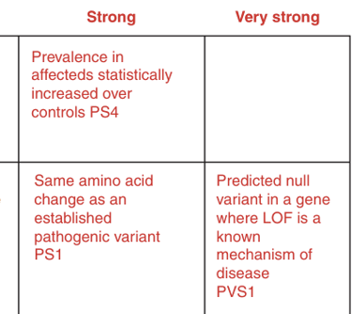
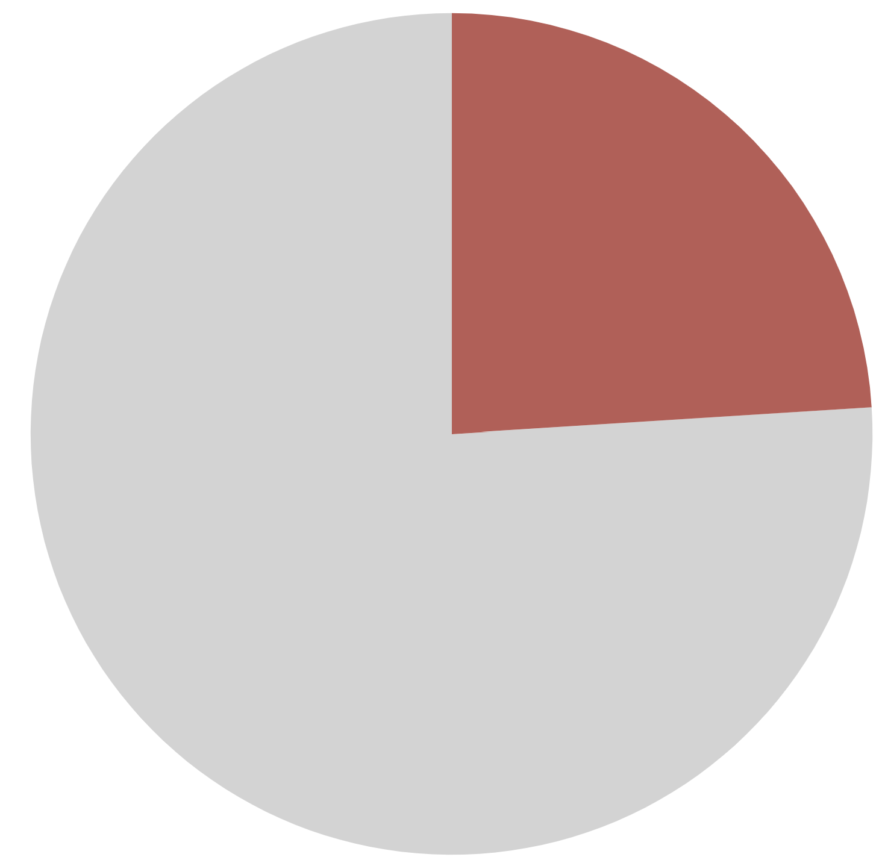
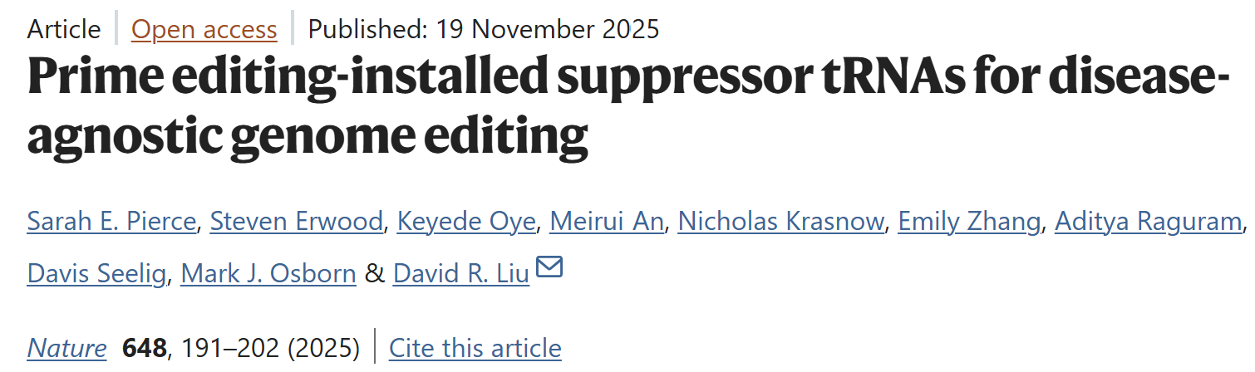


Nonsense variants are clinically important
Pathogenic Variants in ClinVar
Only “Very strong” pathogenic evidence code in ACMG guidelines
24%
Nonsense
76%
Other
Richards et al., 2015, Genet Med.
Created for CAGI 7
genomeinterpretation.org
Yaqi Su

Slide 4
Nonsense variants are often treated simplistically
Most predictors ignore nonsense variants,
or treat them as uniformly deleterious
Nonsense variants commonly used as baseline for “null” in Multiplexed Assays of Variant Effect (MAVE)
However, the consequences of nonsense variants are varied
The impacts are context-dependent
  e.g., position, transcript architecture, sequence content
Created for CAGI 7
genomeinterpretation.org
Yaqi Su

Slide 5



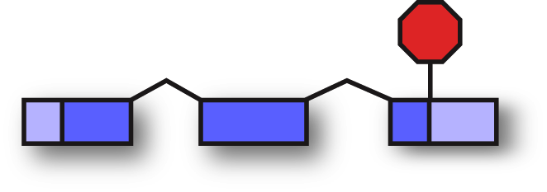
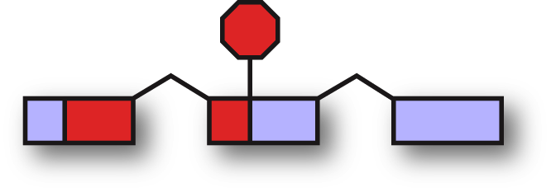

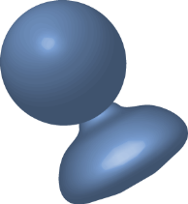



Truncations could be dominant negative
_{…CAA…}
_{…TAA…}
UGA
UAG
UAA
…Q…
truncated protein
(dominant negative)
truncated protein
(dominant negative)
normal protein
Cali and Anderson. (1998) Mol Gen Genet 260:176-84
Nonsense mediated mRNA decay (NMD)
PTC
normal
truncated
hemizygote
haplosufficiency
Created for CAGI 7
genomeinterpretation.org
Yaqi Su

Slide 6
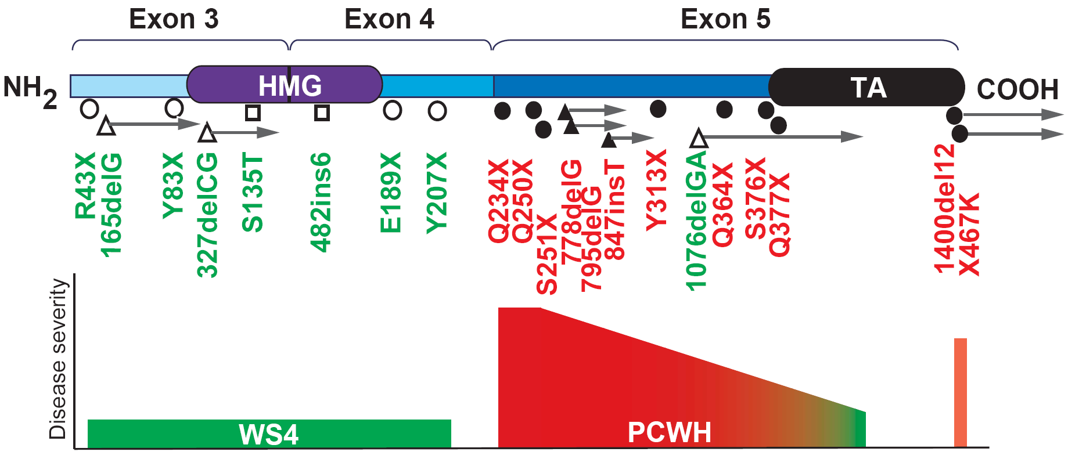
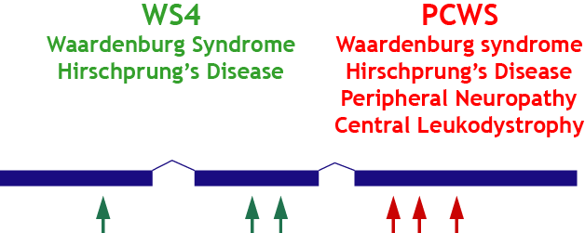
Truncated proteins could be dominant negative
Sox10 transcription factor truncating mutations produce two distinct phenotypes
Inoue et al. (2004) Nat Genet 36:361-9
NMD (haploinsufficiency)
No NMD (Dominant negative most severe)
Created for CAGI 7
genomeinterpretation.org
Yaqi Su

Slide 7
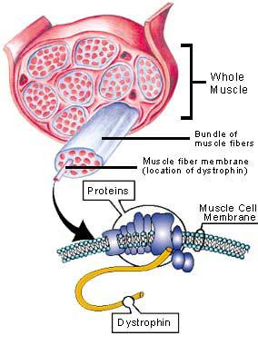
Truncated proteins could also be partially functional
Dystrophin mutations cause muscular dystrophy
2.4 Mb pre-mRNA is spliced into 11 kb, 79 exon mRNA
Frameshift rule
Large C-term deletion = Becker (milder)
Frameshift = Duchenne (severe)
Monaco et al. (1988) Genomics 2:90-5
Kerr et al.(2001) Hum Genet 109:402-7
NMD explains the frameshift rule
Drawing courtesy of Muscular
Dystrophy Assocation
www.mdausa.org
Created for CAGI 7
genomeinterpretation.org
Yaqi Su

Slide 8
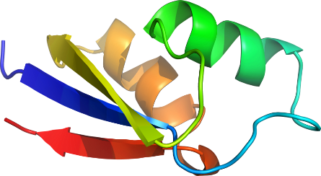
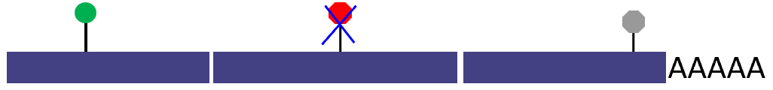


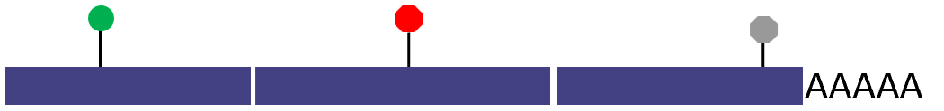

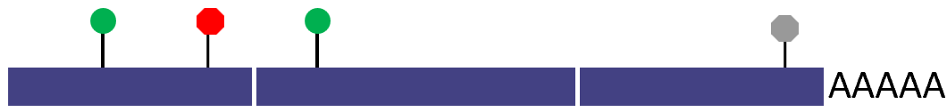

Various consequences of nonsense mutations
Full-length protein (readthrough)
Readthrough
Fully functional
No protein (transcript fully degraded by NMD)
Haplosufficient (Recessive)
Triggers NMD
Loss of function
Haploinsufficient (Dominant)
C-terminal truncated protein / reduced level due to NMD efficiency
Dominant negative
Haplosufficient (Recessive)
N-terminal truncated protein / reduced level due to reinitiation efficiency
Loss of function
Haploinsufficient (Dominant)
Reinitiation
Partially functional
Created for CAGI 7
genomeinterpretation.org
Yaqi Su

Slide 9
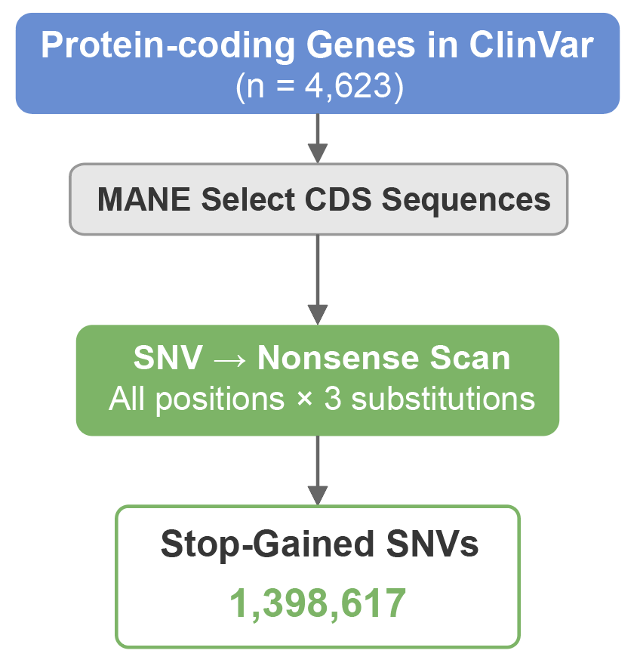
Construction of all stop-gained SNVs
Created for CAGI 7
genomeinterpretation.org
Yaqi Su

Slide 10
It’s impossible to get all frameshift variants
At each position, the insertion/deletion length (N) varies; 4^{N} possible insertions
For example, here’re all possible 4bp insertions at a single position…
AAAA AAAC AAAG AAAT AACA AACC AACG AACT AAGA AAGC AAGG AAGT AATA AATC AATG AATT ACAA ACAC ACAG ACAT ACCA ACCC ACCG ACCT ACGA ACGC ACGG ACGT ACTA ACTC ACTG ACTT AGAA AGAC AGAG AGAT AGCA AGCC AGCG AGCT AGGA AGGC AGGG AGGT AGTA AGTC AGTG AGTT ATAA ATAC ATAG ATAT ATCA ATCC ATCG ATCT ATGA ATGC ATGG ATGT ATTA ATTC ATTG ATTT CAAA CAAC CAAG CAAT CACA CACC CACG CACT CAGA CAGC CAGG CAGT CATA CATC CATG CATT CCAA CCAC CCAG CCAT CCCA CCCC CCCG CCCT CCGA CCGC CCGG CCGT CCTA CCTC CCTG CCTT CGAA CGAC CGAG CGAT CGCA CGCC CGCG CGCT CGGA CGGC CGGG CGGT CGTA CGTC CGTG CGTT CTAA CTAC CTAG CTAT CTCA CTCC CTCG CTCT CTGA CTGC CTGG CTGT CTTA CTTC CTTG CTTT GAAA GAAC GAAG GAAT GACA GACC GACG GACT GAGA GAGC GAGG GAGT GATA GATC GATG GATT GCAA GCAC GCAG GCAT GCCA GCCC GCCG GCCT GCGA GCGC GCGG GCGT GCTA GCTC GCTG GCTT GGAA GGAC GGAG GGAT GGCA GGCC GGCG GGCT GGGA GGGC GGGG GGGT GGTA GGTC GGTG GGTT GTAA GTAC GTAG GTAT GTCA GTCC GTCG GTCT GTGA GTGC GTGG GTGT GTTA GTTC GTTG GTTT TAAA TAAC TAAG TAAT TACA TACC TACG TACT TAGA TAGC TAGG TAGT TATA TATC TATG TATT TCAA TCAC TCAG TCAT TCCA TCCC TCCG TCCT TCGA TCGC TCGG TCGT TCTA TCTC TCTG TCTT TGAA TGAC TGAG TGAT TGCA TGCC TGCG TGCT TGGA TGGC TGGG TGGT TGTA TGTC TGTG TGTT TTAA TTAC TTAG TTAT TTCA TTCC TTCG TTCT TTGA TTGC TTGG TTGT TTTA TTTC TTTG TTTT
Created for CAGI 7
genomeinterpretation.org
Yaqi Su

Slide 11
Construct all frameshift variants leading to distinct stop codons
Assumption: The Premature Termination Codon (PTC) is the primary driver of pathogenicity, outweighing the specific aberrant peptide sequence generated by the frameshift
AAG CTT GAC GTT…
ACA GCT TGA CGT…
AAA GCT TGA CGT…
AGA GCT TGA CGT…
ATA GCT TGA CGT…
AAG CCT TGA CGT…
AAG ACT TGA CGT…
AAG GCT TGA CGT…
AAG TCT TGA CGT…
AAG CCT TGA CGT…
AAG CAT TGA CGT…
AAG CGT TGA CGT…
AAG CTT TGA CGT…
Created for CAGI 7
genomeinterpretation.org
Yaqi Su

Slide 12
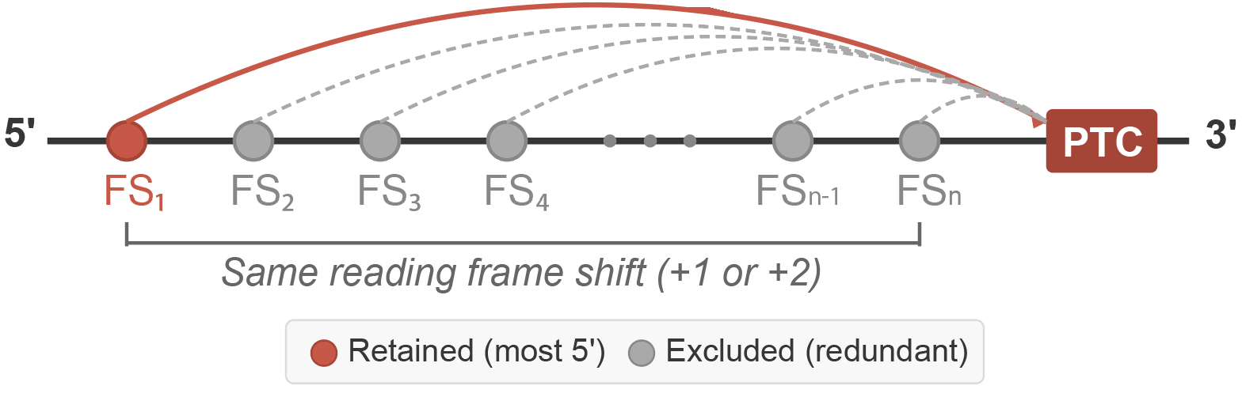
Construct all frameshift variants leading to distinct stop codons
Assumption: The Premature Termination Codon (PTC) is the primary driver of pathogenicity, outweighing the specific aberrant peptide sequence generated by the frameshift
All frameshifts (same reading frame shift) between a variant and its resulting PTC will produce the same stop codon → only the most 5' is retained
Any FS2 – FSn in ClinVar will be used to approximate the effect of FS1
Created for CAGI 7
genomeinterpretation.org
Yaqi Su

Slide 13
Assessment
Assessment will be performed in 2026 Spring to allow new nonsense variants accumulation in ClinVar
Will follow similar metrics as other Annotation Accumulation Accuracy Assessment Challenges, e.g.,
  Full ROC performances
  Performance in high-specificity and high-sensitivity regimes
  Allele frequency bias
  Gene label balancing

